Slide 1
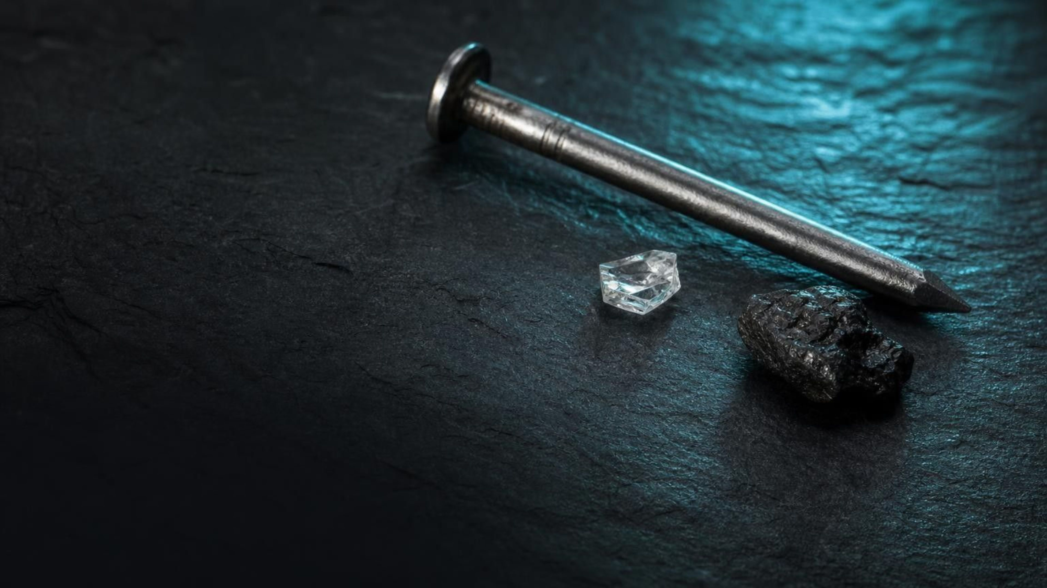
Atoms and Elements
Chapter 1 of 29 · The Composition of Matter
Lesson 1: What are the smallest pieces of matter, and how do we keep track of them?
Angela's Wand · Bring Science Alive! 7th Grade Integrated
Notes:
Welcome to the first chemistry lesson of the year. Over the next week we answer three questions: what is everything made of, how do we know when the pieces are too small to see, and how do scientists organize the different kinds of pieces. Tell students they will run three investigations: a paper-cutting model of scale, a mystery-card version of building the periodic table, and a design challenge to map a hidden surface by touch. Nothing in this lesson needs chemicals or flames.
CONNECTS TO: Overview of Lab 1, Lab 2 and Lab 3; W1 opens the next slide.
PACING: about 2 min

Slide 2
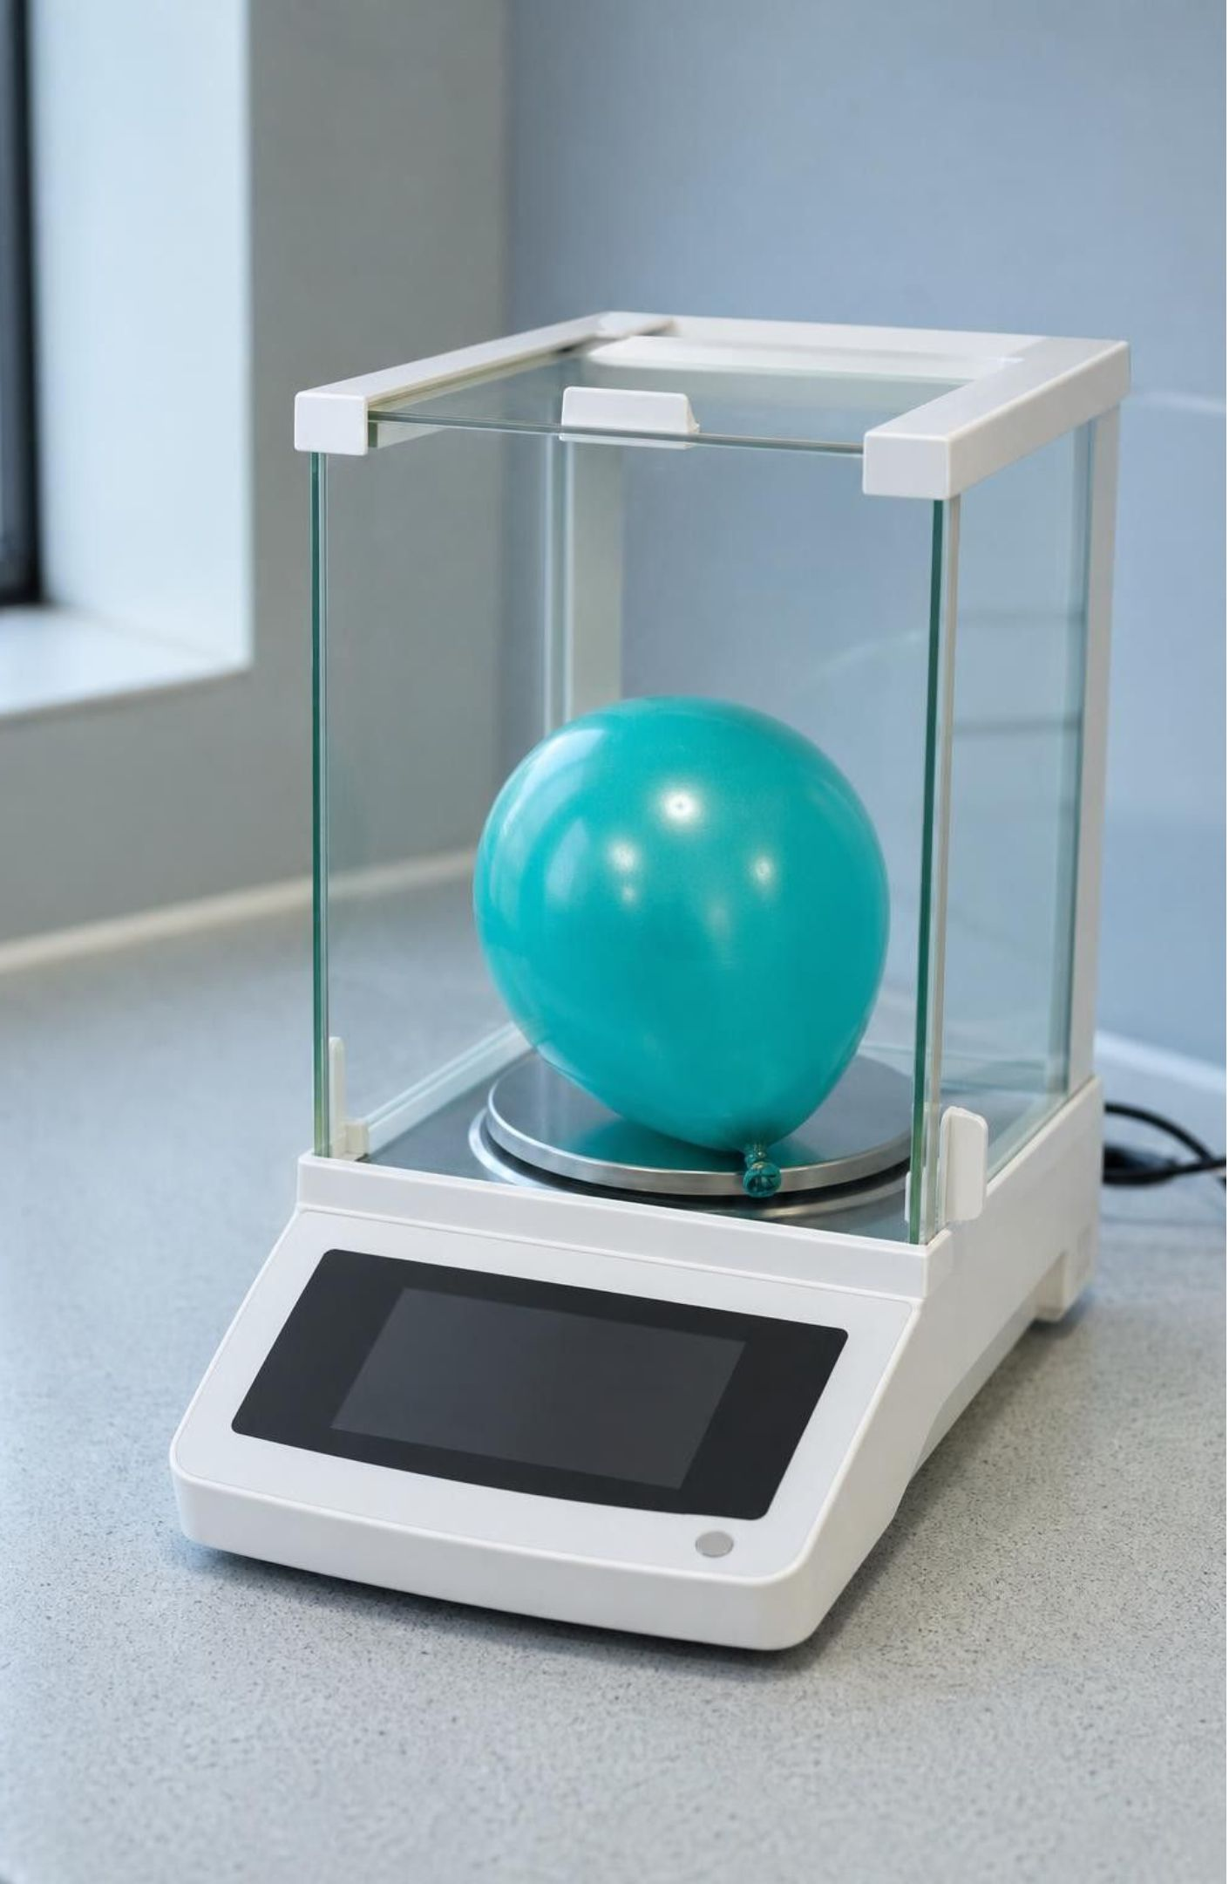
PHENOMENON
A balloon gets heavier from nothing you can see
A limp balloon on a sensitive balance reads 1.85 g. A student pumps it full of air, ties it, dries the outside and puts it back. The balance now reads 1.89 g. Nothing visible went in. Where did the extra mass come from, and what is it made of?
Notice: what changed and what stayed the same?
Wonder: what is inside the balloon now that was not there before?
Predict: would a helium-filled balloon read heavier or lighter than this one?
2
Notes:
If you have a 0.01 g balance and a hand pump, run this live; otherwise use the numbers on the slide; they are illustrative values chosen to be realistic for a small party balloon, not a published measurement. Give students two silent minutes to write a notice and a wonder, then collect answers on the board without judging them. Push on the key idea: the balance does not lie, so something with mass went in. Ask: if it has mass, is it stuff? If it is stuff, what is it made of? Expect some students to argue air is 'nothing' or 'just gas, not matter'; record that claim, because the whole lesson will test it. Teacher background: the balloon reads heavier because pumped air is squeezed to a higher pressure than the room air, so it is denser than the air the balloon pushes aside. You do not need to raise this unless a student asks why a loosely filled balloon barely changes.
EXPECTED RESPONSES: Notice: the number went up by 0.04 g; the balloon is bigger; it looks the same color. Wonder: is air heavy; how much air is in there; would a bigger balloon gain more. Predict: helium balloon reads lighter (it rises), which is a great puzzle to park until the end of the lesson.
WATCH FOR: 'Air is nothing' and 'gases have no mass.' Do not correct yet; write the claims on a parking lot and return on slides 4 and 26.
CONNECTS TO: W1 phenomenon worksheet records the notice/wonder and initial explanation. W6 CER returns to this evidence.
PACING: about 8 min

Slide 3
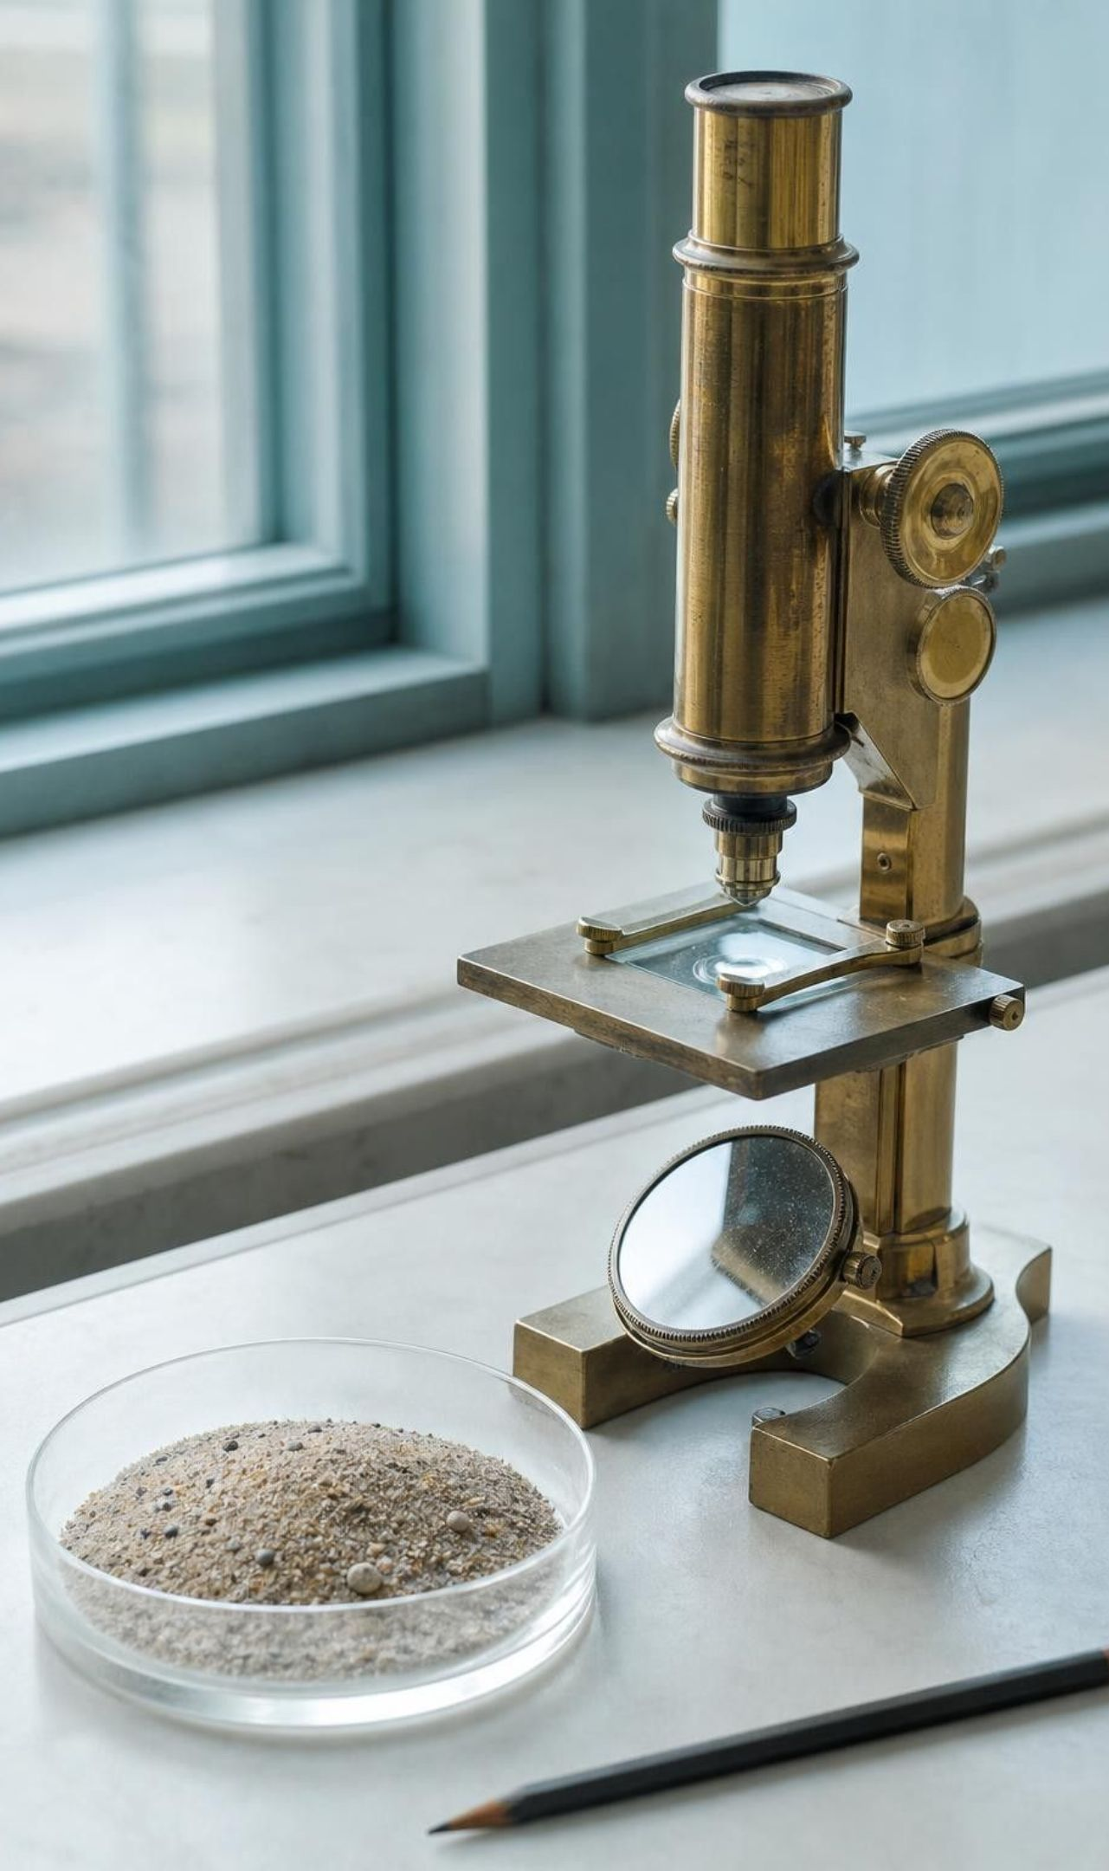
LEARNING TARGETS
What you will be able to do
1
Explain that all matter is made of atoms, and tell an atom from an element.
2
Compare the atomic scale to everyday scales and use the picometer.
3
Describe how a scanning tunneling microscope maps a surface, and name its criteria and constraints.
4
Explain how patterns in properties and mass grew into the periodic table.
5
Use an element's symbol, mass and position to predict how it behaves.
3
Notes:
Read the targets aloud and have students star the one that sounds hardest right now. Point out that targets 1 and 2 belong to the first two days, 3 is the engineering story, and 4 and 5 are about the periodic table. Tell them the exit ticket on the last day asks about all five.
CONNECTS TO: Targets map to W2 (1), Lab 1 (2), Lab 3 and W9 (3), Lab 2 and W5 (4), W10 (5).
PACING: about 2 min

Slide 4

What counts as matter?
1
Matter is anything that has mass and takes up space.
2
Solids, liquids and gases are all matter, including the air in the balloon.
3
Light, sound and heat are not matter: they carry energy but are not made of stuff.
4
The balance proved it: air has mass, so air is matter.
4
Notes:
Return to the parking-lot claim that air is nothing. Ask the class for a test that could settle it. Steer toward the balance reading: anything that adds to the mass must be matter. Then widen the net: is the glow of a neon sign matter? Is the sound of a bell? Those are energy traveling through matter, not matter itself. Have pairs sort a quick list on whiteboards: a rock, steam, a shadow, music, helium, sunlight. Shadows and sunlight and music go in the 'not matter' column.
EXPECTED RESPONSES: Rock, steam and helium are matter; shadow, music and sunlight are not. Some students will hesitate on steam because it is hard to see; remind them that visibility is not the test, mass is.
WATCH FOR: Students may say a gas is 'half matter' or that only heavy things count. Insist on the two-part test: mass and space.
CONNECTS TO: W2 vocabulary sort includes matter versus non-matter examples.
PACING: about 5 min

Slide 5
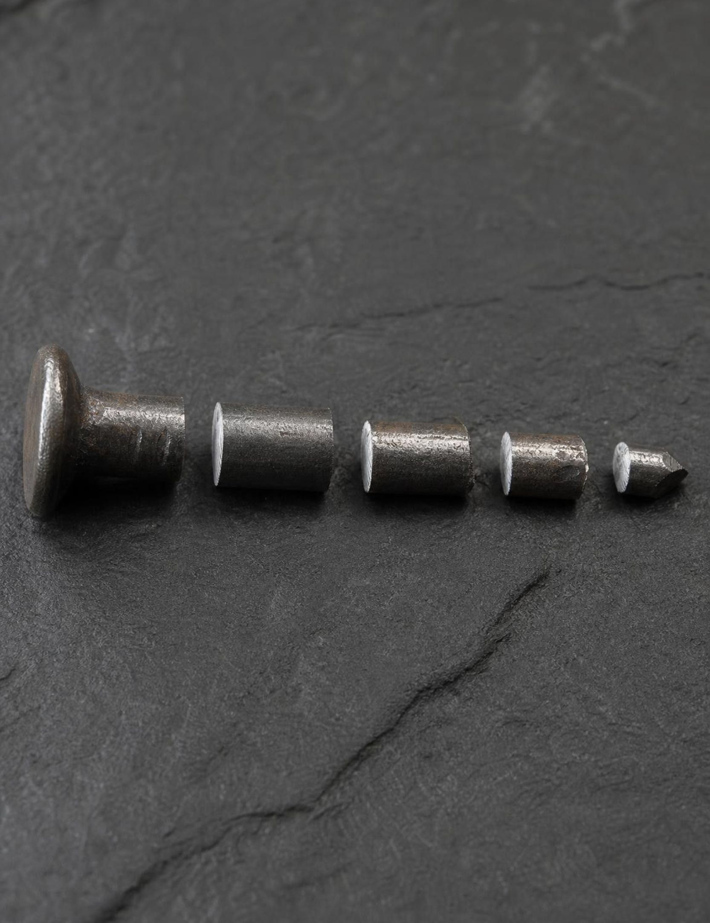
Keep cutting: is there a smallest piece?
Imagine sawing an iron nail in half, then halving one piece, then halving again. Every cut so far has given you a smaller piece of iron. Could that go on forever? Matter turns out to be grainy at the bottom. After about 30 halvings of a 10 cm nail you would be holding a single iron atom, and cutting that would no longer give you iron.
5
Notes:
Run this as a thought experiment first, then tell students they will test it with paper in Lab 1. Ask: has anyone ever cut something so small it stopped being that thing? They have not, which is exactly why the idea is hard. Introduce the word atom here as 'the smallest piece that still counts as that element.' Resist going into protons and electrons; the lesson treats the atom as the unit. If a student asks what is inside an atom, say that atoms do have parts, but those parts are not iron any more, which is the point.
WATCH FOR: 'You can keep halving forever.' Students generalize from every cut they have made. The halving graph in Lab 1 makes the arithmetic concrete.
CONNECTS TO: Lab 1 (halving a strip) is built directly on this slide.
PACING: about 5 min

Slide 6
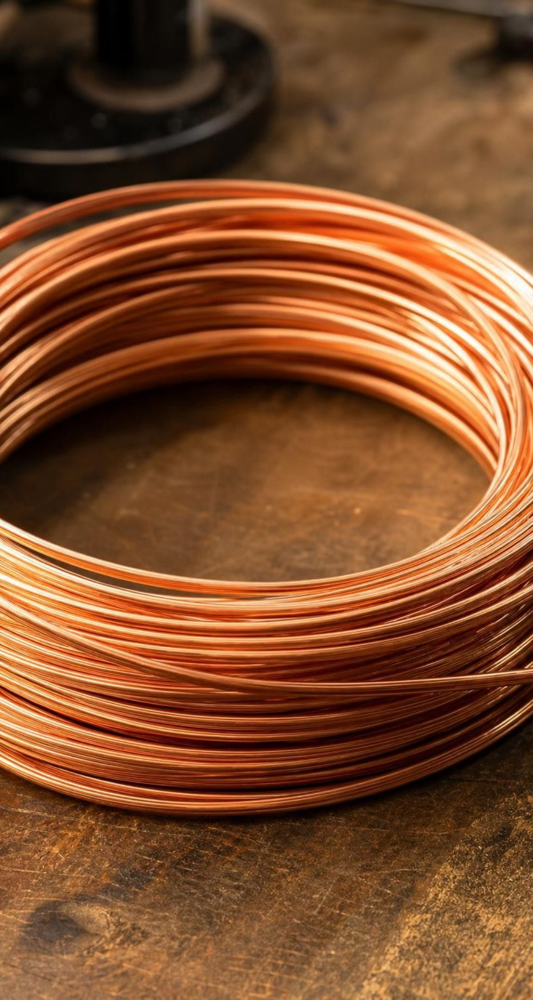
VOCABULARY IN CONTEXT
Three words that must stay separate
matter: Anything that has mass and takes up space. The air in a bike tire is matter; the hiss when it leaks is not.
atom: One single particle of an element, the smallest piece that still counts as that element. One iron atom is about 250 picometers across, far too small to see.
element: A substance made of only one kind of atom. A copper wire is the element copper; it holds an enormous number of copper atoms.
6
Notes:
Say the sentence 'an atom is a particle; an element is a substance' and have students repeat it. The textbook's vocabulary box calls an element a particle, which blurs the two; we use the clearer definition from the book's concept spread. Give a quick test: hold up a paper clip. The paper clip is mostly the element iron (steel is iron with a little carbon). Is the paper clip an atom? No. Is it made of atoms? Yes, an enormous number. Does it contain the element iron? Yes.
WATCH FOR: Students will say 'iron is an atom.' Correct gently: iron is an element; an iron atom is one particle of it.
CONNECTS TO: W2 vocabulary worksheet works with exactly these relationships.
PACING: about 4 min

Slide 7
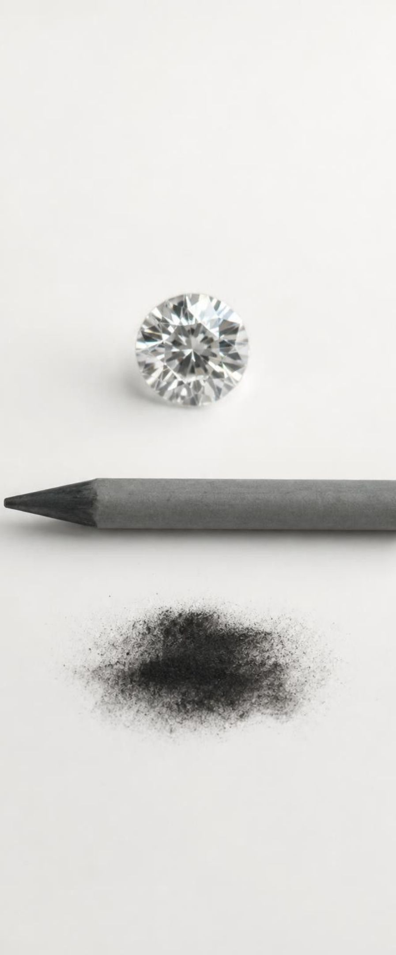
MODEL
One element, many faces: carbon
Model: The element carbon
Center: Carbon (C), atomic mass about 12 Da
One carbon atom: A single particle, roughly 150 pm across. Not visible with any light microscope.
A diamond: Carbon atoms locked in a rigid 3-D pattern. Hard, clear, sparkling.
Pencil graphite: The same carbon atoms stacked in flat sheets that slide. Soft, gray, slippery.
Soot from a candle: Carbon atoms in tiny, jumbled clusters. Black powder.
Symbol C: The one-letter shorthand chemists everywhere use for this element.
Different arrangements of the same kind of atom give very different materials, but the element is the same.
7
Notes:
Use carbon to show why 'element' and 'atom' are different words. A diamond and pencil lead look nothing alike, yet both are made of carbon atoms only, so both are the element carbon. The difference is how the atoms are arranged, which is Lesson 2's topic. Ask: if you had a single carbon atom, would it be hard like a diamond or soft like graphite? Neither; hardness is a property of many atoms arranged together, not of one atom. This is a preview of the extended-structure idea in MS-PS1-1.
WATCH FOR: Students may believe a single atom has the properties of the bulk material (a gold atom is shiny, a carbon atom is black). Properties like color and hardness belong to large groups of atoms.
CONNECTS TO: Sets up L02 Molecules and Extended Structures; W4 diagram worksheet.
PACING: about 5 min

Slide 8
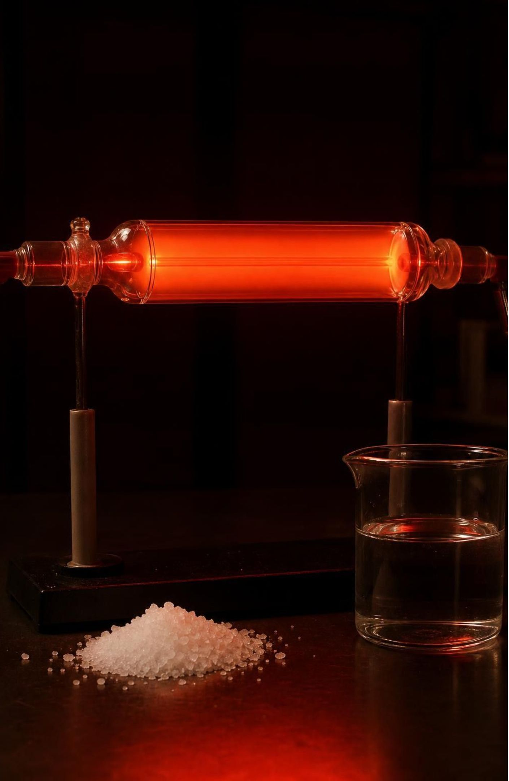
Check for understanding
Quick check: atom or element?
Which of these is an element?
A. Air
B. Water
C. Neon
D. Table salt
8
Notes:
Have students vote with fingers (1 to 4), then defend. Air is a mixture of several gases; water is made of two kinds of atoms joined together; salt is sodium and chlorine. Neon is a substance made of one kind of atom only. Follow up: 'One neon atom is tiny. Is one neon atom an element?' The cleanest answer is that a single atom is a particle of the element neon; the word element names the substance and the kind of atom, not the one particle.
EXPECTED RESPONSES: C, Neon. Students who choose water usually reason that it is 'pure'; point out that pure is not the same as one kind of atom.
WATCH FOR: Pure substance equals element. Water is pure but not an element.
CONNECTS TO: W2 and W10 reuse this distinction.
PACING: about 4 min

Slide 9
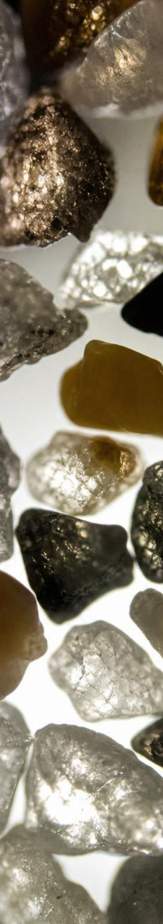
How small is small? A ladder of scales
MODEL
Model: From a meter stick down to one atom
Meter stick, 1 m: Human scale. Rooms, people, desks.
Millimeter, 1 mm: A grain of sand is about 1 mm across and holds on the order of 10¹⁹ atoms.
Hair width, about 0.1 mm: 100 micrometers. The limit of what a sharp eye can resolve.
Bacterium, about 1 micrometer: A thousandth of a millimeter. Light microscopes show these.
Virus, about 100 nanometers: A ten-thousandth of a millimeter. Too small for light; needs an electron microscope.
Atom, about 100 to 300 picometers: A trillionth of a meter is 1 pm. A hair is roughly half a million to a million atoms wide.
Most steps down this ladder are a factor of 10 to 1,000. An atom is roughly ten million times smaller than the millimeter sand grain.
9
Notes:
Walk down the ladder slowly. At each rung ask what tool you would use to see it: eyes, magnifying glass, light microscope, electron microscope, and finally something new. Make the picometer concrete: one meter holds one trillion picometers, so one millimeter holds one billion. A hair about 100 micrometers wide is roughly a million atoms across. The sand-grain figure is a rough estimate that depends on grain size; the book gives 50 quintillion (5 × 10¹⁹), which matches a grain about a millimeter across. Skip the book's Grand Canyon comparison; the arithmetic does not hold up.
EXPECTED RESPONSES: Students should be able to say why we change units: counting an atom in meters gives a number with twelve zeros after the decimal point.
WATCH FOR: Students often think cells and atoms are about the same size. The ladder shows a bacterium is about 10,000 atoms wide.
CONNECTS TO: Lab 1 asks how many halvings reach the bottom rung. W4 and W10 reuse the ladder.
PACING: about 6 min

Slide 10
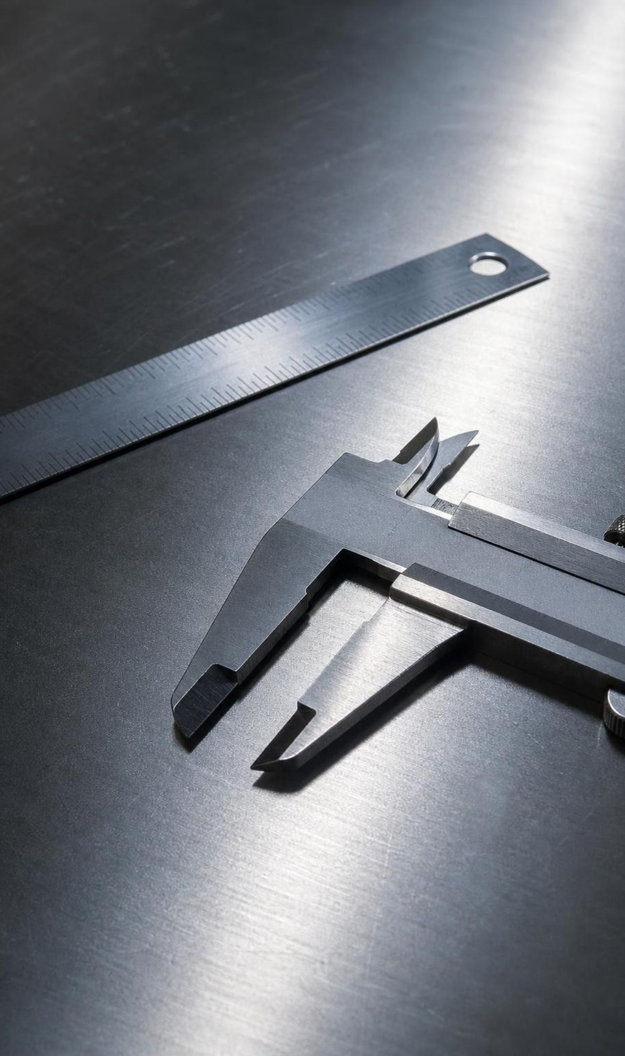
VOCABULARY IN CONTEXT
Talking about size the way scientists do
scale: A size range where things are roughly the same size and the same units make sense. Cities are on the kilometer scale; fingernails grow on the millimeter scale.
atomic scale: The size range of atoms, roughly 100 to 300 picometers across. At the atomic scale a flat-looking metal surface is a bumpy field of atoms.
picometer (pm): One trillionth of a meter, 10⁻¹² m. A hydrogen atom, the smallest, is roughly 100 pm across; its edge is fuzzy, so estimates vary.
10
Notes:
Connect scale to units they already use: nobody measures a road trip in centimeters or a fingernail in kilometers. Atoms are so far down the ladder that even the nanometer (a billionth of a meter) is a bit large, so chemists often use the picometer. Have students write the chain: 1 m = 1,000 mm = 1,000,000 micrometers = 1,000,000,000 nm = 1,000,000,000,000 pm.
WATCH FOR: Mixing up nanometer and picometer. A nanometer is 1,000 picometers.
CONNECTS TO: Lab 1 analysis question on unit choice; W5 data worksheet uses the unit chain.
PACING: about 4 min

Slide 11
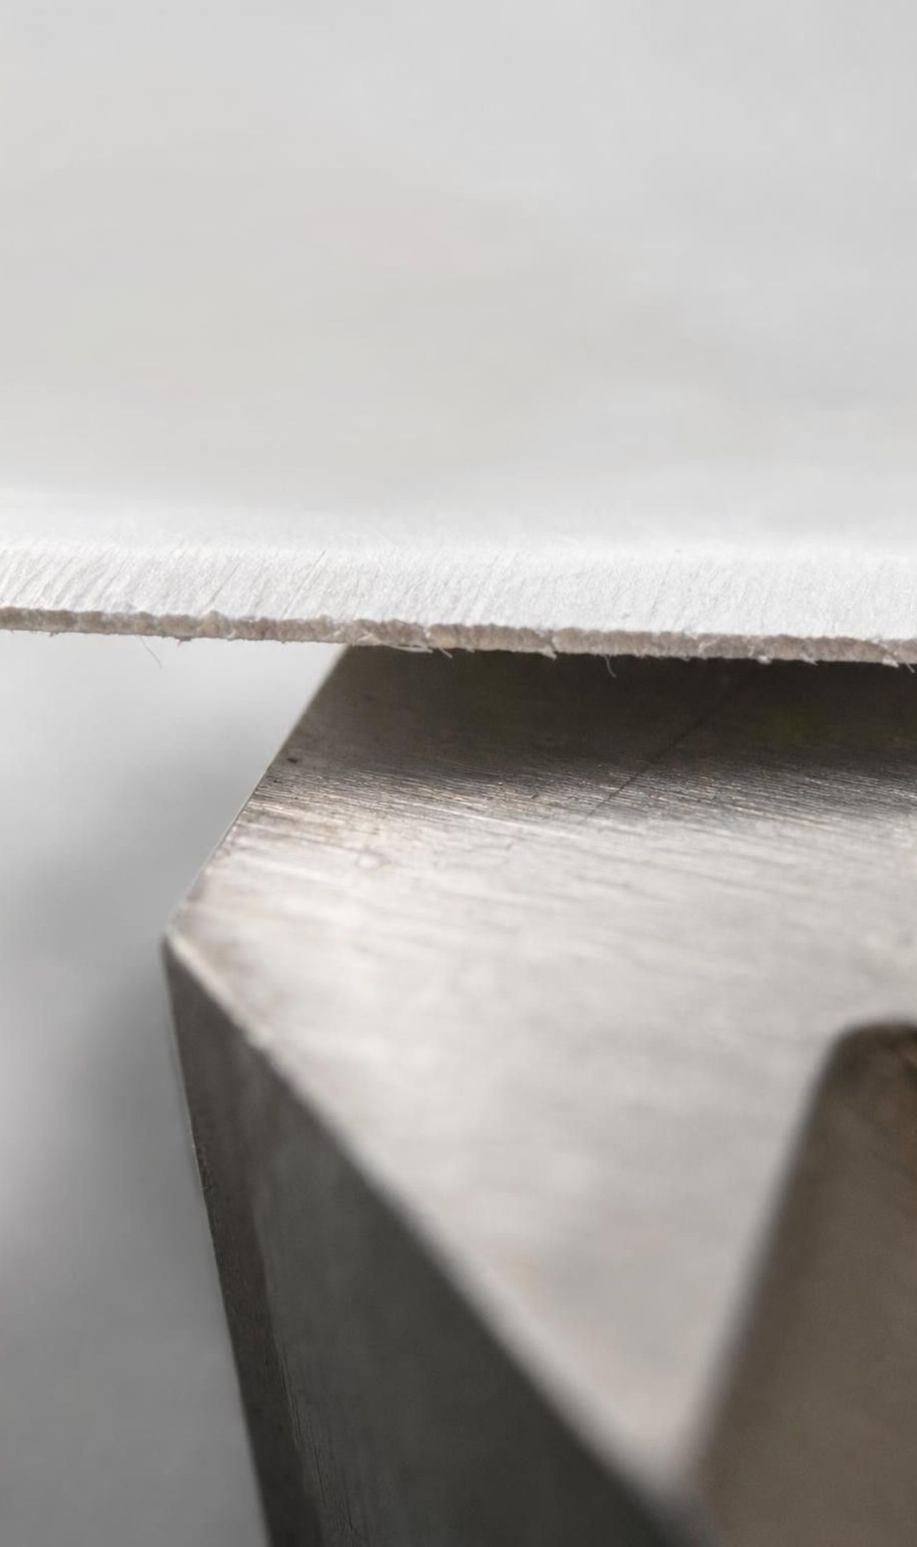
CHECK FOR UNDERSTANDING
Quick check: choose the unit
A strip of paper is 1 mm wide. About how many picometers is that, and how many 200 pm atoms could line up across it?
A. 1,000 pm; 5 atoms
B. 1,000,000 pm; 5,000 atoms
C. 1,000,000,000 pm; 5,000,000 atoms
D. 1,000,000,000,000 pm; 5 billion atoms
11
Notes:
Let students work it on whiteboards for two minutes. The chain from the last slide gives 1 mm = one billion picometers. Dividing by 200 pm per atom gives five million atoms side by side across one millimeter. Ask them to say the number out loud; the size of it is the lesson.
EXPECTED RESPONSES: C: one billion picometers in a millimeter, so about five million atoms across. Students who pick D have used the meter conversion instead of the millimeter.
WATCH FOR: Off-by-a-thousand errors from skipping a rung in the chain.
CONNECTS TO: Lab 1 halving math; W5.
PACING: about 4 min

Slide 12
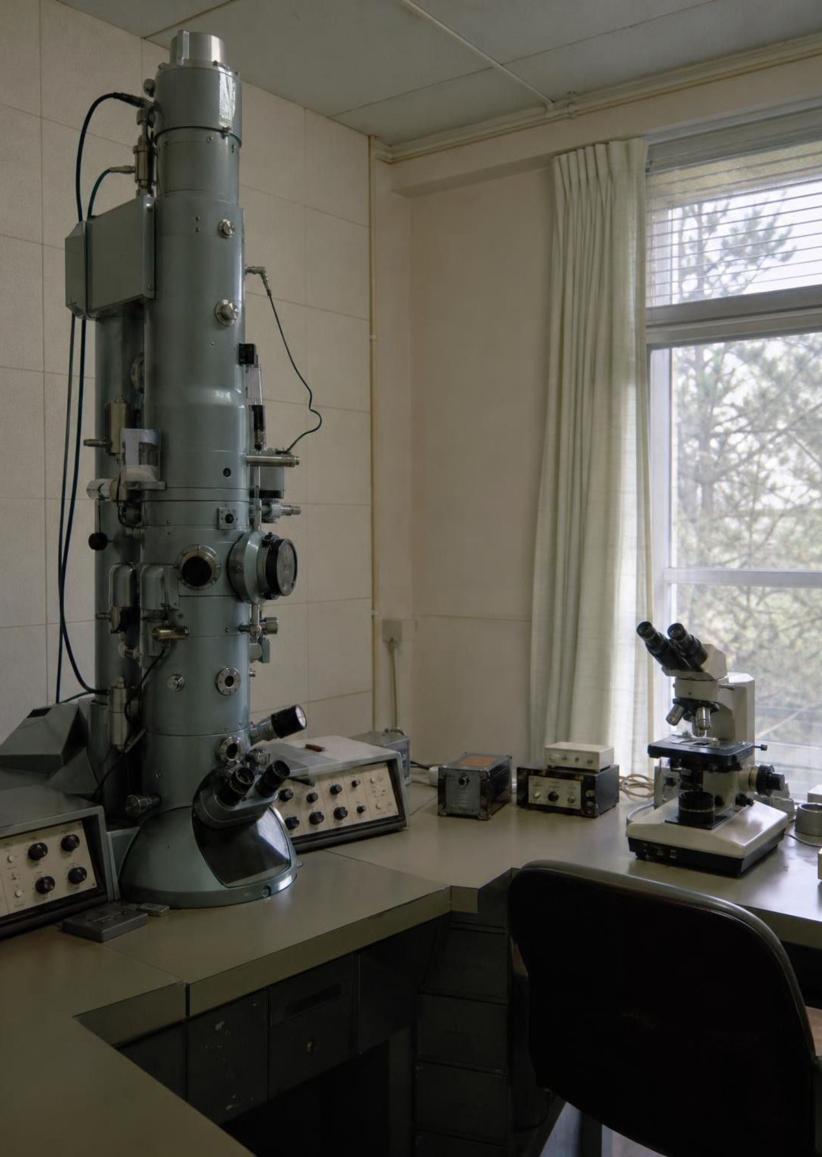
The engineering problem: how do you map atoms?
Light microscopes show bacteria but blur anything below about 200 nm; atoms are 1,000 times smaller still.
Electron microscopes reach further, but in the 1970s could not map single atoms on an ordinary flat surface.
Heinrich Rohrer and Gerd Binnig (IBM, Zurich) decided a new approach was needed, not a better lens.
First step: state exactly what success means and what limits the work.
12
Notes:
Frame this as an engineering story, not a science fact. The two physicists did not start by building; they started by defining. Explain that light cannot show anything much smaller than its own wavelength, which is why a light microscope tops out at a few hundred nanometers, fine enough for bacteria but a thousand times too coarse for atoms. A field ion microscope had shown single atoms on needle tips back in 1955, but it could not map an ordinary surface. Rohrer and Binnig wanted a tool for any flat conducting surface. Tell students to watch for two kinds of statements on the next slide: what the tool must do, and what the team had to work around.
WATCH FOR: The book says the STM let people see atoms 'for the first time' and proved atoms exist. Atoms were well established before 1981; say the STM was the first to map ordinary surfaces atom by atom.
CONNECTS TO: W3 reading passage covers this history; Lab 3 session 1 repeats the define-first step.
PACING: about 4 min

Slide 13
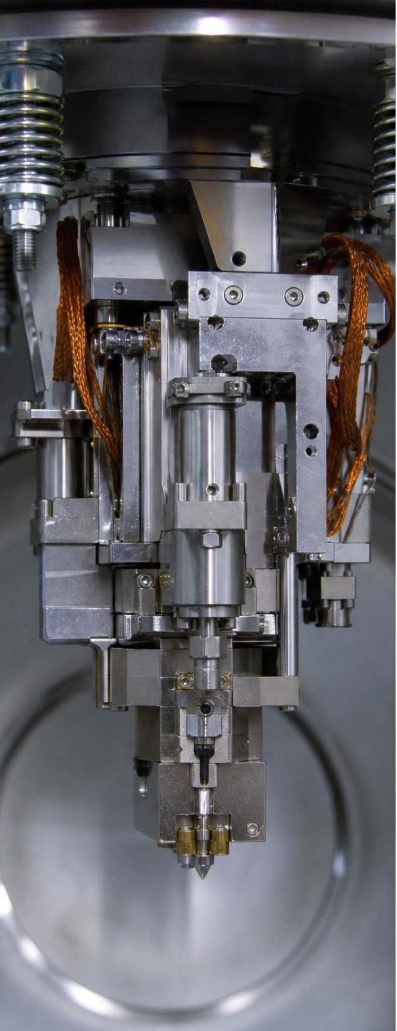
MODEL
Criteria versus constraints for the STM team
Model: What the microscope had to do, and what limited the team
A criterion is a target you aim for; a constraint is a wall you work within.
Criteria (what success requires) | Constraints (limits on the solution)
Show the positions of single atoms on a surface | Existing tools could not do the job, so parts had to be invented
Tell apart features about 100 pm apart | Footsteps and traffic shook the instrument, so data came at night
Measure surface features, not just show them | The probe must come within about a nanometer without touching
Eventually move individual atoms on purpose | Progress had to be shown regularly to keep the lab's support
13
Notes:
Read the two columns and have students explain the difference in their own words: criteria are things the solution must achieve; constraints are limits the solution must respect. Ask which column a budget belongs in (constraint), which column 'the map must be ready in under an hour' belongs in (criterion, because it describes success, though it is also a limit on time; this is a good edge case to discuss). Stress precision: 'see atoms' is vague; 'tell apart features 100 pm apart' can be tested. That precision is the whole of MS-ETS1-1.
EXPECTED RESPONSES: Students should produce one new criterion and one new constraint for a tool of their own choosing, for example a phone case: criterion, survives a 2 m drop; constraint, must cost under $10 to make.
WATCH FOR: Students often call every requirement a constraint. Use the test: does it describe success (criterion) or a limit (constraint)?
CONNECTS TO: Lab 3 session 1 and W9 require students to write criteria and constraints before designing.
PACING: about 6 min

Slide 14
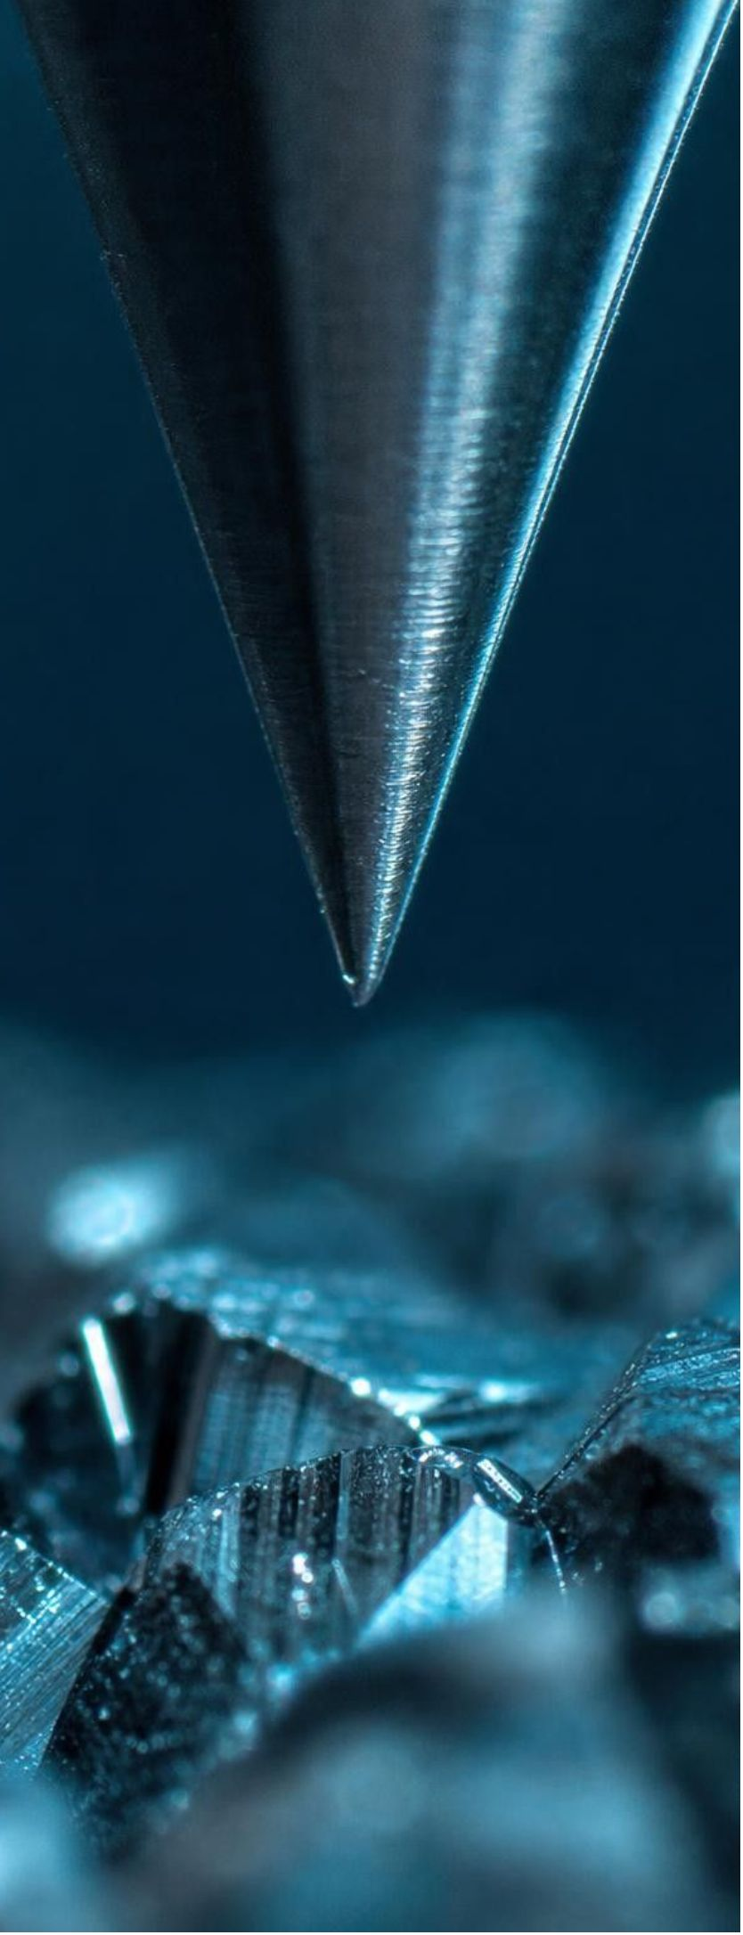
MODEL
How the STM builds a map without light
Model: One scan line of a scanning tunneling microscope
A metal probe sharpened to a tip a few atoms wide
→ (position)
Tip lowered to within about 1 nm of the surface
1
2
→ (approach)
A small voltage lets a tiny current cross the gap
→ (measure)
Current grows sharply when the tip is nearer the surface
3
4
→ (respond)
Tip sweeps side to side, line after line, recording current
→ (scan)
Computer turns the readings into a bumpy map of the atoms
5
6
Over the top of an atom the gap is smaller and the current rises; over the space between atoms it falls.
14
Notes:
Walk through the flow. The key physics for this grade: when two conductors are extremely close, a tiny current can cross the gap even though they do not touch, and that current changes a lot with distance, roughly ten times bigger for every 100 pm closer. So the current is a very sensitive ruler for the gap. Sweep the tip across and the current rises over each atom and falls between atoms. Real STMs usually move the tip up and down to keep the current constant and record the height; our simple picture keeps the height fixed and reads the current. Either way the picture is reconstructed data, not a photo. Have students draw one scan line as a wavy graph of current against position.
EXPECTED RESPONSES: A graph with regularly spaced peaks; students should say the peaks are atoms and the valleys are gaps.
WATCH FOR: 'The probe touches the atoms' and 'the STM takes a picture.' The tip never touches; the image is built from numbers.
CONNECTS TO: W4 diagram worksheet interprets a scan line. Lab 3 is the touch-based analogy, with the limits named on the next slide.
PACING: about 7 min

Slide 15
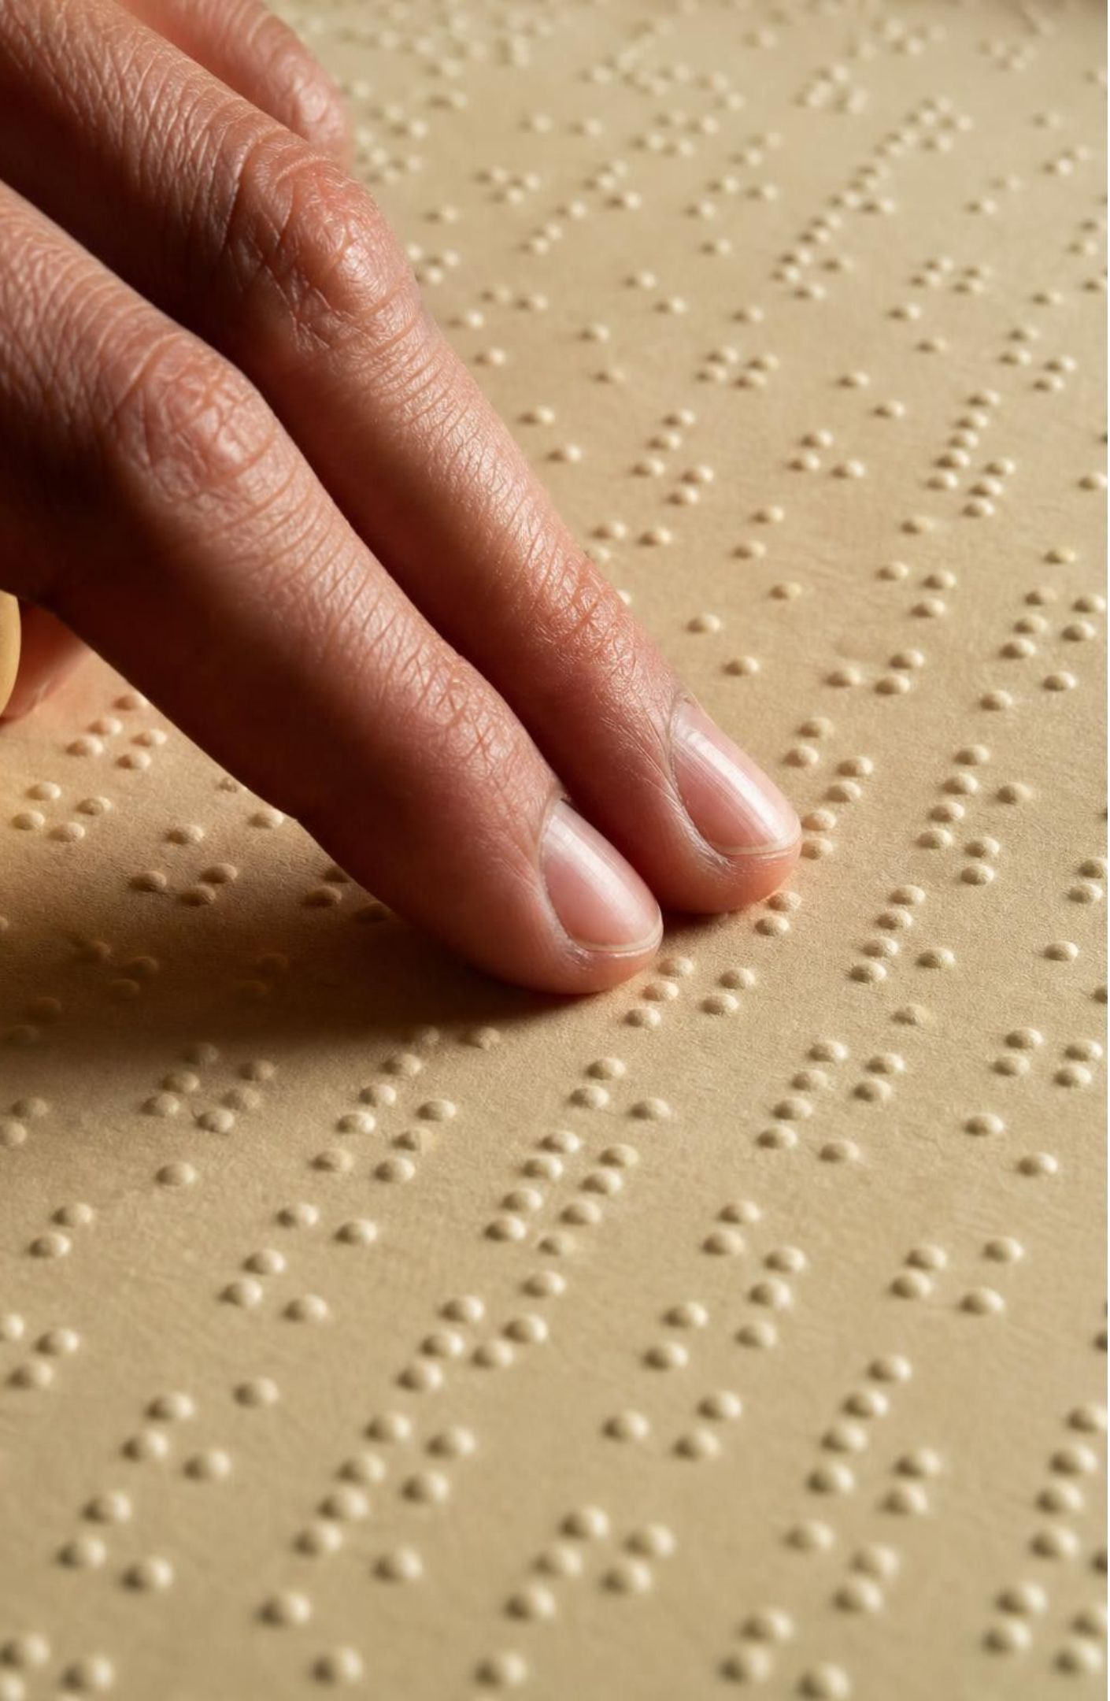
THINK, PAIR, SHARE
Discuss: is the STM like reading braille?
Fair: both build a picture of bumps by moving across a surface in a pattern.
Fair: both work in the dark; neither needs light.
Breaks: a finger presses on the dots; the STM tip never touches.
Breaks: a finger feels height directly; the STM measures a current and infers height.
Reading braille with a fingertip is a common comparison for the STM. In what ways is the comparison fair, and where does it break down?
15
Notes:
Give pairs three minutes, then collect. Push for the two breakdowns on the slide and a third one students often find: a finger is huge compared to braille dots, but the STM tip must be about as small as the atoms it maps. Close with the point that every analogy is a model: useful where it matches, misleading where it does not. Students will build a touch version in Lab 3, so ask them to keep a list of where their shoebox probe is unlike a real STM.
EXPECTED RESPONSES: Fair points as listed; breakdowns include touching versus not touching, measuring current versus feeling, and the size of the probe relative to the features.
CONNECTS TO: Lab 3 analysis question on model limits; W7 misconception repair uses the 'STM is a camera' error.
PACING: about 6 min

Slide 16
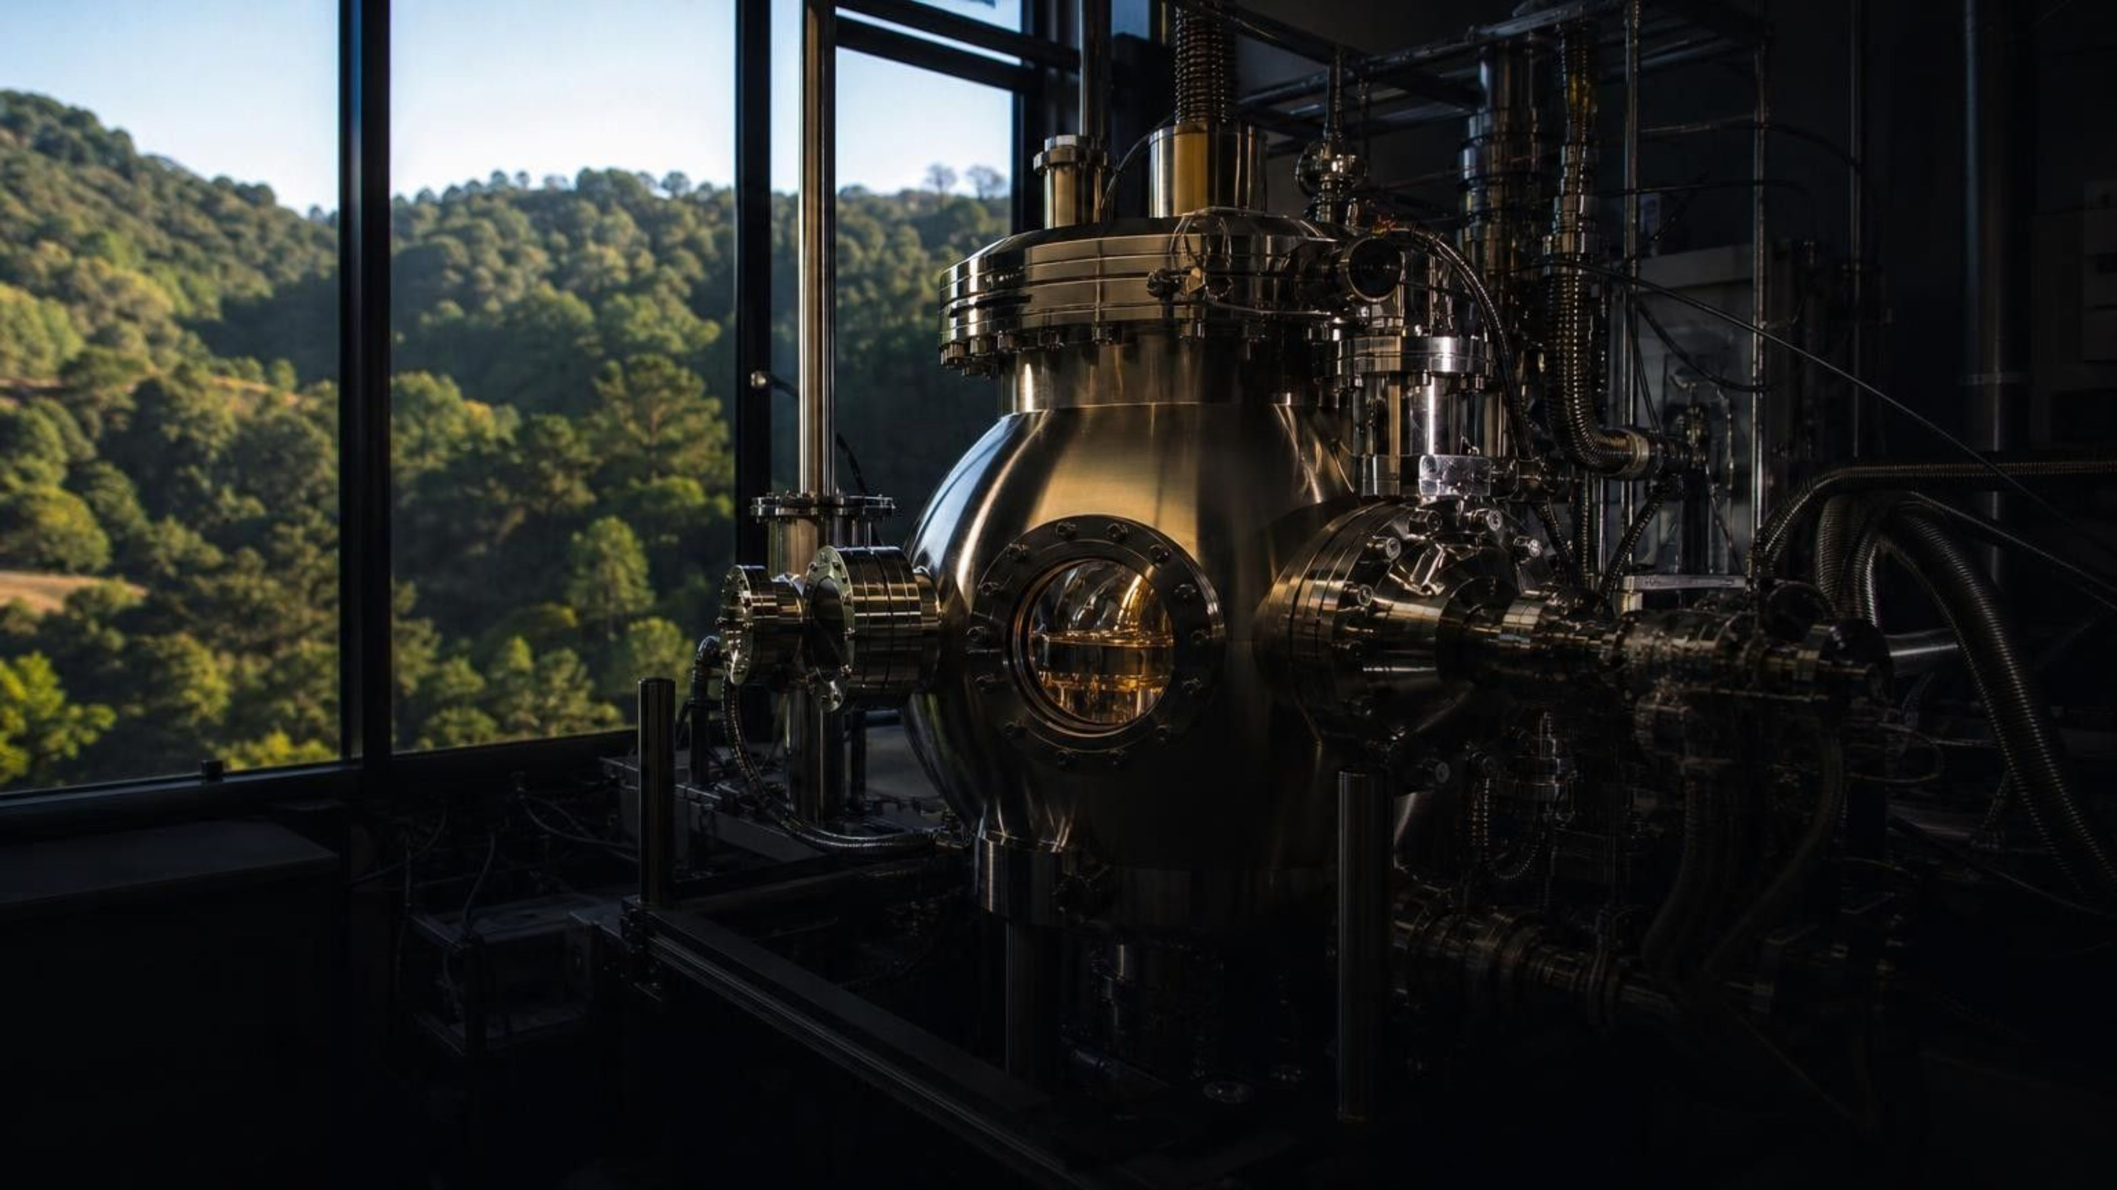
REAL-WORLD CONNECTION
California connection: moving atoms in San Jose
In 1989, at IBM's Almaden Research Center in San Jose, Don Eigler's team used a scanning tunneling microscope to drag 35 xenon atoms across a nickel surface one at a time and arrange them to spell the letters I-B-M. The third criterion from the STM project, moving single atoms on purpose, had been met in California, eight years after the first STM worked.
Notes:
This is a true story and a good one. The surface had to be chilled to about four degrees above absolute zero so the xenon atoms would stay put. Ask: why does meeting the 'move atoms' criterion matter beyond writing a logo? It opened the idea of building structures atom by atom, which is part of what people mean by nanotechnology. Also point out that the first STM was built in Switzerland; the moving-atoms milestone came from a California lab. If you have time, mention the Museum of Neon Art in Glendale as a local place to see glowing tubes of neon, argon and other gases, which connects back to the lesson's opening image of a tube that looks empty until it glows.
CONNECTS TO: W3 reading passage; extension prompt in chapter differentiation.
PACING: about 4 min

Slide 17
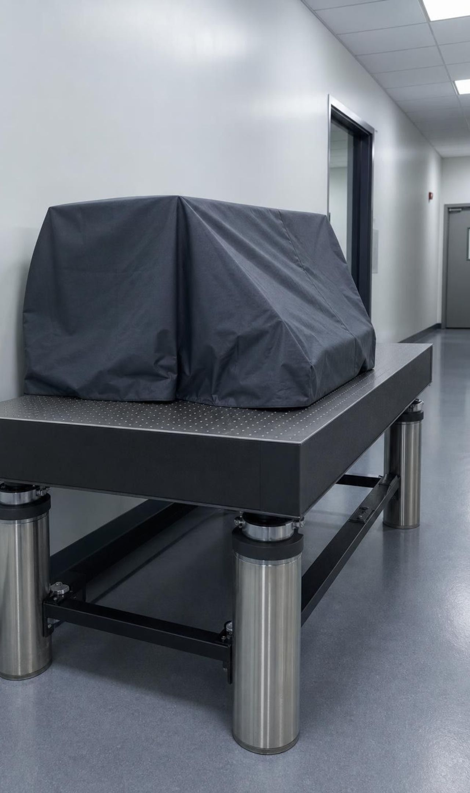
CHECK FOR UNDERSTANDING
Quick check: criterion or constraint?
1
The tool must tell apart two bumps that are 100 pm apart.
2
The building vibrates whenever people walk down the hall.
3
The tool should be able to push one atom to a new spot.
4
Only parts the lab already owns can be used in the first version.
5
The finished map must be readable by someone who did not make it.
Sort each statement about a surface-mapping tool. Hold up C for criterion, K for constraint.
17
Notes:
Run it fast, one statement at a time. After each, ask one student for the reason. The fourth statement is the most useful: it limits what the solution can be made from, so it is a constraint even though it sounds like a rule about success. The fifth is a criterion because it describes what a successful map must be like.
EXPECTED RESPONSES: 1 criterion, 2 constraint, 3 criterion, 4 constraint, 5 criterion.
WATCH FOR: Calling everything a constraint, or thinking criteria are always numbers. Statement 5 is a criterion without a number; ask how you would test it.
CONNECTS TO: Lab 3 recording sheet has a criteria/constraints table; W9 transfer task.
PACING: about 4 min

Slide 18
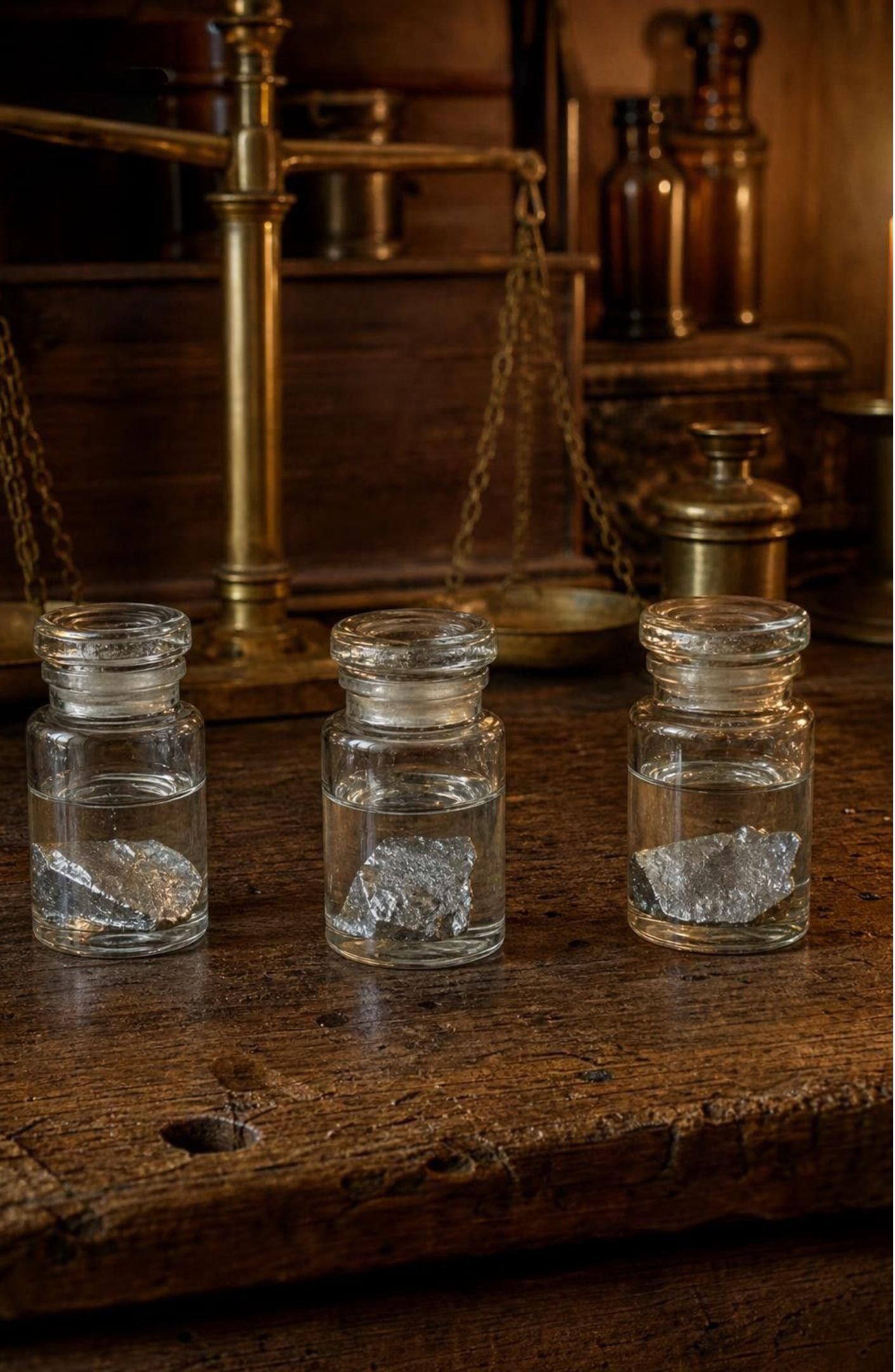
Classifying elements before anyone could map them
In 1829 Johann Döbereiner noticed trios of elements with matching properties.
Lithium, sodium and potassium: all soft, silvery metals, all react with water.
Their atomic masses: about 7, 23 and 39 daltons. The middle one is close to the average of the other two.
Same pattern in chlorine, bromine, iodine and in calcium, strontium, barium.
The middle element's behavior sits between its two partners as well.
18
Notes:
Chemists could not see atoms in the 1800s, but they could measure how much of one element combines with how much of another, which gave relative atomic masses. Döbereiner saw that some trios lined up: similar properties, and the middle mass near the average. Check it: (7 + 39) ÷ 2 = 23. Describe the water reactions in words only. Lithium fizzes steadily. Sodium reacts fast enough that it can catch fire. Potassium ignites at once. Reactivity climbs down the trio. The book's figure caption says all three burn, but its own text says lithium only fizzes; the text is right. Introduce the dalton: hydrogen is about 1 Da, oxygen about 16 Da. Mention that the printed values are averages because an element's atoms can differ slightly in mass; the book skips this.
WATCH FOR: Students may think 'atomic mass' is the mass of a whole sample. It is the mass of one atom, in daltons.
CONNECTS TO: Lab 2 mystery cards use the averaging pattern; W5 data worksheet computes averages for trios.
PACING: about 5 min

Slide 19
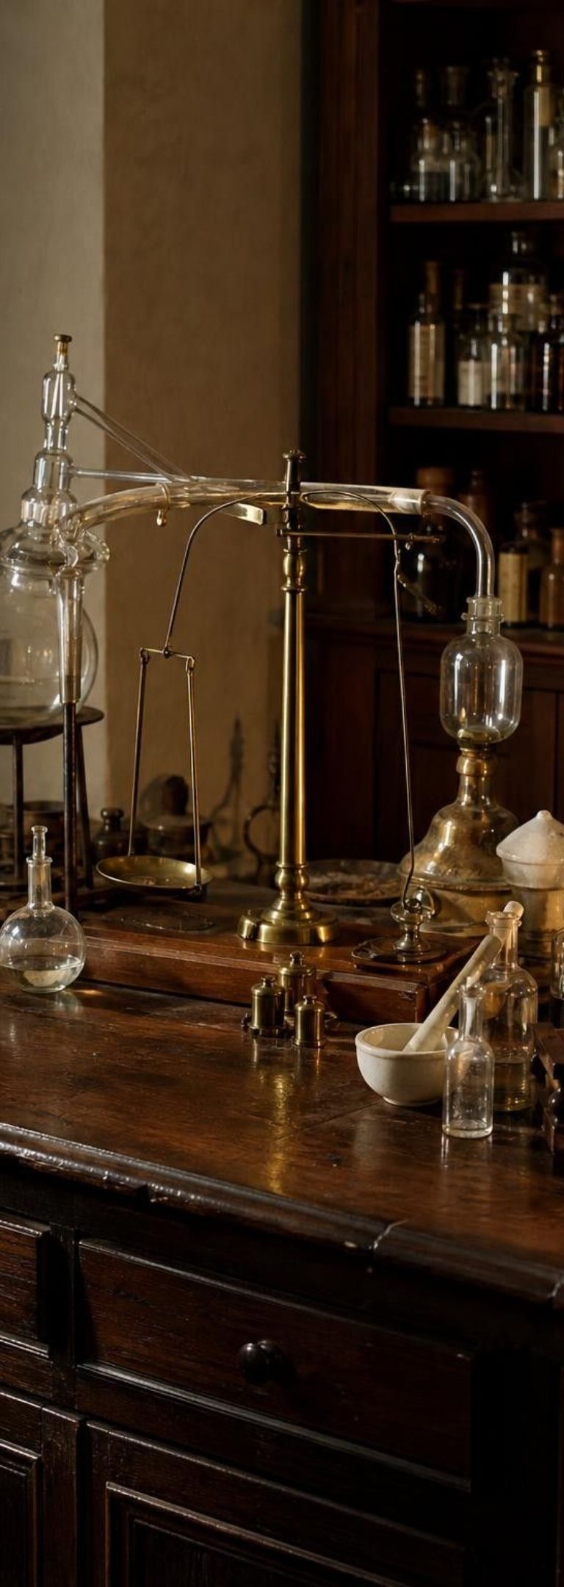
MODEL
A timeline of sorting the elements
Model: From trios to the modern table
1829: Döbereiner's trios: Groups of three elements with alike properties; middle mass near the average.
1864-65: Newlands' eights: Listed elements by mass; properties seemed to repeat every eighth element. Mocked at the time.
1869: Mendeleev's first table: Rows by rising mass, columns by shared properties. Lothar Meyer built a similar table independently.
1871: blanks with predictions: Mendeleev left gaps and predicted the mass and behavior of three missing elements.
1875-1886: predictions confirmed: Gallium (1875), scandium (1879) and germanium (1886) matched the predicted gaps.
1913: atomic number: Henry Moseley showed the true order is by atomic number, fixing the few mass exceptions.
Each step kept the useful part of the last one and fixed what did not work.
19
Notes:
Walk the timeline and stress that this is how science usually moves: a partial pattern (trios), a bolder but flawed pattern (Newlands' eights broke down for heavier elements), then a table strong enough to make predictions. Newlands was laughed at by the Chemical Society in London in 1866; in 1887 the Royal Society awarded him its Davy Medal for the same work. Mendeleev was not the only one building a table; Lothar Meyer in Germany had a similar arrangement at the same time, but Mendeleev's predictions are what made his version famous. The last entry, atomic number, is where the modern table gets its order; students meet it later, but it explains why a few elements are out of mass order.
WATCH FOR: Students think the table appeared fully formed from one genius. The timeline shows at least four people over 80 years.
CONNECTS TO: W3 reading; W8 collaborative jigsaw can assign one timeline entry per expert group.
PACING: about 6 min

Slide 20
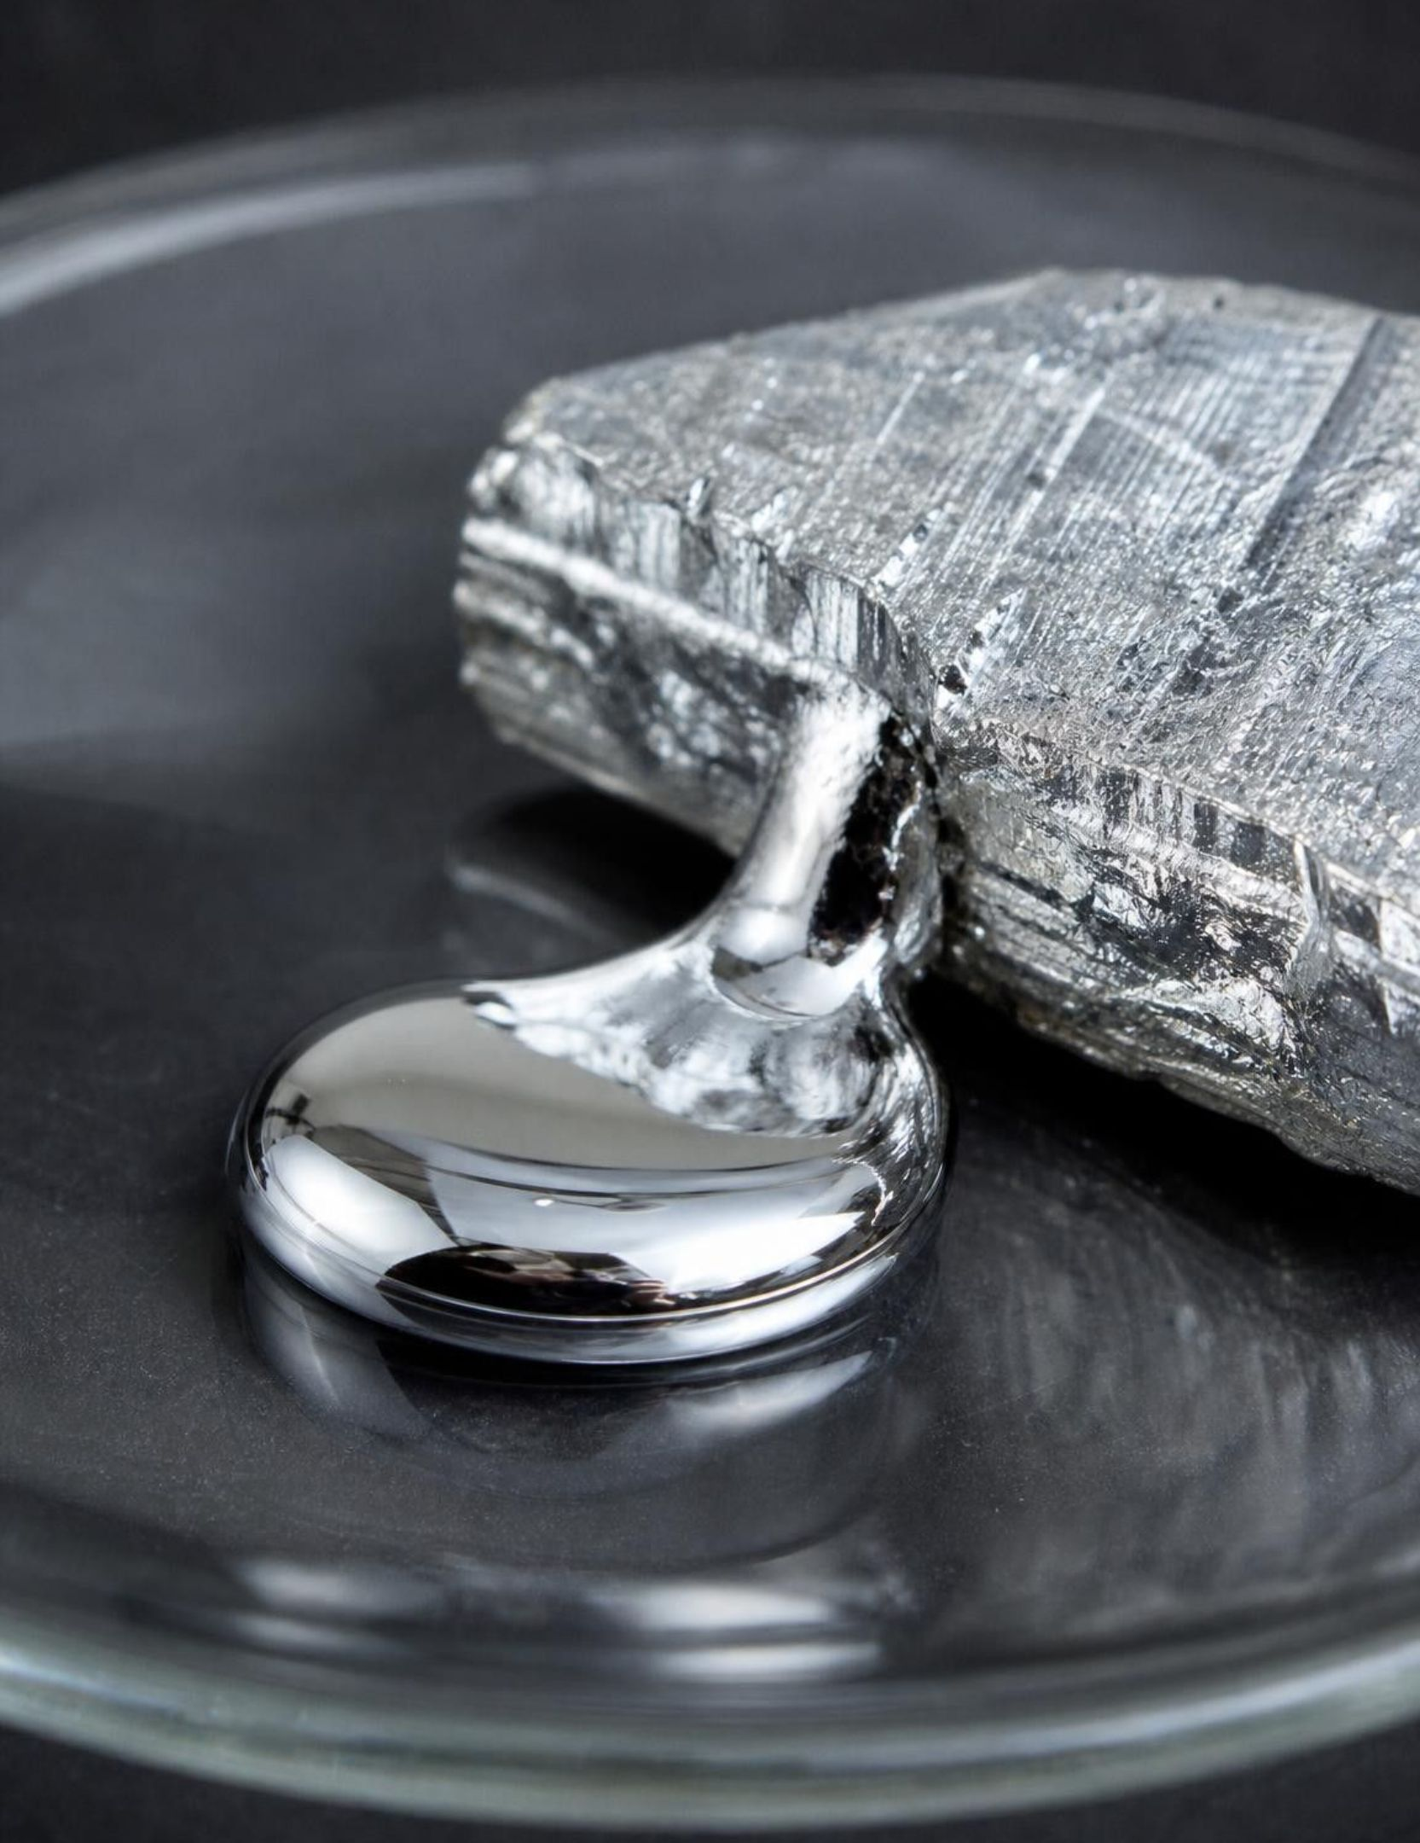
Why leaving a blank space was the brave move
Mendeleev refused to force an element into a column where its properties did not fit. Instead he left a gap and claimed an undiscovered element belonged there. He predicted its atomic mass by averaging its neighbors and predicted its behavior from its column. When gallium turned up in 1875 with almost exactly the predicted properties, the table stopped being a list and became a scientific model.
20
Notes:
Ask students what makes a prediction scientific: it has to say something specific that could turn out wrong. Mendeleev's gap for 'eka-aluminium' said: mass near 68, a soft metal with a low melting point, forming a compound with oxygen in a particular ratio. Gallium matched. A model that only explains the past is weak; one that calls the future correctly earns trust. Connect to Lab 2: groups will leave gaps in their card arrangements and must write a prediction for each gap, with a mass estimate and a property.
WATCH FOR: Students may think blanks mean the table was wrong. Blanks were claims, and the claims were tested.
CONNECTS TO: Lab 2 blank-space prediction; W6 CER can use gallium as supporting evidence.
PACING: about 5 min

Slide 21
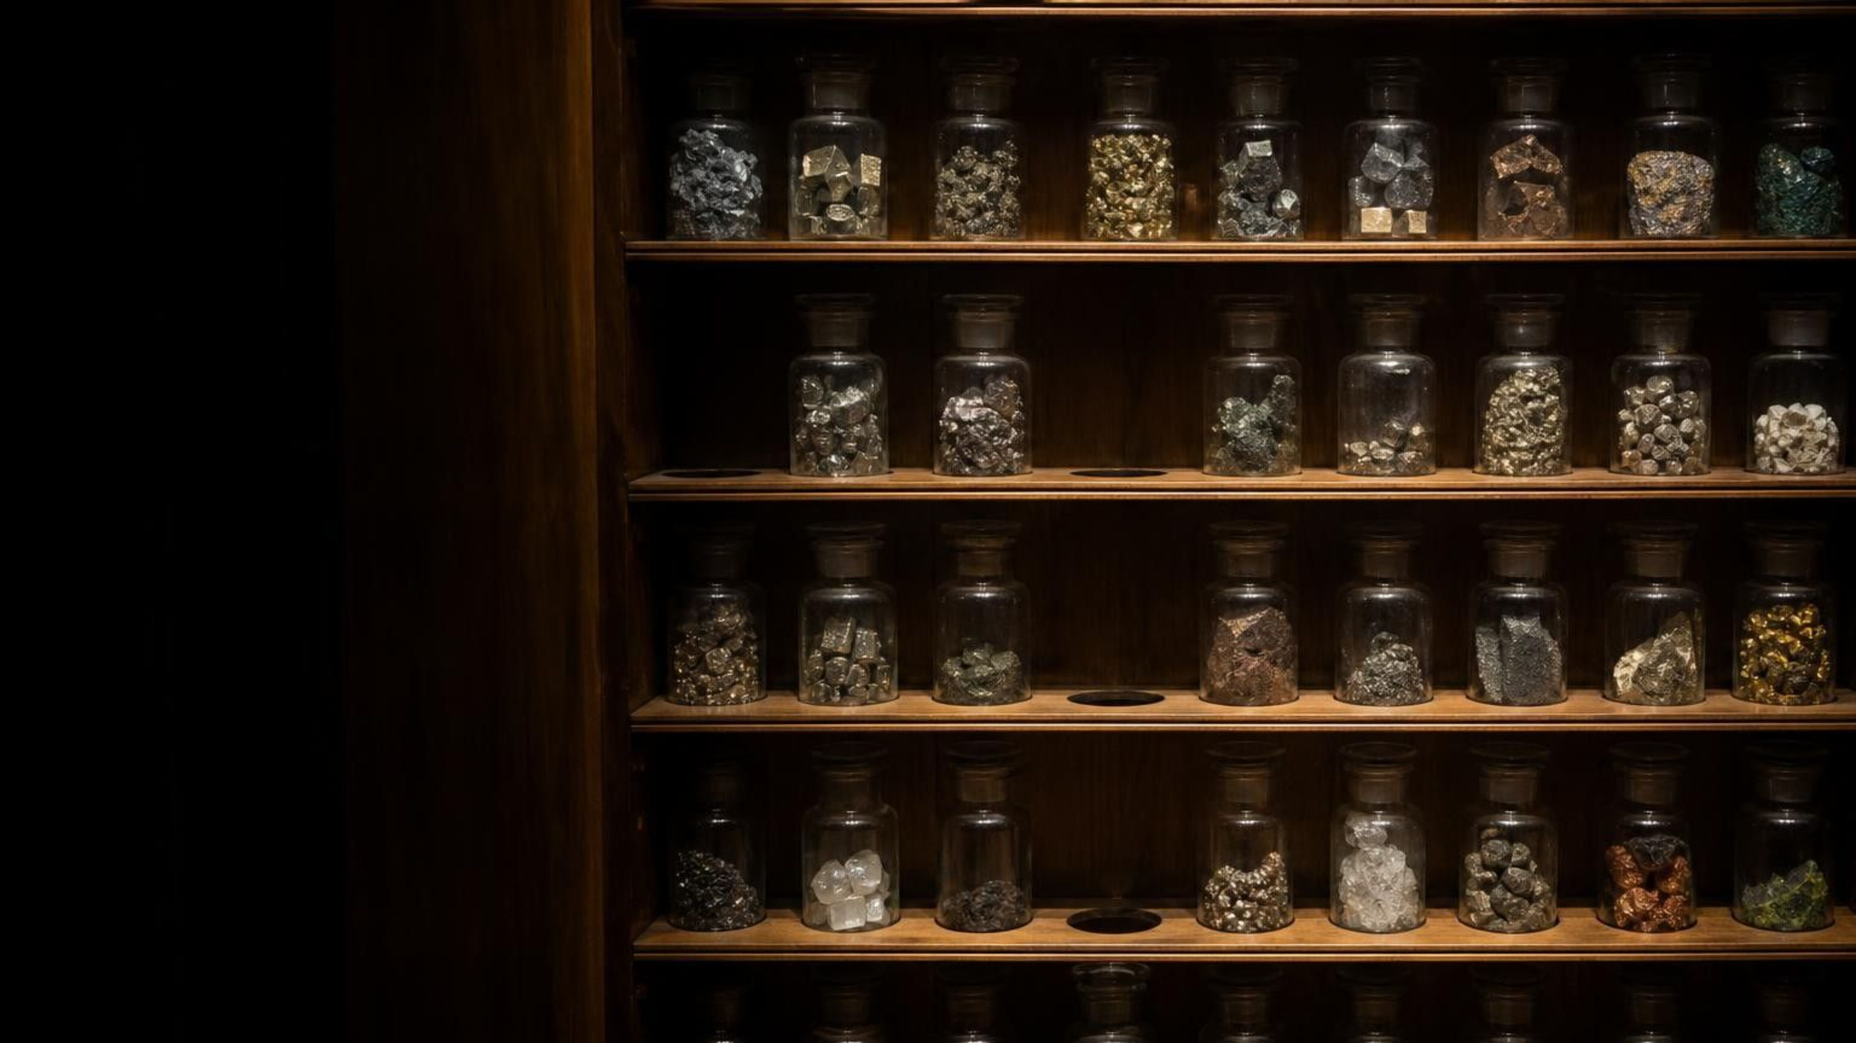
THINK, PAIR, SHARE
Discuss: would you trust a chart with holes in it?
A classmate says a table with blank spaces proves the scientist did not know what they were doing. Argue for and against, using what Mendeleev did with his blanks.
Notes:
Run as a two-minute pair argument, one partner for each side, then switch. Collect the strongest point from each side. The 'against' side should land on the idea that the blanks were specific predictions that were later confirmed, which is stronger evidence for the model than a table with no blanks that explained nothing new. The 'for' side has a fair point too: a table with too many blanks, or blanks whose predictions fail, would be a weak model. Ask: what would have happened to the table if gallium's properties had not matched?
EXPECTED RESPONSES: For: blanks show incomplete knowledge. Against: the blanks were predictions, three of which came true, so they show the model works. Synthesis: blanks are fine when they make testable predictions.
CONNECTS TO: Lab 2 debrief; W8 collaborative task.
PACING: about 6 min

Slide 22
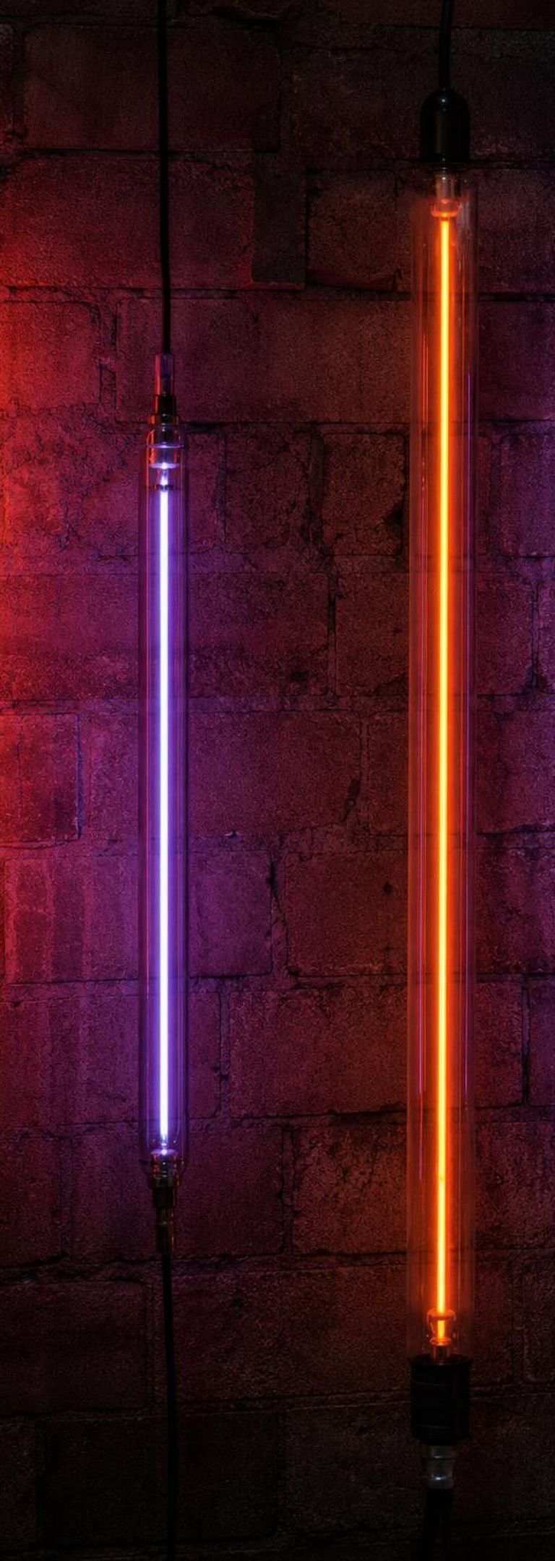
MODEL
Reading the neighborhoods of the periodic table
Model: Where things are on the table and what position tells you
Period (row): Atomic mass generally rises from left to right along a row, with a few exceptions.
Group (column): Elements in one column tend to share properties and react in similar ways.
Far-left column: Li, Na, K, Rb: Soft, silvery metals that react with water, more violently going down the column.
Far-right column: He, Ne, Ar, Kr: Colorless gases at room temperature that form almost no compounds. Neon and argon glow in signs.
Element tile: Shows the symbol, the name and the average atomic mass in daltons.
The exceptions: Ar before K, Te before I: Properties decided the order, not mass. The reason, atomic number, comes later.
Position is a prediction: tell me the column and I can guess how the element behaves.
22
Notes:
Project a real periodic table beside this slide if you have one on the wall. Point to the far-left column and the far-right column and have students describe the pattern in each. Then point to argon (39.9) and potassium (39.1) and ask what is odd: potassium comes after argon even though its mass is lower. Mendeleev had the same issue with tellurium and iodine and chose properties over mass. Tell students the full explanation, atomic number, is coming in a later lesson. Note that hydrogen sits at the top of the left column but is a gas and is not one of the soft metals; it is an exception in its own right.
WATCH FOR: 'The table is sorted by mass.' Mostly, but the modern table is sorted by atomic number.
CONNECTS TO: Lab 2 arrangement; W5 data on masses; W10 mastery items on groups.
PACING: about 6 min

Slide 23
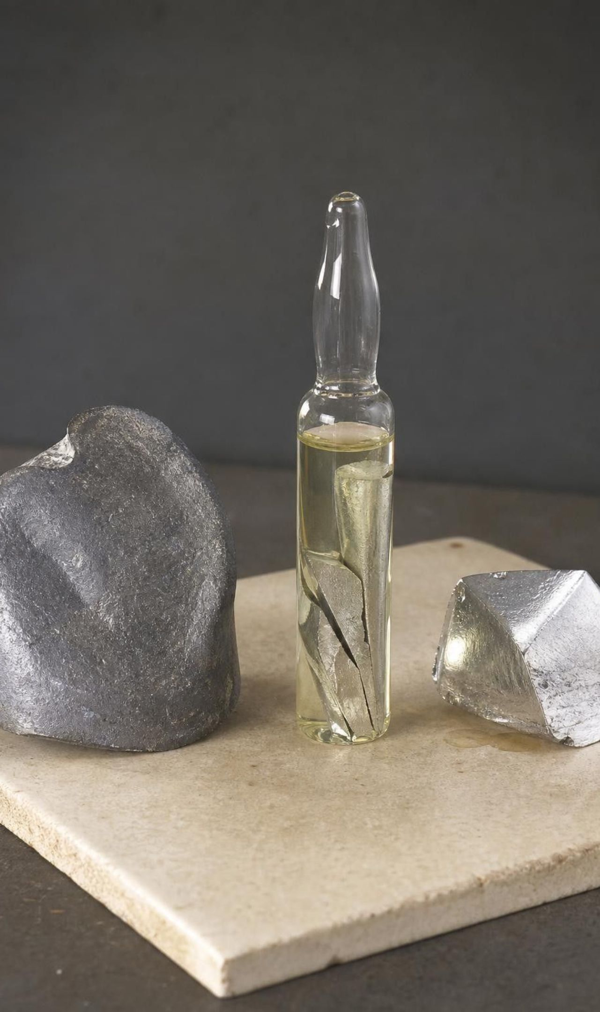
VOCABULARY IN CONTEXT
Reading one tile of the table
atomic mass: The mass of one atom in daltons. The printed value is an average for the element's atoms. Sodium, about 23 Da, has an atom roughly 23 times as massive as a hydrogen atom.
group: A column of the periodic table whose elements tend to behave alike. Neon and argon share a group, and both are unreactive gases used in lights.
chemical symbol: A one- or two-letter shorthand for an element, the same in every language. Pb means lead, from the Latin plumbum; K means potassium, from the Latin kalium.
23
Notes:
Show how to read a tile: symbol big in the middle, name under it, mass in daltons. Explain that symbols are one or two letters and that the first letter is always a capital, the second always lowercase, so Co (cobalt) is not CO (carbon and oxygen). Some symbols come from Latin or other older names, which is why they do not match the English word. Have students find three symbols on a table that do not match the English name (Fe, Ag, Au, Na, K, Pb, Sn, W, Hg).
WATCH FOR: Writing symbols with two capitals, or reading a three-letter placeholder like Uuo as a permanent symbol. Those were temporary and were replaced in 2016.
CONNECTS TO: W2 vocabulary; W10 mastery.
PACING: about 4 min

Slide 24
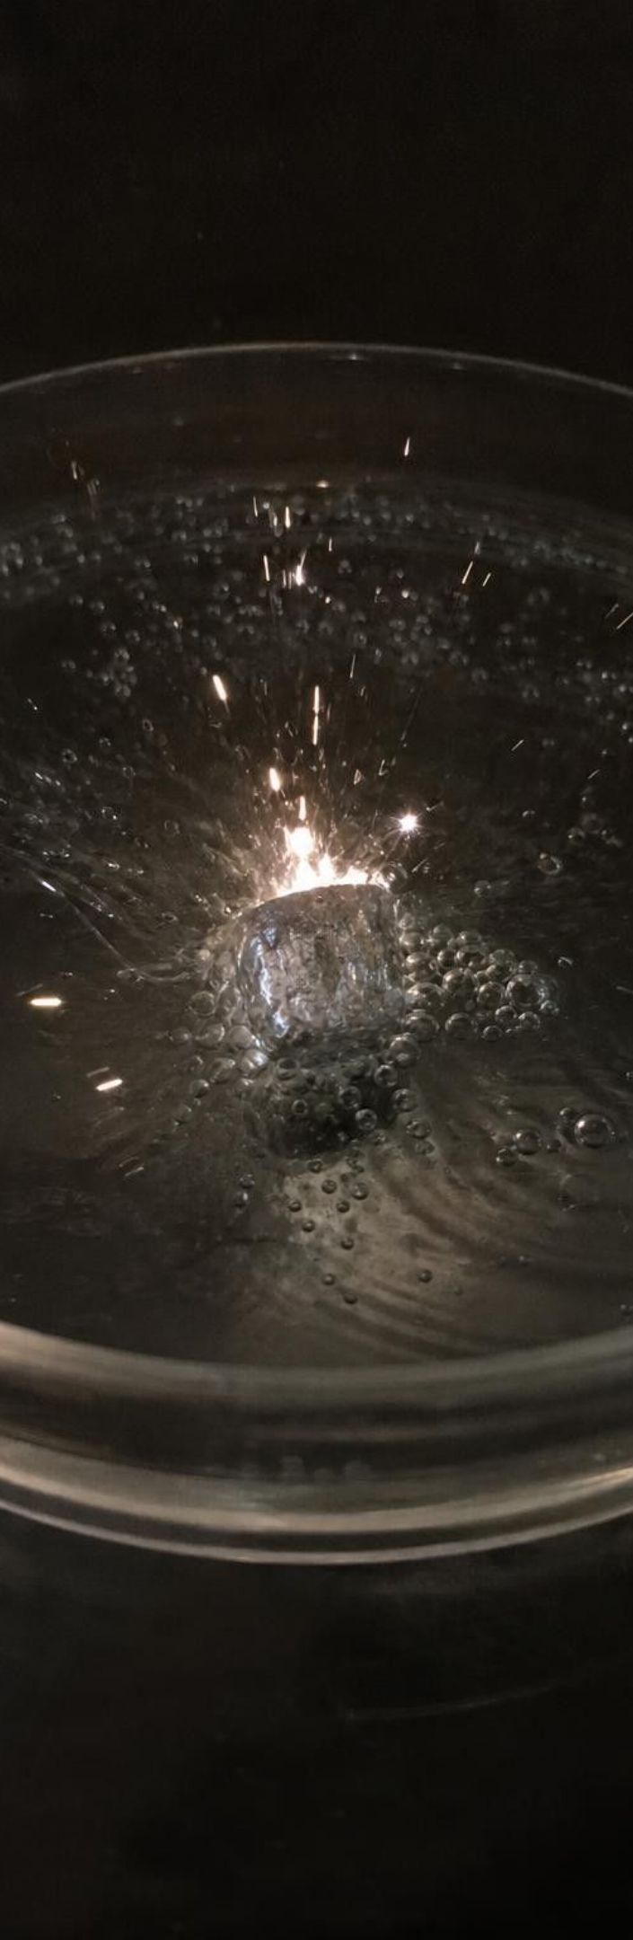
APPLY IT
Task: sort the mystery elements like Mendeleev
Simulated data for practice.
Using only the properties and masses below, decide which elements belong in the same column, order them, and predict a seventh element's mass and behavior.
Mystery element | Atomic mass (Da) | State at room temp. | Reaction with water | Other
Vex | 7 | soft silvery metal | fizzes steadily | lightest metal in the set
Tam | 20 | colorless gas | none | glows red-orange in a lit tube
Rue | 23 | soft silvery metal | fast; can ignite | stored under oil
Pim | 39 | soft silvery metal | ignites at once | stored under oil
Nol | 40 | colorless gas | none | glows violet in a lit tube
Kesh | 84 | colorless gas | none | used in some bright lamps
24
Notes:
This is a teaching dataset: the names are the same invented names as the Lab 2 cards, with the card masses rounded to whole numbers; the properties mirror real elements (lithium, neon, sodium, potassium, argon, krypton). Use it after Lab 2, not before, or it gives the card identities away. Give groups eight minutes. Step 1: sort into columns by properties (metals that react with water; unreactive gases). Step 2: order each column by mass. Step 3: notice that Pim (39) comes before Nol (40) by mass but belongs with the metals, an exception just like the real one. Step 4: a seventh element is a soft metal that reacts even more violently than Pim; predict its mass. The metal column runs 7, 23, 39; the gas column runs 20, 40, 84, so the next metal should be a little above 84, roughly 85. Rubidium is 85.5. Ask which column a glowing-sign gas belongs in and why that fits the lesson's opening image.
EXPECTED RESPONSES: Two columns: metals Vex, Rue, Pim (7, 23, 39) and gases Tam, Nol, Kesh (20, 40, 84). Predicted seventh element: soft metal, mass about 85, reacts violently with water, stored under oil. Students should note Pim/Nol as a mass-order exception.
WATCH FOR: Groups that sort by mass alone will mix the two columns. Ask them what Mendeleev did when mass and properties disagreed.
CONNECTS TO: Lab 2 is the full version with 14 cards; W5 data worksheet; W8 collaborative sort.
PACING: about 10 min

Slide 25
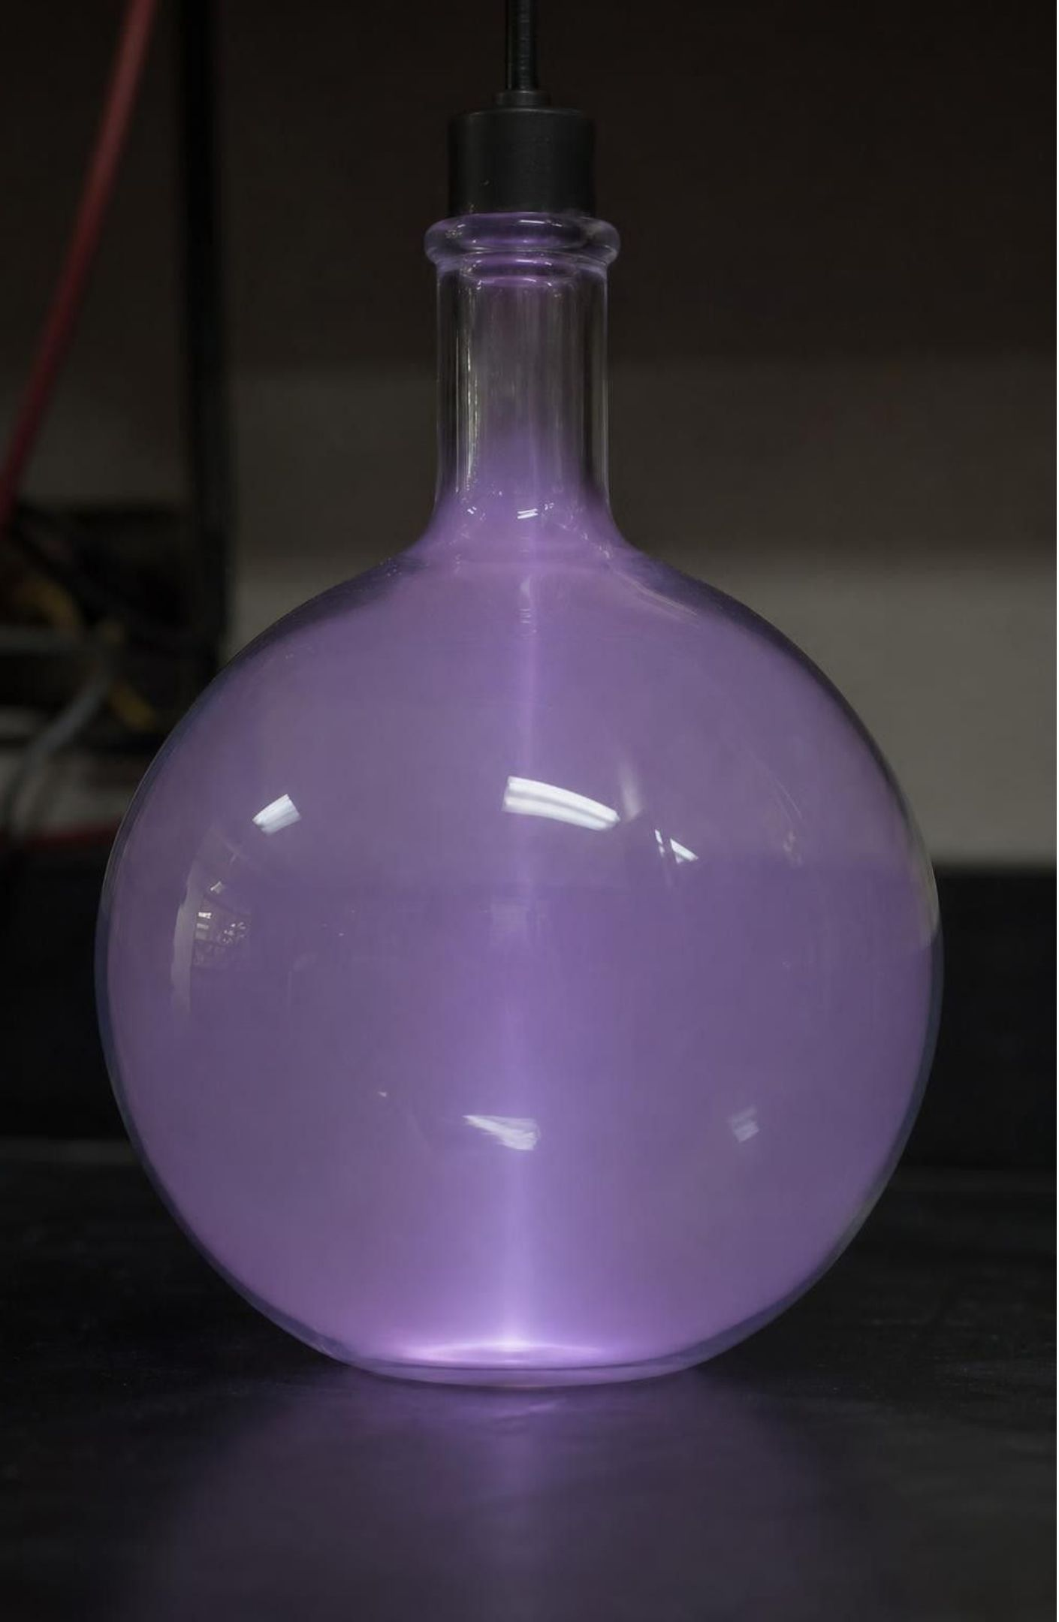
CHECK FOR UNDERSTANDING
Quick check: where does it live?
A newly found element is a colorless gas at room temperature that forms almost no compounds. Where do you expect it on the table, and which elements should it resemble?
A. Far-right column, like neon and argon
B. Far-left column, like sodium and potassium
C. Middle of the table, like iron and copper
D. Impossible to say from two properties
25
Notes:
Quick vote, then one sentence of reasoning. The point is that position predicts behavior and behavior predicts position; that two-way link is why the table is a model, not a list. Push a follow-up: what would you expect its atomic mass to be relative to krypton if it sits below krypton? Larger.
EXPECTED RESPONSES: A. Unreactive gases share the far-right column; it should resemble neon, argon and krypton and should have a larger mass than the element above it.
WATCH FOR: Choosing D because 'you need to see the atoms.' Classification worked for 150 years before anyone mapped an atom.
CONNECTS TO: W10 mastery; Lab 2 analysis.
PACING: about 3 min

Slide 26

MISCONCEPTION CHECK
True or false? Air is nothing
"An inflated balloon weighs the same as an empty one, because air is invisible and invisible things are not made of anything."
True or false? Explain your reasoning.
26
Notes:
Return to the parking lot from day one. Ask students to evaluate the statement in writing with evidence from the lesson. The balance reading rose by 0.04 g, so something with mass entered. Air is a mixture of gas particles, mostly nitrogen and oxygen; each particle has mass; a pump packs a vast number of them into the balloon. Invisibility is about size and spacing, not about existence. Then revisit the helium puzzle from the phenomenon slide: a helium balloon pushed down on a balance would read lighter than when empty, not because helium has no mass (it does, about 4 Da per atom) but because the surrounding air pushes the balloon up more than its contents weigh. Keep that as a preview and do not assess it.
EXPECTED RESPONSES: False. The mass rose, so matter went in; air is made of particles too small and too spread out to see.
WATCH FOR: Students may flip to 'everything invisible is matter.' Light is invisible in a vacuum and is not matter; the test is mass, not visibility.
CONNECTS TO: W6 CER on the balloon evidence; W7 misconception repair.
PACING: about 6 min

Slide 27
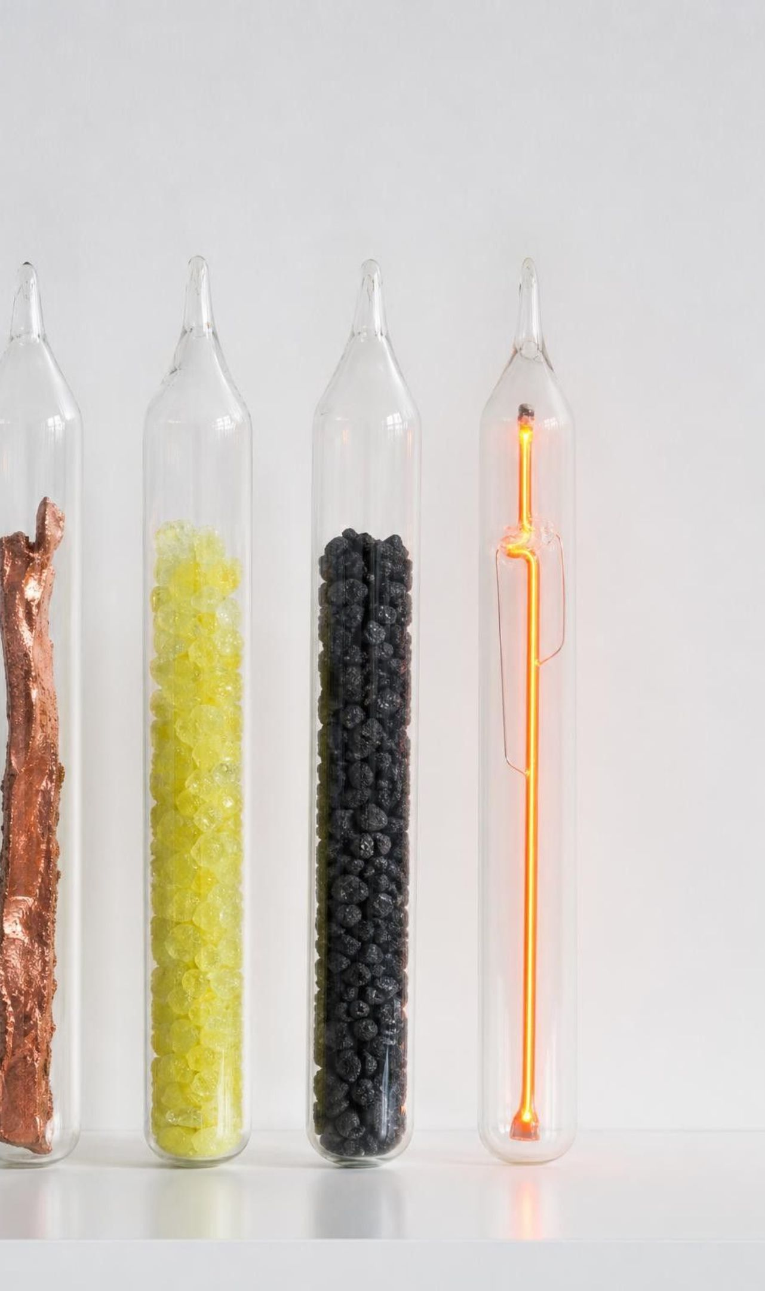
PUTTING IT TOGETHER
Putting it together
1
All matter, including air, is made of atoms; an element is a substance of one kind of atom.
2
Atoms live on the picometer scale, about ten million times smaller than a sand grain.
3
Precise criteria and constraints let Rohrer and Binnig build a tool that maps surfaces atom by atom.
4
Patterns in properties and mass, plus bold predictions, grew into the periodic table.
5
An element's position on the table predicts how it behaves.
27
Notes:
Have students write a three-sentence summary using at least four vocabulary terms, then trade with a partner who checks that atom and element are used correctly. Ask for one thing from each lab: Lab 1 (how many halvings), Lab 2 (what the gaps meant), Lab 3 (one criterion they wrote). Preview Lesson 2: atoms join into molecules and extended structures, which is why diamond and graphite can both be carbon yet behave so differently.
CONNECTS TO: W10 mastery as the quiz; L02 Molecules and Extended Structures next.
PACING: about 6 min

Slide 28

EXIT TICKET
Exit ticket
Write one sentence that uses both 'atom' and 'element' correctly.
Name one criterion and one constraint from your touch-microscope design, and label which is which.
An element glows in a sign and never reacts. Which column of the table is it in, and name a neighbor.
About how many times smaller than a millimeter is an atom: a thousand, a million, or ten million?
28
Notes:
Collect on index cards or a shared form. Use item 1 to spot the atom/element mix-up, item 2 to see whether Lab 3's definitions landed, items 3 and 4 for the table and scale targets. Sort the cards into three piles before the next class and reteach from the largest pile.
EXPECTED RESPONSES: 1: for example 'A gold ring is the element gold, made of a huge number of gold atoms.' 2: criterion such as 'map must show every bump taller than 1 cm'; constraint such as 'only one skewer, no lifting the lid.' 3: far-right column, neighbor neon, argon, krypton or helium. 4: about ten million (1 mm is 10⁹ pm; an atom is a few hundred pm).
WATCH FOR: Item 4 answers of 'a thousand' signal the cell-versus-atom confusion from the scale ladder.
CONNECTS TO: W10 mastery; chapter evidenceOfLearning.
PACING: about 5 min

