Slide 1
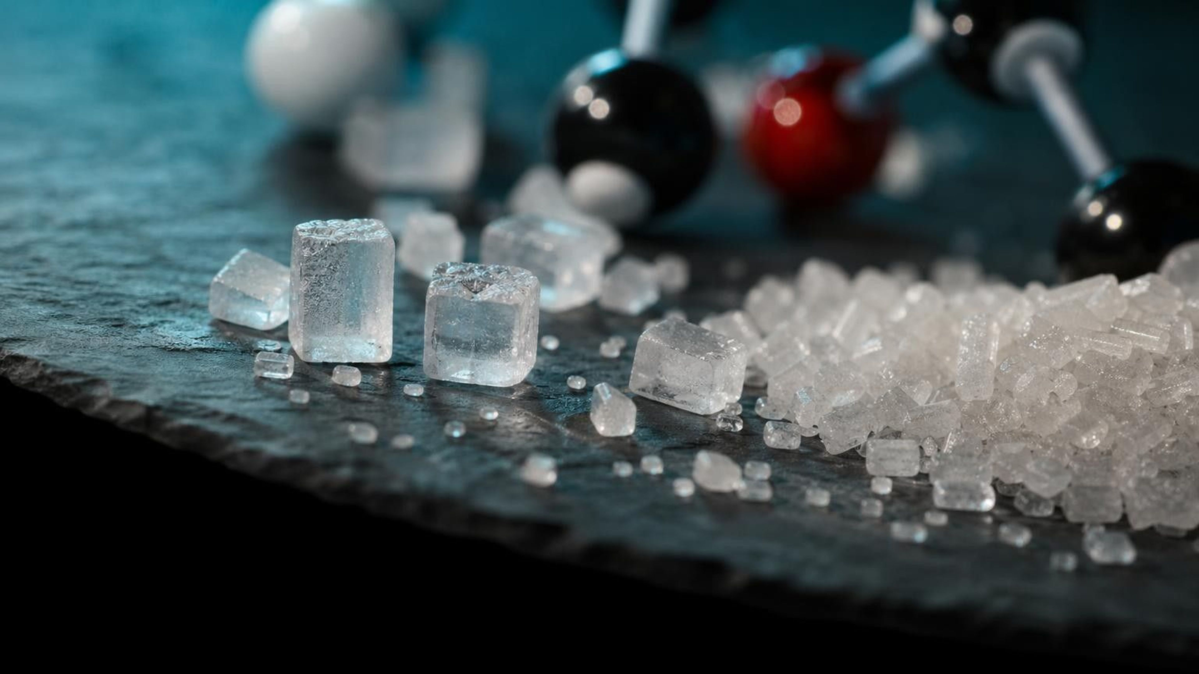
Molecules and Extended Structures
Chapter 2 of 29 · The Composition of Matter
Lesson 2: How do a few kinds of atoms build millions of substances?
Angela's Wand · Bring Science Alive! 7th Grade Integrated
Notes:
Last lesson ended with a puzzle: diamond and pencil graphite are both pure carbon, yet one cuts glass and the other smears on paper. This lesson answers it. We will see that atoms join through chemical bonds, that what a substance is depends on which atoms it has and how they are connected, and that some structures stop at a few atoms while others could keep growing forever. Tell students there are three investigations: building molecules and a salt block out of gumdrops, a station lab where they match real substances to structure types and pick materials for jobs, and an engineering challenge where toothpick sheets and networks are loaded, pushed and dropped. No chemicals or flames anywhere.
CONNECTS TO: Overview of Lab 1, Lab 2 and Lab 3; W1 opens on the next slide.
PACING: about 2 min

Slide 2
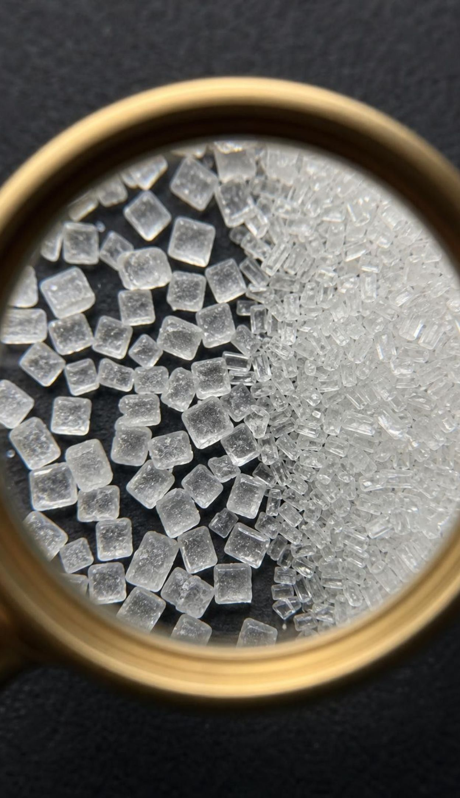
Salt cubes and sugar slants
PHENOMENON
Pour a pinch of salt and a pinch of sugar on dark paper and look through a hand lens. Almost every salt grain is a tiny cube with square faces. Sugar grains are angular too, but slanted, like tilted bricks, never square. Both are white, both dissolve, and grains of all sizes keep their family shape. What inside each grain decides its outside shape?
Notice: what do all the salt grains share, large or small?
Wonder: if you crushed a grain, would the pieces keep the shape?
Predict: are the pieces inside salt and sugar the same kind of thing?
2
Notes:
Run this live if you possibly can: hand lenses, a pinch of each on black construction paper, two minutes of silent looking. Then two minutes of writing a notice and a wonder before anyone speaks. Collect observations without judging. Students usually see the cubes right away and need a prompt to see that sugar grains have slanted faces. Push on the key idea: nothing on the outside of the shaker made these shapes; something inside the grain, too small to see, must repeat in a way that shows up at the surface. Park the question 'what is inside?' on the board. By the end of the lesson students will answer: salt is sodium and chlorine particles alternating at right angles, repeated over and over; sugar is a stack of 45-atom sucrose molecules that pack in a slanted pattern.
EXPECTED RESPONSES: Notice: salt grains are cubes or broken cubes, sugar grains are longer and slanted, both are clear or white, sizes vary. Wonder: why cubes, is sugar a crystal too, would crushed pieces be cubes. Predict: many say both are 'the same kind of pieces'; that claim gets tested on slides 14-17.
WATCH FOR: 'Salt grains are cubes because they are cut that way' or 'because the factory makes them that way.' Do not correct yet; write it down and return on slides 15 and 24.
CONNECTS TO: W1 phenomenon worksheet records the notice/wonder and initial explanation. Lab 2 station 1 returns to the hand lens.
PACING: about 8 min

Slide 3
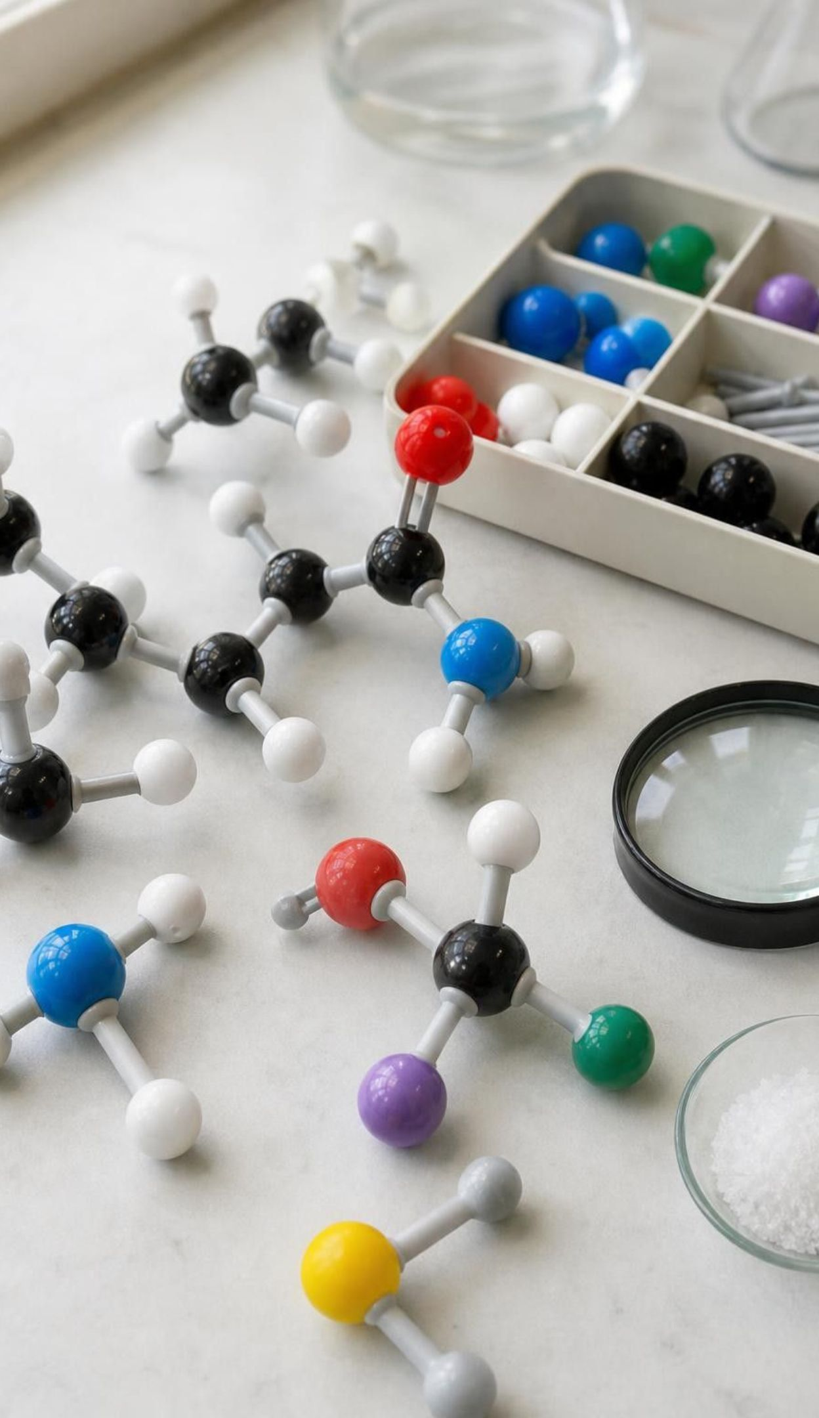
What you will be able to do
LEARNING TARGETS
1
Explain that atoms bond into molecules, and read a model or formula for which atoms and how many.
2
Explain how composition and structure together decide which substance a molecule is.
3
Tell a molecule (exact count) from an extended structure (repeating subunit, fixed ratio).
4
Build or draw a model of a simple molecule and of an extended structure, and say what each part means.
5
Use atomic-level structure to explain patterns you can see, like salt cubes and pencil marks.
3
Notes:
Read the targets aloud and have students star the one that sounds hardest. Point out that targets 1 and 2 belong to the first two days, 3 and 4 are the middle of the lesson and all three labs, and 5 brings us back to the salt and sugar grains. The exit ticket on the last day asks about all five.
CONNECTS TO: Targets map to W2 and Lab 1 (1), W7 (2), W5 and W6 (3), W4 and Lab 1 (4), Lab 2, Lab 3 and W9 (5).
PACING: about 2 min

Slide 4
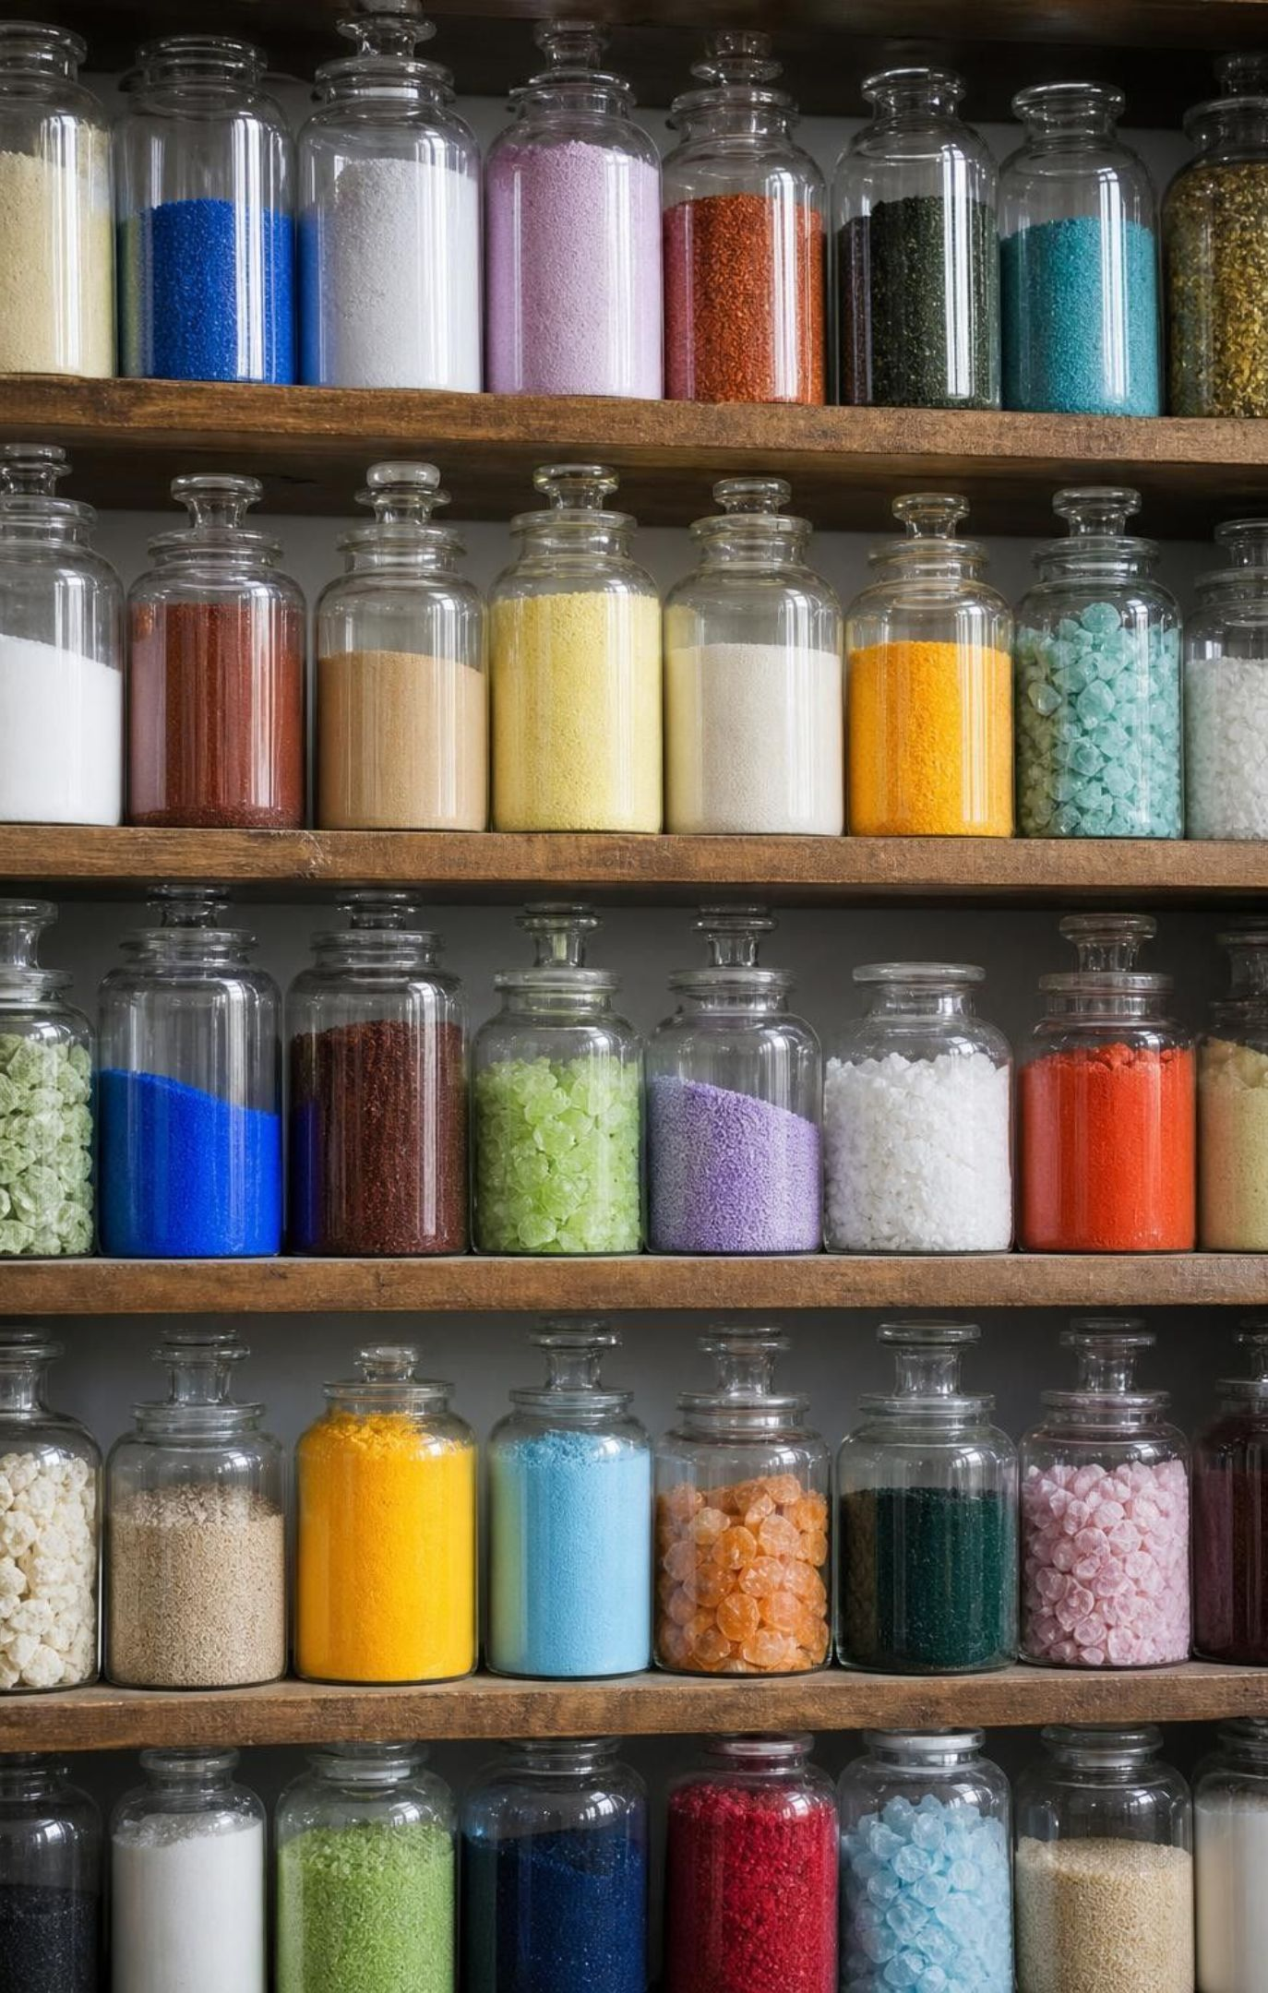




Fewer than 100 kinds of atoms, millions of substances
Fewer than a hundred kinds of atoms occur in nature.
Yet chemists have catalogued many millions of different substances.
Twelve notes in an octave build nearly every song you know; order and combination do the work.
Atoms work the same way: which ones, how many, and how they are joined.
4
Notes:
Connect to Lesson 1's periodic table: fewer than a hundred naturally occurring kinds of atoms. Then give the contrast: the number of known substances is in the hundreds of millions and still growing. Ask how that is possible. Use the music analogy: a piano has only twelve different notes in each octave, yet the number of possible melodies is practically endless, because notes can be combined in different numbers and different orders. Ask students to carry the analogy: what is the 'note' (a kind of atom), what is the 'melody' (a substance), what are the two things that can change (which notes and how they are arranged). The book says 92 natural elements; the count is a matter of convention, so stick with 'fewer than a hundred.'
WATCH FOR: Students may think each substance needs its own kind of atom. The whole point is that a few kinds, combined differently, make everything.
CONNECTS TO: W2 vocabulary; W3 reading passage opens with the same contrast.
PACING: about 4 min

Slide 5
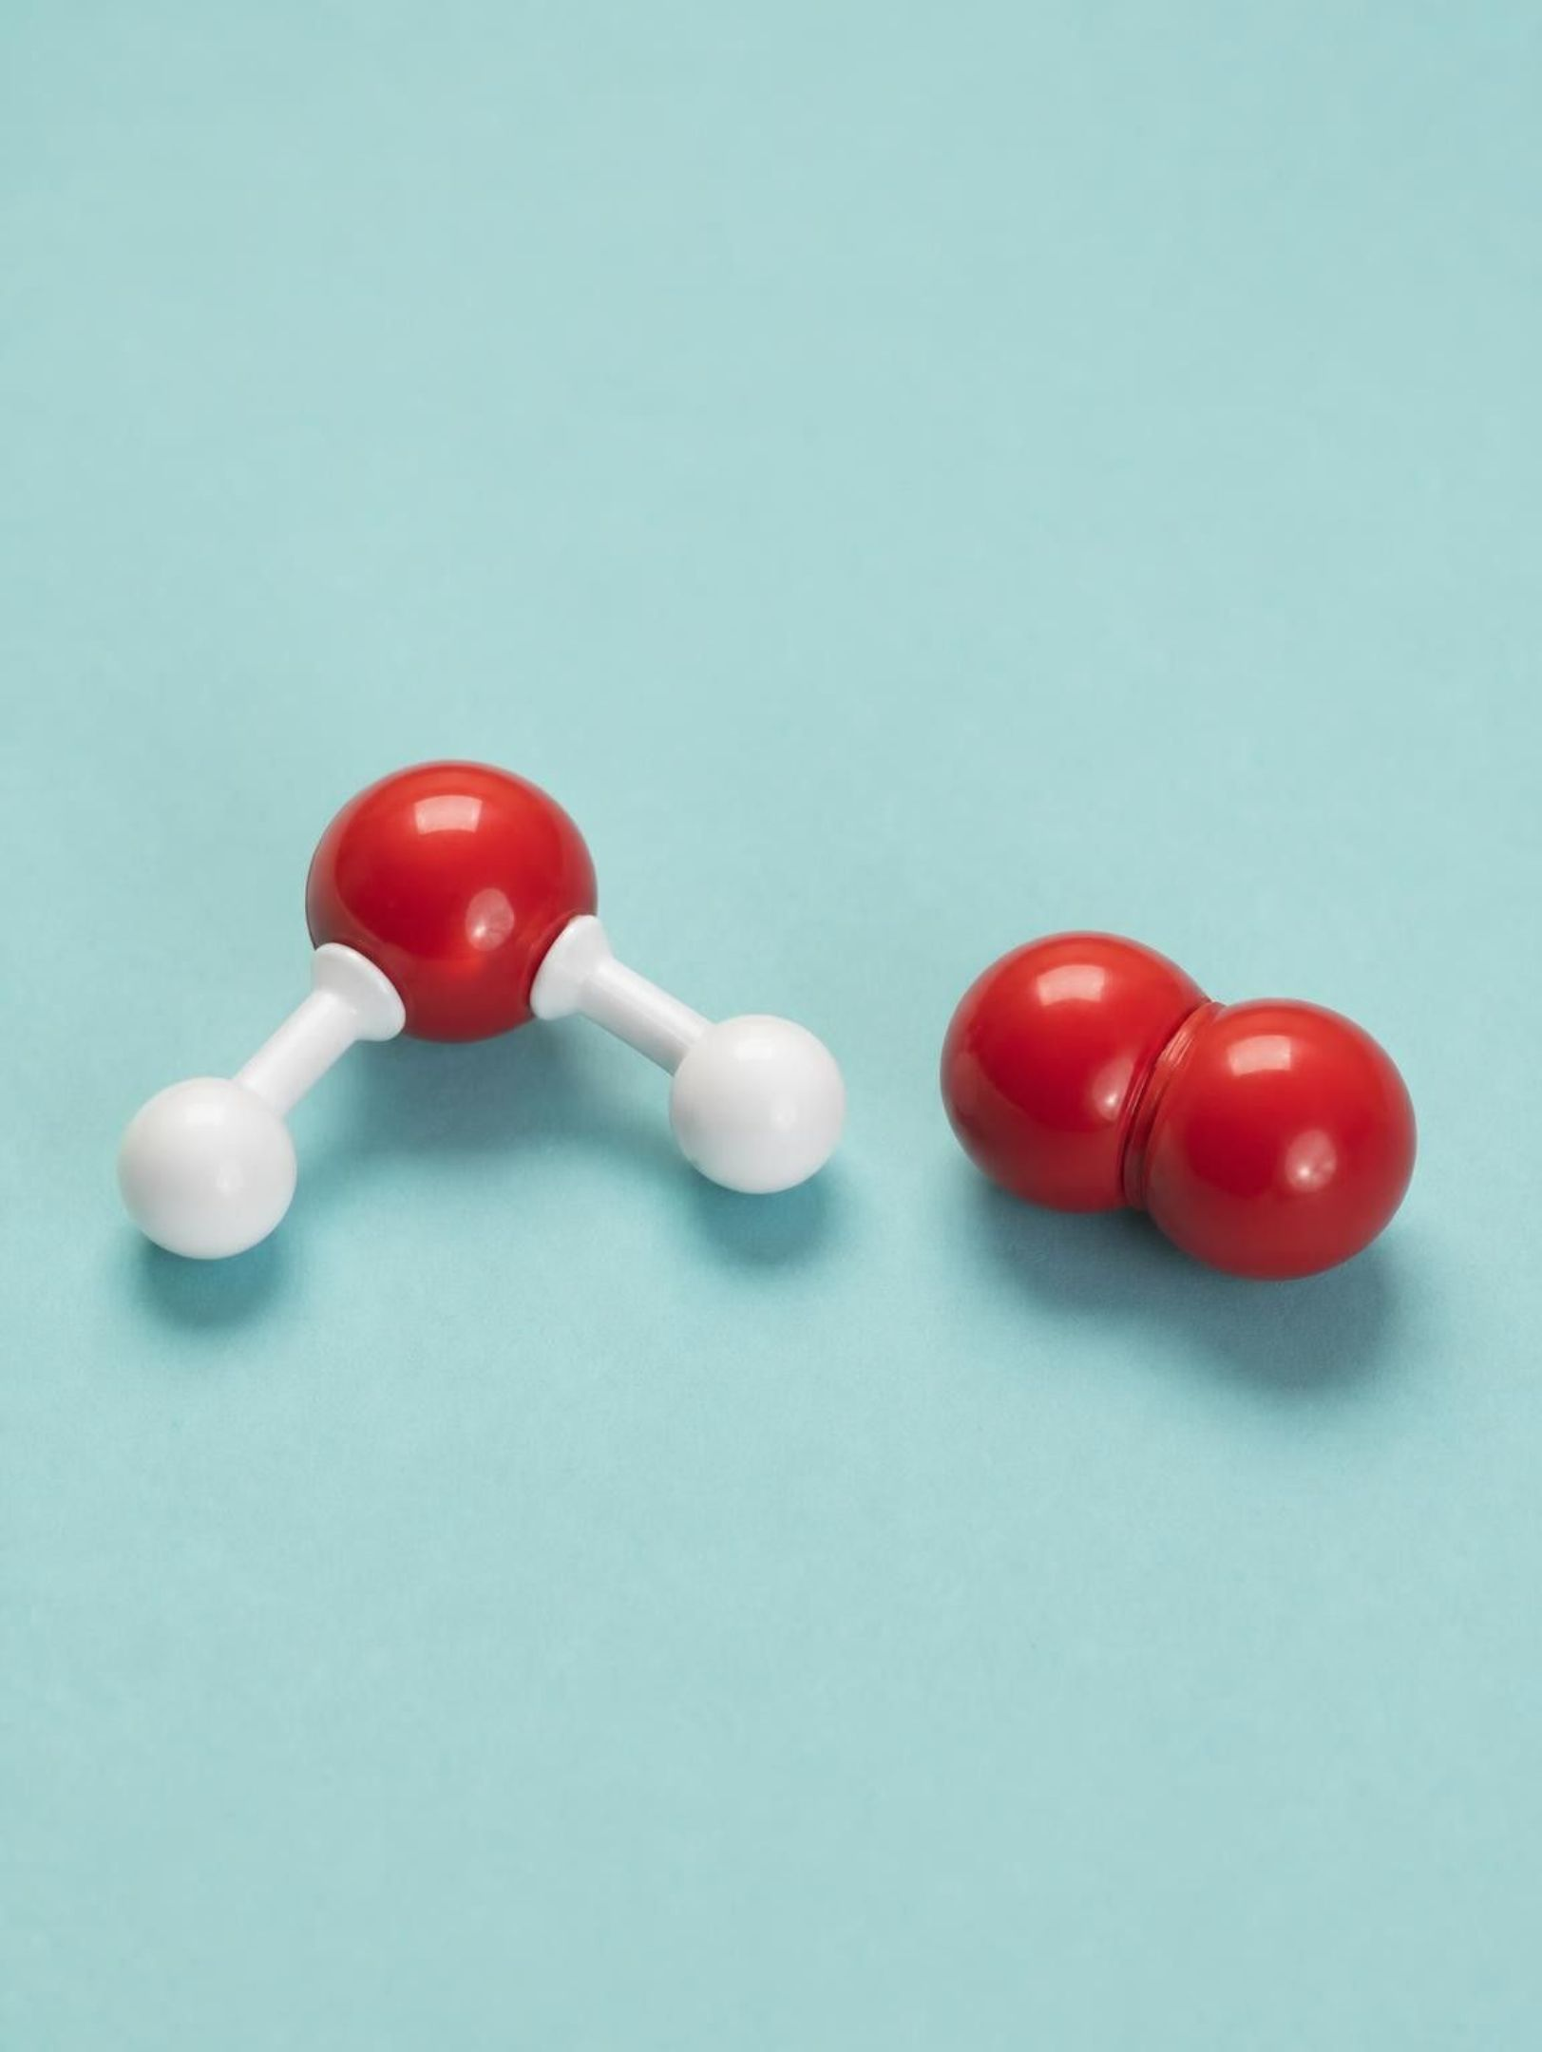
Chemical bonds turn atoms into molecules
When two atoms link strongly, the link is called a chemical bond. A particle made of two or more bonded atoms with a definite count of each is a molecule. One water molecule is always one oxygen atom bonded to two hydrogen atoms: three atoms, two bonds, bent like a boomerang. Oxygen gas is a molecule too, two oxygen atoms bonded to each other.
5
Notes:
Draw water on the board as three circles: a large O in the middle, two small H's attached at an angle of roughly 105 degrees, bent, not straight. Count aloud: three atoms, two bonds. Stress that each bond goes from a hydrogen to the oxygen; the two hydrogens are not bonded to each other. Then draw O₂: two oxygen atoms joined, so a molecule can be made of one element only. Ask: is a single oxygen atom a molecule? No, a molecule needs at least two bonded atoms. At this grade a bond is simply a strong connection; we do not discuss electrons. Introduce the formula idea: H₂O is a count, two H and one O; the small number applies to the symbol just before it, and no number means one.
WATCH FOR: 'H₂O means H-H-O in a line.' A formula counts; it does not show connections. Also watch for 'the 2 belongs to the oxygen.'
CONNECTS TO: Lab 1 builds water and oxygen first; W2 vocabulary.
PACING: about 5 min

Slide 6
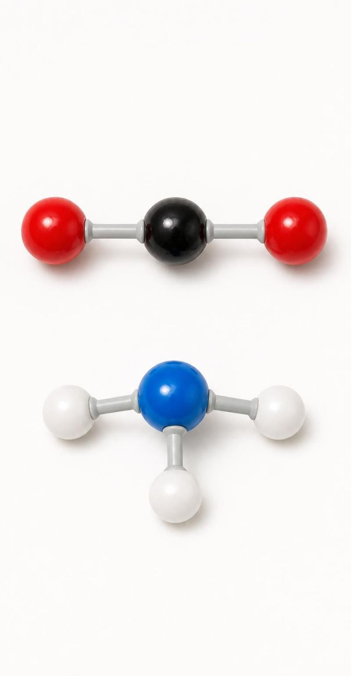
Three words for how atoms join
VOCABULARY IN CONTEXT
chemical bond: A strong connection holding two atoms together inside a particle. Water has two bonds, each joining one hydrogen atom to the oxygen atom.
molecule: Two or more bonded atoms with a definite count of each kind; the atoms may be one element or several. Carbon dioxide, CO₂, is always one carbon atom bonded to two oxygen atoms.
chemical formula: Element symbols with small numbers that count the atoms in one molecule; no number means one. NH₃ (ammonia) is one nitrogen atom and three hydrogen atoms, four atoms in all.
6
Notes:
Have students write each formula and then say the count out loud: 'C-O-two: one carbon, two oxygen, three atoms.' Practice with CH₄ (methane, five atoms) and H₂O₂ (hydrogen peroxide, four atoms). Point out that the small number always counts the symbol right before it. Warn them that the formula idea will get a twist later in the lesson: for some substances the numbers are a ratio, not a count. Do not reveal why yet.
WATCH FOR: Reading H₂O₂ as 'H₂ plus O₂' (two separate things) rather than one molecule of four atoms.
CONNECTS TO: W2 vocabulary relationships; Lab 1 build record uses these formulas.
PACING: about 4 min

Slide 7
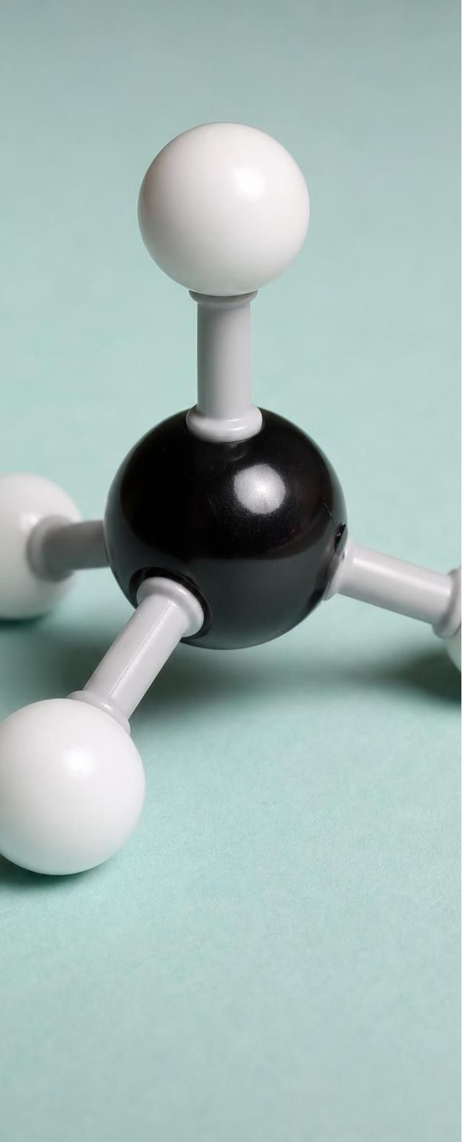
Reading a ball-and-stick model
Model
Model: What each part of a methane model (CH₄) stands for
Sphere: One atom. Methane has one black sphere (carbon) and four white spheres (hydrogen).
Stick: One chemical bond. Four sticks run from the carbon to the four hydrogens; no stick joins two hydrogens.
Color key: A shared convention, not real color: white or gray = hydrogen, red = oxygen, black or gray = carbon, blue = nitrogen.
Shape: The hydrogens point to the four corners of a pyramid around the carbon, so methane is three-dimensional, not flat.
Formula from the model: Count spheres of each color: 1 C, 4 H, so CH₄. The model adds what the formula cannot: who is bonded to whom.
What the model cannot show: Real atoms are not hard balls and bonds are not sticks; the model is about counts and connections, not appearance.
To read any model: count the spheres by color for the formula, then follow the sticks for the structure.
7
Notes:
Project the diagram and, if you have one, hold up a real ball-and-stick kit. Walk through the six items. Emphasize two reading moves: counting by color gives the composition, following the sticks gives the structure. Give one practice model on the board, ammonia: one blue sphere with three white spheres attached, shaped like a shallow pyramid. Students count (1 N, 3 H), write NH₃, and describe the connections (each H to the N). Then say something the book gets slightly wrong: colors are a convention, and many programs draw carbon gray rather than black, so always check the key. Also mention that some models show two or three sticks between a pair of atoms, which marks a double or triple bond, as in O₂; we will not test that.
EXPECTED RESPONSES: Ammonia: 1 nitrogen, 3 hydrogen, formula NH₃, four atoms, three bonds all to the nitrogen.
WATCH FOR: Students count sticks instead of spheres for the formula, or assume the model's colors are the atoms' real colors.
CONNECTS TO: Lab 1 color key matches this slide; W4 diagram worksheet interprets and draws models.
PACING: about 6 min

Slide 8
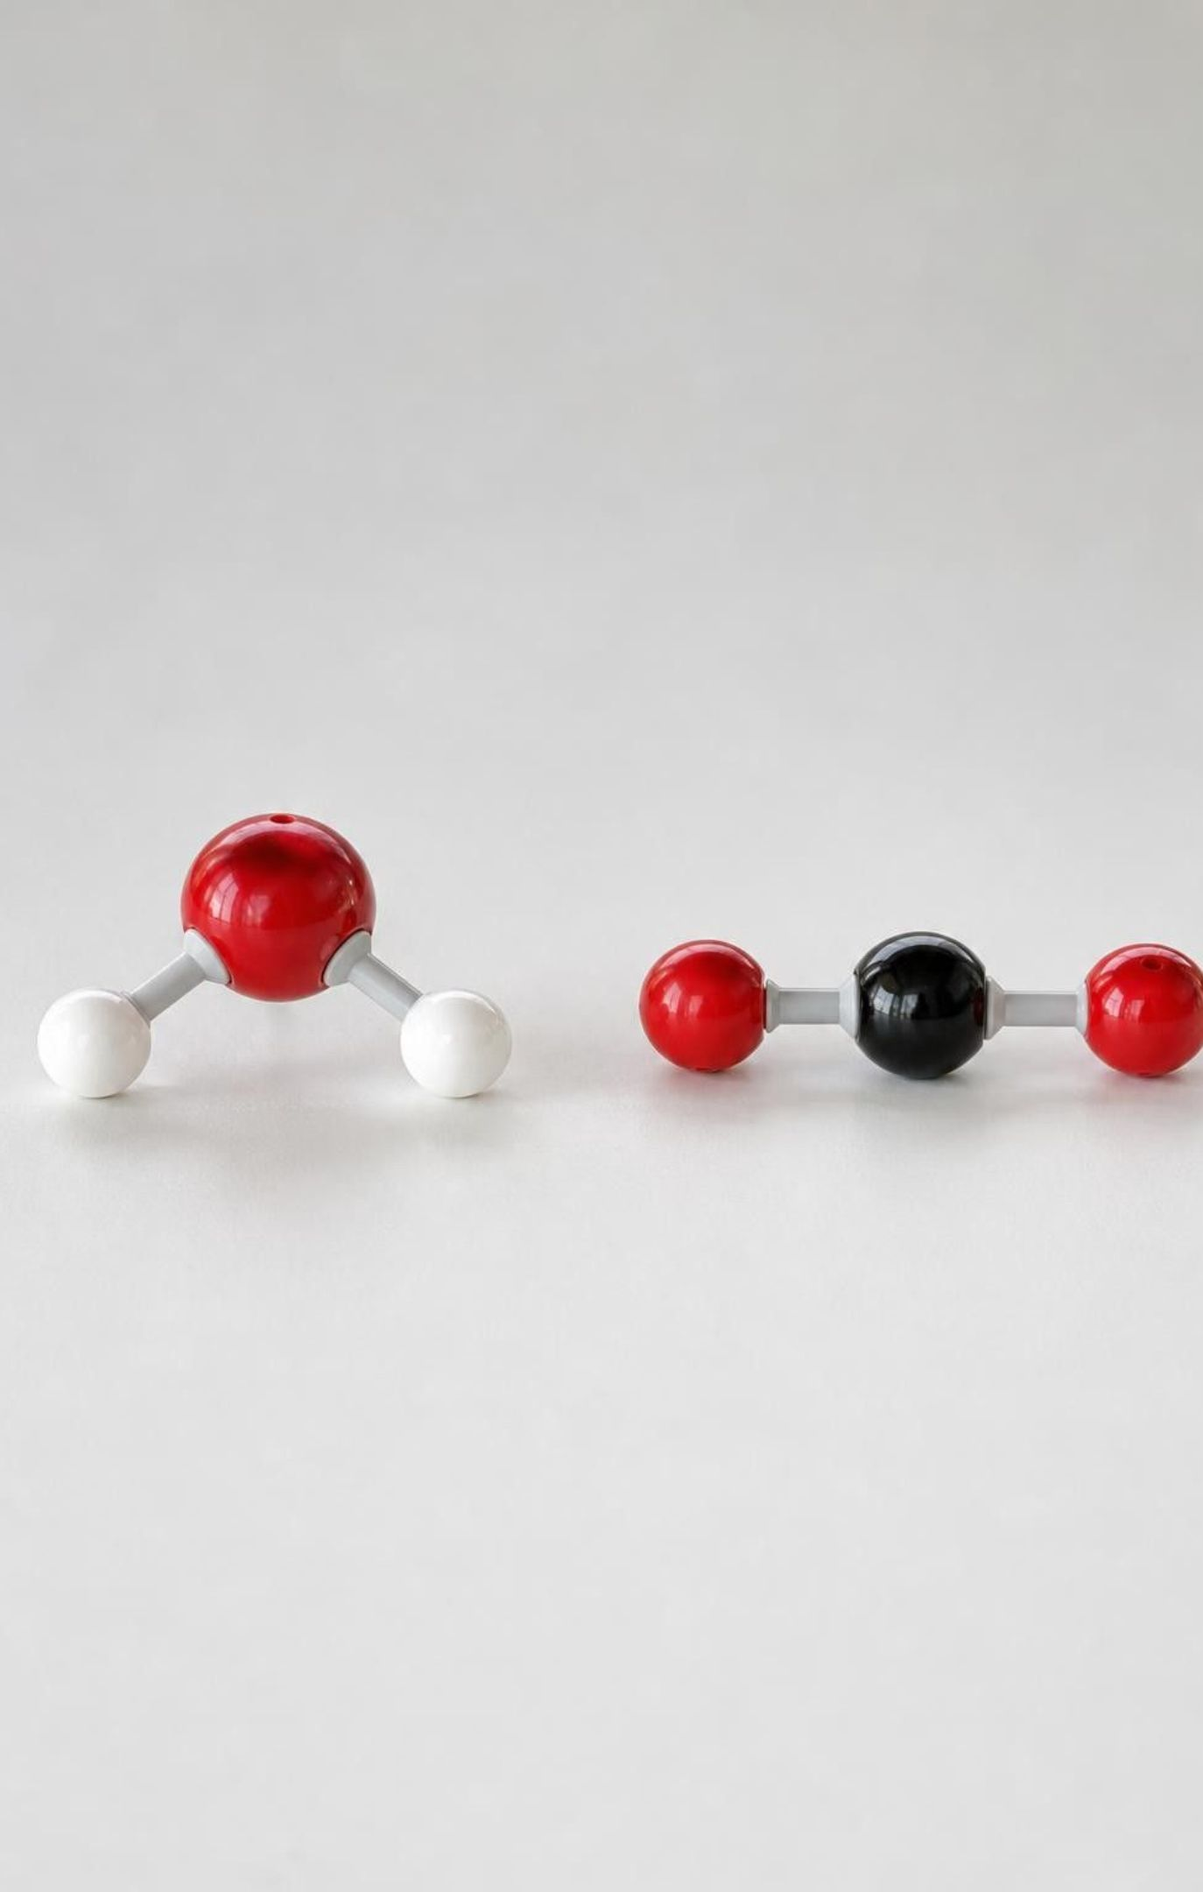
Quick check: read the model
CHECK FOR UNDERSTANDING
A model shows one red sphere bonded to two white spheres, and a second model shows one black sphere bonded to two red spheres. Which pair of formulas is right?
A. H₂O and CO₂
B. HO₂ and C₂O
C. H₂O and C₂O
D. OH₂ and CO
8
Notes:
Vote with fingers, then explain. Use the color key from the last slide: red is oxygen, white is hydrogen, black is carbon. The first model is one O with two H, which is water, H₂O. The second is one C with two O, carbon dioxide, CO₂. Follow up: how many atoms in each? Three and three. How many bonds in each? Two and two in our simple picture. Which model is bent and which is straight? Water is bent; carbon dioxide is straight. This is a good moment to say that two molecules can have the same number of atoms and be completely different substances.
EXPECTED RESPONSES: A: H₂O and CO₂. Students who choose B or C have swapped the color key or put the count on the wrong symbol.
WATCH FOR: Writing the count before the symbol (2HO) or attaching it to the wrong element.
CONNECTS TO: W2 vocabulary; W10 mastery items on reading models.
PACING: about 3 min

Slide 9

Composition: change the count, change the substance
Composition = which elements, and how many atoms of each.
Water, H₂O: 2 hydrogen atoms, 1 oxygen atom. You drink it.
Hydrogen peroxide, H₂O₂: two hydrogens and two oxygens. A disinfectant; never drink it.
Same two elements, one extra oxygen atom per molecule, completely different substance.
9
Notes:
Draw both molecules side by side. Water: H-O-H, bent. Hydrogen peroxide: H-O-O-H, a chain of four atoms with the two oxygens bonded to each other in the middle. Point out that the elements are identical; only the count changed. That one extra oxygen atom in every molecule turns a drink into something that bleaches hair and kills germs. Ask students for other 'one small change, big difference' examples from their lives (one wrong digit in a phone number). The book says people use hydrogen peroxide on cuts; current first-aid advice is to wash a cut with mild soap and water instead, because hydrogen peroxide damages healthy cells too. Do not pass on the first-aid claim.
WATCH FOR: 'H₂O₂ is just water with extra oxygen mixed in.' It is a different molecule, not a mixture.
CONNECTS TO: W7 misconception worksheet uses the water/peroxide pair; Lab 1 builds both.
PACING: about 4 min

Slide 10
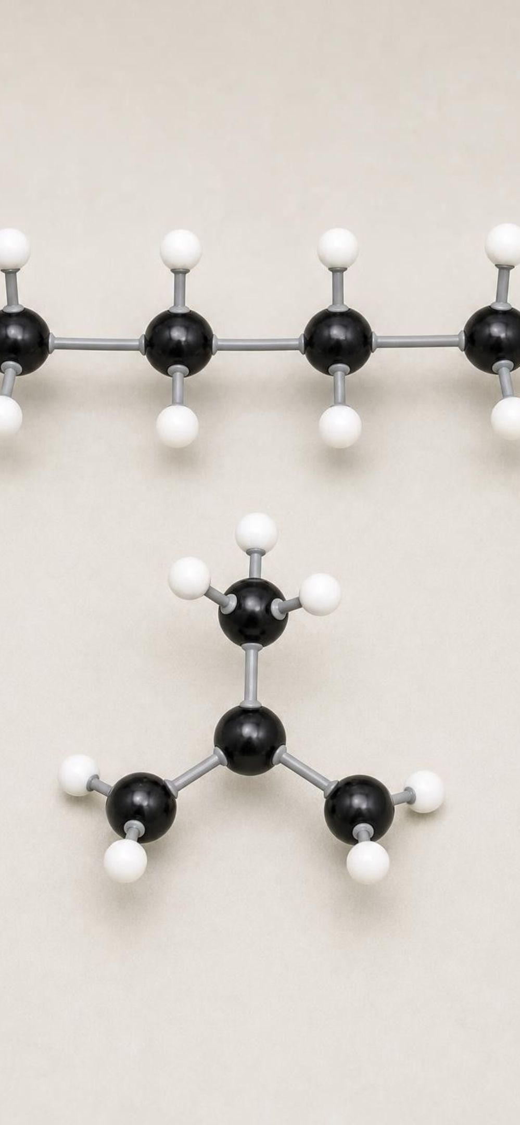
Structure: same atoms, different connections
Model
Model: Butane and isobutane are both C₄H₁₀
Butane | Isobutane
4 carbon atoms in a row, like a chain of four beads | 1 central carbon bonded to 3 other carbons, a branch
Each end carbon holds 3 hydrogens; each middle carbon holds 2 | The three outer carbons are not bonded to each other
10 hydrogens in all | Still 10 hydrogens in all
Fuel in camping-stove canisters | Used as a refrigerant and in some fuel blends
A formula gives the count. Only a model or structural drawing shows the connections, and the connections matter.
10
Notes:
This is the key idea of section 2. Write C₄H₁₀ once on the board and say: this formula names two different substances. Build or draw both carbon skeletons: a chain of four, and a central carbon with three arms. Then hang hydrogens so every carbon has four bonds. Ask students to check the hydrogen count on each: chain gives 3+2+2+3 = 10; branch gives 1 on the center plus 3+3+3 = 10. The book calls isobutane 'triangle-like'; that is misleading, because the three outer carbons are not bonded to one another. Say 'branched' or 'a center with three arms.' Second example in words only: sucrose (table sugar) and maltose (malt sugar) are both C₁₂H₂₂O₁₁, 45 atoms each, but connected differently, so they taste different.
EXPECTED RESPONSES: Students should be able to say what is the same (atoms, counts) and what is different (which carbon is bonded to which), and conclude that a formula alone cannot identify a substance.
WATCH FOR: 'Same formula means same substance' and 'isobutane's carbons form a triangle.'
CONNECTS TO: Lab 1 builds both; W7 misconception repair; W10 mastery.
PACING: about 6 min

Slide 11
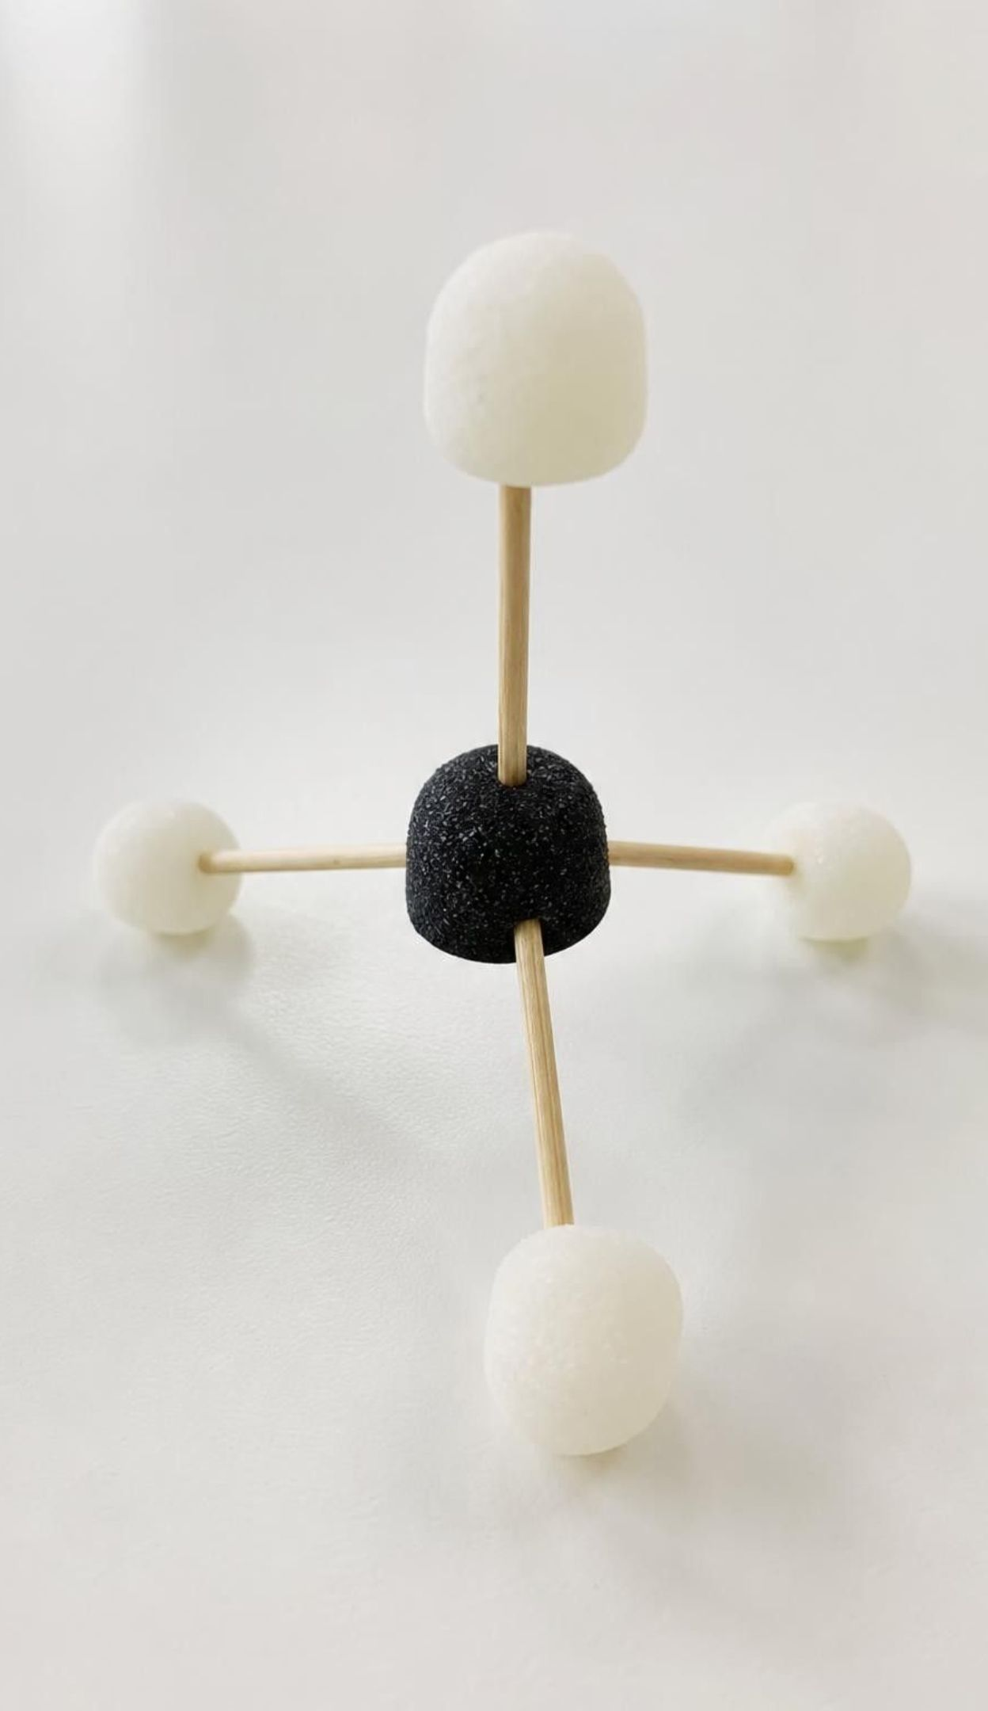
Composition, structure, model
VOCABULARY IN CONTEXT
atomic composition: Which elements a substance has and how many atoms of each (or their ratio). Water and hydrogen peroxide differ in composition: H₂O versus H₂O₂.
chemical structure: How the atoms are connected and arranged in space. Butane and isobutane differ in structure: a straight chain versus a branch.
model: A simplified stand-in that makes the important features of something too small to see easy to notice. A drawing of circles and lines, a gumdrop build or a computer image can each model methane.
11
Notes:
Have students write one sentence that uses both composition and structure correctly, then trade with a partner. Then make the point about models: a model is not a smaller copy of reality; it is a tool that keeps the features we care about (counts, connections, rough shape) and drops the rest (real atoms are fuzzy, not colored balls). Every model in this lesson is useful for some questions and useless for others; part of being a scientist is knowing which.
WATCH FOR: Students may think a 3-D model is 'more true' than a drawing. Each model answers different questions; neither is a photograph.
CONNECTS TO: W2 vocabulary; W4 diagram worksheet asks what a model cannot show.
PACING: about 4 min

Slide 12
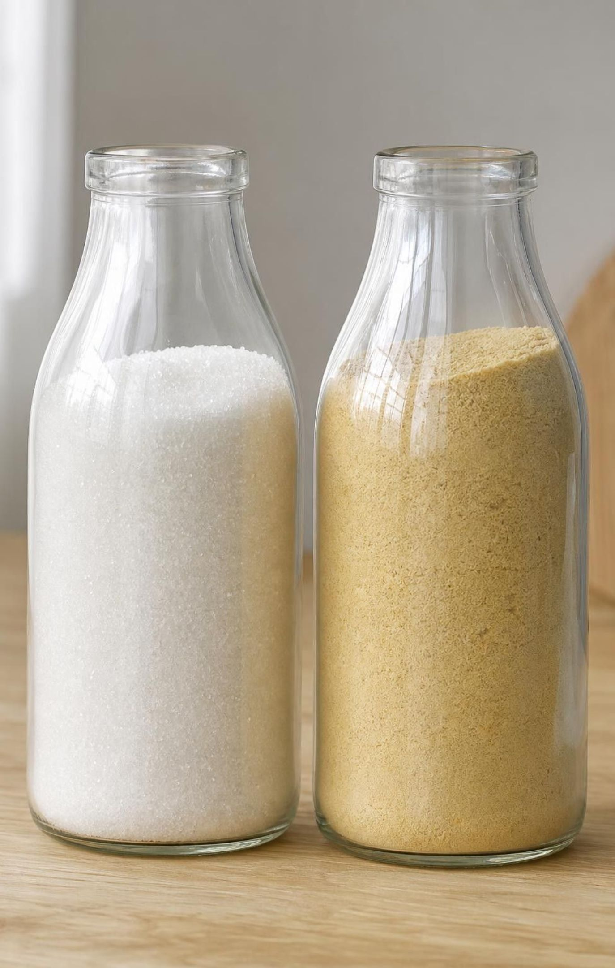
Quick check: same formula, same substance?
CHECK FOR UNDERSTANDING
Two bottles are labeled C₁₂H₂₂O₁₁. One is table sugar, the other is malt sugar, and they taste different. What must be different about their molecules?
A. The number of carbon atoms
B. The elements they contain
C. How the atoms are connected
D. Nothing; the labels must be wrong
12
Notes:
Vote, then one sentence of reasoning. The formula tells us the composition is identical: 12 C, 22 H, 11 O. If the substances differ, the difference has to be in structure, the way those 45 atoms are connected. Follow up: how could a chemist tell the two apart without tasting? By building or drawing the structures, or by measuring properties such as melting point. Preview that Lesson 3 is about properties.
EXPECTED RESPONSES: C: how the atoms are connected. Students who pick D have not yet accepted that one formula can name two substances.
WATCH FOR: Thinking the formula must be a typo. Reinforce: composition the same, structure different, substance different.
CONNECTS TO: W7 misconception; W10 mastery.
PACING: about 3 min

Slide 13

Discuss: is a formula enough to name a substance?
Think, pair, share
True for many small molecules: H₂O is only ever water.
Fails when two substances share a formula, like butane and isobutane.
A model or structural drawing shows the connections a formula leaves out.
Properties (melting point, smell, how it burns) can also tell them apart.
A classmate says 'If I know the formula, I know the substance.' When is that true, and when does it fail? What extra information settles it?
13
Notes:
Give pairs three minutes: one argues the classmate is right, one argues they are wrong, then switch. Collect the strongest point from each side. Land on the synthesis: a formula fixes composition, and for many small molecules that is enough, but it never shows structure, so when two substances share a formula you need a model or a property measurement. Ask a closing question: why do chemists bother drawing structures at all if formulas are shorter? Because the drawing carries information the formula cannot.
EXPECTED RESPONSES: Right side: for water, carbon dioxide and methane the formula is enough. Wrong side: C₄H₁₀ and C₁₂H₂₂O₁₁ each name two substances. Settles it: a structural model or drawing, or a measured property.
CONNECTS TO: W3 reading; W8 collaborative evidence sort includes a shared-formula pair.
PACING: about 5 min

Slide 14
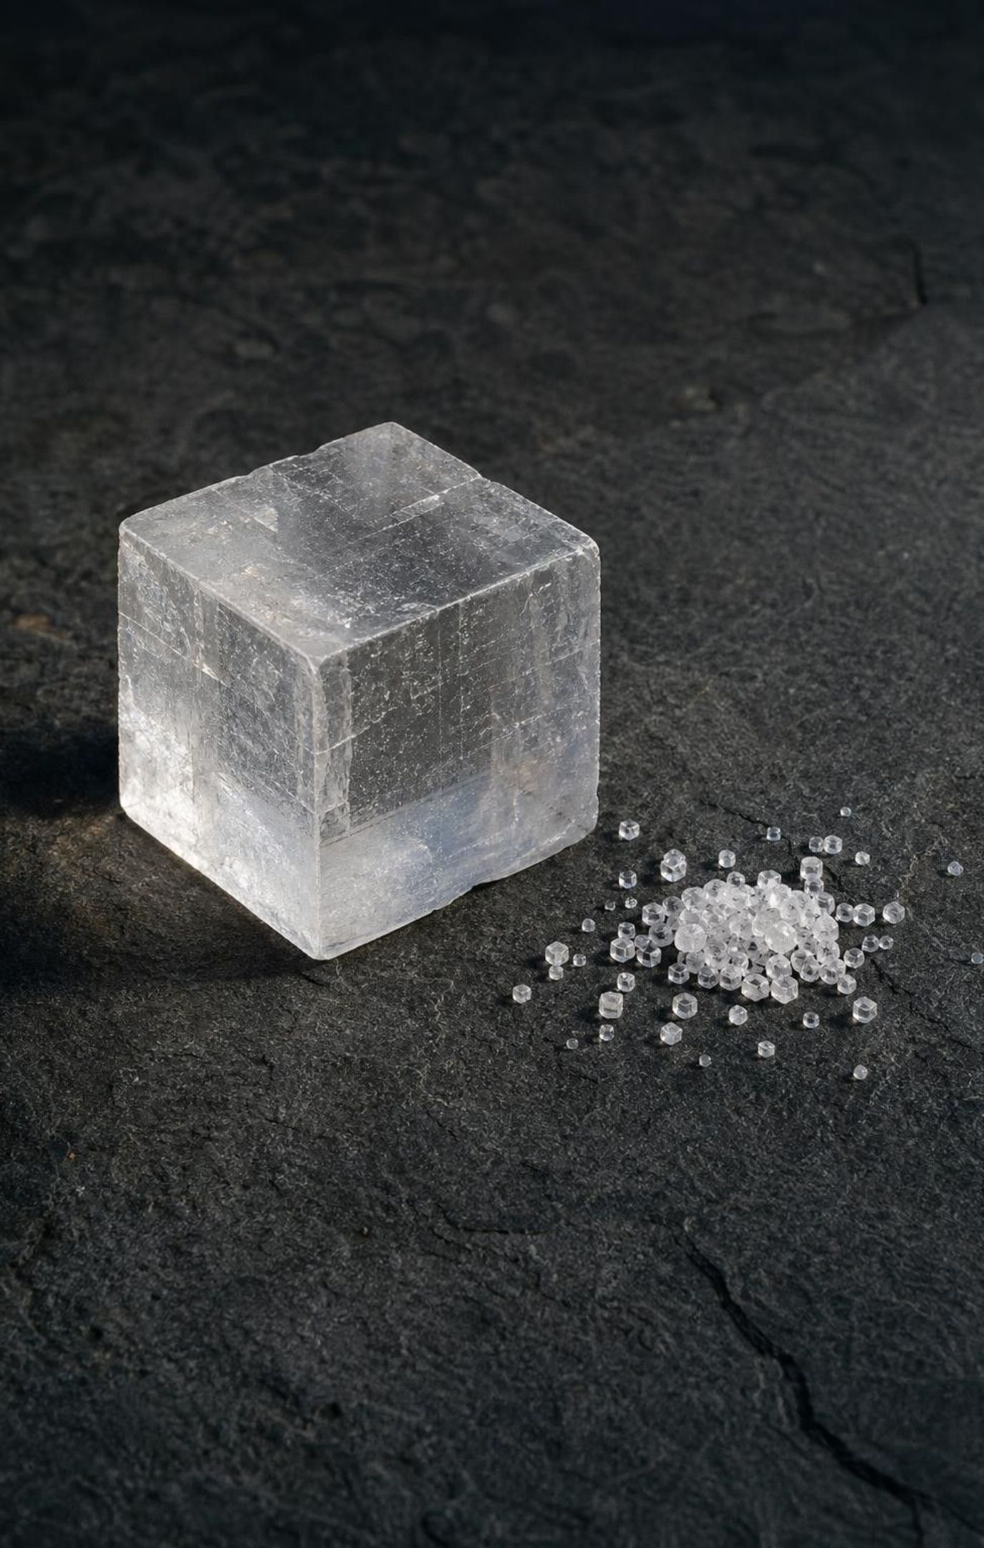
Molecules stop. Some structures keep going.
A molecule has a definite size: every water molecule is exactly 3 atoms.
An extended structure repeats one small subunit over and over, with no set size.
Table salt: sodium and chlorine particles alternate in every direction, as far as the grain goes.
So a formula like NaCl is a ratio,
1 sodium : 1 chlorine,
not a count of a molecule.
A grain with 100 of each and a grain with 10,000 of each are both NaCl.
14
Notes:
Return to the parking-lot question about salt grains. Explain that in solid salt there is no little two-particle unit you could pull out; every sodium particle is surrounded by chlorines and every chlorine by sodiums, and the pattern just continues to the edge of the grain. That is an extended structure. The formula NaCl is still true, but it now means a ratio: one sodium for every chlorine. Contrast carefully with water: pull one water molecule out of a glass and it is complete, three atoms; 'pull one NaCl out of a grain' makes no sense. Teacher note only: salt's particles carry electric charges (sodium ions and chloride ions), which is why they stack this way; the standard leaves that out, so say 'particles' or 'atoms' with students and save ions for anyone who asks.
WATCH FOR: 'Salt is made of NaCl molecules.' This is the chapter's central misconception; it is revisited on slide 25.
CONNECTS TO: Lab 1 salt block; W5 data on fragment counts; W7 misconception repair (Dani's statement 1).
PACING: about 5 min

Slide 15
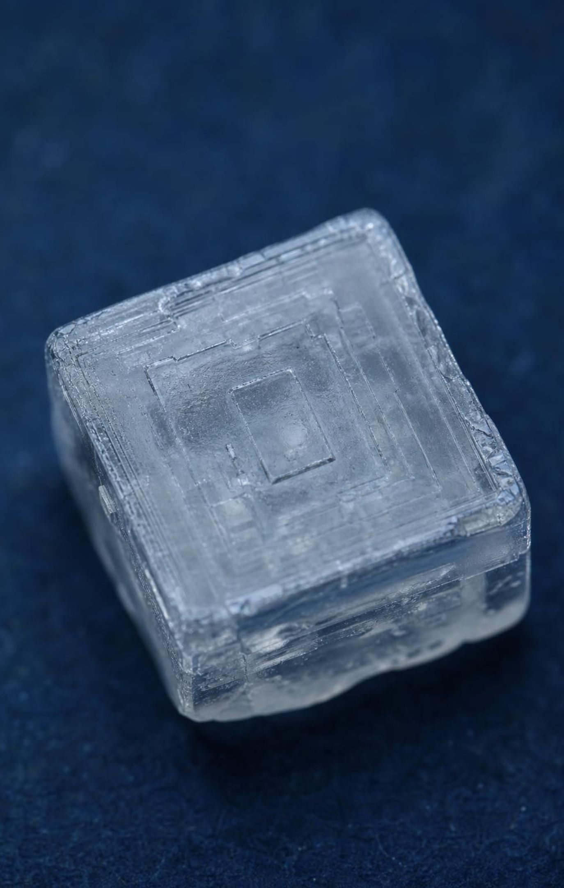
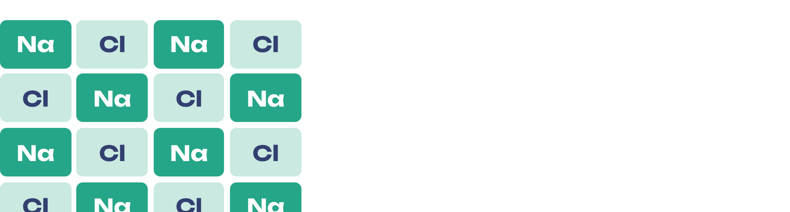
A slice of a salt crystal
MODEL
Model: One layer of table salt: sodium (Na) and chlorine (Cl) alternate like a checkerboard
Shade the squares in two colors, alternating: every Na touches only Cl, every Cl touches only Na. The next layer sits on top with colors swapped, so the pattern repeats in all three directions. Any slice has equal numbers of each, 1:1.
15
Notes:
Have students shade the 4-by-4 grid as a checkerboard on their copy: Na in one color, Cl in the other. Count: 8 and 8, ratio 1:1. Now ask them to imagine a 10-by-10 slice: 50 and 50, still 1:1. A 10-by-10-by-10 block: 500 and 500. The total changes, the ratio never does. Then explain the right angles: because the particles stack in straight rows and columns at 90 degrees, a growing grain builds flat faces that meet at right angles, which is why salt grains are little cubes. That answers the phenomenon for salt. Mention that the book draws the smallest repeating cube as four sodium and four chlorine particles; in the real crystal each particle has six neighbors of the other kind, but the 1:1 ratio is the same.
EXPECTED RESPONSES: 8 Na and 8 Cl in the slice; 1:1; a bigger slice has more of each but the same ratio; cubes come from the right-angle pattern.
WATCH FOR: Students may shade rows of one color, which would give Na-Na neighbors. In salt every neighbor is the other kind.
CONNECTS TO: Lab 1 salt block; W4 diagram worksheet lattice drawing; W5 data.
PACING: about 5 min

Slide 16
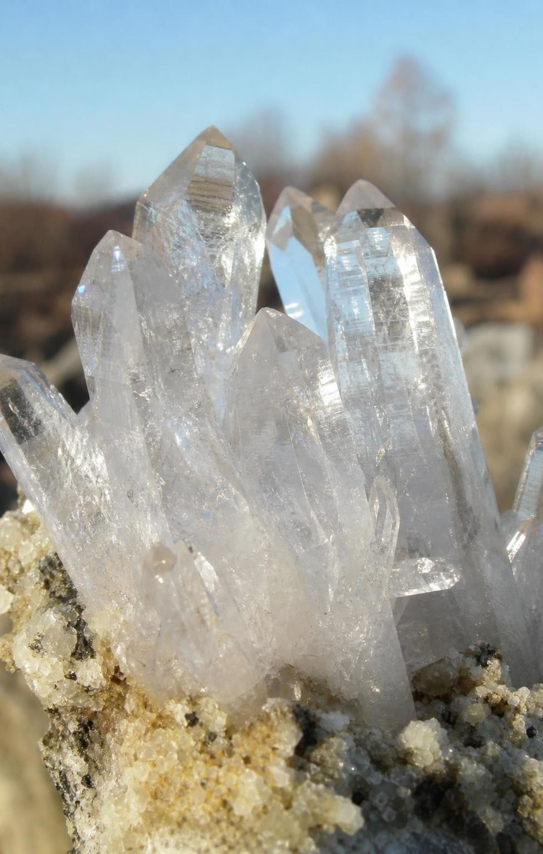
Quick check: ratio or count?
CHECK FOR UNDERSTANDING
Quartz is silicon and oxygen in a 1:2 ratio. A quartz grain contains 300 silicon atoms. How many oxygen atoms does it hold, and does a grain with 3,000 silicon atoms have a different ratio?
A. 150 oxygen; yes
B. 300 oxygen; no
C. 600 oxygen; no
D. 600 oxygen; yes, a bigger ratio
16
Notes:
Whiteboards, two minutes. One silicon to two oxygen means oxygen = 2 × silicon = 600. The bigger grain has 6,000 oxygens, but the ratio is still 1:2. Warn students that the book's Figure 3A caption misprints the quartz ratio as 1:1; the page's own text and every reference give 1 silicon : 2 oxygen, which is the formula SiO₂. Note that SiO₂ looks like a molecule formula but, like NaCl, it is a ratio for an extended structure: in quartz every silicon is bonded to four oxygens and every oxygen to two silicons, in a network that goes on through the whole grain.
EXPECTED RESPONSES: C: 600 oxygen atoms; the ratio does not change with size. Students who pick A have inverted the ratio; those who pick D have confused total count with ratio.
WATCH FOR: 'Bigger crystal, bigger ratio.' Total changes; ratio does not.
CONNECTS TO: W5 data worksheet calculations; Lab 2 quartz sand station.
PACING: about 3 min

Slide 17
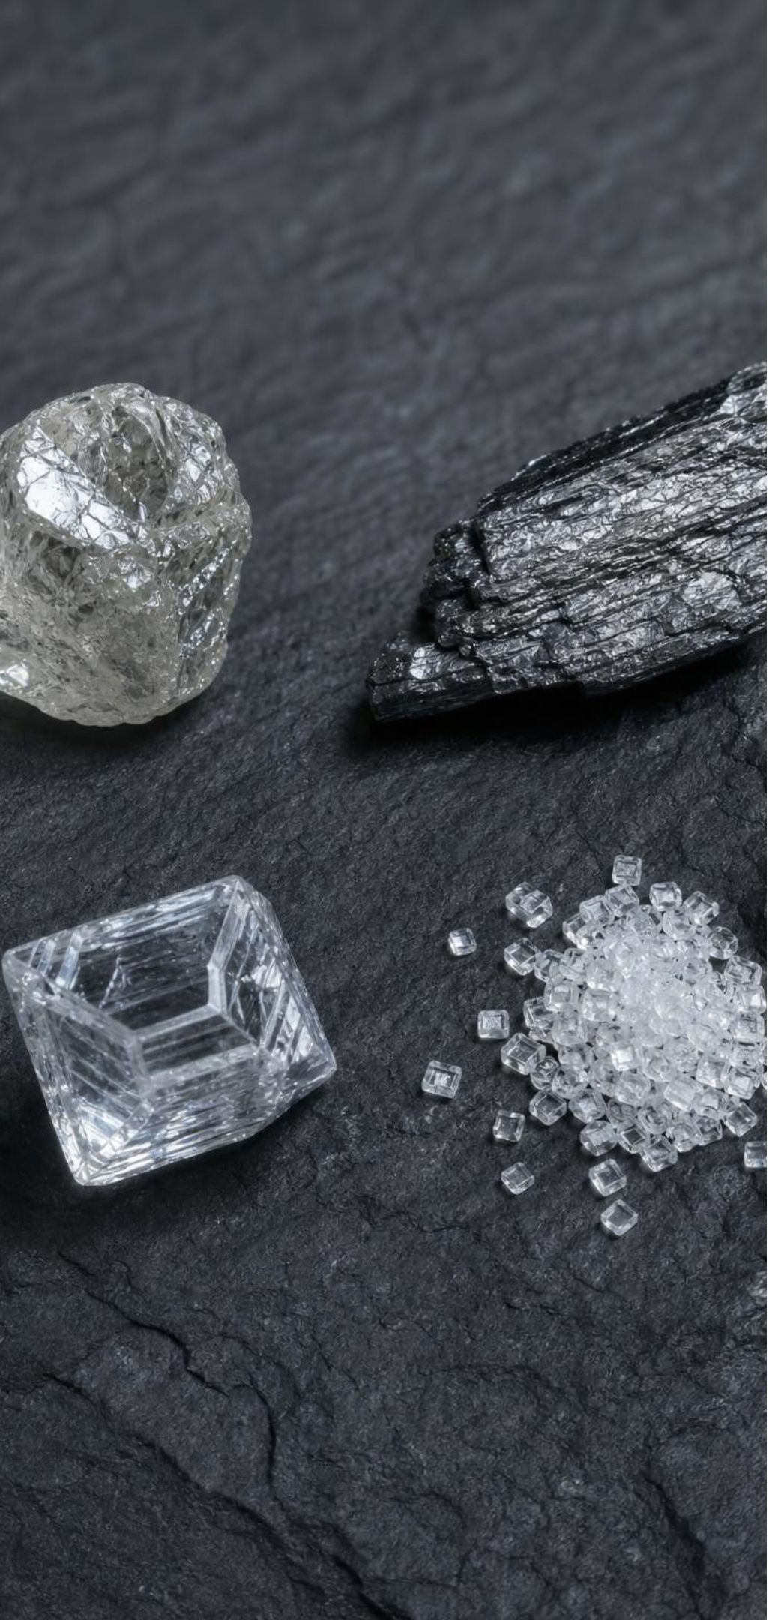
Crystals: three kinds of building blocks
A crystal is a solid whose pattern repeats in all three directions.
Built from atoms of one element: diamond (carbon only), graphite (carbon only).
Built from atoms of several elements in a ratio: salt (1:1), quartz (1:2).
Built from whole molecules stacked in a pattern: ice (water molecules), table sugar (sucrose).
Strong bonds hold the atoms inside each molecule; weaker attractions hold the molecules to each other.
17
Notes:
Sort the crystals students have met into the three kinds and write the list on the board. The third kind answers the rest of the phenomenon: a sugar grain is billions of sucrose molecules, each one exactly 45 atoms, stacked in a repeating slanted pattern. So sugar is both: the molecules are molecules, and the grain is an extended structure made of them. Ice is the same story with water molecules, which lock into a pattern built on hexagons. Stress the two kinds of connection: strong chemical bonds inside each molecule, and weaker attractions between molecules that hold the crystal together. That difference is why sugar melts at a low temperature (the molecules let go of each other but stay intact) while salt needs about 800 degrees Celsius.
WATCH FOR: Students may think 'crystal' means sparkly jewelry only. Salt, sugar, sand and snow are all crystals.
CONNECTS TO: Lab 2 stations (salt, sugar, graphite, sand); W3 reading; W8 evidence cards.
PACING: about 5 min

Slide 18
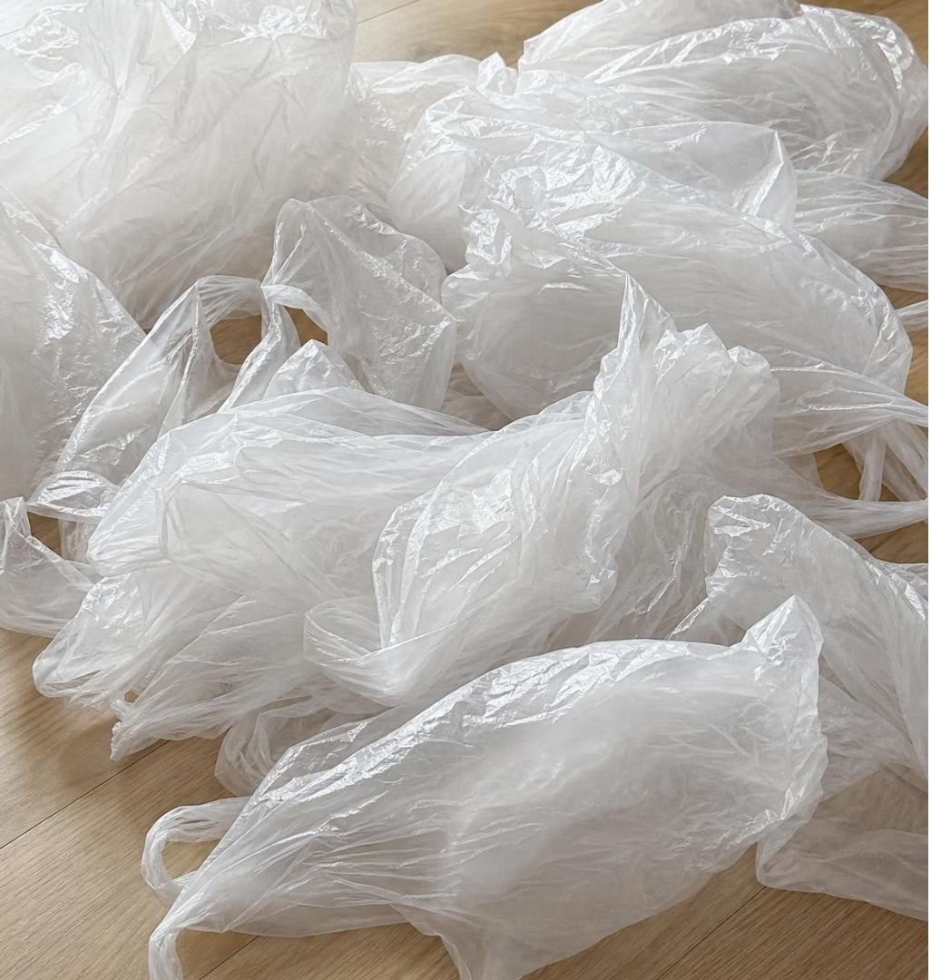
Polymers: a chain of repeating units
Model
Model: Polyethylene, the plastic in grocery bags, is one unit repeated thousands of times
Unit 1: one carbon carrying 2 hydrogens
→ (C-C bond)
Unit 2: the same
Unit 3: the same
... thousands more identical units ...
Last unit: the chain ends
→ (C-C bond)
→ (C-C bond)
→ (C-C bond)
Every unit is the same, so the ratio is fixed (1 C : 2 H) while the chain length is not. The whole chain is one very long molecule.
18
Notes:
A polymer is the other kind of extended structure: instead of repeating in three directions like a crystal, it repeats along a line, like beads on a string. Polyethylene is the simplest: a carbon chain where every carbon carries two hydrogens, repeated thousands of times. A grocery bag, a water bottle (PET), a pipe (PVC) and a sports jersey (polyester) are all polymers, each with its own repeat unit. Your body is full of them too: proteins and DNA are long chains, though they mix several different units in a set order rather than repeating one. Tell students the lesson's simple picture (one unit repeated) is accurate for plastics; chemists also call one whole chain a single giant molecule, which is fine, because it has a definite, if enormous, number of atoms. Preview Lab 2: stretching a strip of bag straightens and lines up the chains, which they can see and feel.
WATCH FOR: 'Polymers are molecules, so they can't be extended structures.' The chain has a repeating unit and a fixed ratio, which is the lesson's definition; its length varies from chain to chain.
CONNECTS TO: Lab 2 polyethylene station; W3 reading; W9 transfer.
PACING: about 5 min

Slide 19
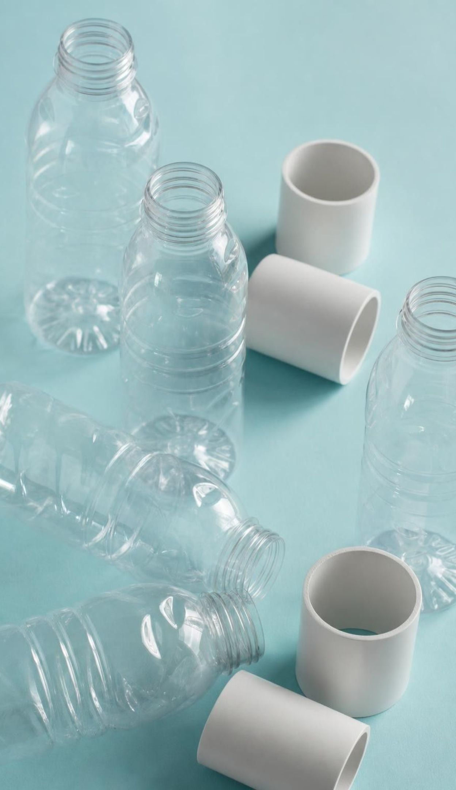
Words for structures that keep going
Vocabulary in context
extended structure: A structure built by repeating one subunit with no fixed size, so it has a constant ratio of elements. A grain of salt of any size is sodium and chlorine in a 1:1 ratio.
crystal: A solid whose atoms or molecules repeat in a regular pattern in all three directions. Diamond, quartz, salt, ice and sugar are all crystals.
polymer: An extended structure made of many small units linked into a long chain. Polyethylene bags, PET bottles and PVC pipes are polymers.
19
Notes:
Build the hierarchy on the board: extended structure is the big category; crystal and polymer are its two kinds in this lesson. Ask students to add one example of each from the lesson and one from their own life (crystal: the frost on a freezer wall; polymer: a nylon backpack strap). Then give the three-question test for any substance: does it have a definite number of atoms (molecule) or a repeating unit (extended structure)? If it repeats, does it repeat in all directions (crystal) or along a chain (polymer)? Careful with sugar and ice: molecules that stack into a crystal, so both answers apply at different scales.
WATCH FOR: Treating 'crystal' and 'extended structure' as the same thing. Polymers are extended structures that are not crystals.
CONNECTS TO: W2 vocabulary; W8 collaborative sort; W10 mastery.
PACING: about 4 min

Slide 20

California connection: salt ponds and Sierra snow
REAL-WORLD CONNECTION
Along the south end of San Francisco Bay, shallow ponds hold bay water while the sun evaporates it. As the water leaves, sodium and chlorine particles stack into their right-angle pattern, and the salt that is harvested comes out as cube-shaped crystals. A few hours east, water vapor in Sierra Nevada storm clouds freezes into ice crystals whose hexagonal pattern shows up as six-armed snowflakes on Tahoe's ski slopes.
Notes:
Two true California examples of structure you can see. The salt ponds near Newark and Fremont have been worked for more than a century; the colored ponds visible from airplanes get their colors from microbes that thrive at different saltiness. The chemistry is simple: evaporation removes water molecules, the remaining sodium and chlorine particles have nowhere to go but into the lattice, and the lattice's right angles produce cubes. In the Sierra, snow crystals grow from water vapor onto a hexagonal ice pattern, so their arms come in sixes. Be honest about the limits: many snow crystals grow as columns, needles or broken bits, so say 'tend to be six-sided' rather than 'always.' If any student has been to a salt pond, a salt flat or a ski resort, let them describe what the crystals looked like.
CONNECTS TO: W3 reading; W9 transfer; Lab 2 salt station.
PACING: about 4 min

Slide 21

THINK, PAIR, SHARE
Discuss: one element, two jobs
Graphite and diamond are both pure carbon. One leaves a mark on paper, the other tips drills that cut through stone. What could be different inside them, if the atoms are identical?
21
Notes:
Pairs, three minutes, then collect ideas. Students now have the tools to answer: if the atoms are the same, the difference must be structure. Push them to propose two arrangements and predict which would flake and which would be hard, before you show the next slide. Good student proposals: 'one is in layers and the layers can slide' and 'one is locked together in all directions.' Hold the answer until the compare diagram.
EXPECTED RESPONSES: The atoms are connected differently; one arrangement lets pieces slide off, the other holds every atom tightly in all directions. Some students will propose that graphite has 'fewer bonds' or 'weaker bonds,' which is partly right (three bonds per atom within a sheet, weak attraction between sheets).
CONNECTS TO: Lab 3 is the physical test of this idea; W9 transfer.
PACING: about 5 min

Slide 22
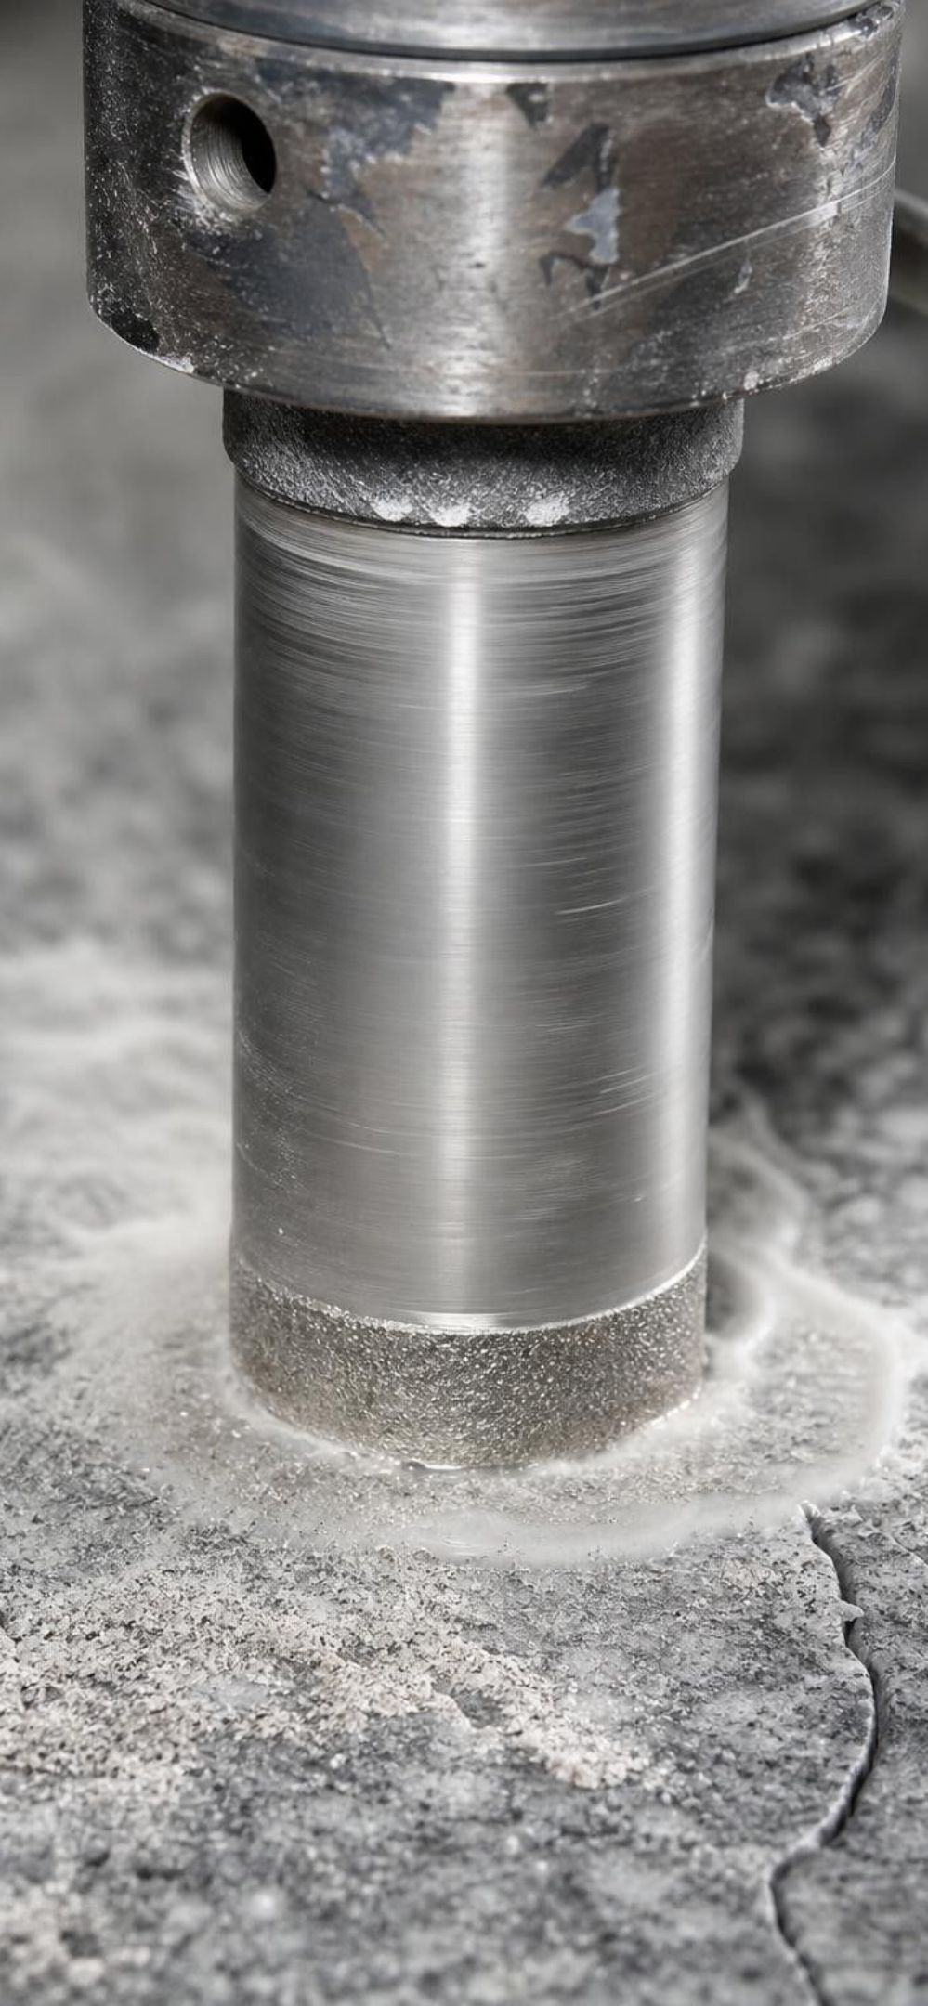
Graphite sheets versus the diamond network
MODEL · MODEL: TWO WAYS TO CONNECT CARBON ATOMS
Graphite | Diamond
Each carbon bonded to 3 neighbors in a flat sheet of hexagons | Each carbon bonded to 4 neighbors pointing in different directions
Sheets stacked like pages, held by weak attraction only | One rigid network in all three directions, no sheets
Sheets slide and peel off under friction: a pencil mark | Nothing can slide; scratching it means breaking bonds
Soft, gray, slippery | Hardest natural material; tips saws and drills for stone and glass
Same atoms, different bonding pattern, opposite behavior. Structure, not composition, does the explaining here.
22
Notes:
Reveal the answer to the discussion. In graphite each carbon has three bonds, all in one flat sheet of hexagons; the sheets stack with only weak attraction between them, so when you drag a pencil, sheets shear off and stick to the paper. In diamond each carbon has four bonds pointing in different directions, which locks every atom into a three-dimensional network; there are no layers to slide, so it is extremely hard. Correct two book details: diamond's atoms are not 'bonded in a cubic shape' (each atom's four bonds point to the corners of a pyramid; 'cubic' describes the crystal as a whole), and diamond tools are used mainly on stone, glass and concrete, because at cutting temperatures diamond's carbon reacts with iron and wears fast on steel. Preview Lab 3: toothpick sheets versus a toothpick network, under load, pushed and dropped.
EXPECTED RESPONSES: Students should restate: three bonds in a sheet and weak attraction between sheets (slides) versus four bonds in all directions (rigid).
WATCH FOR: 'Diamond has stronger carbon atoms.' The atoms are identical; the bonding pattern differs.
CONNECTS TO: W6 CER is the written argument for exactly this comparison; Lab 3 engineering challenge; W9 transfer.
PACING: about 5 min

Slide 23
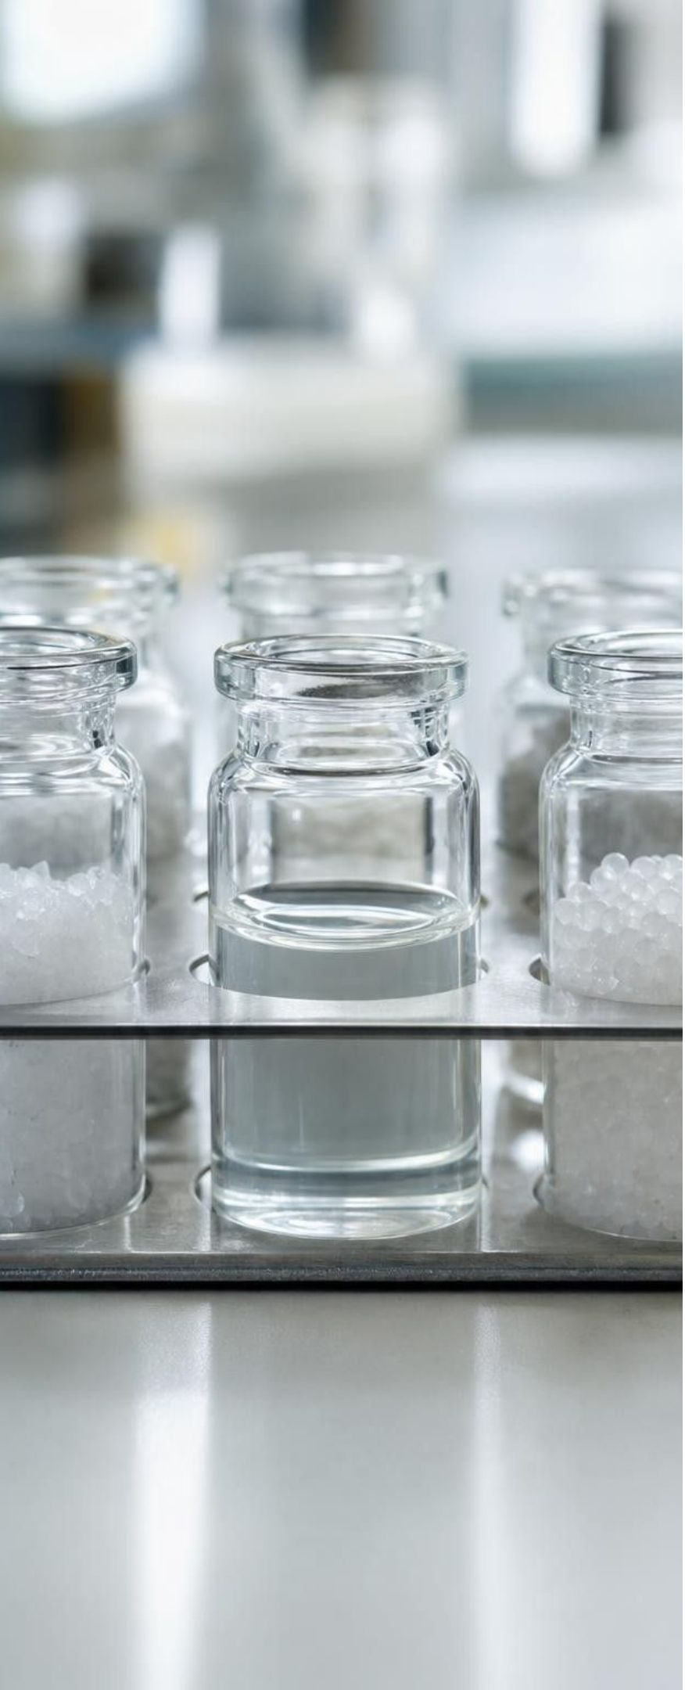
Task: molecule or extended structure? Read the fragment counts
Apply it · Simulated data for practice.
A lab broke each sample into fragments and counted the atoms in three fragments. For each sample decide: molecule (fixed count) or extended structure (fixed ratio), and write the formula or ratio.
Sample | Fragment 1 | Fragment 2 | Fragment 3 | Your call
A | 2 H, 1 O | 2 H, 1 O | 2 H, 1 O
B | 6 Na, 6 Cl | 20 Na, 20 Cl | 150 Na, 150 Cl
C | 4 C, 10 H | 4 C, 10 H | 4 C, 10 H
D | 10 Si, 20 O | 48 Si, 96 O | 300 Si, 600 O
E | 12 C, 22 H, 11 O | 12 C, 22 H, 11 O | 12 C, 22 H, 11 O
F | 30 C, 60 H | 200 C, 400 H | 5,000 C, 10,000 H
23
Notes:
This is a teaching dataset: the counts are invented to mirror real substances. Give groups eight minutes. The test is simple: if every fragment has the same count, the smallest complete piece is a molecule; if the counts grow but the ratio stays fixed, it is an extended structure. A: always 2 H, 1 O, a molecule, H₂O. B: grows, always 1:1, extended, NaCl. C: always 4 C, 10 H, a molecule, C₄H₁₀ (butane or isobutane; the counts cannot say which, a good point to draw out). D: grows, 1:2, extended, SiO₂, quartz. E: always 12, 22, 11, a molecule with 45 atoms, sucrose or maltose. F: grows, always 1 C : 2 H, an extended structure, the polymer polyethylene, repeat unit one carbon with two hydrogens. Ask the follow-up: for sample C and sample E, what extra evidence would you need to name the substance? A structural model or a measured property.
EXPECTED RESPONSES: A molecule H₂O; B extended 1:1 (NaCl); C molecule C₄H₁₀, could be butane or isobutane; D extended 1:2 (SiO₂); E molecule C₁₂H₂₂O₁₁, sucrose or maltose; F extended 1 C : 2 H, a polymer chain. Students should state the rule they used.
WATCH FOR: Groups that call F a molecule 'because it has carbon and hydrogen like butane.' The counts grow; the ratio is what is fixed.
CONNECTS TO: W5 data worksheet is the full version; Lab 2 data cards use the same kind of evidence; W10 mastery.
PACING: about 10 min

Slide 24

Quick check: why six arms?
CHECK FOR UNDERSTANDING
Snow crystals tend to have six arms. Which statement best explains why?
A. Snow freezes in six separate steps
B. Water molecules lock into a hexagonal repeating pattern, and growth follows that pattern
C. Each snowflake is made of exactly six water molecules
D. Cold air is shaped like a hexagon
24
Notes:
Quick vote and one sentence of reasoning. The answer is the pattern inside: in ice, water molecules arrange in a repeating pattern built on hexagons, and a crystal that grows outward from that pattern tends to grow six matching arms. The arms do not mean six molecules; a snowflake holds an astronomically large number of molecules. Connect back to the salt grain: right angles inside give cubes outside; hexagons inside give six-fold shapes outside. Add the honest caveat that columns, needles and broken crystals are common, so 'tend to' is the right phrase.
EXPECTED RESPONSES: B. The visible symmetry comes from the repeating atomic-level pattern, the same logic as salt cubes.
WATCH FOR: Option C is tempting for students who still scale 'six' down to six particles. A crystal's shape is the repeat pattern, not a count.
CONNECTS TO: W9 transfer; W10 mastery.
PACING: about 3 min

Slide 25
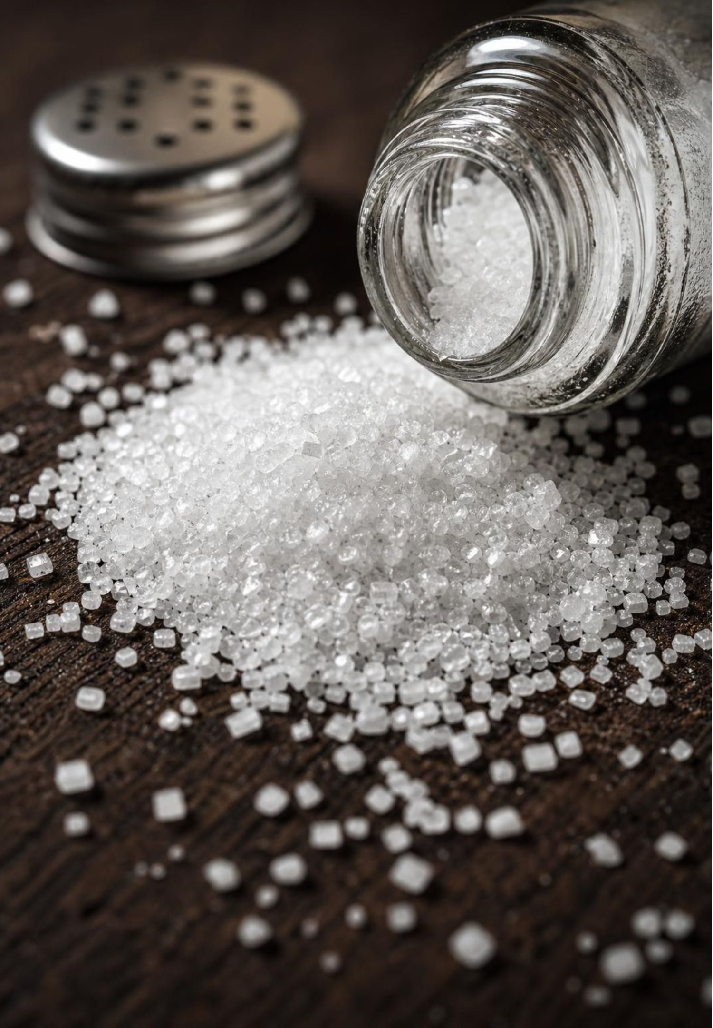
MISCONCEPTION CHECK
True or false? Salt is made of NaCl molecules
"A grain of table salt is a pile of NaCl molecules, and each molecule is one sodium atom bonded to one chlorine atom."
True or false? Explain your reasoning.
25
Notes:
Have students evaluate the statement in writing with evidence from the lesson before any discussion. The statement is false. In solid salt there is no separate two-particle unit; every sodium particle has chlorine neighbors on all sides and every chlorine has sodium neighbors, in one pattern that repeats to the edge of the grain. NaCl is a ratio, 1:1, not a molecule. Evidence students can cite: the fragment counts in sample B grew with fragment size while the ratio stayed 1:1, which never happens for a molecule; the grains are cubes, which comes from the right-angle repeat; the salt block in Lab 1 could be made any size. Contrast with sugar, where the grain is a stack of real 45-atom molecules. Close by asking: which other formula in this lesson is a ratio rather than a molecule count? SiO₂ for quartz.
EXPECTED RESPONSES: False. Salt is an extended structure; NaCl gives the 1:1 ratio; fragment counts grow with size while the ratio stays fixed; there is no molecule to pull out.
WATCH FOR: Students may overcorrect to 'no formula ever names a molecule.' Formulas name molecules for molecular substances (H₂O, CO₂) and ratios for extended structures (NaCl, SiO₂).
CONNECTS TO: W7 misconception worksheet; Lab 1 salt block; W10 mastery.
PACING: about 6 min

Slide 26

Putting it together
PUTTING IT TOGETHER
Fewer than 100 kinds of atoms make millions of substances by bonding in different ways.
A molecule has a definite count of atoms; a formula like H₂O is that count.
Composition and structure together decide the substance: C₄H₁₀ names two.
An extended structure repeats a subunit with no set size; NaCl and SiO₂ are ratios.
Crystals repeat in all directions; polymers repeat along a chain.
Atomic-level structure shows up as patterns you can see: cubes, snowflakes, pencil marks.
26
Notes:
Have students write a three-sentence summary using at least four vocabulary terms, then trade with a partner who checks that molecule and extended structure are used correctly. Ask for one thing from each lab: Lab 1 (what happened to the salt block's ratio as it grew), Lab 2 (one substance and the structure type they matched it to, with the evidence), Lab 3 (which build survived the push test and why). Return to the phenomenon one last time and have the class explain the salt cubes and the sugar slants in two sentences each. Preview Lesson 3: properties such as melting point and solubility, which depend on exactly these structures.
CONNECTS TO: W10 mastery as the quiz; L03 Substances and Their Properties next.
PACING: about 6 min

Slide 27
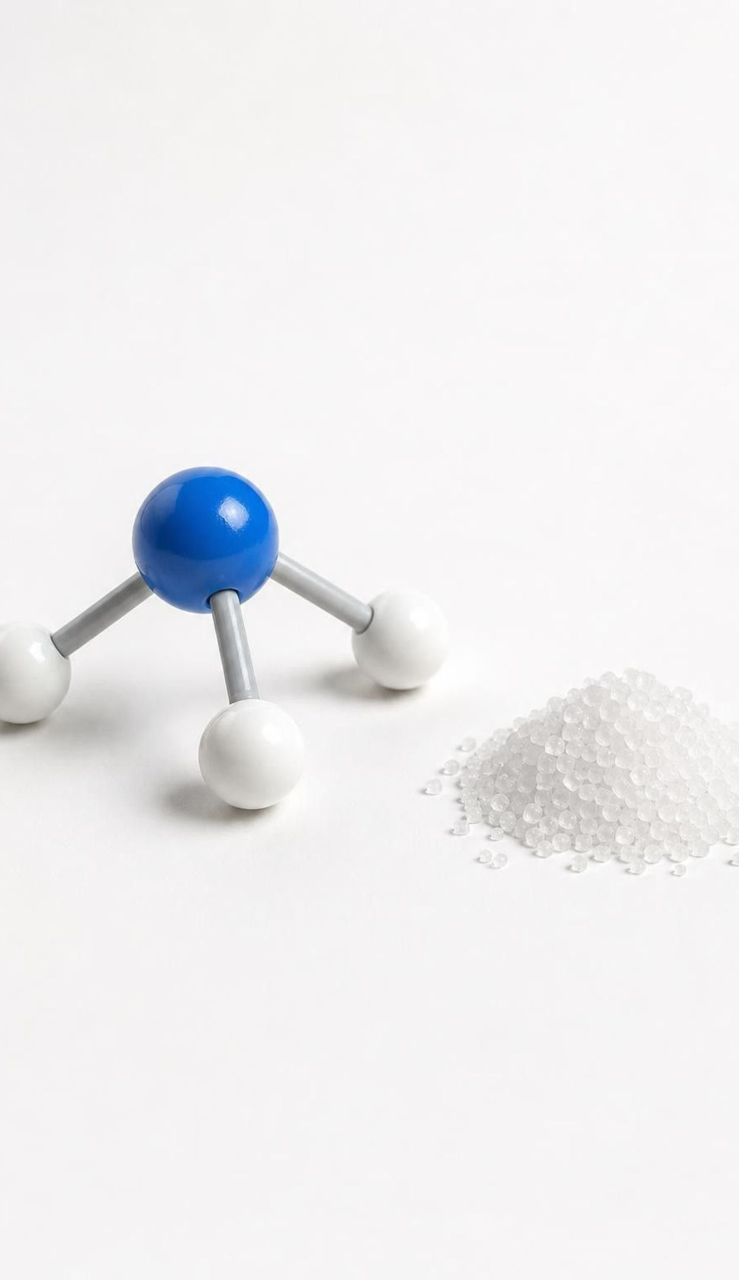
Exit ticket
EXIT TICKET
1
Write the formula for a molecule with 1 nitrogen atom and 3 hydrogen atoms, and say how many bonds it has.
2
A fragment has 40 Na and 40 Cl; another has 90 Na and 90 Cl. Molecule or extended structure? One reason.
3
Butane and isobutane are both C₄H₁₀. In one sentence, why are they different substances?
4
Why are salt grains cubes? Answer with the word 'repeating'.
27
Notes:
Collect on index cards or a shared form. Item 1 checks formula reading and the bond count (three, all to the nitrogen). Item 2 is the molecule-versus-extended-structure target. Item 3 checks composition versus structure. Item 4 is the structure-explains-pattern target and closes the phenomenon. Sort the cards into piles by which item was missed and reteach from the largest pile before W10.
EXPECTED RESPONSES: 1: NH₃, three bonds, each hydrogen bonded to the nitrogen. 2: extended structure, because the count grows with fragment size while the ratio stays 1:1; a molecule would always give the same count. 3: same composition but different structure (a chain of four carbons versus a central carbon with three branches), so different substances. 4: sodium and chlorine particles stack in a repeating pattern at right angles, so a growing grain builds square faces that meet at right angles.
WATCH FOR: Item 2 answers of 'molecule, because it has a formula' show the central misconception is still live; item 3 answers of 'different number of atoms' show composition and structure are still confused.
CONNECTS TO: W10 mastery; chapter evidenceOfLearning.
PACING: about 5 min

