Slide 1
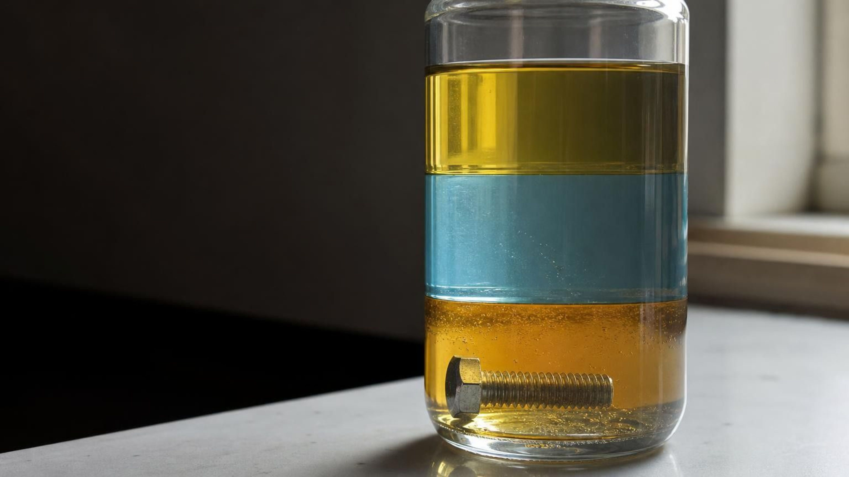
Substances and Their Properties
Chapter 3 of 29 · The Composition of Matter
Lesson 3: How can you tell one substance from another when they look the same?
Angela's Wand · Bring Science Alive! 7th Grade Integrated
Notes:
Frame the week as detective work. Lessons 1 and 2 were about pieces too small to see; this lesson is about the samples we can hold, pour and weigh, and about the measurements that reveal what they are made of. Tell students they will identify four unknown liquids (Lab 1), choose a material for a product using property data (Lab 2), and survey kitchen solids at home to build a class identification key (Lab 3). No flames are used anywhere in the chapter; flammability is taught from descriptions only.
CONNECTS TO: Overview of Lab 1, Lab 2 and Lab 3; W1 opens on the next slide.
PACING: about 2 min

Slide 2
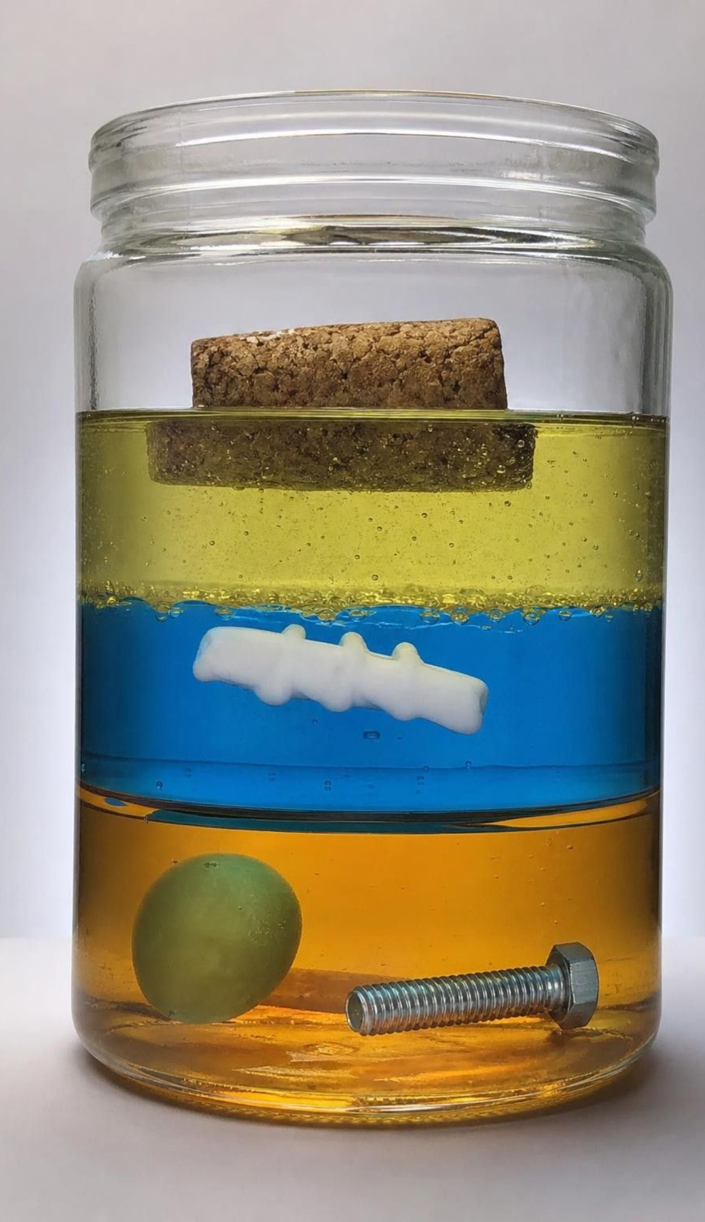
PHENOMENON
Four objects, four stopping points
A jar holds corn syrup, blue-tinted water and vegetable oil in three layers that will not blend. Drop in a steel bolt, a grape, a shaving from a milk-jug cap and a cork. The bolt sinks to the bottom. The grape stops on the syrup. The cap shaving sinks through the oil but floats on the water. The cork stays on top. Nothing holds them up. What decides where each one stops?
Notice: what is different about the places where the objects stop?
Wonder: why do the three liquids stay in layers instead of mixing?
Predict: where would a paper clip stop? An ice cube? A drop of food coloring?
2
Notes:
Build the jar live if you can: pour corn syrup first, then tinted water slowly down the side, then oil. Add the objects one at a time and let students call the stopping point before each drop. Give two silent minutes for a notice and a wonder, then collect on the board without judging. Press on two questions. First, each object stops where the liquid below it is 'heavier for its size' than the object; that phrase is the seed of density. Second, the oil and the water refuse to mix no matter how long you wait, which is the seed of solubility. Park both ideas. Teacher background: the bolt (steel, about 7.9 g/cm³) sinks through everything; the grape (about 1.1) floats on syrup (about 1.4) but sinks in water (1.0); the milk-jug cap shaving (high-density polyethylene, about 0.95) floats on water but sinks in oil (about 0.92); cork (about 0.25) floats on oil.
EXPECTED RESPONSES: Notice: heavier things go lower; the liquids are in a fixed order; the grape sits exactly at a boundary. Wonder: why the water and oil do not mix; whether shaking would change the order; what would happen with a bigger grape. Predict: paper clip to the bottom; ice cube floats on water under the oil; food coloring falls through the oil as beads and spreads out the moment it reaches the water.
WATCH FOR: 'Heavier objects sink' without mentioning size. Ask whether a huge cork would sink; the answer is no, which shows that something other than mass is at work.
CONNECTS TO: W1 phenomenon worksheet records the notice/wonder and first explanation. Lab 1 returns to layered liquids with real measurements.
PACING: about 8 min

Slide 3
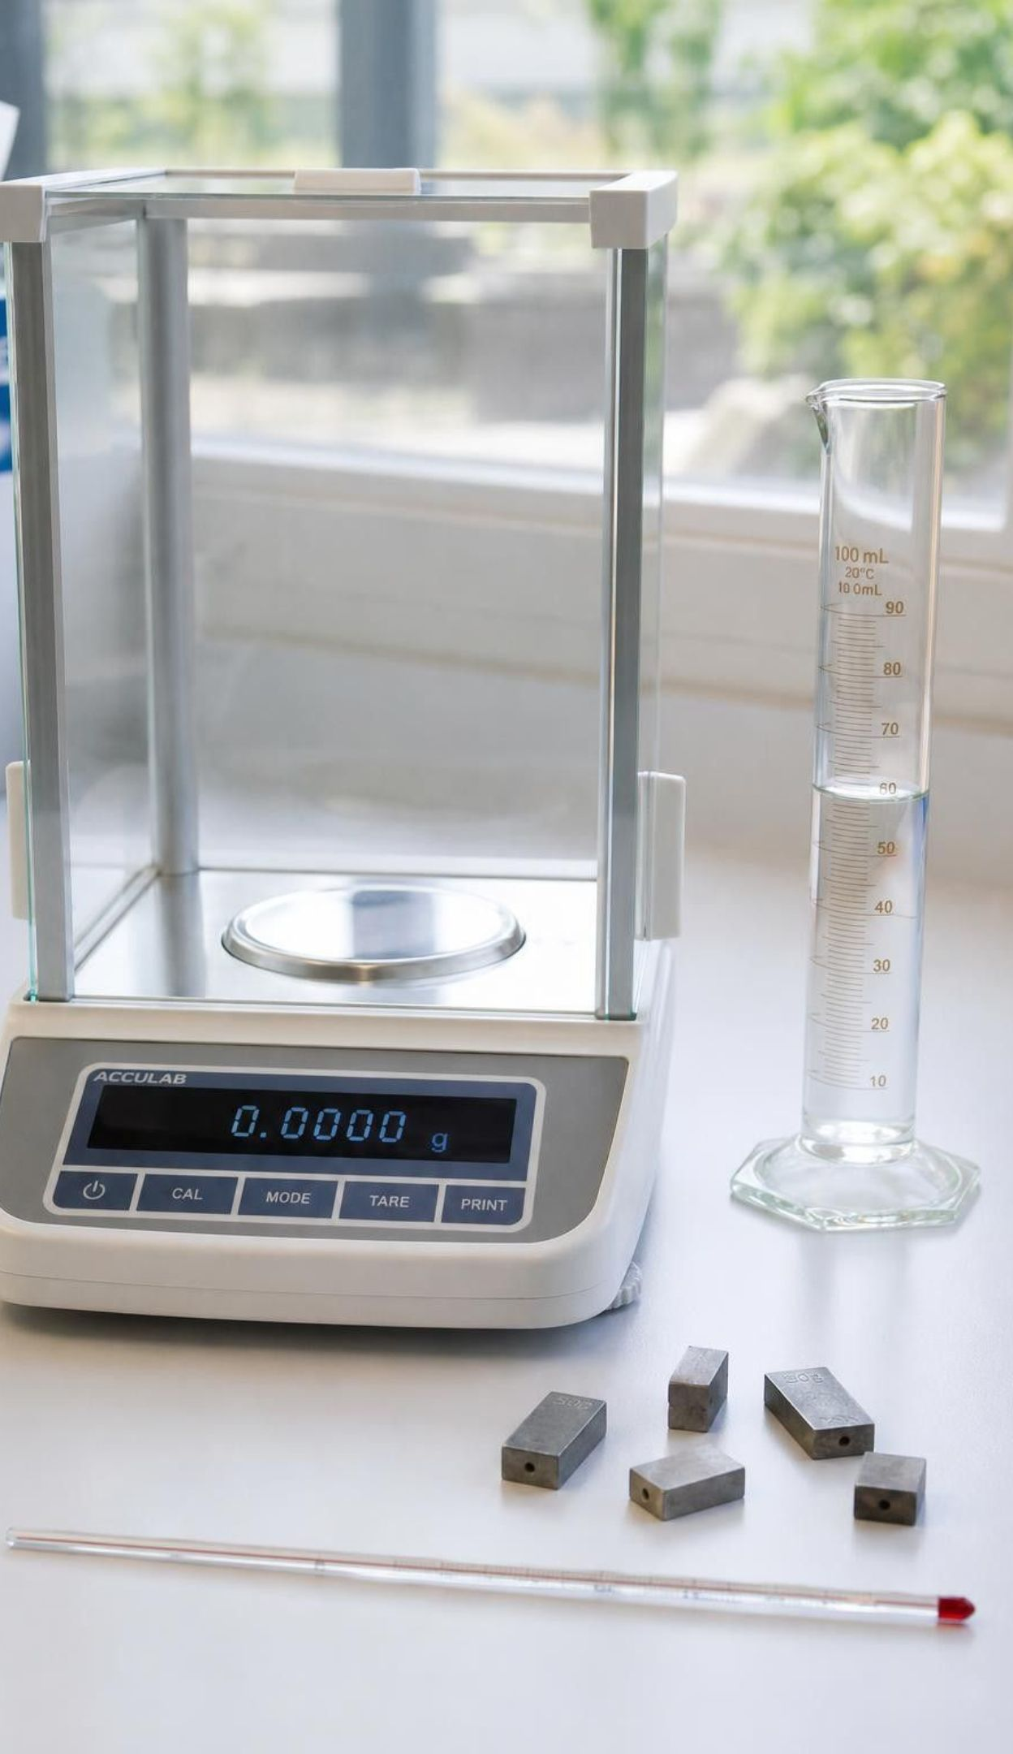
LEARNING TARGETS
What you will be able to do
Explain what a substance is and tell a pure substance from a mixture.
Sort properties that describe one object from properties that identify a substance.
Calculate density and use it to rule a substance in or out.
Explain melting point, boiling point, solubility and flammability, and which tests change the substance.
Combine several tests with a reference table to identify an unknown or choose a material.
3
Notes:
Read the targets aloud. Tell students that targets 1 and 2 are today, target 3 is tomorrow and Lab 1, target 4 is the middle of the week, and target 5 is what every lab ends with. Ask them to star the target that sounds hardest; most will star density, which is a good sign that they know a calculation is coming.
CONNECTS TO: Targets map to W2 (1), W4 (2), W5 and Lab 1 (3), W3 and Lab 3 (4), Lab 2, W9 and W10 (5).
PACING: about 2 min

Slide 4
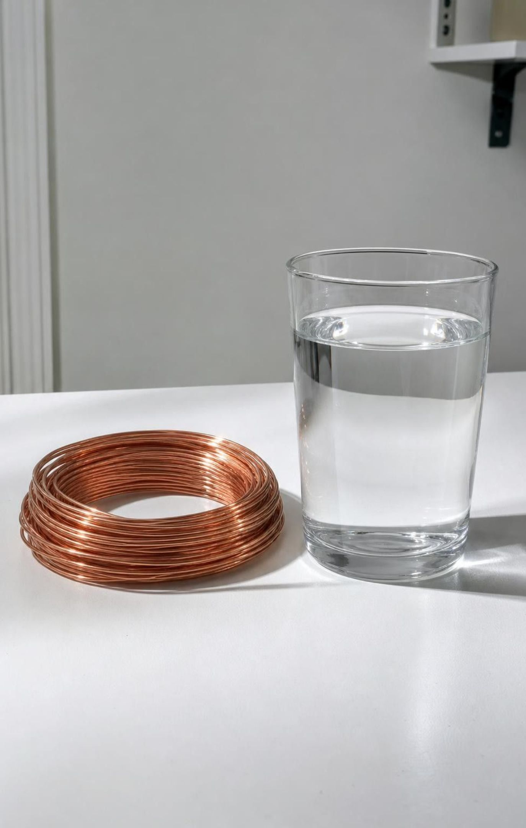
What is a substance?
A substance is matter with one fixed makeup throughout: water, oxygen gas, pure copper.
A single molecule is far too small to see. Trillions of trillions of them together make a sample you can hold.
A sample at that everyday scale is called macroscopic.
Invisible gases count too: the oxygen you breathe and the carbon dioxide you breathe out are substances.
'Chemical' just means substance. Water and table salt are chemicals; so is everything you eat.
4
Notes:
Connect to Lesson 2: students modeled single molecules of water and extended structures like salt. Now ask how many molecules are in a cup of water. The answer is about eight trillion trillion, a number so large that the sample behaves like smooth, continuous stuff. That is what macroscopic means. Push on the gas point: hold up an empty-looking cup and ask what substances are inside. Air is a mixture, but the oxygen in it is a substance even though no one can see it. Then take on the word chemical. Ask students to name a chemical; most will name something scary. Point out that dihydrogen monoxide is water and sodium chloride is table salt. The word tells you nothing about safety.
WATCH FOR: 'Chemicals are dangerous things added to products.' Also 'a gas is not a substance because you cannot see it.' Visibility is not the test; fixed makeup is.
CONNECTS TO: W2 vocabulary sort; W3 reading passage opens with the word chemical.
PACING: about 5 min

Slide 5
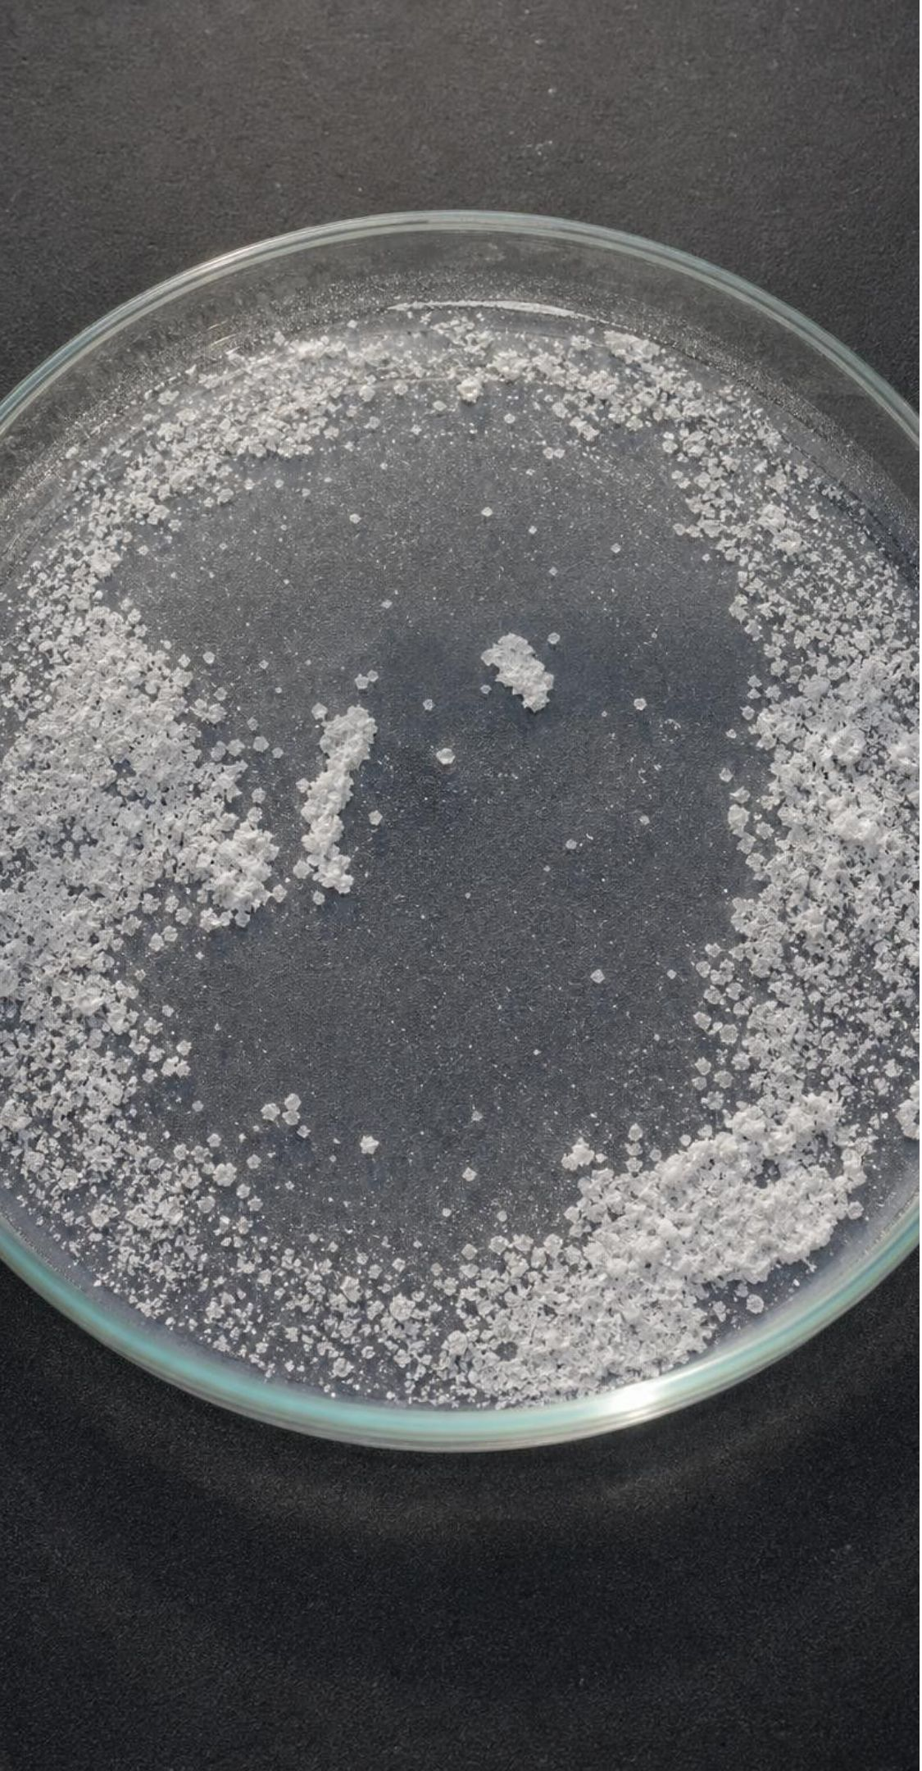
VOCABULARY IN CONTEXT
Three words to keep straight
substance: Matter with one fixed makeup throughout; every pure sample has the same identifying properties. Every drop of pure water, from any tap on Earth, freezes at 0 °C.
macroscopic: At the everyday scale you can see and measure, made of trillions upon trillions of particles. You can measure the density of a copper wire, but not of one copper atom.
mixture: Two or more substances mingled together, each keeping its own properties. Seawater is water with dissolved salts; evaporate the water and the salts are left behind.
5
Notes:
Say the pair 'one makeup, one set of properties' and have students repeat it; that is the test for a substance. Then give a quick sort on whiteboards: oxygen gas, air, pure gold, a gold ring, sugar, a cookie. Oxygen, pure gold and sugar are substances; air, the ring (an alloy) and the cookie are mixtures. The ring surprises students: most jewelry gold is mixed with copper and silver so it is hard enough to wear. Preview that mixtures get their own slide near the end.
WATCH FOR: Students may call anything 'pure-looking' a substance. A gold ring looks pure but is an alloy; air looks like nothing but is a mixture of several gases.
CONNECTS TO: W2 vocabulary worksheet works with exactly these relationships.
PACING: about 4 min

Slide 6
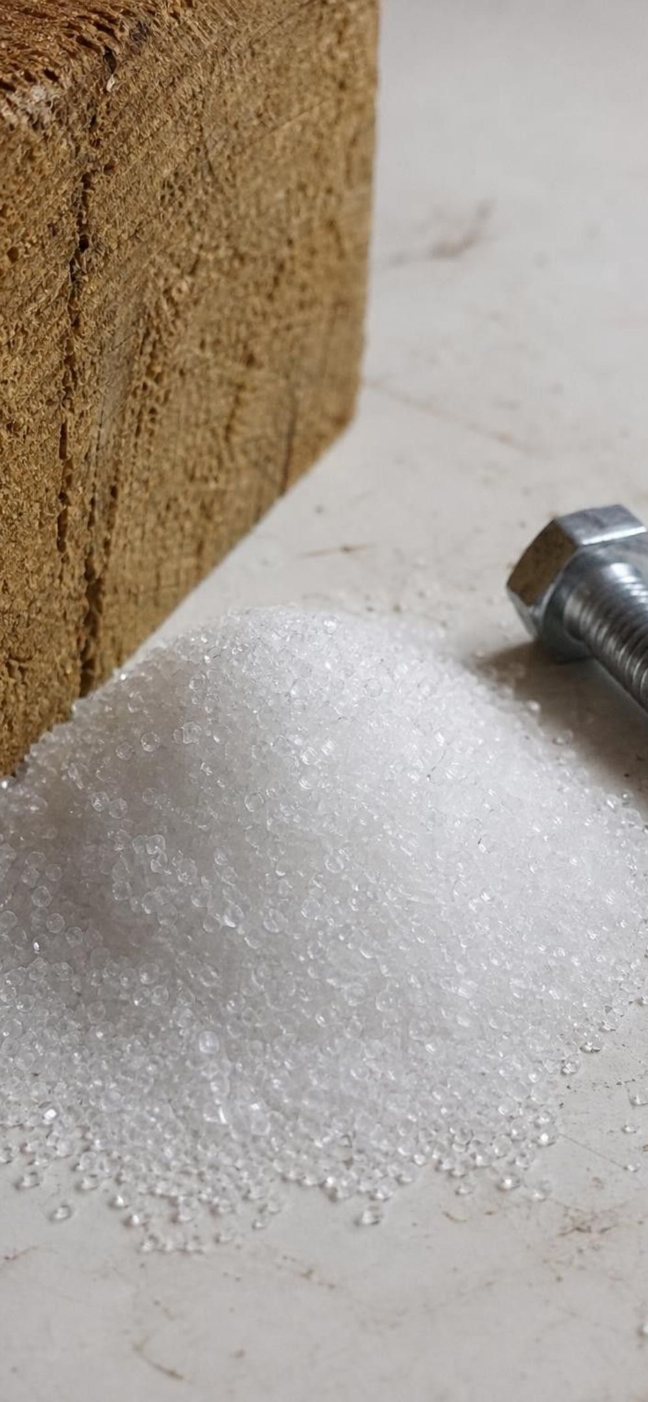
MODEL
Pure substance or mixture?
Model: Two kinds of matter you meet every day
Pure substances (one fixed makeup) | Mixtures (two or more substances mingled)
Water (every molecule is H₂O) | Air: nitrogen, oxygen, argon, carbon dioxide and more
Oxygen gas, invisible but one makeup | Seawater: water plus dissolved salts
Pure copper wire | Steel: iron with a little carbon and other elements
Table salt (one repeating extended structure) | Wood: cellulose, lignin and other substances
Sugar crystals | A gold coin: gold mixed with harder metals
Separate a mixture all the way into its parts and each part is a pure substance with its own properties.
6
Notes:
Walk both columns. The left side is short on purpose: most things in a classroom are on the right. Ask students to look around and name three objects and guess which column each belongs in. The desk (wood or a plastic blend), the window (glass, made from several ingredients), the water bottle contents (tap water has dissolved minerals, so strictly a mixture, though a very dilute one). Make the point that the textbook's examples of iron beams and a copper penny are really steel and a copper-coated zinc coin; the idea is right, the examples are mixtures. The key test is the caption: a mixture can be taken apart into substances; a substance cannot be taken apart without changing what it is.
EXPECTED RESPONSES: Students should be able to name air as a mixture and oxygen as a substance, and should begin to see that 'pure-looking' is not the same as 'pure'.
WATCH FOR: 'Pure substance means natural or clean.' Pure here means one makeup, not safe or natural.
CONNECTS TO: W2 and W10 reuse this sort; slide 25 returns to alloys.
PACING: about 5 min

Slide 7
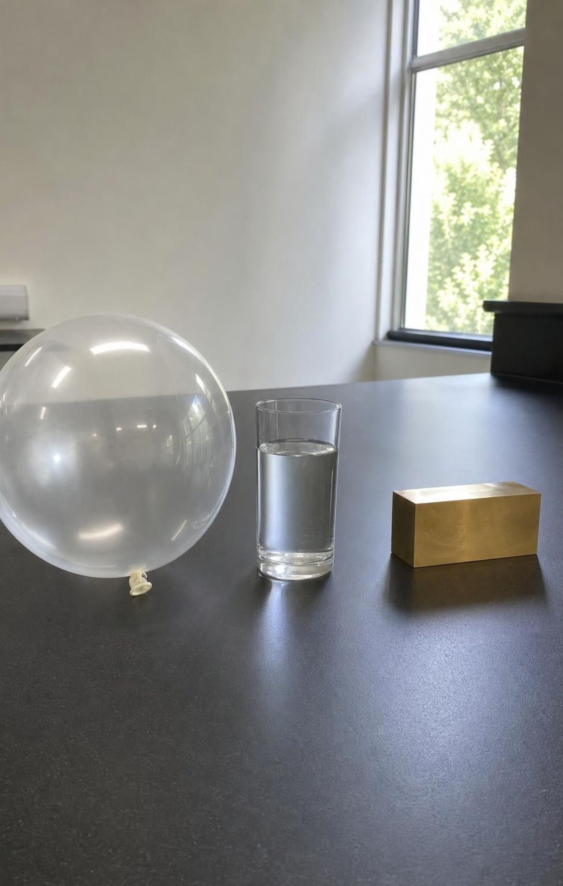
CHECK FOR UNDERSTANDING
Quick check: substance or mixture?
Which one of these is a pure substance?
A. Air in a balloon
B. Salt water
C. Carbon dioxide gas
D. Brass (copper mixed with zinc)
7
Notes:
Vote with fingers, then defend. Air and brass are mixtures of several substances; salt water is water with dissolved salt and can be separated by evaporation. Carbon dioxide has one fixed makeup, so it is a substance even though it is an invisible gas. Follow up: 'Is one carbon dioxide molecule a substance?' Steer to the idea that the word substance names the macroscopic sample and its kind of molecule; a single molecule is a particle of the substance.
EXPECTED RESPONSES: C, carbon dioxide gas. Students who choose B often argue that salt water looks uniform; point out that looking uniform is not the test, because the salt can be taken back out.
WATCH FOR: Choosing A because 'air is just one thing'. Air is the most common mixture students meet.
CONNECTS TO: W2; W10 mastery.
PACING: about 3 min

Slide 8
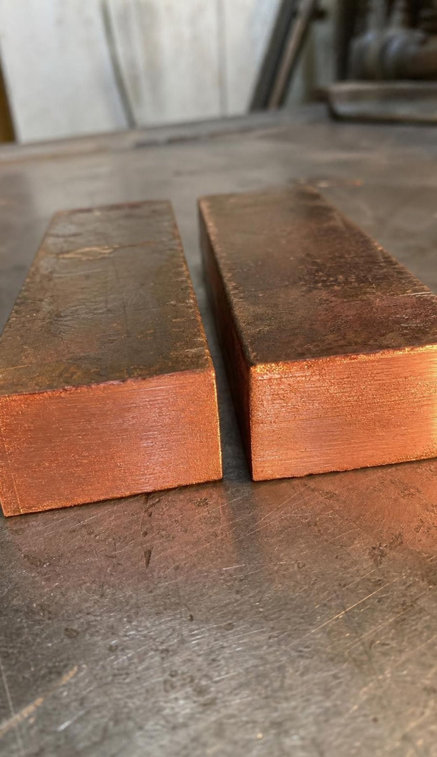
Two kinds of properties
A property is anything about matter you can observe or measure.
Some properties describe one particular object: its mass, its volume, its shape.
Cut a copper bar in half and each half has a new mass, a new volume and a new shape.
Other properties belong to the substance: density, melting point, boiling point, solubility, flammability.
Both halves of the bar have exactly the same density and melt at exactly the same temperature.
Only the second kind can tell you what something is made of.
8
Notes:
Use the cut-in-half test as the tool. Hold up any object (a chalk stick works) and snap it. Ask what changed: mass, volume, length, shape. Ask what did not change: what it is made of, so its density, its melting point, whether it dissolves in water. The textbook uses odor as its example of an identifying property. Odor is weak: many substances have none, and smelling unknowns is unsafe, so this chapter uses the five measurable properties on the slide. Have students write the two lists in their notebooks under the headings 'describes this object' and 'identifies the substance'.
WATCH FOR: Students put mass on the identifying side because 'gold is heavy'. Ask whether a gold flake and a gold bar have the same mass. The property they are reaching for is density.
CONNECTS TO: W2 and W4 both use this sort; W7 misconception repair.
PACING: about 5 min

Slide 9
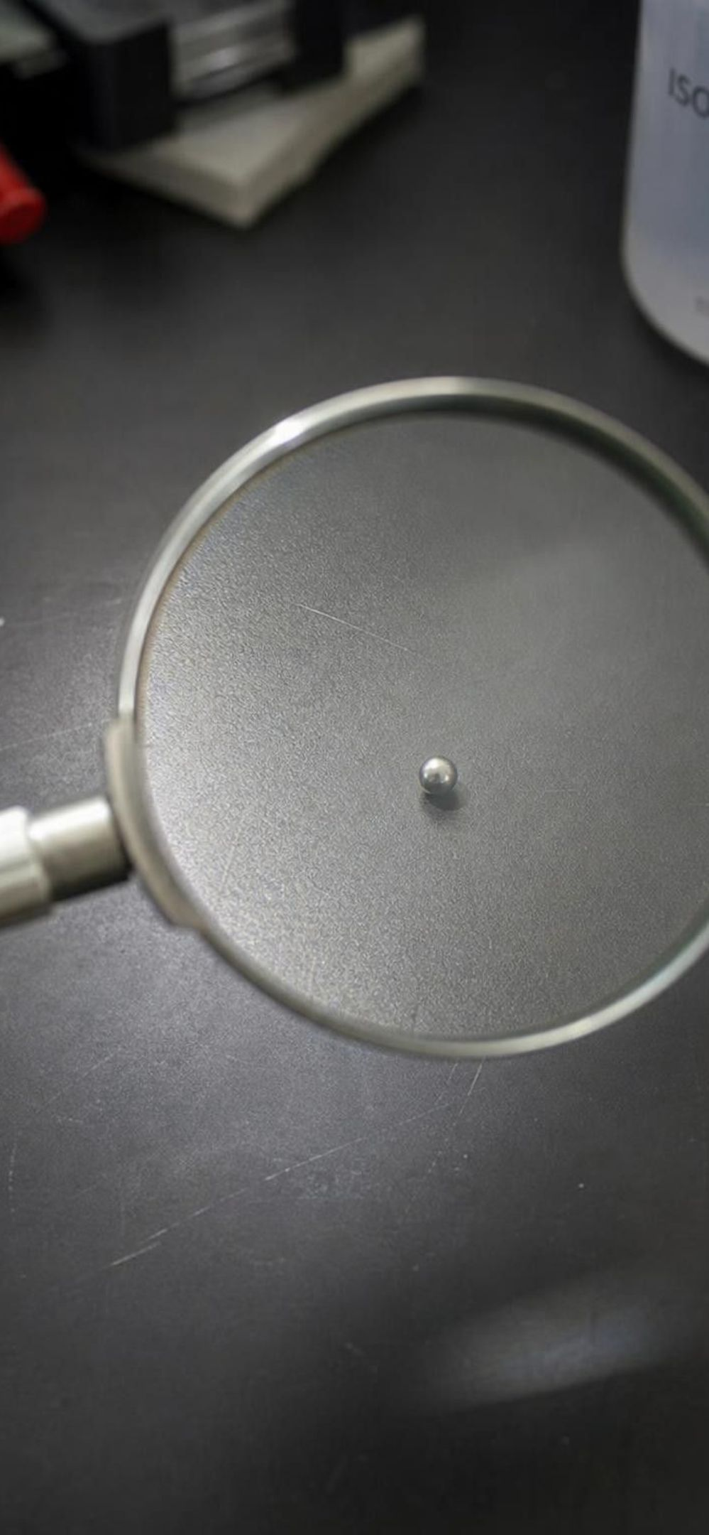
MODEL
Which properties can identify a substance?
Model: Describes one object versus identifies the substance
Describes this one object (changes when you cut it) | Identifies the substance (same for every pure sample)
Mass: a bar has more than a bead | Density: mass per cm³ at a given temperature
Volume: how much space this piece takes up | Melting point: same for a chip or a block
Shape: a ring, a wire, a coin | Boiling point: at the same air pressure
Temperature right now | Solubility: in a named liquid
Position: on the desk or in a drawer | Flammability: whether it burns (a chemical property)
A detective ignores the left column and measures the right column.
9
Notes:
Read the right column slowly and point out the fine print on each item: density at a given temperature, boiling point at the same pressure, solubility in a named liquid. Those conditions matter and the textbook leaves them out. Water boils at 100 °C at sea level but at about 94 °C near Lake Tahoe, 1,900 meters up; a table of boiling points is always a sea-level table. Then draw attention to the last right-hand item: flammability is different from the other four because you can only observe it by letting the substance burn, which turns it into new substances. The other four can be measured and the sample is still the same substance afterward. Those are physical properties; flammability is a chemical property.
EXPECTED RESPONSES: Students should be able to explain why 'temperature' is on the left (it describes the object's current state, not the substance) and why flammability is flagged as different.
WATCH FOR: 'Identifying properties never change under any conditions.' They do not change with amount; boiling point does change with air pressure.
CONNECTS TO: W4 diagram worksheet; W3 reading on physical versus chemical properties.
PACING: about 5 min

Slide 10
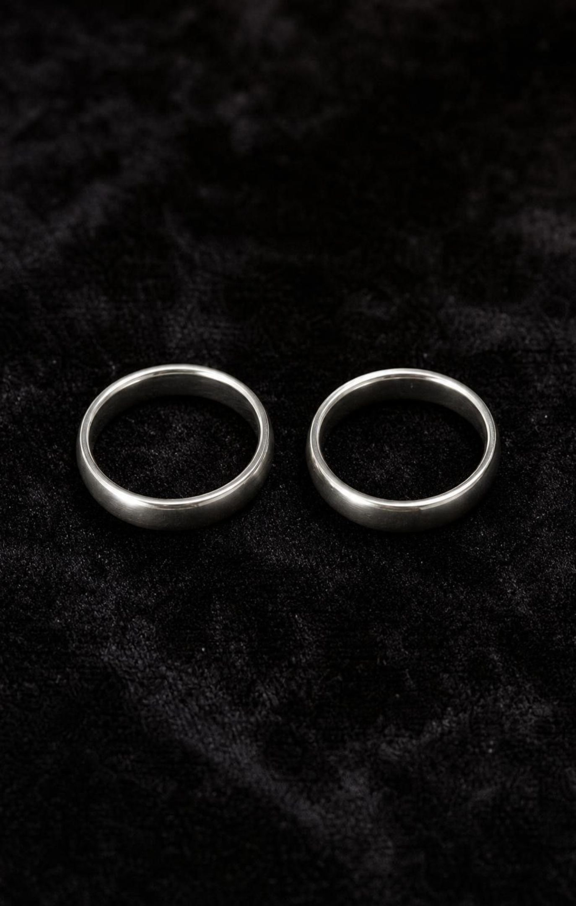
THINK, PAIR, SHARE
Discuss: two gray rings
Both are gray and shiny, so color is no help.
Both can be weighed and measured.
Some tests leave the ring unchanged. Others destroy it.
Two gray, shiny rings look identical. One is silver and one is platinum. Which measurements would you make to tell them apart, and which tests would you refuse to do to someone's ring?
10
Notes:
Give pairs three minutes. Collect ideas in two columns on the board: 'keeps the ring' and 'ruins the ring'. Students usually propose weighing first; push with 'the platinum ring is thinner, so it weighs less; does that prove anything?' This surfaces the need for a fair comparison, which is density. Melting the ring would work (silver melts near 962 °C, platinum near 1768 °C) but destroys it; so would dissolving it in acid, which is really a chemical reaction, not dissolving. Lead the class to the idea that a good test for a valuable object is one that leaves it unchanged, and that density is the first such test.
EXPECTED RESPONSES: Keeps the ring: measure mass and volume and compare the ratio; compare with known densities. Ruins the ring: melt it, burn it, put it in acid. Some students will suggest scratching or a magnet; silver and platinum are both non-magnetic, so a magnet does not separate them.
WATCH FOR: 'The heavier ring is platinum.' Only true if the rings have the same volume.
CONNECTS TO: W6 CER uses two lookalike samples; Lab 1 identifies unknowns with non-destructive tests.
PACING: about 6 min

Slide 11
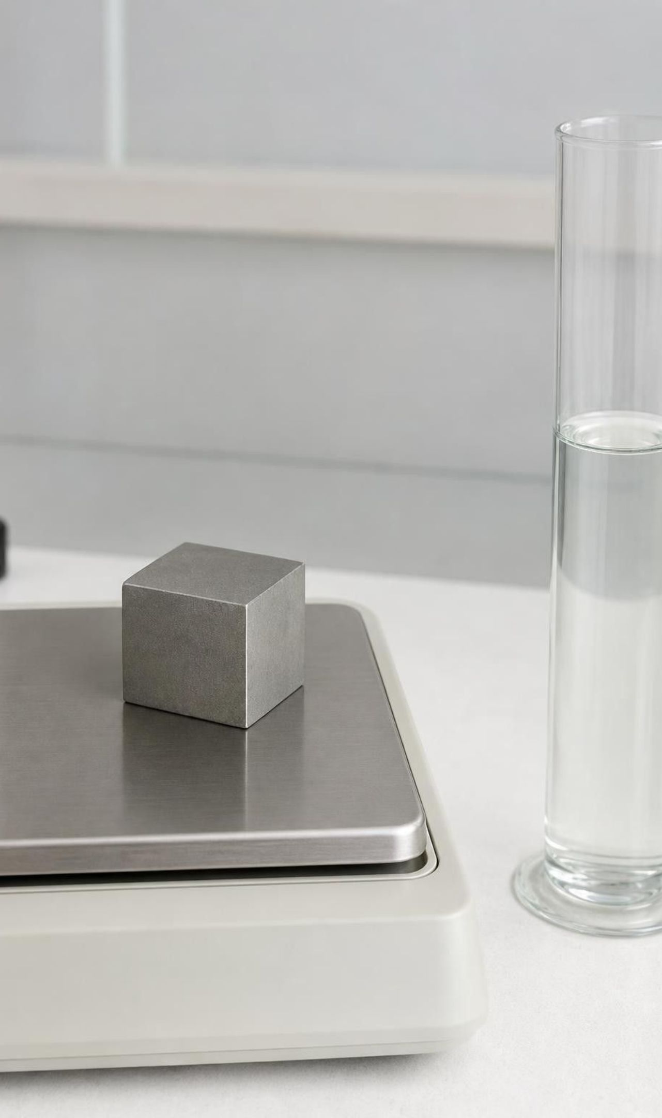
Density: a fair way to compare
Density = mass ÷ volume.
Units are grams per cubic centimeter (g/cm³); 1 cm³ = 1 mL.
Equal volumes make the comparison fair: a 1 cm³ cube of silver has about 10.5 g; platinum about 21.5 g.
A big silver spoon has more mass than a tiny platinum bead, yet platinum is twice as dense.
Cut a sample in half: half the mass, half the volume, the same density.
Measure a sample's density, compare it to a table of known values, and you can rule substances in or out.
11
Notes:
Write the formula and do one example on the board from the textbook's own ingot: 135 g in 50 cm³ gives 2.7 g/cm³. Then compare: silver is about 10.5, so the ingot is far less dense than silver; it matches aluminum. Note for yourself that the textbook says the sample is 'too dense' to be silver, which is backwards; the arithmetic and the conclusion are correct. Show how to get volume for an irregular object: lower it into water in a graduated cylinder and read the rise; 1 mL of rise is 1 cm³. Then ask the cut-in-half question explicitly and have students explain why the ratio survives when both numbers halve. Finally remind them that density shifts a little with temperature, so tables say 'at room temperature'.
WATCH FOR: 'Denser means heavier.' Always ask: heavier than what, at the same volume? Also watch for the division written upside down (volume ÷ mass). Water is a poor check because 1 ÷ 1 is 1 either way, so use numbers that are not equal, such as 54 g and 20 cm³, where the wrong order gives 0.37.
CONNECTS TO: W5 data worksheet on density; Lab 1 and Lab 2 measure density directly.
PACING: about 6 min

Slide 12
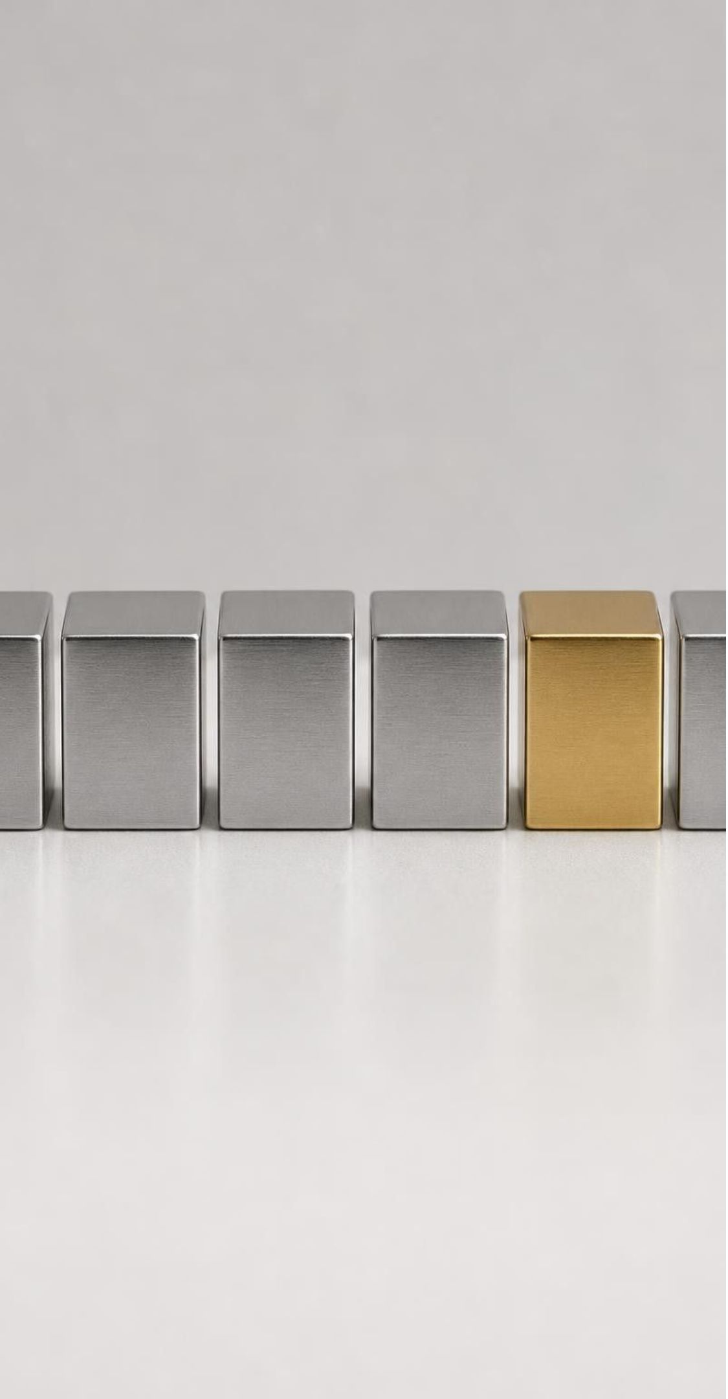
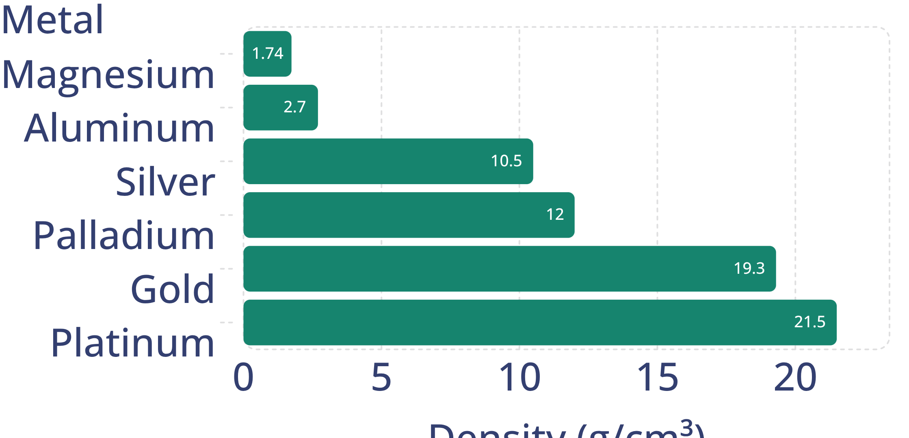
MODEL
Six gray or yellow metals that look alike
Model: Density of six metals (g/cm³, rounded reference values)
Magnesium, aluminum, silver, palladium and platinum are all gray and shiny. Density separates most of them, but silver and palladium are close.
12
Notes:
These are real reference values rounded to three figures. Ask students which pairs density separates easily (magnesium from aluminum, silver from platinum) and which pair is close (silver 10.5 and palladium 12.0). With a careful balance and cylinder those two can still be told apart, but a sloppy measurement could not, which is why a second test, melting point, is coming. Ask a scale question: how many times denser than aluminum is platinum? About eight. A platinum ring the size of an aluminum ring has eight times the mass. Also point out gold: its color helps, but gold-colored brass exists, and density (19.3 versus about 8.5 for brass) settles it at once.
EXPECTED RESPONSES: Students should name silver and palladium as the hard pair and propose a second measurement to separate them.
WATCH FOR: Reading the bar heights as 'how heavy a piece is'. The bars are per cubic centimeter.
CONNECTS TO: W5 data worksheet graphs these values; slide 23 task uses the same reasoning.
PACING: about 5 min

Slide 13
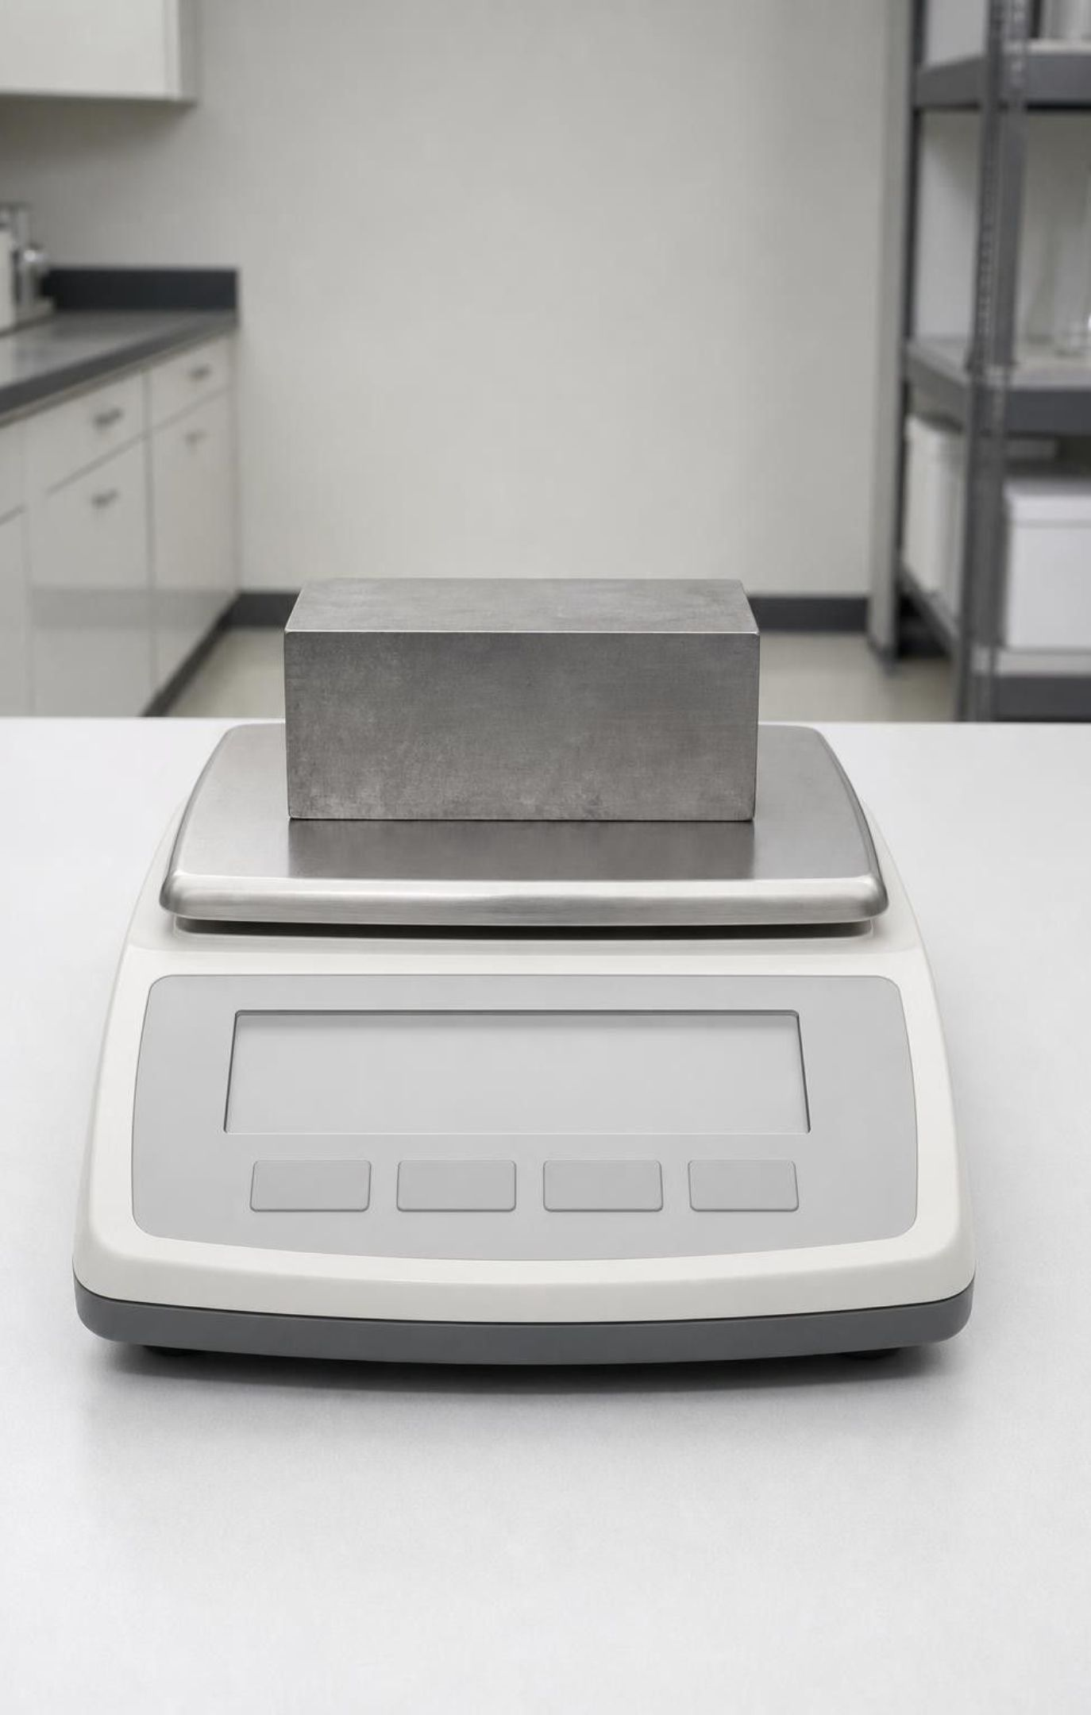
CHECK FOR UNDERSTANDING
Quick check: name the metal
A gray block has a mass of 54.0 g and a volume of 20.0 cm³. What is its density, and which metal on the last slide matches?
A. 0.37 g/cm³; none of them
B. 2.7 g/cm³; aluminum
C. 10.8 g/cm³; silver
D. 1,080 g/cm³; platinum
13
Notes:
Two minutes on whiteboards. 54.0 ÷ 20.0 = 2.70 g/cm³, which matches aluminum. Students who choose A divided the wrong way; students who choose D multiplied. Then ask the follow-up: 'You saw a block of 108 g and 40 cm³. Same metal?' Yes: 108 ÷ 40 = 2.7. Twice the block, same density. That is the whole reason density identifies a substance.
EXPECTED RESPONSES: B. Follow-up: yes, the second block has the same density, so it is consistent with aluminum too.
WATCH FOR: Dividing volume by mass, and the belief that the 108 g block must be a different, 'heavier' metal.
CONNECTS TO: W5; W10 mastery numeric items.
PACING: about 4 min

Slide 14
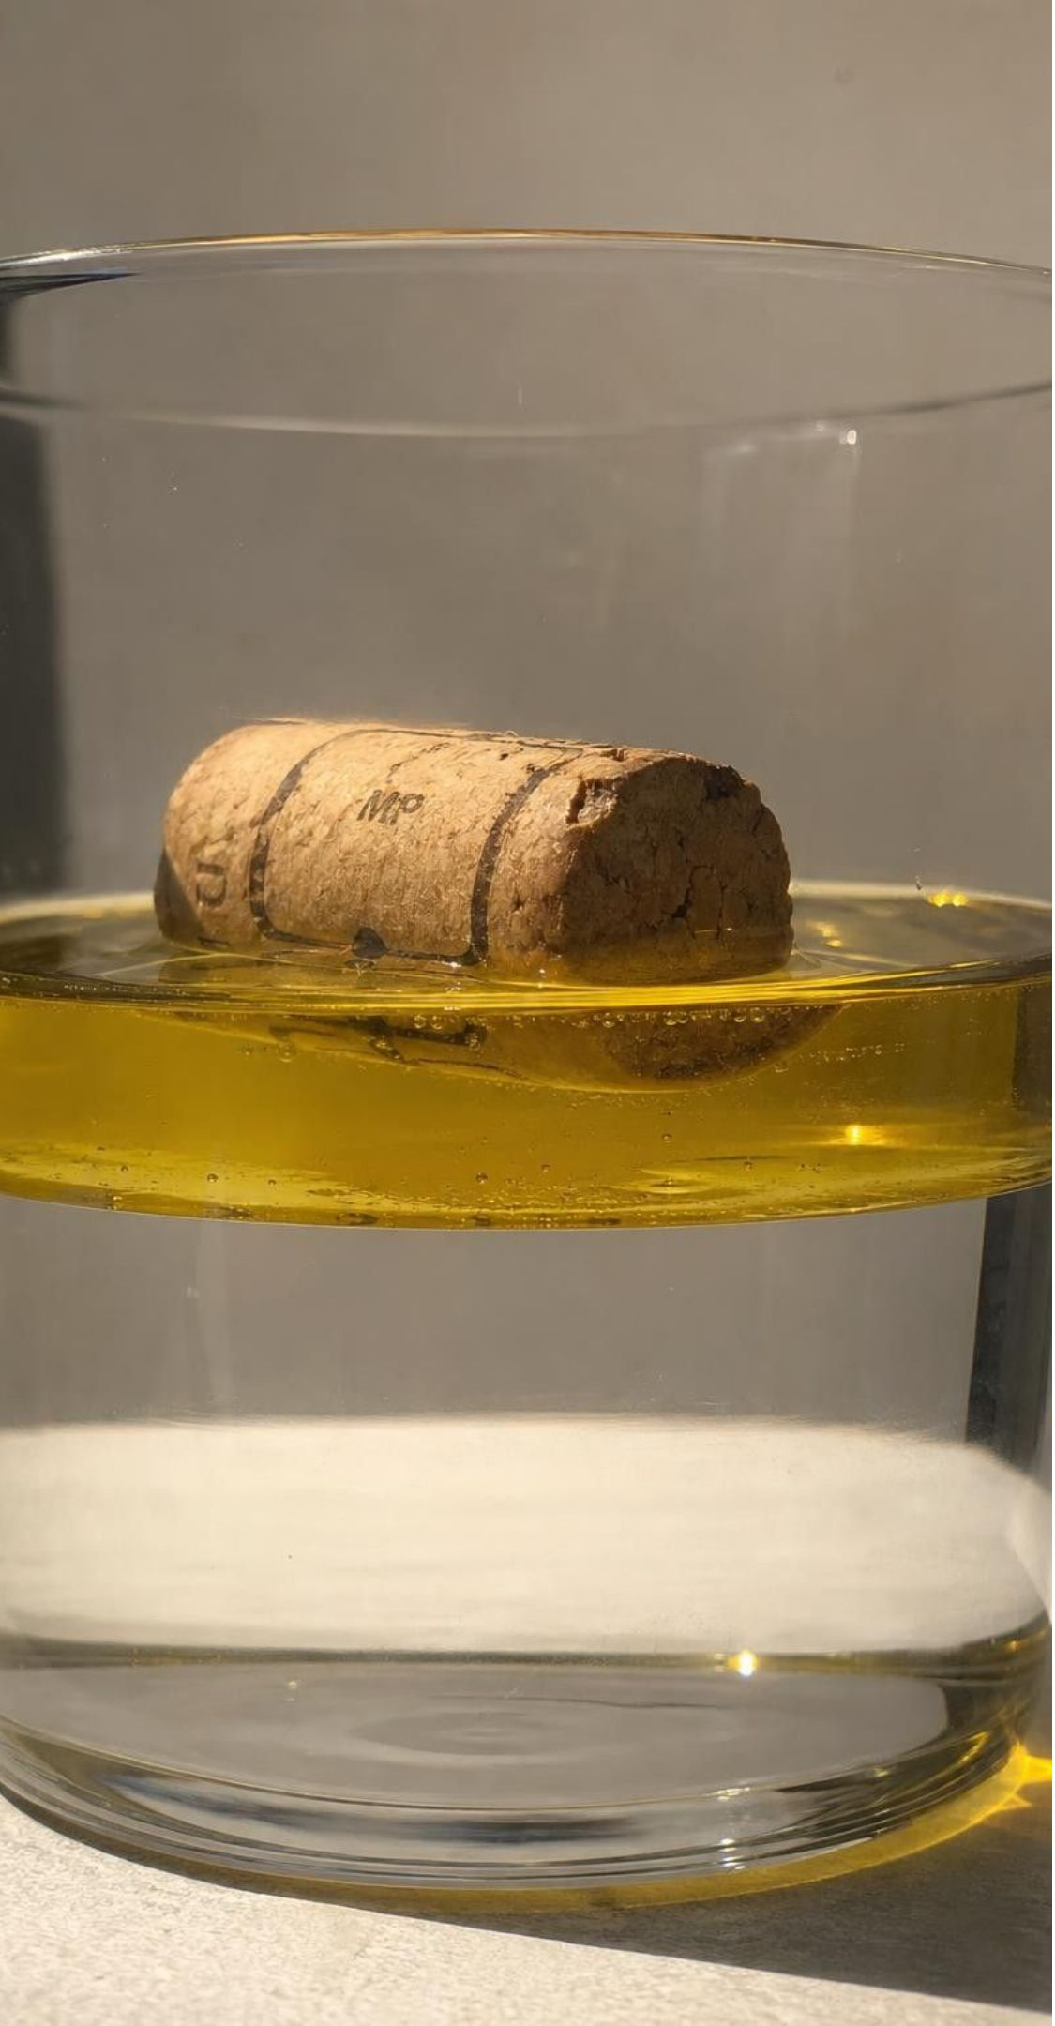
VOCABULARY IN CONTEXT
The measuring words
density: Mass packed into each unit of volume: mass ÷ volume, in g/cm³. A cork at about 0.25 g/cm³ floats on oil at about 0.92 g/cm³.
melting point: The temperature at which a solid turns to liquid; the same for a chip or a block of the same substance. A silver chip and a silver bar both begin to melt at about 962 °C; the bar just takes longer.
boiling point: The temperature at which a liquid boils to gas, listed at sea-level air pressure. Pure water boils at 100 °C at the beach and at about 94 °C near Lake Tahoe.
14
Notes:
Pair each word with its unit and its condition: density in g/cm³ at room temperature; melting and boiling point in °C, with boiling point tied to sea-level pressure. Have students add the words to their notebook glossary with one example each that is not on the slide. Ask why a cook's pasta takes longer to cook at a mountain cabin: the water boils at a lower temperature, so the food cooks more slowly.
WATCH FOR: Confusing melting point with 'how long it takes to melt'. Time depends on the amount; temperature does not.
CONNECTS TO: W2 vocabulary; W3 reading passage; W10.
PACING: about 4 min

Slide 15
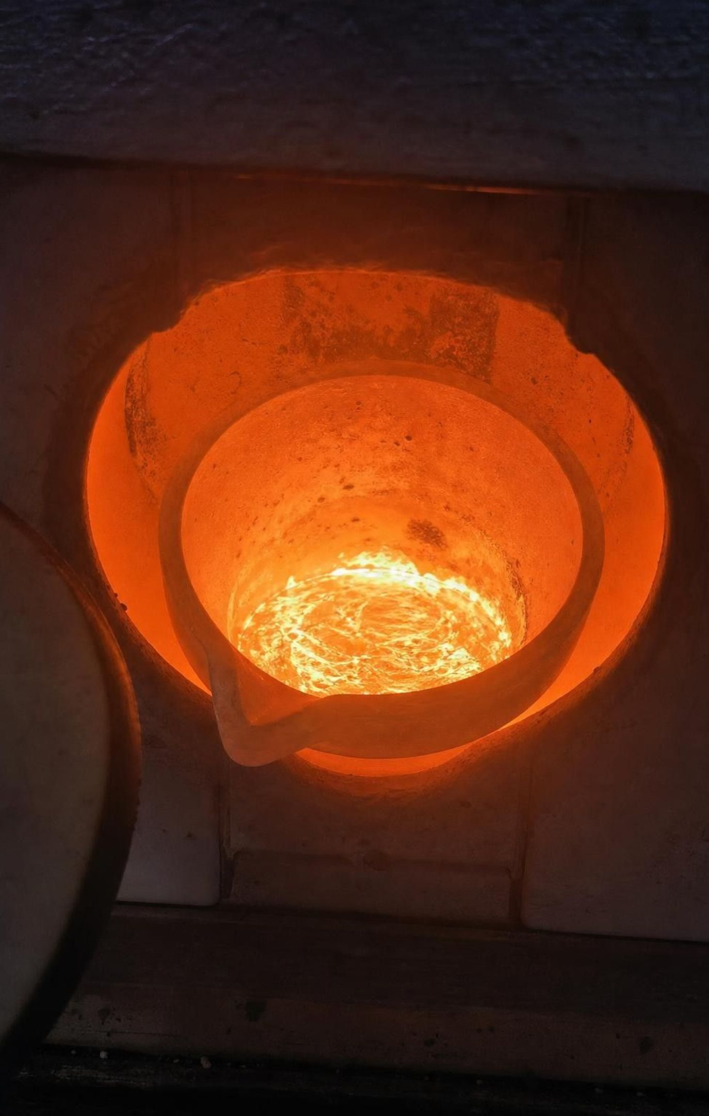
Melting point and boiling point
Heat a solid and watch the thermometer: the temperature where liquid first appears is the melting point.
Keep heating the liquid: the temperature where it boils is the boiling point.
A bigger sample needs more energy and more time, but it melts at the same temperature.
Silver melts near 962 °C and palladium near 1555 °C, so melting point separates these density look-alikes.
Boiling point depends on air pressure; tables give the sea-level value.
15
Notes:
Describe the measurement without running it: a small sample in a heated holder, a thermometer or probe, and a careful eye for the first drop of liquid. The reason a bigger sample melts at the same temperature is that melting is about the particles having enough energy to break out of their fixed positions, and every particle in the sample needs the same amount; a bigger sample has more particles, so it takes more total energy and more time. Lesson 24 develops this. Then address the Lake Tahoe example: at lower air pressure, water boils at a lower temperature, so a boiling-point table is a sea-level table. Finally mention the textbook's magnesium story: the technician tried to measure a melting point and the wire burned instead. Magnesium melts near 650 °C only if air is kept away; in air it burns first.
WATCH FOR: 'A big block of ice has a higher melting point than a cube.' Both melt at 0 °C; the block takes longer.
CONNECTS TO: W7 misconception repair; the heating-curve diagram on the next slide.
PACING: about 5 min

Slide 16
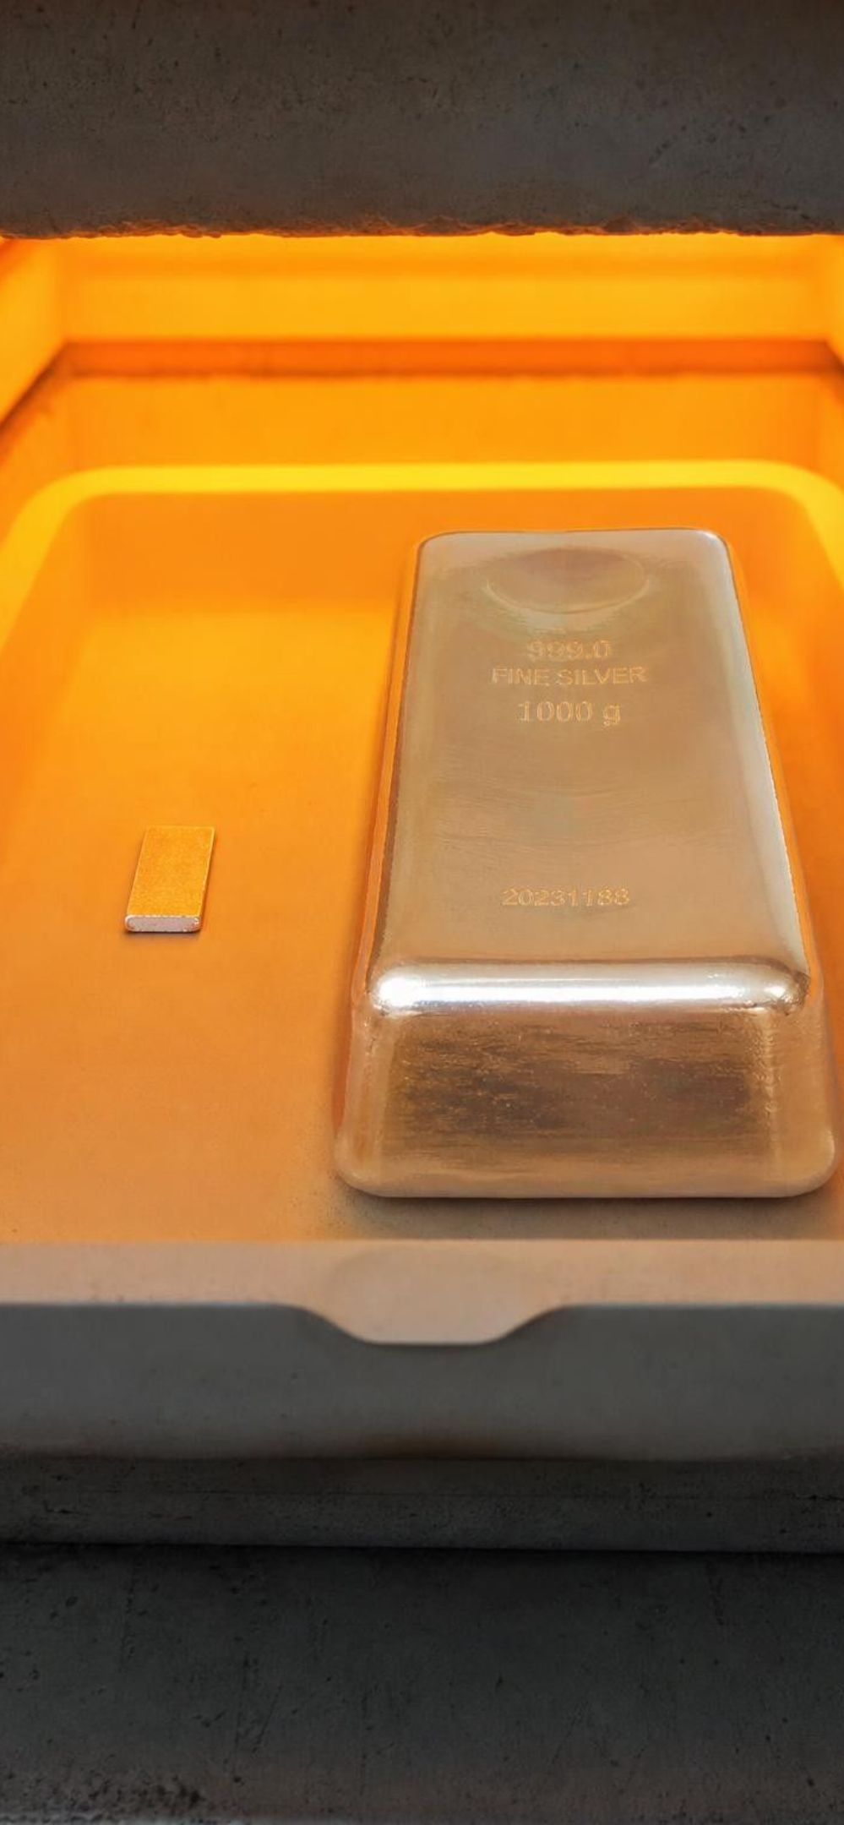
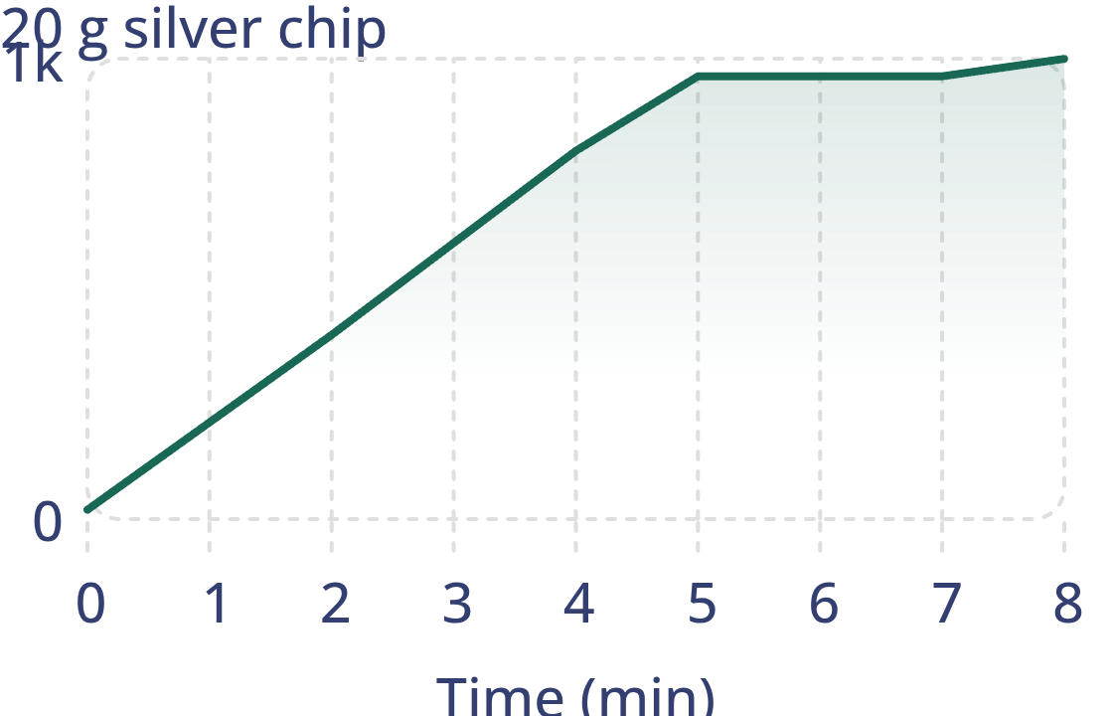
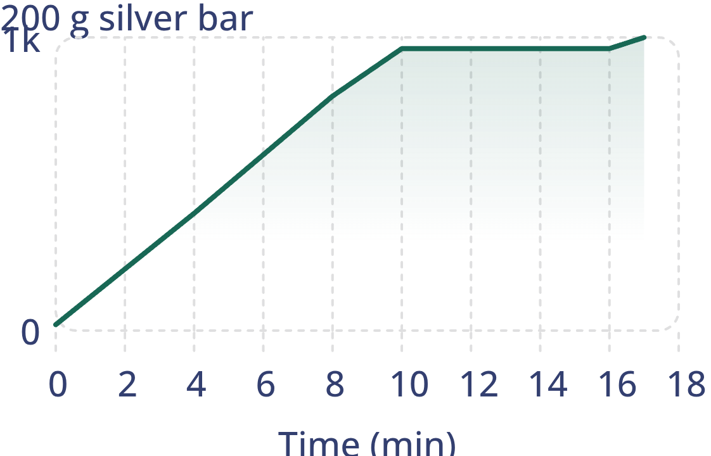
MODEL
Same melting point, different time
Model: Heating a small and a large sample of silver (teaching data)
x: Time in the furnace (minutes) · y: Temperature (°C)
simulated data
20 g silver chip: (0, 20), (2, 400), (4, 800), (5, 962), (6, 962), (7, 962), (8, 1000)
200 g silver bar: (0, 20), (4, 400), (8, 800), (10, 962), (13, 962), (16, 962), (17, 1000)
Both curves flatten at about 962 °C while the silver melts. The bar flattens later and for longer, but at the same temperature.
16
Notes:
This is a teaching dataset, not a recorded experiment; the shapes are what a real heating curve shows. Walk the small-chip curve first: temperature climbs, then stops climbing while the solid turns to liquid, then climbs again once everything is liquid. Ask where the melting point is: the flat part, at about 962 °C. Then the bar: the same flat temperature, reached later, held longer. Ask what the flat part means about energy: energy is still going in, but it is being used to loosen the particles, not to raise the temperature. Keep the particle story short; Lesson 24 is where it belongs. The useful conclusion for this lesson: read the flat part, not the clock, to identify the substance.
EXPECTED RESPONSES: Students should identify 962 °C as the melting point on both curves and say that the bar's longer flat section is because it has more silver to melt.
WATCH FOR: Reading the bar's later flattening as a 'higher melting point'. Same height on the vertical axis means same temperature.
CONNECTS TO: W4 diagram worksheet; W7; connects to L24 heating curves.
PACING: about 5 min

Slide 17
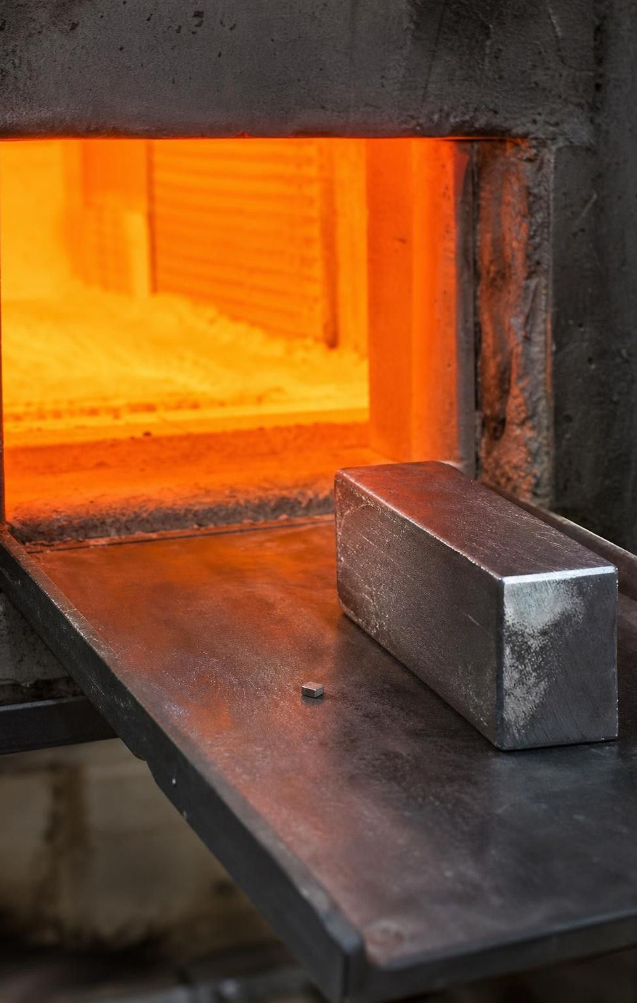
CHECK FOR UNDERSTANDING
Quick check: which statement is true?
A 5 g chip and a 500 g block of the same pure metal are heated in the same furnace. Which statement is true?
A. The block melts at a higher temperature
B. The chip melts at a higher temperature
C. Both melt at the same temperature; the block takes longer
D. They melt at the same time at different temperatures
17
Notes:
Quick vote, then one sentence of reasoning from a student who chose C and one who chose A. Steer the A reasoning toward time: it takes longer, which feels like 'harder to melt', but the thermometer reads the same when the first liquid appears. Extension question if there is time: 'A thermometer in a pot of boiling water at Lake Tahoe reads 94 °C. Is the water impure?' No; the air pressure is lower there.
EXPECTED RESPONSES: C. The melting point belongs to the substance; the time to melt depends on the amount.
WATCH FOR: Amount confused with temperature; pressure effects confused with impurity.
CONNECTS TO: W7 misconception repair; W10 mastery.
PACING: about 3 min

Slide 18
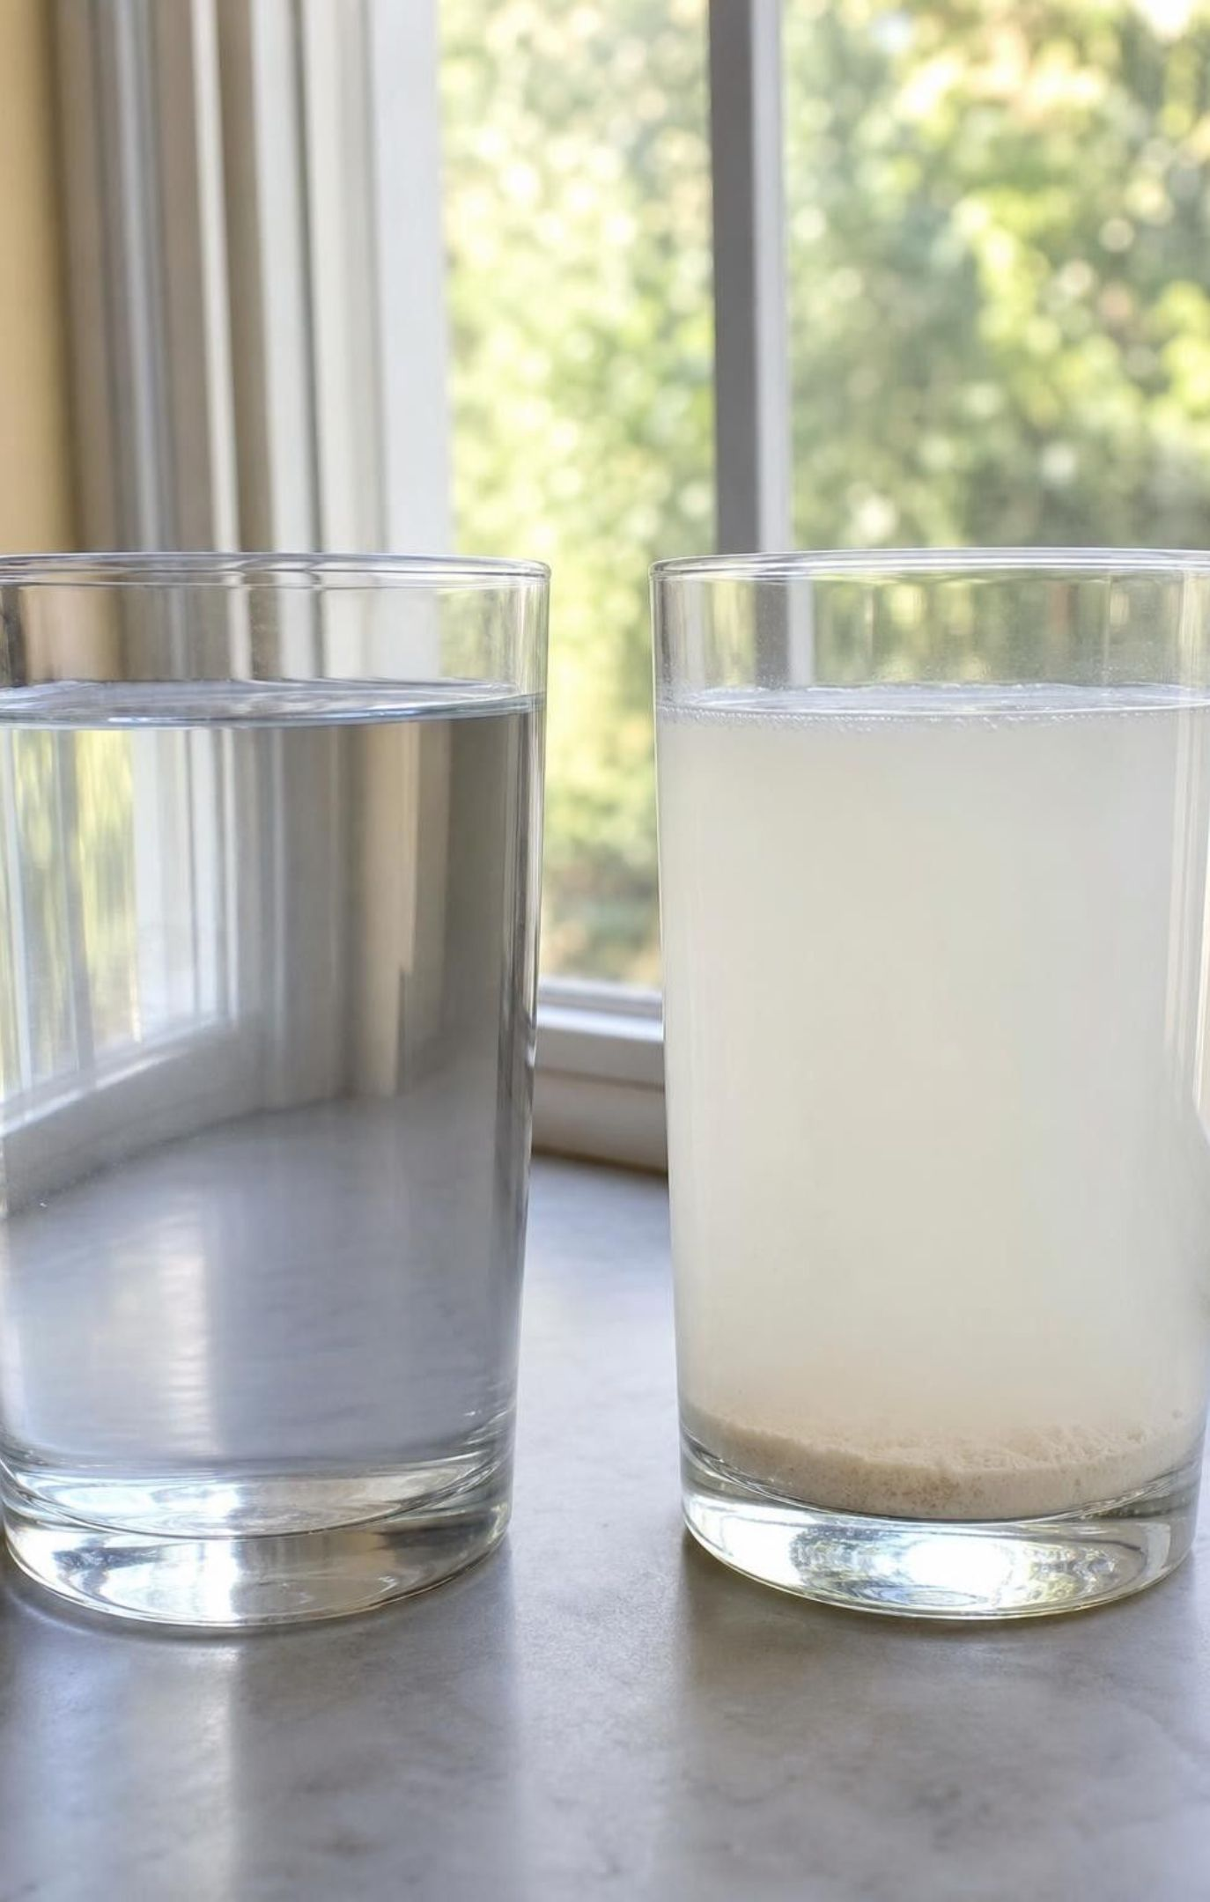
Solubility: it takes two
Solubility: how much of a substance can vanish into a given liquid, particle by particle. It names a pair.
Sugar dissolves in water; flour does not. Both are white powders, so this one test tells them apart.
Permanent-marker ink will not dissolve in water, but it dissolves in isopropyl alcohol.
Dissolved is not gone: the particles spread out among the water particles and the mass is still there.
Oil and water will not dissolve in each other, which is why the jar stays in layers.
18
Notes:
Do the simplest demonstration in the chapter: stir a spoon of sugar into a clear cup of water on a balance. The sugar vanishes from sight; the balance does not change. Ask where the sugar went. The answer is 'everywhere in the water, in pieces too small to see', and you can prove it by tasting (do not; say it) or by letting a drop dry on a slide. Then stir flour into a second cup: cloudy, then settling. Make the pair point: the question 'is it soluble?' has no answer until you say 'in what'. Salt is highly soluble in water and practically insoluble in oil; marker ink is the reverse. Close by returning to the jar: oil and water are each insoluble in the other, so they sit in layers by density. Shake the jar and they separate again.
WATCH FOR: 'Dissolving destroys the sugar' and 'sugar melts in water'. Melting needs heat and no second substance; dissolving needs a second substance and no heat.
CONNECTS TO: Lab 1 mixing test; Lab 3 kitchen solids survey; W8 collaborative evidence cards.
PACING: about 5 min

Slide 19
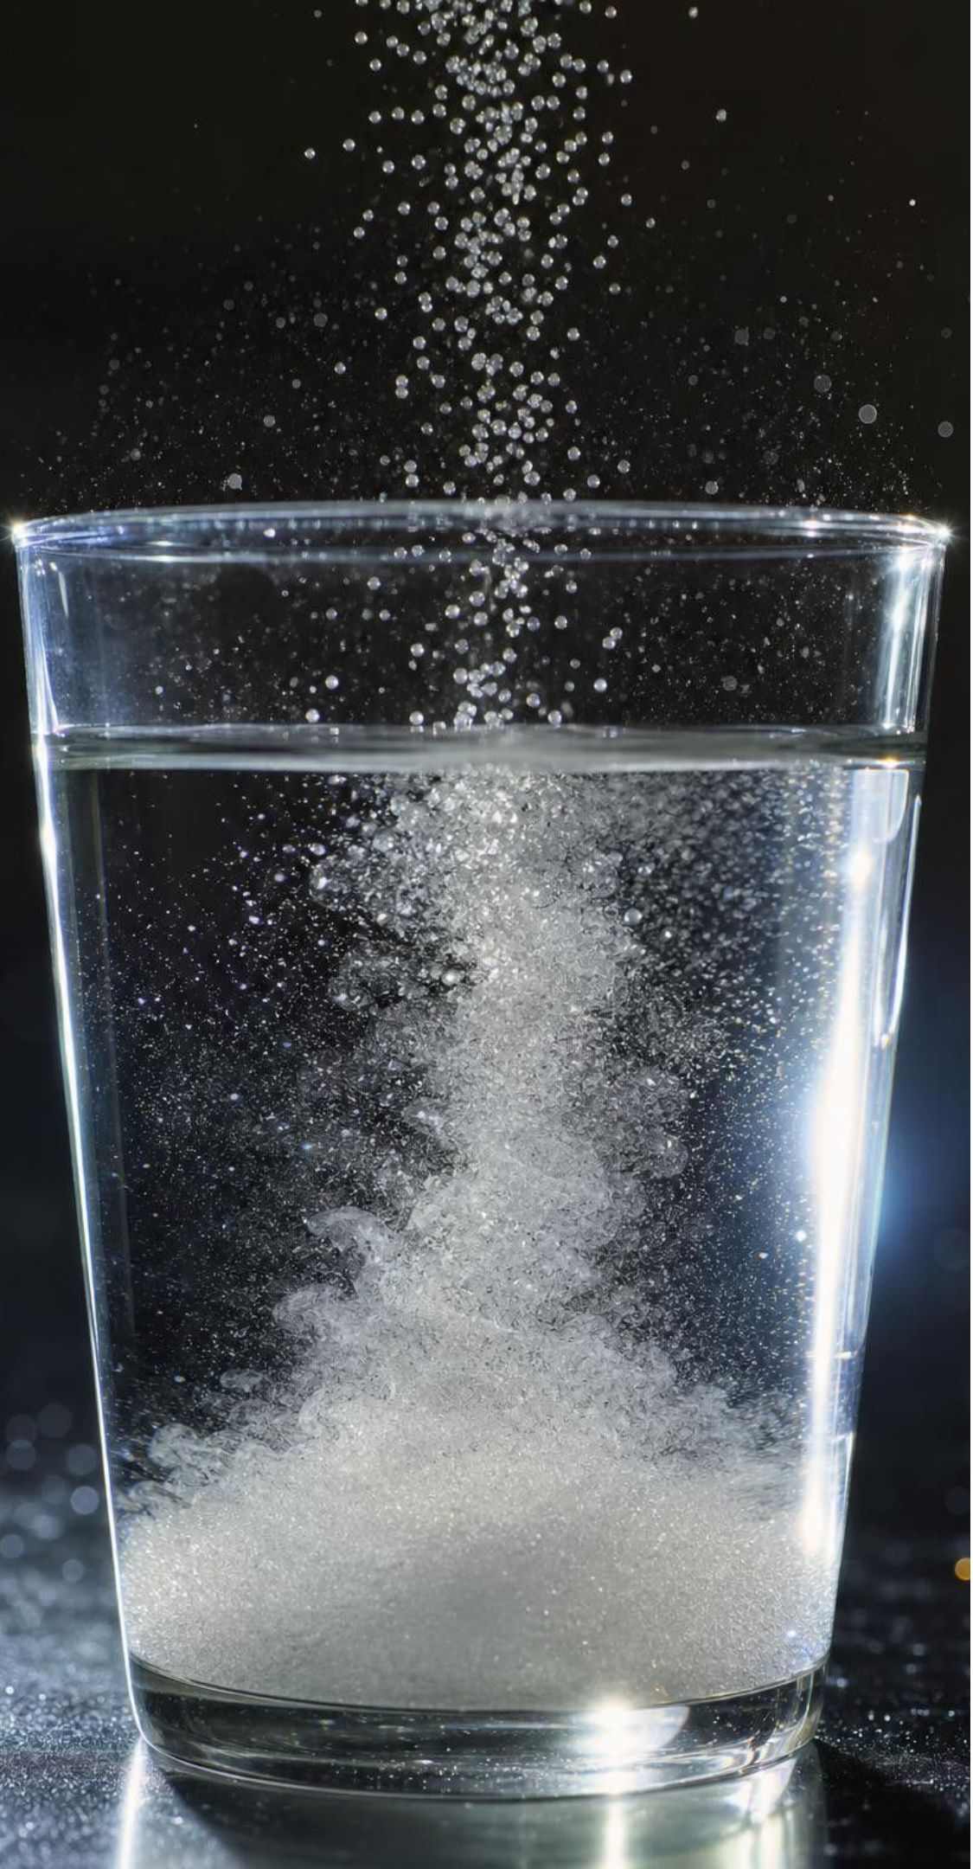
MODEL
Where did the sugar go?
Model: Before and after stirring sugar into water
Sugar crystal: particles tightly spaced; Sugar molecules packed in a regular pattern. Visible as a grain.
Water: particles mediumly spaced; Water molecules close together but free to move past one another.
Sugar solution: particles mediumly spaced; Sugar molecules spread out singly among the water molecules. Too small and too separated to see.
The sugar molecules are still there, still sugar, and still counted on the balance. Only their spacing changed.
19
Notes:
Use the panels to connect the particle models of Lesson 2 to the macroscopic test. In the crystal the molecules are stacked; in solution each one is surrounded by water molecules. Ask: is a sugar molecule in the solution different from one in the crystal? No. That is why evaporating the water brings back sugar, and why dissolving is a physical change. Contrast it with the textbook's metal-in-acid examples: there the metal reacts and becomes new substances, with gas bubbles as a clue; that is not solubility in this sense, and we will not use acid tests. Flour makes a different picture: its particles are huge clumps of many molecules that water cannot pull apart, so they stay visible and settle.
EXPECTED RESPONSES: Students should state that the sugar molecules are unchanged and merely spread out, and that the mass of the solution equals water plus sugar.
WATCH FOR: Drawing the dissolved sugar as smaller dots, as if the molecules shrank or broke. Keep the dots the same size, only farther apart.
CONNECTS TO: W4 diagram worksheet asks for this before-and-after drawing; Lab 3 evaporation test.
PACING: about 4 min

Slide 20
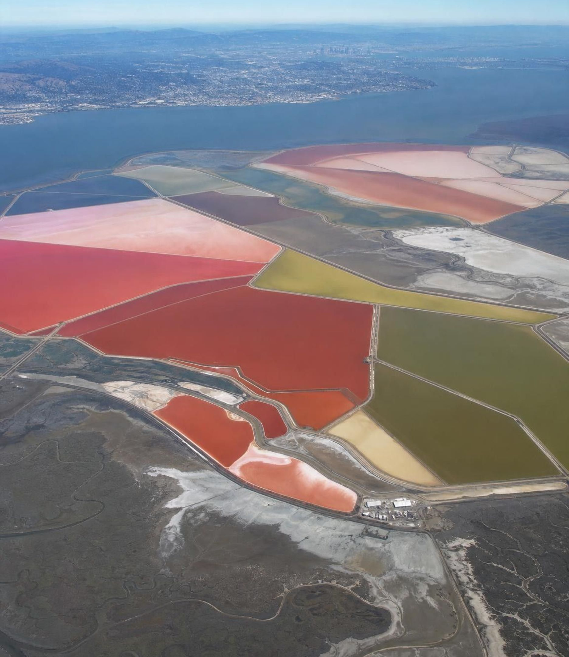
REAL-WORLD CONNECTION
California connection: salt from the South Bay
Along the southern shore of San Francisco Bay, shallow ponds have been used since the 1800s to make salt from seawater. Bay water is pumped from pond to pond while the sun and wind evaporate the water. The dissolved salt cannot evaporate, so it grows more concentrated and finally crystallizes out, and machines scrape it up. Seawater is a mixture; sunlight pulls it apart into its substances.
20
Notes:
This is a true local story and a complete lesson in one picture. Seawater is a mixture of water and dissolved salts. Water has a low enough boiling point that sunshine evaporates it slowly at ordinary temperatures; the salts stay behind because they are dissolved, not destroyed, and they return as crystals when there is too little water left to hold them. The ponds turn pink and orange in the saltiest stages because of salt-loving microbes, which you can see from an airplane landing at SFO or San Jose. Ask students to name the property that makes the separation work: solubility, plus the difference in boiling point between water and salt. Ask what else is left behind besides table salt: other dissolved salts, which is why sea salt and pure sodium chloride are not quite the same substance. Many of the old ponds are now being restored to tidal marsh.
CONNECTS TO: W3 reading passage; Lab 3 evaporation test shows the same idea on a plate.
PACING: about 4 min

Slide 21
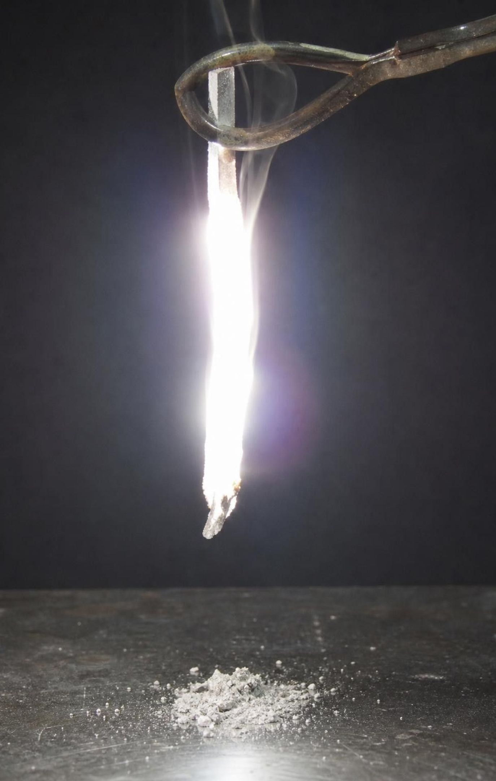
Flammability: a property you can only see by changing the substance
Flammability is whether, and how easily, a substance burns.
Burning is a chemical change: magnesium burning in air becomes magnesium oxide, a white powder.
The sample is used up, so flammability is tested last and never on something you want to keep.
Water is non-flammable. Gasoline, a mixture of many liquids, is highly flammable.
A burning splint near a little hydrogen mixed with air gives a pop; such tests help identify gases.
21
Notes:
Tell the textbook's story: a technician heats a thin gray wire expecting it to melt, and it flares white instead; the wire was magnesium. Use it to make the physical-versus-chemical distinction concrete. Density, melting point, boiling point and solubility can all be measured and the sample is still the same substance afterward. Flammability is different: the only way to observe it is to let the substance react with oxygen and become something else. The ash or powder left behind is a new substance. Add the two accuracy points: a flammable gas pops only when it is mixed with enough air, so 'always ignites' is too strong; and gasoline is a mixture, with octane as one of many components. No flames are used in this chapter; describe, do not demonstrate.
WATCH FOR: 'Flammability is a physical property like the others.' It is a chemical property because the test changes the substance.
CONNECTS TO: W3 reading; W8 evidence cards include a burning observation; previews L12 chemical reactions.
PACING: about 5 min

Slide 22
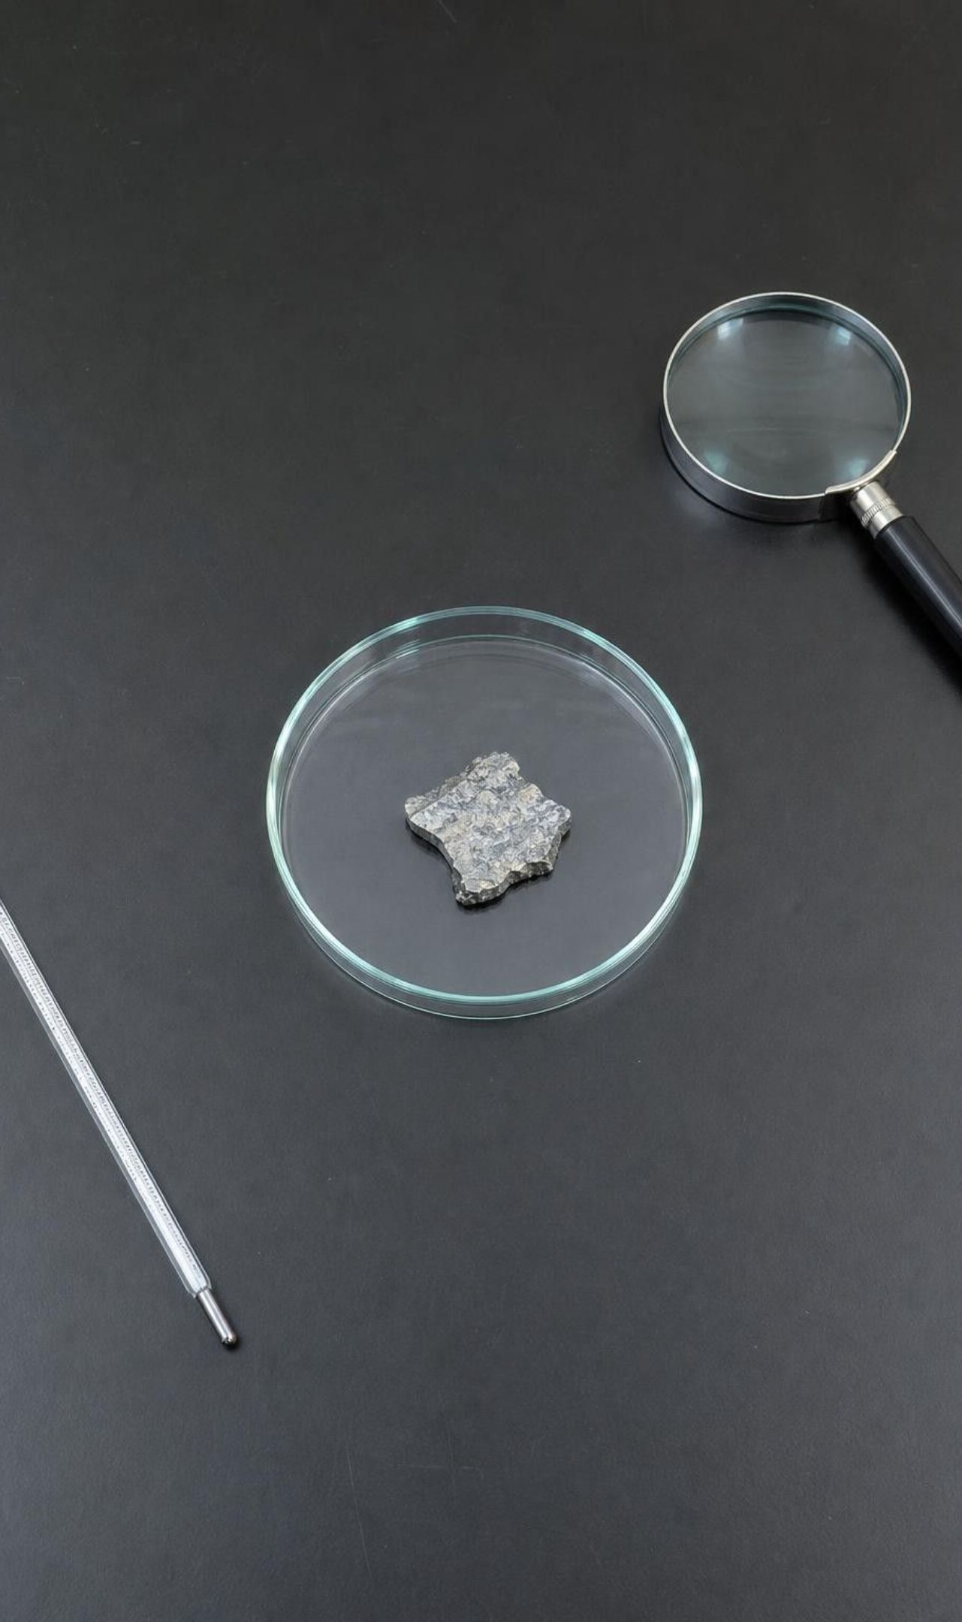
MODEL
How scientists identify an unknown
Model: From an unknown sample to a name
Observe safely: color, shine, state, texture → (narrow)
Measure density: mass ÷ volume → (narrow)
1
2
Test solubility in a named liquid → (narrow)
If still unsure, measure melting or boiling point → (compare)
3
4
Compare every result with a table of known substances → (decide)
Name the substance only when all the results agree
5
6
Each test rules some candidates out. The non-destructive tests come first; a test that uses up the sample comes last, if at all.
22
Notes:
Walk the flow and stress the word 'narrow'. One test rarely gives a name; it crosses candidates off the list. Ask why observation is first (it is free and harmless), why density is second (non-destructive and quick), and why melting point is near the end (needs a furnace and may damage the sample). Then ask where flammability goes: last, and only on a piece you can spare. Finish with the rule in the last node: if any test disagrees with the proposed name, the name is wrong or the measurement is. This flow is the structure of Lab 1 and of the task on the next slide.
EXPECTED RESPONSES: Students should be able to say why the order matters and name at least one candidate that each test could rule out.
WATCH FOR: 'One matching test proves the identity.' A density match is consistent with a substance, not proof of it.
CONNECTS TO: Lab 1 follows this flow; W6 CER; W10 synthesis.
PACING: about 4 min

Slide 23
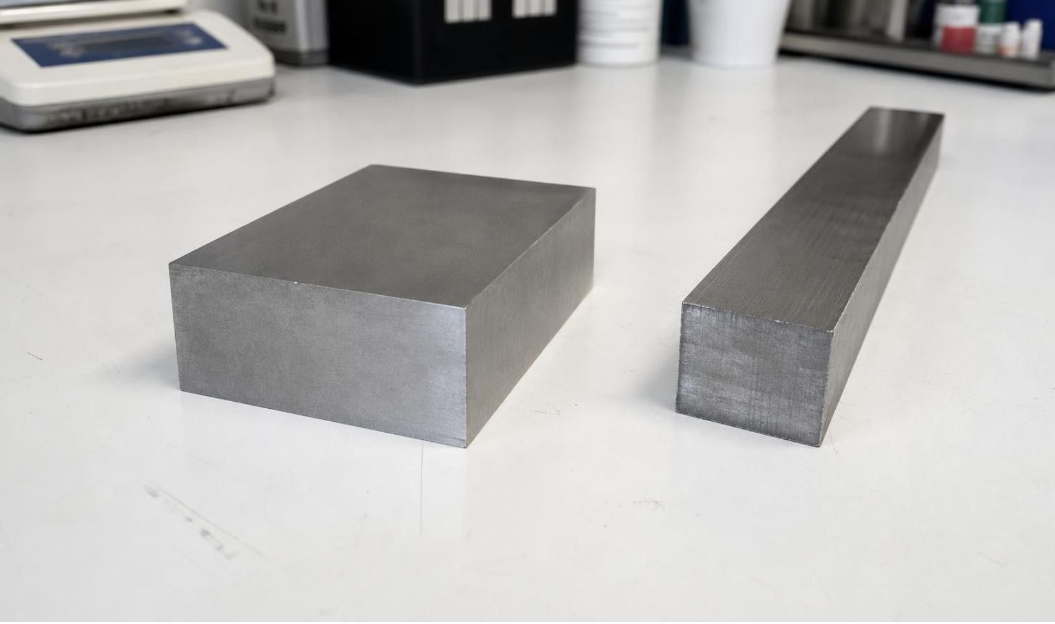
APPLY IT
Metal | Density (g/cm³) | Melting point (°C) | Appearance
Magnesium | 1.74 | 650 | gray, shiny
Aluminum | 2.7 | 660 | gray, shiny
Zinc | 7.14 | 420 | bluish gray
Molybdenum | 10.2 | 2623 | gray, shiny
Silver | 10.5 | 962 | gray, shiny
Lead | 11.3 | 327 | dull gray
Task: name the two gray samples
Sample 1: a gray block, mass 87.0 g, volume 50.0 cm³. Sample 2: a gray bar, mass 210 g, volume 20.0 cm³. The class balance and cylinder give densities good to about ±0.3 g/cm³. A small chip cut from sample 2 begins to melt at about 960 °C. Show each density calculation.
Simulated data for practice.
Use the reference table to identify each sample. Which sample needed a second test, and why?
23
Notes:
The reference values are real, rounded; the two samples are invented for teaching, which is why the table is labeled simulated. Give groups eight minutes. Sample 1: 87.0 ÷ 50.0 = 1.74 g/cm³, which matches magnesium and nothing else within ±0.3, so density alone names it. Sample 2: 210 ÷ 20.0 = 10.5 g/cm³, which matches silver but is also within ±0.3 of molybdenum at 10.2; density cannot decide. The chip melts near 960 °C, which matches silver and rules out molybdenum (2623 °C) and lead (327 °C). Ask groups to write one sentence per sample that names the evidence. Then ask the reflective question: if sample 2 had been a ring, would you have cut a chip? Lead to the idea of a more careful density measurement instead, or a test that leaves the ring intact.
EXPECTED RESPONSES: Sample 1 is magnesium (1.74 g/cm³, no other metal within the error). Sample 2 is silver: density 10.5 matches silver and molybdenum within the stated error, and the melting point near 960 °C picks silver. Sample 2 needed the second test because two candidates share a similar density.
WATCH FOR: Groups that stop at 'sample 2 is silver because 10.5 matches exactly' have ignored the measurement error; ask them what ±0.3 means for the molybdenum row.
CONNECTS TO: Lab 1 uses the same two-test logic with liquids; W5 data worksheet; W6 CER.
PACING: about 10 min

Slide 24
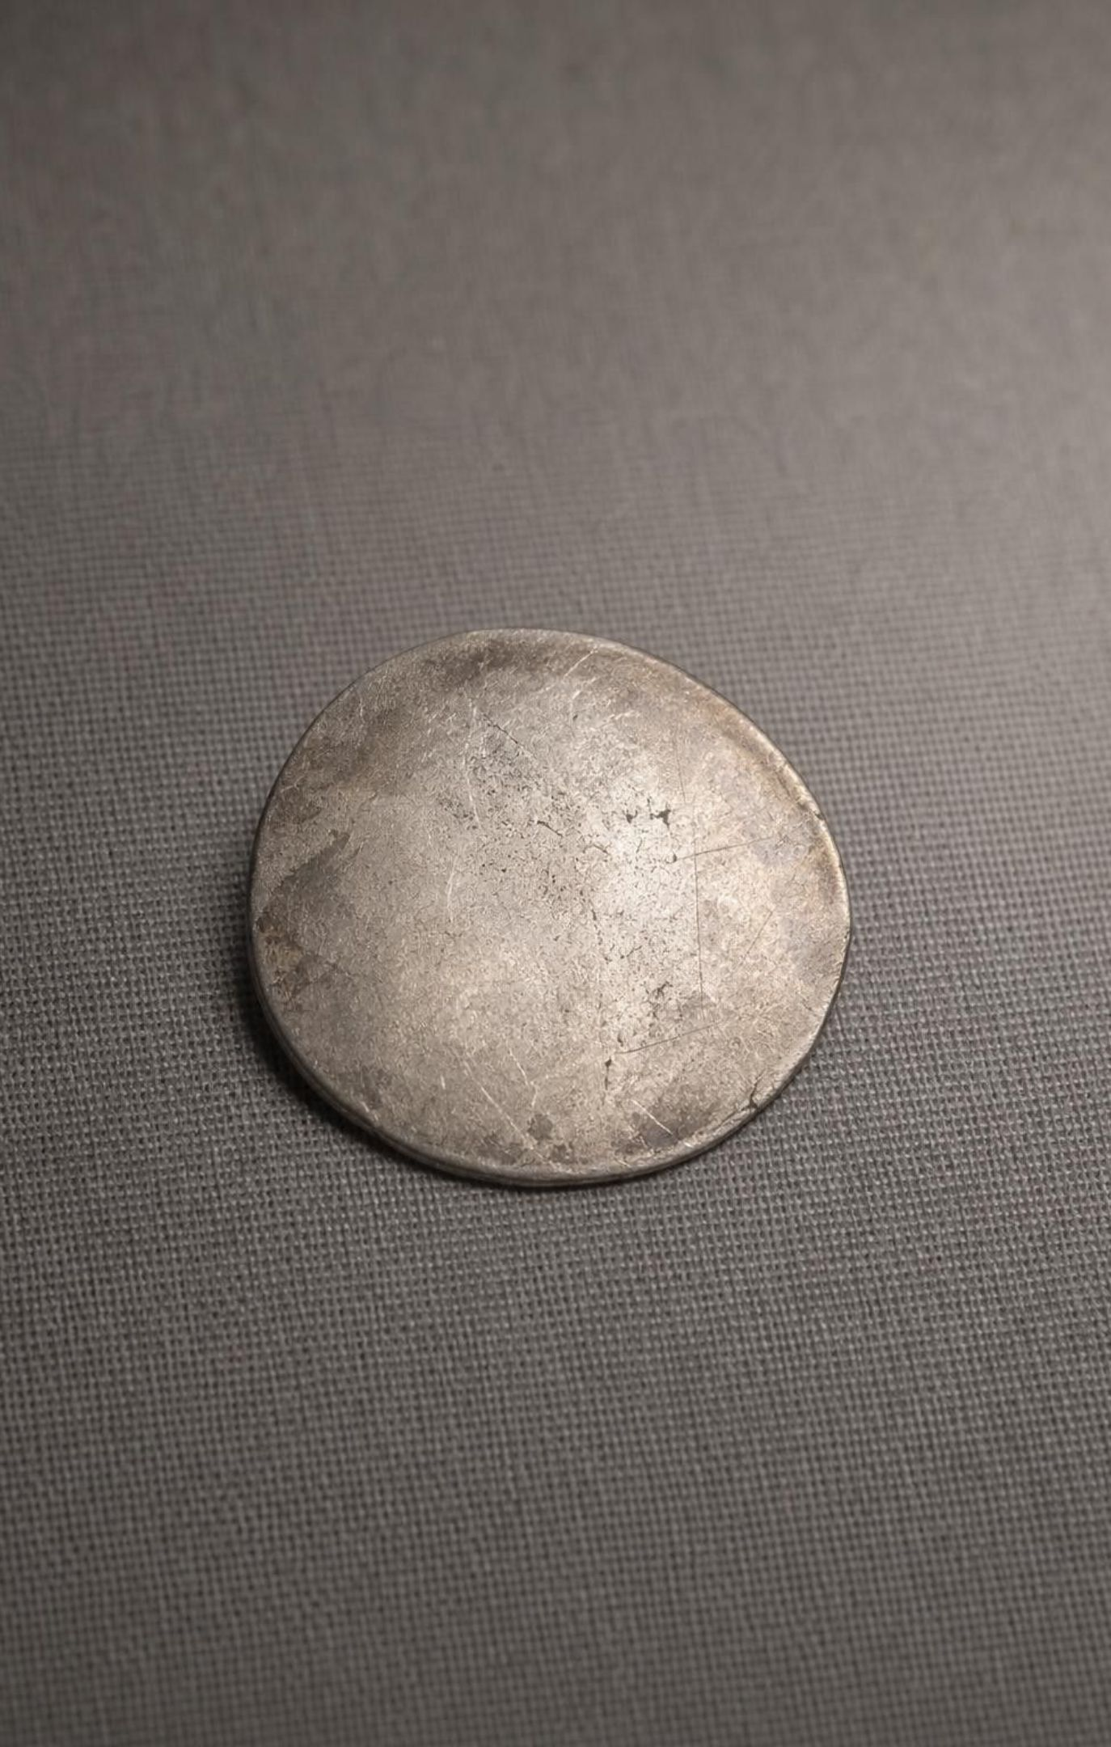
THINK, PAIR, SHARE
Discuss: tests that keep the sample, tests that destroy it
Density: mass and volume, coin unchanged.
Solubility: a drop of liquid on the surface, or the whole coin?
Melting point: the coin becomes a puddle.
Flammability: the coin becomes something else entirely.
A museum wants to know whether an old coin is silver or a silver-colored alloy without damaging it. Rank the five property tests from safest to most destructive and decide where you would stop.
24
Notes:
Pairs rank, then share. Density is nearly harmless; the coin gets wet and dries. A solubility test on a metal means acid, which reacts with the surface, so even a drop leaves a mark; a jeweler does this on a hidden spot. Melting and burning destroy the object. Most pairs stop after density, and that is reasonable, but push them: if density is ambiguous, what can you do without destruction? Measure more carefully, use a bigger sample of the same object type, or compare with a known silver coin side by side. Tie back to the textbook's point that scientists combine several tests, with the addition that they choose tests to fit what the sample is worth.
EXPECTED RESPONSES: Ranking: density, then a surface solubility (acid) test on a hidden spot, then melting, then burning. Most groups stop after density or the surface test and justify it by the coin's value.
CONNECTS TO: Lab 1 debrief; W9 transfer task on material choice includes a 'what can we test' decision.
PACING: about 5 min

Slide 25
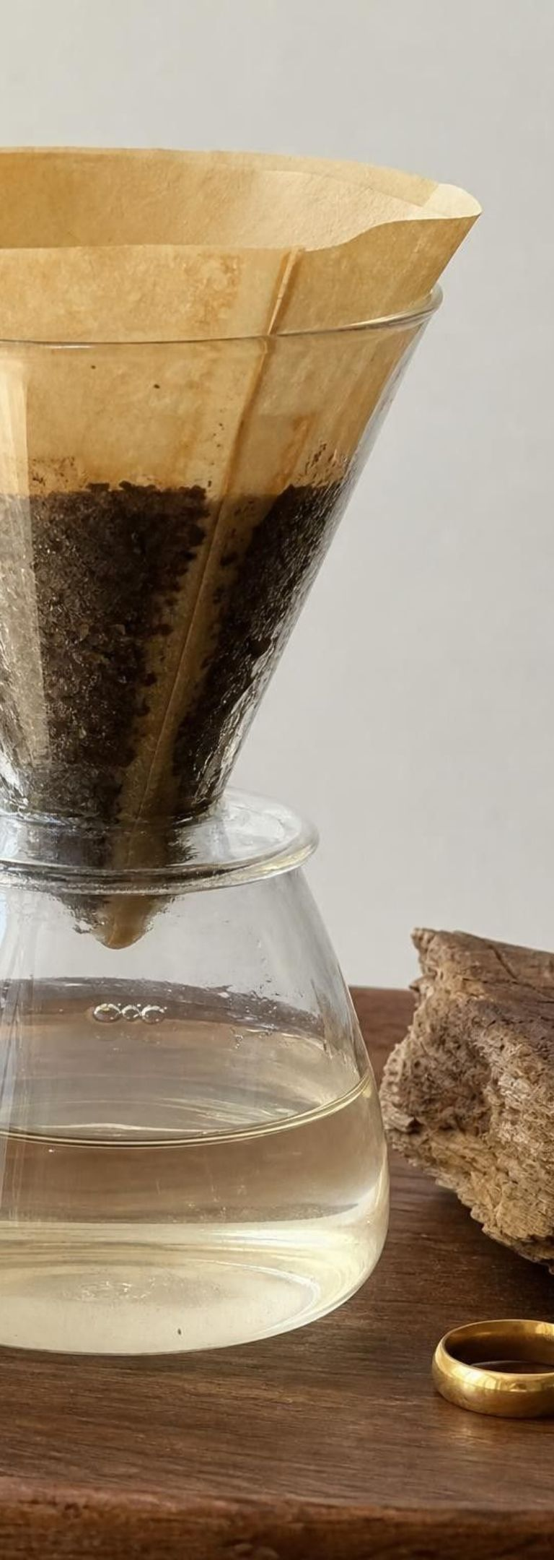
Most things are mixtures
Pure gold is soft; coins and rings are gold alloys, mixed with copper or silver so they do not dent.
Air is a mixture: mostly nitrogen and oxygen, with argon, carbon dioxide, water vapor and more.
1
2
Wood, steel, glass, seawater and gasoline are all mixtures.
Each substance in a mixture keeps its own properties, which is how mixtures can be taken apart.
3
4
The salt ponds, a density jar and a coffee filter are all separation tools.
5
25
Notes:
Return to the pure-versus-mixture slide and add alloys. Ask why anyone would mix gold with copper: pure gold is so soft that a ring would scratch and dent, so the alloy is harder and more useful. Ask what 14-karat means: 14 parts gold in 24, a bit more than half. Then the big idea: a mixture can be separated because each part keeps its properties. Oil and water separate by density; salt and water separate by boiling point; flour and water separate with a filter. Bring up the textbook's examples with a correction: an iron beam is steel, a penny is zinc coated with copper, and both are mixtures, which does not change the lesson's point. Preview that Lesson 12 will ask the opposite question: when two substances are mixed and something new appears, was it a mixture or a reaction?
WATCH FOR: 'An alloy is a new substance.' Alloys are mixtures at the atomic scale; the metals keep their identities and can be separated, though not easily.
CONNECTS TO: W2; W8 evidence cards; sets up L12.
PACING: about 4 min

Slide 26
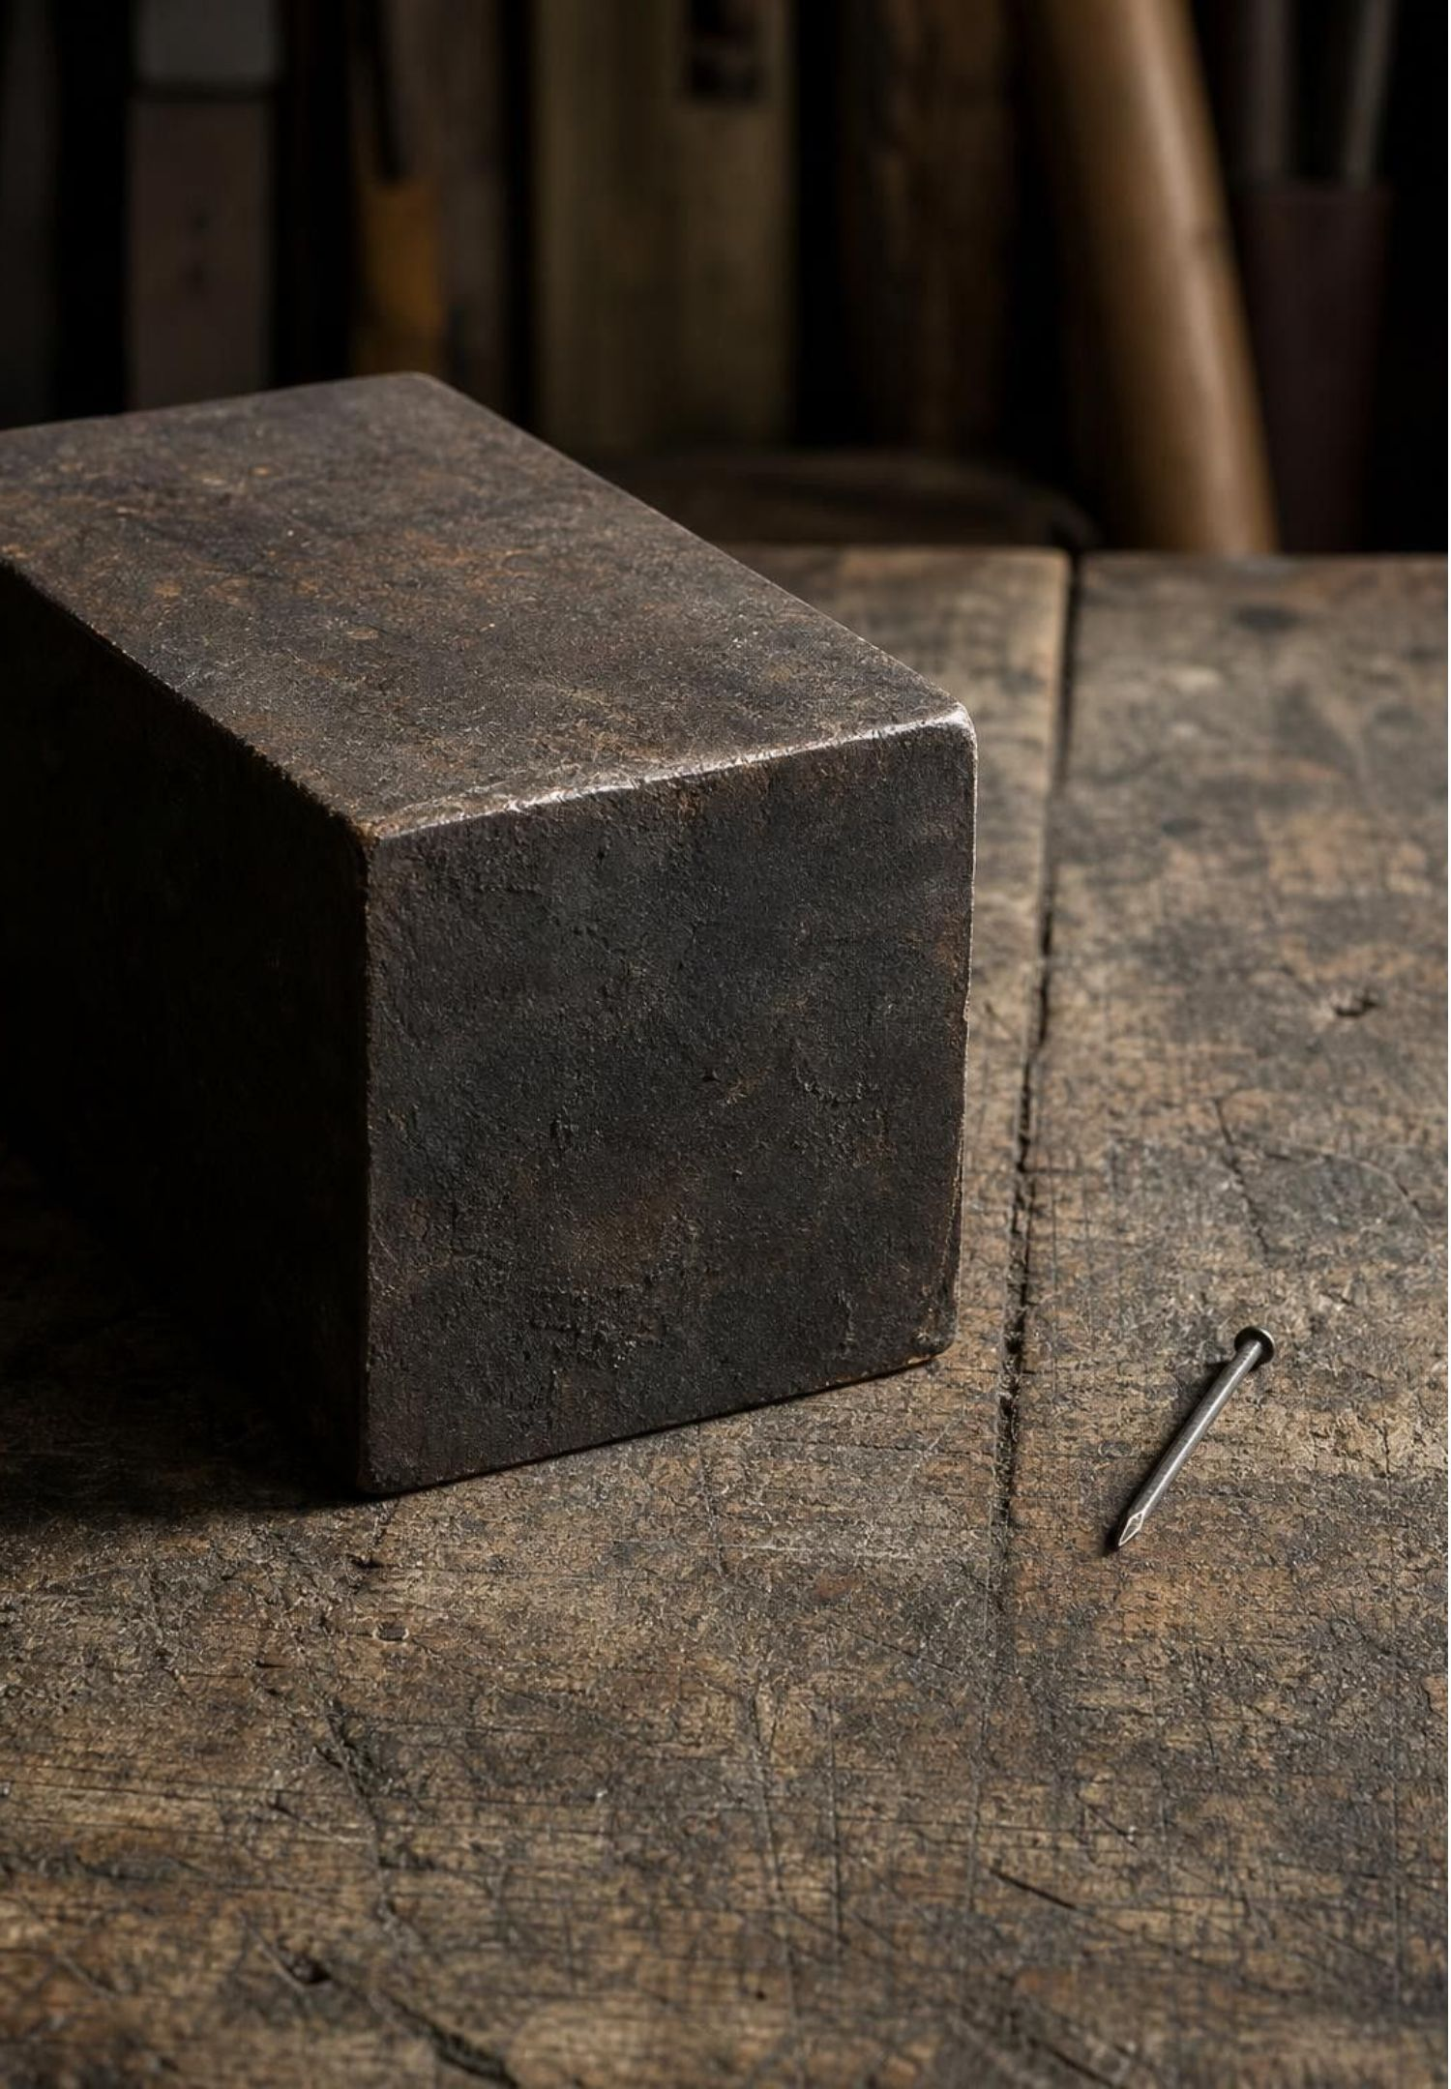
MISCONCEPTION CHECK
True or false? Bigger means denser
"A large block of iron is denser and has a higher melting point than a small iron nail, because there is more iron in it."
True or false? Explain your reasoning.
26
Notes:
Have students evaluate the statement in writing with evidence from the lesson before anyone speaks. The block has more mass and more volume; the ratio of the two is the same 7.87 g/cm³ for any pure iron sample at the same temperature. The block takes longer to melt because it needs more energy, but both begin melting at about 1538 °C. Then flip it: 'A chip and a block have the same density and melting point. Must they be the same substance?' Yes, if both properties match within measurement error; the properties belong to the substance. Collect the writing as evidence for the misconception target.
EXPECTED RESPONSES: False. Density and melting point do not depend on the amount of substance. The block has more mass and volume and takes longer to melt, but its density and melting point are the same as the nail's.
WATCH FOR: Students who write 'false' but then say the block is 'a little denser because it is squeezed'. Solid iron does not compress noticeably under its own weight at this scale.
CONNECTS TO: W7 misconception repair uses a fictional student making this error.
PACING: about 5 min

Slide 27
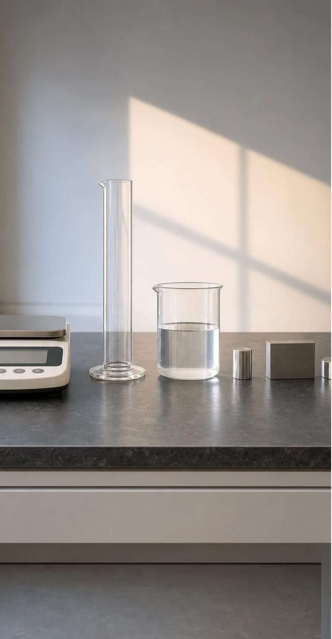
PUTTING IT TOGETHER
Putting it together
A substance has one fixed makeup; most everyday materials are mixtures of substances.
Mass, volume and shape describe one object; density, melting point and solubility identify the substance.
Density = mass ÷ volume, the same for every pure sample at the same temperature.
Melting and boiling point do not depend on amount; boiling point does depend on air pressure.
Solubility names a pair; dissolved is not gone. Flammability is a chemical property that uses up the sample.
Identify an unknown with several tests, non-destructive first, compared against a reference table.
27
Notes:
Have students write a three-sentence summary using at least four vocabulary terms, then trade with a partner who checks that density is defined as a ratio and that solubility names a pair. Ask for one thing from each lab: Lab 1 (which liquid needed two tests), Lab 2 (which material was eliminated first and why), Lab 3 (which kitchen solid fizzed with vinegar and what that showed). Preview Lesson 12: the same property toolkit will decide whether a change was a mixture forming or a chemical reaction making new substances.
CONNECTS TO: W10 mastery as the quiz; W6 CER as the written assessment; L12 next in the chemistry sequence.
PACING: about 6 min

Slide 28
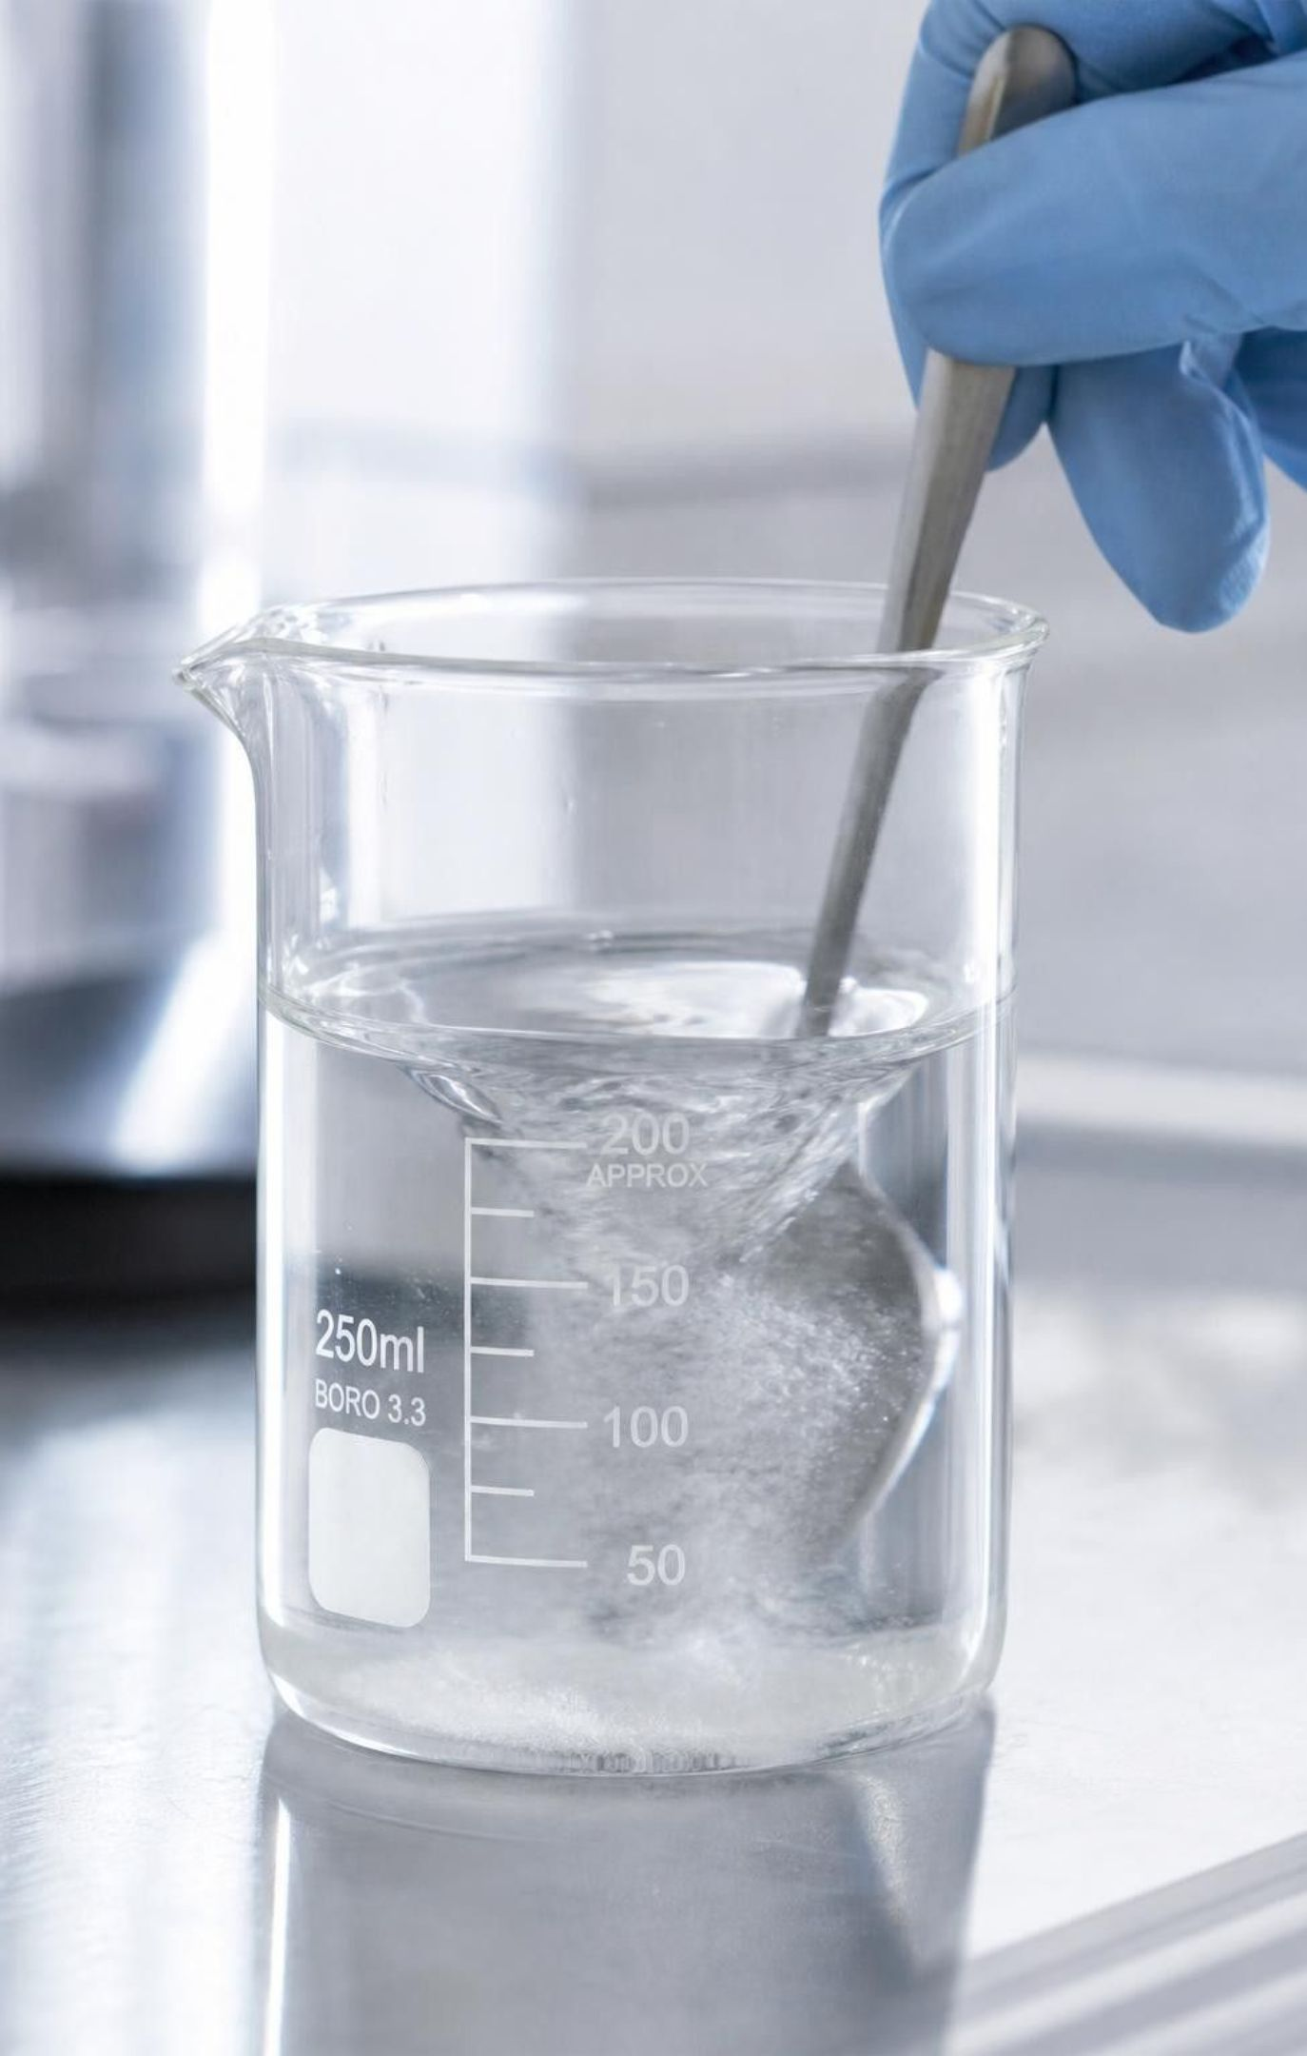
EXIT TICKET
Exit ticket
A sample has a mass of 48 g and a volume of 40 cm³. Give its density with units.
Name one property that describes an object and one that identifies a substance. How can you tell them apart?
A white powder vanishes when stirred into water. Did it stop existing? Give one piece of evidence.
Which of the five identifying properties is a chemical property, and why is it tested last?
28
Notes:
Collect on index cards or a shared form. Item 1 catches the formula upside down; item 2 catches the object/substance mix-up; item 3 catches 'dissolved means gone'; item 4 catches the physical/chemical distinction. Sort into piles before the next class and reteach from the largest pile.
EXPECTED RESPONSES: 1: 48 ÷ 40 = 1.2 g/cm³. 2: for example, mass describes the object and density identifies the substance; cut the object in half and the first changes while the second does not. 3: No; the mass of the cup stays the same, or evaporating the water brings the powder back. 4: Flammability; the test turns the sample into new substances, so you cannot test anything else afterward.
WATCH FOR: Item 1 answers of 0.83 (volume ÷ mass); item 3 answers that mention melting.
CONNECTS TO: W10 mastery; chapter evidenceOfLearning.
PACING: about 5 min

