Slide 1
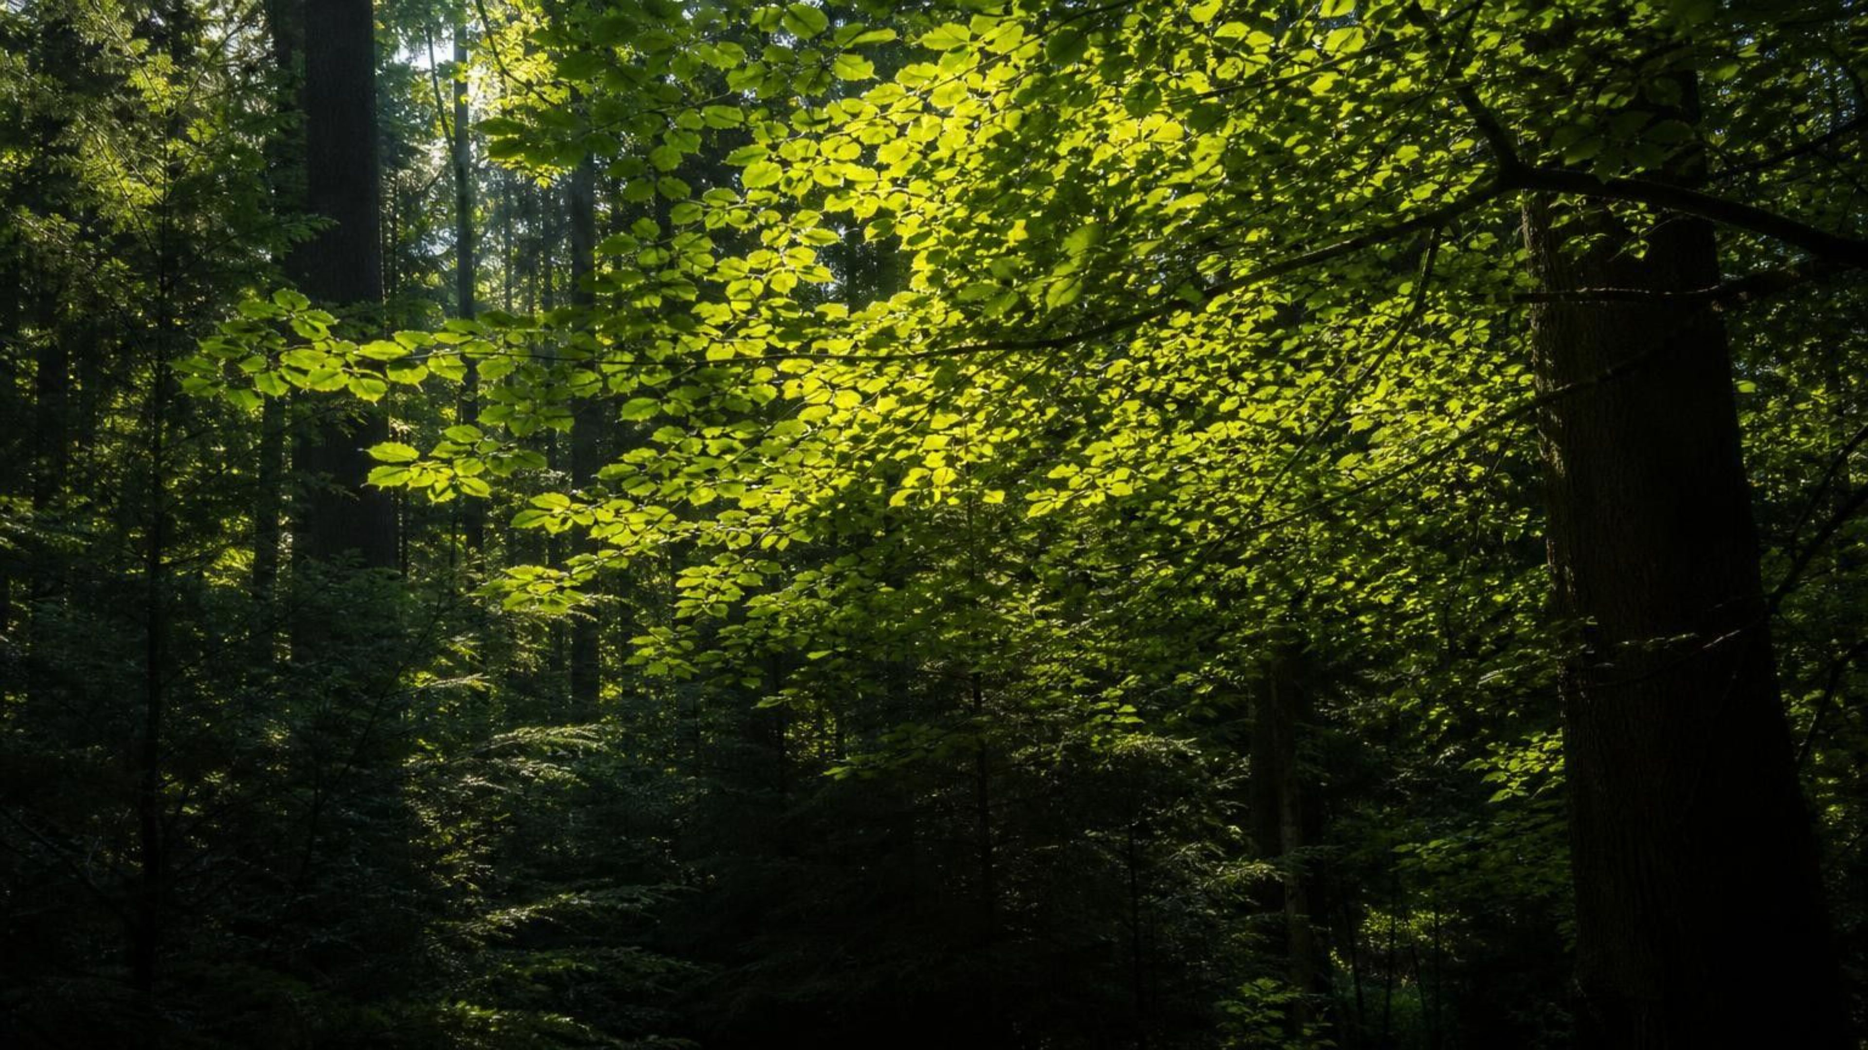
Capturing the Sun's Energy
Chapter 4 of 29 · Energy and Matter in Ecosystems
Lesson 4: Where do producers get the matter and energy to build their bodies?
Angela's Wand · Bring Science Alive! 7th Grade Integrated
Notes:
This lesson opens the unit on living systems. Over the next week students answer one question from several directions: where does the stuff of a tree, a blade of grass or a drifting diatom actually come from, and where does the energy to build it come from? Tell them they will run three investigations: watching leaf disks rise as they make oxygen, building an atom-by-atom model of photosynthesis with tokens, and judging which kind of plant material should become jet fuel. Nothing in the lesson needs flames or hazardous chemicals; the lab with the most setup uses spinach and baking soda.
CONNECTS TO: Overview of Lab 1, Lab 2 and Lab 3; W1 opens the next slide.
PACING: about 2 min

Slide 2
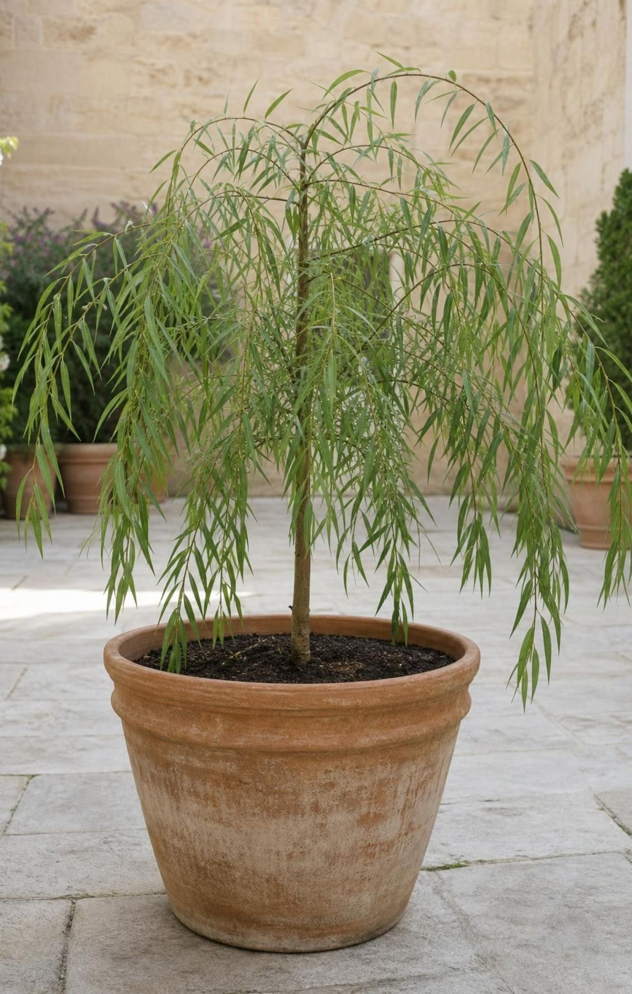
PHENOMENON
A tree gains 74 kilograms; the soil loses 60 grams
In the 1640s Jan Baptist van Helmont dried 90 kg of soil, potted it, and planted a 2 kg willow sapling. For five years he added only water and kept dust out. The tree grew to about 76 kg. The dried soil had lost about 60 g. Where did roughly 74 kg of wood, bark and leaves come from?
Notice: what went into the pot, and what came out?
Wonder: what touches the tree every day that was never weighed?
Predict: van Helmont said the mass came from water. Agree or disagree, and why?
2
Notes:
Give students two silent minutes to write a notice and a wonder, then collect ideas on the board without judging. Most will say soil or water. Push on the numbers: the soil lost less than a tenth of a percent of its mass, so soil cannot be the main source. Water is a reasonable guess, and van Helmont himself believed it, but ask what else surrounds the tree all day. Air is the answer nobody expects, because air seems like nothing. Park the claims and promise that the lesson will test them. Teacher background: the historical figures were 200 pounds of soil, a 5-pound sapling, about 169 pounds after five years, and about 2 ounces of soil lost; the slide uses rounded metric conversions. If you have a balance and a potted seedling, start a class-long version today: weigh the pot and plant now and again at the end of the unit, watering only with measured amounts.
EXPECTED RESPONSES: Notice: the tree got far heavier; the soil hardly changed; only water was added. Wonder: does water weigh that much; does air count; did roots pull something invisible from the soil. Predict: many agree with van Helmont; some will say sunlight, which is a chance to ask whether light has mass.
WATCH FOR: 'Plants eat soil' and 'sunlight becomes the tree.' Write both on a parking lot; slides 12, 14 and 25 return to them.
CONNECTS TO: W1 gives a second phenomenon (an air plant gaining mass with no soil) for notice/wonder and a first explanation. W3 reading and W6 CER return to the willow evidence.
PACING: about 8 min

Slide 3
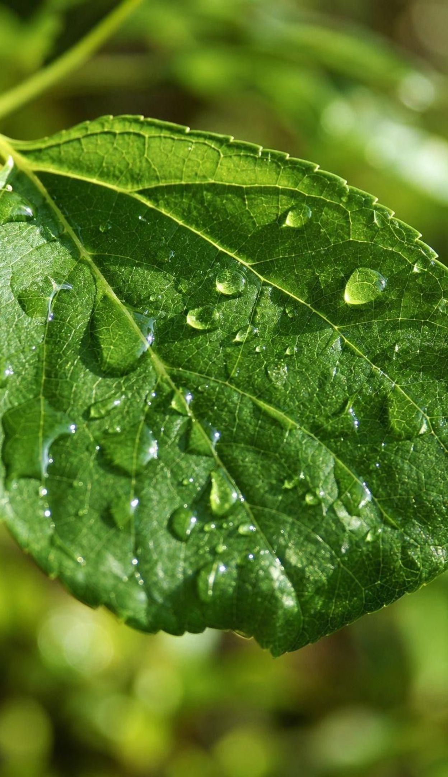
LEARNING TARGETS
What you will be able to do
Identify producers on land and in water and explain how they make food instead of eating it.
Describe the leaf parts that capture light and explain why most producers look green.
Count atoms across the photosynthesis equation and separate matter from energy.
Use experimental evidence to explain where a plant's mass comes from.
Trace sugar into energy use, storage and building, and link it to biomass.
Judge sources of biomass for jet fuel against criteria and constraints.
3
Notes:
Read the targets aloud and have students star the one that sounds hardest. Point out that targets 1 and 2 belong to the first two days, 3 and 4 are the heart of the lesson and the labs, 5 is about storage, and 6 is the engineering decision at the end. The exit ticket on the last day touches all six.
CONNECTS TO: Targets map to W2 (1), W4 (2), Lab 2 (3), Lab 1 and W6 (4), W3 and W8 (5), Lab 3 and W9 (6).
PACING: about 2 min

Slide 4
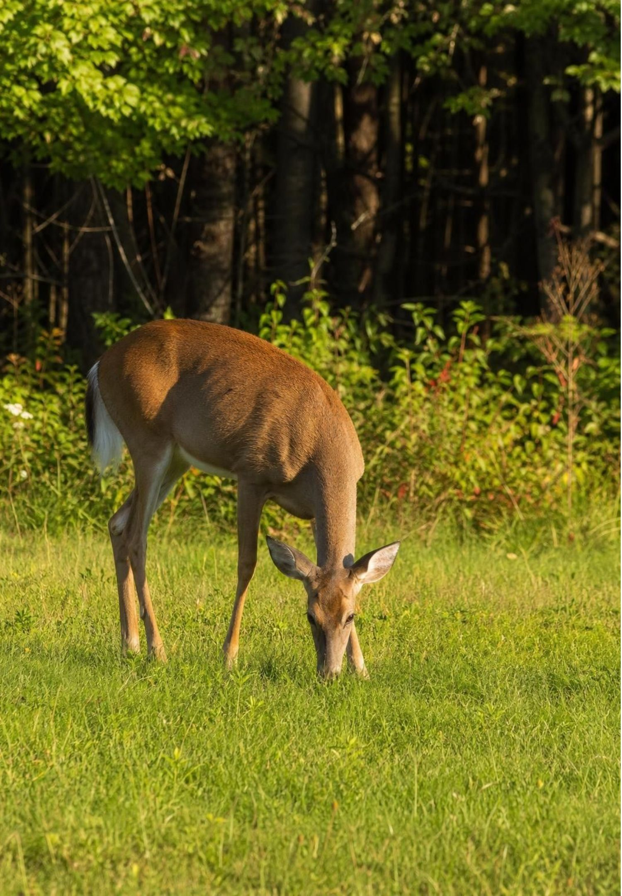
Every living thing needs matter and energy
Matter is anything with mass that takes up space. Bodies, cells and air are all matter.
Growing means adding matter: new cells, new wood, new leaves.
Moving, growing and repairing all take energy.
Animals get both by eating. Producers do not eat; they build food from simple substances.
Nearly every other organism on Earth lives on what producers make.
4
Notes:
Separate the two needs clearly, because the whole lesson depends on keeping them apart. Matter is stuff made of atoms; you can weigh it. Energy is not stuff; it is what lets things change and move. A cow gets both from grass. Ask: what does the grass get them from? Students will say soil, water and sun; hold the answer. Introduce producer as an organism that builds its own food from simple substances in its surroundings. Say 'nearly every' other organism rather than 'every': a few deep-sea communities live on chemical energy from vents instead of sunlight.
EXPECTED RESPONSES: Students should be able to give one example of matter being added to a body (a scrape healing, a child growing) and one example of energy being used (running, keeping warm).
WATCH FOR: Students may call sunlight 'matter' or say energy is 'a kind of stuff.' Use the balance test: can you weigh it? Light has no mass to put on a balance.
CONNECTS TO: W2 vocabulary worksheet.
PACING: about 5 min

Slide 5
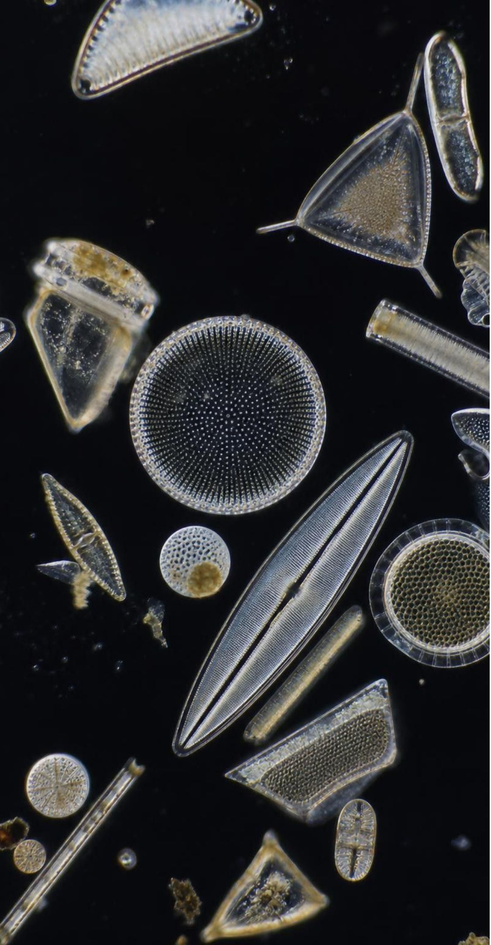
MODEL
Producers live almost everywhere
Model: Six producers, two of them not plants
Pine, maple, sequoia: Land plants. Leaves or needles catch light; roots pull up water.
Grasses, mosses, ferns: Land plants that dominate prairies, forest floors and damp rocks.
Eelgrass: A true plant that grows under water in bays and lakes.
Diatoms: Single-celled algae drifting in the sunlit top of the ocean; the main producers of open water.
Volvox: Green algae living as spinning spheres of thousands of cells in ponds.
Cyanobacteria: Single-celled bacteria that photosynthesize; found in ponds, soil crusts, very hot springs and frozen lakes.
Plants are the familiar producers on land, but algae and cyanobacteria do most of the photosynthesis in water.
5
Notes:
Walk through the six and ask students to sort them into 'plant' and 'not a plant.' Diatoms, Volvox and cyanobacteria are not plants, yet they are producers. The ocean is more than two thirds of Earth's surface and its producers are mostly microscopic algae, so a large share of all photosynthesis on the planet happens in cells you would need a microscope to see. Cyanobacteria are tough: some live in hot springs, though not boiling ones; photosynthetic cyanobacteria stop growing above about 70 °C. Connect to the phenomenon: a sequoia and a diatom are solving the same problem, getting matter and energy without eating.
WATCH FOR: 'Only green plants are producers.' Kelp is brown and diatoms are golden, and both photosynthesize; they carry chlorophyll plus other pigments.
CONNECTS TO: W2 vocabulary; W8 collaborative task.
PACING: about 5 min

Slide 6
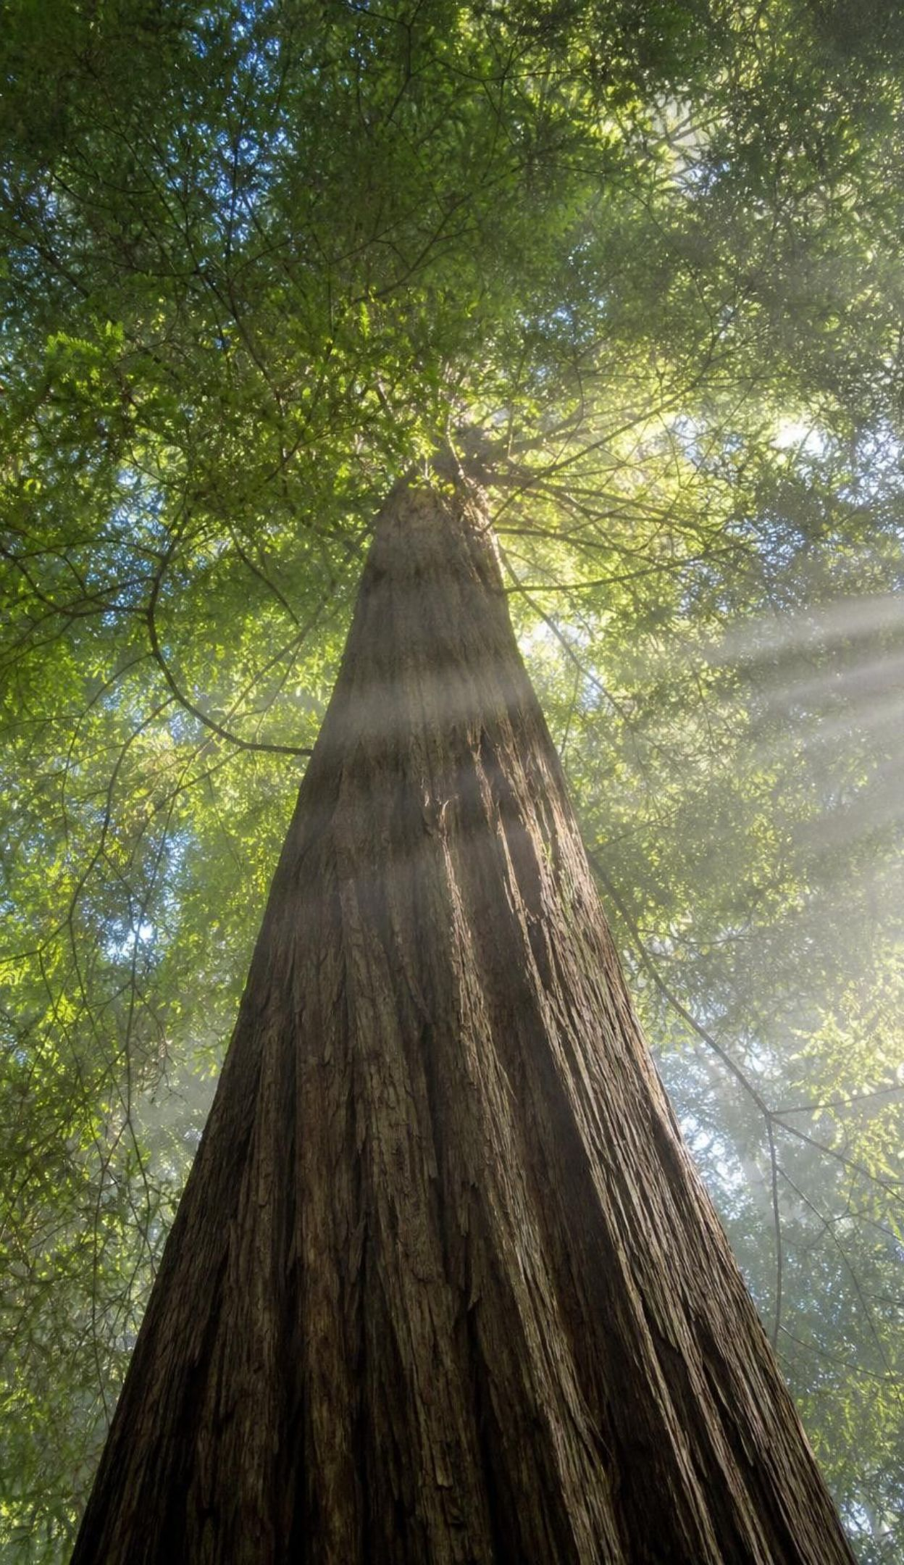
VOCABULARY IN CONTEXT
Three words to anchor the lesson
matter: Anything that has mass and takes up space; it is made of atoms. The carbon dioxide a leaf takes in is matter you cannot see.
producer: An organism that builds its own food from simple substances, usually using light energy. A diatom in the Pacific is a producer; so is a redwood.
photosynthesis: The reaction in which a producer uses light energy to turn carbon dioxide and water into sugar and oxygen. Photosynthesis slows in the shade, so the shaded leaves make less sugar.
6
Notes:
Have students say the three terms aloud and write each in a sentence about the willow. Point out the shape of the word photosynthesis: photo means light, synthesis means putting together. So the word itself says 'building with light.' Ask what is being built (sugar) and from what (carbon dioxide and water). Those two inputs are the answer to the willow mystery, and students will test them in Lab 1.
WATCH FOR: Students may define photosynthesis as 'how plants breathe' or 'how plants make oxygen.' Oxygen is a byproduct; the product that matters to the plant is sugar.
CONNECTS TO: W2 vocabulary worksheet.
PACING: about 4 min

Slide 7
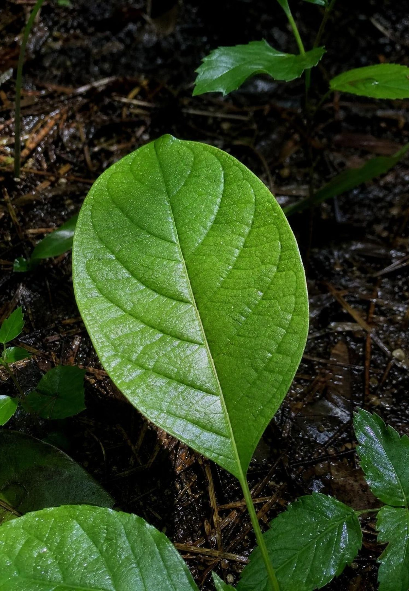
CHECK FOR UNDERSTANDING
Quick check: which one is a producer?
Which organism makes its own food from carbon dioxide, water and light?
A. A mushroom growing on a log
B. A diatom drifting in the ocean
C. A caterpillar eating a leaf
D. A sponge filtering seawater
7
Notes:
Vote with fingers, then defend. The mushroom is the trap: it is not an animal, it does not move, and it sits in the dirt, so students assume it is a plant-like producer. Fungi have no chlorophyll and get their matter and energy by breaking down the log, which was once a producer. The diatom is a single cell with chloroplasts; it is a producer even though it is not a plant.
EXPECTED RESPONSES: B, the diatom. Students who pick A reason that mushrooms 'grow like plants'; ask what color a mushroom is and whether it has anything to catch light with.
WATCH FOR: Fungi as producers. Fungi are decomposers; Lesson 6 returns to them.
CONNECTS TO: W2; W10 mastery.
PACING: about 3 min

Slide 8
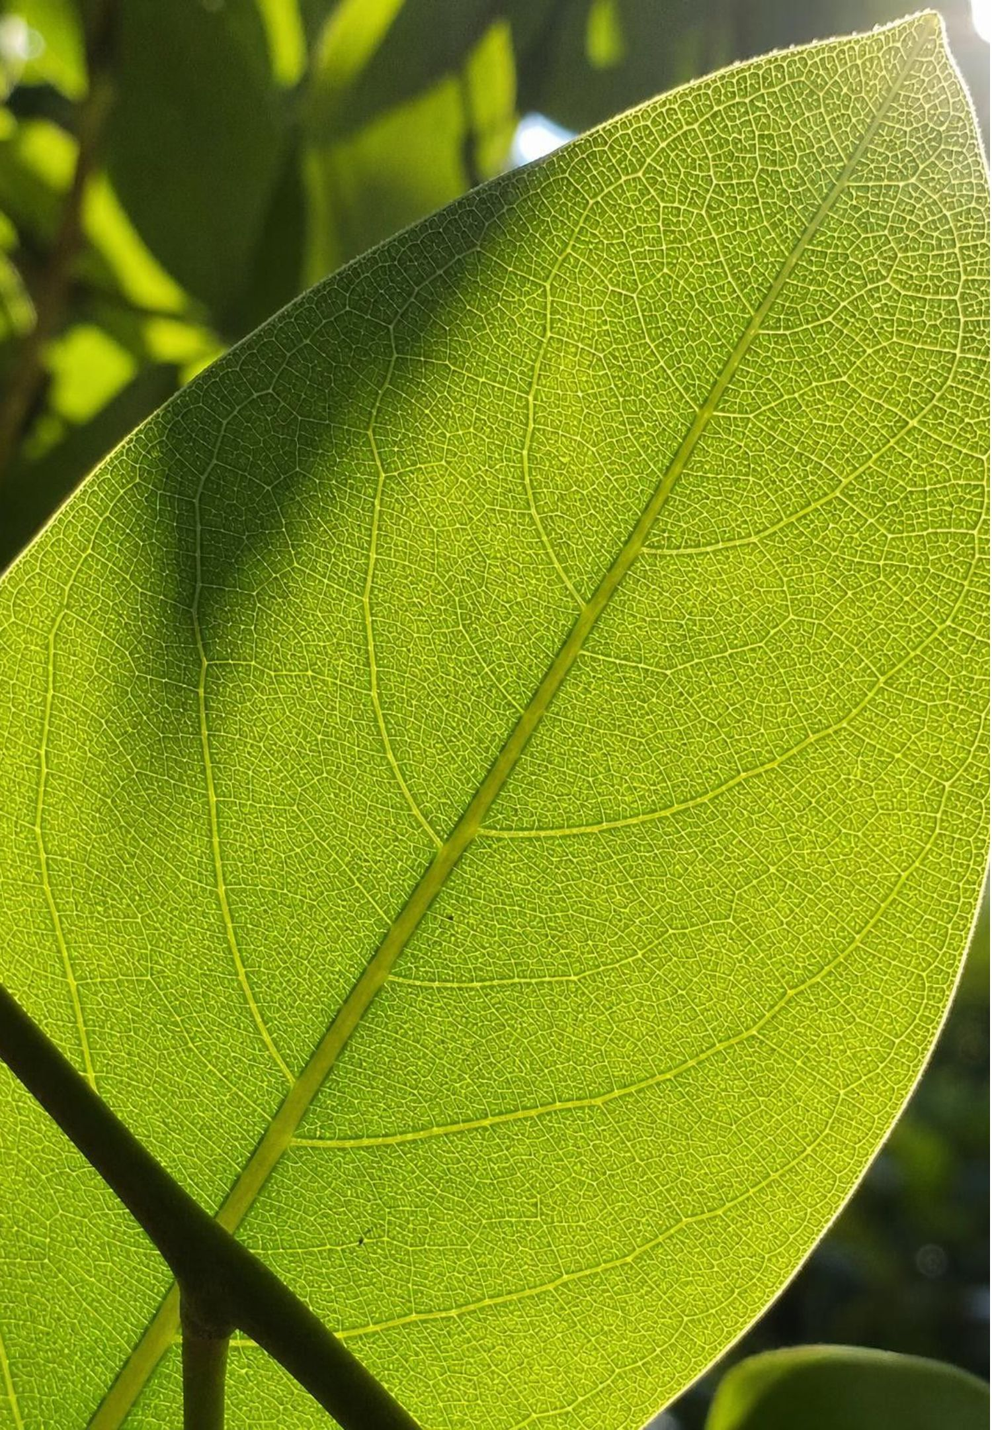
Zoom in: where a leaf catches light
A leaf is made of cells. Many of them are packed with chloroplasts.
Chloroplasts are the structures where photosynthesis happens.
Inside each chloroplast is chlorophyll, a green pigment that absorbs light energy.
Chlorophyll absorbs red and blue light strongly and green light less strongly.
More green light leaves the leaf than any other color, so the leaf looks green to you.
8
Notes:
Build the zoom in three steps: leaf, cell, chloroplast, and then chlorophyll inside the chloroplast. If you have a microscope, a thin strip of moss leaf or an Elodea leaf shows chloroplasts clearly in ten minutes. On color: the textbook says chlorophyll does not absorb green light. That is a simplification. A leaf absorbs most of the green light that hits it, just not as much as red and blue, so green is the color that escapes most. Students only need the idea that the color you see is the light that is not absorbed. Ask why a plant under a pure green lamp would still grow, slowly: some green light is absorbed and drives photosynthesis.
WATCH FOR: 'Chlorophyll reflects all green light' and 'plants are green because they like green light.' The absorbed colors, not the reflected one, power the plant.
CONNECTS TO: W4 diagram worksheet.
PACING: about 5 min

Slide 9
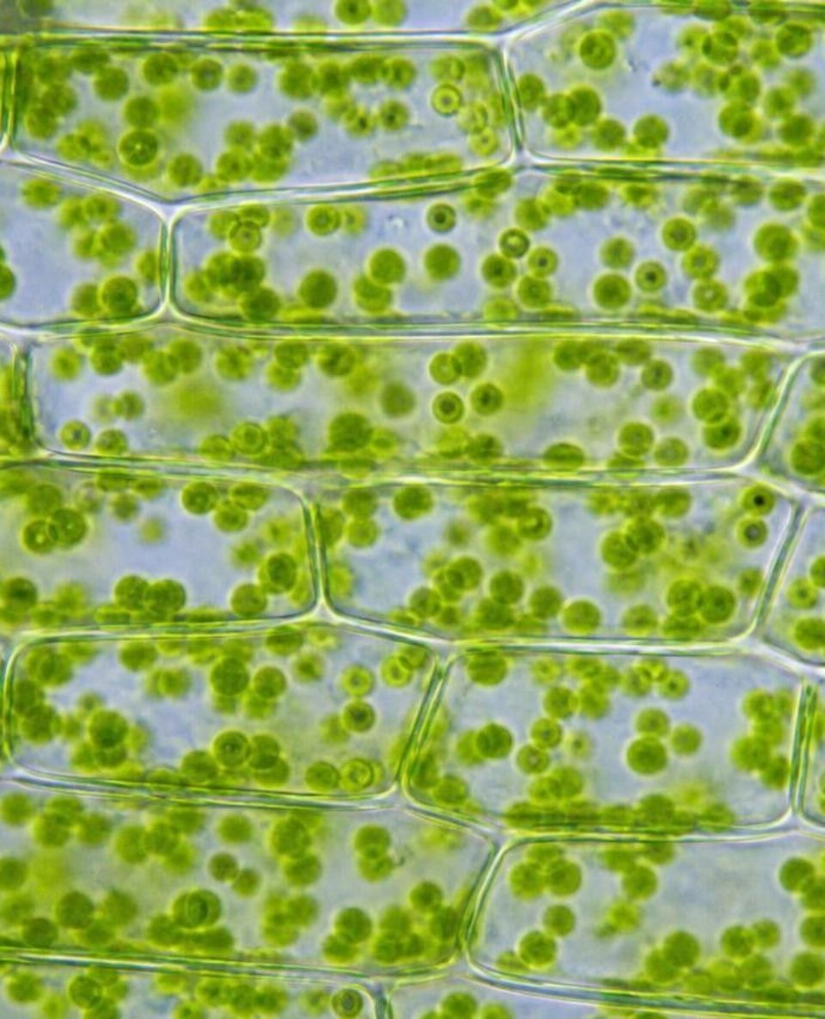
MODEL
From a whole leaf to a single pigment
Model: Zooming into a leaf
Leaf: flat and thin so light reaches every cell →
(look inside the leaf) Leaf cell: one of millions in the leaf →
1
2
(look inside one cell) Chloroplast: dozens in each cell; the site of photosynthesis →
(look inside one chloroplast) Chlorophyll: the pigment that absorbs light energy
3
4
Each step is a closer look at the same leaf. Photosynthesis happens at the third level, inside the chloroplast.
9
Notes:
Use the flow to connect the visible (a leaf) with the invisible (a pigment molecule). Ask students to estimate: if a leaf cell has about 50 chloroplasts and a leaf has about a million cells, how many chloroplasts are catching light in one leaf? Tens of millions. Point out that a diatom skips the first two levels: it is one cell with its own chloroplasts, and it floats where the light is. The ocean's producers are built the same way as the leaf's cells, just not organized into leaves.
EXPECTED RESPONSES: About 50 million chloroplasts in one leaf (50 x 1,000,000). The number is an estimate; the point is that the light-catching happens in a huge number of tiny structures.
CONNECTS TO: W4 diagram worksheet; Lab 1 uses leaf disks, which contain all four levels.
PACING: about 4 min

Slide 10
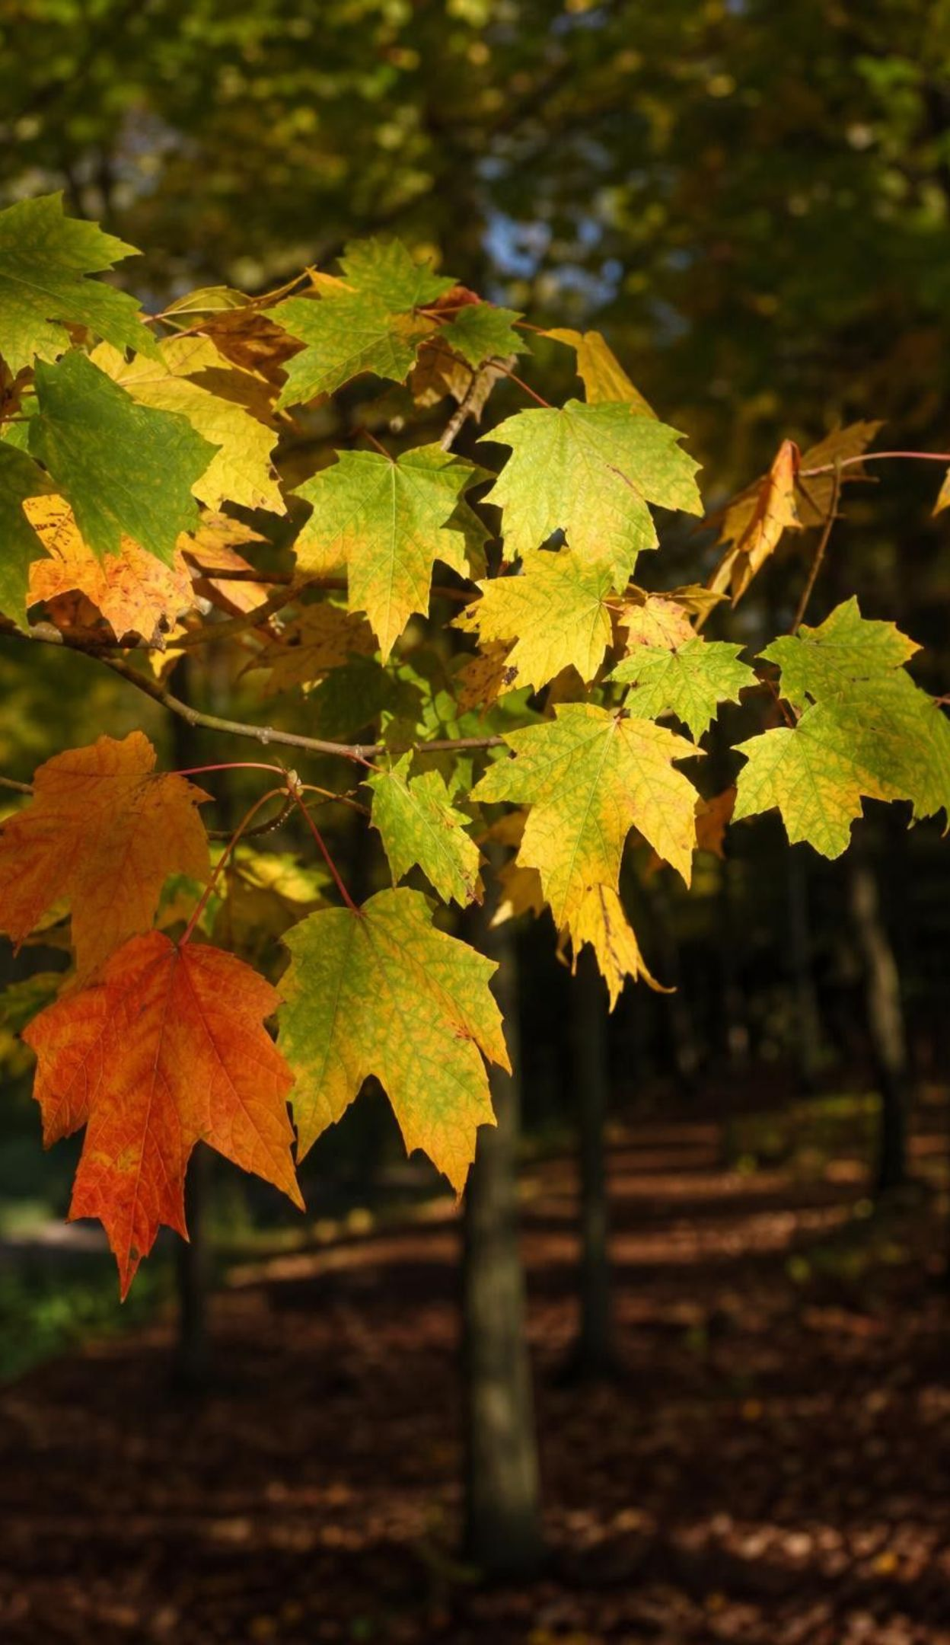
VOCABULARY IN CONTEXT
The parts that capture light
chloroplast: A small green structure inside plant and algae cells where photosynthesis takes place. A single spinach leaf cell can hold dozens of chloroplasts.
chlorophyll: The green pigment inside chloroplasts that absorbs light energy. When chlorophyll breaks down in autumn, yellow and orange pigments show through.
pigment: A substance that absorbs some colors of light and lets others pass or bounce back. Kelp looks brown because its extra pigments absorb different colors than chlorophyll alone.
10
Notes:
Keep the two 'chloro' words apart with a container-and-contents picture: the chloroplast is the room; chlorophyll is the solar panel inside it. Both start with chloro because both are green (chloros is Greek for yellow-green). Pigment is the general word; chlorophyll is one pigment, and producers have others, which is why algae come in browns, reds and golds.
WATCH FOR: Chloroplast and chlorophyll used interchangeably. The quick test: which one is a structure you could see with a microscope? The chloroplast.
CONNECTS TO: W2 vocabulary; W10 mastery.
PACING: about 3 min

Slide 11
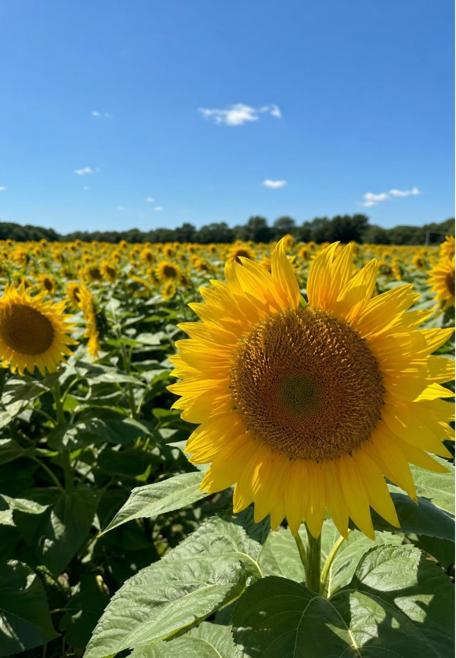
What goes in, what comes out
One energy input: light, absorbed by chlorophyll.
Two matter inputs: carbon dioxide from the air (or dissolved in water) and water.
Two matter outputs: sugar (glucose) and oxygen gas.
In words: carbon dioxide + water + light energy → sugar + oxygen
In symbols: 6CO₂ + 6H₂O + light energy → C₆H₁₂O₆ + 6O₂
11
Notes:
Write the word equation and the symbol equation on the board side by side. Reactants are on the left, products on the right. Each formula names one substance; the whole line is a chemical equation. The textbook calls the line a formula, which is a loose use of the word. Explain the two kinds of numbers: a big number in front counts molecules (6CO₂ means six carbon dioxide molecules); a small number below the line counts atoms inside one molecule (CO₂ has one carbon and two oxygens). Light sits on the left because the reaction cannot run without it, but it is not a substance. Ask: which input does a water plant get from the water around it instead of from air? Carbon dioxide dissolved in the water, which is how the baking soda in Lab 1 works.
WATCH FOR: Reading 6CO₂ as 'six carbons and two oxygens.' Have students draw six separate CO₂ molecules as circles to see 6 C and 12 O.
CONNECTS TO: Lab 2 builds this equation with atom tokens; W4 diagram worksheet.
PACING: about 6 min

Slide 12
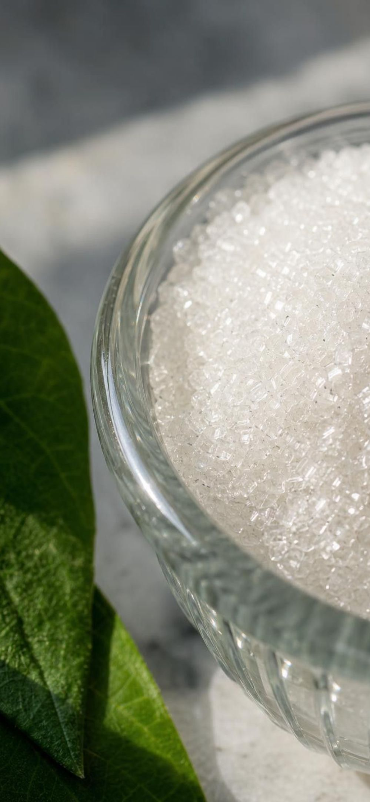
MODEL
Count the atoms: nothing is created or destroyed
Model: Reactants versus products in photosynthesis
Reactants (go in) | Products (come out)
6 CO₂ molecules: 6 carbon, 12 oxygen | 1 C₆H₁₂O₆ molecule: 6 carbon, 12 hydrogen, 6 oxygen
6 H₂O molecules: 12 hydrogen, 6 oxygen | 6 O₂ molecules: 12 oxygen
Light energy (not matter, no atoms) | Stored chemical energy in the sugar
Total atoms: 6 C, 12 H, 18 O | Total atoms: 6 C, 12 H, 18 O
Every atom in the sugar came from carbon dioxide or water. The light contributed energy, not atoms.
12
Notes:
Count aloud with the class. Carbon: six on each side. Hydrogen: twelve from the six waters, twelve in the sugar. Oxygen: twelve from carbon dioxide plus six from water is eighteen; six in the sugar plus twelve in the oxygen gas is eighteen. The atoms have changed partners and nothing was lost. Now point to the light: it appears on the left with no atom count, because it has none. This is the slide that answers the willow: the tree's carbon came in as carbon dioxide through the leaves, atom by atom, and was rearranged into sugar and then into wood. Ask why six carbon dioxide molecules are needed for one sugar: the sugar has six carbons and each CO₂ brings one.
EXPECTED RESPONSES: Students should state the three totals and explain the six-to-one ratio for carbon.
WATCH FOR: 'Light becomes sugar.' If light turned into atoms, the atom count on the right would be larger than on the left. It is not.
CONNECTS TO: Lab 2 atom tokens; W5 data worksheet.
PACING: about 6 min

Slide 13
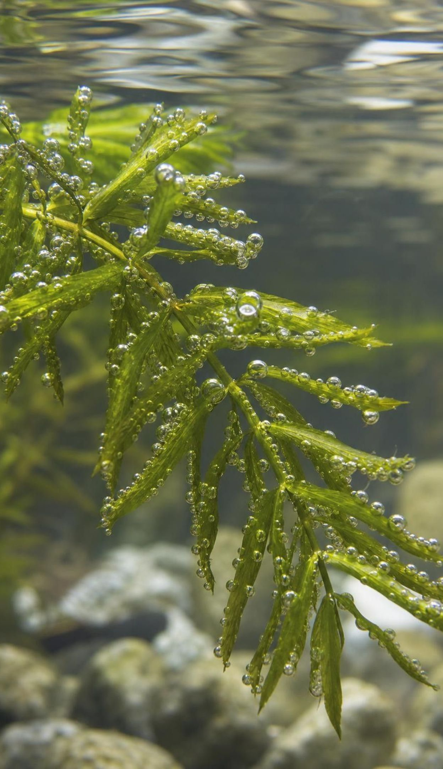
CHECK FOR UNDERSTANDING
Quick check: oxygen atoms
How many oxygen atoms are on each side of 6CO₂ + 6H₂O → C₆H₁₂O₆ + 6O₂, and where do the twelve oxygen atoms in the oxygen gas come from?
A. 12 on each side; all from carbon dioxide
B. 18 on each side; from carbon dioxide and water together
C. 24 on each side; from the air
D. 18 on the left, 12 on the right; six are lost
13
Notes:
Two minutes on whiteboards. Left: 6 x 2 from CO₂ is 12, plus 6 from water is 18. Right: 6 in the sugar plus 12 in the six O₂ molecules is 18. At this grade, say that the oxygen gas's atoms come from the reactants together; the equation alone cannot tell you which molecule each oxygen atom came from. Advanced students sometimes know that the oxygen gas comes from water; that is true and comes from experiments with labeled atoms, but it is beyond the lesson.
EXPECTED RESPONSES: B. 18 on each side. Students who pick D have not counted the sugar's six oxygens; students who pick A have forgotten the water.
WATCH FOR: Forgetting that the sugar itself holds oxygen atoms.
CONNECTS TO: Lab 2; W4; W10.
PACING: about 4 min

Slide 14
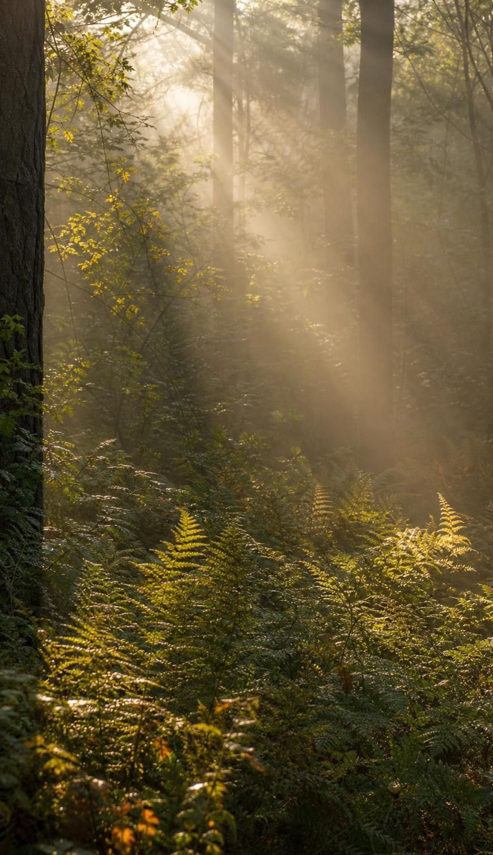
THINK, PAIR, SHARE
Discuss: where did the light go?
Light is energy, not matter. It cannot become atoms.
The reaction needs an energy input; without light it does not run.
The light's energy ends up stored as chemical energy in the sugar.
That stored energy is released later when the sugar reacts with oxygen.
A classmate says, 'The sunlight turned into the sugar.' Another says, 'The sunlight is gone; it just made the reaction happen.' Who is closer to right, and what actually happened to the light's energy?
14
Notes:
Pairs take one side each for two minutes, then switch. Land on this: neither is fully right. The light did not become sugar (no atoms), and it did not vanish (energy is conserved). Its energy was transferred into the sugar as chemical energy, which the cell can release later by reacting the sugar with oxygen. Avoid saying 'energy is stored in the bonds' or 'breaking bonds releases energy'; breaking a bond always costs energy, and the release comes from the whole reaction with oxygen. 'Stored as chemical energy in the sugar' is accurate and enough for this grade.
EXPECTED RESPONSES: The second student is closer: light does not become matter. But the energy is not gone; it is stored as chemical energy in the sugar and released when the sugar reacts with oxygen (in the plant or in an animal that eats it).
WATCH FOR: 'Energy is used up' and 'light becomes matter.' Keep the two conservation ideas separate: atoms are conserved, and energy is conserved.
CONNECTS TO: Lab 2 tracks energy cards separately from atom tokens; W7 misconception repair.
PACING: about 6 min

Slide 15

How scientists found the answer
1640s: van Helmont's willow gained about 74 kg; the soil lost about 60 g. Not soil.
1770s: Joseph Priestley found a sprig of mint could 'restore' air that a candle had spoiled.
1779: Jan Ingenhousz put leaves under water in sunshine: bubbles of oxygen only in light.
1804: Nicolas-Théodore de Saussure sealed plants in jars and tracked the carbon dioxide they took in.
Result: most of a plant's dry mass traces back to carbon dioxide from the air.
15
Notes:
Tell the story as a chain of experiments, each ruling something out. Van Helmont ruled out soil but wrongly credited water. Priestley showed plants change the air. Ingenhousz showed the change needs light and green parts, and that the gas is oxygen; he saw the bubbles because the leaves were under water, where gas collects as bubbles. De Saussure measured carbon dioxide going in and showed that it, with water, accounts for the mass gain. Modern measurements: about 90 percent of a plant's dry mass is carbon and oxygen that came in as carbon dioxide, about 6 percent is hydrogen from water, and only a few percent is minerals from soil. The textbook says 'about 70 percent' from carbon dioxide; the share depends on what you count, so teach 'most' rather than a number.
WATCH FOR: Students may conclude water contributes nothing. Water supplies the hydrogen atoms and some oxygen; it is a real input, just not the main source of mass.
CONNECTS TO: W3 reading; W6 CER; Lab 1 repeats Ingenhousz's light-versus-dark comparison.
PACING: about 5 min

Slide 16
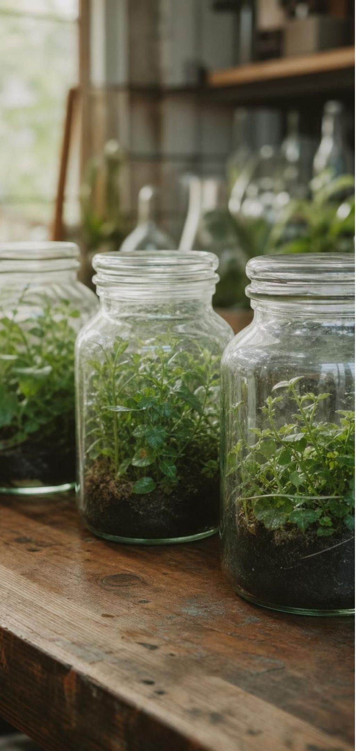
A timeline of experiments on plant matter
MODEL
Model: Ruling out the wrong answers, one experiment at a time
1640s: van Helmont's willow: Soil barely lost mass while the tree gained about 74 kg. Soil is not the source.
1771: Priestley's mint: A living sprig restored air that a burning candle had spoiled. Plants change the air.
1779: Ingenhousz's bubbles: Submerged green leaves gave off oxygen bubbles only in light. Light and green parts are needed.
1804: de Saussure's sealed jars: Measured carbon dioxide taken in; it and water account for the mass gain.
Today: tracking atoms: Scientists follow labeled carbon atoms from the air into sugar, starch and wood.
Each experiment kept the useful finding of the last one and fixed what it got wrong.
16
Notes:
Walk the timeline and ask at each step what question it answered and what it could not answer. Van Helmont could not see that air was involved because air seemed weightless. Priestley did not know the gas was oxygen. Ingenhousz linked light to oxygen but could not weigh the carbon. De Saussure closed the loop by measuring the carbon dioxide. Ask students which experiment Lab 1 copies most closely (Ingenhousz: submerged leaves, light versus dark) and which the willow phenomenon copies (van Helmont).
CONNECTS TO: W3 reading; W8 collaborative task; Lab 1.
PACING: about 5 min

Slide 17
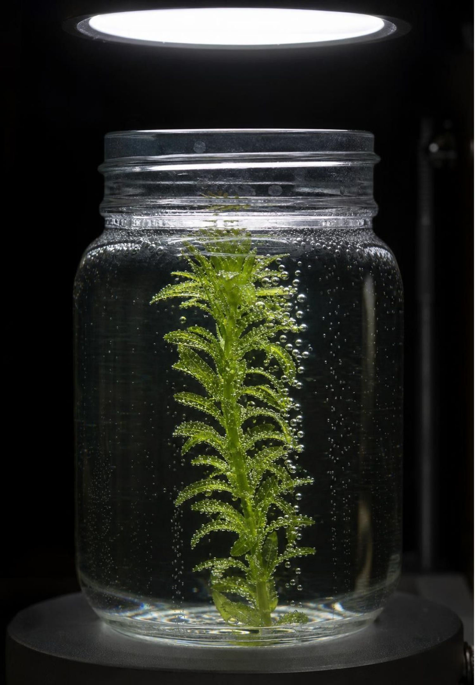
CHECK FOR UNDERSTANDING
Quick check: predict the bubbles
A water plant sits in a sealed jar of water under a bright lamp and bubbles steadily. After an hour the bubbles stop, though the lamp is still on. What most likely ran out?
A. Light
B. Water
C. Carbon dioxide dissolved in the water
D. Chlorophyll
17
Notes:
Quick vote, then reasoning. The lamp is on, so light is not missing. The plant is sitting in water. Chlorophyll is not used up by the reaction. The jar is sealed, so once the plant uses the carbon dioxide dissolved in the water, no more can come in, and sugar-making stalls even under bright light. Follow up: how could you restart the bubbles without opening the jar? You cannot; you would need to add a source of carbon dioxide, which is exactly why Lab 1 adds baking soda to the water.
EXPECTED RESPONSES: C. Carbon dioxide. Students who pick A or B need to re-read the setup; students who pick D think chlorophyll is consumed like a fuel.
WATCH FOR: Chlorophyll as a consumable ingredient. It is a tool that is reused, not a reactant.
CONNECTS TO: Lab 1 (baking soda supplies carbon dioxide); W5 data worksheet.
PACING: about 4 min

Slide 18
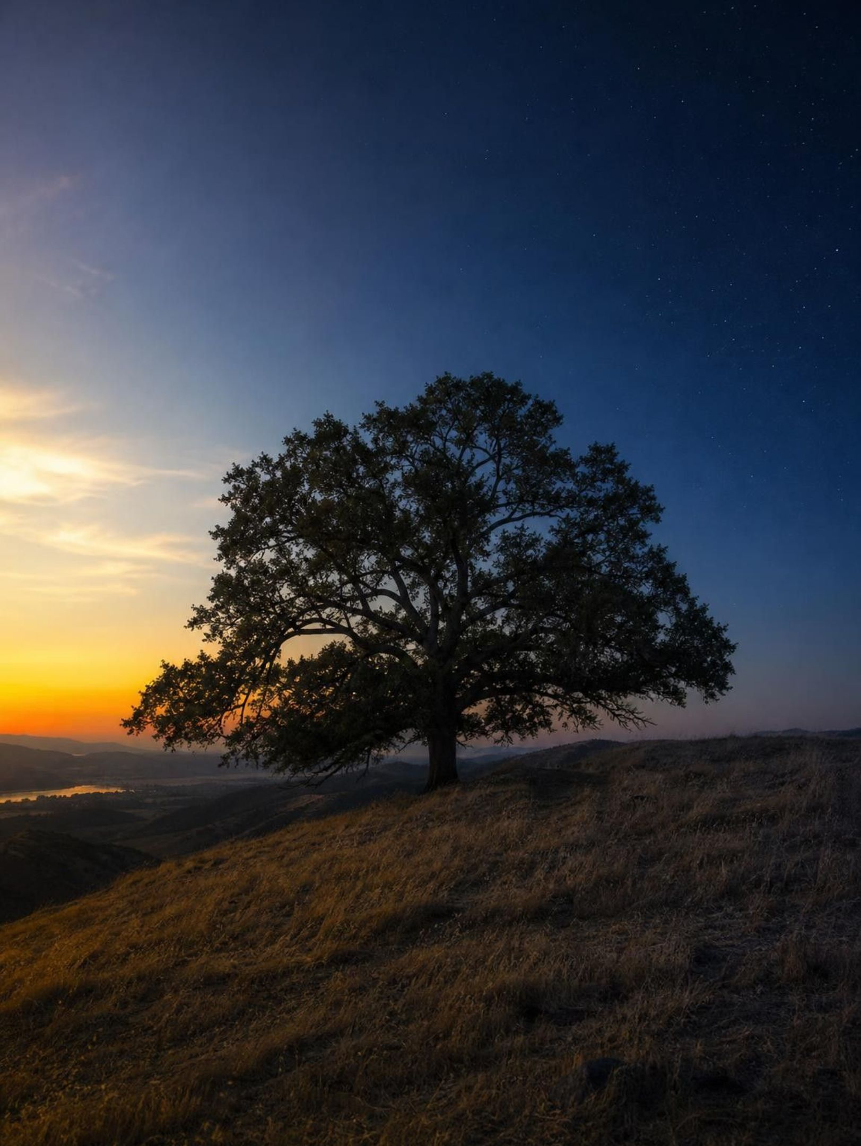
Day and night: two things happen at once
Plant cells break sugar down with oxygen to release energy all the time, day and night, the same way animal cells do. In bright light, photosynthesis runs much faster than that, so the plant takes in more carbon dioxide than it gives off and releases oxygen overall. In the dark, photosynthesis stops, the breakdown continues, and the plant gives off carbon dioxide. Nothing switches modes; one process stops.
18
Notes:
This slide corrects a picture many diagrams create, including the textbook's: oxygen in the day, carbon dioxide at night, as if the plant flips a switch. Say it plainly: plants use their own sugar for energy at all hours. Photosynthesis is the extra process that runs only in light, and in good light it is so much faster that the net effect is oxygen out. If Lab 1 groups move a cup of floating disks into the dark, the disks slowly sink again as the oxygen inside them is used up; that is this slide made visible. Lesson 5 covers the breakdown process in detail; here students only need that it exists and never stops.
WATCH FOR: 'Plants breathe at night' as a separate mode. The breakdown of sugar runs continuously; only photosynthesis comes and goes with light.
CONNECTS TO: Lab 1 extension (disks sink in the dark); L05 Using Stored Energy.
PACING: about 4 min

Slide 19
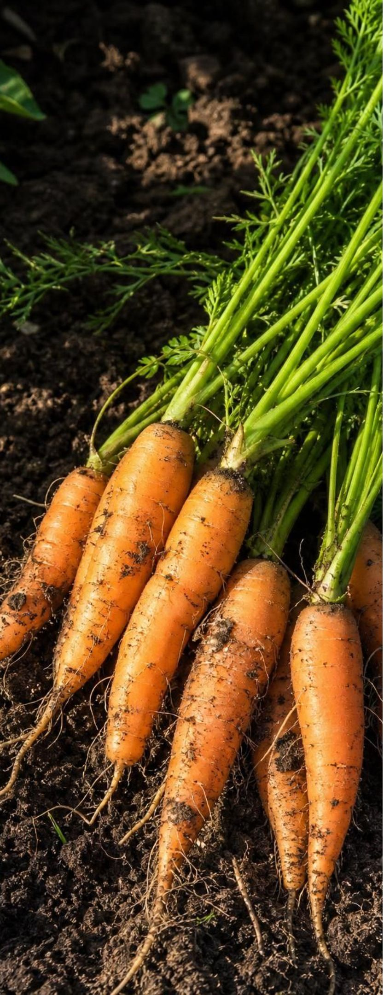
MODEL
Three jobs for every sugar molecule
Model: What a producer does with the sugar it makes
Use it now: React it with oxygen to release energy for growth, repair and moving materials. Carbon dioxide and water leave.
Store it: Link sugar units into starch and pack it into roots, seeds and fruits for nights, winters and sprouting.
Center: Sugar made in the leaf
Build with it: Link sugar units into cellulose, the tough chains that form cell walls and most of wood.
Pass it on: When an animal eats the plant, the sugar, starch and cellulose become that animal's matter and energy supply.
A carrot's sweetness, a seed's head start and a sequoia's trunk are all sugar sent to different jobs.
19
Notes:
Return to the willow: 74 kilograms of wood is mostly cellulose and other cell-wall materials built from sugar, which was built from carbon dioxide and water. Starch is the pantry: a potato, a bean seed and a carrot root are starch stores that let the plant live through darkness or let a seed sprout before it has leaves. On cellulose, be precise in your own head: each link in the chain leaves out the atoms of one water molecule, and dry wood is roughly 40 to 50 percent cellulose. Tell students 'chains of linked sugar units' and 'the largest single ingredient of wood.' The fourth branch previews Lesson 5 and 6: the stored matter and energy is what the rest of the ecosystem lives on.
WATCH FOR: 'Plants store sunlight' or 'plants store energy without matter.' Energy is stored only as part of a substance, here as sugar, starch or cellulose.
CONNECTS TO: Lab 2 has storage and consumer steps; W3 reading; W8 collaborative.
PACING: about 5 min

Slide 20
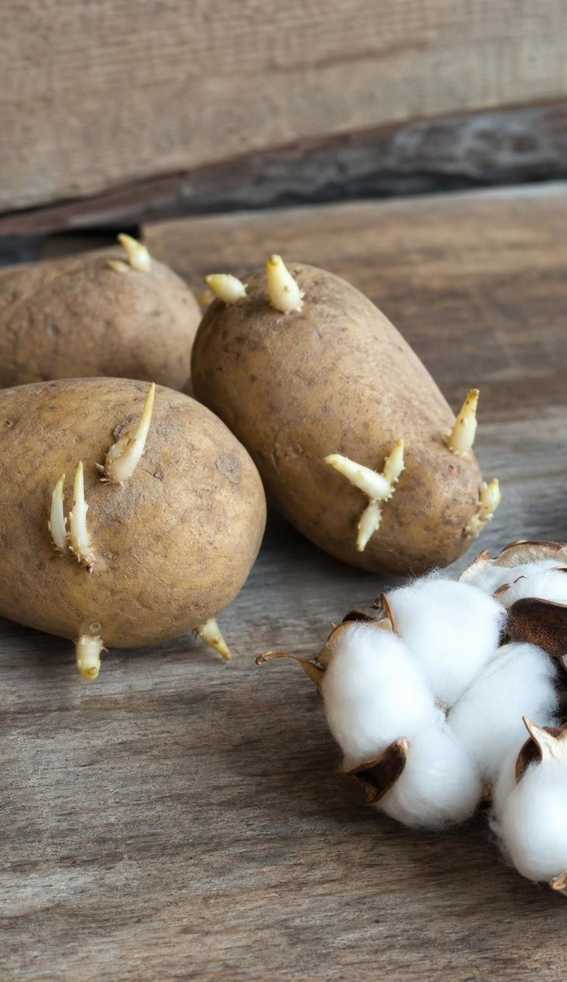
VOCABULARY IN CONTEXT
Words for stored matter and energy
starch: A storage molecule made of many linked sugar units, packed into roots, seeds and fruits. A potato is a starch store that fed the plant's next spring shoots before they had leaves.
cellulose: Long chains of linked sugar units that form plant cell walls; the largest single ingredient of wood. A cotton T-shirt is nearly pure cellulose, which is why you cannot digest it.
biomass: The total mass of living things; it holds both matter and stored chemical energy. Most of a forest's biomass is tree trunks, not animals.
20
Notes:
Starch and cellulose are both chains of sugar units; the difference is how the units are linked, which is why you can digest bread (starch) but not paper (cellulose). Biomass is the word for the total: all the matter in living things, which also means all the stored energy. Ask which has more biomass, all the deer in a forest or all the trees? The trees, by an enormous margin, because producers are where the matter enters the living world. Carry this into the biofuel discussion: biomass is also a resource people can burn.
WATCH FOR: Biomass as 'the mass of animals' only. It includes producers, which are most of it.
CONNECTS TO: W2 vocabulary; Lab 3 uses biomass as a fuel source.
PACING: about 3 min

Slide 21
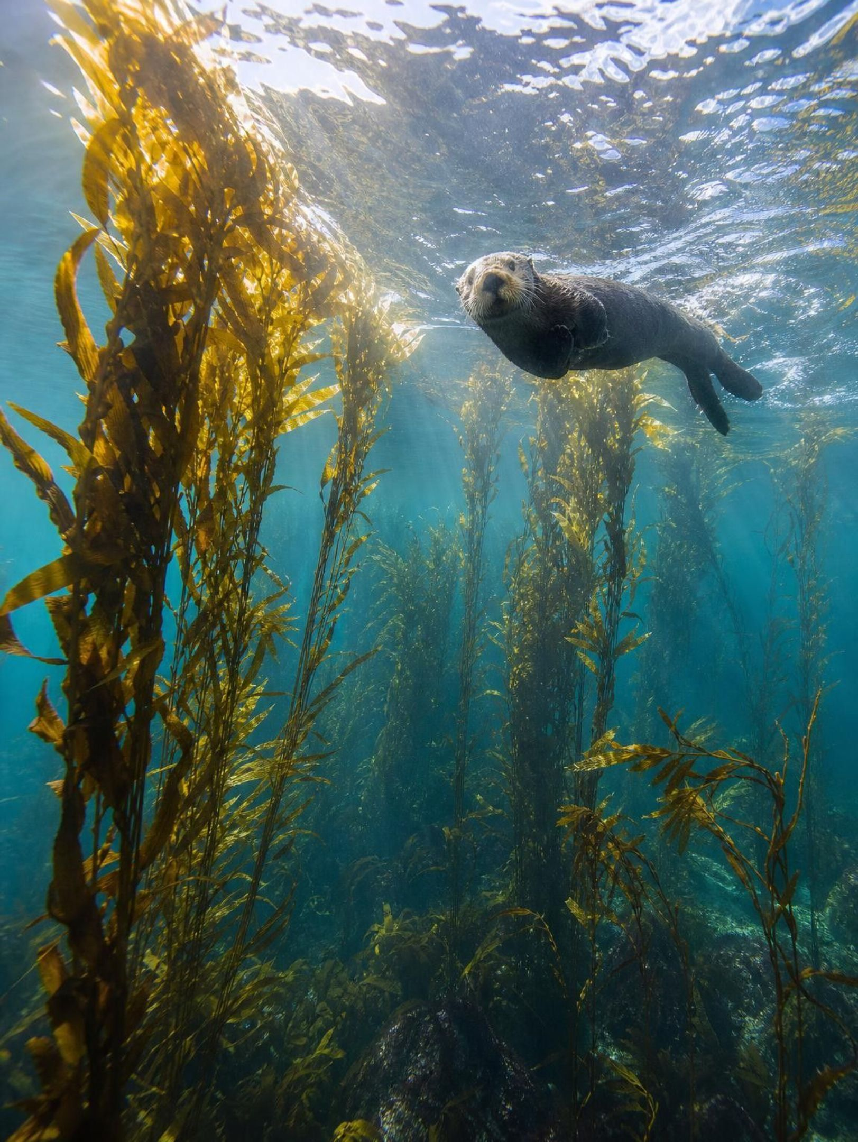
REAL-WORLD CONNECTION
California connection: a forest that is not made of plants
Off Monterey and along much of the California coast, giant kelp forms underwater forests 30 meters tall. Kelp is a brown alga, not a plant, yet the whole kelp forest depends on it. In good conditions it can grow up to about 60 centimeters a day on carbon dioxide from seawater and light from the surface. Urchins, snails and fish eat it; sea otters eat the urchins. All that biomass starts with the kelp.
21
Notes:
Kelp is a good check on everything so far. It is not green (its extra pigments make it brown), it has no roots that feed it (its holdfast only anchors it to rock), and it takes its carbon dioxide from the water, not the air. Yet it is a producer with chloroplasts and chlorophyll, and it builds enormous biomass fast. Ask: where does the matter for 60 centimeters of new growth each day come from? Carbon dioxide dissolved in the seawater and the water itself; the energy comes from the light at the surface, which is why kelp forests grow only in fairly shallow, clear water. If students have visited the Monterey Bay Aquarium, its kelp forest tank is this slide in person. On land, Sequoia National Park's giant sequoias are the same lesson at the largest scale: trunks built from air and water over thousands of years.
CONNECTS TO: W3 reading; extension prompt in chapter differentiation (why kelp is brown).
PACING: about 4 min

Slide 22
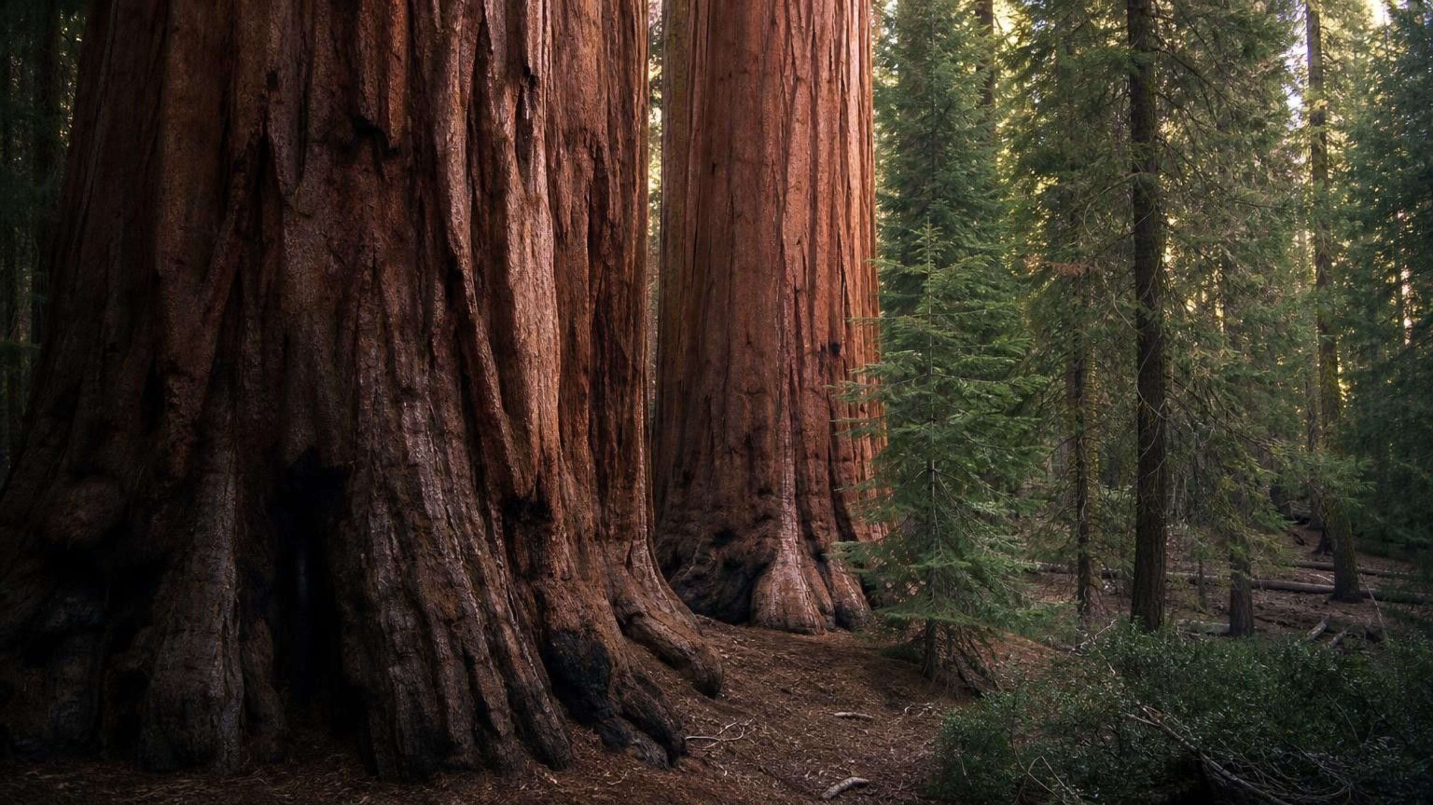
THINK, PAIR, SHARE
Discuss: where did the sequoia's mass come from?
A visitor to Sequoia National Park says all the wood in a giant sequoia must have come up from the ground through its roots. Use evidence from this lesson to agree, disagree or correct the claim.
Notes:
This is the phenomenon revisited with the full toolkit. Give pairs three minutes to build an argument from at least two pieces of evidence: the willow's soil barely changed; the equation shows carbon entering as carbon dioxide; de Saussure measured it; kelp builds biomass with no soil at all. Push them to say what the roots do supply: water (a real input) and small amounts of minerals. The strongest answers will say that the tree's carbon, which makes up almost half of dry wood, came from the air through the needles, and that water from the roots supplied hydrogen and some oxygen. End with the reverse question: when a sequoia burns or rots, where does its carbon go? Back to the air as carbon dioxide, which Lesson 7 picks up.
EXPECTED RESPONSES: Disagree. Roots supply water and minerals, but the carbon in wood came in through the leaves as carbon dioxide; evidence: the willow's soil loss of about 60 g, the atom count in the equation, de Saussure's sealed jars, and kelp growing with no soil.
CONNECTS TO: W6 CER; W7 misconception repair; Lab 2 boundary diagram.
PACING: about 6 min

Slide 23
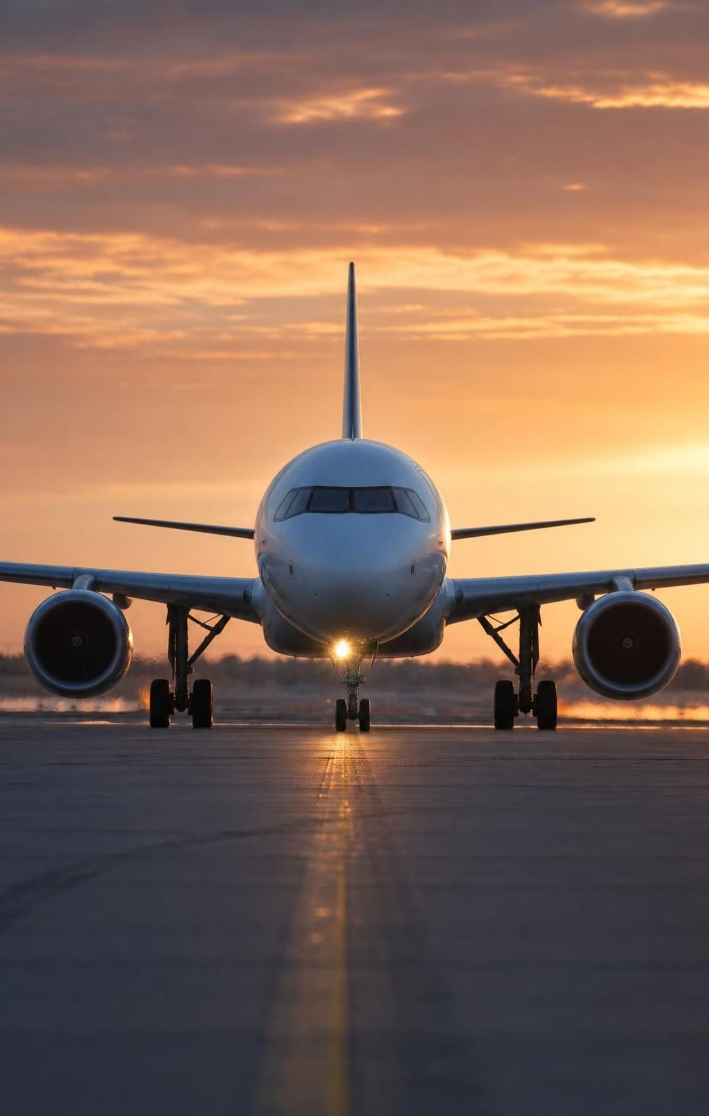
Engineering: can biomass fuel a jet?
Jets burn fuel to release stored chemical energy. Every extra kilogram of fuel is more to lift.
Criterion: pack as much energy as possible into each kilogram of fuel.
For decades fossil fuels met that criterion, but they are not renewable.
In the 2000s airlines added a constraint: the fuel source should be renewable.
Biofuel: a fuel made from biomass. Its carbon was pulled from the air by producers recently.
More constraints: affordable, regrown fast enough, and not pushing out food crops.
23
Notes:
Shift to engineering. Remind students of the difference: a criterion is a goal you want as much of as possible; a constraint is a line you cannot cross. Energy per kilogram is the big criterion for anything that flies. Renewable, affordable and no competition with food are constraints. Then introduce the trade-off: biomass is renewable, but growing crops just to burn them can take farmland from food, and cutting slow-growing trees is not renewable on a useful timescale. The textbook's engineers favored city waste: yard trimmings, food scraps and cardboard, a steady supply of cellulose that would otherwise go to a landfill. Be honest about the present: as of 2026, aviation biofuels cost several times more than ordinary jet fuel and are well under 1 percent of jet fuel use, and many are made from waste fats and oils rather than cellulose. The reasoning is the lesson, not the market.
WATCH FOR: 'Biofuels do not release carbon dioxide.' They do when burned; the difference is where the carbon came from and whether the supply can be regrown.
CONNECTS TO: Lab 3 and W9 use a decision matrix; task slide next.
PACING: about 5 min

Slide 24
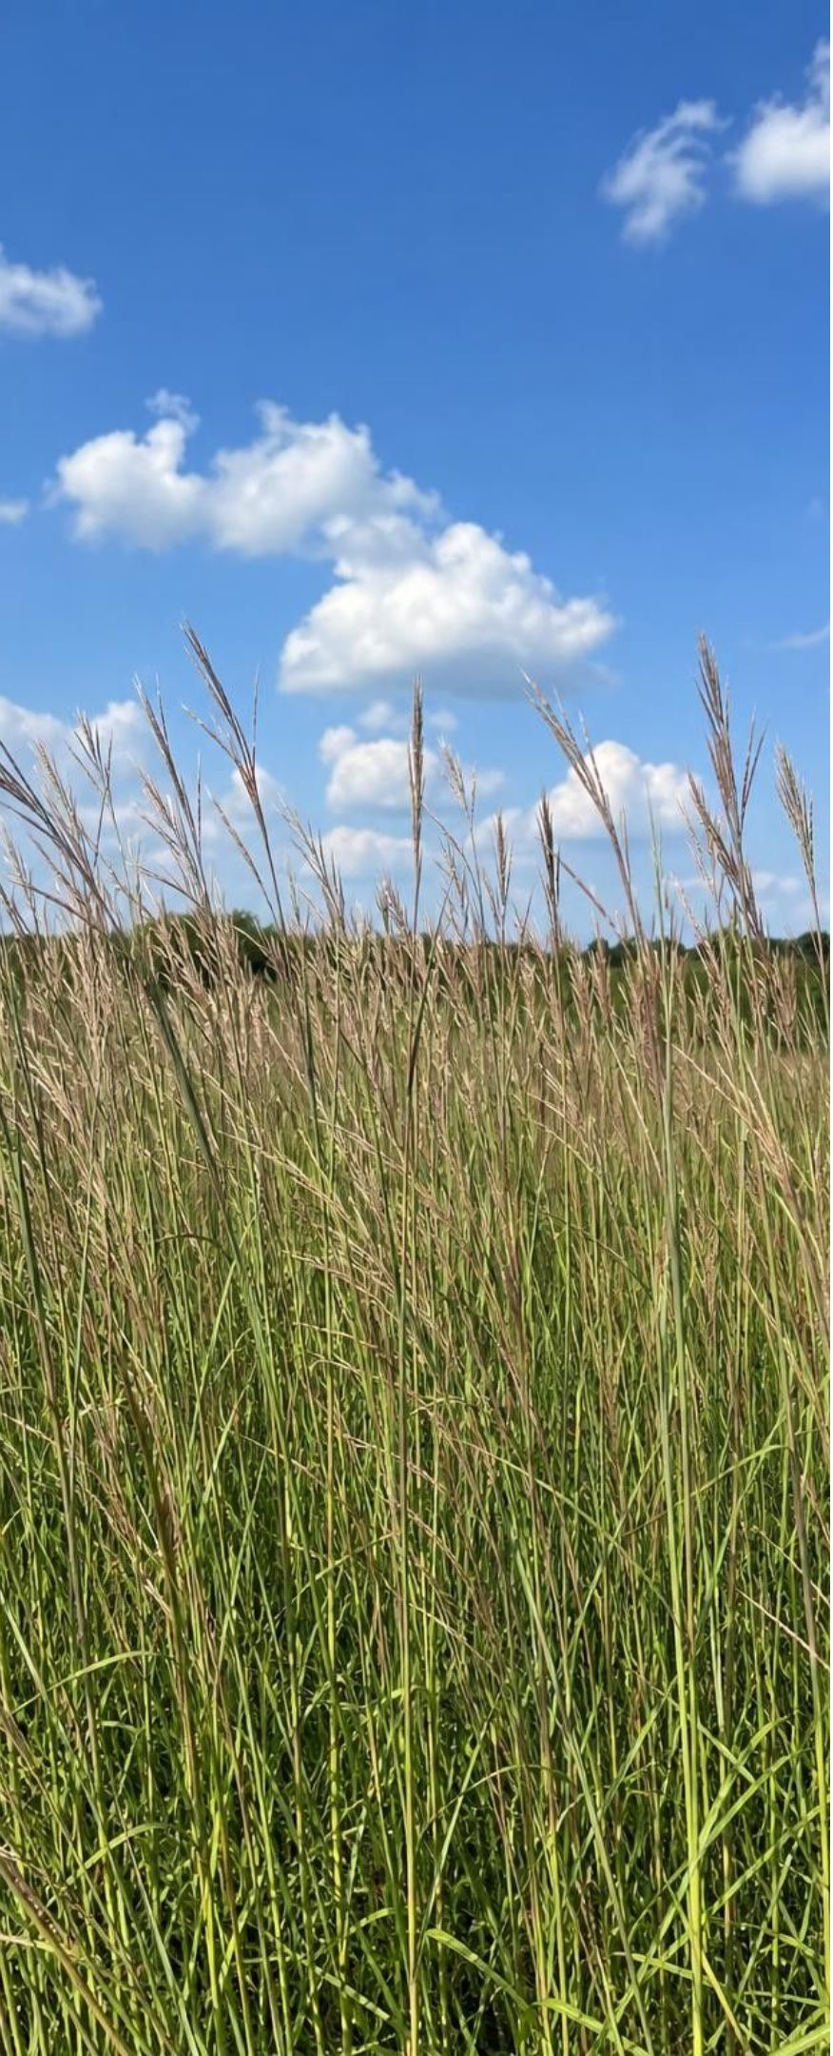
APPLY IT
Task: which biomass should become jet fuel?
Screen the four sources with three constraints (regrows within 5 years, under $0.40 per kg, no competition with food), then compare energy per kg. Which do you recommend, and what is its weakness?
Biomass source | Energy per kg of feedstock (MJ) | Years to regrow | Cost ($ per kg) | Competes with food?
City yard and food waste | 12 | 0.1 | 0.05 | No
Corn grain | 16 | 1 | 0.25 | Yes
Fast-growing grass crop | 17 | 1 | 0.15 | Only if planted on farmland
Forest timber | 19 | 40 | 0.1 | No
Simulated data for practice.
24
Notes:
This is a simulated teaching dataset; the numbers are rounded and invented to make the trade-offs visible, not measured values. Give groups eight minutes. Step 1: apply the constraints first, because a source that breaks a constraint is out no matter how good it scores. Timber fails 'renewable within 5 years.' Corn fails 'no competition with food.' Step 2: among the survivors, compare the criterion. Grass has more energy per kilogram than city waste, but it carries a conditional constraint: it is fine only on land not needed for food. Step 3: decide and name a weakness. A strong answer picks city waste (passes every constraint, cheapest, steady supply) and names its weakness (lowest energy per kilogram, and the supply is messy and mixed), or picks grass on non-farmland and names its weakness (needs land and water, and farmers may switch good land to it). Both are defensible; the quality of the reasoning is what you grade.
EXPECTED RESPONSES: Timber out (40 years), corn out (food). City waste: passes all constraints, cheapest, lowest energy per kg. Grass: passes if kept off farmland, higher energy per kg. Recommendation with a named weakness and the constraint screening shown first.
WATCH FOR: Groups that pick timber because it has the highest energy number have skipped the constraints. Ask what happens to the supply after the first harvest.
CONNECTS TO: Lab 3 is the full decision matrix with weighted scores; W9 transfer task.
PACING: about 10 min

Slide 25
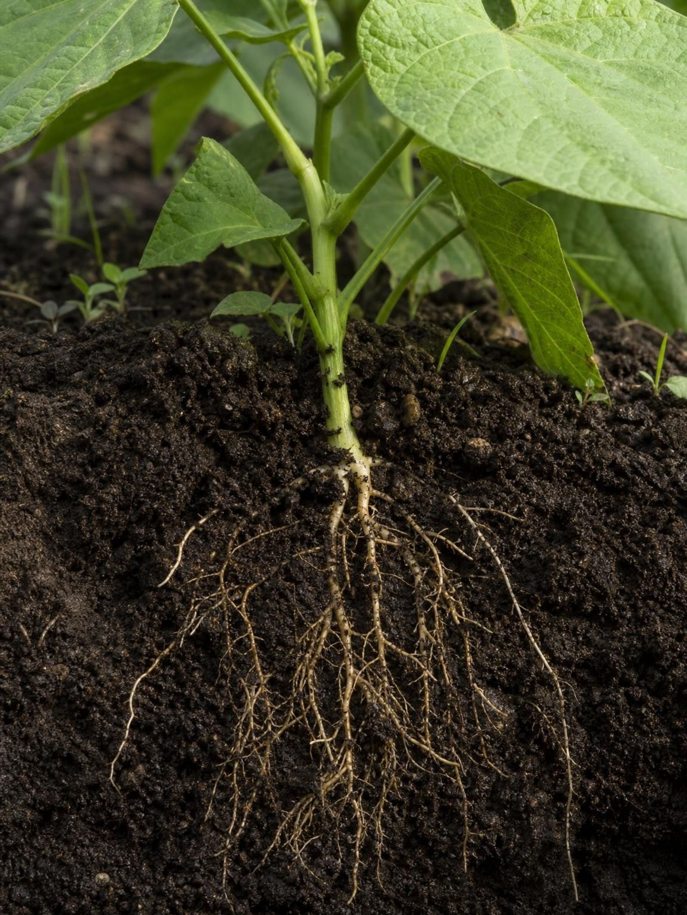
MISCONCEPTION CHECK
True or false? Plants eat soil
"A plant gets its food from the soil through its roots, the way an animal gets food through its mouth. That is why we feed plants with fertilizer."
True or false? Explain your reasoning.
25
Notes:
Have students evaluate the statement in writing with at least two pieces of evidence from the lesson before anyone speaks. Then collect. The willow's soil lost about 60 grams while the tree gained about 74 kilograms; the atom count shows carbon entering as carbon dioxide; kelp builds a forest with no soil at all. Fertilizer is the sharp edge: it supplies minerals such as nitrogen and phosphorus that the plant needs in small amounts to build certain molecules, but it supplies no sugar and almost no mass. A plant with fertilizer and no light starves. Close with the correct sentence: plants make their food from carbon dioxide and water using light energy; soil provides water and a little mineral seasoning.
EXPECTED RESPONSES: False. Roots take in water and small amounts of minerals, not food. The plant's mass comes mainly from carbon dioxide in the air, rearranged into sugar with light energy; evidence from the willow, the equation and kelp.
WATCH FOR: Students may overcorrect to 'soil does nothing.' Water and minerals are real and necessary; they are just not the food.
CONNECTS TO: W7 misconception repair; W6 CER.
PACING: about 6 min

Slide 26
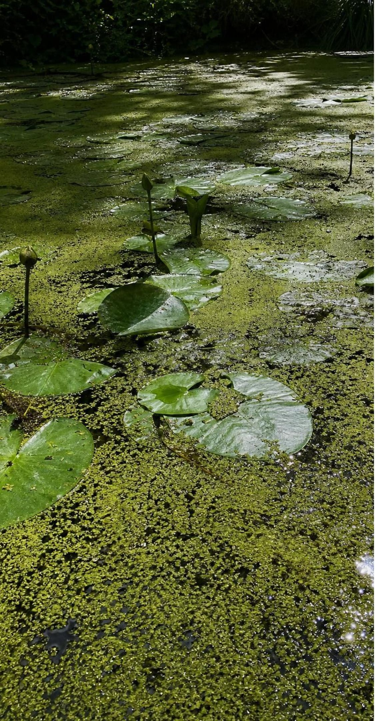
PUTTING IT TOGETHER
Putting it together
Producers (plants, algae, cyanobacteria) build food from carbon dioxide, water and light energy.
Chlorophyll in chloroplasts absorbs the light; the reaction rearranges atoms into sugar and oxygen.
Atoms are conserved: 6 C, 12 H, 18 O on each side. Light adds energy, never atoms.
Experiments from van Helmont to de Saussure traced a plant's mass to the air, not the soil.
Sugar is used now, stored as starch, or built into cellulose; all of it is biomass others live on.
Biomass can be a fuel, judged by energy per kilogram and by renewable, cost and food constraints.
26
Notes:
Have students write a four-sentence explanation of the willow using at least five vocabulary terms, then trade with a partner who checks that matter and energy are never mixed up. Ask for one thing from each lab: Lab 1 (which cup rose and why), Lab 2 (what crossed the boundary and in which direction), Lab 3 (which feedstock and which constraint knocked out the runner-up). Preview Lesson 5: how producers and consumers release the energy stored in sugar, which is the breakdown process that ran in the dark cup.
CONNECTS TO: W10 mastery as the quiz; L05 Using Stored Energy next.
PACING: about 6 min

Slide 27
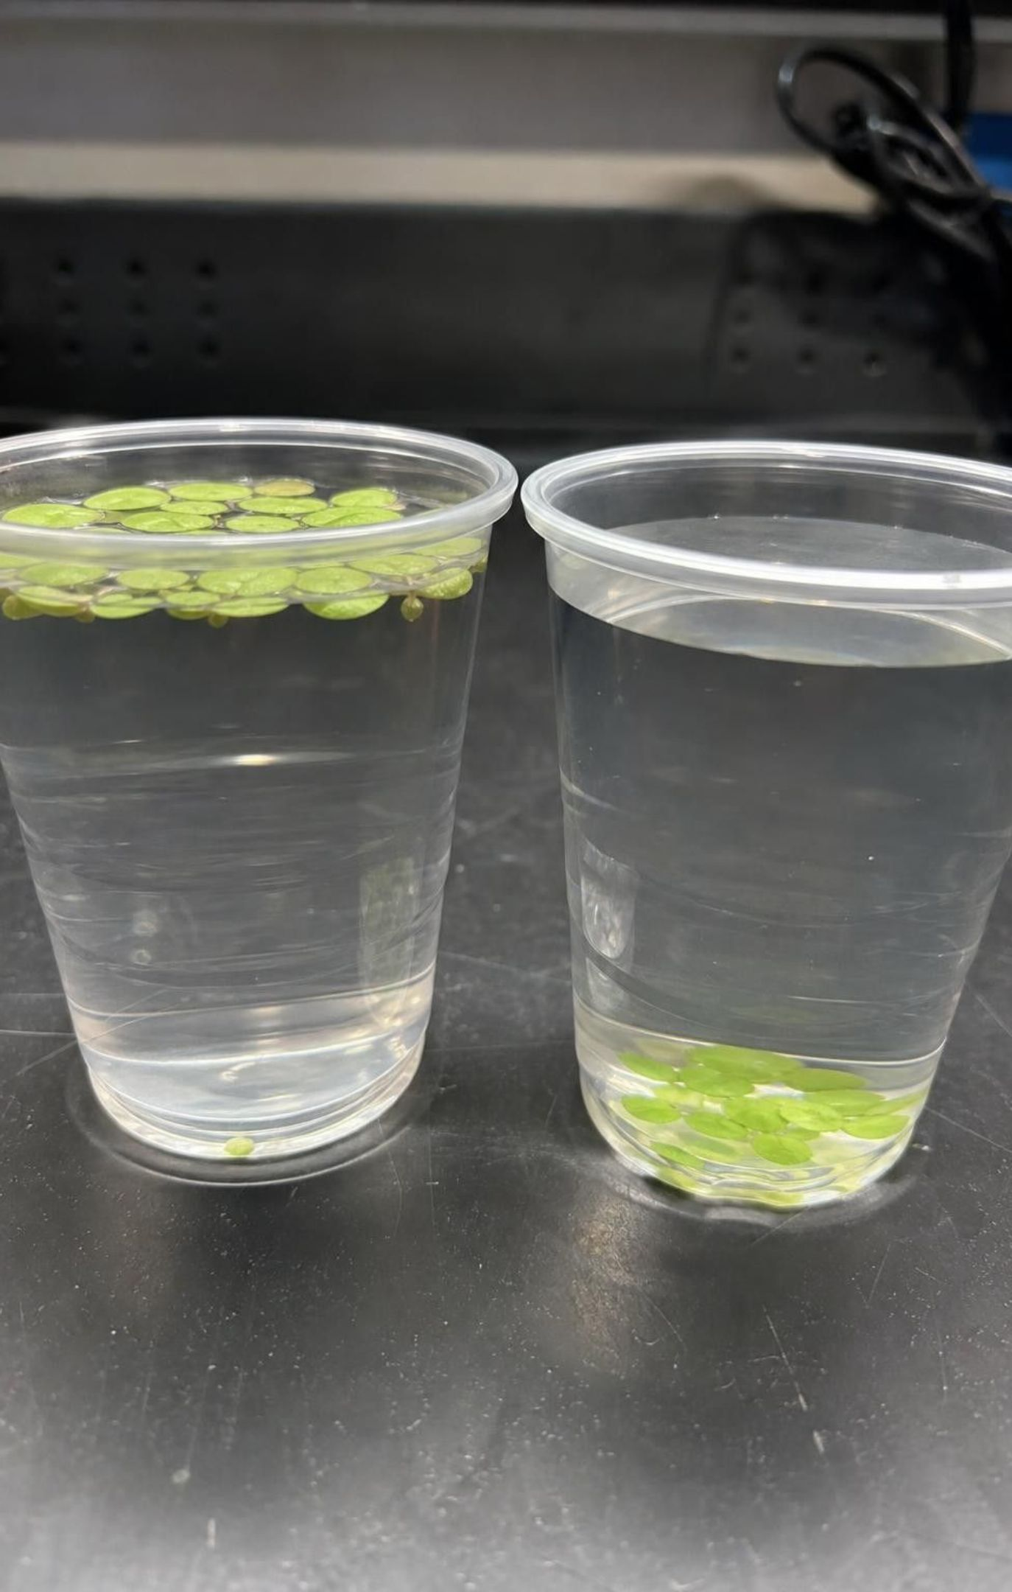
EXIT TICKET
Exit ticket
Name the one energy input and the two matter inputs of photosynthesis.
A sapling gains 5 kg in a year. In one sentence, say where most of that mass came from and how it got in.
What happened to the light's energy? Finish: 'It ended up ___.'
Name one criterion and one constraint for a jet biofuel, and label which is which.
Leaf disks in a dark cup never rose. What does that show photosynthesis needs?
27
Notes:
Collect on index cards or a shared form. Item 1 checks the inputs; item 2 is the whole of MS-LS1-6 in one sentence and is the one to read most carefully; item 3 catches the 'light becomes sugar' error; item 4 checks the engineering vocabulary; item 5 checks that Lab 1's dark cup was understood as evidence. Sort cards into three piles before the next class and reteach from the largest.
EXPECTED RESPONSES: 1: light; carbon dioxide and water. 2: for example 'Most of the mass came from carbon dioxide in the air, which entered through the leaves and was rearranged into sugar and then wood.' 3: 'stored as chemical energy in the sugar.' 4: criterion, high energy per kilogram; constraint, renewable, affordable or no competition with food. 5: light.
WATCH FOR: Item 2 answers of 'soil' or 'water' alone signal the misconception survived; item 3 answers of 'turned into sugar' signal matter and energy are still blended.
CONNECTS TO: W10 mastery; chapter evidenceOfLearning.
PACING: about 5 min

