Slide 1
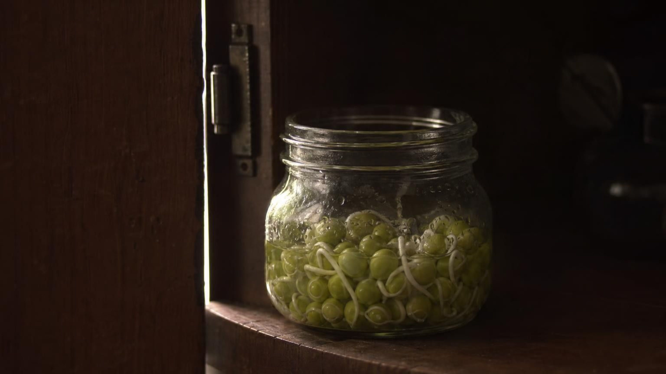
Using Stored Energy
Chapter 5 of 29 · Energy and Matter in Ecosystems
Lesson 5: How do living things get usable energy and building materials out of food?
Angela's Wand · Bring Science Alive! 7th Grade Integrated
Notes:
Last lesson we followed sunlight into sugar. This lesson follows the sugar. Over the week we answer three questions: how does any cell, in a root or in a squirrel, get energy out of food; what happens to the atoms; and how does a meal become part of you. Students will run three investigations: sealed jars of sprouting seeds in the dark, an atom-token model of the respiration reaction, and a field investigation of their own breathing before and after exercise. Nothing needs flames or strong chemicals; the only reagent is a color indicator.
CONNECTS TO: Overview of Lab 1, Lab 2 and Lab 3; W1 opens on the next slide.
PACING: about 2 min

Slide 2
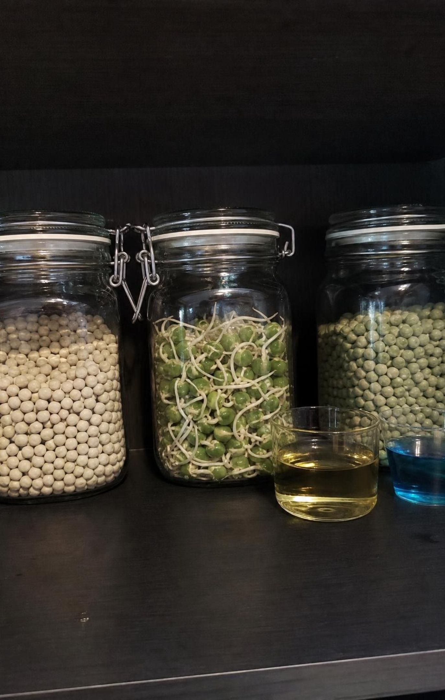
PHENOMENON
Seeds that grow in the dark
Soaked peas are sealed in a jar with a cup of blue indicator and a thermometer, then left in a dark cupboard. A day later: roots have pushed out, the jar is a few degrees warmer, and the indicator has turned yellow, its carbon dioxide color. A jar of dry peas shows no change. A jar of soaked peas that were boiled first stays blue and cool. No light reached any jar.
Notice: which jar changed, and in how many ways?
Wonder: where did the energy to warm the jar and grow a root come from?
Predict: what would happen if the living seeds' jar had no air in it?
2
Notes:
If you set up the Lab 1 jars a day ahead, show them now; otherwise use the slide. Give two silent minutes for a notice and a wonder, then collect them on the board without judging. Push on the puzzle: plants are supposed to get energy from light, yet these seeds grew, warmed up and made a gas with no light at all. Ask what the seed must contain to do that. Expect 'water made it grow' and 'seeds have energy inside'. Record both. The dry jar shows water matters; the boiled jar shows the seeds must be alive. Park the 'no air' prediction; Lab 1 analysis and the flooded-root discussion return to it.
EXPECTED RESPONSES: Notice: only the living soaked jar changed; it changed in three ways (growth, warmth, yellow indicator). Wonder: what the gas is; whether the seed is getting lighter; whether the seeds would keep going for a week. Predict: with no air the seeds would stop or slow, which is the right instinct and the reason roots drown.
WATCH FOR: 'Plants only get energy from the sun' and 'the water gave it energy.' Water activates the seed but carries no usable energy; leave the correction for slide 8 and Lab 1.
CONNECTS TO: W1 phenomenon worksheet records the notice/wonder and first explanation. Lab 1 is the live version of this slide. W6 CER returns to this evidence.
PACING: about 8 min

Slide 3
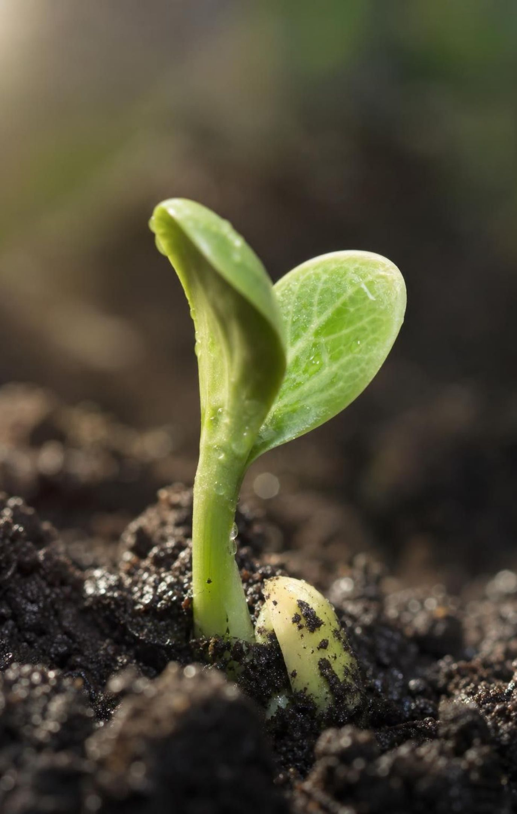
LEARNING TARGETS
What you will be able to do
1
Tell producers from consumers by where they get matter and energy, and show both run on sugar.
2
Model cellular respiration with a word equation and atom counts: atoms rearranged, energy released.
3
Use evidence to argue that plants respire too, and tell breathing apart from cellular respiration.
4
Describe how digested food becomes fuel or building blocks for carbohydrates, fats and proteins.
5
Compare photosynthesis and cellular respiration and trace matter and energy through both.
3
Notes:
Read the targets aloud and have students star the one that surprises them most; usually it is the third, because many believe plants do not need oxygen. Map the week: targets 1 and 2 are the first two days and Lab 2, target 3 is Lab 1 and the plant discussion, target 4 is the digestion day, target 5 is the closing comparison. The exit ticket on the last day touches all five.
CONNECTS TO: Targets map to W2 (1), Lab 2 and W4 (2), Lab 1, Lab 3 and W7 (3), W9 (4), W10 (5).
PACING: about 2 min

Slide 4
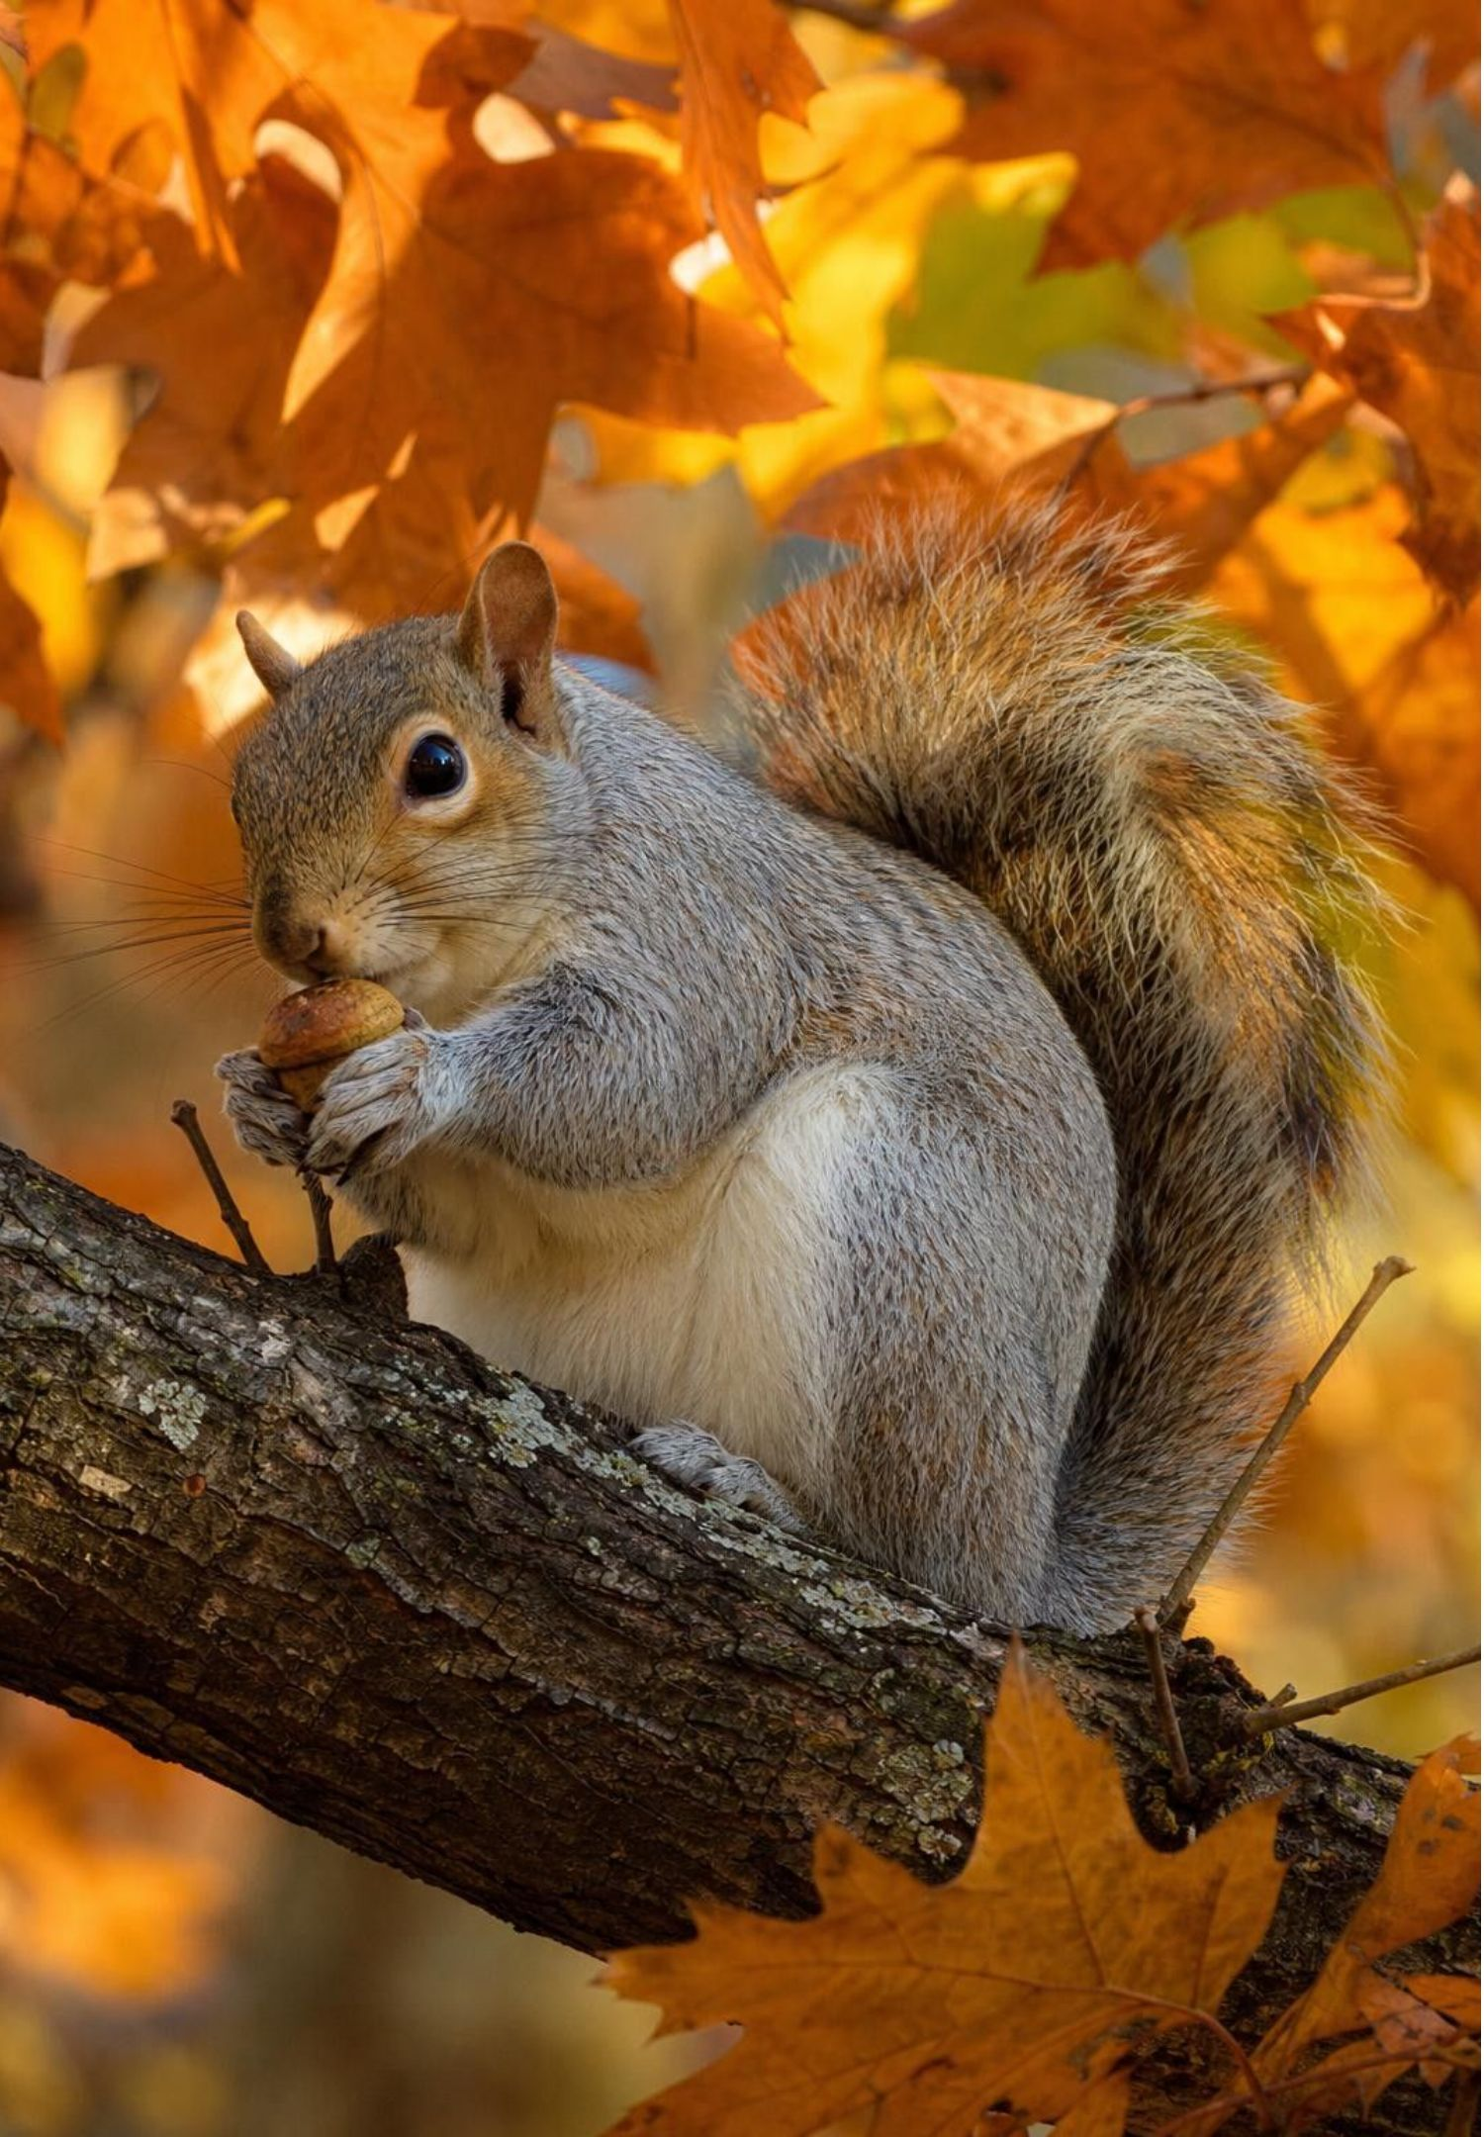
Who makes food, and who has to find it
Every organism needs two things from food: matter to build with and energy to do work.
Producers make their own food. Most build sugar from carbon dioxide and water using light.
Consumers cannot make food. They eat or absorb other organisms to get matter and energy.
A squirrel, a dolphin, a mushroom and a one-celled amoeba are all consumers.
A consumer is not always a predator: a squirrel eating an acorn is eating a plant part.
4
Notes:
Start from the acorn. An oak packed matter and energy into a seed meant to become a tree; a squirrel took it instead. Ask: did the matter and energy in the acorn vanish when it was eaten? No, some of it becomes squirrel and some leaves the squirrel as gas and heat; that is the whole lesson in one sentence. Define producer and consumer by whether the organism makes its own food, not by whether it uses sunlight, because a few producers at deep-sea vents make food from chemical energy with no light. Mention the amoeba: it wraps part of its cell around a smaller cell and absorbs it, so it is a consumer with no mouth. Note that the textbook calls the squirrel a predator; in science, predators kill and eat animals, and eating plants is herbivory. Every eater is a consumer.
WATCH FOR: 'Consumer means animal.' Fungi and many single-celled organisms are consumers; the test is whether the organism makes its own food.
CONNECTS TO: W2 vocabulary sorts organisms by how they get food; W8 cards include an amoeba and a mushroom.
PACING: about 5 min

Slide 5
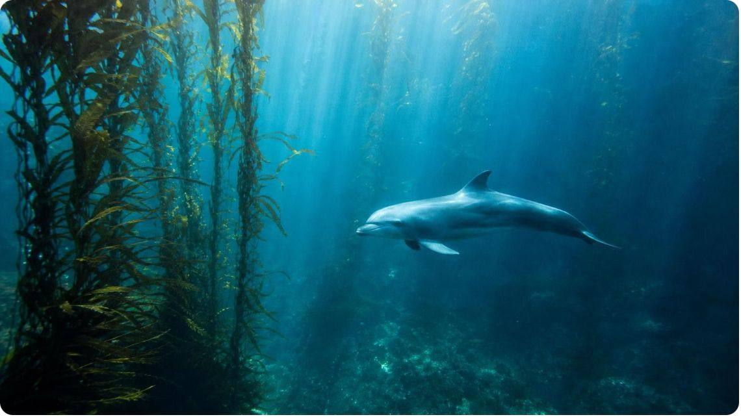
MODEL
Same fuel, different sources
Model: Where producers and consumers get what they need
The middle column is the surprise: a root cell and a muscle cell use the same reaction to release energy.
Producers (oak tree, kelp, grass) | Consumers (squirrel, dolphin, amoeba, mushroom)
Capture light energy and store it in sugar they build | Get sugar and other molecules from the organisms they eat or soak up
Get carbon for their bodies from carbon dioxide in the air | Get every carbon-containing building molecule from food
Get hydrogen for their bodies from water taken up by the roots | Use water they drink as a large part of their bodies
Take small amounts of minerals from soil or water | Cannot build sugar from carbon dioxide and water
5
Notes:
Walk the three columns. Left: a plant's mass is mostly carbon from the air plus hydrogen and oxygen from water; soil supplies minerals in small amounts, which corrects the textbook table that lists soil as a source of plant matter. Right: a consumer drinks water and that water really does become part of its cells, so the book's claim that consumers do not use water to build is too strong; what a consumer cannot do is make carbon-containing molecules from carbon dioxide and water, so those must come from food. Middle: this is the point of the lesson. Both kinds of organism release energy from sugar the same way. Ask students which column the sprouting pea belongs in. It is a producer that, in the dark, is behaving exactly like a consumer of its own stored food.
EXPECTED RESPONSES: Students should be able to say that a plant makes its sugar and a squirrel eats its sugar, but both then use the sugar the same way.
WATCH FOR: 'Plants eat soil' and 'animals are made of what they drink and breathe.' Point to the carbon: it comes from air for plants and from food for animals.
CONNECTS TO: W2 vocabulary; W4 model; Lab 1 analysis question on the seed as its own food source.
PACING: about 6 min

Slide 6
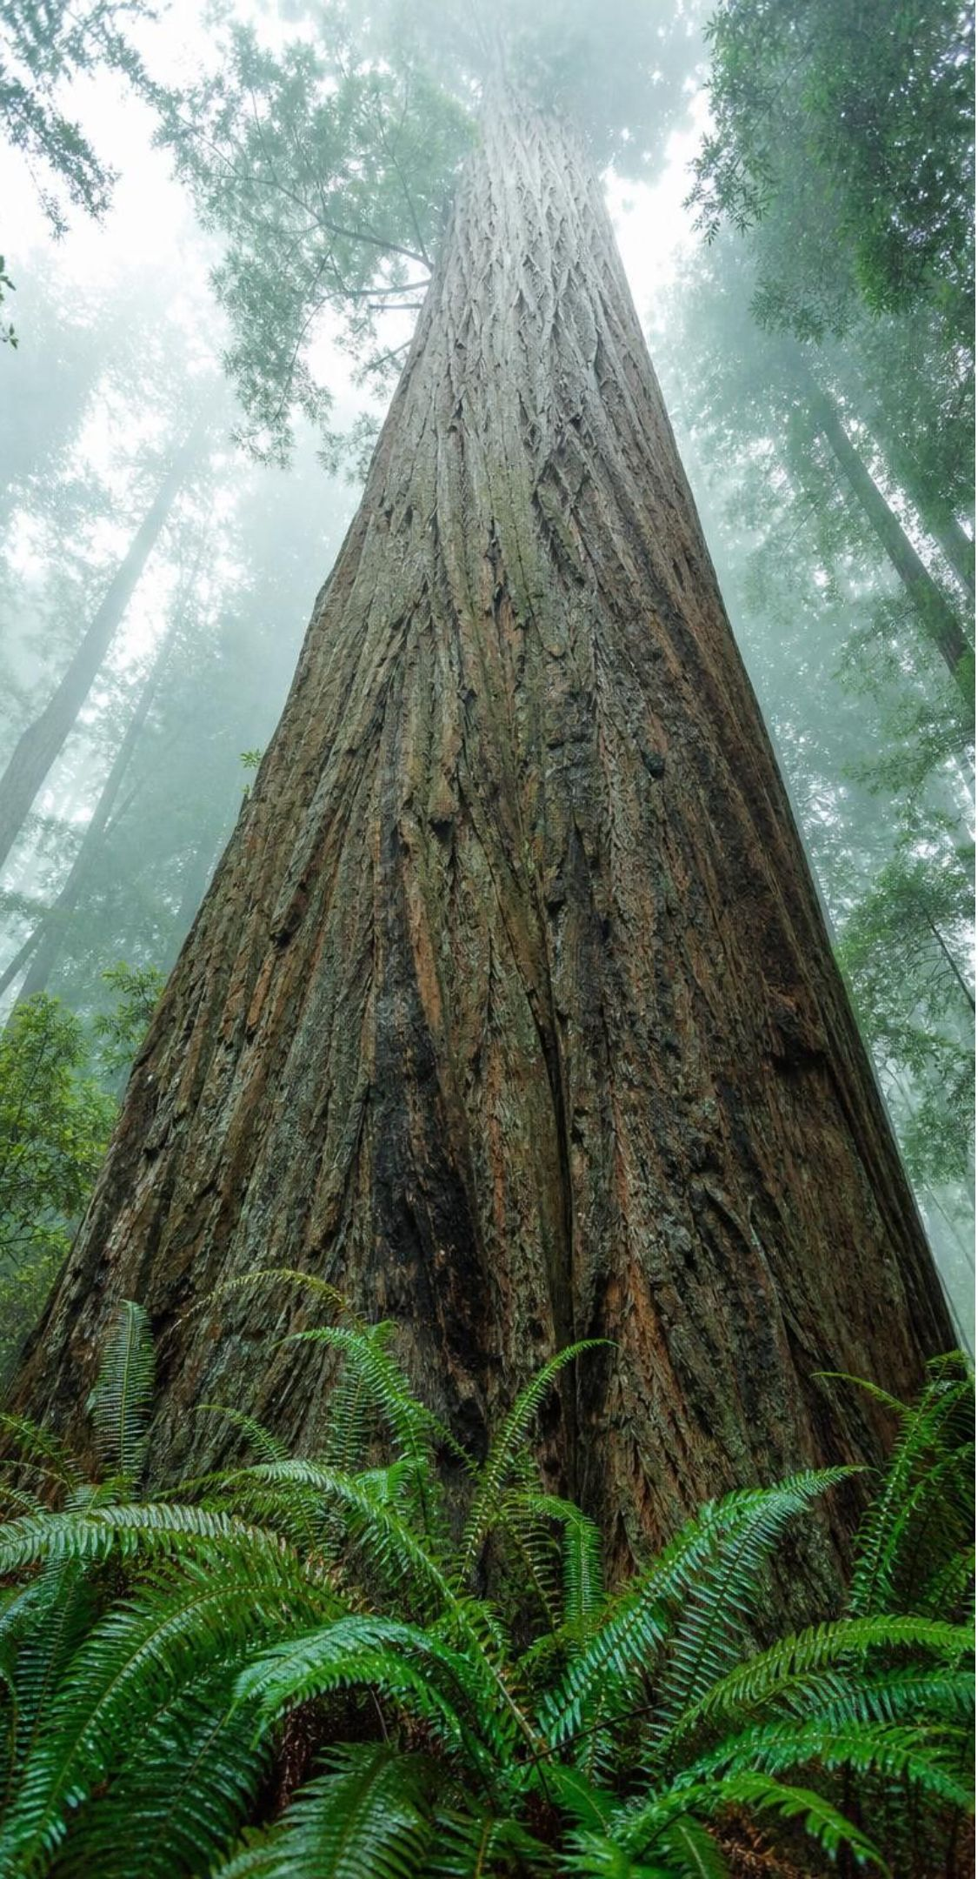
VOCABULARY IN CONTEXT
Three words for where food and energy come from
producer: An organism that makes its own food, most often by building sugar from carbon dioxide and water with light energy. A redwood, a pond alga and a blade of grass are producers.
consumer: An organism that cannot make its own food and must take matter and energy from other living things, by eating them or by soaking up their molecules. A mushroom on a log, a dolphin and an amoeba are all consumers.
chemical energy: Energy held in the arrangement of atoms in a molecule; reactions can store it or release it. An acorn holds enough chemical energy to power a squirrel for hours.
6
Notes:
Have students say the test aloud: 'Does it make its own food? Yes, producer. No, consumer.' Then introduce chemical energy as energy you cannot see but can get out by a reaction; a dry pea on the shelf holds it for years. Ask for everyday examples of chemical energy being released: a candle, a car engine, a glow stick. All are reactions; respiration is one too, but it runs at body temperature in small controlled steps.
WATCH FOR: Students may think chemical energy is a kind of matter stored in the food. It is a property of how the atoms are arranged, not a substance.
CONNECTS TO: W2 vocabulary worksheet builds relationships among these terms.
PACING: about 4 min

Slide 7
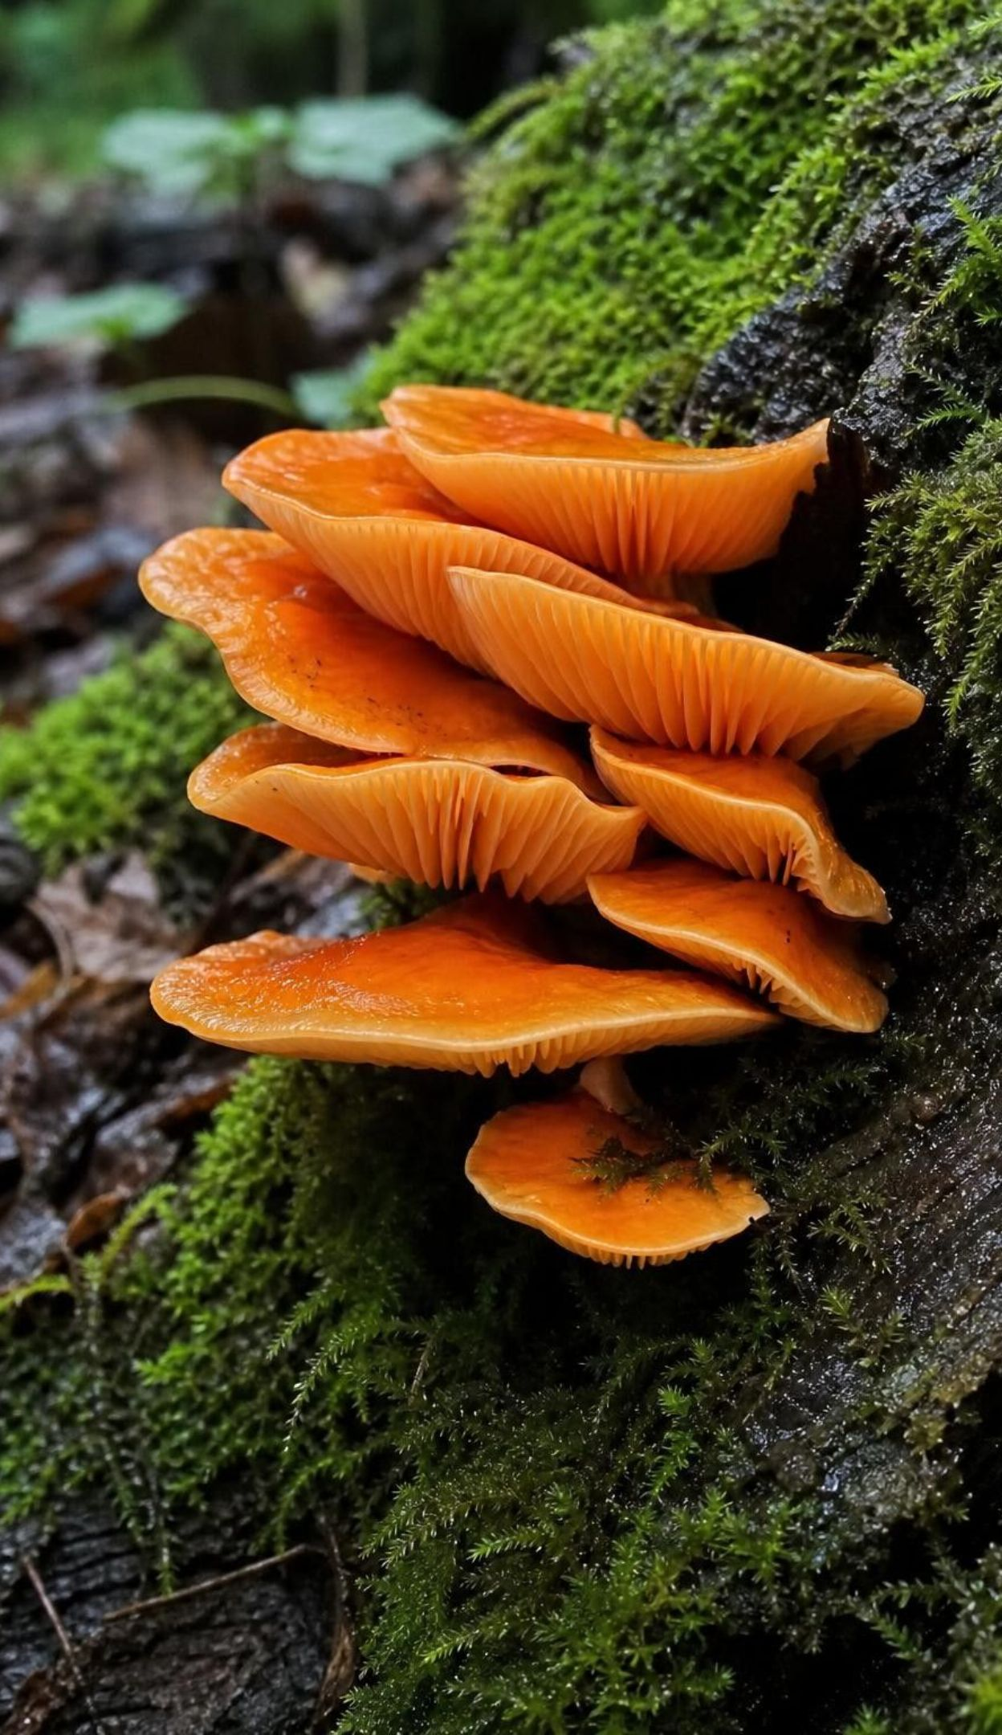
CHECK FOR UNDERSTANDING
Quick check: producer or consumer?
Which organism is a consumer?
A. A bacterium at a deep-sea vent that builds sugar from chemicals, with no light
B. A mushroom absorbing molecules from a rotting log
C. A green alga drifting near the surface of a lake
D. A pea seedling that has just unfolded its first leaves in sunlight
7
Notes:
Vote with fingers, then defend. The vent bacterium makes its own food without light, so it is a producer and shows why the definition is about making food, not about sunlight. The alga and the seedling make sugar with light. The mushroom cannot make food; it absorbs molecules from the log it digests, so it is a consumer without a mouth. Follow up: the same pea seedling the day before it reached light, sprouting in the dark, was living on sugar from its stored starch. Was it a producer then? It is still a producer by kind, but it was running on stored food, which is exactly what consumers do all the time.
EXPECTED RESPONSES: B, the mushroom. Students who pick A are using 'no sunlight' as the test; the test is whether the organism makes its own food.
WATCH FOR: 'Mushrooms are plants' and 'anything that does not use light is a consumer.'
CONNECTS TO: W2 and W10 reuse the producer/consumer test.
PACING: about 4 min

Slide 8
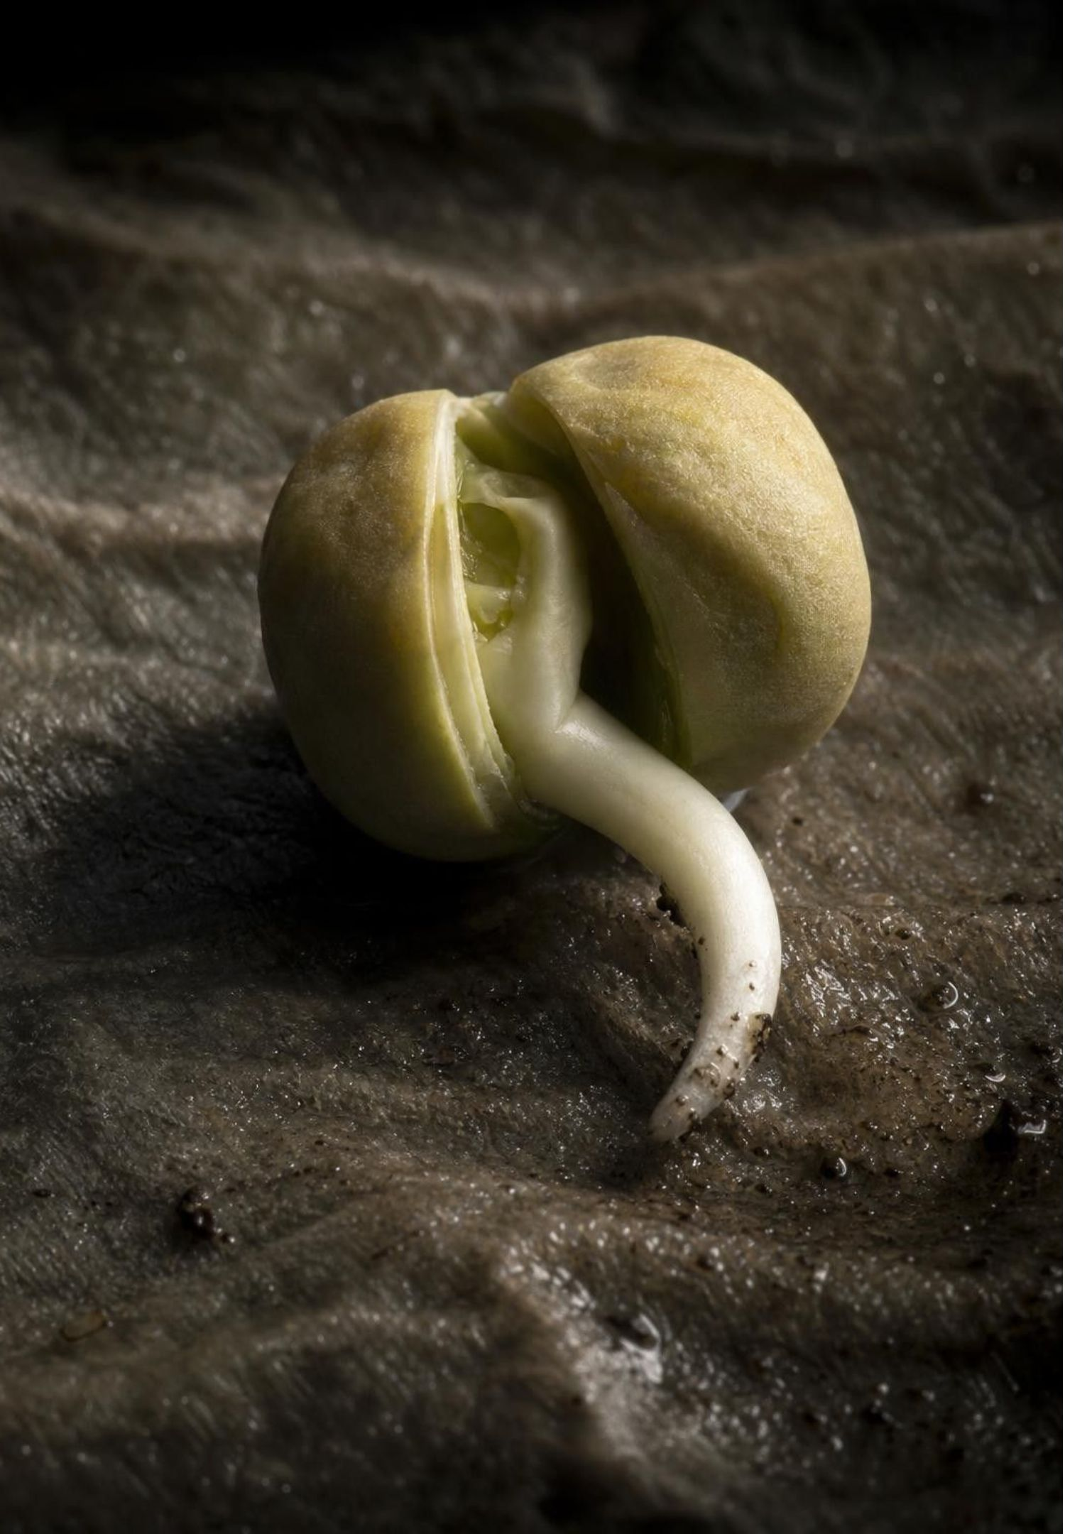
Food is fuel, and every cell needs it
A dry seed can sit for years. Add water and it warms, breathes out a gas, and grows, all in the dark.
The seed stored starch, a chain of sugar units, when its parent plant made it.
Once awake, the seed's cells take sugar apart to release that stored energy.
A root cell, a muscle cell and an amoeba all release energy from sugar the same way.
The name for this process is cellular respiration.
8
Notes:
Connect to the jars. The living seeds had no light, so their energy had to come from inside: the parent plant stored starch in the seed, and the seedling breaks that starch into sugar and runs on it until leaves open. The warmth in the jar is energy that the reaction released but the cells did not capture; the yellow indicator shows a gas product. Make the general claim now: there is no special plant way and animal way of releasing energy; every living cell uses cellular respiration. Tell students the next slide shows the reaction, and that in Lab 2 they will build it with beads.
WATCH FOR: 'The seed got energy from the water.' Water lets the seed's reactions start; it carries no usable chemical energy for the cell.
CONNECTS TO: Lab 1 analysis; W3 reading passage covers the sprouting seed story.
PACING: about 4 min

Slide 9
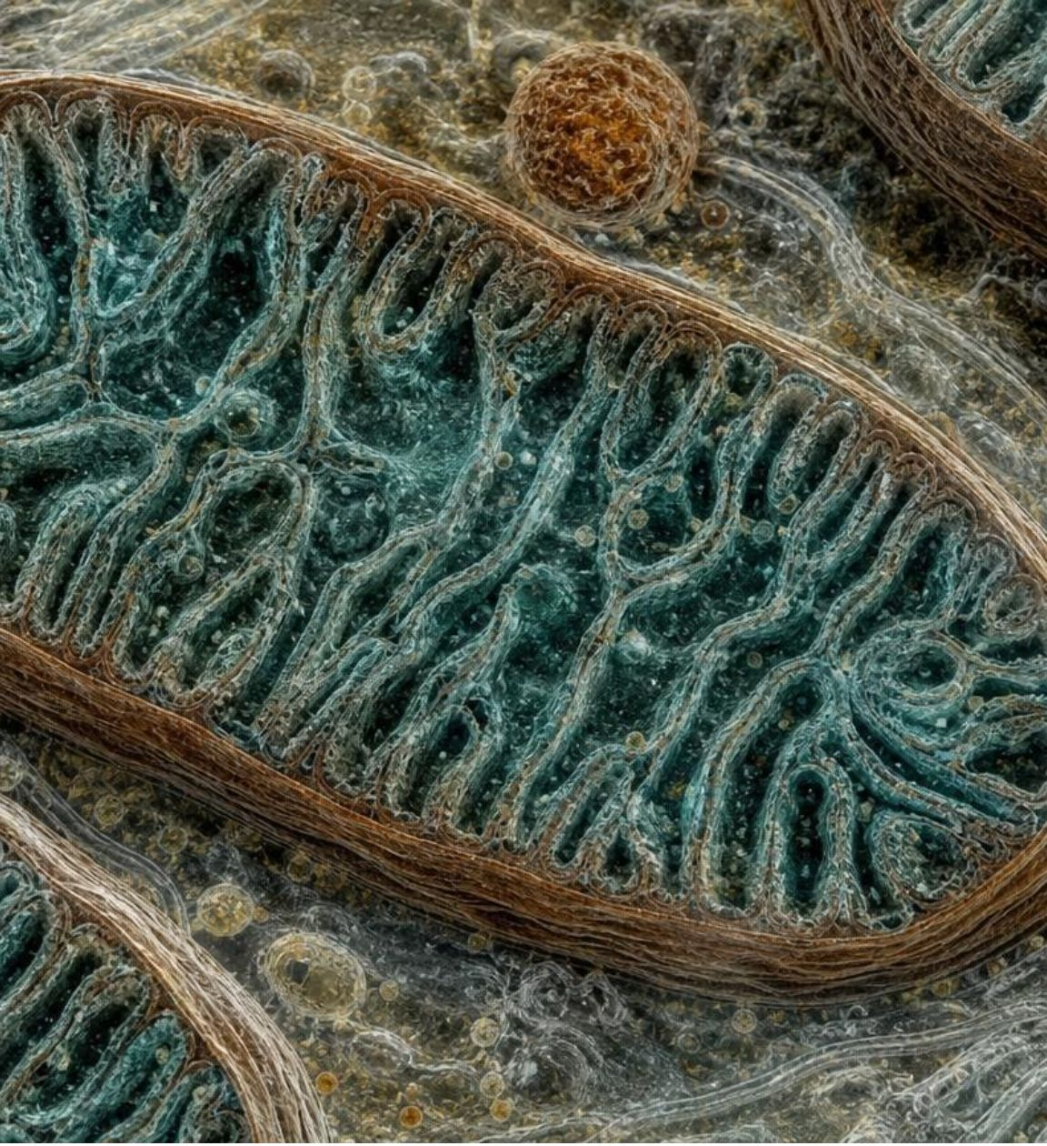
Cellular respiration: one trip through a cell
Model
Model: How a cell releases the energy stored in sugar
Sugar (from food or from stored starch) and oxygen enter the cell →
(take in) Reactions in the cell fluid and, mostly, in mitochondria regroup the atoms with oxygen →
(give off) Carbon dioxide and water leave the cell →
(use) Released energy powers the cell's work; the rest becomes heat
Word equation: sugar + oxygen → carbon dioxide + water + energy. Energy is written with the products because the reaction gives it off.
9
Notes:
Read the flow left to right. Sugar and oxygen are the reactants, carbon dioxide and water are the products, and energy comes out. Be accurate about place: the first stage happens in the cell fluid, and most of the rest happens in mitochondria, which is why we say 'most of respiration is in the mitochondria', not all. Mitochondria are in plant cells, animal cells and many single-celled organisms; bacteria have none and release energy with their whole cell, and mature red blood cells have none either, so avoid 'every cell'. The energy that is not captured warms the organism, which is why the seed jar and a working muscle both get warm. Have students copy the word equation and label reactants and products.
WATCH FOR: 'Energy is a product like carbon dioxide.' Energy is not matter; it is listed on the right to show it is released, but it is not counted with the atoms.
CONNECTS TO: Lab 2 builds this equation with atom tokens; W4 diagram worksheet labels a version of this flow.
PACING: about 6 min

Slide 10
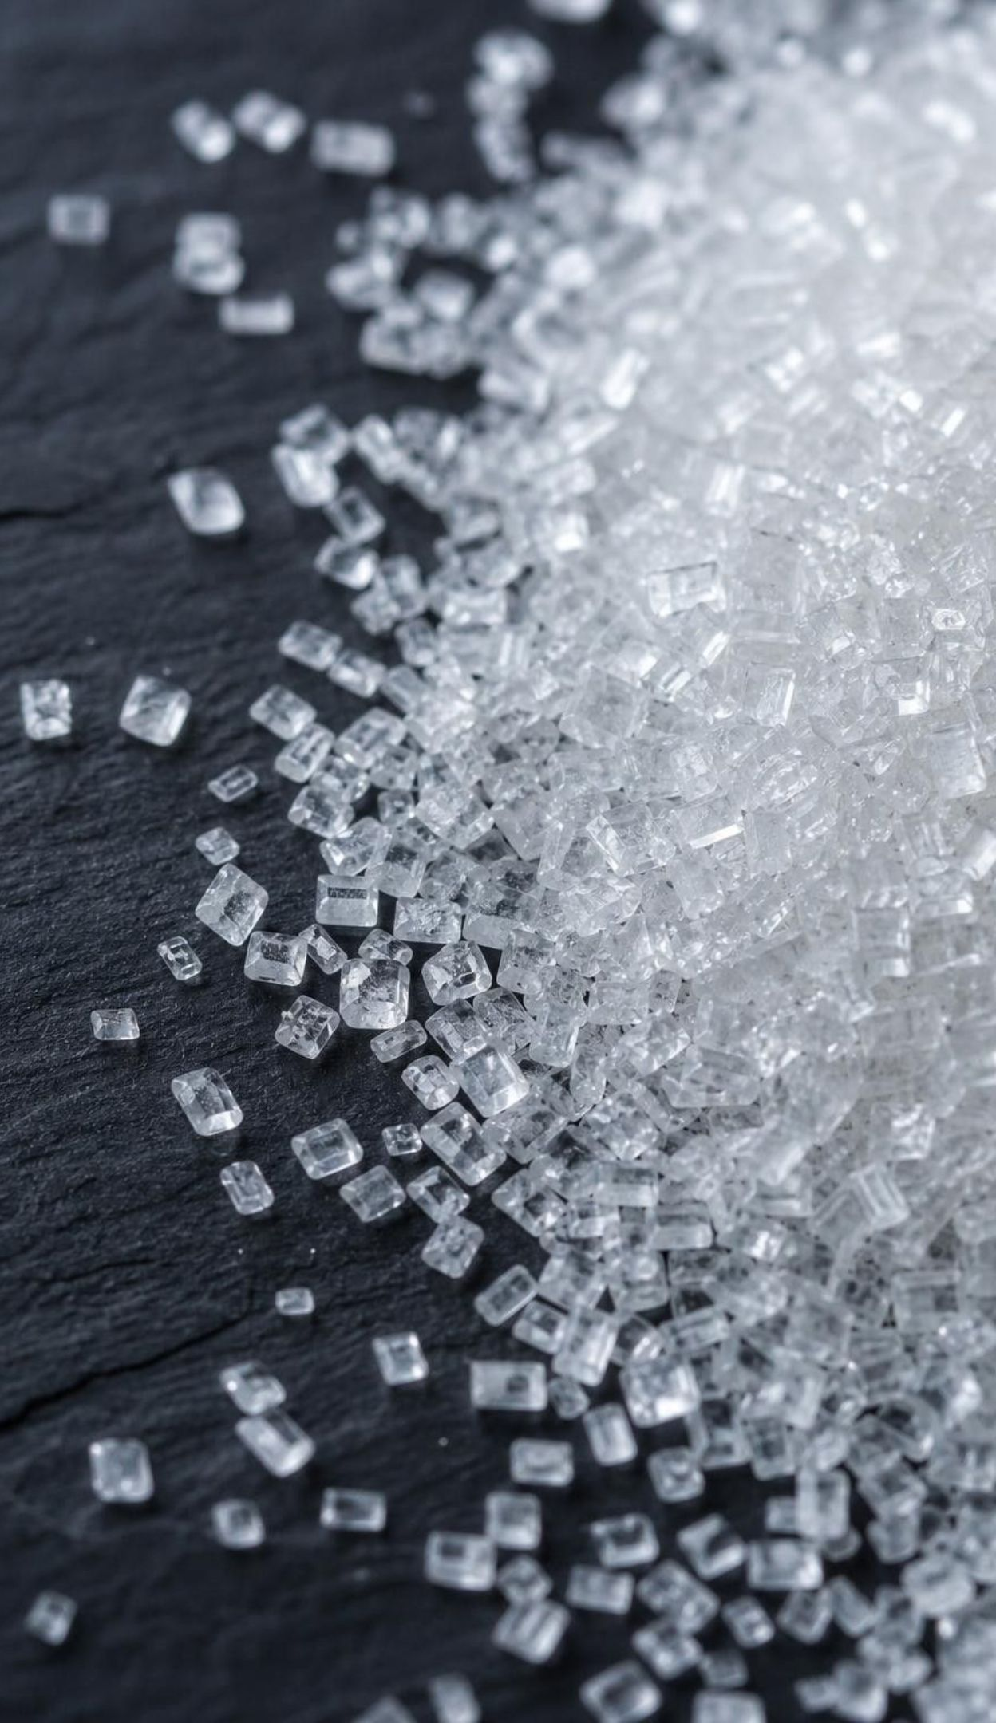
Count the atoms: nothing is lost
One sugar molecule: 6 carbon, 12 hydrogen, 6 oxygen atoms (C₆H₁₂O₆).
Six oxygen molecules add 12 more oxygen atoms (6 O₂).
In: 6 C, 12 H, 18 O. That is 36 atoms.
Out: six CO₂ (6 C, 12 O) and six H₂O (12 H, 6 O). Also 36 atoms: 6 C, 12 H, 18 O.
Every atom that went in comes out in a new partner. Mass in equals mass out.
10
Notes:
Do the count slowly on the board with three colors, and have students count with you. The sugar's six carbons each leave in a carbon dioxide; the sugar's twelve hydrogens each leave in water; the eighteen oxygens are shared between the two products. Then make the point that matters most for the week: the atoms did not become energy. Food's mass leaves the body as carbon dioxide you breathe out and water. If a student asks about weight loss, this is where body fat goes: most of it exits through the lungs as carbon dioxide. Tell them Lab 2 will check this with a balance.
EXPECTED RESPONSES: Students should be able to say where the sugar's carbon ends up (carbon dioxide) and where its hydrogen ends up (water).
WATCH FOR: 'The sugar turns into energy.' Atoms are conserved; the rearrangement releases energy but the atoms all remain.
CONNECTS TO: Lab 2 atom inventory; W4; W5 uses dry-mass data to show where seed mass goes.
PACING: about 5 min

Slide 11
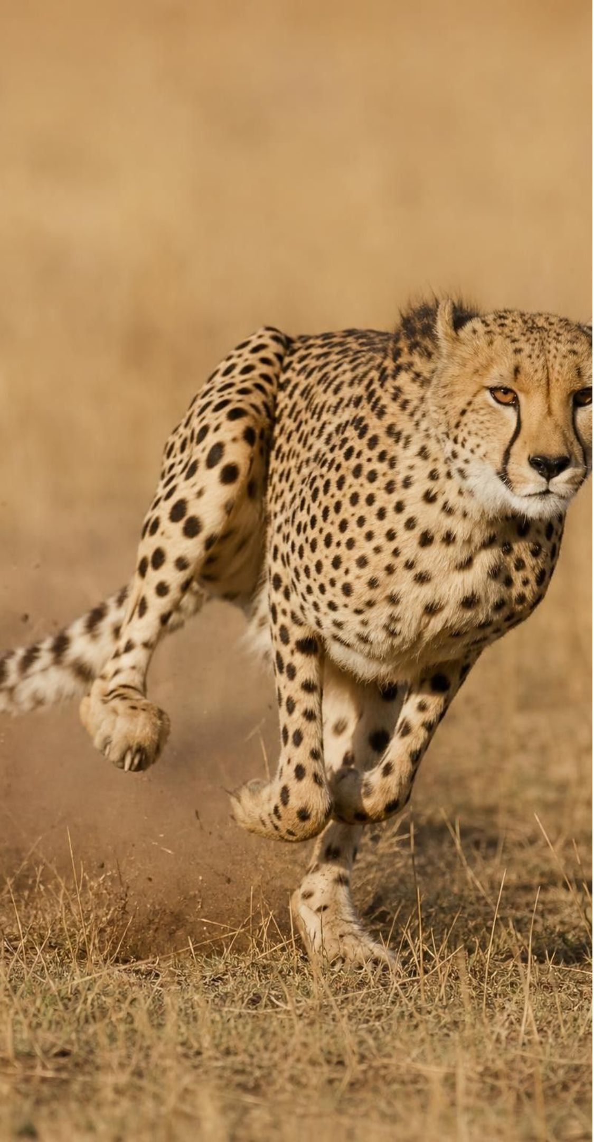
VOCABULARY IN CONTEXT
The words of the reaction
cellular respiration: The chain of reactions in cells that combines sugar with oxygen, making carbon dioxide and water and releasing usable energy. A sprouting pea, a sprinting cheetah and a yeast cell all carry out cellular respiration.
mitochondrion: A structure inside a cell where most of cellular respiration happens (plural: mitochondria). Heart muscle cells hold thousands of mitochondria because they never rest.
reactant and product: A reactant goes into a reaction and is changed; a product is what the reaction makes. In respiration the reactants are sugar and oxygen; the products are carbon dioxide and water.
11
Notes:
Say 'reactants in, products out' and have students point to each in the word equation. Mitochondrion is singular, mitochondria plural; students will see both. Ask where a cell that works hard, such as heart muscle, would need more mitochondria, and why a mature red blood cell, which just carries oxygen, has none. Then ask the question that leads into the next slide: the word respiration sounds like breathing; are they the same thing? Collect first guesses without correcting.
WATCH FOR: 'Mitochondria make energy.' They release energy that was already stored in sugar; nothing makes energy.
CONNECTS TO: W2 vocabulary; W10 mastery.
PACING: about 4 min

Slide 12
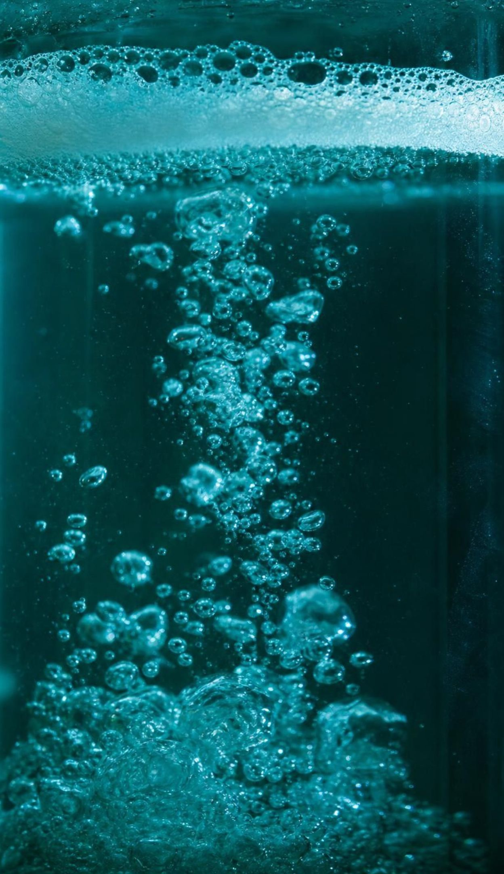
CHECK FOR UNDERSTANDING
Quick check: where do the atoms go?
A cell takes apart two sugar molecules by cellular respiration. How many carbon dioxide molecules leave, and how many oxygen molecules were needed?
A. 6 carbon dioxide; 6 oxygen
B. 12 carbon dioxide; 12 oxygen
C. 12 carbon dioxide; 6 oxygen
D. 2 carbon dioxide; 2 oxygen
12
Notes:
Give two minutes on whiteboards. One sugar gives six carbon dioxide and uses six oxygen molecules, so two sugars give twelve and use twelve. Students who answer C have doubled the product but not the reactant; ask them to count the carbons: twelve carbons need twelve carbon dioxide, and twelve carbon dioxide hold twenty-four oxygen atoms, which with the twelve in the water must come from the two sugars (12) and the oxygen gas (24, which is twelve O₂).
EXPECTED RESPONSES: B: 12 carbon dioxide and 12 oxygen molecules. Reasoning: each sugar has 6 carbons and each carbon leaves in its own carbon dioxide; the equation scales up as a whole.
WATCH FOR: Treating the equation as one-off rather than a ratio. Lab 2 includes a scaling step for exactly this.
CONNECTS TO: Lab 2 scaling step; W5 data worksheet ratios.
PACING: about 4 min

Slide 13
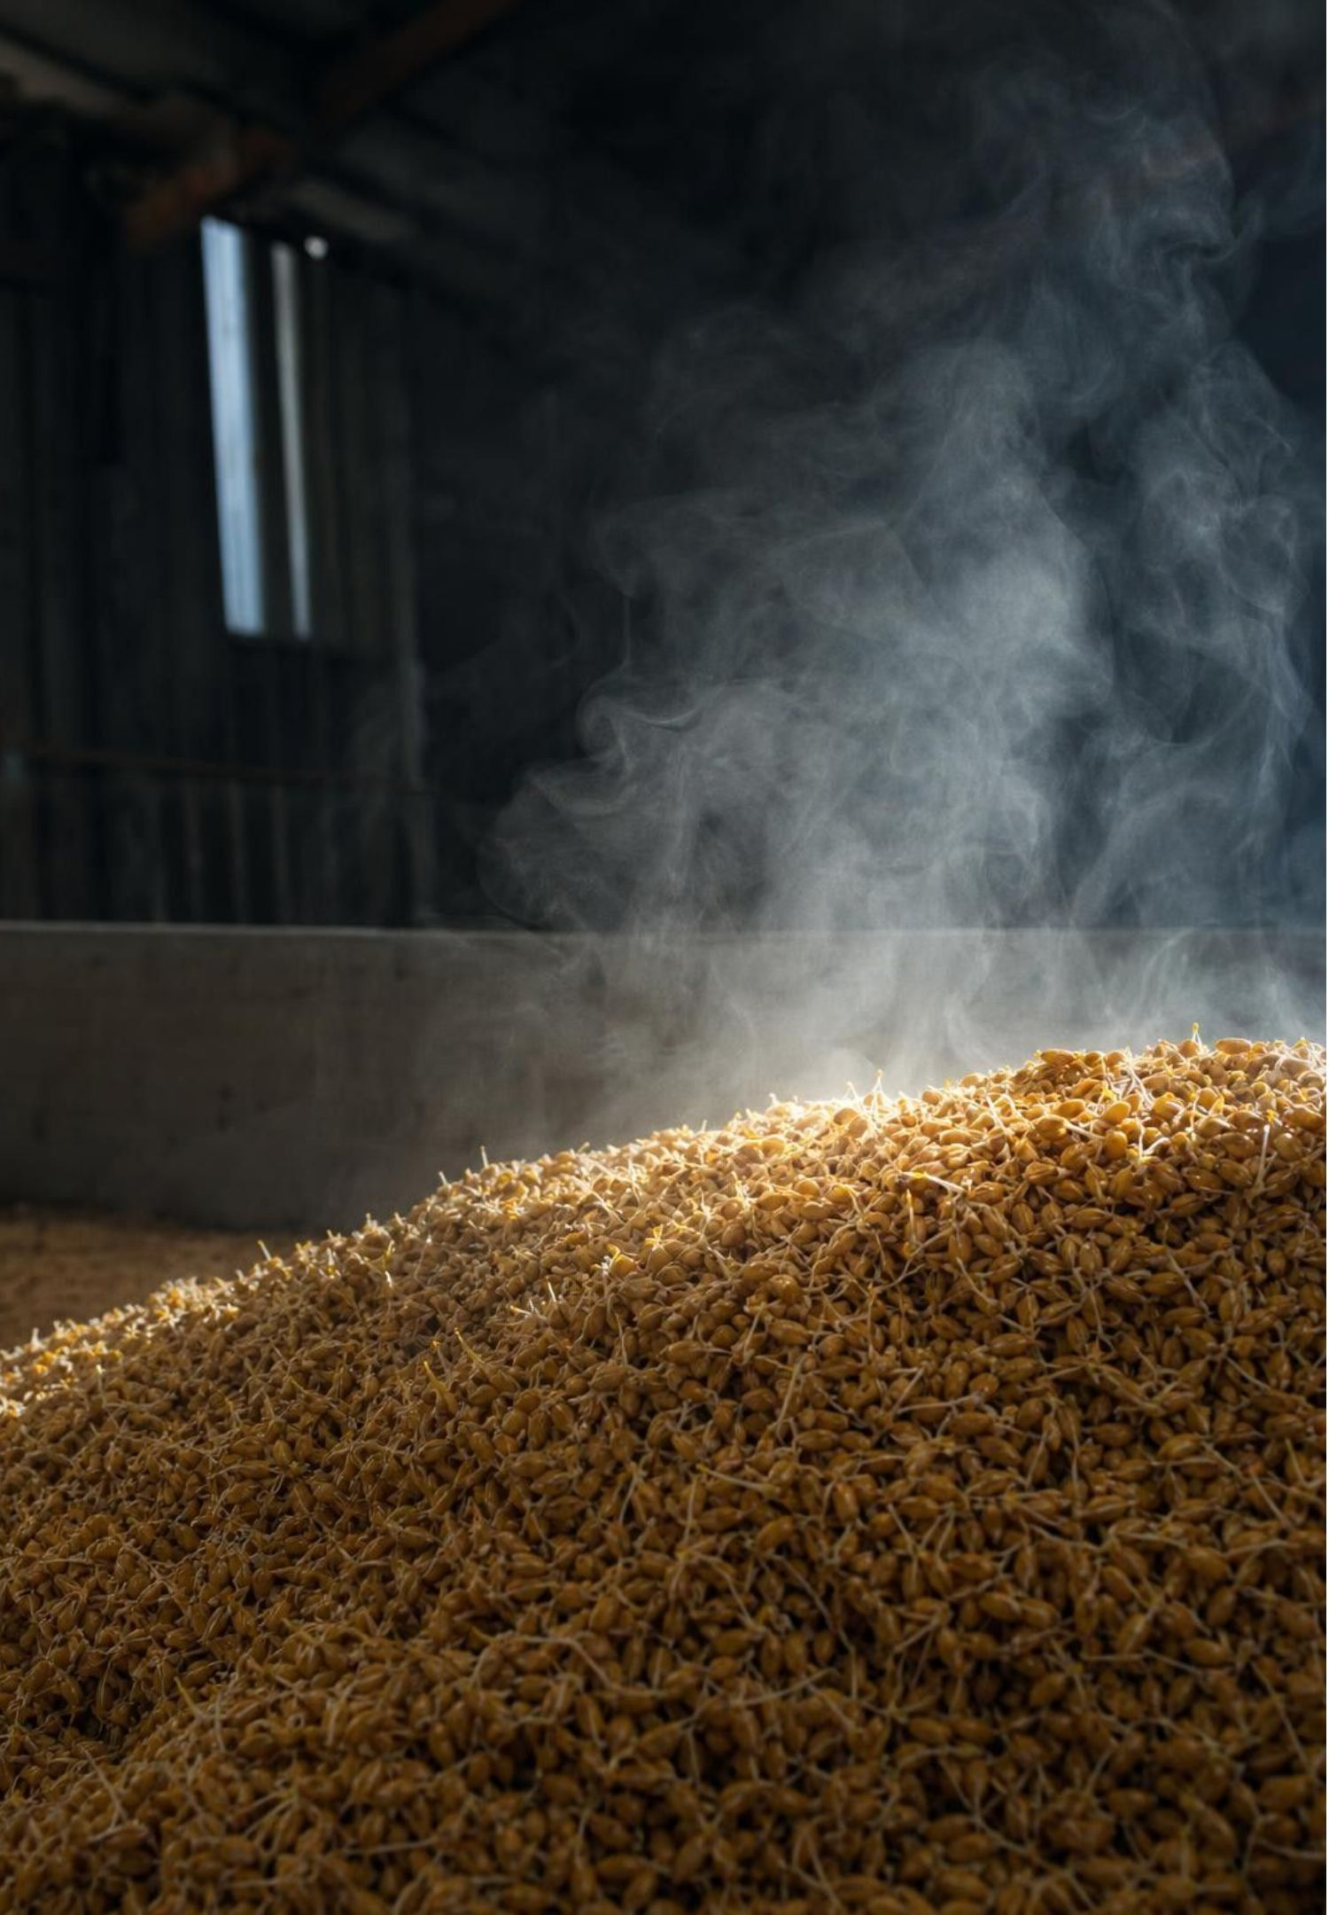
Where does the energy really come from?
Sugar and oxygen together hold more chemical energy than carbon dioxide and water do.
Taking molecules apart always costs energy; forming the new, stronger bonds gives energy back.
The reaction comes out ahead, so energy is released overall. Nothing created it.
Cells capture part of that energy for their work; the rest leaves as heat.
That heat is what warmed the seed jar and what warms you when you run.
13
Notes:
The textbook says energy is stored in the bonds of sugar and released when the molecule is broken. That is a shortcut that misleads later: breaking any bond costs energy. The honest picture at this level is that the starting molecules hold more energy than the ending ones, and the difference is given off. Use a hill: sugar and oxygen sit high, carbon dioxide and water sit low, and respiration lets the system roll down in small controlled steps instead of all at once like a fire. Also replace 'cells generate energy' with 'cells release energy'. Finally, ask why a plant stores light energy in sugar instead of using light directly for everything: sugar can travel to roots and work at night; light cannot.
WATCH FOR: 'Breaking bonds releases energy' and 'respiration makes energy.' Both are in the book; use 'released by the reaction' and 'converted'.
CONNECTS TO: W7 misconception repair includes the 'makes energy' error; W3 reading.
PACING: about 5 min

Slide 14
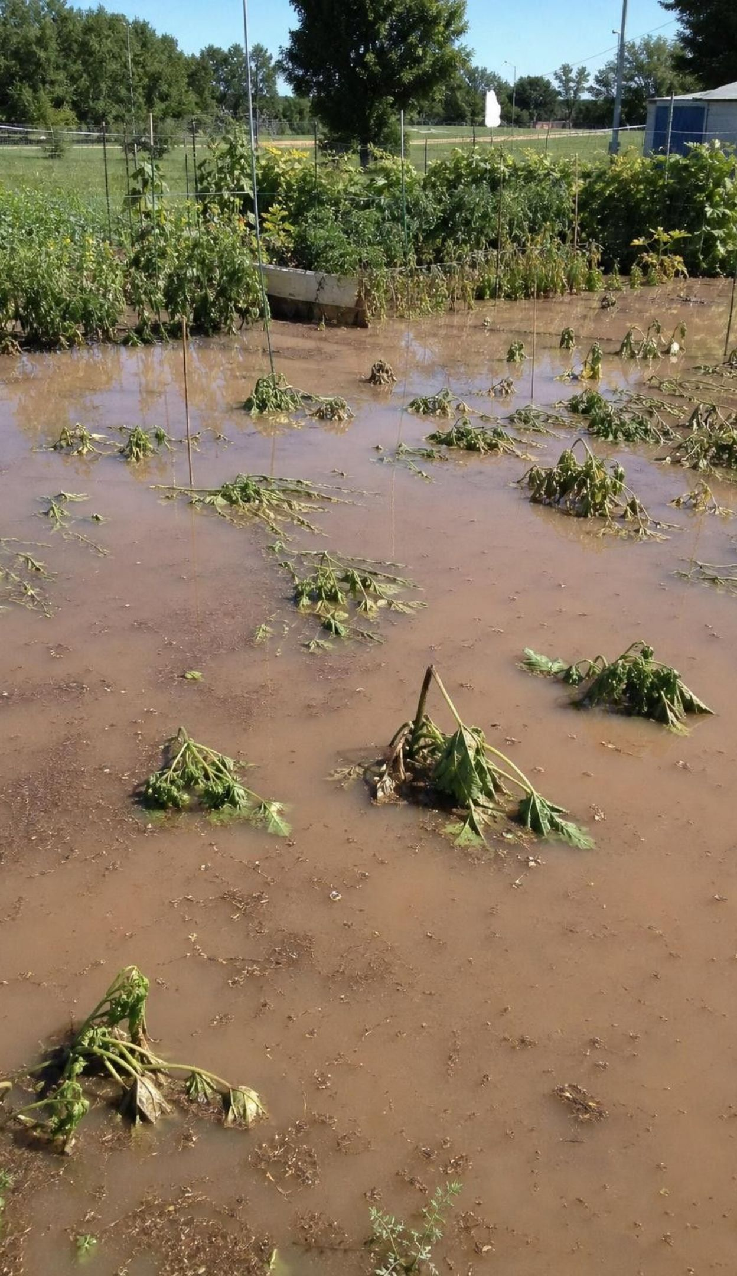
Think, pair, share
Discuss: do plants breathe?
Sprouting seeds in a dark jar give off carbon dioxide and warm up with no light at all.
A root in waterlogged soil cannot get oxygen and dies, even in full sun.
A leaf at night makes no oxygen, yet its cells keep working.
Plants have no lungs, but gases pass in and out through tiny pores and through root surfaces.
A classmate says plants do not need oxygen because photosynthesis makes all the oxygen they need. Use the seed jars and a flooded garden to argue for or against.
14
Notes:
Pairs take opposite sides for two minutes, then switch. The claim on the slide is close to what the textbook says, so tell students the book oversimplified here. A sunlit leaf does make more oxygen than it uses, but roots, seeds, fruits and every cell at night make none and must take oxygen from the air or soil. The flooded garden is the clincher: houseplants drown when overwatered because their roots run out of oxygen. Land the distinction: breathing is moving air in and out of lungs or gills; cellular respiration is the reaction inside cells. Plants respire without breathing, and so do yeast and amoebas. Keep 'plants breathe' off the board; say 'plants exchange gases'.
EXPECTED RESPONSES: Against the claim: seeds respire in the dark with no photosynthesis; roots drown; night leaves need oxygen. For the claim, the only defensible part: a green cell in bright light produces more oxygen than it uses at that moment. Synthesis: every living plant cell respires all the time and takes in oxygen whenever it is not making its own.
CONNECTS TO: Lab 1 analysis questions; W7 misconception repair; W6 CER evidence.
PACING: about 7 min

Slide 15
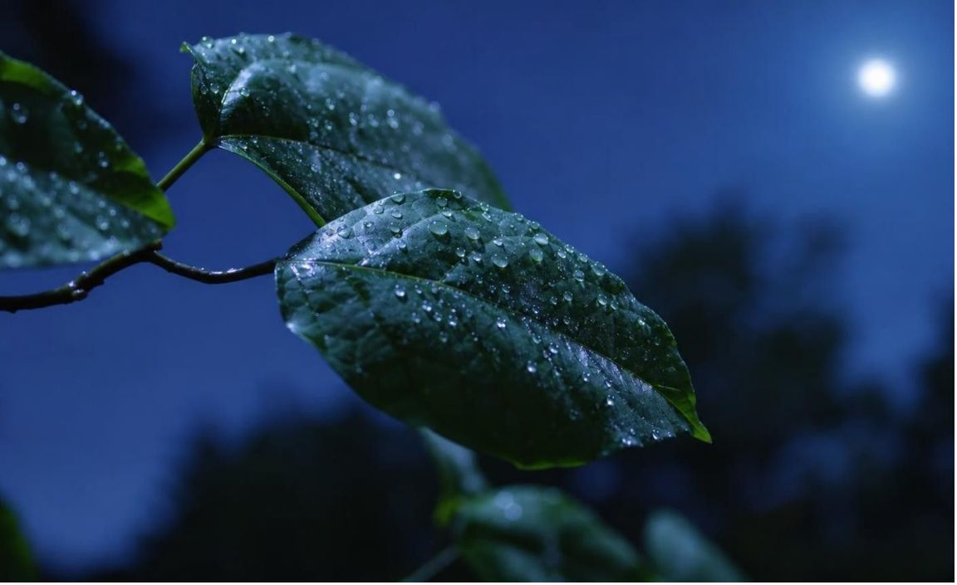
MODEL
Where a plant respires: everywhere, all the time
Model: Four places in one plant
Leaf in sunlight: Photosynthesis makes sugar and oxygen; respiration runs at the same time, using some of each.
Leaf at night: No photosynthesis. Respiration continues; the leaf takes in oxygen and gives off carbon dioxide.
Root in soil: No light ever. Lives on sugar sent down from the leaves; takes oxygen from air spaces in the soil.
Sprouting seed: No leaves yet. Runs on stored starch and oxygen from the air until its first leaves open.
Ripening fruit: Keeps respiring after picking, which is why harvested produce warms and spoils.
Photosynthesis happens only in green cells with light. Cellular respiration happens in every living cell, day and night.
15
Notes:
Point to each location and ask two questions: is photosynthesis happening here, and is respiration happening here? The answers are yes/yes for the sunlit leaf and no/yes for everything else. The sugar for roots and seeds was made elsewhere or earlier, which is why a plant stores energy in sugar and starch in the first place. The fruit entry sets up the next slide. If asked how gases get in without lungs: through tiny pores in leaves and stems and across the thin surfaces of roots; it works because plants are built thin and spread out, and it is why a root sealed in water suffocates.
EXPECTED RESPONSES: Students should state that respiration is yes in all five places and photosynthesis yes in only the first.
WATCH FOR: 'Plants photosynthesize by day and respire by night.' Respiration never stops; photosynthesis is added on top in light.
CONNECTS TO: W4 diagram worksheet; W8 cards on roots and night leaves.
PACING: about 5 min

Slide 16
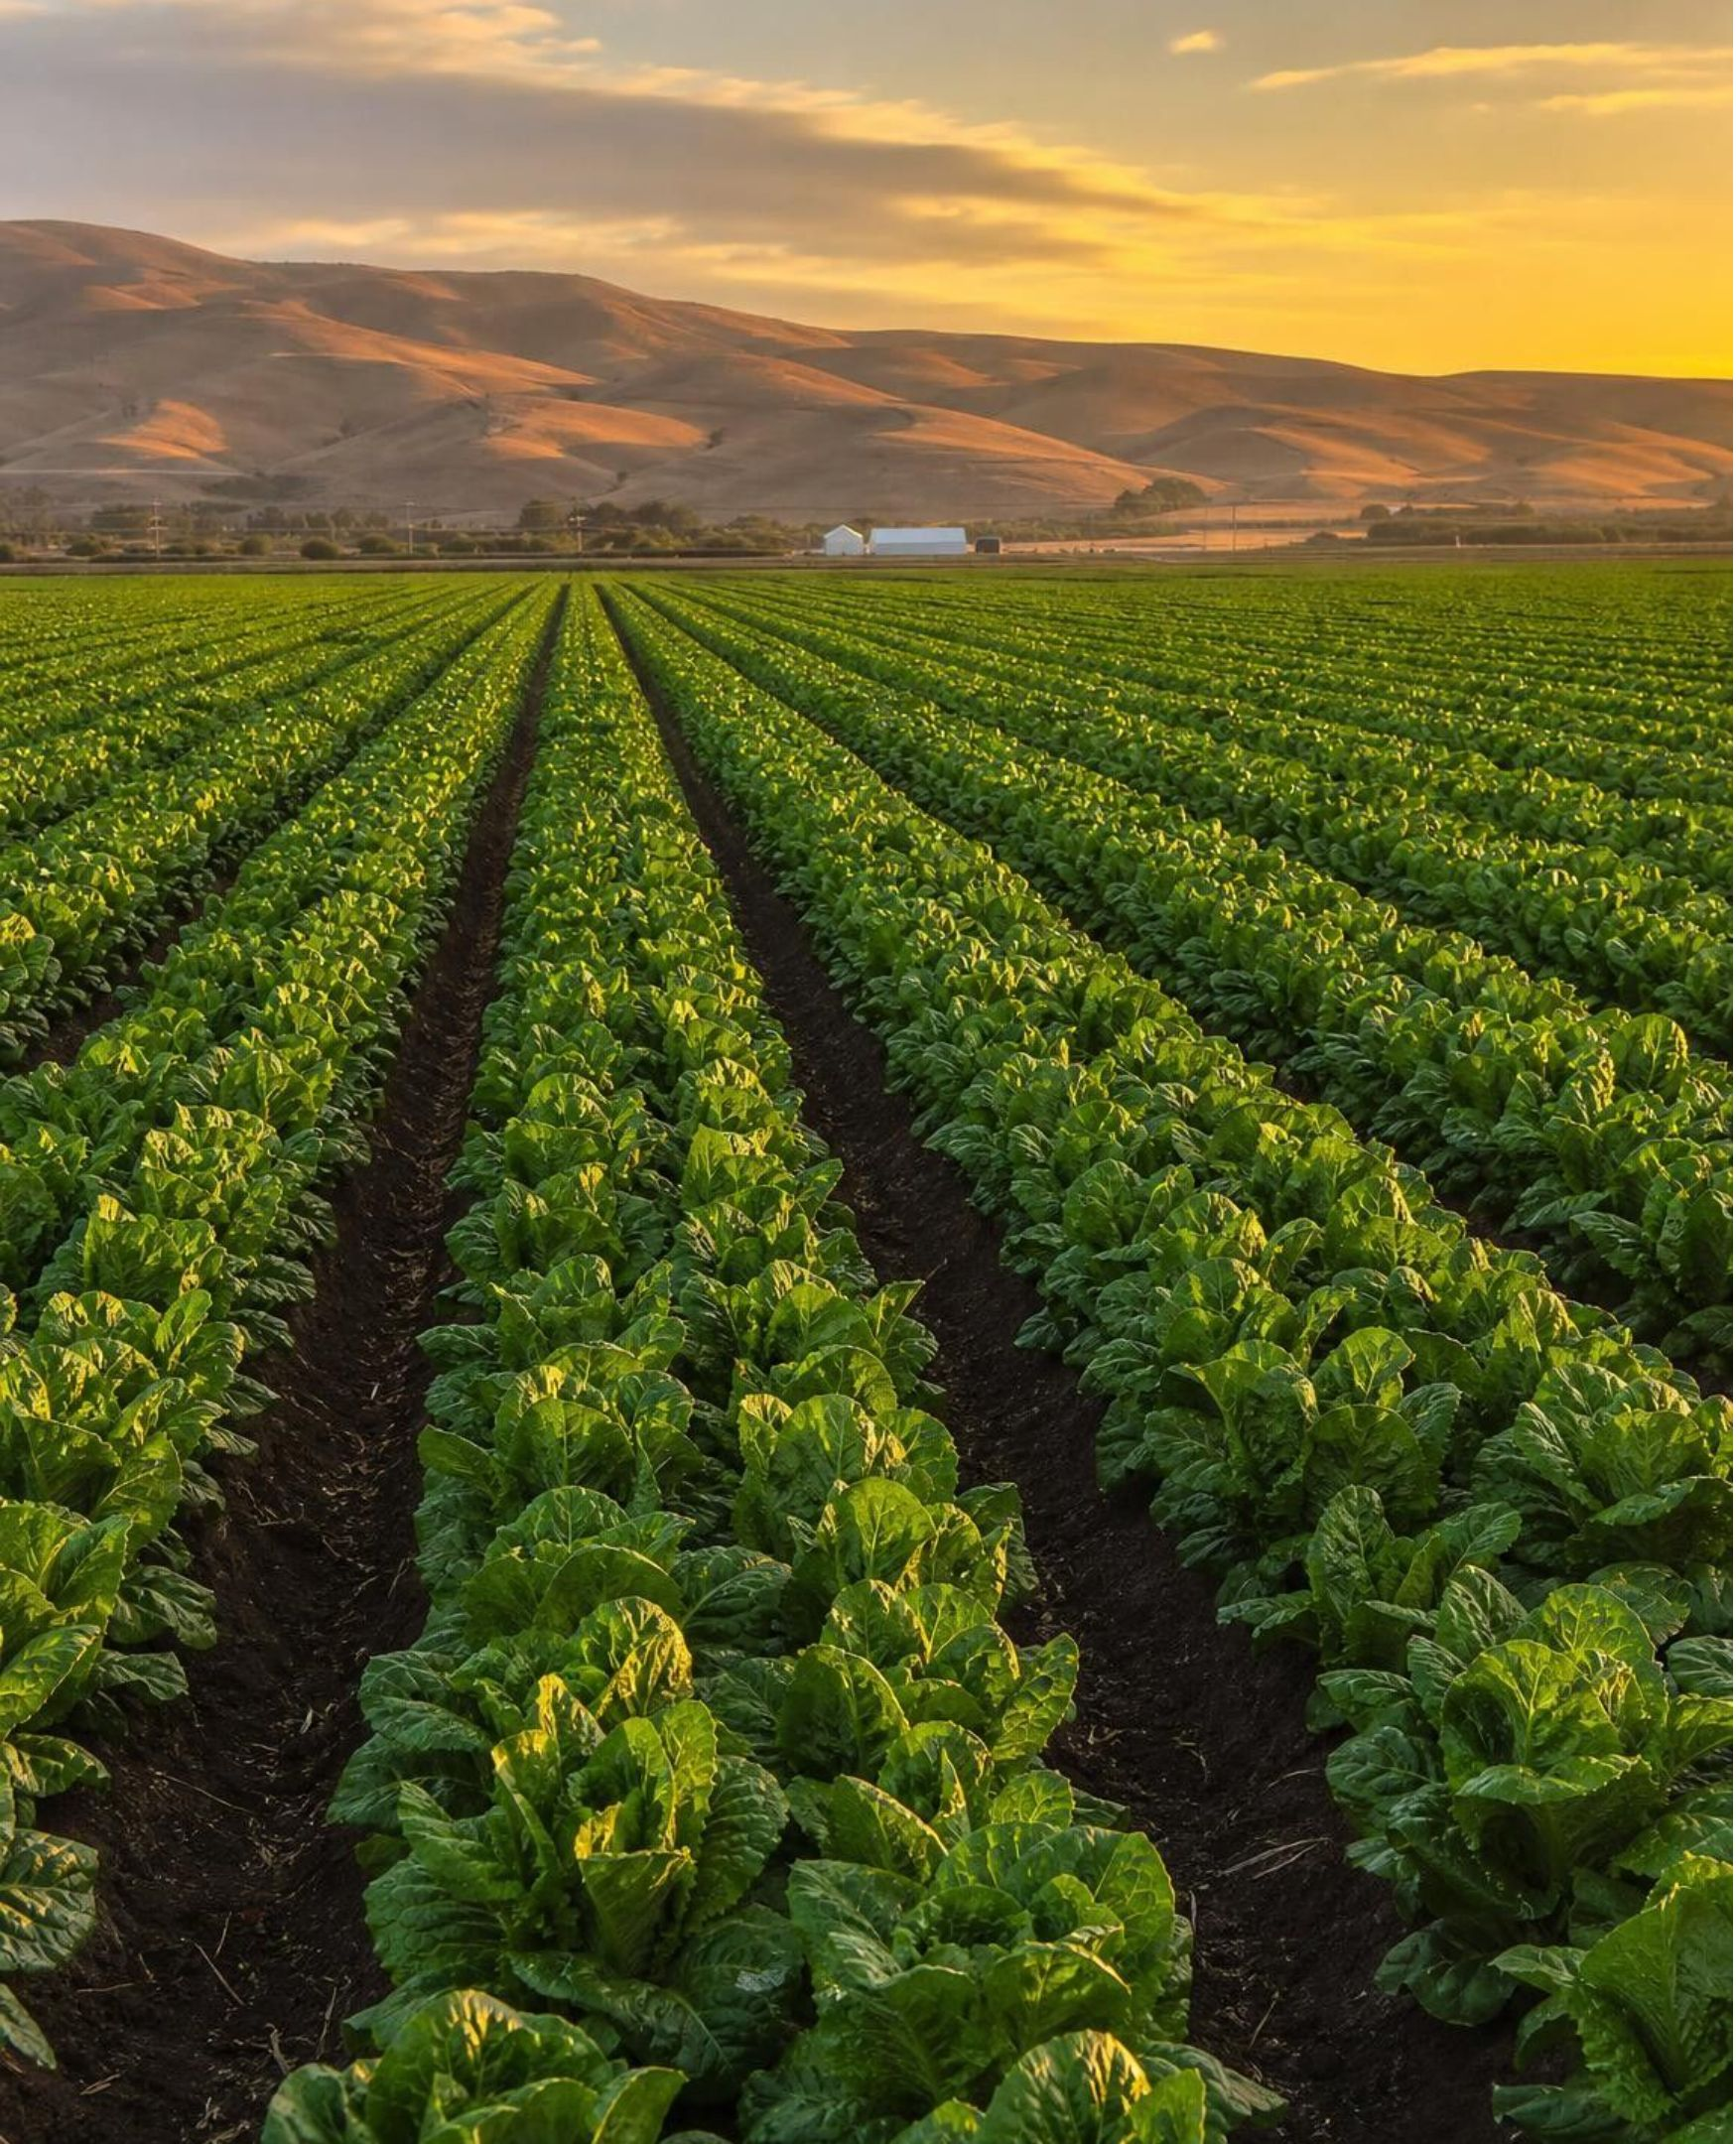
REAL-WORLD CONNECTION
California connection: lettuce that must be cooled fast
The Salinas Valley grows a large share of the lettuce eaten in the United States. A head of lettuce keeps respiring after it is cut: its cells go on using stored sugar and oxygen and giving off carbon dioxide and heat. Left in a warm field, the crop warms itself and spoils in days. So growers rush it into vacuum coolers that chill it within an hour, slowing respiration so the leaves stay crisp for the trip to stores.
16
Notes:
This is a true and local example of the lesson's idea: harvested produce is still alive, cell by cell, and respiration is the reason it warms, loses sugar and spoils. Cold slows reactions, including respiration, which is why a refrigerator keeps lettuce longer than a counter. Ask: why is a pile of freshly cut lettuce warmer in the middle than at the edges? The same reason the seed jar warmed. Ask: when you store an apple for months, is it losing mass? Yes, a little, as carbon dioxide and water. If you have time, connect to the sprouting seeds: a stored seed is doing the same thing extremely slowly, and seed banks keep seeds cold and dry to slow it further.
CONNECTS TO: W3 reading passage; extension prompt in chapter differentiation; Lab 1 debrief.
PACING: about 4 min

Slide 17
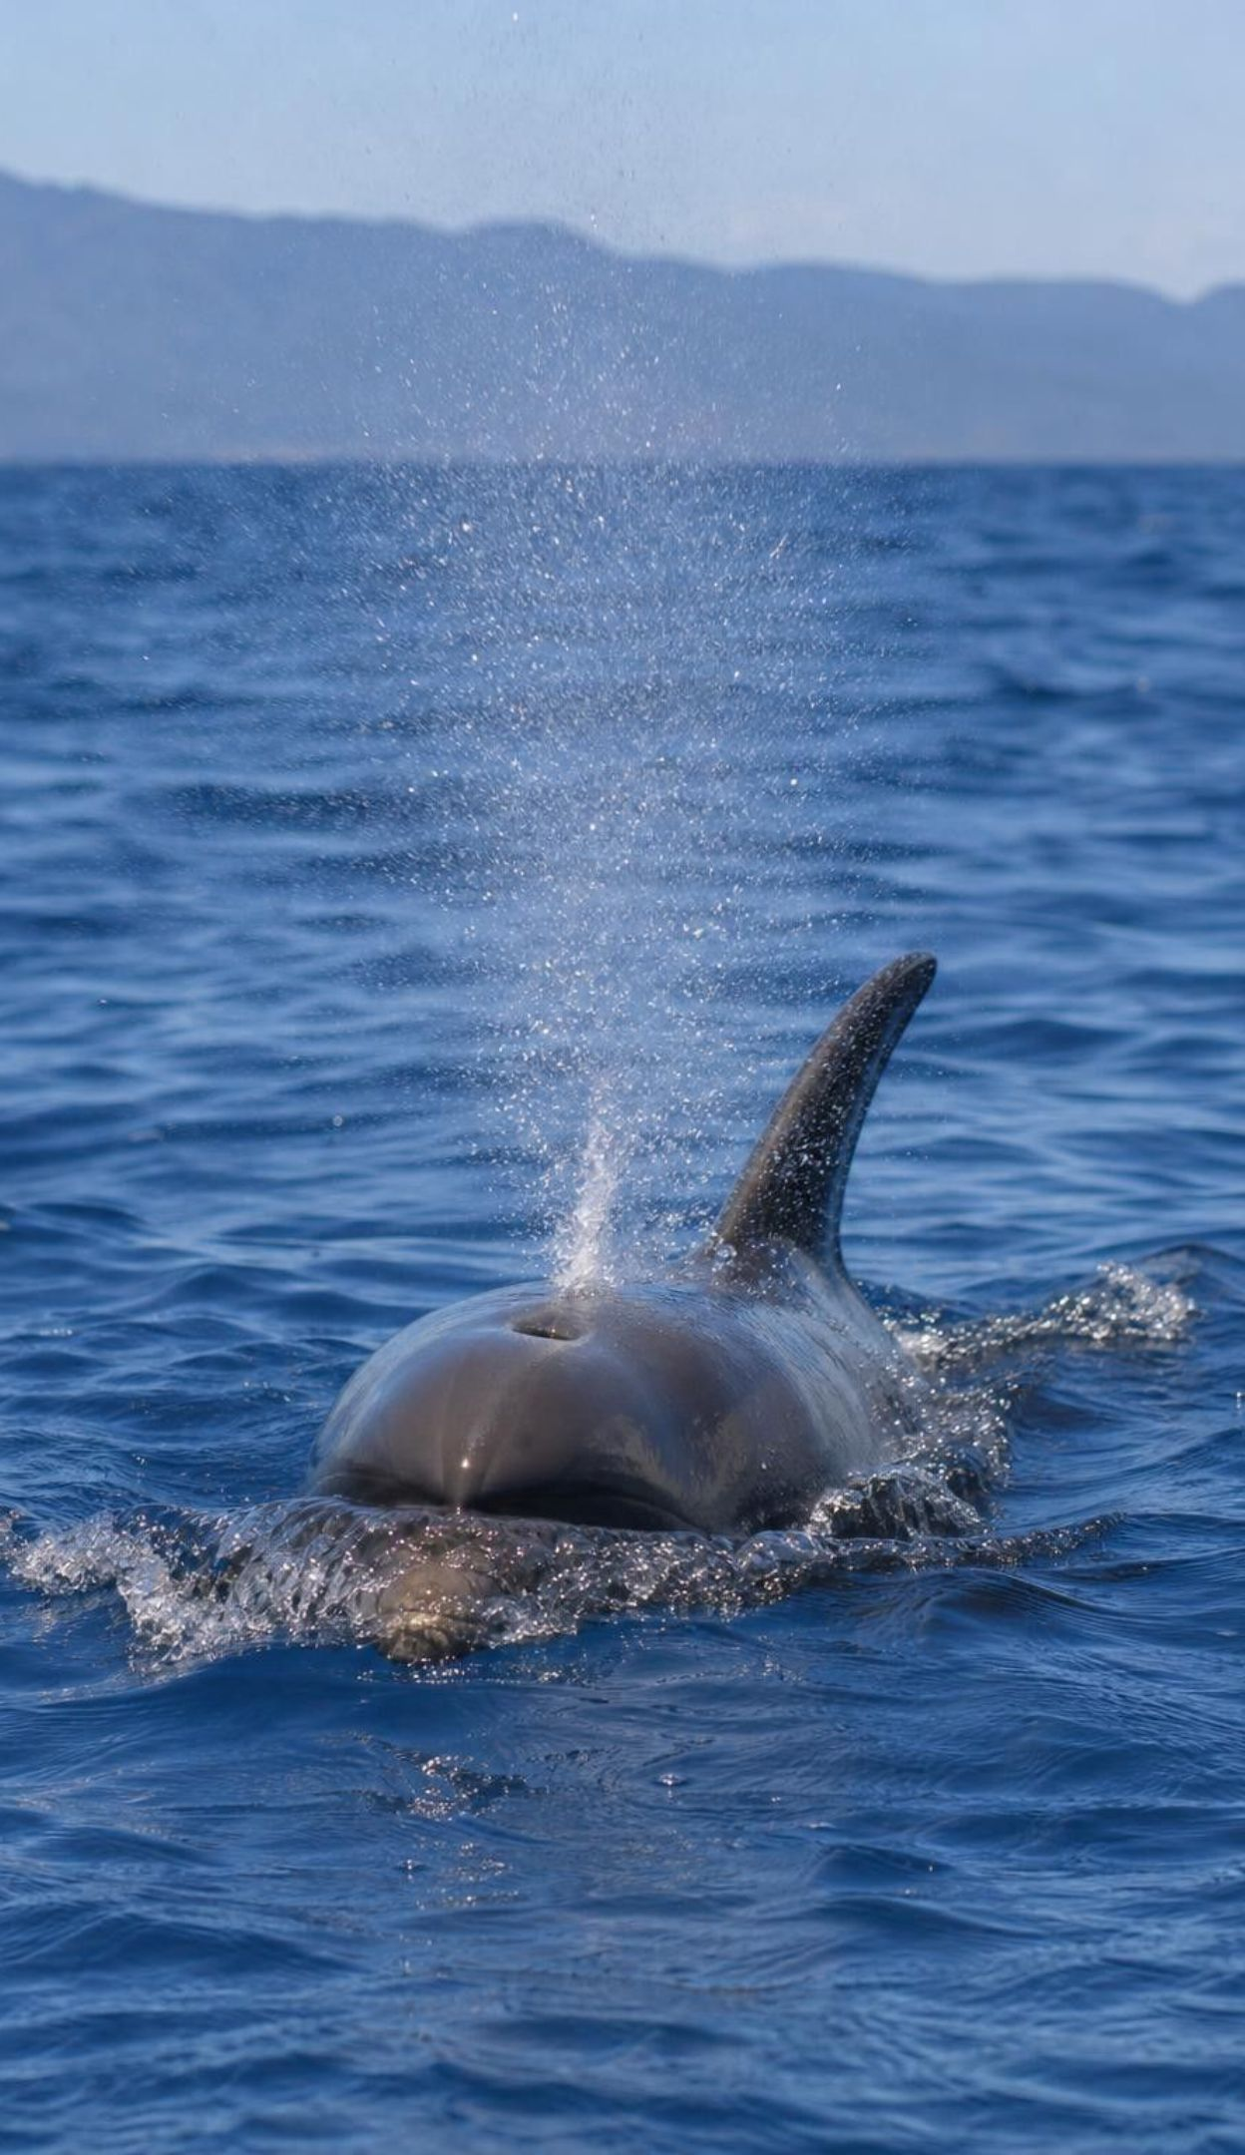
CHECK FOR UNDERSTANDING
Quick check: breathing or cellular respiration?
1
Air moves into the lungs and back out.
2
Sugar and oxygen are rearranged into carbon dioxide and water inside a cell.
3
A yeast cell in bread dough releases energy from sugar and gives off a gas.
4
A root cell takes oxygen from the soil and uses it to release energy.
5
A dolphin surfaces and takes a gulp of air through its blowhole.
Decide for each statement: is it about breathing (B) or about cellular respiration (R)?
17
Notes:
Run it fast, one statement at a time with a reason from one student. Statements 1 and 5 are breathing; 2, 3 and 4 are cellular respiration. Statement 3 is the useful one: yeast is a single cell with no lungs, yet it releases energy from sugar. (In dough yeast gets little oxygen and uses a different route that still releases energy and gives off carbon dioxide; mention it only if a student asks.) Close with the relationship: breathing exists to deliver oxygen to, and remove carbon dioxide from, cellular respiration.
EXPECTED RESPONSES: 1 B, 2 R, 3 R, 4 R, 5 B.
WATCH FOR: Marking the yeast or root statement as breathing because gas is exchanged. Gas exchange without lungs is not breathing in the sense of the lesson.
CONNECTS TO: Lab 3 analysis separates the two; W7 misconception repair.
PACING: about 4 min

Slide 18
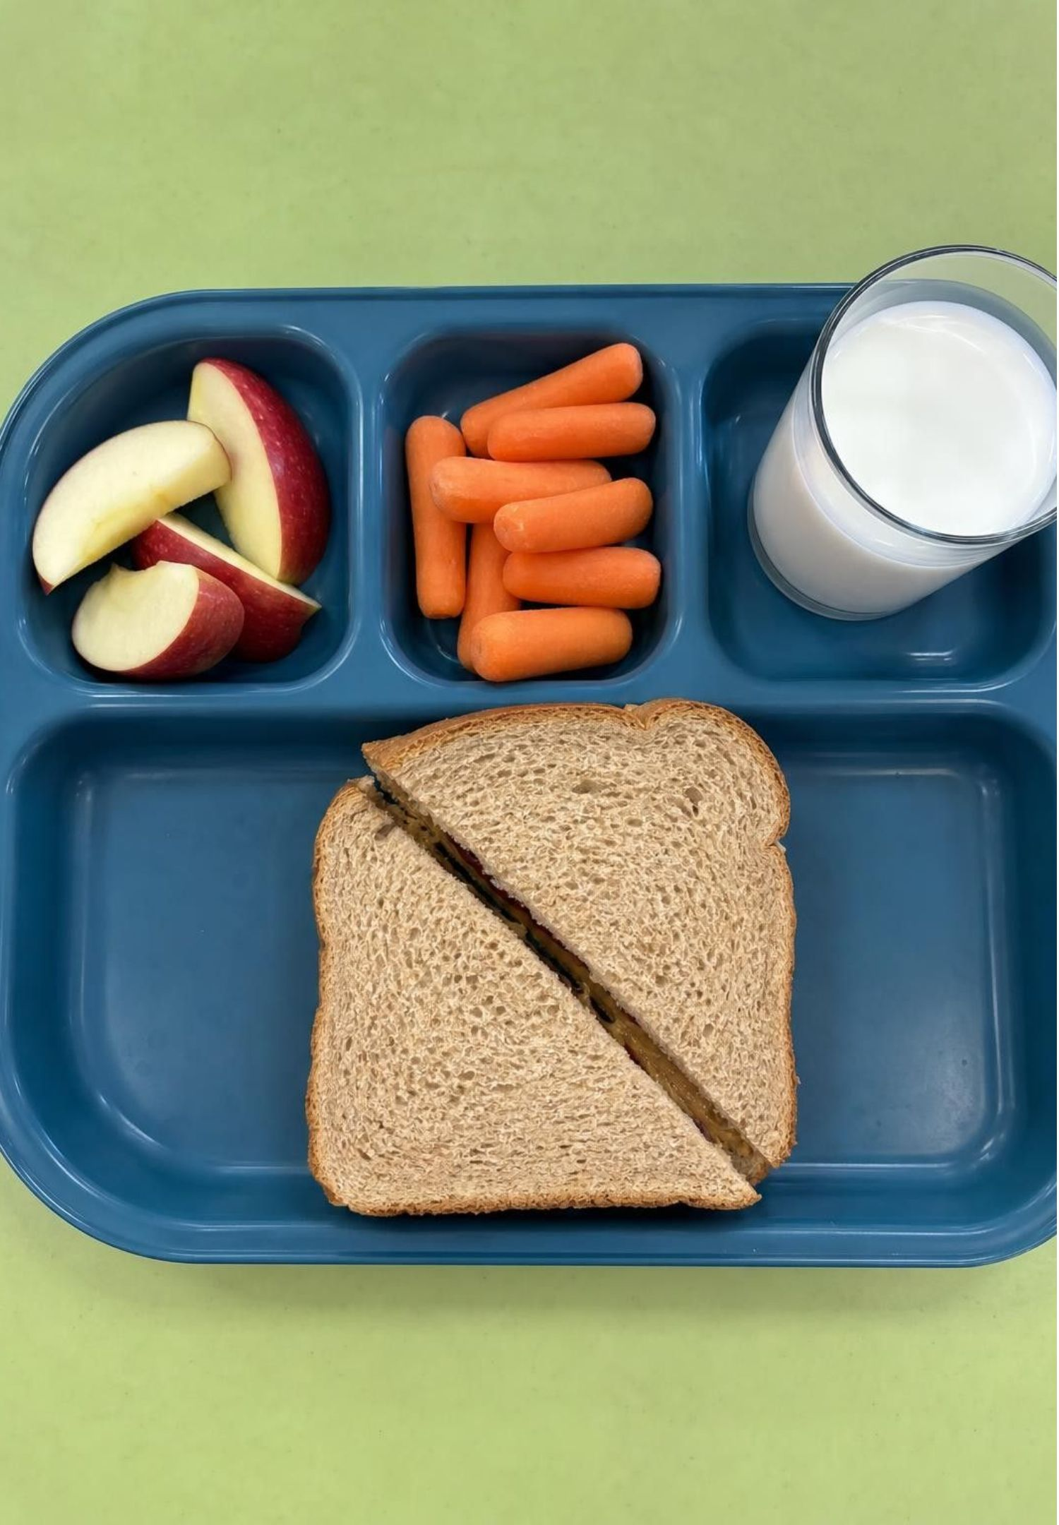
From lunch to your cells
Chewing breaks food into pieces; saliva starts breaking starch into sugar.
The stomach churns food and begins breaking down proteins.
The small intestine finishes digestion and absorbs the small molecules into the blood.
Blood carries sugar, amino acids, fat pieces and water to every cell.
Each cell then decides: use a molecule as fuel, or use it as a building block.
18
Notes:
Trace a bite of bread. Starch is a long chain of sugar units; digestion cuts it into single sugars, which is why bread tastes slightly sweet if you chew it long enough. The book says food is digested into small molecules in the stomach; in fact most digestion and nearly all absorption happen in the small intestine, so teach the three-stop sequence. Then the key idea: once inside a cell, a sugar can be fed to respiration for energy, or joined with others into glycogen for later, or its atoms can be used to build fat. Amino acids from protein are mostly reused to build the body's own proteins. Food is both the fuel and the building material.
WATCH FOR: 'Digestion happens in the stomach' and 'the stomach sends food to the cells.' The small intestine does most of the work and the blood carries the molecules.
CONNECTS TO: W9 transfer task traces a meal; W3 reading.
PACING: about 5 min

Slide 19
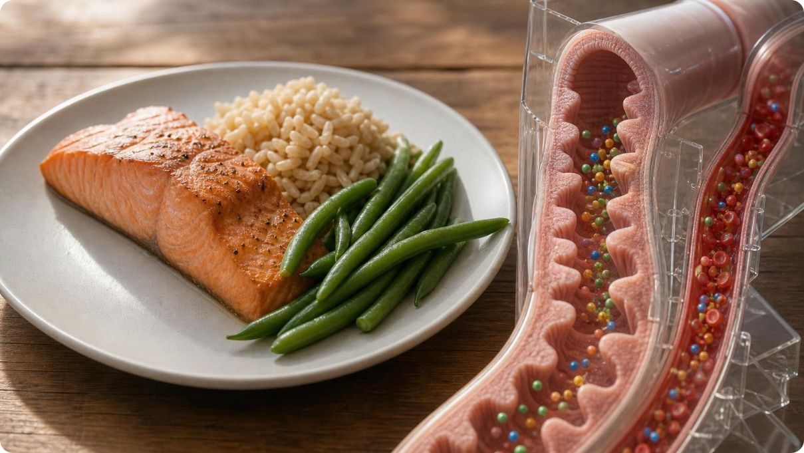
MODEL
What a meal can become
Model: Two jobs for the molecules from food
CENTER: SMALL MOLECULES ABSORBED FROM DIGESTED FOOD
Fuel: cellular respiration: Sugar reacts with oxygen; energy is released; carbon dioxide and water leave the body.
Glycogen: Spare sugar linked into chains in the liver and muscles; broken back into sugar when needed.
Body fat: Built from fat pieces, and from extra sugar, for long-term energy storage and for membranes.
Proteins: Amino acids from food proteins are reassembled into muscle, enzymes and transport molecules.
Water: From drink and from respiration itself; part of every cell.
Growth means atoms from food becoming part of you. Energy means atoms from food leaving as carbon dioxide and water.
19
Notes:
Use the map to answer the lesson's second question: how does a squirrel build a squirrel out of an acorn? The acorn's starch becomes sugar, some of which is respired and some of which is stored or rebuilt into other molecules; the acorn's proteins are taken apart into amino acids and rebuilt as squirrel proteins; its fats become squirrel fat and membranes. Ask: which branch makes you heavier and which makes you lighter? Building adds atoms to the body; respiration sends atoms out. Mention that plants do the same building from the sugar they make, which is where cellulose for cell walls and starch for storage come from.
EXPECTED RESPONSES: Students should identify respiration as the branch where mass leaves the body and the other branches as where mass is added.
WATCH FOR: 'Protein food becomes muscle directly.' It is taken apart first; the body builds its own proteins from the pieces.
CONNECTS TO: W9 transfer; W4 model can be extended with this map.
PACING: about 5 min

Slide 20
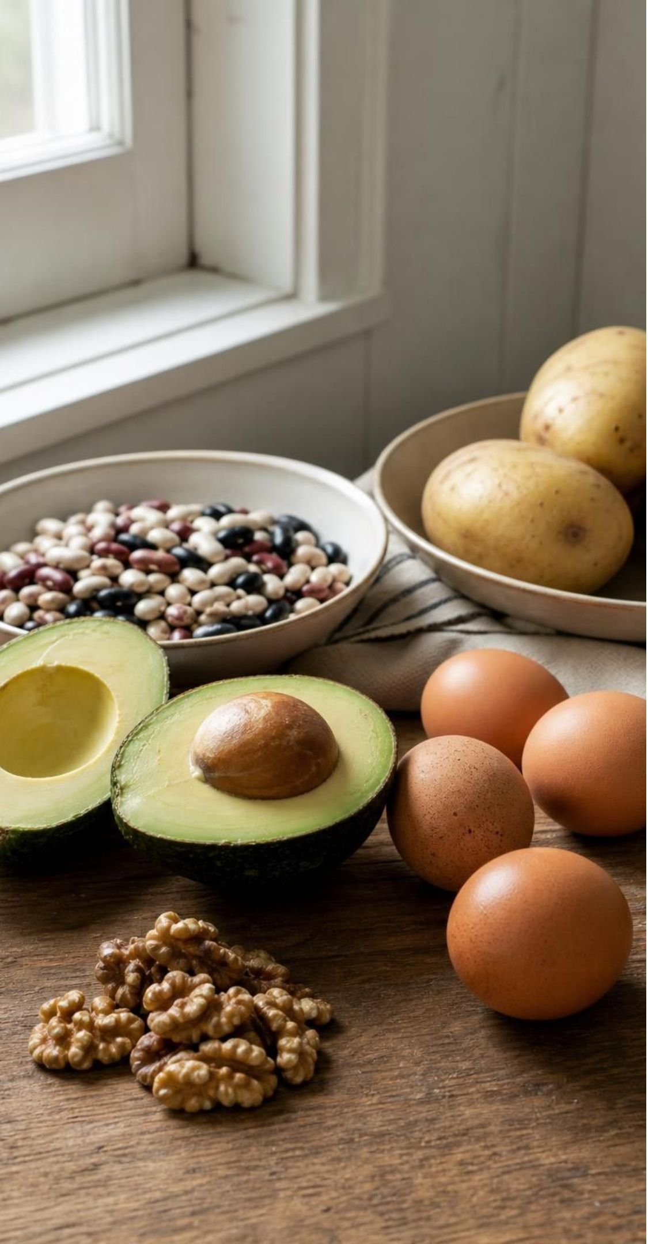
VOCABULARY IN CONTEXT
Three kinds of food molecules
carbohydrate: A molecule of carbon, hydrogen and oxygen that stores energy or builds structure; sugars are single units, starch, glycogen and cellulose are long chains. A potato stores starch; a plant cell wall is built of cellulose; your liver stores glycogen.
fat: An energy-rich molecule for long-term storage and, with its relatives, for building cell membranes; liquid fats are called oils. Avocados, nuts and salmon are rich in fats; a bear stores fat before winter.
protein: A large molecule built from amino acid units that forms structures, moves materials and speeds reactions. Beans, eggs and fish supply proteins that your body takes apart and rebuilds as its own.
20
Notes:
Correct two small things from the book. First, sugars are simple not because they have few atoms but because each is one unit or two joined; complex carbohydrates are long chains of those units. Second, carbohydrates are not only for energy: cellulose is the tough material of plant cell walls, and your body cannot digest it, which is why it is called fiber. On fats: fats and oils are the same family, oils being the liquid ones; the book's 'stores energy in the form of oils' blurs that. On proteins: your body cannot use a bean protein as is; it cuts it into amino acids and builds its own.
WATCH FOR: 'Carbohydrates are sugar' and 'fat in food becomes fat on you unchanged.' Both are taken apart and rebuilt.
CONNECTS TO: W2 vocabulary; W9 transfer; W10 mastery.
PACING: about 4 min

Slide 21
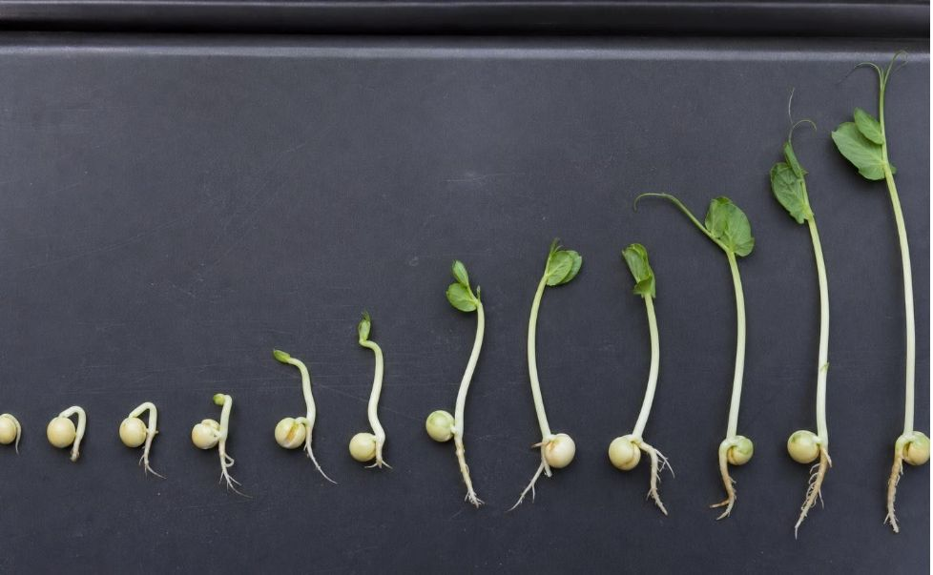
Apply it
Task: where did the seed's mass go?
Simulated data for practice.
A class sprouted 100 pea seeds in the dark, dried a sample every two days and weighed it, and collected the gas the seeds released. Use the data to explain where the missing mass went and why the sprouts still grew.
Day | Dry mass of 100 seeds or sprouts (g) | Root plus shoot length (mm) | Carbon dioxide released since last reading (g)
0 | 24.0 | 0 | 0.0
2 | 23.1 | 6 | 1.2
4 | 21.8 | 18 | 1.7
6 | 20.4 | 35 | 1.9
8 | 19.2 | 52 | 1.6
21
Notes:
This is a teaching dataset, invented to match the pattern real germination studies show. Give groups eight minutes with three prompts. First: what happens to dry mass over eight days? It falls from 24.0 g to 19.2 g, a loss of 4.8 g, even though the sprouts grew to 52 mm. Second: add up the carbon dioxide: 1.2 + 1.7 + 1.9 + 1.6 = 6.4 g. Ask why the gas mass can exceed the dry-mass loss: the carbon dioxide also carries oxygen atoms that came from the air, not from the seed, so the seed's lost carbon is only part of each carbon dioxide molecule. Third: how can something grow while losing mass? Growth here is rearrangement: stored starch is taken apart, some is respired away, and some is rebuilt into root and shoot. Dry mass will only rise once leaves open and photosynthesis begins. Have each group write a two-sentence explanation using the words reactant, product and conserved.
EXPECTED RESPONSES: Dry mass drops 4.8 g while length rises; the carbon dioxide total is 6.4 g; the seed's carbon left as carbon dioxide while the oxygen in that gas came partly from the air; the sprouts grew by reorganizing stored matter, not by adding new matter from outside; mass will increase only after photosynthesis starts.
WATCH FOR: 'The seeds lost mass because water evaporated.' The table is dry mass, so water is already excluded. 'The mass turned into energy.' The atoms left as gas.
CONNECTS TO: W5 data worksheet uses a related dataset with graphing; Lab 1 analysis; W6 CER.
PACING: about 10 min

Slide 22
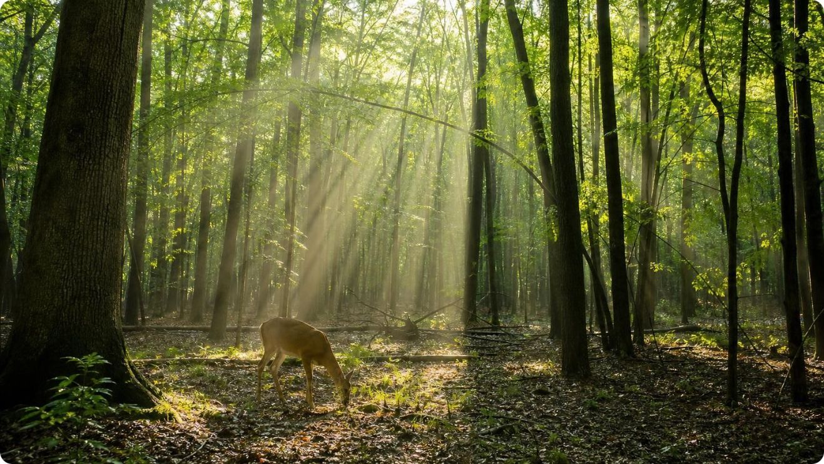
Two processes, one loop of matter
Photosynthesis: carbon dioxide + water + light energy → sugar + oxygen.
Cellular respiration: sugar + oxygen → carbon dioxide + water + energy released.
The products of each are the reactants of the other, so atoms go round and round.
The atom counts match: 6 C, 12 H and 18 O on every side of both summaries.
Only energy differs: it enters as light and leaves as heat and work.
22
Notes:
Put the two summaries one above the other and have students draw arrows from each product to the matching reactant. This is the pattern the lesson has been building toward: matter cycles, energy flows. Add two honest cautions. The summaries are mirror images, but the processes are not one reaction run backward: photosynthesis runs in chloroplasts through its own chain of steps, respiration in the cell fluid and mitochondria through a different chain, and the oxygen a leaf gives off comes from splitting water, not from carbon dioxide. And both processes run at once in a lit leaf. The equations are bookkeeping tools for atoms and energy, and they are excellent at that job.
WATCH FOR: 'Respiration is photosynthesis backward.' Same totals, different pathways, different places.
CONNECTS TO: W9 transfer; W10 mastery; sets up L06 food webs and L07 cycles.
PACING: about 5 min

Slide 23
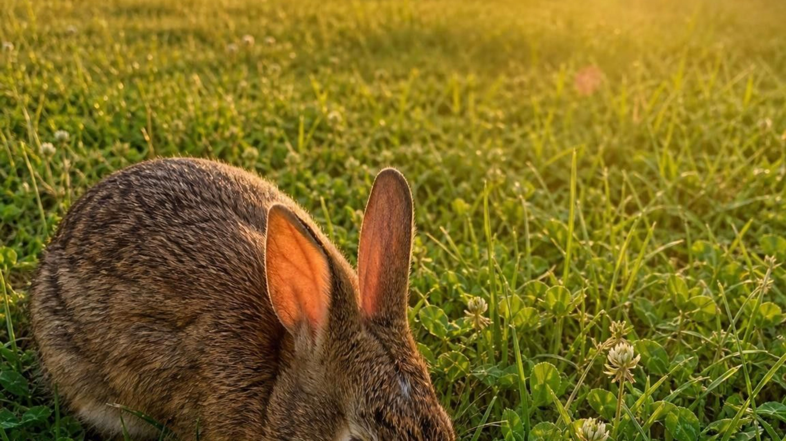
MODEL
Matter loops, energy passes through
Model: The carbon dioxide to sugar loop between the two processes
Carbon dioxide and water in air, soil and water →
(light energy in) Photosynthesis in green cells with light: stores light energy as chemical energy →
(eaten or used in place) Cellular respiration in every living cell: releases the stored energy → (energy out as work and heat) (back to the start)
(sugar made, oxygen released) Sugar and oxygen, in plants and in whatever eats them →
The same atoms circle for years. The energy makes one trip: sunlight in, heat out, with living work done in between.
23
Notes:
Trace one carbon atom around the loop with a finger: in the air as carbon dioxide, into a leaf, into sugar, into an acorn, into a squirrel, out through the squirrel's lungs as carbon dioxide, back into the air. Then trace energy: it enters as light, is stored in sugar, is released in the squirrel's cells, and leaves as heat from the squirrel's body. It does not return. Ask why the sun must keep shining if atoms are reused. Because energy is not reused; every pass turns some of it into heat that spreads out and cannot drive the reactions again. That one-way street is the subject of the next discussion.
EXPECTED RESPONSES: Students should trace a carbon atom through both processes and state that energy enters as light and leaves as heat.
WATCH FOR: 'Energy cycles like matter.' Matter cycles; energy flows through and leaves as heat.
CONNECTS TO: W8 collaborative cards trace atoms and energy; L06 and L07 extend this loop to ecosystems.
PACING: about 5 min

Slide 24

THINK, PAIR, SHARE
Discuss: if atoms are reused, why does life need the sun every day?
The same carbon atoms have cycled between air and living things for millions of years. Energy does not cycle. Explain, with the two equations, why an ecosystem sealed in the dark would run down.
Notes:
Give pairs three minutes. The target reasoning: respiration releases energy that ends as heat, which spreads out and cannot be gathered up to make sugar again; only photosynthesis puts new chemical energy into the loop, and it needs light. In the dark, every organism would keep respiring stored sugar until it ran out, as the seed jar would if left for weeks. Connect to the sealed-jar prediction from the phenomenon slide. If students raise deep-sea vents, say yes, those ecosystems run on chemical energy from inside the Earth rather than on light, which is another one-way energy supply, not a cycle.
EXPECTED RESPONSES: Atoms cycle because each process's products are the other's reactants. Energy enters only through photosynthesis (light) and leaves as heat from respiration, so without light the stored sugar is used up and nothing replaces it.
CONNECTS TO: W8 collaborative task; W9 transfer; L06 trophic pyramids build on energy loss as heat.
PACING: about 6 min

Slide 25
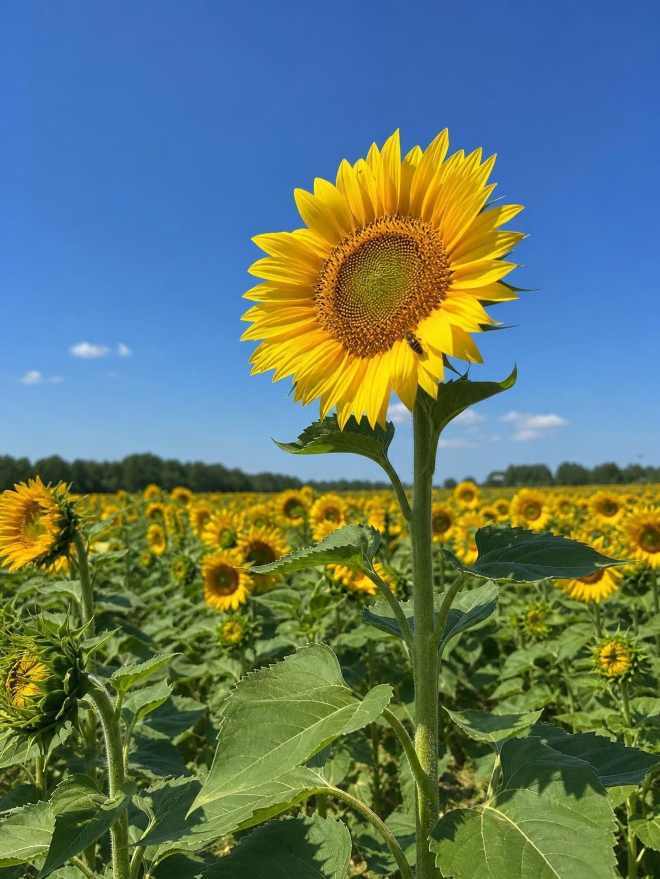
MISCONCEPTION CHECK
True or false? Only animals do cellular respiration
"Plants get their energy from the sun, so they do not carry out cellular respiration and do not need oxygen. Animals get energy from food and are the only organisms that respire."
True or false? Explain your reasoning.
25
Notes:
Have students evaluate the statement in writing with two pieces of evidence from this week. Expect the seed jars (living seeds warmed, grew and gave off carbon dioxide with no light), drowned roots, the fact that leaves keep working at night, and the atom-token model showing that sugar is the fuel for any cell. Then collect the corrected statement: light energy is stored in sugar by photosynthesis; every living cell of the plant then releases that energy by cellular respiration, which needs oxygen; animals do the same with sugar they eat. Close by asking what the plant does with oxygen when it is making more than it needs: it releases the extra, which is the oxygen we breathe.
EXPECTED RESPONSES: False. Plants carry out respiration in every living cell, day and night, and take in oxygen wherever they are not producing it; animals and plants release energy from sugar the same way.
WATCH FOR: Students may overcorrect to 'plants breathe.' Plants exchange gases without breathing.
CONNECTS TO: W7 misconception repair; W6 CER; Lab 1.
PACING: about 6 min

Slide 26
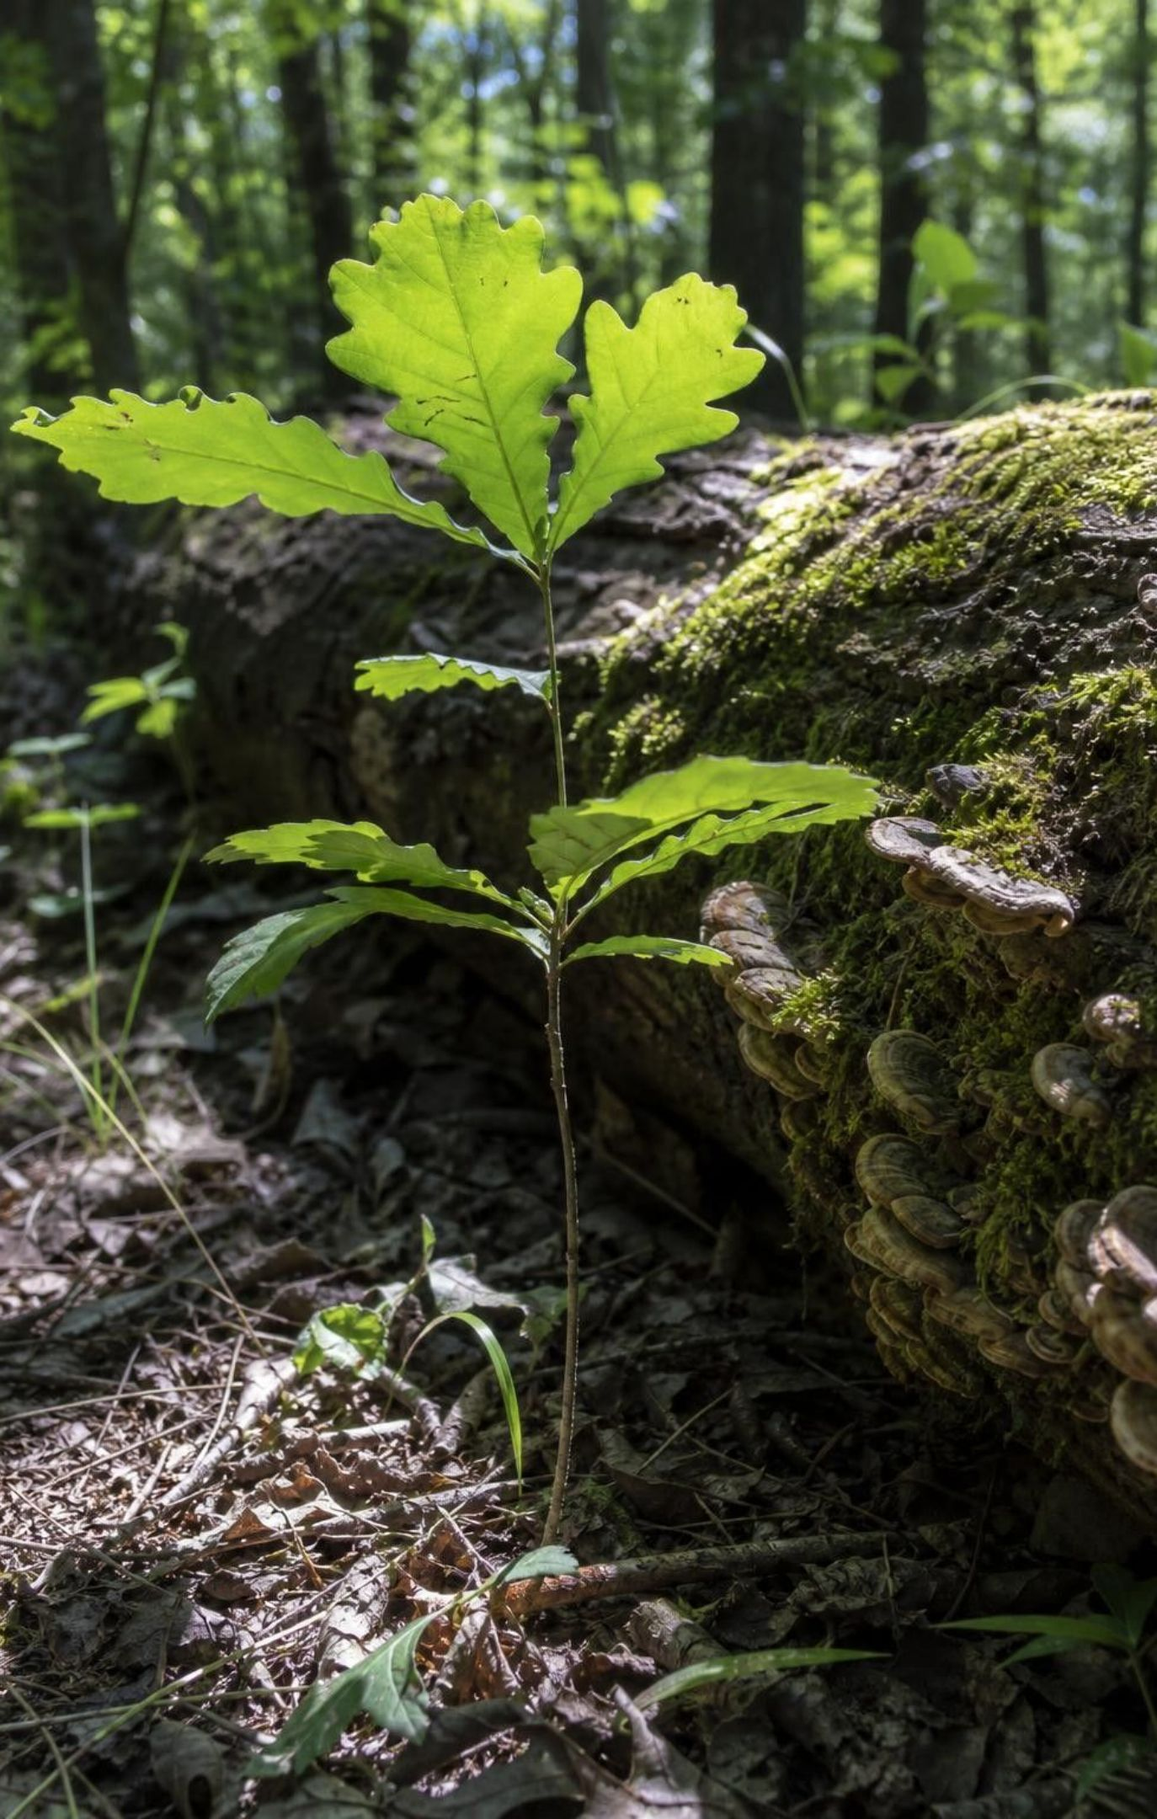
PUTTING IT TOGETHER
Putting it together
Producers make sugar; consumers eat it. Every cell then runs on sugar the same way.
Cellular respiration: sugar + oxygen → carbon dioxide + water + energy; 36 atoms in, 36 atoms out.
Plants respire in every living cell, all the time. Breathing is not respiration.
Digested food is fuel or building material: carbohydrates, fats and proteins are taken apart and rebuilt.
Matter cycles between the two processes; energy enters as light and leaves as heat.
26
Notes:
Have students write a three-sentence summary using at least four vocabulary terms, then trade with a partner who checks that reactant and product are used correctly and that 'plants' appears in the sentence about respiration. Ask for one thing from each lab: Lab 1 (which jar changed and why), Lab 2 (what the balance showed), Lab 3 (what changed in their breathing and why). Preview Lesson 6: once energy is released as heat it is gone from the ecosystem, which is why food webs are shaped like pyramids.
CONNECTS TO: W10 mastery as the quiz; L06 Food Webs and Trophic Pyramids next.
PACING: about 6 min

Slide 27
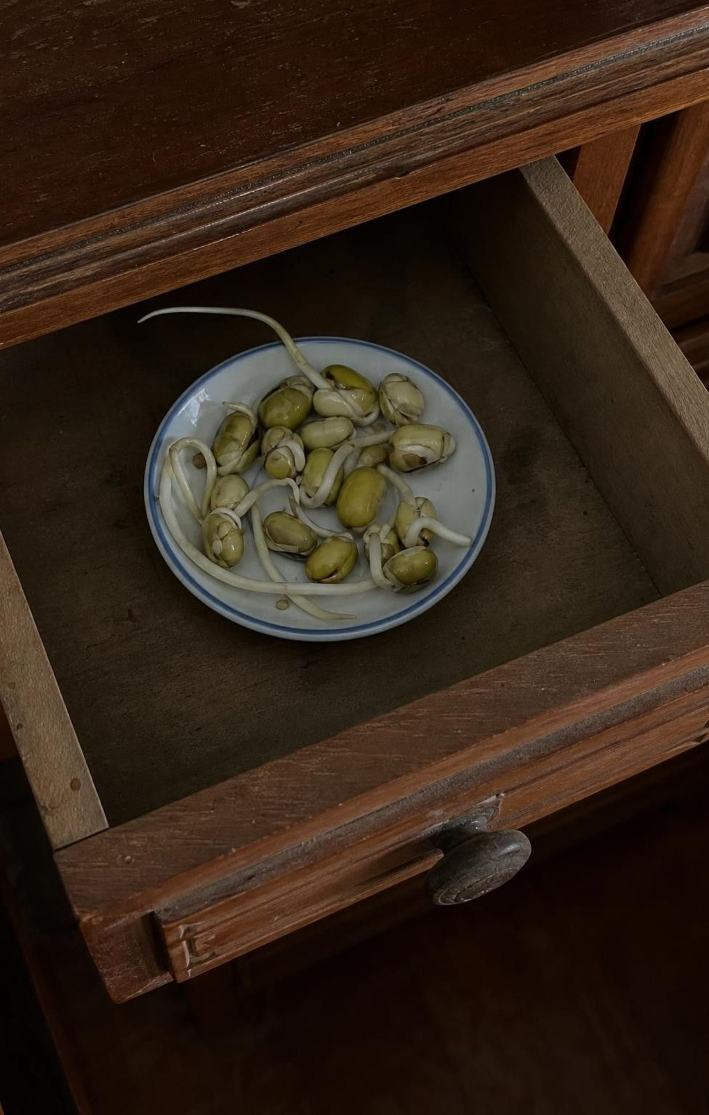
EXIT TICKET
Exit ticket
Write the word equation for cellular respiration and circle the reactants.
A seed sprouts in a dark drawer and the drawer gets warm. In one sentence, where did the energy come from?
Name one way plants get oxygen when they are not making it, and one place in a plant where that happens.
A sugar molecule has six carbon atoms. After respiration, where are those six atoms?
Give one molecule from food that your body uses as a building block rather than as fuel.
27
Notes:
Collect on index cards or a shared form. Item 1 checks the model; item 2 checks that stored chemical energy, not light or water, is the answer; item 3 checks the plant-respiration target; item 4 checks conservation; item 5 checks the fuel-versus-building idea. Sort cards into three piles before the next class and reteach from the largest pile.
EXPECTED RESPONSES: 1: sugar + oxygen → carbon dioxide + water + energy, with sugar and oxygen circled. 2: from chemical energy stored in the seed's starch by the parent plant, released by cellular respiration. 3: from the air or soil through pores or root surfaces; roots, seeds, or leaves at night. 4: in six carbon dioxide molecules that left the cell. 5: amino acids from protein (or fat pieces, or sugar built into glycogen).
WATCH FOR: Item 2 answers of 'from the water' or 'from the drawer' signal the stored-energy idea has not landed; item 4 answers of 'turned into energy' signal the conservation idea needs Lab 2 revisited.
CONNECTS TO: W10 mastery; chapter evidenceOfLearning.
PACING: about 5 min

