Slide 1
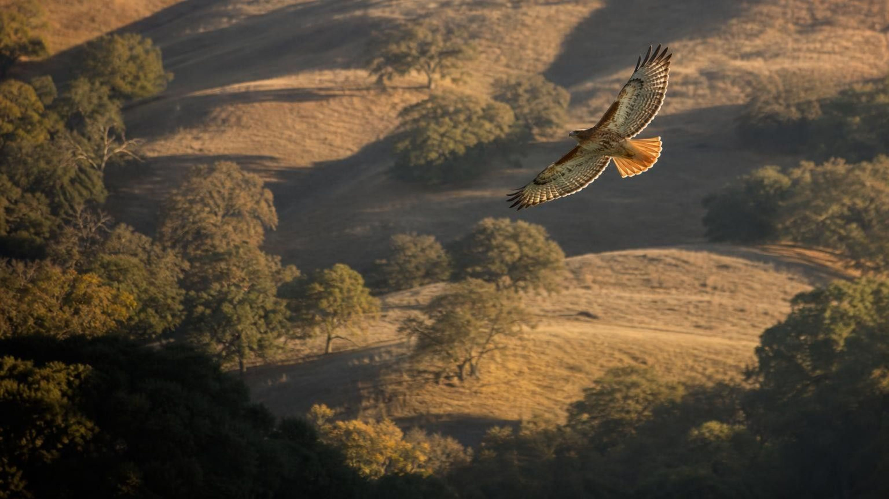
Chapter 6: Food Webs and Trophic Pyramids
Chapter 6 of 29 · Energy and Matter in Ecosystems
Lesson 6: How do matter and energy move through an ecosystem, and why do they behave so differently?
Angela's Wand · Bring Science Alive! 7th Grade Integrated
Notes:
This lesson connects the last two: producers capture sunlight and build sugar (Lesson 4), and every organism burns sugar for energy (Lesson 5). Now we zoom out to a whole ecosystem and follow the matter and the energy from grass to grasshopper to hawk to the soil and back. Tell students they will run three investigations: a string-and-card food web they will deliberately break, a water-pouring model of an energy pyramid, and a paper lake they must restore on a budget. Nothing needs chemicals, flames or live animals.
CONNECTS TO: Overview of Lab 1, Lab 2 and Lab 3; W1 opens on the next slide.
PACING: about 2 min

Slide 2
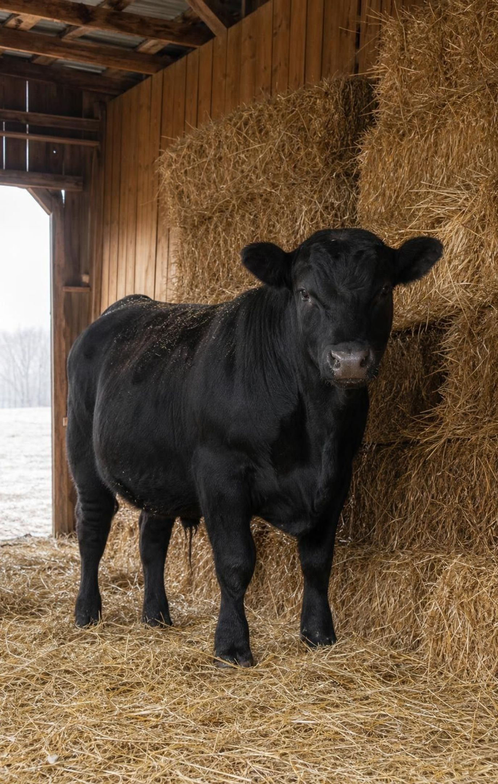
PHENOMENON
Three and a half tonnes of hay, one steer
A 4-H student weighs every bale her steer eats for a year: about 3,600 kg of dry feed. On show day the steer has gained about 360 kg, one tenth of what it ate. The barn is not full of leftover hay and the steer is not ten times heavier. Where did the other 3,200 kg go? (Typical rounded figures.)
Notice: what numbers do you have, and what number is missing?
Wonder: what leaves a steer's body every day that you could collect and weigh?
Predict: if a cougar ate the steer, about how much of it would become cougar?
2
Notes:
Give two silent minutes for a notice and a wonder, then collect answers on the board without judging them. Push on one point: mass does not vanish, so the missing 3,200 kg must be somewhere. Ask where. Students will offer manure first; accept it and ask whether manure alone could weigh 3,200 kg. Then ask what else leaves an animal all day long, every breath. Most have never thought of exhaled carbon dioxide as mass leaving the body. Park the heat idea too: a warm barn in winter is energy leaving the animals. Do not resolve yet; slides 13 and 24 return to the steer with the full accounting.
EXPECTED RESPONSES: Notice: 3,600 in, 360 kept, 3,200 unaccounted. Wonder: dung, urine, breath, sweat, heat, hair. Predict: much less than 360 kg becomes cougar; a good guess is about a tenth again, roughly 36 kg, and the rest leaves the cougar the same ways.
WATCH FOR: 'The food was used up' or 'turned into energy.' Matter is not turned into energy in a steer; write that claim on the parking lot and test it on slide 13.
CONNECTS TO: W1 phenomenon worksheet records the notice/wonder and a first explanation; W6 CER returns to this evidence.
PACING: about 8 min

Slide 3
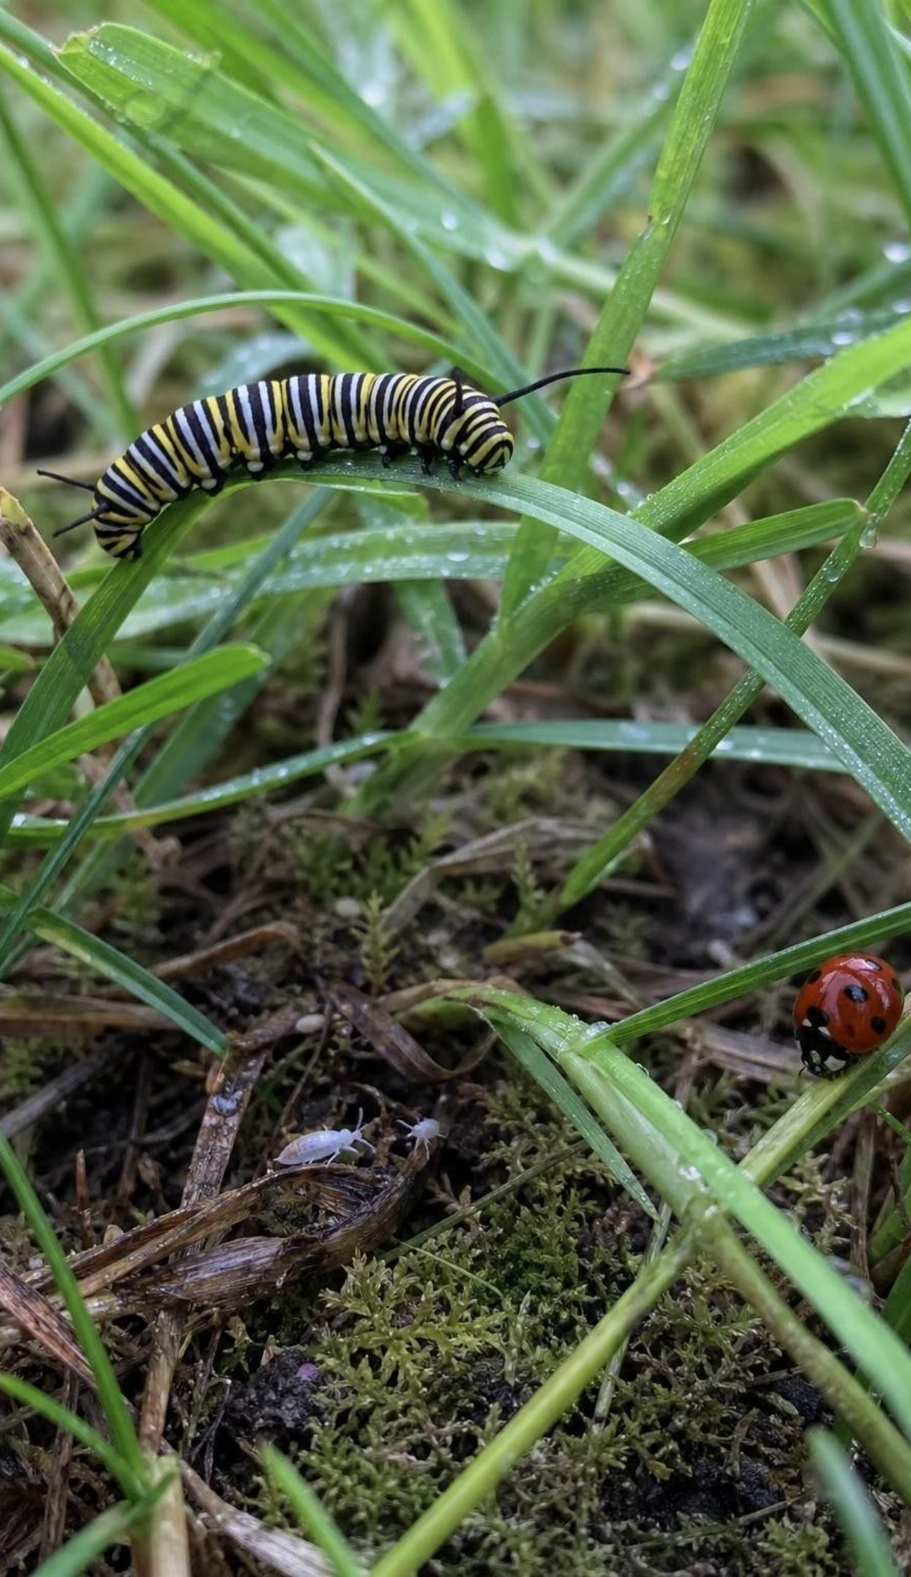
LEARNING TARGETS
What you will be able to do
Read a food web: say what each arrow means and find producers, consumers, decomposers and chains.
Predict direct and indirect effects when one population changes.
Account for every kilogram an animal eats: tissue, breath, wastes and remains.
Use a trophic pyramid and the ten-percent rule of thumb to calculate energy at each level.
Build a model in which matter cycles and energy flows through and leaves as heat.
Explain how scientists tested and modified a food-web fix for a polluted lake.
3
Notes:
Read the targets aloud and have students star the one that sounds hardest. Point out that targets 1 and 2 are about reading and predicting with a model, 3 and 4 are about accounting for matter and energy with numbers, 5 ties both together, and 6 is the engineering story. The exit ticket on the last day touches all six.
CONNECTS TO: Targets map to W2 and W4 (1), Lab 1 and W7 (2), W6 (3), Lab 2 and W5 (4), Lab 1 and W4 (5), Lab 3 and W9 (6).
PACING: about 2 min

Slide 4
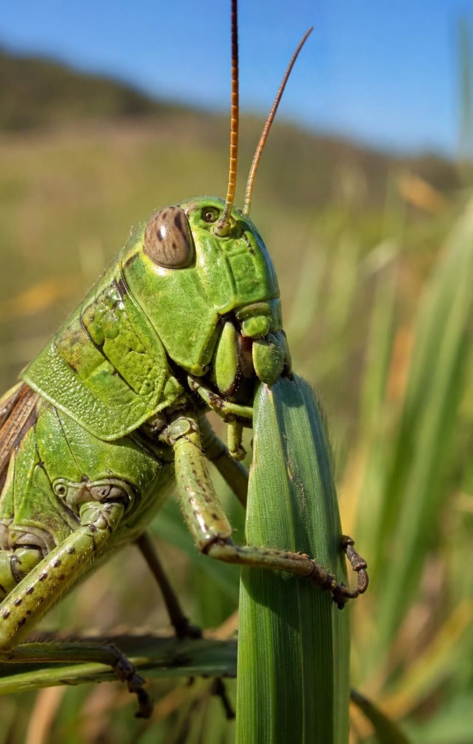
Who eats whom: reading the arrows
A food web is a model of feeding links among the populations in an ecosystem.
Each arrow runs from the food to the eater: grass → grasshopper means grass becomes grasshopper.
The arrow tracks matter and energy. They move toward the arrowhead.
No arrow points at a producer: producers build food from air, water and light, not from other organisms.
A food chain is one path through the web, from a producer to an animal nothing in the model eats.
4
Notes:
Draw a single arrow on the board from 'grass' to 'grasshopper' and ask what it means. Many students will say 'grass eats grasshopper' or 'grasshopper attacks grass'. Fix the rule once and firmly: the arrow follows the meal. Matter and energy in the grass become matter and energy in the grasshopper, so the arrow points at the grasshopper. Then ask why no arrow can point at a plant: plants take in carbon dioxide and water and use light, none of which is an organism. Finally define a food chain as a single path and a food web as all the paths together. Ask for a quick sketch of a three-link chain from their own neighborhood.
WATCH FOR: Arrow means 'eats'. Use the phrase 'the arrow points to the eater' and repeat it on every diagram this week.
CONNECTS TO: W2 vocabulary relationships; Lab 1 string arrows follow this rule.
PACING: about 5 min

Slide 5

MODEL
One chain through a California oak woodland
Model: A food chain: five trophic levels
1
2
3
4
5
Bunchgrass (producer)
→ (eaten by)
→ (eaten by)
→ (eaten by)
→ (eaten by)
Grasshopper
Western fence lizard
Gopher snake
Red-tailed hawk
Each arrow carries matter and energy toward the eater. Grass is level 1; the hawk here is level 5.
5
Notes:
Walk the chain and number the levels: grass 1, grasshopper 2, lizard 3, snake 4, hawk 5. Then complicate it the way a real woodland does. Hawks also eat ground squirrels and mice, which eat grass seeds, so a hawk can also feed at level 3. Coyotes eat squirrels and also fruit. Ask: does the hawk belong to one level? No, an animal's level depends on which meal you follow. That is why a web, not a chain, is the honest model. Tell students that Lab 1 uses nineteen cards from this woodland, including the sun, the air and the soil.
WATCH FOR: Students assign each species one fixed level. Levels belong to a path, not a species.
CONNECTS TO: Lab 1 card set; W4 diagram worksheet asks students to find and number chains in a web.
PACING: about 5 min

Slide 6
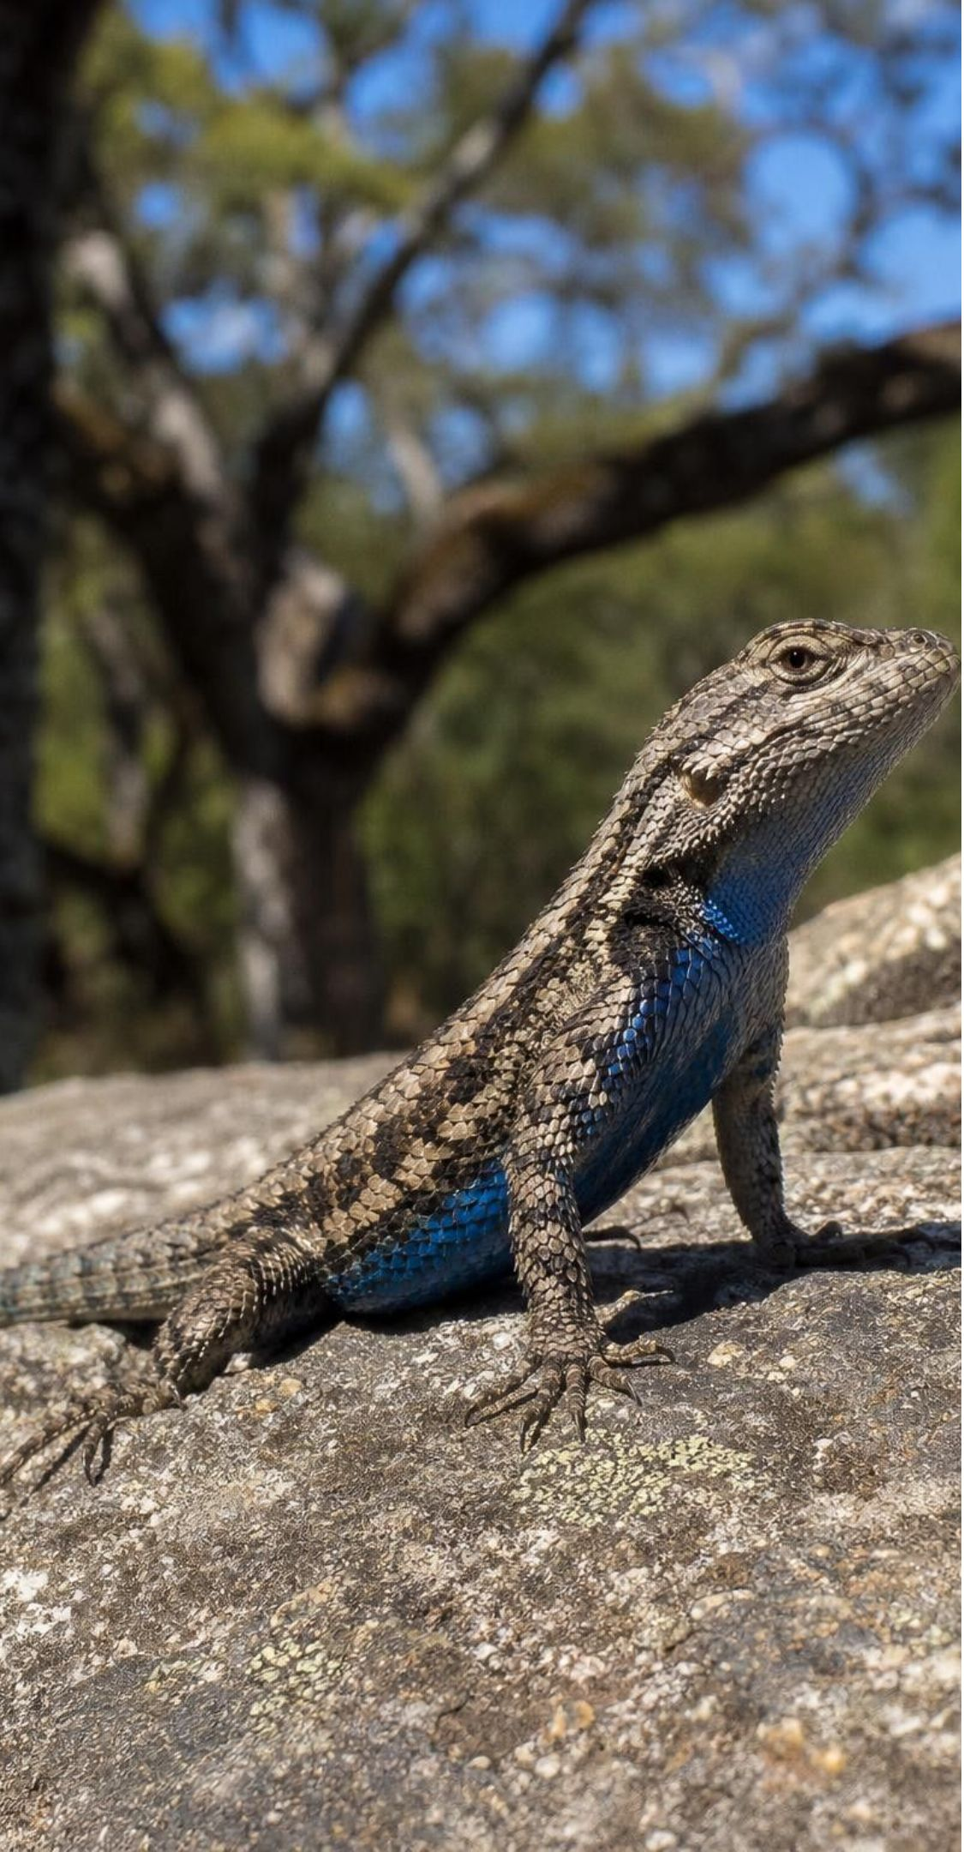
VOCABULARY IN CONTEXT
Three words for reading a web
food web: A model of the feeding connections among the populations in an ecosystem; arrows run from food to eater. In the woodland web, five arrows leave the needlegrass because so many animals feed on it.
food chain: One single path through a food web, from a producer to an organism nothing in the model eats. Grass → grasshopper → lizard → snake → hawk is one chain; grass → squirrel → hawk is another.
top predator: An animal no other animal in the model eats. It is 'top' only relative to the organisms the model includes. The hawk is a top predator in a five-card chain; add a great horned owl, which takes young hawks, and it is not.
6
Notes:
Have students say the arrow rule aloud once more while writing the definitions. Spend a moment on 'top predator': it is a label about a model, not a crown. If a model includes only grass, mice and snakes, the snake is the top predator; add a hawk and it is not. Ask who would be the top predator in a model of the school field, and what you would have to add to change the answer.
WATCH FOR: 'Top predator' as the strongest or most important animal. It just means no arrow leaves it in this model.
CONNECTS TO: W2 vocabulary worksheet; W10 mastery.
PACING: about 4 min

Slide 7
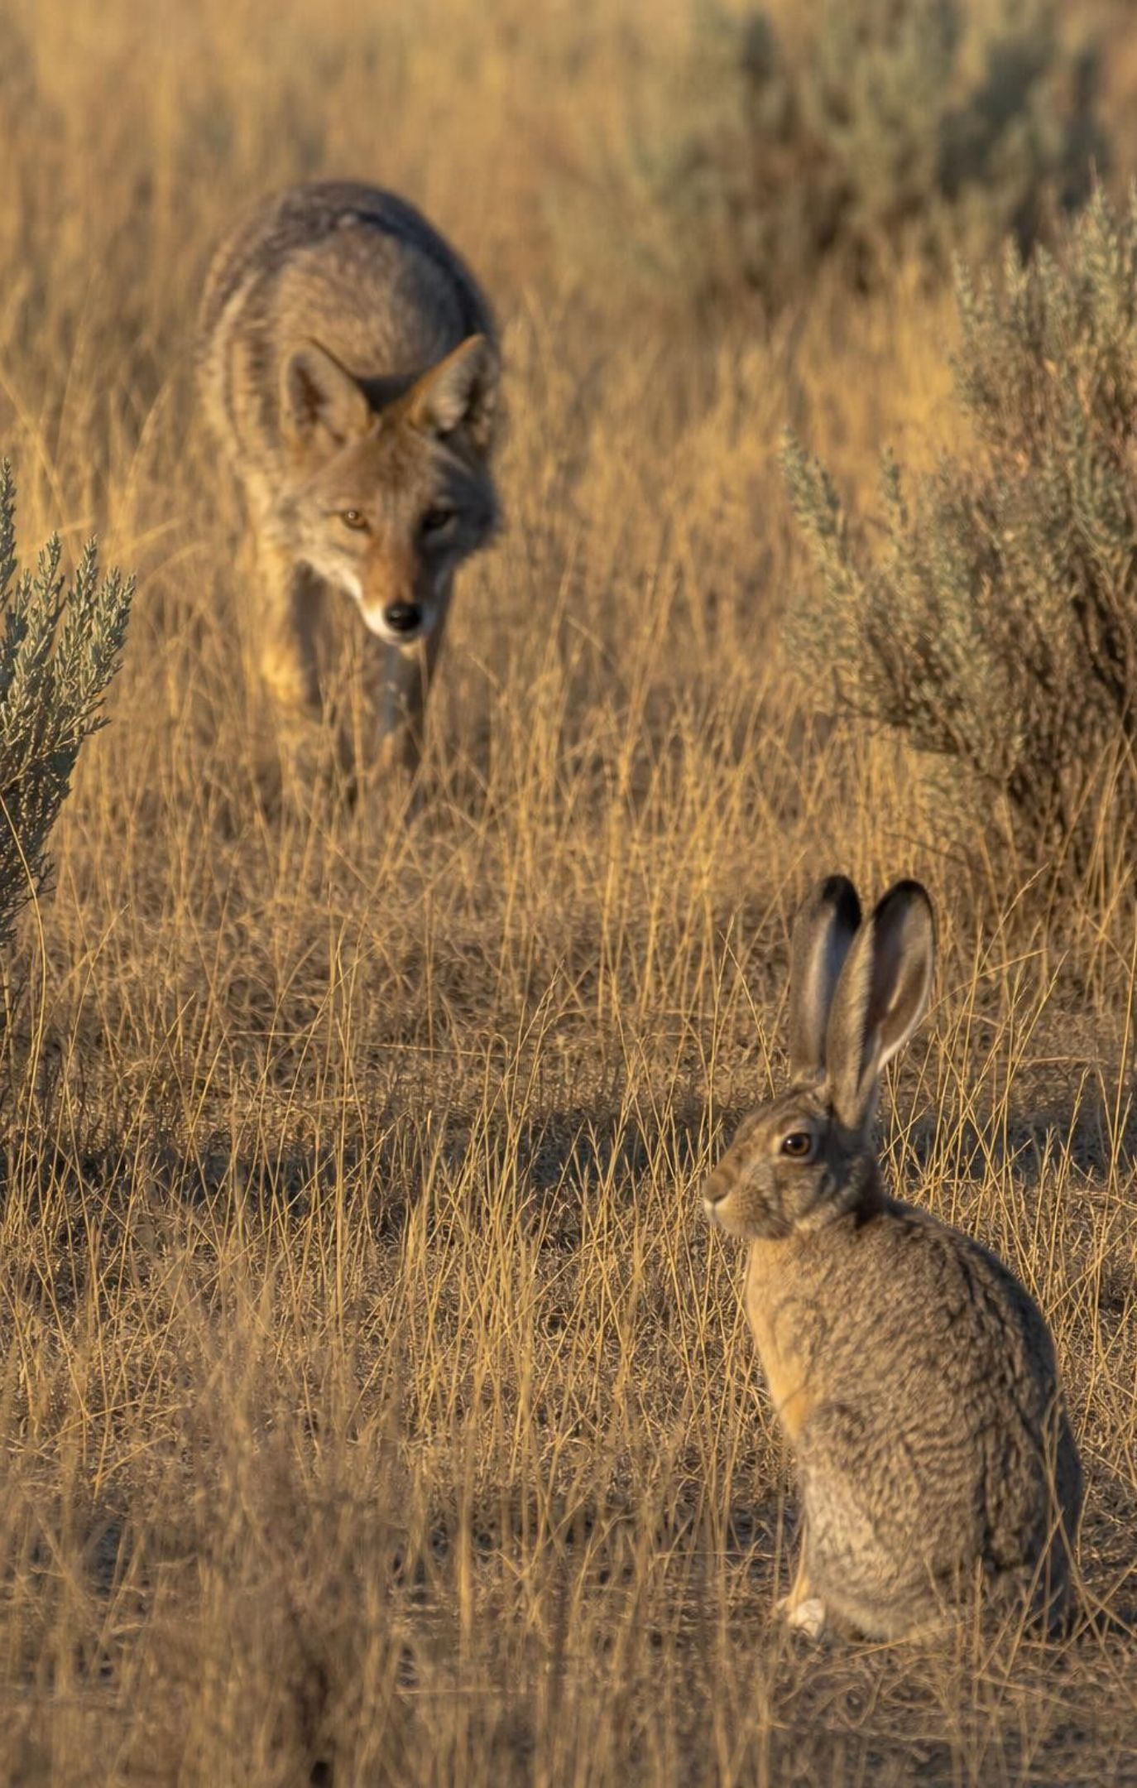
Ripples: direct and indirect effects
Direct effect: a change in a population that eats, or is eaten by, the one that changed.
More coyotes → fewer jackrabbits. Coyotes eat jackrabbits, so this is direct.
Indirect effect: a change passed through a third population in the middle.
Fewer jackrabbits → more grass survives the summer. Coyotes never touch grass, so this is indirect.
To predict a ripple, follow the arrows one link at a time and write the sign (+ or −) at each step.
7
Notes:
Work the coyote example on the board as a chain of signs: coyotes up, jackrabbits down, grass up. Then ask students to extend it one more link: if grass goes up, what happens to grasshoppers? Up. And to the lizards that eat grasshoppers? Up. Point out the sign flips at each predator link and stays the same at a 'more food' link. Then try a removal: a disease wipes out most coyotes. Jackrabbits up, grass down, grasshoppers down. Insist on the chain being written out; a bare answer is a guess.
WATCH FOR: Students predict that everything goes down when a predator is removed, or that effects stop after one link. The sign chain is the fix.
CONNECTS TO: Lab 1 session 2 disturbance table; W7 misconception repair uses a broken sign chain.
PACING: about 5 min

Slide 8
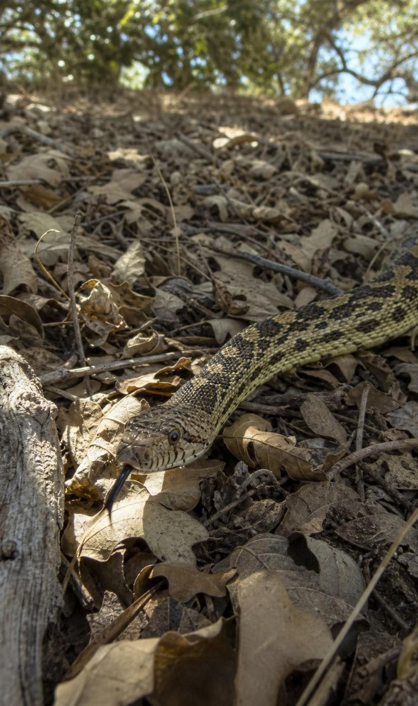
CHECK FOR UNDERSTANDING
Quick check: direct or indirect?
More gopher snakes → fewer deer mice.
More gopher snakes → more beetles.
Fewer deer mice → more grass seeds sprout next spring.
More gopher snakes → more hawks (hawks eat gopher snakes).
More gopher snakes → fewer seeds eaten, so more grass → more grasshoppers.
In the woodland web, gopher snakes eat deer mice, and deer mice eat grass seeds and beetles. Label each effect D (direct) or I (indirect).
8
Notes:
Run it fast with hand signals, D or I, then ask one student per statement for the chain. Statement 2 is the key one: snakes do not eat beetles; the effect passes through the mice. Statement 4 is direct even though the snake is the prey this time; direction of eating does not matter, only whether there is a population in between. Statement 5 is indirect through two links, and the sign still comes out positive.
EXPECTED RESPONSES: 1 D, 2 I, 3 D (mice eat seeds, so the seed population is directly affected by mice), 4 D, 5 I.
WATCH FOR: Calling statement 3 indirect because 'seeds are not animals'. A producer eaten by a consumer is a direct link.
CONNECTS TO: Lab 1 session 2; W7; W10 mastery item on effects.
PACING: about 4 min

Slide 9
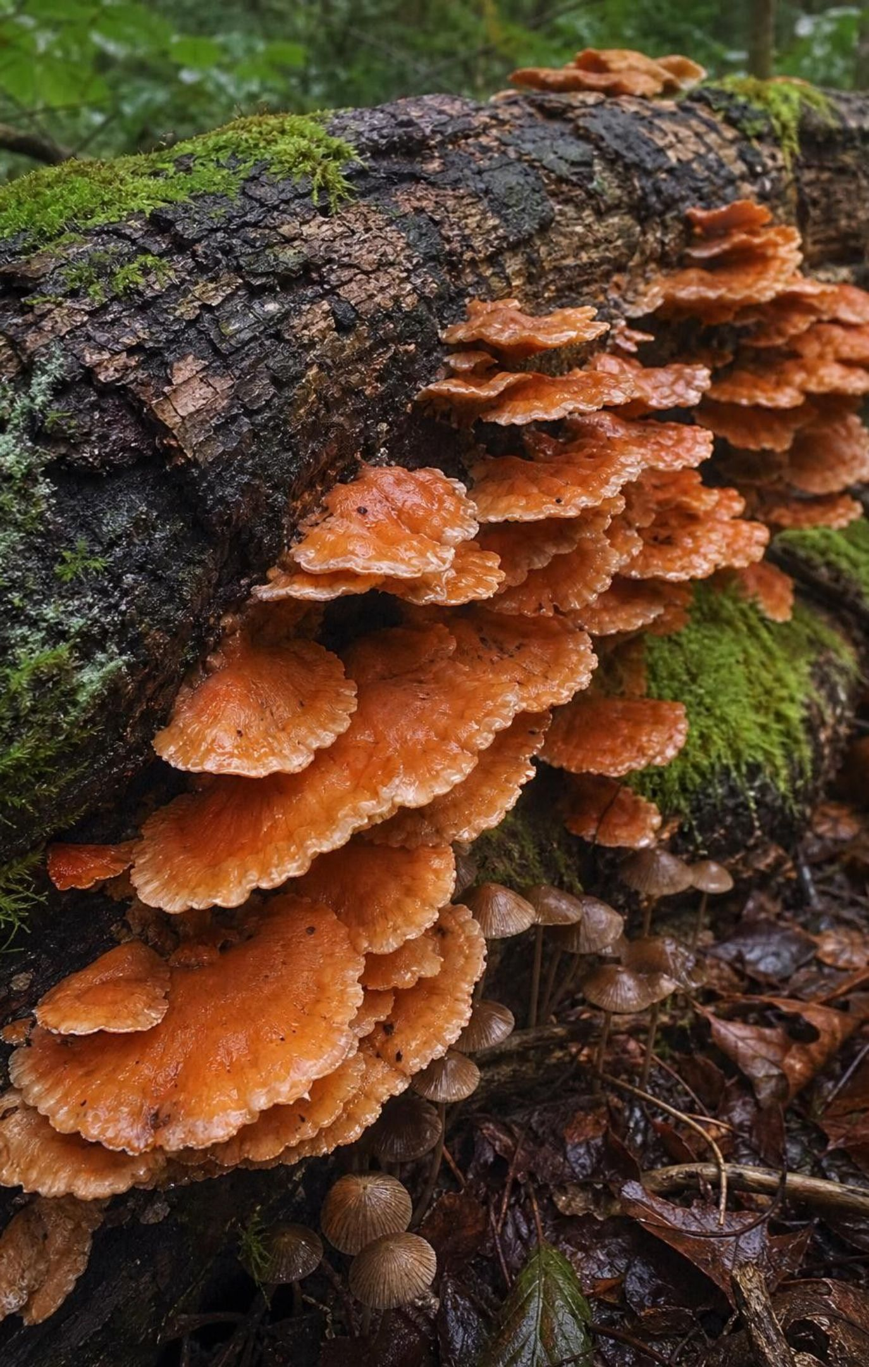
The arrows most diagrams leave out: decomposers
Every organism eventually dies or sheds wastes, leaves, hair, skin, dung.
Decomposers, mainly bacteria and fungi, feed on those wastes and remains.
They are consumers: they get matter and energy from food, by cellular respiration, like you.
An arrow should run from every organism in a web to the decomposers.
Their wastes are carbon dioxide, water and mineral nutrients: exactly what producers take in.
9
Notes:
Ask the class what happens to a mouse that is never eaten and dies of old age under a log. Its matter does not vanish; bacteria and fungi grow on it, and within months the body is gone. Where did it go? Into the decomposers' bodies, into the air as carbon dioxide from their respiration, and into the soil as nutrients. Stress that decomposers are consumers with a specialty, not a separate kind of life. Then ask why a web shows no arrow from decomposers to plants: plants do not eat decomposers; they absorb the carbon dioxide and nutrients the decomposers released into the air and soil. Introduce the word detritivore for animals like millipedes and earthworms that chew dead material; the textbook calls them decomposers, and either label is fine for now.
WATCH FOR: 'Plants get their food from decomposers' and 'decomposers are not consumers'. Both appear on W7.
CONNECTS TO: Lab 1 adds a decomposer card connected to every organism; W3 reading passage covers the leaf-litter story.
PACING: about 5 min

Slide 10
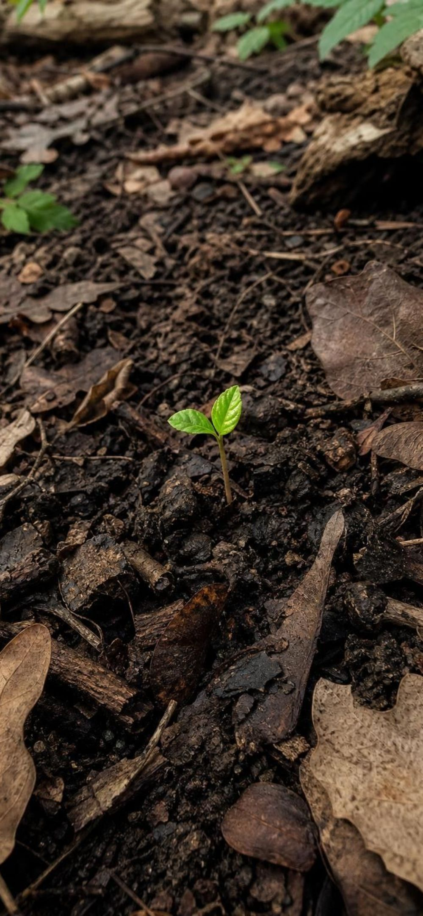





MODEL
Matter comes back around
Model: The matter loop of an ecosystem
Air, water and soil
Producers
build sugar and tissue → (eaten by)
(carbon dioxide, water, nutrients) → (taken in by)
2
1
Consumers
eat and build their own tissue → (shed by)
3
Decomposers
5
break remains down and respire → (released back to) (back to the start)
Wastes and remains
4
from every level → (fed on by)
Atoms travel this loop again and again. Nothing is created or destroyed along the way.
10
Notes:
Follow one carbon atom around the loop out loud: in the air as carbon dioxide, taken into a grass leaf and built into sugar, eaten by a grasshopper and built into muscle, the grasshopper dies, a fungus breaks the muscle down and breathes the carbon out as carbon dioxide, and it is back in the air. Ask: could that atom have gone around before? Yes, countless times; the carbon in your body has been in dinosaurs, oceans and volcanoes. Note that consumers and producers also release carbon dioxide directly when they respire, so there is a shortcut from each living box back to the air that the diagram keeps simple. Lesson 7 extends this loop to the whole planet.
WATCH FOR: Students think the loop is also the path of energy. Hold that question for slide 17; here we are following atoms only.
CONNECTS TO: Lab 1 nonliving pools (air, soil); W4 diagram worksheet; L07 Global Cycles of Matter.
PACING: about 5 min

Slide 11
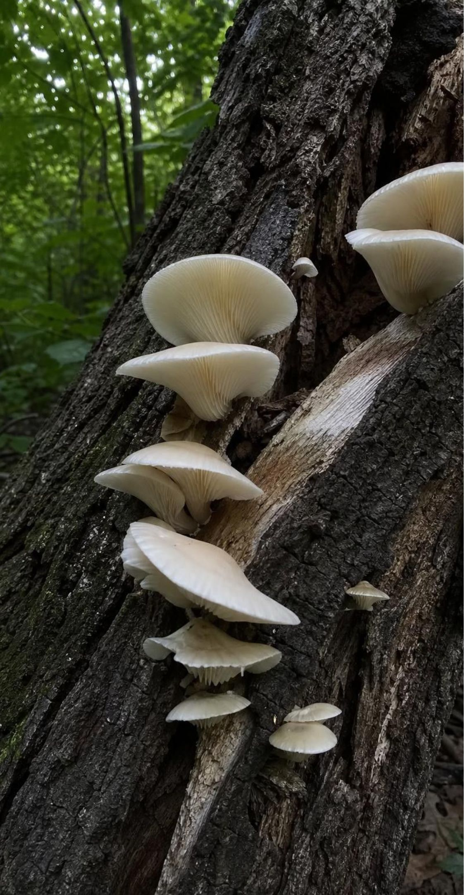
VOCABULARY IN CONTEXT
Words for the loop and the levels
decomposer: A consumer, such as a bacterium or a fungus, that feeds on wastes and dead remains and releases simple substances that producers can reuse. A mushroom on a fallen oak is the visible part of a fungus that is turning the log into carbon dioxide and soil nutrients.
trophic level: A feeding step in a food chain: producers are level 1, their eaters level 2, and so on. A lizard eating a grasshopper that ate grass is feeding at level 3.
biomass: The total mass of living matter in a group of organisms, usually measured dry. All the grass in a hectare of meadow has far more biomass than all the hawks that hunt over it.
11
Notes:
Say 'trophic' simply means 'feeding'. Have students number the levels of their own three-link chain from slide 4. For biomass, explain why scientists dry the sample first: a watermelon is mostly water, and water is not built by the organism, so wet mass hides the real comparison. Ask students to estimate which has more biomass in the school field, the grass or the insects, and why they think so.
WATCH FOR: Confusing a trophic level with a species. The level belongs to the meal being traced.
CONNECTS TO: W2 vocabulary; Lab 2 uses 'level' for every cup.
PACING: about 4 min

Slide 12
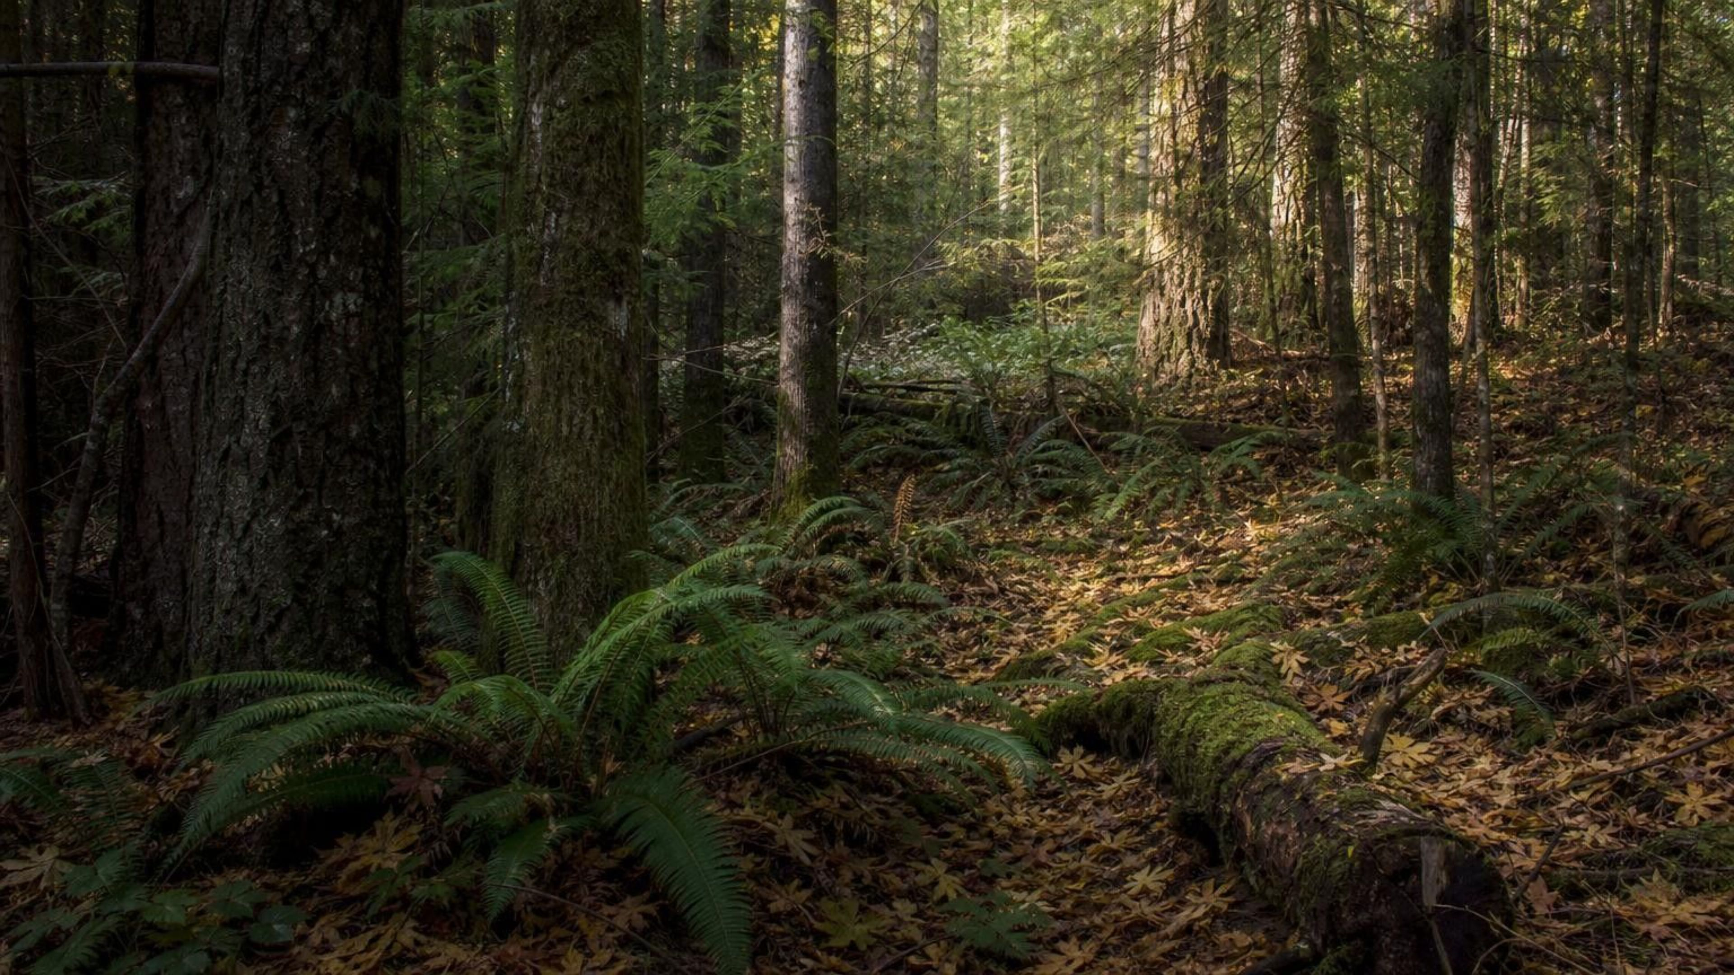
THINK, PAIR, SHARE
Discuss: a forest with no decomposers
Think about: fallen leaves, dead animals, animal dung.
Think about: where the carbon dioxide and soil nutrients for new growth come from.
Think about: whether the trees could keep growing forever on what the soil already holds.
Imagine every bacterium and fungus in a forest vanished overnight. Describe the forest after one year, after ten years, and explain what would eventually happen to the trees.
12
Notes:
Give pairs three minutes, then collect. After a year: leaf litter and carcasses pile up and do not rot; the forest floor gets deep. After ten years: the piles are enormous, and the soil's supply of mineral nutrients is dropping because nothing is returning them. Eventually: producers slow down because the nutrients and even the carbon they need are locked in undecayed remains. Push on the subtlety: carbon dioxide in the air would not run out quickly, because the whole atmosphere is one big pool, but soil nutrients like nitrogen compounds would. Also note that fire and slow chemical weathering can release some nutrients without decomposers, so 'locked away forever' is too strong; 'locked away for a very long time' is right.
EXPECTED RESPONSES: Remains and wastes pile up; the soil runs short of nutrients; new growth slows; the matter loop is broken at the decomposer step. Strong answers mention that producers absorb nutrients from the soil, not from decomposers directly.
CONNECTS TO: W3 reading; W8 jigsaw (fallen willow leaves and the creek decomposers); Lab 1 debrief.
PACING: about 6 min

Slide 13
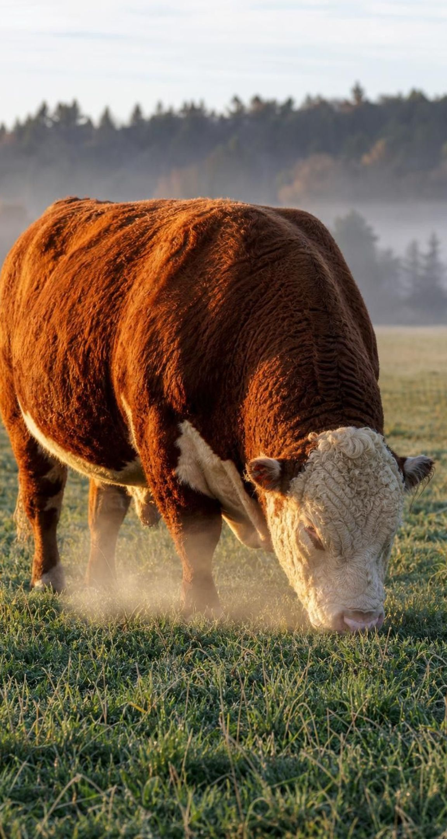





Back to the steer: where 3,600 kg of feed went
About 360 kg became new steer: muscle, bone, fat, hide. That is the only part the next eater can use.
Most of the rest left as carbon dioxide and water vapor in every breath, released by cellular respiration.
A large share left as dung and urine, and went to decomposers in the soil.
Energy left too, as body heat. Heat is not matter, but a large share of the feed's energy left that way.
Every kilogram is somewhere. None was destroyed and none 'turned into energy'.
13
Notes:
Return to the parking lot and settle the phenomenon. Build the accounting on the board as a sum: new tissue plus breath plus wastes equals feed eaten. The exact split varies with the animal and the feed, so give ranges rather than a formula: for a growing grazing animal, roughly a tenth becomes body, a large share leaves as dung and urine, and a large share leaves as carbon dioxide and water from respiration. Separate the two questions clearly: where did the matter go (breath, wastes, tissue) and where did the energy go (a large share as heat from staying warm and moving, a large share still stored in the dung, a little stored in tissue). Then generalize: the same accounting applies to a grasshopper, a hawk or a tuna. That is why each level of a food chain has far less to pass on than it received.
WATCH FOR: 'Matter turned into energy.' Cellular respiration releases energy stored in food, but the atoms all come out the other side as carbon dioxide and water.
CONNECTS TO: W6 CER on the steer; W1 initial explanation revisited; Lab 2 heat and decomposer cups.
PACING: about 5 min

Slide 14
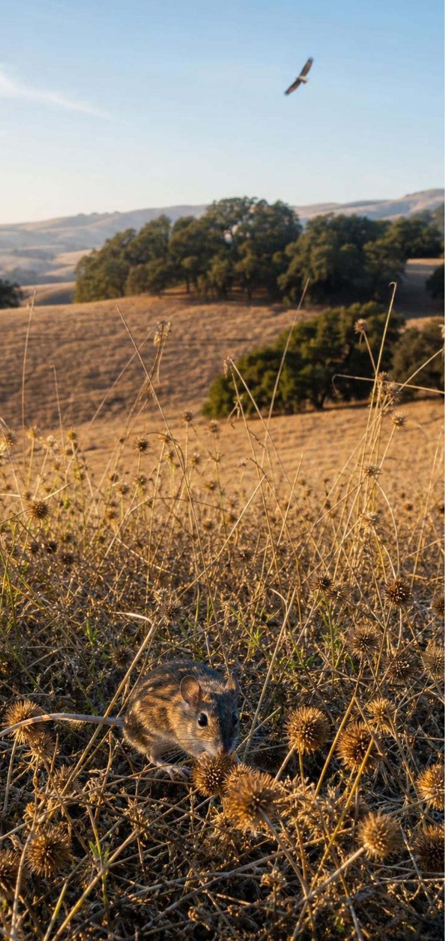
The trophic pyramid: energy shrinks at every step
Model
Model: Energy available at each level (ten-percent rule of thumb)
Top to bottom:
Level 4, hawks: about 10 units /
Level 3, snakes and lizards: about 100 units /
Level 2, grasshoppers and mice: about 1,000 units /
Level 1, grass and oaks: 10,000 units captured from sunlight
Each layer receives roughly a tenth of the energy stored by the layer below. The other nine tenths left as heat or went to decomposers.
14
Notes:
Explain that the units are arbitrary energy units for teaching; a real pyramid would be in kilojoules per square meter per year. Walk up: 10,000 to 1,000 to 100 to 10. Ask where the missing 9,000 went between the first two layers. Three places: used by the plants themselves for living and released as heat, never eaten and sent to decomposers when the plant died, and eaten but passed out as waste. Only the share built into tissue that then gets eaten moves up. Point out that the pyramid is about energy passed up over time, which is why it can never be upside down: no level can receive more than the one below stored. Numbers and biomass can flip (slide 19); energy cannot.
WATCH FOR: Students read the top as 'most powerful' or 'has the most energy'. The top has the least energy available to it.
CONNECTS TO: Lab 2 pours exactly these numbers as milliliters; W5 data worksheet graphs a pyramid.
PACING: about 6 min

Slide 15
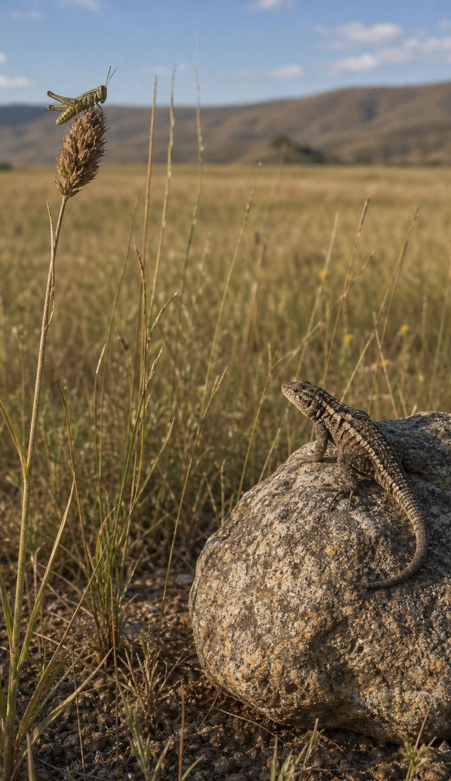
The ten-percent rule of thumb, and where the ninety goes
On average, only about one tenth of the energy at one level becomes stored energy at the next.
Much is used for living (moving, staying warm, growing) and leaves as heat.
Some is never eaten: roots, bark, bones and bodies go to decomposers.
Some is eaten but not digested, and leaves as waste.
Ten percent is an average. Measured values run from a few percent to over twenty.
To estimate the next level: multiply by 0.1. To estimate two levels up: multiply by 0.01.
15
Notes:
Model the arithmetic once: 50,000 units in the producers gives about 5,000 at level 2, 500 at level 3 and 50 at level 4. Then challenge the number itself. Ask: would a cold-blooded lizard or a warm-blooded hawk pass on a larger share of what it eats? The lizard, because it spends far less energy keeping warm. Some real measurements for cold-blooded animals are well above ten percent, and some for warm-blooded animals are well below. So the rule is a tool for estimates, not a law of nature. Every time students use it in this lesson they should write 'using the ten-percent rule of thumb'. Lab 2 lets each group pour a different efficiency and compare.
WATCH FOR: 'Exactly ten percent, always.' The book's worked example uses ten at every level, which is fine for estimating but not for claiming.
CONNECTS TO: Lab 2 round 2 (5, 10 and 20 percent); W5 computes a measured efficiency; W10.
PACING: about 5 min

Slide 16
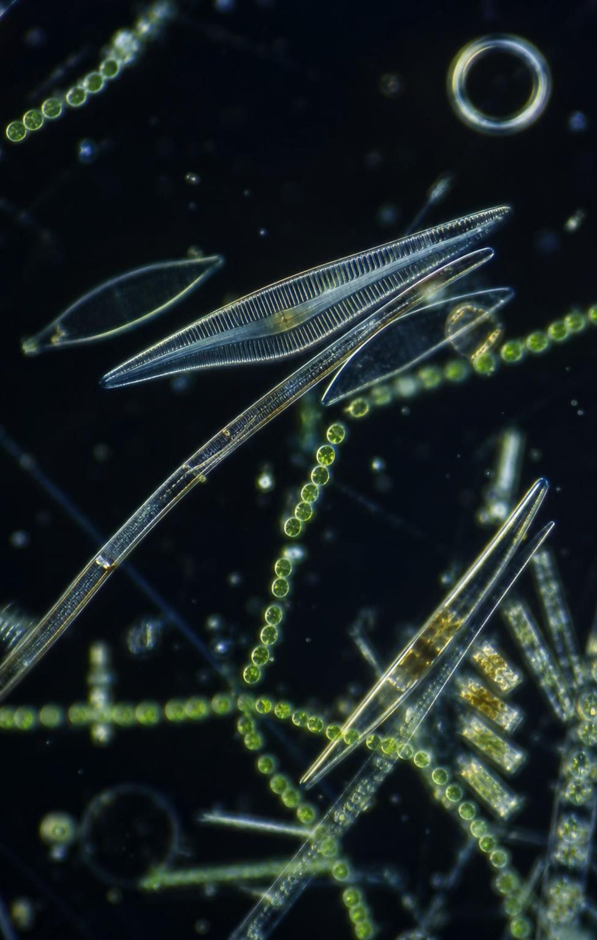
CHECK FOR UNDERSTANDING
Quick check: energy up the pyramid
The phytoplankton in a bay store 40,000 units of energy in a year. Using the ten-percent rule of thumb, about how much is available to small fish at level 3?
A. 4,000 units
B. 400 units
C. 40 units
D. 4 units
16
Notes:
Two minutes on whiteboards. Level 1 is the phytoplankton at 40,000. Level 2, the zooplankton, gets about 4,000. Level 3, the small fish, gets about 400. Students who answer 4,000 stopped one level short; students who answer 40 went one level too far, to the tuna. Ask a follow-up: if a real study found 12 percent at the first step and 8 percent at the second, would the answer be exactly 400? No, about 384, and that is fine; the rule is for estimates.
EXPECTED RESPONSES: B, 400 units: 40,000 × 0.1 = 4,000 at level 2, × 0.1 again = 400 at level 3.
WATCH FOR: Off-by-one-level errors from counting the producers as level 0 or forgetting them.
CONNECTS TO: W5 data worksheet; W10 mastery numeric items.
PACING: about 4 min

Slide 17

MODEL
Matter cycles. Energy flows. Here is the difference.
Model: Two things that travel through a food web · The textbook says energy 'cycles' and is 'recycled'. It is not: energy flows one way and leaves as heat.
Matter (atoms) | Energy
Enters living things from air, water and soil | Enters living things as sunlight captured by producers
Is passed from food to eater | Is passed from food to eater, about a tenth at a time
Leaves living things as carbon dioxide, water, wastes and remains | Leaves living things as heat at every level
Is returned to air, water and soil by decomposers | Cannot be gathered back by producers once it is heat
Goes around again and again; never used up | Flows through once; the ecosystem needs a new supply every day
17
Notes:
This is the heart of the chapter, so go slowly. Read both columns. Then test the idea with questions: if the sun stopped shining, how long could an ecosystem run? Only until stored food ran out, because no new energy arrives. If no new atoms ever came to Earth, how long could ecosystems run? Forever, as long as decomposers keep returning the atoms. Be careful with 'conserved': energy is conserved too, in the sense that the heat still exists; it has just spread out into the surroundings where no producer can capture it. Tell students plainly that the textbook's wording about energy cycling is wrong and that scientists say energy flows through an ecosystem.
EXPECTED RESPONSES: Students should be able to say: matter loops through decomposers; energy comes in as light and goes out as heat; the arrows carry both, but only the matter comes back.
WATCH FOR: 'Energy is destroyed' is as wrong as 'energy is recycled'. It is conserved but spread out as heat.
CONNECTS TO: W4 model completion; Lab 1 session 1 (sun in, heat out); misconception slide 24.
PACING: about 6 min

Slide 18

THINK, PAIR, SHARE
Discuss: why sunlight every day, but never new atoms?
An ecosystem needs sunlight every single day but has not needed a delivery of new atoms in billions of years. Explain both halves using what you know about matter and energy.
Notes:
Give pairs three minutes and ask each to write one sentence per half. The matter half: decomposers return every atom to the air, water and soil, so producers can take the same atoms in again. The energy half: every transfer releases heat, and heat spreads into the surroundings; producers can capture light but not that spread-out heat, so the energy that came in yesterday is gone from the food web today. Push for the word 'heat' and the phrase 'cannot be captured again'. A strong extension: ask what deep-sea vent ecosystems, which have no sunlight, use as their energy source (chemical energy from the vent fluids) and whether they still need a continual supply (yes).
EXPECTED RESPONSES: Atoms cycle through decomposers so none are lost; energy leaves as heat that producers cannot reuse, so new light must arrive. Credit answers that say 'the same carbon atom can be grass this year and hawk next year'.
CONNECTS TO: W6 CER reasoning; W8 jigsaw q4 (trace a leaf's matter back to a producer and its energy to heat).
PACING: about 6 min

Slide 19
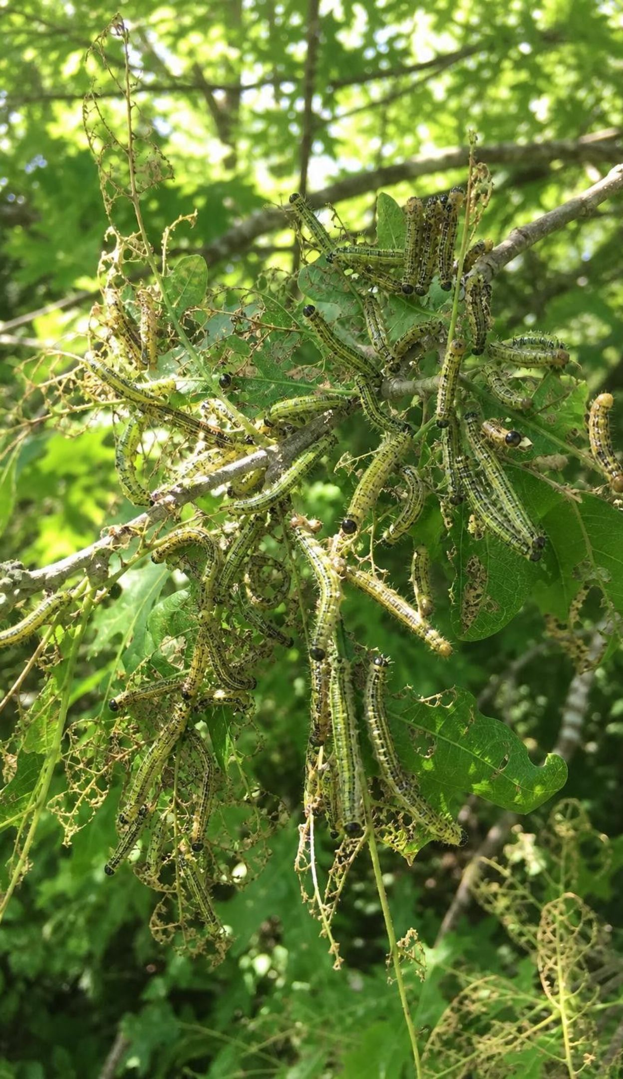
Pyramids that flip, and the one that never does
A pyramid of numbers counts organisms. One oak can feed thousands of caterpillars, so it flips.
A pyramid of biomass weighs each level. On land it usually narrows upward.
In open water a biomass snapshot can flip: phytoplankton are eaten almost as fast as they grow.
A pyramid of energy tracks energy passed up over a year. It can never flip.
Reason: no level can receive more energy than the level below captured and stored.
19
Notes:
The textbook says populations get smaller at every level. Correct that with two cases. Numbers: an oak woodland may have a few hundred trees and millions of leaf-eating insects, so the count pyramid is widest at level 2. Biomass in the open ocean: at any moment the phytoplankton may weigh less than the zooplankton grazing them, because phytoplankton divide so fast that a small standing crop produces a huge amount of food over a year. Then the rule that always holds: add up the energy each level passes on over a whole year and the pyramid must narrow, because energy only comes in at the bottom and leaks out as heat at every step. Ask: which pyramid should scientists use to compare ecosystems fairly? The energy pyramid.
WATCH FOR: 'Fewer organisms at every level, always.' True for energy per year, often for biomass, not for counts.
CONNECTS TO: W5 extension; W10 mastery; chapter accuracyNotes.
PACING: about 5 min

Slide 20
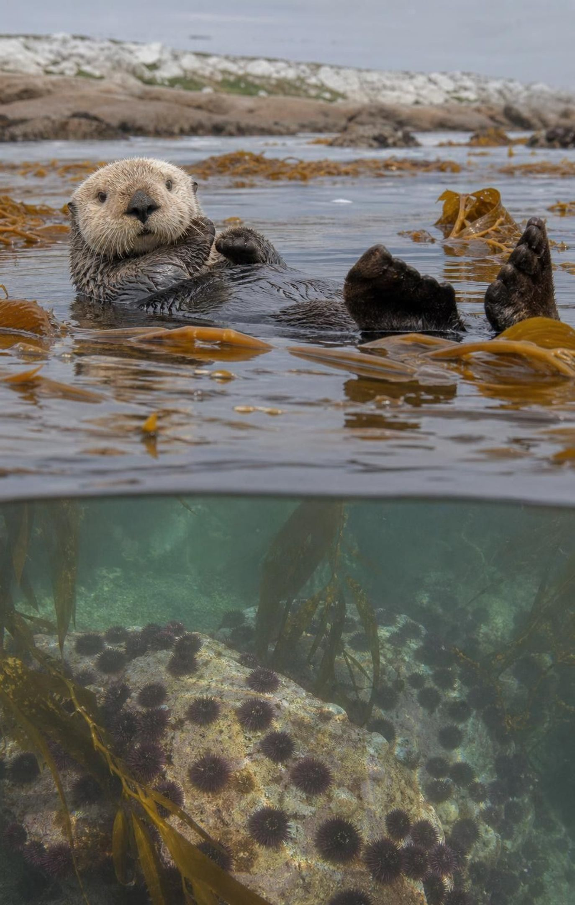
REAL-WORLD CONNECTION
California connection: sea otters, urchins and kelp
Along the central California coast, sea otters eat purple sea urchins, and urchins graze kelp. Where otters are numerous, urchins stay in cracks and kelp forests stand tall. North of San Francisco otters are absent; after a disease killed sea stars in 2013 and a marine heat wave began in 2014, urchins boomed and most of the bull kelp forest was grazed down to bare rock.
Otter → urchin: a direct effect.
Otter → kelp: an indirect effect, through the urchins.
Kelp is the producer that feeds fish, abalone and the whole forest web.
20
Notes:
Have students write the sign chain: otters up, urchins down, kelp up. This is a real example of an indirect effect strong enough to change a whole ecosystem, sometimes called a trophic cascade. Add the honesty note: otters are one control on urchins, not the only one. In northern California, where otters have been absent for over a century, sunflower sea stars kept urchins in check until a wasting disease killed them; then a long marine heat wave weakened the kelp, and urchin numbers exploded. Scientists and volunteer divers have since removed urchins by hand in some coves to give kelp a chance. Ask: which Lake Vesijärvi-style tools might apply here (remove the grazer, add a predator), and what would be different in the ocean.
CONNECTS TO: W3 reading passage tells the kelp story in full; W9 transfer task; Lab 3 compares restoration tools.
PACING: about 5 min

Slide 21
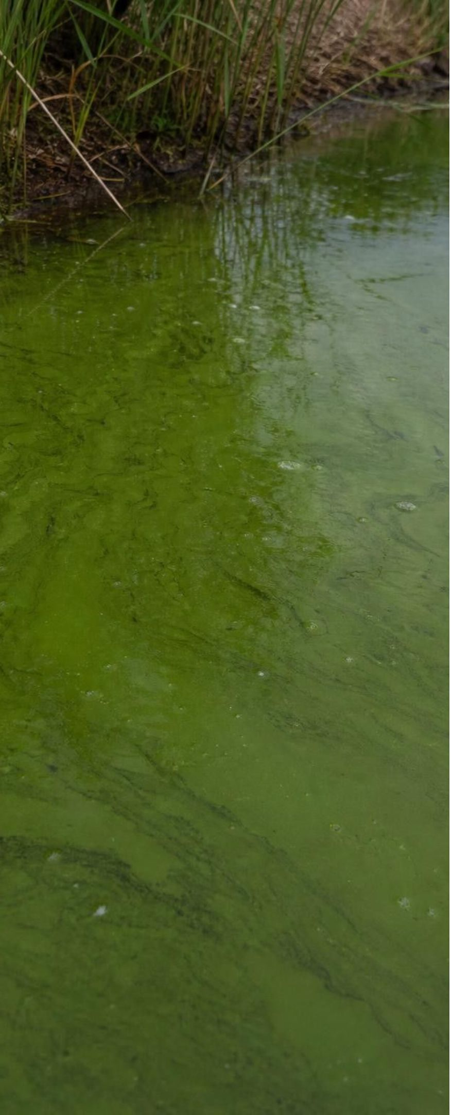
APPLY IT · SIMULATED DATA FOR PRACTICE.
Task: did the lake fix work? Read the monitoring data
A murky lake was treated in two steps. Use the table to decide whether step 1 worked, why the team modified it, and what evidence shows step 2 worked.
Year | Action taken | Roach per net-night | Zooplankton per liter | Algae cells per drop | Clarity depth (m)
1 | Monitoring only | 42 | 12 | 900 | 0.7
2 | Half the roach netted out | 20 | 30 | 600 | 1.1
3 | Netting continued | 24 | 28 | 550 | 1.2
4 | Predatory fish stocked, netting continued | 15 | 45 | 300 | 1.9
5 | Predators growing | 8 | 60 | 150 | 2.8
6 | Monitoring only | 9 | 58 | 160 | 2.7
21
Notes:
This is a teaching dataset for a fictional lake, built to match the pattern the food-web model predicts; tell students that plainly. Give groups eight minutes. Steps: (1) Write the sign chain the team was betting on: fewer roach, more zooplankton, fewer algae, clearer water. (2) Check years 1 to 3: roach fell by half, zooplankton more than doubled, algae dropped, clarity improved, but only from 0.7 m to 1.2 m and it was leveling off, so step 1 helped but was not enough. (3) Check years 4 to 6: after predators were added, roach kept falling, zooplankton rose further, algae fell to a sixth of the start, clarity reached 2.8 m and held after netting stopped. (4) Ask what else could explain the change: weather, less nutrient inflow, measurement differences. A good scientist names those before claiming success. Clarity depth is measured by lowering a white disk until it disappears; deeper is clearer.
EXPECTED RESPONSES: Step 1 worked partly: every variable moved the predicted way but clarity plateaued near 1.2 m. The team modified because the criterion (clear water) was not met. Evidence for step 2: roach 15 → 8, zooplankton 45 → 60, algae 300 → 150, clarity 1.9 → 2.8 m, and the gains held in year 6 with no netting. Alternative explanations: a drier year, less fertilizer runoff, different sampling spots.
WATCH FOR: Students claim success from a single year or a single variable. Require at least two variables and the year-6 hold.
CONNECTS TO: Lab 3 runs a model of this lake; W6 CER can use this table; W9 transfer.
PACING: about 10 min

Slide 22
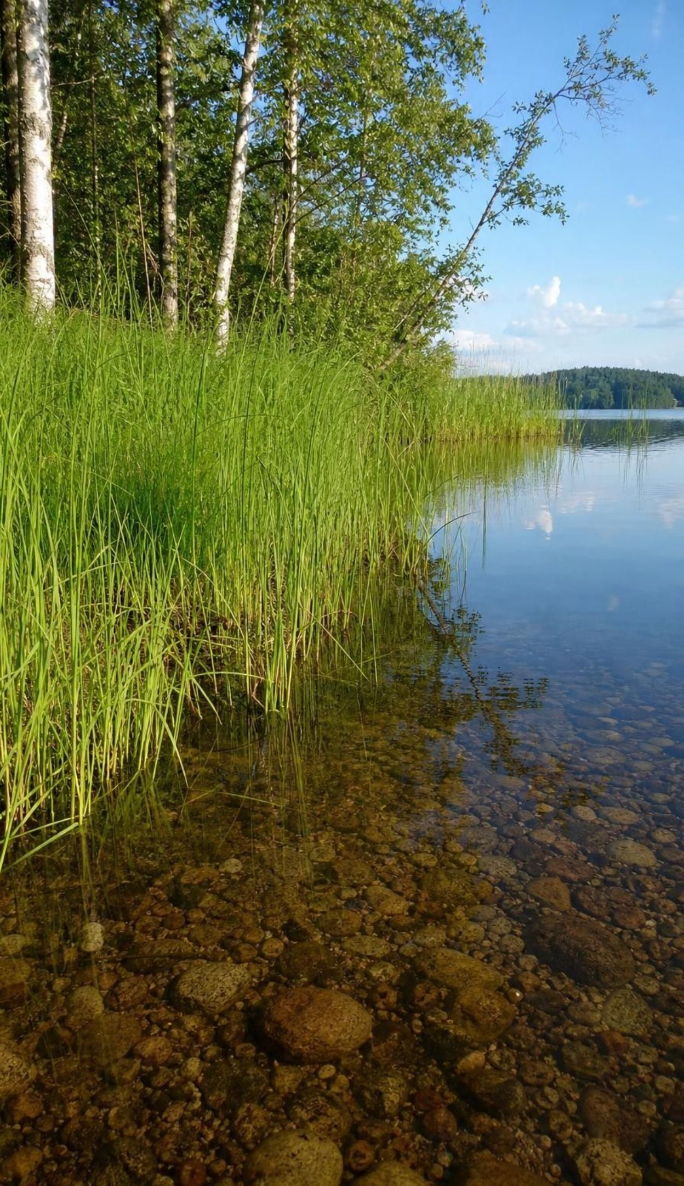
Engineering with a food web: test, measure, modify
Lake Vesijärvi, Finland: years of sewage fed the algae; the water turned murky and stayed that way.
The model's bet: plankton-eating fish were keeping zooplankton low, so algae grew unchecked.
Test 1: net out huge numbers of roach. Measured result: better, but not clear enough.
Modify: stock predatory fish that eat roach. Measured result: zooplankton up, algae down, water clear.
Measuring: count algae cells in a drop of lake water under a microscope, then scale up to the whole lake.
The real history was messier: cutting off the sewage did much of the work, and the fish steps overlapped.
22
Notes:
Tell the story the textbook tells, then add what the scientists' own published review says, because students deserve the real version. The sewage was diverted in the mid-1970s, and that diversion, with the slow flushing of the lake, did a large part of the recovery. The predatory fish stocked were pikeperch, over a million young ones from 1984 to 1991, and that started before the big roach removal of 1989 to 1993, which cut the plankton-eating fish by about nine tenths. The removed fish also carried phosphorus, a key nutrient, out of the lake in their bodies. And the researchers themselves say the drop in algae was not clearly caused by extra zooplankton grazing; the exact mechanism is still debated. So the clean two-step story is the model's prediction and a good example of test-measure-modify, not a settled account. Ask students what they would want to measure to tell the explanations apart.
WATCH FOR: Treating a food-web fix as a guaranteed recipe. A model predicts the direction of change, not the size, and every lake differs.
CONNECTS TO: Lab 3 Fixing Lake Vesipuro; W9 reservoir decision; chapter accuracyNotes for the sources.
PACING: about 6 min

Slide 23
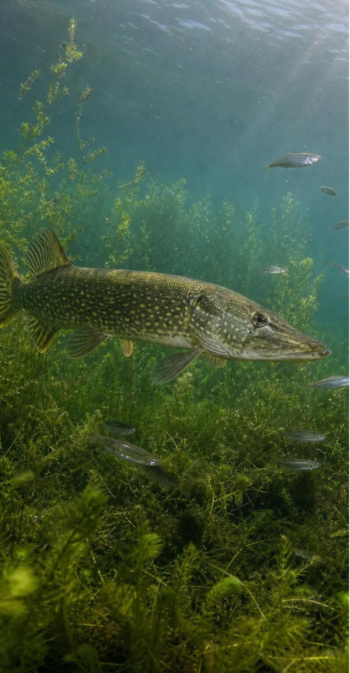
CHECK FOR UNDERSTANDING
Quick check: what counts as good evidence?
A team claims that adding predatory fish cleared a lake. Which single piece of evidence supports that claim most strongly?
A. The lake looked clearer to visitors the summer after stocking.
B. Algae counts fell in the two years after stocking, and roach and zooplankton changed in the predicted directions.
C. Predatory fish are known to eat roach in other lakes.
D. The team expected the plan to work because the food-web model said it would.
23
Notes:
Vote, then defend. Option A is an impression, not a measurement. Option C is background knowledge, not evidence from this lake. Option D is a prediction, which is exactly what needs testing. Option B is measured data from this lake that move in the predicted pattern across more than one variable. Follow up: even B is not proof. Ask what would make it stronger: a nearby untreated lake for comparison, or several years of data showing the change held.
EXPECTED RESPONSES: B. Strongest because it is measured, specific to this lake, and covers several linked variables that all moved as predicted. A comparison lake or more years would strengthen it further.
WATCH FOR: Choosing D: a model's prediction is a reason to test, not evidence of success.
CONNECTS TO: Lab 3 decision justification; W6 CER rubric; W9.
PACING: about 4 min

Slide 24
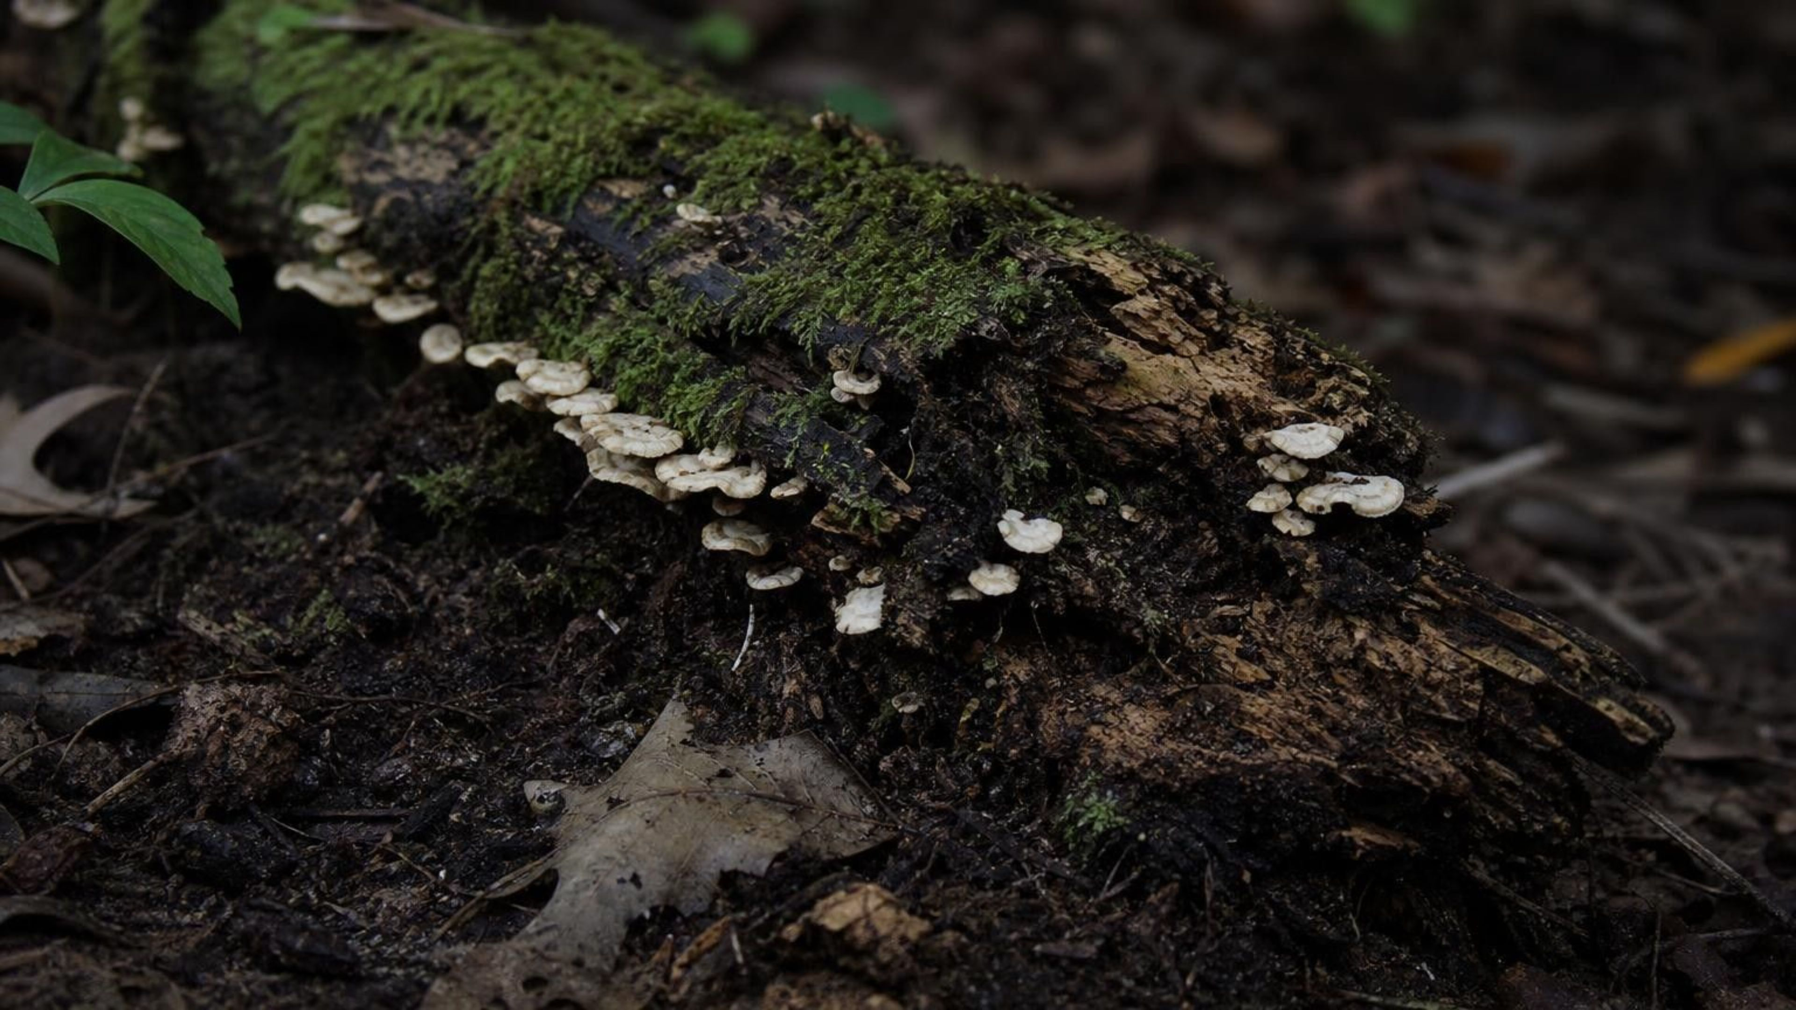
MISCONCEPTION CHECK
True or false? Energy goes around the loop too
"Decomposers recycle matter back to the producers, and in the same way they recycle energy back to the producers, so an ecosystem could keep running without the sun once it got started."
True or false? Explain your reasoning.
24
Notes:
Have students evaluate the statement in writing with evidence from the lesson, then share. The first half is right: decomposers return carbon dioxide and nutrients to the air and soil, and producers take them in. The second half fails. Decomposers get their energy from the chemical energy in remains and, like every consumer, release most of it as heat while they live. Producers cannot capture heat; they capture light. So no energy goes 'back' to producers through decomposers, and an ecosystem cut off from the sun would run down as its stored food was used up. Connect to the steer: the warmth of the barn was energy leaving the system for good. Finish with the two-word summary: matter cycles, energy flows.
EXPECTED RESPONSES: False. Matter is recycled through decomposers; energy is not, because it leaves as heat at every level and producers can only capture light. Without the sun the ecosystem would stop once stored food ran out.
WATCH FOR: Students may overcorrect to 'decomposers destroy energy'. They release it as heat; it still exists, but spread out and unusable to producers.
CONNECTS TO: W7 misconception repair; W6 CER; chapter misconceptions list.
PACING: about 6 min

Slide 25

PUTTING IT TOGETHER
Putting it together
A food web's arrows point from food to eater and carry matter and energy together.
Change one population and the effects ripple: direct through one link, indirect through two or more.
Decomposers return every atom to the air, water and soil, so matter cycles.
Only about a tenth of each level's energy is passed up; the rest leaves as heat or goes to decomposers.
Energy enters as sunlight and leaves as heat, so it flows through, and the pyramid can never flip.
A food-web model can guide an ecosystem repair, but the plan must be tested, measured and modified.
25
Notes:
Have students write a four-sentence summary that uses at least five vocabulary terms and includes the phrase 'matter cycles, energy flows'. Trade with a partner, who checks that every arrow described points to the eater. Then ask for one thing from each lab: Lab 1 (which indirect effect surprised them), Lab 2 (how many levels their efficiency could support), Lab 3 (which plan they chose and what it cost). Preview Lesson 7: the matter loop we drew for one woodland is part of planet-wide cycles of carbon and nitrogen, and the lake's trouble began with a nitrogen and phosphorus overload from sewage.
CONNECTS TO: W10 mastery as the quiz; L07 Global Cycles of Matter next.
PACING: about 6 min

Slide 26
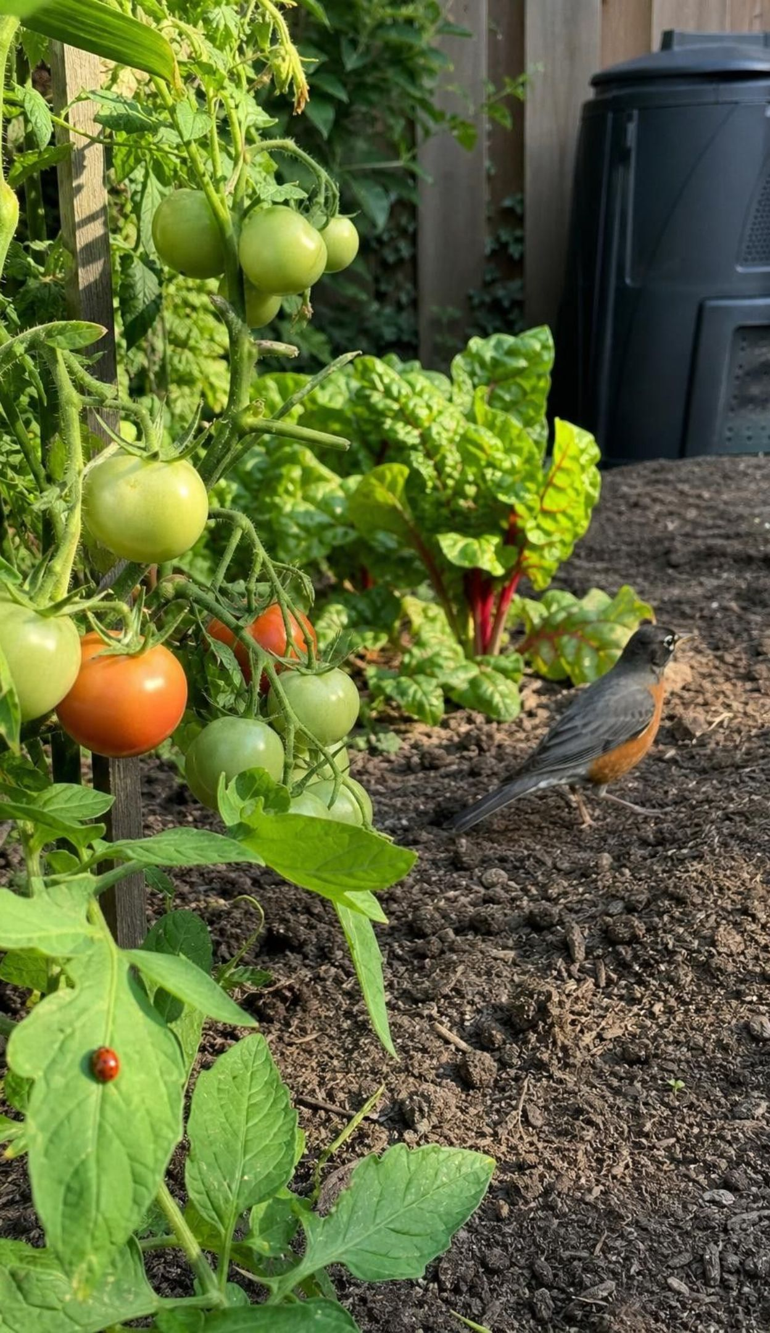
EXIT TICKET
Exit ticket
Draw a three-link food chain from your neighborhood, arrows pointing the right way, and number the levels.
Coyotes are removed from a valley. Write the sign chain for jackrabbits, then grass, then grasshoppers.
Producers store 20,000 energy units. Using the ten-percent rule of thumb, how much reaches level 3?
Finish the sentence: 'Matter cycles but energy flows because ___.'
26
Notes:
Collect on index cards or a shared form. Item 1 catches the arrow-direction error; item 2 catches students who stop after one link or get a sign wrong; item 3 catches off-by-one-level arithmetic; item 4 is the chapter's central idea in the student's own words. Sort the cards into three piles before the next class and reteach from the largest pile.
EXPECTED RESPONSES: 1: for example lawn grass → rabbit → coyote, levels 1, 2, 3, arrows toward the eater. 2: jackrabbits up, grass down, grasshoppers down. 3: 200 units (20,000 × 0.1 = 2,000 at level 2; × 0.1 = 200 at level 3). 4: '... decomposers return atoms to the air and soil for producers to reuse, but energy leaves as heat at every level and producers can only capture light.'
WATCH FOR: Item 3 answers of 2,000 (one level short) or 20 (one level too far); item 4 answers that say energy is 'used up' or 'destroyed'.
CONNECTS TO: W10 mastery; chapter evidenceOfLearning.
PACING: about 5 min

