Slide 1
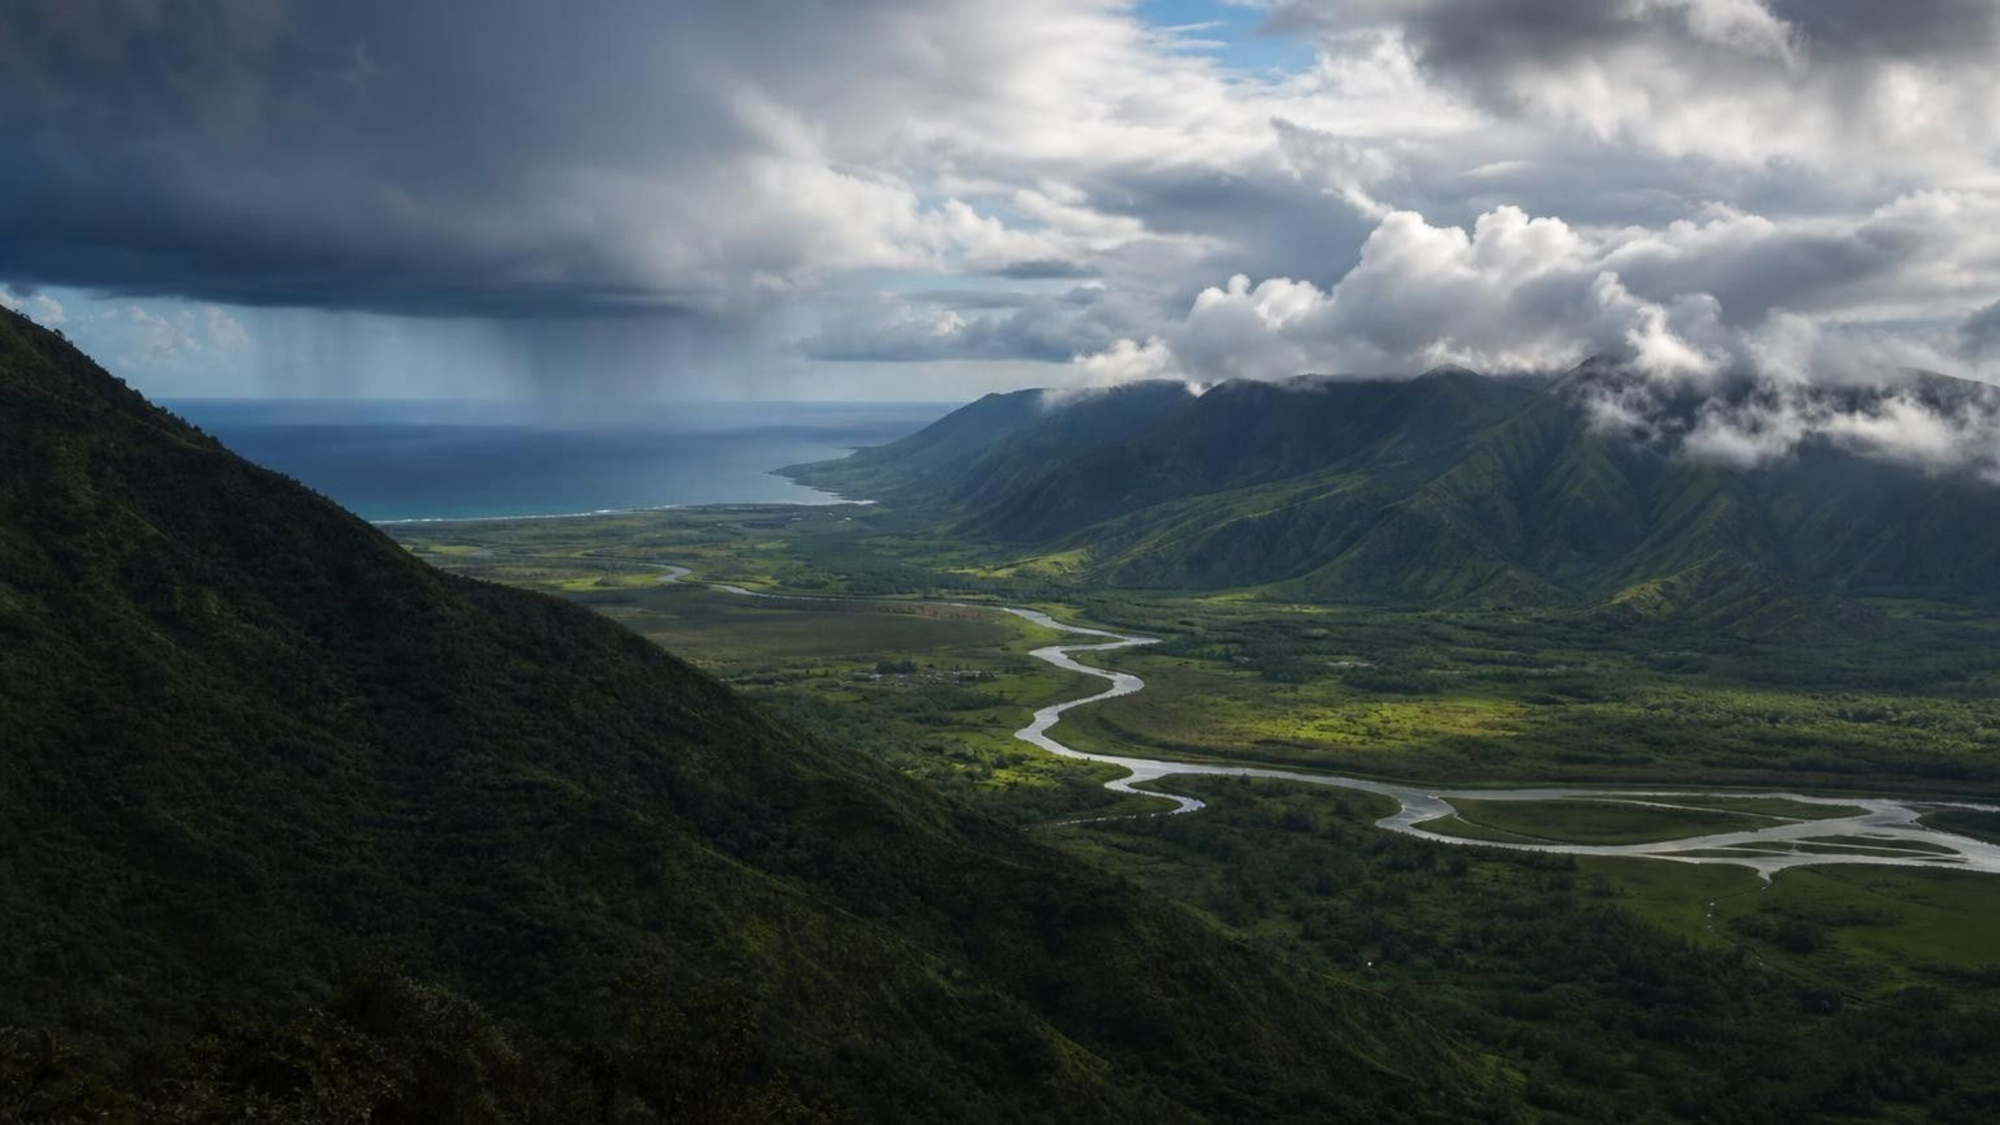
Chapter 7: Global Cycles of Matter
Chapter 7 of 29 · Energy and Matter in Ecosystems
Lesson 7: How does the same matter keep moving through Earth's living and nonliving parts?
Angela's Wand · Bring Science Alive! 7th Grade Integrated
Notes:
Open with a claim that sounds impossible: almost every atom in this room has been on Earth for about four and a half billion years, and the carbon atoms you breathe out today may be inside a leaf by summer. Over the next week the class will test that claim three ways: a dice game in which each student is a carbon atom moving between stations, a sealed jar that changes inside while its mass stays put, and a decision about fertilizer that only makes sense once the nitrogen cycle is understood. Tell students the lesson has three cycle maps, water, carbon and nitrogen, and that the skill is the same for all three: name the storage places and name the process on every arrow.
CONNECTS TO: Overview of Lab 1 (atom passports), Lab 2 (sealed jar, starts period 2) and Lab 3 (fertilizer decision).
PACING: about 2 min

Slide 2
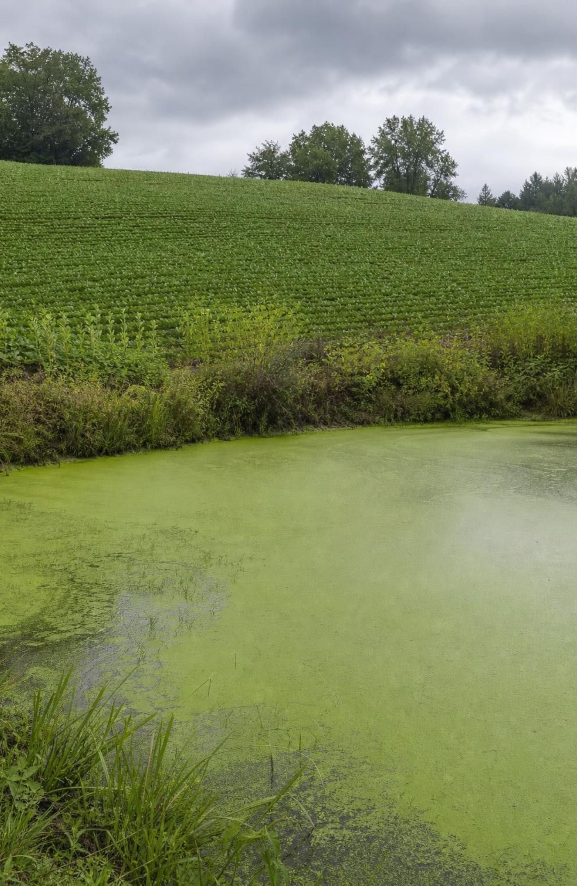
PHENOMENON
The pond that turned green after the rain
A pond sits below a sloping field. In early spring the field is fertilized and the pond is clear. A heavy storm sweeps the field two weeks later. Ten days after that, the pond is covered in green scum, the edges smell of rot, and a few fish float in the shallows. Nobody poured anything into the pond, and the field looks better than ever.
Notice: what changed in the pond, and what changed in the field?
Wonder: green scum is made of living matter. Where did that matter come from in ten days?
Predict: if the storm had missed the field, would the pond have turned green anyway?
2
Notes:
Give two silent minutes for a notice and a wonder, then collect answers without judging. Press on the chain of events: fertilizer, storm, pond, scum, smell, fish. Ask what the storm could have carried downhill. Expect some students to say the fertilizer 'poisoned' the fish directly; park that claim, because the real story is stranger: the fertilizer fed the pond so well that the feast killed the fish. Ask students to keep a list of every place matter was stored in this story (bag, soil, water, algae, dead algae, fish) and every move between them. That list is the first cycle map of the chapter. If you have a jar of pond or aquarium water, set it in a sunny window today; it will green up over the week.
EXPECTED RESPONSES: Notice: the pond went from clear to green, the field stayed healthy, fish died after the scum appeared. Wonder: did the fertilizer get into the pond; is the scum plants or something else; why did the fish die if plants were growing. Predict: most will say no scum without the storm, which is the hypothesis Lab 3's data tests.
WATCH FOR: 'The fertilizer is poison.' Fertilizer is plant food; the harm comes from too much growth followed by decomposition that uses up oxygen. Do not resolve this yet; slide 20 does.
CONNECTS TO: W1 phenomenon worksheet records the notice/wonder and first explanation. W5, the W8 evidence jigsaw and Lab 3 return to this pond.
PACING: about 8 min

Slide 3
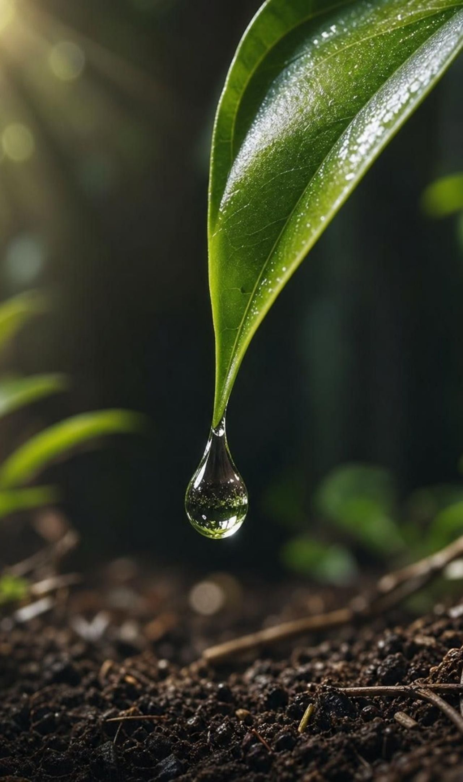
LEARNING TARGETS
What you will be able to do
Explain why Earth is nearly closed for matter but open for energy, and name the exceptions.
Trace one atom of carbon or nitrogen through living and nonliving reservoirs, naming each process.
Build a cycle model that shows reservoirs, processes and the system boundary.
Use a cycle model to predict what fossil-fuel burning or fertilizer runoff changes.
Evaluate competing plans, such as fertilizer schedules or tree-planting sites, with criteria and constraints.
3
Notes:
Read the targets aloud and have students mark the one that sounds least familiar. Point out the shape of the week: targets 1 and 2 belong to the first two days, target 3 is the carbon and nitrogen maps, targets 4 and 5 are the human-decision days at the end. Say plainly that the water cycle is a review of sixth-grade work and will go fast; the carbon and nitrogen cycles are new and will get the time.
CONNECTS TO: Targets map to Lab 2 and W6 (1), Lab 1 and W4 (2 and 3), W5 and W8 (4), Lab 3 and W9 (5).
PACING: about 2 min

Slide 4
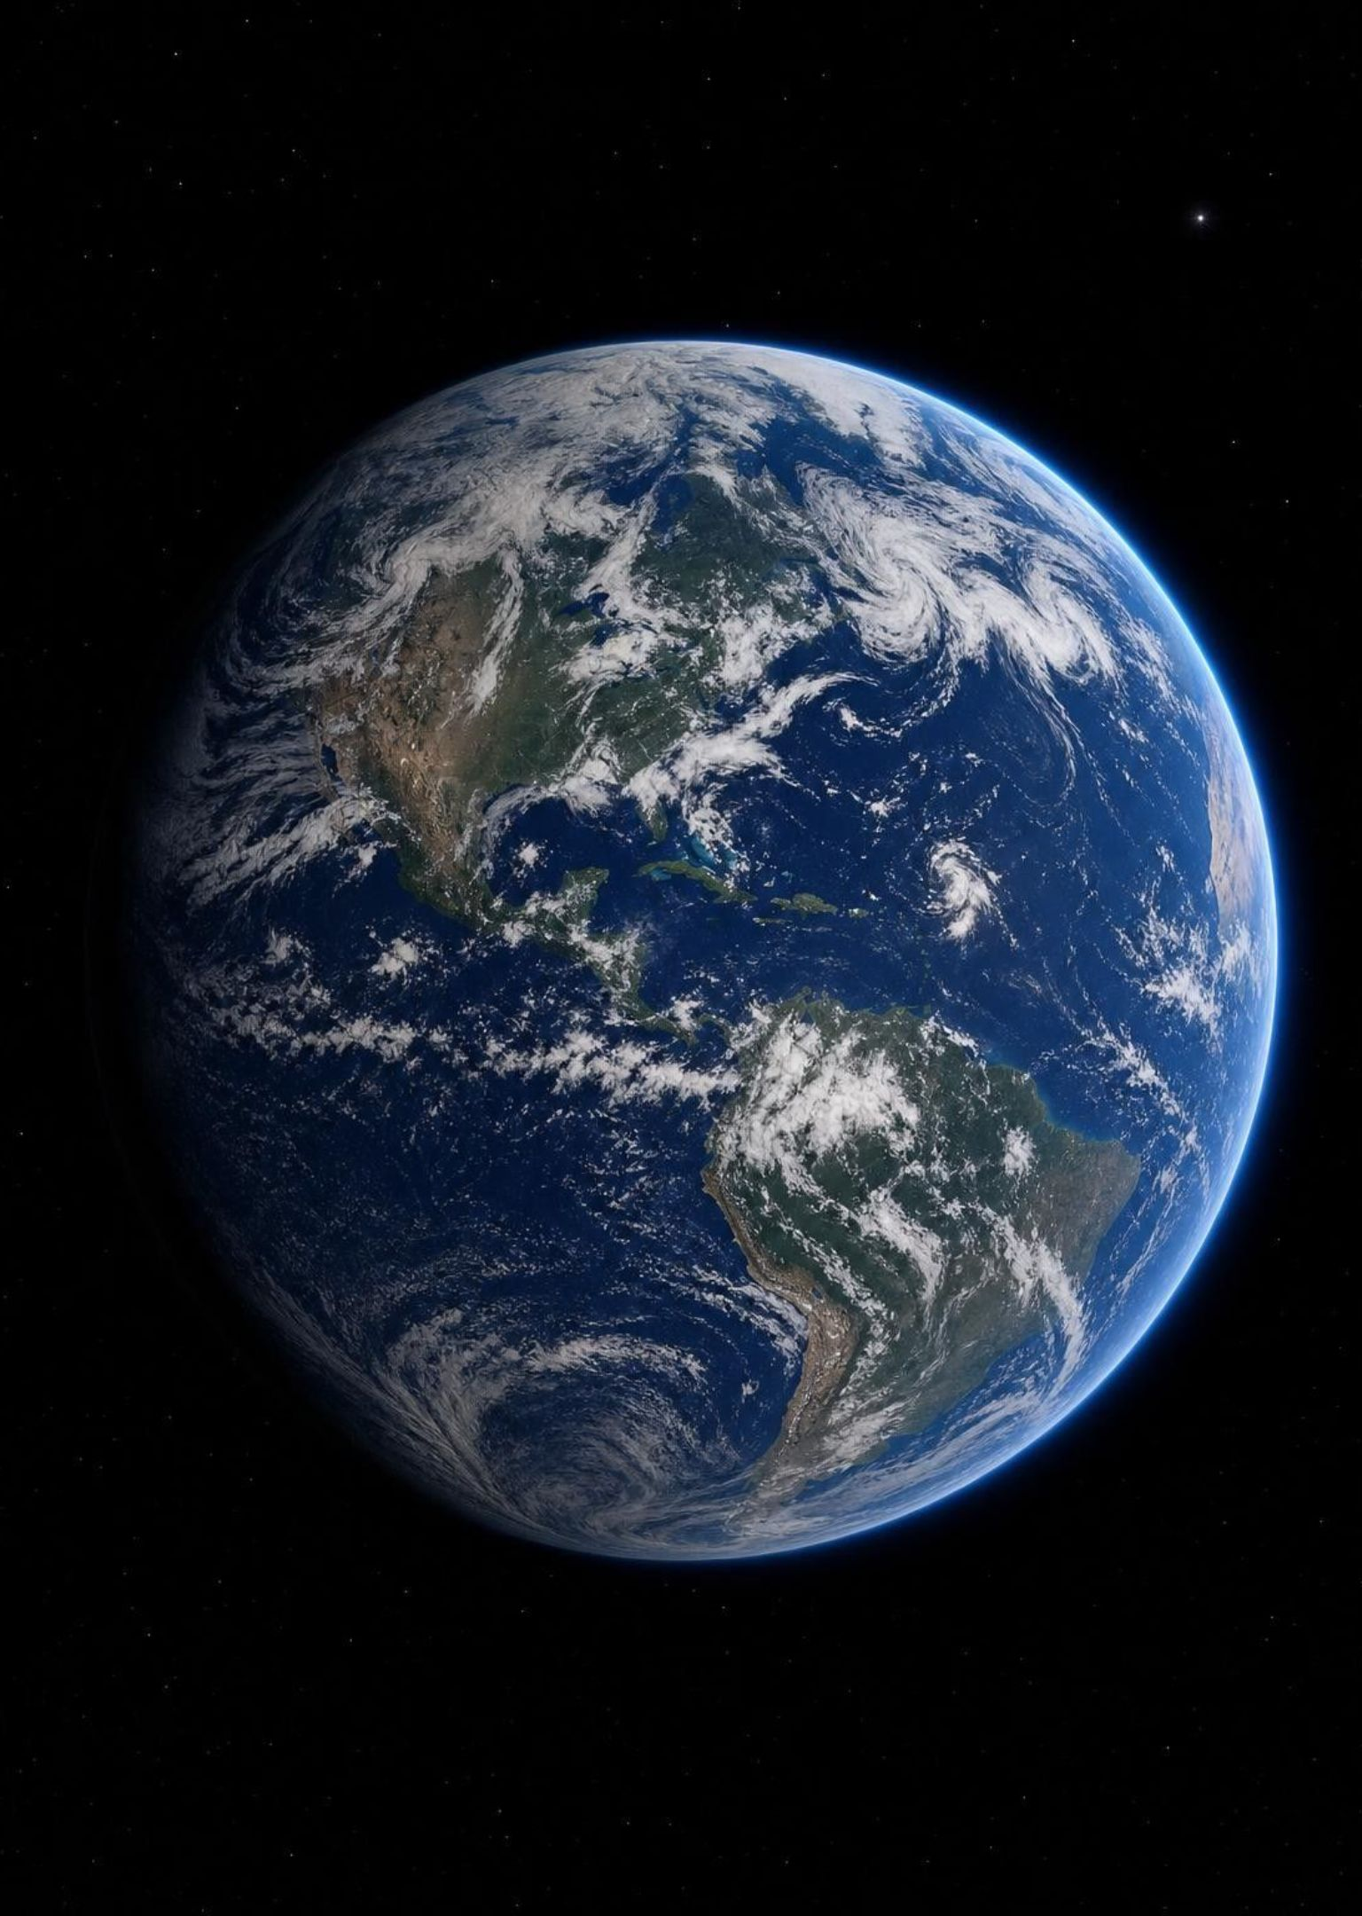
Spaceship Earth: what comes aboard, what leaves
Nearly every atom on Earth has been here since the planet formed about 4.6 billion years ago.
Matter is not created or destroyed by ordinary changes; it only changes form or location.
Small leaks exist: about 100 tons of space dust arrive daily; some gas escapes the top of the air.
Next to a planet of six trillion trillion kilograms, those leaks are nothing: Earth is closed for matter.
Energy is different: sunlight pours in every day and heat radiates back out to space.
4
Notes:
Build the spaceship picture: a ship launched with all the supplies it will ever have must reuse everything, and Earth is that ship. Then be precise about the two kinds of traffic across the boundary. Matter: almost none in or out, so the atoms aboard are the atoms we have. Energy: constant traffic, in as light, out as heat. Students need both halves, because a system that was closed to energy would be a dead rock; the cycles run on sunlight. The textbook says the number of atoms never changes and then mentions spacecraft and meteors. Ask: does a few hundred tons a day break the model? No; compare it with the planet's mass and the model holds for every practical purpose. Keep the 'open to energy' idea alive for Lab 2, where the jar on the windowsill is closed to matter and open to light.
WATCH FOR: 'Closed means sealed from everything.' Separate matter from energy explicitly and return to it on slide 6.
CONNECTS TO: Lab 2 sealed jar is the physical test of this slide. W2 vocabulary.
PACING: about 5 min

Slide 5
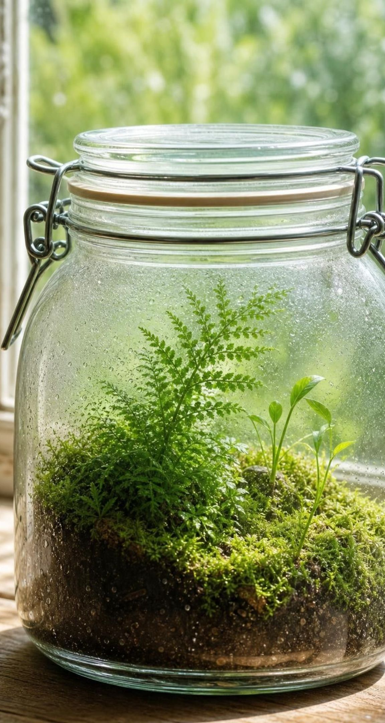
VOCABULARY IN CONTEXT
Three words for a planet that reuses everything
law of conservation of matter: Ordinary changes never create or destroy atoms. Seal a system so nothing gets in or out, and its total mass holds steady no matter how its contents change form. A sealed jar with sprouting seeds keeps the same mass for weeks; atoms only moved from air and water into the seedlings.
closed system: A system that matter does not enter or leave; energy can still cross the boundary. A sealed terrarium is closed to matter but needs light coming in to stay alive.
reservoir: A place where matter is stored for a while inside a cycle. The atmosphere, the ocean, soil, a tree trunk and a coal seam are all reservoirs for carbon.
5
Notes:
Have students say 'closed to matter, open to energy' together once; it is the sentence they will need on the exit ticket. For reservoir, use the water-tank image: a reservoir holds water and pipes carry it in and out. In a matter cycle the tanks are places and the pipes are processes. Ask for one reservoir of water they can see from the window (a puddle, a cloud, the lawn) and one process that moves water out of it. Every cycle map in this lesson is just reservoirs and the processes between them.
WATCH FOR: Students may think a reservoir has to be nonliving. A body is a reservoir too; a whale holds carbon for decades.
CONNECTS TO: W2 vocabulary worksheet sorts reservoirs from processes.
PACING: about 4 min

Slide 6
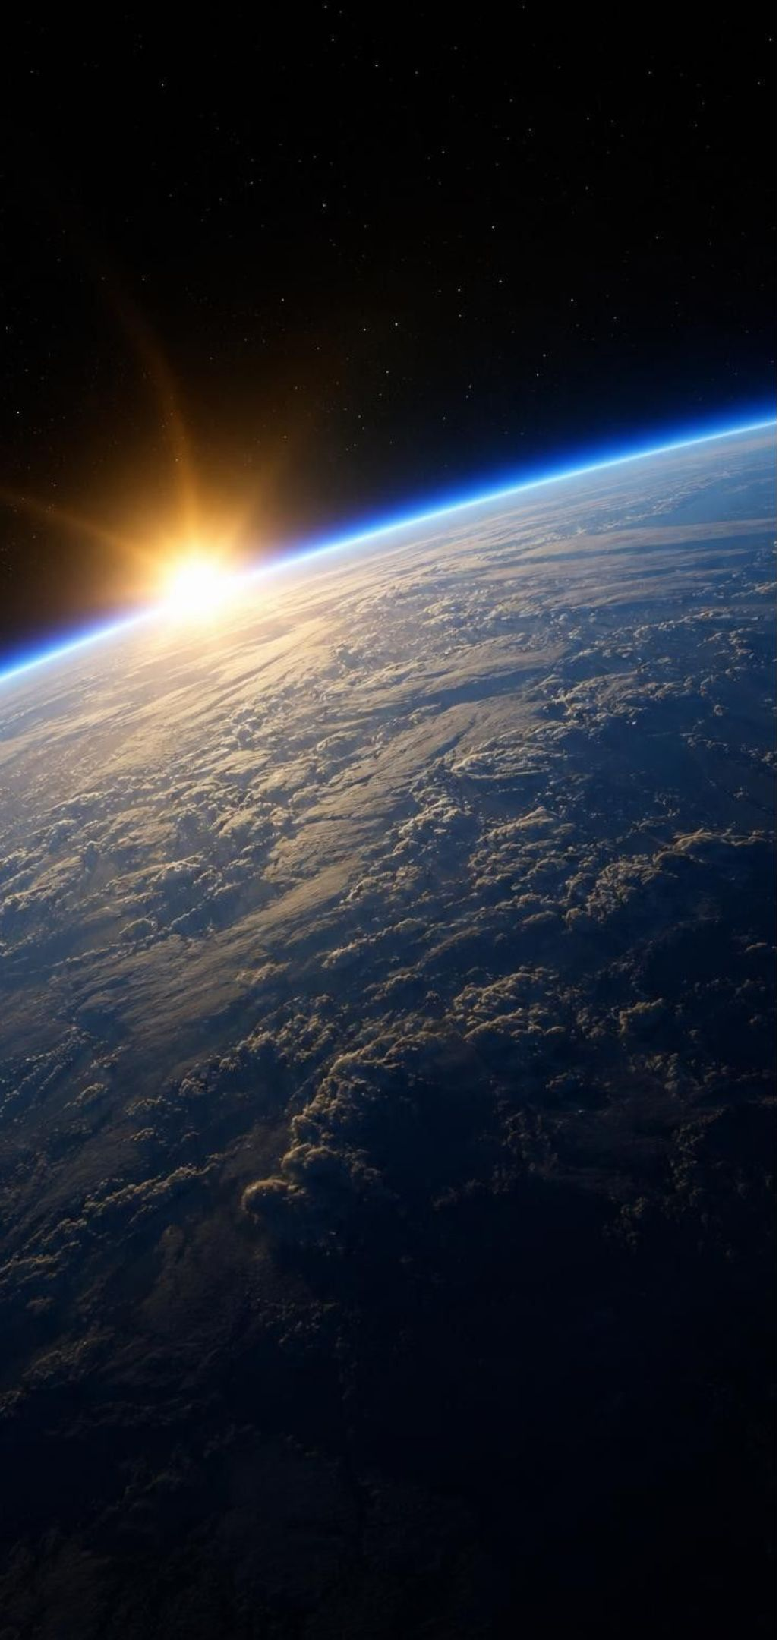
MODEL
At the edge of the planet: matter stays, energy flows
Model: What crosses Earth's boundary with space
Matter: stays aboard | Energy: passes through
The same atoms since Earth formed | Sunlight arrives every day
Water, carbon and nitrogen move only between reservoirs on Earth | Drives evaporation, photosynthesis, wind and weather
Tiny exceptions: space dust in, a little gas and a few spacecraft out | Heat radiates from Earth back out to space
Result: the cycles must reuse what is here | Result: the cycles never run out of power
Define the system first. For the whole planet, the boundary is the top of the atmosphere.
6
Notes:
Read both columns, then ask students to draw the same two-column picture for a smaller system: a sealed jar on a windowsill. What crosses the lid? Nothing with mass. What crosses the glass? Light in, heat out. This is the boundary-defining skill named in MS-LS2-3: before you model a system you decide where its edge is and what can cross it. Then ask about an open aquarium: water evaporates out, fish food goes in, so it is open to matter. Have students explain why a cycle needs the right column to keep going: without sunlight no evaporation, no photosynthesis, no growth, and the matter would sit still.
EXPECTED RESPONSES: Jar: no matter crosses, light and heat do. Aquarium: both matter (food, evaporation) and energy cross, so it is an open system.
WATCH FOR: Some students will put sunlight in the matter column. Light has no mass; it carries energy only.
CONNECTS TO: Lab 2 recording sheet asks for this two-column boundary table for the jar. W4 asks students to draw the boundary on their model.
PACING: about 5 min

Slide 7
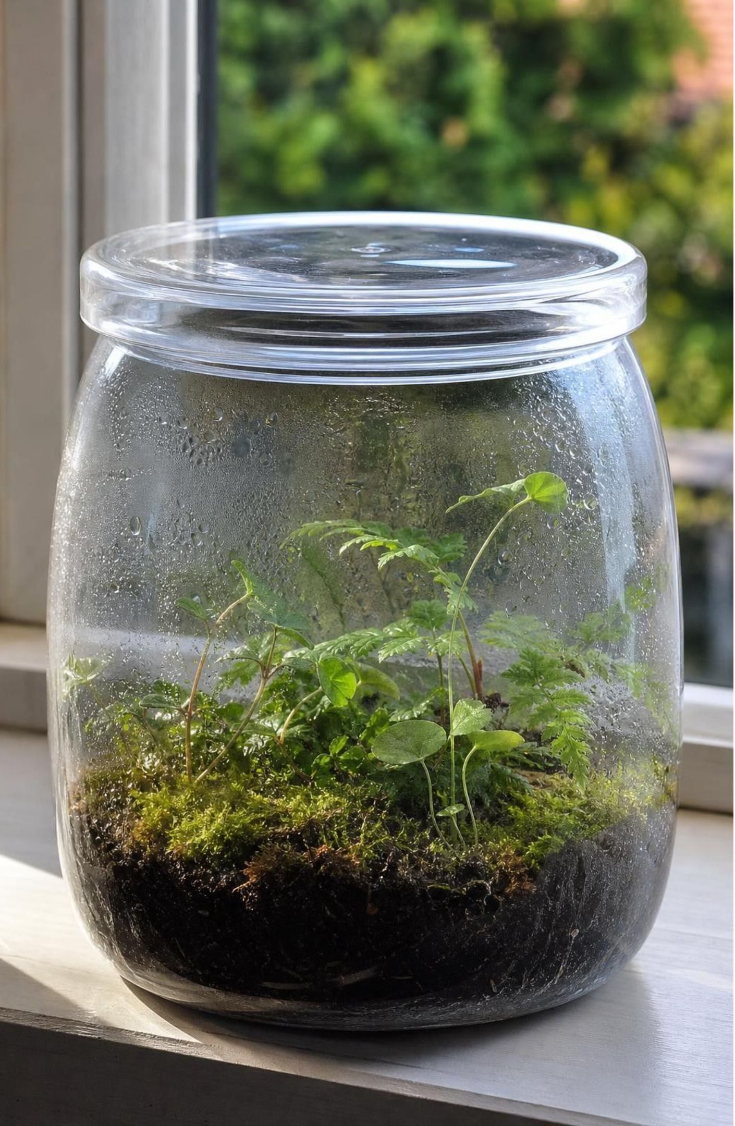
CHECK FOR UNDERSTANDING
Quick check: which one is closed for matter?
Which of these systems is closed for matter during the time described?
A. An open aquarium over a month, with fish fed daily
B. A sealed glass terrarium on a windowsill for a year
C. A campfire burning for an hour
D. A pond with a stream running in and out
7
Notes:
Vote with fingers, then defend. The aquarium gains food and loses water vapor. The campfire takes in oxygen from the air and sends out carbon dioxide, water vapor and smoke; it is wide open. The pond has matter flowing through it constantly. Only the sealed terrarium keeps its matter, and it still needs the window. Follow up: could you make the campfire a closed system? Only by putting the whole fire, its air supply and every bit of smoke inside a sealed container, and then the mass would not change while it burned. That thought experiment is the setup for the combustion misconception at the end of the lesson.
EXPECTED RESPONSES: B, the sealed terrarium. Students who choose D often reason that 'the pond is still there'; point out that the water in it is not the same water.
WATCH FOR: Choosing the campfire because 'the fire uses everything up' signals the matter-is-destroyed idea; note who says it for slide 25.
CONNECTS TO: Lab 2; W7 misconception repair.
PACING: about 4 min

Slide 8
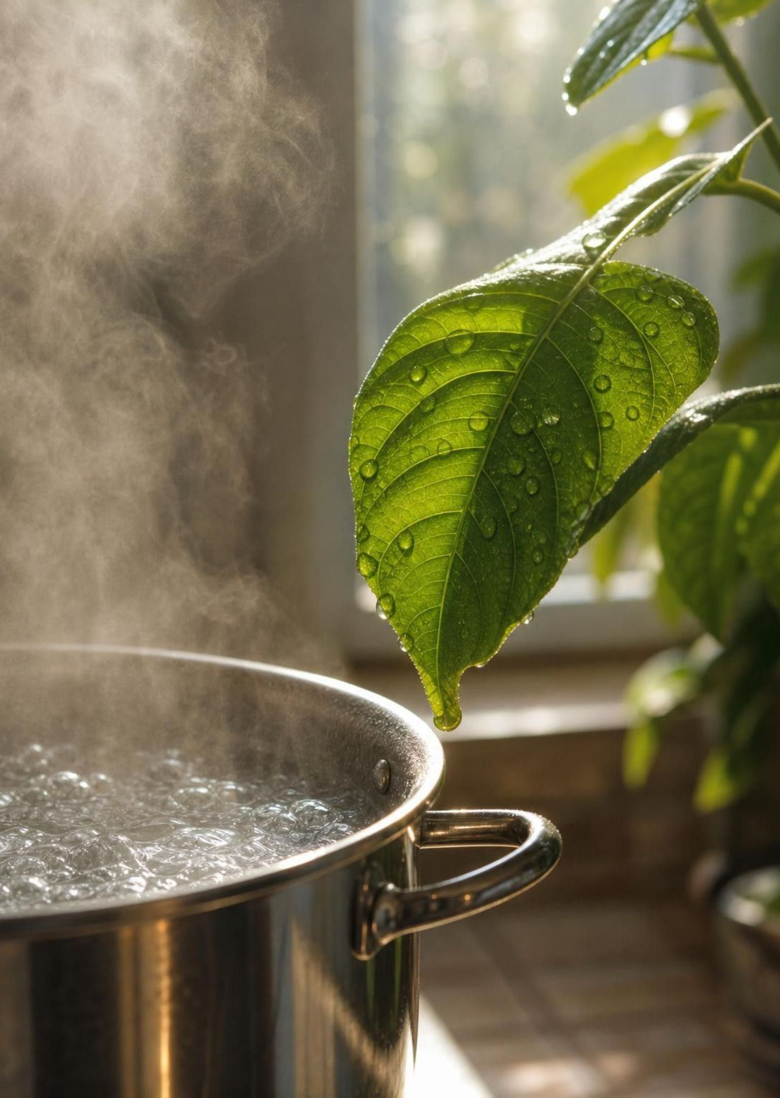
Same atoms, new molecules
Matter changes form two ways inside the cycles. It can change state: liquid water becomes vapor, and the molecules stay whole. Or its atoms can be rearranged into different molecules: carbon dioxide and water become sugar and oxygen in a leaf. In both cases every atom is still there. What is not guaranteed to survive is the molecule. Plants split water molecules apart, and your cells build brand-new ones.
8
Notes:
The textbook says your glass of water holds molecules a dinosaur drank. The honest version is better: it holds atoms that may have passed through a dinosaur, but many of those atoms have been taken apart and put back together many times since. Photosynthesis splits water molecules; cellular respiration makes new water molecules. Ask: what is the smallest thing that is guaranteed to survive a chemical change? The atom. That is why we trace atoms, not molecules, through every cycle in this lesson. Keep this at the level of 'atoms rearranged into new molecules' and do not write equations; the standard is not assessed with reaction chemistry, and Lesson 13 handles atom counting in reactions.
WATCH FOR: 'Molecules are forever.' Also watch for the opposite error, that atoms get used up; both are fixed by the sentence 'atoms persist, molecules get rebuilt.'
CONNECTS TO: W7 misconception worksheet includes the dinosaur-water claim. Links forward to L13 Atoms in Chemical Reactions.
PACING: about 5 min

Slide 9
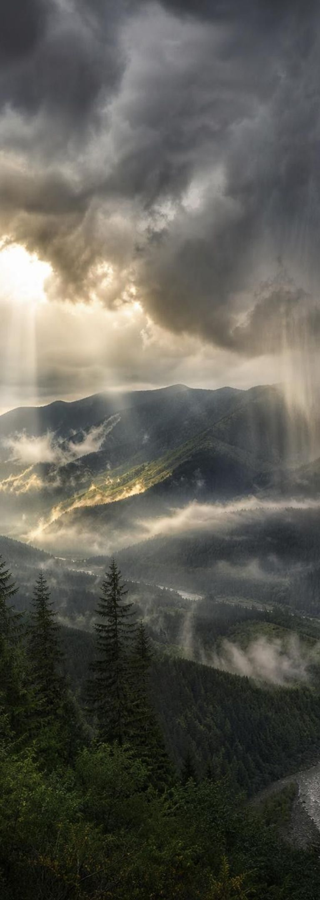
The water cycle as a reservoir map
Model
Model: One route a water molecule can take
Water vapor in the air →
(condensation)
Cloud droplets and ice →
(precipitation)
Rain and snow on land →
(soaking in, runoff)
Soil water, rivers, lakes, ocean →
(root uptake)
Inside plants and animals →
(transpiration)
(back to the start)
Sun and gravity drive this cycle: sunlight lifts water as vapor, gravity brings it down as rain and runoff. Animals drink water and return it to the air by exhaling; evaporation from soil, lakes and the ocean sends water back without passing through living things. Ice can go straight to vapor by sublimation.
9
Notes:
This is review from sixth grade, so go fast and use it to teach the reading skill: for every arrow, ask where the matter starts and where it ends. Trace one molecule out loud: vapor, cloud, rain, soil, root, leaf, back to vapor through the leaf's pores (transpiration). Then show that the map is a set of options, not a single loop: rain can fall straight into the ocean and evaporate again without ever touching a plant. Add the two energy sources, sun for lifting and gravity for falling, because the Grade 6 standard names them. Note the two corrections to the book's figure: solid ice turning directly to vapor is sublimation, not evaporation; and water vapor is a gas you cannot see, while clouds are droplets you can.
WATCH FOR: Clouds are water vapor (they are liquid droplets and ice); ice 'evaporates' (it sublimates).
CONNECTS TO: MS-ESS2-4 is a Grade 6 PE; this slide reviews, it does not assess. W4 asks for a comparable map of the carbon cycle.
PACING: about 5 min

Slide 10
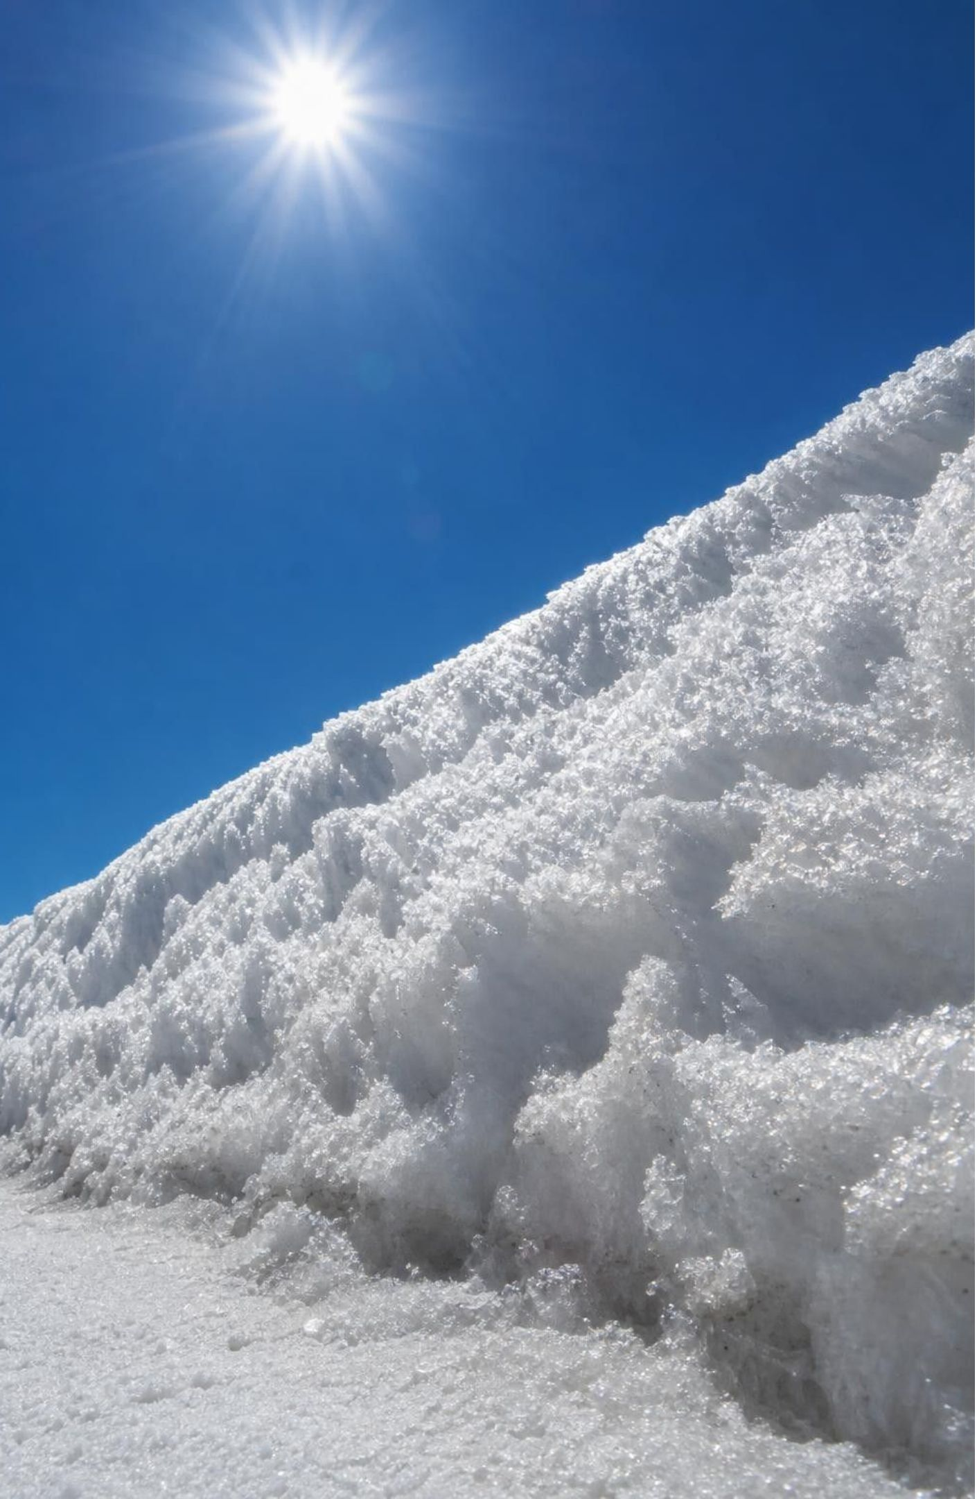
CHECK FOR UNDERSTANDING
Quick check: name the arrow
A snowbank shrinks during a week of dry, sunny, below-freezing weather and no meltwater appears. Which process moved the water out of the snow?
A. Evaporation
B. Sublimation
C. Condensation
D. Transpiration
10
Notes:
Quick vote. The trap is evaporation, which the textbook figure uses for this arrow. Evaporation starts from a liquid; there was no liquid here because the air stayed below freezing. Solid straight to gas is sublimation, and it is common on cold, sunny, windy days in the mountains. Follow up: where did the water go, and what reservoir is it in now? The air, as vapor.
EXPECTED RESPONSES: B, sublimation. The water is now vapor in the atmosphere.
WATCH FOR: Students who pick A are following the book's label; explain the liquid requirement rather than just marking it wrong.
CONNECTS TO: W10 mastery; the chapter accuracy notes.
PACING: about 3 min

Slide 11
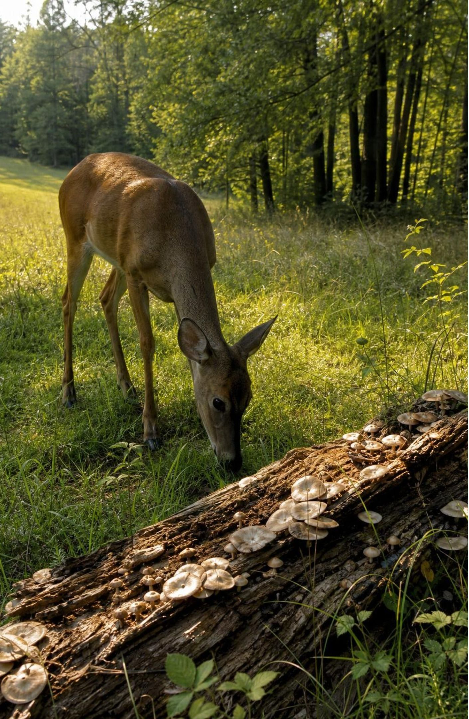
Carbon's main doorway in, and its main doorway out
In: photosynthesis. Producers take carbon dioxide from air or water and build it into sugars.
Along: eating. Consumers take in producers' carbon and rebuild it into their own fats, proteins and DNA.
Out: cellular respiration. Every living cell, plant or animal or microbe, releases carbon dioxide.
Decomposers eat dead remains and wastes; their respiration returns most of that carbon to the air.
Slow side road: remains buried under sediment can become fossil fuels over millions of years.
11
Notes:
Set the rhythm: one road in, one road out, and everything else is carbon moving from body to body in between. Photosynthesis is the only large natural process that moves carbon from the nonliving world into living things, which is why producers are the base of every food web from Lesson 6. Cellular respiration is the return trip, and stress that plants do it too, day and night; students often think only animals respire. Decomposers are the recyclers: the carbon in a fallen leaf mostly ends up back in the air through their respiration, with some left in the soil. The fossil-fuel road is real but slow and rare; most dead matter is recycled within years, not buried for ages. Keep this at the level of processes and atoms, not reactions.
WATCH FOR: 'Plants do photosynthesis, animals do respiration.' Plants do both. 'Decomposers destroy matter.' They move it.
CONNECTS TO: Lab 1 station rules follow exactly these doorways. W3 reading passage.
PACING: about 5 min

Slide 12
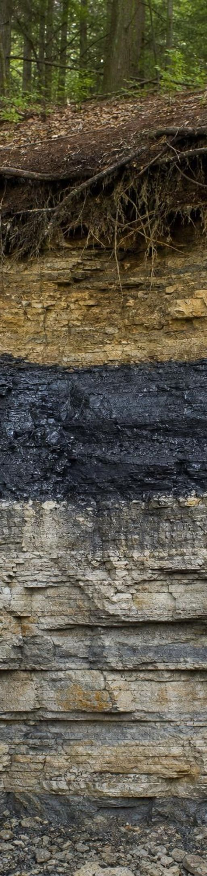
The carbon cycle as a reservoir map
MODEL
Model: Where a carbon atom can be, and how it moves
Fossil fuels (rare, slow)
→
(combustion) Carbon dioxide in air and water
→
(photosynthesis) Producers (plants, algae)
→
(burial) (back to the start)
→
(decomposition) Decomposers
→
(death) Dead remains and soil
→
(eating) Consumers
Start at carbon dioxide (upper right) and follow the arrows clockwise. Consumers also pass carbon to the remains reservoir as wastes. Burial under sediment for millions of years turns a small share of remains that decomposers never finish into fossil fuels; combustion returns that carbon to the air. Not shown: every living node also has its own arrow straight back to the air, labeled cellular respiration, and carbon dioxide moves both ways between air and water.
12
Notes:
Read the loop, then immediately break it: ask students to add the missing arrows. Every living reservoir (producers, consumers, decomposers) has a return arrow to the air by cellular respiration. Air and water trade carbon dioxide in both directions, which is why algae in the pond have carbon to use. Then ask residence-time questions: how long might a carbon atom sit in a lettuce leaf (weeks), in an oak trunk (centuries), in deep soil (thousands of years), in coal (hundreds of millions of years)? The map shows routes; it does not show how long each stop lasts or how many atoms take each route. Lab 1 will add both with dice and a class tally.
EXPECTED RESPONSES: Students add respiration arrows from all three living nodes to the air and a two-way arrow between air and water.
WATCH FOR: Reading the diagram as the one path every atom follows in order. Lab 1 cures this quickly.
CONNECTS TO: Lab 1 uses these six reservoirs as stations. W4 diagram worksheet.
PACING: about 6 min

Slide 13
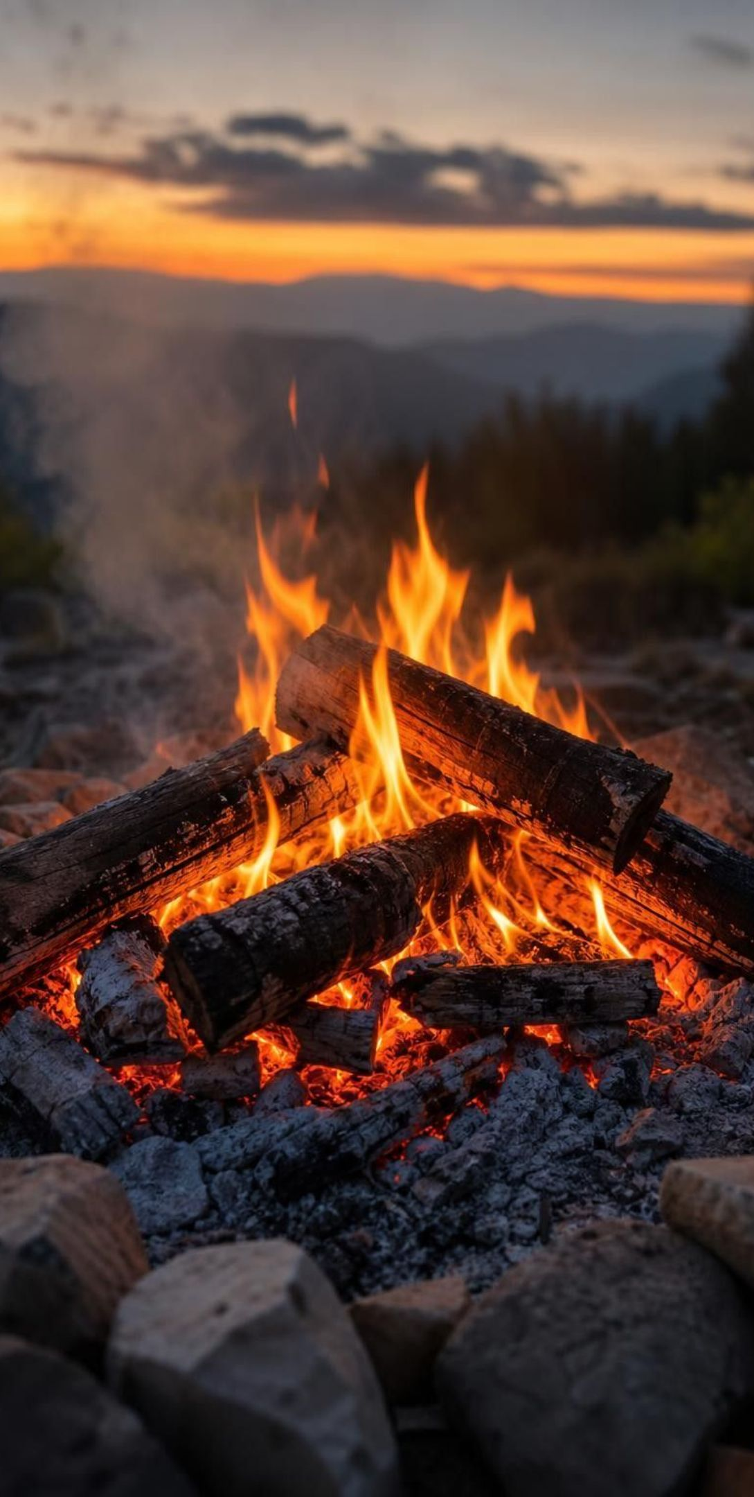
VOCABULARY IN CONTEXT
Three processes that move carbon
cellular respiration: The process in every living cell that breaks down sugar with oxygen to release usable energy, giving off carbon dioxide and water. A sprouting seed in a sealed jar respires, so the carbon in its stored food moves into the jar's air as carbon dioxide.
combustion: Burning: a fast reaction between a fuel and oxygen that releases energy and sends the fuel's carbon into the air as carbon dioxide. A campfire turns most of a log into gases; the ash is the small part that was never carbon-based fuel.
fossil fuel: Coal, oil or natural gas, formed over millions of years from buried remains of living things under sediment, heat and pressure. The carbon in coal was pulled from the air by photosynthesis in swamp forests roughly 300 million years ago, before the first dinosaurs.
13
Notes:
Point out that cellular respiration and combustion do the same job for the cycle, moving carbon from a carbon-based substance into carbon dioxide in the air, at very different speeds and with the energy going to different places: usable energy inside a cell versus heat and light in a fire. Breathing is not respiration: respiration happens in cells, and breathing is how the lungs carry the gas out. Fossil fuels: the book says carbon stored 'under soil' becomes fossil fuel; correct that to burial under sediment and rock, with heat and pressure, over millions of years, and only for a small fraction of dead matter that escaped decomposers.
WATCH FOR: Breathing equals respiration; coal is 'old soil'.
CONNECTS TO: W2 vocabulary; W7 includes a student who confuses breathing with respiration.
PACING: about 4 min

Slide 14

THINK, PAIR, SHARE
Discuss: where were your breakfast's carbon atoms a year ago?
Backward: food, then the plant or animal it came from, then photosynthesis, then the air.
Forward: your cells, then cellular respiration, then the air, then maybe a leaf.
Name the process on every step, not just the places.
Pick one thing you ate this morning. Work backward: where were its carbon atoms one year ago, and what processes moved them to your plate? Then go forward: where will they be next week?
14
Notes:
Give pairs four minutes, one partner tracing backward and the other forward, then swap. Toast: wheat plant, photosynthesis last spring, carbon dioxide in the air before that, perhaps exhaled by someone on another continent. Milk: cow, grass, photosynthesis, air. Forward: digestion, your cells, respiration, exhaled carbon dioxide, perhaps a tree in the schoolyard. Push for the surprise that an atom in the breakfast was probably in the air less than two years ago; most food carbon is recently captured. Then ask for the exception: a potato chip fried in oil made from plants is still recent carbon, but the plastic bag is fossil carbon captured hundreds of millions of years ago.
EXPECTED RESPONSES: A chain of at least four reservoirs with a process on every arrow; most chains pass through the air within a year or two in both directions.
WATCH FOR: Chains that skip the air entirely, or that say the carbon 'turns into energy' when the body uses it.
CONNECTS TO: W3 reading; W9 transfer task.
PACING: about 6 min

Slide 15
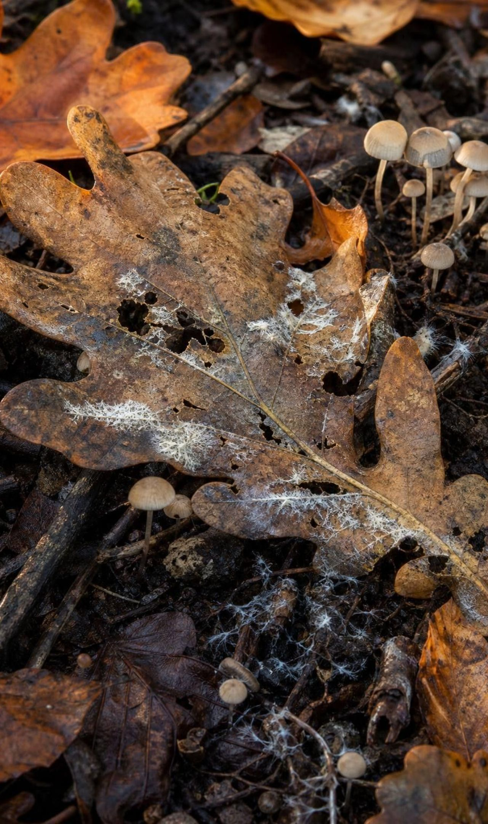
CHECK FOR UNDERSTANDING
Quick check: the fallen leaf
An oak leaf falls in October. By the next summer it has vanished from the forest floor. Where did most of its carbon atoms go?
A. Into the soil, where they stay as part of the dirt
B. Into the air as carbon dioxide, released by decomposers' cellular respiration
C. They were destroyed as the leaf rotted away
D. Into the roots of the oak tree, which pulled them back up
15
Notes:
Quick vote, then reasons. Decomposers eat the leaf and, like every living thing, respire, so most of the leaf's carbon leaves as carbon dioxide; a smaller share stays in the soil for a while as dark organic matter, and some becomes the decomposers' own bodies. Option D is a common and interesting error: roots take in water and minerals, not carbon; the tree gets its carbon from the air. Option C is the conservation error; nothing was destroyed.
EXPECTED RESPONSES: B. Some credit for mentioning that a portion stays in the soil.
WATCH FOR: 'The tree eats the leaf through its roots' is the soil-feeds-the-tree misconception; it returns on slide 22 for reforestation.
CONNECTS TO: Lab 1 soil-and-decomposers station; W10.
PACING: about 3 min

Slide 16
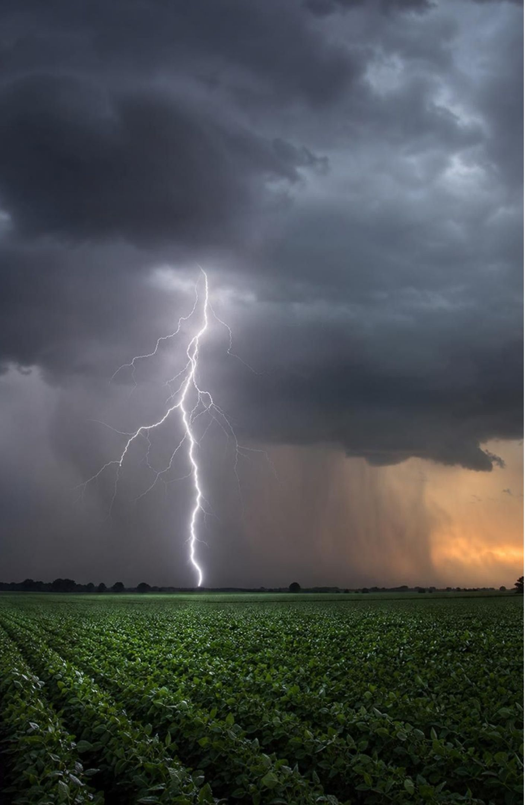
Nitrogen: an ocean of it in the air, and almost none usable
About 78 percent of the air is nitrogen gas, two atoms locked together by a very strong bond.
Every protein and every strand of DNA needs nitrogen, but almost no living thing can use the gas.
Fixation breaks the lock. Bacteria in soil and in the roots of beans and peanuts do most of it.
Lightning fixes a little, making nitrogen oxides that reach the ground in rain as nitrate.
Fertilizer factories fix nitrogen too, on a huge scale, using natural gas for energy.
16
Notes:
Start with the paradox: animals breathe nitrogen in and out all day and get nothing from it. The two atoms in nitrogen gas are joined so tightly that ordinary cells cannot pull them apart. Only certain bacteria can, and they live free in soil and water or inside swellings on the roots of legumes, where the plant feeds them sugar in exchange for usable nitrogen. The book says lightning's products fall as ammonia; they actually fall as nitrate, after the nitrogen oxides dissolve in rain. The book also leaves out the third fixer: factories. Since the early 1900s the Haber-Bosch process has made ammonia for fertilizer, and a large share of the nitrogen in the food people eat today passed through a factory. That is the link to the pond: a bag of fertilizer is fixed nitrogen, ready to feed whatever it lands on.
WATCH FOR: 'Animals get nitrogen by breathing.' They cannot; nitrogen gas passes through lungs unchanged.
CONNECTS TO: W3 reading passage; Lab 3 scenario starts with a fertilizer bag.
PACING: about 5 min

Slide 17
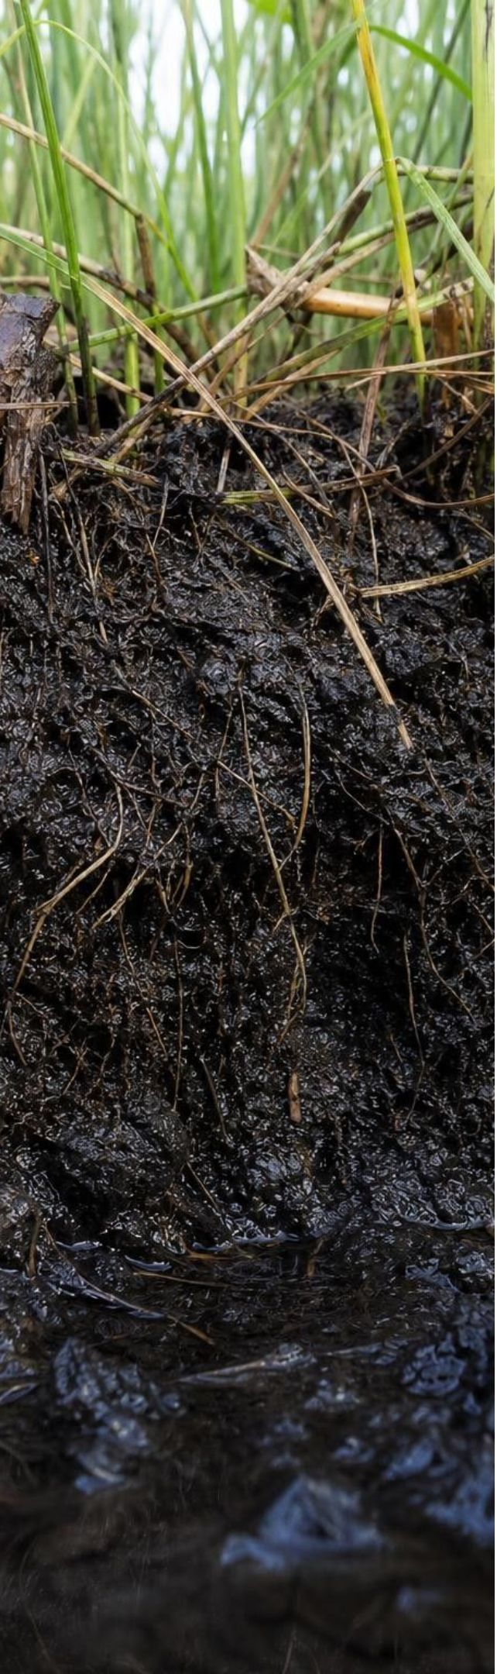
MODEL
The nitrogen cycle as a reservoir map
Model: Where a nitrogen atom can be, and who moves it
Ammonium in soil and water → (nitrifiers)
Nitrate in soil and water → (root uptake)
Producers (proteins, DNA) → (eating)
Consumers (proteins, DNA) → (death)
Dead remains and wastes → (soil bacteria)
Nitrogen gas in the air → (fixation)
(back to the start)
Start at nitrogen gas (upper left) and follow the arrows clockwise. Bacteria run four of these arrows: nitrogen-fixing bacteria make ammonium from the gas, nitrifying bacteria turn ammonium into nitrate, decomposers release ammonium from remains and wastes, and denitrifying bacteria turn nitrate back into nitrogen gas, closing the loop. Roots absorb ammonium as well as nitrate; consumers also shed nitrogen in wastes. Lightning and factories also fix nitrogen; fertilizer adds it straight to the soil.
17
Notes:
Walk the loop with a single atom: nitrogen gas, fixed by a root bacterium into ammonia, converted by nitrifying bacteria to nitrate, absorbed by a peanut plant and built into protein, eaten by a student, digested to amino acids and rebuilt into the student's muscle, released in waste, broken down by decomposers to ammonium, and finally turned back into nitrogen gas by denitrifying bacteria in waterlogged soil. Then show the branches: a plant can absorb ammonium directly, skipping the nitrate step; nitrate that is not absorbed washes away easily with rain, which is the pond's problem. Stress who does the work: bacteria run fixation, nitrification, decomposition and denitrification. Without them, nitrogen would be stuck in the air and life would stop.
EXPECTED RESPONSES: Students should be able to name the four bacterial jobs and say which form of nitrogen washes away most easily (nitrate).
WATCH FOR: 'Decomposers make nitrate.' Decomposers release ammonium; nitrifying bacteria make nitrate. 'Plants need nitrate only.' They use ammonium too.
CONNECTS TO: W4 can use this cycle as the model to complete; Lab 3 traces fertilizer nitrogen into the pond.
PACING: about 6 min

Slide 18
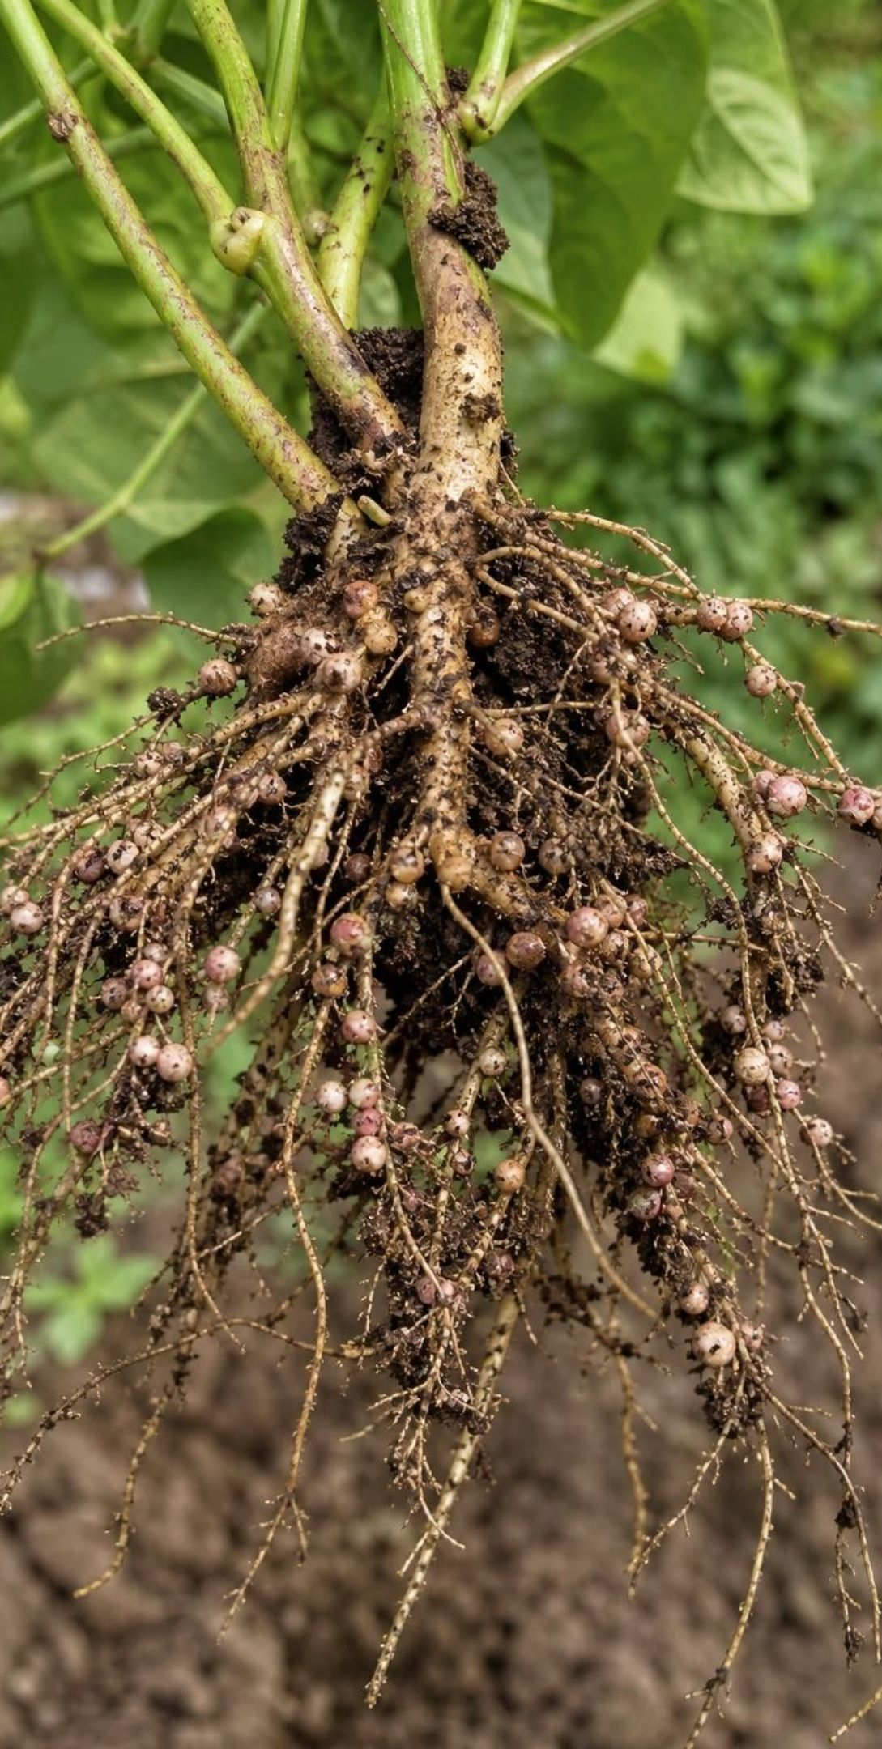
VOCABULARY IN CONTEXT
Three jobs that bacteria do for everyone
nitrogen fixation: Turning nitrogen gas into usable nitrogen compounds such as ammonia. Bacteria do most natural fixing; lightning and factories also fix nitrogen. Bacteria in the root nodules of a bean plant fix enough nitrogen to leave the soil richer after harvest.
nitrification: Bacteria in soil and water changing ammonium into nitrate, a form that dissolves easily and that roots absorb readily. After a farmer spreads ammonium fertilizer, nitrifying bacteria convert much of it to nitrate within weeks.
denitrification: Bacteria in low-oxygen soil or mud changing nitrate back into nitrogen gas, which returns to the air. In a soggy wetland, denitrifying bacteria remove nitrate from the water before it reaches the river.
18
Notes:
Three jobs, three kinds of bacteria. A memory hook: fixation gets nitrogen in from the air, nitrification gets it ready for roots, denitrification sends it back out. Ask which of the three a farmer wants more of (fixation, in legume roots) and which a pond needs more of (denitrification, to clear excess nitrate). Point out that wetlands are valued partly because their waterlogged mud is where denitrification thrives; a buffer strip of plants between a field and a pond helps for the same reason, which Lab 3 uses.
WATCH FOR: Confusing nitrification with fixation; both 'make' nitrogen compounds, but only fixation starts from the gas.
CONNECTS TO: W2 vocabulary; Lab 3 buffer-strip plan.
PACING: about 4 min

Slide 19
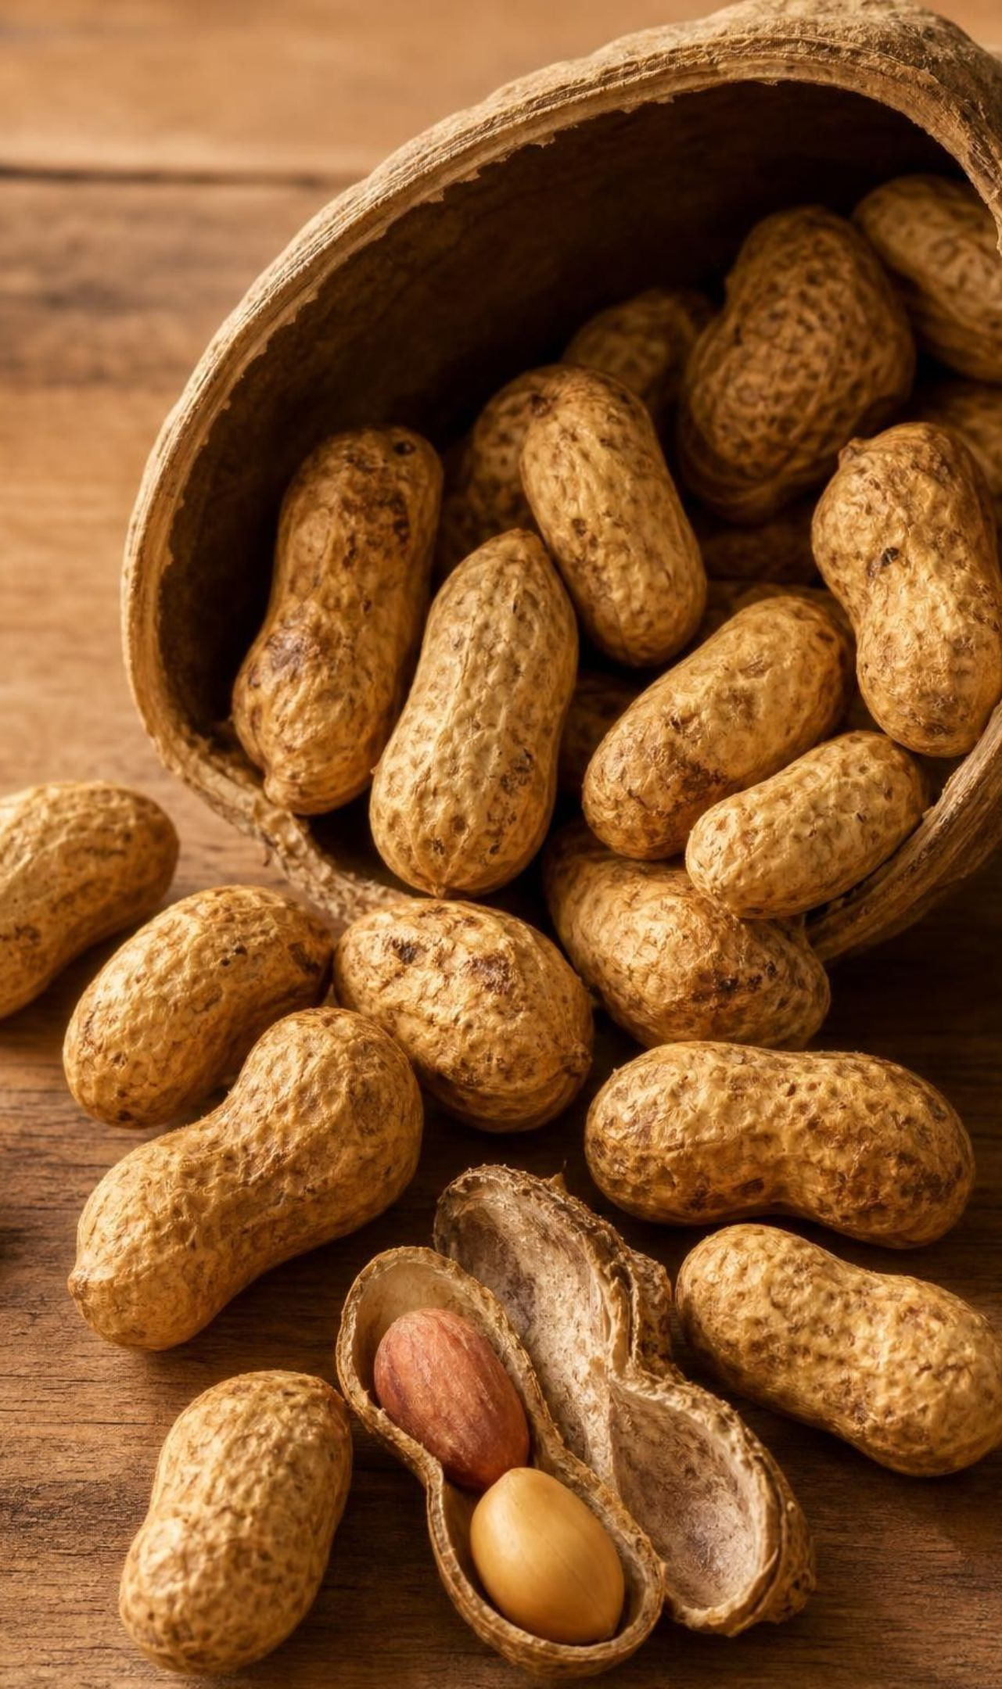
CHECK FOR UNDERSTANDING
Quick check: the nitrogen in your muscles
You eat a handful of peanuts. Which statement correctly describes how your body gets nitrogen from them to build your own proteins?
A. Your cells absorb nitrates stored in the peanuts and turn them into protein
B. Your lungs take nitrogen from the air you breathe while you chew
C. You digest the peanut proteins into amino acids and rebuild them into your own proteins
D. Bacteria in your stomach fix nitrogen gas from swallowed air
19
Notes:
Vote and defend. Option A is close to what the textbook says and is wrong: animals cannot build protein from nitrate; only plants and microbes can. Option B is the breathing error. Option D sounds scientific but is false for people; nitrogen-fixing bacteria live in soil, water and plant roots, not in human stomachs in any meaningful amount. The correct chain is plant protein, digestion into amino acids, then rebuilding. Where did the peanut get its nitrogen? From fixation by bacteria in its own roots and from nitrate and ammonium in the soil.
EXPECTED RESPONSES: C. Follow-up: the peanut's nitrogen came from bacterial fixation in its root nodules and from soil nitrogen.
WATCH FOR: Option A; the book's own peanut passage says 'nitrates in the peanut', so some students will cite it. Say the book simplified.
CONNECTS TO: W7 misconception repair; W10.
PACING: about 3 min

Slide 20
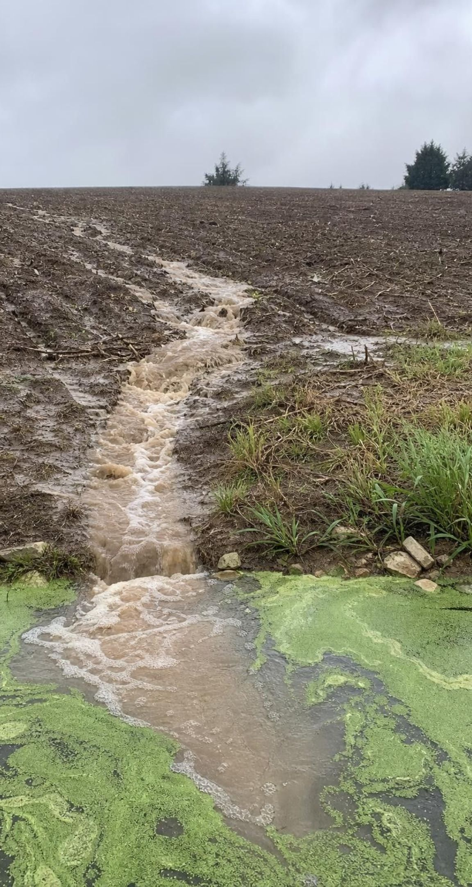
MODEL
The pond explained: a nutrient flood, then an oxygen famine
Model: From fertilizer bag to dead fish
Fertilizer on the field (fixed nitrogen, phosphorus) → (rain) Storm runoff carries nitrate downhill → (nutrients in) Pond algae take up nutrients and bloom → (fast growth) Bloom dies; decomposers feed on it → (die-off) Decomposers' respiration uses up dissolved oxygen → (oxygen out) Fish suffocate, worst before dawn
Nothing was created: the atoms in the scum came from the fertilizer, the air and the water. Runoff carries phosphate as well as nitrate. The harm comes from one flow running far faster than usual.
20
Notes:
Return to the phenomenon and build the explanation one node at a time, asking students which cycle each step belongs to. The fertilizer is fixed nitrogen (and usually phosphorus); the storm moves it as dissolved nitrate and phosphate, the forms that wash away most easily; the algae are producers that grab the nutrients and the pond's carbon dioxide and sunlight and multiply; when the bloom crashes, decomposers get a feast and respire so hard that the dissolved oxygen drops, worst just before dawn when no photosynthesis has run all night; fish suffocate. Two accuracy points: in many ponds and lakes phosphorus, not nitrogen, is the nutrient that limits algae, so say 'nitrogen and phosphorus'; and the fish were not poisoned by fertilizer, they were starved of oxygen. Ask: which arrow would you cut to save the pond? Lab 3 tests three answers: less fertilizer, better timing, or a buffer strip to slow the runoff.
EXPECTED RESPONSES: Students should place each node in a cycle: nitrogen (fertilizer, runoff, algae), carbon (algae growth, decomposers), and both in the die-off; they should say the fish died from low oxygen.
WATCH FOR: 'The fertilizer poisoned the fish.' 'The algae used up the oxygen.' Living algae add oxygen by day; it is decomposition of the dead bloom that removes it.
CONNECTS TO: W8 evidence jigsaw on the pond; W5 data worksheet; Lab 3 decision. W6 is the CER on the decaying log.
PACING: about 6 min

Slide 21
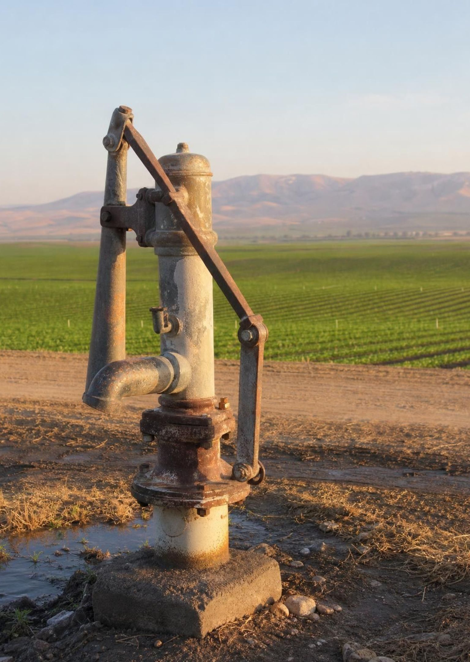
REAL-WORLD CONNECTION
California connection: nitrate under the Central Valley
In the Tulare Lake Basin and the Salinas Valley, decades of fertilizer and dairy manure have let nitrate seep down into groundwater. A 2012 UC Davis study for the State Water Board found that roughly a quarter of a million people there rely on wells at risk of nitrate above the drinking-water limit, with farms the main source. The nitrogen cycle does not stop at the pond; it reaches the kitchen tap.
21
Notes:
This is a true and current California story. Nitrate is the form of nitrogen that dissolves and travels, so what is not taken up by crops moves down through the soil over years into the aquifers that small towns pump for drinking water. The federal limit is 10 milligrams per liter of nitrate measured as nitrogen, the same number Lab 3 uses as a criterion. Ask students which arrows in the nitrogen cycle a farmer can change: how much is applied, when it is applied, what crop is planted (legumes fix their own), and whether a buffer of plants sits between field and water. Mention that cleaning nitrate out of an aquifer is slow and expensive, so prevention at the field is the engineering problem. If your school is in the Valley, students may know families on bottled water for this reason; treat the topic with care.
CONNECTS TO: Lab 3 uses the 10 mg/L nitrate limit; W9 transfer task.
PACING: about 4 min

Slide 22
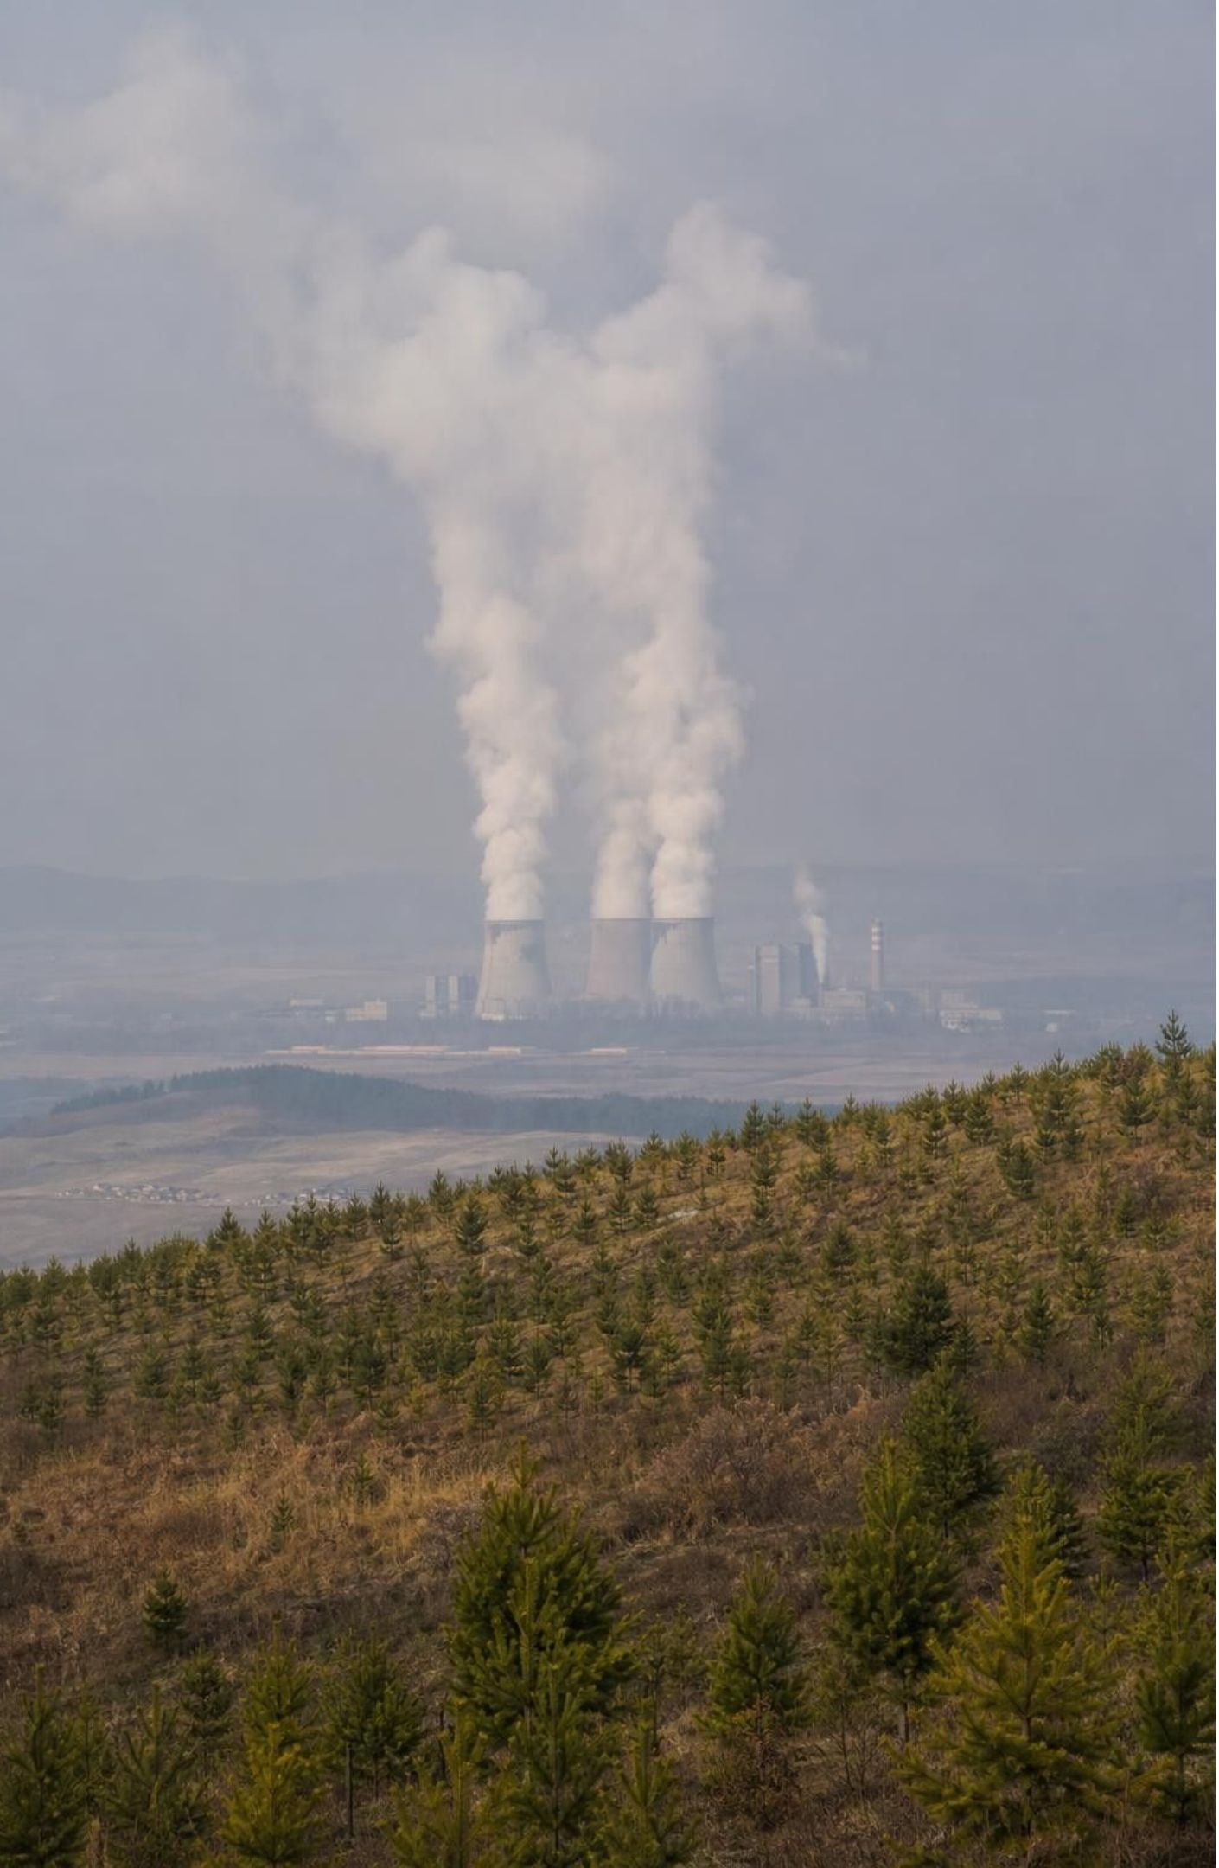
People and the carbon cycle: a fast arrow added to a slow one
Burial of remains that become fossil fuels takes millions of years; burning them takes seconds.
Since the 1800s people have moved fossil carbon into the air far faster than nature buries it.
Carbon dioxide in the air traps heat, so the extra carbon is warming the climate.
One partial fix: reforestation. Growing trees pull carbon from the air into wood through photosynthesis.
Engineers choose sites by criteria (most carbon, kept longest) within constraints (cost, land, roads, people).
22
Notes:
Use the map from slide 12. The natural cycle has a tiny, slow arrow from soil to fossil fuels. People added a big, fast arrow from fossil fuels to the air, so the air reservoir grows. That is the whole climate connection at this level; the physics of heat trapping belongs to later lessons, and do not assess a percentage for how much comes from fossil fuels (it is the main source; clearing forests and making cement add more). Reforestation moves carbon the other way, but only while the trees grow and only as long as they stand; a burned or logged forest gives its carbon back. So a good evaluation needs criteria for both speed of capture and length of storage, plus constraints. The book's spread uses a map of forest growth rates; we will use a site table instead.
WATCH FOR: 'Trees grow from soil' returns here: a planted forest's carbon comes from the air, which is exactly why planting helps.
CONNECTS TO: Lab 1 run 2 models the fast arrow; the next slide's task and W9 evaluate reforestation.
PACING: about 5 min

Slide 23
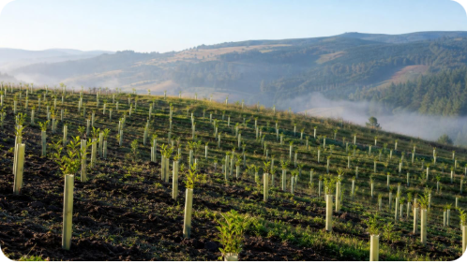
APPLY IT
Task: choose the reforestation site
Site | Carbon captured (tons per hectare per year) | Cost per hectare | People living on the land | Road access | Wildfire risk
A: warm, wet river valley | 6 | $900 | a village farms part of it | good | low
B: cool mountain slope | 2 | $400 plus $300 to build a road | none | none yet | low
C: edge of dry grassland | 3 | $500 | none | good | high
D: abandoned farmland, mild and rainy | 5 | $600 | none | good | moderate
Simulated data for practice.
A fund will plant trees on one site. Criteria: capture the most carbon over 30 years and keep it stored. Constraints: at most $600 per hectare, nobody displaced, reachable by road. Score the sites and choose.
23
Notes:
This is a teaching dataset; the numbers are invented but the trade-offs are real. Give groups eight minutes. Step 1: apply the constraints as pass/fail. A fails cost and would displace farmers. B fails cost once the road is counted (700) and has no road. C passes the constraints. D passes. Step 2: score the survivors on the criteria. Thirty-year capture: C 90 tons per hectare, D 150. Storage: C has high fire risk, so its carbon is likely to return to the air; D is moderate. D wins on both criteria. Step 3: ask for the carbon per dollar for all four as a check on intuition: A 180/900 = 0.20, B 60/700 = 0.09, C 90/500 = 0.18, D 150/600 = 0.25 tons per dollar. Then the harder question: what would it take to make A acceptable? Planting only the unused part with the village's agreement, which changes the constraint rather than ignoring it. That is how real projects are negotiated.
EXPECTED RESPONSES: D. Constraints eliminate A (cost, displacement) and B (cost with road, no access); C fails the storage criterion because of fire risk; D captures 150 tons per hectare over 30 years at the best carbon-per-dollar rate.
WATCH FOR: Groups that pick A because it has the biggest growth number have skipped the constraints. Groups that ignore fire risk have skipped the storage criterion.
CONNECTS TO: Lab 3 uses the same decision-matrix method on fertilizer plans; W9 transfer task.
PACING: about 10 min

Slide 24
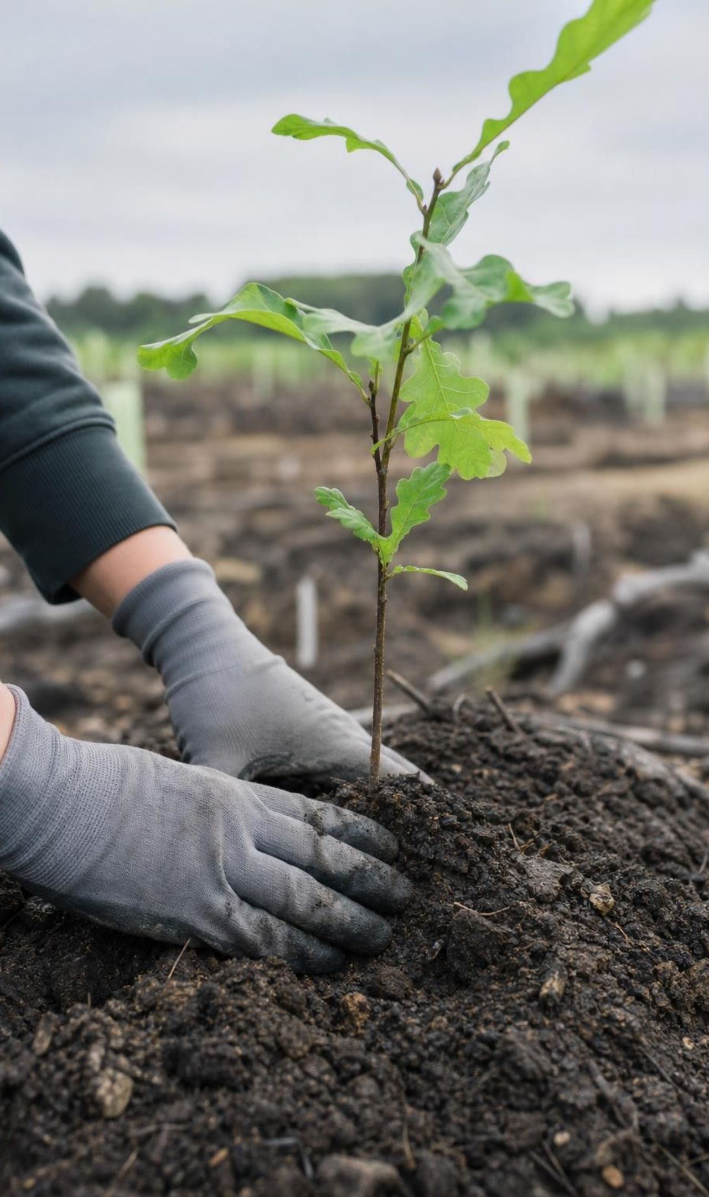
THINK, PAIR, SHARE
Discuss: is planting trees enough?
For: growing trees really do move carbon from the air into wood.
Against: the fossil carbon was stored for millions of years; a forest stores it only while it stands.
Against: a forest stops absorbing much once it is mature; the burning does not stop.
What would change your answer?
A company says it will keep burning fossil fuels and plant a forest to balance it. Using the carbon-cycle map, argue for and against. What would the forest have to do, and for how long, to truly balance the burning?
24
Notes:
Run as a two-minute pair argument with assigned sides, then switch. The strongest 'against' point comes straight from the reservoir map: burning moves carbon from a reservoir with a residence time of millions of years into the air, and a forest moves it into a reservoir with a residence time of decades to centuries that can empty in one fire. The strongest 'for' point is that any capture helps while better solutions are built. Land the discussion on the modeling skill: the answer depends on rates and residence times, which is why the task's criteria included storage, not just capture. Avoid turning this into a policy debate; keep it on what the model shows.
EXPECTED RESPONSES: For: capture is real. Against: storage is temporary and limited; a mature forest captures little more; the planting must be repeated or protected forever. Synthesis: reforestation can slow the growth of the air reservoir but cannot by itself balance an ongoing fast arrow.
CONNECTS TO: Lab 1 run 2 and its analysis question on adding a reforestation rule; W9.
PACING: about 6 min

Slide 25
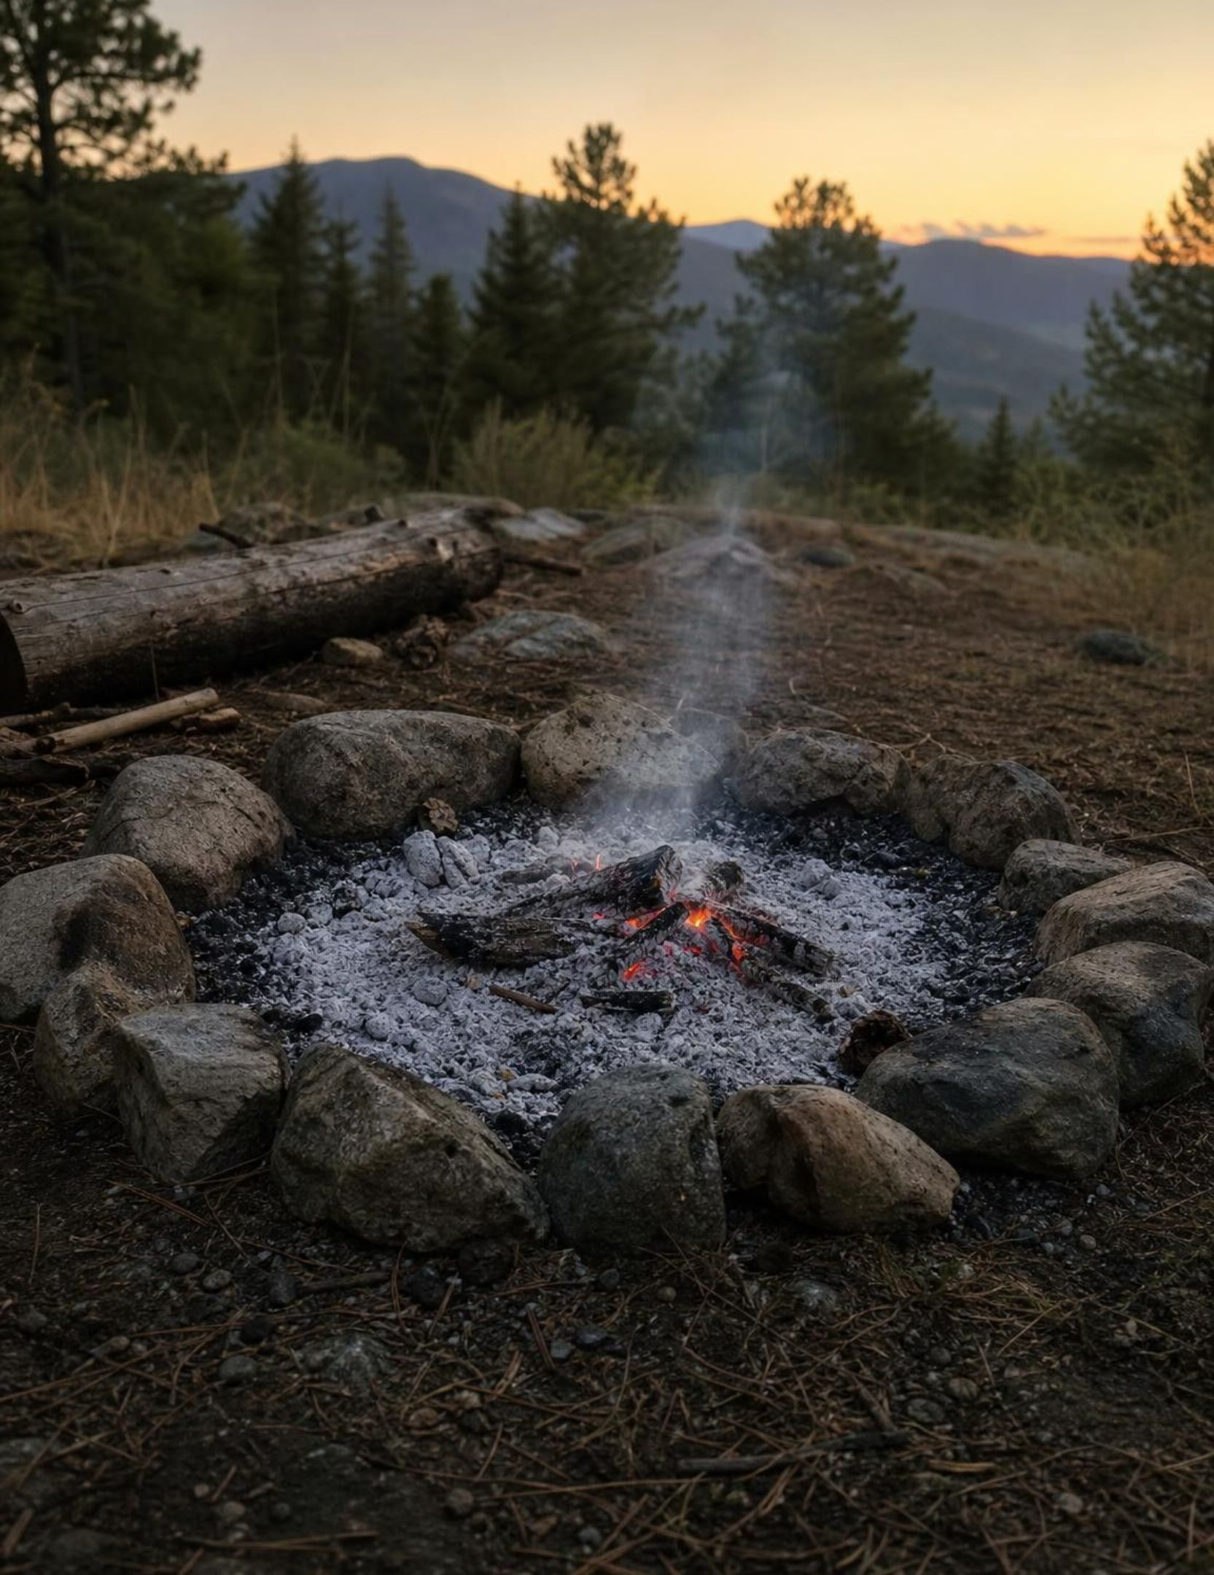
MISCONCEPTION CHECK
True or false? Fire destroys matter
"When a log burns in a campfire, most of its matter is destroyed and turned into heat and light, which is why only a small pile of ash is left."
True or false? Explain your reasoning.
25
Notes:
Have students evaluate the statement in writing using the lesson's ideas, then share. The ash is light because most of the log left as gases: carbon dioxide and water vapor, invisible and drifting away. Combustion rearranged the log's atoms with oxygen from the air; not one atom was destroyed. The energy that came out as heat and light was stored in the wood by photosynthesis years earlier, and energy is not matter. Return to the quick-check thought experiment from slide 7: burn the log inside a sealed container with its own air and the mass of the container does not change. If students did Lab 2, connect it: the jar's mass held steady while seeds sprouted and leaves rotted, which are chemical changes too.
EXPECTED RESPONSES: False. The matter left as invisible gases; atoms were rearranged, not destroyed; the energy released is not matter and was stored by photosynthesis.
WATCH FOR: Students may say the matter 'turned into energy.' Matter and energy are tracked separately in this lesson; the atoms are all still present as gases and ash.
CONNECTS TO: W7 misconception repair; Lab 2 conclusion; W10 mastery.
PACING: about 6 min

Slide 26
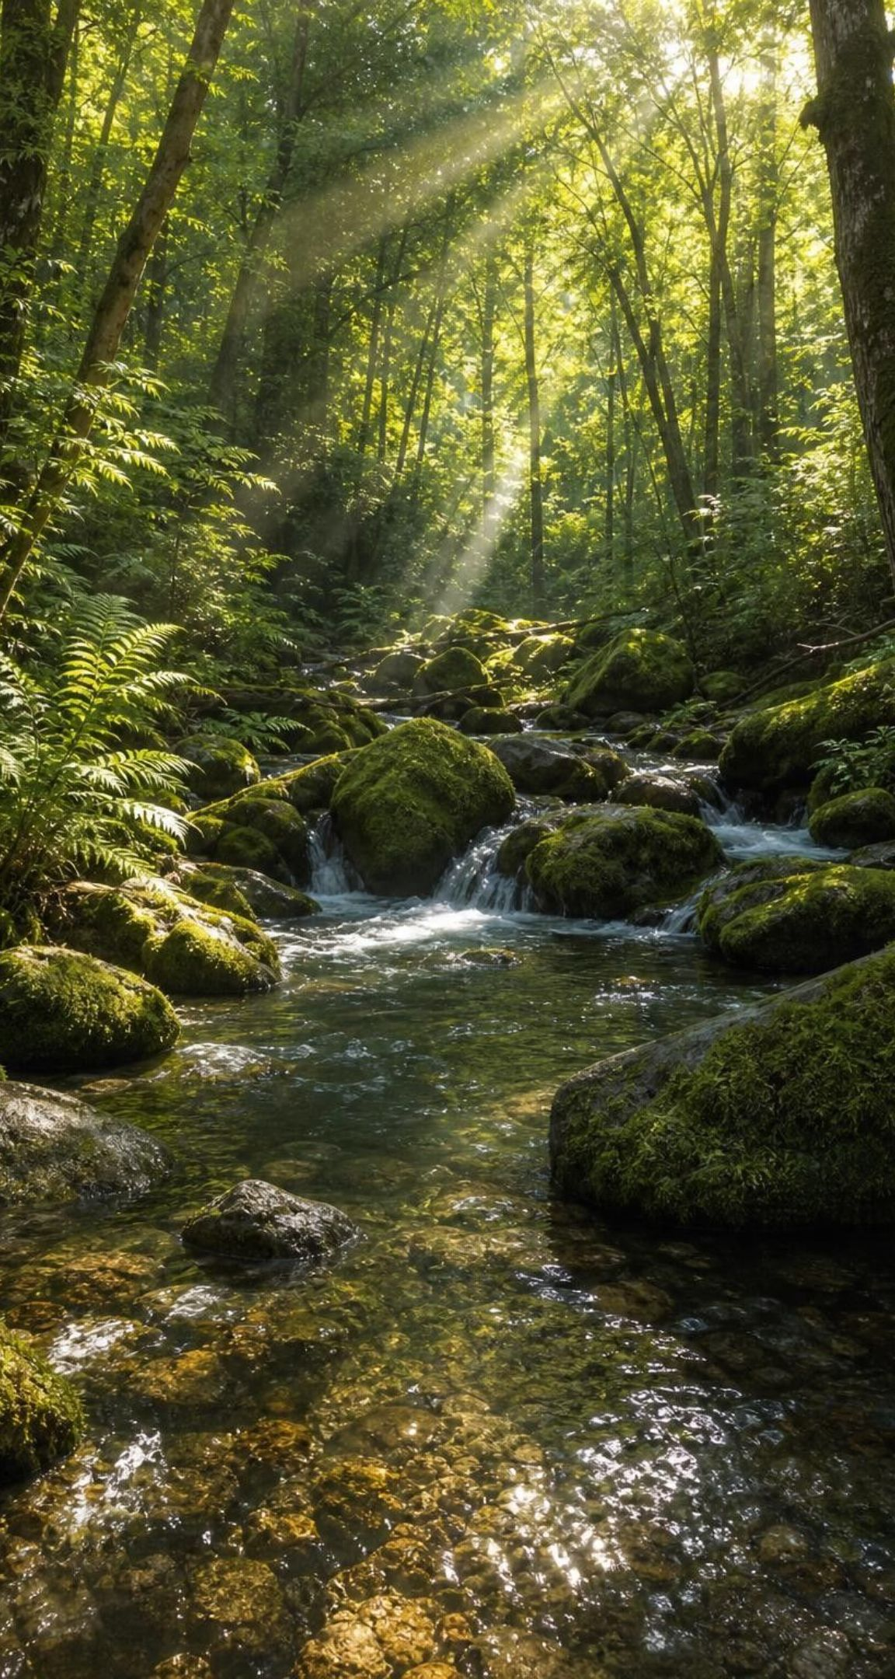
PUTTING IT TOGETHER
Putting it together
Earth is nearly closed for matter and open for energy, so the same atoms cycle on solar power.
Every cycle is a map of reservoirs joined by processes; atoms persist while molecules get rebuilt.
Carbon enters life by photosynthesis and leaves by cellular respiration or combustion.
Nitrogen is locked in the air until bacteria, lightning or factories fix it; bacteria run the rest.
People change the cycles by speeding one arrow: fossil-fuel burning, or fertilizer washed into a pond.
Good solutions are judged against criteria and constraints, with storage and side effects included.
26
Notes:
Have students write a three-sentence summary of the pond phenomenon using at least four vocabulary terms, then trade with a partner who checks that each term is used for the right process. Ask for one thing from each lab: Lab 1 (what changed when the fossil-fuel rule changed), Lab 2 (what the jar's mass did and what crossed the glass), Lab 3 (which plan won and what it gave up). Preview the next unit: the rock cycle and Earth's history move matter too, on far longer timescales, and the water cycle returns in full in Lesson 18.
CONNECTS TO: W10 mastery as the quiz; L08 Investigating Rock Strata next; L18 The Water Cycle later.
PACING: about 6 min

Slide 27
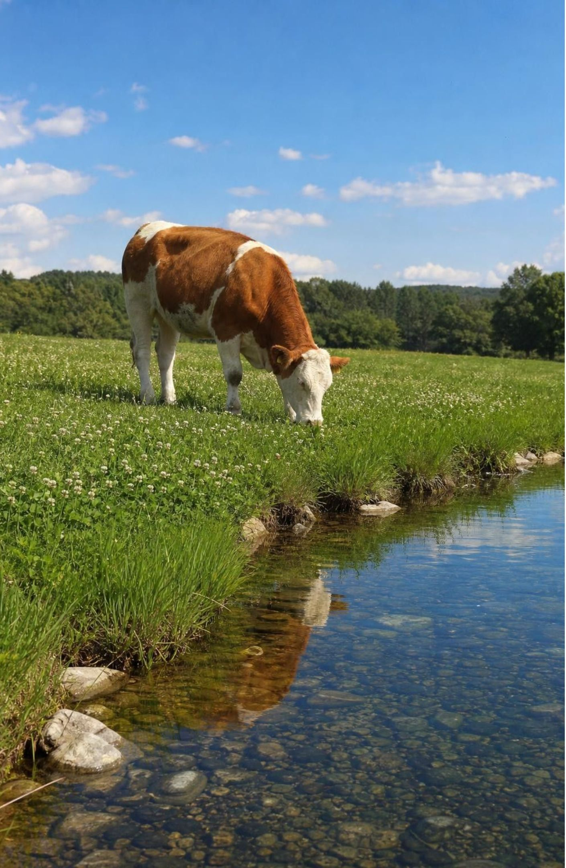
EXIT TICKET
Exit ticket
Finish the sentence: Earth is closed to ___ but open to ___, and the exception for the first is ___.
Trace a carbon atom from the air into your body and back out, naming the two processes.
Why can a cow not get nitrogen from the air it breathes? Who fixes the nitrogen it finally eats?
The pond turned green after the rain. Where did the nutrients come from, and what process killed the fish?
27
Notes:
Collect on index cards or a shared form. Item 1 checks the boundary idea, item 2 the carbon doorways, item 3 the nitrogen lock and fixation, item 4 the phenomenon explanation. Sort the cards into three piles before the next class and reteach from the largest pile; the most common weak spot is item 4, where students name the algae but not the decomposers.
EXPECTED RESPONSES: 1: matter, energy; space dust in and a little gas and spacecraft out. 2: carbon dioxide in air, photosynthesis into a plant, eating, then cellular respiration back to the air. 3: nitrogen gas is locked by a strong bond; bacteria (in soil or in legume roots) fix it, and the cow eats the plant protein. 4: fertilizer on the field (soil reservoir), carried by runoff; decomposers' respiration used up the oxygen after the algae bloom died.
WATCH FOR: Item 4 answers of 'the fertilizer poisoned them' or 'the algae used the oxygen' signal that slide 20's flow did not land.
CONNECTS TO: W10 mastery; chapter evidenceOfLearning.
PACING: about 5 min

