Slide 1
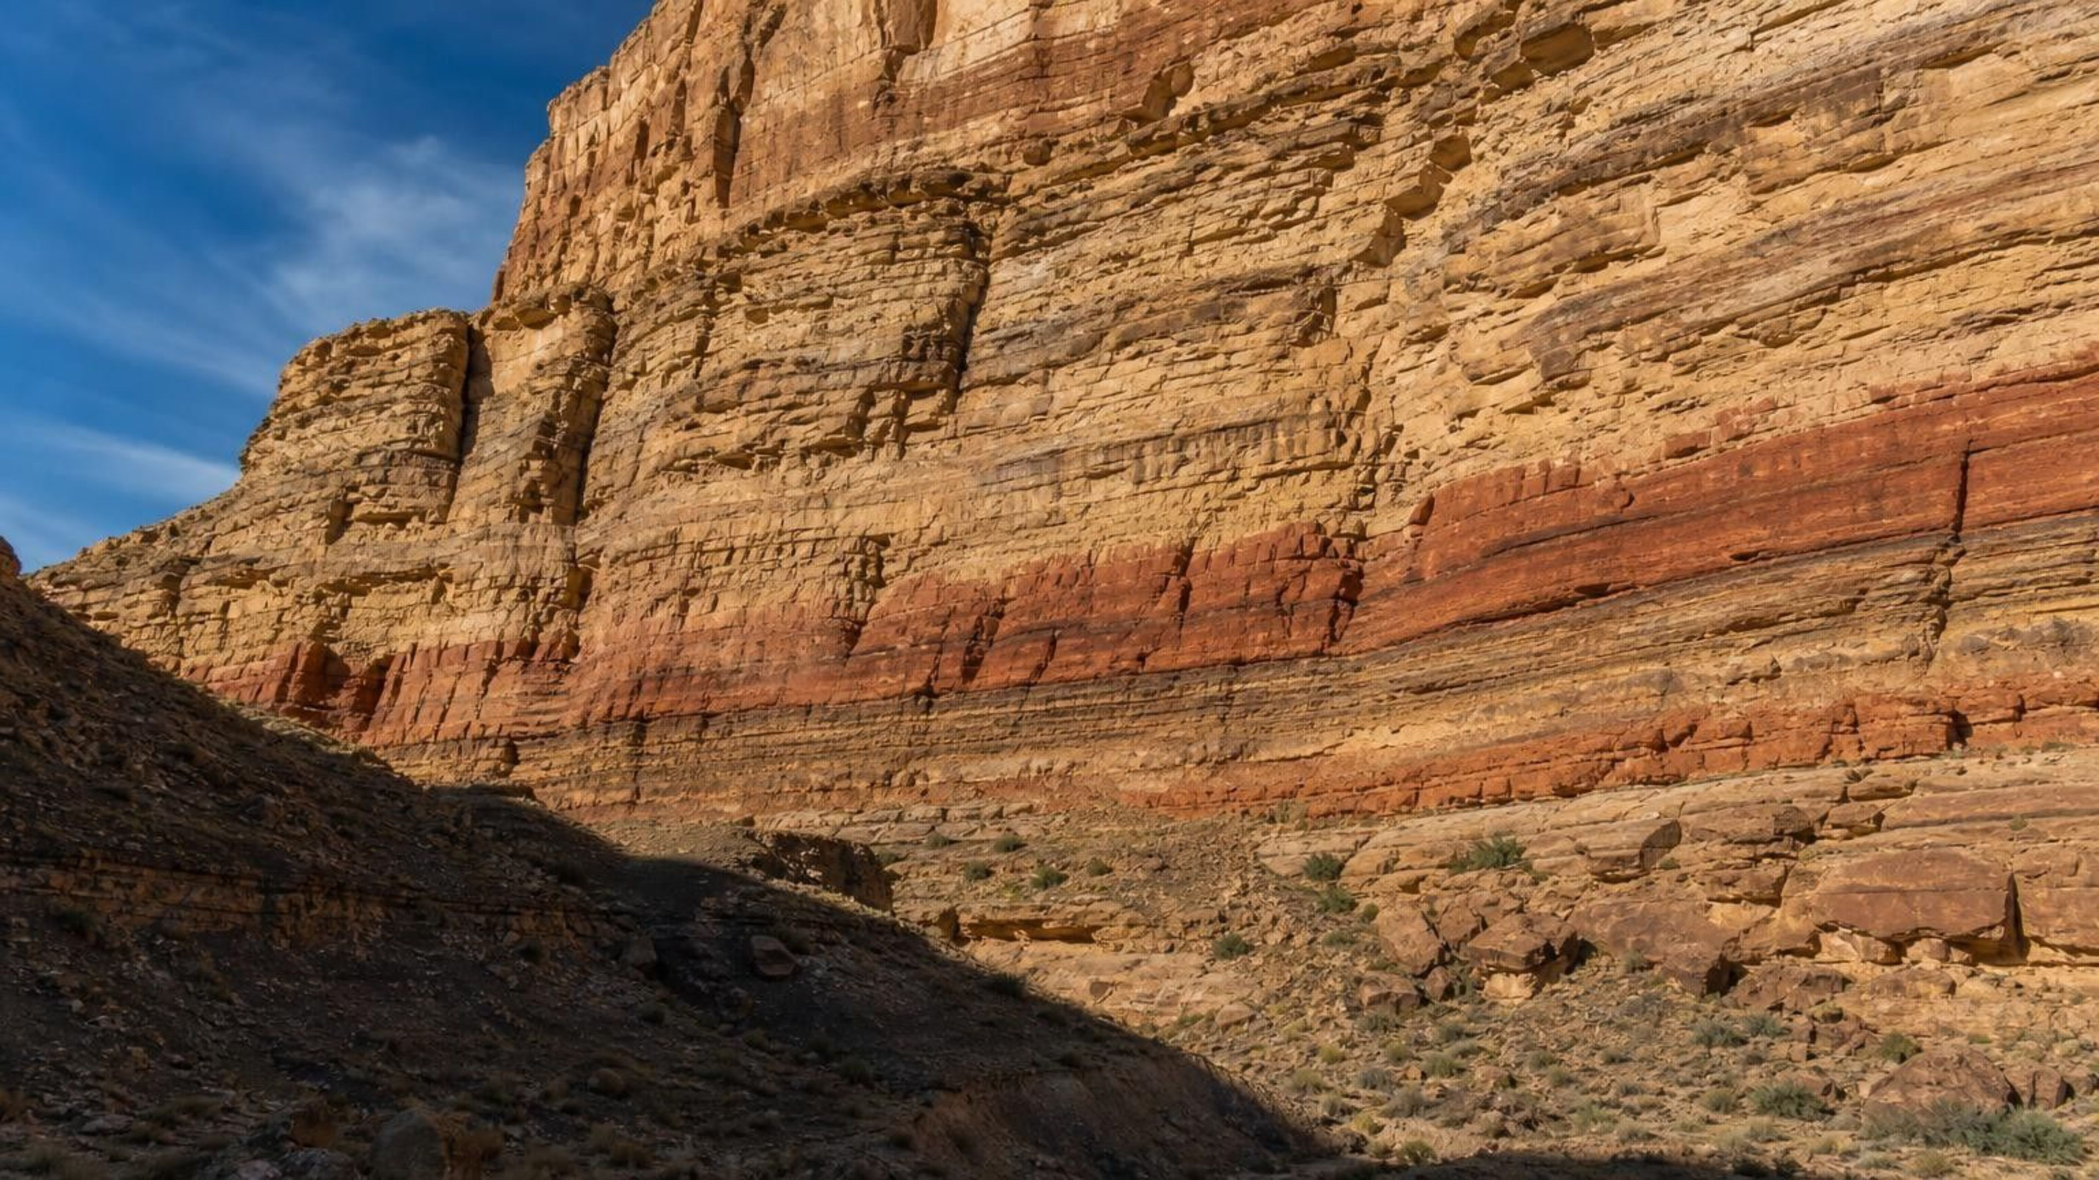
Chapter 8: Investigating Rock Strata
Chapter 8 of 29 · Earth Processes Through Geologic Time
Lesson 8: How can rock layers tell us what happened, in what order, and sometimes when?
Angela's Wand · Bring Science Alive! 7th Grade Integrated
Notes:
This lesson is about reading rock the way a detective reads a room: nobody saw the events, but the evidence is arranged in a way that only certain orders could produce. Tell students they will learn five rules that geologists use to put events in order, then one method that puts numbers on some of those events. They will build and core hidden layers (Lab 1), solve a quarry case file (Lab 2) and make their own layers and canyon in a tray (Lab 3). Point out that this is a Grade 8 standard in California's sequence (MS-ESS1-4), so they are getting a head start.
CONNECTS TO: Overview of Lab 1, Lab 2 and Lab 3; W1 opens on the next slide.
PACING: about 2 min

Slide 2
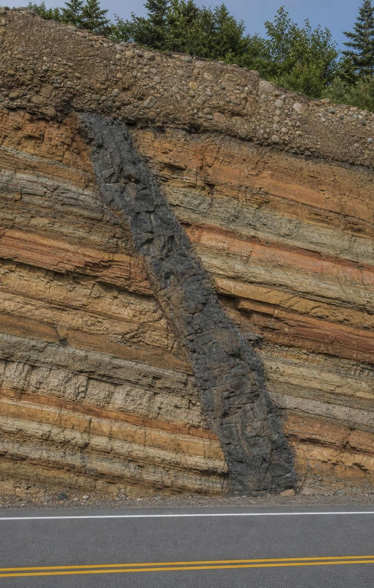
The road cut with a dark stripe
PHENOMENON
A highway crew blasts a fresh wall through a hillside. It shows striped layers of sandstone, shale and limestone, all leaning about 20 degrees. A dark band a meter wide runs diagonally through every layer. Partway along, the layers on the left sit a meter higher than the same layers on the right. Flat river gravel lies across the top, and nothing cuts it. A geologist says she can list the events in order. How?
Notice: what is tilted, what is flat, what cuts what?
Wonder: was the dark stripe there before the layers, or after?
Predict: which part of the wall is oldest, and which is youngest?
2
Notes:
Sketch the wall on the board as you read: tilted stripes, the diagonal dark band, the offset partway along, the flat gravel on top. Give two silent minutes for a notice and a wonder, then collect without judging. Push on three things. First, the gravel is flat and the stripes are tilted; what does that suggest about which came first? Second, the dark band crosses every layer; could it have been there first with the layers forming around it? Let students argue. Third, the offset: what could shift one side of a wall up by a meter? Park every claim on a list; the lesson will test each one. Do not give the order yet. By the end of slide 17 students will be able to write it themselves: layers, tilting, fault, dike, erosion, gravel, with one pair that cannot be ordered from this evidence alone.
EXPECTED RESPONSES: Notice: layers lean, gravel is flat, dark stripe crosses everything, one side is higher. Wonder: what the dark rock is, why the layers lean, how long it took. Predict: most say the bottom layer is oldest and the gravel youngest; some will say the dark stripe is oldest because it 'goes all the way through'. Record that claim; it is the misconception for slide 15.
WATCH FOR: 'The dike was there first and the layers formed around it.' Also 'the layers were deposited tilted.' Park both.
CONNECTS TO: W1 phenomenon worksheet records notice/wonder and a first explanation; W6 CER returns to the cross-cutting evidence.
PACING: about 8 min

Slide 3
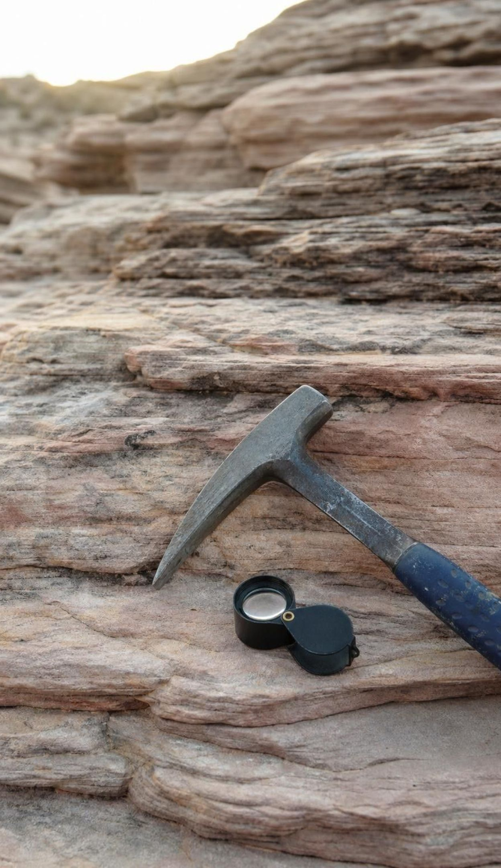
What you will be able to do
LEARNING TARGETS
1
Use superposition and lateral continuity to tell which layers are older, younger or the same age.
2
Show that tilting, folding, faults, intrusions and erosion came after the layers they affect.
3
Explain how fossil succession and index fossils match layers in places far apart.
4
Use half-life to find an igneous rock's age, and bracket a sedimentary layer between dated ash beds.
5
Reconstruct the order of events in a cross section and say what the evidence cannot show.
3
Notes:
Read the targets and have students star the one that sounds hardest. Point out the shape of the lesson: targets 1 and 2 are the rules for order, 3 adds fossils, 4 adds years, and 5 puts it all together on one cross section, which is exactly what the exit ticket and Lab 2 ask for. Say plainly that relative means order and absolute means years, and that most of this lesson is about order.
CONNECTS TO: Targets map to Lab 1 and W4 (1), W6 and W7 (2), W8 (3), W5 (4), Lab 2 and W10 (5).
PACING: about 2 min

Slide 4
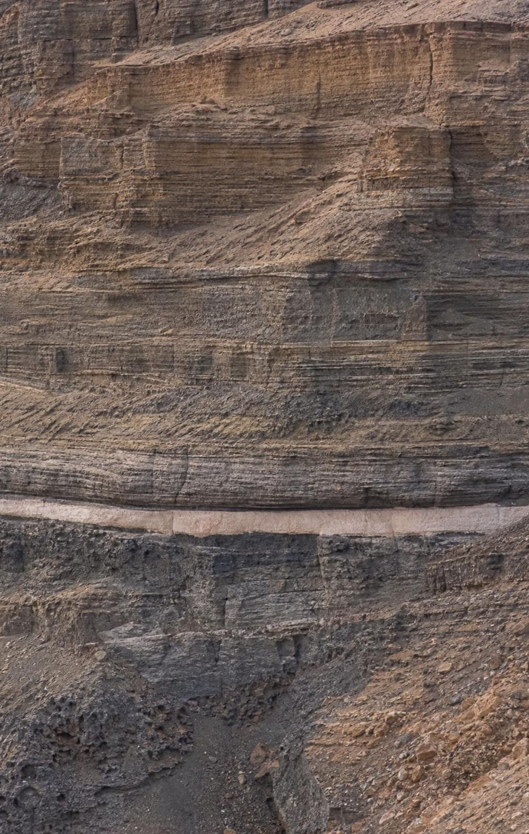
Two different questions about a rock
Question 1: Which came first? That is relative dating. The answer is an order.
Question 2: How many years ago? That is absolute dating. The answer is a number with an uncertainty.
Relative dating works on any rock you can see the arrangement of; it needs no lab.
Absolute dating needs igneous minerals with radioactive atoms, and a laboratory.
Most of Earth's story was worked out in order long before anyone could put years on it.
4
Notes:
Use a bookshelf or a laundry pile as the hook: you can tell which shirt was dropped last without knowing what day it was dropped. That is relative dating. To know the day you need a timestamp, which rocks only carry if they contain the right radioactive atoms; that is absolute dating, and we return to it at the end. Stress that absolute does not mean exact: every lab date comes with a plus-or-minus. Geologists built the whole order of Earth's history in the 1800s with no dates at all; the dates came after 1905 and confirmed the order. That history matters because it shows order and years are separate questions with separate evidence.
WATCH FOR: 'Absolute means exact.' Say numerical with an uncertainty. Also 'relative dating is a guess': it is a logical deduction from how layers form.
CONNECTS TO: W2 vocabulary worksheet sorts statements into relative versus absolute.
PACING: about 4 min

Slide 5
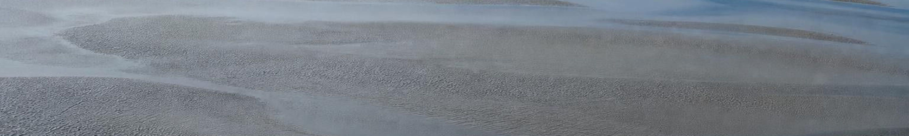
How one layer of rock comes to exist
MODEL MODEL: FROM OLD ROCK TO A NEW STRATUM
1
2
3
4
5
6
Weathering breaks existing rock into sediment
(erosion) Water, wind or ice carry the sediment away
(transport) Sediment settles in a flat or nearly flat layer where the flow slows
(deposition) More layers pile on top, one after another
(repeat) Burial squeezes the layers and minerals cement the grains
(compaction and cementation) A stack of sedimentary strata, youngest on top
Every rule in this lesson comes from this sequence. Each new layer can only land on whatever is already there.
5
Notes:
Walk the flow and connect it to the rock cycle they already know. The key move for this lesson is the third and fourth boxes: sediment settles under gravity into a nearly flat layer, and the next layer can only land on top of it. Ask: could a new layer form underneath an old one? Only if something lifted the old one, which does not happen in deposition. Then ask what 'where the flow slows' means: a river entering a lake, a flood spreading across a plain, a current dying out on a seafloor. Lab 3 will make this happen in a tray. Mention that volcanic ash settling from the air also makes a layer, and that those ash layers are the ones that later carry dates.
WATCH FOR: Students may think the layers are deposited already hard. They are soft sediment for a long time; the hardening comes later under burial.
CONNECTS TO: Lab 3 deposition runs; W3 reading passage covers this sequence.
PACING: about 5 min

Slide 6
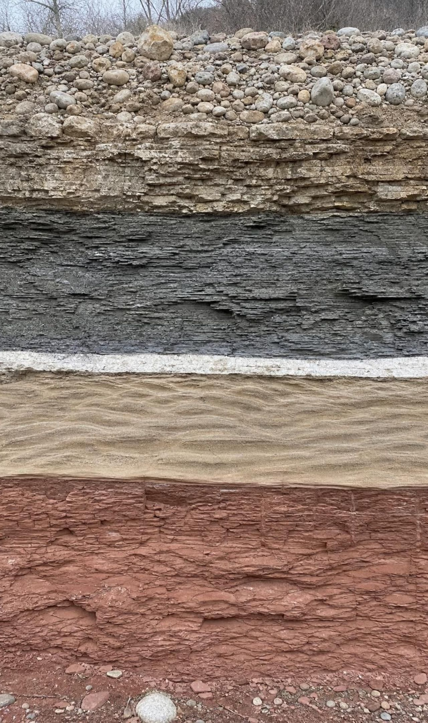
Superposition: reading an undisturbed stack
MODEL
Model: A stack of layers that has not been tilted, folded or broken
Top to bottom:
River gravel: youngest, deposited last
Limestone with marine shells
Gray shale
Volcanic ash bed
Tan sandstone with ripple marks
Red mudstone: oldest, deposited first
In an undisturbed stack each layer is younger than the one below and older than the one above. Age increases downward.
6
Notes:
State the law of superposition and underline its condition: undisturbed, meaning not overturned, not sliced apart. Read the stack from the bottom: red mud first, then sand with ripples, then an ash fall, then more mud, then a sea full of shells, then a river. Ask students to narrate the environment changes as a story, because that is what geologists actually do. Then ask the trap question: does the thickness of the shale tell you it took longer than the ash bed? No. An ash bed can form in an afternoon; a shale that thick might take a hundred thousand years, or a flood could drop it fast. Thickness is not a clock. Finally, note the textbook's summary drops the word undisturbed; we keep it, because slide 12 shows what happens when a stack is folded.
WATCH FOR: 'Thicker means older' or 'thicker means longer.' Thickness depends on deposition rate, which varies by a factor of millions.
CONNECTS TO: Lab 1 builds a stack like this; W4 diagram worksheet reads one.
PACING: about 5 min

Slide 7
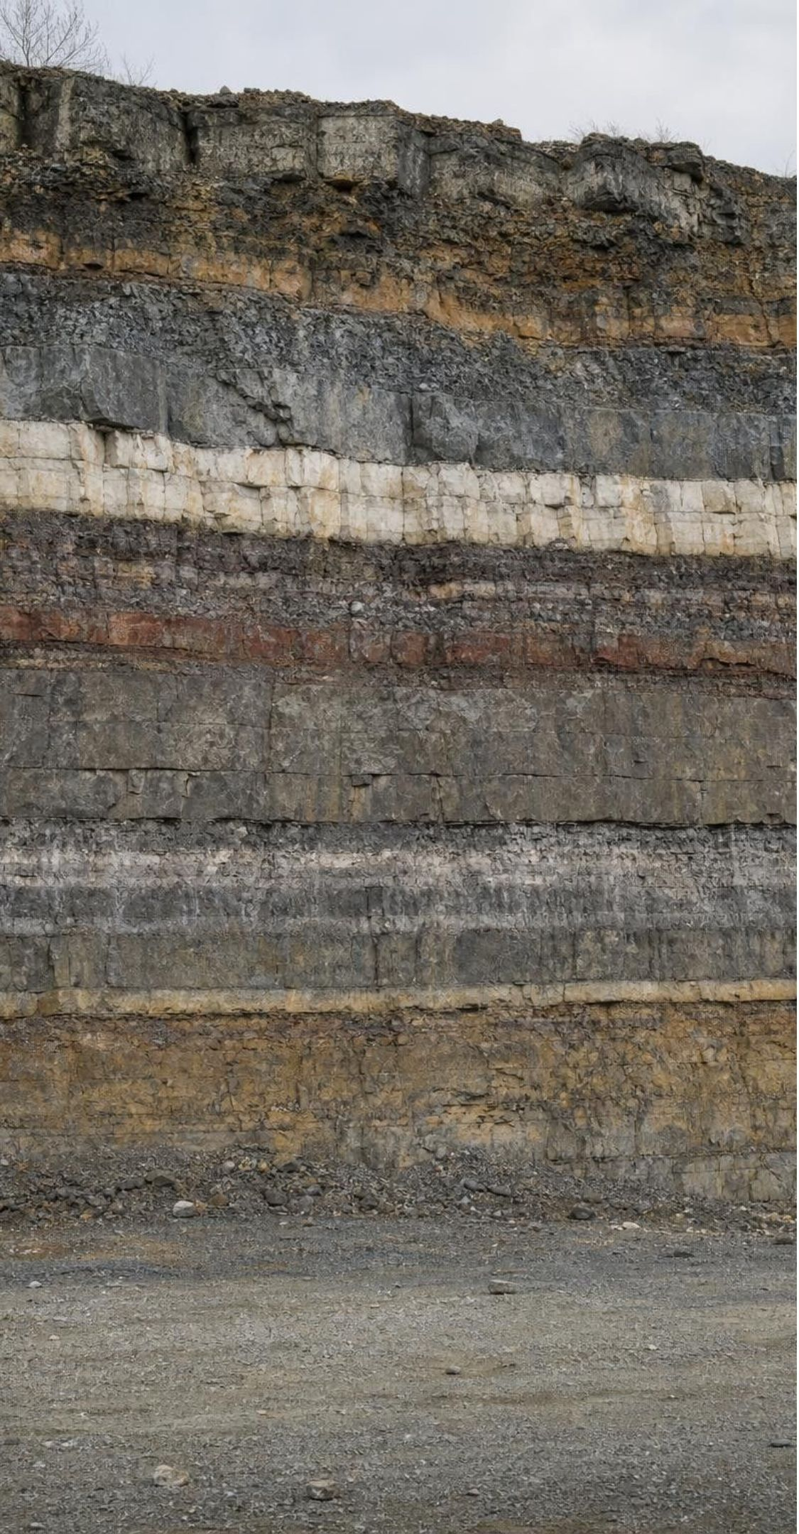
Three words to keep straight
VOCABULARY IN CONTEXT
strata: Layers of rock, usually sedimentary. One layer is a stratum. The quarry wall shows nine strata; the fourth stratum from the bottom is limestone.
relative dating: Working out the order of rocks and events without giving ages in years. The dike is younger than the shale: that is a relative date.
absolute dating: Finding an approximate age in years, with an uncertainty, usually from radioactive atoms in igneous minerals. The ash bed is 150 million years old, give or take two million.
7
Notes:
Have students say stratum and strata aloud; singular and plural trip them up on tests. Then give three statements and have them classify each as relative or absolute: 'the gravel is the youngest layer' (relative), 'the lava flow is 2.1 million years old' (absolute), 'the fault happened after the limestone formed' (relative). Point out that an absolute date always includes a plus-or-minus; a date without one is incomplete.
WATCH FOR: Writing 'stratas'. Also treating relative dating as less scientific than absolute; it is deduction, not guessing.
CONNECTS TO: W2 vocabulary relationships.
PACING: about 3 min

Slide 8
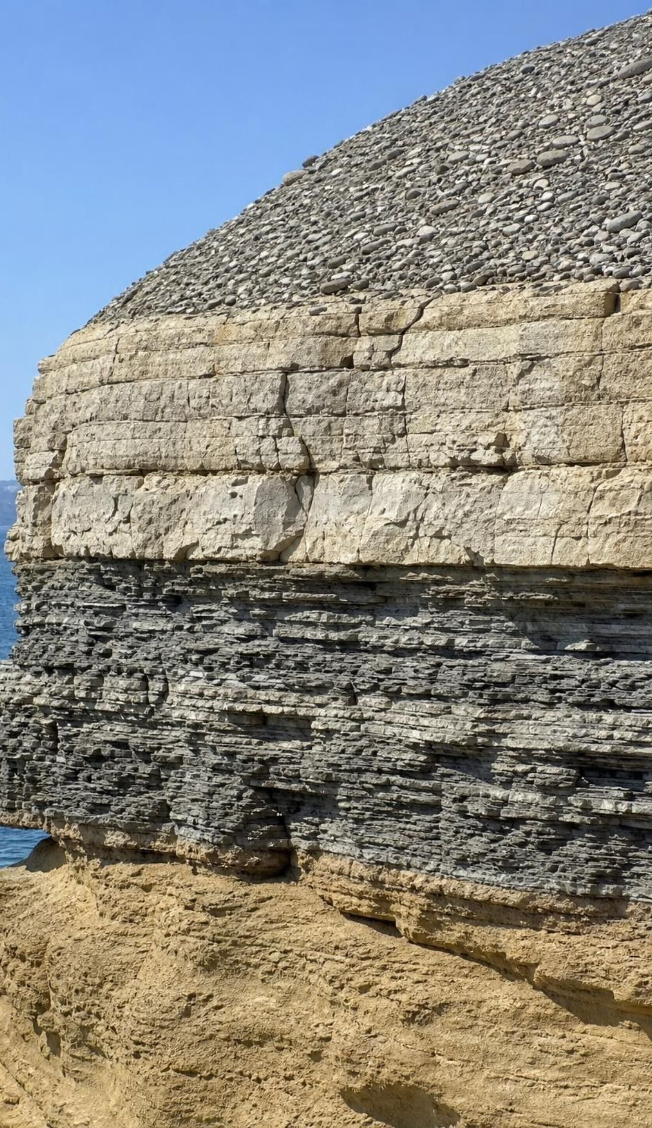
Quick check: read the stack
CHECK FOR UNDERSTANDING
A cliff shows, from top to bottom: gravel, limestone, shale, sandstone. The layers are flat and unbroken. Which statement must be true?
A. The sandstone is the oldest layer and the gravel is the youngest.
B. The gravel is the oldest because it is loose and not yet rock.
C. The limestone and the shale are the same age because they touch.
D. You cannot tell the order without a laboratory date.
8
Notes:
Vote with fingers, then ask for the rule by name. The condition 'flat and unbroken' is in the question on purpose; ask what would change if the cliff were overturned. Option B is a common confusion between hardness and age: loose gravel on top is the newest deposit, not the oldest. Option C: touching layers are adjacent in time, not the same age. Option D: order needs no lab, only arrangement.
EXPECTED RESPONSES: A, by the law of superposition, because the layers are undisturbed. Students who pick D have not separated the two questions from slide 4.
WATCH FOR: Hardness equals age. Also 'touching equals same age'.
CONNECTS TO: W4 and W10 reuse this reading.
PACING: about 3 min

Slide 9
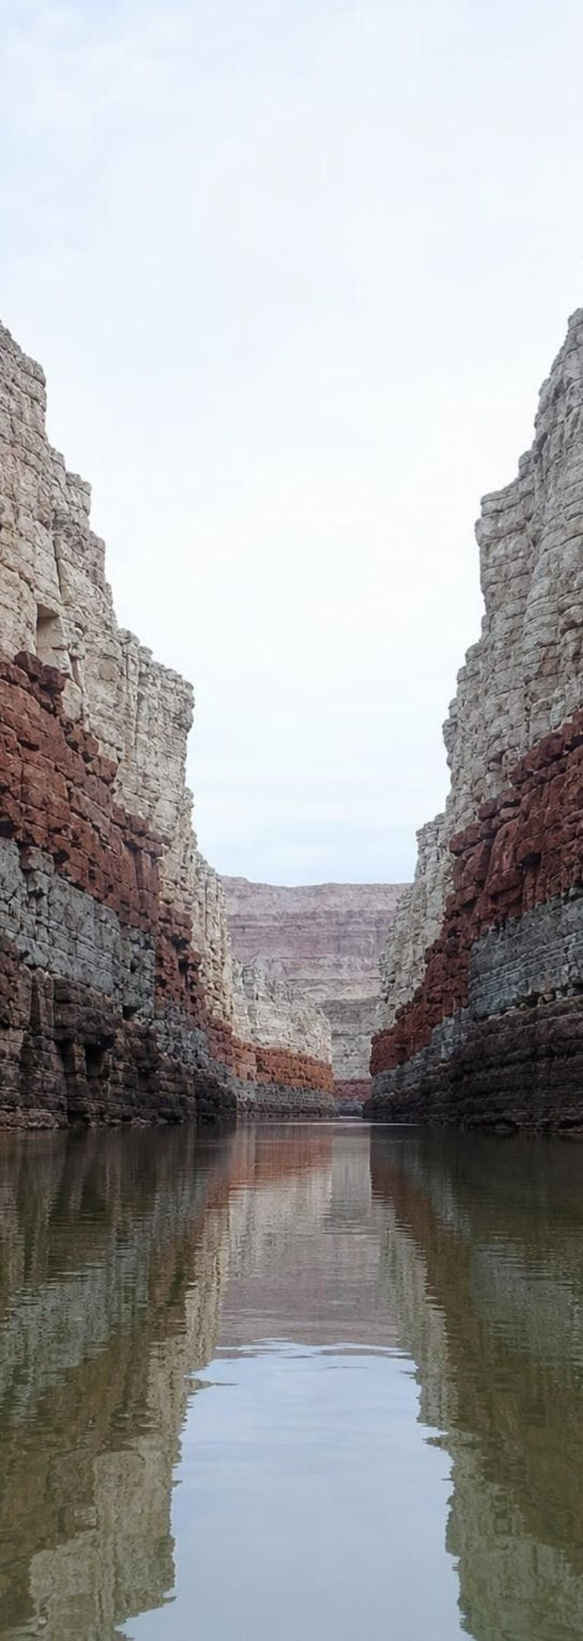
Lateral continuity: matching layers across a gap
Model Model: Two canyon walls, one original stack
West wall, top to bottom: Pale limestone 4 m, red sandstone 10 m, gray shale 6 m, dark sandstone 8 m.
East wall, top to bottom: Pale limestone 4 m, red sandstone 10 m, gray shale 6 m, dark sandstone 8 m. Same rocks, same thicknesses, same order.
The gap between them: A river has been carrying the missing rock away as sediment for a long time.
What the match tells you: Each layer once stretched across the gap as one continuous sheet, so matching layers on both walls are the same age.
What the gap tells you: The canyon cut through all four layers, so the canyon is younger than every one of them.
A caution: Only matching layers count: same rock, same thickness, same position in the sequence. A pale limestone on one wall and a pale sandstone on the other do not match.
Sediment spreads sideways until it thins out or meets a barrier. Erosion later removes pieces, but the pieces still match.
9
Notes:
Give students a minute to compare the two wall descriptions and say what they notice: identical sequences. Then ask where the rock in the gap went. Weathering and erosion by the river carried it off grain by grain, and some of it is sand in a delta now. State the principle of lateral continuity: a layer of sediment spreads out sideways in all directions until it thins or hits something, so matching layers on two sides of a gap were once one layer. Then draw out the second conclusion, which the book's summary skips: the gap is a feature that cuts across the layers, so it is younger than all of them. That is cross-cutting reasoning before we name it. End with the caution: the book's summary says layers on either side of a gap are the same age, which is too loose; only matching layers are.
EXPECTED RESPONSES: Students should state that the four layers on each wall were once connected and that the canyon formed after the limestone was deposited.
WATCH FOR: 'Any two layers across a gap are the same age.' Insist on matching.
CONNECTS TO: Lab 1 correlates cores from two spots; Lab 3 cuts a channel through a tray deposit.
PACING: about 5 min

Slide 10
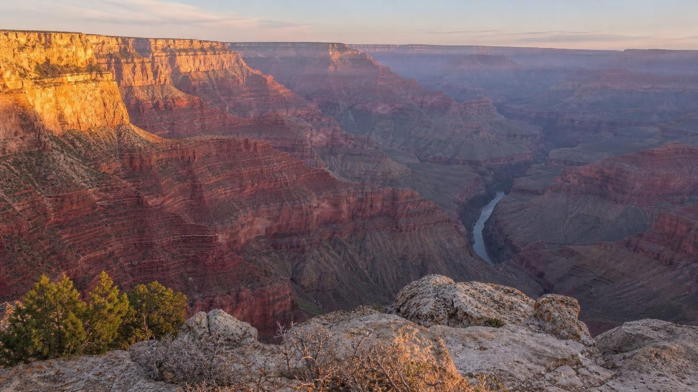
Discuss: the Grand Canyon as a slice through time
THINK, PAIR, SHARE
Rim rock: limestone about 270 million years old.
Bottom rock: about 1.8 billion years old.
The canyon itself: carved mostly in the last 6 million years.
The Colorado River has cut about 1.6 km down through the layers. Is the canyon older or younger than the rock at the rim? Than the rock at the bottom? Does the wall record every year in between?
Notes:
Run as a pair discussion for three minutes, then collect. Part one is cross-cutting logic: the canyon cuts every layer, so it is younger than the rim and the bottom alike, even though the bottom is far older than the rim. Part two is the gaps question. Between 1.8 billion and 270 million years there are about 1.5 billion years, but the stack does not record all of them: there are surfaces where layers were eroded away before the next layer formed, so whole chapters are missing. Geologists call such a buried erosion surface an unconformity; the word is optional. Also point out that layers younger than the rim once existed above it and have been eroded off. The numbers on the slide are from the National Park Service; the textbook's '1.7 to 2 billion years recorded' overstates the record.
EXPECTED RESPONSES: Canyon younger than all the layers because it cuts them. No, the wall has gaps where erosion removed layers before new ones formed, and layers above the rim are gone.
WATCH FOR: 'The bottom is oldest, so the canyon started at the bottom.' The river cut from the top down; the canyon is the newest feature.
CONNECTS TO: W3 reading; W9 transfer task uses a canyon-scale scenario.
PACING: about 6 min

Slide 11
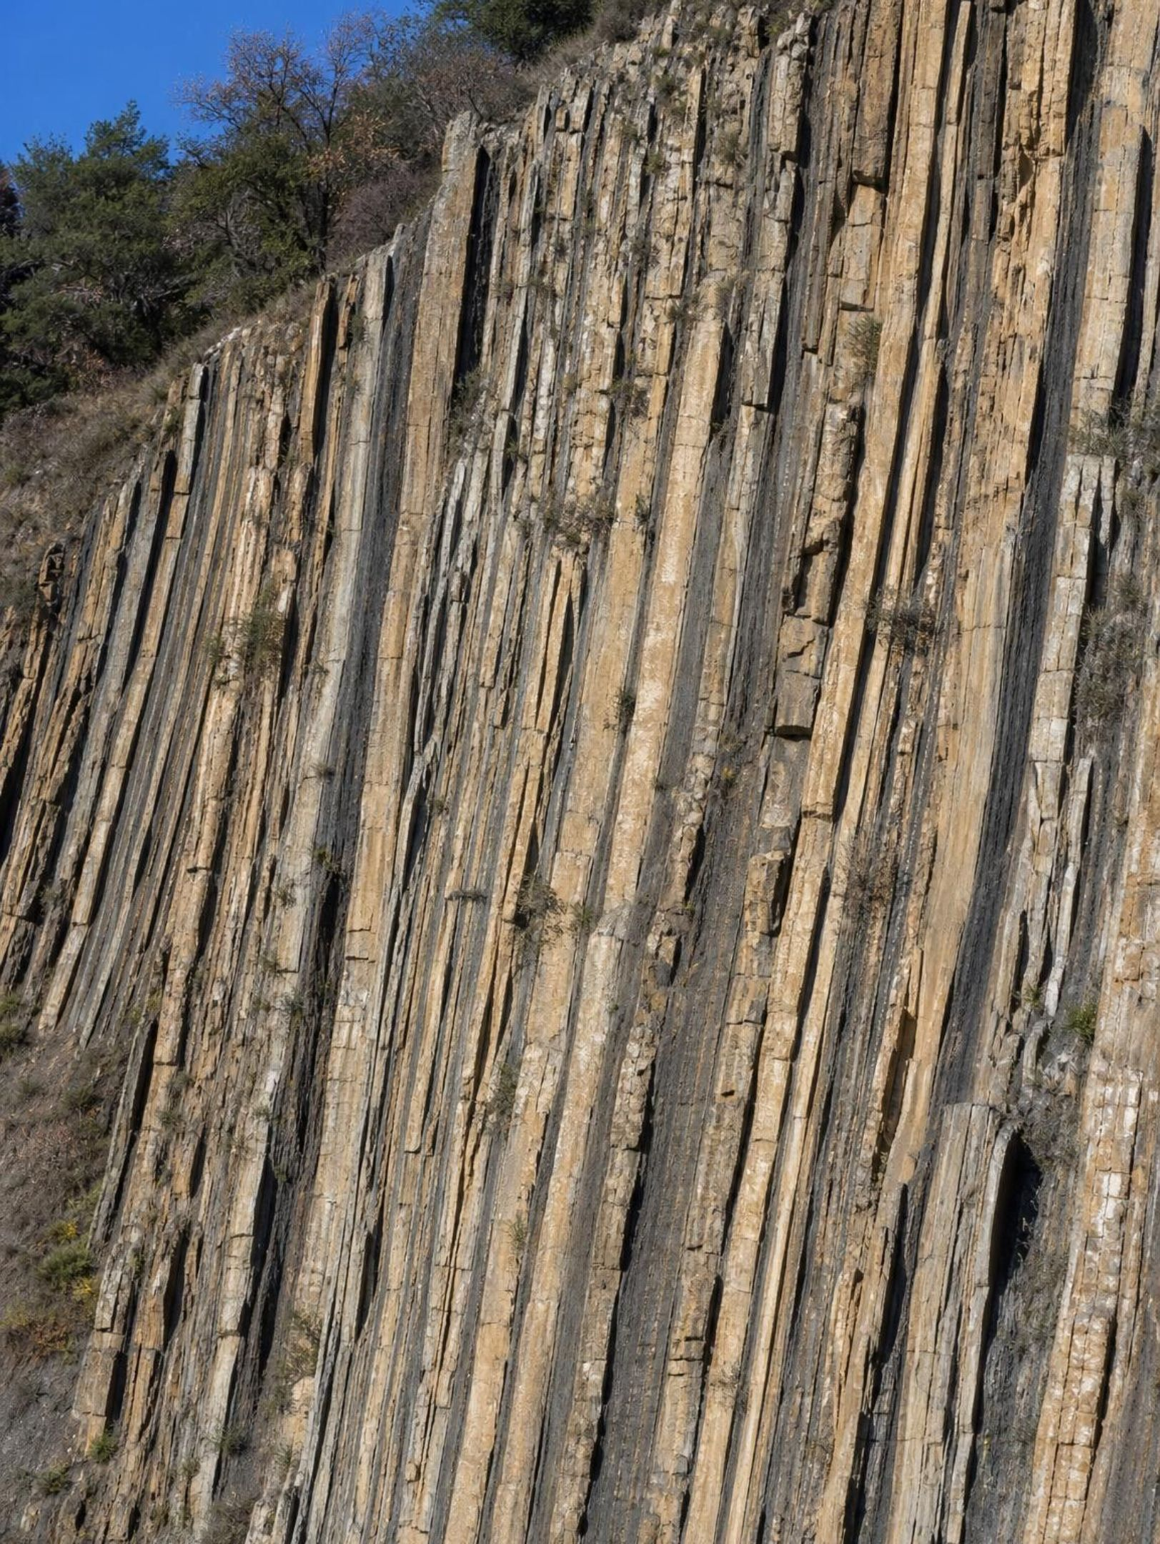
Layers that tipped: original horizontality
Gravity settles sediment into flat or nearly flat layers. So when you find layers standing at 30, 60 or 90 degrees, or bent into arches, you know two things in order: the layers formed first, flat, and something tilted or folded them afterward. The something is almost always the slow squeeze of tectonic plates, which can bend solid rock over millions of years the way a thick rug wrinkles when you push one end.
11
Notes:
Bring back the road cut: its stripes lean at 20 degrees. By original horizontality they were flat when they formed, so tilting is an event that goes after every tilted layer in the list. Ask how solid rock can bend. Over millions of years and under enormous pressure, rock deep underground deforms slowly instead of snapping; braces moving teeth is the textbook's analogy and a fair one. Two cautions. First, 'nearly flat': a delta front or a dune face deposits sediment on a gentle slope of a few degrees, so a slight tilt is not proof of a later event; steep tilts and folds are. Second, folding can go so far that part of the stack flips upside down, which is why superposition carries the word undisturbed.
WATCH FOR: 'The layers were deposited tilted.' Also 'rock cannot bend': it can, slowly, under pressure and heat at depth.
CONNECTS TO: Lab 2 quarry layers are tilted; W7 misconception worksheet.
PACING: about 4 min

Slide 12
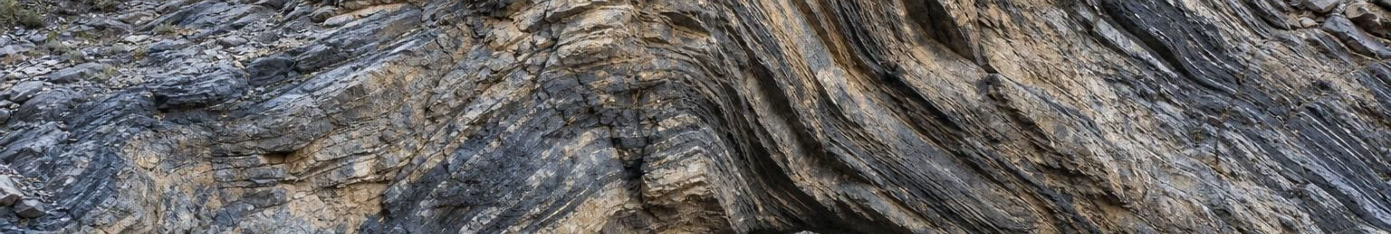
From flat to folded: what the shape tells you
Model
Model: A stack of layers under slow tectonic squeezing
Layers deposited flat, oldest at the bottom
(time) Buried and hardened into rock
(pressure) Plates push; the stack tilts as one block
(more pressure) Pushing continues; the stack bends into an arch or trough
(even more) Extreme folding flips one limb: older rock now lies on top
Work out the fold first, then apply superposition to the layers as they were before folding.
12
Notes:
Step through the flow. At the tilted stage superposition still works if you read perpendicular to the layers rather than straight down. At the arch stage, the layers on each side mirror each other: the same sequence appears twice. At the overturned stage the oldest layer can sit on top, so reading straight down gives the wrong answer. Ask: how could a geologist tell a stack is upside down? Clues inside the layers, such as ripple marks that point the wrong way or coarse grains that sit above fine grains in a layer that should grade the other way. Students ready for extension can research these. The practical rule: look for tilting and folding before you read the order.
EXPECTED RESPONSES: Students should say that in a folded stack the oldest layer is not necessarily at the bottom, and that the fold happened after all the folded layers formed.
WATCH FOR: 'Deepest is always oldest.' The last node of the flow is the counterexample.
CONNECTS TO: W7 misconception repair on an overturned fold.
PACING: about 5 min

Slide 13
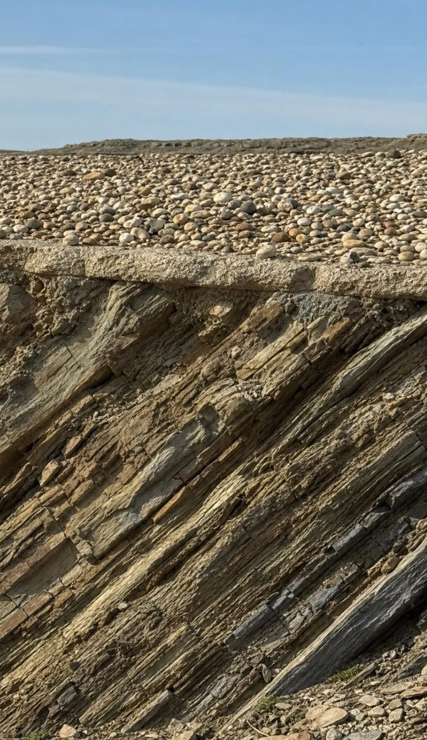
Quick check: tilted layers under flat gravel
CHECK FOR UNDERSTANDING
A wall shows layers tilted 30 degrees. Their upper ends are worn flat, and a bed of flat river gravel lies across them. Which order of events fits the evidence?
A. Gravel deposited, layers deposited, layers tilted.
B. Layers deposited flat, layers tilted and their tops eroded, gravel deposited.
C. Layers deposited already tilted, then gravel deposited.
D. Layers deposited flat, gravel deposited, both tilted together.
13
Notes:
Vote, then ask for the rule behind each step. Original horizontality rules out C. Superposition says the gravel is youngest, which rules out A. If D were true the gravel would be tilted too; it is flat, so the tilting came before the gravel. The eroded tops of the tilted layers are a surface that cuts across them: another cross-cutting feature, younger than the layers and older than the gravel. This is the road cut's top half.
EXPECTED RESPONSES: B. Students who pick D have not used the fact that the gravel is still flat.
WATCH FOR: Reading 'tilted' as a property of the sediment rather than an event that happened to it.
CONNECTS TO: W4 diagram worksheet; Lab 2 case file has the same structure with more features.
PACING: about 3 min

Slide 14
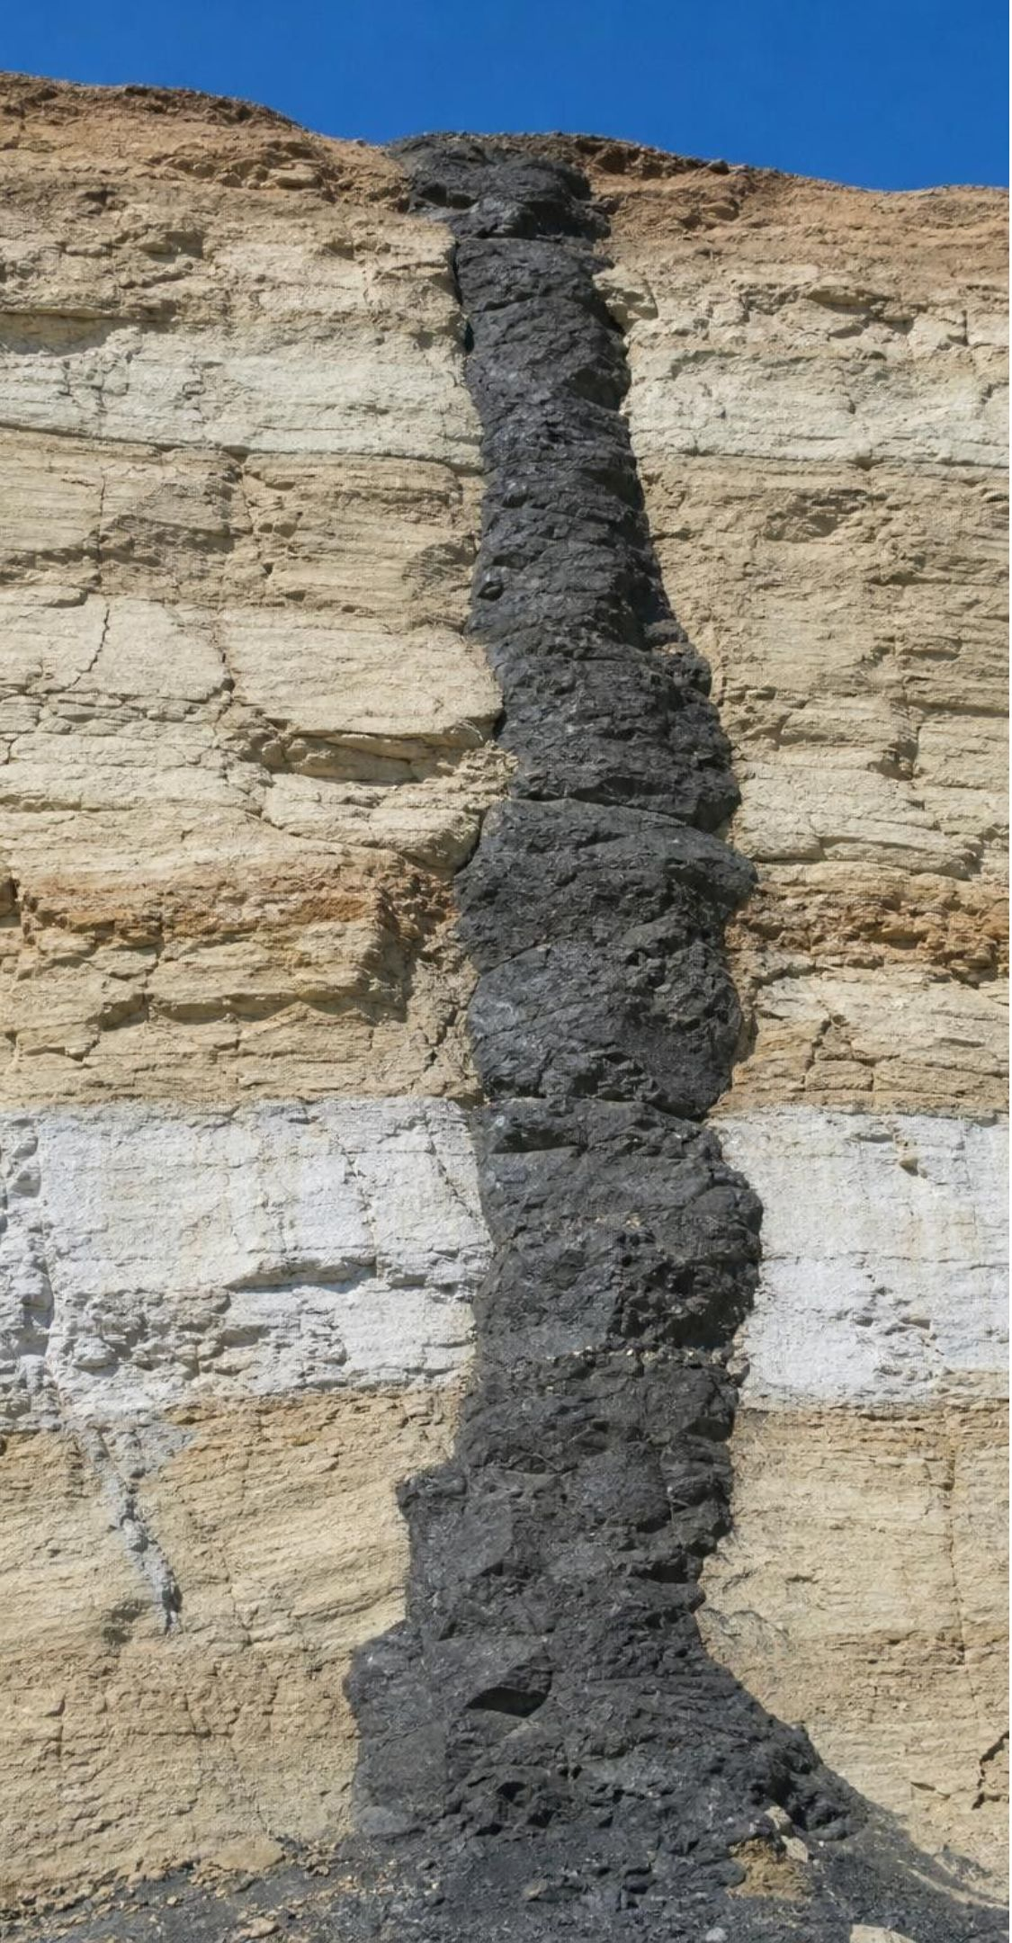
Three rules, three names
VOCABULARY IN CONTEXT
principle of original horizontality: Sediment settles in flat or nearly flat layers, so steep tilting or folding came later. Layers standing on end in the Mojave were laid down flat in an ancient lake and tipped afterward.
principle of lateral continuity: A layer spreads sideways until it thins out or meets a barrier, so matching layers across a gap were once one layer. The same limestone on both rims of a canyon is one sheet the river cut through.
law of cross-cutting relationships: Anything that cuts through rock, such as an intrusion, a fault or an erosion surface, must be younger than whatever it cuts through. A dark dike through three layers is younger than all three.
14
Notes:
The textbook calls some of these laws and some principles; geologists use both words, and Nicolas Steno stated the first three stacking rules in 1669. Accept either word. Have students write each rule as a question they can ask a cliff: Is it flat? Does it match across the gap? What does it cut? Then preview the next slide: cross-cutting is the rule that handles the dark stripe and the offset in the road cut.
WATCH FOR: Mixing up lateral continuity (sideways spreading) with superposition (vertical stacking).
CONNECTS TO: W2 vocabulary; W8 collaborative evidence sort assigns one rule per expert group.
PACING: about 3 min

Slide 15
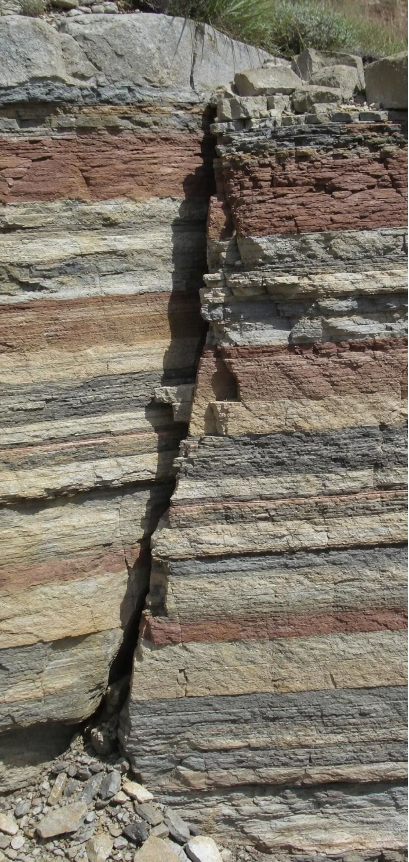
Features that cut across strata, and the rule for each
Model
Model: Three kinds of cutting feature
Igneous intrusion (dike): Magma pushed into cracks in existing rock and cooled. Younger than every layer it crosses. A dike cannot form in rock that is not there yet.
Fault: A break where rock on one side moved past the other, so layers no longer line up. Younger than every layer it offsets.
Erosion surface: A surface where layers were worn away before new ones were deposited. Younger than the layers it cuts, older than the layers on top of it.
Fault with unbroken layers above it: If a layer lies across a fault without being offset, that layer formed after the fault stopped moving.
A fault cut by another fault: The fault that is broken is older; the fault that breaks it is younger. Same for a dike cut by a fault, or a fault cut by a dike.
Scale: Some faults fit in a hand sample. The San Andreas runs about 1,200 km and offsets stream channels by more than 100 m near Wallace Creek.
15
The feature doing the cutting is always the younger one. The textbook's page 101 callout states this backward; pages 96-97 and 103 are correct.
Notes:
Return to the parked claim that the dike 'was there first'. Ask how a dike forms: magma squeezes into a crack. Can a crack exist in rock that has not formed yet? No. So the dike is younger than everything it crosses, and the same logic applies to faults: you cannot break what is not there. Then do the two advanced cases on the slide, because Lab 2 uses both: a layer lying unbroken across a fault is younger than the fault, and when two cutting features cross, the broken one is older. Warn students that the textbook's Key Science Concept callout on page 101 says the cutting feature is older, which contradicts the book's own body text and summary; W7 asks them to fix that claim. On scale: a fault you can step across and the San Andreas obey the same rule. At Wallace Creek in the Carrizo Plain, a dry stream channel is offset about 130 meters where it crosses the fault: the channel was cut first, then moved, so the offset is younger than the channel.
EXPECTED RESPONSES: Students should state the rule for a dike, a fault and an erosion surface in their own words and apply the 'unbroken layer above a fault' case to the road cut's gravel.
WATCH FOR: 'The cutting feature is older.' Push students to explain how the feature forms, not what the picture looks like.
CONNECTS TO: W6 CER on which of two cutting features is older; W7 corrects the backward claim; Lab 2 case file.
PACING: about 6 min

Slide 16
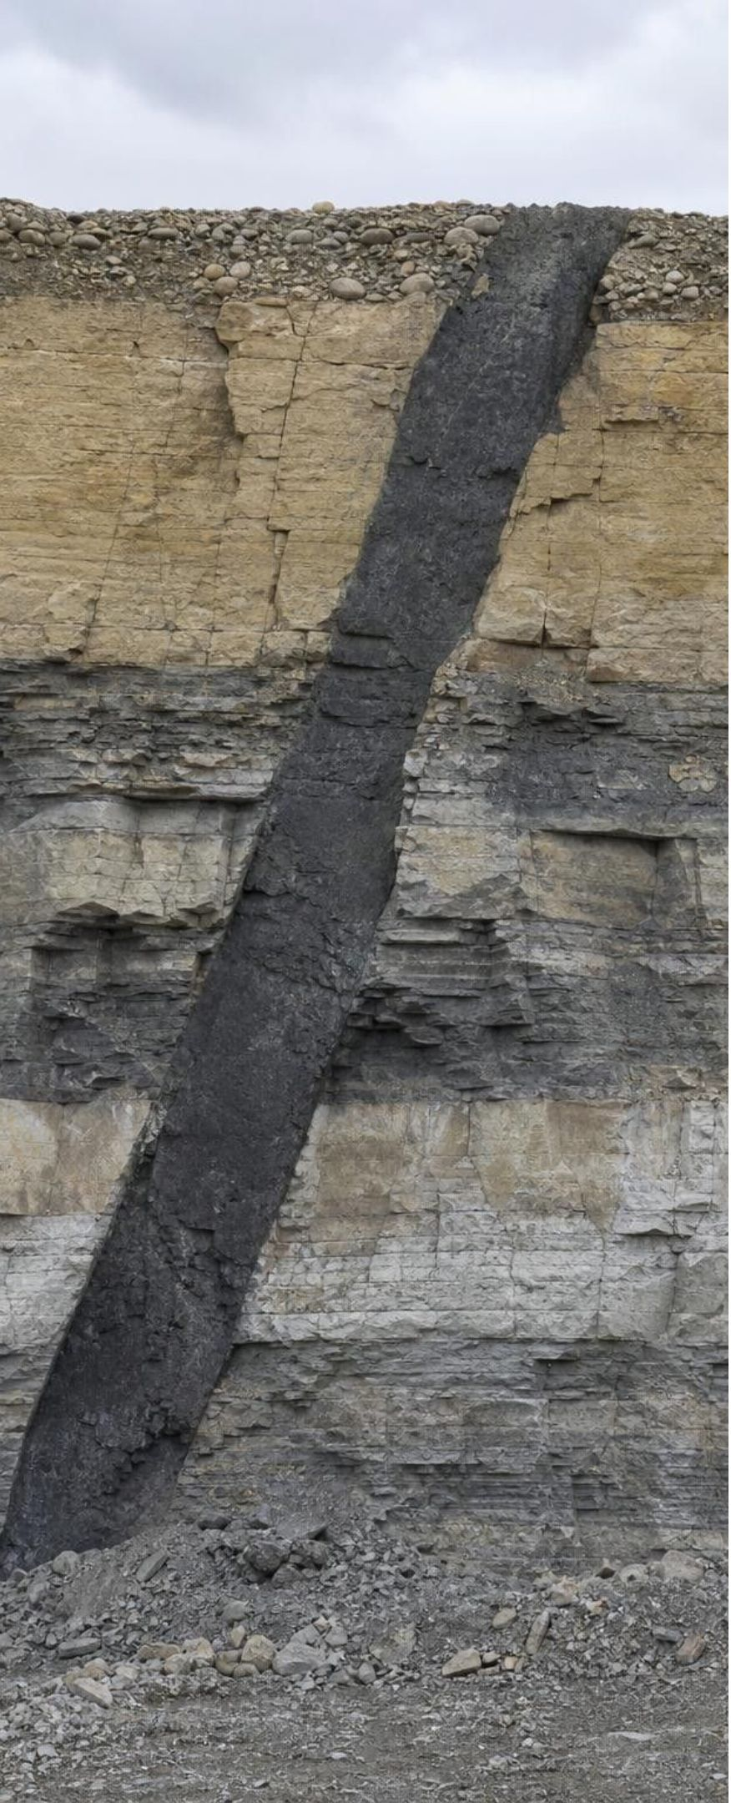
Task: put the events in order
Apply it · Simulated data for practice.
A quarry wall shows the features below. Using the rules, list the events from oldest to youngest and name the rule for each step.
Feature | What you observe
Layer A, sandstone | Lowest layer. Cut by fault F and by dike D.
Layer B, shale | Lies on A. Cut by fault F and by dike D.
Fault F | Offsets A and B by 2 m. Stops at the base of layer C.
Layer C, limestone | Lies flat across the top of F, unbroken. Cut by dike D.
Dike D, dark igneous rock | Cuts A, B and C. Its top is sliced off by surface E.
Surface E | A flat erosion surface truncating A, B, C and D.
Layer G, river gravel | Lies on E. Nothing cuts it.
16
Notes:
This is a teaching scenario, not a real quarry. Give groups eight minutes with whiteboards. Coach the method: start with the layers by superposition (A then B then C then G), then slot each cutting feature in by what it cuts and what it does not. Fault F cuts A and B but stops at C, so F goes after B and before C. Dike D cuts A, B and C, so it goes after C. Surface E slices the top of D, so E is after D. G lies on E, so G is last. Ask each group to read its list aloud with the rule for each step; listen for the phrase 'cuts, so younger'. Then ask the stretch question: where would tilting go if all the layers A, B and C were tilted but G were flat? After C and before E, and the evidence does not say whether it came before or after the fault or the dike unless the dike is also tilted. Lab 2 is built on exactly this kind of ambiguity.
EXPECTED RESPONSES: Oldest to youngest: A (superposition), B (superposition), fault F (cuts A and B; C lies unbroken across it), C (lies on B and across F), dike D (cuts A, B, C), erosion surface E (truncates D), gravel G (lies on E, uncut). Students who put D before C have missed that D cuts C.
WATCH FOR: Groups that place the dike first because it 'reaches the bottom'. Depth of a cutting feature is not age.
CONNECTS TO: Lab 2 is the full version with tilting and dated ash beds; W4 and W10 reuse the ordering skill.
PACING: about 10 min

Slide 17
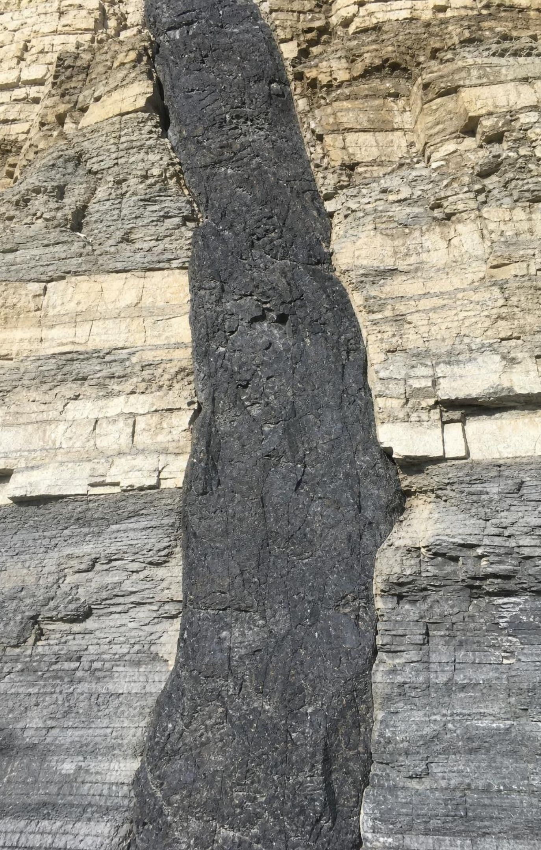
Quick check: which is youngest?
CHECK FOR UNDERSTANDING
A fault offsets layers A and B. Layer C lies flat across the fault, unbroken. A dark dike cuts A, B and C. Which feature is the youngest?
A. The fault
B. Layer C
C. The dike
D. Layer A
17
Notes:
Quick vote and a one-sentence reason. The dike cuts C, and C is younger than the fault, so the dike is youngest of the four. Follow up: what would change if the dike were offset by the fault? Then the fault would be younger than the dike, and C, lying unbroken across the fault, would be younger still.
EXPECTED RESPONSES: C, the dike: it cuts layer C, which itself lies across the fault and so is younger than the fault.
WATCH FOR: Choosing the fault because it is 'a big event'. Size is not age.
CONNECTS TO: W6 CER; W10 mastery.
PACING: about 3 min

Slide 18
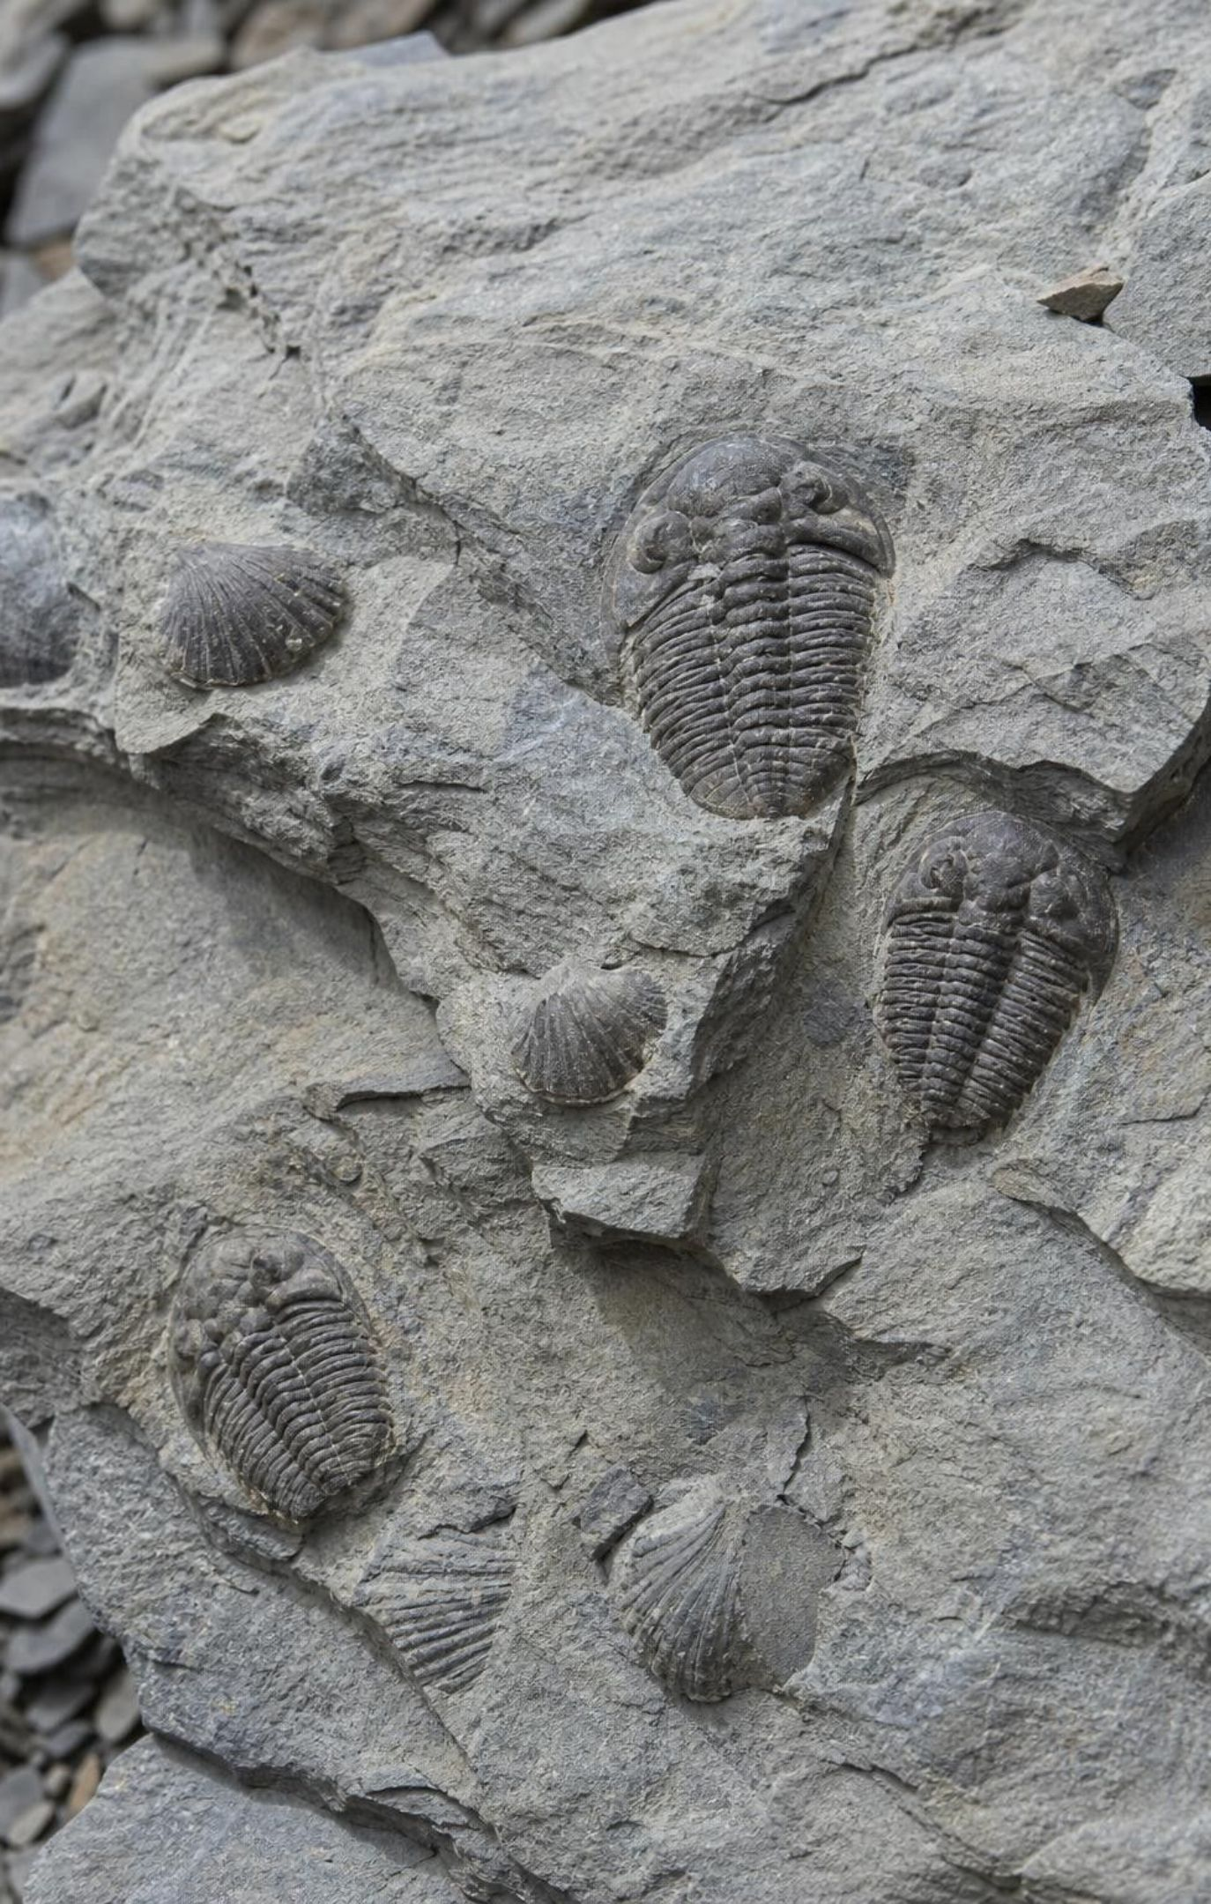
Fossils as time markers
Life on Earth changed over time, and the changes happened in one order that never repeated.
So fossil species appear in rock layers in the same order everywhere: the law of fossil succession.
A species' fossils occur only in layers from the span of time it was alive.
The best markers, index fossils, lived a short time, spread widely and are easy to identify.
Matching fossils mean about the same age: within the species' lifespan, never an exact year.
18
Notes:
Explain the logic in order. Species appear, exist for a while and go extinct, and no extinct species returns. So the order of fossils up through a stack is the order in which those species lived, and that order is the same in Ohio, Morocco and China. A surveyor named William Smith noticed this in English canal cuts in the early 1800s and used it to map rock layers across the country. Then the useful part: if you find a species that lived only two million years, any layer with it formed inside that window, anywhere on Earth. That is an index fossil. A clam type that lasted 200 million years tells you almost nothing. Mention that marine organisms make the best index fossils because the ocean spreads them widely: ammonites (extinct shelled relatives of squid), graptolites (extinct colonial animals) and foraminifera (tiny single-celled protists, many still living today). The book calls foraminifera animals and ammonites shellfish; both are loose.
WATCH FOR: 'Same fossil, same exact age.' Also 'fossils give years': they give a position in the sequence; years come from radiometric dates tied to that sequence.
CONNECTS TO: Lab 1 uses pasta 'fossils' as short-lived and long-lived markers; W8 collaborative evidence sort.
PACING: about 5 min

Slide 19
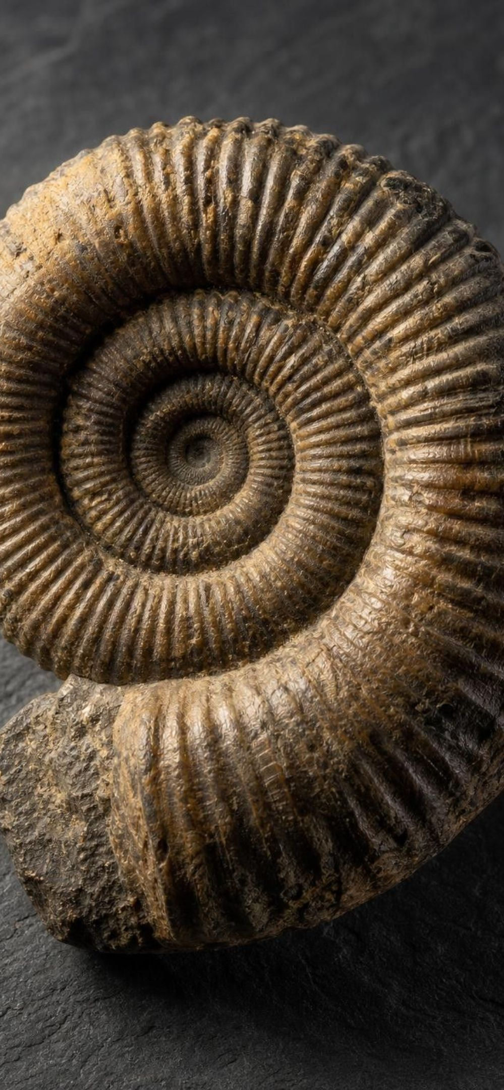
What makes a fossil a good time marker?
Model
Model: Good index fossil versus poor index fossil
Good index fossil | Poor index fossil
Species existed for a short span of geologic time | Species lasted hundreds of millions of years, so its window is huge
Spread across a wide area, often by ocean currents | Lived in one small region or one rare habitat
Common and well preserved, so it is found often | Rarely preserved, so finds are scarce
Distinctive shape that is easy to tell from relatives | Looks like many other species, so misidentified
A short lifespan narrows the age; a wide range lets distant layers be matched; easy identification avoids mistakes.
19
Notes:
Have students explain each left-column trait as a reason, not a fact: why does a short lifespan help? Because it narrows the time window. Why wide area? Because the point is to match layers in distant places. Why easy to identify? Because confusing two look-alike species from different times ruins the match. Then test the idea with invented cases: a species found on every continent that lived for 300 million years (poor: too long), a species that lived two million years but only in one lake (poor: too local), a species that lived three million years across all the world's oceans and has a unique spiral shell (good). Point to the shared column: even the best index fossil gives a range, not a date.
EXPECTED RESPONSES: Students classify the three invented cases correctly and explain the reason for each trait.
WATCH FOR: Students think the oldest or rarest fossil is the most useful. Usefulness is about narrowness of time and breadth of place.
CONNECTS TO: Lab 1 analysis compares the star-pasta (one layer) and shell-pasta (three layers) markers; W8.
PACING: about 4 min

Slide 20
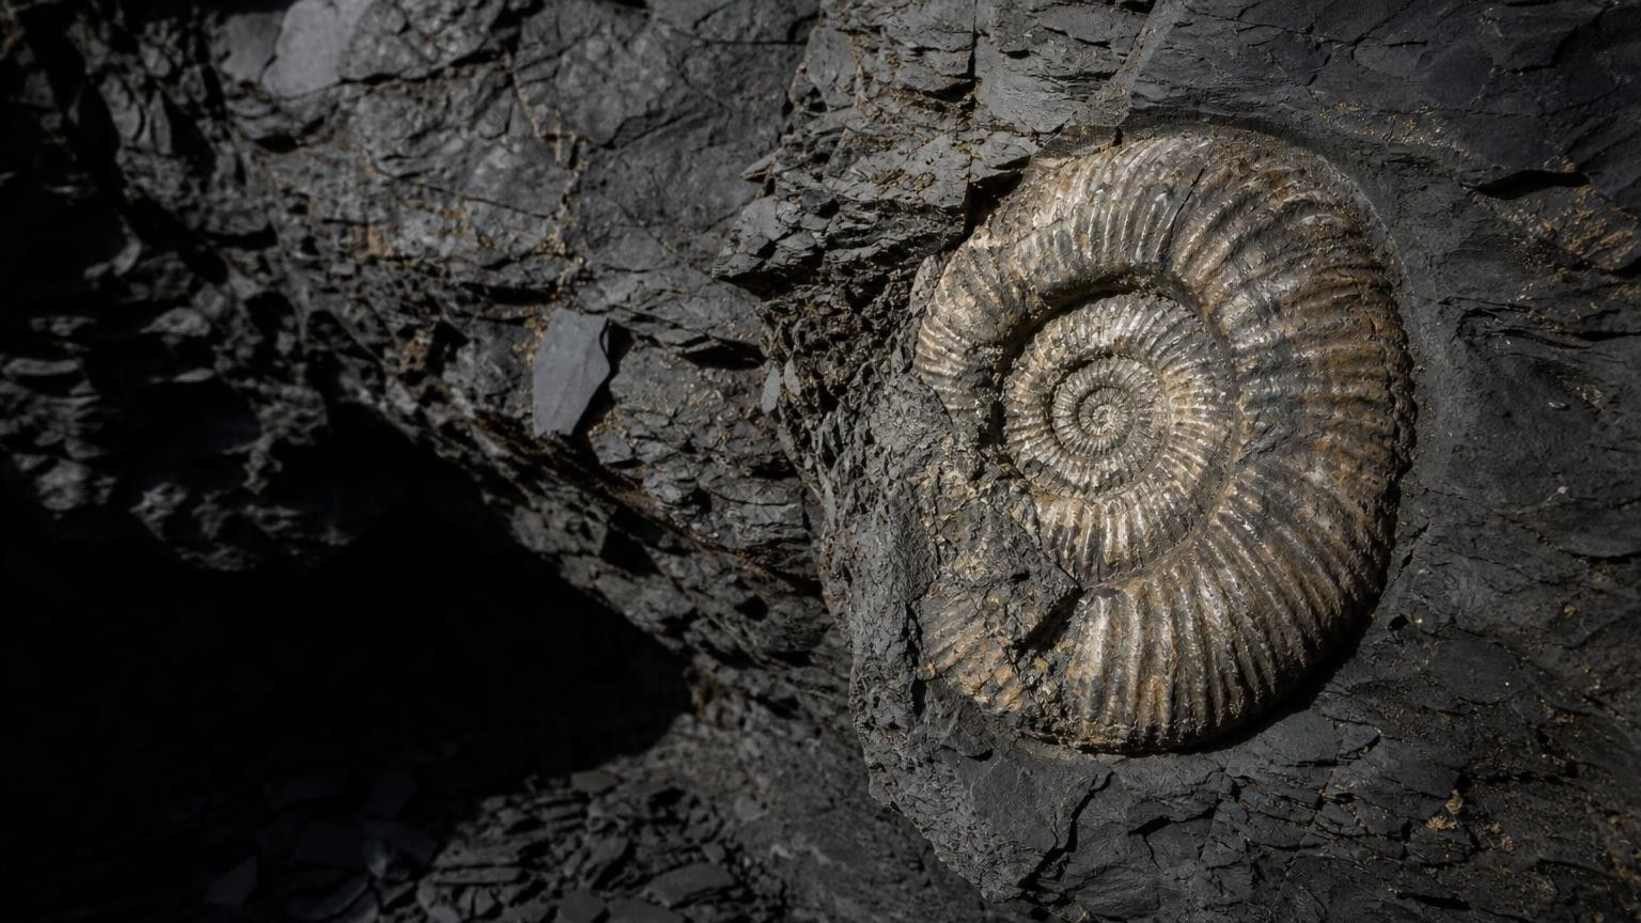
Discuss: same fossil, same age?
THINK, PAIR, SHARE
Two quarries 500 km apart each have a shale layer with the same ammonite species. A student says the two shales formed in the same year. How close in age can you honestly claim? What would make you more confident?
Notes:
Pairs, three minutes, then collect. The honest claim is that both shales formed sometime during the span that species was alive, which might be a few million years. Confidence improves if the species was short-lived, if several species with overlapping lifespans are found together (the overlap is narrower than any one span), and best of all if a dated ash bed lies near the shale in one quarry. Connect to the textbook's wording that layers with the same fossils 'are the same age'; ask students to rewrite it accurately. Good rewrite: 'formed within the same span of time, as long as that species existed.'
EXPECTED RESPONSES: Within the lifespan of the species, perhaps millions of years, not one year. More confidence from a short-lived species, from several overlapping species, or from a radiometric date on a nearby ash layer.
WATCH FOR: 'Same year.' Also the reverse overcorrection, 'fossils tell you nothing'; they give a real, bounded range.
CONNECTS TO: W6 CER alternative prompt; W8 collaborative task matches two quarries.
PACING: about 5 min

Slide 21
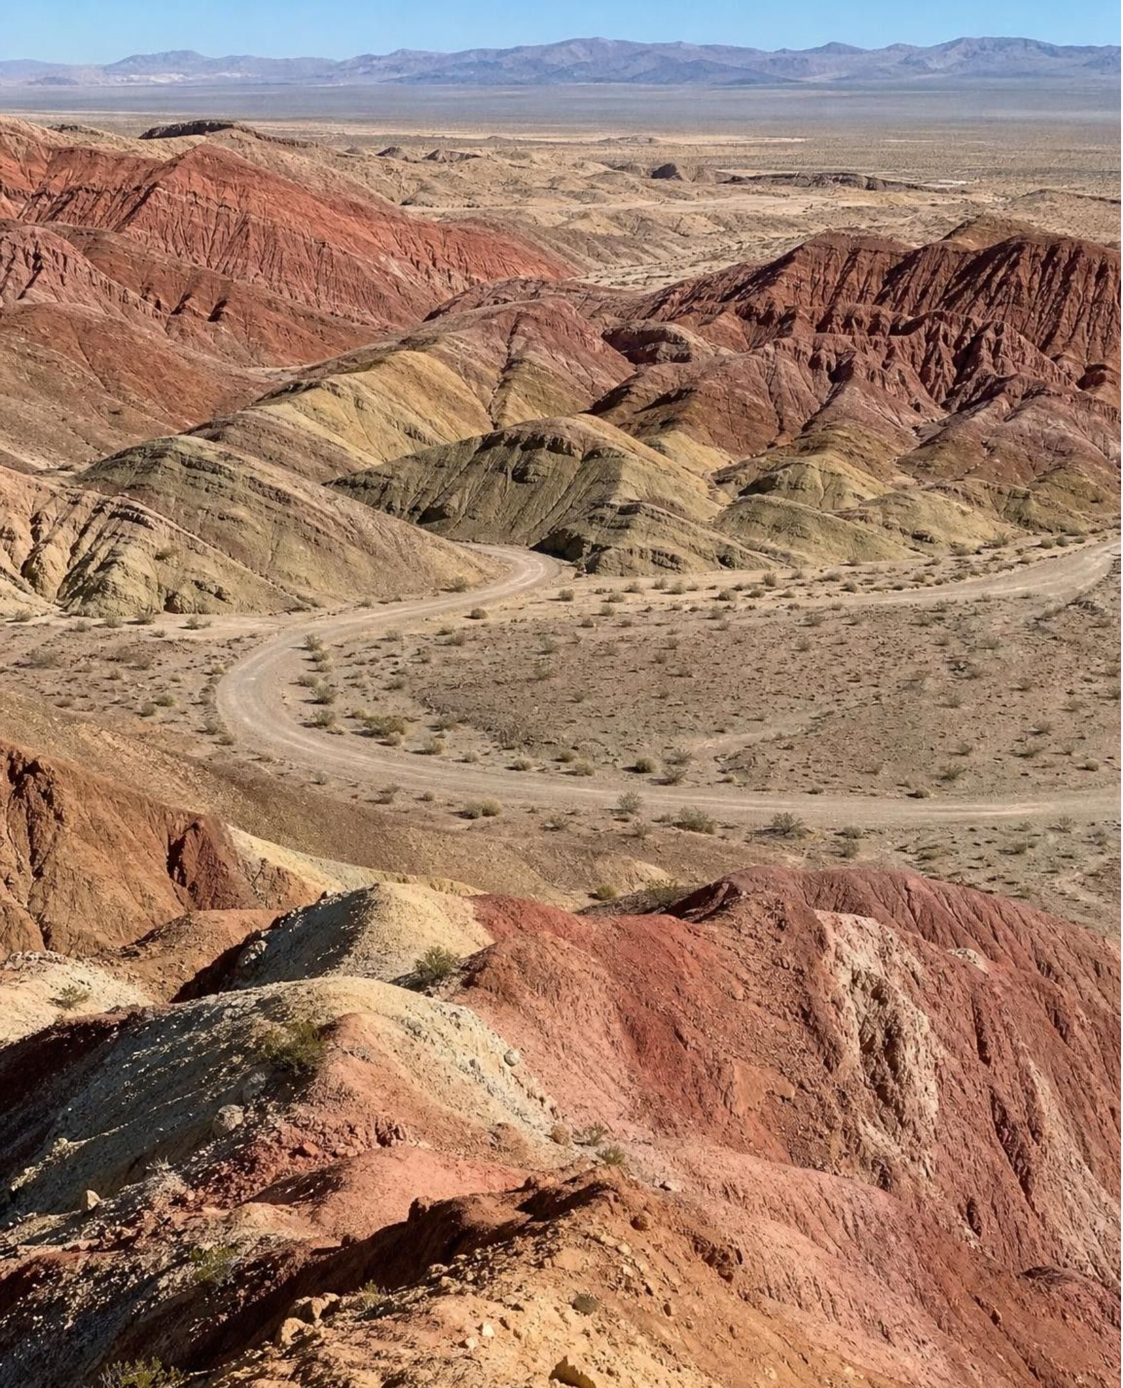
California connection: Rainbow Basin near Barstow
REAL-WORLD CONNECTION
In the Mojave Desert north of Barstow, Rainbow Basin shows layers of ancient lake and stream sediment bent into a huge trough and tilted on edge, with faults slicing through them. Ash beds between the layers have been radiometrically dated to roughly 13 to 19 million years, and the layers hold fossils of early horses, camels and other land mammals. Every rule in this lesson is on display along one short loop road.
21
Notes:
Rainbow Basin Natural Area is managed by the Bureau of Land Management and has a short loop road through the folded Barstow Formation. Walk through how a geologist reads it: the sediments were deposited flat in lakes and streams (original horizontality), stacked over millions of years (superposition), then folded into a trough and faulted (cross-cutting). The ash beds are the key: ash falls in hours, settles in a flat layer and carries datable crystals, so each dated ash bed brackets the fossil-bearing layers above and below it. The mammal fossils, in turn, became reference points for matching layers of similar age elsewhere in North America. The dates on the slide are rounded; check a current source before quoting exact figures. If you can, show a photo of the folded beds.
CONNECTS TO: W9 transfer task; Lab 2's dated ash beds use the same bracketing logic.
PACING: about 4 min

Slide 22
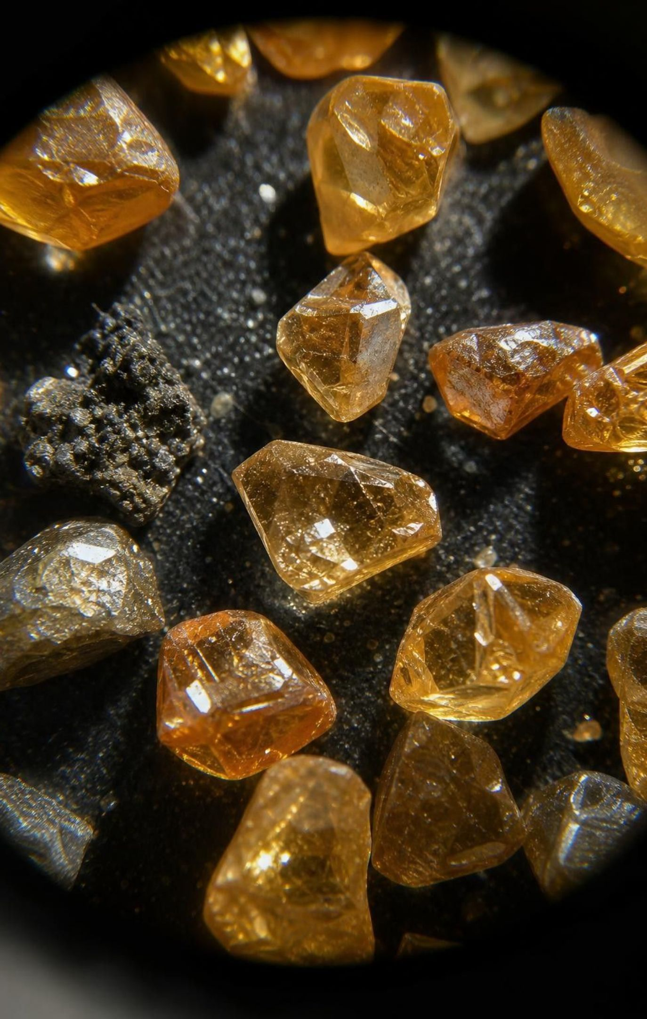
Clocks inside crystals
When magma cools, minerals crystallize and trap radioactive atoms inside, like starting a stopwatch.
Those parent atoms decay into daughter atoms at a steady rate that heat and pressure cannot change.
Measure the ratio of parent to daughter in a crystal, and you can calculate when it formed.
Works on igneous rock: lava flows, ash beds, dikes. Not on the sedimentary layers themselves.
Why not? Sand grains are pieces of older rock; their clocks started in a different rock, long before.
22
Notes:
Build the model carefully. Crystallization is the moment the clock starts because that is when atoms get locked into a fixed crystal. From then on, each radioactive parent atom has a fixed chance of decaying in any given year, which produces a steady, predictable decline, like a large number of coins flipped every year with the heads removed. Decay happens in the nucleus and nothing chemical, hot or heavy reaches it, which is why it is a reliable clock. The method also assumes the crystal gained or lost no atoms after it formed; a cracked or heated crystal can fail that test, and the book skips this assumption. Then the limitation: a sandstone is made of grains eroded from older rock, so dating its grains gives the age of that older rock, at best a maximum age for the layer. That is why ash beds matter so much.
WATCH FOR: 'Heating speeds up decay.' Decay rates are not affected by temperature. Also 'you can date any rock': only igneous minerals that trapped parent atoms at formation.
CONNECTS TO: W5 data worksheet on parent and daughter fractions; Lab 2 uses dated ash beds and a dated dike.
PACING: about 5 min

Slide 23
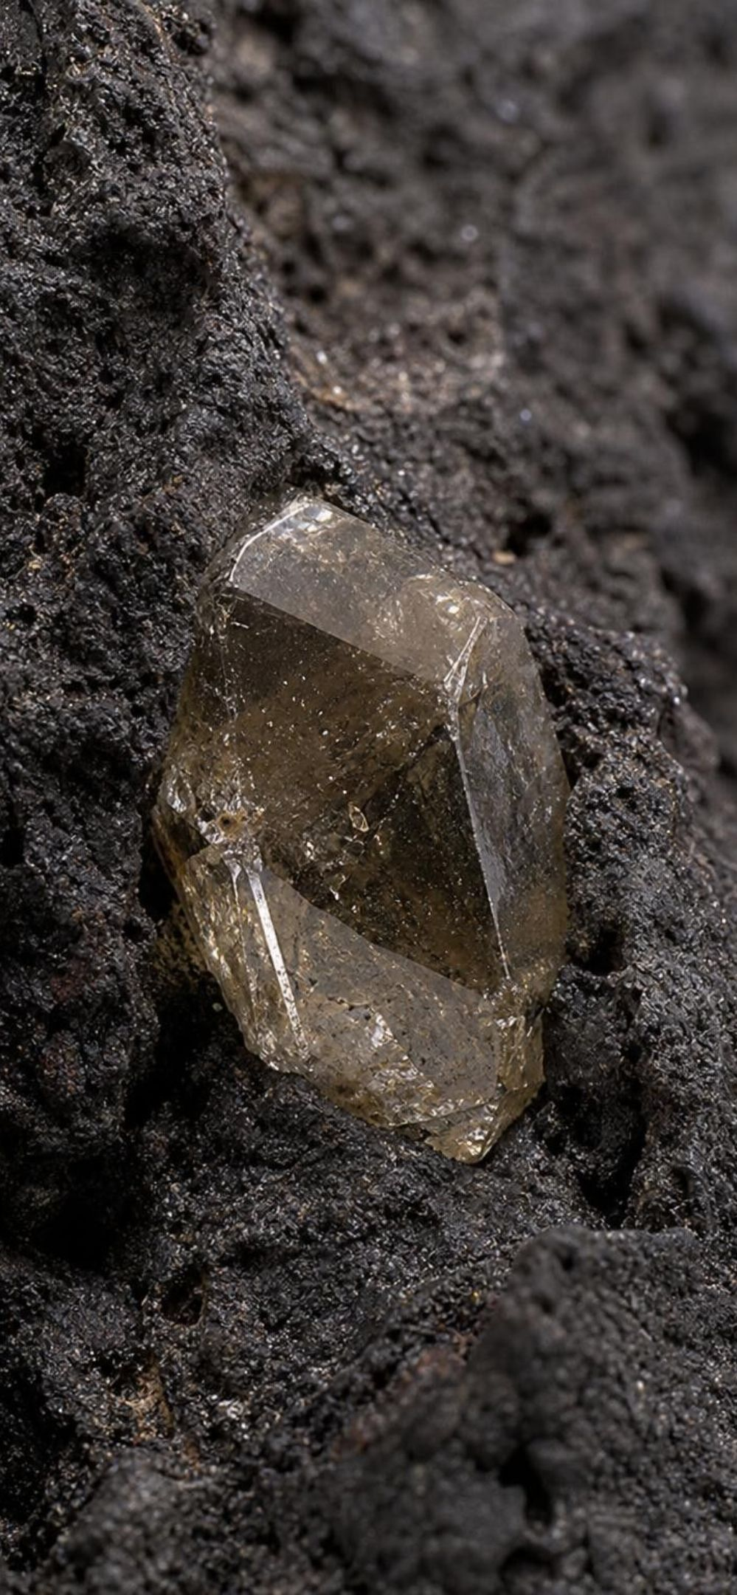
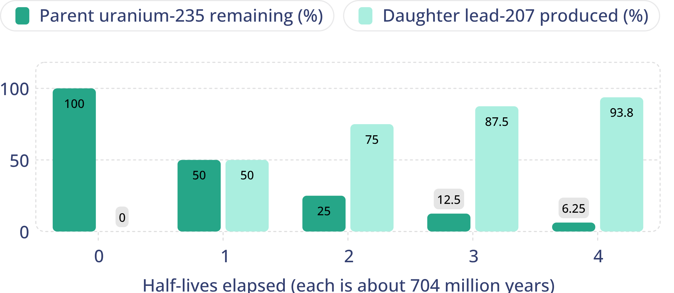
Half-life: each step halves what is left
Model · Model: Uranium-235 decaying to lead-207 in a crystal
After one half-life half the parent is left; after two, a quarter; after three, an eighth. The parent never reaches zero in a fixed number of steps.
23
Notes:
Read the two curves together: parent down, daughter up, always summing to 100 percent if no atoms escaped. A half-life is the time for half of whatever is left to decay; it is not half of a total lifetime. Walk the chain aloud: 100, 50, 25, 12.5, 6.25. Then ask: after two half-lives, is all the uranium gone? No, a quarter remains. Give the uranium-235 half-life as about 704 million years, the textbook's figure, and mention that other clocks have other half-lives: potassium-40 about 1.25 billion years, uranium-238 about 4.47 billion years. Longer half-lives suit older rocks. Have students write the chain in their notes with the ages beside it: 0, 704, 1,408, 2,112, 2,816 million years.
EXPECTED RESPONSES: Students reproduce the halving chain and can state what fraction remains after three half-lives (one eighth).
WATCH FOR: 'Two half-lives means everything is gone.' Use the curve: 25 percent left.
CONNECTS TO: W5 data worksheet graphs this decay; W10 mastery has a half-life item.
PACING: about 5 min

Slide 24
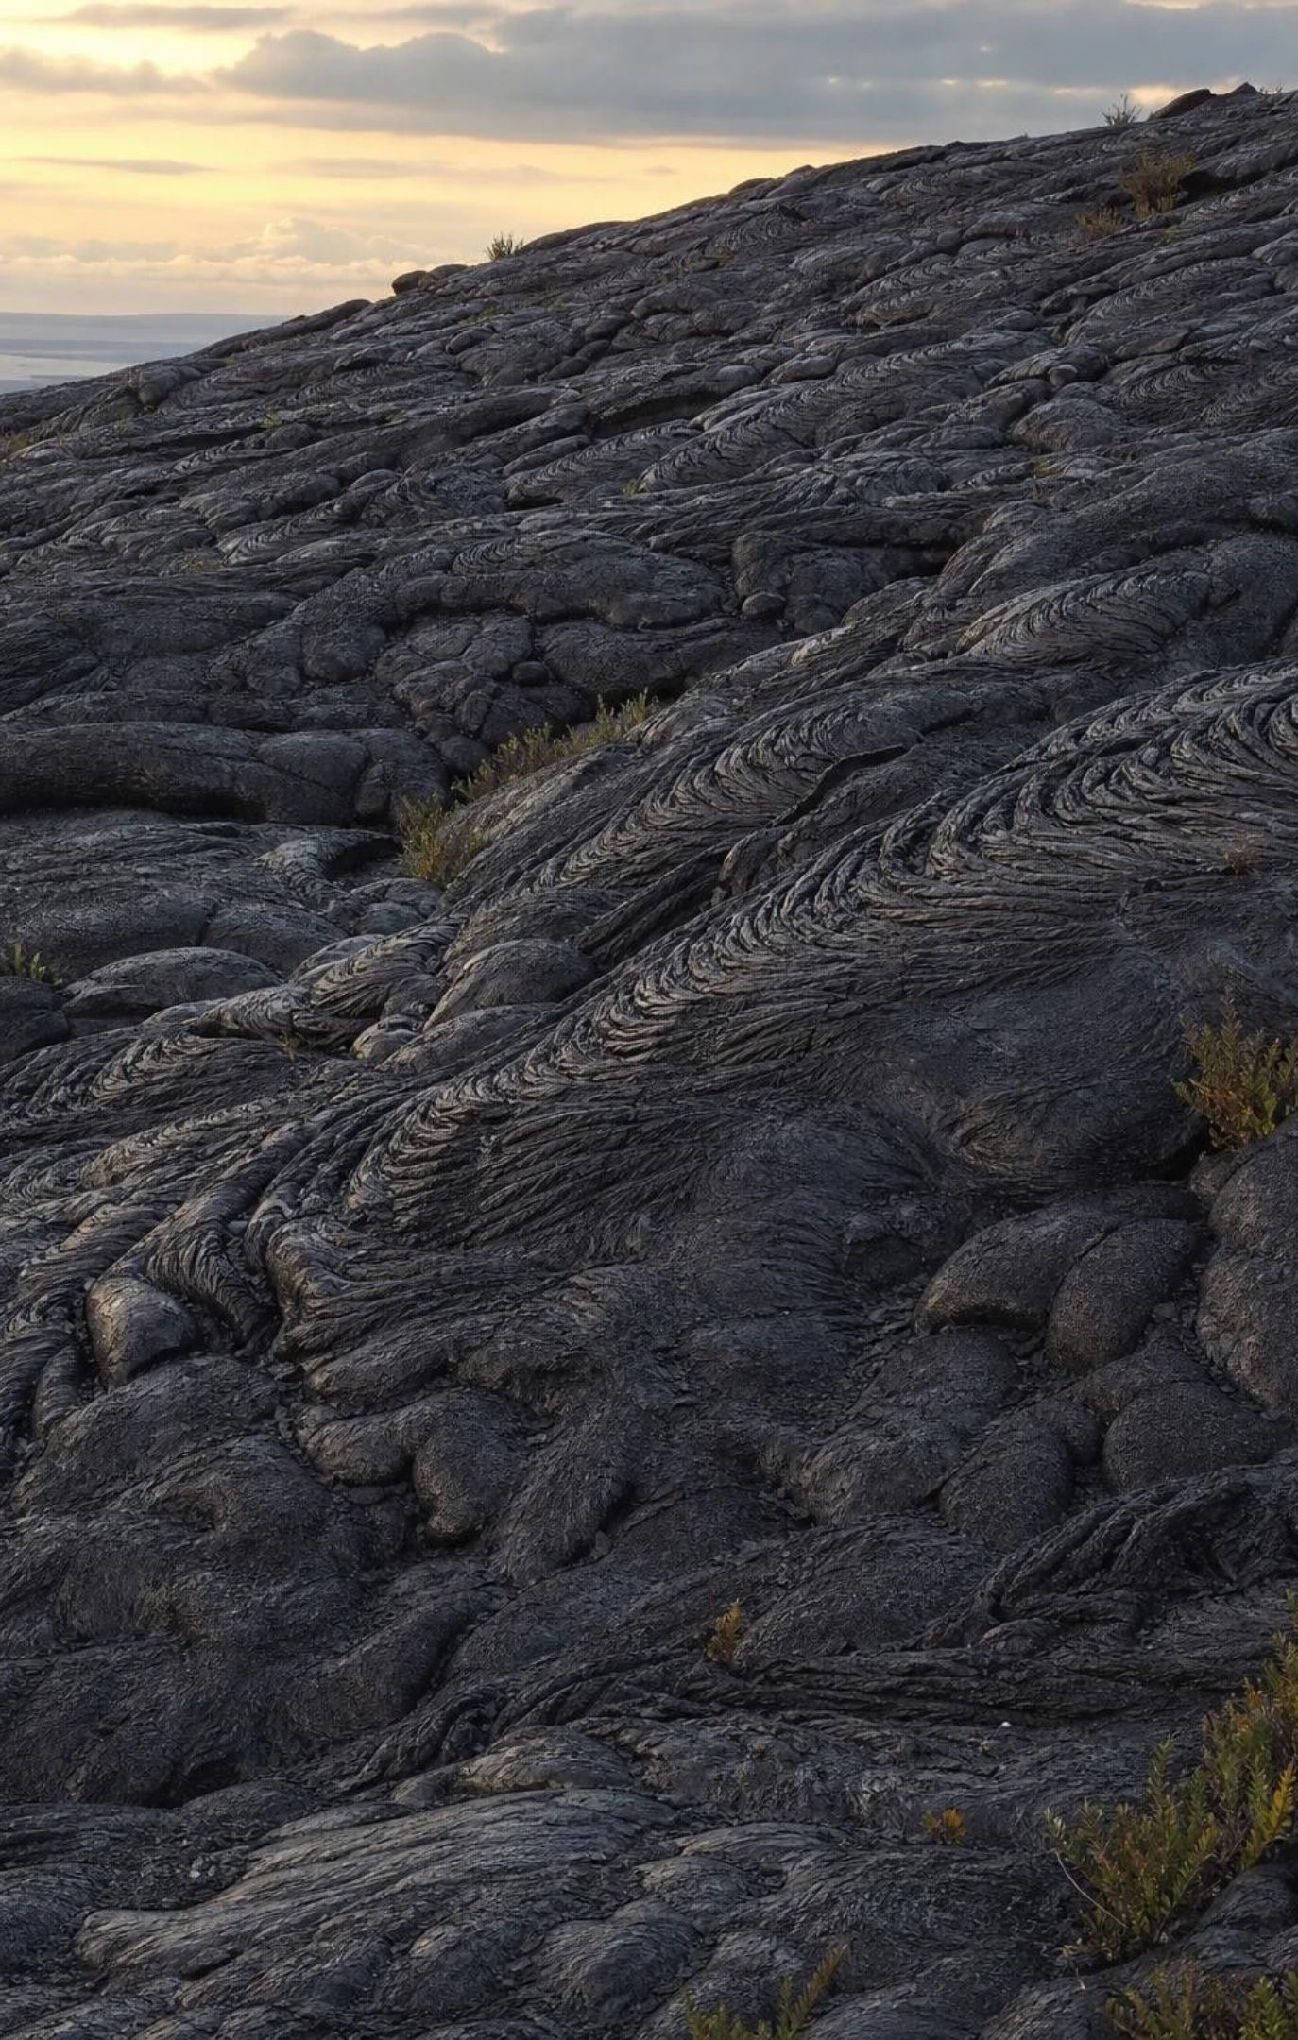
Quick check: how old is the lava flow?
CHECK FOR UNDERSTANDING
A zircon crystal in a lava flow has 12.5% of its original uranium-235 left. The half-life of uranium-235 is about 704 million years. How old is the flow?
A. 704 million years
B. 1,408 million years
C. 2,112 million years
D. 5,632 million years
24
Notes:
Whiteboards, two minutes. Count the halvings: 100 to 50 is one, 50 to 25 is two, 25 to 12.5 is three. Three half-lives times 704 million years is 2,112 million years, about 2.1 billion. Students who pick D have multiplied by eight (the one-eighth fraction) instead of by three (the number of halvings). Ask the follow-up: if 12.5 percent is left, what percent is now lead-207? 87.5 percent, assuming the crystal started with no lead-207 and nothing leaked.
EXPECTED RESPONSES: C: 12.5% is one eighth, three halvings, 3 × 704 = 2,112 million years. Lead-207 is 87.5% of the total.
WATCH FOR: Multiplying by the denominator of the fraction instead of counting halvings.
CONNECTS TO: W5 and W10 half-life calculations.
PACING: about 4 min

Slide 25
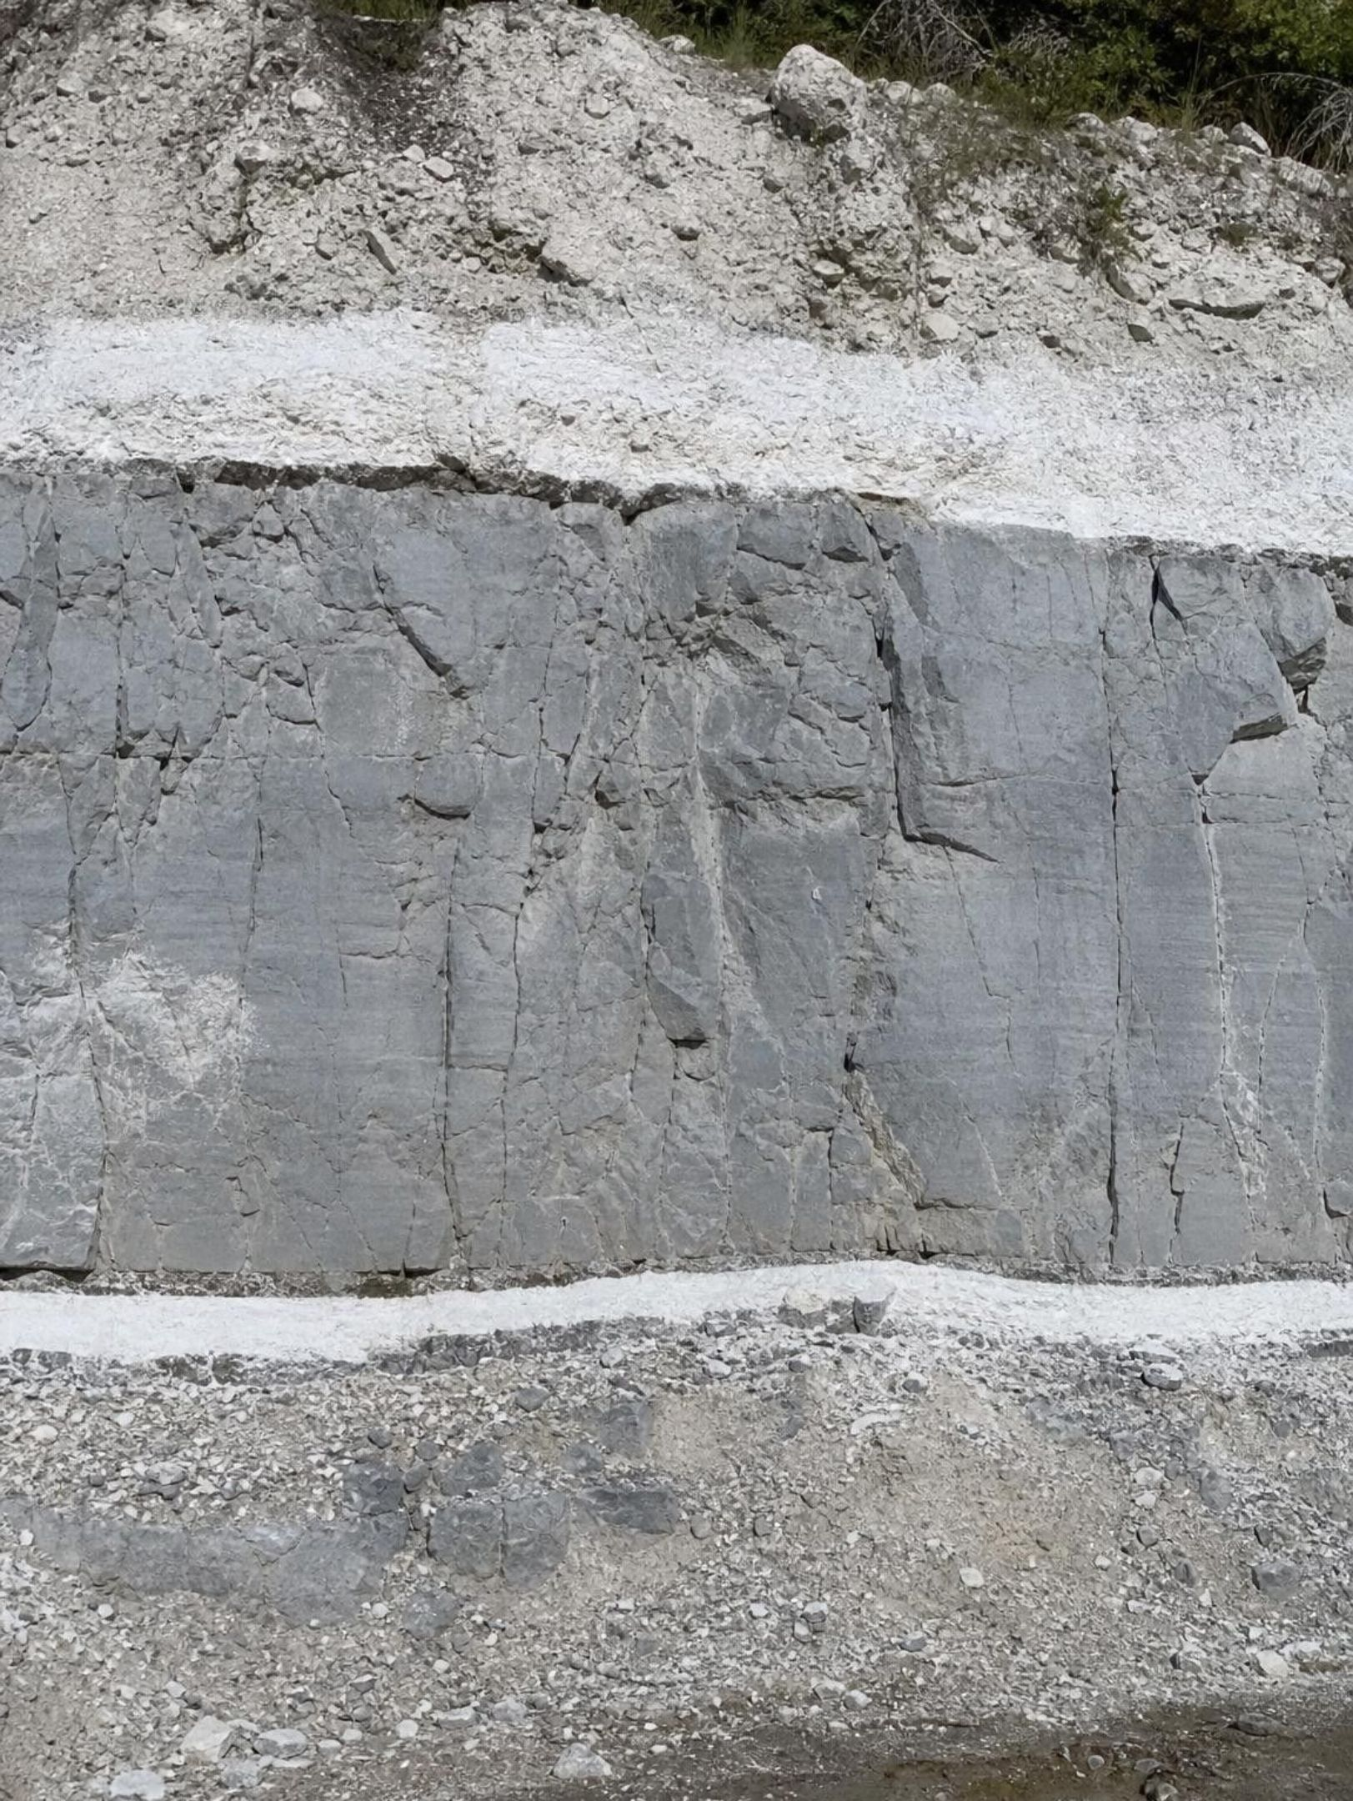
140 million
Putting years on layers that cannot be dated
Ash from an eruption settles in hours into a flat layer of fresh crystals, so an ash bed can be dated. A limestone between an ash bed dated at 150 million years and one dated at 140 million must be 140 to 150 million years old. Layers below the lower ash are older than 150 million; layers above the upper ash are younger than 140 million. Relative dating gives the order; dated igneous layers add the numbers.
150 million
25
Notes:
This slide answers the question the textbook raises but never resolves: how does a sedimentary layer get an age in years? By bracketing. Draw the stack: ash at 150, limestone, ash at 140. Superposition says the limestone is younger than the lower ash and older than the upper, so it is between 140 and 150 million years. Then widen the idea: a dated dike cutting a layer gives that layer a minimum age (the layer is older than the dike), and a dated lava flow lying on top of an erosion surface gives a minimum age for everything under it. This is how geologists put numbers on the whole order of Earth's history: a worldwide relative sequence, pinned at hundreds of points by dated igneous rock. Lesson 9 builds the time scale from this.
WATCH FOR: Students may think the limestone itself was dated. It was bracketed; its own grains would give older, misleading ages.
CONNECTS TO: Lab 2 brackets the quarry limestone between two dated ash beds; W5; W9.
PACING: about 4 min

Slide 26
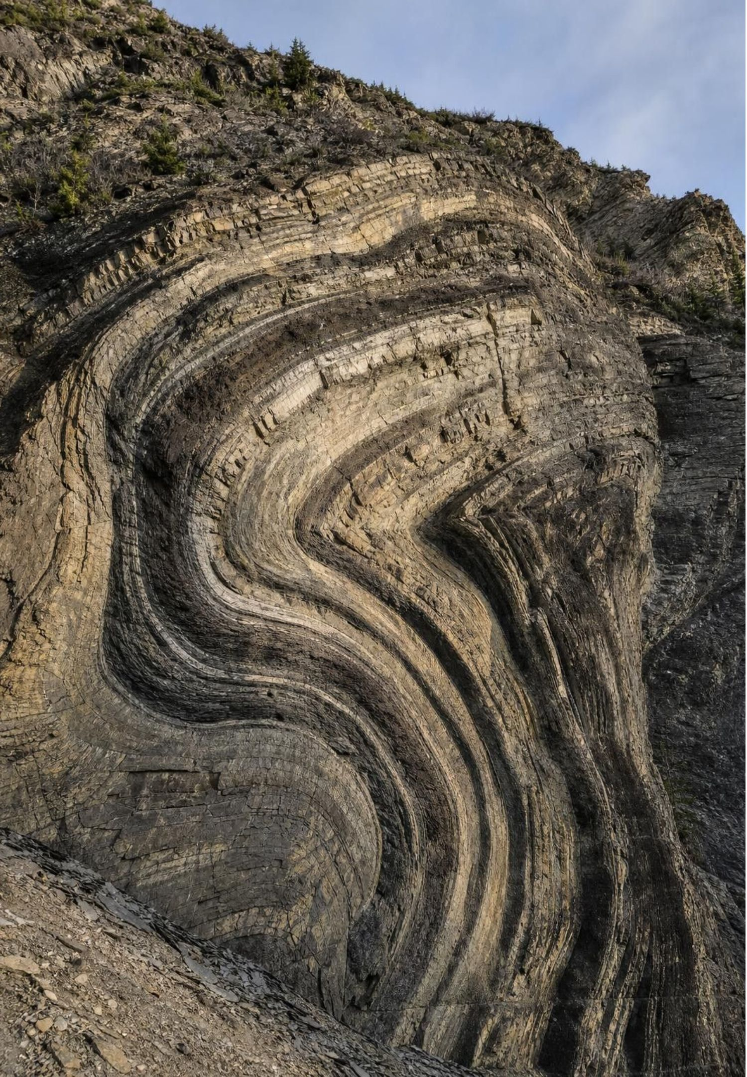
True or false? Deeper is always older
MISCONCEPTION CHECK
"In any cliff, the deepest layer is always the oldest, and a thick layer always took longer to form than a thin one."
True or false? Explain your reasoning.
26
Notes:
Have students evaluate the statement in writing with one counterexample for each half. First half: superposition needs an undisturbed stack. In an overturned fold the oldest layer can sit on top; across a fault the same layer sits at two depths; and a dike reaches the bottom of a cliff while being the youngest feature in it. Second half: deposition rates vary enormously. A flood or an ash fall can leave a meter in a day; deep-sea mud gains about a millimeter in a century. Thickness is not a clock. Then ask what does give time: only radiometric dates on igneous layers, and even those give the age of the crystal's formation with an uncertainty. Close by having students rewrite the statement so it is true.
EXPECTED RESPONSES: False on both counts. Accurate rewrite: 'In a stack that has not been overturned or broken, the deepest layer is the oldest. Thickness does not tell you how long a layer took to form.'
WATCH FOR: Students who fix the first half but keep the second. Push on the ash-bed example from slide 6.
CONNECTS TO: W7 misconception repair; W10 mastery.
PACING: about 5 min

Slide 27
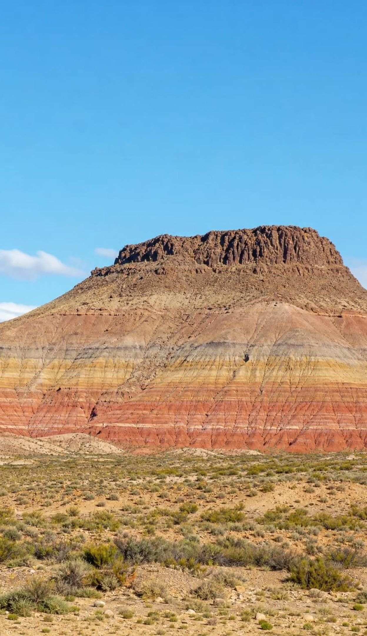




Putting it together
PUTTING IT TOGETHER
Sediment settles flat, each layer on the last: in an undisturbed stack, deeper is older.
Matching layers across a gap were once one layer; the gap is younger than all of them.
Tilting, folding, faults, dikes and erosion surfaces all come after the rock they change.
Fossils appear in one worldwide order; short-lived, widespread species mark narrow time windows.
Radioactive atoms in igneous crystals give ages in years; dated ash beds bracket the layers between.
27
Notes:
Return to the road cut from slide 2 and have the class write the order of events together: layers deposited flat, tilted, faulted, dike intruded, eroded flat, gravel deposited. Then ask which pairs the evidence cannot order: tilting versus the fault, and the fault versus the dike unless one cuts the other. That honesty about what evidence cannot show is a skill, not a weakness. Collect one thing from each lab: Lab 1 (what one core could not tell you), Lab 2 (the limestone's age bracket), Lab 3 (what the channel walls showed). Preview Lesson 9: these rules, applied worldwide and pinned by dates, give the geologic time scale.
CONNECTS TO: W10 mastery as the quiz; L09 Reconstructing Earth's History next.
PACING: about 6 min

Slide 28
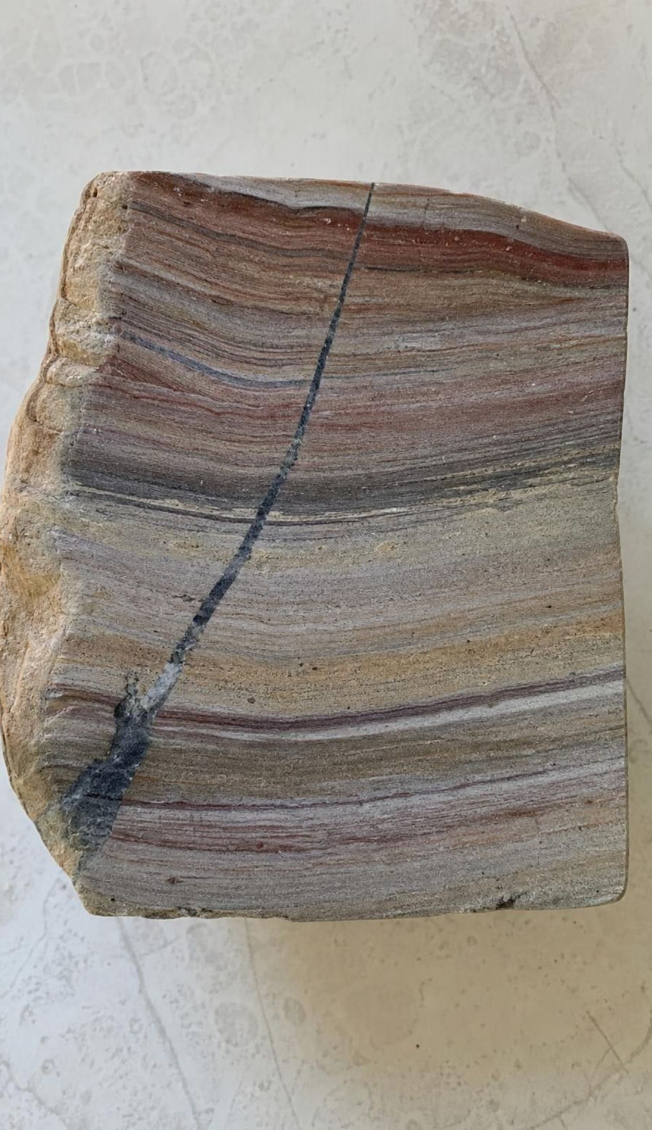
Exit ticket
EXIT TICKET
A dike cuts three flat layers and is itself offset by a fault. List the four features from oldest to youngest.
A layer with a certain fossil is found in two places. Finish the sentence: 'The two layers formed within...'
A crystal has 25% of its uranium-235 left (half-life 704 million years). How old is it? Show the steps.
Name one thing relative dating can tell you and one thing it cannot.
28
Notes:
Collect on index cards or a shared form. Item 1 tests cross-cutting in two steps; item 2 tests the 'about the same age' idea; item 3 is the half-life chain; item 4 separates order from years. Sort into piles before the next class and reteach from the largest. Students who write 'the dike is oldest because it goes through everything' need the slide 15 reasoning again.
EXPECTED RESPONSES: 1: layers (all three), then the dike (cuts the layers), then the fault (offsets the dike). 2: '...the span of time that species was alive', not the same year. 3: 25% is two halvings, 2 × 704 = 1,408 million years. 4: can tell the order of events; cannot tell how many years ago or how long each took.
WATCH FOR: Item 3 answers of 704 (one halving) or 2,816 (multiplying by four) show the counting error from slide 24.
CONNECTS TO: W10 mastery; chapter evidenceOfLearning.
PACING: about 5 min

