Slide 1
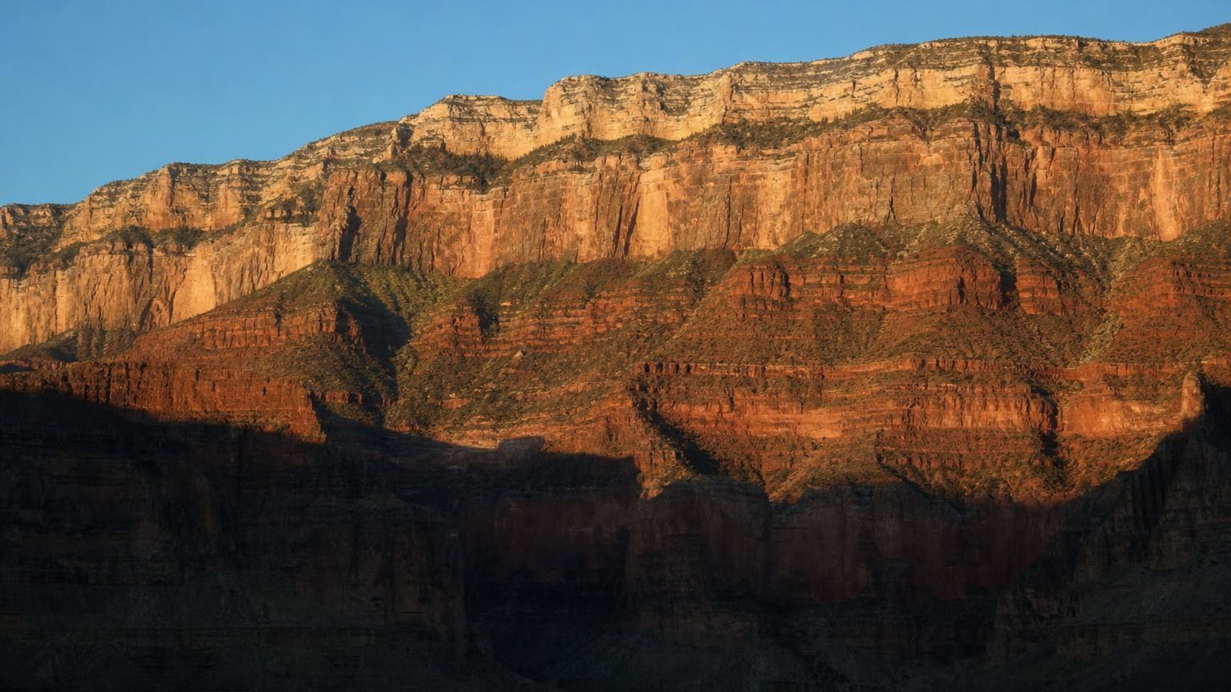
Reconstructing Earth's History
Chapter 9 of 29 · Earth Processes Through Geologic Time
Lesson 9: How do scientists rebuild and organize 4.54 billion years that nobody saw?
Angela's Wand · Bring Science Alive! 7th Grade Integrated
Notes:
This lesson turns the strata skills from Lesson 8 into a tool for telling the whole story of the planet. Tell students they will run three investigations: a 4.54-meter string model of all of Earth's time, a mystery in which three rock sites have to be stitched into one history, and a decision lab in which they act as the committee that chooses where the big boundaries on the time scale belong. Nothing in the lesson needs chemicals or heat. Warn them now that the numbers get enormous and that the whole point is learning to feel them.
CONNECTS TO: Overview of Lab 1, Lab 2 and Lab 3; W1 opens on the next slide.
PACING: about 2 min

Slide 2
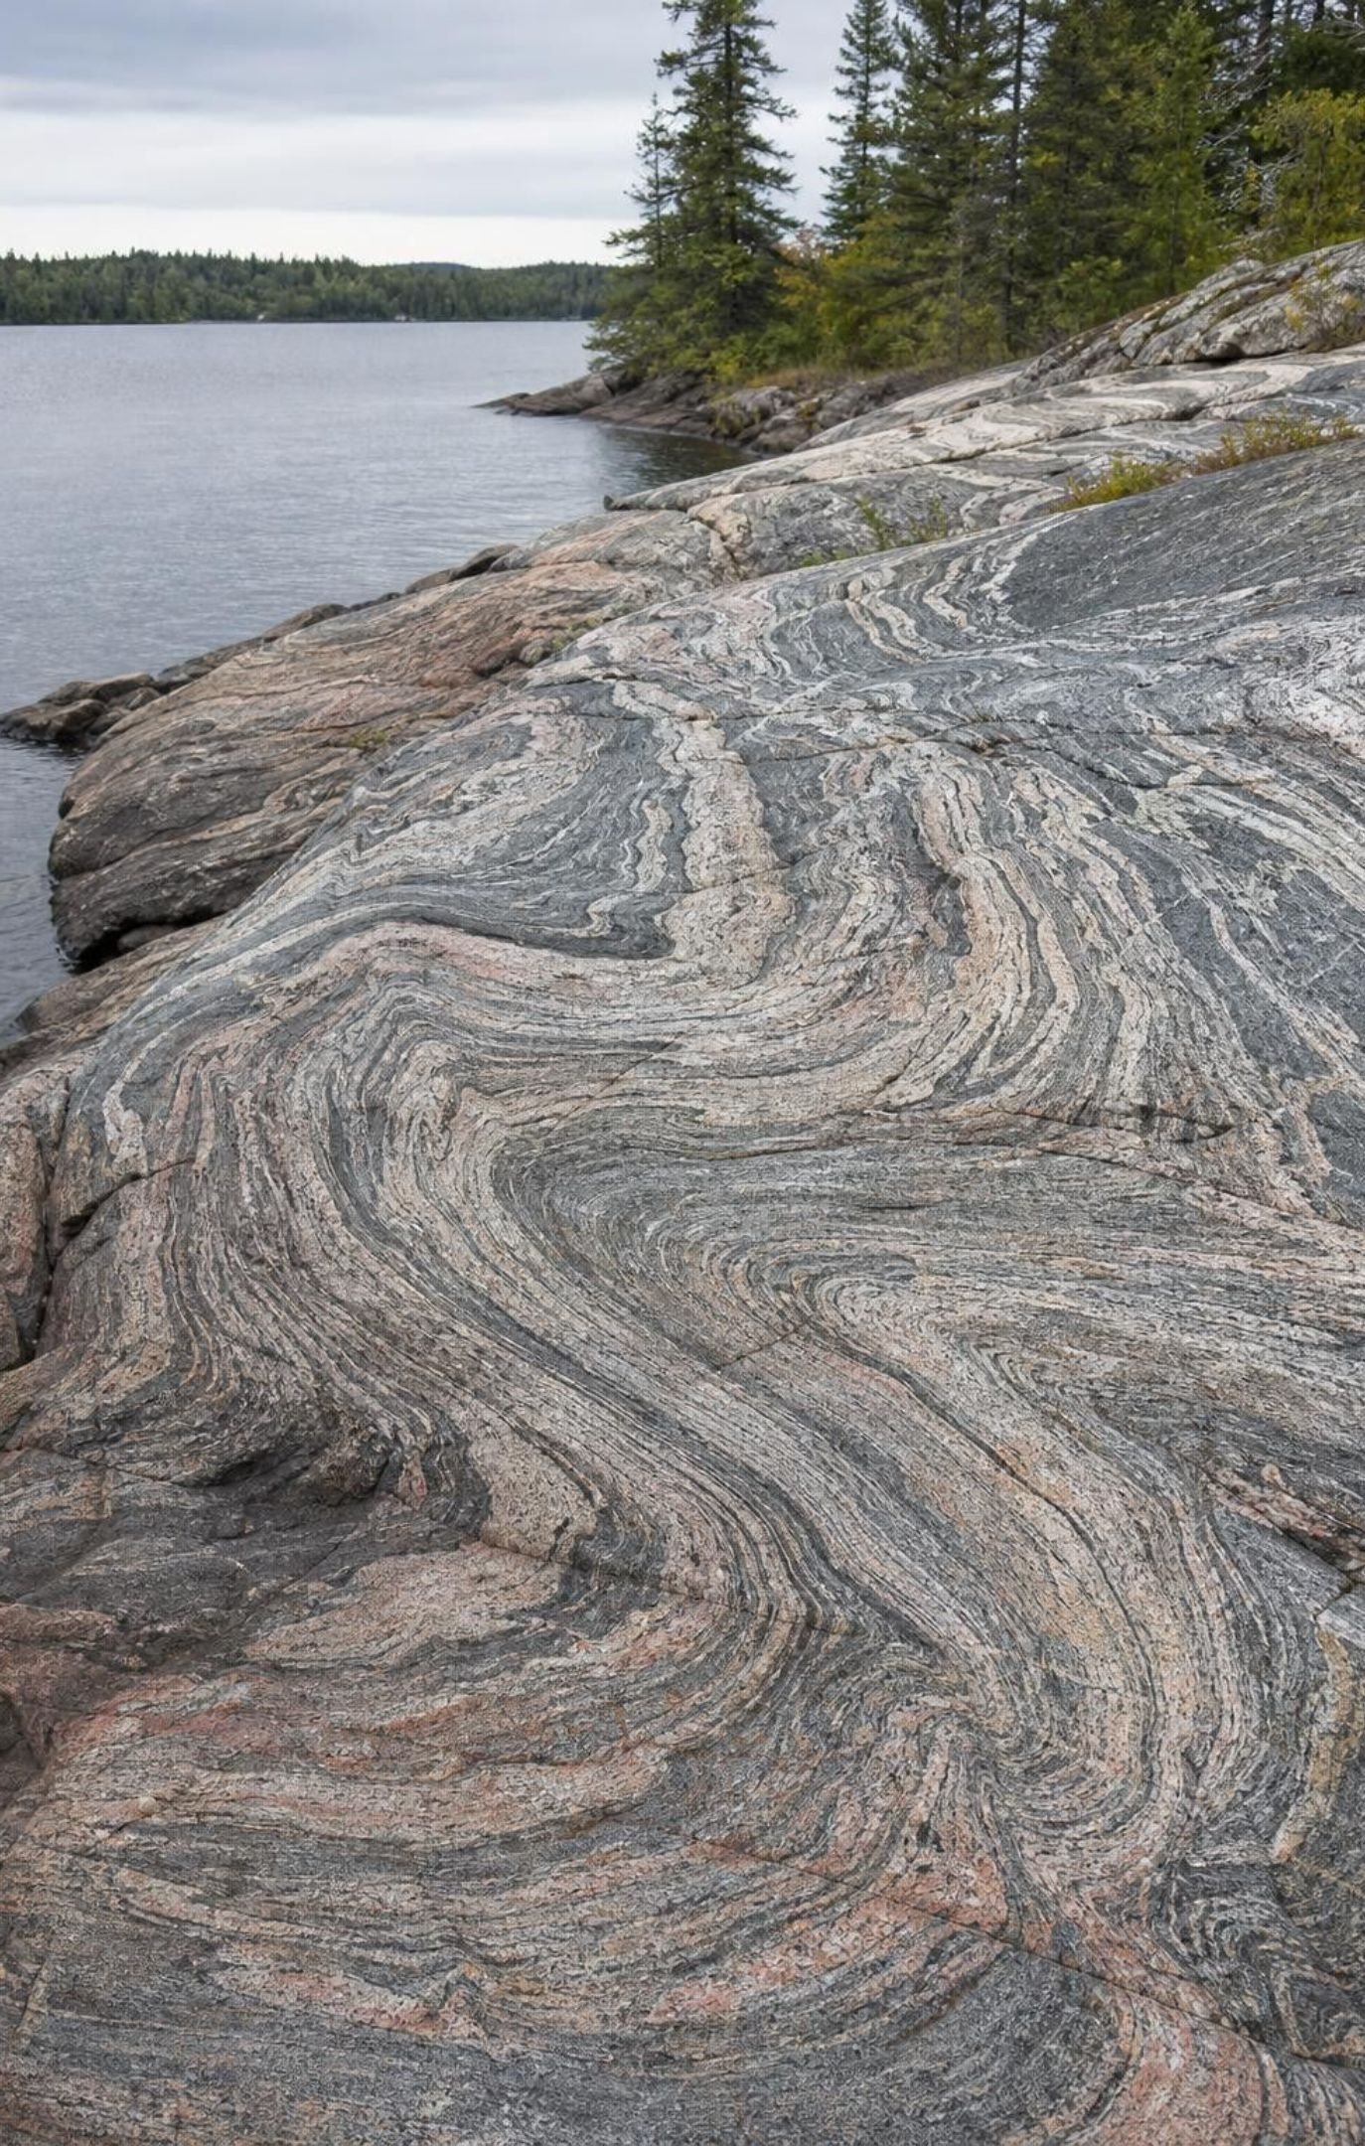
PHENOMENON
Earth's oldest rocks are younger than Earth
The oldest whole rock ever found, in northern Canada, is about 4.0 billion years old. A few zircon crystals in Australia are 4.4 billion, but the sandstone holding them is far younger. Meteorites give about 4.57 billion years, and the oldest moon rocks 4.4 to 4.5 billion. Earth seems to have lost its own first chapter. How can we know how old it is, and how do we rebuild the rest?
Notice: which objects give the oldest ages, and where did each come from?
Wonder: what could erase a planet's earliest rocks but not a meteorite?
Predict: if Earth and the meteorites formed together, how old is Earth?
2
Notes:
Give students two silent minutes to write one notice and one wonder, then collect without judging. Push on the gap: if the oldest Earth rock is 4.0 billion years old, does that mean Earth is 4.0 billion years old? Many students will say yes; record the claim. Then ask what Earth does to its rocks that a meteorite drifting in space does not experience: plate tectonics pushes crust back into the mantle, mountains erode, rock melts and re-forms. Park the zircon puzzle (how can a crystal be older than its rock?) for the extension; the answer is that a tough crystal can survive its parent rock melting or eroding and end up in a younger sediment. Do not resolve the age question yet; slide 12 does.
EXPECTED RESPONSES: Notice: meteorites and moon rocks are oldest; the Canada rock is the oldest Earth rock; the zircons are older than their rock. Wonder: why Earth has no rocks that old; how ages are measured. Predict: Earth is about 4.5 to 4.6 billion years old because it formed with the meteorites.
WATCH FOR: 'The oldest rock equals the age of the planet.' Do not correct yet; return on slide 12 and the misconception slide.
CONNECTS TO: W1 phenomenon worksheet records the notice/wonder and first explanation.
PACING: about 8 min

Slide 3
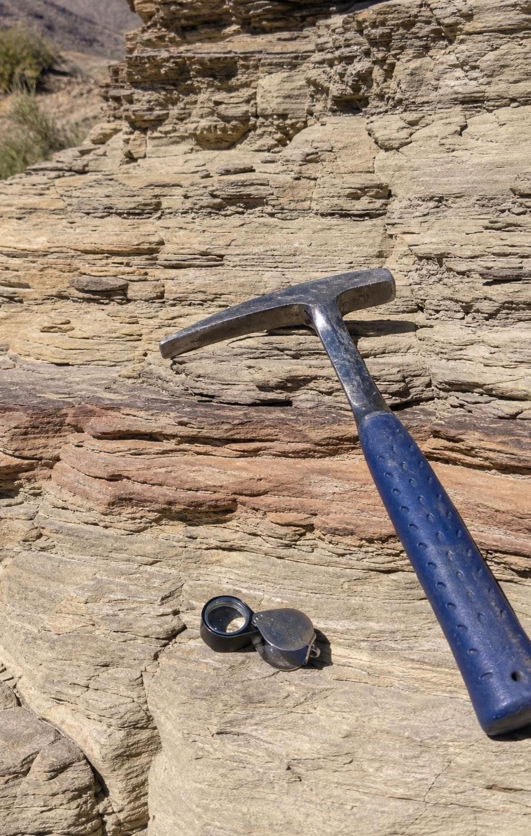
Learning targets
What you will be able to do
1
Match rock layers from different places and combine them into one longer record.
2
Read the geologic time scale: its nested units, Ga/Ma/ka, and why boundaries sit at big fossil changes.
3
Explain from strata evidence how the time scale organizes Earth's history.
4
Describe the evidence for Earth's age and for the origin of its core, moon, oceans and oxygen.
5
Use a scaled model to compare spans of Earth's history and explain why most charts are not to scale.
3
Notes:
Read the targets aloud and have students star the one that sounds hardest. Point out that target 1 is Lesson 8's skill applied across sites, target 3 is the big written explanation they will produce in Lab 2 and W6, and target 5 is the string model. Tell students the exit ticket asks about all five, and that nobody will be tested on memorizing the names of periods; the names are labels, the reasoning is the goal.
CONNECTS TO: Targets map to Lab 2 (1, 3), slides 8-10 and W2 (2), slides 12-16 and W3 (4), Lab 1 (5).
PACING: about 2 min

Slide 4
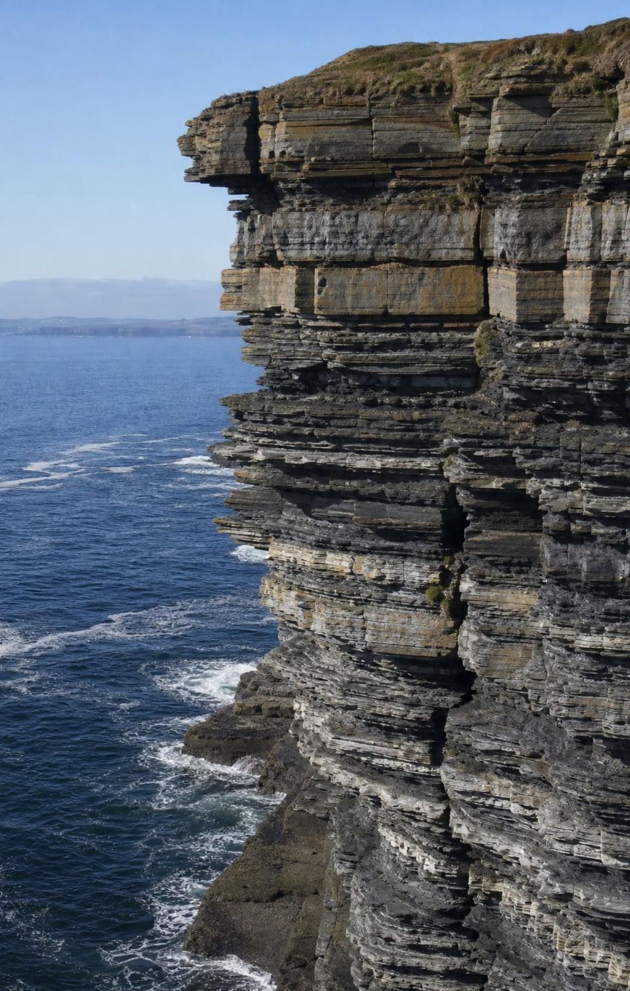
A cliff is a book you read from the bottom up
In an undisturbed stack, the lowest layer formed first and the top layer last.
Each layer records its setting: limestone from a shallow sea, red sandstone from a desert.
Fossils inside a layer show what lived while it formed.
The order of layers gives relative age: older or younger, not years.
Watch for the exceptions: tilted, folded or faulted layers must be unscrambled first.
4
Notes:
Review Lesson 8 quickly: superposition, and fossils as a record of the organisms alive when the sediment settled. Ask students to describe, from a layer's rock type alone, what the place looked like: a limestone full of sea-lily stems means a clear shallow sea; a red sandstone with footprints means dry land. Then ask what a stack of limestone under sandstone says happened over time (the sea withdrew). Stress the limits: the order is relative. A cliff cannot tell you that a layer is 252 million years old; it can only tell you that it is older than the one on top. Years come from somewhere else, which is slide 12.
WATCH FOR: Thick layer equals long time. Hold the thought for the diagram on the next slide, where a thin ash bed records a single day.
CONNECTS TO: W2 vocabulary sort; Lab 2 uses exactly this reading of site logs.
PACING: about 5 min

Slide 5
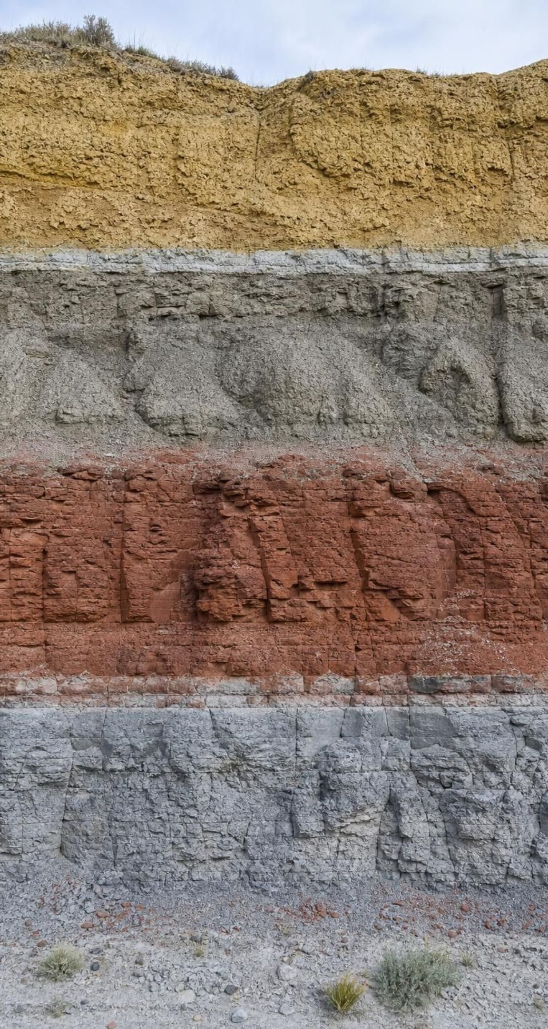
Reading one wall: four layers, one story
Model
Model: A cliff face from the top (youngest) down (oldest)
Top to bottom:
Yellow mudstone with mammal teeth and broad leaves (a wooded floodplain) /
Thin gray clay with glassy beads, dated 66 Ma (fallout from an impact, settled in weeks) /
Gray mudstone with dinosaur bones and conifer wood (a river plain) /
Red sandstone with reptile footprints (a desert of dunes) /
Gray limestone with crinoids and trilobites (a clear shallow sea)
Reading upward, this place changed from sea to desert to river plain. The thin clay records the shortest time but the biggest event.
5
Notes:
Walk the wall from the bottom. Sea, then desert, then a river plain with dinosaurs, then a thin clay layer, then a floodplain with mammals. Ask: which fossils never appear above the clay? Dinosaur bones. Which never appear above the sandstone? The sea-floor animals. Then make the time point: the clay is a centimeter thick and formed in weeks; the limestone is meters thick and took far longer. Thickness is not time. Finally ask how we know the clay is 66 million years old: it cannot be read from the stack; it was measured from the decay of atoms in the glassy beads and in volcanic layers nearby. This slide is a preview of the composite column students will build in Lab 2.
EXPECTED RESPONSES: Students should say the dinosaur fossils stop at the clay and the sea fossils stop at the sandstone, and that the clay records a sudden event in a short time.
WATCH FOR: 'The dinosaurs are in the clay layer.' The clay marks the event; the bones are below it.
CONNECTS TO: Lab 2 composite column; W4 diagram worksheet.
PACING: about 6 min

Slide 6
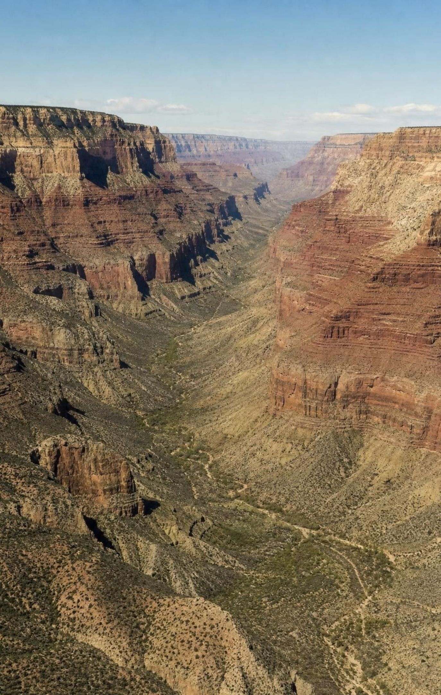
No single place holds the whole story
A sediment layer spreads sideways as a wide sheet until it thins out or hits an edge.
So the same layer can appear in cliffs many kilometers apart: lateral continuity.
Match a shared layer, and two short records become one longer record.
Best matches: a distinctive key bed, such as a volcanic ash with its own chemical fingerprint.
Rock type alone can fool you; geologists also match fossils and position in the sequence.
6
Notes:
Ask: if one canyon shows ten layers and another shows ten different layers, how could you know which canyon is older, or whether they overlap? Introduce lateral continuity: a layer is a sheet, so the same bed may be exposed in two places. The trick is finding a layer you can trust as the same one. A thin volcanic ash is ideal: it falls over a huge area in days, looks distinctive, and the mix of elements in its glass is unique to one eruption. Line the two sequences up at the ash and the overlap tells you the order of everything else. Warn students that 'gray limestone' in two canyons is not proof; many seas made gray limestone at many times. In the western United States, geologists have combined sequences from several canyons into one record spanning well over a billion years.
WATCH FOR: 'Same rock type means same layer.' Insist on at least two lines of evidence: key bed plus fossils, or fossils plus position.
CONNECTS TO: Lab 2 is the full version with three sites; W8 collaborative evidence sort.
PACING: about 5 min

Slide 7
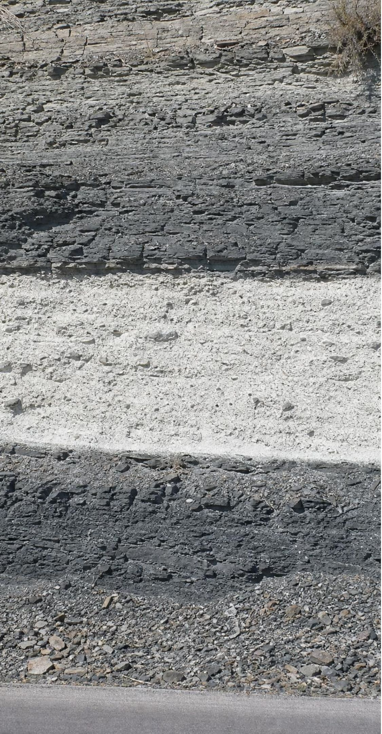
CHECK FOR UNDERSTANDING
Quick check: stitch two sites
Site 1 (top to bottom): shale, white ash, limestone. Site 2 (top to bottom): sandstone, shale, white ash. Same ash at both sites. Which is the complete order, youngest first?
A. sandstone, shale, ash, limestone
B. shale, ash, limestone, sandstone
C. sandstone, limestone, shale, ash
D. ash, shale, sandstone, limestone
7
Notes:
Give pairs two minutes with whiteboards; have them draw both stacks and line up the ash beds. Site 2 adds a sandstone above the shale; Site 1 adds a limestone below the ash. The combined sequence, youngest first, is sandstone, shale, ash, limestone. Ask a follow-up: which site records the oldest rock (Site 1) and which the youngest (Site 2)? Then ask what would go wrong if the two ash beds were actually from different eruptions: the whole match would collapse, which is why a chemical fingerprint matters.
EXPECTED RESPONSES: A. The shale sits above the ash at both sites, so the stacks line up with sandstone on top and limestone at the bottom.
WATCH FOR: Students who choose B have read Site 1 as the whole story and tacked the sandstone on at the bottom.
CONNECTS TO: Lab 2 procedure step 3; W10 mastery.
PACING: about 4 min

Slide 8
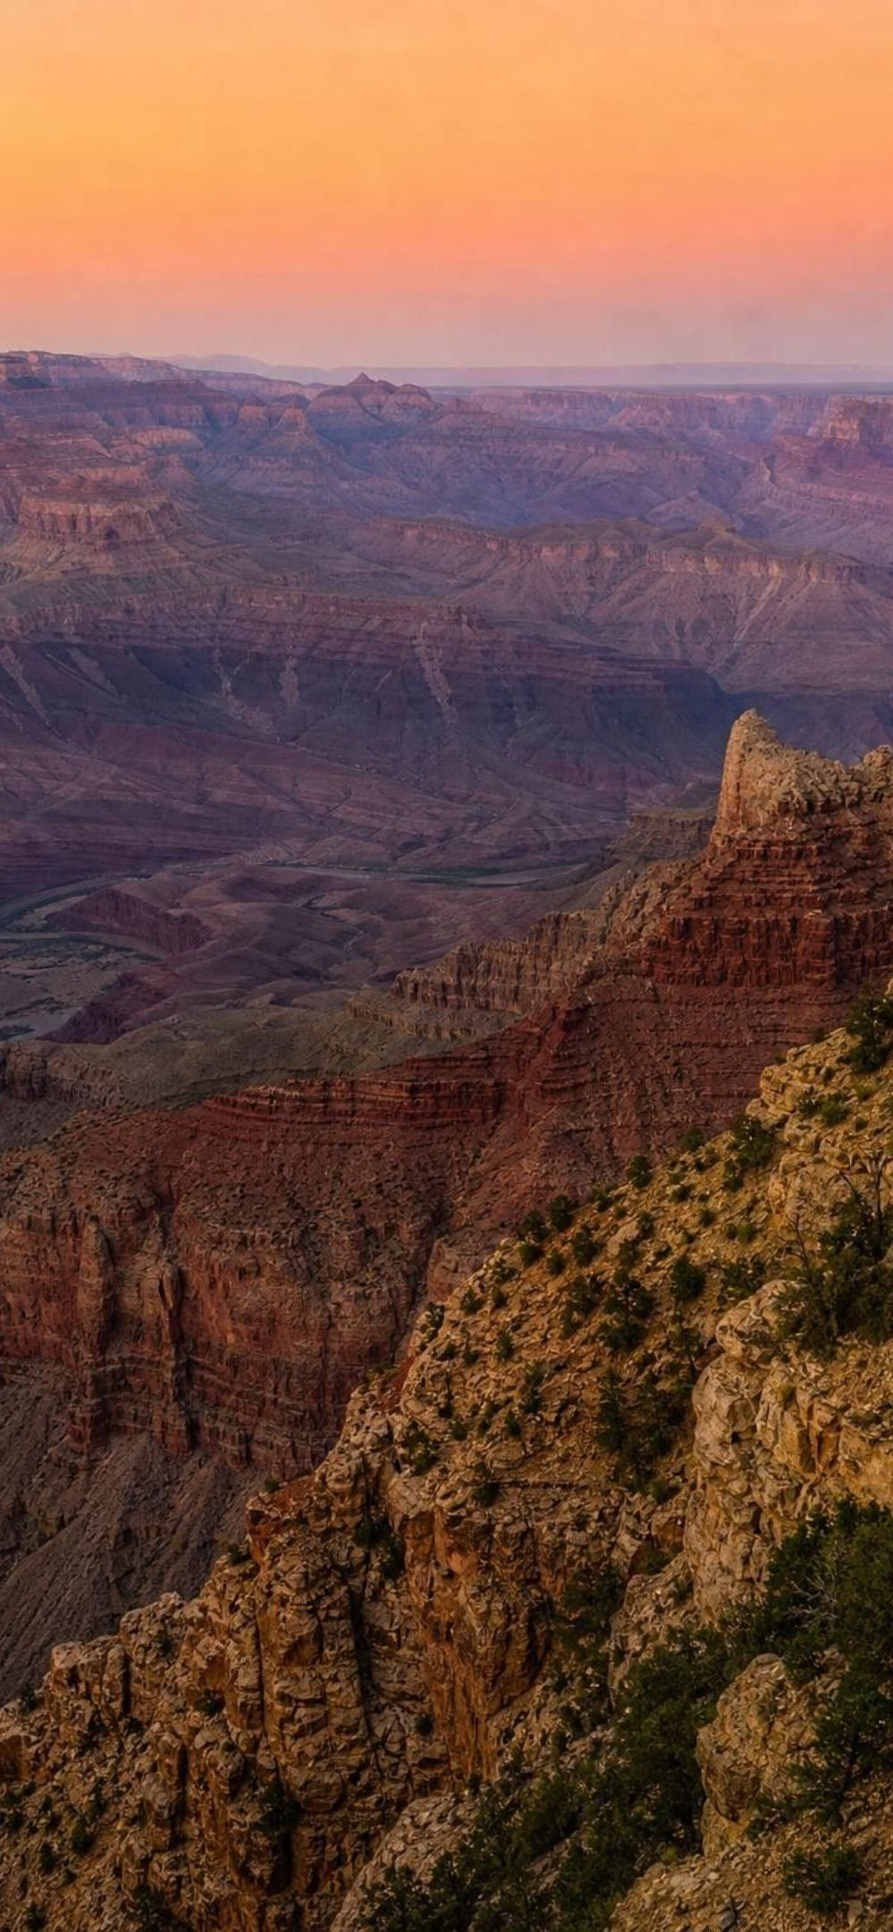
VOCABULARY IN CONTEXT
The units of deep time
geologic time scale: A model that divides Earth's whole history into named spans, built from the order of strata and fossils and pinned to years by dated layers. A geologist who finds trilobites can place a layer on the scale before any date is measured.
eon, era, period, epoch: The nested units, longest to shortest. Eons hold eras, eras hold periods, periods hold epochs. We live in the Phanerozoic Eon, Cenozoic Era, Quaternary Period and Holocene Epoch.
Ga, Ma, ka: Billions, millions and thousands of years, from the Latin annum. On a timeline, 66 Ma means 66 million years ago. The present interglacial began 11.7 ka, which is 11,700 years ago.
8
Notes:
Compare the nesting to a date: year, month, day. A geologist locating an event names the eon, era, period and epoch the way you would name the year, month and day, except the boxes are wildly uneven in length. Practice the abbreviations out loud: 4.54 Ga is 4,540 Ma is 4,540,000 ka. Have students write 66 Ma, 2.58 Ma and 11.7 ka in full years. Point out that 'Ma' can mean a date (66 Ma, 66 million years ago) or a duration (the period lasted 56 Ma); context tells which.
WATCH FOR: Mixing Ma and Ga: a thousand times apart. Students also assume all periods are the same length; the next slide fixes that.
CONNECTS TO: W2 vocabulary; Lab 1 calculation sheet uses the conversions.
PACING: about 4 min

Slide 9

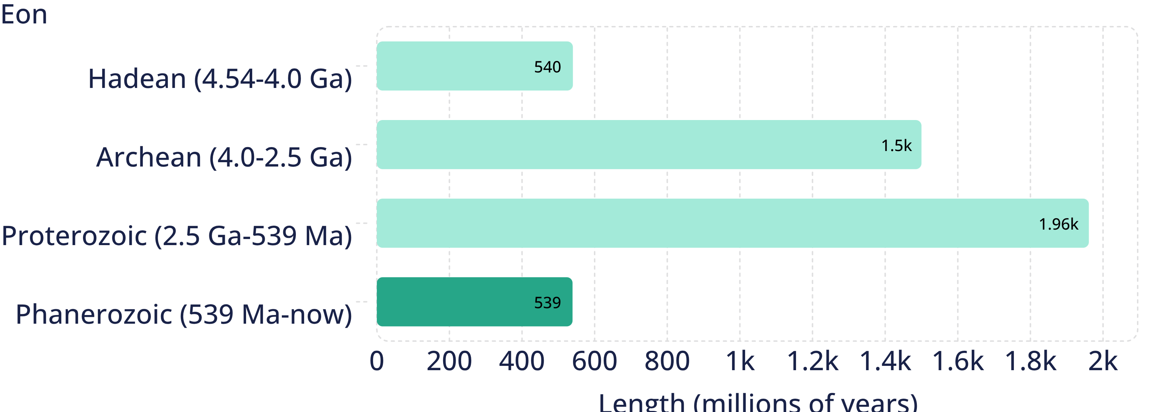
MODEL
The four eons drawn to scale
Model: Length of each eon in millions of years
The eon with all the animals, plants and people is the shortest of the four. Most charts give it the most space anyway.
9
Notes:
Ask students which eon their textbook chart makes look biggest (the Phanerozoic, because it is split into so many named units). Then ask which bar here is shortest. Same eon. Do the division together: 539 divided by 4,540 is about 0.12, so the Phanerozoic is about 12 percent of Earth's history, roughly one-eighth; the textbook says about 10 percent, which is a loose rounding. Why does the Phanerozoic get so much chart space? Not because most of the crust formed then (the ancient cores of the continents are Precambrian) but because its rocks are full of fossils, well preserved and widely exposed, so geologists can subdivide it finely. The three Precambrian eons hold almost 88 percent of the time but few fossils, mostly microbes. The Hadean has no surviving whole rocks at all, which is the phenomenon from slide 2.
EXPECTED RESPONSES: Students should compute about 12 percent and explain that chart space follows the number of named units, not the length of time.
WATCH FOR: 'The Phanerozoic is most of Earth's history.' Lab 1's string makes the 88 percent Precambrian impossible to miss.
CONNECTS TO: Lab 1 string timeline; misconception slide 26.
PACING: about 6 min

Slide 10
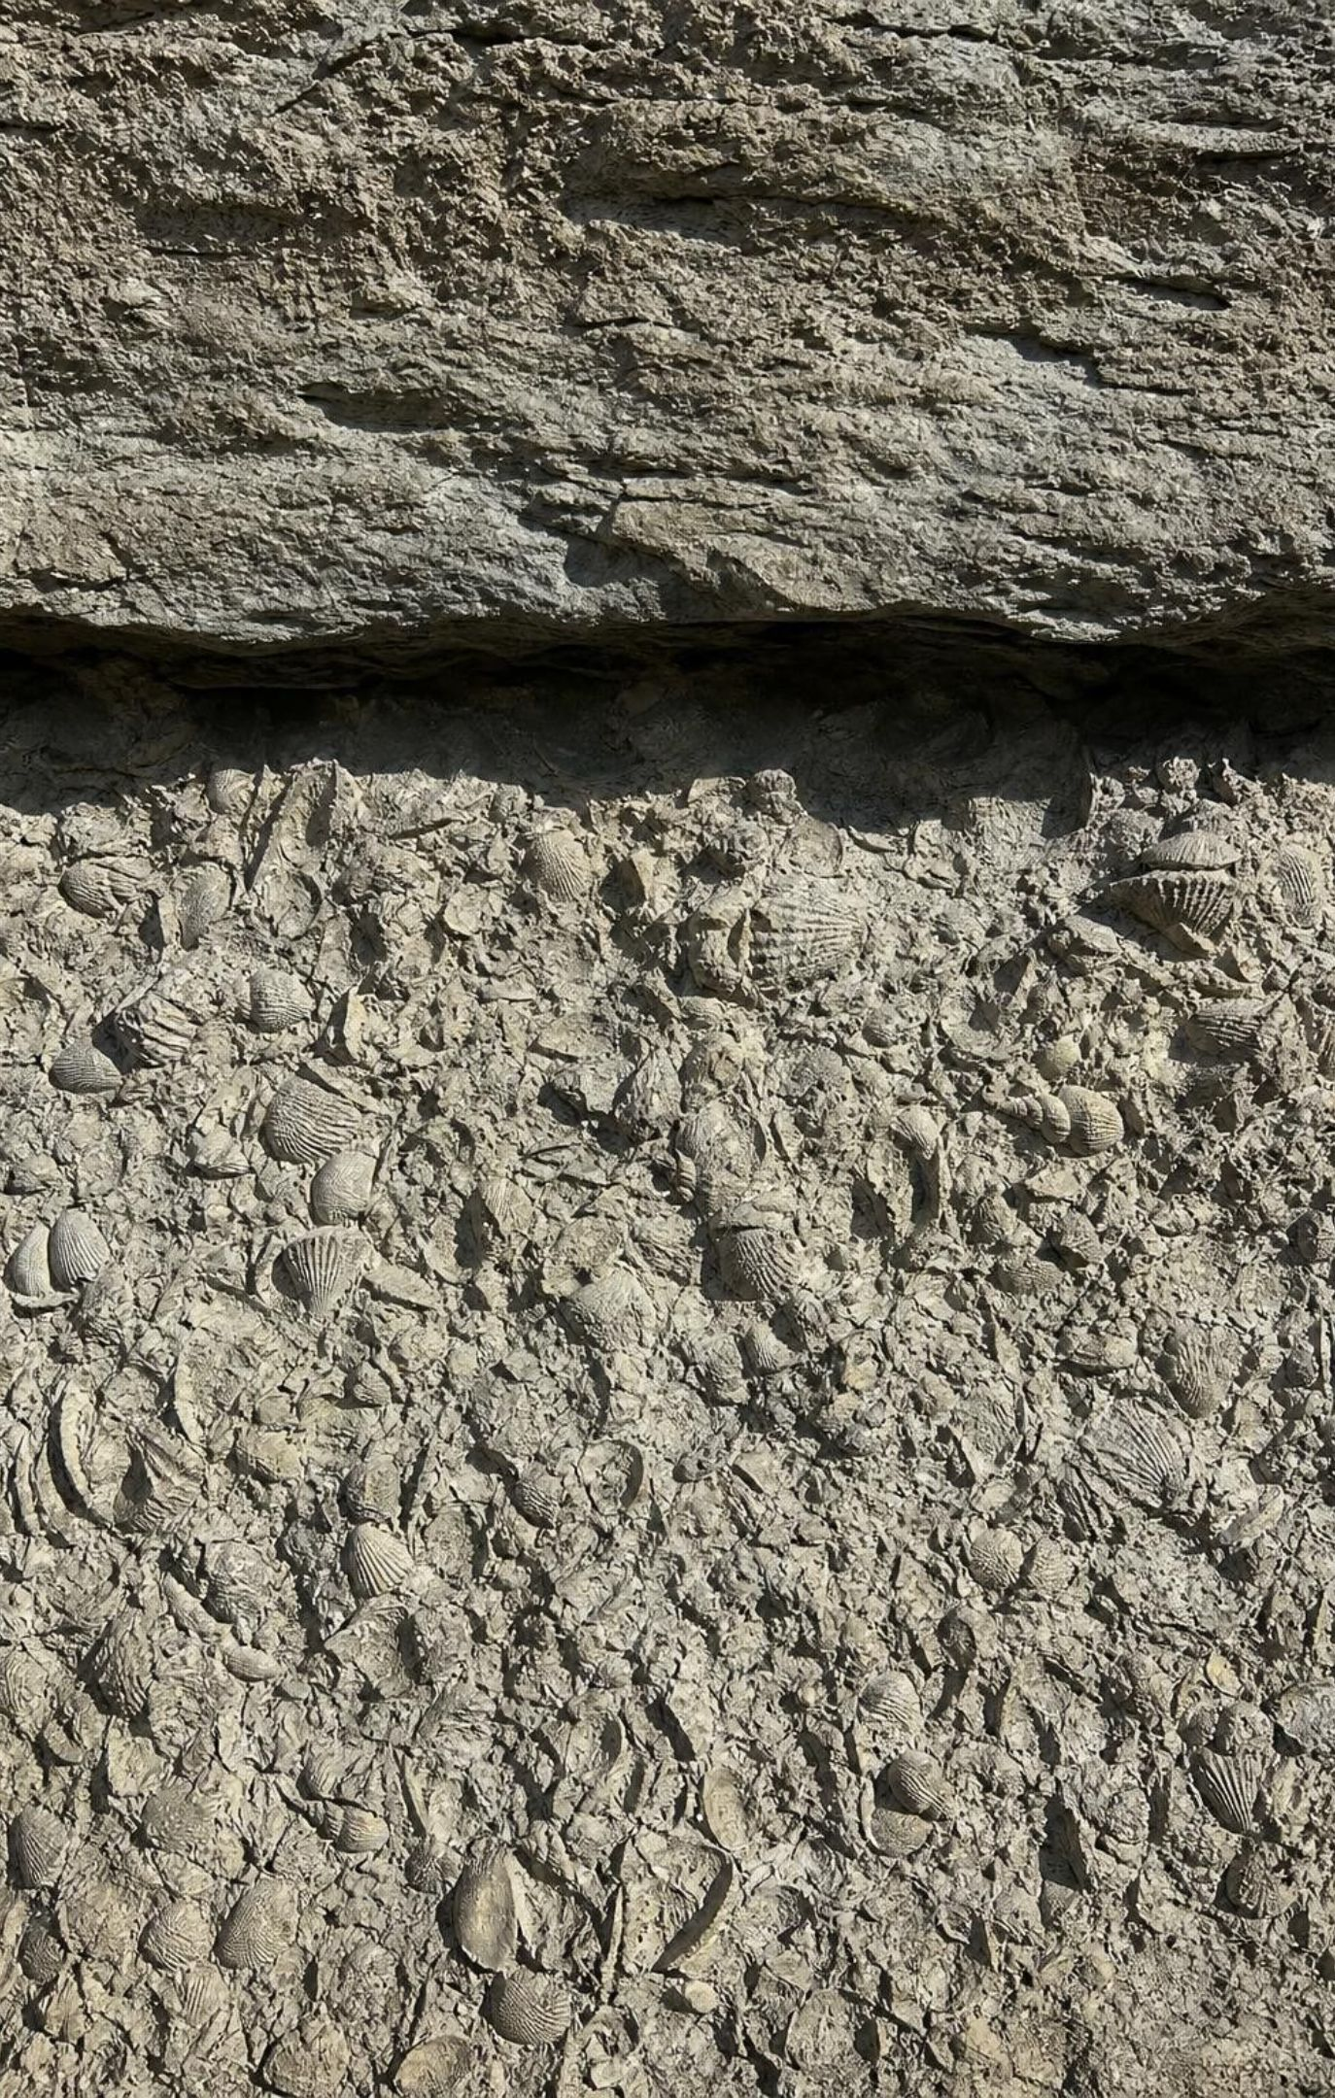
Why the boundaries sit where they do
Geologists draw a boundary where the rock and fossil record shows a big change.
The biggest changes: mass extinctions, when many fossil types vanish at the same level.
Others: the first appearance of a new kind of fossil, such as animals with hard shells.
Because those changes came at irregular times, the units have uneven lengths.
The scale was built from relative order first; dated layers added the years later.
10
Notes:
Return to the life-timeline idea: nobody divides their life into equal five-year boxes; they use events that changed things. Geologists working in the 1800s did the same with rocks, long before any date in years existed. They noticed levels where whole sets of fossils disappeared and new sets appeared, and they drew the lines there. Five of those levels are mass extinctions, about 443, 372, 252, 201 and 66 million years ago. Explain that the years were measured much later from volcanic layers, meteorites and other datable materials, and that the current international chart still adjusts boundaries as measurements improve; the base of the Cambrian moved from 541 to 538.8 million years in recent years. Note for yourself: the names of periods are not an assessment target in the California standard; the reasoning about boundaries is.
WATCH FOR: 'The periods are equal, like centuries.' Point back to the bar chart and ahead to Lab 3, where students place boundaries themselves.
CONNECTS TO: Lab 3 boundary decision; W5 data worksheet.
PACING: about 5 min

Slide 11
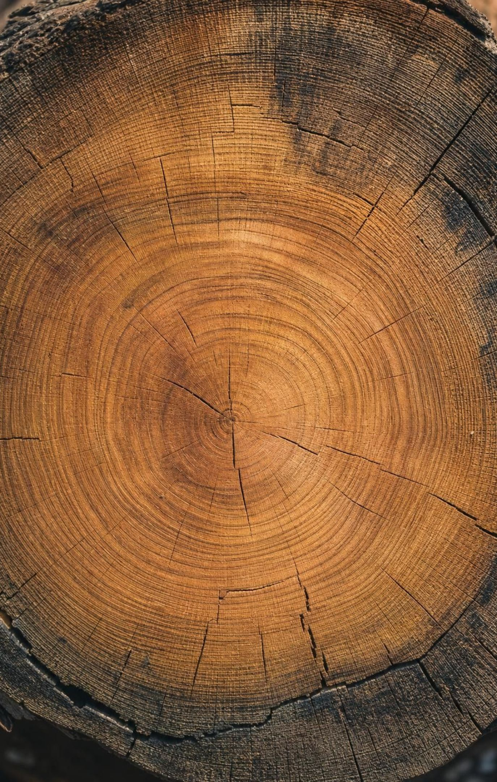
THINK, PAIR, SHARE
Discuss: where would you draw the lines in your own life?
Pick changes that left a visible mark: a move, a new school, a new sibling.
Would a stranger looking at your photos be able to find your boundaries?
Which of your spans has the most 'records' (photos, drawings, grades)? Is it the longest?
If you had to split your life into four spans using only big changes as boundaries, which events would you pick, and why would the spans not be equal?
11
Notes:
Three minutes in pairs, then collect two or three examples. Steer toward the geologists' logic: boundaries at big, visible changes; uneven spans; and the span with the most records is not necessarily the longest. That last point is the Phanerozoic story again: babies leave few records, so the first years of a life get little space in an album even though they are the same number of years. Close by asking what a geologist's 'photos' are: layers and fossils.
EXPECTED RESPONSES: Events such as a move or a new school; spans of different lengths; the most-documented span is often recent, because records are kept better now, which mirrors the fossil-rich Phanerozoic.
CONNECTS TO: Lab 3 debrief; W8 collaborative task.
PACING: about 6 min

Slide 12
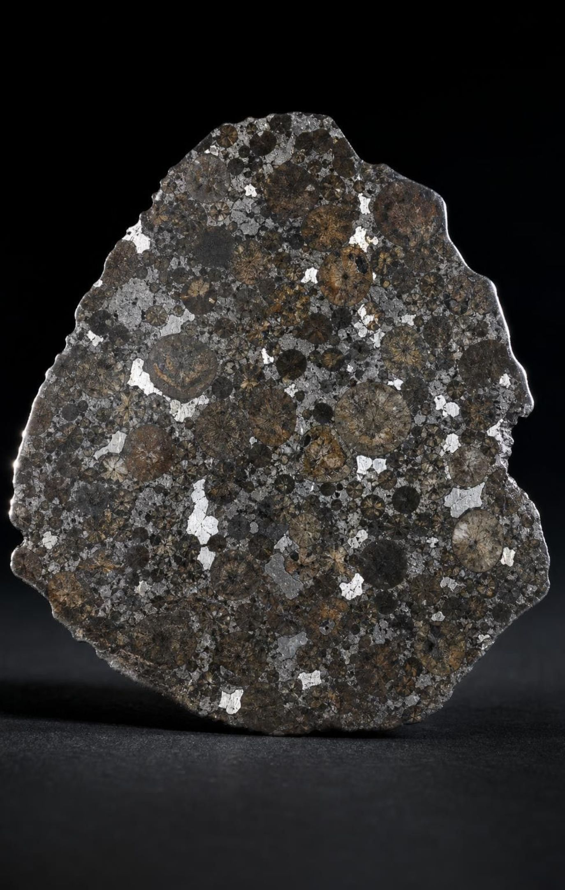
Dating the beginning: the answer to the missing chapter
Meteorites are leftover pieces of the cloud that made the planets; they were never recycled.
Dated by the slow decay of atoms inside them, the oldest give about 4.57 billion years.
Earth's own age, 4.54 billion years, comes from meteorites plus lead in Earth rocks and moon rocks.
Earth's oldest whole rocks (4.0 Ga) are younger because plate tectonics recycled the first crust.
The oldest zircon grains (4.4 Ga) survived their parent rock and were buried in younger sand.
12
Notes:
Resolve the phenomenon. The solar system's first solid grains formed about 4.57 billion years ago, and Earth had assembled by about 4.54 billion. These ages come from absolute dating: some atoms inside minerals change into other kinds at a steady, known rate, so the ratio of parent to product atoms is a clock. Keep it at that level; the mechanics belong to a later grade. The Canyon Diablo meteorite from Arizona's Barringer Crater was one of the first used this way in the 1950s. Then explain why Earth's own rocks fall short: subduction, melting and erosion have recycled nearly all of the first crust. A meteorite in the cold of space skipped all that. Finally revisit the zircon puzzle: zircon is extremely tough; a grain can outlive its original rock and end up in a sandstone that formed billions of years later. So the mineral is older than the rock around it.
WATCH FOR: 'Earth's age was measured from Earth's oldest rock.' It was measured mainly from meteorites, and the oldest moon rocks and zircons agree.
CONNECTS TO: W3 reading passage; W7 misconception repair.
PACING: about 5 min

Slide 13
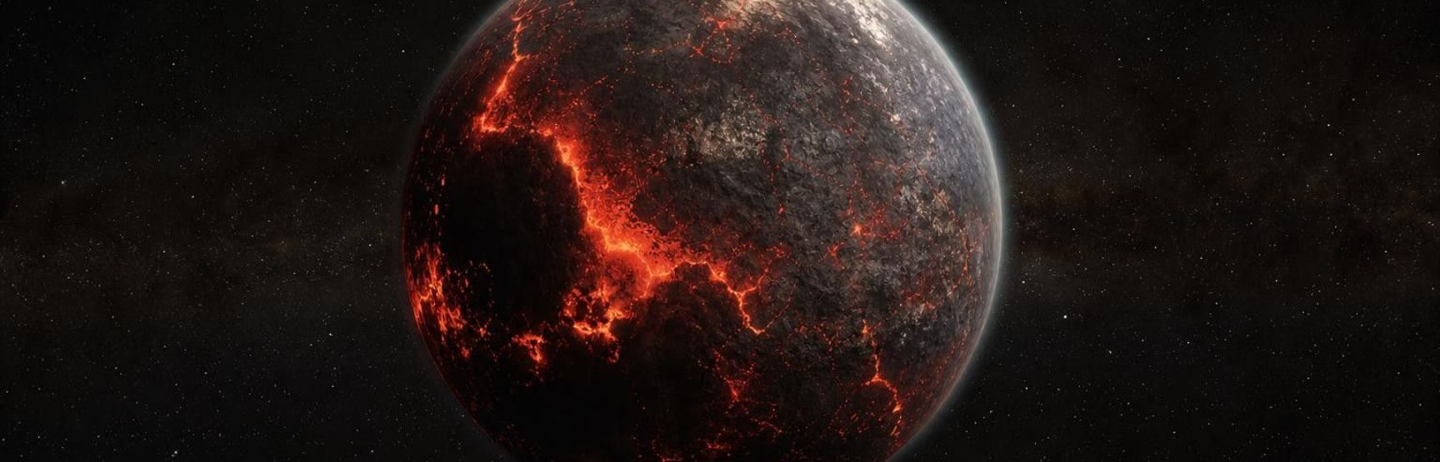
Earth's first chapter, rebuilt from evidence
Model
Model: From a cloud of dust to a planet with oceans
1
2
3
A spinning cloud of gas and dust contracts; the sun forms at its center → (gravity)
Dust clumps into pebbles, boulders and planets; leftovers become asteroids → (collisions)
Young Earth is largely molten; dense iron sinks to make the core → (melting)
4
5
6
A Mars-sized body strikes Earth; debris from both forms the moon → (impact)
The surface cools; the first crustal rocks form → (cooling)
Volcanoes vent water vapor and carbon dioxide; rain fills the first oceans
Each step is an explanation built to fit evidence, from meteorite ages to the near-match between moon rock and Earth's mantle.
13
Notes:
Walk the flow, and at each step name the evidence that supports it. Nebula and clumping: meteorites with the same age and composition as the planets. Molten Earth and a sinking core: Earth's density and the iron meteorites that are pieces of broken-up asteroid cores. The giant impact: moon rocks closely match Earth's mantle, and the moon is about 4.5 billion years old; current models put material from both Earth and the impactor into orbit. First crust: 4.4-billion-year zircons. Oceans: volcanic gas is mostly water vapor and carbon dioxide, and the oldest sediments laid down in water are nearly 4 billion years old. Stress that 'the core formed in a hot molten Earth' is an explanation, not something anyone observed, and that it survives because many kinds of evidence fit it. The next check tests that distinction.
WATCH FOR: 'The moon broke off Earth' or 'the moon was captured.' Both were old ideas; the near-match in composition and the moon's age favor a debris disk from a giant impact.
CONNECTS TO: W3 reading; W4 diagram worksheet; Lab 1 places these events on the string.
PACING: about 6 min

Slide 14
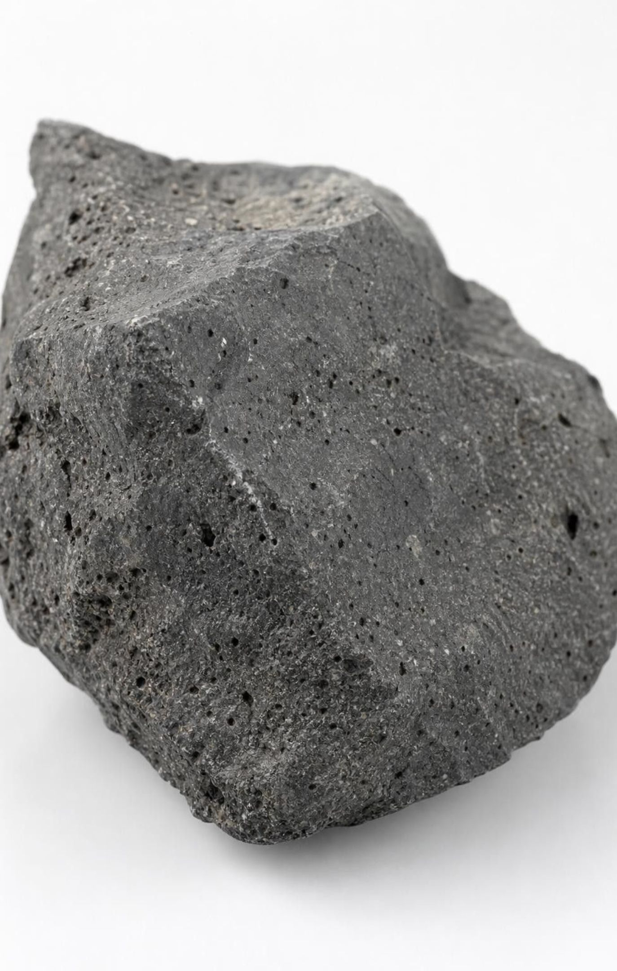
CHECK FOR UNDERSTANDING
Quick check: evidence or explanation?
Moon rocks have a chemical makeup very close to Earth's mantle.
A Mars-sized body struck young Earth and the debris formed the moon.
Meteorites give ages of about 4.57 billion years.
Earth's first crust was recycled by plate tectonics.
The oldest Earth rocks are about 4.0 billion years old.
Label each statement E (evidence, something measured or observed) or X (explanation, an idea built to account for evidence).
14
Notes:
Run it fast, thumbs up for evidence and sideways for explanation, then ask one student per item for the reason. Items 1, 3 and 5 are measurements. Items 2 and 4 are explanations that account for them. Push a follow-up: could item 2 be wrong while item 1 stays true? Yes; that is what makes it an explanation. Then ask what new evidence would weaken the giant impact idea (for example, moon rocks that did not match Earth at all). Students will use the same E/X labeling in Lab 2 and in the W6 CER.
EXPECTED RESPONSES: 1 E, 2 X, 3 E, 4 X, 5 E.
WATCH FOR: Students often label anything in a textbook as evidence. The test: was it measured or observed, or was it reasoned?
CONNECTS TO: Lab 2 analysis question on evidence versus explanation; W6 CER.
PACING: about 4 min

Slide 15
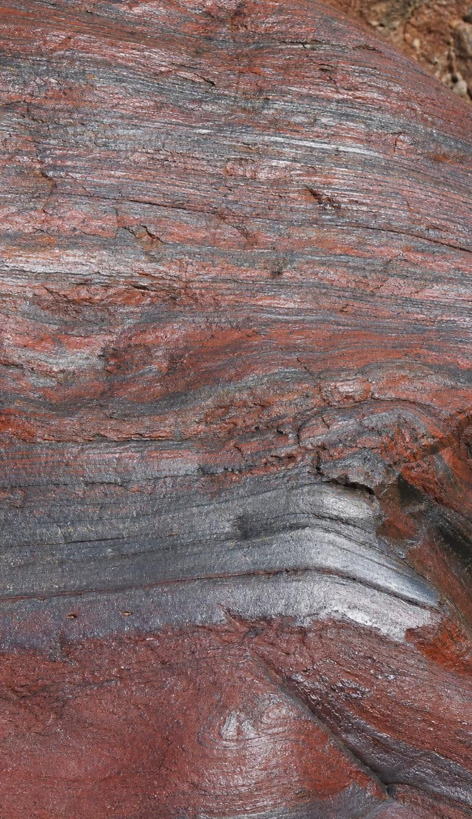
Air without oxygen, then an ocean that rusted
Volcanoes vent water vapor, carbon dioxide and sulfur gases, but no free oxygen.
The early air was mostly nitrogen and carbon dioxide; oxygen atoms were locked in water and CO₂.
Microbial mats were thriving by 3.5 billion years ago; stromatolites are their fossil mounds.
Cyanobacteria were the first organisms known to release oxygen by photosynthesis.
For a very long time that oxygen reacted with iron in seawater: banded iron formations.
Only after the dissolved iron ran low did oxygen build up in the air, about 2.4 billion years ago.
15
Notes:
Set the scene: a planet with oceans, volcanoes and air you could not breathe. Explain that 'no oxygen' means no free oxygen gas; oxygen atoms were everywhere, bound up in water and carbon dioxide. Microbial mats trapped sediment in shallow water and built layered mounds; fossils of these stromatolites go back about 3.5 billion years in Western Australia. Other microbes used sunlight before cyanobacteria, but cyanobacteria are the first known to split water and release oxygen. The oxygen did not go straight into the air: seawater held dissolved iron, which reacted with oxygen to make rusty minerals that settled in thin bands. Those banded iron formations are mined for iron today. Once the iron supply was used up, oxygen began accumulating in the atmosphere, the Great Oxidation Event, about 2.4 billion years ago. When exactly cyanobacteria first appeared is debated; some evidence puts oxygen release hundreds of millions of years before the air changed. Reaching about 21 percent took far longer still.
WATCH FOR: 'Plants made the oxygen.' Land plants came billions of years later; microbes did the first work. Also 'the early atmosphere had no oxygen atoms at all.'
CONNECTS TO: W4 diagram worksheet on the oxygen chain; Lab 1 places stromatolites and the Great Oxidation Event.
PACING: about 6 min

Slide 16
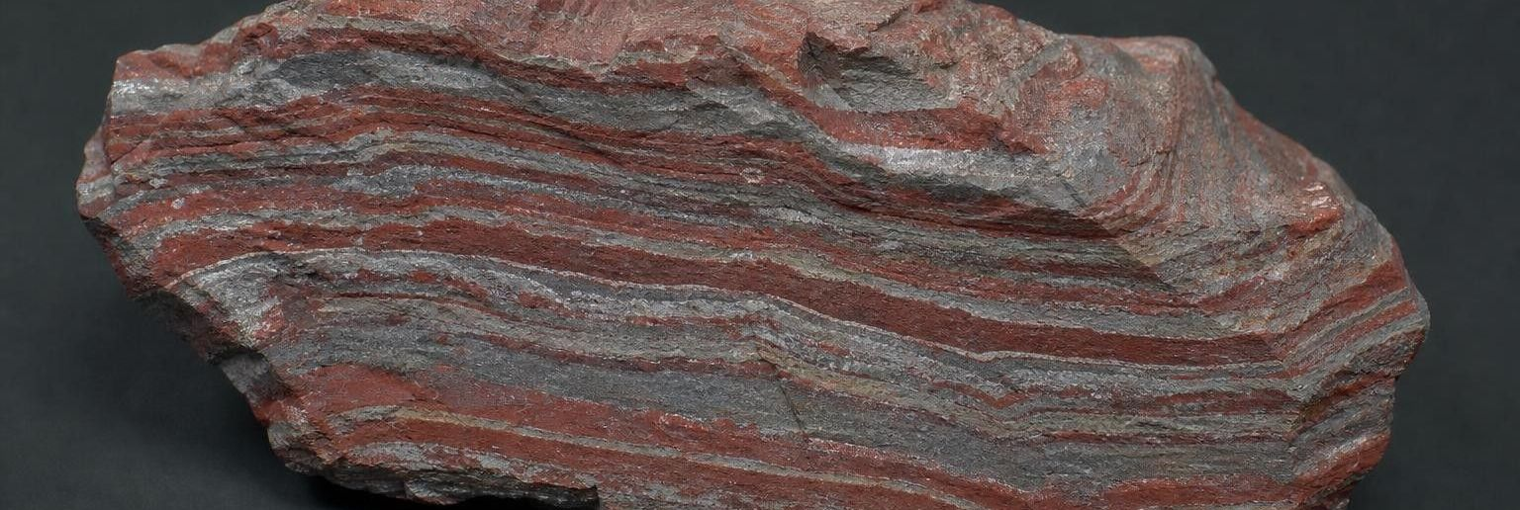
MODEL
How oxygen reached the air: a cause-and-effect chain
Model: From the first oxygen-releasing microbes to breathable air
Cyanobacteria in shallow seas release oxygen → (releases)
Oxygen reacts with iron dissolved in seawater → (reacts)
Rusty iron minerals settle in bands on the seafloor → (settles)
1
2
3
Dissolved iron runs low; oxygen starts to escape into the air → (saturates)
Oxygen rises in the atmosphere over hundreds of millions of years → (accumulates)
Animals that need oxygen can finally evolve and grow large
4
5
6
The rock evidence for this chain is the banded iron formations: thin alternating iron-rich and iron-poor layers on ancient seafloors.
16
Notes:
Have students trace the chain and then identify the one node that leaves a rock record (the banded iron). Ask why oxygen took so long to show up in the air even though microbes were releasing it: the ocean acted as a sink until the iron was used up. This is a good place for a cause-and-effect check: what would the chain look like if there had been no dissolved iron? Oxygen would have reached the air sooner. Ask also what the chain says about animals: large, active animals need plenty of oxygen, which is one reason animal life appears so late in the story.
EXPECTED RESPONSES: Students should name the banded iron formations as the evidence and explain the delay by the iron sink.
WATCH FOR: Reading the arrows backward, as if oxygen in the air caused the microbes.
CONNECTS TO: W4 diagram worksheet asks students to complete and label this chain.
PACING: about 5 min

Slide 17

VOCABULARY IN CONTEXT
Three words for the record of life
stromatolite: A layered mound built by mats of microbes that trap sediment; fossil mounds are among the oldest signs of life. Stromatolites still grow today in a salty bay in Western Australia, the same state where 3.5-billion-year-old fossil ones are found.
mass extinction: A large share of Earth's kinds of living things dying out within a geologically short time. In a rock sequence, a mass extinction shows up as many fossil types vanishing at the same level.
Cambrian explosion: A burst of animal evolution starting about 539 million years ago when early relatives of most major animal groups appear in the fossil record. Trilobites with hard shells show up in Cambrian rocks worldwide, which makes the boundary easy to find.
17
Notes:
Connect the three terms to the way the time scale was built: stromatolites are the record of life before animals, the Cambrian explosion is the change that opens the Phanerozoic, and mass extinctions are the changes that close most of its periods. Point out that 'explosion' means fast in geologic terms, a few tens of millions of years, not an instant. Ask students which of the three they would expect to find in a limestone from a shallow Cambrian sea (trilobites, so the Cambrian explosion).
WATCH FOR: 'Life began in the Cambrian explosion.' Microbial life is about three billion years older; the Cambrian is when animals with hard parts became common fossils.
CONNECTS TO: W2 vocabulary; W10 mastery.
PACING: about 4 min

Slide 18
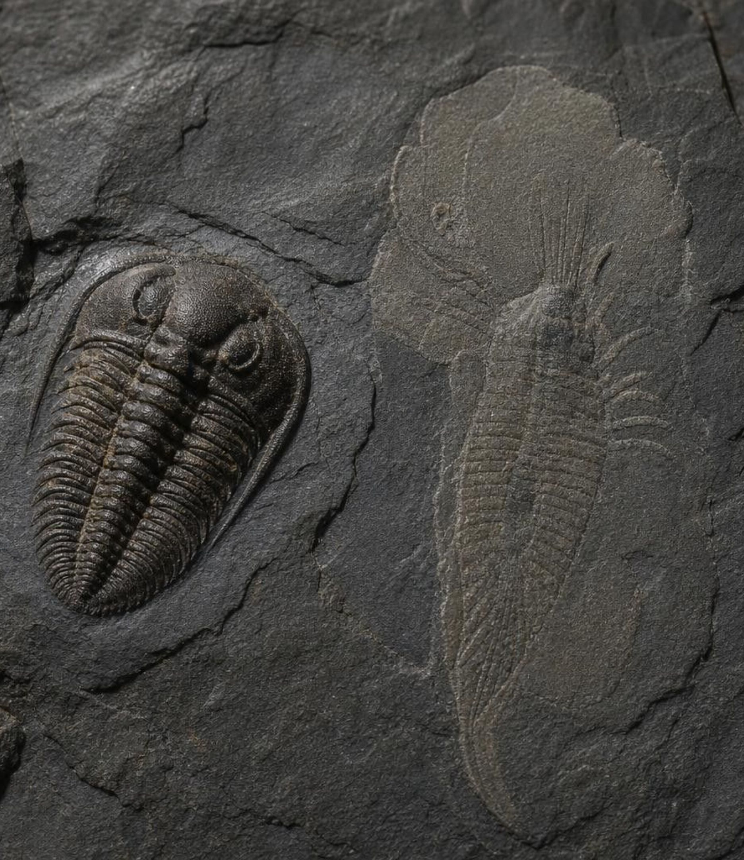
Life gets big: the Cambrian explosion and a shale in Canada
For about three billion years nearly all life was microscopic. Then, from about 539 million years ago, early relatives of most major animal groups appear in the rocks within a few tens of millions of years, many with shells that fossilize well. The Burgess Shale in British Columbia preserved even soft-bodied animals from about 508 million years ago: around 200 species from well over 150,000 specimens.
18
Notes:
Make the gap concrete: on the Lab 1 string, microbes have been around for about 3 meters before the roughly half-meter stretch that holds all the animals. Ask why the Cambrian makes such a convenient boundary: hard parts fossilize, so the change is visible in rocks everywhere. Explain why the Burgess Shale matters: ordinary sites keep shells and bones; this one buried animals in fine mud so fast that soft tissue left impressions, showing that the Cambrian seas held far more kinds of animals than shells alone reveal. Correct the textbook's number if students have seen it: the site has about 200 species, not 60,000; the larger number is the scale of the specimen collection. Some animals, the Ediacaran forms, lived before the Cambrian; the 'explosion' is about diversity and hard parts, not the first animals.
WATCH FOR: 'All living things descend from Cambrian animals.' Plants, fungi and microbes have their own much older lines.
CONNECTS TO: W3 reading passage; Lab 1 event cards.
PACING: about 4 min

Slide 19
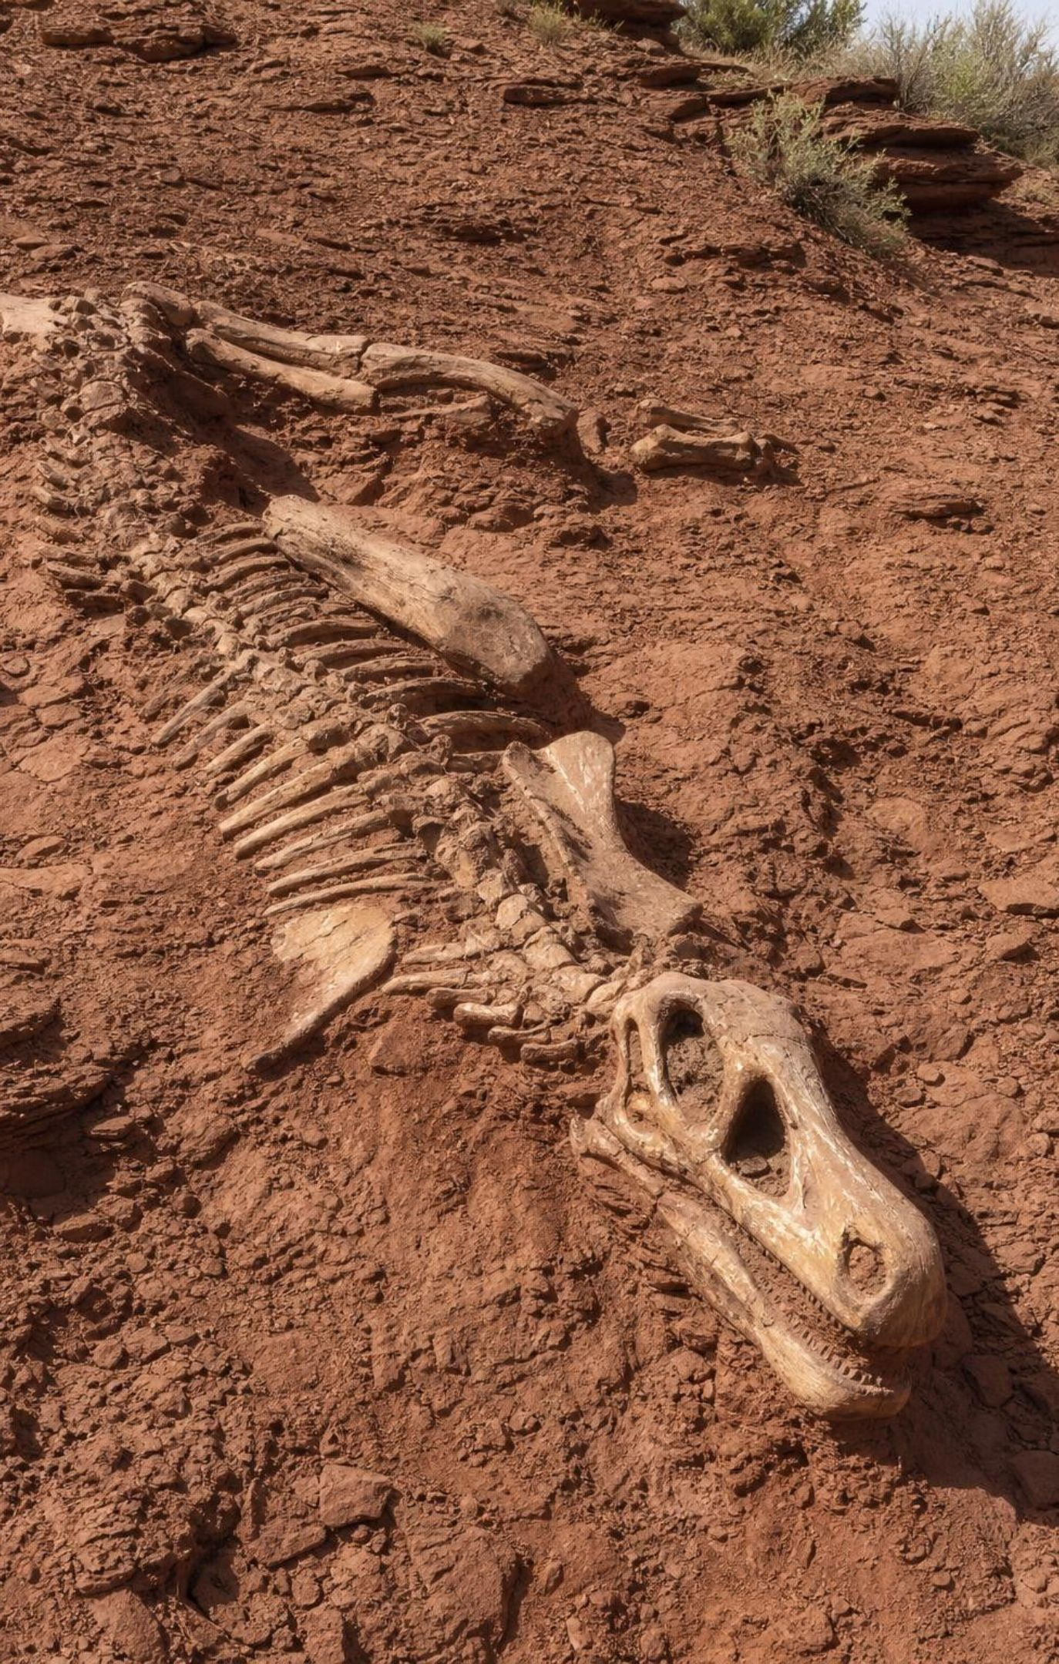
Pangaea, three extinctions and the rise of the dinosaurs
Moving plates assembled the supercontinent Pangaea by about 300 million years ago.
About 252 Ma, enormous long-lasting eruptions in Siberia line up with the worst extinction ever.
Most species died, especially in the oceans; trilobites and most crinoids vanished for good.
Survivors diversified; the first dinosaurs appear about 230 Ma, dominant after the 201 Ma extinction.
Pangaea began splitting about 200 to 180 Ma, separating populations that evolved apart.
66 Ma: an asteroid struck at Chicxulub, Mexico; the non-bird dinosaurs died out. Birds lived on.
19
Notes:
Tell the three extinction stories briefly and keep the causes honest. End-Permian: the Siberian eruptions covered an area larger than Alaska with lava and vented gases for a very long time; the timing matches the extinction, and warming, acidifying oceans and loss of oxygen in seawater are the proposed killers. Matching timing makes the eruptions the prime suspect; the mechanism makes the case. End-Triassic: another pulse of eruptions as Pangaea began to split, and the dinosaurs came out of it as the dominant land animals. End-Cretaceous: a crater about 180 kilometers across under the Yucatan, a worldwide clay layer with iridium and glassy beads, and the disappearance of the non-bird dinosaurs at the same level. Note that India was already heading north and that huge eruptions in India were also under way at that time; scientists debate how much they contributed. Always say 'non-bird dinosaurs': birds are dinosaurs. Percentages differ by source, so say 'most species' rather than a single number.
WATCH FOR: 'Dinosaurs ruled from the moment they appeared' and 'all dinosaurs went extinct.' Also the idea that one bad day explains the Permian event; it took thousands of years at least.
CONNECTS TO: Lab 3 extinction data; W6 CER on strata evidence for an extinction; W8 evidence cards.
PACING: about 6 min

Slide 20
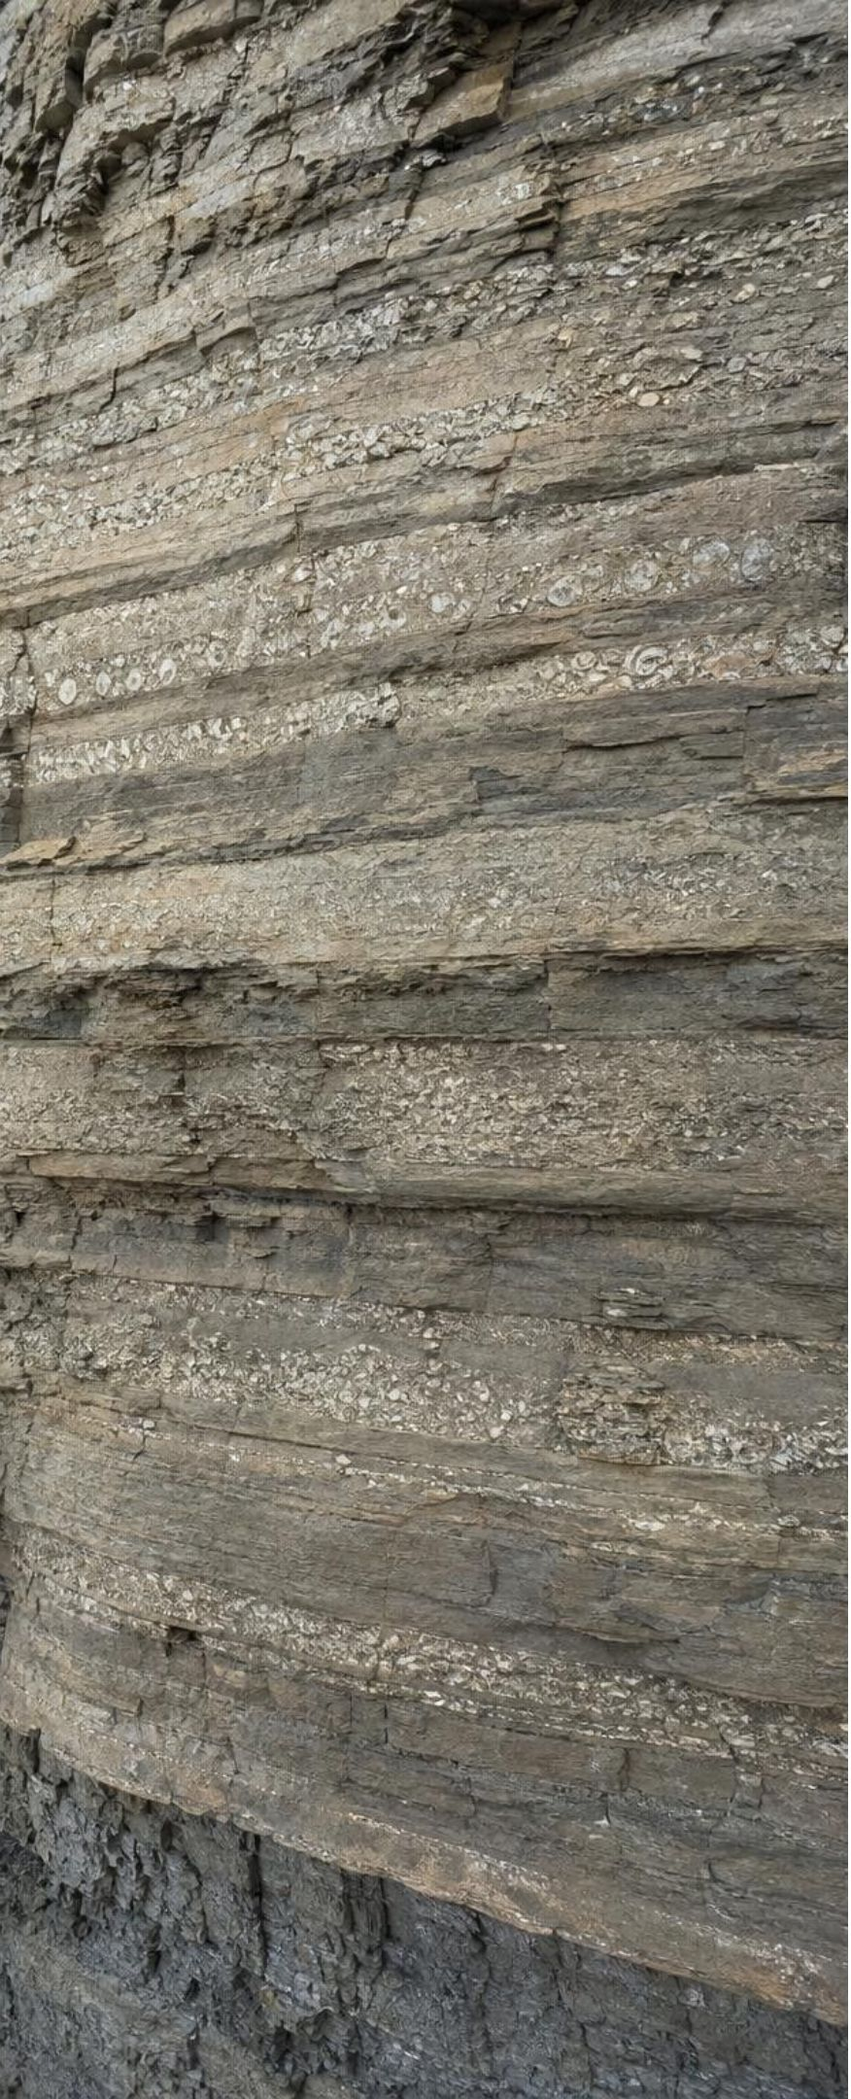
APPLY IT
Task: where do the boundaries go?
Simulated data for practice.
A team logged which fossil groups appear in each layer of a cliff (bottom layer first). Decide where you would draw era-level boundaries, and justify each with a number.
Layer (1 = oldest) | Fossil groups present | Number of groups | Groups lost since layer below | Percent lost
1 | A, B, C | 3 | - | -
2 | A, B, C, D, E | 5 | 0 | 0%
3 | A, B, C, D, E, F | 6 | 0 | 0%
4 | C, D, F | 3 | ? | ?
5 | C, D, F, G, H | 5 | 0 | 0%
6 | C, F, G, H | 4 | ? | ?
7 | C, F, G, H, I | 5 | 0 | 0%
20
Notes:
This is a teaching dataset, invented for the task. Give groups eight minutes. Step 1: compute the missing cells. Layer 3 to 4 loses A, B and E, three of six groups, 50 percent. Layer 5 to 6 loses D, one of five, 20 percent. Step 2: decide. Most groups will put a major boundary between layers 3 and 4; the question is whether the 20 percent step earns one. There is no single right answer, but the justification must use the numbers and a stated rule, for example 'a boundary needs at least a third of the groups lost.' Step 3: ask what else could cause a group to vanish from a layer without an extinction: the environment changed (a sea became land) or the layer simply did not preserve that group. That is why geologists compare many sites before drawing a line. Lab 3 is the full twelve-layer version.
EXPECTED RESPONSES: Missing cells: layer 4 lost 3 groups (50%); layer 6 lost 1 group (20%). A major boundary between layers 3 and 4; a defensible argument either way for layers 5 to 6, with a stated threshold. Students should also note that new groups appearing (D and E at layer 2, G and H at layer 5) can mark boundaries too.
WATCH FOR: Groups that count only the number present and miss that layer 4 has fewer groups because three disappeared and none appeared.
CONNECTS TO: Lab 3 is the full version; W5 data worksheet uses the same percent-lost calculation.
PACING: about 10 min

Slide 21

CHECK FOR UNDERSTANDING
Quick check: say it in years
Which pair is correct?
A. 66 Ma = 66,000 years ago; 11.7 ka = 11,700 years ago
B. 66 Ma = 66,000,000 years ago; 2.58 Ma = 2,580,000 years ago
C. 4.54 Ga = 454,000,000 years ago; 66 Ma = 66,000,000 years ago
D. 2.58 Ma = 258,000 years ago; 4.54 Ga = 4,540,000,000 years ago
21
Notes:
Quick vote, then have students write all four quantities in full on a whiteboard: 4.54 Ga is 4,540,000,000; 66 Ma is 66,000,000; 2.58 Ma is 2,580,000; 11.7 ka is 11,700. Ask which of these is about when the current interglacial began (11.7 ka), when the Quaternary began (2.58 Ma), when the non-bird dinosaurs ended (66 Ma) and when Earth formed (4.54 Ga). This check prepares the arithmetic in Lab 1.
EXPECTED RESPONSES: B. Option A confuses Ma with ka; C drops a zero from Ga; D drops a zero from Ma.
WATCH FOR: Factor-of-a-thousand errors between ka, Ma and Ga.
CONNECTS TO: Lab 1 calculation sheet; W10 mastery.
PACING: about 3 min

Slide 22
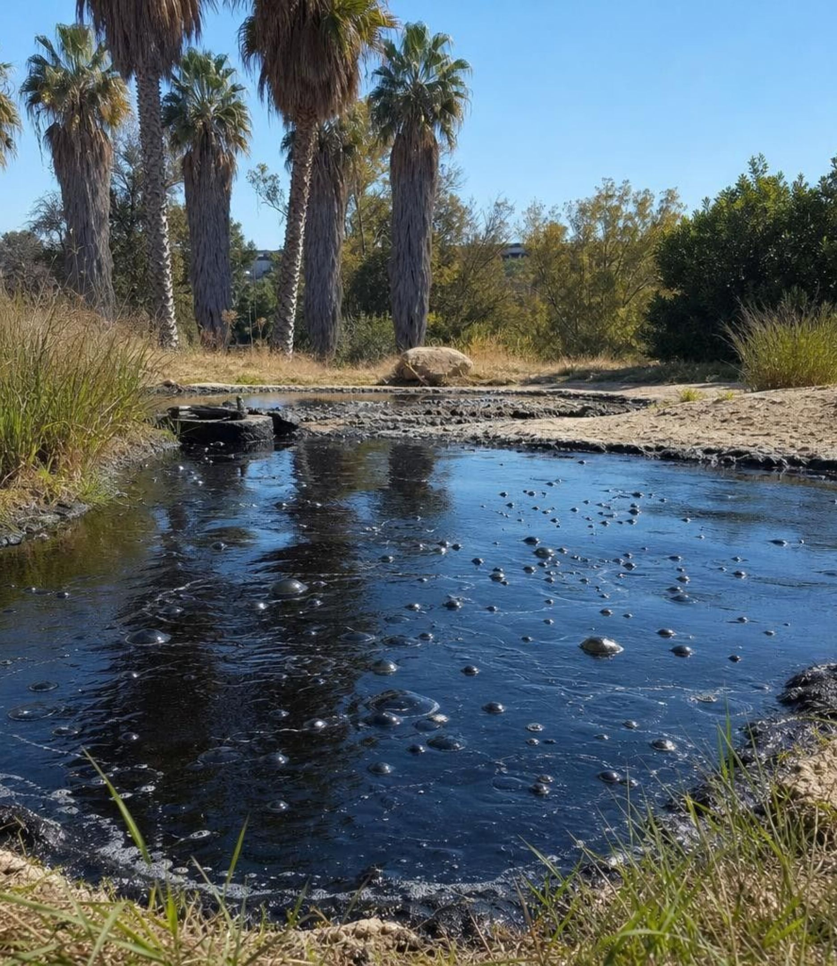
REAL-WORLD CONNECTION
California connection: ice-age Los Angeles at Rancho La Brea
In the middle of Los Angeles, natural asphalt still seeps up through the ground. For about 50,000 years it trapped animals that wandered in: mammoths, saber-toothed cats, dire wolves, ground sloths, birds and insects. Their bones, dated to roughly 50,000 to 11,000 years ago, record the last glacial period in Southern California. The big mammals vanished from the region as the present interglacial began.
22
Notes:
Students may have visited the La Brea Tar Pits museum. Use it to make the last glacial period local: Southern California was cooler and wetter, and the large mammals that lived here are gone. Ask: how would a geologist know these bones are from the last glacial period rather than the age of the dinosaurs? Absolute dating of the bones and of plant material in the asphalt gives tens of thousands of years, not millions; and the animals are mammals of modern families, which only diversified after 66 Ma. Point out that the loss of the big ice-age mammals about 11,000 years ago is a small, recent example of extinction in the fossil record, with climate change and newly arrived humans both suspected. If you want a second local link: the granite of the Sierra Nevada crystallized underground during the age of the dinosaurs, roughly 100 million years ago, and erosion has since uncovered it.
CONNECTS TO: Slide 24 on the current ice age; W9 transfer task.
PACING: about 4 min

Slide 23
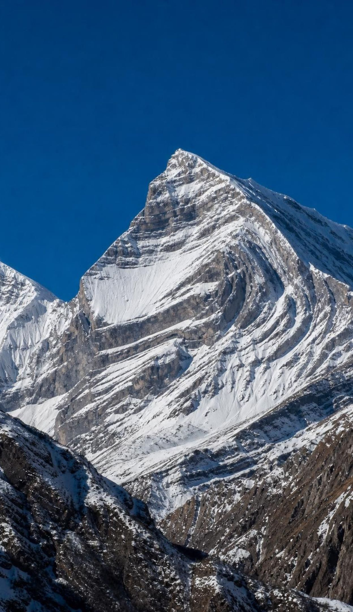
After the dinosaurs: mammals rise, continents keep moving
With the big reptiles gone, mammals diversified into forms from bats to whales within 20 million years.
Fully marine whales appear by about 40 Ma; the first primates about 55 Ma.
India collided with Eurasia about 50 Ma; the Himalayas are still rising, up to about 1 cm a year in places.
About 34 Ma, Antarctica iced over as carbon dioxide fell and ocean currents around it changed.
About 30 to 25 Ma, East Africa began splitting apart along the Great Rift Valley.
Same planet, very different speeds: an impact in a day, a mountain range over 50 million years.
23
Notes:
Frame this slide around rates, the Grade 7 standard on surface change at varying time scales. The Chicxulub impact rearranged the surface in a day; the India-Eurasia collision has been building the Himalayas for 50 million years and continues; the East African Rift has been opening for tens of millions of years and may eventually split the continent. Ask students to rank these by speed and by total change. Then the biology: small mammals already lived alongside dinosaurs; with the large reptiles gone, they diversified rapidly. Whale ancestors walked on land about 50 million years ago, were amphibious soon after, and were fully marine by about 40 million years ago. For Antarctica, give both causes: falling carbon dioxide is thought to be the main driver, and the opening of ocean passages around the continent helped cool its coasts.
WATCH FOR: 'Mammals appeared after the dinosaurs died.' Mammals are about as old as dinosaurs; they diversified after.
CONNECTS TO: W9 transfer task on rates of surface change; Lab 1 event cards.
PACING: about 5 min

Slide 24
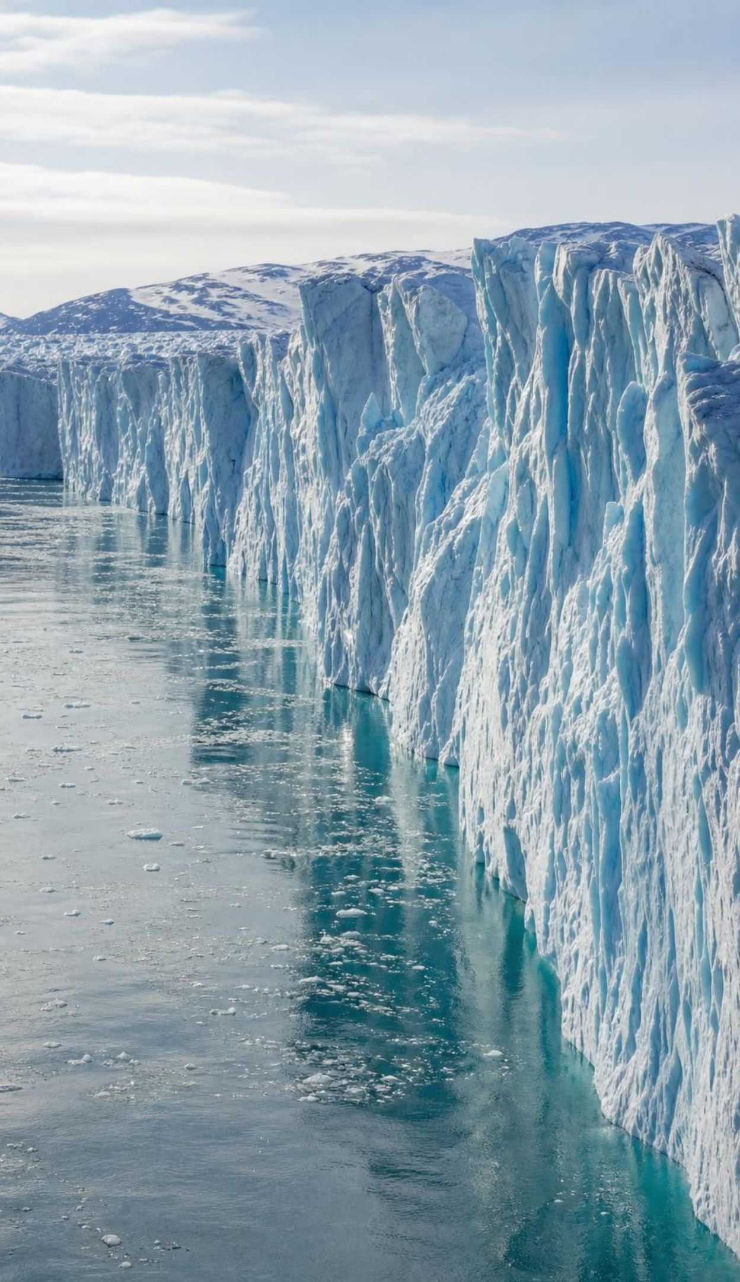
We live in an ice age
An ice age is a long stretch of cool climate with lasting ice at the poles; Earth is in one now.
Northern ice sheets have grown and shrunk in cycles for about the last 2.6 million years.
Glacial periods: ice sheets spread toward the equator. Interglacials: they shrink back.
The present interglacial, the Holocene, began about 11,700 years ago.
Moving ice gouged and deepened the Great Lakes basins; meltwater filled them.
Natural interglacial warming takes thousands of years; today's human-caused warming is far faster.
24
Notes:
Students are surprised that 'ice age' describes today. Define it by polar ice, which Earth has had on Antarctica for 34 million years and in the north for about 2.6 million. Within the ice age, the swings between glacial and interglacial periods are driven by slow changes in Earth's orbit and tilt; mention that only as the cause and move on. Use the Great Lakes as the surface-change example: ice more than a kilometer thick scraped and deepened old river valleys and pressed the crust down; when it melted, water filled the basins. Then draw the contrast carefully: the warming that ended the last glacial period unfolded over thousands of years; the warming measured over the last century is roughly ten times faster and is caused mainly by people burning fossil fuels. The textbook makes the same distinction, with 11,500 years for the Holocene; the international chart uses 11,700.
WATCH FOR: 'The ice age ended 11,000 years ago.' Only a glacial period ended; the ice age continues. Also 'current warming is just the next interglacial.'
CONNECTS TO: W10 mastery; connection slide on Rancho La Brea.
PACING: about 5 min

Slide 25
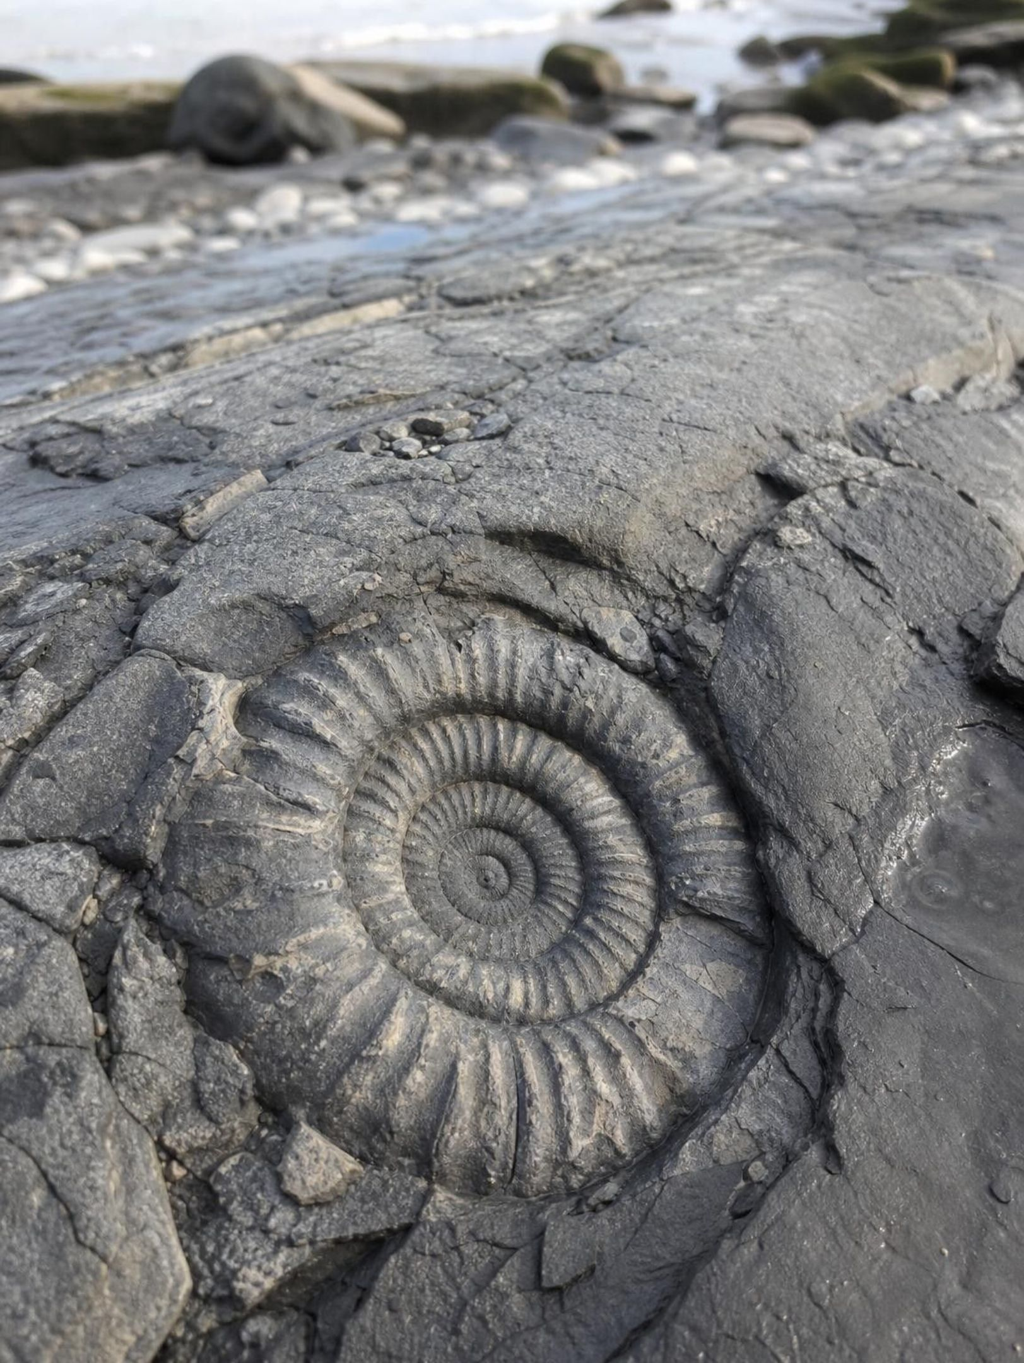
THINK, PAIR, SHARE
Discuss: is the geologic time scale discovered or invented?
The rocks and fossils are real. The names, the unit boundaries and the chart were made by people. So is the geologic time scale a discovery, an invention, or both? Defend your answer with one example.
25
Notes:
Run as a two-minute pair argument, one partner for each side, then switch. Collect the strongest point for each. The 'discovered' side should point to the changes themselves: the trilobites really do stop at one level everywhere they are found. The 'invented' side should point to the choices: whether a 20 percent loss earns a boundary, where exactly to put the Cambrian base, what to name things. Land on 'both': the time scale is a model built from real evidence, and like any model it gets revised when measurements improve, as the base of the Cambrian did. Tie back to Lab 3, where students made exactly these choices.
EXPECTED RESPONSES: Discovered: the fossil changes and the measured ages are real. Invented: the names, the thresholds and the drawing choices. Synthesis: a model built from evidence, revisable but not arbitrary.
CONNECTS TO: Lab 3 debrief; W8 collaborative task.
PACING: about 6 min

Slide 26
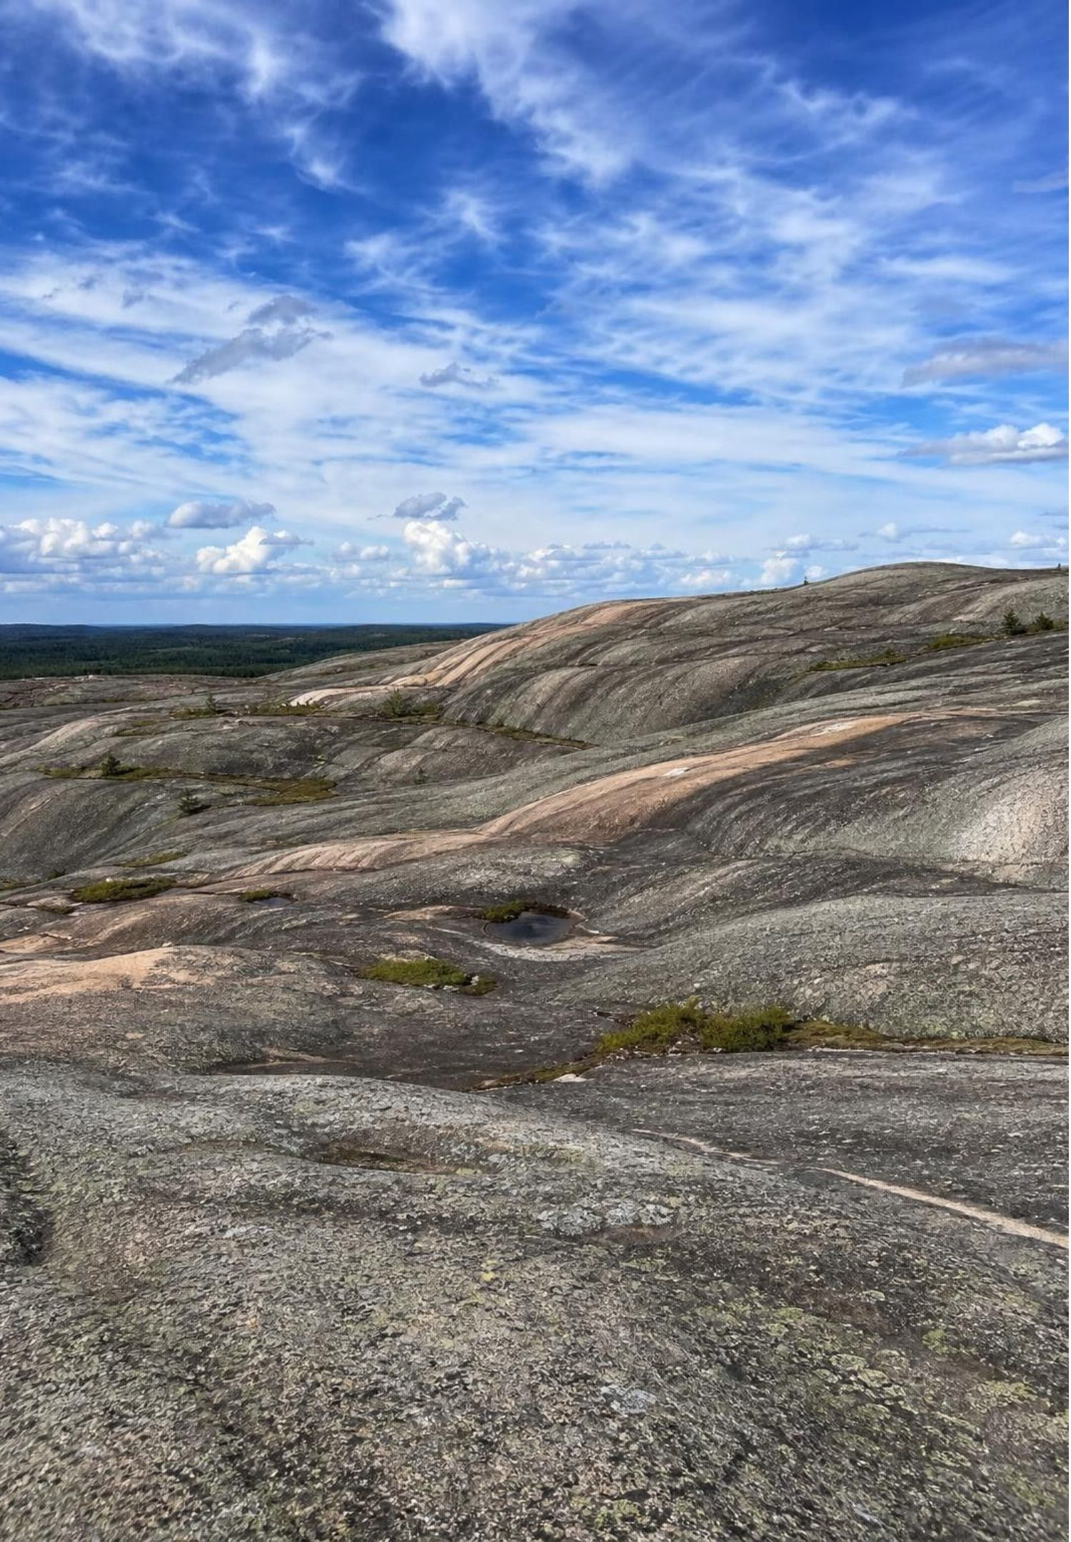
MISCONCEPTION CHECK
True or false? Most of Earth's history came after the Cambrian
"Because the geologic time scale chart gives the Phanerozoic Eon most of the space, most of Earth's history happened after animals appeared, and the dinosaurs must have lived not long before the first humans."
True or false? Explain your reasoning.
26
Notes:
Have students evaluate the statement in writing with two numbers from the lesson. The Phanerozoic is about 539 of 4,540 million years, about 12 percent; the Precambrian is about 88 percent. On the Lab 1 string, animals occupy the last 54 centimeters of 4.54 meters, non-bird dinosaurs end 6.6 centimeters from today, and modern humans begin 0.3 millimeters from today, so there is a gap of about 66 million years between the last non-bird dinosaur and the first modern human. Charts give the Phanerozoic room because its fossil-rich rocks have been split into many named units, not because it is long. Ask students to sketch a to-scale version of their textbook chart.
EXPECTED RESPONSES: False. About 12 percent of Earth's history is Phanerozoic; chart space follows the number of named units; dinosaurs and humans are separated by about 66 million years.
WATCH FOR: Students may overcorrect to 'the Precambrian was boring.' Oceans, continents, oxygen and life all began then.
CONNECTS TO: Lab 1 string model; W7 misconception repair.
PACING: about 6 min

Slide 27
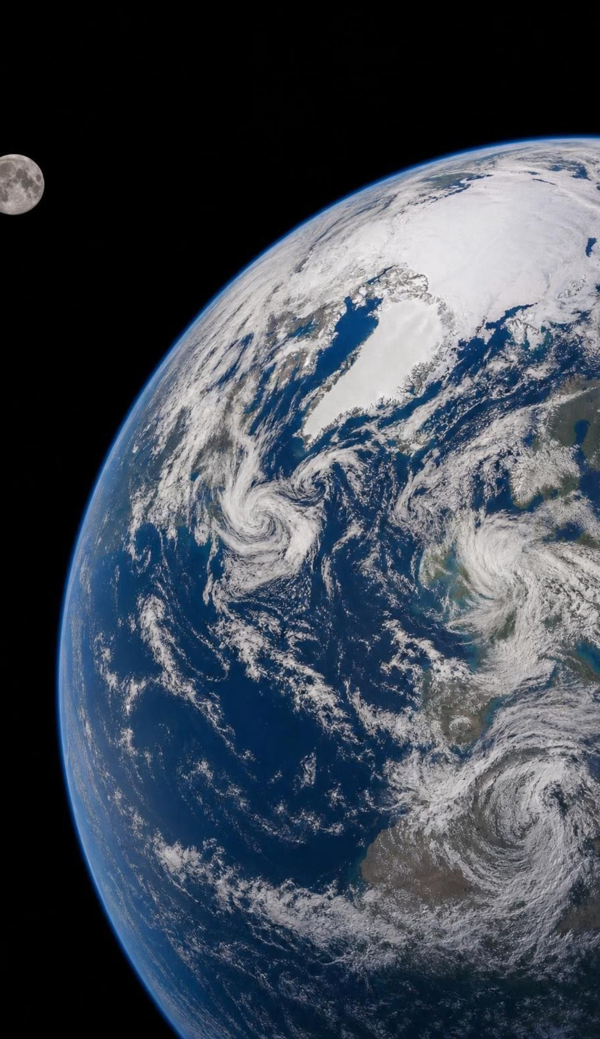
PUTTING IT TOGETHER
Putting it together
Layers and fossils give the order of events; dated ash, meteorites and moon rocks give the years.
Matching a key bed across sites stitches short records into one long one.
Boundaries on the time scale sit where the fossil record changes most, so the units are uneven.
Earth is 4.54 billion years old; its core, moon, oceans and oxygen each left evidence.
The Phanerozoic is only about one-eighth of the story; we live in its ice age, in a warm interglacial.
27
Notes:
Have students write a four-sentence summary using at least five vocabulary terms, then trade with a partner who checks that relative and absolute dating are used correctly. Ask for one thing from each lab: Lab 1 (the length of the Precambrian on the string), Lab 2 (which layer let them line up the sites), Lab 3 (the threshold they chose for a boundary). Preview the next lessons: the energy that drives Earth's surface processes and the scales at which they change the land.
CONNECTS TO: W6 CER as the written assessment; W10 mastery as the quiz.
PACING: about 6 min

Slide 28
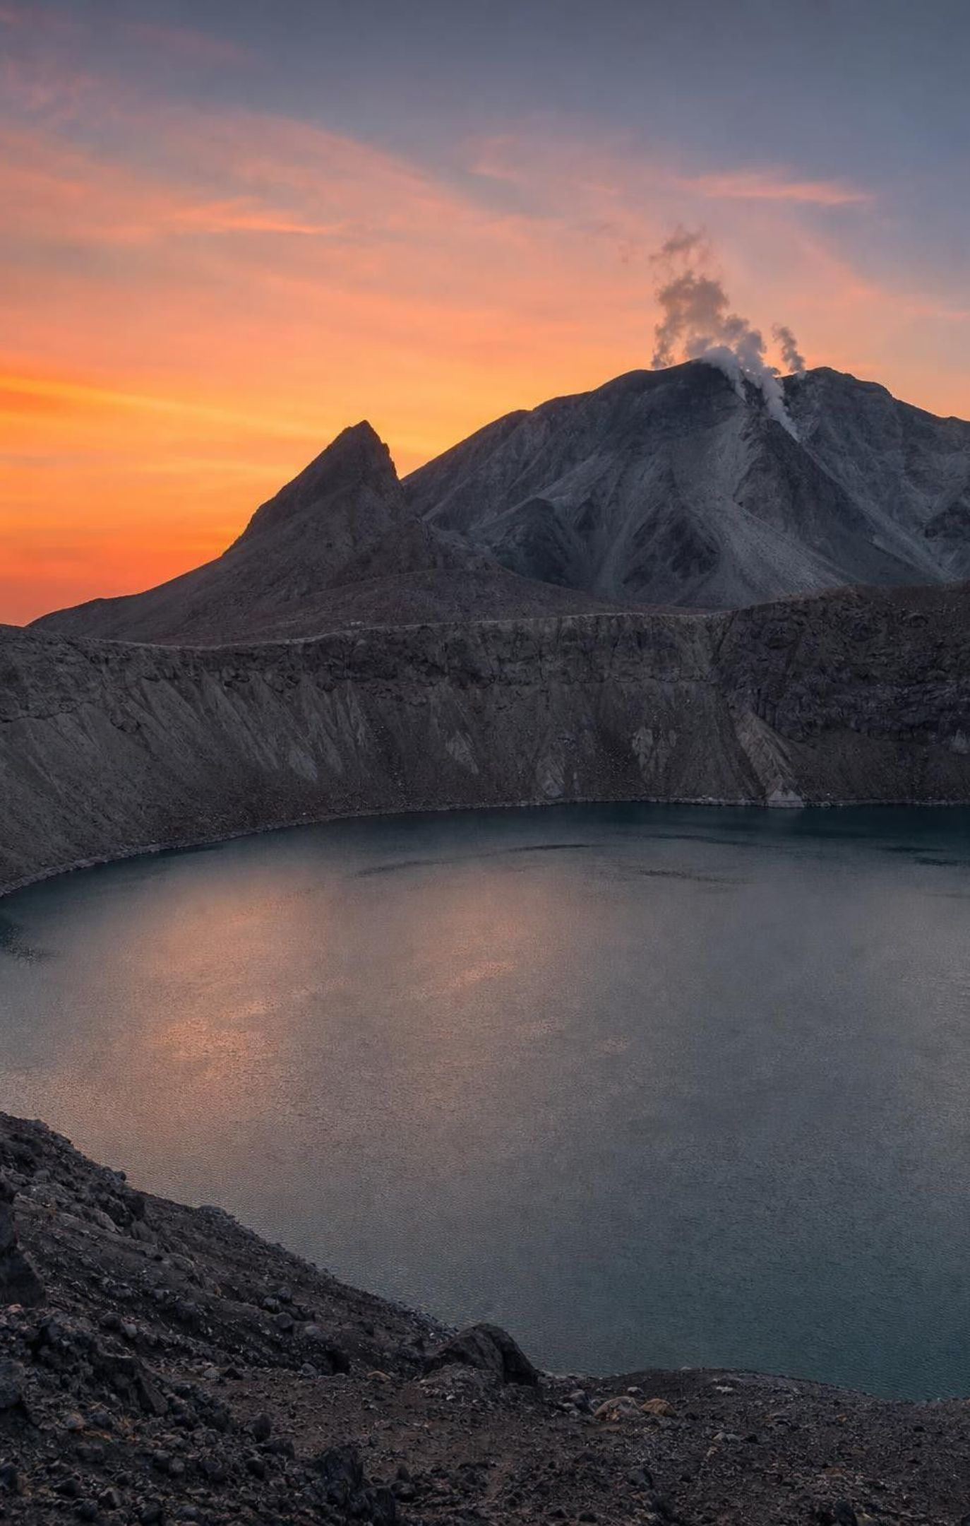
EXIT TICKET
Exit ticket
1
Name one material suited to absolute dating and one thing that can only be dated relatively.
2
Two cliffs share a white ash bed. In one sentence, explain what the ash lets a geologist do.
3
About what fraction of Earth's history is the Phanerozoic: half, one-quarter, or one-eighth?
4
Write one piece of evidence and one explanation about how the moon formed, labeled E and X.
28
Notes:
Collect on index cards or a shared form. Item 1 checks the dating distinction; item 2 checks lateral continuity and key beds; item 3 checks scale; item 4 checks the evidence-explanation habit that the W6 CER depends on. Sort the cards before the next class and reteach from the largest pile.
EXPECTED RESPONSES: 1: volcanic ash, meteorites or moon rocks for absolute dating; a fossil-bearing sandstone or shale layer is dated relatively from its position. 2: line up the two sequences at the same moment in time and combine them into one longer record, and if the ash is dated, give both sites a year. 3: about one-eighth (12 percent). 4: E: moon rocks closely match Earth's mantle, or the moon is about 4.5 billion years old; X: a Mars-sized body struck Earth and the debris formed the moon.
WATCH FOR: Item 3 answers of 'half' signal that the chart-space idea has not been displaced; revisit the string.
CONNECTS TO: W10 mastery; chapter evidenceOfLearning.
PACING: about 5 min

