Slide 1
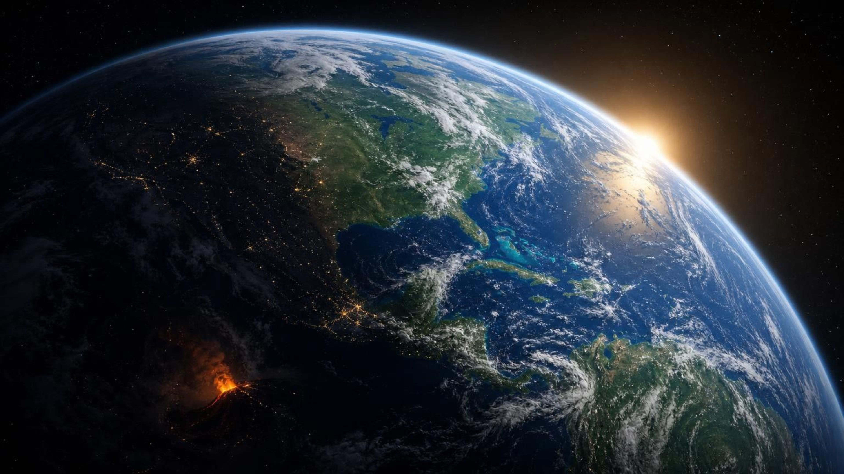
ANGELA'S WAND · BRING SCIENCE ALIVE! 7TH GRADE INTEGRATED
Chapter 10: Energy in Earth's Systems
Chapter 10 of 29 · Earth's Systems
Lesson 10: How does energy from the Sun and from deep inside Earth set rock, water, air and life in motion?
Notes:
This lesson is about one mechanism that shows up everywhere: energy changes the density of a material, and gravity then sorts the dense from the less dense. That sorting is convection, and it turns over the solid mantle, the oceans and the air. Tell students they will run three investigations: a tank model of convection with warm and cold dye, a string-and-card model of energy and matter moving between Earth's four systems, and a data decision about where to drill for geothermal heat. Nothing in this lesson needs flames; the only hot water is handled by you.
CONNECTS TO: Overview of Lab 1, Lab 2 and Lab 3; W1 opens on the next slide.
PACING: about 2 min

Slide 2
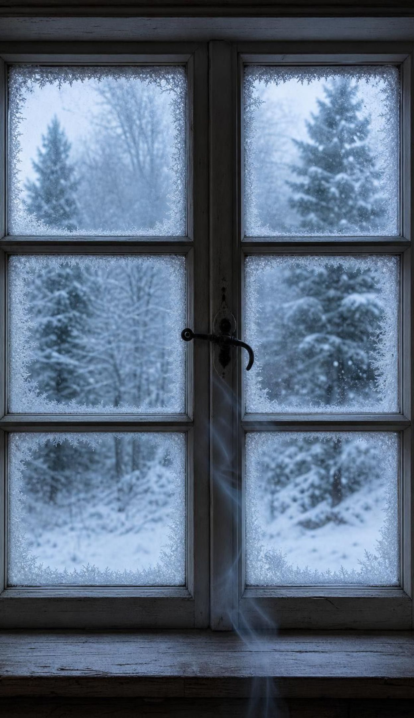
PHENOMENON
A cold draft from a window that is shut
A cold morning. The heater is on the far wall. The window on the opposite wall is closed and locked, yet the students next to it feel a cold draft sliding down the glass and across their ankles. A smoke stick held at the sill shows the smoke drifting down the window, along the floor to the heater, up the warm wall and back across the ceiling. No fan. No open window. The air is circulating in a silent loop.
Notice: which way does the smoke move at the window, the floor, the heater, the ceiling?
Wonder: with no fan, what is pushing the air around the room?
Predict: what happens to the loop if the heater is switched off?
2
Notes:
If you have a cold window and a heater, run this live with a stick of incense or a strip of tissue paper taped to a pencil; otherwise describe it. Give two silent minutes for a notice and a wonder, then collect without judging. Push on the mechanism: the air near the glass is cooling, the air near the heater is warming. What does cooling do to air? Expect 'hot air rises' as the explanation and write it on a parking lot, because the lesson will sharpen it: warm air does not rise on its own, cooler denser air sinks under gravity and pushes it up. Ask the prediction question and hold the answers until the free-fall candle discussion.
EXPECTED RESPONSES: Notice: smoke sinks at the window, crawls along the floor, rises at the heater, spreads along the ceiling. Wonder: why does it sink at the window; does the loop ever stop; is this what happens in a house. Predict: with the heater off the loop slows and stops once the whole room is the same temperature.
WATCH FOR: 'Heat rises' stated as a cause. Do not correct yet; return on slides 10, 11 and 19.
CONNECTS TO: W1 phenomenon worksheet records notice, wonder and a first explanation. Lab 1 and its recording sheet settle the heat-or-dye question.
PACING: about 8 min

Slide 3

Learning targets
What you will be able to do
Name Earth's four systems and sort real things into them, including things in two at once.
Explain how heating changes density and how gravity turns that into a convection cell.
Tell conduction, convection and radiation apart in real situations.
Trace where each system gets its energy and follow energy and matter across system borders.
Explain why matter cycles in the biosphere but energy flows through and leaves as heat.
Use data from a physical model, like Biosphere 2, to decide what the next version must fix.
3
Notes:
Read the targets aloud and have students star the one that sounds hardest. Targets 1 and 2 belong to the first two days; 3 and 4 are the middle of the lesson; 5 and 6 come at the end. Point out that target 2 is the engine of the whole lesson: if they can explain the window draft, they can explain the mantle, the ocean and the wind.
CONNECTS TO: Targets map to W2 (1), Lab 1, W4 and W5 (2), W3 and Lab 3 (3), Lab 2 and W8 (4), W7 (5), W6 and W9 (6).
PACING: about 2 min

Slide 4






One planet, four overlapping systems
Geosphere: all the rock and metal, from the surface to the center.
Hydrosphere: all the water, as liquid, ice and invisible vapor.
Atmosphere: the layer of gases, mostly nitrogen and oxygen, thinning with height.
Biosphere: every living thing plus every place where life can survive.
The borders overlap: water vapor is hydrosphere and atmosphere; a fish is biosphere in the hydrosphere.
4
Notes:
Scientists split Earth into systems so they can study the flows between them, not because the pieces are separate. Do a quick sort on whiteboards: a glacier, a cloud, an earthworm, lava, a puddle, the air in a tire, a seashell on the beach. Push for double answers: the cloud is water (hydrosphere) floating in air (atmosphere); the earthworm is biosphere living inside the geosphere's soil; the seashell was made by an organism and is now part of the geosphere's sediment. The atmosphere has no top; it fades into space. The book's thickness numbers for the water and air layers are rough model values, so we will not test them.
EXPECTED RESPONSES: Glacier: hydrosphere. Cloud: hydrosphere and atmosphere. Earthworm: biosphere (in geosphere). Lava: geosphere. Puddle: hydrosphere. Tire air: atmosphere. Seashell: geosphere, made by the biosphere.
WATCH FOR: Students may think each thing belongs to exactly one system. Reward the overlaps.
CONNECTS TO: W2 vocabulary sort is built on these overlaps.
PACING: about 5 min

Slide 5
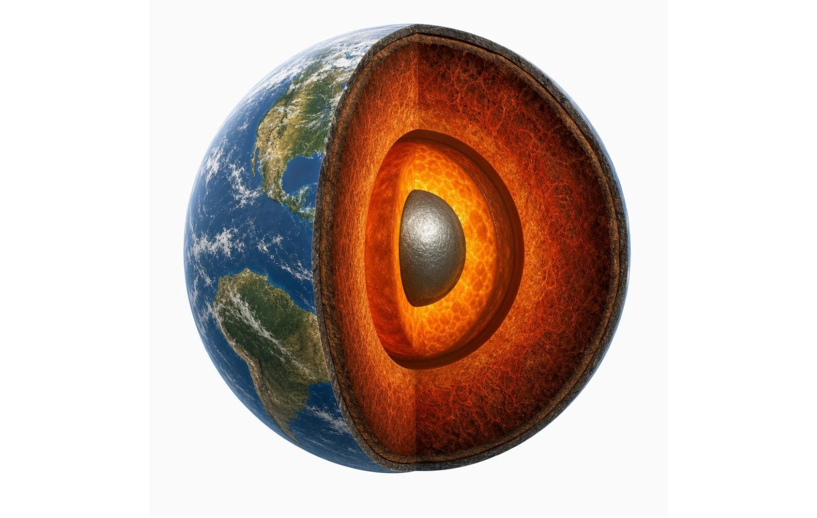
Inside the geosphere: three layers, three densities
MODEL
Model: From the surface to the center (not to scale)
Top to bottom: Crust: cool, brittle rock; about 35 km under continents, about 7 km under oceans; least dense /
Mantle: about 2,865 km of hot, solid rock that creeps a few centimeters per year /
Outer core: liquid iron and nickel metal /
Inner core: solid iron and nickel metal; the core is the densest and hottest layer
Each layer is denser than the one above it. The core is metal, not rock, and its heat is left over from Earth's formation plus radioactive decay.
5
Notes:
Two corrections to the textbook as you go. First, the core is metal, mostly iron and nickel, with a liquid outer part and a solid inner part; the book calls it a rock layer. Second, the book says the core is hottest because of pressure from above. Pressure keeps the inner core solid; it does not make the core hot. The heat is leftover from when Earth formed, from radioactive atoms decaying, and from the outer core slowly freezing onto the inner core. Ask: which layer would you expect to be moving fastest? Students usually say the liquid outer core, which is right; the mantle is the slow one and is still solid. Hold the question of how a solid can flow for slide 11.
WATCH FOR: Core as rock; pressure as a source of heat; mantle as liquid. Correct the first two now, the third on slide 11.
CONNECTS TO: W4 diagram worksheet; Lab 3 uses the crust's temperature gradient.
PACING: about 5 min

Slide 6
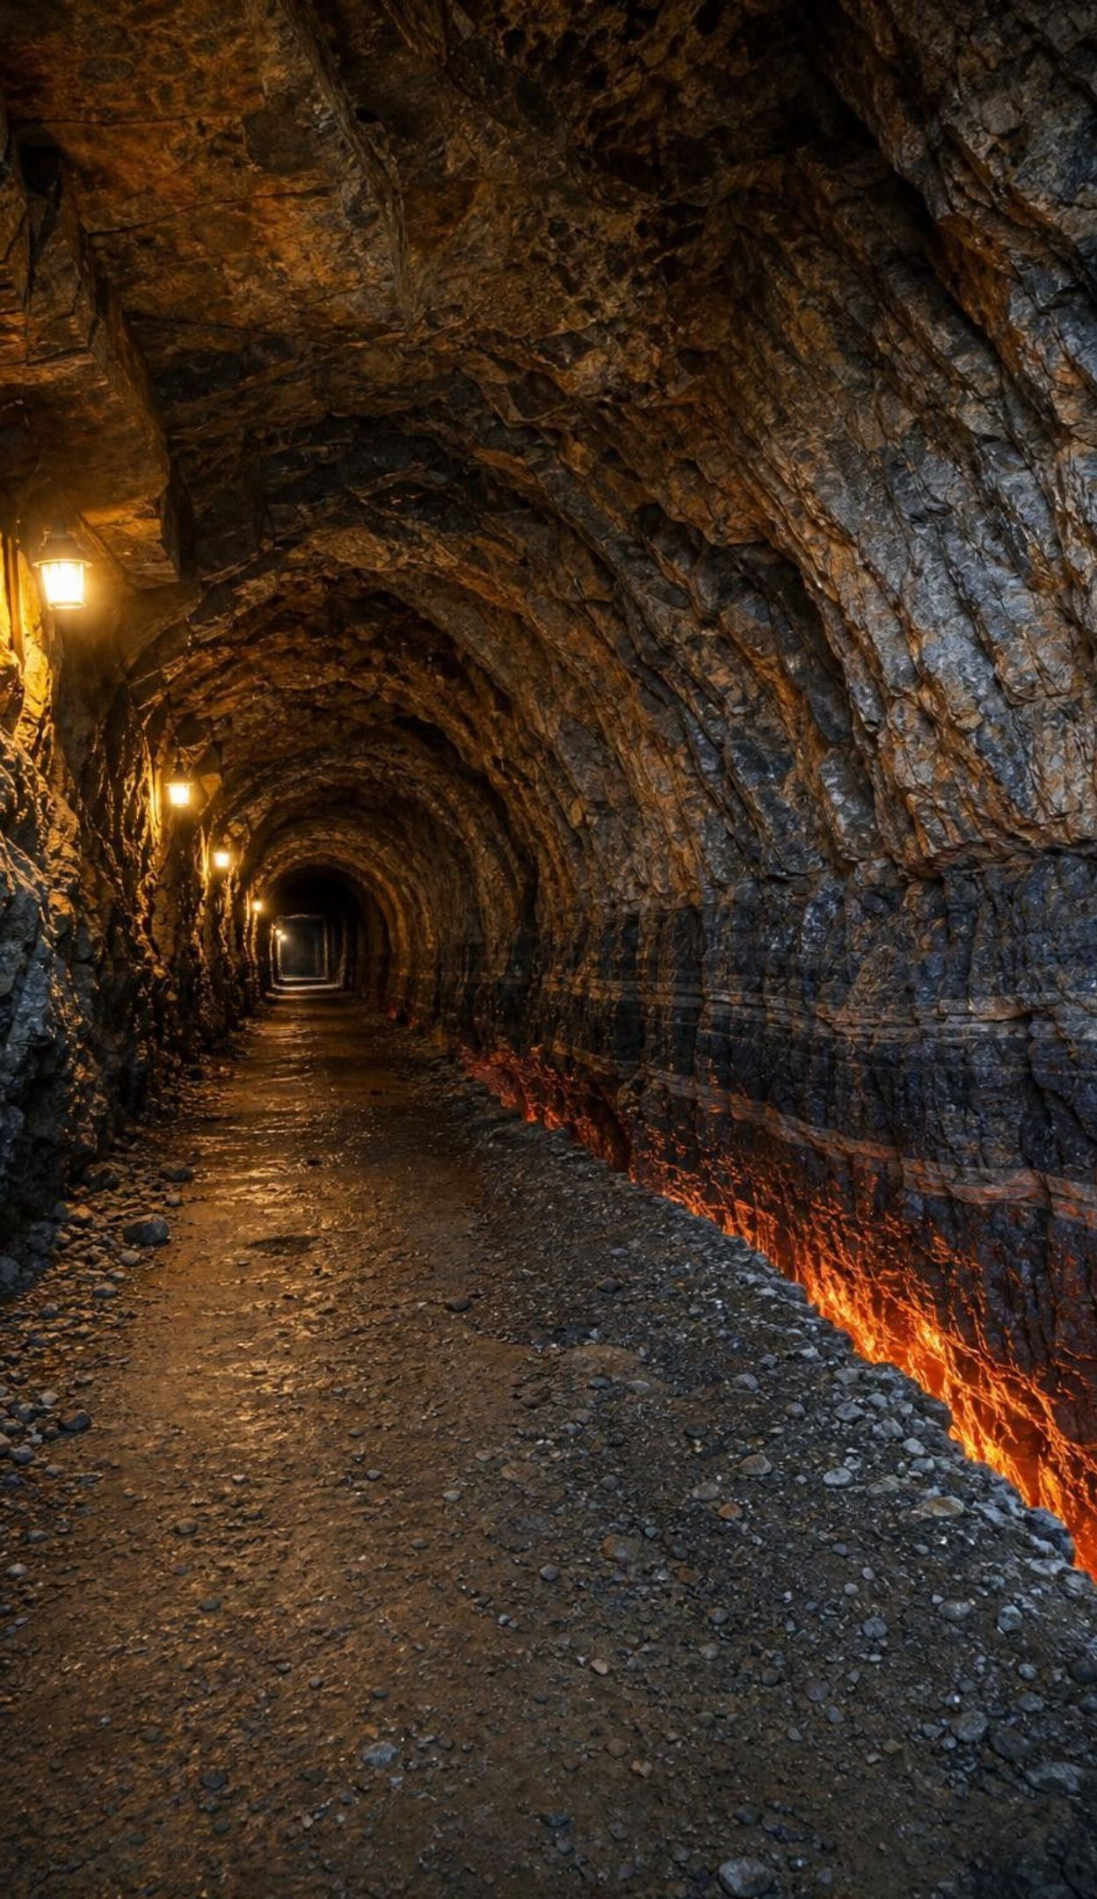
VOCABULARY IN CONTEXT
The three layers
crust: The outermost layer: a cool, brittle shell of rock, thin next to the layers below it and the least dense. A deep mine three kilometers down is still inside the crust, and the rock there is already hot to the touch.
mantle: The thick layer of hot rock between crust and core; solid, but it creeps over millions of years. Mantle rock rising under the middle of the Atlantic moves about as fast as your fingernails grow.
core: Earth's center, mostly iron and nickel metal; liquid outside, solid inside; densest and hottest. The outer core's flowing metal is what gives Earth its magnetic field, which a compass needle follows.
6
Notes:
Have students repeat 'the mantle is solid' once, out loud. Then connect density to the order of the layers: when Earth was young and largely molten, the densest material, iron and nickel, sank to the center and the lightest rock floated to the top. That same density sorting under gravity is the mechanism of this whole lesson. The magnetic-field example is a bonus fact for the curious and is not assessed.
WATCH FOR: 'Mantle equals magma.' Keep saying solid.
CONNECTS TO: W2 vocabulary; W10 mastery.
PACING: about 4 min

Slide 7

Three ways energy gets from here to there
Convection: moving matter carries the energy along; needs a fluid (or very slowly creeping rock) and gravity.
Radiation: energy travels as light, including infrared; needs no matter, so it crosses space.
Conduction: particle to particle through things that touch; the material itself stays put.
Energy always moves from the warmer place to the cooler place in all three.
7
Notes:
Give an everyday example for each: a metal spoon in hot soup (conduction), the room draft (convection), the warmth on your face from a campfire across the circle (radiation, since the air between you is not hot). Then ask which one the Sun uses to reach Earth. Space is almost empty, so conduction and convection cannot work; only radiation makes the trip. Stress that real situations combine the three: energy leaves Earth's core into the mantle by conduction, moves through the mantle mainly by convection, crosses the stiff crust by conduction, and finally leaves the surface by radiation and by convection in the air.
WATCH FOR: Students often think radiation here means radioactivity. Say 'light energy' every time.
CONNECTS TO: W3 reading passage; W2 vocabulary relationships.
PACING: about 5 min

Slide 8

VOCABULARY IN CONTEXT
Say it like a scientist
conduction: Energy passing between particles that touch, from warmer to cooler, without the material moving. Rock at the bottom of a mine is warmer than rock at the top because heat conducts slowly up through the crust.
convection: Energy carried by moving matter when warmer, less dense material is pushed up as cooler, denser material sinks. A pot of soup heated from below turns over in loops you can see in the floating bits.
radiation: Energy traveling as light, including invisible infrared light; it needs no matter to carry it. The Sun's light crosses 150 million kilometers of near-empty space to warm the ocean surface.
8
Notes:
Point out the word 'pushed' in the convection definition. The textbook says warm material rises, which is what we see; the cause is that cooler, denser material next to it is pulled down harder by gravity and shoves the warm material out of the way. Students will test this idea in Lab 1 by comparing a hot dyed vial, a warm dyed vial and a room-temperature dyed vial. Only the temperature difference produces a plume.
WATCH FOR: 'Warm things rise because heat rises.' Keep the gravity half of the story in every sentence.
CONNECTS TO: Lab 1 tank model; W2.
PACING: about 4 min

Slide 9

CHECK FOR UNDERSTANDING
Quick check: which transfer is this?
You hold a mug of hot cocoa. Your hands warm up. Steam curls upward from the surface. Across the table, your friend feels the mug's warmth on their face. Match each to conduction, convection or radiation.
A. Your hands warm up.
B. Steam and warm air curl upward above the mug.
C. Your friend feels warmth from across the table.
9
Notes:
Let pairs decide, then poll. A is conduction (mug and hands touch). B is convection (warm, less dense air and vapor are pushed up by the cooler air around them). C is radiation (the air between the mug and the friend's face is not warm; infrared light carries the energy). Follow up: how did the energy get into the cocoa in the first place? Probably conduction from a hot pan or microwave radiation, which is a nice reminder that each situation is a chain of transfers.
EXPECTED RESPONSES: A conduction, B convection, C radiation. Some students will call B conduction because the vapor touches the air; the key is that the matter itself moves and carries the energy.
WATCH FOR: Choosing radiation for B because 'the steam radiates heat.' Steam is moving matter, so it is convection.
CONNECTS TO: W3 reading questions; W10 mastery items on the three mechanisms.
PACING: about 4 min

Slide 10
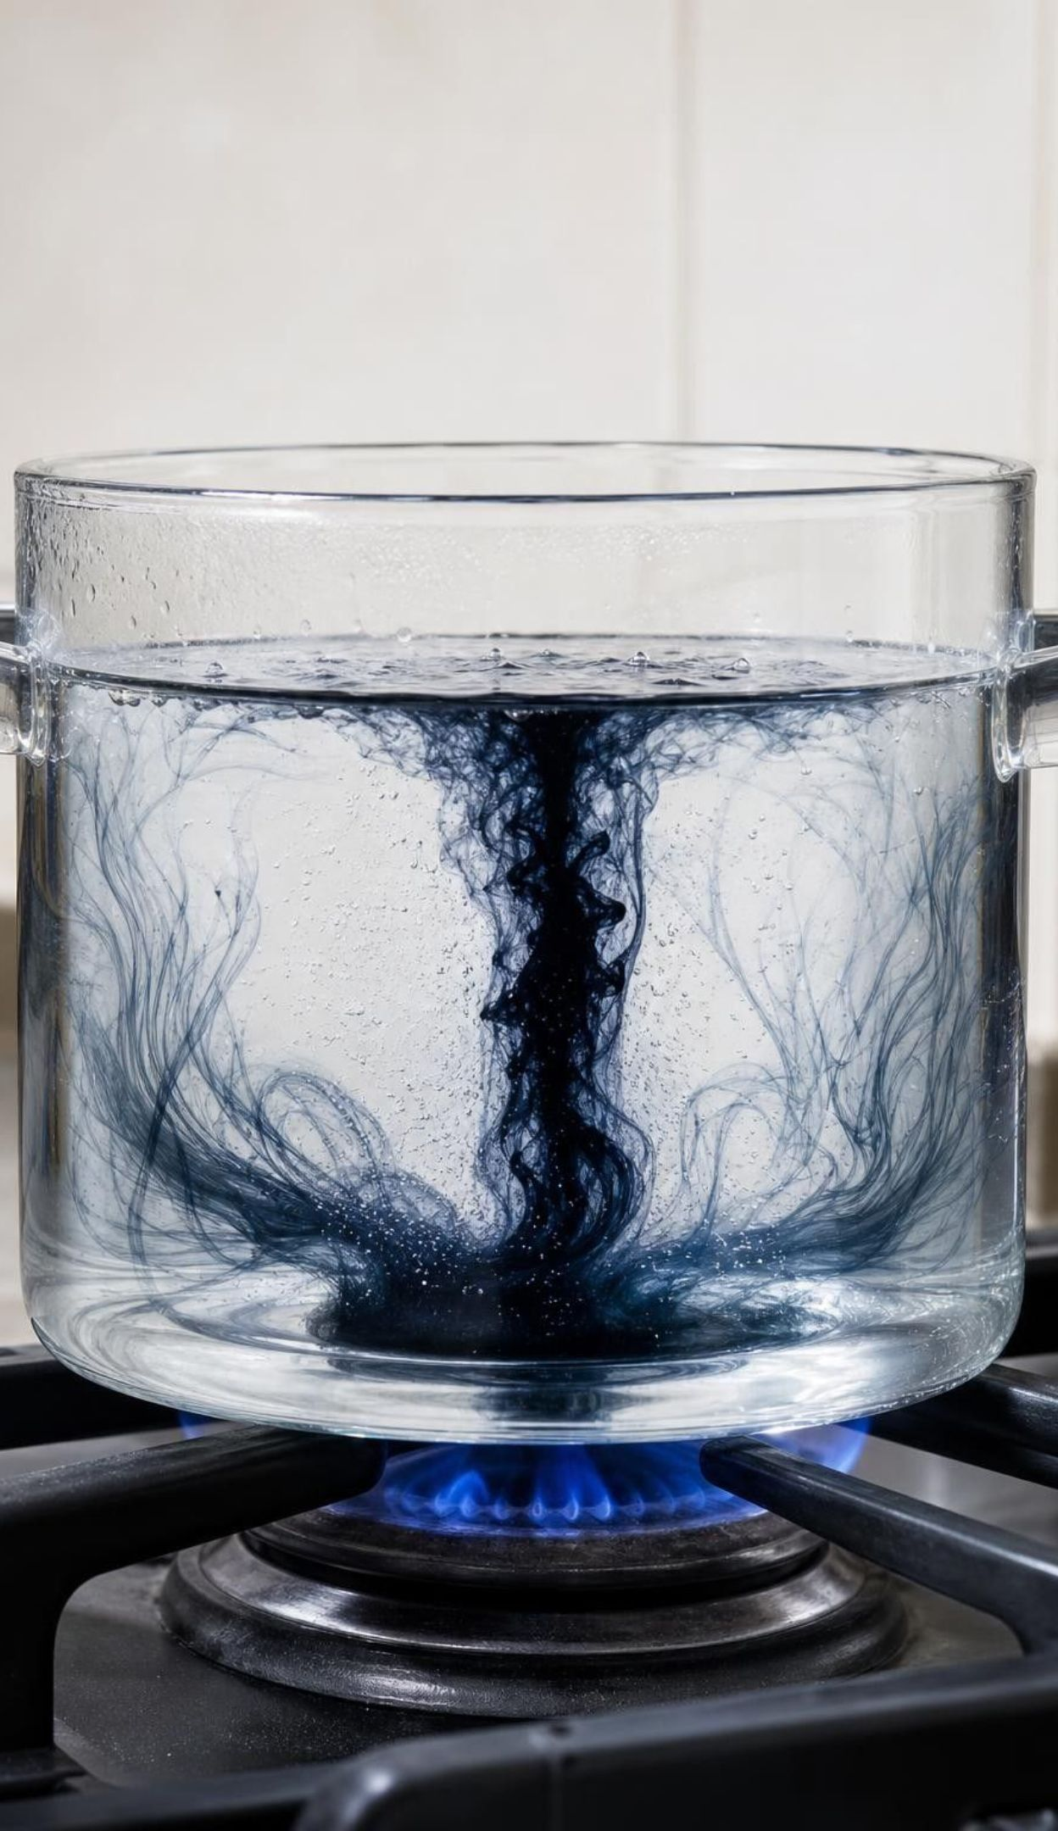




MODEL
Anatomy of a convection cell
Model: One loop, four steps, driven by a warm bottom and a cool top
Cooler, denser material beside it sinks under gravity and pushes the warm material up → (spreads across the top)
Material at the bottom is warmed: particles spread out, density drops → (rises)
1
2
The now-denser material sinks, replacing what is being warmed below → (returns to the heat source) (back to the start)
4
At the top the material loses energy to its surroundings: it cools and its density rises → (sinks)
3
The loop runs as long as the bottom stays warmer than the top. Energy rides along with the moving matter.
10
Notes:
Walk the loop with the window draft: the heater is the warm bottom, the window is the cool top, the floor is the return path. Ask at each node what is happening to density. Then ask what two conditions the loop needs: a temperature difference and gravity. Remove either and it stops. Close with the vocabulary: this loop is a convection cell, and energy is carried along with the moving matter, which is why convection moves both energy and matter at once. This is the same picture students will draw for the mantle, the ocean and the air.
EXPECTED RESPONSES: Density drops when warmed, rises when cooled; gravity pulls the denser material down; the loop stops when the temperatures even out.
WATCH FOR: Students draw the loop with warm material rising and nothing coming down. Insist both legs exist.
CONNECTS TO: Lab 1 recording sheet drawing; W4 diagram worksheet completes this model.
PACING: about 6 min

Slide 11
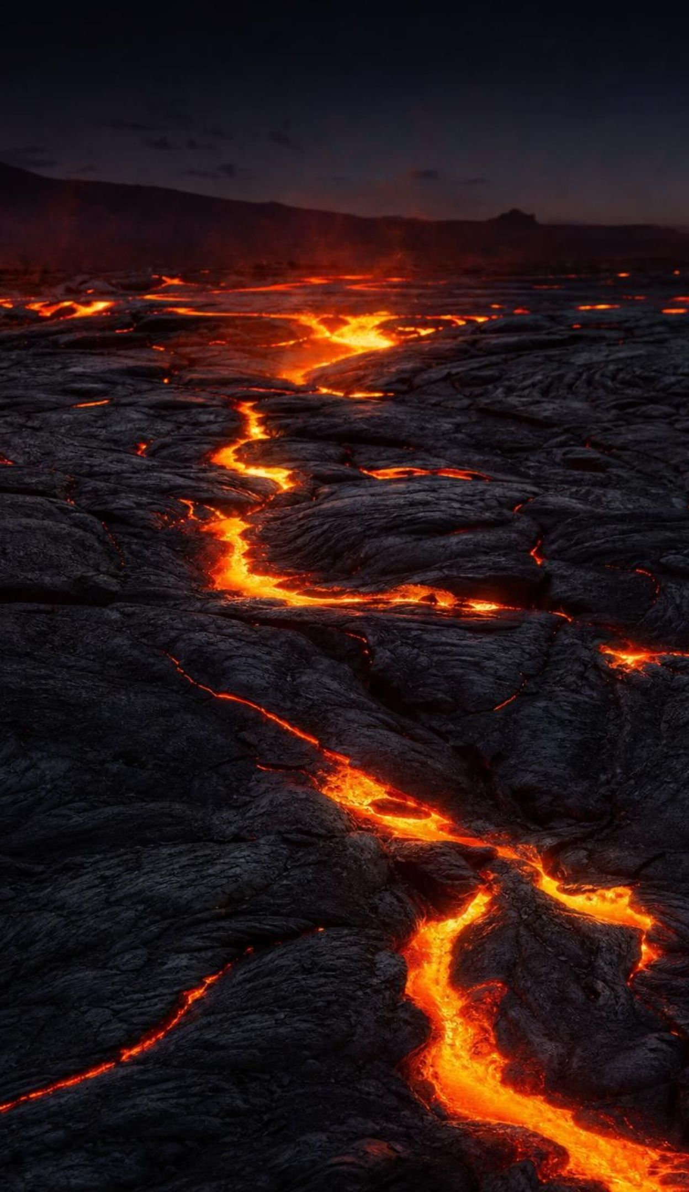
Density, gravity and a solid that flows
Warming spreads particles out: same mass, more volume, lower density.
Gravity pulls harder on the denser material, so it sinks and shoves the less dense material up.
Mantle rock is solid, yet over millions of years it creeps a few centimeters a year, like very stiff putty.
Heat from the core keeps the bottom of the mantle warmer than the top, so the slow loop never stops.
Where the rising rock nears the surface, some of it partly melts into magma and can erupt.
11
Notes:
Do the arithmetic for scale: at 3 cm per year, moving 3,000 km (about the mantle's thickness) takes 100 million years. One full loop is longer still. That is why nobody can watch mantle convection; we know it from the way earthquake waves travel and from the ages of ocean floor rocks. The cake-batter comparison in the book captures the slow flow but can make students picture a liquid. Use 'stiff putty' or glacier ice, which is also a solid that flows. Magma forms only in pockets where conditions let rock partly melt, mostly near the top of the mantle and in the crust; the mantle as a whole never melts. Ask: if the mantle were liquid, what would an earthquake wave do? It would not pass through the way it does.
WATCH FOR: 'The crust floats on liquid magma.' The crust rides on solid, slowly creeping rock.
CONNECTS TO: W7 misconception repair uses the liquid-mantle error; slide 12 discussion.
PACING: about 5 min

Slide 12
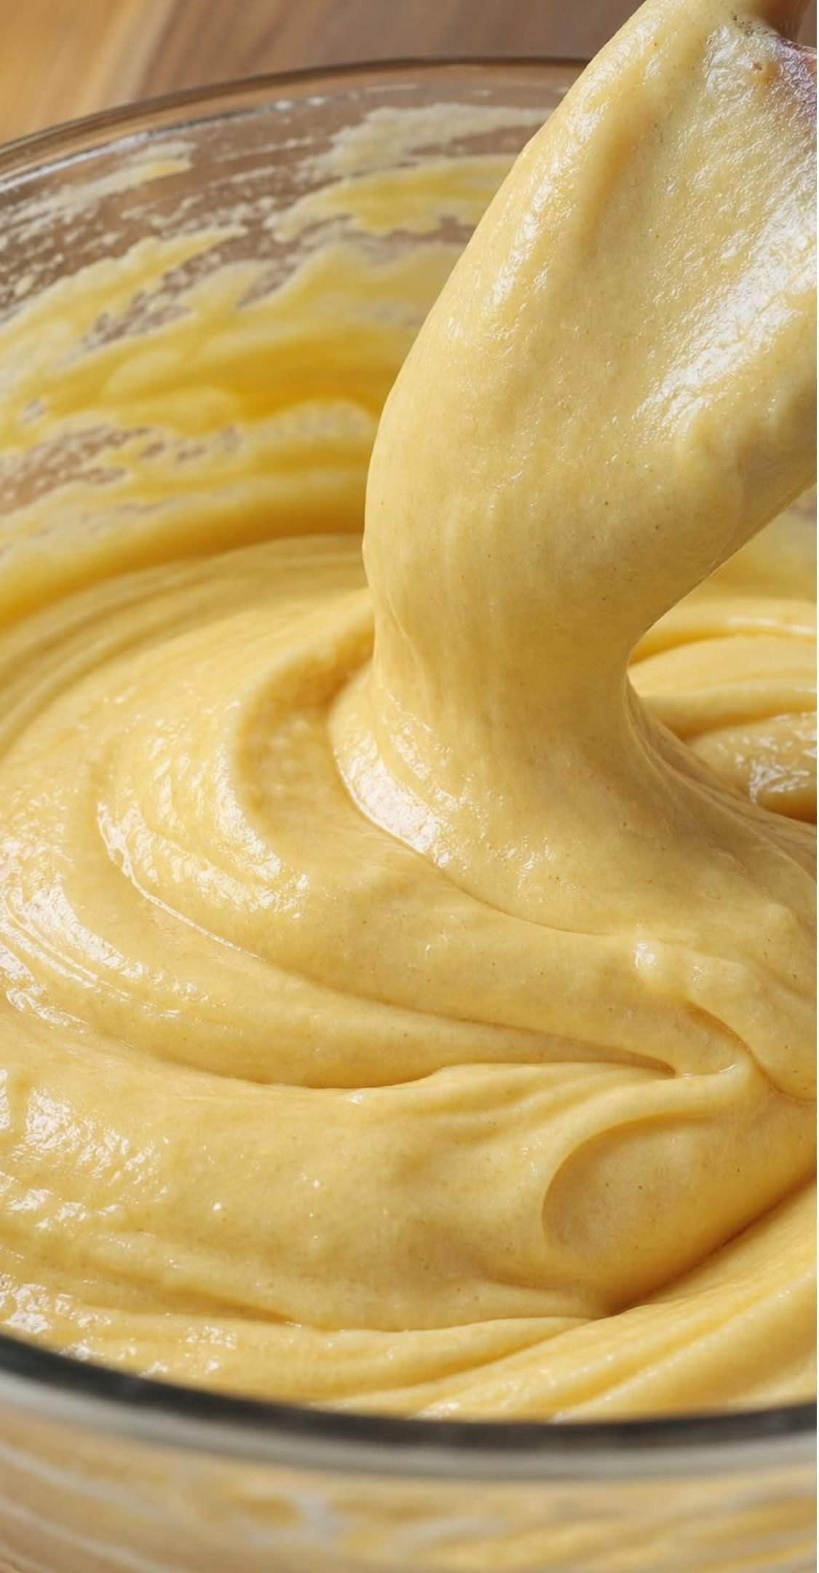
THINK, PAIR, SHARE
Discuss: is the mantle like cake batter?
The textbook says the mantle flows like cake batter. In what ways is that comparison useful, and in what ways could it mislead you?
Useful: both move slowly and in loops when heated from below.
Useful: both are thick, so the motion is smooth rather than splashy.
Misleading: batter is a liquid; the mantle is solid rock.
Misleading: batter turns over in minutes; the mantle takes a hundred million years.
12
Notes:
Give pairs three minutes and then collect. Push for the third point students often miss: batter in a bowl is heated on the outside by the oven, while the mantle is heated from the inside at the core-mantle boundary and cooled at the surface. Then ask for a better analogy. Glacier ice is a good one: solid, creeps downhill, deforms over years. Close with the idea that every analogy is a model that matches in some ways and not others, which is exactly what they will say about their tank in Lab 1.
EXPECTED RESPONSES: Useful for slow looping flow and thickness; misleading about liquid versus solid, about speed, and about where the heat comes from. A glacier or hot asphalt on a summer day are better pictures of a solid that creeps.
CONNECTS TO: Lab 1 model-limits question; W7 misconception repair.
PACING: about 6 min

Slide 13
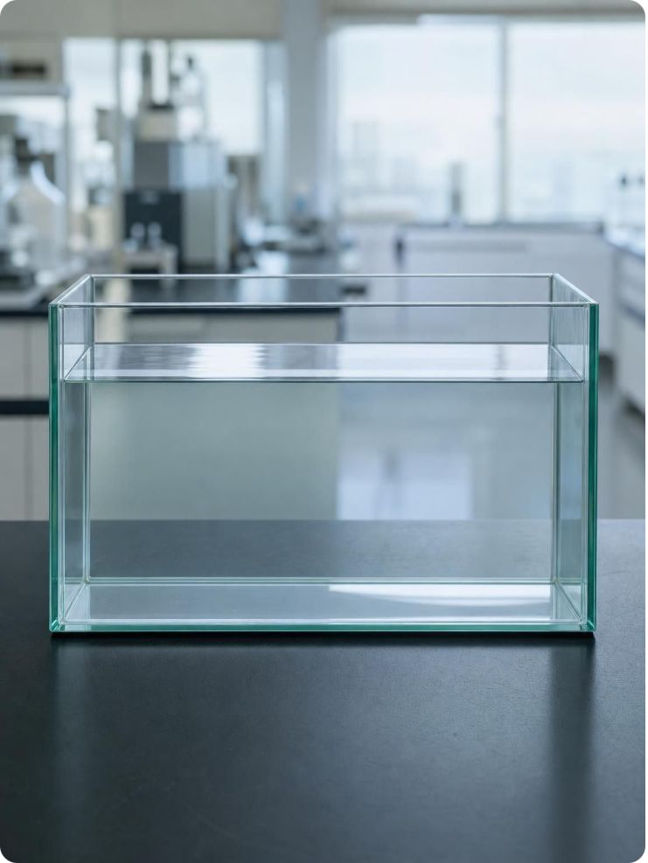
CHECK FOR UNDERSTANDING
Quick check: what starts the loop?
A tank of room-temperature water sits still. Which single change will start a convection loop?
A. Adding food coloring to the bottom
B. Warming the water at the bottom while the top stays cool
C. Warming the whole tank evenly to 40 °C
D. Warming the water at the top while the bottom stays cool
13
Notes:
Vote with fingers, then defend. B is the answer: warm, less dense water at the bottom is pushed up by the cooler water sinking from above. A adds no energy; the dye just spreads slowly by diffusion, which is the control run in Lab 1. C makes everything the same density, so nothing sorts. D is the interesting wrong answer: warm, less dense water at the top is already where gravity wants it, so the layers are stable and the tank just sits in layers. Ask: where in Earth is the heat source, at the top or the bottom? For the mantle, the bottom (the core); for the ocean and air, the bottom too, because the Sun warms the surface, which is the bottom of the atmosphere.
EXPECTED RESPONSES: B. Students who choose D have the 'heat rises' idea without the gravity half; ask them what sinks in their picture.
WATCH FOR: Choosing A shows the belief that dye or 'stuff' moves on its own; the Lab 1 control settles it.
CONNECTS TO: Lab 1 control, warm and hot runs; W5 data worksheet.
PACING: about 4 min

Slide 14
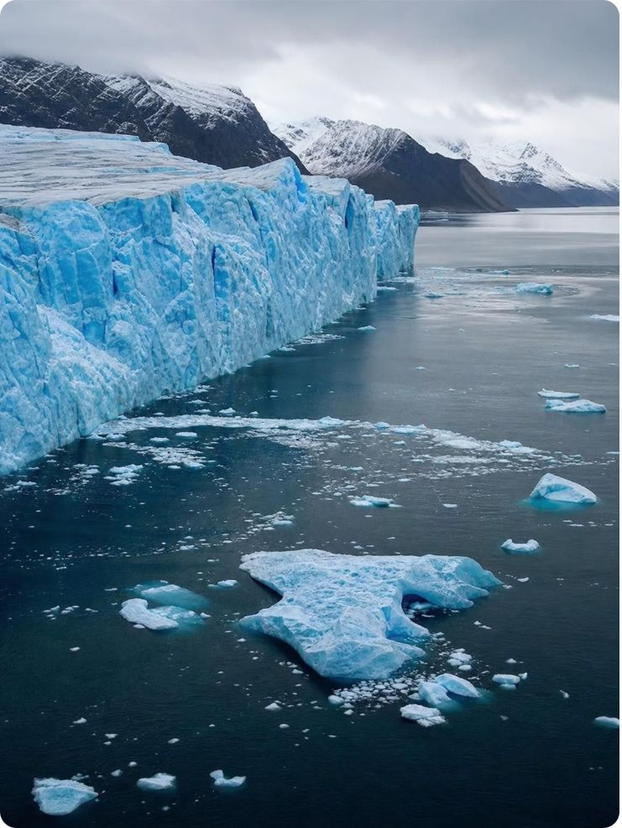
MODEL
The hydrosphere: where Earth's water is
Model: Share of all water on Earth (rounded, USGS)
About 97.5% of Earth's water is salty. Of the small fresh share, most is ice, next most is underground, and only a sliver is in lakes and rivers.
14
Notes:
These are rounded USGS values: about 97.5% salty, 2.5% fresh; of the fresh water about 69% is ice, 30% groundwater and about 1% surface water, which includes rivers, lakes, soil moisture, water vapor and living things. The book's numbers are close but slightly off for lakes and rivers; teach the ranking, not the decimals. The hydrosphere reaches from groundwater several kilometers down to water vapor high in the air, so it overlaps the geosphere and the atmosphere. Ask: which part of the hydrosphere moves fastest, and which slowest? Rivers run in days; the deep ocean loop takes about a thousand years; some groundwater stays put for tens of thousands.
WATCH FOR: Students assume most fresh water is in lakes and rivers because that is the fresh water they see.
CONNECTS TO: W2 vocabulary; W10 mastery item on where fresh water is.
PACING: about 4 min

Slide 15
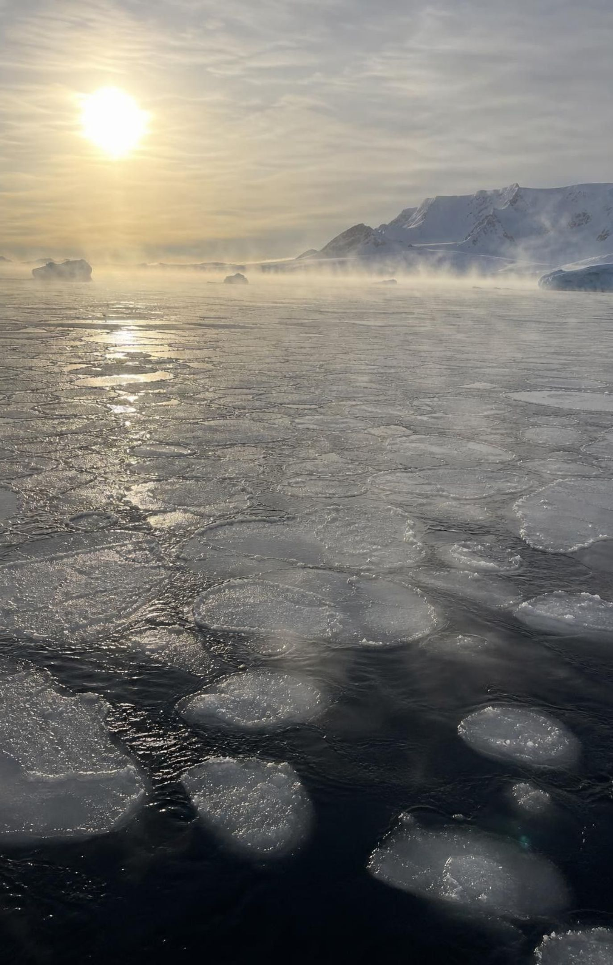
The ocean's slow loop
Sunlight is strongest near the equator, so the ocean surface is warmest there and stays on top.
Near the poles the surface loses energy to cold air, and sea ice forming leaves salt behind.
Cold and salty means dense: that water sinks and creeps along the sea floor toward the equator.
Winds drag the surface water along and help pull deep water back up.
One trip around the whole loop takes roughly a thousand years.
15
Notes:
This is convection with a twist the book leaves out: salt. Temperature alone would do some of the job, but water near the poles sinks hardest where sea ice is forming, because the ice is almost pure water and the salt stays in the liquid, raising its density. Winds, which are themselves driven by the Sun, push the surface currents. The book draws one giant current; the real pattern is a tangle of loops that scientists sum up as the global overturning circulation. Note the energy source: the Sun delivers far more energy to the ocean than Earth's interior does. Also note the condition on 'warm water is less dense': it holds for seawater and for fresh water above 4 °C; between 0 and 4 °C fresh water gets less dense as it cools, which is why lakes freeze from the top. That exception is worth a sentence here and is a good extension.
WATCH FOR: Students may say the Sun's energy reaches the ocean by conduction. It arrives by radiation; conduction then moves it between the water surface and the air.
CONNECTS TO: Lab 2 ocean cards; W3 reading; W8 collaborative sort.
PACING: about 5 min

Slide 16
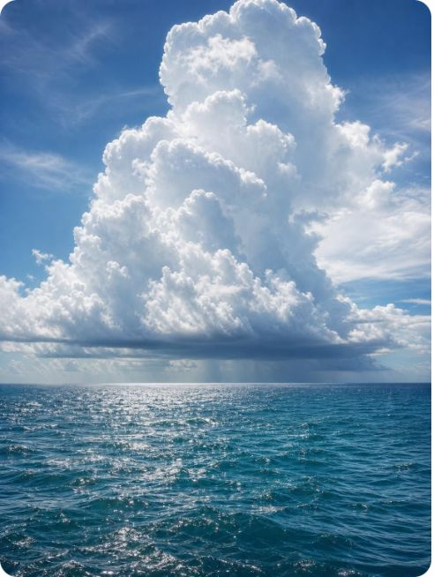
Same loop, three systems
Mantle, ocean, air: the same four-step loop runs in all three, with different energy sources, speeds and materials.
System | What warms the bottom | What cools the top | What moves | Typical speed
Mantle | Heat from the core (interior) | Cool crust and surface | Solid rock, creeping | Centimeters per year
Ocean | Sunlight on the tropical surface | Cold polar air, sea ice forming | Seawater | Centimeters per second in deep flow
Air | Sun-warmed ground and sea | Radiation to space from high, cold air | Air with water vapor | Meters per second
16
Notes:
Have students find what is the same across the rows (warm bottom, cool top, gravity, a loop) and what differs (energy source, material, speed). For the air row, correct a common shortcut: sunlight mostly passes through clear air and is absorbed by the ground and ocean, which then warm the air touching them. So the Sun warms the surface and the surface warms the air; convection in the atmosphere starts at the bottom for that reason. Water rides along: warm air carries vapor up, the air cools as it rises, the vapor condenses into cloud droplets, and gravity brings rain and snow down. That evaporation-condensation-precipitation path is the water cycle you studied in sixth grade, seen here as an energy story.
WATCH FOR: 'The Sun heats the air directly.' Say surface first, air second.
CONNECTS TO: Lab 2 cards cross these rows; W4 diagram worksheet picks one row to model.
PACING: about 5 min

Slide 17
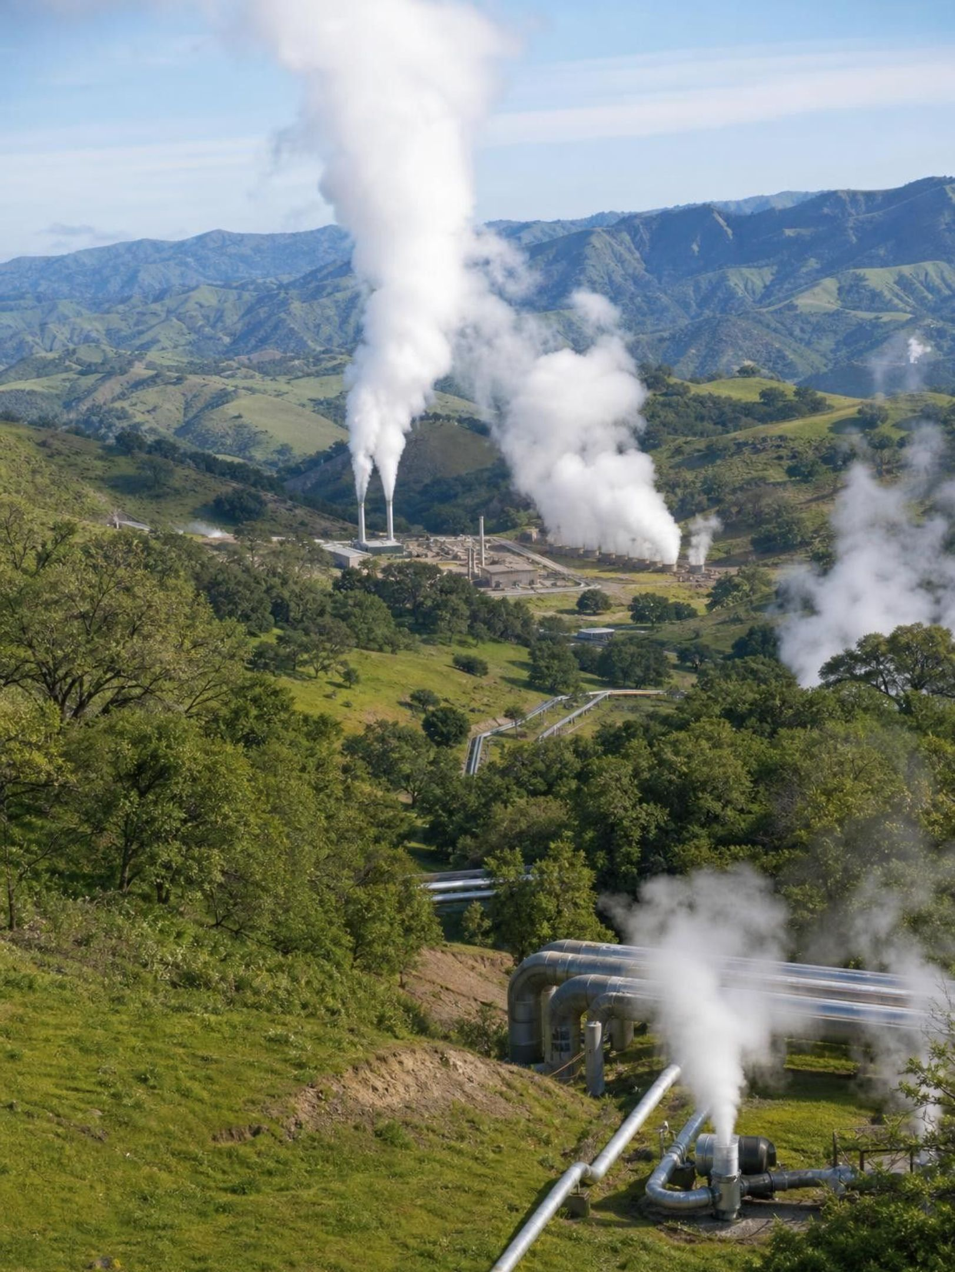
REAL-WORLD CONNECTION
California connection: steam from the ground at The Geysers
In the hills of Sonoma and Lake Counties, about 120 km north of San Francisco, hot rock a few kilometers down turns groundwater into steam. The Geysers geothermal field pipes that steam to turbines and generates roughly 700 megawatts, the largest geothermal complex in the world. Because the steam was running low, Santa Rosa now pumps treated wastewater back into the rock to keep the cycle going.
17
Notes:
This is energy from Earth's interior being used directly in California. The heat comes from a body of hot rock beneath the field, left from past volcanic activity; water seeping down through cracks is heated and returns as steam, a small convection loop that people tap. Ask: which two of the four systems meet here, and which transfer mechanisms are at work? (Geosphere and hydrosphere; conduction from the hot rock into the water, convection as the steam rises.) The wastewater pipeline from Santa Rosa, running since 2003, is a nice engineering point: the heat was still there, but the matter, water, was being used up faster than rain replaced it. Lab 3 asks students to choose a drilling site for a plant like this using borehole data.
CONNECTS TO: Lab 3 borehole decision; W9 transfer task.
PACING: about 4 min

Slide 18
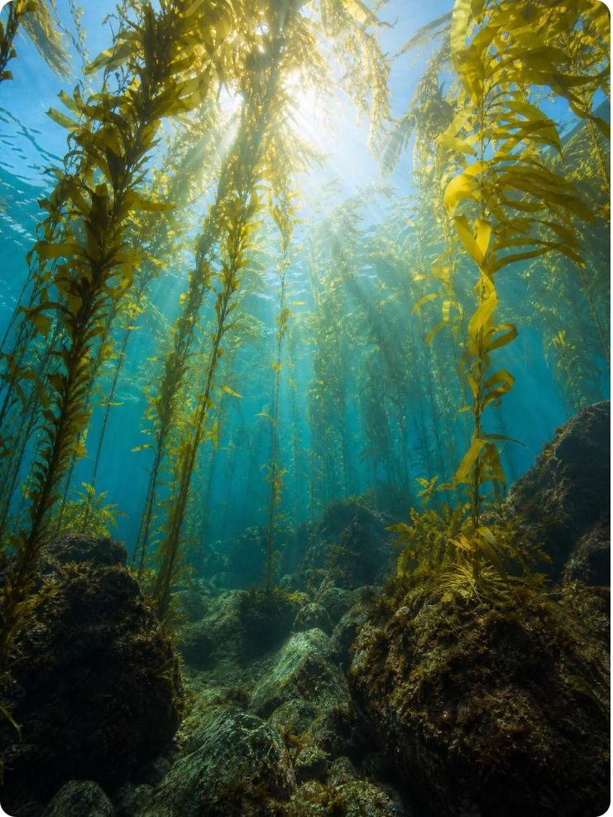
CHECK FOR UNDERSTANDING
Quick check: Sun or interior?
For each process, name the main energy source: the Sun or Earth's hot interior.
A. Mantle rock slowly rising under the middle of the Atlantic Ocean
B. A thunderstorm building on a hot afternoon
C. Cold, salty water sinking near Antarctica
D. Steam rising from the ground at The Geysers
E. A kelp forest growing off Monterey
18
Notes:
Whiteboards, one minute, then poll each item. A and D are interior; B, C and E are the Sun. Item C surprises some students because sinking cold water seems to have nothing to do with sunlight; the point is that the Sun warms the tropics and the contrast with the cold poles drives the loop. Mention that the Moon's gravity adds a small third source, tidal energy that helps stir the deep ocean, so 'nearly all' energy in Earth's systems comes from the two sources. Item E previews the biosphere: the kelp captures sunlight.
EXPECTED RESPONSES: A interior, B Sun, C Sun, D interior, E Sun.
WATCH FOR: Students assign the ocean loop to the interior because the deep sea is 'near the hot rock.' The seafloor warms the ocean very little compared with the Sun.
CONNECTS TO: Lab 2 energy-source tags; W8 collaborative sort; W10.
PACING: about 4 min

Slide 19

THINK, PAIR, SHARE
Discuss: a candle on the space station
Astronauts on the International Space Station are in constant free fall, so nothing there sinks or floats. Predict what a candle flame looks like on the station, and what that tells you about convection on Earth.
19
Notes:
Give pairs three minutes. The real result: the flame is a small, dim, blue sphere, because with no sinking and rising there is no convection to carry away hot exhaust and bring in fresh air; it burns slowly on what diffuses in. On Earth the flame is tall and yellow because the hot gas is pushed up by cooler, denser air and the flame pulls in fresh air at its base. The lesson: convection is not 'heat rising'; it is gravity sorting dense from less dense. Now return to the phenomenon prediction: turn off the heater and the loop fades as the room evens out, because there is no density difference left for gravity to sort. Ask for a second prediction: a sealed room with the window just as warm as the heater? No loop at all.
EXPECTED RESPONSES: Flame becomes a round blue ball and burns weakly; without gravity nothing sinks, so no convection; on Earth the loop needs both a temperature difference and gravity. Heater off: loop stops once the room is uniform.
WATCH FOR: 'Hot gas rises because it wants to go up.' Push for who is pushing it.
CONNECTS TO: Lab 1 debrief; W7 misconception repair.
PACING: about 6 min

Slide 20
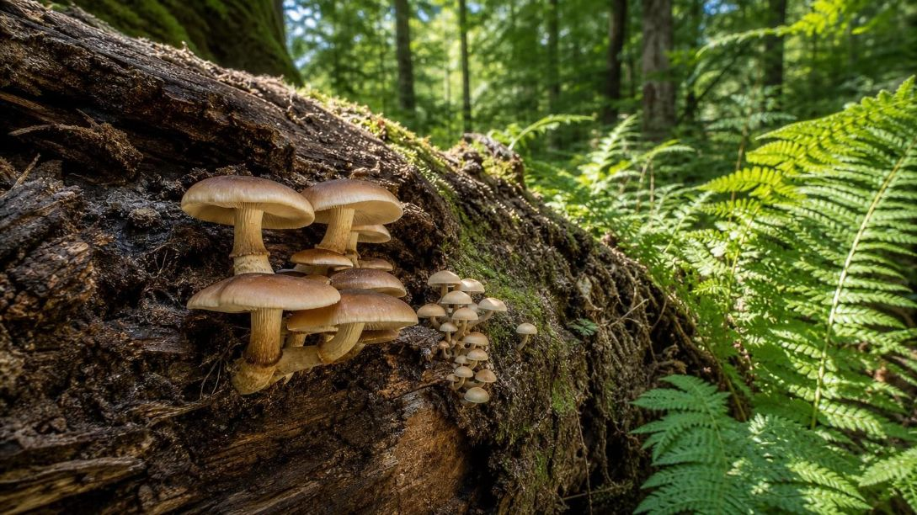
MODEL
The biosphere: energy flows through, matter goes around
Model: Following the Sun's energy through living things
1
2
3
4
5
Sunlight (radiation) → (captured)
Producers capture it and store it in food → (eaten)
Consumers eat and use it → (broken down)
Decomposers break down remains → (lost as heat)
Heat leaves at every step and radiates to space
Matter (carbon, nitrogen, water) loops from decomposers back to producers. Energy does not loop; it enters as sunlight and leaves as heat.
20
Notes:
Draw the matter loop on the board as a second line: decomposers release carbon dioxide and nutrients, which producers take up again. Then draw the energy line as a one-way street with a heat exit at every organism. The textbook labels its arrow from decomposers back to producers 'energy and matter'; that is a shortcut we will not use, because plants get fresh energy only from the Sun. Ask: in Lesson 6, what fraction of energy moved from one level to the next? Most was lost as heat, which is why the energy line cannot loop. Also say 'nearly all' food chains start with sunlight; deep-sea vent communities run on chemical energy from the geosphere instead.
WATCH FOR: Energy recycling. Also the idea that decomposers 'give energy back' to soil.
CONNECTS TO: Slide 25 check; W7 misconception repair; L06 Food Webs.
PACING: about 5 min

Slide 21

Crossing the borders between systems
Model
Model: Energy and matter moving between Earth's four systems
Center: Earth's systems: two energy inputs, one energy exit, matter looping
Sun to hydrosphere and geosphere: Radiation warms the ocean surface and the ground; the surface then warms the air.
Interior to geosphere: Heat from the core drives slow mantle convection; rising rock partly melts and erupts as lava and ash.
Hydrosphere to atmosphere: Water evaporates into warm rising air; vapor condenses into clouds; rain and snow fall under gravity.
Atmosphere to biosphere: Producers take in carbon dioxide; every organism breathes gases back out.
Biosphere to geosphere: Shells and dead organisms settle into sediment; roots break rock into soil.
Earth to space: The only exit: infrared radiation from the surface and the air, balancing the sunlight that comes in.
Matter stays on Earth and loops; energy comes in from the Sun and the interior and leaves as infrared light.
21
Notes:
This map is the big picture of the lesson and the skeleton of Lab 2. Point to the two inputs and the one exit. Ask students to find a path that starts in the geosphere and ends in the atmosphere (volcano to ash to air; or hot rock to geyser water to vapor). Then ask what would happen if the exit were partly blocked: Earth would warm until the exit balanced the inputs again, which is a preview of the greenhouse idea without going into it. Close by naming the two crosscutting concepts: energy and matter, and systems and system models.
EXPECTED RESPONSES: Paths such as volcano to air, ocean to cloud to rain to river to ocean, sunlight to kelp to otter to decomposers to carbon dioxide to air.
CONNECTS TO: Lab 2 string-and-card model; W8 collaborative evidence sort.
PACING: about 5 min

Slide 22
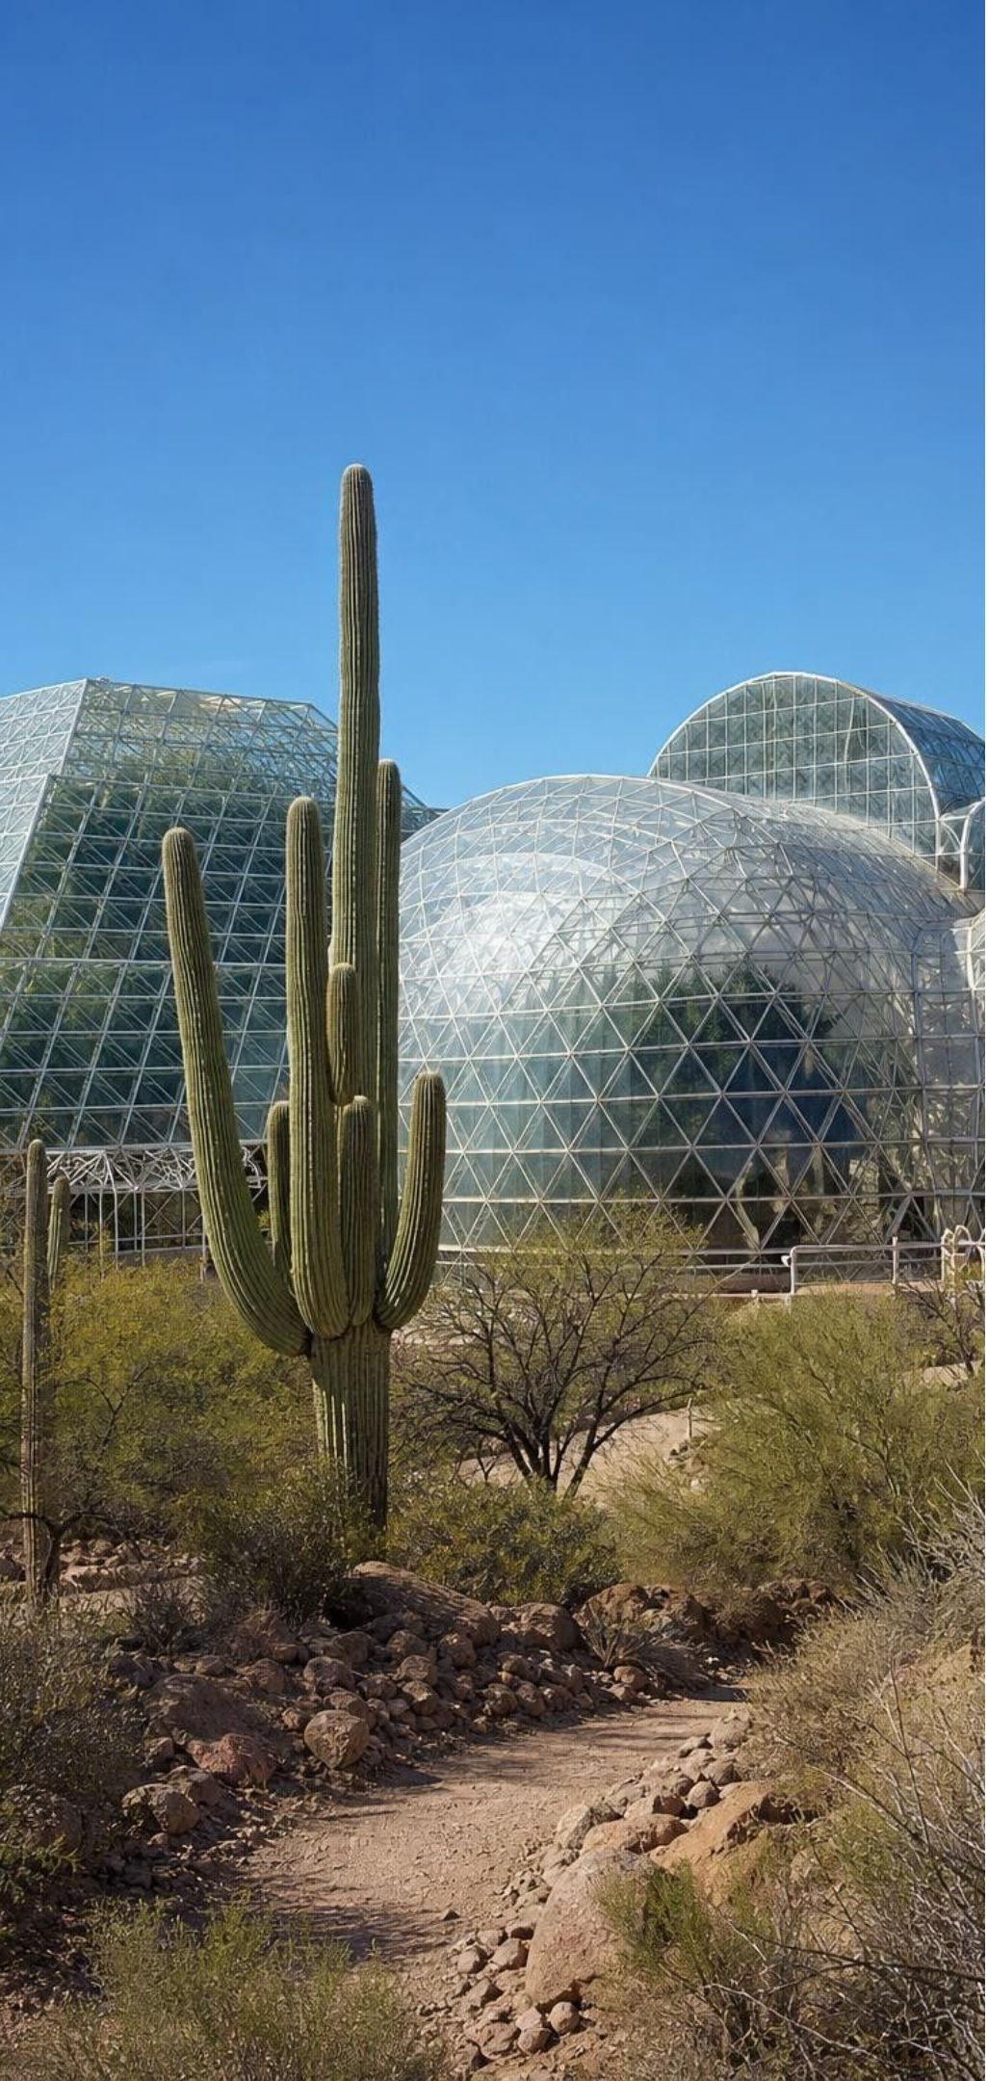
Task: what the oxygen data told the Biosphere 2 team
Apply it
Simulated data for practice.
Biosphere 2 was sealed with eight people inside in September 1991. Use the oxygen readings below to decide when the model started to fail, propose a cause, and plan the next test.
Months since sealing | Oxygen in the air (%) | Crew notes
0 | 20.9 | Sealed; plants and animals in place
4 | 19.5 | Winter: short days, less sunlight
8 | 18.2 | Soil kept moist for crops
12 | 16.9 | Crew tired on stairs
16 | 14.5 | Crew short of breath; medical review
17 | 19.0 | Oxygen pumped in from outside
22
Notes:
This is a teaching dataset: the start and 16-month values are close to reported figures (about 21% down to about 14%), and the middle rows are smoothed. Give groups eight minutes. Step 1: describe the trend (a steady fall of about 0.4 percentage points per month). Step 2: what in a sealed building consumes oxygen? People and animals breathing, but also soil microbes decomposing the rich organic soil, which turned out to be the main cause. Step 3: what should have risen if oxygen was being used up by respiration? Carbon dioxide; it rose far less than expected, which puzzled the team. The missing carbon dioxide was being absorbed by the building's exposed concrete. Step 4: next test. Students should propose measuring soil respiration directly, sealing or coating concrete, or changing the soil. The team eventually pumped in oxygen (row 6). Connect to the engineering idea: the model generated data, the data exposed a problem, and the next design changed. Also stress that Biosphere 2 was closed to matter but open to energy; sunlight came in through the glass and heat left, so it was never a closed system for energy.
EXPECTED RESPONSES: Trend: oxygen falls about 0.4 points per month, reaching a dangerous 14.5% at 16 months. Cause: oxygen used faster than plants replaced it; strong answers name soil microbes and ask where the carbon dioxide went. Next test: measure gas exchange from soil samples, compare rooms with and without exposed concrete, or reduce soil organic matter. Row 6 shows the stopgap fix, not the root fix.
WATCH FOR: Students may conclude the plants 'stopped working.' Plants did make oxygen; consumption simply outran production, especially in winter.
CONNECTS TO: W6 CER on sealed-jar oxygen data; W9 transfer task designs a sealed tub model and a test plan; Lab 2 perturbation question.
PACING: about 10 min

Slide 23
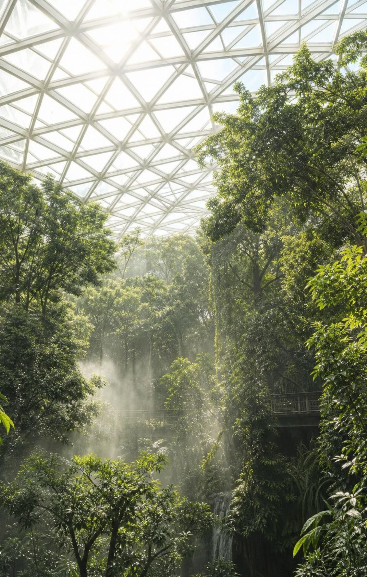
Biosphere 2: a model you can live inside
A conceptual model is a diagram or equation; a physical model is a built, testable copy at smaller scale.
Biosphere 2 in Oracle, Arizona, was a glass-sealed physical model: rainforest, ocean, desert, farm.
Closed to matter, open to energy: sunlight came in through the glass and heat went out.
Its data exposed a problem the designers had not predicted, and the next version changed.
Today the University of Arizona runs it as a research site for climate and ecosystem experiments.
23
Notes:
Tie this to Lab 2, where students will build a conceptual model, and Lab 1, where the tank is a physical model. Both kinds have limits, and the test is whether the model's behavior matches the real system's. Ask: what is one thing the Biosphere 2 building could not model about the real Earth? Answers include no mantle or interior heat, no weather from space-cooled air, a tiny ocean, and no way to lose matter. Avoid the textbook's claims that it was the first artificial biosphere or that it brought space colonization closer; those are not supported by evidence we can show. What it did show is the value of iteration: test, read the data, modify, test again.
WATCH FOR: 'Closed system means nothing gets in or out.' Energy crossed the glass every day.
CONNECTS TO: W9 transfer task; Lab 2 model-limits question.
PACING: about 4 min

Slide 24
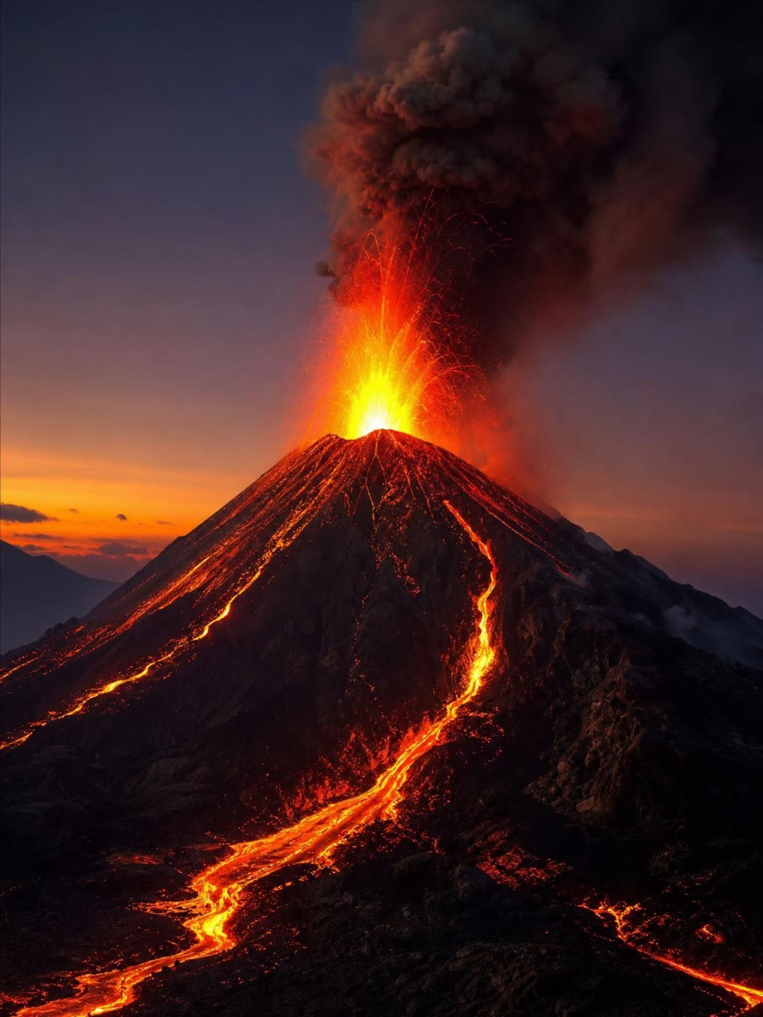
MISCONCEPTION CHECK
True or false? Volcanoes prove the mantle is liquid
"Lava is liquid rock that comes from the mantle, so the mantle must be a sea of liquid magma with the crust floating on top."
True or false? Explain your reasoning.
24
Notes:
Ask students to evaluate the statement in writing with evidence from the lesson. The claim is false. Earthquake waves that cannot travel through liquids pass through the mantle, which shows it is solid. Mantle rock convects by creeping a few centimeters per year while staying solid, like glacier ice. Magma forms only where rising hot rock reaches lower pressure near the surface or where water lowers the melting point, so it is a local, partial melt, not the normal state of the mantle. The crust rides on solid rock that moves slowly, which is the subject of Lesson 16. Have two or three students read their evaluations aloud and ask the class to add one piece of evidence to each.
EXPECTED RESPONSES: False. The mantle is solid and flows slowly; lava comes from small pockets of melt; evidence includes earthquake waves passing through and the centimeters-per-year speed.
WATCH FOR: Students may swing to 'the mantle never moves.' It moves, slowly and solid.
CONNECTS TO: W7 misconception repair; L16 Earth's Tectonic Plates.
PACING: about 6 min

Slide 25

CHECK FOR UNDERSTANDING
Quick check: fix the arrow
A diagram shows an arrow from decomposers back to producers labeled 'energy and matter.' What should the label say, and why?
A. Energy only; decomposers give plants the energy they need
B. Matter only; energy leaves organisms as heat and plants get new energy from the Sun
C. Energy and matter; both are recycled in a food chain
D. Nothing; decomposers do not connect to producers
25
Notes:
Vote, then ask a student who chose B to explain where the energy went. The answer is B: decomposers return carbon dioxide, water and nutrients to the soil and air, which producers use to build new material, but every organism, including decomposers, loses energy as heat, and the only fresh energy producers get is sunlight. Point out that this check is also about reading models critically: the textbook's own diagram uses the shortcut label.
EXPECTED RESPONSES: B. Students choosing C are reading the textbook figure literally; ask what fraction of energy reached each next level in Lesson 6.
WATCH FOR: Energy as a substance that can be stored in soil and handed back.
CONNECTS TO: W7 misconception repair; W10 mastery.
PACING: about 4 min

Slide 26

Putting it together
Putting it together
Earth has four overlapping systems: rock and metal, water, gases, and life plus where it lives.
Two energy inputs, the Sun and the hot interior; one exit, infrared radiation to space.
Heating lowers density; gravity sinks the denser material; the result is a convection cell.
The same loop turns the solid mantle, the ocean and the air at wildly different speeds.
Matter cycles; energy flows through and leaves as heat.
A physical model earns trust by being tested, and its data decide what to change next.
26
Notes:
Have students write a three-sentence explanation of the window draft using at least four vocabulary terms (density, gravity, convection, conduction, radiation are all available), then swap with a partner who checks that both legs of the loop appear. Ask for one takeaway from each lab: Lab 1 (what the control vial showed), Lab 2 (one cross-system link), Lab 3 (which site and why). Preview Lesson 11: the energy that moves rock and water also reshapes Earth's surface, sometimes slowly and sometimes in a single afternoon.
CONNECTS TO: W10 mastery as the quiz; L11 Scales of Change on Earth's Surface next.
PACING: about 6 min

Slide 27
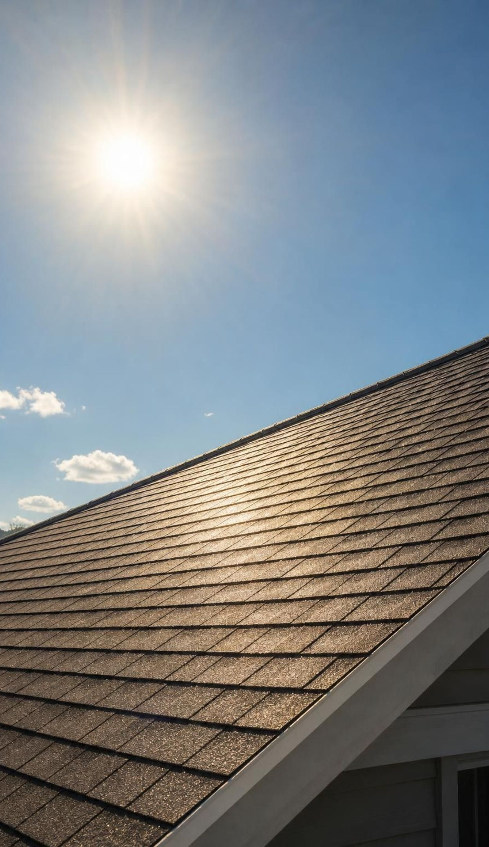
Exit ticket
Exit ticket
Explain the window draft in two sentences that use the words density and gravity.
Name the main energy source for mantle convection and for ocean convection.
A spoon handle gets hot in soup; sunlight warms a roof; soup turns over in the pot. Name each transfer.
Why can energy not loop from decomposers back to plants the way carbon does?
What did the Biosphere 2 oxygen data tell the designers to change?
27
Notes:
Collect on index cards or a shared form. Use item 1 to spot 'heat rises' with no gravity, item 2 for the energy-source target, item 3 for the three mechanisms, item 4 for the energy-flow idea, and item 5 for the engineering strand. Sort the cards into piles before the next class and reteach from the largest pile.
EXPECTED RESPONSES: 1: air cooled by the glass becomes denser and gravity pulls it down the window and across the floor, pushing warm, less dense air up at the heater; the loop is convection. 2: interior heat for the mantle; the Sun for the ocean. 3: conduction, radiation, convection. 4: every organism loses energy as heat and plants can only capture new energy from sunlight; carbon atoms are not used up, so they can be reused. 5: oxygen was being used faster than it was made, so they had to find the consumer (soil microbes) and the missing carbon dioxide (absorbed by concrete), and in the short term add oxygen.
WATCH FOR: Item 1 answers with 'hot air rises' and nothing sinking; item 4 answers that energy is 'stored in the soil.'
CONNECTS TO: W10 mastery; chapter evidenceOfLearning.
PACING: about 5 min

