Slide 1
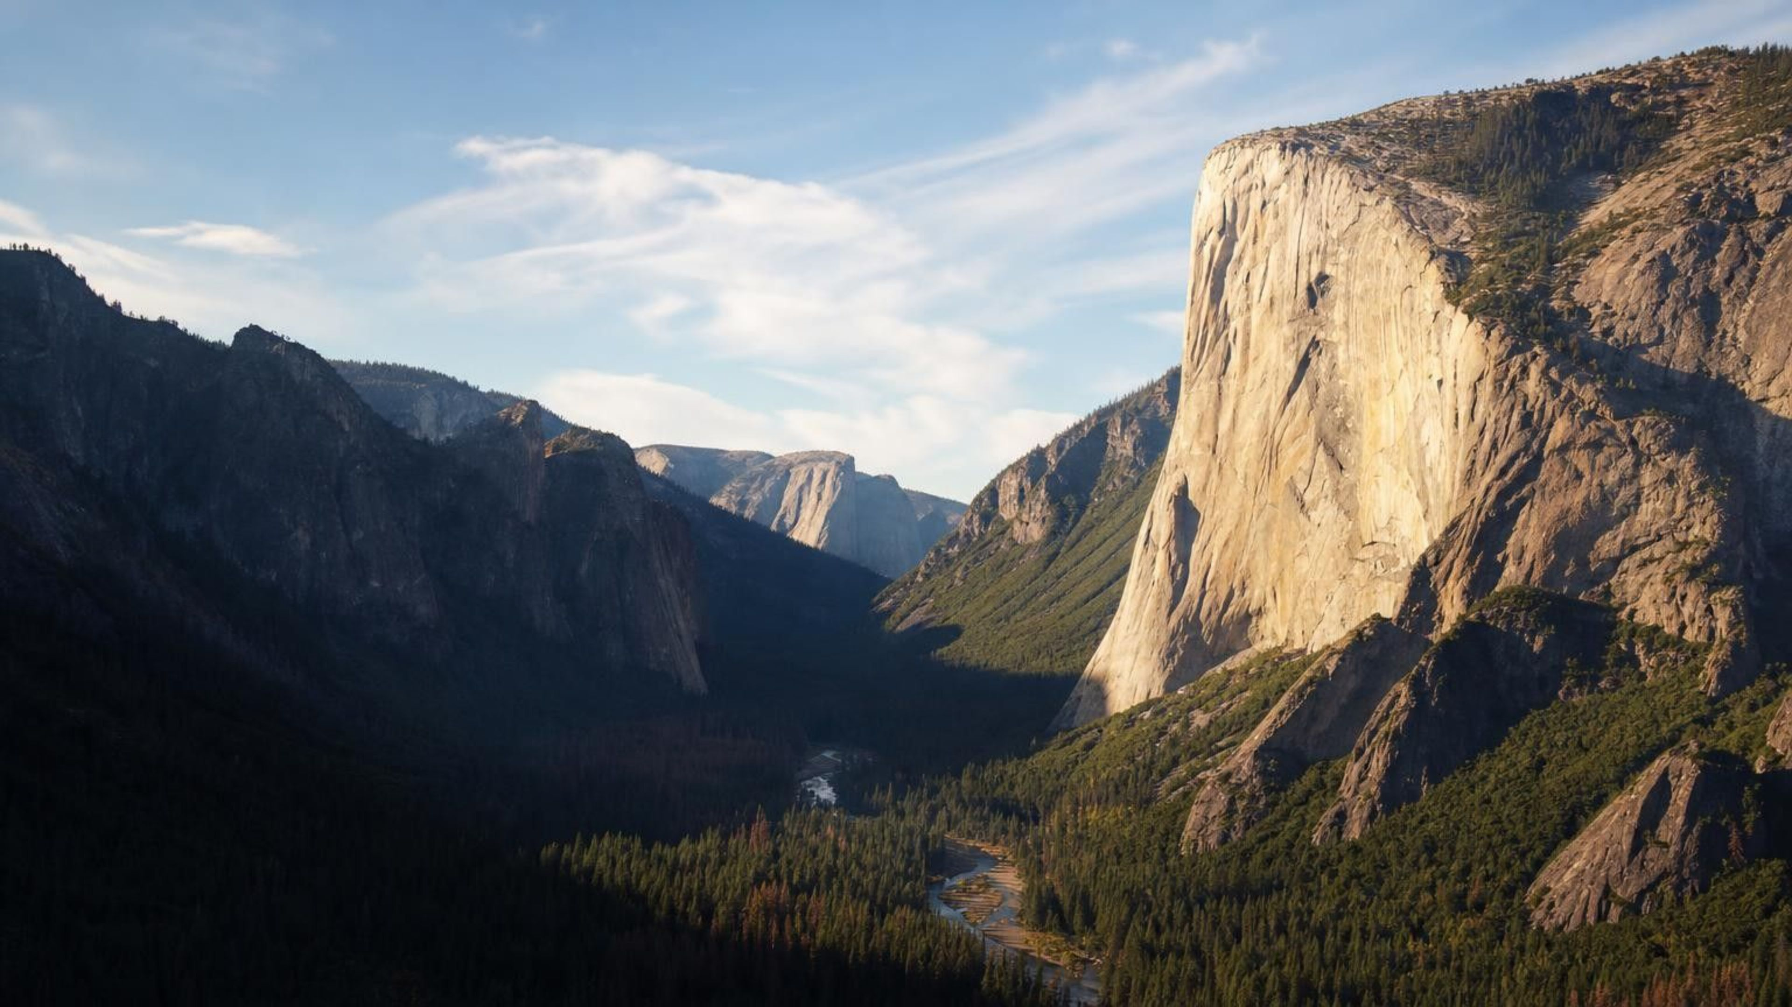
Chapter 11: Scales of Change on Earth's Surface
Chapter 11 of 29 · Earth's Systems
Lesson 11: How does Earth's surface change, and how do we compare changes of every size and speed?
Angela's Wand · Bring Science Alive! 7th Grade Integrated
Notes:
Open by asking who has seen a landscape change: a flooded street, a crack in a sidewalk, a cliff that fell. Tell students that this lesson gives them two rulers, one for size and one for time, so they can compare a beetle's footprint with the carving of a canyon and the planet-wide cooling after an asteroid hits. Preview the three investigations: a crystal that grows while they are not looking (Lab 1), a valley whose history they must reconstruct from evidence cards (Lab 2), and a walk around the school grounds to measure how fast their own campus is changing (Lab 3). Tell them the crystal lab starts next period and will run for a week, so they will be measuring something that changes too slowly to watch.
CONNECTS TO: Overview of Lab 1, Lab 2 and Lab 3; W1 opens with the next slide.
PACING: about 2 min

Slide 2
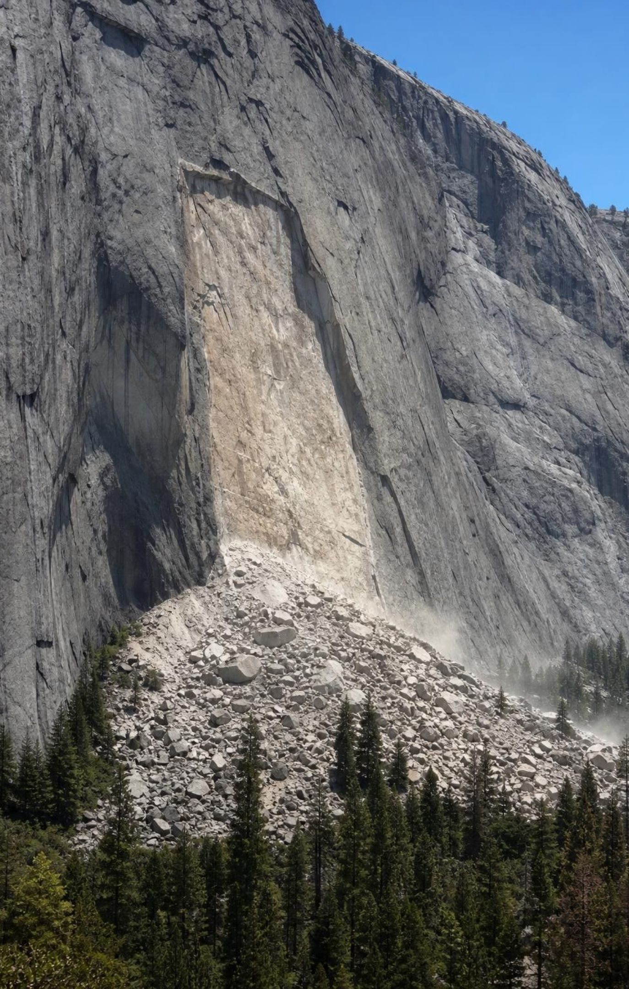
PHENOMENON
A century of nothing, then ten seconds of change
A granite cliff in Yosemite Valley matches photographs taken more than a hundred years ago. One afternoon a slab the size of a classroom peels off, falls for about ten seconds and leaves a pale scar. The valley around it, nearly a kilometer deep, was carved by glaciers that melted away about fifteen thousand years ago. Both changes are still going on.
Notice: what changed in ten seconds? What stayed the same for a hundred years?
Wonder: what was happening inside the cliff during the hundred quiet years?
Predict: which change was bigger, and which was faster? Do big and fast go together?
2
Notes:
Describe the scene slowly. Yosemite's granite walls shed slabs because water gets into cracks behind the surface, freezes, expands and pries, year after year, until a sheet is held on by almost nothing. Then one warm afternoon, or one cold night, or nothing you could point to, it lets go. The park documents dozens of rockfalls in a typical year. The valley itself is a different story: ice filled it during several ice ages, scraped the floor and walls for thousands of years at a time, and left when the last glacier melted back about fifteen thousand years ago. Have students write a notice, a wonder and a prediction on W1 before anyone talks. Then collect predictions on the board under two headings, bigger and faster, and leave them up for the whole lesson. Do not resolve the question today; slide 16 and the misconception slide come back to it.
EXPECTED RESPONSES: Notice: the slab fell fast, the cliff looked unchanged before. Wonder: why then, was it cracking inside, is the valley still changing. Predict: most will say the valley carving was bigger and slower, the rockfall smaller and faster; a few will argue the rockfall was 'the real change' because it was visible.
WATCH FOR: 'Nothing happened for a hundred years.' Park that claim on the board; the misconception slide tests it at the end.
CONNECTS TO: W1 phenomenon worksheet; W6 CER returns to this evidence.
PACING: about 6 min

Slide 3
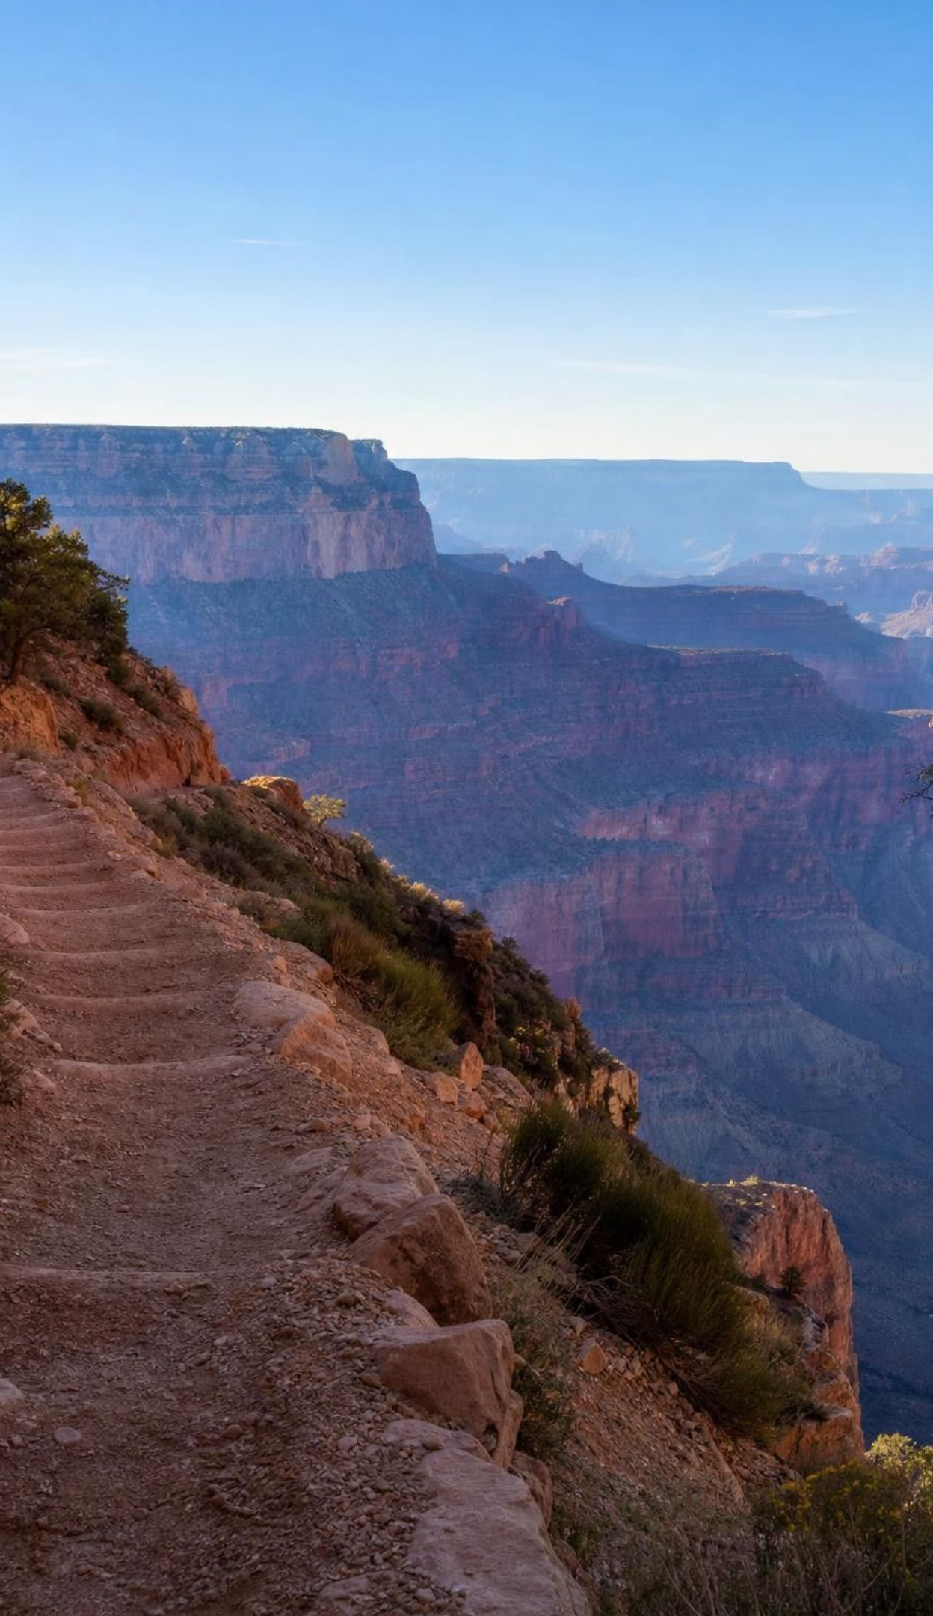
LEARNING TARGETS
What you will be able to do
1
Tell apart weathering, erosion, deposition and uplift, and name what drives each.
2
Place a change on a space scale and a time scale, and explain why both are needed.
3
Calculate a rate of change and use it to predict a big change or a long time.
4
Explain, with evidence, how slow processes and sudden events together reshape a landscape.
5
Use uniformitarianism to read the past, and say what it does and does not claim.
3
Notes:
Read the targets aloud. Point out that target 1 is vocabulary they will use every day this week, targets 2 and 3 are the two rulers and the math that goes with them, target 4 is the Yosemite question, and target 5 is a big idea about how geologists think. Ask students to star the one that sounds hardest. Tell them every lab produces a rate (target 3) and every lab ends with an explanation (target 4).
CONNECTS TO: Targets map to W2 (1), Lab 2 and W4 (2), Lab 1, Lab 3 and W5 (3), W6 and W9 (4), W7 and W10 (5).
PACING: about 2 min

Slide 4
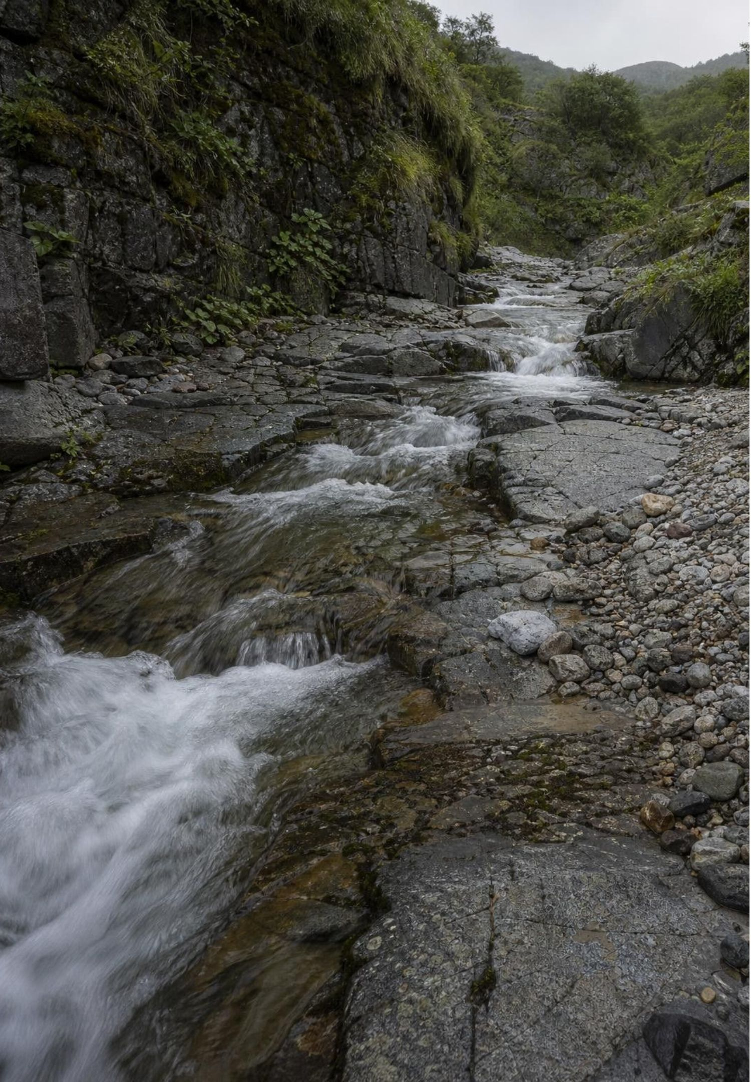
Earth's surface is a work in progress
Rock looks permanent, but every surface you can touch is being broken down, moved and rebuilt.
Weathering breaks rock apart where it sits. Erosion carries the pieces. Deposition drops them somewhere new.
Uplift pushes large areas of crust upward from below, usually very slowly.
The agents: water, ice, wind, gravity, living things and chemical reactions.
4
Notes:
Use three hand motions and keep them all week: break (fists apart) for weathering, carry (sweep) for erosion, drop (open hand down) for deposition. Add lift (palms rising) for uplift. Ask: if a boulder splits in two on a flat field and never moves, which process happened? Weathering only. If a river carries sand that was already loose, which process? Erosion only. The point is that the words name different jobs, even though in real landscapes they usually happen together. Mention that uplift is the one that builds up instead of wearing down, and that without it the other three would eventually flatten every continent.
EXPECTED RESPONSES: Boulder splitting: weathering. River carrying loose sand: erosion. Students should be able to give one example of each process from the phenomenon slide: frost prying the slab (weathering), the slab falling (erosion by gravity), the rubble pile at the base (deposition).
WATCH FOR: Weathering and erosion used as one word. Insist on the test: did the rock break (weathering) or did it move (erosion)?
CONNECTS TO: W2 vocabulary relationships; Lab 2 evidence cards each name one process.
PACING: about 5 min

Slide 5
Vocabulary in context
Three verbs for rock: break, carry, drop
weathering: Breaking rock down where it sits, by physical forces or by chemical reactions. Frost splits a boulder; roots widen a sidewalk crack; acidic rain dissolves limestone.
erosion: Picking up loosened rock material and moving it, by water, wind, ice or gravity. A muddy stream after a storm is erosion you can see; a glacier hauling boulders is erosion you cannot.
deposition: Dropping carried material in a new place when the water, wind or ice slows or stops. A gravel fan where a canyon opens onto a valley; a sand dune; mud on a flooded floor.
5
Notes:
Have students copy the three definitions in their own words and add the hand motion next to each. Then play 'which verb': you name a scene, they show the motion. Mud left on a floor after a flood (drop). Wind sandblasting a cliff face (break). A landslide sliding (carry). A beetle's feet grinding sand grains smaller (break). Push on the beetle: living things weather rock too, physically with roots and feet and chemically with acids from lichens. Point out that chemical weathering makes new substances, not just smaller pieces: dissolved limestone leaves as ions in water.
WATCH FOR: Students may think weathering is about weather (rain and wind). Weather is often the cause, but the word means breakdown of rock, including by roots and chemistry.
CONNECTS TO: W2 vocabulary; W10 mastery.
PACING: about 4 min

Slide 6
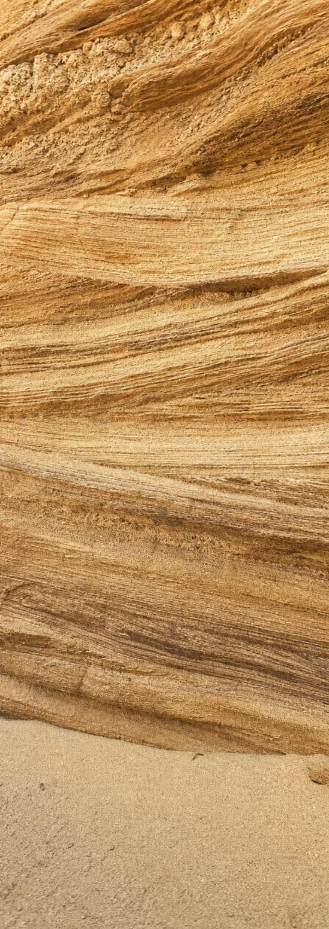
One sand grain's long journey
Model
Model: From cliff to sandstone and (eventually) back again
Solid rock on a cliff → (weathering (frost, roots, grinding, chemistry))
Loose grains → (erosion (wind, water, ice, gravity))
1
2
Grains on the move → (deposition (the carrier slows down))
Grains settle in a dune or river bed → (compaction (weight of layers above))
3
4
Buried and squeezed → (cementation (minerals from groundwater))
Glued into sandstone
5
6
One of many paths. Uplift can raise the sandstone into a new cliff and the journey starts over; that full loop is the rock cycle in Lesson 17.
6
Notes:
Trace one grain through the chain. Stress the two steps at the end, because the textbook blurs them: burial squeezes the grains together (compaction), but what turns loose sand into rock is minerals carried by groundwater that are left behind between the grains and glue them (cementation). Ask how long the whole journey might take: the grain can be weathered loose in a winter, travel down a river in a season, sit in a dune for centuries, and need millions of years of burial to become sandstone. Then ask what could put the sandstone back on a cliff. Uplift. That closes the loop they will study fully in Lesson 17.
EXPECTED RESPONSES: Students should name the process on each arrow without looking, and say that cementation, not weight alone, makes rock.
WATCH FOR: 'Pressure alone turns sand into stone.' Compaction packs; cementation glues.
CONNECTS TO: W4 diagram worksheet; Lab 2 card on the layered sandstone.
PACING: about 5 min

Slide 7
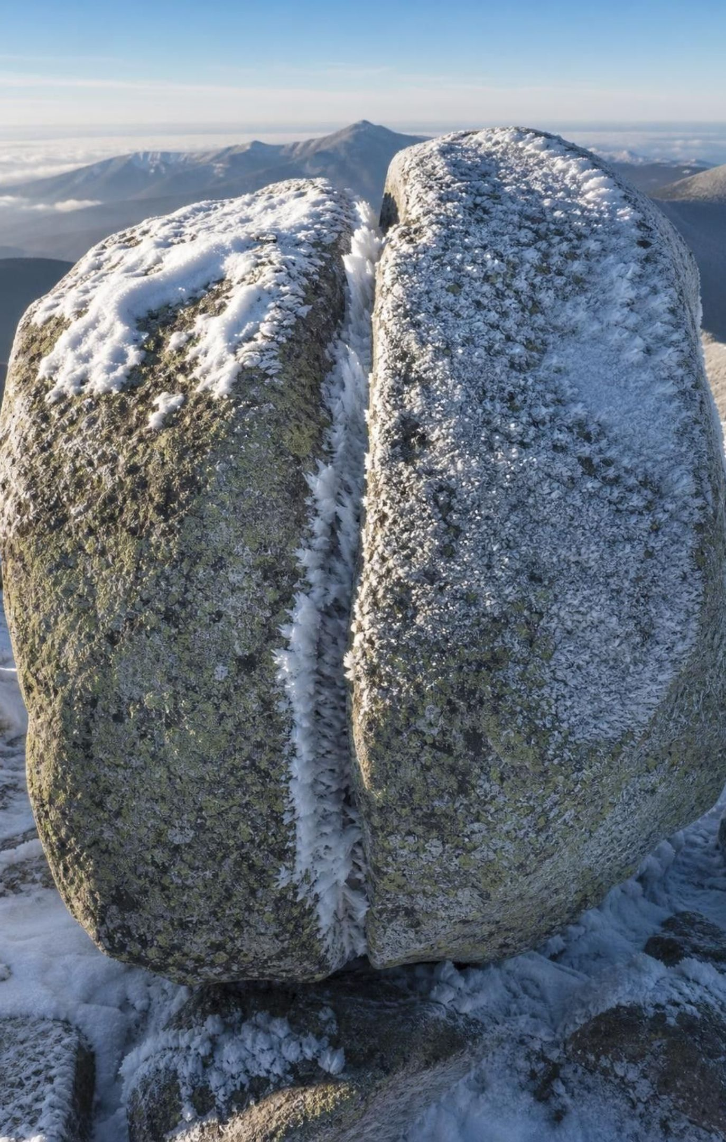
CHECK FOR UNDERSTANDING
Quick check: which process?
A stream drops gravel where it reaches a flat valley. Frost splits a boulder on a ridge. Which pair names these two events, in order?
A. Erosion, then weathering
B. Deposition, then weathering
C. Deposition, then erosion
D. Weathering, then deposition
7
Notes:
Vote with fingers. The gravel is dropped, so the first event is deposition; the boulder breaks in place, so the second is weathering. Students who pick A are reading 'stream' and jumping to erosion; ask them what the stream did with the gravel (it stopped carrying it). Follow up: what had to happen before the stream could drop gravel? It had to carry it (erosion), and before that the gravel had to be broken loose (weathering). The three verbs come in order for any one grain.
EXPECTED RESPONSES: B, Deposition, then weathering.
WATCH FOR: Any mention of a stream read as erosion. The test is what the material did: moved (erosion) or settled (deposition).
CONNECTS TO: W2 and W10 reuse this distinction.
PACING: about 4 min

Slide 8
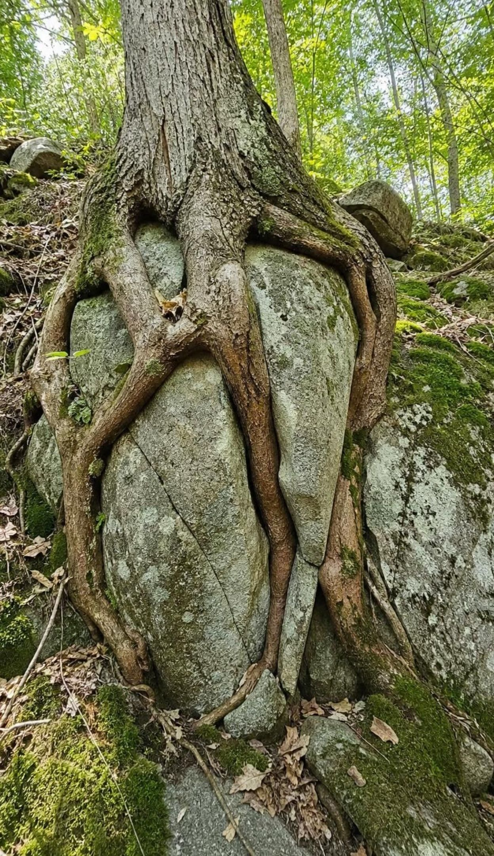
Who does the breaking and the moving?
Water dissolves some rock, pries cracks open when it freezes, and carries almost anything.
Ice in glaciers scrapes bedrock and hauls boulders the size of houses.
Wind sandblasts rock and lofts dust across whole oceans.
Gravity pulls everything downhill, from one grain to an entire hillside.
Living things split rock with roots, grind it underfoot and dissolve it with acids.
Most of these are Earth's other systems, water, air, ice and life, acting on rock.
8
Notes:
Connect to Lesson 10: the lesson before this one introduced Earth's interacting systems. Weathering, erosion and deposition are those systems meeting rock. Ask students to name the system behind each agent: water and ice are the water system, wind is the air, living things are the biosphere, and gravity is the force that pulls on all of them. Ask which agent is at work in the Yosemite cliff (water freezing in cracks, then gravity) and in the valley (ice). Point out that the sand in the phenomenon dune fields was once solid rock that these agents took apart grain by grain.
EXPECTED RESPONSES: Cliff: water (frost) weathers, gravity erodes. Valley: ice erodes. Students should also recognize that one feature usually involves several agents.
CONNECTS TO: Lab 3 asks students to name the agent at each campus station; L10 Energy in Earth's Systems.
PACING: about 5 min

Slide 9
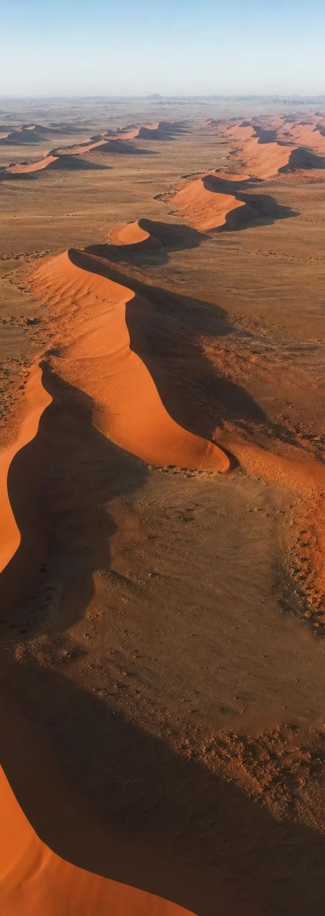
MODEL
One process, many sizes: wind on sand
Model: The same wind doing the same thing, added up
A grain, about 1 mm: Bounces a few centimeters in a gust. Grinds against its neighbors and gets smaller.
A ripple, centimeters high: Forms in minutes as grains pile up on the sheltered side of a bump.
A dune, tens to hundreds of meters: Grains climb the windward slope and tumble down the steep side; the whole dune creeps downwind.
A dune field, kilometers across: Hundreds of dunes marching in the same direction.
A sand sea, tens of thousands of km²: Visible from orbit. The Namib sand sea in southwest Africa covers about 34,000 km².
Dust plumes, across an ocean: The finest grains, worn to dust, blow from Africa over the Atlantic.
Six sizes, one process. Each level is built from the one below it.
9
Notes:
Walk up the ladder. At each rung ask what tool you would need to see it: a hand lens, your eyes, a hilltop, an airplane, a satellite. The process never changes; only the amount of it does. A single gust moves a grain a few centimeters. Trillions of gusts over thousands of years move a dune field. Point out that the Namib's tallest dunes are a little over 300 m, taller than most skyscrapers, and that the desert is thought to be among the oldest on Earth, tens of millions of years old, though individual dunes dated so far are thousands of years old. The dust at the top of the ladder is the end of the weathering story: grains worn so small the wind can carry them across an ocean, where they settle as deposition on the sea floor and in the Amazon rainforest.
EXPECTED RESPONSES: Students should state that the spatial scale changed by a factor of a million or more from grain to sand sea while the process stayed the same.
WATCH FOR: Students may think a dune is a pile that formed all at once in one storm. Dunes grow and migrate grain by grain over years to centuries.
CONNECTS TO: W4 diagram; Lab 3 extrapolation from small measured changes.
PACING: about 5 min

Slide 10
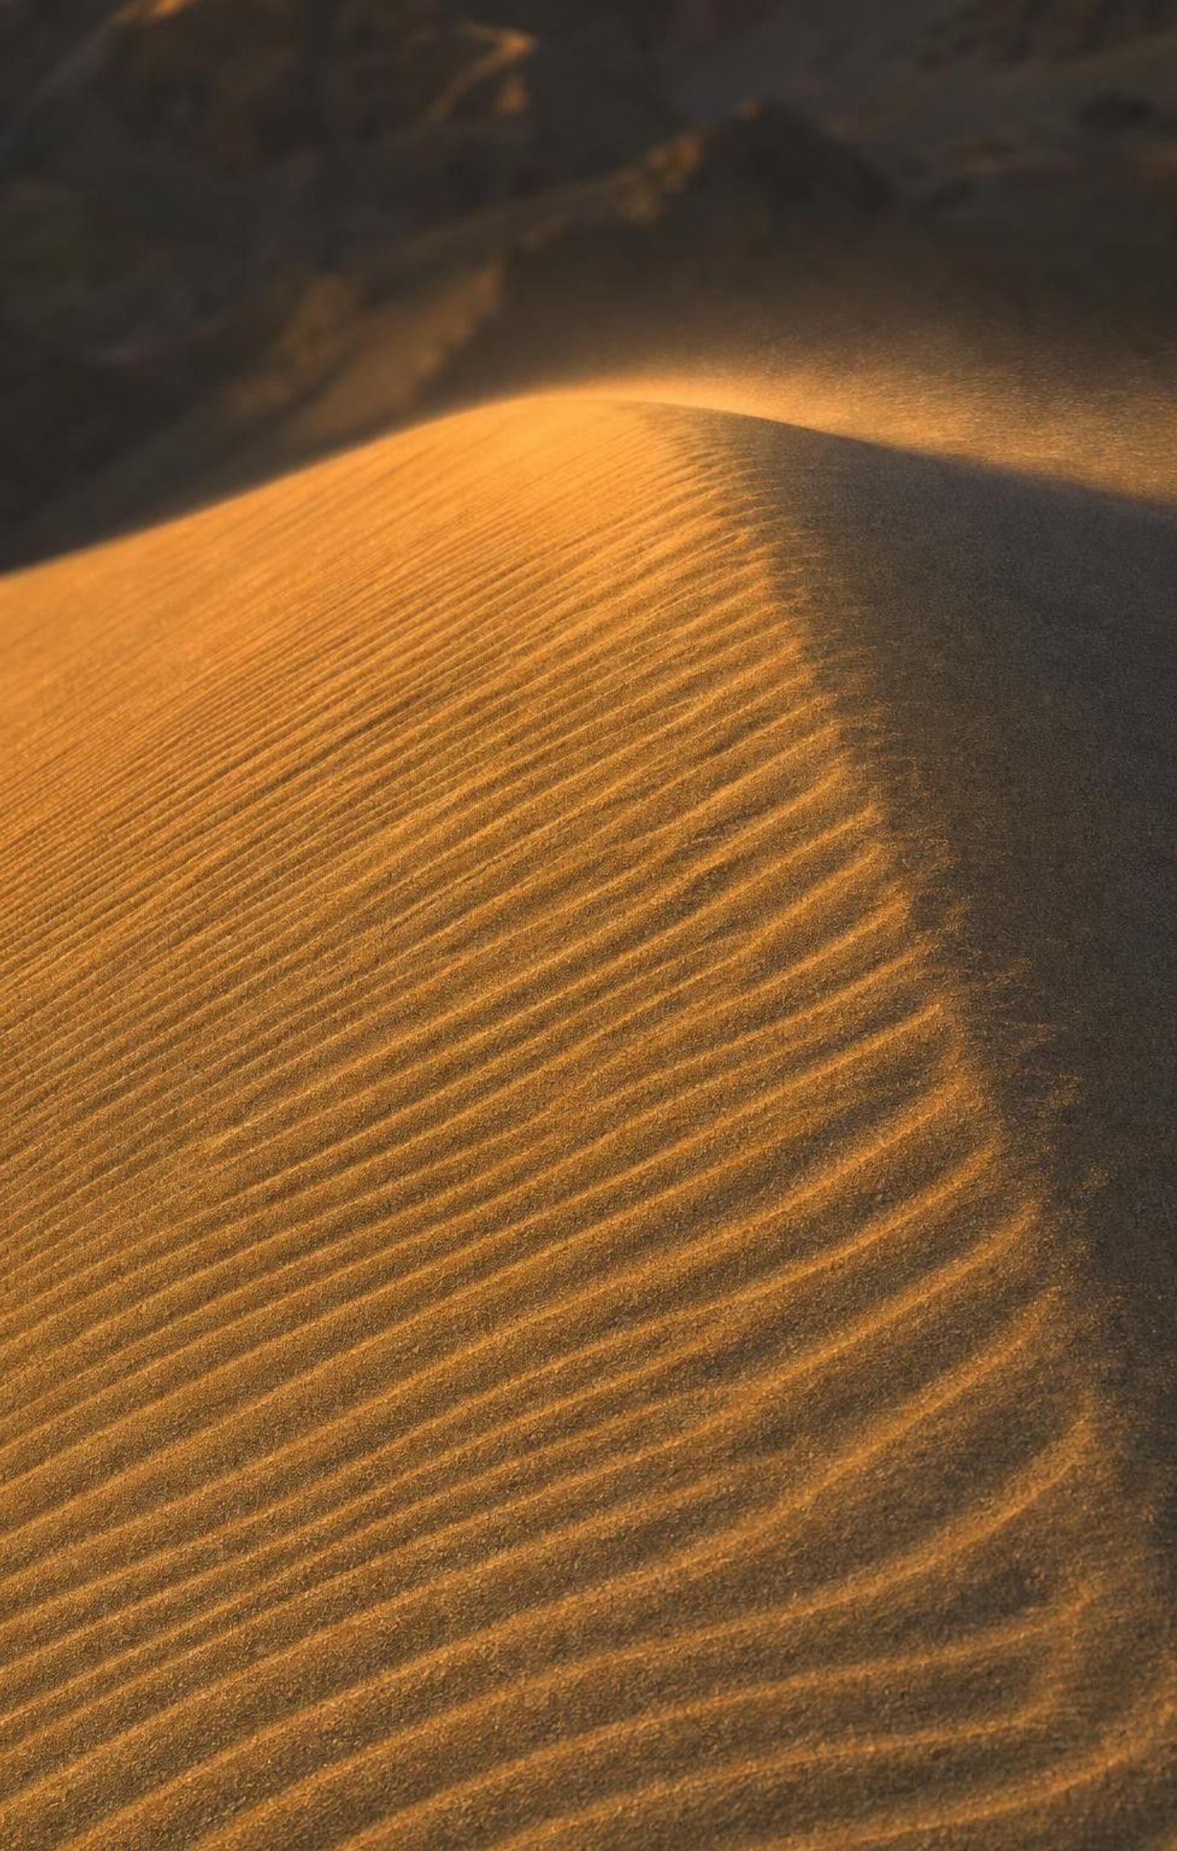
THINK, PAIR, SHARE
Discuss: can a change you cannot see build a 300 m dune?
What is the smallest change you could measure on a dune in one day? In one year?
How would you turn that measurement into a rate?
What else, besides the rate, would you need to know to predict the dune's size?
A gust moves each sand grain only a few centimeters, and nobody has ever watched a dune grow. Could gusts alone build a dune 300 m tall? What would you need to measure to decide?
10
Notes:
Pairs talk for three minutes, then collect. Steer toward measurement: stake a marker at the dune crest, come back in a year, measure how far the crest moved or how much sand piled against the stake. That gives a rate, say centimeters per year or meters per year. Then the key move: rate times time equals change, so a slow rate over a long time gives a large change. Ask what else they need: how long the wind has been blowing from that direction, whether sand keeps arriving, whether anything removes sand. Close by telling students that Lab 1 is exactly this: a crystal that grows too slowly to watch, measured daily, turned into a rate, then multiplied out to a giant.
EXPECTED RESPONSES: Yes, if the rate is multiplied by a long enough time and sand keeps arriving. Students should name a measurable quantity (crest position, sand depth against a stake), a time interval, and the idea of rate times time.
CONNECTS TO: Lab 1 crystal clock; Lab 3 campus rates; W5 data worksheet.
PACING: about 6 min

Slide 11
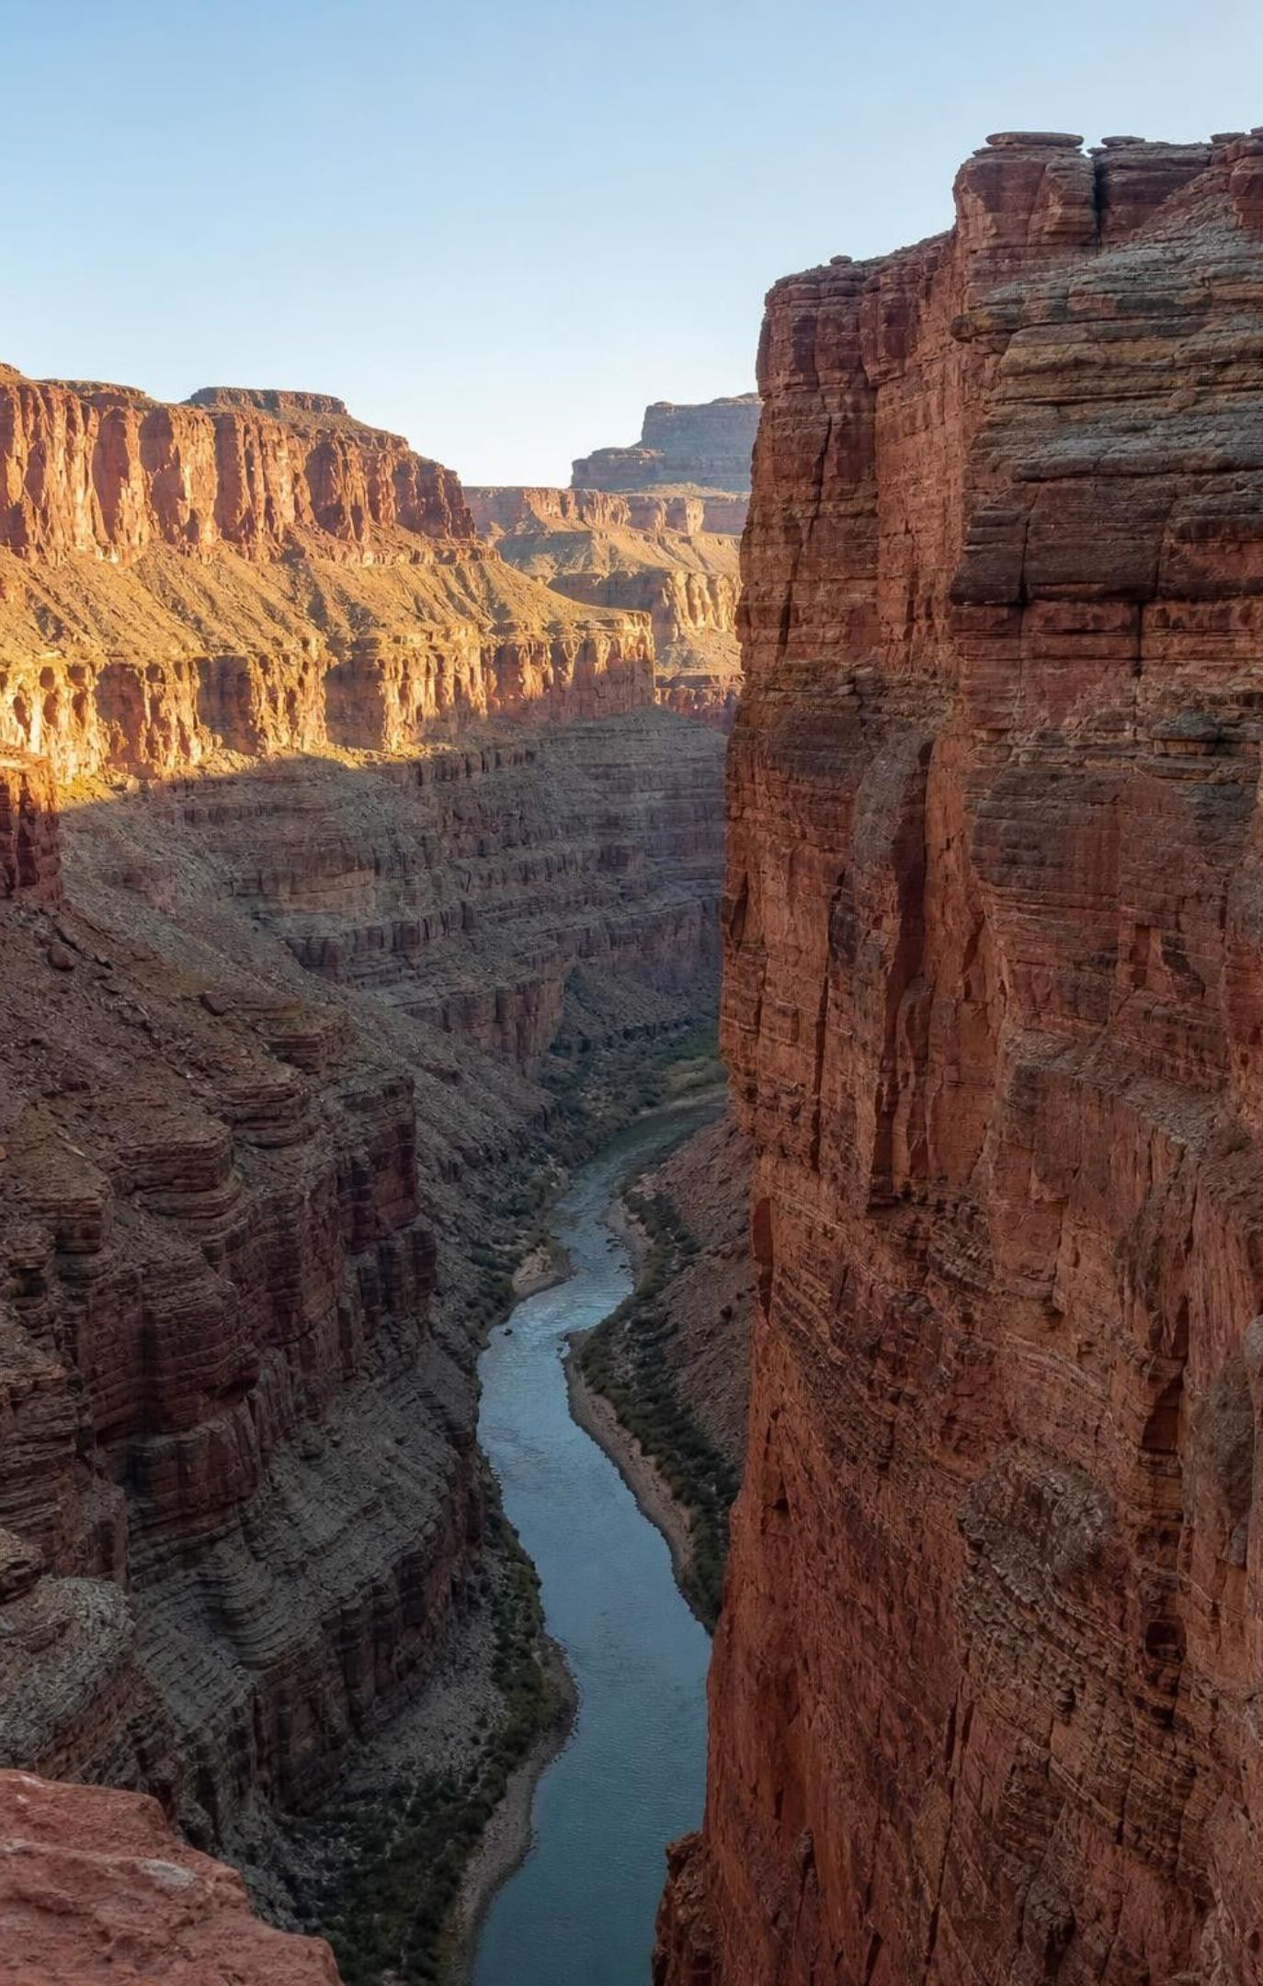
Slow changes: the ones you cannot feel
Plates carrying continents creep a few centimeters a year, about as fast as fingernails grow.
Uplift raises mountain ranges over millions to tens of millions of years.
Buried sand becomes sandstone: compaction squeezes, cementation glues. Millions of years.
Weakly acidic water dissolves limestone into caves over hundreds of thousands of years.
A river cutting a fraction of a millimeter a year can carve a canyon in a few million years.
11
Notes:
Give the fingernail comparison and let it land: your nails grow about 3 to 4 cm a year, and that is roughly how fast the continents move. Nobody feels it, but GPS stations measure it. Different plates move at different speeds; the book's 1 to 3 cm is on the low side, and the plate carrying Australia moves about 7 cm a year. For caves, add the piece the book leaves out: rainwater picks up a little carbon dioxide and becomes weakly acidic, which is why it can dissolve limestone; passages widen by about a millimeter a year at most. For the canyon, say that the Grand Canyon is about 1.6 km deep and that the connected canyon is usually dated at 5 to 6 million years, though geologists still debate it, which is why any calculation should say 'if the canyon is about 5 million years old'.
WATCH FOR: 'Continents used to move fast and have stopped.' They are moving right now; GPS measures it every day.
CONNECTS TO: W3 reading passage; W5 data worksheet rate table.
PACING: about 5 min

Slide 12
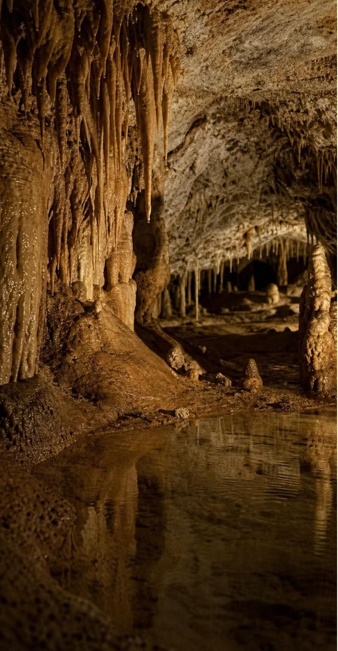
VOCABULARY IN CONTEXT
Words for slow change and for measuring it
uplift: The raising of a large area of crust by forces from deep inside Earth; usually very slow, but an earthquake can lift land several meters in minutes. Sea-floor fossils found high in the Himalaya got there by uplift.
chemical weathering: Weathering by a chemical reaction that dissolves or changes rock. Weakly acidic groundwater dissolving limestone to open a cave.
rate of change: Change divided by time, such as millimeters per year. Rate times time gives the total change. 0.3 mm per year of river cutting, times 5 million years, is 1,500 m of canyon.
12
Notes:
Write the two forms of the rate relationship on the board and leave them up: rate = change ÷ time, and change = rate × time. Do the canyon example together, paying attention to units: 0.3 mm/yr × 5,000,000 yr = 1,500,000 mm = 1,500 m. Then ask for the reverse: if a river cuts 0.3 mm a year, how long to cut 1,600 m? 1,600,000 mm ÷ 0.3 mm/yr is about 5.3 million years. Tell students uplift is usually in the slow column but add the exception, because the book does not: in the 1964 Alaska earthquake some land rose about 11 m in a few minutes. Most uplift, averaged over millions of years, is far slower.
WATCH FOR: Unit slips: mixing millimeters and meters in the same calculation. Insist on converting before multiplying.
CONNECTS TO: Lab 1 and Lab 3 rate calculations; W5.
PACING: about 4 min

Slide 13
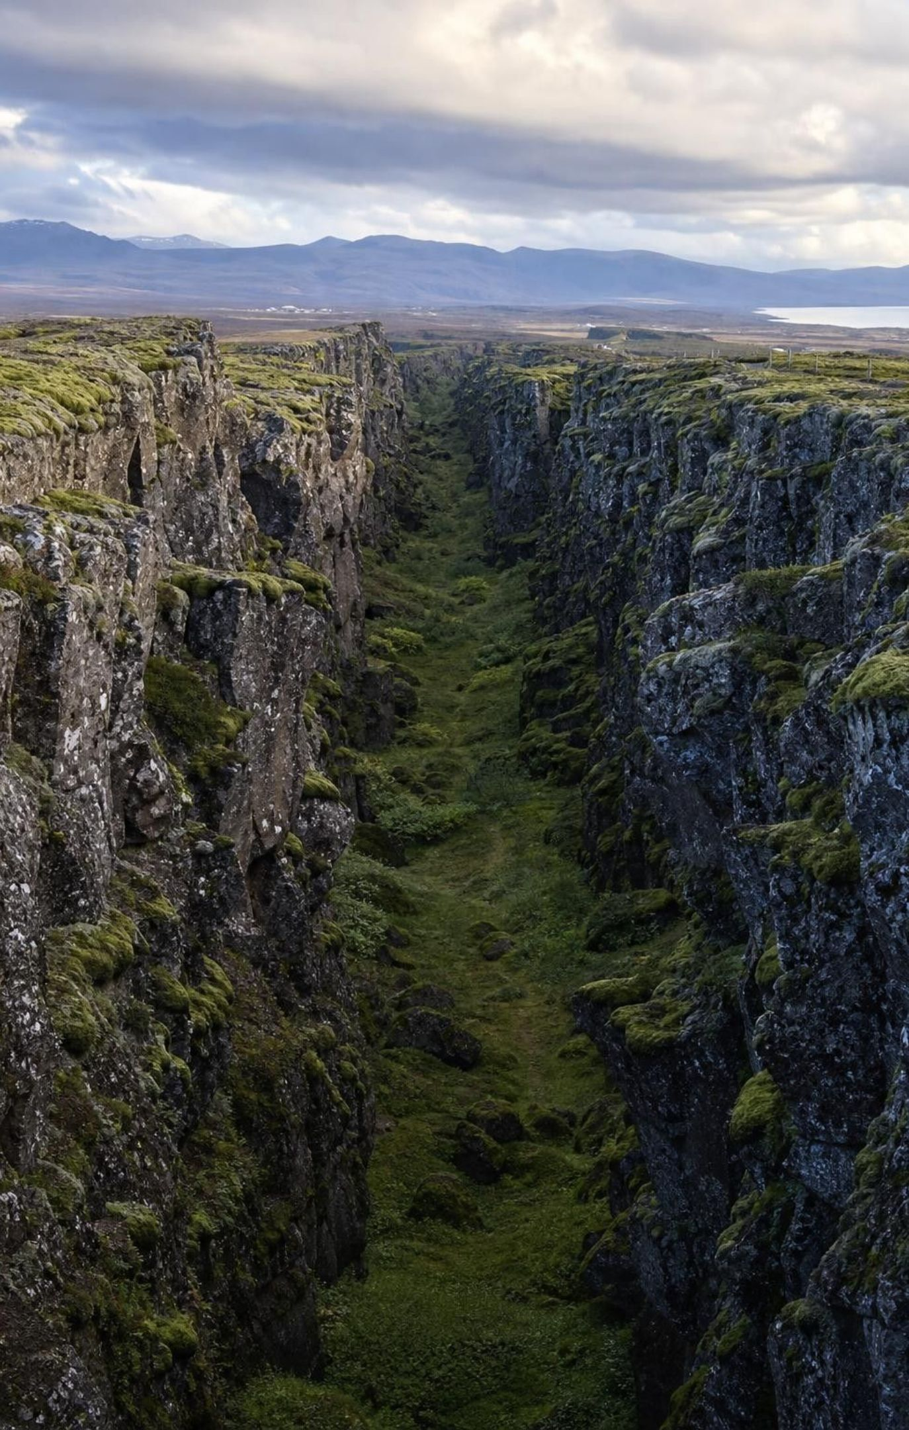
CHECK FOR UNDERSTANDING
Quick check: how far does slow go?
A plate moves 2.5 cm every year. If it keeps that pace, how far does it travel in one million years?
A. 25 meters
B. 2.5 kilometers
C. 25 kilometers
D. 250 kilometers
13
Notes:
Give two minutes with calculators. 2.5 cm × 1,000,000 = 2,500,000 cm. Convert: 2,500,000 cm ÷ 100 = 25,000 m = 25 km. Ask what that means over the 200 million years since the Atlantic began to open: at this pace, about 5,000 km, which is the right order of magnitude for the ocean's width. That is the lesson in one calculation: a rate you cannot feel, multiplied by a time you cannot imagine, equals an ocean.
EXPECTED RESPONSES: C, 25 kilometers. Students who answer 2.5 km dropped a factor of ten in the centimeter-to-meter conversion; students who answer 250 km multiplied by ten too many.
WATCH FOR: Centimeters to kilometers is a factor of 100,000, not 1,000.
CONNECTS TO: W5 data worksheet; W10 mastery numeric item.
PACING: about 4 min

Slide 14
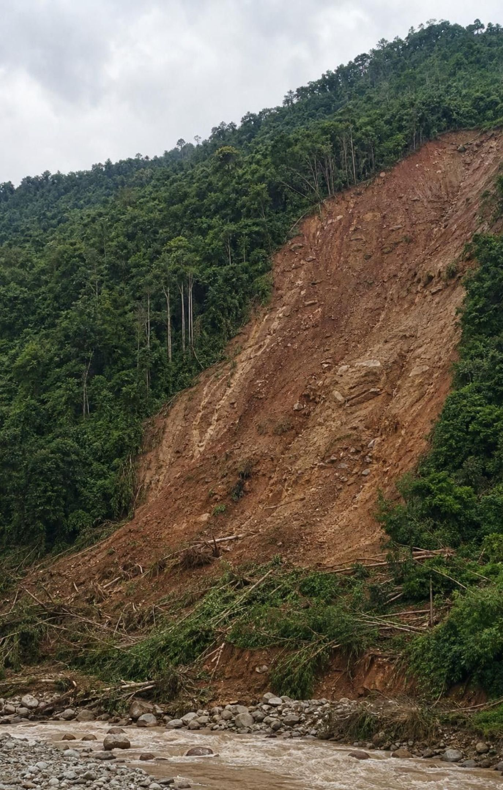
Fast changes: seconds to weeks
Landslide: minutes. A slope soaked by rain or shaken by an earthquake lets go.
Flash flood: hours. Heavy rain in a short time, or a dam, levee or ice jam giving way.
Volcanic eruption: often weeks, though some run for years.
Asteroid impact: seconds to blast a crater; dust can cool the whole planet for years.
'Sudden' describes the event. The conditions behind it usually build slowly.
14
Notes:
For each event ask the same two questions: how long does the event last, and how long did its causes take? A landslide takes minutes, but the slope spent weeks soaking up rain or centuries weathering into loose material. The 1980 Mount St. Helens eruption began with the largest landslide in recorded history, which took minutes, after two months of swelling; its ash fell on more than 57,000 km² in about nine hours. An asteroid orbits for billions of years before one hits; the impact itself takes seconds; the dust it throws up can cool the planet for years. Correct the book quietly: asteroids range from a few meters to about 500 km across, not all 'mountain-sized'; eruptions range from under a day to decades; flash floods also come from dam and ice-jam failures, and earthquakes trigger landslides, not floods.
EXPECTED RESPONSES: Students should pair each event with a slow cause: rain or weathering before a landslide, magma rising for months before an eruption, strain building for decades before an earthquake.
WATCH FOR: 'Catastrophes are unpredictable because they have no cause.' They have slow causes; whether we can measure those causes in time is Lesson 25's question.
CONNECTS TO: L25 and L26 for forecasting; W3 reading; Lab 2 sudden-event cards.
PACING: about 5 min

Slide 15
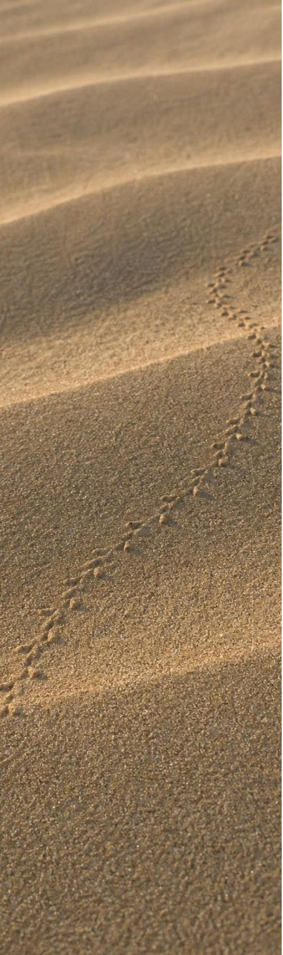
MODEL
Two rulers for every change
Model: Space ruler and time ruler, read separately
Beetle tracks in sand: | Space: millimeters. | Time: seconds.
A landslide: | Space: hundreds of meters. | Time: minutes.
Impact dust cools Earth: | Space: global. | Time: days to years.
A cave formation grows: | Space: tens of centimeters. | Time: thousands of years.
Ice sheets of an ice age: | Space: continents, millions of km². | Time: tens of thousands of years.
The Grand Canyon is carved: | Space: regional, hundreds of km long. | Time: about 5 million years (estimated; debated).
Rocky Mountains rise by uplift: | Space: continental. | Time: tens of millions of years.
Size and speed are separate rulers. Big is not always slow; small is not always fast.
15
Notes:
Read each item's two numbers. Then ask students to find the pair that breaks the pattern they expect: impact dust (global and fast) and the cave formation (tiny and slow). Those two are why scientists always give both rulers. Explain how the textbook's chart works: each step along its axes is a jump of ten or a thousand times the step before, so the chart is not drawn to an even scale and distances on it do not show true proportions. If students ask about the book's stromatolite card: those pillow-shaped fossils were built by mats of microbes (cyanobacteria), not algae, and the 'billions of years' on the chart is how old the oldest ones are, not how long one took to grow, so leave them off any 'how long does it take' list.
EXPECTED RESPONSES: Students should identify impact dust as fast and global and the cave formation as small and slow, and explain that one ruler does not predict the other.
WATCH FOR: Reading the chart as if equal distances mean equal time. Each tick is a multiplying jump.
CONNECTS TO: Lab 2 space-time grid; W4 diagram; W5.
PACING: about 6 min

Slide 16
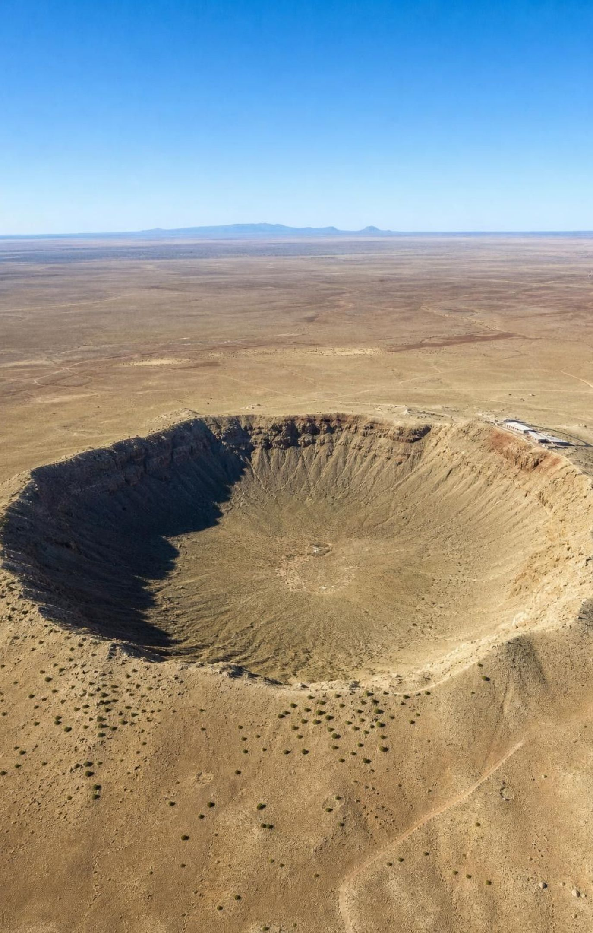
CHECK FOR UNDERSTANDING
Quick check: big and fast, or small and slow?
Which example is both fast (days or less) and global (affects the whole planet)?
A. A hoodoo toppling over
B. Dust from a large asteroid impact cooling the planet
C. A cave formation growing from drips
D. Two continents drifting apart
16
Notes:
Vote, then ask each wrong option's defenders to give its two rulers: the hoodoo is fast but local (meters); the cave formation is slow and small; the continents are slow and global. Only the impact dust is fast and global. Return to the board from day one: the Yosemite rockfall is fast and small; the glacier is slow and large. Those happened to line up, which is why the pairing feels natural, but the impact dust shows it is not a rule.
EXPECTED RESPONSES: B. Students should be able to state the two rulers for every option.
WATCH FOR: 'Global things must be slow.' The dust example breaks it.
CONNECTS TO: W7 misconception repair uses the fast-equals-small error.
PACING: about 4 min

Slide 17
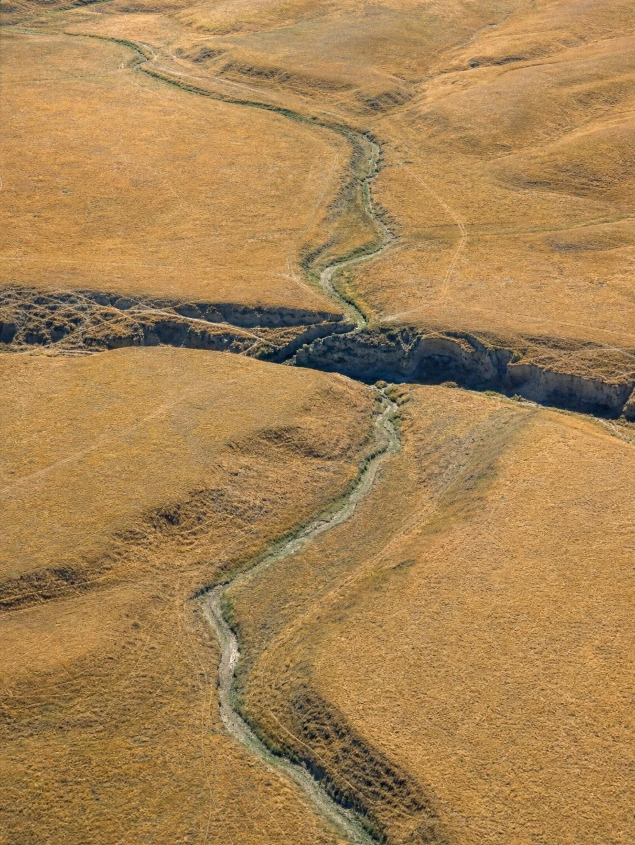
REAL-WORLD CONNECTION
California connection: Wallace Creek on the San Andreas Fault
On the Carrizo Plain in San Luis Obispo County, a dry stream called Wallace Creek crosses the San Andreas Fault and bends sharply: its channel is offset by about 130 m. Averaged over a few thousand years the fault slips about 3.4 cm a year, but it does not creep smoothly here. In the great 1857 earthquake the ground jumped about 9 m in minutes. A slow sum, released in sudden jolts.
17
Notes:
This is a real place, visited by geology classes from all over the state; you can see the offset on satellite images. Walk through the arithmetic: 130 m of offset at about 3.4 cm a year is roughly 3,800 years of motion. But the fault at this spot is locked between earthquakes; the Pacific plate keeps moving, strain builds for a century or more, then the fault slips several meters in a few minutes. So the 'rate' of 3.4 cm a year is an average of long stillness and short jumps. Ask: on a time scale of one year, is the fault stable or changing? On a time scale of ten thousand years? Both answers are right, which is the point of giving a time scale. Note for yourself that the figures are rounded from published geologic surveys; confirm them against a current USGS or NPS page before putting them on a test.
CONNECTS TO: Lab 2 includes a fault-offset evidence card; W9 transfer task; L25 for earthquakes.
PACING: about 4 min

Slide 18
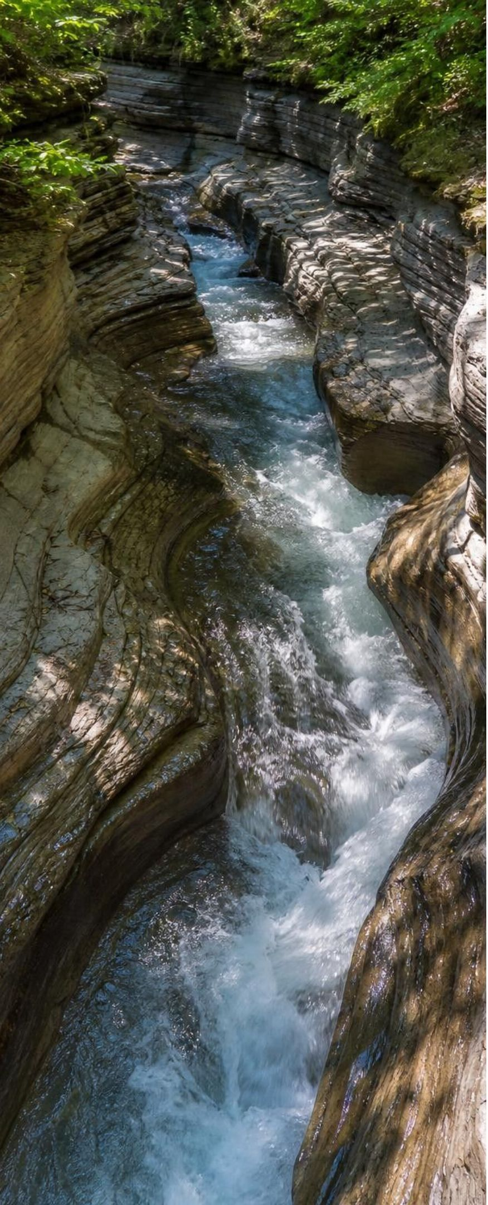
APPLY IT
Task: rate detectives
Simulated data for practice.
For each row, calculate the rate with units. Decide whether it is a slow process or a sudden event. Then use row C to predict how long a river at that rate would take to cut a canyon 1,600 m deep.
Row | Change measured | Amount | Time | Rate (you compute)
A | Cave formation lengthened | 12 cm | 1,000 years
B | Dune crest moved downwind | 15 m | 1 year
C | River cut its bed deeper | 30 cm | 1,000 years
D | Plate carried a continent | 35 m | 1,000 years
E | Landslide moved a hillside | 400 m | 2 minutes
F | Hoodoo pillar narrowed | 5 cm | 100 years
18
Notes:
This is a teaching dataset: the numbers are invented but typical in size. Give groups eight minutes. Rates: A, 12 cm ÷ 1,000 yr = 0.012 cm/yr = 0.12 mm/yr. B, 15 m/yr. C, 30 cm ÷ 1,000 yr = 0.3 mm/yr. D, 35 m ÷ 1,000 yr = 3.5 cm/yr. E, 400 m ÷ 2 min = 200 m/min. F, 5 cm ÷ 100 yr = 0.5 mm/yr. Sudden event: E only; every other row is a slow process (B is fast for a landform but still gradual, grain by grain). Prediction: 1,600 m = 1,600,000 mm; 1,600,000 ÷ 0.3 = about 5.3 million years. Ask the follow-up: which of these slow rows could lead to a sudden event? F, the hoodoo pillar, which will topple when it gets thin enough. Insist on units in every answer; a rate without units is not a rate.
EXPECTED RESPONSES: A 0.12 mm/yr; B 15 m/yr; C 0.3 mm/yr; D 3.5 cm/yr; E 200 m/min; F 0.5 mm/yr. Only E is sudden. Canyon: about 5.3 million years. Students should notice F builds toward a sudden collapse.
WATCH FOR: Calling B a sudden event because 15 m/yr sounds big. Ask how long one grain's hop takes and how many hops make 15 m.
CONNECTS TO: W5 data worksheet is the full version; Lab 3 computes real rates; W10 numeric item.
PACING: about 10 min

Slide 19
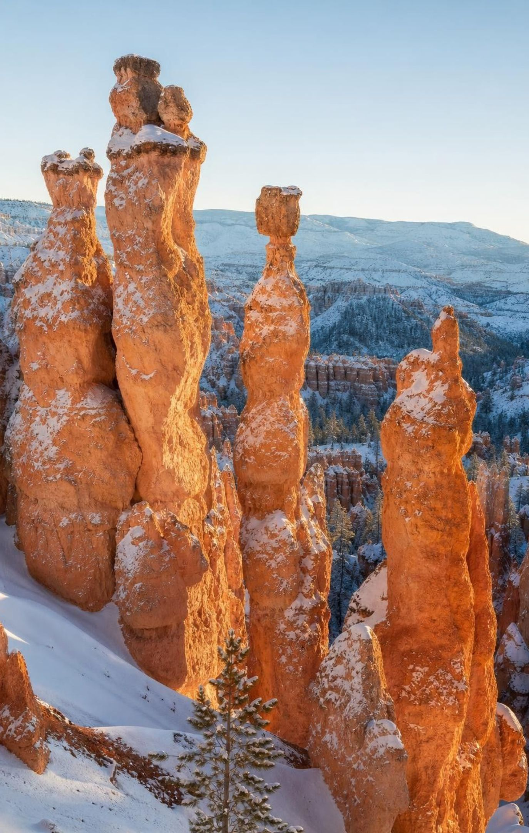
Patterns: the same recipe, all over the world
Hoodoos stand in Utah, Alberta, Italy, Serbia and New Zealand, and all share one shape.
A tougher cap shields a softer pillar; rain, frost and wind strip the rock around it.
Details differ by site: at Bryce Canyon, about 200 freeze-thaw cycles a year do most of the work.
The same shape in many places is evidence that the same processes act everywhere.
A hoodoo looks unchanged from year to year, then topples when its pillar gets too thin.
19
Notes:
Show or describe hoodoos from several continents and ask what they have in common: a pillar with a cap. Ask why the cap matters: it is made of rock that weathers more slowly, so it shelters the softer rock directly under it while the rock around it wears away. Add the nuance the book skips: the recipe is shared, but the ingredients vary. At Bryce Canyon in Utah, water seeps into cracks, freezes on cold nights and pries the rock apart about two hundred times a year, and weakly acidic rain dissolves the limestone-rich layers. Elsewhere the rock, the climate and the main agent differ. The matching shapes are evidence for the pattern, not proof that every detail is identical. End on the collapse: the pillar thins a fraction of a millimeter a year, looks the same for a human lifetime, then falls in seconds.
EXPECTED RESPONSES: Students should explain the cap-and-pillar mechanism in their own words and give one reason details might differ between sites (rock type, climate).
CONNECTS TO: W4 hoodoo model; W8 collaborative evidence sort on patterns.
PACING: about 5 min

Slide 20
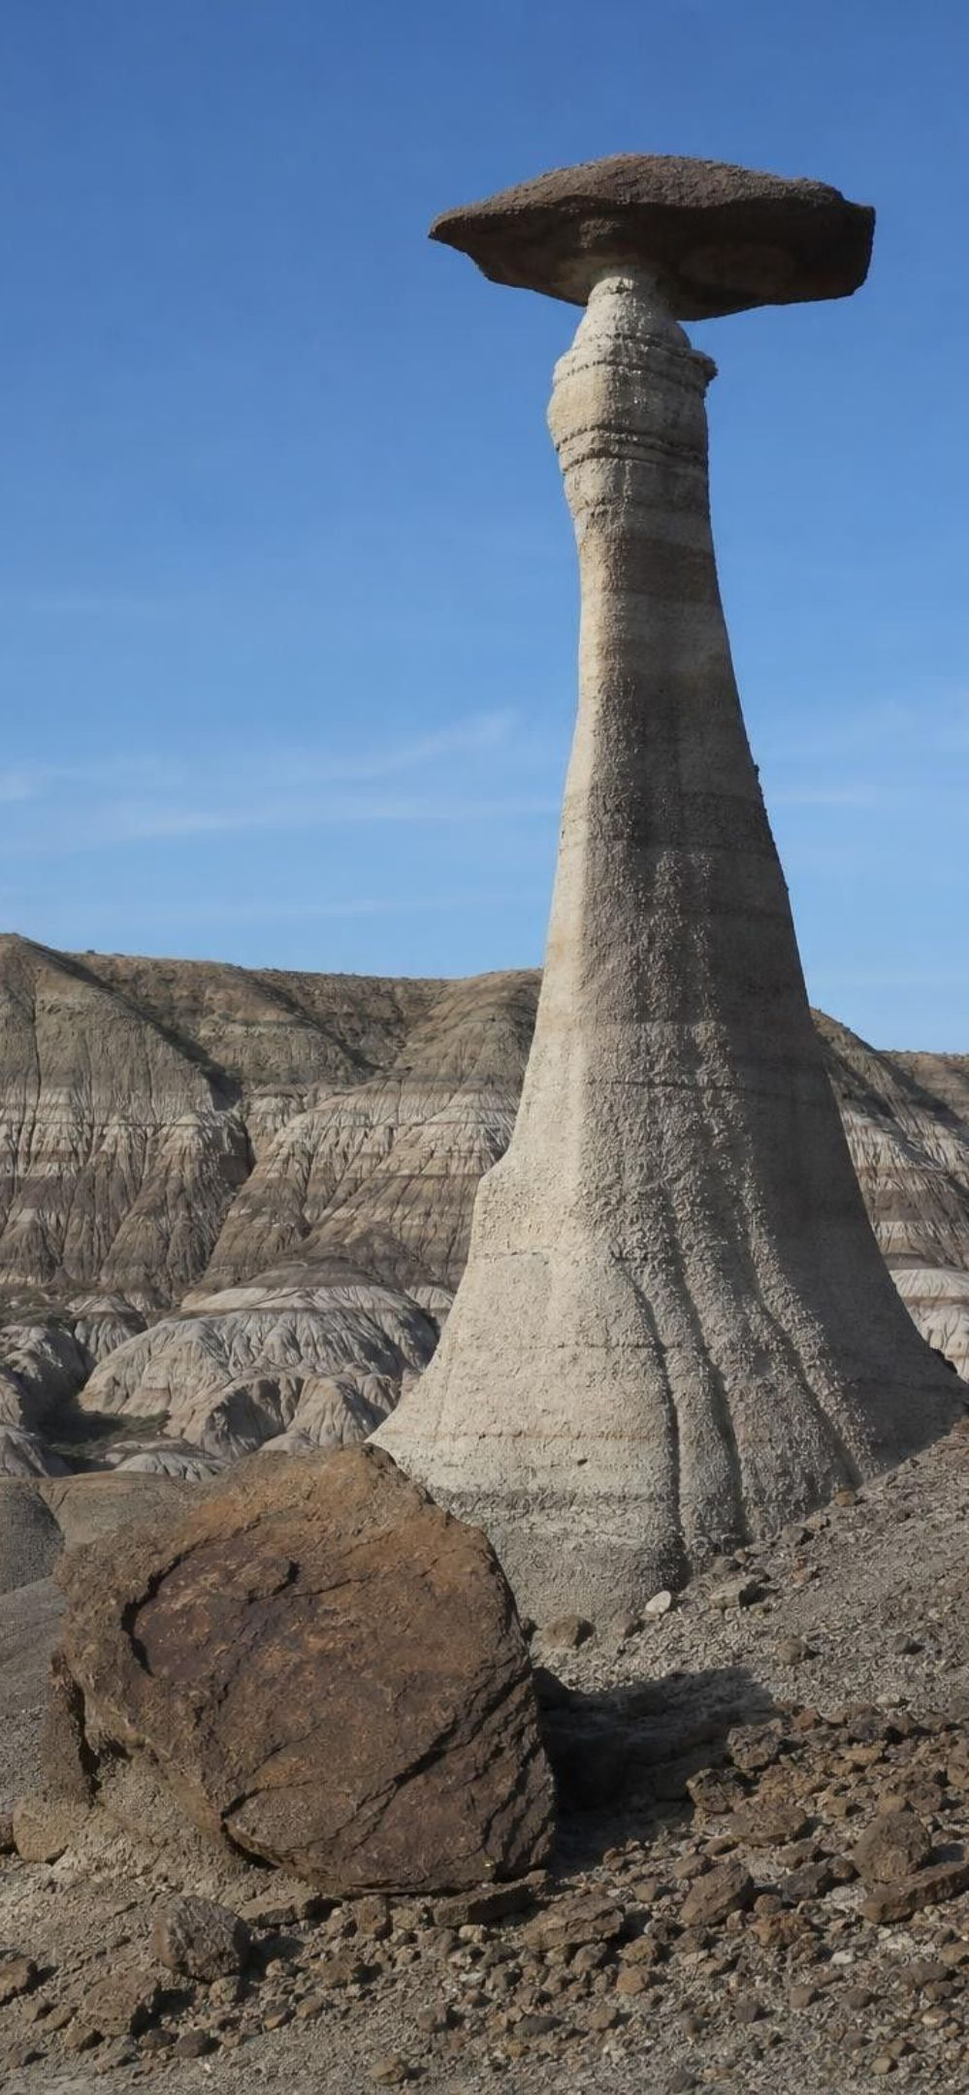
MODEL
The life of a hoodoo: slow, slow, slow, sudden
Model: Stages from layered rock to toppled cap
Layered rock is uplifted and cracks → (millions of years)
Frost and rain widen cracks into gaps → (thousands of years)
Softer layers wear away; a tougher cap shields the pillar → (thousands of years)
Pillar thins a fraction of a millimeter a year → (centuries)
Cap topples in seconds → (seconds, then on and on)
Debris is weathered and carried off
Five slow stages and one sudden one. The sudden stage is caused by all the slow ones.
20
Notes:
Have students label each arrow slow or sudden before you reveal the edge labels. Then ask the central question: what caused the cap to fall? Not the wind that day. The cause was the centuries of thinning. The sudden event is the release of a slow build-up, which is the same story as the Yosemite slab (frost pries for decades, the slab falls in seconds) and Wallace Creek (strain builds for a century, the fault slips in minutes). Ask students to find that pattern in all three and write it as one sentence.
EXPECTED RESPONSES: The pattern: slow build-up, sudden release. Students should be able to name the slow stage and the sudden stage for the hoodoo, the Yosemite slab and the fault.
WATCH FOR: 'The cap fell because of the last storm.' The last storm was the trigger; the cause was the thinning.
CONNECTS TO: W4 diagram worksheet builds this model; W6 CER.
PACING: about 5 min

Slide 21
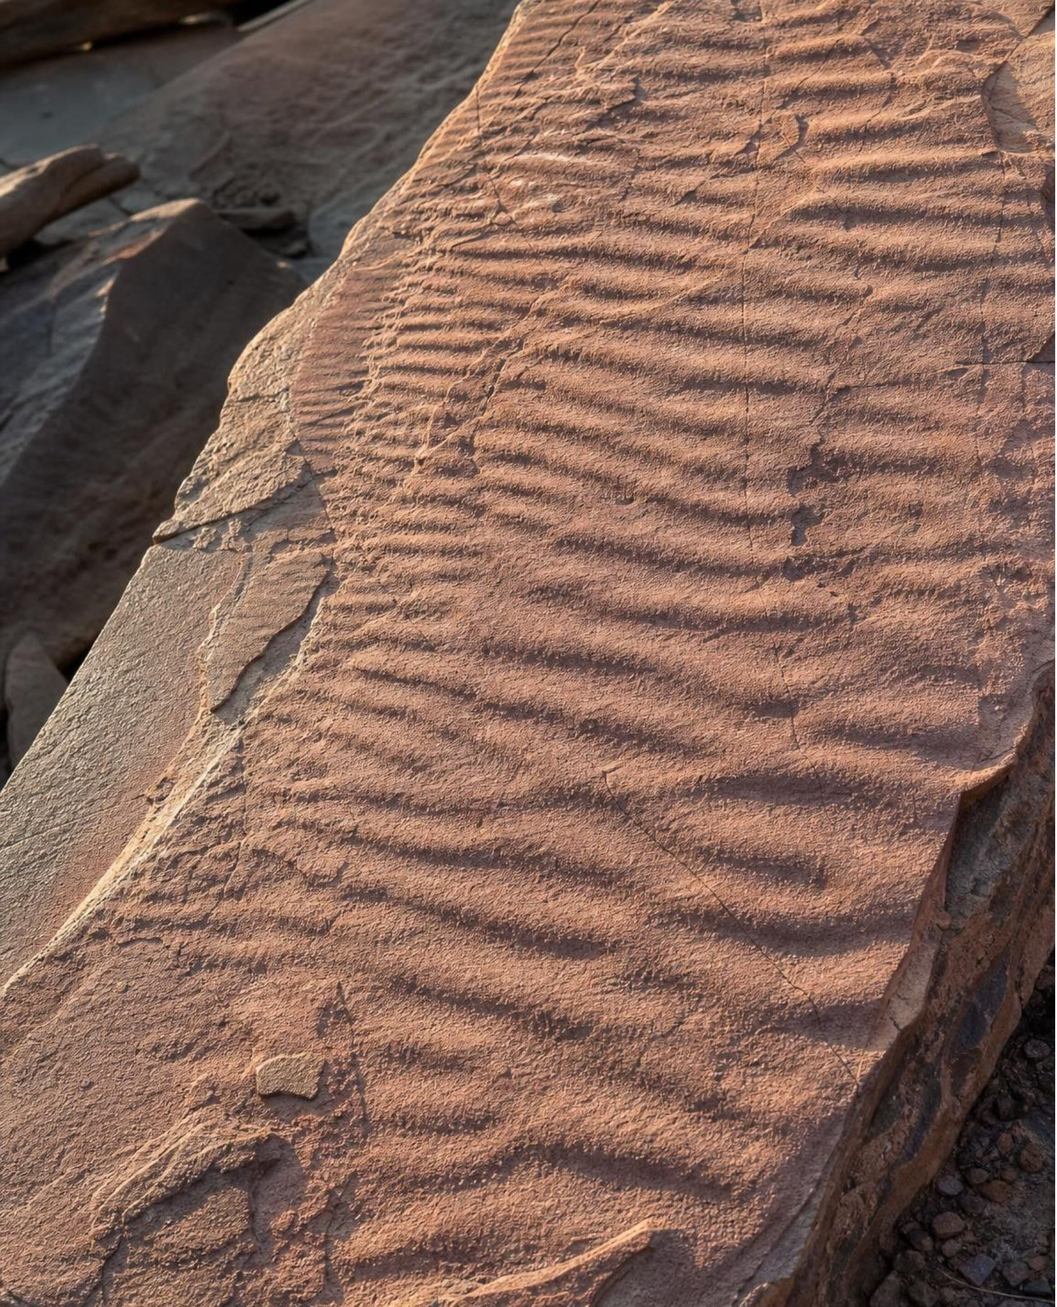
THINK, PAIR, SHARE
Discuss: the present is the key to the past
A geologist finds ancient sandstone with ripple marks just like the ones forming in a shallow stream today. What can she safely conclude about the past? What can she not conclude?
21
Notes:
Pairs for three minutes, then collect on two columns: can conclude, cannot conclude. Can: the sand was once loose and under moving water or wind, because that is what makes ripples today, and the same laws of physics shaped it then. Cannot: how fast the water flowed, exactly how long ago, or that the climate was the same as today; those need other evidence. This is the principle the book calls uniformitarianism: observing today's processes is the key to reading the past. Push on the limit: does the principle say the stream ran at the same speed as streams today? No. It says the same kind of process made the ripples.
EXPECTED RESPONSES: Can conclude: loose sand, moving water or wind, same physical process. Cannot conclude: exact rate, exact age, same climate. Students should separate 'same process' from 'same speed'.
CONNECTS TO: W7 misconception repair; Lab 2 asks students to use present-day processes to explain the valley's past.
PACING: about 6 min

Slide 22
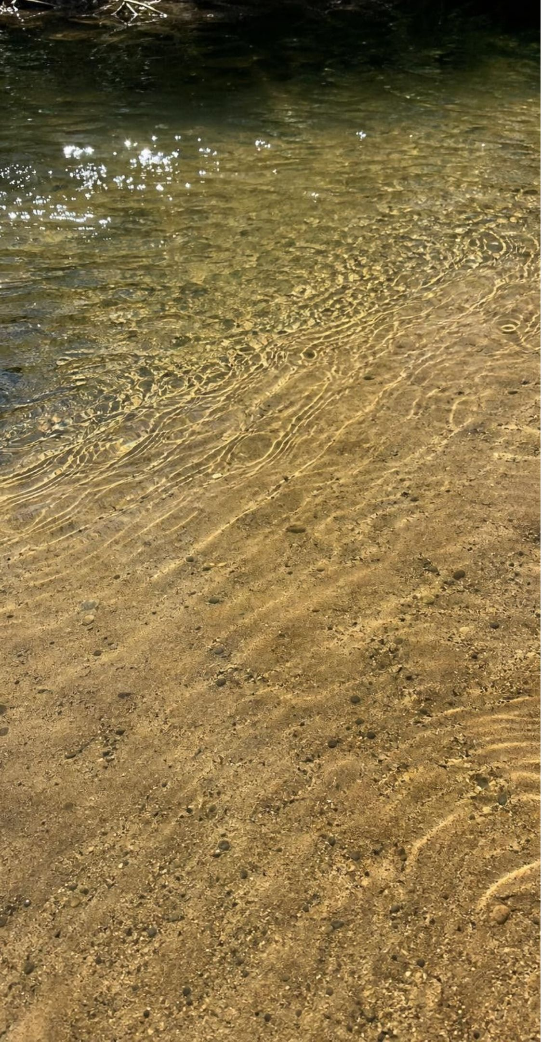
Uniformitarianism: what it claims and what it does not
Claims: the processes we watch today (weathering, erosion, deposition, uplift) also worked in the past.
Claims: the same natural laws, such as gravity, applied then and will apply tomorrow.
Does not claim: every process always ran at today's speed. Ice ages and changing climates change rates.
Does not claim: nothing sudden ever happened. Impacts, giant floods and eruptions are part of the record.
Short version, the geologists' old motto: the present is the key to the past.
22
Notes:
Define the word and immediately fence it. The textbook's wording, 'in the same way', can be read as 'at the same rate', and that reading is wrong; modern geologists keep the same processes and laws but let rates vary and include catastrophes. Give an example of each limit: during the last ice age, glaciers eroded Yosemite far faster than today's trickle of rockfalls does (rates change), and 66 million years ago an asteroid about 10 km across struck near what is now Mexico and changed the whole planet in a day (sudden events happen). Then ask why the principle is still useful: without it, no rock layer could be explained at all, because nobody was there. It lets us explain the past with processes we can test today.
WATCH FOR: 'Uniform means unchanging.' The landscape changes constantly; what stays uniform is the kind of process and the laws it obeys.
CONNECTS TO: W7; W10 mastery.
PACING: about 5 min

Slide 23
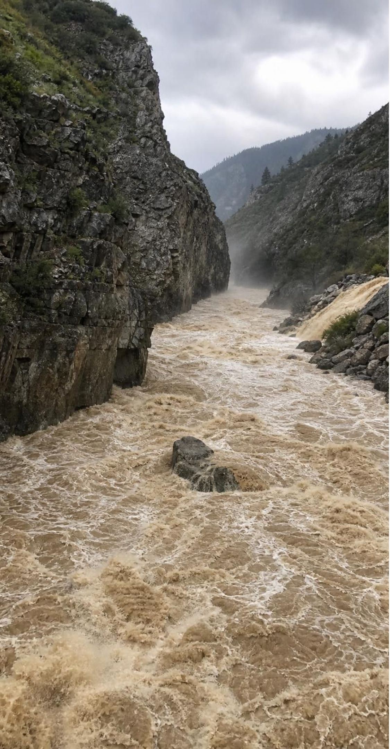
CHECK FOR UNDERSTANDING
Quick check: which statement fits uniformitarianism?
Which statement matches the modern meaning of uniformitarianism?
A. Canyons formed only during ancient catastrophes that no longer happen.
B. Rivers today cut rock the way rivers did millions of years ago, though some cut faster or slower.
C. Every process on Earth has always run at exactly the same speed.
D. The past cannot be understood because nobody was there to see it.
23
Notes:
Vote, then take apart each wrong option. A denies that today's processes explain the past. C is the 'same rate' misreading. D is the view the principle replaced. B keeps the process the same and lets the rate vary, which is the modern version. Ask students to rewrite C so it becomes true (change 'exactly the same speed' to 'in the same kinds of ways').
EXPECTED RESPONSES: B. Students who choose C are reading uniform as 'same rate'; have them look at the 'does not claim' bullets on the previous slide.
WATCH FOR: Choosing A: treating uniformitarianism as the opposite of catastrophes. It includes them.
CONNECTS TO: W7 misconception repair; W10.
PACING: about 4 min

Slide 24
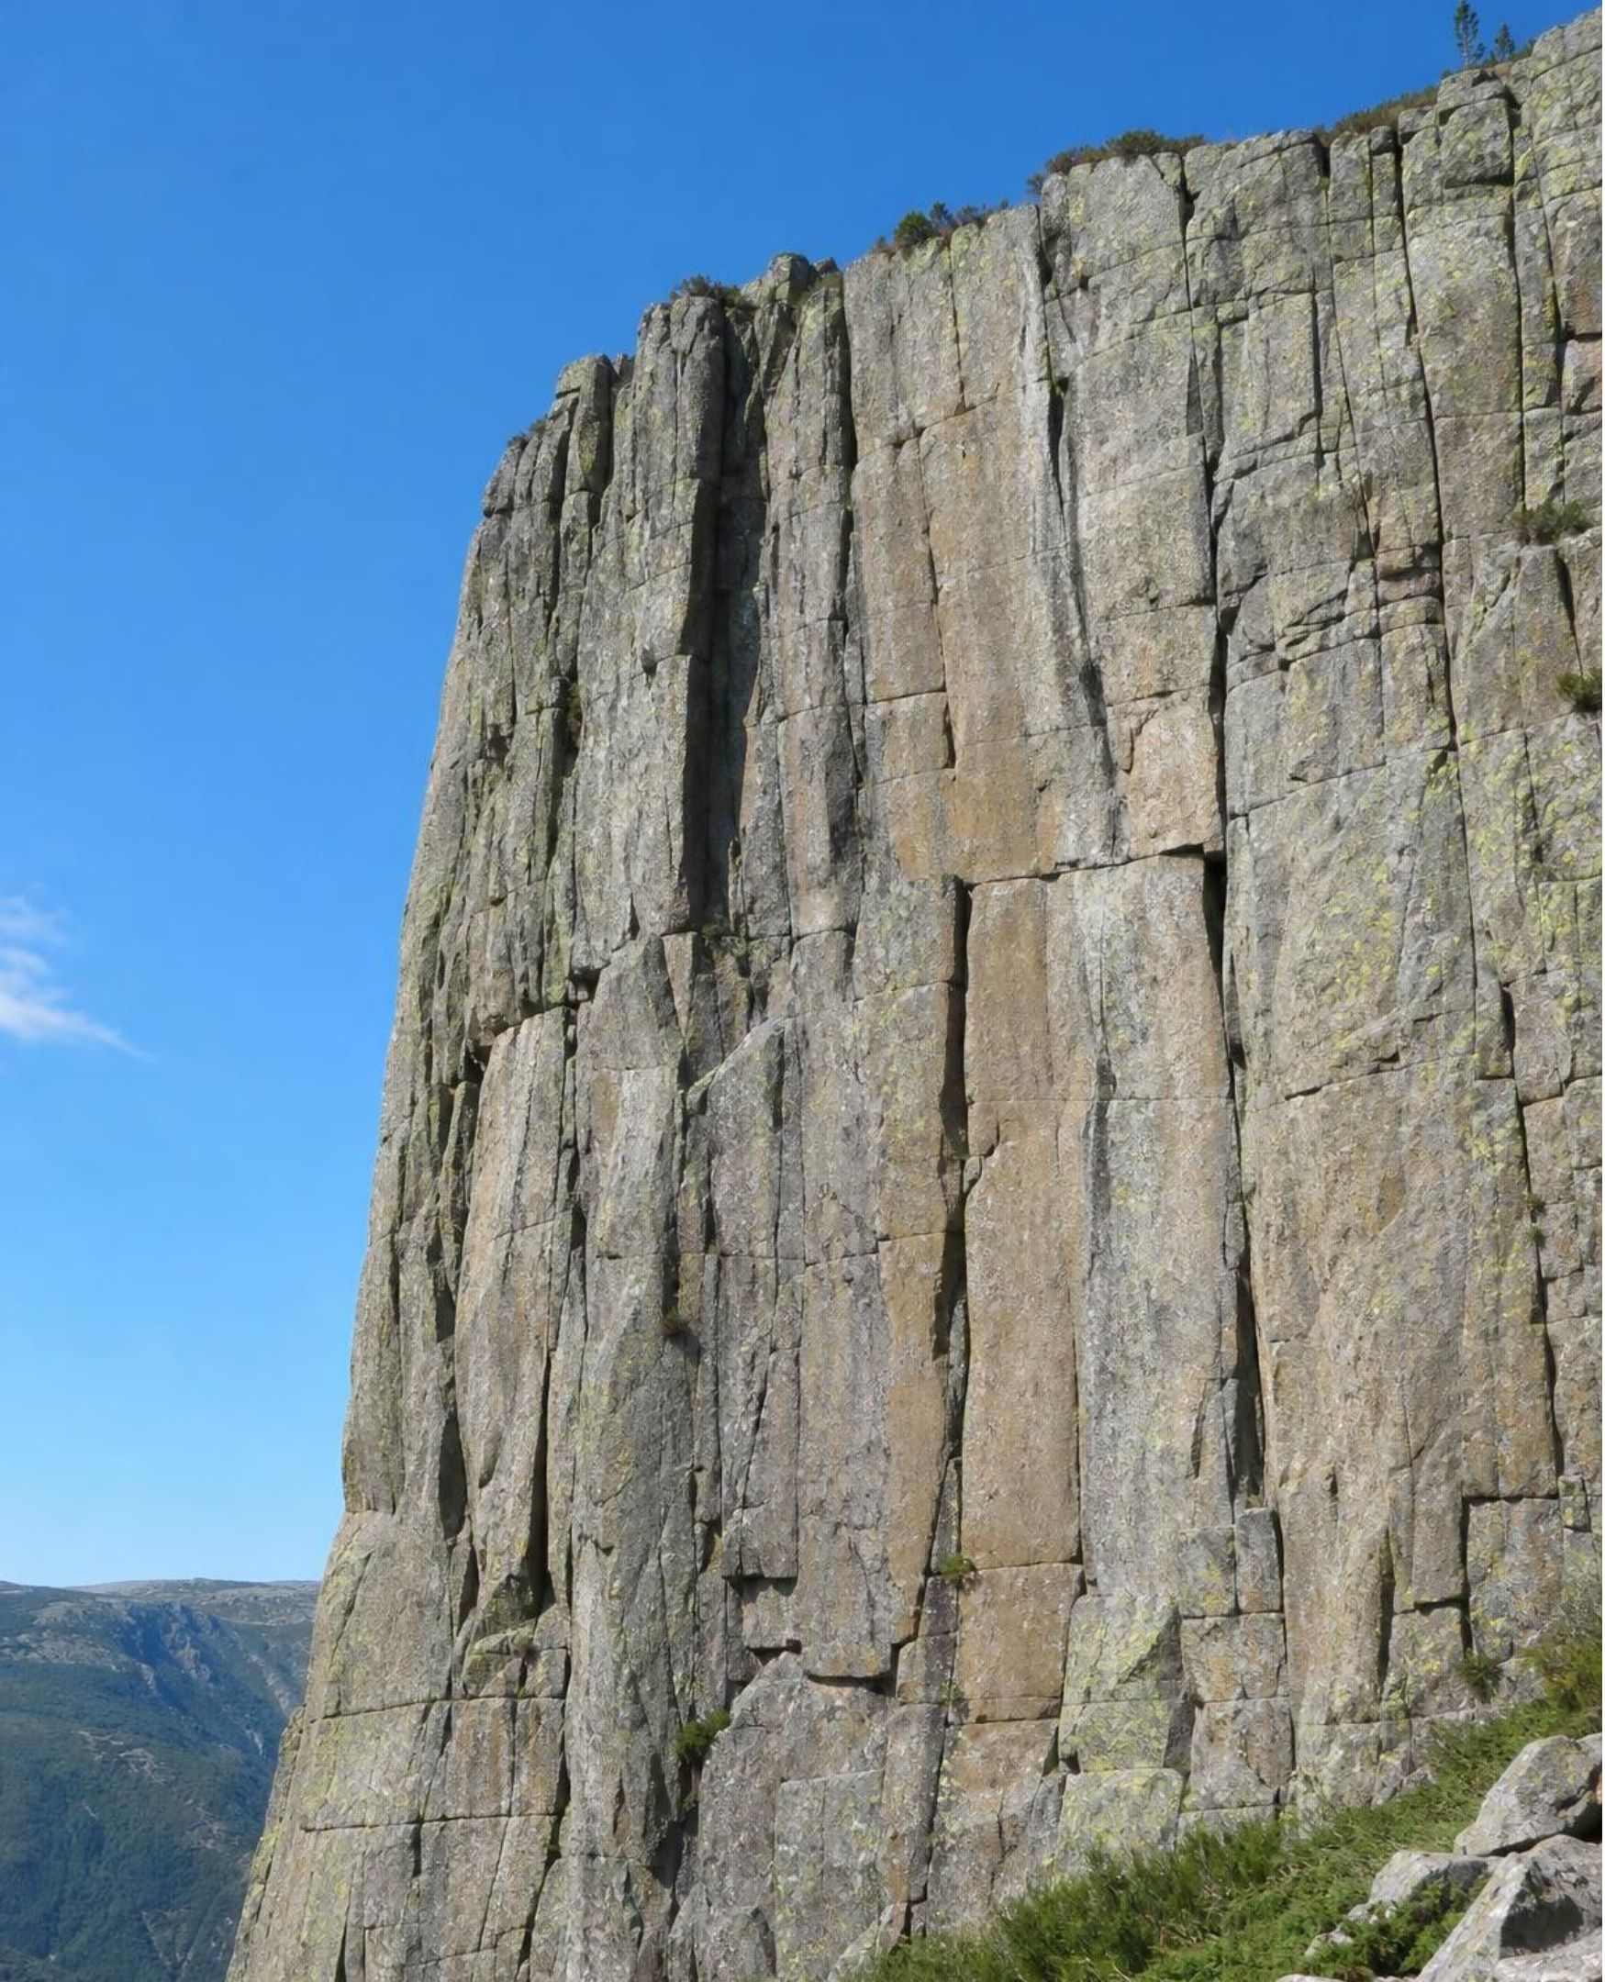
MISCONCEPTION CHECK
True or false? The unchanging cliff
"The cliff looks exactly the way it did in a photograph from 1900, so nothing has happened to it since then."
True or false? Explain your reasoning.
24
Notes:
Return to the claim parked on day one. Ask students to evaluate it in writing with evidence from the lesson. Water has been freezing in the cliff's cracks every winter for a century, prying slabs loose by fractions of a millimeter; the change per year is far below what a photograph can show. The rockfall is the proof: the slab did not weaken in ten seconds. The same logic applies to the hoodoo, the fault and the crystal in Lab 1, which looks the same hour to hour and is measurably bigger day to day. Then flip it: how could you detect the change without waiting a century? Measure a rate over a short time with a precise tool, then multiply. That is what Lab 3 does on the campus.
EXPECTED RESPONSES: False. The cliff was weathering the whole time at a rate too small for a photograph to show; the rockfall released a century of slow change. Students should cite at least one slow process and the idea of a rate below the limit of what we can see.
WATCH FOR: Students may swing to 'everything is changing fast'. Rates differ; the point is that zero visible change is not zero change.
CONNECTS TO: W6 CER on the Yosemite evidence; W7 misconception repair.
PACING: about 6 min

Slide 25
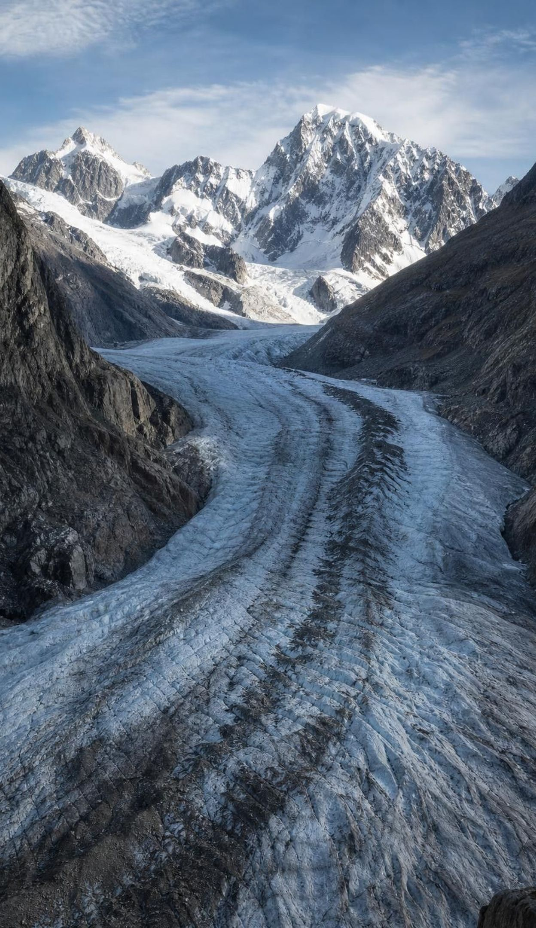
PUTTING IT TOGETHER
Putting it together
Weathering breaks, erosion carries, deposition drops, uplift raises; water, ice, wind, gravity, life do it.
Every change gets two rulers, space and time, and the rulers are independent.
Rate times time is the key: a few millimeters a year becomes a canyon over millions of years.
Slow build-ups end in sudden releases: rockfalls, toppling hoodoos, earthquakes.
The same kinds of processes, following the same laws, explain the past and predict the future.
25
Notes:
Have students write a four-sentence summary that uses at least five vocabulary terms and includes one number from a lab. Then trade with a partner who checks that weathering and erosion are used differently. Ask for one result from each lab: Lab 1 (the crystal's growth rate and how long a meter-long crystal would take), Lab 2 (the valley's oldest and youngest events), Lab 3 (the fastest rate measured on campus). Preview Lesson 17, where the sand grain's journey becomes the full rock cycle, and Lessons 25 and 26, where the sudden events return as hazards people try to forecast.
CONNECTS TO: W10 mastery as the quiz; L17 The Rock Cycle; L25 and L26 hazards.
PACING: about 6 min

Slide 26
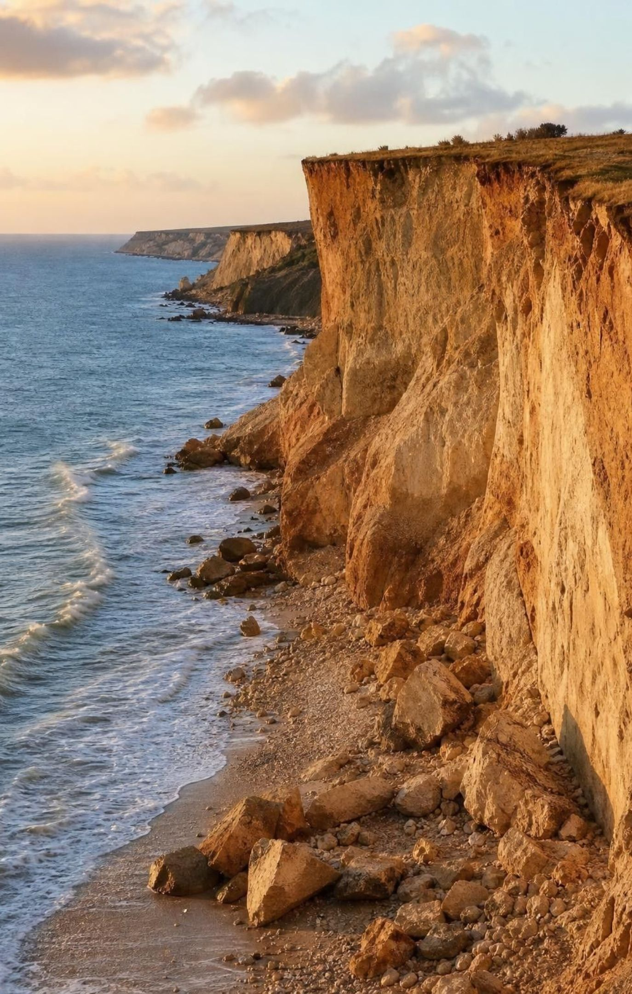
EXIT TICKET
Exit ticket
1
Give one example each of weathering and erosion from this lesson, and say how you told them apart.
2
Name one change that is fast and global, and one that is slow and small.
3
A cliff retreats 2 mm a year. How far does it retreat in 10,000 years? Show the units.
4
In one sentence, say what uniformitarianism does NOT claim.
26
Notes:
Collect on index cards or a shared form. Item 1 checks the process distinction, item 2 the two rulers, item 3 the rate math, item 4 the limit on uniformitarianism. Sort the cards into piles before the next class and reteach from the biggest pile. Item 3 is the quickest diagnostic for unit trouble.
EXPECTED RESPONSES: 1: for example frost splitting the Yosemite slab (weathering, the rock broke in place) and the slab falling (erosion, the rock moved). 2: fast and global, impact dust cooling the planet; slow and small, a cave formation growing. 3: 2 mm/yr × 10,000 yr = 20,000 mm = 20 m. 4: it does not claim that processes always ran at the same speed, or that sudden events never happened.
WATCH FOR: Item 3 answers of 2 m or 200 m signal a unit-conversion slip; item 4 answers that restate the claim instead of the limit signal the 'uniform means same rate' reading.
CONNECTS TO: W10 mastery; chapter evidenceOfLearning.
PACING: about 5 min

