Slide 1
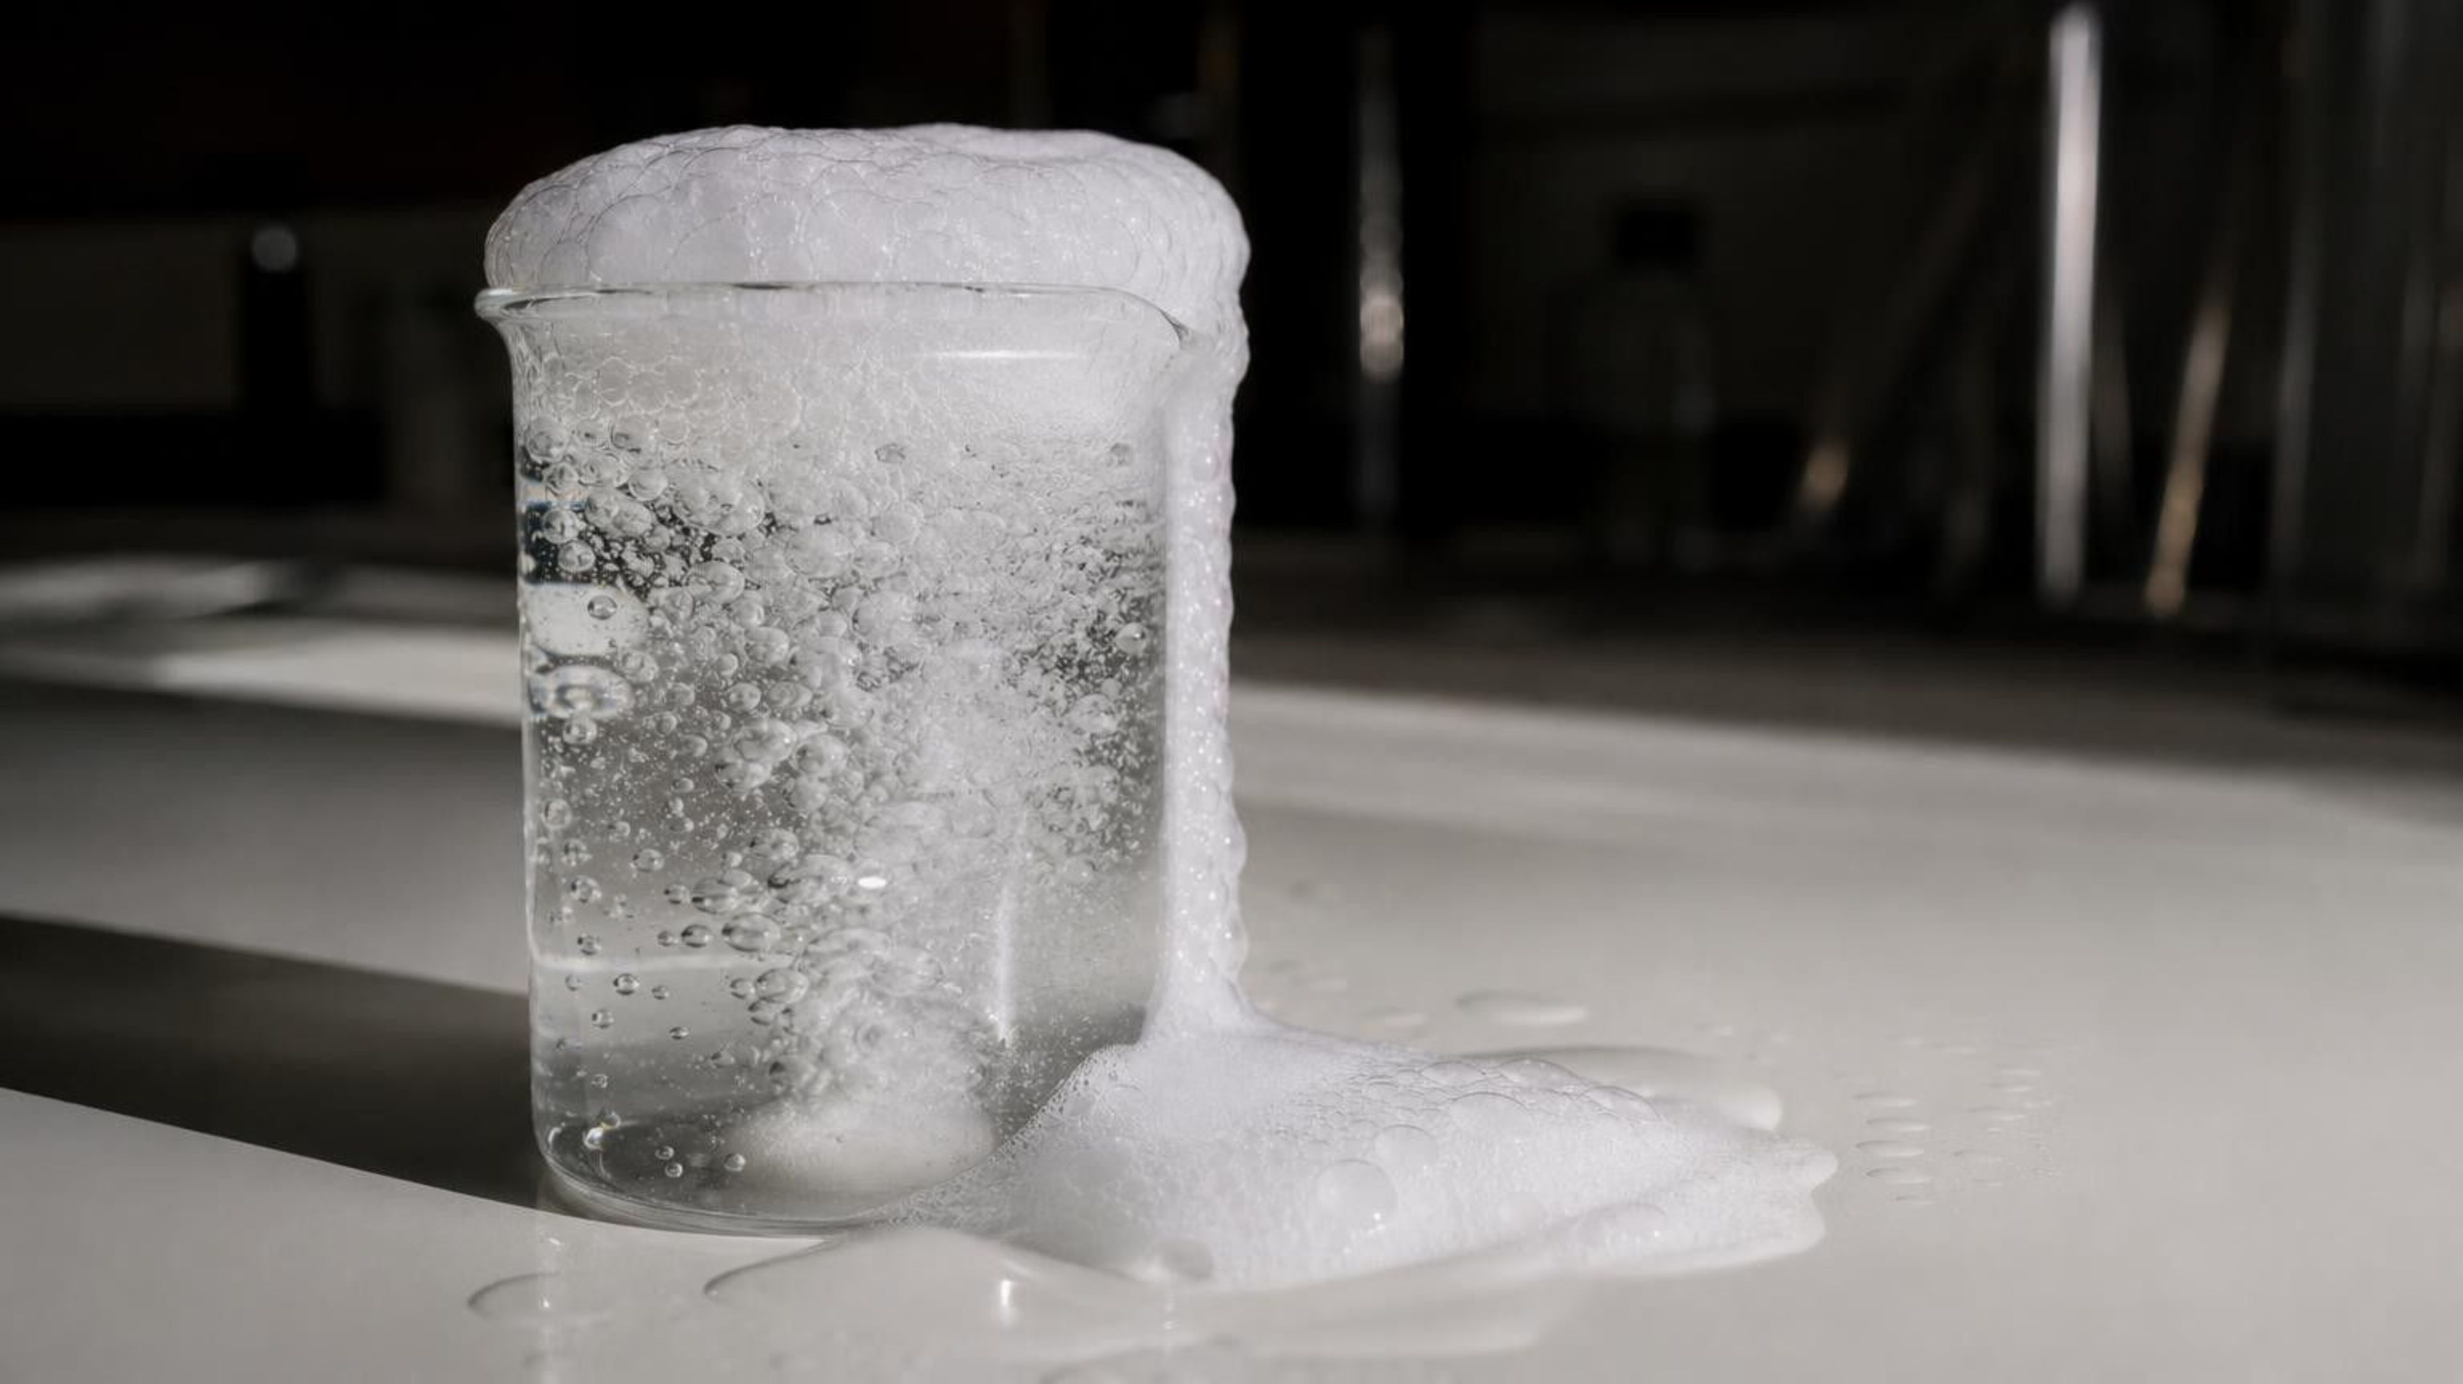
Identifying Chemical Reactions
Chapter 12 of 29 · Chemical Reactions
Lesson 12: Clue or proof? Telling when something new was made
Angela's Wand · Bring Science Alive! 7th Grade Integrated
Notes:
This lesson is about a detective question. Things around us change all the time: ice melts, bread bakes, a nail rusts, sugar vanishes into tea. Some of those changes make brand-new substances and some do not. By the end of the week students will be able to tell the two apart using evidence rather than guesswork, and they will know why a fizz or a warm cup is a clue but not proof. Preview the three labs: identifying mystery powders by how they react, a six-station decision lab, and a lab that finds out why fizzing stops. Everything uses kitchen and hardware-store chemicals; goggles every time.
CONNECTS TO: Overview of Lab 1, Lab 2 and Lab 3; W1 opens on the next slide.
PACING: about 2 min

Slide 2
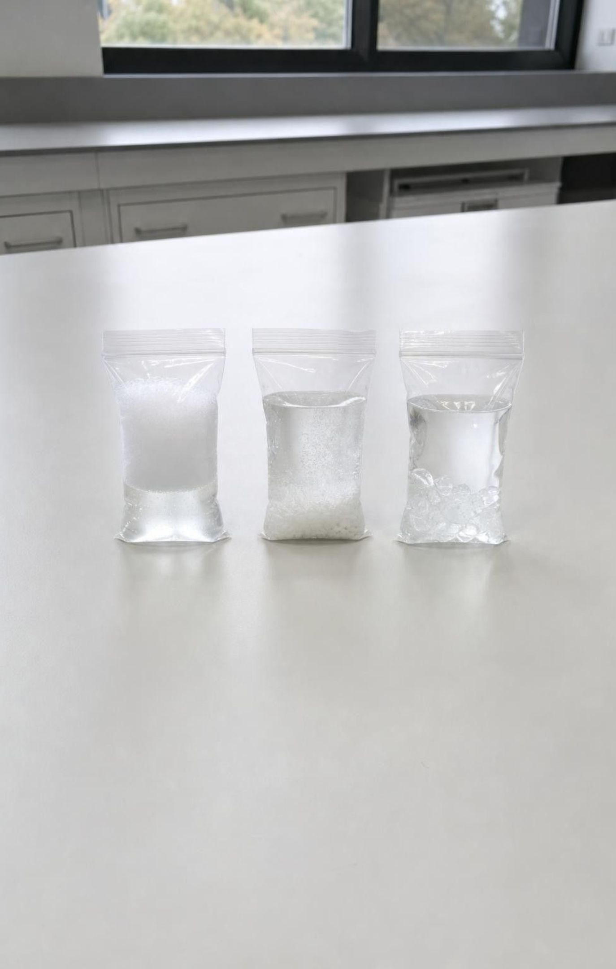
PHENOMENON
Three bags, three changes
Bag A: baking soda + vinegar. It fizzes, puffs up tight and feels cool. Bag B: calcium chloride pellets + water. It gets hot and the pellets vanish. Bag C: Epsom salt + water. It feels slightly cool and the crystals disappear. Every bag changed. In which bags did a new substance form, and how could you know for sure?
Notice: which clues did more than one bag share?
Wonder: is getting hot enough to prove something new was made?
Predict: if the water in Bags B and C dried up, what would be left?
2
Notes:
If you can, run the three bags live at the front with goggles on and a thermometer in each; otherwise describe them with the slide. Use a teaspoon of each solid and about 30 mL of liquid, and keep the calcium chloride bag small because it gets genuinely hot. Sealing Bag A is a teacher demonstration only; in every lab, students never seal anything that is fizzing. Give students two minutes of silent notice-and-wonder writing before any discussion. Collect notices and wonders on the board in two columns and do not resolve anything yet. Park the question 'which bag made something new' on a visible chart; the class returns to it on the misconception slide. Point out that Bag B had the most dramatic change and ask whether dramatic means chemical.
EXPECTED RESPONSES: Notice: A and B both changed temperature; A was the only one with gas; the solid disappeared in B and C. Wonder: where did the gas come from, why did B get hot, is the stuff in C still Epsom salt. Predictions will split; many will say B made something new because it got hot.
WATCH FOR: Students equate dramatic with chemical. Bag B (dissolving) is the trap; Bag A is the only reaction. Do not confirm yet.
CONNECTS TO: W1 phenomenon worksheet follows with a second case (an iron nail in copper sulfate solution); Lab 2 changes 1 to 3 repeat these three changes with property tests.
PACING: about 8 min

Slide 3
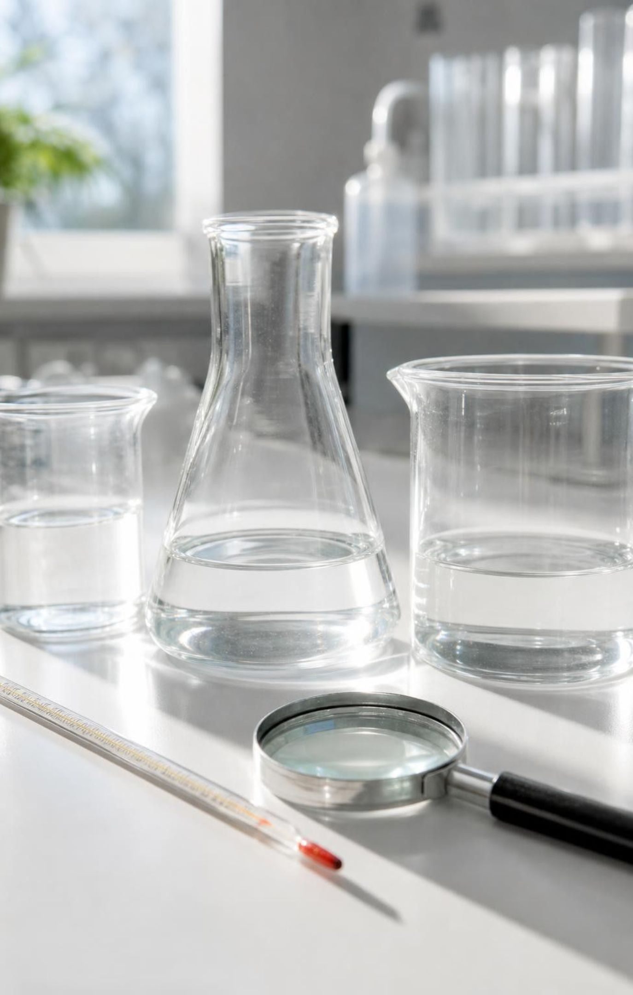
LEARNING TARGETS
What you will be able to do
Name the reactants and products in a reaction and explain why products have their own properties.
Tell a chemical reaction from a physical change by asking whether a new substance formed.
Explain how heating, cooling or mixing can start a reaction, and why it stops when a reactant runs out.
Use before-and-after property data to decide whether a reaction happened and how strong the evidence is.
Judge competing designs, such as two medicines, against their criteria using test results.
3
Notes:
Read the targets aloud and have students mark the one they think they can already do. Most will pick the second one, which is exactly the one the three bags just made harder. Explain that targets 1 and 2 belong to the first two days, 3 to the stations and the fizz lab, 4 is the heart of the chapter and is what the exit ticket and quiz test, and 5 is the engineering strand at the end of the week.
CONNECTS TO: Targets map to W2 (1), Lab 1 and W7 (2), Lab 3 (3), Lab 2, W5 and W6 (4), W9 (5).
PACING: about 2 min

Slide 4
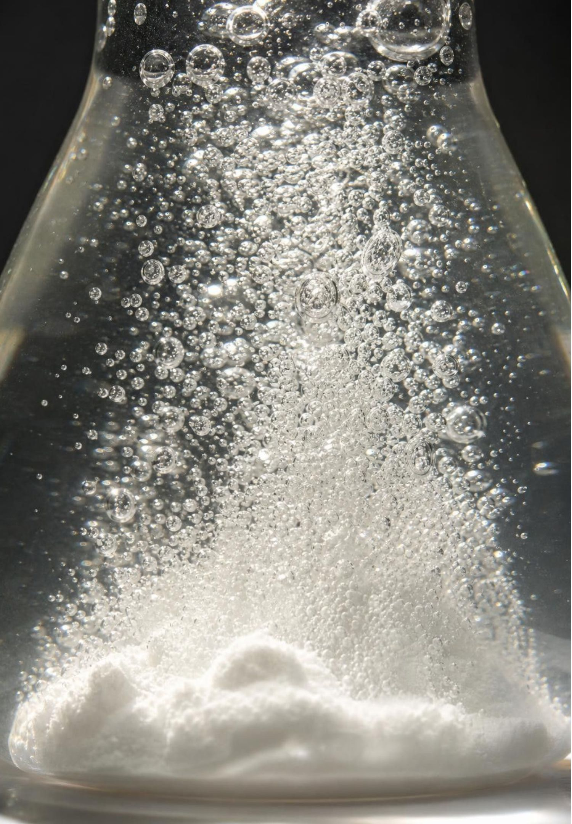
What a chemical reaction actually is
A chemical reaction turns one or more substances into one or more different substances.
The starting substances are reactants; the new ones are products.
In Bag A, acetic acid (from vinegar) and sodium bicarbonate (baking soda) are the reactants.
The products are carbon dioxide gas, water and a dissolved salt called sodium acetate.
Each product is a different substance, so each has its own set of properties.
4
Notes:
Define the three words with Bag A so they are attached to something students watched. Stress that 'different substance' is the whole idea: the atoms of the reactants are regrouped into new combinations, and new combinations have new properties. Ask: what property of carbon dioxide did we see that neither vinegar nor baking soda has? (It is a gas at room temperature, so it inflated the bag.) Mention that the liquid left behind is not vinegar anymore; later they will test it. Avoid saying 'molecules' for sodium acetate; say 'substance'.
WATCH FOR: Students may think the gas was 'inside' the baking soda waiting to get out. Neither reactant contains carbon dioxide; it is made during the reaction.
CONNECTS TO: W2 vocabulary relationships; Lab 3 uses this reaction as its system.
PACING: about 5 min

Slide 5
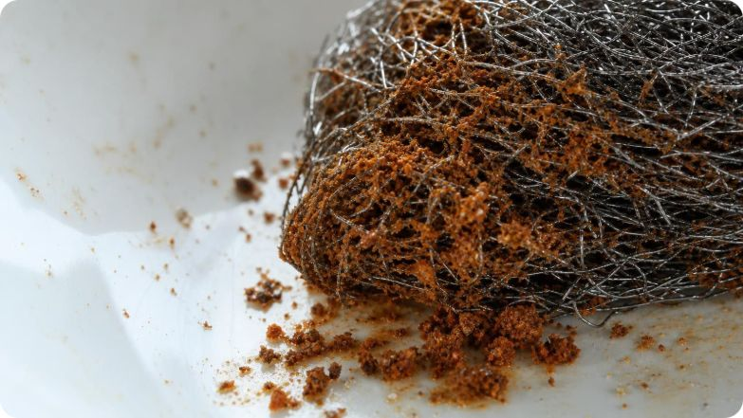
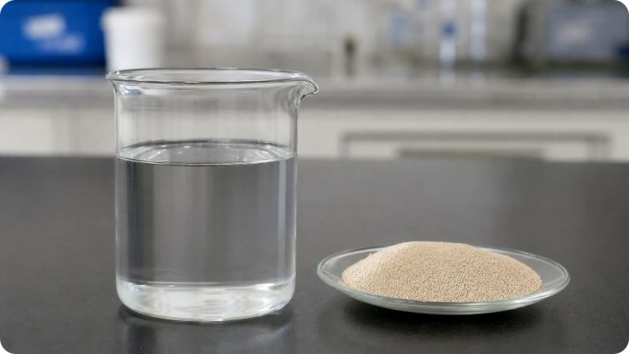
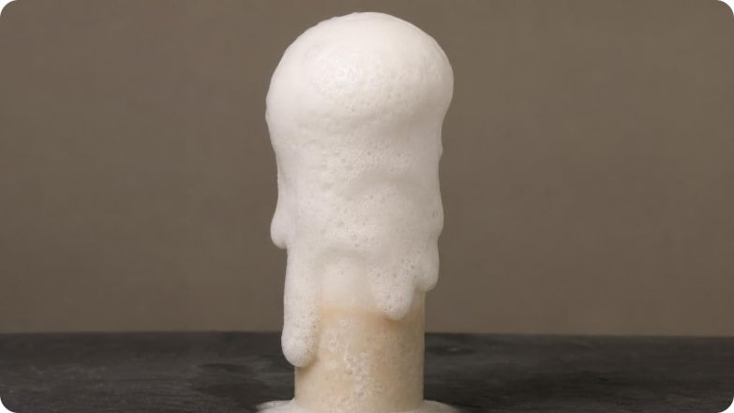
VOCABULARY IN CONTEXT
Three words every reaction needs
chemical reaction: A change in which substances turn into different substances with their own properties. Steel wool turning into orange, crumbly rust.
reactant: A substance present before the reaction that gets changed by it. Hydrogen peroxide is the reactant that gets used up when it foams on yeast.
product: A substance made by the reaction that was not there before. Oxygen gas is a product of hydrogen peroxide breaking down.
5
Notes:
Have students write each term with their own example from the bags or from the kitchen. Check that the examples name substances, not events: 'fizzing' is not a product, carbon dioxide is. Use the yeast example to plant a seed for later: the yeast itself is not a reactant, because it is still there and still works after the foam stops. Students will test that at Lab 2 station 6.
WATCH FOR: Listen for 'the yeast is used up.' It is not; it speeds the reaction without being consumed.
CONNECTS TO: W2 vocabulary; Lab 2 station 6 (yeast leftover test).
PACING: about 4 min

Slide 6
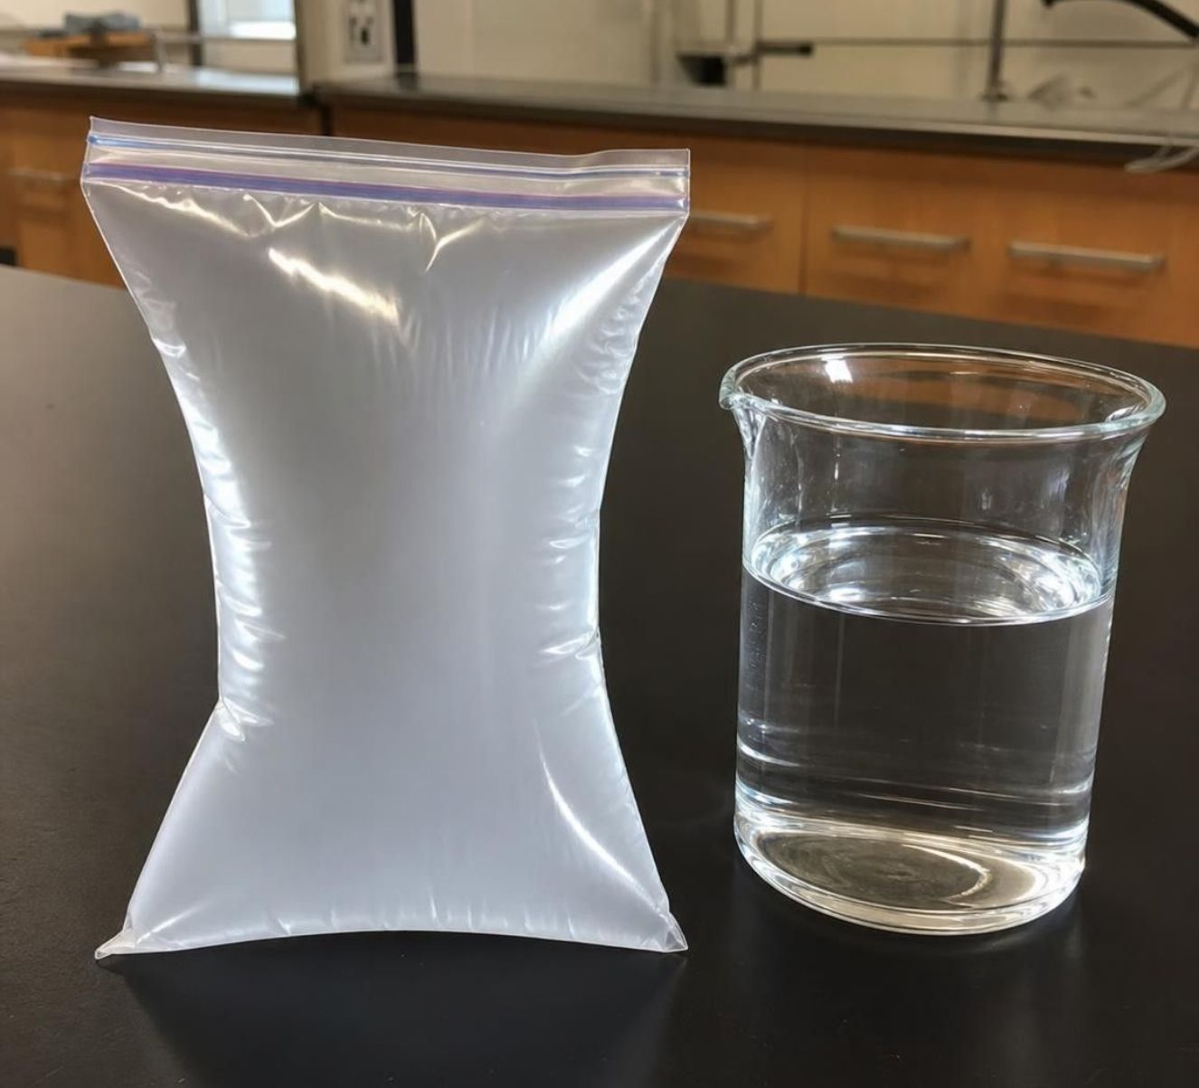
Following one reaction from start to finish
MODEL
Model: Baking soda and vinegar as a chemical reaction
Reactants: sodium bicarbonate (baking soda) and acetic acid (from vinegar)
1
(mixing) They mix; the reaction starts at once
2
(reacting) Products: carbon dioxide gas, water and dissolved sodium acetate
3
(testing) Products have their own properties: the gas inflates a bag; the leftover liquid no longer fizzes with vinegar
4
The last box is the key: products are known by their properties, not by the show they put on.
6
Notes:
Walk the arrows. Mixing is the condition that starts this reaction; nothing else is needed. Ask students what they would expect if they poured more vinegar onto the liquid left after the fizz stopped. If all the baking soda was used up, nothing happens, because the leftover liquid is a different substance from baking soda and does not share its chemical property of fizzing with acid. If baking soda was left over, it fizzes again. That simple leftover test is a real property test and it comes back in Lab 3.
WATCH FOR: Students may think the reaction 'wears out' rather than running out of a reactant. The leftover test is the cure.
CONNECTS TO: Lab 3 leftover test; W4 diagram worksheet.
PACING: about 5 min

Slide 7
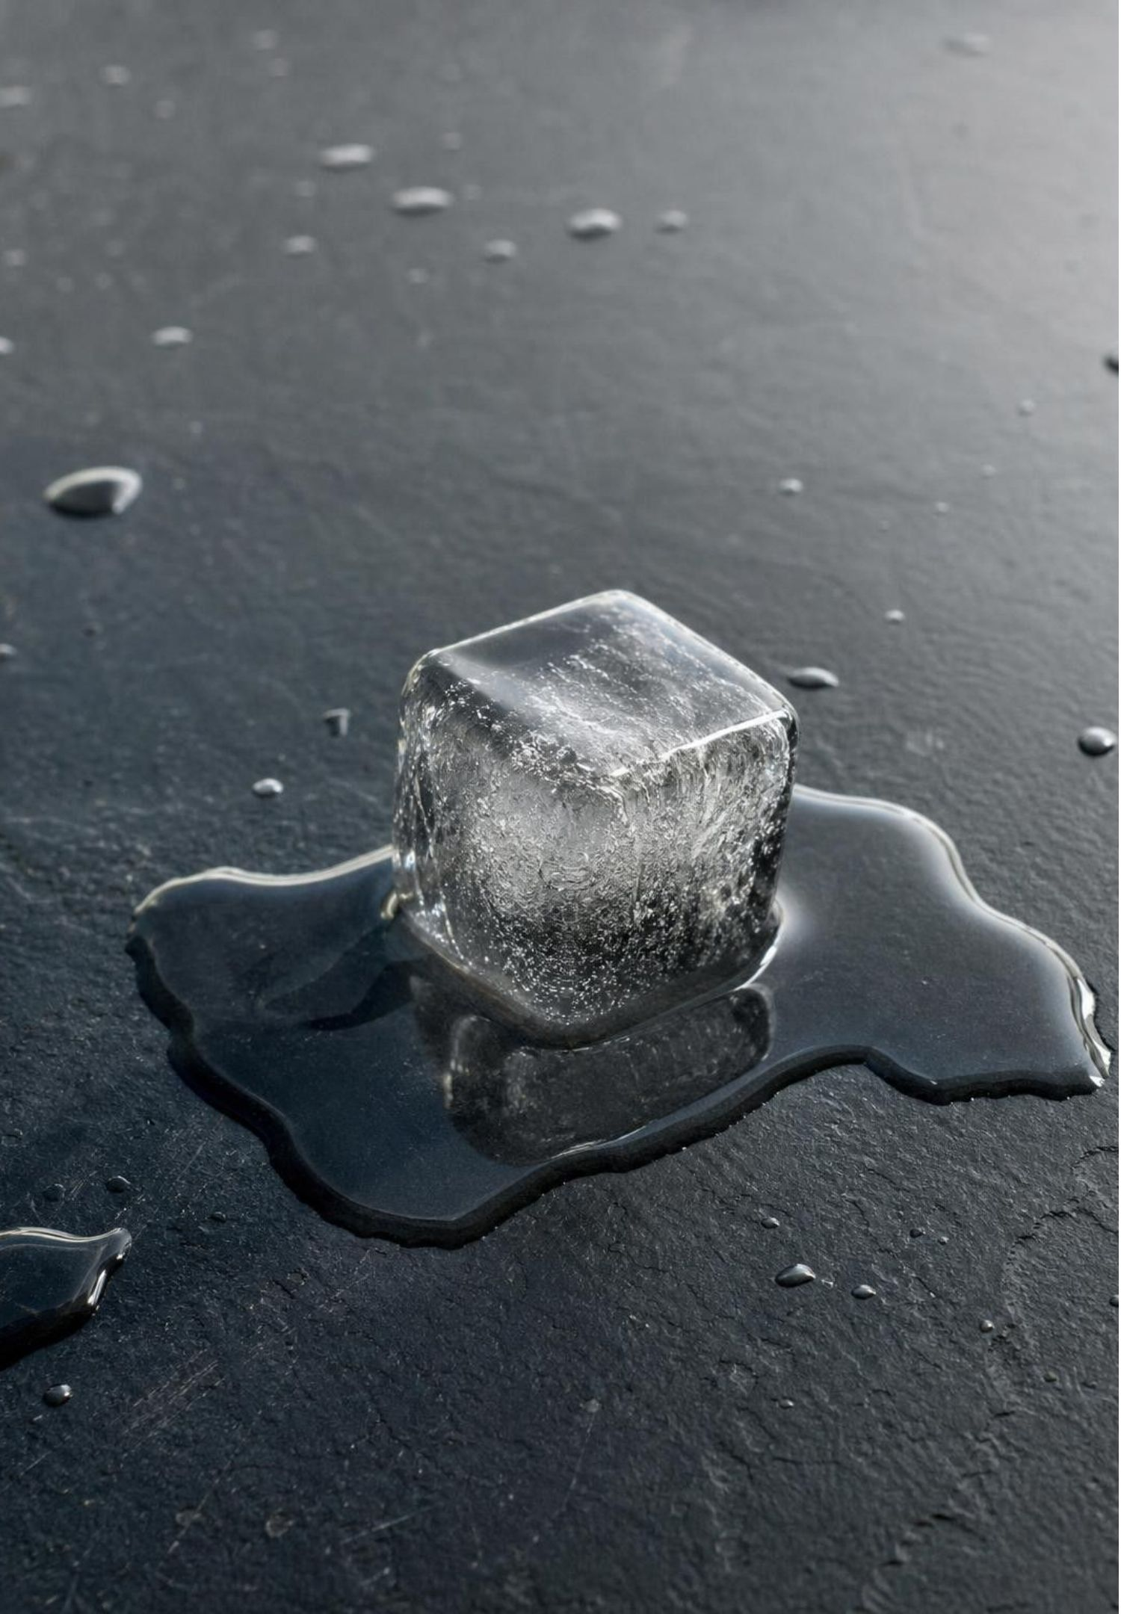
Change without a new substance: physical changes
Melting, freezing, boiling: the substance changes state but stays the same substance.
Dissolving: the solid spreads out among the water particles; evaporate the water and it comes back.
Crushing, cutting, stretching: new shape, same substance.
A physical change can bubble (boiling), get cold (melting ice) or get hot (calcium chloride dissolving).
Test for a physical change: can you get the original substance back with its original properties?
7
Notes:
Return to Bags B and C. Both solids vanished, one bag got hot, one got cool. Ask what would be left if the water evaporated. For Epsom salt the answer is Epsom salt, with the same crystals and the same behavior as before, which is the recovery test students will run in Lab 2. Calcium chloride is harder to dry because it pulls water out of the air, and what comes back is calcium chloride holding some water, so it no longer warms water the way the dry pellets did, but its other behavior matches. Point out the trap in the fourth bullet: temperature changes and bubbles happen in physical changes too. That is why the question is never 'did something dramatic happen' but 'is there a new substance'.
WATCH FOR: 'The salt is gone' means 'the salt stopped existing' to many students. Dissolved means spread out, not destroyed.
CONNECTS TO: Lab 2 stations 2 and 3 (recovery test); W7 misconception repair.
PACING: about 5 min

Slide 8
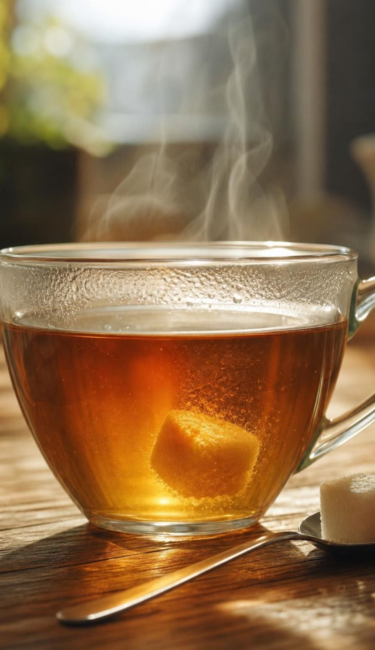
CHECK FOR UNDERSTANDING
Quick check: which change made a new substance?
Four changes. Only one made a new substance. Which?
A. An ice cube melts into a puddle of water.
B. A spoon of sugar disappears into hot tea.
C. A pad of steel wool turns into orange, crumbly rust.
D. A pot of water boils and bubbles rise through it.
8
Notes:
Vote with fingers, then ask one defender for each option. For A, B and D, press for the recovery argument: the water can be frozen again, the sugar can be recovered by evaporating the tea, the steam can be condensed back to water. For C, ask what property changed: color, texture, and (as they will see) whether a magnet pulls on it. Then ask the harder follow-up: is 'it looks different' enough on its own? No; rust is a reaction because tests of its properties show a different substance, not merely because it changed color.
EXPECTED RESPONSES: C. Rust is a different substance from iron (different color, texture, solubility behavior, magnetism). A, B and D are state changes or dissolving; the original substance can be recovered.
WATCH FOR: Some students choose D because of the bubbles. Boiling bubbles are water vapor, the same substance as the liquid.
CONNECTS TO: W10 mastery item on physical versus chemical change; Lab 2 station 5 (steel wool).
PACING: about 4 min

Slide 9
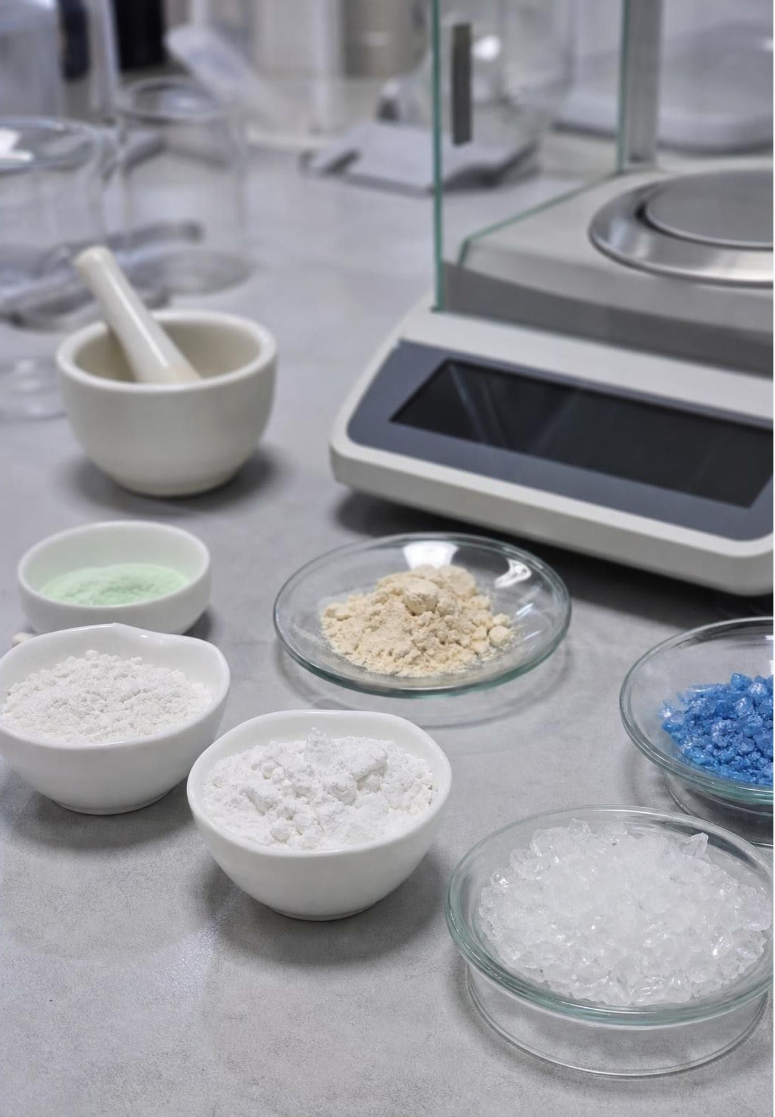
Two kinds of properties, one job: identifying substances
Physical properties are measured without changing the substance: color, density, melting point, solubility.
Chemical properties describe whether a substance can change into new ones: does it burn? react with an acid?
You find a chemical property only by trying the reaction.
Every pure substance has its own combination of properties, like a fingerprint.
So a different fingerprint after a change means a different substance is present.
9
Notes:
Connect to Lesson 3, where students used properties to identify substances. The new idea is that chemical properties are also part of the fingerprint. Baking soda fizzes with vinegar; Epsom salt does not; calcium chloride does not. That difference identifies baking soda as surely as its solubility does. Ask: if a white powder does not fizz with vinegar, can it be baking soda? No. If it does fizz, must it be baking soda? Not necessarily; other substances fizz too, so one test narrows the list and several tests settle it. That logic is Lab 1.
WATCH FOR: Students may call 'fizzes with vinegar' a physical property because they can see it. It requires a reaction, so it is chemical.
CONNECTS TO: Lab 1 mystery powders; L03 Substances and Their Properties.
PACING: about 5 min

Slide 10
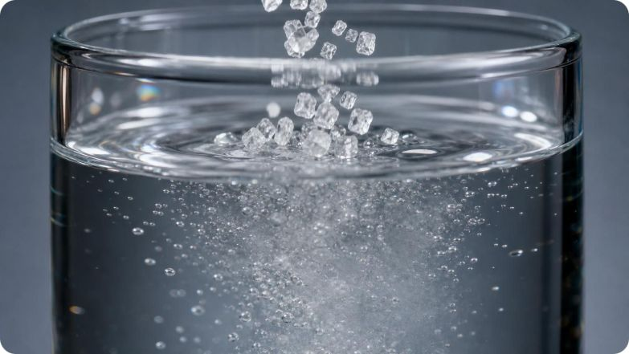
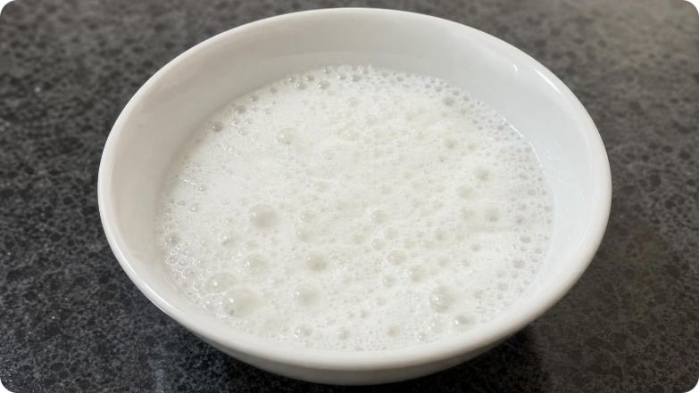
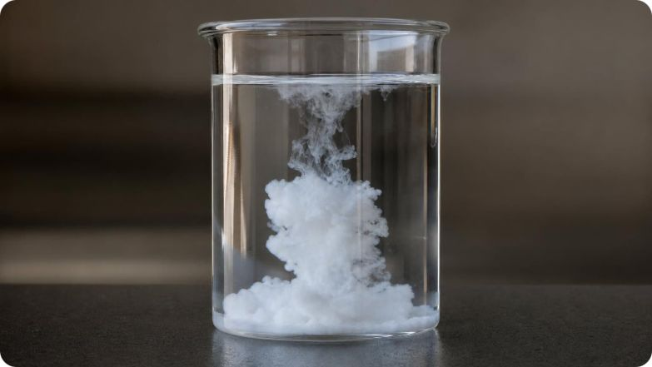
VOCABULARY IN CONTEXT
Property words you will use all week
physical property: A trait you can observe or measure without turning the substance into a different one. Epsom salt is clear and colorless and dissolves readily in water.
chemical property: Whether and how a substance can change into new substances; found by trying the reaction. Baking soda fizzes with vinegar; steel wool rusts in moist air.
precipitate: A solid that forms inside a liquid when dissolved substances react to make something that barely dissolves. Two clear solutions are mixed and a cloudy white solid appears and sinks.
10
Notes:
Precipitate is the new word. Students will make one at Lab 2 station 4 when baking soda solution meets calcium chloride solution. Preview the logic: both starting solutions are clear because both solids dissolve well; the white solid that appears must be a substance that does not dissolve well, so it cannot be either starting solid. A change in solubility is one of the six properties on the chapter's approved list. The textbook's version uses lead compounds that we never handle; ours uses kitchen chemicals.
WATCH FOR: Students may think the precipitate is one of the original solids 'un-dissolving'. The solubility argument rules that out.
CONNECTS TO: Lab 2 station 4; W2 vocabulary.
PACING: about 4 min

Slide 11
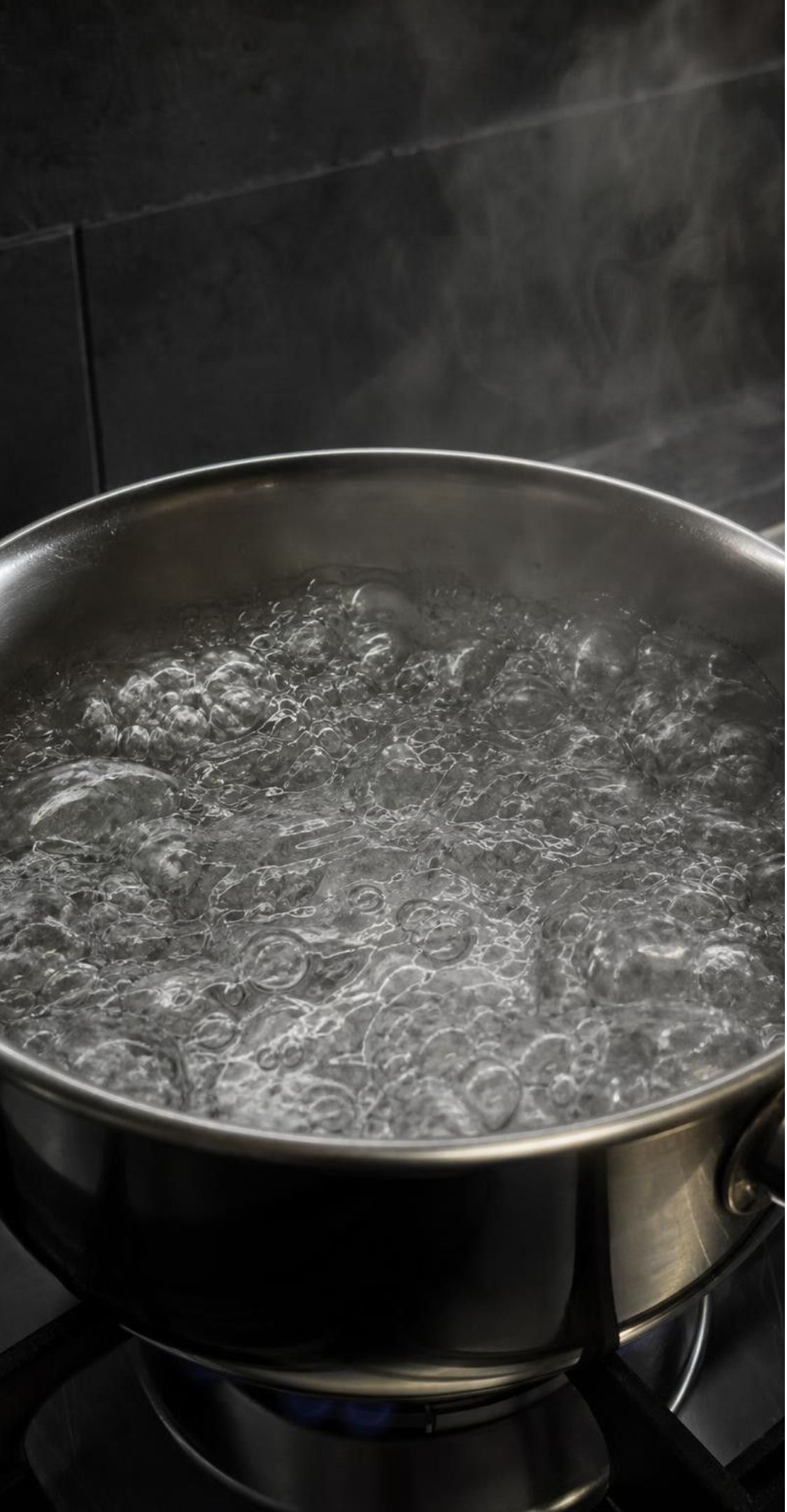
MODEL
Looks like a reaction versus is a reaction
Model: Physical change or chemical reaction?
Physical change: same substance | Chemical reaction: new substance
Ice melting (gets cold) | Baking soda + vinegar (gas forms)
Water boiling (bubbles) | Steel wool rusting (color, texture change)
Epsom salt dissolving (slightly cool) | Two clear solutions making a solid
Calcium chloride dissolving (hot!) | Hydrogen peroxide foaming on yeast
The middle is the problem: the clues overlap. The decision comes from comparing properties before and after.
11
Notes:
Spend time on the overlap. Ask students to find, for every clue on the right, a physical change on the left that shows the same clue: gas (boiling, soda), temperature (ice, calcium chloride), appearance (dissolving). Then ask what is left to tell them apart. The answer is on the last line of the overlap: test the properties of what you end up with. Soda fizz is a useful case: the carbon dioxide was dissolved in the drink under pressure, so it is a gas leaving, not a gas being made.
EXPECTED RESPONSES: Students should produce matched pairs across the diagram and conclude that no single clue is decisive.
WATCH FOR: Students may insist calcium chloride must react because it gets so hot. The recovery test in Lab 2 is the answer; do not just assert it.
CONNECTS TO: Lab 2 decision table; W4 diagram worksheet; W8 collaborative sort.
PACING: about 6 min

Slide 12
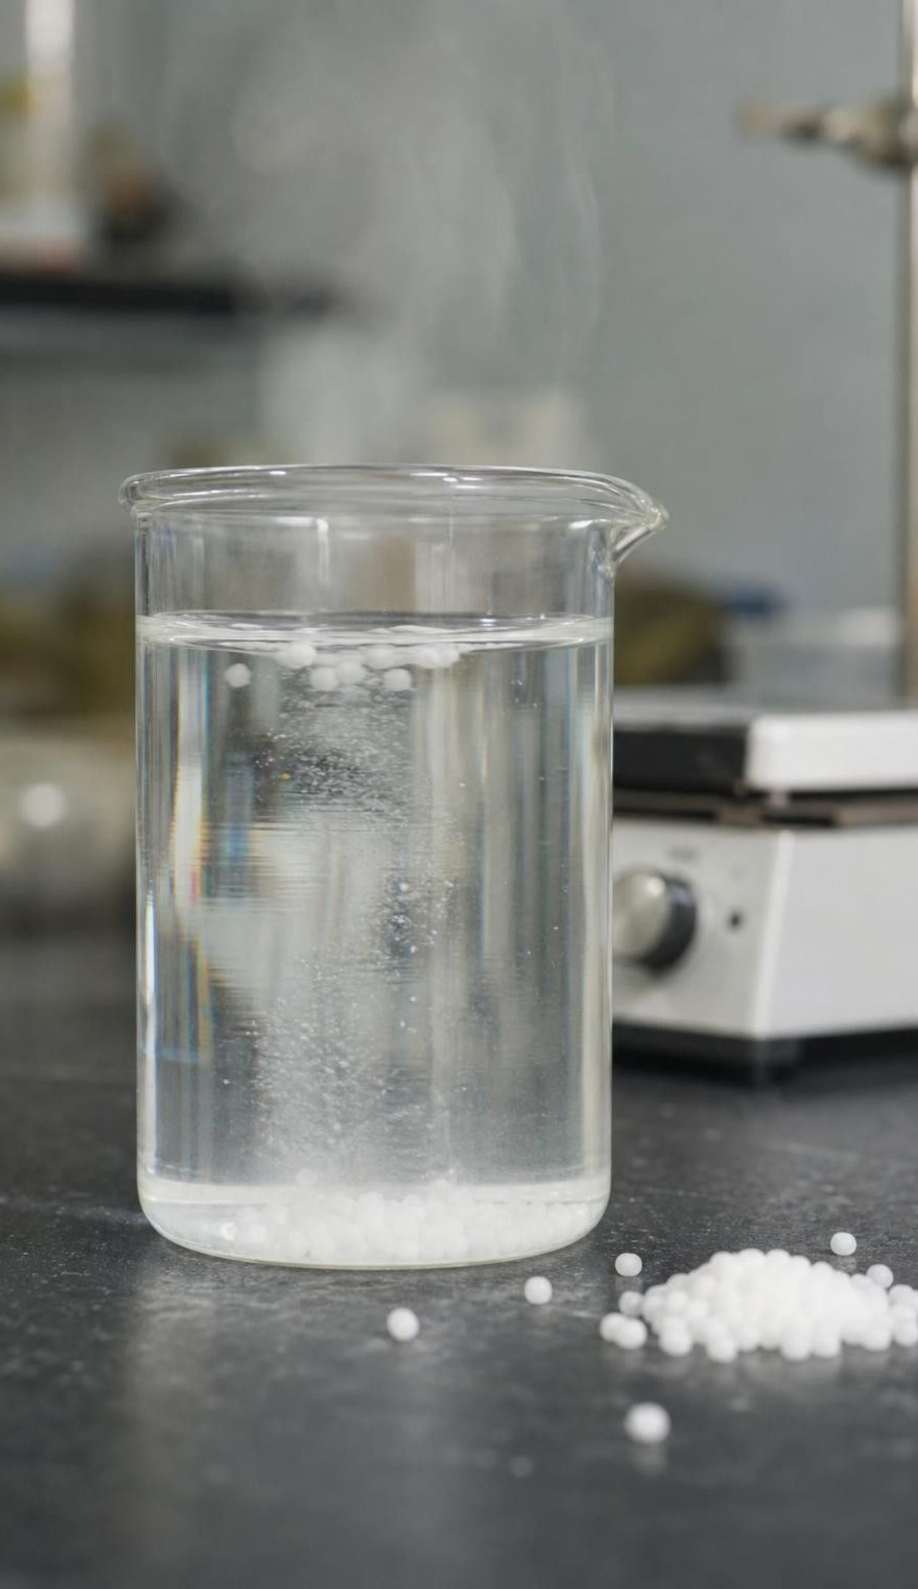
CHECK FOR UNDERSTANDING
Quick check: clue or proof?
Bag B (calcium chloride + water) got hot and the pellets vanished. Which statement is the best science?
A. Getting hot proves a chemical reaction happened.
B. The pellets vanished, so they must have changed into something new.
C. Heat and vanishing are clues; evaporate the water and test what is left before deciding.
D. No bubbles appeared, so nothing happened at all.
12
Notes:
Ask students to answer alone first, then convince a partner. Option C is the only one that separates observation from conclusion. Push on A: name a physical change that gets hot or cold (ice melting takes in heat; the bag that got hot is a dissolving). Push on D: something clearly happened, the question is what. Then ask what result of the evaporation test would change their mind in each direction: if the residue behaves like calcium chloride again (dissolves readily, does not fizz with vinegar, turns a drop of baking soda solution cloudy), it was physical; if a substance with different properties is left, a reaction is back on the table.
EXPECTED RESPONSES: C. A: temperature change is an indicator, not proof. B: dissolving also makes a solid vanish. D: the absence of one clue proves nothing.
WATCH FOR: Students who pick A are treating energy change as the definition of a reaction. Reactions do involve energy, but so do state changes and dissolving.
CONNECTS TO: Lab 2 station 3; W6 CER.
PACING: about 4 min

Slide 13

What makes a reaction start, and what makes it stop?
A reaction needs the right substances and the right conditions; having the substances together is not enough.
Heating: a match head holds its reactants already mixed; friction heats it and the reaction begins.
Cooling: brown nitrogen dioxide gas in a sealed tube fades toward a colorless gas as it cools.
Mixing: some reactants react the moment they meet, like baking soda and vinegar.
A reaction keeps going while both reactants are present and stops when one runs out.
13
Notes:
The match example makes the point that reactants can sit together for years without reacting until a condition changes. Cooling as a trigger surprises students; describe the nitrogen dioxide tube only (it is a toxic smog gas and is never used in class) and say that in the sealed tube both gases are present and cooling shifts the mixture toward the colorless one, so a cold tube can stay faintly yellow. Mixing is the condition at every one of our stations. Then land on the last bullet, which Lab 3 investigates: the fizz stops because a reactant is used up, and the leftover test tells which one.
WATCH FOR: Students may generalize 'heat always speeds up and starts reactions.' The cooling example is the counterexample; conditions are specific to the substances.
CONNECTS TO: Lab 3 (what makes it stop); W3 reading passage.
PACING: about 5 min

Slide 14




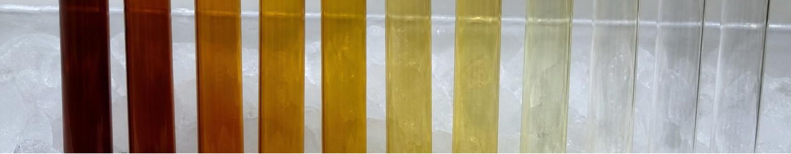
MODEL
Conditions: three ways in, one way out
Model: Conditions that start a reaction, and the condition that ends it
Heating: Friction warms a match head; the already-mixed reactants begin to react and the head flares.
Cooling: Brown nitrogen dioxide in a sealed tube fades toward colorless dinitrogen tetroxide as it is chilled; warming brings the brown back.
Mixing: Two clear solutions meet and a solid forms at once; baking soda meets vinegar and fizzes immediately.
Running out: The fizz stops when either the baking soda or the vinegar's acetic acid is used up; adding more of the missing one restarts it.
Described examples only: matches, lead compounds and nitrogen dioxide are never handled in this chapter.
14
Notes:
Have students copy the four labels and write one of our stations next to each where it fits (mixing fits all six; running out fits the fizz and the peroxide). Ask whether heating always helps: the cooling panel says no. Ask whether a reaction can stop with reactant still present: yes, if the other reactant is gone, which is why a cup of vinegar can still be sour after all the baking soda is used. Preview Lab 3, where they will find the amount of baking soda that exactly uses up 50 mL of vinegar.
WATCH FOR: 'Running out' is not a loss of energy; it is a reactant being consumed.
CONNECTS TO: Lab 3; W4 diagram worksheet.
PACING: about 5 min

Slide 15
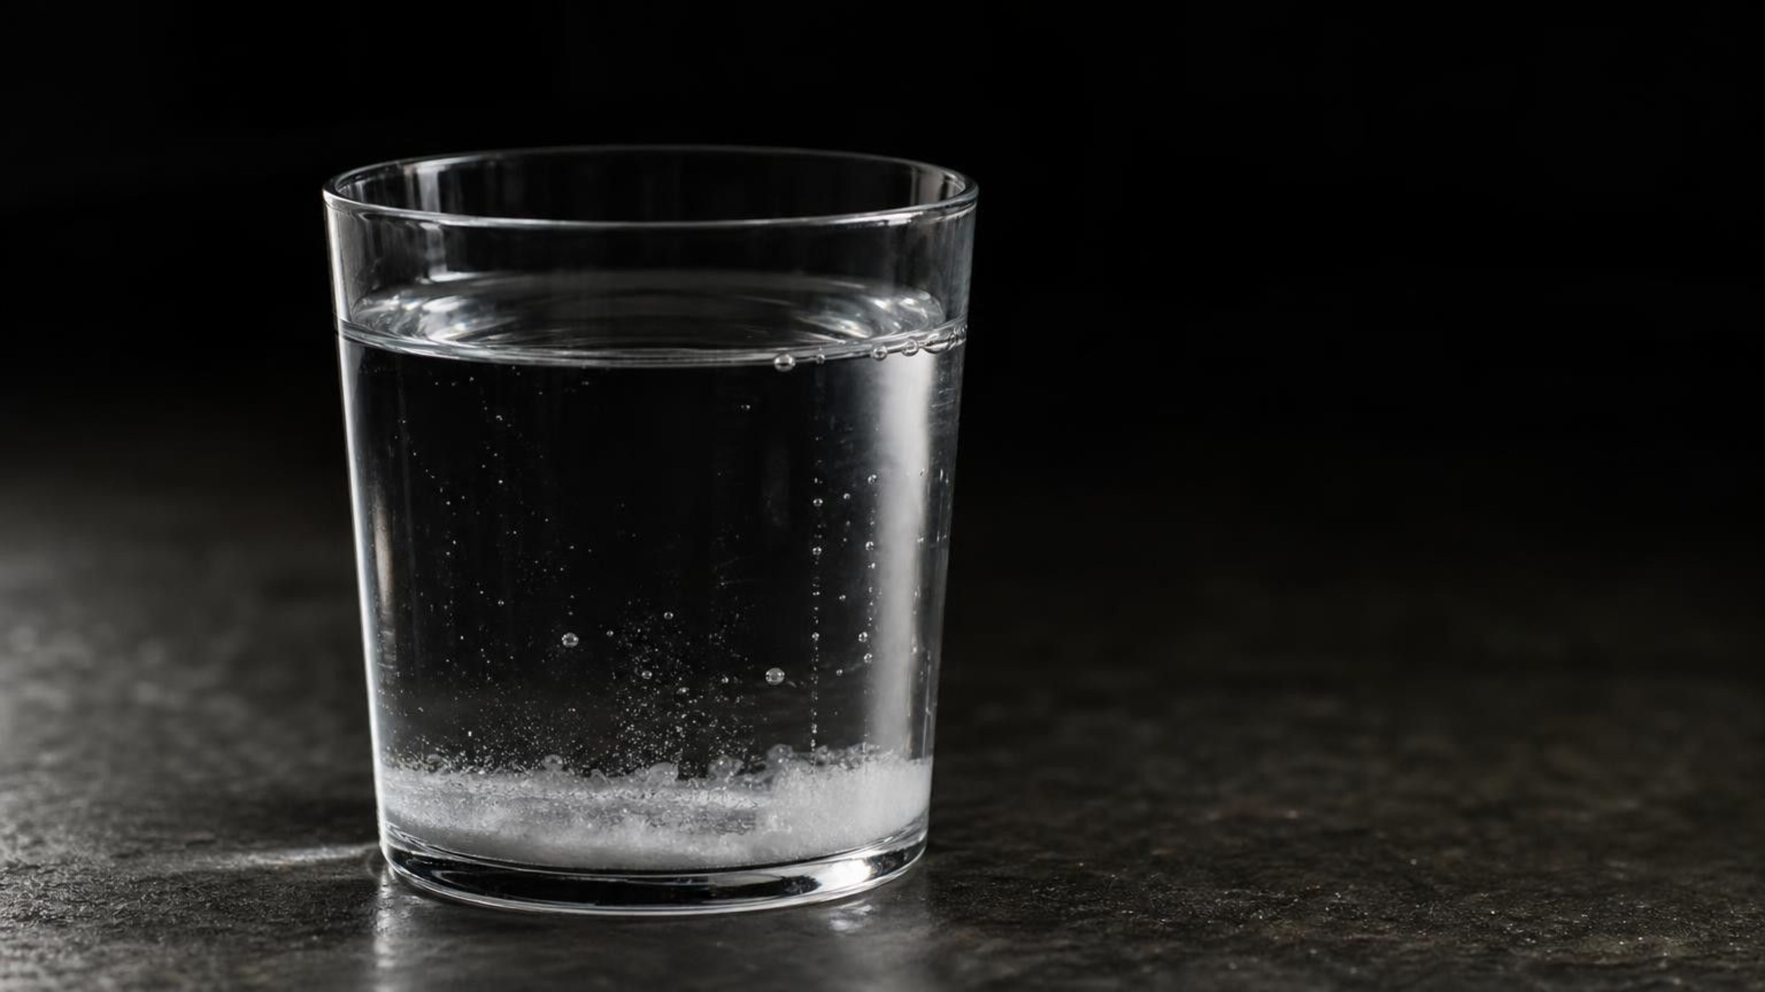
THINK, PAIR, SHARE
Discuss: why does the fizzing stop?
A cup of vinegar with a spoon of baking soda fizzes hard, then slows, then stops. The cup is still full of liquid. Why did it stop, and how could you find out which ingredient ran out?
Notes:
Give pairs three minutes. Collect explanations on the board without judging, then sort them into 'reaction wore out' and 'a reactant was used up'. Ask how the two explanations could be told apart: add a pinch of baking soda to the liquid (fizz means acid remains) or a few drops of vinegar (fizz means baking soda remains). If the 'wore out' explanation were right, neither addition would do anything. Tell students they will run exactly this test in Lab 3 and that it is a chemical property test of what is left in the cup.
EXPECTED RESPONSES: Target: one of the reactants was used up, so nothing is left to react; add a little of each reactant separately and see which one restarts the fizz. Common alternative: 'the reaction ran out of energy' or 'the vinegar got weak'.
CONNECTS TO: Lab 3 leftover test; W6 CER can use this evidence.
PACING: about 6 min

Slide 16
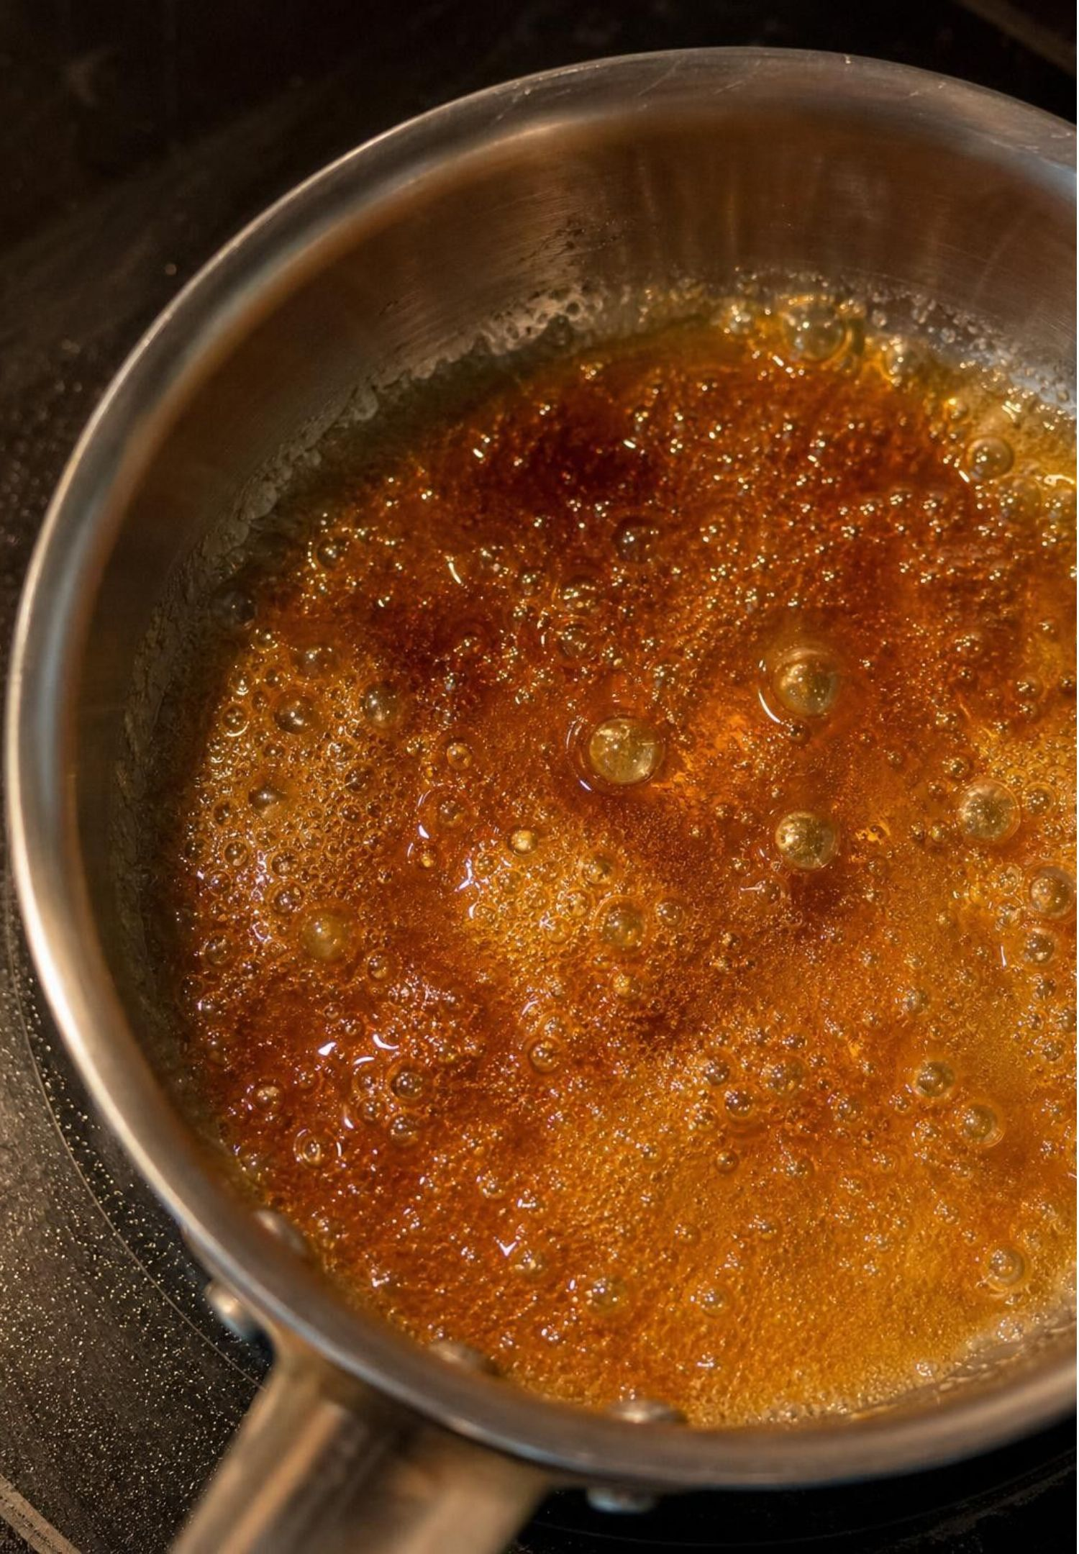
Clues that a reaction may have happened
A gas forms where there was none (bubbles, foam, a bag inflating).
A new color appears, or a solid (precipitate) forms inside a liquid.
The mixture gets warmer or colder than its surroundings, or gives off light.
A new smell appears, like the caramel smell when sugar is heated until it browns.
Every one of these is also seen in some physical change. Clues start an investigation; they do not end it.
16
Notes:
This is the indicator list, and the last bullet is the rule. Have students pair each clue with its physical-change twin from the compare diagram. Note the sugar example: heating sugar until it browns makes new substances with a new smell, which is a reaction; that is different from burning sugar in a flame, and nothing is tasted in a lab, so smell and appearance are the clues we can use. Then ask: when a chemist sees a clue, what is the next step? The next slide is that step.
WATCH FOR: Light and heat get treated as proof. Light-sticks are reactions, but a hot bag can be a dissolving; the clue only says 'look closer'.
CONNECTS TO: W5 data worksheet; W8 collaborative evidence sort.
PACING: about 4 min

Slide 17
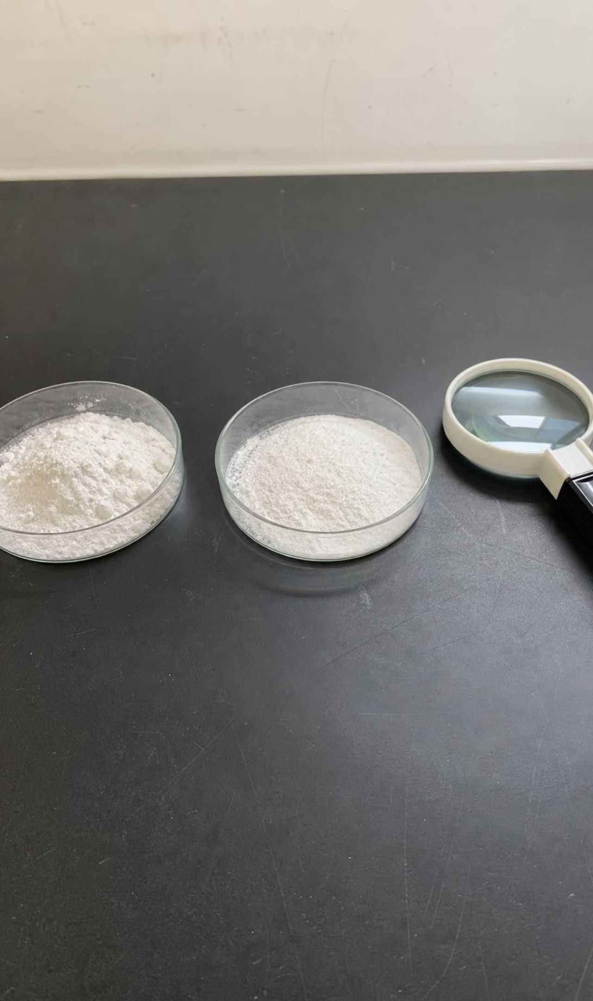
From clue to claim: how a chemist decides
MODEL
Model: The before-and-after method
Notice a clue: gas, color, solid, temperature, light, smell
Ask: which substance might be new, and what do I have after the change?
Measure properties of the substances before and after: solubility, melting point, density, odor, flammability
Compare: do the characteristic properties differ, or can the original be recovered?
Decide: new substance or not, and rate how strong the evidence is
Two agreeing tests make a stronger claim than one. A test that gives the same value before and after is not evidence against a reaction; it just did not help.
17
Notes:
This flow is the procedure for Lab 2 session 2 and for the written CER. Walk it with Bag A: clue is gas and cooling; the substances after are a gas and a liquid; the leftover liquid does not fizz with more vinegar when the baking soda is gone, which is a chemical property that baking soda has and the product lacks; decide: new substances, strong evidence. Walk it with Bag C: clue is cooling and vanishing; after evaporation the crystals look and behave like Epsom salt; decide: physical change. Stress the caption: a matching result is not evidence either way.
EXPECTED RESPONSES: Students should be able to narrate the five steps for one bag without prompting by the end of the slide.
WATCH FOR: Students treat a matching density as proof that nothing happened. It is a test that simply could not tell the two apart.
CONNECTS TO: Lab 2 session 2; W6 CER; W5 data worksheet.
PACING: about 6 min

Slide 18
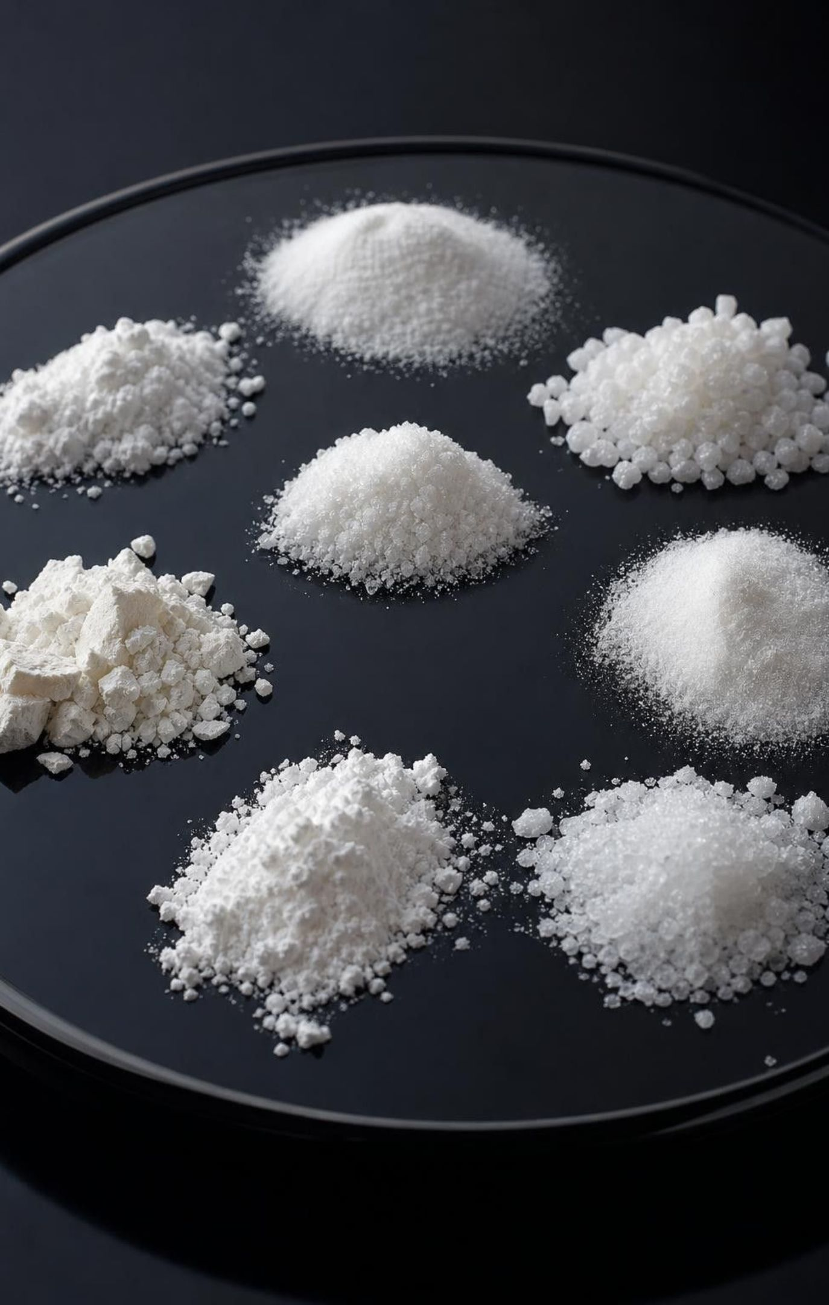
The six properties that count as evidence
Density: mass per unit volume; hard to measure well for a powder, easy for a liquid or solid block.
Melting point and boiling point: a pure substance melts or boils at its own temperature.
Solubility: how much dissolves in a set amount of water at the same temperature.
Flammability: whether it burns (a chemical property; a teacher-only test, and never in this chapter).
Odor: a new smell can mean a new substance, but many substances have no smell.
Why not color alone? Thousands of substances are white powders.
18
Notes:
These six are the properties the state standard names for deciding whether a reaction occurred, so they are the ones the quiz will use. Explain why each is characteristic: melting point depends on the substance, not on how much you have. Point out the practical limits: a powder's density depends on how it is packed, so two powders can read the same even if they differ; a solubility comparison only counts when both measurements are at the same temperature. Flammability tests are described in data tables, never performed. Then set up the task on the next slide: two white powders, five tests.
WATCH FOR: Students may believe appearance is a strong test. Aspirin and salicylic acid look identical.
CONNECTS TO: W5 data worksheet; W10 mastery.
PACING: about 5 min

Slide 19
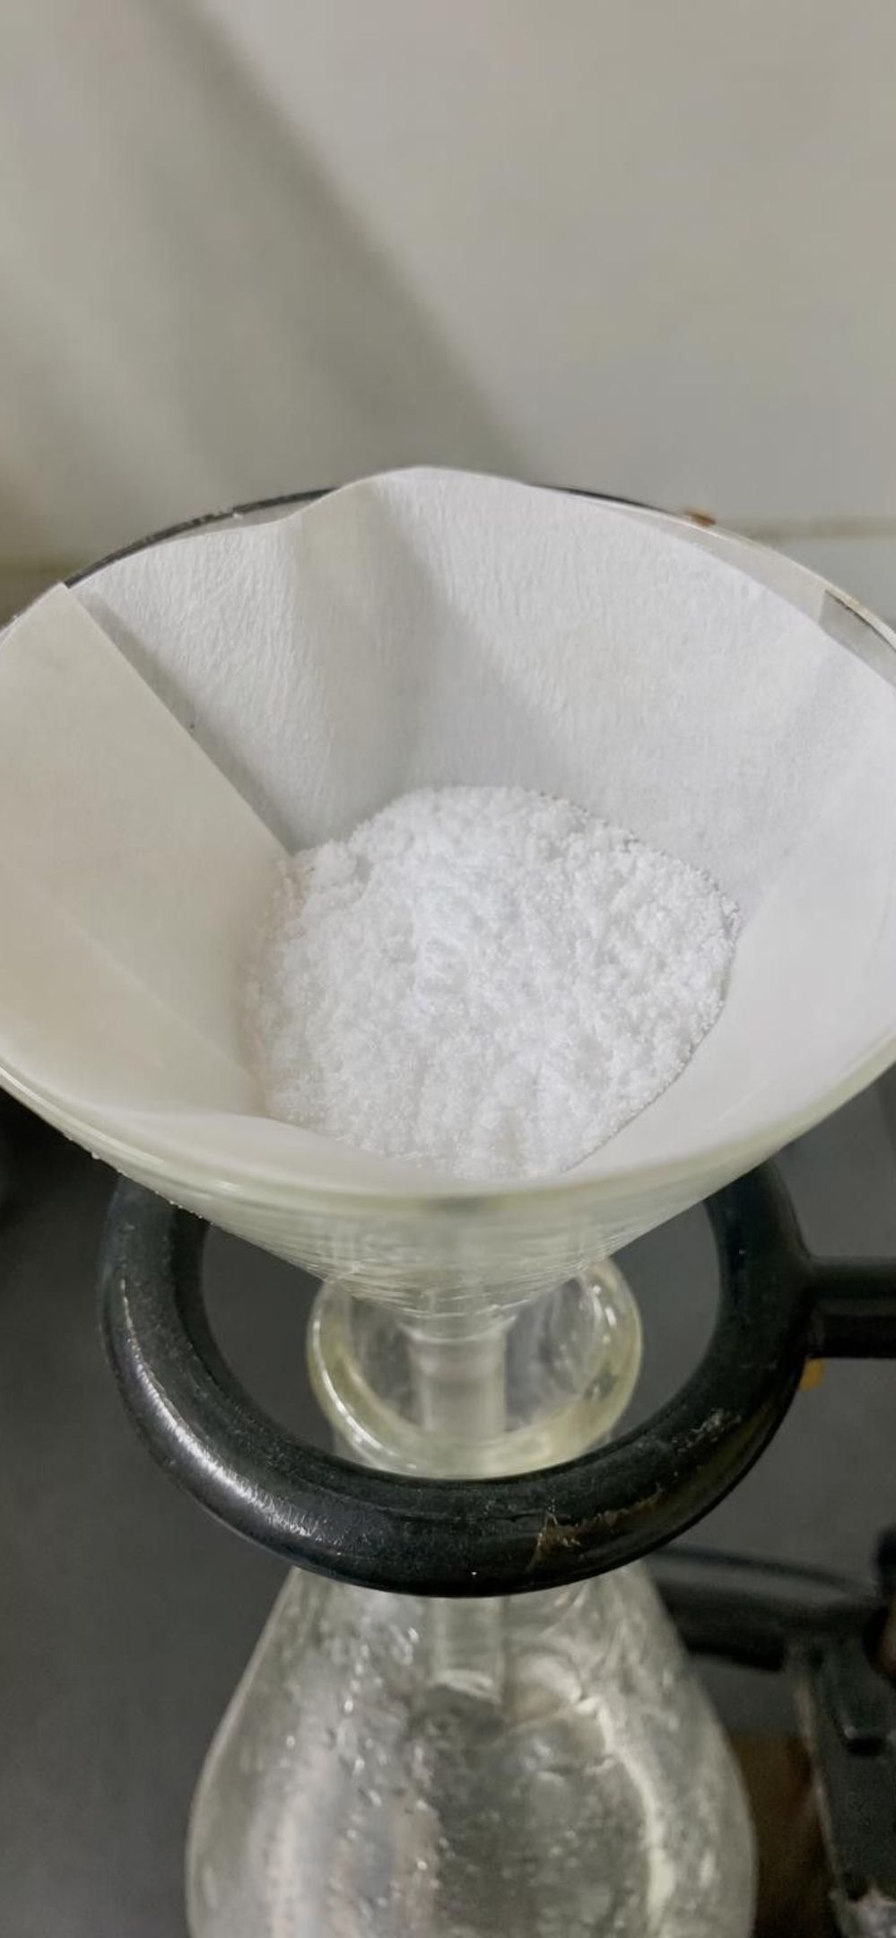
APPLY IT
Task: did the chemist make a new substance?
Simulated data for practice.
A chemist reacts salicylic acid with a second substance, heats and cools the mixture, and collects a white powder. Use the five test results to decide if it is a new substance and which results carry the argument.
Test | Starting powder (salicylic acid) | Powder after the procedure
Appearance | white powder | white powder
Density of a packed cube | about 1.4 g/cm³ | about 1.4 g/cm³
Solubility in water at 25 °C | about 2.2 g per liter | about 3.3 g per liter
Melting range | 158-159 °C (narrow) | 134-136 °C (narrow)
Odor | none noticed | none noticed
19
Notes:
This is a teaching dataset: the values are rounded from published reference data for salicylic acid and for aspirin, and the chemist's story is the textbook's example retold. Give groups eight minutes with three questions: which rows show a difference, which rows show no difference, and what does a no-difference row tell you. Rows 1, 2 and 5 match; that does not argue against a new substance, it just means those tests could not tell the powders apart (and a packed-powder density is a rough number anyway). Row 3 differs, with both measurements at the same temperature, so it counts. Row 4 differs by more than 20 °C and both ranges are narrow, which makes the 'impure sample' explanation very unlikely for a lower melting point. Conclusion: a new substance, supported by two independent property changes. Then reveal that the new powder is aspirin.
EXPECTED RESPONSES: Yes, a new substance. Evidence: solubility differs (2.2 vs 3.3 g/L at the same temperature) and melting range differs (158-159 vs 134-136 °C, both narrow). Appearance, density and odor matched, which is uninformative rather than contrary. Two agreeing tests make the claim strong.
WATCH FOR: Some groups will say 'three tests matched, two differed, so it is probably the same.' Counting is not weighing: one reliable characteristic difference is enough; matching tests are neutral.
CONNECTS TO: W5 data worksheet uses the same logic on a different pair; W6 CER.
PACING: about 10 min

Slide 20
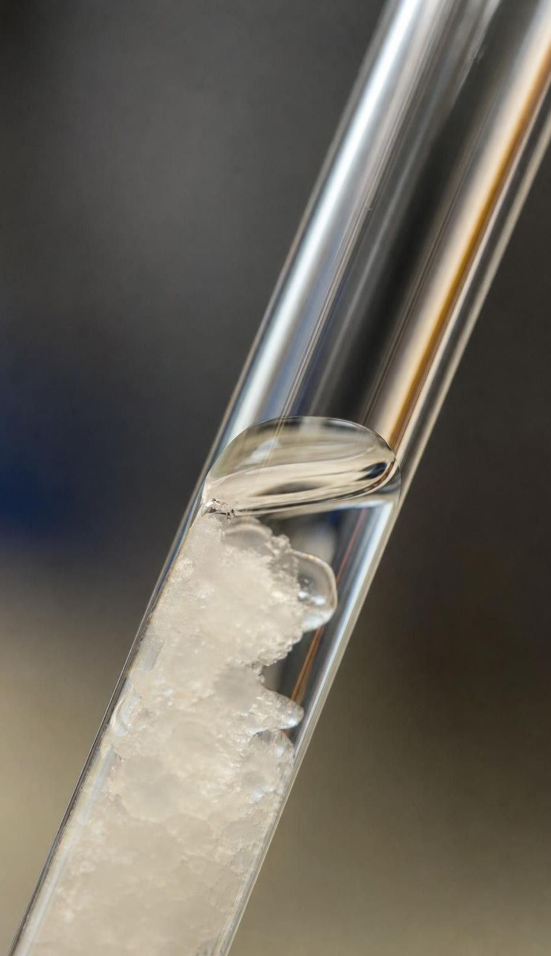
CHECK FOR UNDERSTANDING
Quick check: which pair of results makes the case?
From the task table, which two results together give the strongest evidence that the chemist made a new substance?
A. Appearance and density
B. Density and solubility
C. Solubility and melting range
D. Appearance and melting range
20
Notes:
Quick vote. C is right because both results differ, both are characteristic properties, and they are independent of each other. Ask why B is weaker: the density numbers matched, so that half contributes nothing. Ask why D is weaker: appearance matched. Then the stretch question: what if the melting range had been wide, say 120-136 °C? That would suggest an impure sample rather than a clean new substance, so the chemist would purify and remeasure before claiming anything.
EXPECTED RESPONSES: C. Solubility (at the same temperature) and melting range both differ and are both characteristic properties; a matching result in the other options adds nothing.
WATCH FOR: Students who choose A or D are treating 'looks the same' as evidence. It is a test that failed to discriminate.
CONNECTS TO: W10 mastery; W5 data worksheet.
PACING: about 3 min

Slide 21
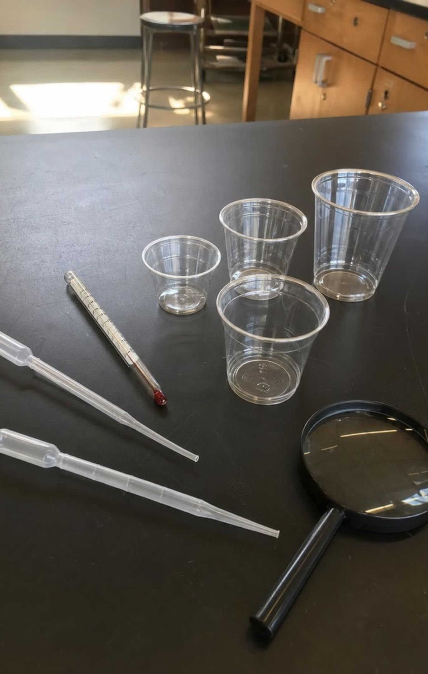
THINK, PAIR, SHARE
Discuss: design the test that settles Bag B
Use only our materials: cups, water, vinegar, baking soda solution, droppers, a thermometer, a hand lens.
Your test must compare something before with the same thing after.
Bag B got hot and the pellets vanished. Design one test, say what result would convince you it was a physical change, and what result would convince you it was a reaction.
21
Notes:
Pairs write a test on a card. The strongest design is a recovery test: let a drop or a shallow dish of the Bag B liquid dry, then compare the residue with fresh pellets in the same tests. If it dissolves as readily, does not fizz with vinegar and turns a drop of baking soda solution cloudy, as the pellets do, the residue has the pellets' properties and it was a dissolving. If it will not dissolve, or behaves differently in those tests, something with different properties is present. Accept other before-and-after property comparisons. Name two practical catches: calcium chloride pulls water from the air, so the residue may stay damp (a property it shares with the pellets); and a thermometer will not help, because a few dried drops are far too little to warm water and calcium chloride dried at room temperature comes back holding water, which no longer warms water as it dissolves. Collect cards for Lab 2 session 2.
EXPECTED RESPONSES: A recovery or property test with two stated outcomes, e.g. 'dry it out; if the solid dissolves and behaves like the pellets in the same tests, physical; if a solid with different properties appears, reaction.' Weak answers restate the clue ('check if it gets hot again').
CONNECTS TO: Lab 2 station 3 and session 2; W9 transfer task uses the same two-outcome format.
PACING: about 6 min

Slide 22

REAL-WORLD CONNECTION
California connection: the bridge that never stops rusting
The Golden Gate Bridge is steel, and the fog that rolls through the Golden Gate carries salt water. Iron in the steel reacts with oxygen and water to form rust, a different substance that is crumbly and flakes away. Painters work year-round removing rust and repainting the orange steel, because the reaction never stops while iron, oxygen and moisture meet. Paint works by keeping two of the three reactants apart.
22
Notes:
Use this to show the chapter's ideas at work in a place students know. Rust is a new substance: different color, no metallic shine, crumbly, not held by a magnet the way steel is. Conditions matter: salt fog speeds it up, dry desert air slows it. And the painters are applying the running-out idea in reverse: the reaction continues while all reactants are present, so the job is to remove one of them (paint blocks oxygen and water from the iron). Connect to Lab 2 station 5, where vinegar strips the steel wool's protective coating and peroxide supplies oxygen fast, so the rusting that takes years on a bridge takes minutes in a cup.
CONNECTS TO: Lab 2 station 5 (steel wool); W3 reading passage; W9 transfer.
PACING: about 4 min

Slide 23
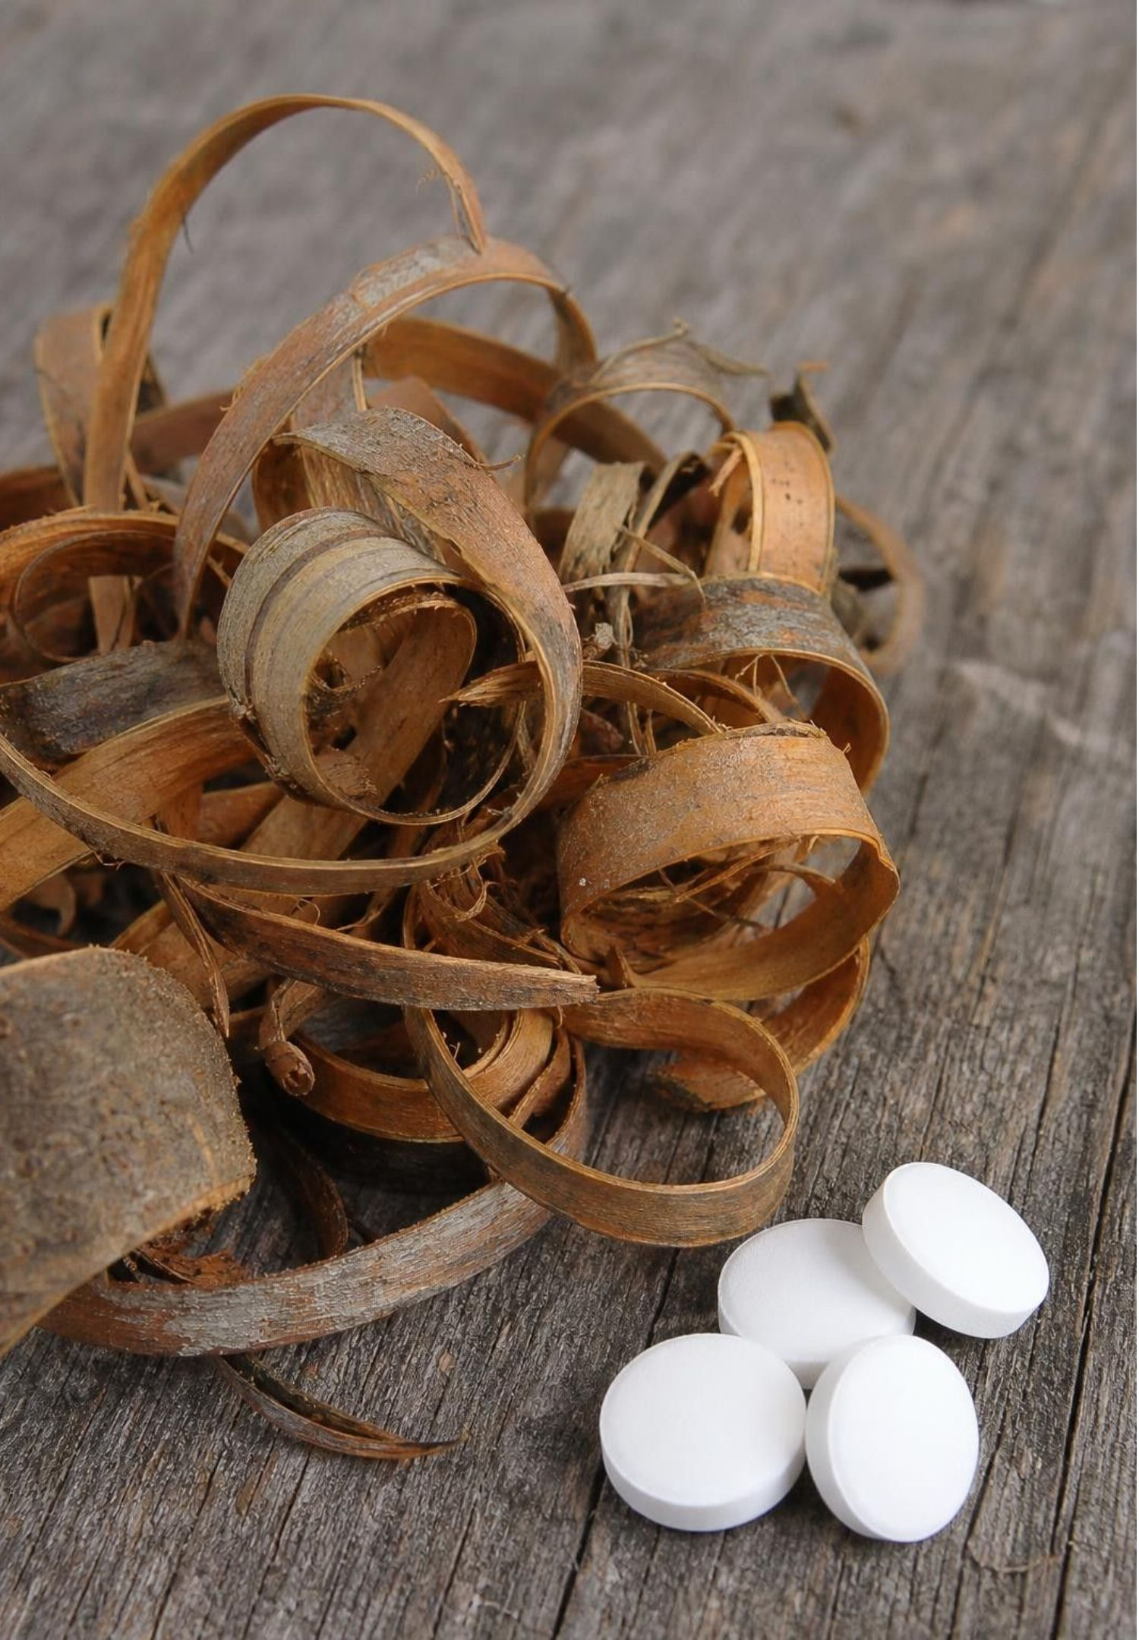
Medicines made by reactions, tested against criteria
For centuries people chewed willow bark for pain and fever; chemists wanted the substance that worked.
Salicin was taken from the bark; reactions turned it into salicylic acid, the form that acts in the body.
Salicylic acid worked but irritated the stomach; some patients could not keep taking it.
Chemists reacted salicylic acid into a new substance, acetylsalicylic acid, now called aspirin.
Criteria for the design: reduce pain and fever, and cause few side effects. Patient tests judged both.
23
Notes:
Frame this as engineering: a problem (pain and fever), criteria (relief with few side effects), and competing solutions tested against the criteria. Each step in the chain is a chemical reaction, and chemists knew they had a new substance by the same before-and-after tests students did on the task slide: aspirin's solubility and melting point differ from salicylic acid's. Be careful with the history: the patient tests of the 1800s were not clinical trials in the modern sense (no comparison groups, no ethics boards), and aspirin is not free of side effects; it can irritate the stomach and cause breathing trouble in some people, and it is not routinely given to children or teens. We are evaluating a design, not giving medical advice.
WATCH FOR: 'Aspirin has no side effects' is the wrong lesson. It met the criteria better than salicylic acid in those tests; that is all the evidence supports.
CONNECTS TO: W9 transfer task on evaluating designs; W3 reading passage.
PACING: about 5 min

Slide 24
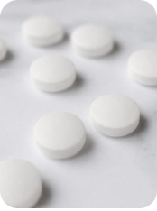
From bark to tablet: a timeline of reactions
MODEL
Model: How willow bark became aspirin
For centuries: Willow bark chewed or brewed for pain and fever; nobody knows which substance helps.
1853: Charles Gerhardt first makes acetylsalicylic acid from salicylic acid; it is not yet used as a medicine.
1829: Salicin is isolated from willow bark by the French pharmacist Henri Leroux.
1897: Felix Hoffmann at Bayer makes it in pure form; patient tests follow and Bayer sells it as Aspirin from 1899.
1838: Raffaele Piria makes salicylic acid from salicin by chemical reactions; it treats fever but irritates the stomach.
Early 1900s: Aspirin becomes one of the most widely used medicines in the world.
Each arrow in the chain is a chemical reaction that produced a substance with different properties from the one before it.
24
Notes:
Read the timeline as a chain of reactions, each confirmed by property changes. Ask which step solved the stomach problem (the last reaction) and which criterion each step improved. Dates are from the U.S. National Library of Medicine's aspirin history; the textbook's dates differ slightly, and historians still debate who at Bayer deserves credit and whether a patent was granted, so no quiz asks for dates or names. The point students should keep: a chemical reaction can turn a natural substance into a synthetic one with more useful properties, which Lesson 15 picks up.
WATCH FOR: Students may think aspirin comes straight from willow bark. It is made by reactions from substances that originally came from bark; today factories make the salicylic acid from petroleum-based chemicals, not from bark.
CONNECTS TO: W3 reading passage; L15 Chemical Engineering and Society.
PACING: about 4 min

Slide 25
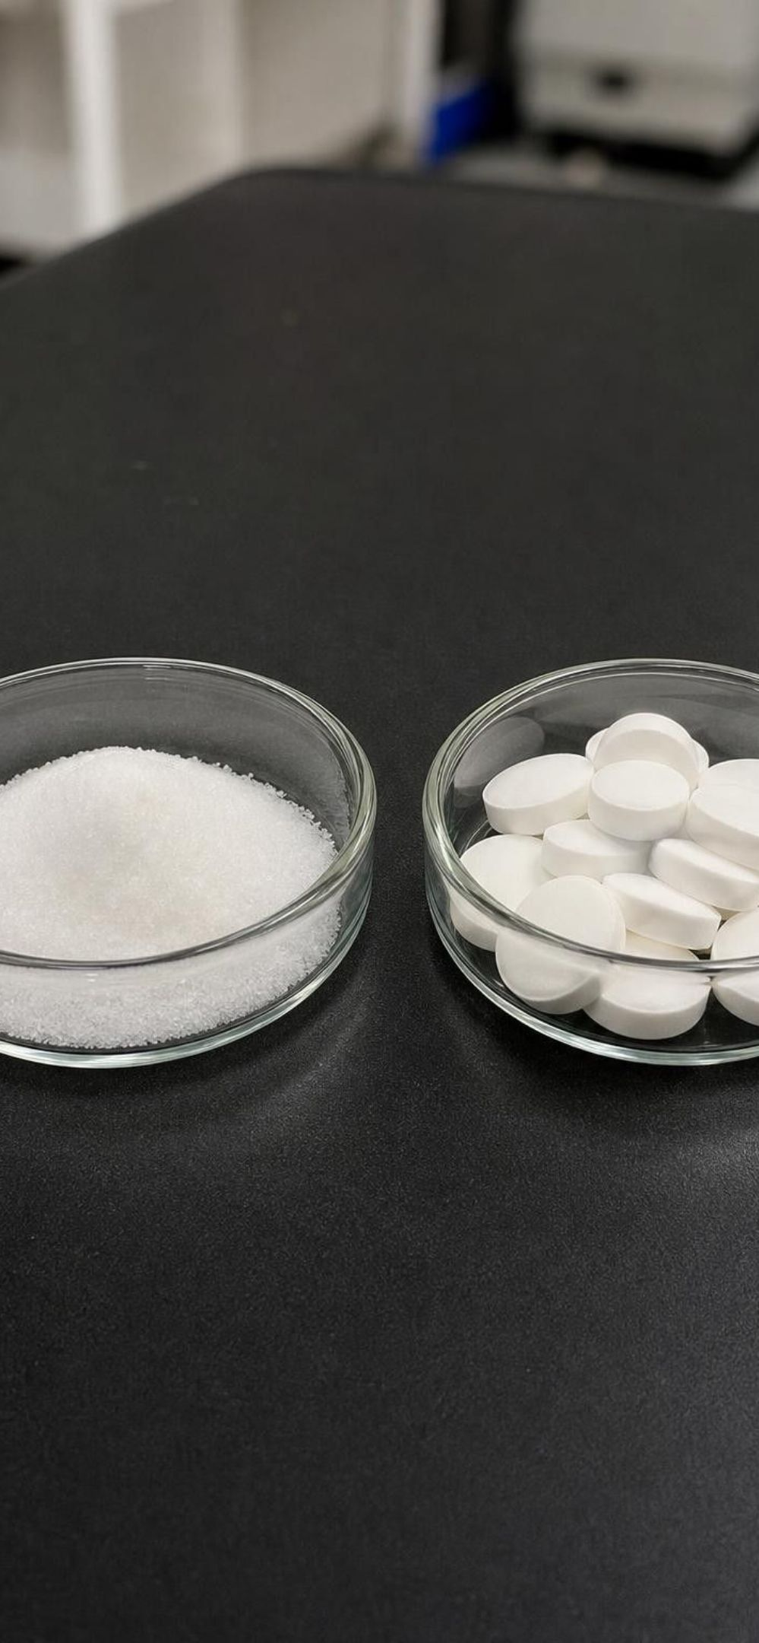
CHECK FOR UNDERSTANDING
Quick check: which conclusion do the tests support?
Salicylic acid: fevers and pain reduced; stomach irritation common, some patients stopped taking it.
Aspirin: fevers and pain reduced; fewer complaints of stomach trouble in the patients tested.
Criteria: reduce fever and pain; cause few side effects. Which conclusion do the test results below support?
A. Aspirin has no side effects, so it is safe for everyone.
B. Aspirin met both criteria better than salicylic acid in these tests.
C. Salicylic acid failed both criteria, so it was never a useful medicine.
D. The tests prove that aspirin works for every illness.
25
Notes:
Vote, then ask students to say what each wrong option adds that the evidence does not contain. A claims an absence of side effects the data never showed and ignores that the patients tested were a small group. C ignores that salicylic acid met the first criterion. D goes beyond fever and pain. B stays inside the evidence: better on the second criterion, equal on the first, for these patients. This is the discipline the W9 task asks for: conclusions no bigger than the data.
EXPECTED RESPONSES: B. The data show equal performance on relief and fewer side-effect complaints for aspirin in the patients tested; nothing in the data supports 'no side effects', 'failed both' or 'every illness'.
WATCH FOR: Students overgeneralize from a small historical test to a universal claim; point out modern trials use comparison groups and much larger numbers.
CONNECTS TO: W9 transfer task; W10 mastery.
PACING: about 4 min

Slide 26
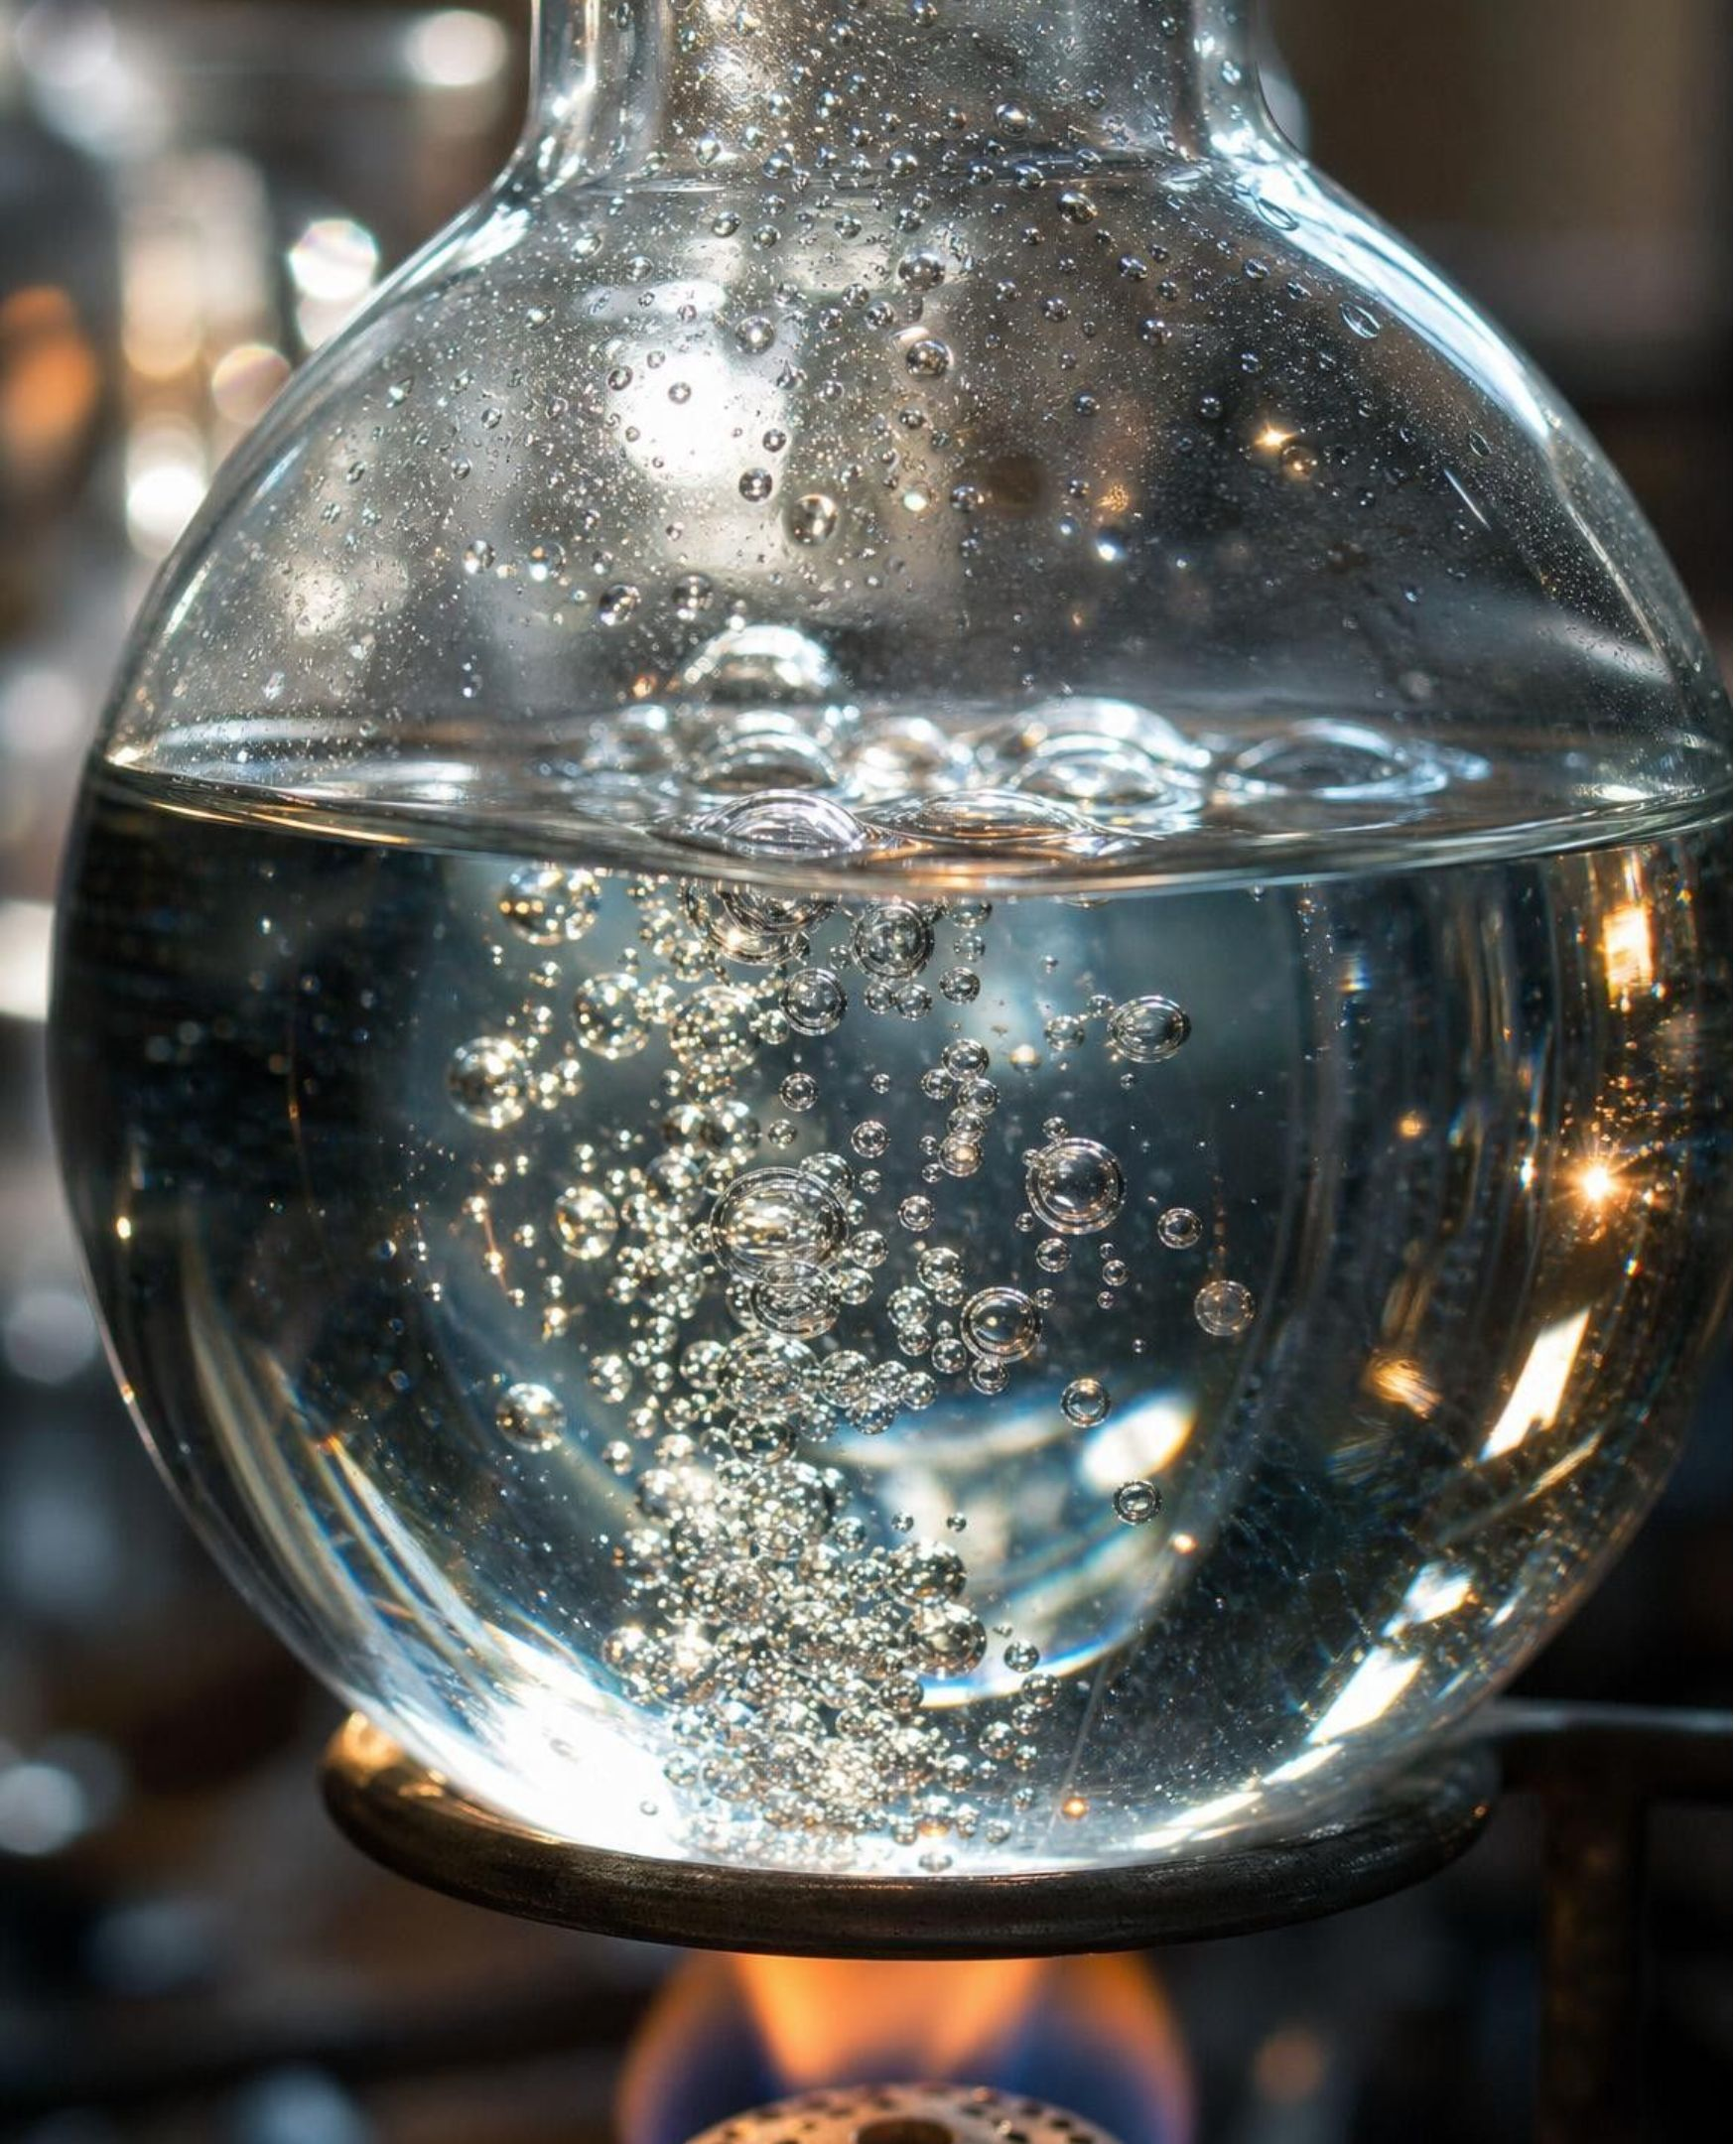
MISCONCEPTION CHECK
True or false? If it bubbles, it reacted
"If something bubbles when you mix or heat it, a chemical reaction definitely happened."
True or false? Explain your reasoning.
26
Notes:
Return to the parked question from day one and to the compare diagram. Ask students to write a verdict with two pieces of evidence from the week. Bubbles mean a gas is leaving the liquid. In boiling water the gas is water vapor, the same substance; in an opened soda it is carbon dioxide that was dissolved under pressure, already present. In Bag A the carbon dioxide was not present in either reactant, and the leftover liquid lost a chemical property that baking soda has, which is what made the bubbles count. So the statement is false as written: bubbles are a clue, and the claim needs a property comparison. Then settle the three bags: A reaction; B and C dissolving, shown by recovery of the original solids.
EXPECTED RESPONSES: False. Boiling and soda fizz bubble with no new substance; bubbles are evidence only when a property test shows the gas, or the leftover material, is a different substance (Bag A's leftover liquid no longer fizzes with vinegar once the baking soda is gone).
WATCH FOR: Students may swing to 'bubbles never mean a reaction.' They often do; the point is that they must be confirmed.
CONNECTS TO: W7 misconception repair; W6 CER.
PACING: about 6 min

Slide 27
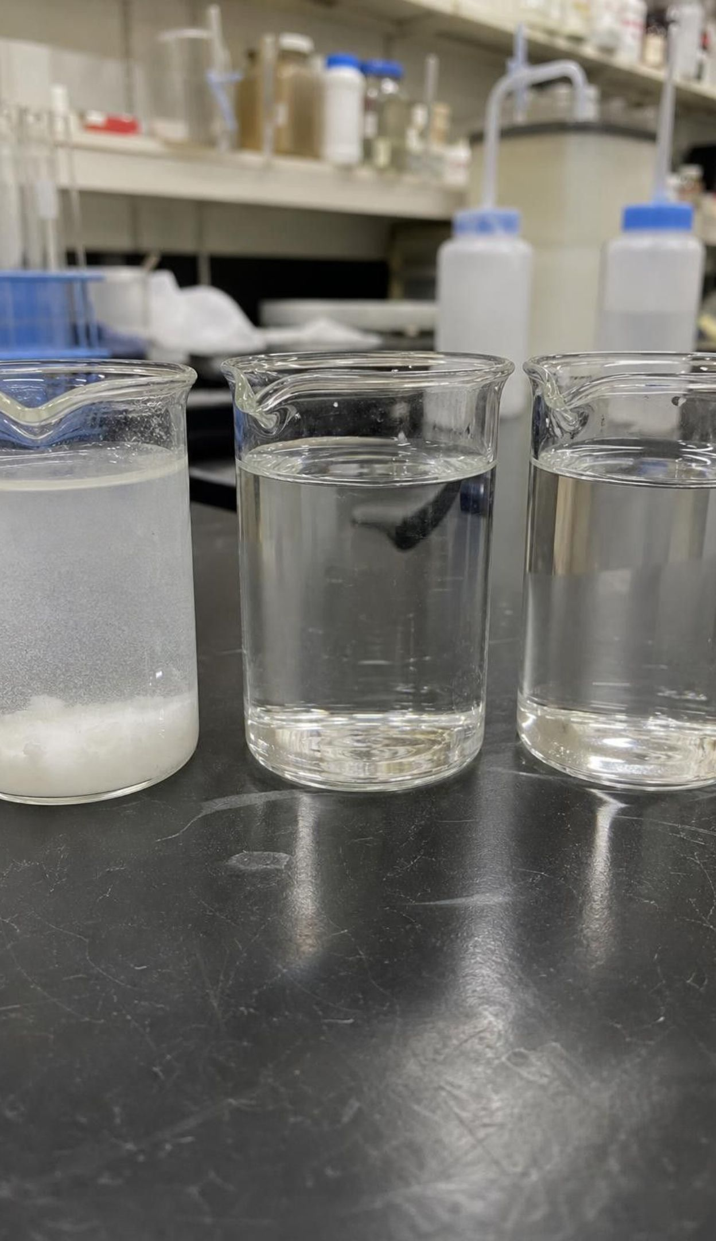
PUTTING IT TOGETHER
Putting it together
A chemical reaction makes different substances; reactants in, products out, each with its own properties.
Melting, boiling and dissolving change how a substance looks but leave it the same substance.
Gas, color, solid, heat, light and smell are clues. They also show up in physical changes.
Proof comes from before-and-after tests: solubility, melting point, density, odor, flammability.
Conditions (heating, cooling, mixing) decide whether a reaction starts; it stops when a reactant runs out.
The same tests confirmed each step from willow bark to aspirin, and criteria judged which medicine was better.
27
Notes:
Have students write a three-sentence summary that uses reactant, product, physical change and one of the six properties, then trade and check each other's use of 'clue' versus 'proof'. Ask for one takeaway from each lab: Lab 1 (which test identified your unknown), Lab 2 (which station fooled you at first), Lab 3 (where the plateau was and which reactant ran out). Preview Lesson 13: if products are made of the same atoms as reactants, rearranged, then a sealed bag like Bag A should weigh the same before and after, and the mass an open cup loses is the mass of the gas that escaped, which is what Lab 3 measured.
CONNECTS TO: W10 mastery; L13 Atoms in Chemical Reactions next.
PACING: about 6 min

Slide 28
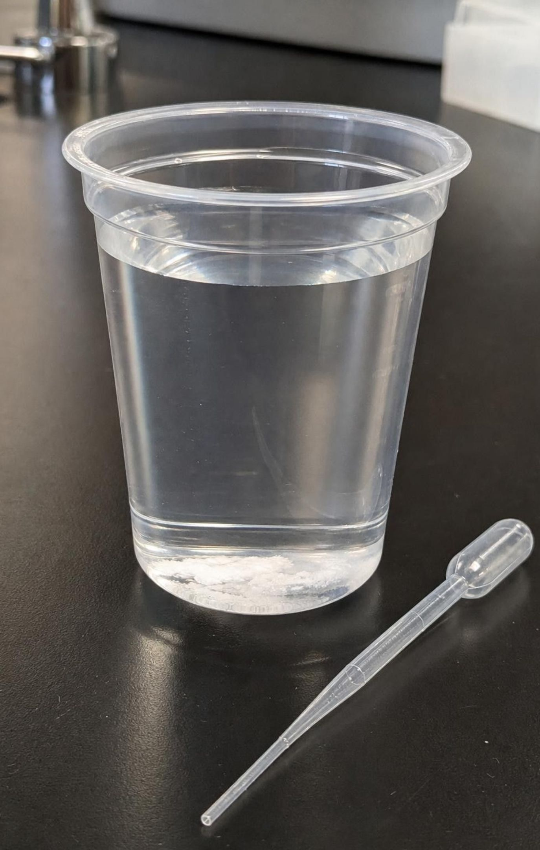
EXIT TICKET
Exit ticket
Name one clue that a reaction may have happened and one physical change that shows the same clue.
A powder dissolves at 20 g/L before a change and 20 g/L after. Does this prove no reaction happened? Explain.
Which reactant ran out in your Lab 3 cup, and what test told you?
In one sentence: why did aspirin count as a better design than salicylic acid?
28
Notes:
Collect on cards or a shared form. Item 1 checks the clue/twin pairing; item 2 is the hardest and most important: a matching result is uninformative, not proof of no reaction. Item 3 checks that the leftover test landed. Item 4 checks that the engineering conclusion stays inside the evidence. Sort into three piles before the next class and reteach from the biggest one; expect item 2 to need it.
EXPECTED RESPONSES: 1: e.g. bubbles and boiling water; heat and calcium chloride dissolving; a solid vanishing and sugar dissolving. 2: No; an unchanged property means that test could not tell the substances apart, so other properties must be compared. 3: usually the baking soda for small amounts (a pinch of baking soda fizzed, so acid was left) or the vinegar's acid at large amounts (drops of vinegar fizzed, so baking soda was left). 4: it met the same relief criterion with fewer side-effect complaints in the patients tested.
WATCH FOR: Item 2 answers of 'yes, same solubility means same substance' show the counting-tests error from the task slide.
CONNECTS TO: W10 mastery; chapter evidenceOfLearning.
PACING: about 5 min

