Slide 1
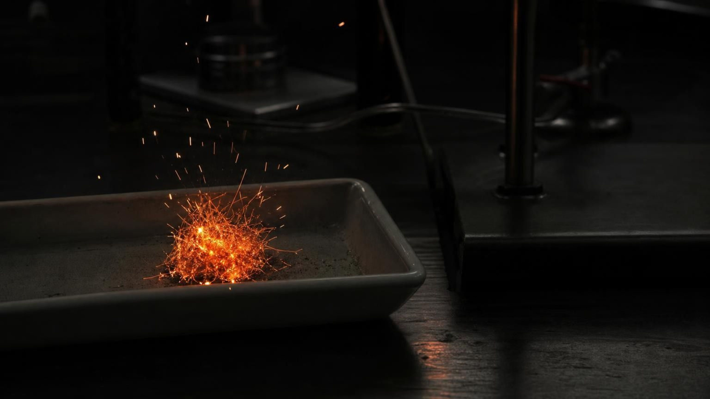
Atoms in Chemical Reactions
Chapter 13 of 29 · Chemical Reactions
Lesson 13: What happens to atoms when new substances form, and why does a sealed system never change mass?
Angela's Wand · Bring Science Alive! 7th Grade Integrated
Notes:
In Lesson 12 students learned to tell that a reaction happened by looking at properties. This week we zoom in to the atoms and answer one question from two directions: where do the atoms go, and what does that mean for the mass on a balance? Tell students they will run three investigations: a mystery with three balances where mass is lost, kept and gained; a bead model where they regroup atoms and catch fake reactions; and a design challenge to trap every gram of gas a reaction makes. Students will never use a flame; the one burning demonstration is yours alone, or a described phenomenon.
CONNECTS TO: Overview of Lab 1, Lab 2 and Lab 3; W1 opens on the next slide.
PACING: about 2 min

Slide 2
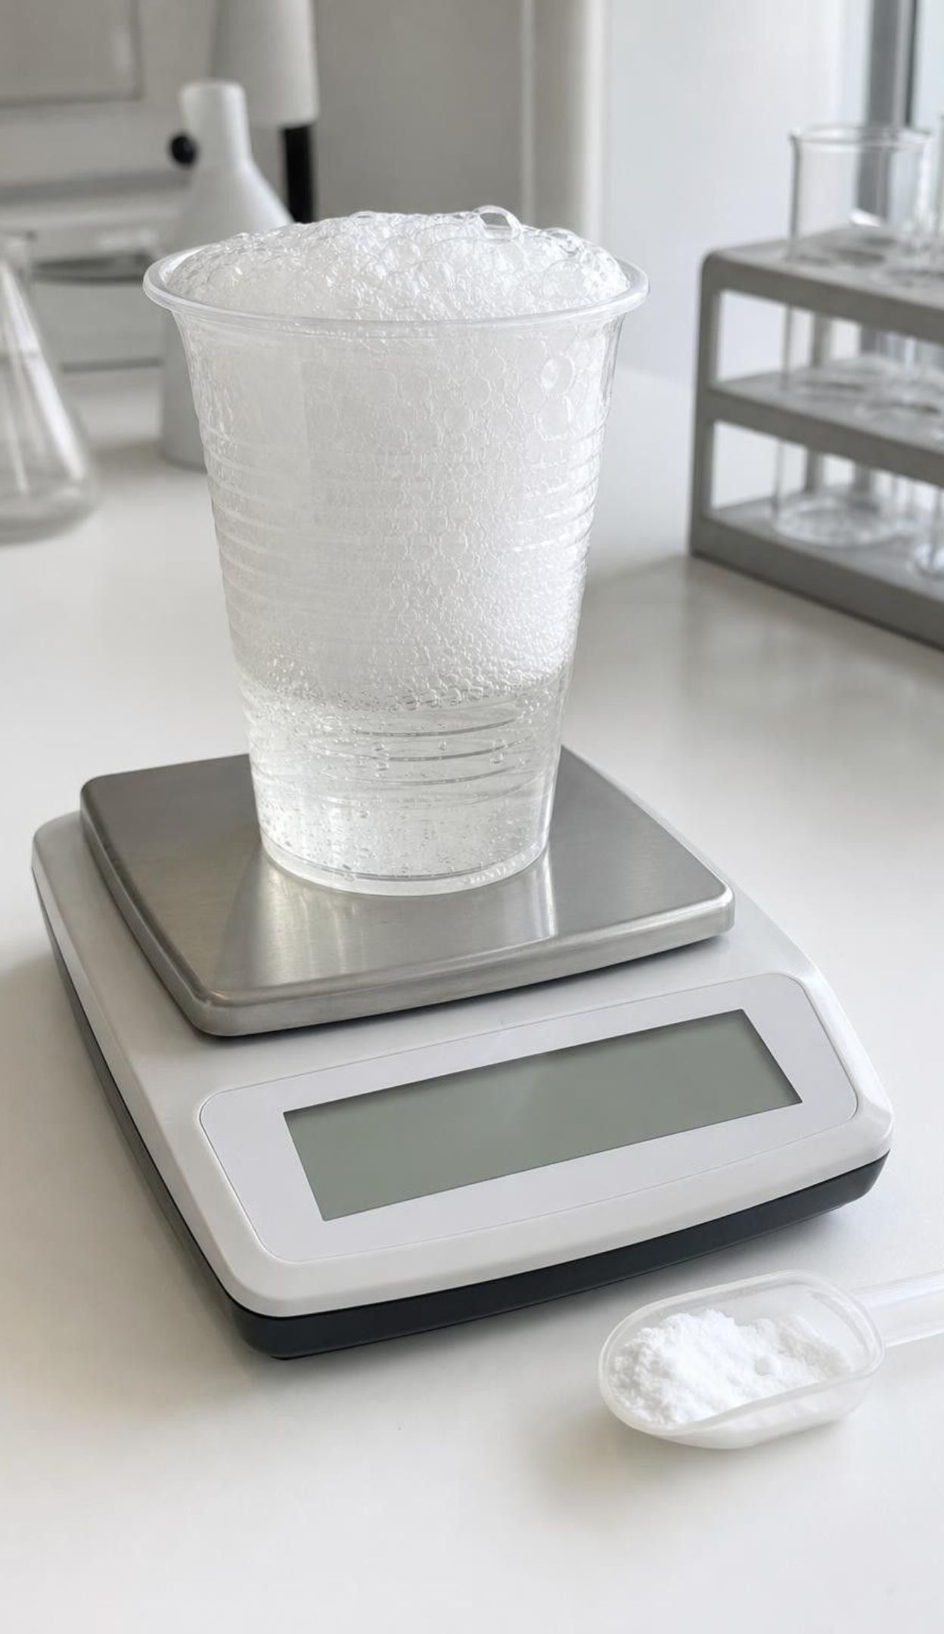
PHENOMENON
Two balances, two surprises
Balance 1: a cup of vinegar and a scoop of baking soda, 142.6 g together. Tip the soda in; it fizzes for two minutes and the reading settles at 141.5 g. Balance 2: a tuft of fine steel wool, 2.00 g. Burned on a tray (teacher only), cooled and put back with every crumb: 2.14 g. One reaction seems to lose matter; the other seems to gain it.
Notice: which reading went down, which went up, and by how much?
Wonder: what could leave a cup, and what could join a steel pad?
Predict: run both inside sealed bags on the balance. What happens to each reading?
2
Notes:
If you have a 0.1 g balance, run the fizzing cup live; it is safe and reliable. The steel wool burn is a teacher-only demonstration behind a shield on a heat-proof tray with goggles, or simply describe it with the numbers on the slide; the readings are illustrative values that are realistic for these amounts, not published measurements. Give two silent minutes for a notice and a wonder, then collect without judging. Push on the contradiction: one balance says matter vanished, the other says matter appeared. Ask whether a balance can lie. Park the two leading student claims, usually 'the gas is nothing' and 'the heat added weight', because the week will test both.
EXPECTED RESPONSES: Notice: cup lost 1.1 g, steel wool gained 0.14 g. Wonder: did the bubbles weigh something; did the fire add something; would a bigger pad gain more. Predict: in a sealed bag the cup reading would stay the same; many will say the steel wool would still gain, which is the productive error.
WATCH FOR: 'Gas has no mass' and 'heat is what was added.' Record them on a parking lot; return on slides 10, 16 and 23.
CONNECTS TO: W1 phenomenon worksheet records predictions for both balances. Lab 1 recreates all three cases (mass lost, kept and gained).
PACING: about 8 min

Slide 3
Learning targets
What you will be able to do
1
2
3
Explain that a reaction breaks and forms bonds so the same atoms regroup into new substances.
Read a chemical equation: tell a coefficient from a subscript and count atoms on each side.
Sort a reaction by how its atoms regroup: break apart, join, swap, or a mix.
4
5
Use an atom model to explain why a closed system keeps its mass and an open one can seem not to.
Compare data from several process designs and combine their best features.
3
Notes:
Read the targets aloud and have students star the one that sounds hardest. Point out that targets 1 to 3 are about what atoms do, target 4 is about what the balance does, and target 5 is the engineering strand at the end of the week. The exit ticket on the last day asks about all five.
CONNECTS TO: Targets map to Lab 2 (1-3), Lab 1 and W6 (4), Lab 3 and W9 (5), W10 (all).
PACING: about 2 min

Slide 4
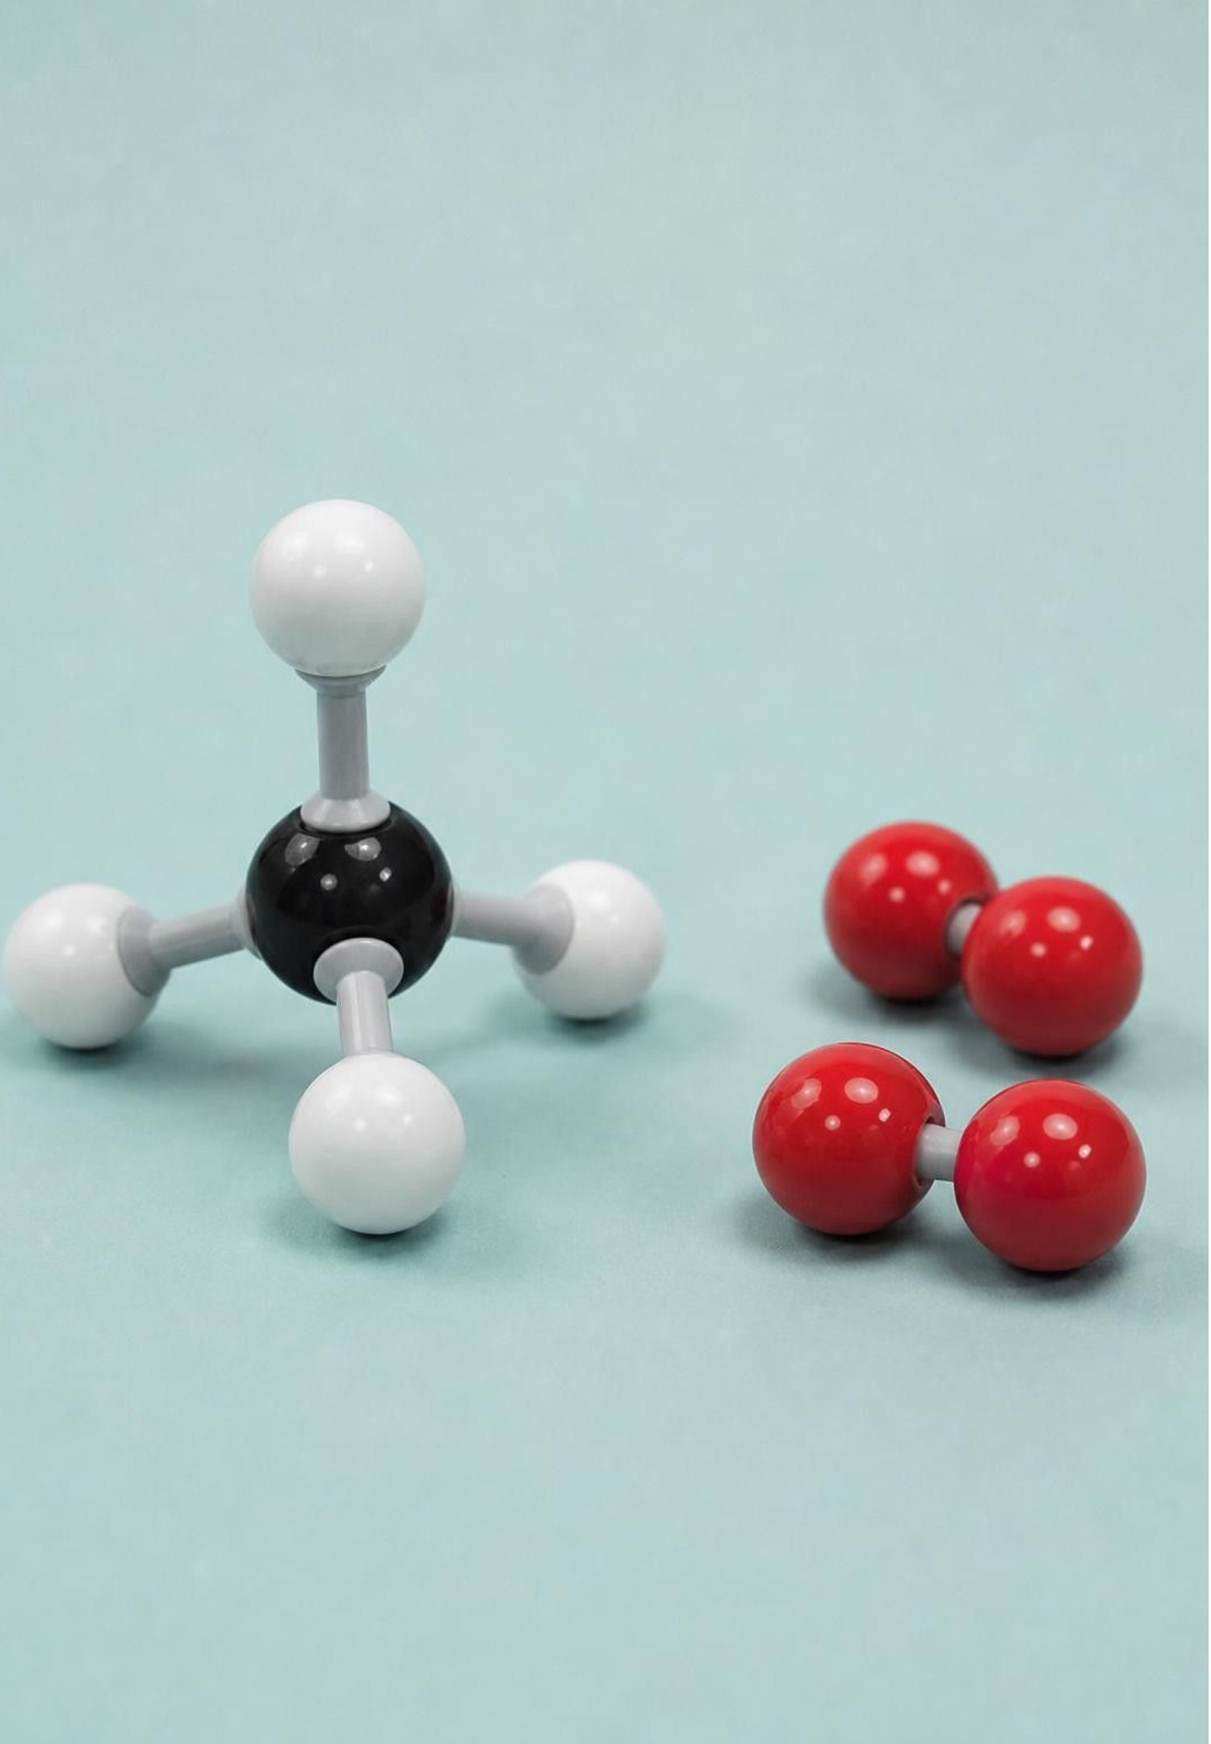
Zooming in: what a reaction actually does
1
Reactants are the substances you start with; products are the new substances that form.
2
A reaction breaks some bonds between atoms and forms new bonds. The atoms themselves stay whole.
3
The same atoms end up grouped differently, so the products have different properties.
4
No atom is created, destroyed or turned into a different element.
4
Notes:
Use the bubbles from the phenomenon. Before: vinegar and baking soda, two substances with their own properties. After: carbon dioxide gas, water and a dissolved salt. Nothing was added except the mixing, so every atom in the products must have come from the reactants. Stress the sentence 'bonds break, atoms do not.' Students will meet the book's phrase 'atoms break apart' on its concept spread; tell them the careful version now. If someone asks whether atoms can ever change into other atoms, say yes in nuclear reactions, which are a different kind of change we are not studying, and that in every chemical reaction an atom keeps its identity.
WATCH FOR: 'The atoms split' or 'carbon turned into oxygen.' Insist on the bond/atom distinction every time it comes up.
CONNECTS TO: Lab 2 bead models make the bonds (pipe cleaners) breakable and the atoms (beads) permanent.
PACING: about 5 min

Slide 5
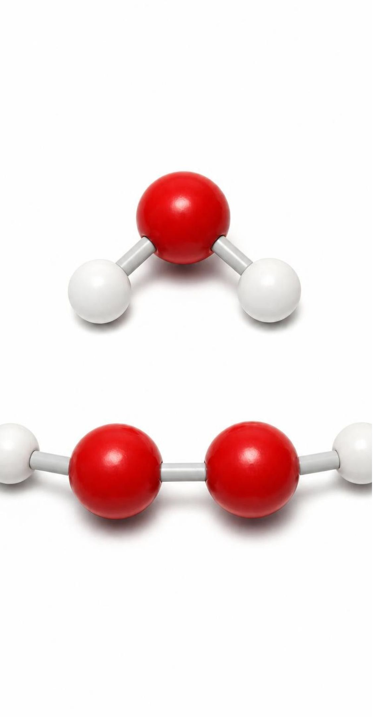
MODEL
What changes in a reaction, and what never does
Model: Before and after any chemical reaction
A reaction is a regrouping. The guest list is fixed; only the seating changes.
Changes | Stays exactly the same
Which atoms are bonded to which | The kind of each atom: an iron atom stays iron
The substances present and their properties | The number of atoms of each element
How many molecules or formula units there are | The total number of atoms
The energy stored in the bonds (Lesson 14) | The total mass of everything, if nothing leaves or enters
5
Notes:
Walk both columns. Students are often surprised that the number of molecules can change: two hydrogen peroxide molecules become three molecules (two water, one oxygen), yet the atom count is identical. That is the difference between counting molecules and counting atoms, and it is why atoms, not molecules, are what we track. Introduce the party image on the caption: guests (atoms) change tables (molecules); nobody arrives or leaves. The last item on the right has a condition, 'if nothing leaves or enters,' and that condition is the whole of Lab 1.
WATCH FOR: Students who hear 'the number of molecules changes' may conclude matter was made. Ask them to count atoms, not molecules.
CONNECTS TO: W2 vocabulary sort uses these two columns. Lab 1 tests the condition in the last right-hand item.
PACING: about 5 min

Slide 6
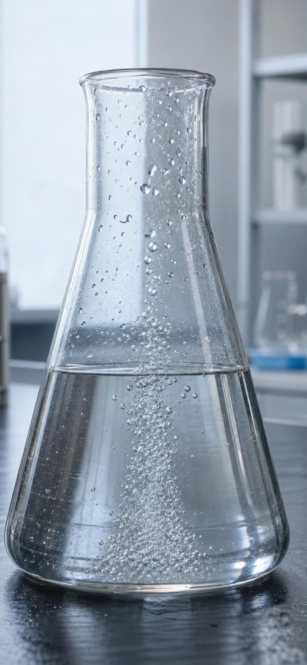



VOCABULARY IN CONTEXT
Three words for talking about a reaction
reactant: A substance you start with. Its atoms are the only atoms the products can be made from. Iron and oxygen are the reactants when steel wool burns.
product: A new substance formed from the regrouped atoms of the reactants. Carbon dioxide is the product that bubbles out of the vinegar cup.
chemical equation: A one-line record of a reaction: reactants, an arrow, products, with plus signs between substances. 2H₂O₂ → 2H₂O + O₂ records hydrogen peroxide breaking down into water and oxygen gas.
6
Notes:
Say the layout aloud: left of the arrow is what you had, right of the arrow is what you got, and the arrow means 'turns into.' Have students read the example equation as a sentence: two hydrogen peroxide molecules become two water molecules and a single oxygen molecule. Then ask which side the atoms that make the oxygen gas came from. From the left, there is nowhere else. That is the point of the next slide.
WATCH FOR: Reading the arrow as an equals sign. The substances are different; only the atoms are the same.
CONNECTS TO: W2 vocabulary worksheet; Lab 2 reaction cards use this layout.
PACING: about 4 min

Slide 7

Reading an equation as an atom inventory
A subscript (small, after a symbol) counts atoms inside one molecule: H₂O has 2 H and 1 O.
A coefficient (big, in front) counts whole molecules or formula units: 2H₂O means two water molecules.
Atoms of one element = coefficient × subscript. In 3O₂ there are 3 × 2 = 6 oxygen atoms.
Check: 2H₂O₂ → 2H₂O + O₂.
Left: 4 H, 4 O. Right: 4 H, 2 + 2 = 4 O. Same inventory.
Changing a subscript changes the substance. H₂O₂ is not 'water with extra oxygen'; it is hydrogen peroxide.
7
Notes:
Do the count on the board slowly, element by element, and have students copy the two-column tally. Then give the key rule: a subscript belongs to the substance and cannot be touched; a coefficient is just how many of that substance you have. Use an analogy: 'bicycle' always has two wheels (subscript); '3 bicycles' is a coefficient and gives 6 wheels. Mention that for extended structures such as iron oxide there are no separate molecules, so the coefficient counts formula units, the smallest repeating group; the book says 'molecules' for both, and we will be more careful. Keep the activity at counting; students are not being assessed on balancing equations, so when a count does not match, the lab fix is to add or remove whole units with beads.
WATCH FOR: Multiplying only the first element by the coefficient (reading 2H₂O as 4 H and 1 O). Make them say 'the coefficient multiplies everything in the formula.'
CONNECTS TO: Lab 2 recording sheet is an atom inventory for each reaction. W4 and W10 reuse the count.
PACING: about 6 min

Slide 8
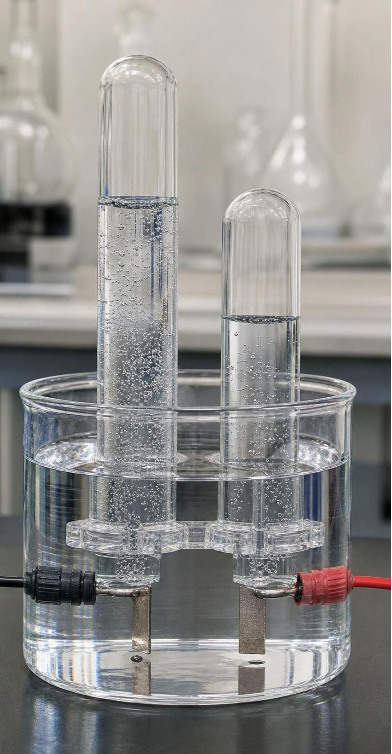
CHECK FOR UNDERSTANDING
Quick check: count the oxygen
Water can be split by electricity: 2H₂O → 2H₂ + O₂. How many oxygen atoms are on each side, and how many hydrogen atoms?
A. Left: 1 O, 2 H. Right: 2 O, 2 H. The equation makes oxygen.
B. Left: 2 O, 4 H. Right: 2 O, 4 H. Same on both sides.
C. Left: 2 O, 2 H. Right: 2 O, 4 H. The equation makes hydrogen.
D. Left: 2 O, 4 H. Right: 1 O, 2 H. Atoms were lost.
8
Notes:
Whiteboards, ninety seconds. Walk the count: 2H₂O is two molecules, each with 2 H and 1 O, so 4 H and 2 O. On the right, 2H₂ is 4 H and O₂ is 2 O. The hydrogen tube in the book's picture holds twice the volume of the oxygen tube because there are twice as many hydrogen molecules; it does not hold twice the mass, and we will not use masses of atoms in this lesson.
EXPECTED RESPONSES: B. Students who choose A or C have forgotten to multiply by the coefficient; D comes from ignoring the coefficient on H₂.
WATCH FOR: Reading the coefficient as applying only to the first atom in the formula.
CONNECTS TO: Lab 2 reaction card 1 is this reaction built in beads.
PACING: about 4 min

Slide 9
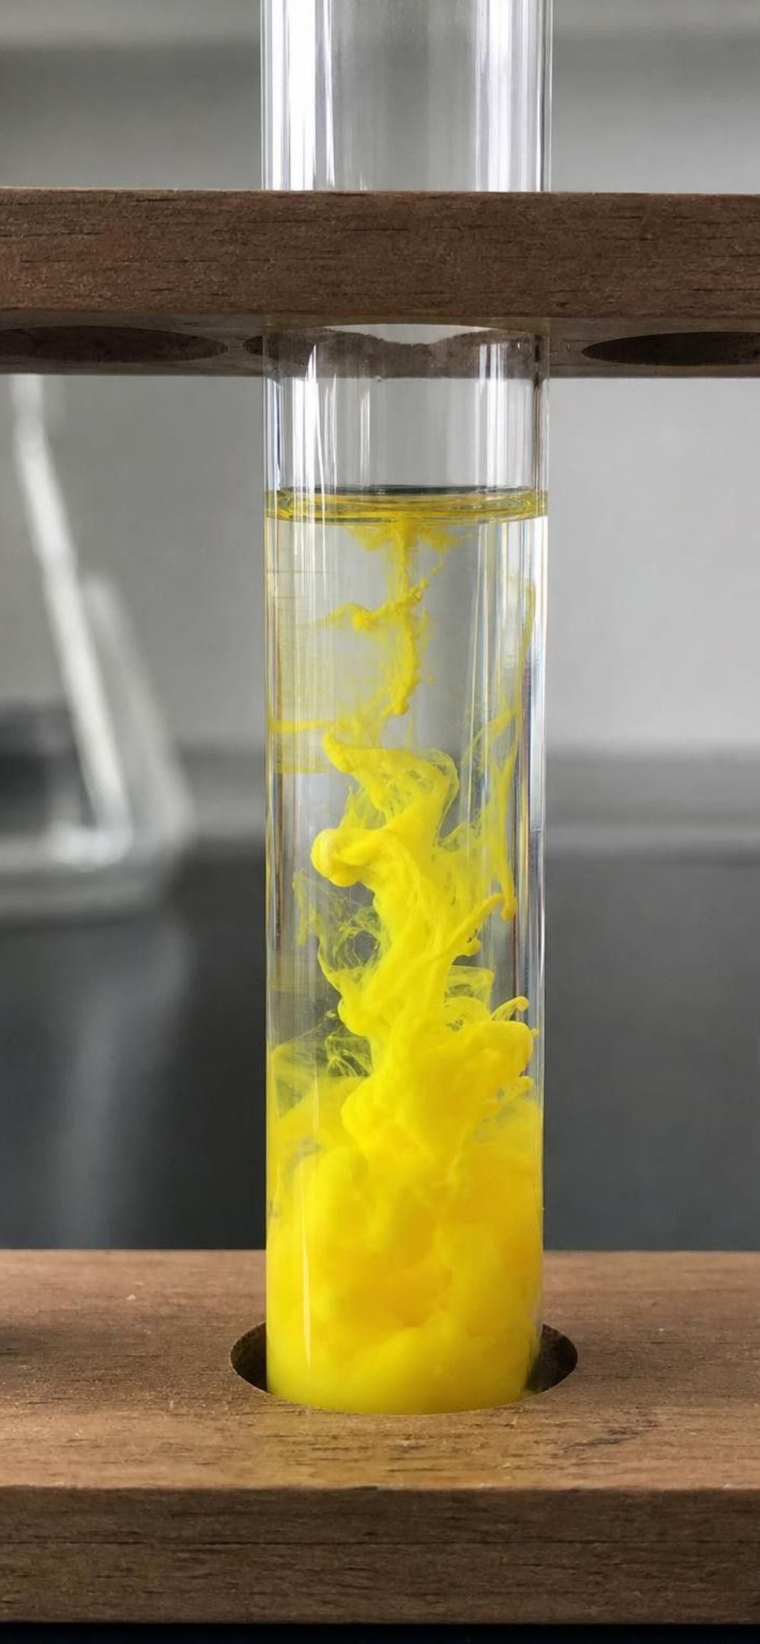
MODEL
Three ways atoms regroup
Model: Patterns of regrouping, with an example of each
Break apart: one substance becomes two or more: 2H₂O₂ → 2H₂O + O₂. Hydrogen peroxide's atoms regroup into water and oxygen gas.
Join together: two or more substances become one: 4Fe + 3O₂ → 2Fe₂O₃. Iron atoms and oxygen atoms bond into one extended structure, iron oxide.
Swap partners: two substances trade and make two new ones: Pb(NO₃)₂ + 2KI → PbI₂ + 2KNO₃. Lead ends up with iodine; potassium ends up with the nitrate group.
A mix of patterns: CH₄ + 2O₂ → CO₂ + 2H₂O. Methane and oxygen both come apart and the atoms rejoin in two new ways.
Sort by counting substances on each side of the arrow: one to many, many to one, two to two.
9
Notes:
Give students a sorting rule they can apply without chemistry knowledge: count the substances on each side. One reactant, several products: break apart. Several reactants, one product: join. Two and two with the pieces traded: swap. Anything else is a mix. Have them practice on the methane equation: two reactants and two products, but it is not a clean swap because both reactants come apart completely. Two accuracy notes for you: the swap picture is bookkeeping for where atoms end up; in water the potassium nitrate is dissolved as separate ions, not bonded pairs. And Fe₂O₃ is a formula unit of a network solid, not a molecule, so '2Fe₂O₃' means two repeating units.
WATCH FOR: Students may think the pattern tells you how fast or how violent the reaction is. It only describes the regrouping.
CONNECTS TO: Lab 2 asks students to build and sort all four. W2 applies the sort to new equations.
PACING: about 6 min

Slide 10
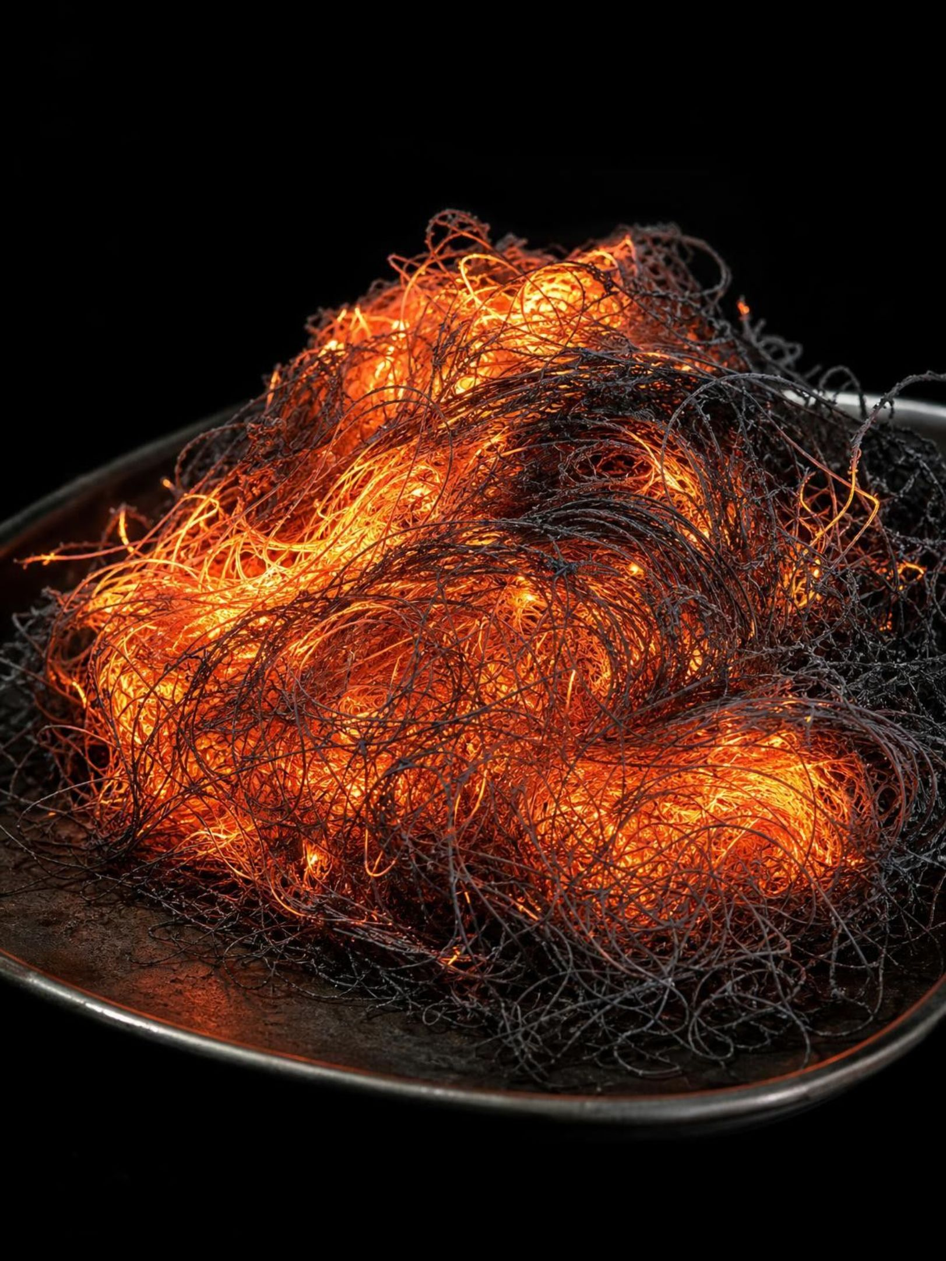
Why burning steel wool gets heavier
Steel wool is mostly iron. When it burns, iron atoms bond with oxygen atoms from the air: 4Fe + 3O₂ → 2Fe₂O₃. Every oxygen atom that joins brings its mass along, so the dark, crumbly product has more mass than the shiny pad. Nothing was created. Atoms moved from the air, where the balance could not count them, onto the pad, where it could.
10
Notes:
Connect back to balance 2. Count with the class: 4 Fe and 6 O on the left, 2 × 2 = 4 Fe and 2 × 3 = 6 O on the right. The product is heavier than the iron alone because it contains six oxygen atoms that used to be in the air. Ask: if we had weighed the air too, would the total change? No. Two accuracy notes: the book's printed equation has a typo, '2F₂O₃', and F is fluorine, so write Fe. And real burned steel wool can form more than one iron oxide; Fe₂O₃ is our model. Rust on a car is the slow cousin of this reaction and needs water as well as oxygen, which is why the steel-wool pads in Lab 1 are kept damp.
WATCH FOR: 'The fire added the weight.' Heat is energy, not matter; it cannot register on a balance. The extra mass is oxygen atoms.
CONNECTS TO: Lab 1 station C (rusting pads) measures this gain without any flame. W7 repairs the 'heat added mass' error.
PACING: about 5 min

Slide 11
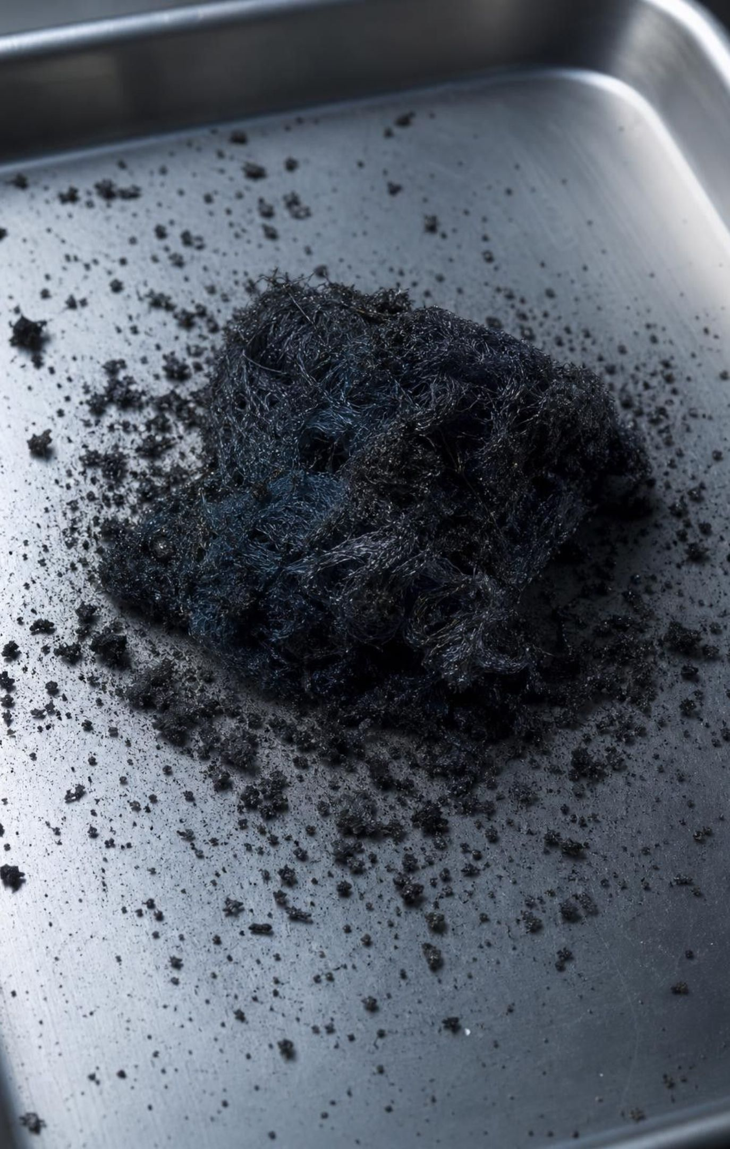
THINK, PAIR, SHARE
Discuss: did the steel wool make new matter?
Where could 0.14 g of atoms come from if not from nowhere?
What would you have to include on the balance to catch those atoms before and after?
What reading would prove the classmate wrong? What reading would prove you wrong?
A classmate says, 'The steel wool gained 0.14 g, so burning created matter.' Argue against this using atoms, then design one test that would settle it.
11
Notes:
Pairs, four minutes, then collect. Steer toward the sealed-container test: put the steel wool and the air it needs in a closed jar on the balance, burn it inside (as a thought experiment or a video), and read the balance again. If the total stays the same, the gain on the pad was a transfer from the air. Push the last bullet: a good test says in advance what would count against you. If the sealed jar read heavier, the classmate would be right. It does not.
EXPECTED RESPONSES: The oxygen atoms came from the air; weigh the pad and its air together in a sealed container; equal readings before and after support conservation, a higher reading would support creation.
CONNECTS TO: Lab 1 station C and the analysis questions; Lab 3 is the student version of 'include everything on the balance.'
PACING: about 6 min

Slide 12
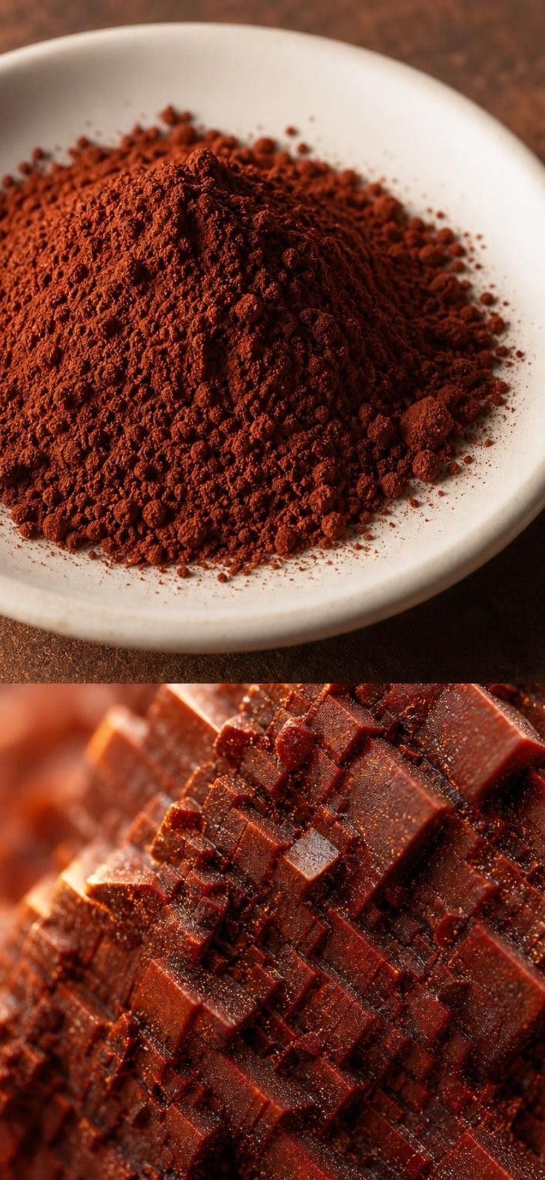



VOCABULARY IN CONTEXT
Numbers in a formula and what they count
coefficient: The whole number in front of a formula; how many molecules or formula units take part. It multiplies every atom in the formula. 3O₂ is three oxygen molecules, six oxygen atoms.
subscript: The small number after a symbol inside a formula; how many atoms of that element are in one unit. Part of the substance's identity. The 3 in Fe₂O₃ means three oxygen atoms for every two iron atoms.
formula unit: The smallest repeating group of atoms in an extended structure that has no separate molecules. Fe₂O₃ is a formula unit of iron oxide; the real solid is one huge network.
12
Notes:
Have students write each term next to a number in 2Fe₂O₃ on their whiteboards: the 2 in front is the coefficient, the ₂ and ₃ are subscripts, Fe₂O₃ is one formula unit. Then ask the trick question: how many oxygen atoms in 2Fe₂O₃? Six, from 2 × 3. The reason we bother with 'formula unit' is honesty: iron oxide, table salt and most minerals are networks, not collections of little molecules, and the book calls everything a molecule.
WATCH FOR: Changing a subscript to make a count come out even. Say it plainly: a changed subscript is a different substance.
CONNECTS TO: Lab 2 claimed-reaction cards include a 'fixed' equation that changed a subscript; W7 misconception repair.
PACING: about 4 min

Slide 13

Check for understanding
Quick check: coefficient or subscript?
In the equation 4Fe + 3O₂ → 2Fe₂O₃, how many oxygen atoms are on the right side, and which number told you that?
A. 3, from the subscript alone
B. 5, from 2 + 3
C. 6, from the coefficient 2 times the subscript 3
D. 2, from the coefficient alone
13
Notes:
Quick vote, then one sentence of reasoning from a student who chose C. Follow up: how many iron atoms on the right (2 × 2 = 4) and does that match the left (4Fe)? Yes. Finish by asking what would happen to the substance if a student changed Fe₂O₃ to Fe₂O₂ to 'make the oxygen easier.' It would describe a different substance, which is not what forms.
EXPECTED RESPONSES: C: 2 × 3 = 6 oxygen atoms. Students who answer B have added instead of multiplying.
WATCH FOR: Adding the coefficient and subscript. Repeat the bicycle example: 3 bicycles have 3 × 2 = 6 wheels, not 3 + 2 = 5.
CONNECTS TO: Lab 2 inventory table; W10 mastery.
PACING: about 3 min

Slide 14
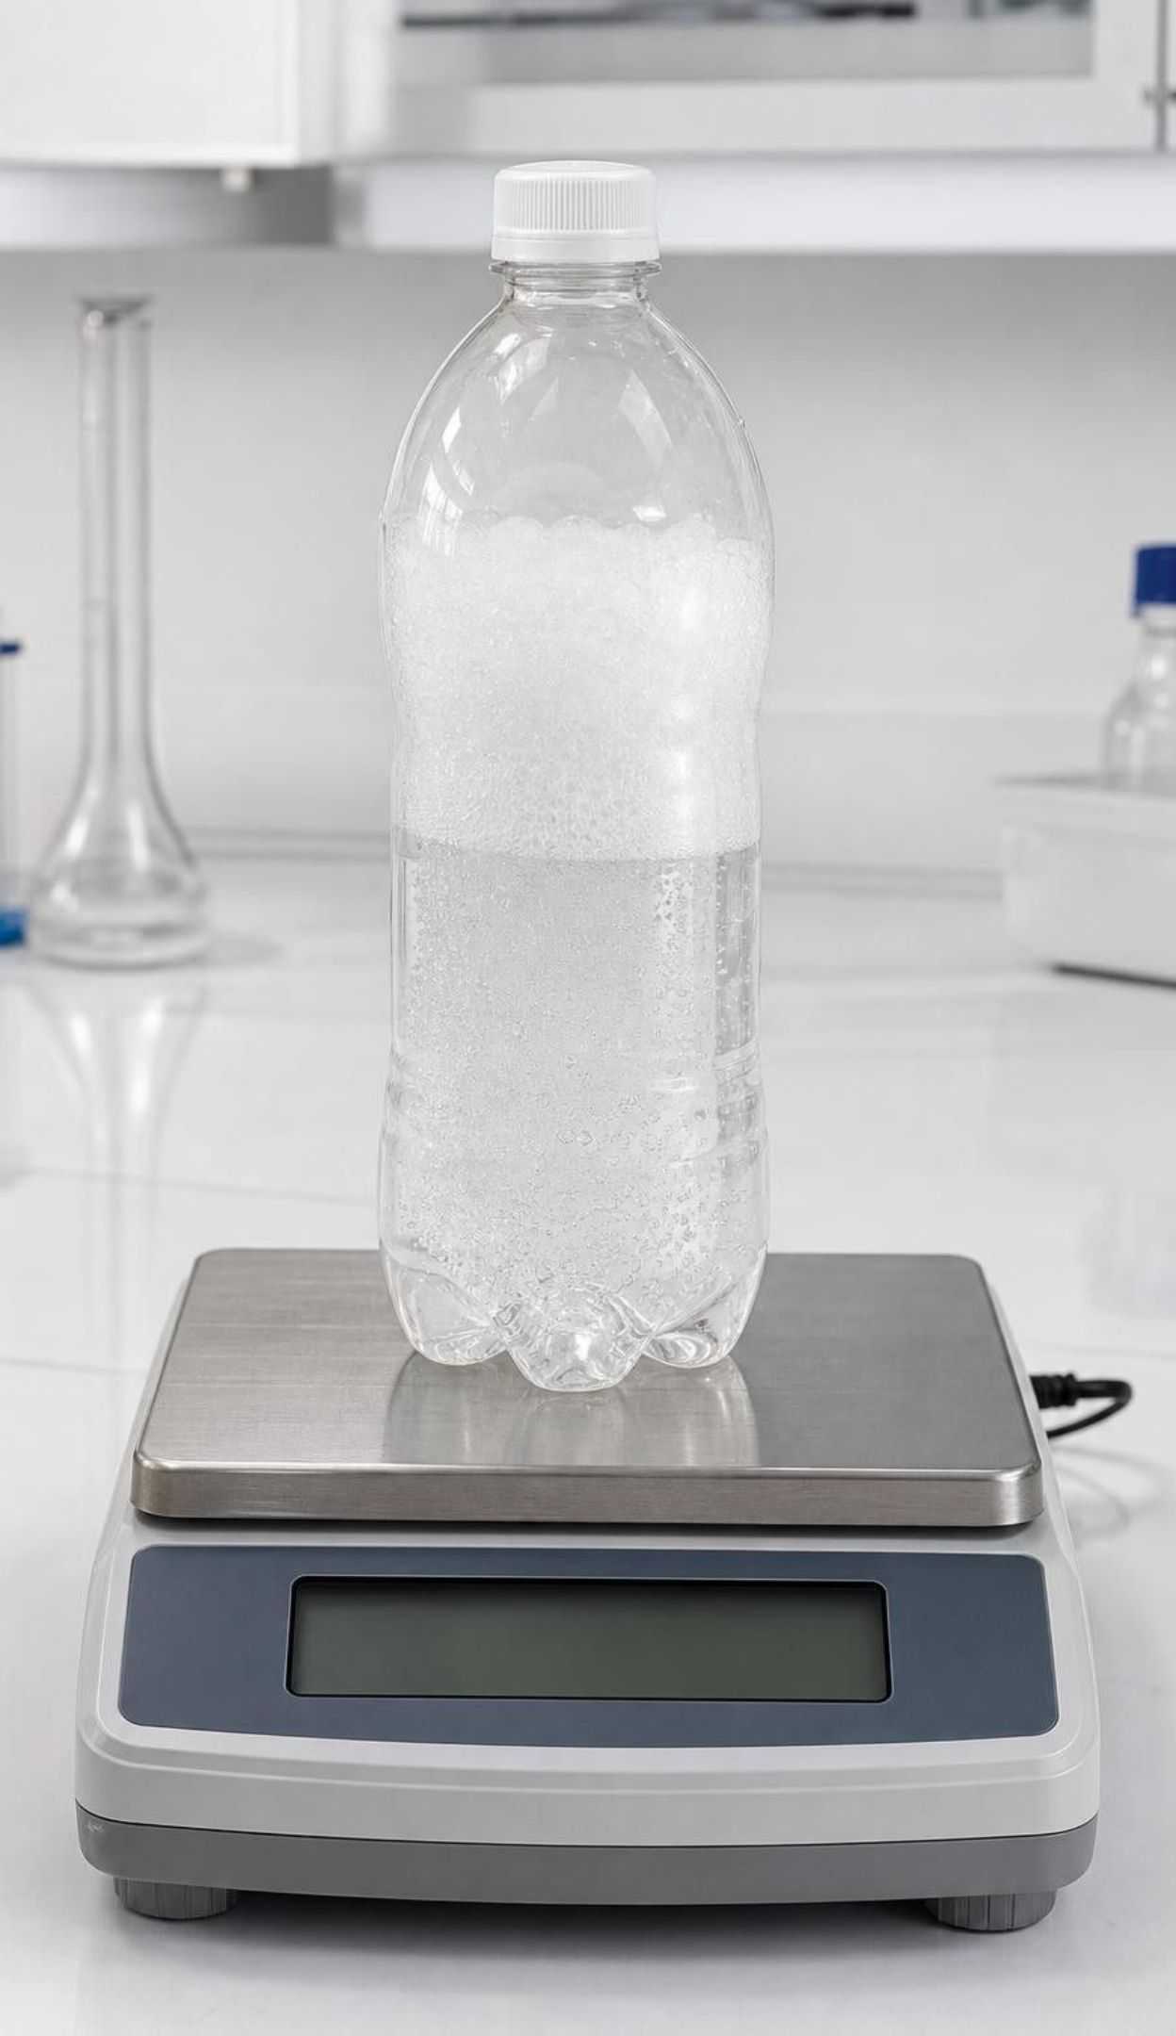
The law of conservation of matter
In every ordinary chemical or physical change, matter is neither created nor destroyed.
Reason at the atom level: atoms are only regrouped, and each atom keeps its own mass.
So the mass of the products equals the mass of the reactants, every time, for every reaction.
A scientific law describes a pattern that has held in every careful test. The atom model explains why.
The rule applies to chemical and physical changes. Nuclear changes are a separate topic.
14
Notes:
Write the one-line version on the board: mass before = mass after. Ask the class which is the law and which is the explanation: the mass statement is the law (a pattern you can test with a balance); the atom story is the model that explains the pattern. This matches how the book separates laws from theories. Add the scope carefully: the book says the rule holds for 'any other change in matter,' but nuclear reactions can turn one element into another, so we say 'ordinary chemical and physical changes.' Then raise the obvious objection: balance 1 lost 1.1 g. Either the law is wrong or the measurement left something out. The next slide decides.
WATCH FOR: Students may treat the law as a rule that is sometimes broken (burning, fizzing). It is never broken; the measurement is what fails to include everything.
CONNECTS TO: W3 reading passage on how the law was established; W6 CER.
PACING: about 5 min

Slide 15
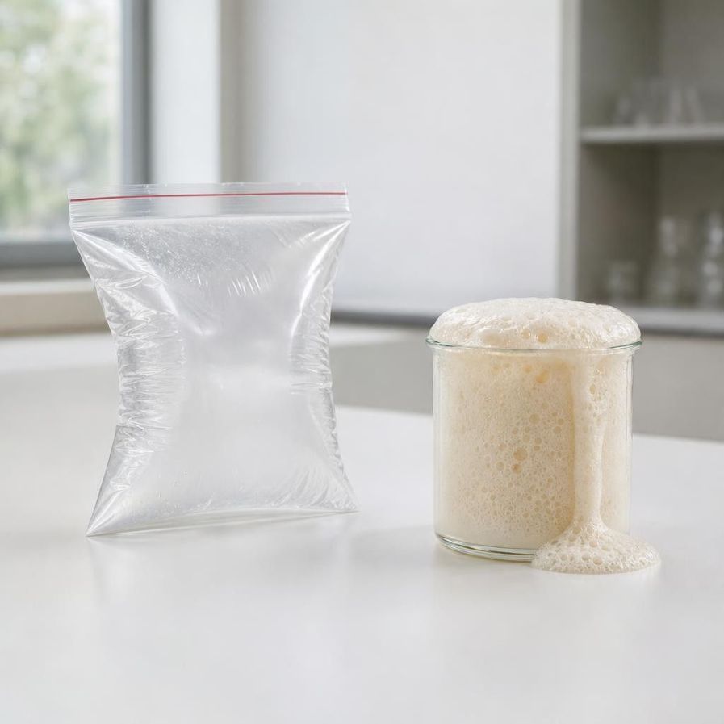
MODEL
Open system or closed system: what does the balance see?
Model: The same reaction, two different boundaries
Define the system first. Then every change in the reading is atoms crossing the boundary.
Closed system (sealed container on the balance) | Open system (cup on the bench)
No atoms can enter or leave the container | Atoms can cross the boundary: gas out, air in
Carbon dioxide forms and stays inside | Carbon dioxide forms and floats away into the room
Total mass is the same before and after | Balance reads lower by the mass of gas that left
Shows the law directly | Seems to break the law until you count the gas
15
Notes:
This is the slide that resolves the phenomenon. The cup was an open system, so the carbon dioxide left and took its mass with it. The steel wool was an open system in the other direction: oxygen came in. In both cases the atoms are still somewhere; the balance simply did not have them all. Have students define the boundary of each of the three Lab 1 stations before they weigh anything and predict which way the reading can move. Point out that energy can still cross a closed boundary; a sealed bag can warm or cool, and a sealed jar can be lit by a lamp. Closed means closed to matter. One measurement caution for Lab 1: a sealed bag that puffs up is lifted by the air it pushes aside, about 1.2 g for every liter of puff, so it reads lower on the balance even though its mass has not changed; a rigid container that cannot swell reads exactly the same.
WATCH FOR: 'Closed means nothing can get in or out at all.' Energy can; matter cannot. This matters in Lesson 14.
CONNECTS TO: Lab 1 recording sheet asks for the boundary and a prediction at each station. Lab 3 designs a closed boundary.
PACING: about 6 min

Slide 16
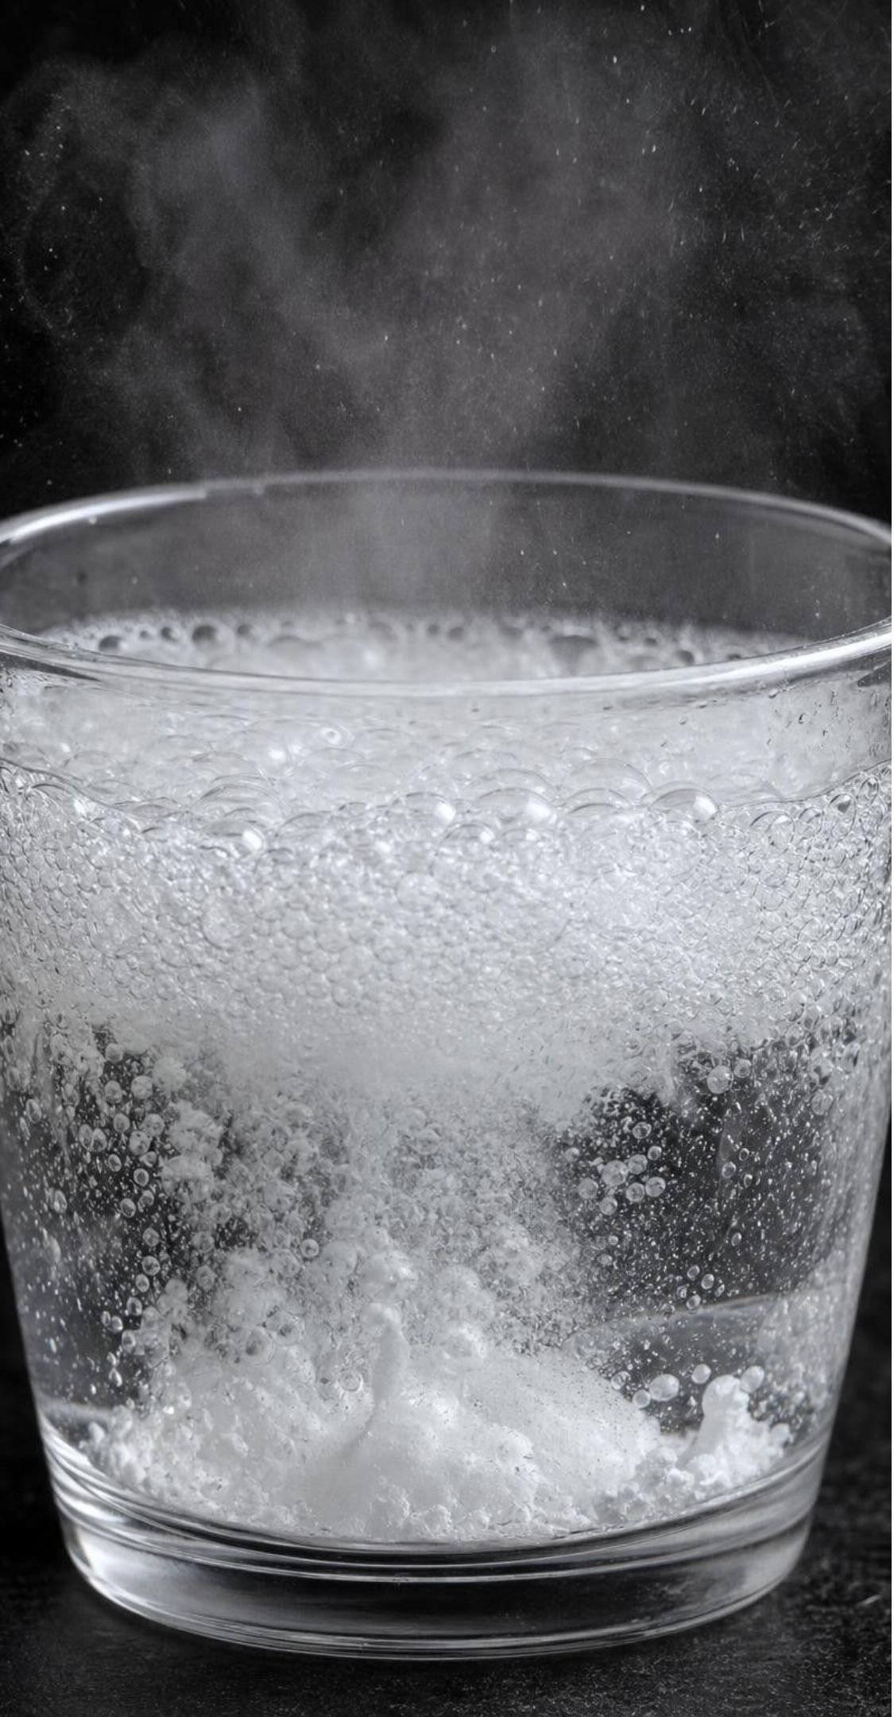
CHECK FOR UNDERSTANDING
Quick check: the cup that lost 1.1 g
The open cup of vinegar and baking soda read 142.6 g before and 141.5 g after. Which statement is correct?
A. 1.1 g of matter was destroyed by the reaction.
B. 1.1 g of carbon dioxide left the cup; the atoms still exist in the room's air.
C. The reading dropped because the cup got colder.
D. Baking soda has no mass once it dissolves.
16
Notes:
Vote, then ask a B voter to explain where the carbon and oxygen atoms in the gas came from (the baking soda and the vinegar). Then ask: if we sealed the cup inside a rigid container before mixing, what would the reading do? Stay at 142.6 g. (Inside a zip bag the mass would also stay 142.6 g, but the puffed-up bag would read about 0.7 g low because the air around it lifts it; see the Lab 1 teacher notes.) A student may ask why a bit less than the whole gas escapes; some carbon dioxide stays dissolved in the liquid, so a real open-cup loss is a little smaller than the total gas made. That is a good observation, not an error.
EXPECTED RESPONSES: B. The gas has mass; it left the system. Sealing the system would keep the mass at 142.6 g; a rigid container would also read 142.6 g, while a puffed-up bag reads lower because of the air's lift.
WATCH FOR: Choosing C: temperature changes do not change mass. The balance measures mass, not temperature.
CONNECTS TO: Lab 1 stations A and B test the open and sealed versions. W5 data worksheet; W6 applies the same open-versus-sealed reasoning to a burning candle.
PACING: about 4 min

Slide 17
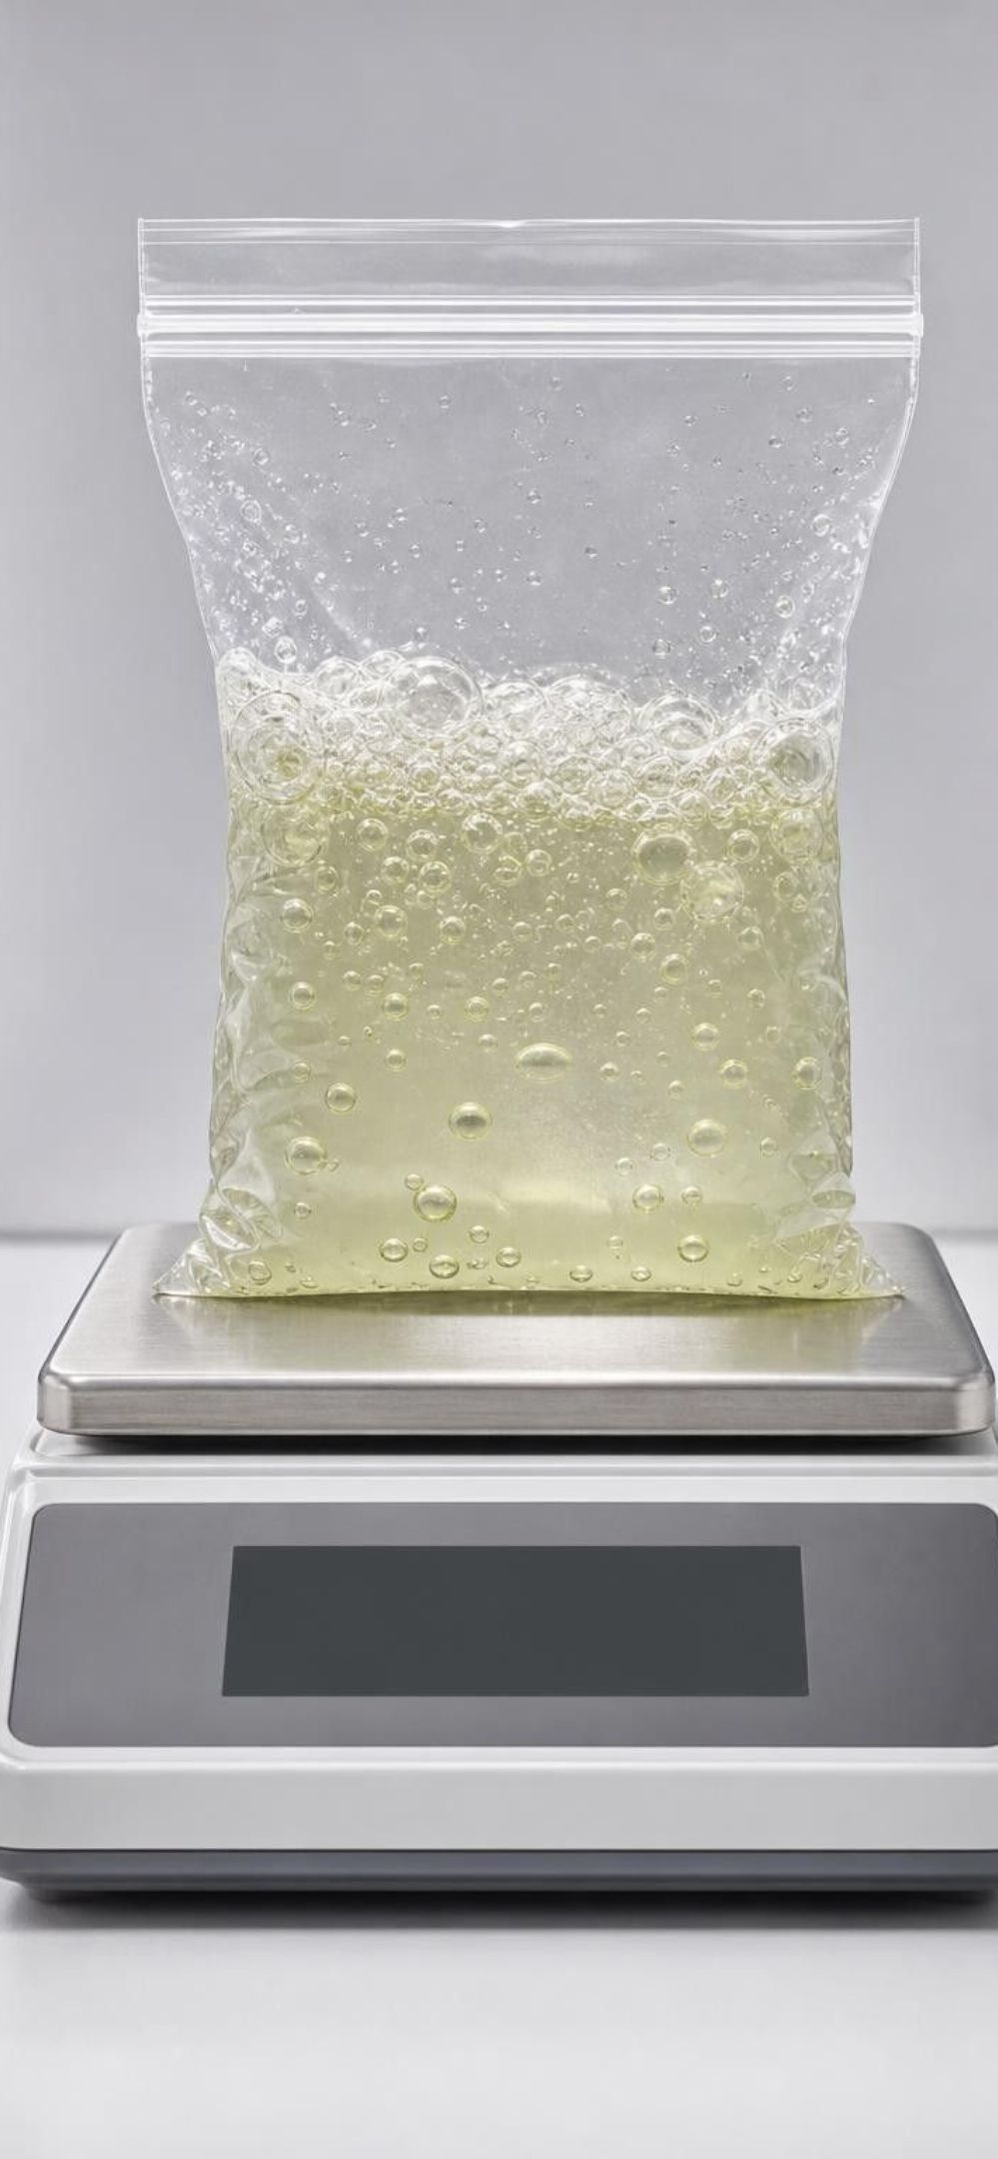



VOCABULARY IN CONTEXT
Words for the law and for the boundary
law of conservation of matter: In any ordinary chemical or physical change, matter is neither created nor destroyed, so total mass stays the same. A capped bottle of fizzing vinegar and baking soda has the same mass before and after.
closed system: A region that matter cannot enter or leave during the change you study. Energy can still cross. A zip bag sealed before the reaction starts.
open system: A region whose boundary matter can cross, so readings can rise or fall as atoms come and go. A cup on a bench loses gas to the room; a damp steel pad gains oxygen from it.
17
Notes:
Ask students to sort three systems they know: a sealed can of soda (closed until opened), a boiling pot without a lid (open: steam leaves), a sealed terrarium under a lamp (closed to matter, open to light energy). Then have them write one sentence using 'open system' to explain balance 2 from the phenomenon slide. Remind them that the law never stops being true in an open system; it is just harder to see because you have to count the atoms that crossed.
WATCH FOR: 'Open system means the law does not apply.' It always applies; the system boundary decides what the balance can see.
CONNECTS TO: W2 vocabulary; Lab 1 boundary table.
PACING: about 4 min

Slide 18

REAL-WORLD CONNECTION
California connection: a bridge that is always being painted
The Golden Gate Bridge in San Francisco is steel, and it stands in salty fog. Iron in the steel bonds with oxygen and water from the air to form rust, the same kind of atom-joining that made the steel wool heavier. Rust is weaker than steel and flakes away, so a crew of painters works on the bridge year round, scraping rust and sealing the steel under fresh paint to keep oxygen and water away from the iron.
Notes:
This is a true example and students may have seen the bridge. Ask: what is the paint actually doing at the atom level? It is a boundary that keeps oxygen and water molecules from reaching iron atoms. Ask why salt fog makes it worse: salty water speeds the reaction, which is also why cars rust faster near the coast or on salted roads. Connect to Lab 1: the damp steel-wool pads rust faster than dry ones for the same reason, water is a necessary partner. Keep the engineering idea simple: you cannot stop the law of conservation of matter, but you can control the boundary so the reaction cannot happen.
CONNECTS TO: Lab 1 station C; W9 transfer problem can use corrosion control as a design context.
PACING: about 4 min

Slide 19

Atom accounting in a factory: where does every atom go?
Every reactant atom ends up in a product. Some products are wanted; the rest are waste.
Chemists measure a process by its atom economy: the share of reactant mass that lands in wanted products.
Making ibuprofen in the 1960s took six reaction steps and sent about 60 percent of the reactant mass to waste.
1990s: a reusable catalyst cut it to three steps; about 77 percent of the mass became ibuprofen.
A by-product, acetic acid, was collected and used elsewhere instead of discarded: about 99 percent useful.
19
Notes:
Conservation of matter has a consequence engineers cannot escape: waste is not something that disappears, it is atoms that went to the wrong product. So a green chemist's first question is how to send more atoms into the wanted product. Explain a catalyst as a helper that is not used up and can be recovered, so it does not become waste. Give the ibuprofen story as a design example: fewer steps meant fewer reactants and less waste, and collecting the acetic acid turned a waste product into a useful one. Accuracy notes for you: the efficiency figure is a calculated percentage from the balanced equations, not a weighing of a batch; the book prints both 75 and 77 percent for the three-step process, and 77 (or 'about 80') is the right figure; the polyvinyl alcohol detail in the book is not verified, so we only say the acetic acid was collected and used.
WATCH FOR: 'Efficient means fast.' Atom economy is about where the atoms go, not about speed.
CONNECTS TO: W3 reading; W9 transfer problem; Lab 3 criteria include waste.
PACING: about 5 min

Slide 20
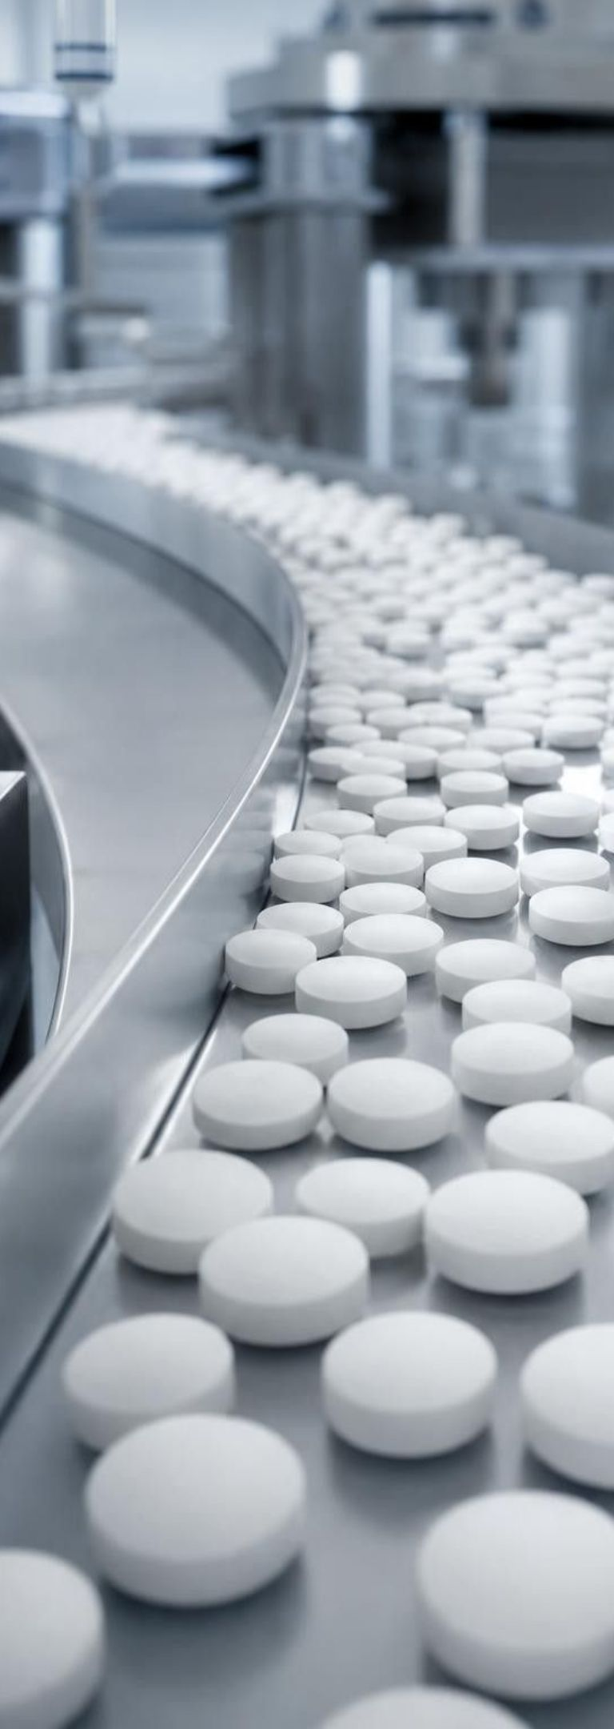
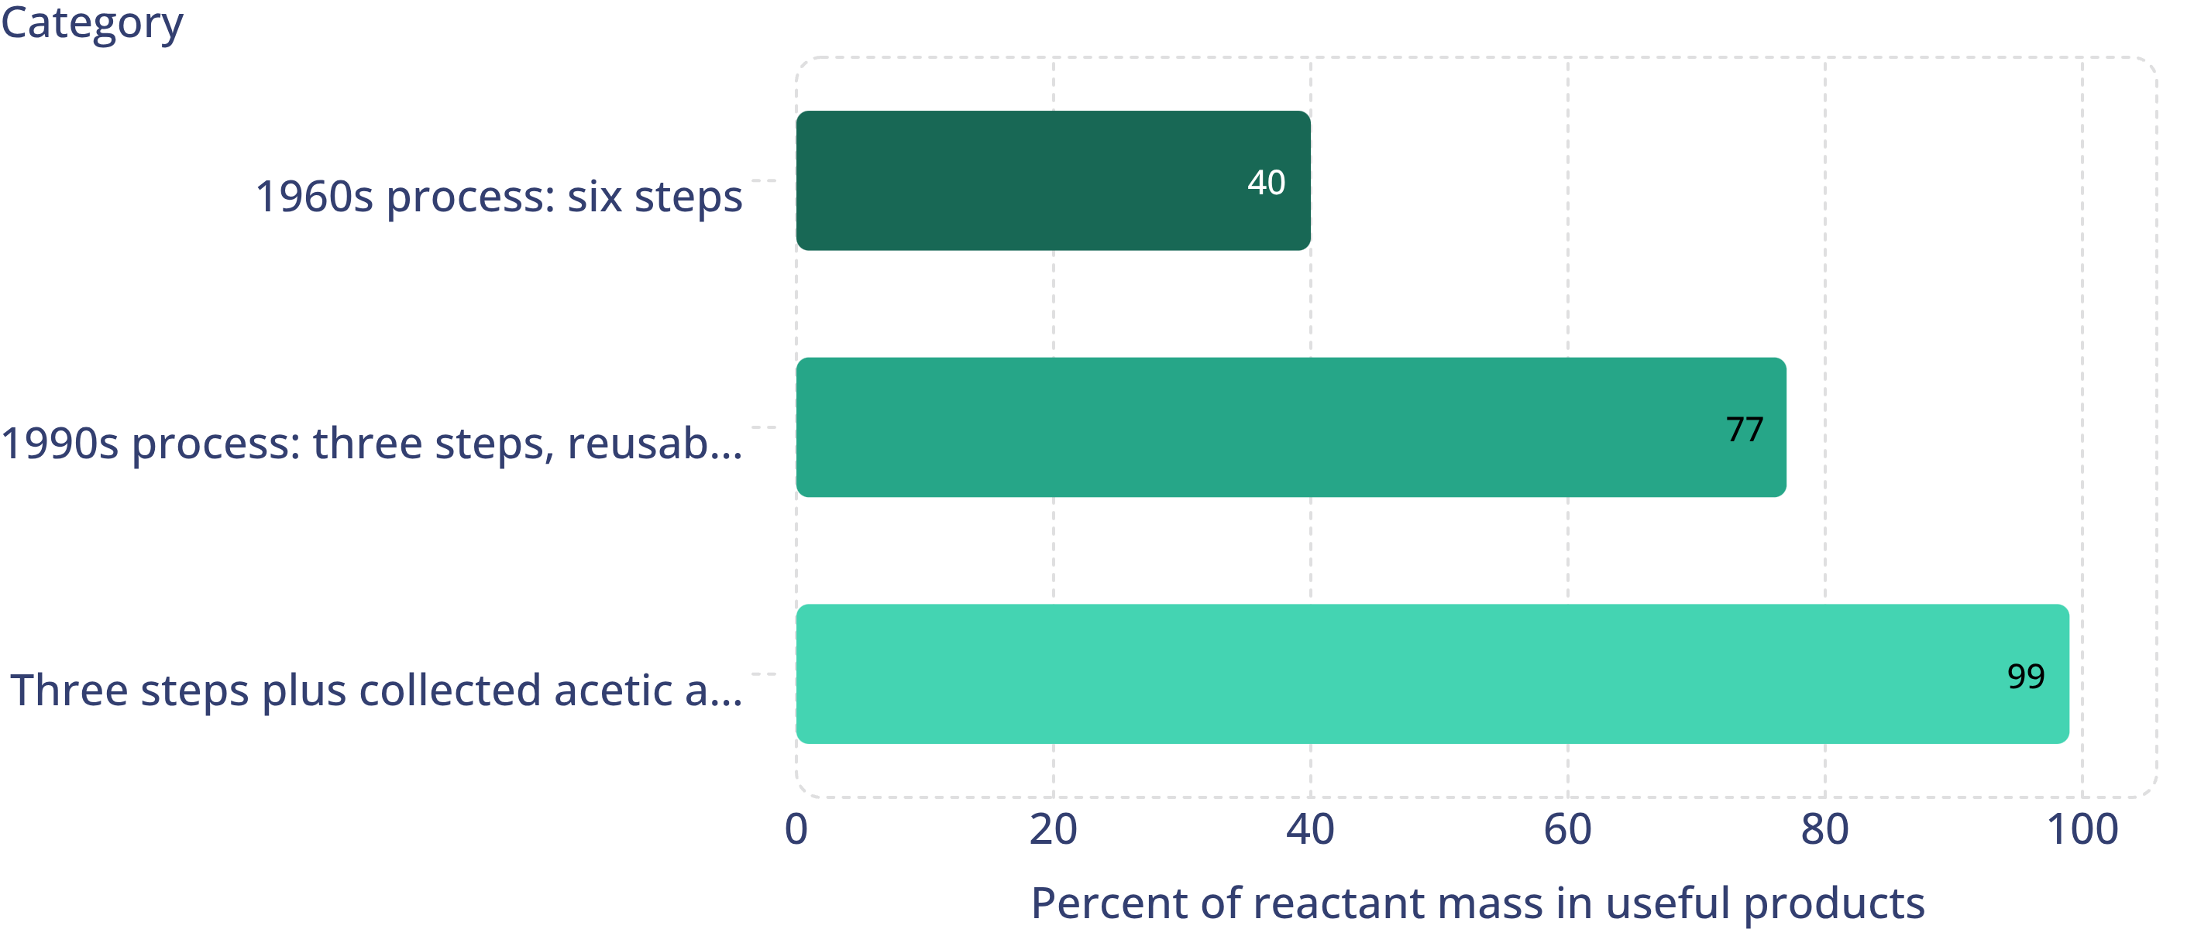
MODEL
Three designs for the same medicine
Model: Share of reactant mass that ends up in useful products (atom economy)
Rounded values for the ibuprofen processes. The last improvement kept the three-step catalytic route and added by-product recovery.
20
Notes:
Read the bars with the class. Ask what the gap above each bar represents: atoms that went to waste. The jump from 40 to 77 came from a different route with fewer steps and a catalyst that is recovered; the jump from 77 to 99 came from reclassifying a by-product as useful by finding a use for it. Point out the engineering pattern that the standard MS-ETS1-3 names: the second solution did not throw away the first; it added to it. The 40 and 99 percent figures match EPA's Green Chemistry Challenge records; 77 percent is the textbook's figure (206 ÷ 266), which EPA rounds to about 80. The exact numbers depend on how the calculation is set up, so treat them all as 'about.'
WATCH FOR: Students may think 99 percent means almost no waste in the building. It means almost no reactant atoms went to unwanted products; energy use and other issues are separate.
CONNECTS TO: The task on the next slide; W5 data worksheet graphs a similar comparison.
PACING: about 4 min

Slide 21
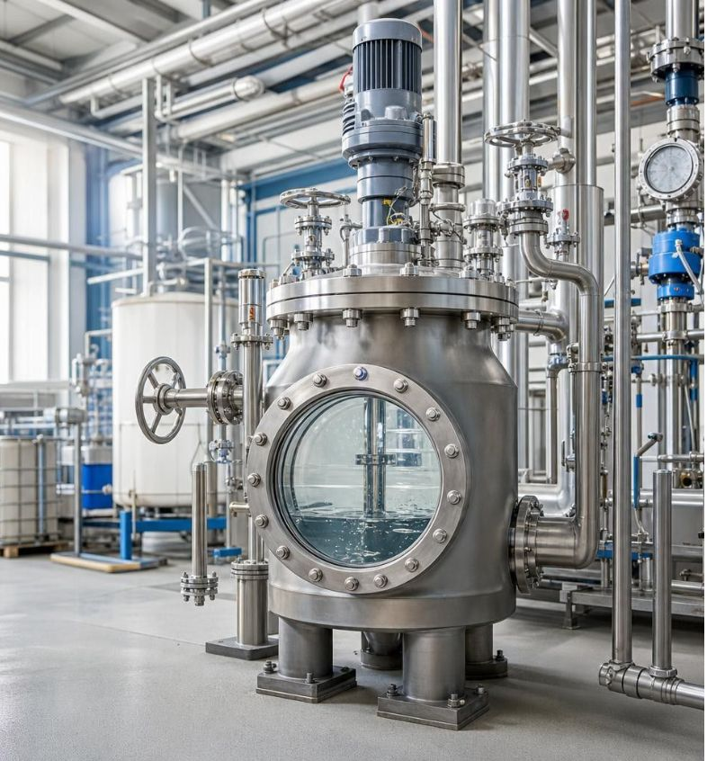
Apply it
Task: which features should the engineers combine?
Simulated data for practice.
Three test runs of a new cleaning-product process gave the data below. Identify the best characteristic of each design, then propose a combined design and predict its results.
Design | Reaction steps | Catalyst recovered? | Reactant mass (kg) | Wanted product (kg) | Waste (kg) | Time per batch (h)
A | 5 | no | 100 | 45 | 55 | 6
B | 3 | yes | 100 | 70 | 30 | 9
C | 4 | no, but waste is sold as fertilizer | 100 | 60 | 40 (sold) | 5
21
Notes:
This is a teaching dataset, invented so the numbers are clean; say so. Groups get eight minutes. Step 1: check conservation in every row: product plus waste must equal 100 kg (45 + 55, 70 + 30, 60 + 40), which it does, because atoms do not vanish. Step 2: name the strongest feature of each design. A is weak everywhere except that it is simple to run; B has the fewest steps, a recovered catalyst and the most product; C is fastest and turns its waste into a product someone buys. Step 3: combine: B's three catalytic steps plus C's idea of selling the by-product, and look for why C is faster. Step 4: predict: product stays about 70 kg, but the 30 kg of 'waste' may become useful, so the useful share could approach 100 percent. Insist that predictions keep the 100 kg total.
EXPECTED RESPONSES: Best features: B for fewest steps, recovered catalyst and highest product; C for speed and for selling the by-product; A offers little beyond simplicity. Combined design: B's route plus C's by-product sale, aiming for about 70 kg product and 30 kg sold by-product from 100 kg of reactants, with time somewhere between 5 and 9 hours. Any prediction that adds to more than 100 kg is wrong.
WATCH FOR: Groups that pick one design and stop. The standard asks them to combine characteristics, not crown a winner.
CONNECTS TO: Lab 3 session 2 does this with the class's own gas-trap data. W9 transfer problem is a fuller version.
PACING: about 10 min

Slide 22
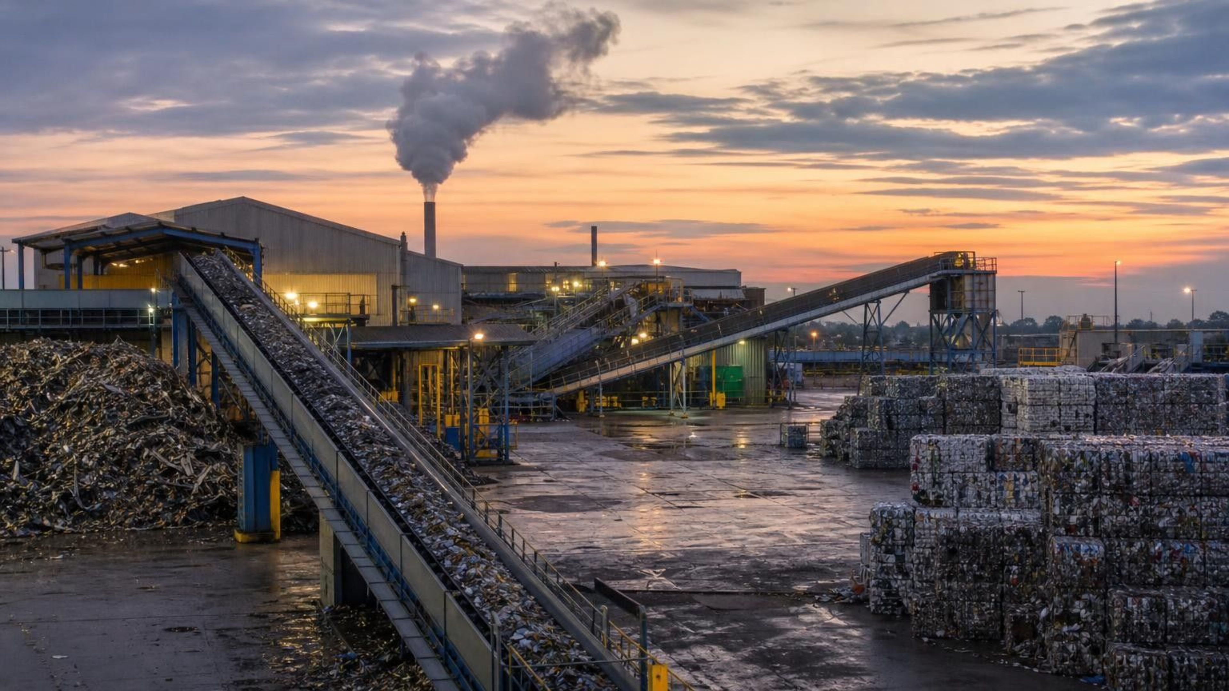
THINK, PAIR, SHARE
Discuss: is there really such a thing as 'throwing it away'?
At the atom level, what happens to the carbon dioxide from the open cup, the oxygen that joined the steel wool, and the waste from a factory? Where is 'away'?
Notes:
Pairs, four minutes. Steer toward the realization that atoms always go somewhere: into the air, into water, into soil, into another substance. The open cup's carbon dioxide is now part of the room's air; the oxygen on the steel wool came out of the room's air; a factory's waste atoms end up in a landfill, a river or the atmosphere unless a chemist finds a product for them. Ask: if atoms cannot be destroyed, what are the only two options for waste? Store it somewhere, or turn it into something useful. That is the whole reason green chemistry exists, and it is the reason conservation of matter is an engineering idea as much as a science idea.
EXPECTED RESPONSES: Atoms are conserved, so 'away' is just another place: air, water, ground, or another product. The two choices are to store waste or to redesign so it becomes a product.
CONNECTS TO: W8 collaborative stations; Lesson 15 (Chemical Engineering and Society) continues this thread.
PACING: about 6 min

Slide 23

MISCONCEPTION CHECK
True or false? Burning destroys most of the wood
"When a log burns in a campfire, almost all of it is destroyed. Only a little ash is left, so this is a case where matter is not conserved."
True or false? Explain your reasoning.
23
Notes:
Have students write a verdict with evidence before any discussion. The wood is mostly carbon, hydrogen and oxygen atoms. Burning joins the carbon and hydrogen with oxygen from the air to make carbon dioxide and water vapor, which rise with the heat; the ash is the small part that was not turned into gas. Ask them to imagine the campfire inside a giant sealed, see-through box on a balance: the box would read the same before and after, because every atom of wood and the oxygen it used is still inside. Then flip it: the gases plus ash together have more mass than the wood alone, by exactly the mass of oxygen that joined in. Same rule as the steel wool.
EXPECTED RESPONSES: False. Most of the wood's atoms left as gases (carbon dioxide and water vapor) that have mass; in a sealed box the mass would be unchanged. The products even outweigh the wood because oxygen from the air joined them.
WATCH FOR: Students who accept conservation for the fizzing cup but not for burning. Both are open systems with a gas leaving; burning also has a gas (oxygen) coming in.
CONNECTS TO: W7 misconception worksheet; W6 CER.
PACING: about 6 min

Slide 24
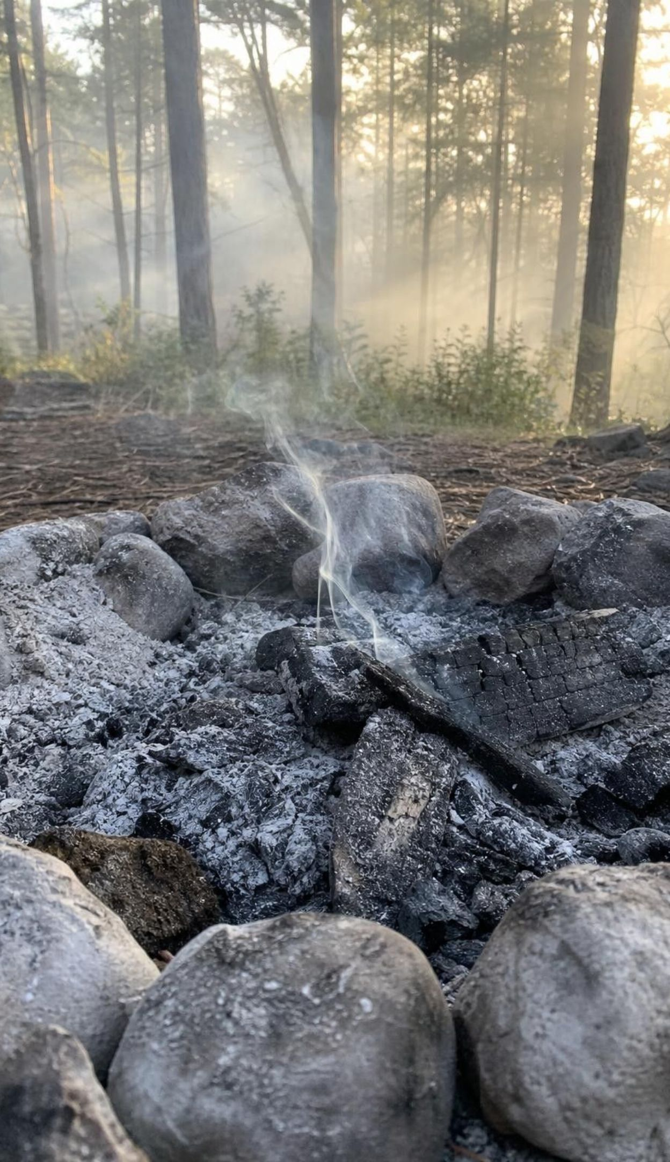
PUTTING IT TOGETHER
Putting it together
1
A reaction breaks and forms bonds; the atoms stay whole and keep their identity.
2
A chemical equation is an atom inventory: coefficient × subscript, the same count on both sides.
3
Atoms regroup by breaking apart, joining, swapping, or a mix. Count substances to sort.
4
Atoms are conserved, so mass is conserved. A closed system shows it; an open one hides it.
5
Engineers use atom accounting to send more reactant atoms into products and fewer into waste.
24
Notes:
Have students write a three-sentence explanation of both balances from the first day, using at least four vocabulary terms, then trade with a partner who checks that 'open system' and 'conserved' are used correctly. Ask for one thing from each lab: Lab 1 (which station went up and why), Lab 2 (one claimed reaction they rejected and the atom that was missing), Lab 3 (one feature they borrowed from another group's design). Preview Lesson 14: the same reactions also absorb or release energy, and energy is not an atom, so it is tracked separately.
CONNECTS TO: W10 mastery as the quiz; L14 Energy in Chemical Reactions next.
PACING: about 6 min

Slide 25
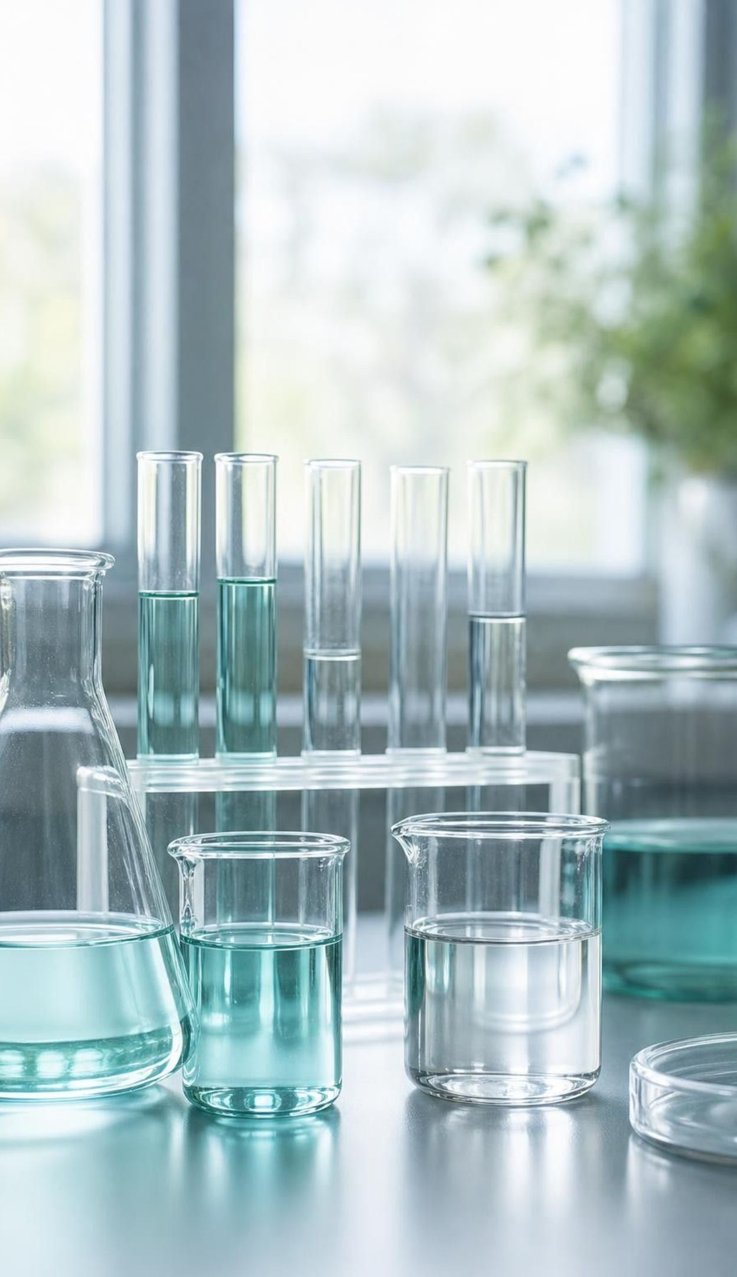
EXIT TICKET
Exit ticket
In 2Fe₂O₃, how many iron atoms and how many oxygen atoms? Show the multiplication.
The fizzing cup lost 1.1 g and the steel wool gained 0.14 g. Explain both with one rule.
Name the regrouping pattern for 2H₂O → 2H₂ + O₂ and for 4Fe + 3O₂ → 2Fe₂O₃.
A sealed, rigid bottle of reactants reads 85.0 g before the reaction. What does it read after, and why?
25
Notes:
Collect on index cards or a shared form. Item 1 checks coefficient versus subscript; item 2 is the heart of the lesson; item 3 checks the sort; item 4 checks the closed-system idea. Sort the cards before the next class and reteach from the largest pile; items 2 and 4 together tell you whether students see the open cup and the sealed bottle as the same law.
EXPECTED RESPONSES: 1: 4 Fe (2 × 2) and 6 O (2 × 3). 2: atoms are conserved; in an open system atoms cross the boundary, carbon dioxide left the cup and oxygen from the air joined the iron, so the readings changed while total matter did not. 3: break apart; join together. 4: 85.0 g, because no atoms can enter or leave the sealed bottle, every atom keeps its mass, and a rigid bottle cannot puff up.
WATCH FOR: Item 2 answers that explain the cup but say the steel wool 'made' mass or gained it from heat.
CONNECTS TO: W10 mastery; chapter evidenceOfLearning.
PACING: about 5 min

