Slide 1
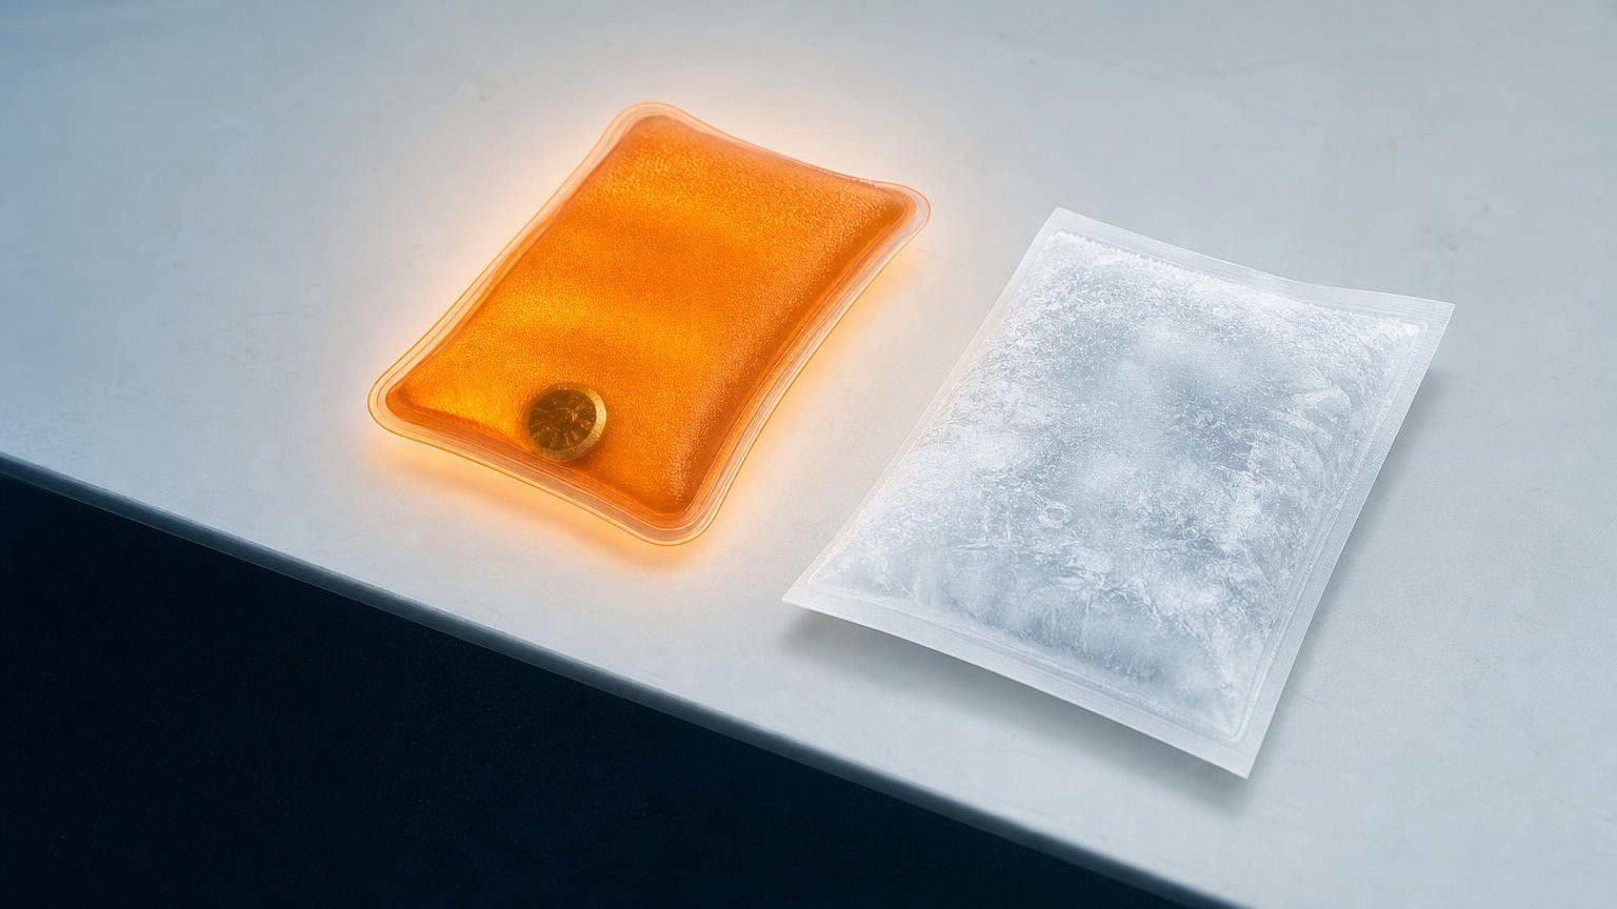
Energy in Chemical Reactions
Chapter 14 of 29 · Chemical Reactions
Lesson 14: Which way does the energy go, and how can we put that flow to work?
Angela's Wand · Bring Science Alive! 7th Grade Integrated
Notes:
Welcome to the third chemistry lesson of this unit. In Lesson 13 we followed atoms as they regrouped; this week we follow energy. Over seven periods we answer two questions: which way does energy move when a reaction happens, and how do engineers control that flow to make a pack that warms or cools on demand. Tell students they will run three investigations: a set of mystery packets to classify by temperature, a design challenge where they build and improve their own hot or cold pack, and a decision meeting where they pick a hand warmer for three different customers from test data. No flames anywhere in this lesson; everything that burns is described, not lit.
CONNECTS TO: Overview of Lab 1, Lab 2 and Lab 3; W1 opens with the next slide.
PACING: about 2 min

Slide 2
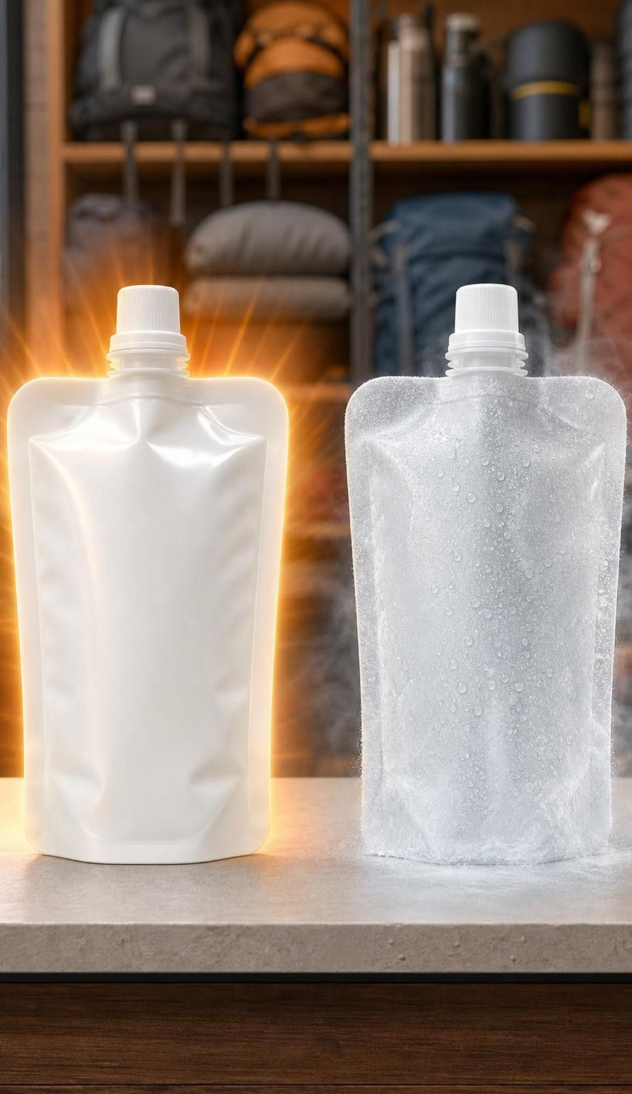
PHENOMENON
Two white pouches, one squeeze, opposite results
A camping-store clerk squeezes a white pouch until the water bubble inside bursts. Within a minute it is almost too warm to hold: about 45 °C. She squeezes a second, identical-looking pouch. It turns cold enough to fog over: about 5 °C. Nothing was plugged in, lit or chilled. Where did the energy come from in the first pouch, and where did it go in the second?
Notice: what was the same about the two pouches, and what was different?
Wonder: does the cold pouch send 'cold' into your hand, or does something leave your hand?
Predict: if you doubled the powder, would the pouch get hotter, last longer, or both?
2
Notes:
Give students two minutes of silent writing on W1 before any discussion. The readings are illustrative values typical of instant hot and cold packs; if you have a commercial pair, demonstrate them now with a probe thermometer and let students touch the outside of each. Collect noticings on the board under 'same' and 'different'. The key observation to surface: the same action (bursting a water bubble so a powder meets water) produced opposite temperature changes, so the direction of the energy flow depends on the substances, not on the squeeze. Park the 'cold flows in' question for slide 11; do not resolve it yet.
EXPECTED RESPONSES: Same: size, color, squeeze, water bubble. Different: the powder inside, the temperature direction. Predictions will split between hotter and longer; both are testable in Lab 2.
WATCH FOR: Students who say the cold pouch 'makes cold' are showing the cold-as-a-substance idea; note who says it for the slide-11 discussion.
CONNECTS TO: W1 phenomenon worksheet; Lab 2 tests the doubling prediction.
PACING: about 7 min

Slide 3
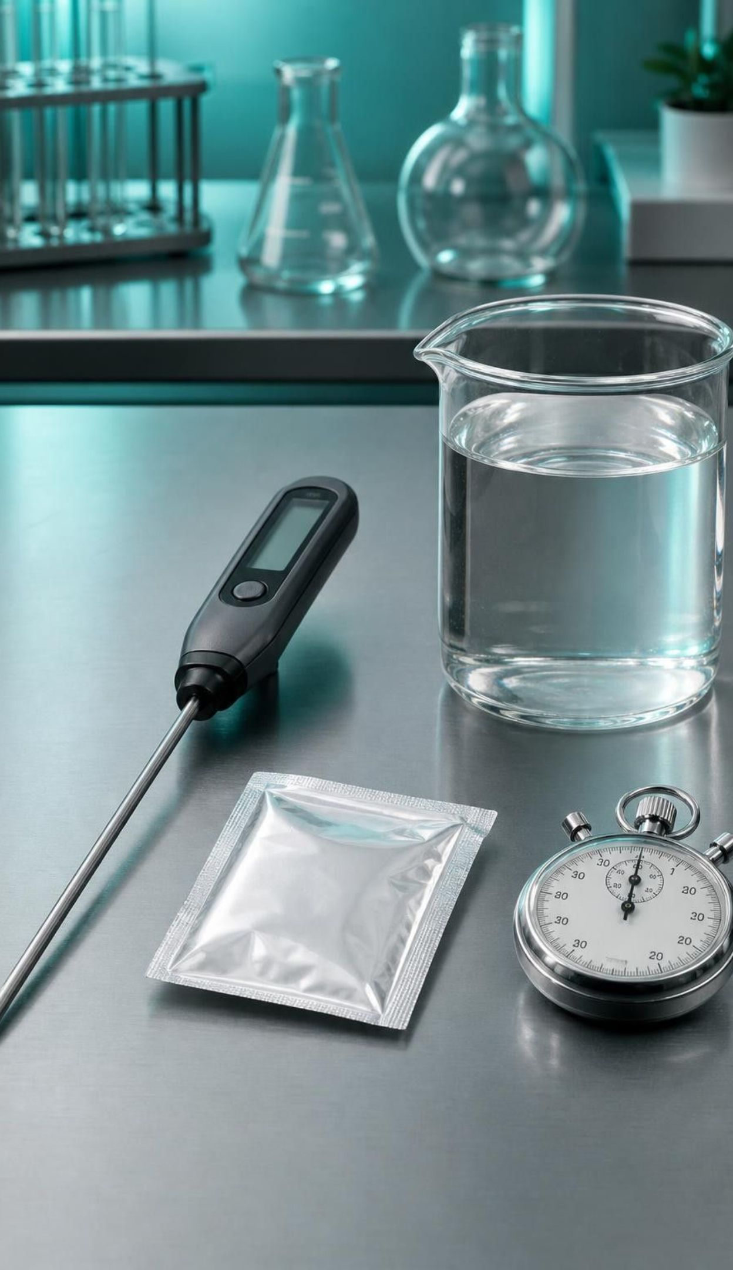
What you will be able to do
Learning targets
Identify the system and surroundings and use evidence to say which way energy flows.
Explain qualitatively why a reaction releases or absorbs energy using bond breaking and forming.
Show energy in a chemical equation on the reactant side or the product side.
Design, test and modify a pack that warms or cools, judged by amount, time and temperature.
Analyze data from several prototypes and combine their best features into a better design.
3
Notes:
Read the targets aloud. Point out the shape of the week: targets 1 to 3 are the science of where energy goes, targets 4 and 5 are the engineering of using it. Ask students to star the target they think will be hardest. The last day's exit ticket touches all five.
CONNECTS TO: Targets map to Lab 1 and W2 (1), W4 and W7 (2), W4 and W10 (3), Lab 2 and W9 (4), Lab 3 and W5 (5).
PACING: about 2 min

Slide 4

Every reaction moves energy; the question is which way
A firework bursting: light, sound and heat pour out of the reacting chemicals.
Magnesium burning: a white flash so bright you must not look straight at it. Light is energy too.
An instant cold pack: energy pours in from your hand, and your hand feels it leave.
To follow energy we need a boundary: what is reacting, and what is around it?
4
Notes:
Set the central idea: atoms regrouping always involves an energy change, never zero. The three examples show energy leaving in different forms (light, sound, thermal energy) or arriving. Stress that the magnesium flash is energy leaving the system as light, not a side effect; a photographer's old flash powder used exactly this. Say plainly that we will never burn magnesium or strike a match in class; those are described examples. Then pose the problem: to say 'energy went out' we have to agree on out of what. That is the next slide.
WATCH FOR: Students may think only heat counts as energy leaving. Light and sound leaving the system count as well.
CONNECTS TO: W2 Part A uses the burning-magnesium example; the W3 reading covers the cold pack and other examples.
PACING: about 4 min

Slide 5
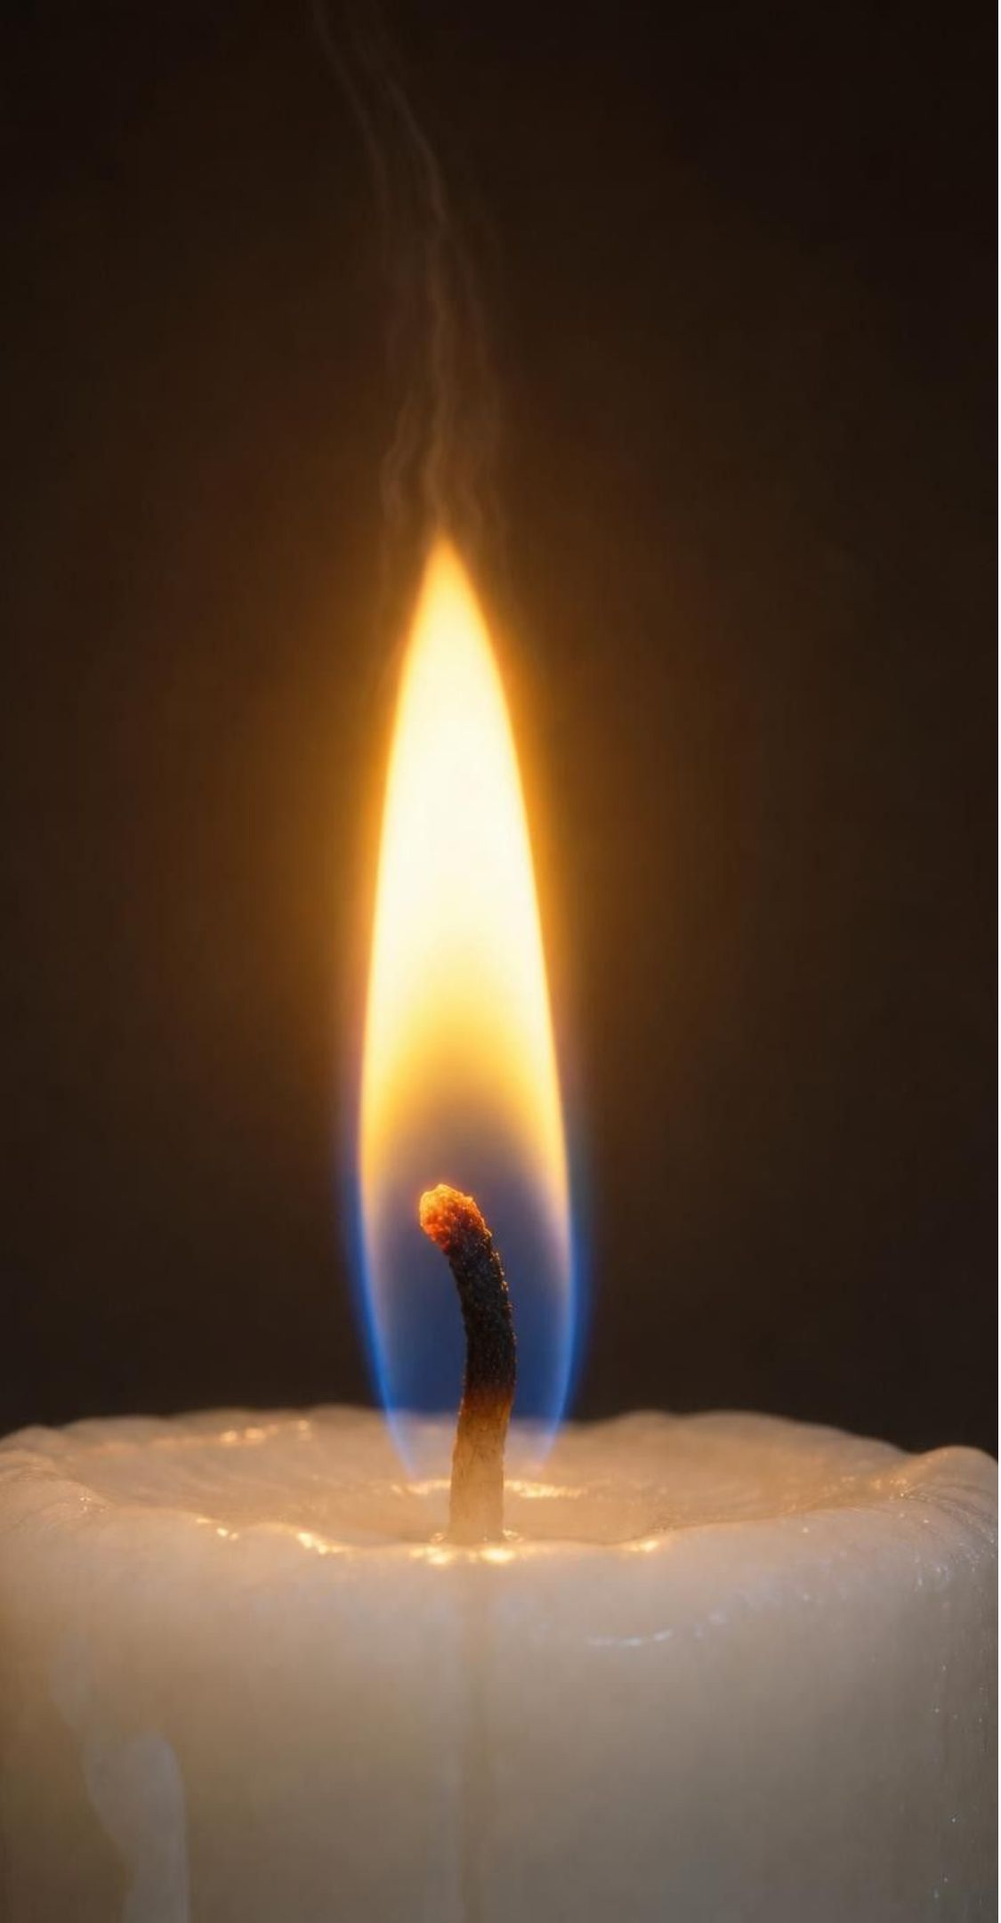
VOCABULARY IN CONTEXT
Drawing the line: three words for tracking energy
system: The matter you are tracking: the reactants and the products they become. For a burning candle: the wax, the oxygen that joins in, and the carbon dioxide and water vapor they form.
surroundings: Everything outside the system that can trade energy with it. The candle holder, the air in the room, your hand near the flame.
thermal energy: The energy matter has because its particles are moving; its transfer from warm to cool is called heat. A hand warmer passes thermal energy to your skin, so your skin's particles speed up and it feels warm.
5
Notes:
Have students draw an imaginary dashed line around the reacting matter in their notes. Inside the line is the system; outside is the surroundings. Practice with the cold pack: the salt and the ions it becomes are the system; your hand, the plastic and the air are surroundings. Chemists disagree about whether the pack's water belongs inside or outside, so accept either as long as the student can defend it. Then preview the thermal-energy language of Lessons 23 and 24: more particle motion means higher temperature. Remind them that temperature is not the amount of thermal energy; a bathtub of warm water holds far more thermal energy than a cup at the same temperature.
WATCH FOR: Students often put the products outside the system. The products are the same atoms, regrouped, so they stay inside.
CONNECTS TO: W2 vocabulary relationships; Lab 1 q1 and its boundary drawing ask for system and surroundings at stations A and B.
PACING: about 5 min

Slide 6
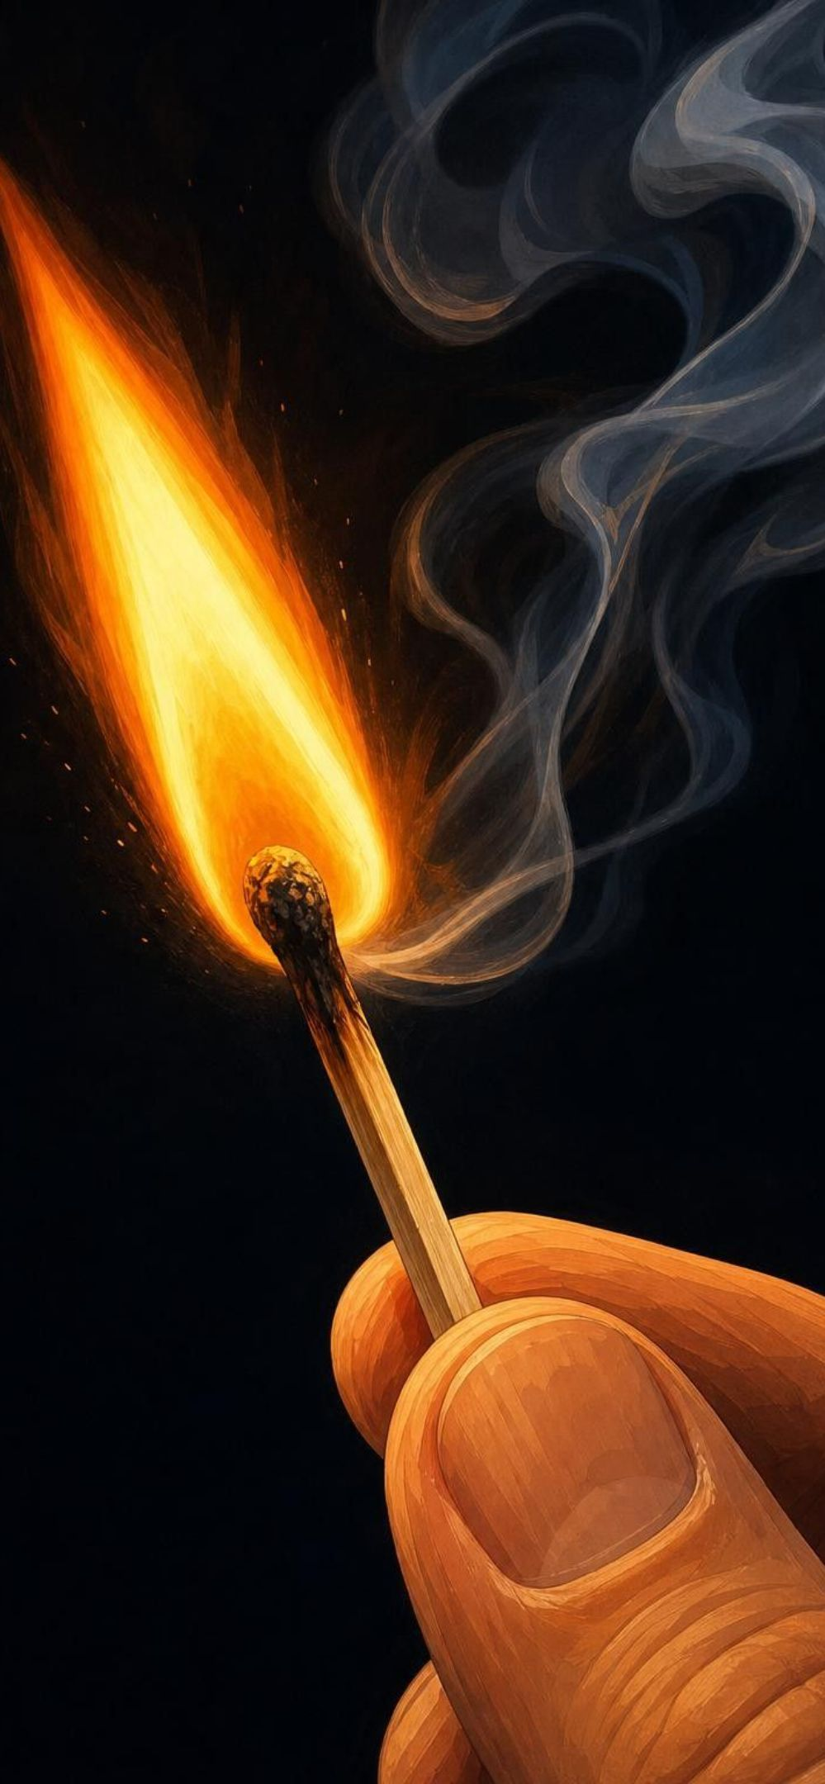
MODEL
The boundary model: one match, two sides of a line
Model: System and surroundings for a lit match
System: match-head chemicals and wood: The reactants. They hold chemical energy because of how their atoms are arranged.
System: oxygen that joins the reaction: Still part of the system; it becomes part of the products.
System: ash, carbon dioxide, water vapor: The products. Same atoms as before, regrouped.
Surroundings: nearby air, fingers, the striker: Receive energy as thermal energy and light. The air warms; the light reaches your eyes.
Boundary: An imaginary line. Energy crossing it outward means exothermic; inward means endothermic.
Energy leaves the system across the boundary, so the surroundings warm up and light up: exothermic.
6
Notes:
Walk through the five items. The hardest idea is that the oxygen is inside the boundary even though it came from the air: the line is drawn around matter that reacts, not around a place. Ask: where does the nitrogen in the air belong? It takes no part, so it is surroundings. Ask: when the match goes out, does energy keep leaving? No; once the reactants are used up, the products simply cool to room temperature, which is ordinary heat flow, not a reaction. Point out the detail that a match needs a scrape to start; keep that thread for slide 15.
WATCH FOR: Students may say the boundary is the matchbox or the room. The boundary is around matter, not space.
CONNECTS TO: W4 diagram worksheet asks students to draw the boundary for a different reaction.
PACING: about 5 min

Slide 7

Exothermic: the system gives out more than it takes in
Net flow is out of the system; the surroundings warm up, light up, or hear a bang.
Burning anything: wood, candle wax, a match, the gas in a stove.
Iron hand warmer: iron reacts with oxygen from the air; the pouch warms for hours.
Calcium chloride pellets dissolving in water: the water gets hot fast (not a reaction, but exothermic).
Exo- means out; -thermic means heat. Exothermic: energy goes out.
7
Notes:
Define exothermic by the net flow, not by 'it feels hot'. The iron hand warmer is the lesson's main example: a cloth pouch of iron powder sealed in plastic; open the plastic, air gets in, iron and oxygen react slowly, and the pouch warms for hours. Real pouches also hold salt, water, activated carbon and vermiculite to control the speed, and the product is rust, hydrated iron oxide; the simple equation on slide 16 leaves those out. Add the calcium chloride example because it is what students will use in Lab 2: dissolving is not a chemical reaction (no new substance forms), but it is strongly exothermic, and the state standard accepts it for the design task. Say 'exothermic process' for it.
WATCH FOR: Students may credit the warmth of a rubbed hand warmer to friction. Rubbing only speeds the mixing of air with the iron; the energy comes from the reaction.
CONNECTS TO: Lab 1 packets A and D are exothermic; Lab 2 hot-pack option.
PACING: about 4 min

Slide 8
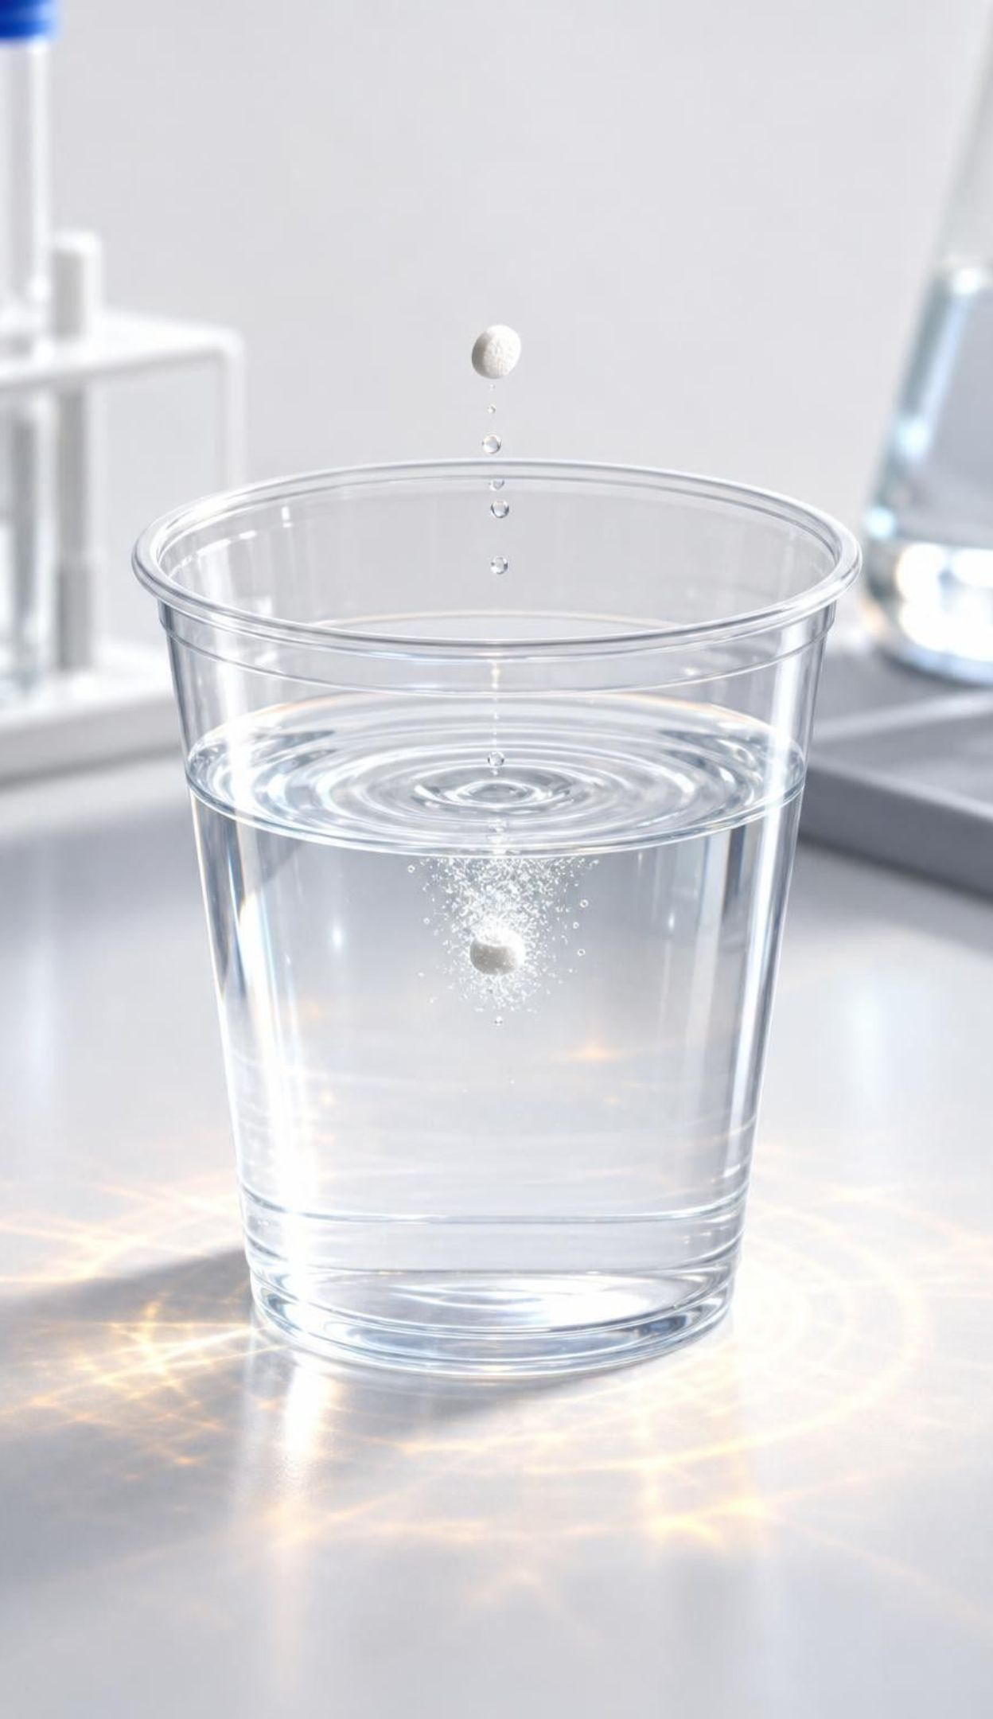
CHECK FOR UNDERSTANDING
Quick check: what shows energy leaving the system?
A student drops a pellet into water in a cup. Which observation is evidence that energy is leaving the system?
A. The pellet disappears into the water
B. The outside of the cup becomes warm to the touch
C. Bubbles rise through the water
D. The water level rises slightly
8
Notes:
Vote with fingers, then defend. Only B shows energy crossing the boundary outward: the cup and your hand are surroundings and they warmed. A and D show the pellet dissolving and taking up space, which says nothing about energy direction. C is the trap: bubbles are a gas leaving, which is matter, not energy, and gas-producing changes can be exothermic or endothermic. Students will test exactly this in Lab 1, where two fizzing packets go in opposite directions.
EXPECTED RESPONSES: B, the cup becomes warm. Students who pick C are using 'fizzing means energetic'; ask them what a thermometer would show.
WATCH FOR: Bubbles as evidence of energy release. Gas is matter; energy direction needs a thermometer or light/sound.
CONNECTS TO: Lab 1 packets B and D; W7 misconception repair.
PACING: about 3 min

Slide 9
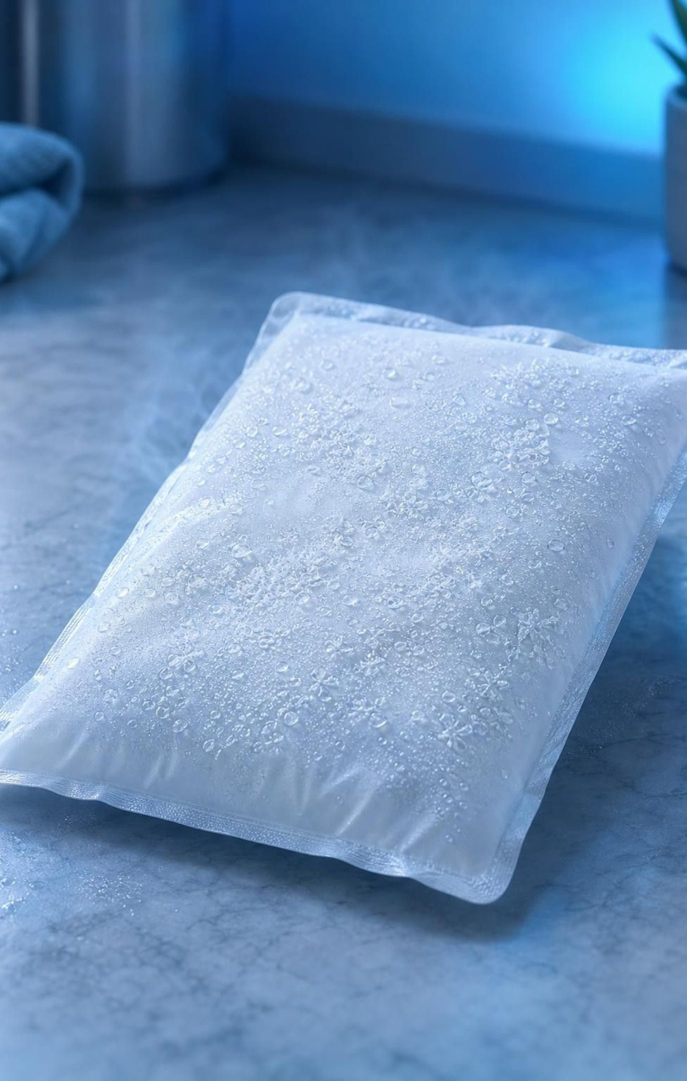
Endothermic: the system takes in more than it gives out
Net flow is into the system; the surroundings lose energy and usually cool down.
Instant cold pack: ammonium chloride dissolves in water and absorbs energy from your hand.
Citric acid + baking soda in water: fizzes and gets cold at the same time.
Photosynthesis: leaves absorb light energy to build sugar; endothermic, powered by light.
Endo- means in. Endothermic: energy goes in.
9
Notes:
The cold pack is the lesson's example. The book describes ammonium chloride splitting into 'ammonium and chlorine particles'; the correct words are ammonium ions and chloride ions, and chlorine gas is a different, toxic substance that never appears here. The dissolving first cools the pack's own water, then the cold pack draws thermal energy from whatever touches it: your hand. Photosynthesis is the big endothermic process on Earth and connects to Lesson 4; it shows that the absorbed energy can be light, and that endothermic does not always mean 'feels cold'. Citric acid and baking soda is what the cold-pack teams use in Lab 2; it is a genuine reaction that makes carbon dioxide and absorbs energy.
WATCH FOR: Students may say the cold pack 'produces cold'. Hold this for the next two slides.
CONNECTS TO: Lab 1 packet B; Lab 2 cold-pack option; W3 reading.
PACING: about 4 min

Slide 10
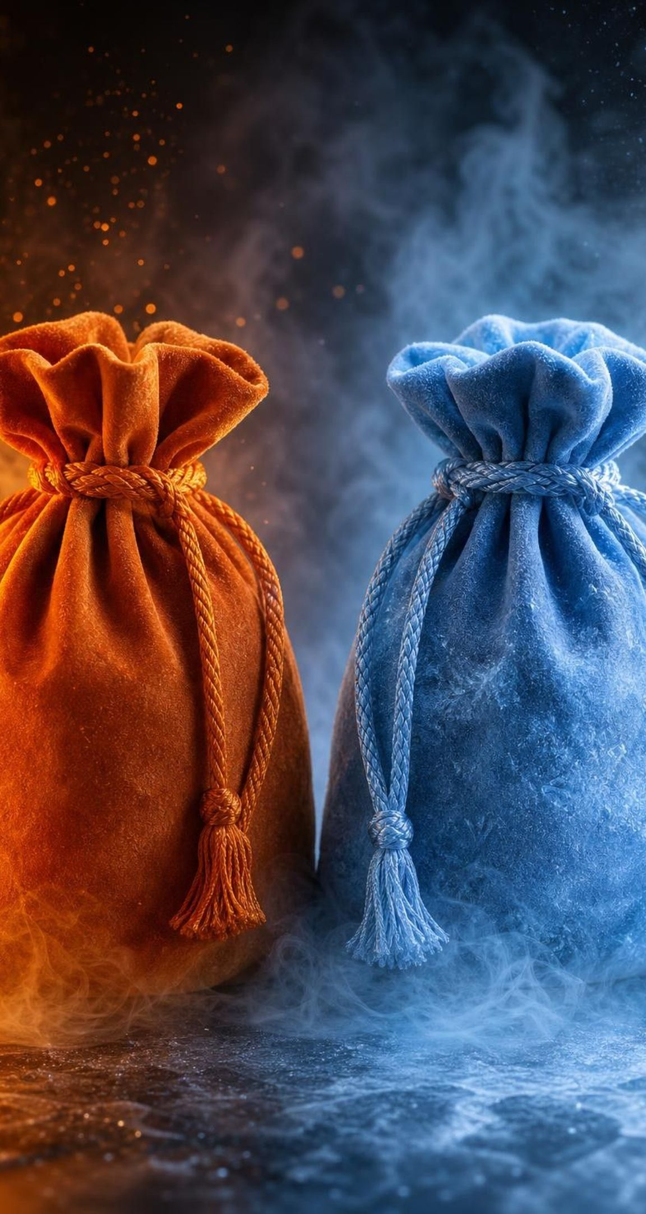
Two directions, one rule: compare energy in with energy out
MODEL
Model: Exothermic versus endothermic
Exothermic | Endothermic
Net energy flows out of the system | Net energy flows into the system
Surroundings warm up, or receive light and sound | Surroundings cool down, or supply light
Energy released by forming new bonds is greater than energy needed to break old ones | Energy needed to break old bonds is greater than energy released by forming new ones
Examples: burning, iron hand warmer, calcium chloride in water | Examples: instant cold pack, citric acid with baking soda, photosynthesis
The only test that always works: measure the surroundings. Warmer means out; cooler means in.
10
Notes:
Build the comparison from the examples students already have. Spend the most time on the shared middle: both kinds obey conservation of atoms (Lesson 13) and conservation of energy, and both may need a push to start. The bond lines preview slide 13; for now, say only that the direction depends on comparing two amounts. Ask students to add one more example to each column from their own lives (a self-heating meal, a glow stick, bread rising in an oven).
WATCH FOR: Students may think exothermic reactions never need a start. The match does; keep 'needs a start' in the shared column.
CONNECTS TO: W2 sorting task; W6 CER uses this rule.
PACING: about 5 min

Slide 11
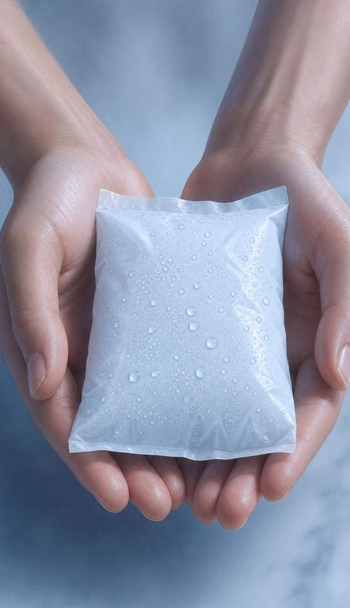
Think, pair, share
Discuss: does cold flow into your hand?
Claim A: cold moves from the pack into the hand.
Claim B: thermal energy moves from the hand into the pack.
Think: which direction does energy move on its own between warm and cool objects?
Think: the pack's water got cold first. What did the dissolving salt do to it?
When you hold an instant cold pack, your hand feels cold. Is something flowing from the pack into your hand, or from your hand into the pack? What evidence would settle it?
11
Notes:
Give pairs four minutes. Push toward Claim B: there is no substance called cold; energy moves on its own from warmer matter to cooler matter (an idea students will meet again in Lesson 24), so when the pack is cooler than your hand, thermal energy leaves your hand. The pack got cold in the first place because the dissolving salt absorbed thermal energy from the pack's own water. Evidence that settles it: a thermometer in the pack rises slightly when you hold it (your hand is warming it), and a thermometer on your skin falls. Close by having students restate the phenomenon slide in energy terms: pouch one gave energy to the hand; pouch two took energy from the hand.
EXPECTED RESPONSES: Claim B. Evidence: thermal energy always moves from warmer to cooler; a probe in the pack warms up while it is held; the pack eventually reaches hand temperature, not the other way around.
WATCH FOR: The cold-as-substance idea is one of the chapter's listed misconceptions; W7 repairs it in writing.
CONNECTS TO: W7 misconception repair; Lab 1 question on the direction of flow.
PACING: about 6 min

Slide 12
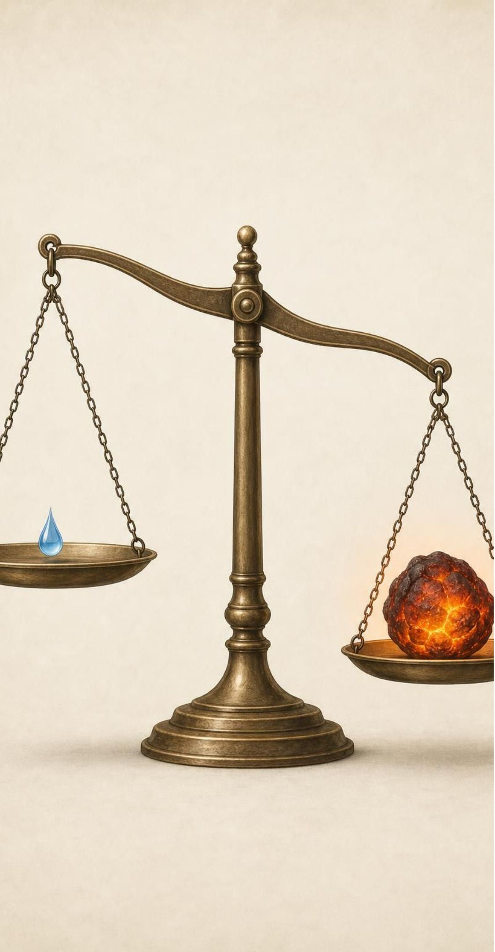
VOCABULARY IN CONTEXT
The two names, and the number that decides between them
exothermic reaction: A reaction that gives out more energy than it takes in; net flow out of the system. Iron reacting with oxygen in a hand warmer keeps a pocket warm for hours.
endothermic reaction: A reaction that takes in more energy than it gives out; net flow into the system. Citric acid reacting with baking soda in water makes the cup cold to the touch.
net energy transfer: The overall direction and size of the flow after adding up all energy in and all energy out. A match takes a little energy to start and releases much more, so its net transfer is outward.
12
Notes:
Have students say the two words with the gestures: push out for exo, pull in for endo. Then stress 'more than': every reaction both absorbs and releases some energy; the name comes from which is bigger. That is why 'net' matters. Quick test: a gas stove flame needs a spark. Is the net transfer in or out? Out, obviously, since the kitchen warms up. The book calls some dissolving changes reactions; we say 'endothermic process' for a dissolving salt and 'endothermic reaction' when new substances form.
WATCH FOR: Students may define exothermic as 'gets hot' and miss that light and sound are also energy leaving.
CONNECTS TO: W2 vocabulary; W10 mastery items on definitions.
PACING: about 4 min

Slide 13
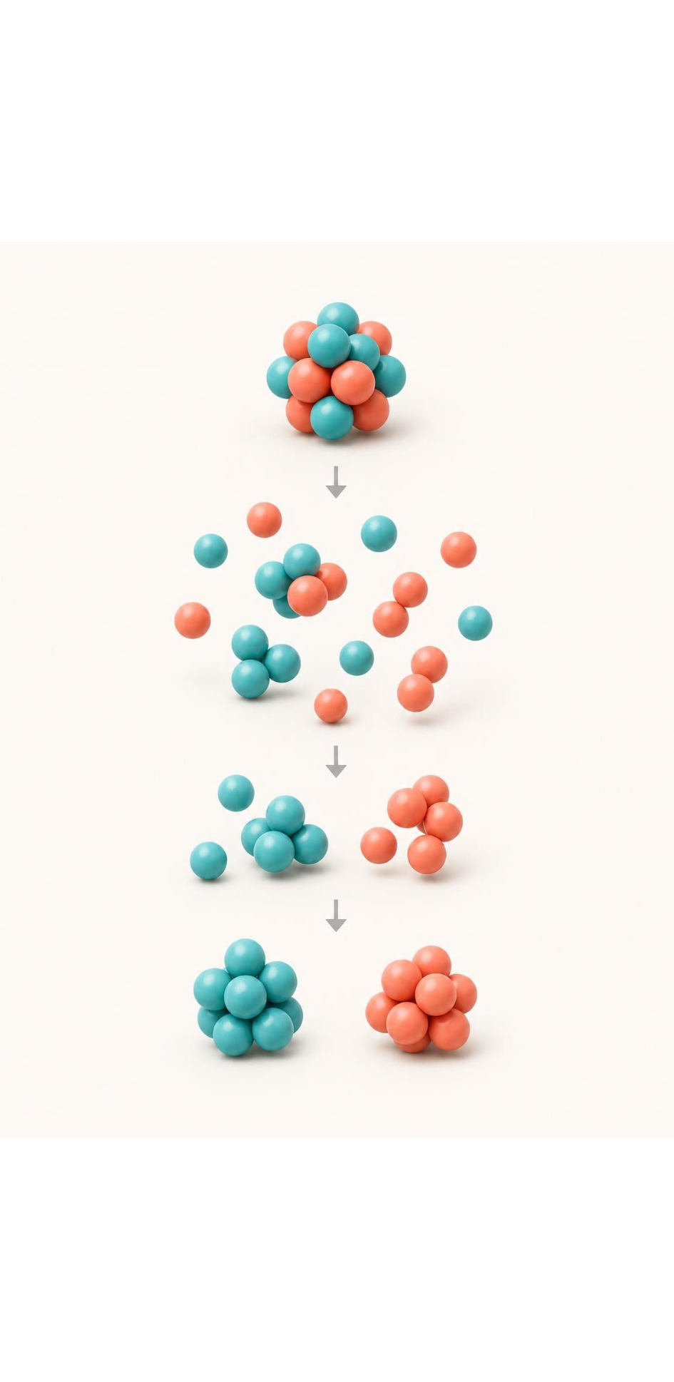
MODEL
Bonds: pay in to break, get paid to form
Model: Where the energy of a reaction comes from
Reactants: atoms held by old bonds → (always costs energy)
1
Energy goes IN to break old bonds → (same atoms, new partners)
2
Atoms regroup → (always releases energy)
3
Energy comes OUT as new bonds form → (bigger OUT: exothermic; bigger IN: endothermic)
4
Compare the two amounts
5
Breaking a bond never gives out energy. The net result depends on which total is larger.
13
Notes:
This is the one place the chapter explains why. Keep it qualitative: no numbers, no bond energies. Breaking any bond takes energy in, the way pulling apart two magnets does; forming any bond gives energy out, the way the magnets snap together. Most reactions do both. If forming the new bonds gives out more than breaking the old ones took in, the extra leaves the system: exothermic. If breaking costs more than forming pays back, the difference has to come from the surroundings: endothermic. Then conservation: the energy an exothermic reaction releases was stored in the arrangement of the reactants' atoms; an endothermic reaction stores the energy it absorbs in the arrangement of its products. Avoid the phrase 'energy stored in bonds'; it leads straight to the slide-24 misconception. Use the magnet analogy carefully: magnets are a model of attraction, not of chemistry.
WATCH FOR: 'Breaking bonds releases energy' will appear within minutes. Correct it every time: breaking costs; forming pays.
CONNECTS TO: W4 diagram worksheet; slide 24 misconception; W7.
PACING: about 7 min

Slide 14

Nothing is created or lost: energy is moved and stored
An exothermic reaction releases energy that was stored in how the reactants' atoms were arranged.
An endothermic reaction stores the energy it absorbs in how the products' atoms are arranged.
Burning sugar releases energy; photosynthesis stored it there using light (Lessons 4 and 5).
A used pack cools to room temperature because its energy spread into the room, not because it vanished.
Track it like money: it changes accounts, but the total stays the same.
14
Notes:
Tie this lesson to the energy-flow lessons of Unit 2: the sugar a plant made by an endothermic process powered by light is the sugar an animal breaks down in an exothermic process. Use the money analogy sparingly: energy can be in different 'accounts' (thermal energy of the surroundings, chemical energy of the system), and a reaction moves it between accounts. Ask: when a hand warmer is finished and cold, where did all the energy go? Into the air, your hands and your gloves, spread out so thinly you cannot get it back. That is why the pack is single-use.
WATCH FOR: Students may say the energy is 'used up'. It is spread out, not destroyed.
CONNECTS TO: W3 reading passage; W10 mastery.
PACING: about 4 min

Slide 15
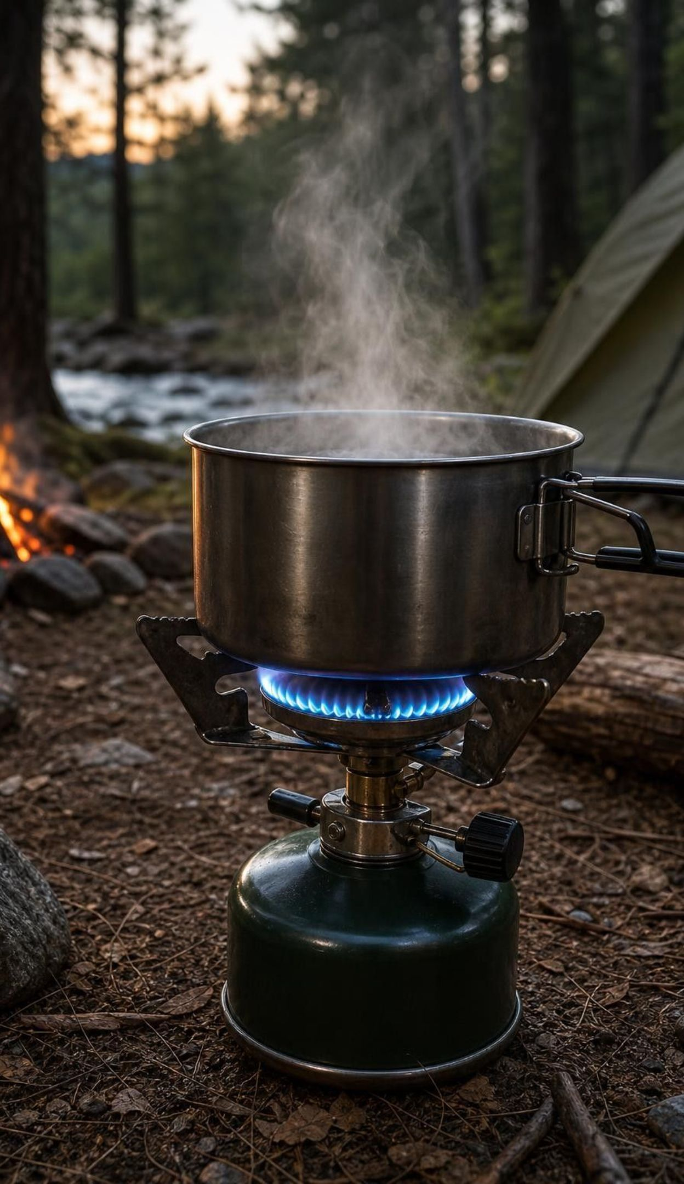
CHECK FOR UNDERSTANDING
Quick check: needs a spark, then burns on its own
A camp stove needs a spark to light. Once lit, it burns for hours and warms the pot above it. Is the burning exothermic or endothermic, and what is the evidence?
A. Endothermic, because it needed a spark to start
B. Exothermic, because the surroundings (the pot) gain energy for hours
C. Endothermic, because gas is used up
D. Neither, because the spark and the heat cancel out
15
Notes:
This check targets the book's rule that a reaction needing an energy supply is endothermic. The spark is a tiny one-time input; the net transfer over the whole burn is enormously outward. Compare: a cold pack needs no spark but still absorbs energy for twenty minutes. The deciding evidence is always the net flow, measured in the surroundings. Option C confuses matter being used with energy direction; option D ignores the sizes of the two amounts.
EXPECTED RESPONSES: B. The pot and the air gain far more energy than the spark supplied; the net transfer is out, so exothermic.
WATCH FOR: 'Needs heat to start, so endothermic' is one of the chapter's listed misconceptions.
CONNECTS TO: W7 misconception repair includes this exact error.
PACING: about 3 min

Slide 16
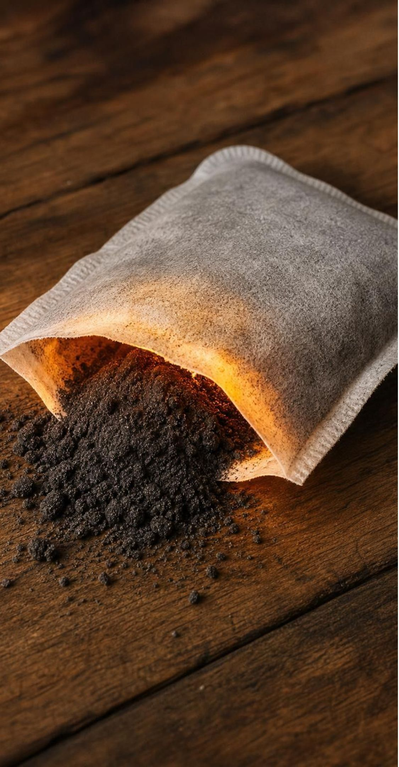
Showing energy in the equation
Energy is not matter, so it has no atoms to count. Chemists still write it into the equation to show which way it flows. Energy that flows IN is written with the reactants; energy that flows OUT is written with the products.
Hand warmer (exothermic): 4Fe + 3O₂ → 2Fe₂O₃ + energy
Cold pack (endothermic): NH₄Cl + energy → NH₄⁺(aq) + Cl⁻(aq)
Adding the word energy never changes the atom count on either side.
The iron equation is a simplified model; real pouches hold other helpers too.
16
Notes:
Give the rule and then read each equation aloud in words: four iron atoms and three oxygen molecules become two units of iron oxide and energy leaves. The cold pack: ammonium chloride plus energy becomes ammonium ions and chloride ions spread through water; '(aq)' means dissolved in water. The textbook prints a different cold-pack equation with ammonium hydroxide and hydrochloric acid as products; that equation is not what happens in a cold pack and does not balance in the figure, so we do not use it. Check the iron equation's atoms with students: 4 Fe and 6 O on each side, which is Lesson 13 practice. Ask: why is energy not given a coefficient? Because it is not a substance; the word only shows direction.
WATCH FOR: Students may try to 'balance' energy or count it as an atom. It is a label for direction.
CONNECTS TO: W4 and W10 equation items; Lab 1 analysis question on writing the energy term.
PACING: about 5 min

Slide 17
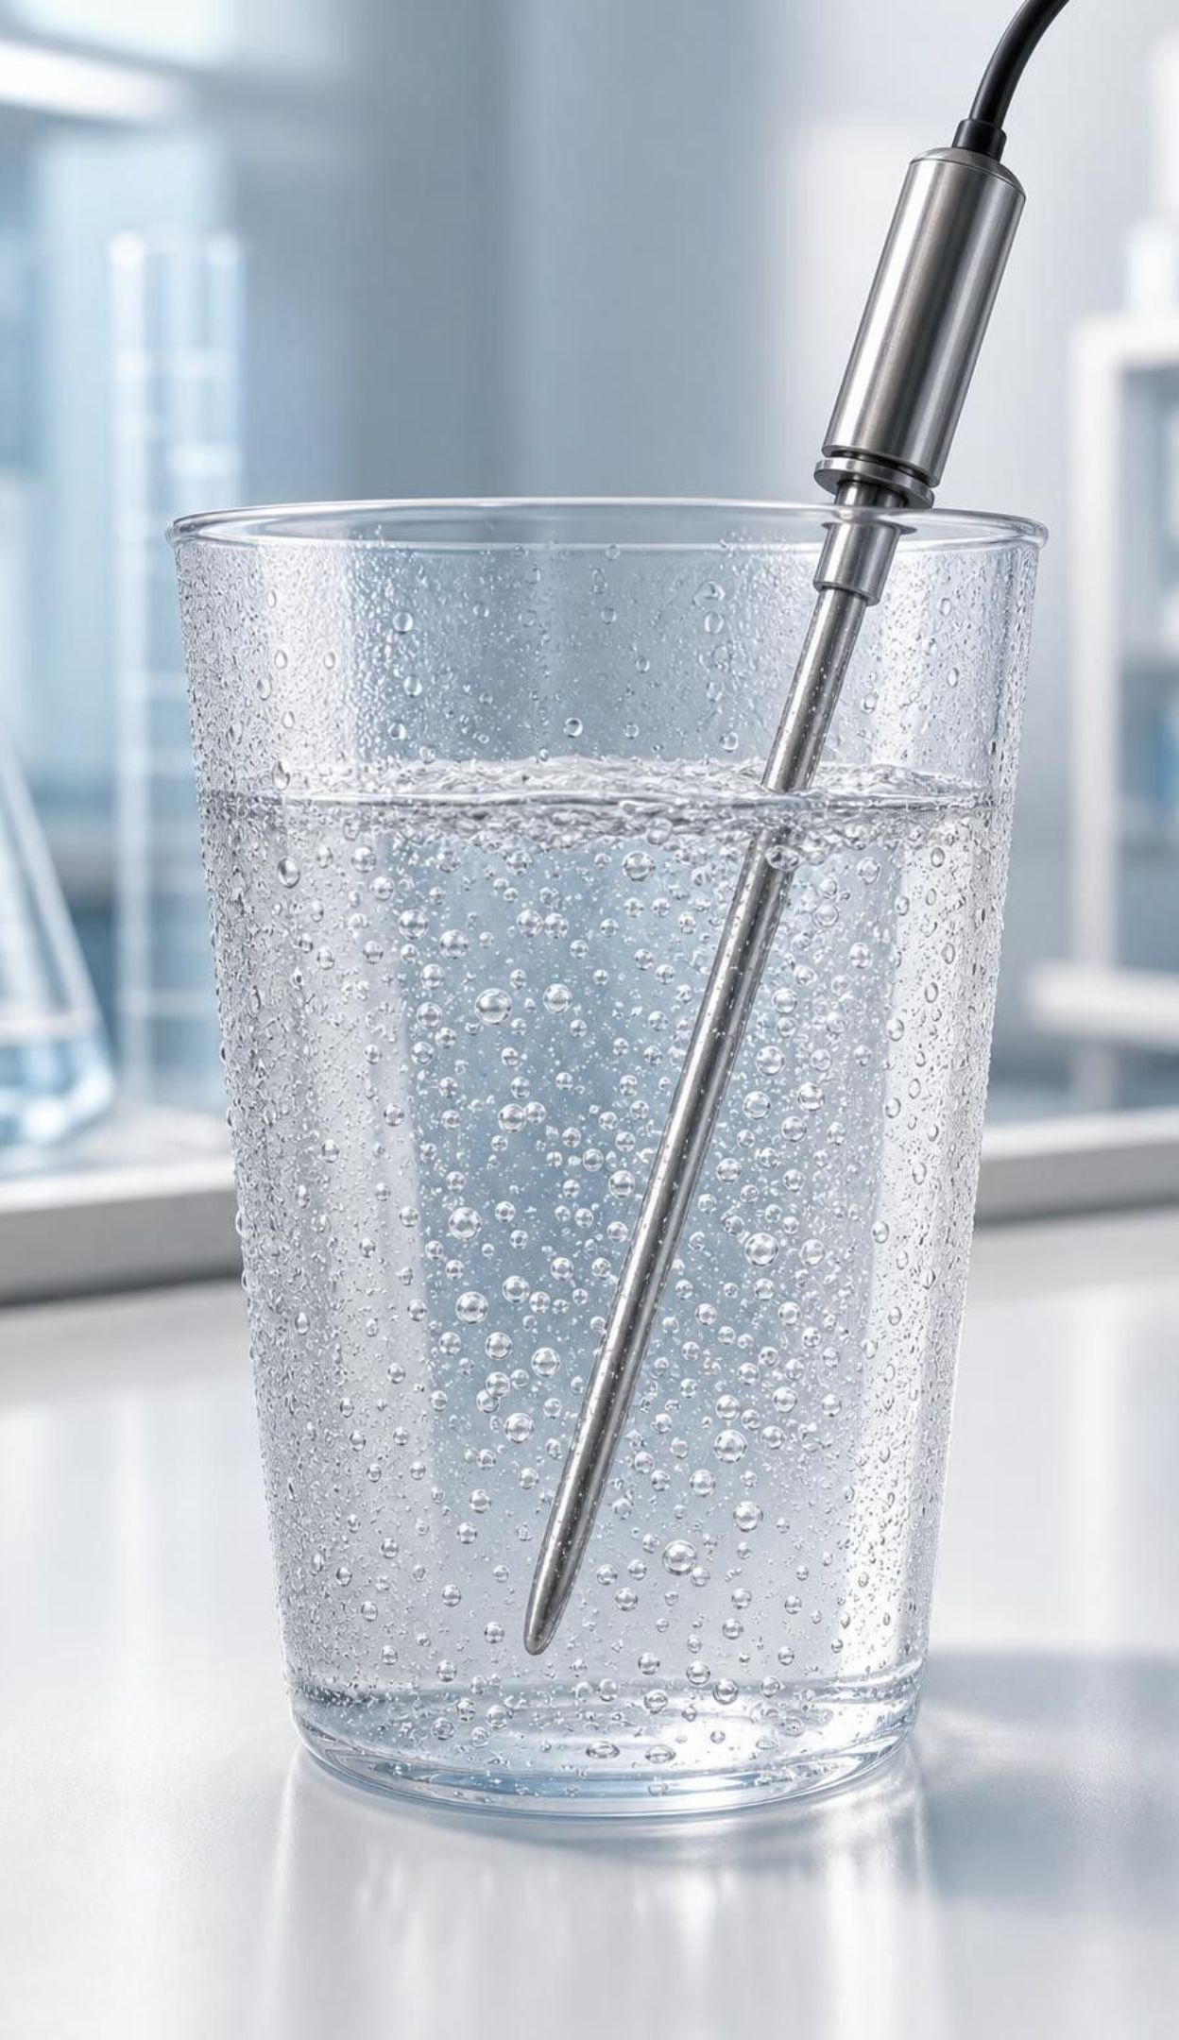
CHECK FOR UNDERSTANDING
Quick check: where does the energy term go?
Citric acid and baking soda react in water. The thermometer drops from 22 °C to 14 °C. Where does the word 'energy' belong in the equation for this reaction?
A. With the reactants, because the system absorbed energy
B. With the products, because the reaction made gas
C. On both sides, because energy is conserved
D. Nowhere, because dissolving is not a reaction
17
Notes:
Students need two steps: read the direction from the surroundings (the water cooled, so energy went into the system), then apply the placement rule (energy in goes with reactants). Option B repeats the gas trap. Option C misreads conservation: energy is conserved across system plus surroundings, but the equation shows the system's side only. Option D is wrong twice: this is a genuine reaction (carbon dioxide forms), and even a dissolving process can carry an energy term.
EXPECTED RESPONSES: A. The surroundings cooled, so the system absorbed energy; energy is written with the reactants.
WATCH FOR: 'Both sides because conserved' shows a confusion between the system's equation and the whole-universe energy total.
CONNECTS TO: Lab 1 packet B; W10.
PACING: about 3 min

Slide 18
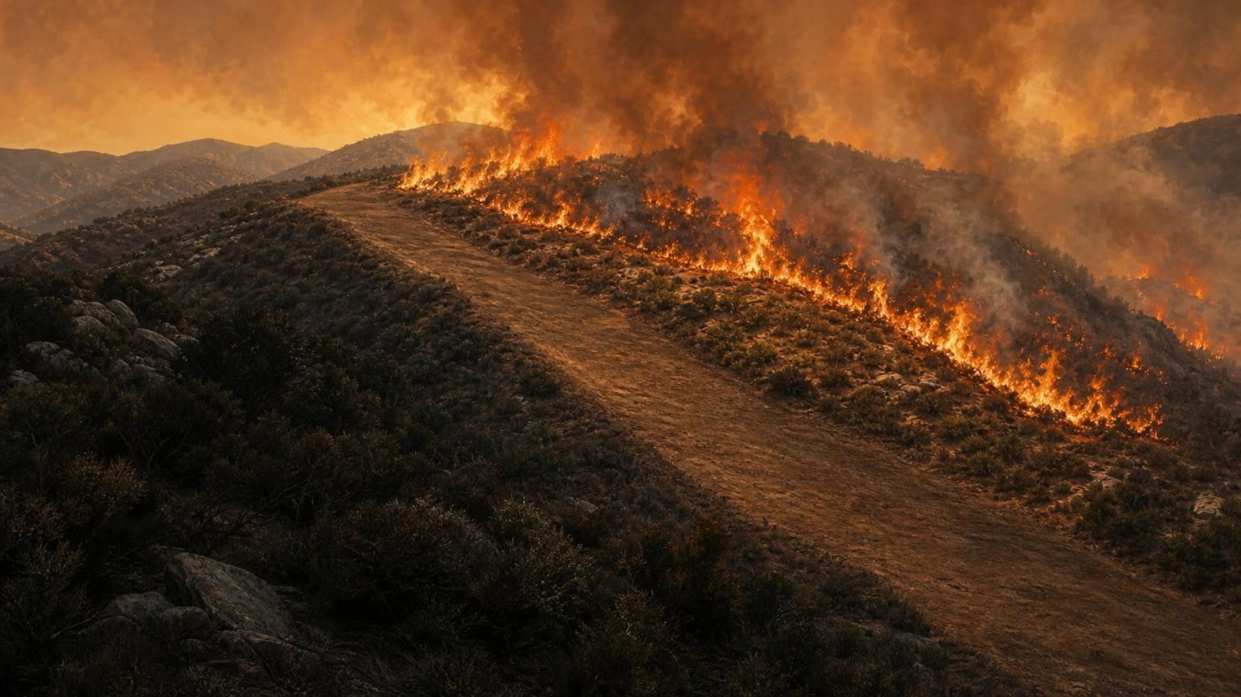
REAL-WORLD CONNECTION
California connection: why a wildfire keeps itself going
Every autumn, Cal Fire crews face burning brush in the Sierra foothills and the Santa Ana wind country of Southern California. Burning is strongly exothermic: energy released by one patch of burning plants heats the plants beside it until they react. The reaction supplies the start-up energy for the next patch, so a fire spreads by itself. Fuel breaks remove the reactants: no fuel ahead of the flames, no reaction.
Notes:
This is a real and local example of the net-transfer idea. A single ember is the small start-up input; the exothermic reaction then pays back far more energy than that, enough to ignite the next fuel. Fuel breaks and defensible space work by removing reactants, not by removing energy. Keep the tone practical, not frightening; some students will have evacuation memories. Ask: in energy terms, why does wind make a fire worse? It brings fresh oxygen (a reactant) and carries thermal energy to new fuel. Mention that the same chemistry, controlled, is what the charcoal hand warmer in the lesson uses, which is one reason engineers prefer the slow iron reaction for pocket warmers.
CONNECTS TO: W3 paragraph 4 (a reaction that pays for its own start); W8 Part B on choosing a safe warming process.
PACING: about 4 min

Slide 19
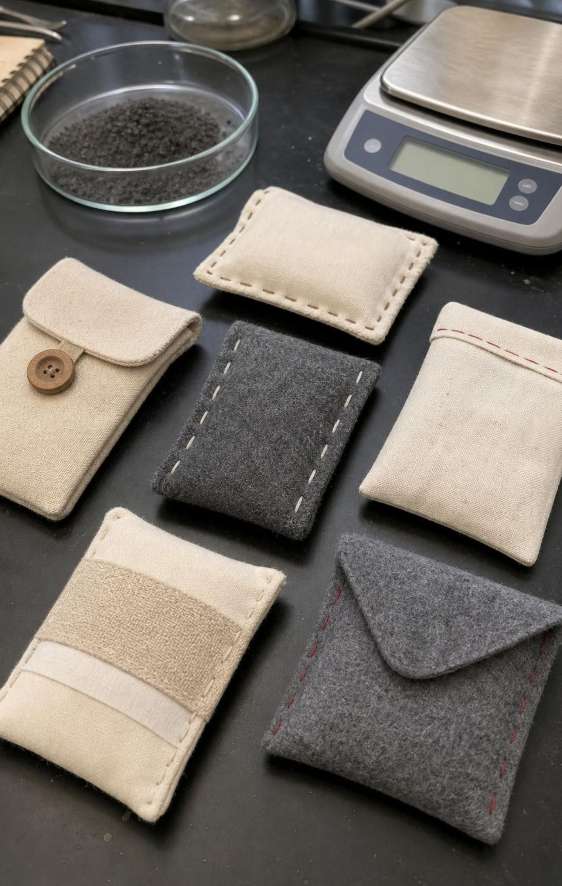
Engineering a hand warmer: criteria, constraints, prototype
Criteria (goals): reach about 45 °C and stay warm for several hours.
Constraints (limits): safe to hold (never above 50 °C), cheap, light, no flame.
Prototype: a working test version. The lesson's team sealed iron powder away from air, then opened it.
Test 1 measured temperature: their first pouch reached only a few degrees above room temperature.
Test 2 measured time: the hotter pouch was back at room temperature in under an hour.
19
Notes:
Retell the lesson's engineering story in your own words: the team defined what success meant, built a pouch of iron grains, kept it under nitrogen so no reaction could start, then exposed it to air and tracked the temperature with a probe. The first prototype was too cool, so they doubled the iron and got a good peak temperature. Then they measured time and found the pouch burned out in an hour, so they changed the pouch material to let air in more slowly, which lengthened the time but lowered the temperature. Then more iron again, until both criteria were met. Point out the pattern: change one thing, test, read the data, choose the next change. The book's figures are 28 °C, then 41 °C, then 40 °C for 4 hours, then 43 °C for 4 hours, with room temperature about 25 °C; do not use the photo's thermometer label, which disagrees with the text.
WATCH FOR: Students will mix criteria and constraints. A criterion is a target you aim to hit; a constraint is a wall you must not cross.
CONNECTS TO: Lab 2 brief uses the same criteria and constraints structure; Lab 3 data.
PACING: about 5 min

Slide 20

MODEL
The design cycle the hand-warmer team followed
Model: Build, test, read, change
Define criteria and constraints → (amount of reagent, pouch material)
Build a prototype → (probe thermometer, timer)
Test: record temperature over time → (too cool? too short? too hot?)
Compare the data with the criteria → (more iron, slower air, more insulation)
Change one feature → (same test, same conditions)
Retest the new prototype → (repeat until criteria are met within constraints) (back to the start)
Each loop produces data; the data, not a guess, decides the next change.
20
Notes:
Trace the loop with the lesson's story: the first pass fixed temperature, the second fixed time, the third fixed temperature again. Emphasize two habits students must use in Lab 2: change only one feature per loop so you know what caused the difference, and test every prototype the same way (same water volume, same starting temperature, same timing) so the comparison is fair. Ask: what would happen if the team doubled the iron and changed the pouch in the same loop and the pouch got hotter? They could not tell which change did it.
WATCH FOR: Students may think the first prototype should work. A prototype that fails is still a success if it produces data.
CONNECTS TO: Lab 2 recording sheet is organized around this loop; W9.
PACING: about 5 min

Slide 21

APPLY IT
Task: read the data, choose the next change
Simulated data for practice.
A team wants a hand warmer that holds at least 42 °C for 3 hours and never passes 50 °C. Room temperature was 23 °C. Using the test data, what single change should they make for trial 4, and why?
Trial | Iron (g) | Pouch | Peak temp (°C) | Time above 42 °C | Time above 35 °C
1 | 15 | thin cotton | 33 | 0 min | 0 min
2 | 30 | thin cotton | 46 | 50 min | 95 min
3 | 30 | thick felt | 39 | 0 min | 4 h 10 min
21
Notes:
This is a teaching dataset, invented to show the trade-off; it is not the book's data and not Lab 3's. Give groups six minutes. Guide the reading: trial 1 to 2 doubled the iron and the peak rose by 13 °C, so iron controls temperature. Trial 2 to 3 changed only the pouch; the peak dropped 7 °C but the warm time stretched from 95 minutes to over 4 hours, so the pouch controls how fast air reaches the iron and therefore how long the pack lasts. Neither trial meets both criteria. The felt pouch solved time; the problem left is temperature, so the one change for trial 4 is more iron with the felt pouch, perhaps 40 to 45 g, keeping an eye on the 50 °C ceiling. Reject 'go back to cotton with more iron': it would get hotter but still burn out fast, and might cross 50 °C.
EXPECTED RESPONSES: Keep the thick felt pouch and increase the iron (for example to 40-45 g). Reasoning: felt fixed the time criterion; iron raises peak temperature; change one thing. Students should mention checking that the peak stays under 50 °C.
WATCH FOR: Groups that change two things at once, or that pick trial 2 because it was hottest, are missing the time criterion.
CONNECTS TO: Lab 2 justification; Lab 3 uses six prototypes with the same logic; W5.
PACING: about 8 min

Slide 22
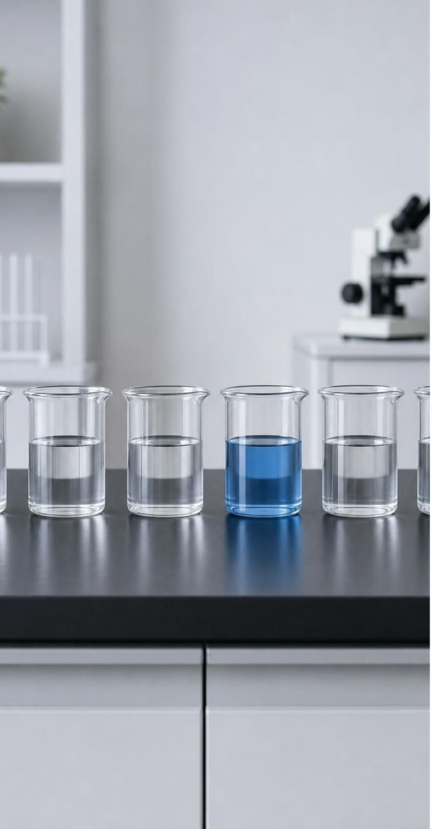
THINK, PAIR, SHARE
Discuss: why change only one thing at a time?
If two things change and the result improves, which change deserves the credit?
If two things change and the result gets worse, did both hurt, or did one help and one hurt more?
Testing costs time and money. Is there a case for changing two things anyway?
How does this connect to controlled variables in a science investigation?
Changing two features at once would reach a good design faster, if it worked. Why do engineers usually resist that, and when might they break the rule?
22
Notes:
Give pairs four minutes. The core answer: one change per loop lets the data assign cause and effect. The exceptions are worth hearing: when a prototype is hopeless on every criterion, engineers sometimes make a big jump and then fine-tune, or when two features are known to be independent (color of the pouch and amount of iron), they can change both. Connect to the controlled-variables language students know: a design loop is an experiment with one independent variable. In Lab 2, the rule is firm; they will change exactly one feature between prototypes.
EXPECTED RESPONSES: One change lets you know what caused the difference; two changes confound the result. Breaking the rule can be justified when the first prototype fails every criterion or when the two features clearly do not interact.
CONNECTS TO: Lab 2 procedure step on single changes; Lab 3 analysis.
PACING: about 5 min

Slide 23
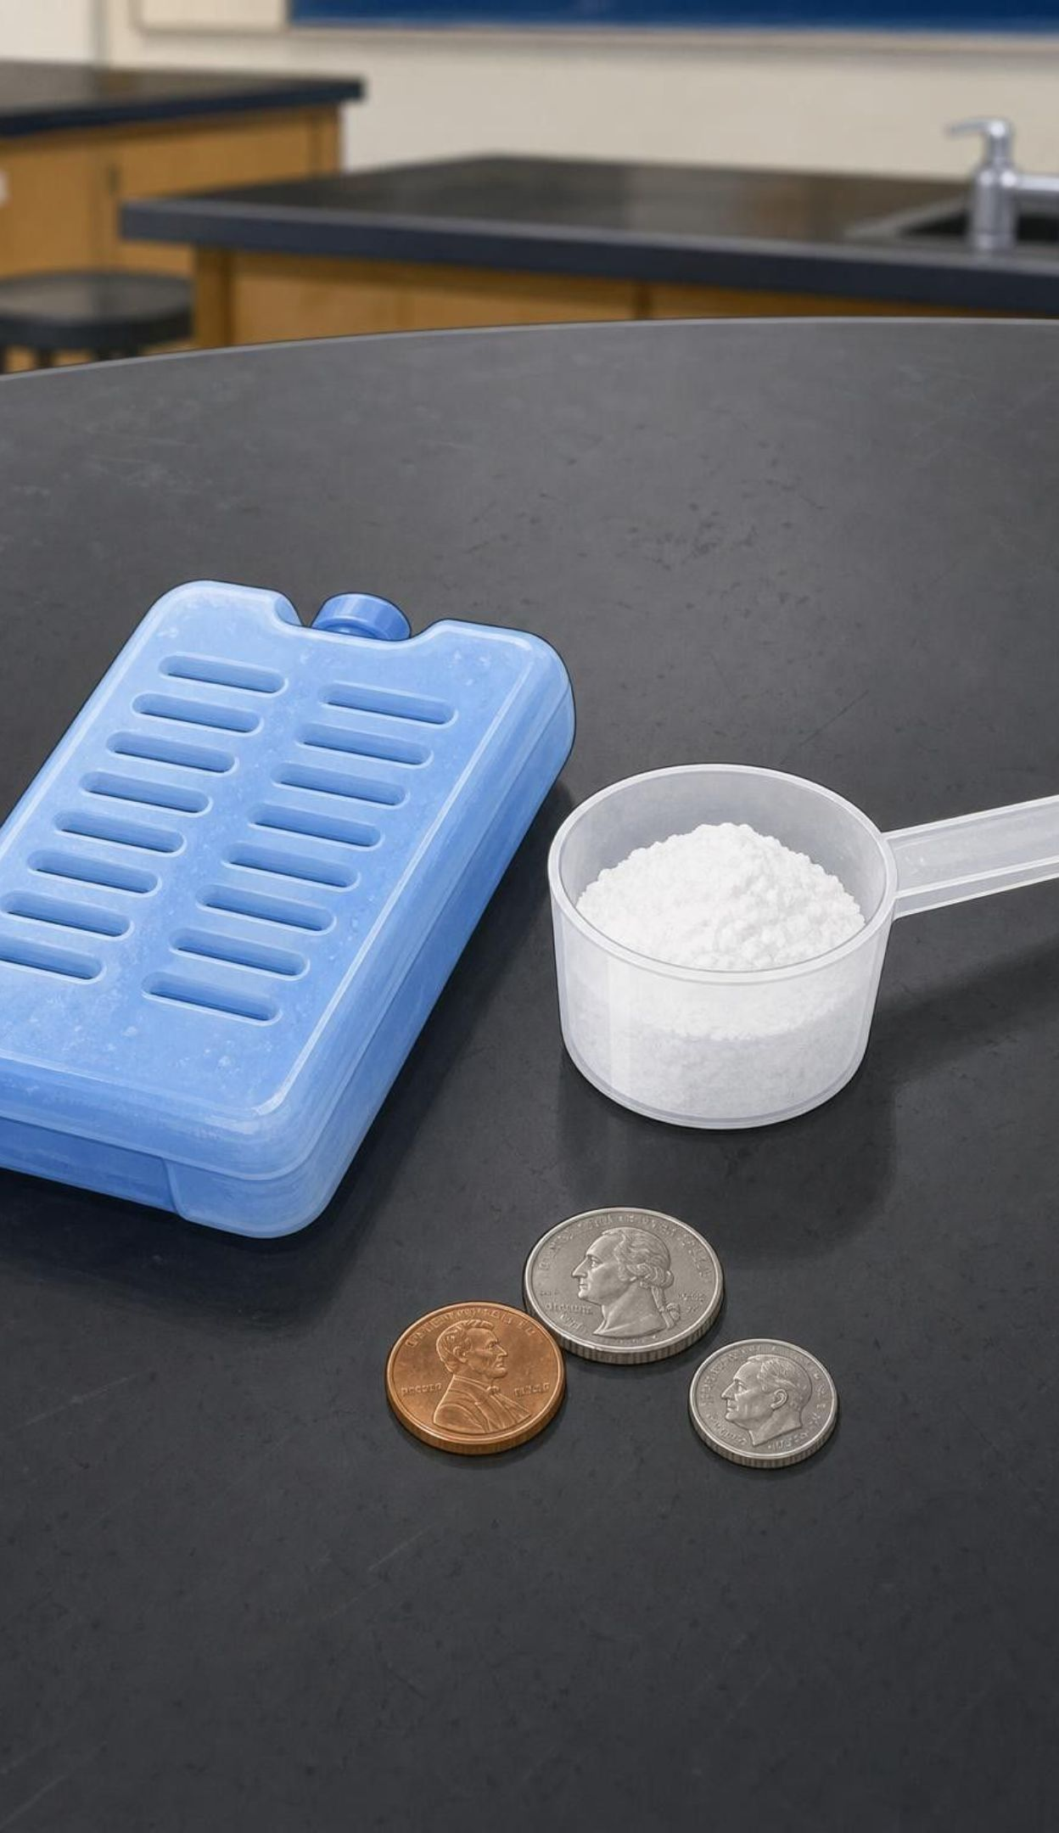
CHECK FOR UNDERSTANDING
Quick check: criterion or constraint?
Drops at least 8 °C within 2 minutes.
Costs no more than $1.50 in materials.
Stays at least 4 °C below start after 10 minutes.
Must be vented so gas can escape; no sealed bags.
Uses no more than 12 g of reagent mix.
For a classroom cold pack: sort each item as a criterion (a goal to hit) or a constraint (a limit you must not cross).
23
Notes:
Thumbs up for criterion, thumbs down for constraint, item by item. Items 1 and 3 are criteria: they describe how well the pack performs. Items 2, 4 and 5 are constraints: they limit what you are allowed to build. The venting rule is a safety constraint because a gas-producing reaction inside a sealed bag can burst it. Point out that these are the actual criteria and constraints for the Lab 2 cold-pack option, so students are previewing their brief.
EXPECTED RESPONSES: Criteria: 1 and 3. Constraints: 2, 4 and 5.
WATCH FOR: Students may call the 12 g limit a criterion because it has a number. Numbers appear in both; the test is goal versus limit.
CONNECTS TO: Lab 2 brief; W9 transfer task.
PACING: about 3 min

Slide 24
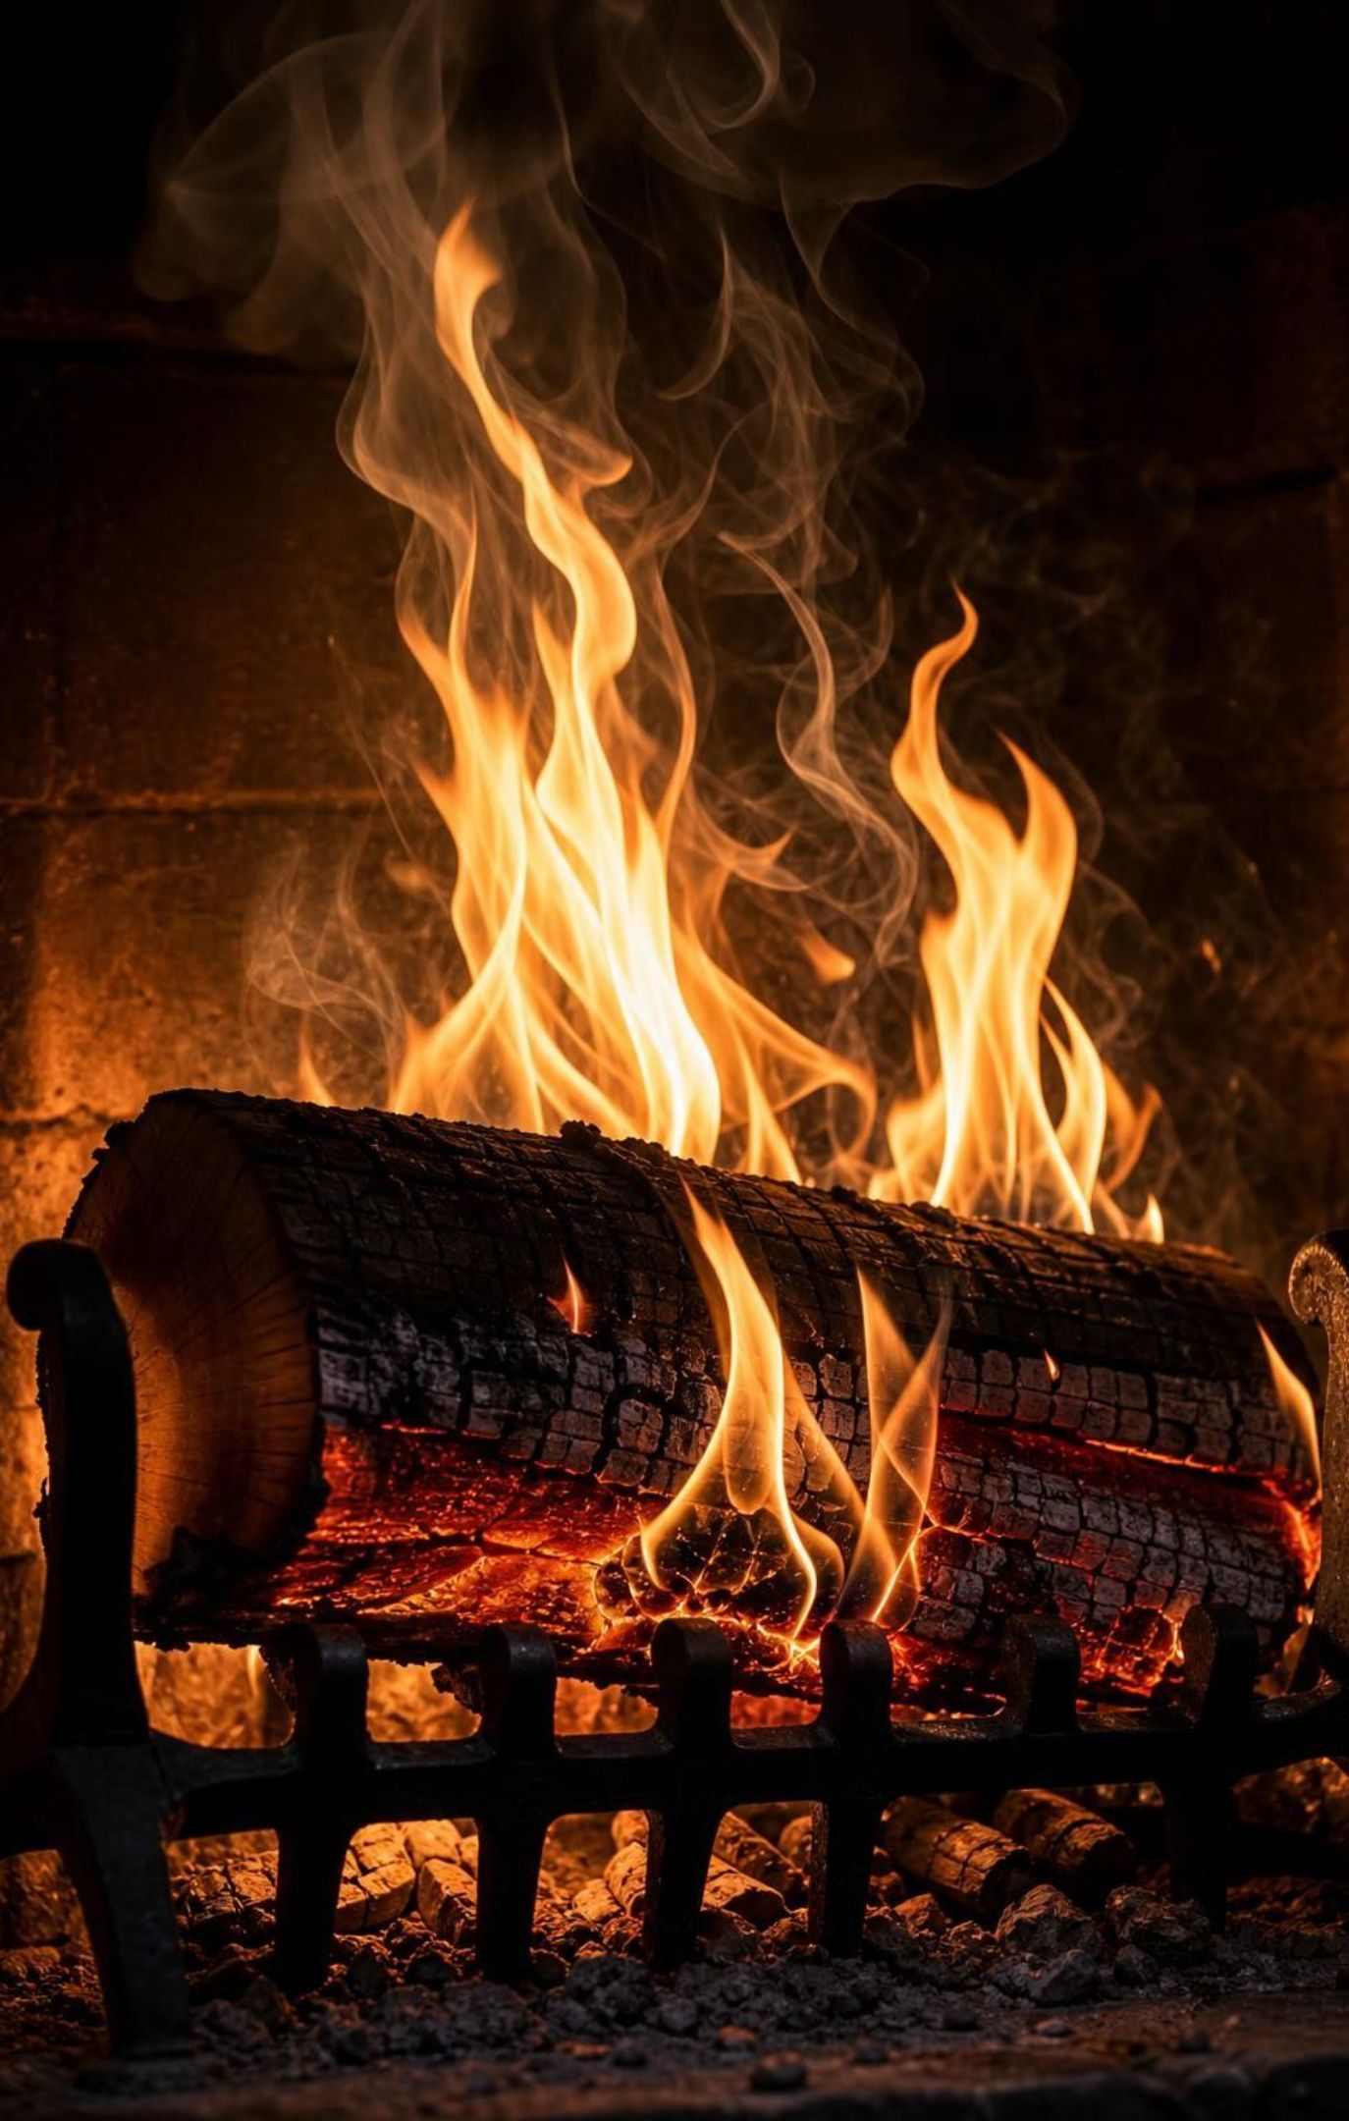
MISCONCEPTION CHECK
True or false? Breaking bonds releases energy
"Burning releases energy because the bonds in the fuel are broken, and energy was stored inside those bonds."
True or false? Explain your reasoning.
24
Notes:
Ask students to write a verdict with reasoning before anyone speaks. The statement is false, and it is the most common error in this topic, even in some textbooks. Breaking any bond takes energy in. Burning releases energy because the new bonds formed in carbon dioxide and water give out more energy than it cost to break the bonds in the fuel and the oxygen. The energy was stored in the arrangement of the reactant atoms as a whole, not inside individual bonds. A good test: if breaking bonds released energy, then pulling the atoms of a water molecule apart would warm the room, and it does the opposite; it takes a lot of energy. Rewrite the statement together as a class until it is correct.
EXPECTED RESPONSES: False. Breaking bonds costs energy; forming the new bonds in the products gives out more than the breaking cost, and that difference is what leaves the system.
WATCH FOR: Students who fix the first half but keep 'energy stored in bonds' are halfway; push them to 'stored in the arrangement of the atoms'.
CONNECTS TO: W7 misconception repair; W6 CER reasoning.
PACING: about 6 min

Slide 25
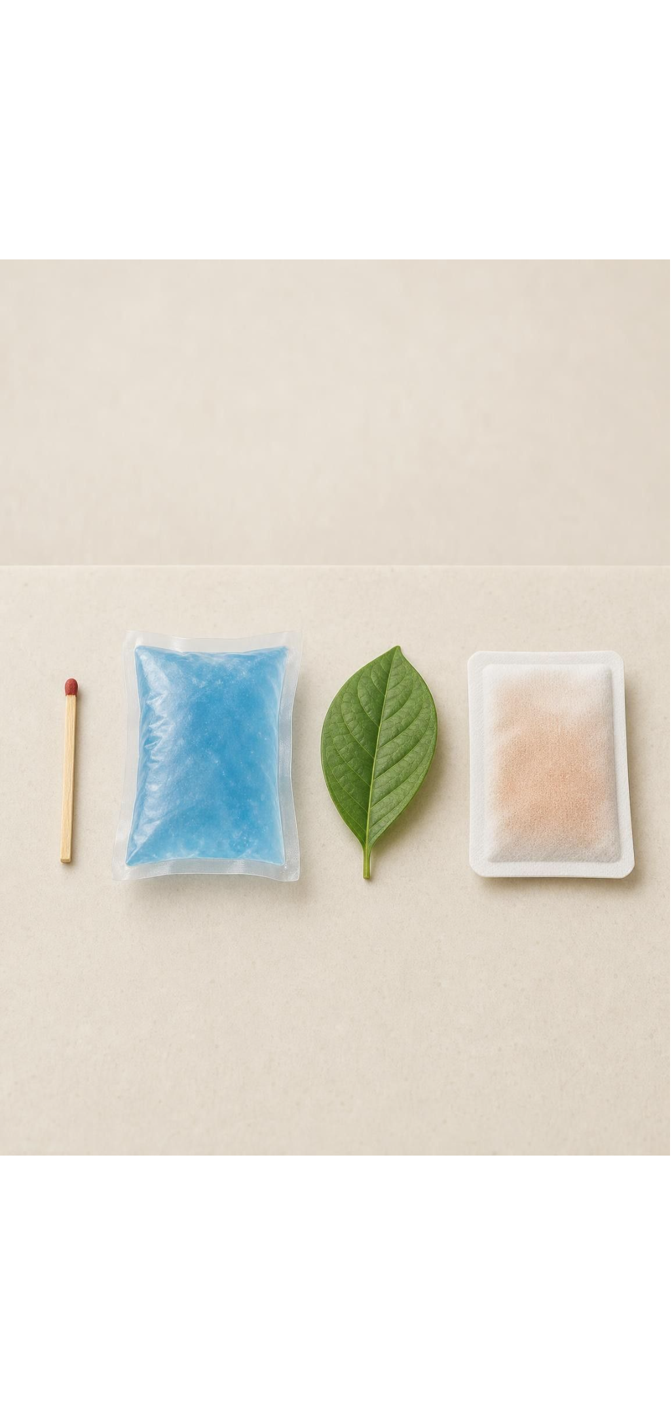
PUTTING IT TOGETHER
Putting it together
Draw the boundary: system inside, surroundings outside. Measure the surroundings to read the direction.
Exothermic: net energy out; the surroundings warm, light up or hear it. Endothermic: net energy in.
Breaking bonds costs energy; forming bonds pays it back. The bigger total decides the direction.
Energy in goes with the reactants; energy out goes with the products. It never changes the atom count.
Engineers test prototypes by amount, time and temperature, change one feature, and loop.
25
Notes:
Have students write a four-sentence summary that uses system, surroundings, exothermic, endothermic and prototype, then trade with a partner who checks that 'breaking bonds' is paired with 'costs energy'. Ask for one thing from each lab: Lab 1 (which packet surprised you), Lab 2 (the single change that helped most), Lab 3 (which prototype you chose for the backpacker and why none was perfect). Preview Lesson 15: chemical engineers weigh these same energy choices against cost, safety and the environment.
CONNECTS TO: W10 mastery as the quiz; L15 Chemical Engineering and Society next.
PACING: about 6 min

Slide 26
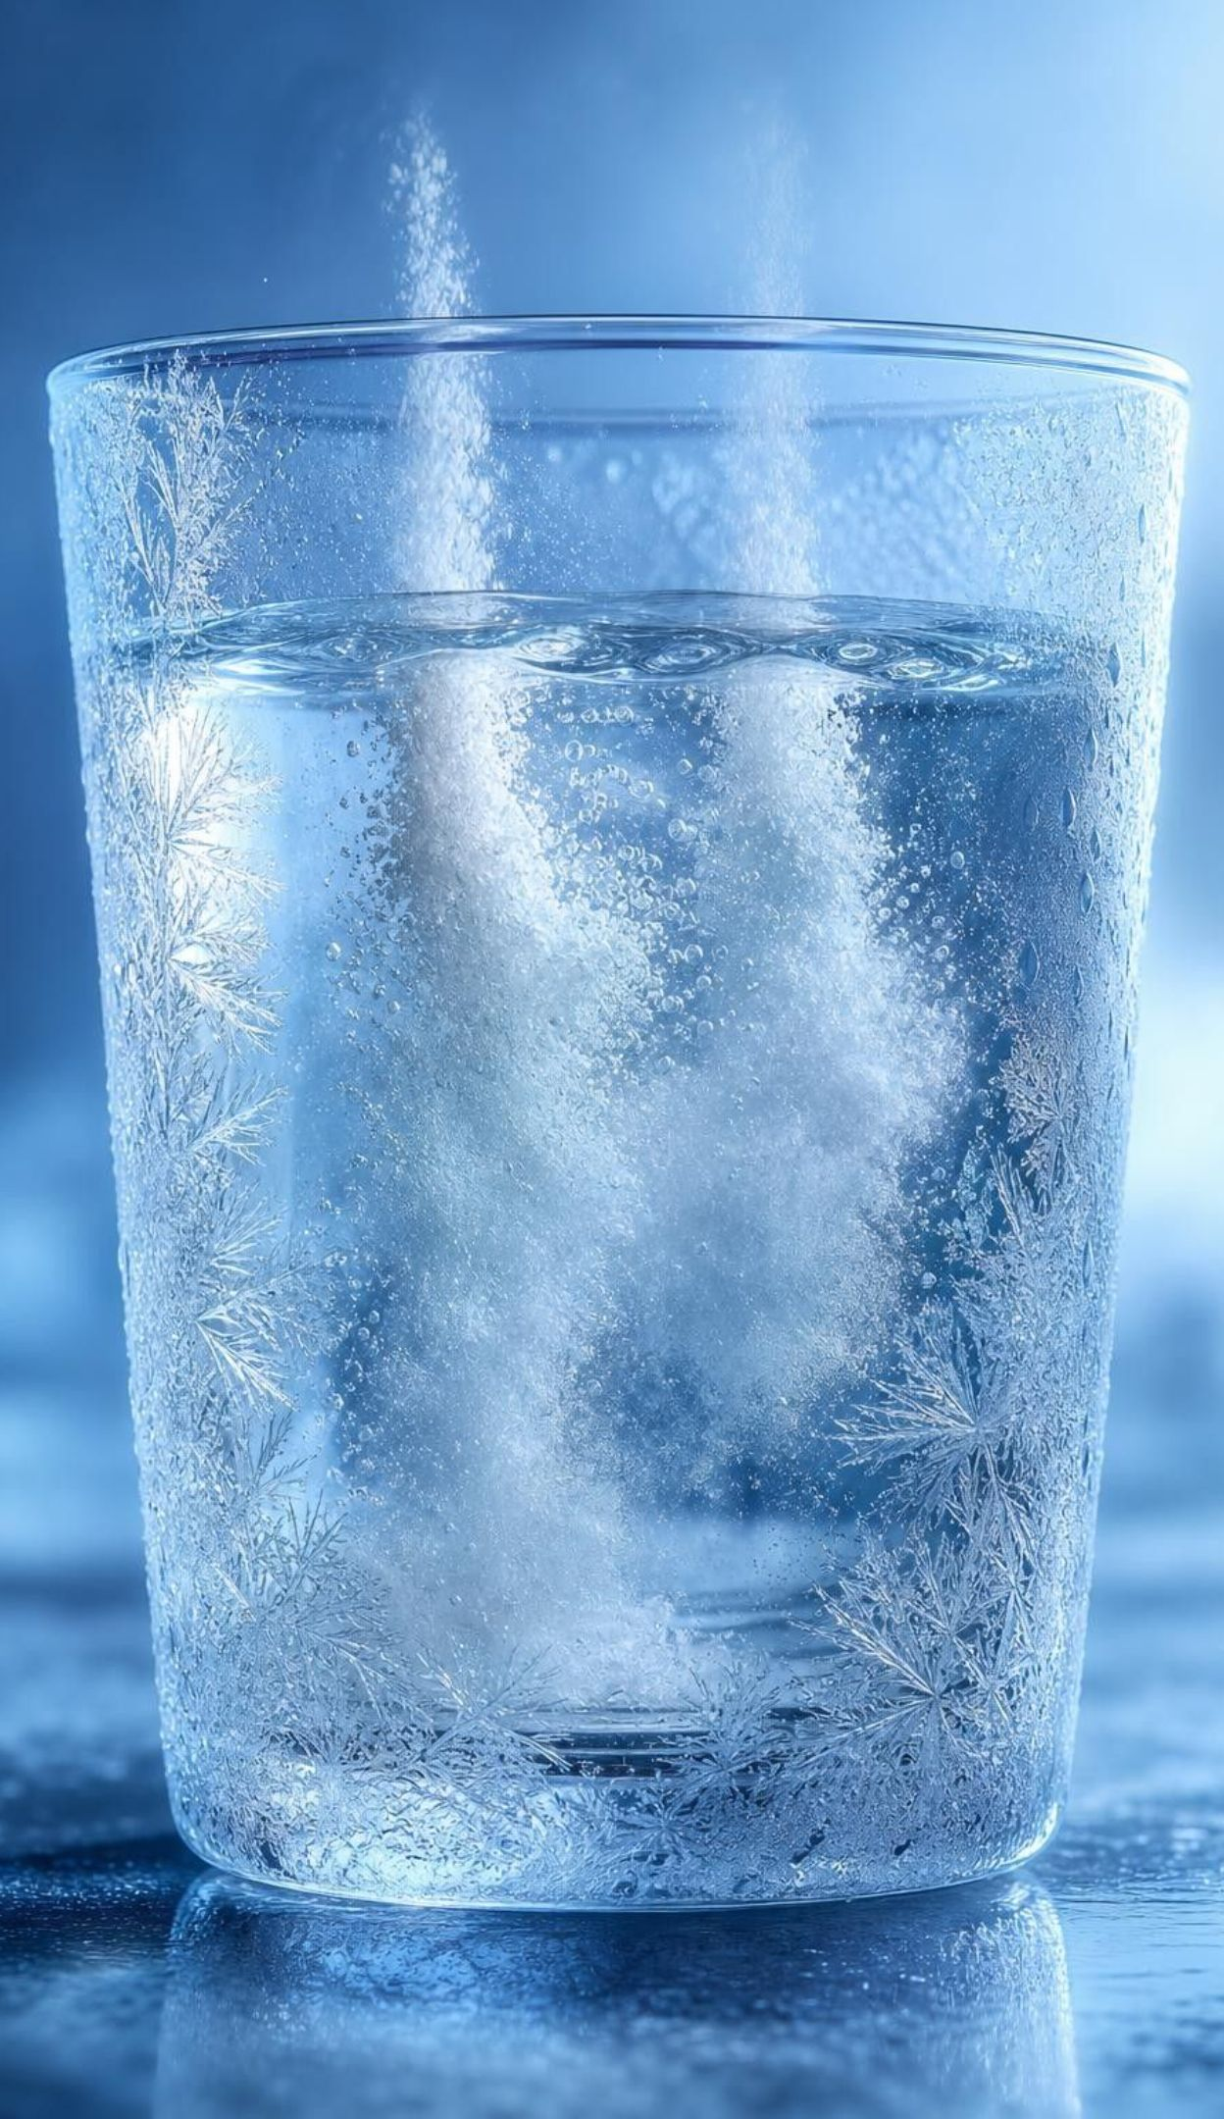
EXIT TICKET
Exit ticket
A cup gets cold when two powders dissolve in it. Which way did energy flow, and what is the system?
Write the energy term into this equation on the correct side: A + B → C, where the surroundings warmed up.
Name one criterion and one constraint from your Lab 2 pack and label which is which.
Finish the sentence: breaking bonds ____ energy; forming bonds ____ energy.
26
Notes:
Collect on index cards or a shared form. Item 1 checks the boundary and direction targets; item 2 the equation rule; item 3 the engineering vocabulary; item 4 the bond model. Sort into piles before the next class and reteach from the largest pile, most often item 4.
EXPECTED RESPONSES: 1: energy flowed from the surroundings (cup, water, hand) into the system (the two powders and what they became); endothermic. 2: A + B → C + energy. 3: for example criterion 'reach 10 °C above start within 2 minutes'; constraint 'no more than 9 g of calcium chloride'. 4: breaking bonds absorbs (costs, takes in) energy; forming bonds releases (gives out) energy.
WATCH FOR: Item 4 answers of 'releases, absorbs' flag the bond misconception for reteaching.
CONNECTS TO: W10 mastery; chapter evidenceOfLearning.
PACING: about 5 min

