Slide 1
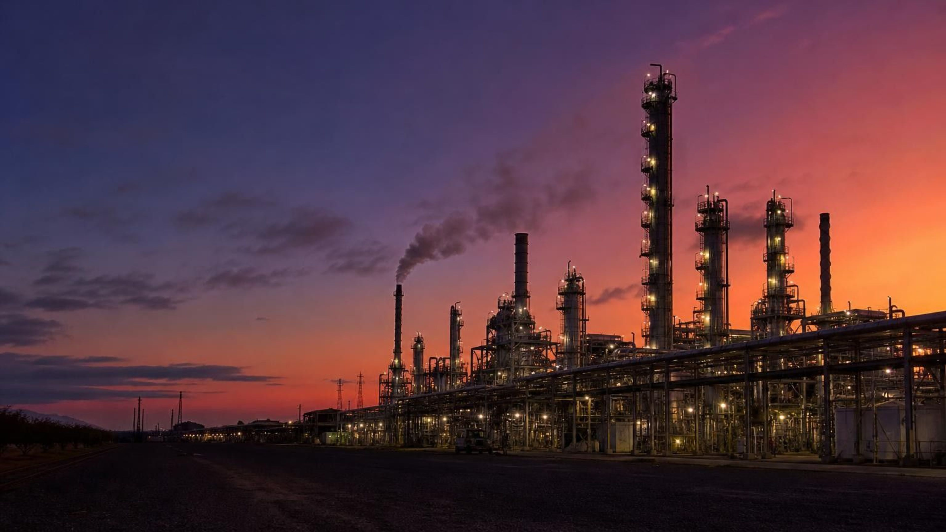
Chemical Engineering and Society
Chapter 15 of 29 · Chemical Reactions
Lesson 15: Where do synthetic materials come from, and what do our choices cost?
Angela's Wand · Bring Science Alive! 7th Grade Integrated
Notes:
This lesson closes the chemical reactions unit by asking what reactions are for. Over the week students trace everyday materials back to the natural resources they came from, weigh the benefits and costs of choosing a synthetic material, and practice the engineering move of revising a design when it causes a new problem. Tell them there are three investigations: a mystery lab with unlabeled fabric swatches, a decision lab about which cup a school fair should buy, and a design challenge to build a produce bag from a limited menu of materials. There are no flames and no hazardous chemicals in this chapter; the fabric burn test some of them have heard of is deliberately not used.
CONNECTS TO: Overview of Lab 1, Lab 2 and Lab 3; W1 opens the next slide.
PACING: about 2 min

Slide 2

PHENOMENON
Two black jackets, same price, same look
One tag says 'genuine leather'. The other says 'vegan leather, 100% polyurethane'. They bend the same way and both shed water. One began as a cow's hide. The other began as crude oil pumped from deep underground; chemists broke its molecules apart and joined the pieces into long chains that can be spread into a sheet that acts like skin. Why make a material the hard way when nature already makes one?
Notice: what could you test to tell them apart without the tags?
Wonder: how far back can you trace each jacket's raw material?
Predict: which one will still be around in a landfill in fifty years?
2
Notes:
If you can bring in one real-leather item and one faux-leather item (a wallet, a belt, a phone case), pass them around face down so students cannot read the labels. Give two silent minutes for a notice and a wonder, then collect on the board without judging. Push the big question: where did each material come from, and how many steps back can we go? Students will usually trace leather to a cow and stop; ask what the cow ate and where the tanning chemicals came from. For the polyurethane jacket most students have no idea where it came from, which is exactly the gap this lesson fills. Park the question 'which is better' on the board; the lesson will give them tools to answer it with evidence instead of a label.
EXPECTED RESPONSES: Tests: smell, look at the cut edge, a water drop, scratch it, check how it wrinkles. Trace: leather to a cow to grass; faux leather to 'plastic' or 'a factory', rarely to oil. Prediction: most say the plastic one lasts longer in a landfill, which is right; leather eventually rots, though tanned leather is slow.
WATCH FOR: 'Vegan means natural' and 'synthetic means fake.' Do not correct yet; write both claims on the parking lot and return on slides 5 and 25.
CONNECTS TO: W1 phenomenon worksheet records notice, wonder and a first explanation. W6 CER and W9 transfer return to material choice.
PACING: about 8 min

Slide 3
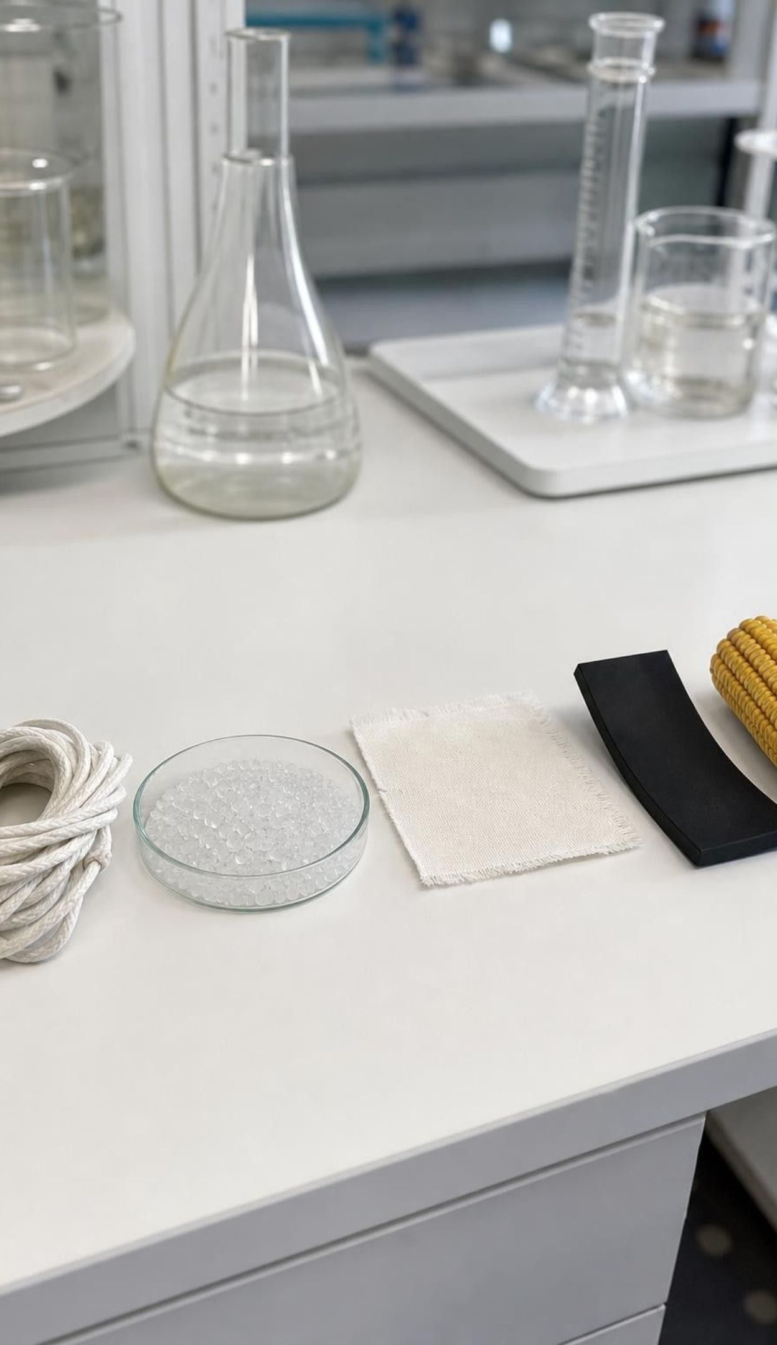
LEARNING TARGETS
What you will be able to do
1
Tell a natural resource from a synthetic material and trace the synthetic one back to its source.
2
Explain how a material's molecular structure gives it the properties people want.
3
Describe benefits and costs of a synthetic material for people and the environment.
4
Judge whether a source of information about a material is credible.
5
Write criteria and constraints precise enough to compare designs fairly.
3
Notes:
Read the targets aloud and have students star the one that sounds least familiar. Point out that target 1 is the first two days, target 2 is the structure day, targets 3 and 4 run through the fuels, foods, medicines and cup decision, and target 5 is the design challenge. Tell them the exit ticket on the last day touches all five, and that the standard for this lesson asks them to gather and make sense of information, so reading carefully and checking sources counts as science here.
CONNECTS TO: Targets map to W2 and W4 (1), W4 and Lab 1 (2), Lab 2 and W6 (3), W6 and W8 (4), Lab 3 and W9 (5).
PACING: about 2 min

Slide 4
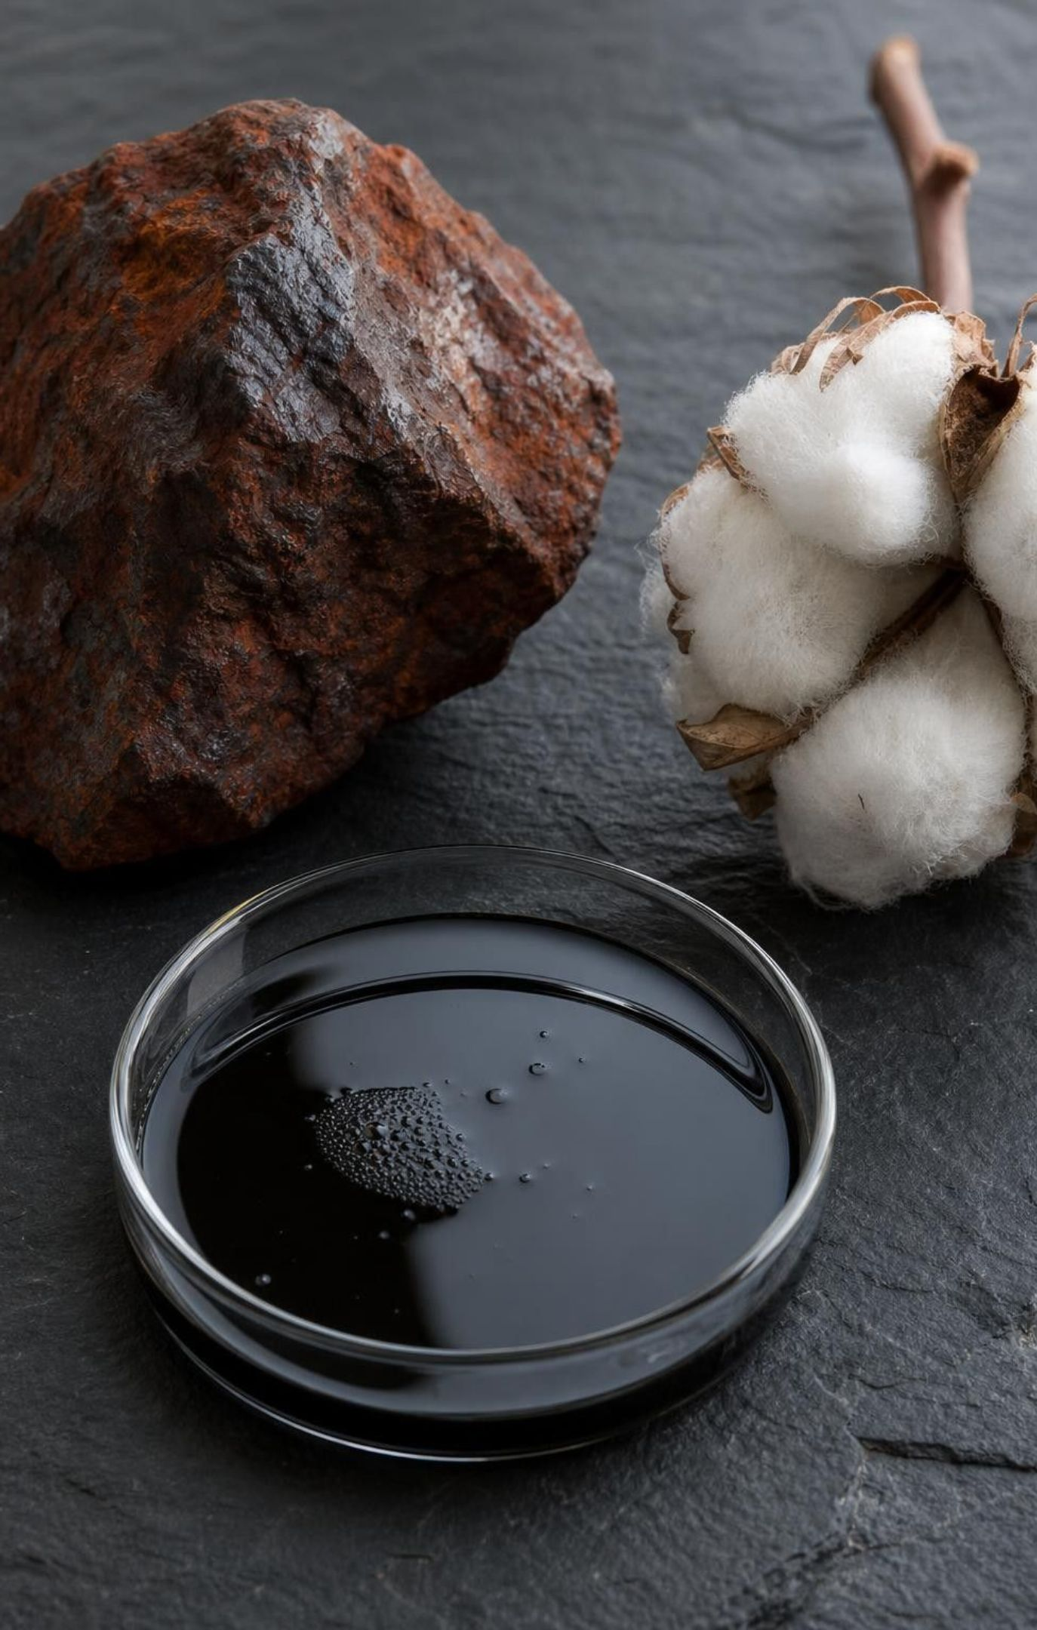
Natural resources: what people take from Earth and living things
Dug or pumped from the ground: iron ore, gold, salt, crude oil, natural gas, coal.
Collected from the air: nitrogen, which is most of what you breathe.
Grown or harvested from living things: cotton, wood, wool, hides, corn, fish oil.
Taking a resource does not change its molecules. Refining or reacting it does.
Coal is a rock formed from ancient plants, not a mineral like gold or salt.
4
Notes:
Build the three categories on the board with student examples before showing the bullets. The test for 'natural resource' in this lesson is whether people obtained it from nature without chemically changing it into a new substance. Mining ore, pumping oil, picking cotton and cutting wood all pass that test. Ask what happens to the ore in a furnace or the cotton in a dye bath: now reactions are involved, and the output is no longer a raw resource. Flag the coal point: the textbook groups coal with minerals, but coal is an organic sedimentary rock made from swamp plants buried long ago. Also note that the textbook says water comes from the air; we get water mostly from rivers, lakes and underground, and nitrogen gas from the air.
WATCH FOR: Students may count anything in a store as a natural resource if it 'came from nature originally.' Everything did; the question is whether reactions changed it.
CONNECTS TO: W2 vocabulary sort; W4 resource-to-product trace.
PACING: about 5 min

Slide 5
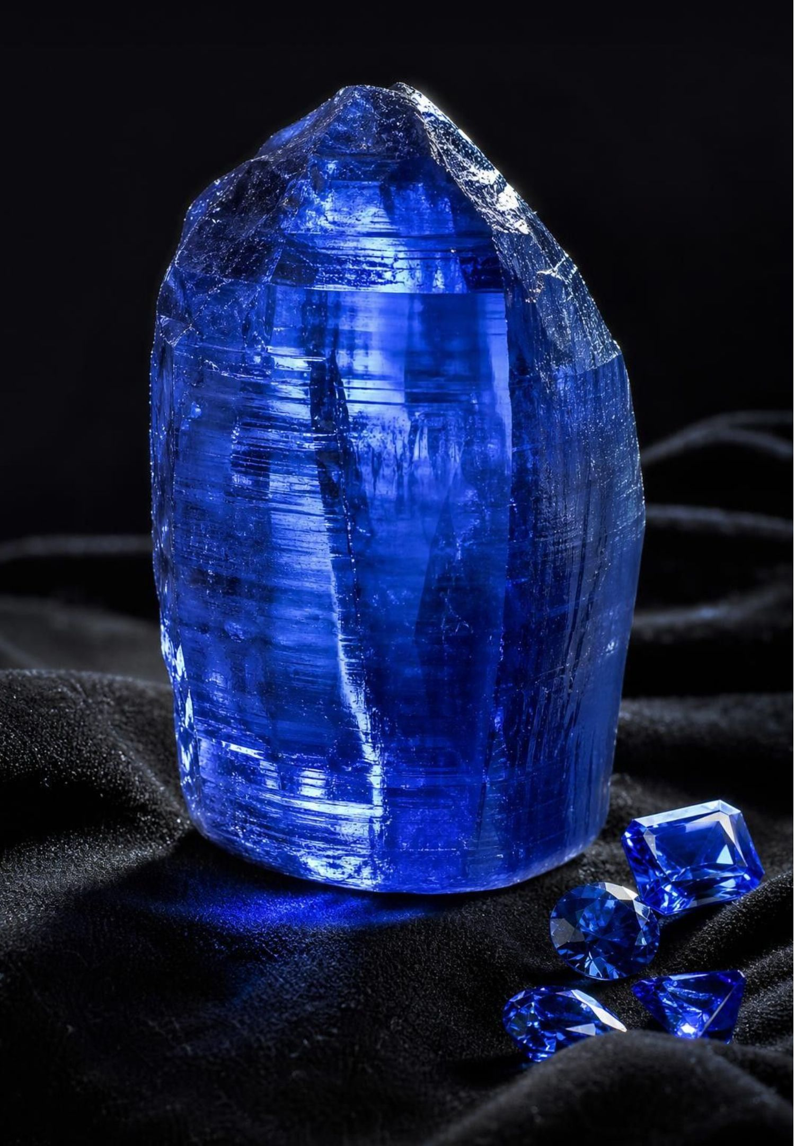
Synthetic means made by chemical processes, not fake
A synthetic material is one that people produce from natural resources through chemical reactions. The word describes how it was made, nothing more.
Some synthetic materials are brand new, like nylon, which no living thing makes. Others copy nature: a sapphire grown in a lab has the same atoms in the same arrangement as a mined one, and synthetic vanillin is the same molecule that gives vanilla beans their smell.
5
Notes:
Return to the parking-lot claim that synthetic means fake. Use the sapphire: a jeweler needs instruments to tell a lab-grown sapphire from a mined one because chemically they are the same substance. So 'synthetic' cannot mean fake, and it cannot mean 'does not exist in nature' either, even though the lesson summary in the book says that. The honest definition is about production: did chemical processes turn a natural resource into this material? Ask students to apply the test to a brass doorknob (synthetic alloy made by melting copper and zinc together), a wooden spoon (natural resource shaped but not chemically changed) and a cotton T-shirt dyed blue (the fiber is natural; the dye is almost certainly synthetic). Those edge cases are the point: many products are mixtures of natural and synthetic parts.
WATCH FOR: 'Synthetic means it does not occur in nature.' The sapphire and vanillin examples break that definition.
CONNECTS TO: W2 vocabulary (q19 repairs 'fake sugar'); W7 statement 1 repairs 'not from nature'.
PACING: about 5 min

Slide 6

From an oil well to a plastic bag
MODEL
Model: How petroleum becomes polyethylene
1
2
3
4
5
Crude oil pumped from underground: a mixture of many carbon-hydrogen compounds
(separate)
(crack)
(polymerize)
(shape)
Refinery heats the oil and separates it into fractions by boiling point
Some fractions are cracked: large molecules split into small ones, including ethylene
Ethylene molecules are joined end to end into chains thousands of units long
Polyethylene pellets are melted and formed into film, bottles and bags
Two of the five steps are chemical reactions: cracking breaks molecules, and polymerizing joins them. The product has properties crude oil never had.
6
Notes:
Walk the flow left to right and have students say at each arrow whether a chemical reaction happened. Pumping: no. Separating by boiling point: no, that is a physical change, the molecules are the same. Cracking: yes, big molecules break into smaller ones such as ethylene. Polymerizing: yes, thousands of ethylene molecules bond into one enormous chain. Shaping: no, melting and molding are physical. So the plastic bag is a synthetic material because of the two reaction steps, and the crude oil was the natural resource. Connect to Lesson 13: atoms are rearranged, not created; every carbon atom in the bag was in the oil. Mention that the same refinery makes gasoline, which is a blend of separated and cracked fractions, which is why the book's label of gasoline as 'synthetic' is debatable; we call it refined.
EXPECTED RESPONSES: Students should identify cracking and polymerizing as the reaction steps and separating and shaping as physical changes.
WATCH FOR: Students may think the refinery 'makes' oil into plastic in one step, or that plastic is 'oil hardened.' The chain structure is new.
CONNECTS TO: W4 diagram worksheet asks for the same trace with a different product; Lab 1 swatches include three petroleum-based fibers (polyester, nylon and acrylic).
PACING: about 6 min

Slide 7
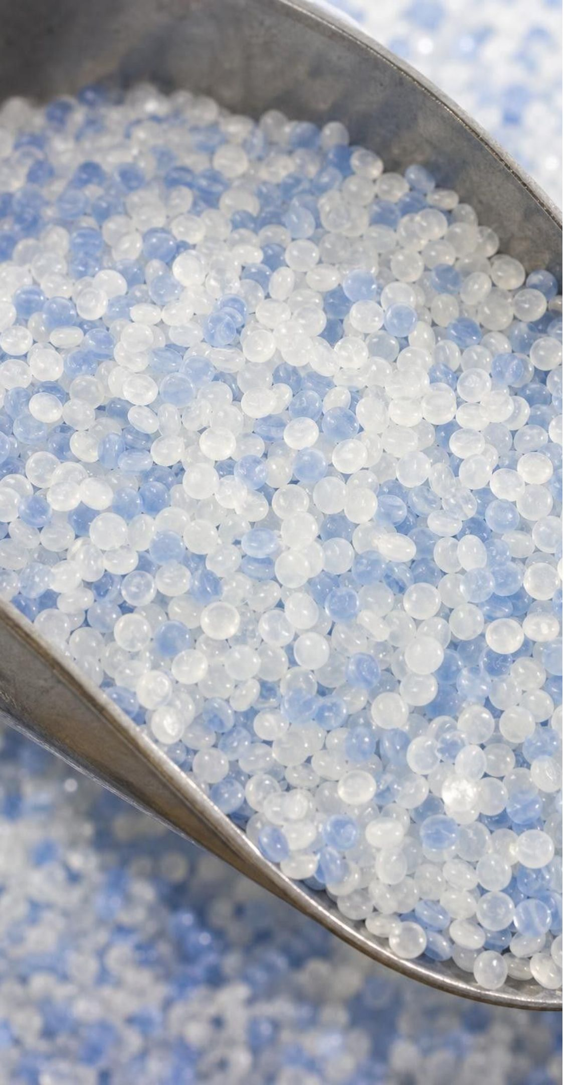
VOCABULARY IN CONTEXT
Three words to keep straight
natural resource: A useful material people take from Earth or living things without chemically changing it. Crude oil, cotton, iron ore and nitrogen from the air.
synthetic material: A material made from natural resources by chemical processes. Nylon, polyester, PLA, sucralose, a lab-grown sapphire.
polymer: A substance whose molecules are long chains of repeating units. Polyethylene is a chain of ethylene units; cellulose in cotton is a chain of glucose units.
7
Notes:
Have students say the production test out loud: 'synthetic means made by chemical processes from natural resources.' Then give the polymer surprise: cotton is a polymer too. Cellulose is a chain of glucose units that the plant built. So 'polymer' does not mean synthetic; it means long-chain molecule. Nature makes polymers (cellulose, wool protein, natural rubber) and factories make polymers (polyethylene, nylon, polyester). The chain structure is what matters for properties, which is the next day's topic. Quick check: is wool a natural resource? Yes. Is it a polymer? Yes, a protein chain. Is it synthetic? No.
WATCH FOR: 'Polymer means plastic.' Cellulose, wool, silk and natural rubber are polymers made by living things.
CONNECTS TO: W2 vocabulary relationships; Lab 1 fiber observations.
PACING: about 4 min

Slide 8
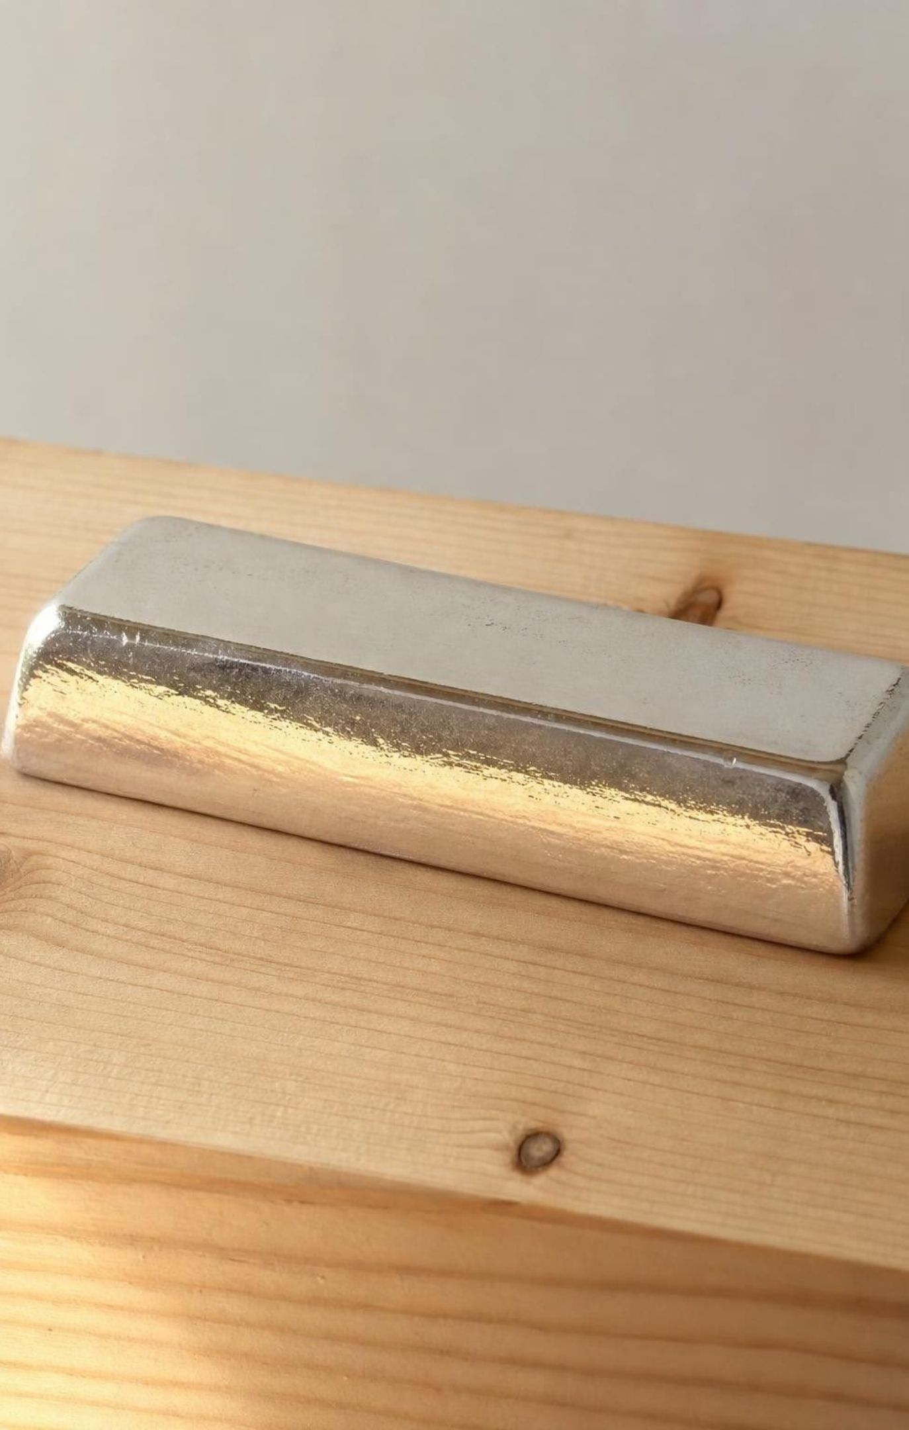
Check for understanding
Quick check: natural resource or synthetic material?
A bar of silver dug from a mine and polished.
A polyester jersey made from petroleum.
A lab-grown sapphire used in a watch face.
A pine board cut from a tree.
A cotton T-shirt with a printed plastic logo.
Sort each item. Hold up N for natural resource, S for synthetic material, or B for both parts.
8
Notes:
Run it one item at a time with a one-sentence reason from a student. Silver: natural, polishing is physical. Polyester: synthetic, the molecules were built by reactions. Sapphire: synthetic even though it matches a natural one, because it was made by a chemical process. Pine board: natural, cutting is physical. T-shirt: both, natural fiber plus a synthetic print. Item 3 is the one to slow down on; it tests whether students use the production definition or the 'not in nature' definition.
EXPECTED RESPONSES: 1 N, 2 S, 3 S, 4 N, 5 B. Students who mark the sapphire N are using 'exists in nature' as the test.
WATCH FOR: Marking the sapphire natural; marking the T-shirt fully synthetic because it was made in a factory.
CONNECTS TO: W2 and W10 reuse this sort.
PACING: about 4 min

Slide 9
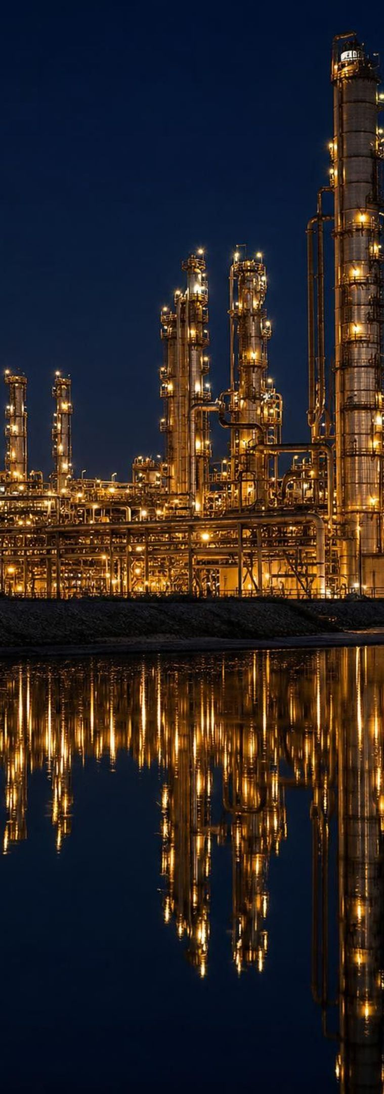
MODEL
One natural resource, a whole family of products
Model: What comes out of a barrel of petroleum
CENTER: PETROLEUM (CRUDE OIL)
Fuels: Gasoline, diesel and jet fuel: fractions separated and blended at the refinery.
Plastics: Polyethylene bags, polypropylene cups, PET bottles: built from small molecules made from oil fractions.
Fabrics: Polyester, nylon and acrylic fibers: polymer chains drawn into threads.
Rubber: Synthetic rubber for tires (blended with natural rubber) and many gloves, from styrene and butadiene.
Dyes and flavors: Food coloring such as Blue No. 1 and synthetic vanillin, made by reaction steps.
Medicines: Many drugs are built from small petroleum molecules such as toluene through long chains of reactions.
Asphalt and wax: The heaviest fractions pave roads and coat paper.
Each branch needs different reactions, so each product has properties the oil never had.
9
Notes:
Ask students to name something they touched today from each branch; most can find all seven within a minute (a bus ride, a water bottle, a jersey, a bike tire, a blue sports drink, an ibuprofen tablet, the road). The point is dependence: a huge share of daily objects trace to one nonrenewable resource. Raise the natural-rubber contrast here: rubber trees make latex, a natural polymer, and natural rubber is still preferred for aircraft tires and some gloves because it stretches and recovers so well; synthetic rubber from petroleum now supplies more than half of the world's rubber. Ask what a society does when it cannot get a natural material; that is tomorrow's discussion.
EXPECTED RESPONSES: Students name products across several branches and can explain that each needed a chemical process, not just separation.
WATCH FOR: Students may think medicines or food dyes are 'natural' because they are safe to swallow. Origin and safety are separate questions.
CONNECTS TO: Lab 1 reveal (polyester, nylon and acrylic swatches); W3 reading on nylon and rubber; W8 jigsaw cards.
PACING: about 6 min

Slide 10
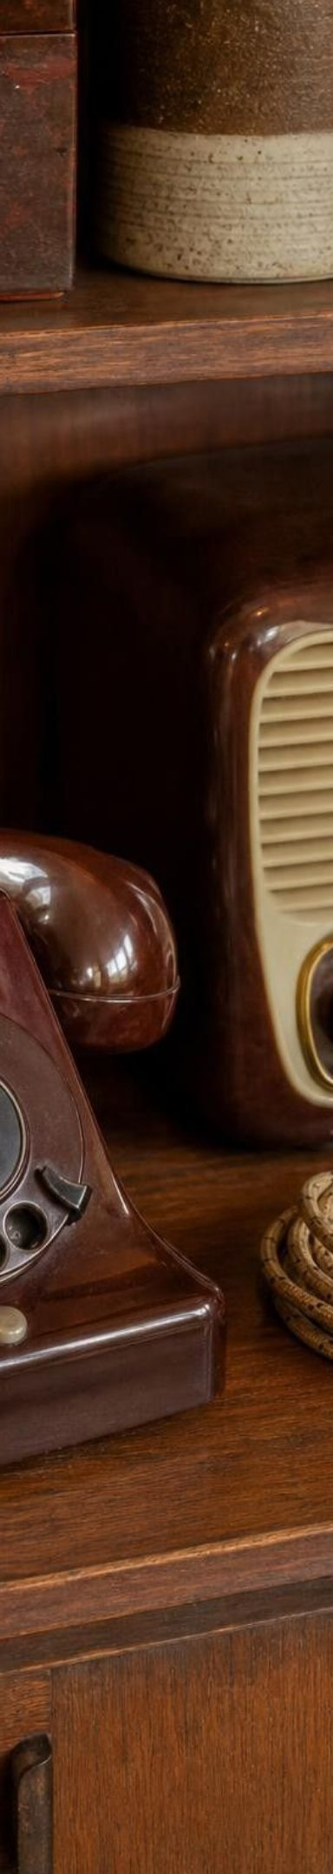
A short history of making materials nature did not
MODEL
Model: Milestones in synthetic materials
1879: saccharin: A sweetener about 300 times sweeter than sugar, discovered by accident in a Baltimore lab.
1907: Bakelite: Leo Baekeland's hard, heat-resistant plastic from phenol and formaldehyde, the first fully synthetic plastic.
1935: nylon: Wallace Carothers' DuPont team makes the first nylon; toothbrush bristles 1938, stockings 1940.
1941: polyester: Whinfield and Dickson in England make PET, now the fiber in fleece and the plastic in soda bottles.
1942-45: synthetic rubber: Cut off from Asian rubber plantations, the U.S. builds plants making rubber from petroleum and grain alcohol.
1976: sucralose: Chemists in London modify sugar with chlorine atoms; approved for U.S. foods in 1998.
Early 2000s: PLA at scale: The first large plant making plastic from fermented corn sugar opens in Nebraska.
Each new material solved a problem of its time, and several of them later created a new one.
10
Notes:
Walk the timeline quickly and pick two stories to tell. Nylon: silk for stockings and parachutes came from silkworms in Asia; DuPont's chemists built a polymer chain from starting molecules made from coal (later from petroleum) that could be drawn into a strong, fast-drying fiber. Stores stocked millions of pairs when nylon stockings went on sale nationally in May 1940, and they sold out quickly; during the war the fiber went to parachutes instead. Synthetic rubber: when Japan took control of Southeast Asia in 1942, the United States lost roughly nine tenths of its natural rubber supply with a war to fight on tires; within three years government-built plants were producing hundreds of thousands of tons of styrene-butadiene rubber a year, with much of the butadiene made from grain alcohol as well as from petroleum. Stress that these dates are real and that the materials were answers to needs, not just inventions for their own sake. The timeline sets up the next discussion.
WATCH FOR: Students may assume synthetic materials are recent. Bakelite is older than their great-grandparents.
CONNECTS TO: W3 reading passage covers Bakelite, nylon, synthetic rubber and PET in depth; W8 Card 9 covers saccharin's history.
PACING: about 6 min

Slide 11
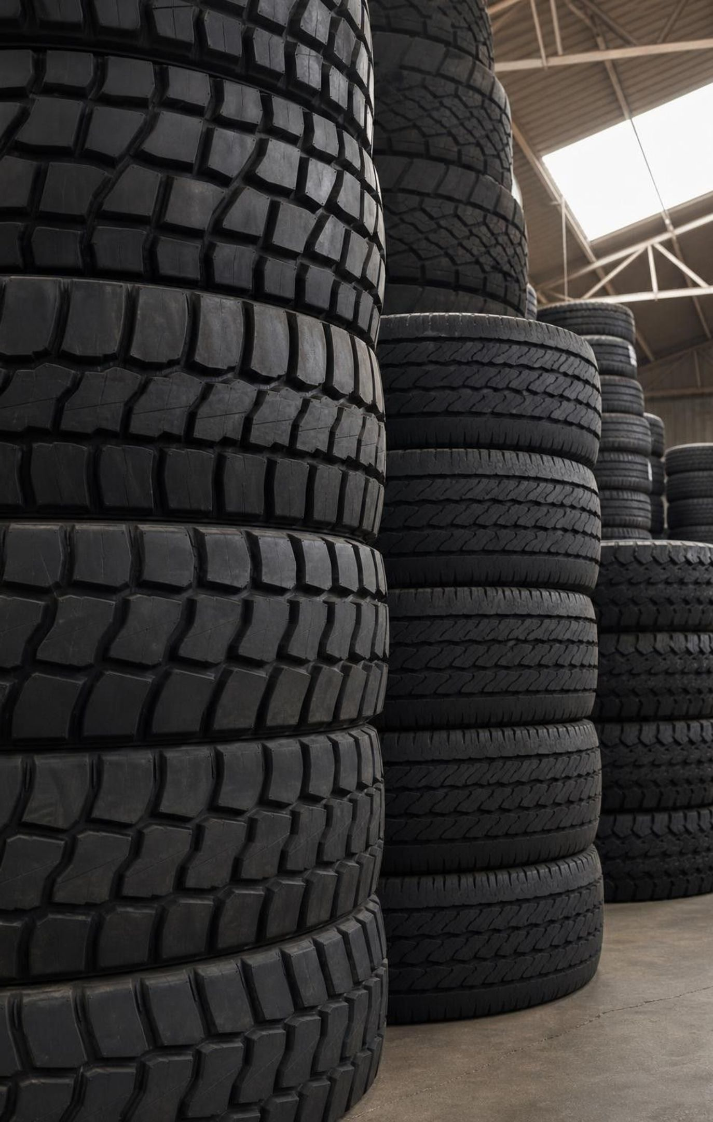
THINK, PAIR, SHARE
Discuss: when does a whole society switch materials?
What pushed each switch: price, supply, a new property, a law?
What would make people go back to the natural material?
Who benefits and who pays when a society changes materials?
In World War I sugar ran short and many people switched to saccharin, then switched back. In World War II the U.S. built a synthetic rubber industry in three years, and it stayed. Why the difference?
11
Notes:
Give pairs three minutes, then collect. Steer toward two kinds of reasons. Saccharin was a stopgap: people preferred sugar's taste and sugar came back cheap, so the natural material won when supply returned. Synthetic rubber was different: it could be made at home instead of shipped from plantations an ocean away, it could be tuned for different jobs, and the plants were already built, so there was no reason to return to full dependence on plantations. Then push the third bullet: rubber plantation workers and countries that exported latex faced new competition; tire makers and drivers gained. Every material switch moves costs and benefits between groups of people, which is part of what 'impact society' means in the standard.
EXPECTED RESPONSES: Saccharin: a temporary fix because people liked sugar better and it returned. Rubber: the synthetic could be made at home, was adjustable and was already in production. Going back would need the natural material to be cheaper or better. Winners and losers differ.
CONNECTS TO: W3 reading (paragraphs 4 and 5); Lab 2 q7 on who gains and who pays when a material is chosen.
PACING: about 6 min

Slide 12
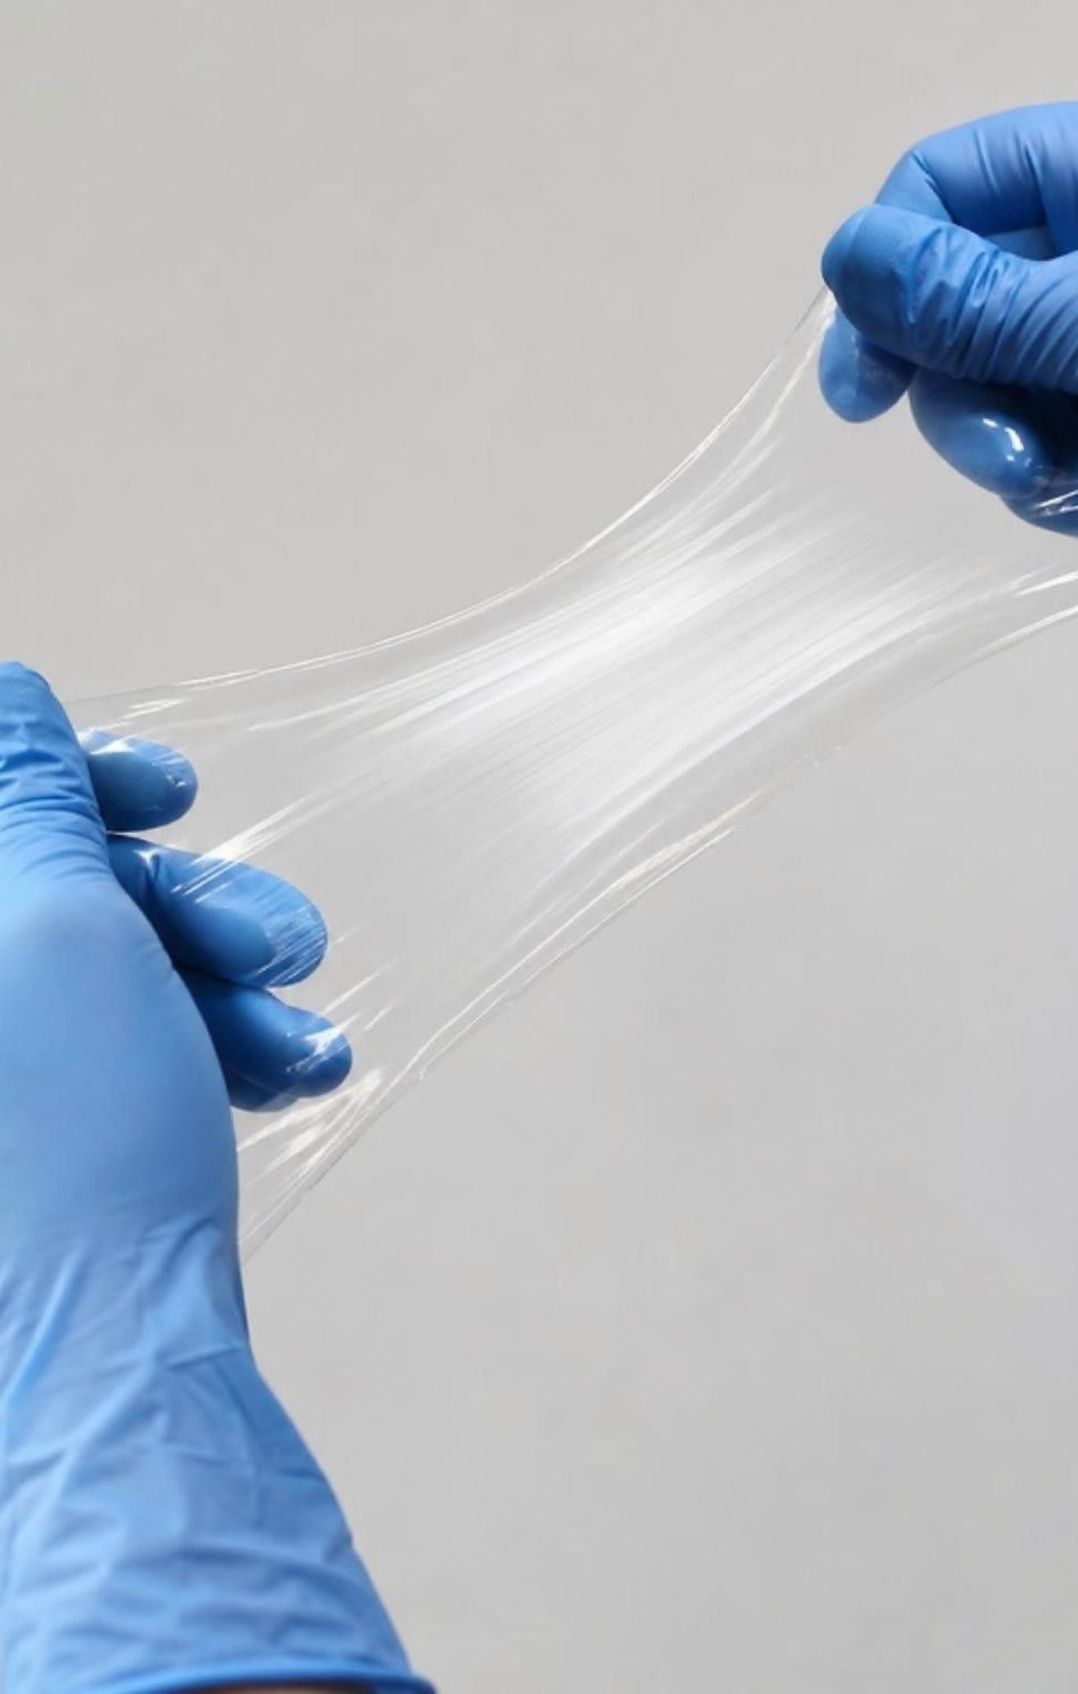
Structure decides the job: chains and shapes
Plastics, nylon and polyester are long tangled chains; chains give strength and let thin pieces flex.
How far a plastic bends before cracking depends on which plastic: PET bottles flex, PLA cups are stiffer.
Sucralose is shaped like sugar: two rings joined by an oxygen atom, so it fits the tongue's sweet sensors.
Three chlorine atoms replace three OH groups, so the body cannot use it for energy: sweet, but zero calories.
Engineers choose or build a molecular structure to get the property they want.
12
Notes:
Use a bowl of cooked spaghetti or a handful of string as the chain model: a single strand is weak, but a tangled mass resists pulling apart and still bends. That is why a polyethylene bag stretches instead of shattering. Add the honest limit: PLA is also a chain polymer but is stiff and cracks at room temperature, so the textbook's picture of a squeezable PLA bottle is off; bottles are usually PET. For sucralose, draw two rings connected by an O on the board, then mark three spots where sugar has O-H and sucralose has Cl. The shape still fits the sweet-taste sensor, but the body's digestive enzymes do not recognize the changed molecule, so almost no energy is released. Molecule drawings show how atoms connect, not real sizes or colors.
WATCH FOR: 'A tiny change in a molecule makes a tiny change in properties.' Three atoms swapped turn food into a zero-calorie sweetener.
CONNECTS TO: W4 q4 and q6 link polymer structure to properties; Lab 1 q7 compares cotton and polyester chains.
PACING: about 5 min

Slide 13
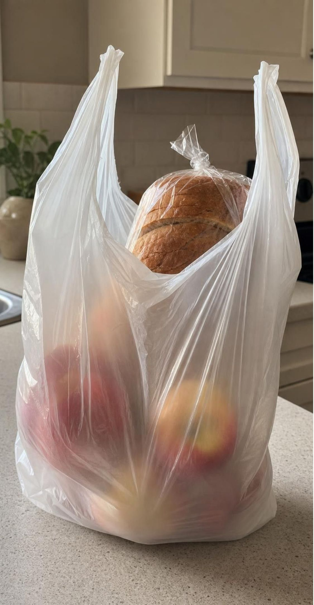
CHECK FOR UNDERSTANDING
Quick check: why does the bag stretch?
A polyethylene grocery bag stretches a little and resists tearing. Which explanation fits best?
A. Its molecules are small and round, so they roll past each other
B. Its molecules are long tangled chains that can slide and straighten without separating
C. It contains oil that keeps it soft
D. It was heated, and heated things are always flexible
13
Notes:
Vote with fingers, then ask a student who chose B to explain with the spaghetti model. Address C directly: the bag contains no liquid oil; the oil's molecules were taken apart and rebuilt into chains. Address D: heating shaped the bag, but the bag is cool now and still flexible, so the property lives in the structure. Then extend: what structural change would make a chain polymer stiffer? Chains that are lined up in orderly bundles or chemically linked to each other move less, which is roughly the difference between a soft bag and a rigid bottle cap.
EXPECTED RESPONSES: B. Long chains tangle; pulling straightens and slides them but does not break the chains.
WATCH FOR: Option C is popular because 'made from oil' sounds like 'contains oil.'
CONNECTS TO: W4 q4; Lab 1 soak-and-weigh test on polyester and nylon.
PACING: about 4 min

Slide 14
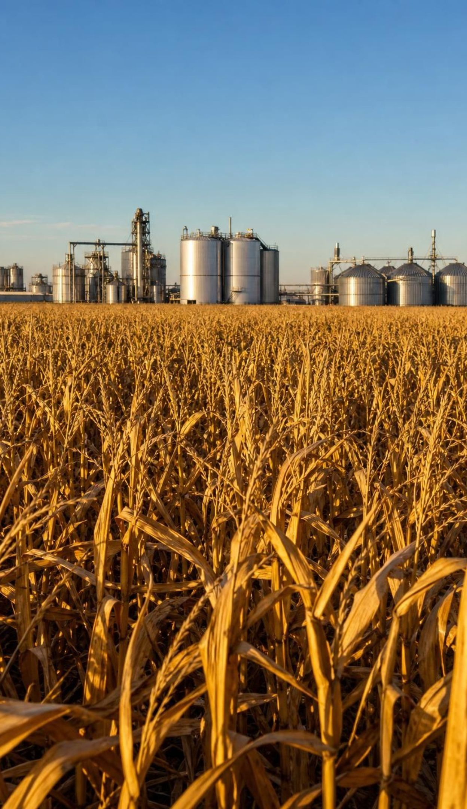
Fuels: gasoline from oil versus ethanol from corn
Gasoline is refined from petroleum: separated, cracked and blended, then burned for energy.
Petroleum took millions of years to form; we use it far faster than Earth makes more.
Ethanol is made when enzymes turn corn starch into glucose and yeast ferment the glucose.
Corn regrows every year, but it uses farmland and water and competes with food and feed.
Growing, harvesting and distilling take energy; how much comes back is measured and debated.
14
Notes:
Write the fermentation equation on the board and count atoms with the class: C₆H₁₂O₆ → 2 C₂H₅OH + 2 CO₂, six carbons, twelve hydrogens, six oxygens on each side, which connects to Lesson 13. Make two corrections to the book as you go. First, petroleum took millions of years to form from buried marine organisms, not hundreds of years. Second, the book states as fact that ethanol takes more energy to make than it releases; USDA studies since the 1990s have found the opposite for typical corn ethanol, and the answer depends on how the corn is farmed and distilled. The classroom position is 'it depends on method and is measured, not assumed.' Also note that ethanol plants return part of the corn as distillers grains fed to livestock, so 'competes with feed' is fairer than 'cannot be used as feed.' Ask: if corn regrows every year, why is corn ethanol not a free win? Collect the trade-offs on the board.
WATCH FOR: 'Renewable fuel has no downsides' and 'petroleum forms in hundreds of years.'
CONNECTS TO: W5 extension computes the energy in a liter of E10; W7 statement 4 repairs 'switching to ethanol has no downsides'.
PACING: about 6 min

Slide 15
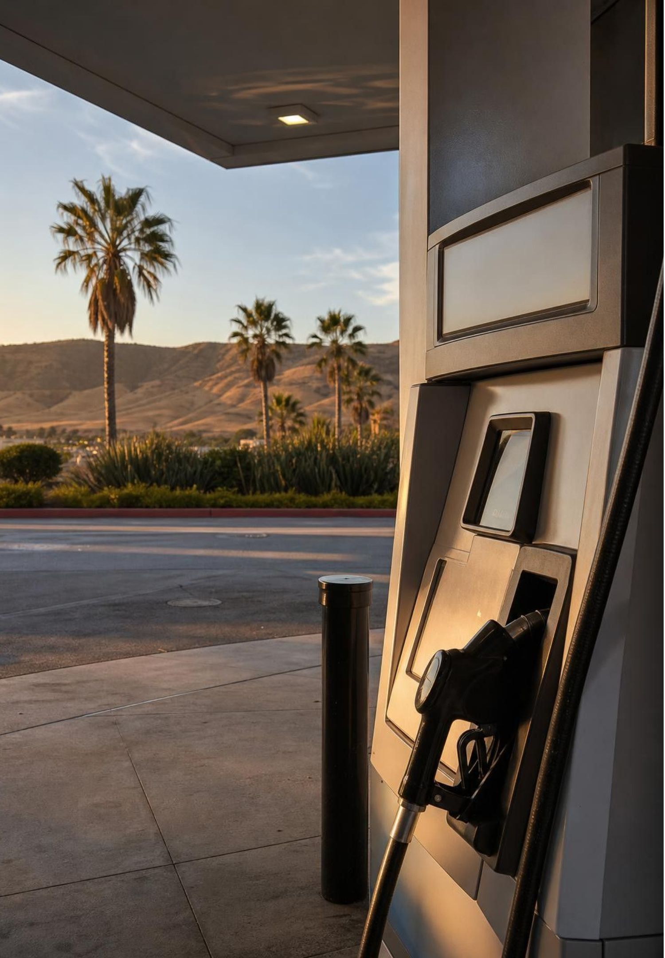
REAL-WORLD CONNECTION
California connection: what is in the pump and the bag
Almost every gallon of gasoline sold in California is E10: about one tenth ethanol, mostly fermented from Midwest corn and blended in before it reaches the station. And since January 2026, under a 2024 state law, California grocery checkouts can no longer hand out plastic carryout bags of any thickness; recycled-content paper bags are allowed. Both are society-level material choices made with trade-offs in mind.
15
Notes:
Both facts are checkable and local. E10 means the state's cars already run partly on a biofuel; ask students whether they knew, and why the ethanol share is not higher (ethanol carries about a third less energy per gallon than gasoline, and many older and small engines are not designed for higher blends). The bag law is a direct example of a society revising its criteria for a material: California first banned thin single-use bags in 2016 after voters upheld the law, then found that the thicker 'reusable' plastic bags stores switched to were rarely reused or recycled, so the 2024 law removed plastic carryout bags from checkouts entirely from 2026. That is the plastics design cycle from this lesson playing out in state law. Ask what criteria the lawmakers were using and what constraints stores face. If your community has its own composting or recycling rules, bring them in here; they matter for Lab 2.
CONNECTS TO: Lab 2 cup decision uses local facility information; Lab 3 produce-bag design challenge; W9 transfer.
PACING: about 5 min

Slide 16
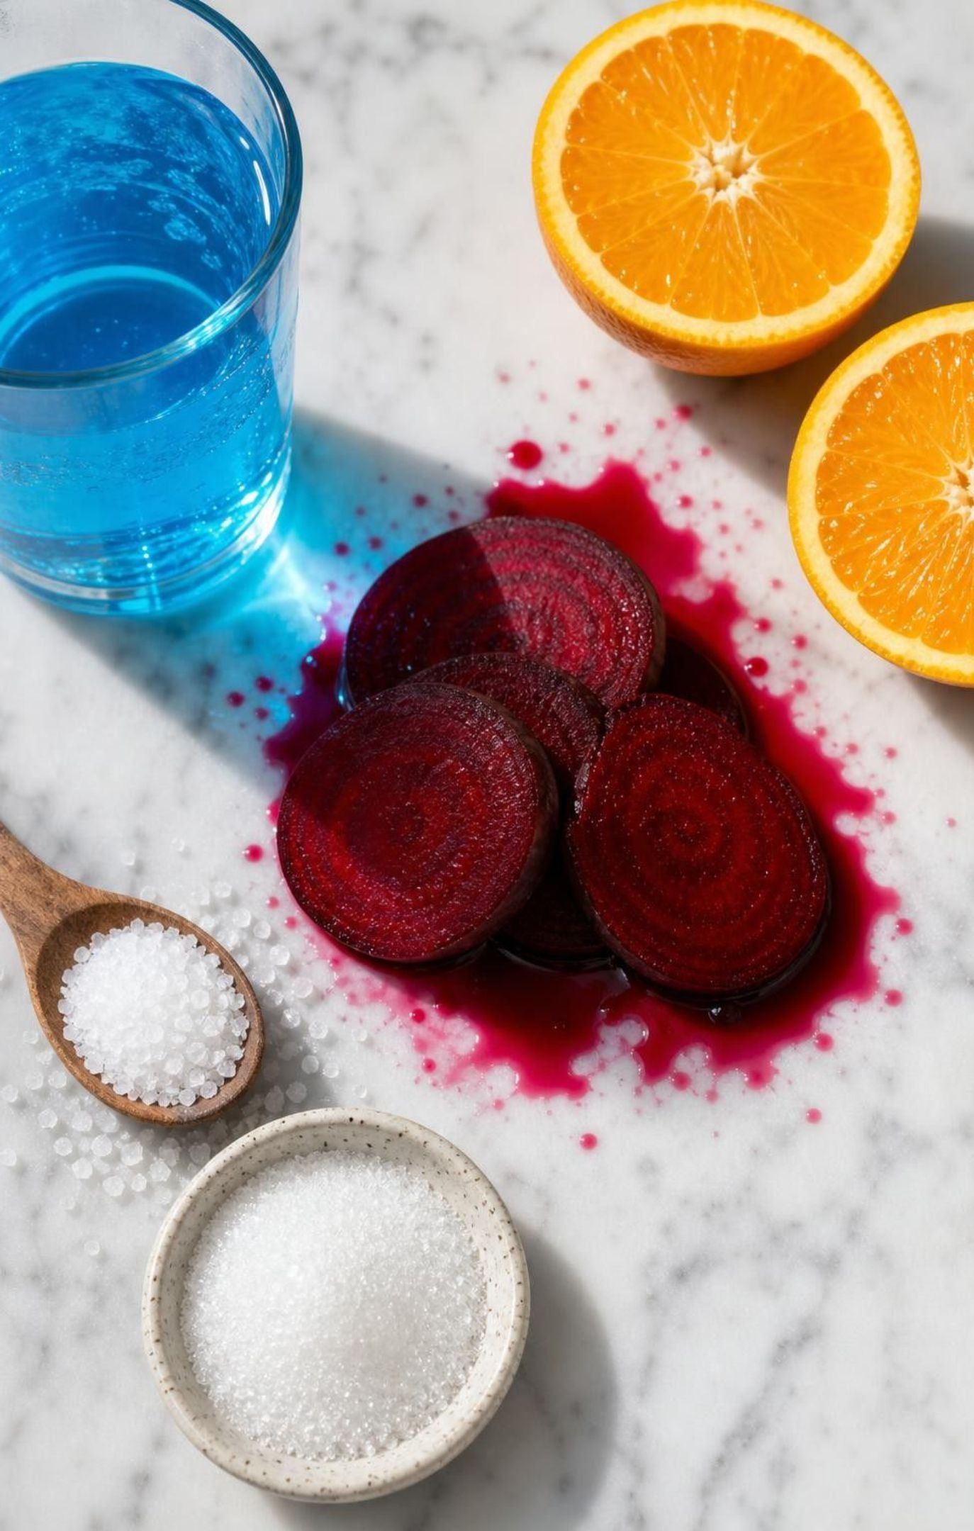
Foods: additives, natural and synthetic
A food additive is anything added to change flavor, color, texture, shelf life, nutrition or safety.
Natural additives: salt, sugar, vitamin C, beet juice for color.
Synthetic additives: sucralose, saccharin, Blue No. 1, synthetic vanillin.
Zero-calorie sweeteners let people enjoy sweet tastes while limiting sugar and calories.
Regulators review safety evidence before an additive is allowed; evidence, not origin, is the test.
16
Notes:
Start with a sports-drink label if you have one; students can usually spot two or three additives. Sort them natural or synthetic as a class. The useful idea is that both kinds do jobs: vitamin C keeps cut apples from browning whether it came from an orange or a factory, because it is the same molecule. On sweeteners, keep to what regulators actually say: high-intensity sweeteners contribute few or no calories and generally do not raise blood sugar, and the FDA approved sucralose in 1998 after reviewing safety studies. Do not repeat the book's line that a person with diabetes can use sucralose without worrying about medical problems; that is medical advice, and it is not our job. The saccharin story from the timeline shows a whole society switching additives when sugar was scarce.
WATCH FOR: 'Additive means artificial' and 'natural additives are always healthier.' Sugar is natural; too much of it is still a problem.
CONNECTS TO: W7 misconception repair; W10 mastery.
PACING: about 5 min

Slide 17
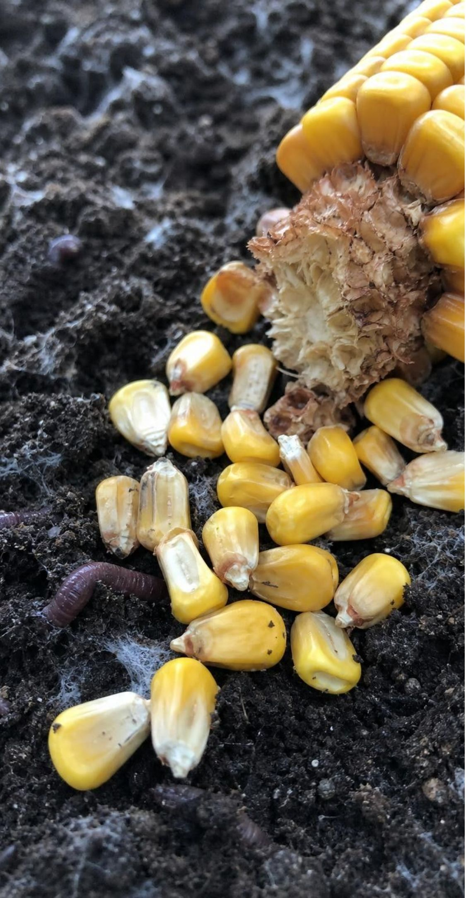
VOCABULARY IN CONTEXT
Words for fuels, foods and endings
biofuel: A fuel made from recently living material, such as corn or algae, instead of from fossil fuels. The ethanol in E10 gasoline was fermented from last year's corn crop.
food additive: Any substance added to food to change its flavor, color, texture, freshness, nutrition or safety. Salt in crackers and Blue No. 1 in a sports drink are both additives; one is natural, one is synthetic.
biodegradable: Able to be broken apart into simpler substances by living things such as bacteria and fungi, under the right conditions. A PLA cup is biodegradable in a hot industrial compost pile but lasts for years in a landfill.
17
Notes:
Say each term, then ask for a non-example. Biofuel non-example: gasoline, even though it also came from living things, because those organisms died millions of years ago. Additive non-example: the flour in bread is an ingredient, not an additive. Biodegradable is the term to slow down on: it is a property that depends on conditions, like 'flammable' depends on having oxygen. Have students write the conditions that matter: heat, moisture, oxygen and the right microbes. Paper in a hot wet compost pile breaks down in months; a newspaper in a dry landfill has been dug up readable after decades.
WATCH FOR: 'Biodegradable means it disappears wherever you drop it.' Conditions decide.
CONNECTS TO: Lab 2 information cards on cup materials; W6 CER on the biodegradable cup.
PACING: about 4 min

Slide 18

Medicines: start in nature, then make it last
1
Many medicines began as natural substances: penicillin from a mold, paclitaxel from a tree.
2
In 1962 bark from the Pacific yew entered a U.S. cancer-drug screening program.
3
The bark worked, but stripping it kills a slow-growing tree; one patient could need several trees' worth.
4
Chemists found a related compound in European yew needles and convert it into paclitaxel by reaction steps.
5
Needles regrow, so the supply became renewable; later the compound was made by yew cells grown in tanks.
18
Notes:
Tell the story as a resource problem solved by chemistry. Paclitaxel is a natural compound; the book calls it synthetic, which is not quite right. The first supply came from Pacific yew bark; the Pacific yew is a slow-growing tree of the Pacific Northwest and northern California that takes roughly a century to mature; the book's figure of up to six trees per patient is a rough historical estimate. Demand for the drug threatened the species, so the solution had to change the resource, not the medicine. Chemists learned to extract a related molecule from European yew needles, which regrow, and finish the conversion in the lab; that is called semisynthesis. By 2004 one manufacturer had replaced harvested needles with yew cells grown in culture tanks and won a federal green chemistry award for it. Ask: which step is the natural resource, which is the chemical process, and which is the synthetic material? That is the whole standard in one story.
WATCH FOR: 'The needles contain the finished drug.' They contain a starting compound; reactions finish it.
CONNECTS TO: W2 q14 and W10 q6 (bark used faster than trees regrow); W7 statement 7 and q8.
PACING: about 6 min

Slide 19
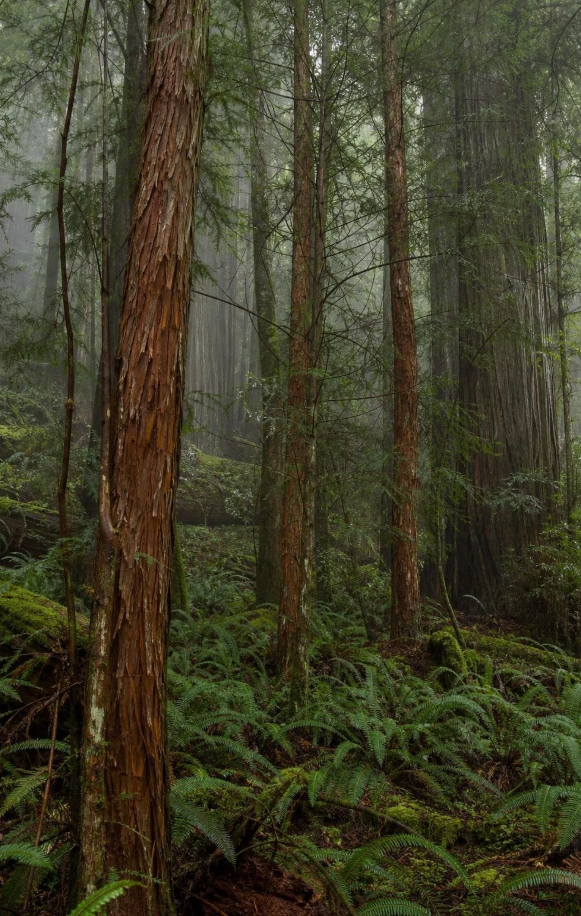
Think, pair, share
Discuss: can a renewable resource run out?
Compare how fast it is taken with how fast it regrows.
Does taking it kill the organism or just trim it?
Would the answer change for corn, for wood, for fish, for groundwater?
Pacific yew trees grow back, so bark should be renewable. Yet scientists worried the species would be wiped out. What makes a resource truly renewable, and what would you measure to decide?
19
Notes:
Pairs for three minutes. The target idea is a rate comparison: a resource is renewable in practice only when the harvest rate is below the regrowth rate. Bark harvest killed trees that need about a century to mature, so the rate could never balance; needle harvest trims without killing, and needles regrow in seasons. Push the third bullet: corn is renewable yearly; forests are renewable over decades if replanted; a fishery collapses if the catch outpaces breeding; groundwater in parts of California is pumped faster than rain refills it. Connect back to the fuels slide: corn regrows, but the farmland, water and fossil energy used to grow it are their own resources with their own rates.
EXPECTED RESPONSES: Renewable depends on taking it slower than it regrows; bark harvest killed trees, needle harvest did not; corn yes, wood only with replanting, fish only with limits, groundwater only if recharge keeps up.
CONNECTS TO: W2 q14 and W10 q6 (yew bark used faster than it regrows); W9's birch option (trees that regrow in decades).
PACING: about 6 min

Slide 20
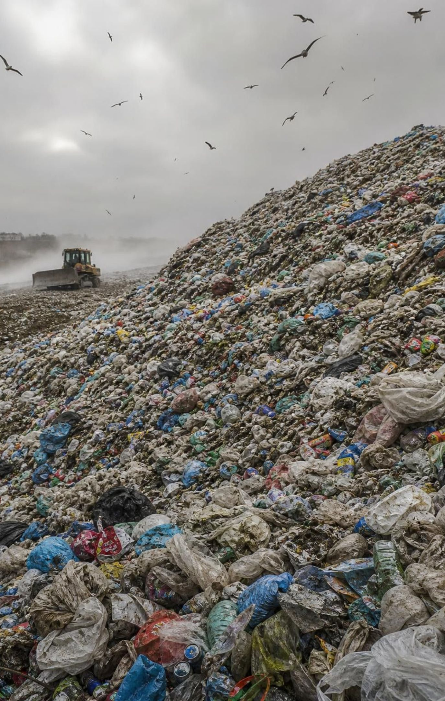
Plastics: a solution that created a new problem
First criteria: sturdy, flexible, light, long-lasting. Constraint: cheap to make. Plastics met them all.
Then evidence arrived: single-use items, little actually recycled, landfills filling, wildlife eating pieces.
In the U.S. only about 9 percent of plastic waste was recycled in 2018; most went to landfills.
New criterion: still sturdy in use, but breaks down within months after use.
PLA from corn meets it only in an industrial composter kept hot and moist for weeks.
20
Notes:
Frame this as engineering done honestly: the first plastics were a success by their own criteria, and that success is exactly what created the new problem, because a material designed to last does last. The recycling figure is from EPA's 2018 data; PET bottles alone do better but still under a third. Then introduce the revision: engineers did not throw out the old criteria, they added one. Point out that cost sits in the constraint column, not the criteria column, even though the book lists it as a criterion. Finally the PLA reality: it breaks down within about six months in an industrial composting facility, not in a landfill, a backyard pile or the ocean, and if it gets mixed into PET recycling it can contaminate the batch. Raise one more twist: fast breakdown inside a landfill would release methane, because landfills are oxygen-poor, so 'breaks down in a landfill' is not automatically a win. Ask students to name a better end-of-life criterion.
WATCH FOR: 'Plant-based means biodegradable' and 'recyclable means recycled.'
CONNECTS TO: Lab 2 cup decision; Lab 3 design challenge; W6 CER.
PACING: about 6 min

Slide 21
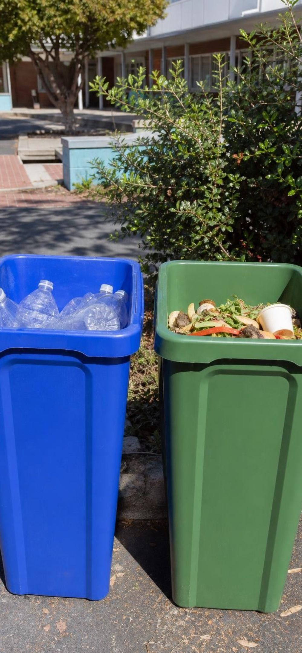
Model
The design cycle in the plastics story
Model: How a working solution leads to a revised problem
Define criteria and constraints → (plastics: sturdy, light, cheap)
Design and produce a solution → (containers everywhere)
Use it widely and gather evidence → (landfills, wildlife, low recycling)
Discover new problems → (add: breaks down after use)
Revise the criteria → (test PLA and others) (back to the start)
The loop does not end: PLA's limits are the evidence for the next revision.
21
Notes:
Trace the loop once with plastics, then ask students to trace it with the California bag law from the connection slide: criteria (fewer bags in litter and landfills), solution (ban thin bags, allow thick reusable ones), evidence (thick bags were used once too), new problem, revised criteria (no plastic carryout bags at all). Then preview Lab 3: groups will go around this loop twice with a produce bag, and the second loop is where the learning is. Ask what evidence a group would need to justify revising a criterion rather than just a design.
EXPECTED RESPONSES: Students should be able to place each event of the bag law on a node and say that revision happens when evidence shows the old criteria missed something.
WATCH FOR: 'Revising means the engineers were wrong.' They met the criteria they had; the criteria were incomplete.
CONNECTS TO: Lab 3 sessions 1 and 2; W9 transfer design task.
PACING: about 5 min

Slide 22
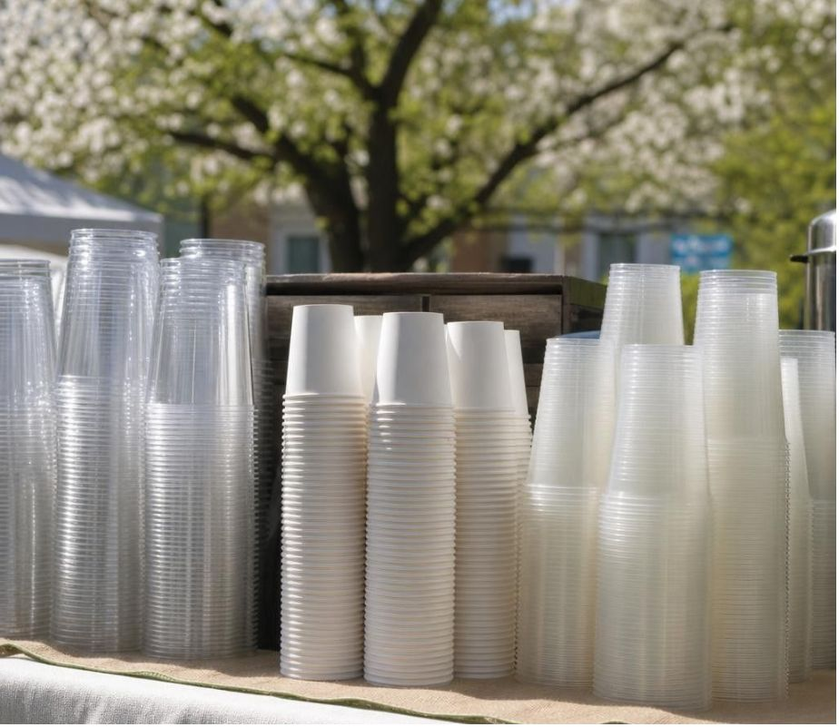
APPLY IT SIMULATED DATA FOR PRACTICE.
Task: which cup should the spring fair buy?
The fair needs 600 cold-drink cups and has $75. Score each option 0-2 on sturdiness, renewable origin and fate after use here, check the budget, pick one, and name the trade-off you accepted.
Option | Natural resource and process | Sturdy for a cold drink? | What happens after use at this school | Cost per cup (teaching values)
PET plastic cup | Petroleum; cracked, reacted into polyester, molded | Yes | Recycling bin accepts PET; many are still thrown in trash | 7 cents
Paper cup with plastic lining | Trees pulped; thin polyethylene lining from petroleum | Yes, goes soft after an hour | Lining blocks paper recycling; goes to landfill | 9 cents
PLA cup | Corn starch; fermented to lactic acid, polymerized | Yes, cracks if squeezed hard | No industrial composter within 100 km; goes to landfill | 11 cents
Reusable polypropylene cup | Petroleum; polymerized, molded thick | Yes, for hundreds of uses | Washed and reused; needs water, soap and volunteers | 60 cents, reused
22
Notes:
Give groups eight minutes. The costs and the school's facilities are teaching values, labeled simulated, chosen to be realistic; the origin and end-of-life descriptions are accurate in general. Criteria to score: sturdy for the event, made from a renewable resource, and actually handled responsibly after use at this school. Constraint: a total budget of 75 dollars, as in Lab 2. At these prices 600 PET cups cost $42, paper $54 and PLA $66; the reusable cup fits only if the fair buys about 120 of them ($72) and washes each about five times. Have groups score each cell 0, 1 or 2 and add. There is no single right answer, and that is the lesson: the PLA cup scores well on origin but poorly on end of life because the facility does not exist nearby; the reusable cup scores best on waste but costs most up front and needs people to wash it; the PET cup is cheapest and recyclable in principle but much of it will be thrown away. Full credit is a choice that follows from the scores plus a named trade-off. The bigger version with information cards is Lab 2.
EXPECTED RESPONSES: Most groups choose reusable polypropylene if the budget and volunteers allow, or PET if the budget is tight; a group choosing PLA must notice the missing composter. Trade-offs named: money and washing labor for reuse; nonrenewable origin and low real recycling for PET; landfill fate for paper and PLA.
WATCH FOR: Groups that pick PLA because it is 'biodegradable' without reading the end-of-life column; groups that treat 'recyclable' as 'recycled.'
CONNECTS TO: Lab 2 is the full information-card version; W6 CER; W9 transfer.
PACING: about 10 min

Slide 23

CHECK FOR UNDERSTANDING
Quick check: criterion, constraint or neither?
It must hold hot soup for 30 minutes without leaking.
The company can spend at most 12 cents per container.
It must break down within 180 days in an industrial composter.
The design team likes the color green.
Only materials already approved for food contact may be used.
For a new compostable food container, sort each statement: C for criterion, K for constraint, N for neither.
23
Notes:
Fast, one statement at a time, with a reason each. Statements 1 and 3 describe success and can be tested, so they are criteria. Statement 2 is a budget limit and statement 5 is a legal limit on materials, so both are constraints. Statement 4 is neither; a preference that does not define success or limit the solution should not be in the list, though a customer requirement about color could be a criterion. Point out that statement 3 is the new criterion from the plastics story stated precisely, with a number and a condition, which is what MS-ETS1-1 asks for.
EXPECTED RESPONSES: 1 C, 2 K, 3 C, 4 N, 5 K.
WATCH FOR: Calling cost a criterion; calling anything with a number a constraint.
CONNECTS TO: Lab 3 session 1 criteria and constraints table; W9 transfer.
PACING: about 4 min

Slide 24
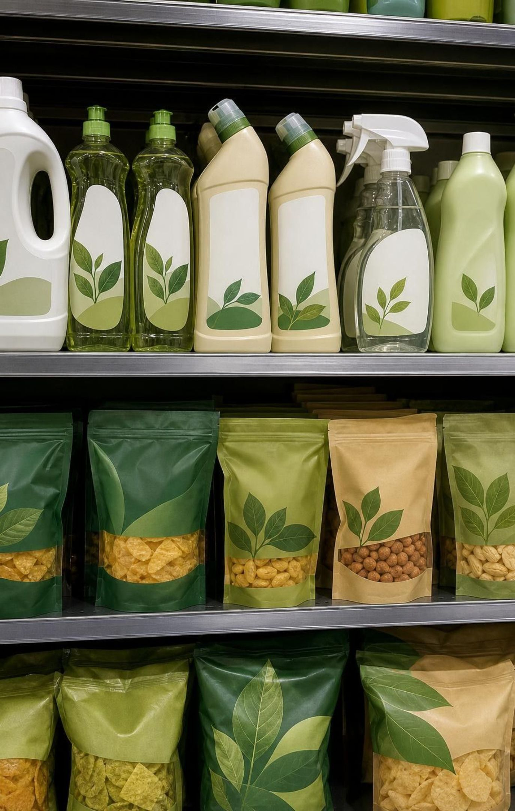
Reading claims about materials like a scientist
Who wrote it, and do they gain if you believe it? A seller, an agency, a researcher, a stranger online?
Is the claim specific and testable? 'Eco-friendly' is vague; 'composts in 180 days at 58 °C' is testable.
Does it cite evidence you could check, or just repeat a label?
Do two independent sources agree? If they disagree, what would settle it?
'Natural' and 'chemical-free' on a label are marketing words, not measurements.
24
Notes:
This slide is the heart of the standard's practice: gather and make sense of information. Show two short invented claims on the board, for example a cup sleeve that says 'made from plants, returns to the earth' and an extension-service fact sheet that says 'PLA breaks down only in industrial composting.' Ask the four questions of each. Have students notice that the first claim is written by a seller, is vague, cites nothing, and conflicts with the second, which is written by a university program with no product to sell and gives a condition. Then the 'chemical-free' point: everything made of matter is made of chemicals, so the phrase cannot be true of any product; it is a signal that the writer is selling a feeling. Students will rate sources on W6 and W8 and in Lab 2, so practice the four questions out loud here.
WATCH FOR: Students may rank a source as credible because it is confident or popular. Confidence is not evidence.
CONNECTS TO: W6 flyer claims (q3); W8 jigsaw source rating; Lab 2 card review.
PACING: about 5 min

Slide 25
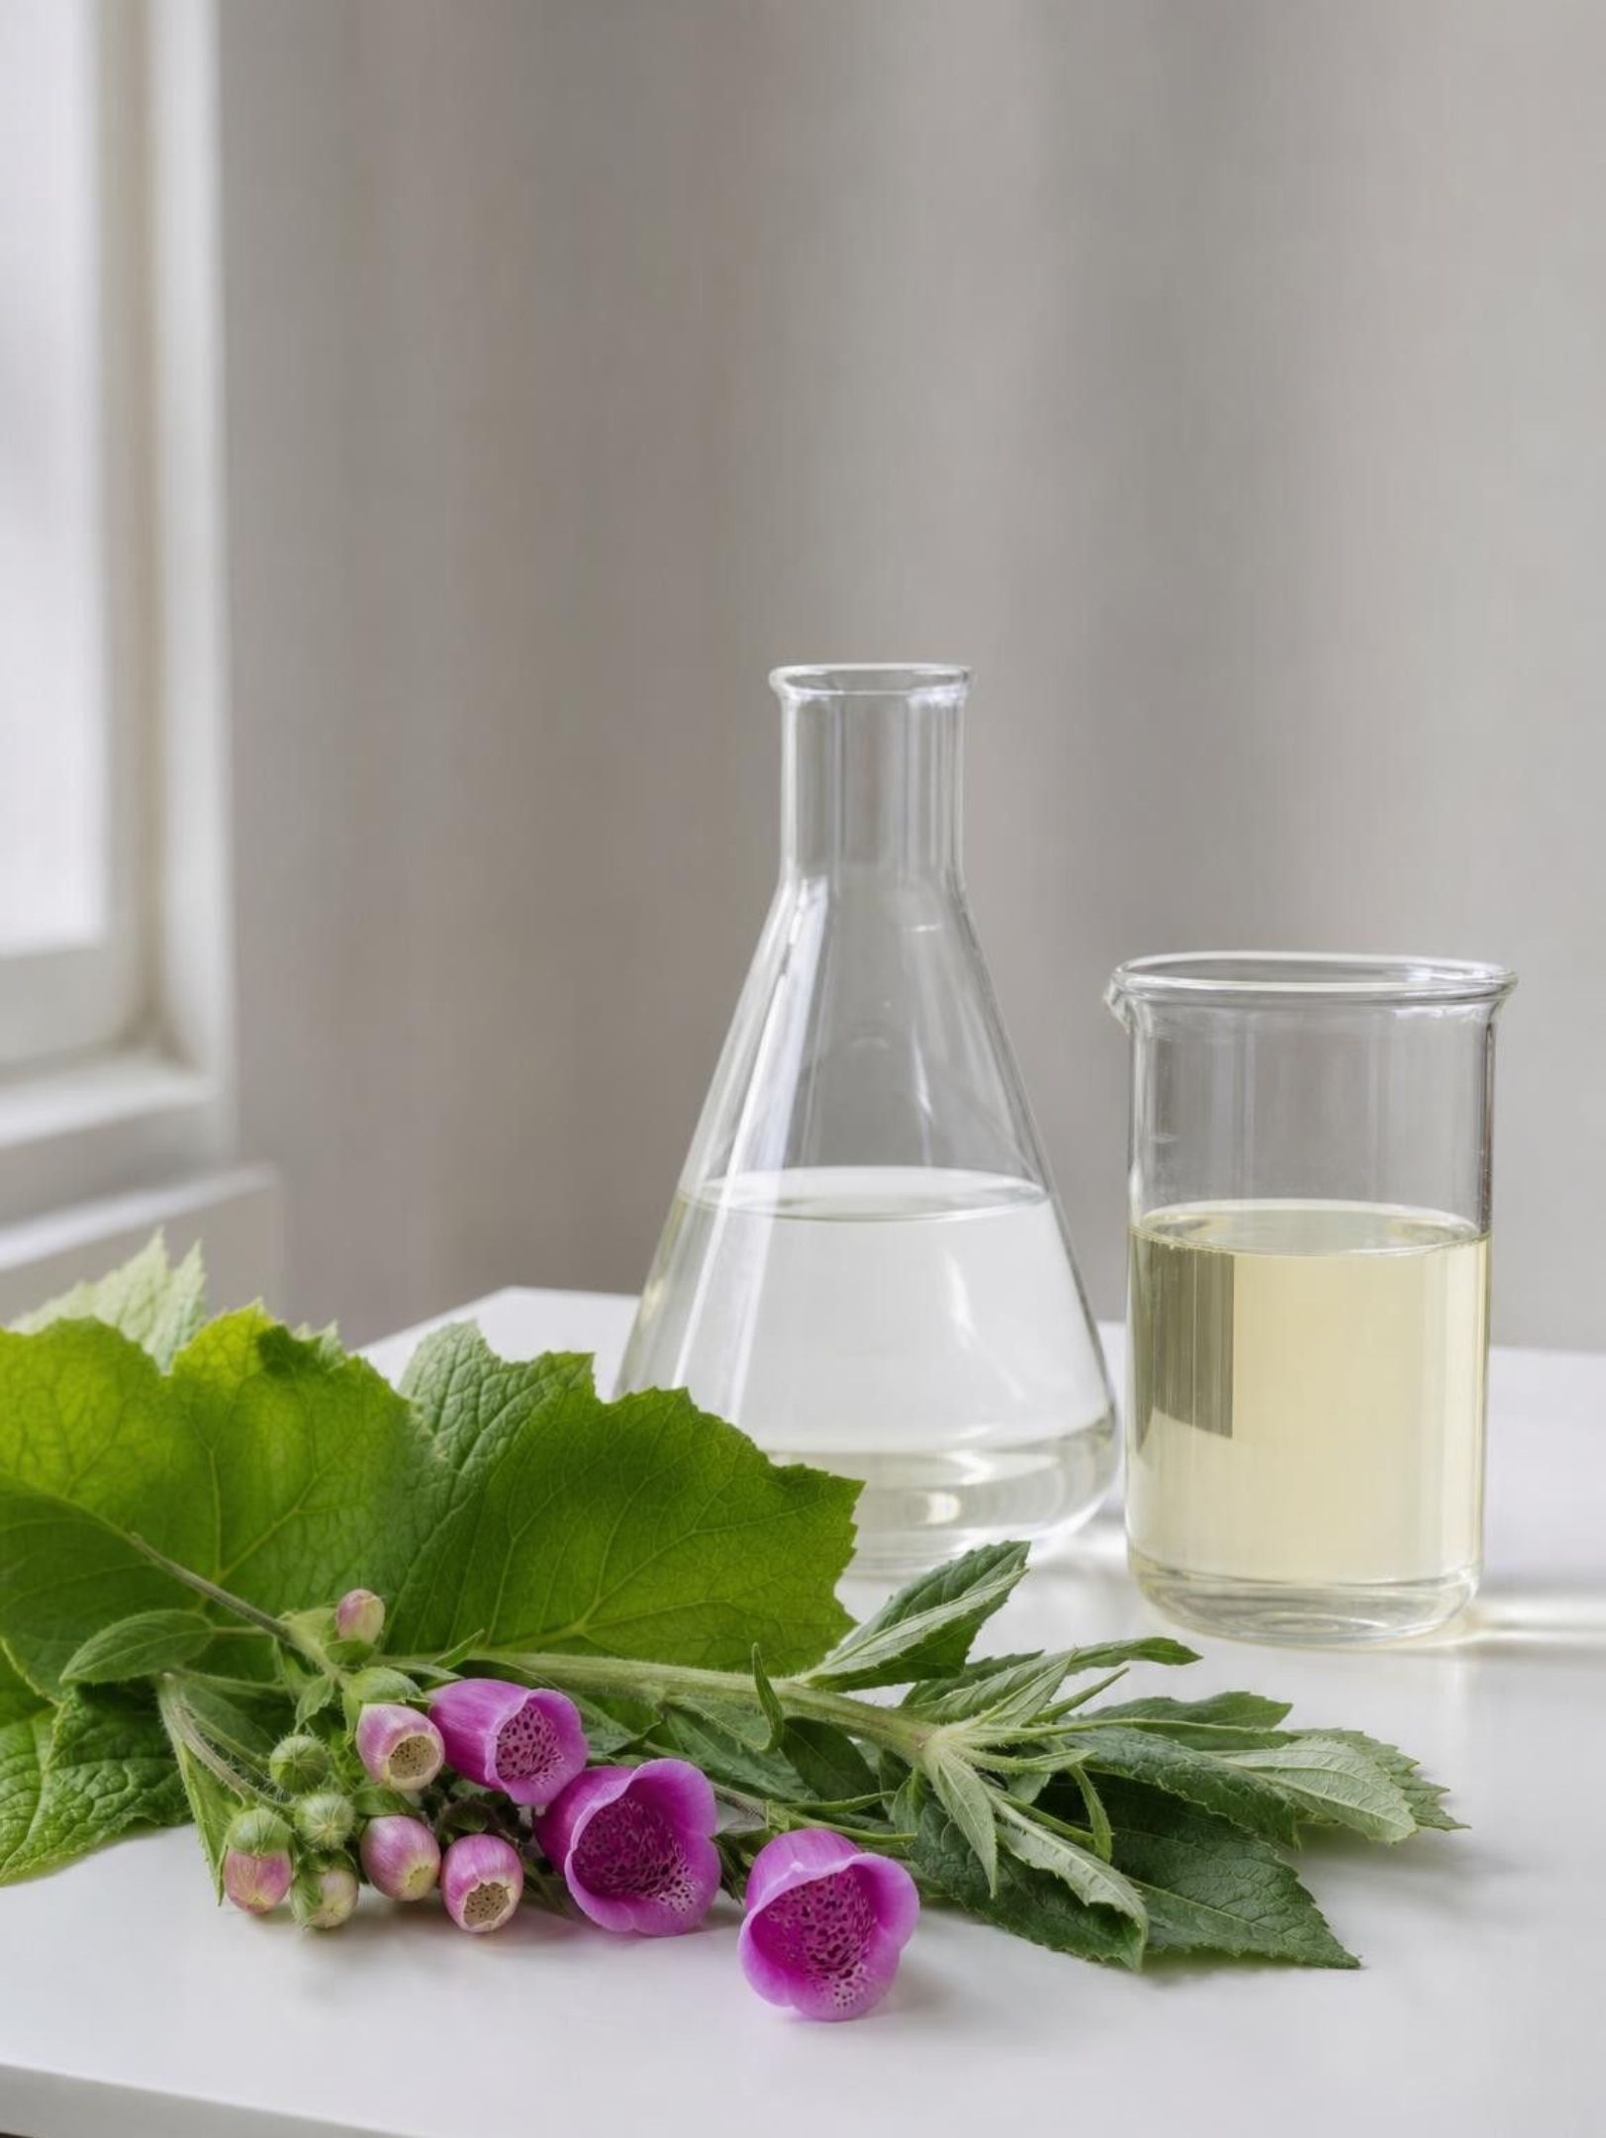
MISCONCEPTION CHECK
True or false? Natural is safe, synthetic is harmful
"If a material came straight from nature it is safe to use, and if it was made by chemical reactions in a factory it is harmful to people or the environment."
True or false? Explain your reasoning.
25
Notes:
Return to the parking lot from day one. Have students evaluate the statement in writing with two examples from the lesson before anyone speaks. Then collect counterexamples in two columns. Natural and harmful: poison hemlock, lead ore, mold toxins, too much sugar, natural rubber latex allergies. Synthetic and helpful: aspirin, semisynthetic paclitaxel, nylon parachutes, water-purification chemicals. Then the honest other half: synthetic materials can and do cause harm, and plastics in the ocean and landfills are the lesson's own example. The correction is not 'synthetic is fine'; it is that origin does not predict safety or harm. Each material has to be judged by evidence about its own properties, amounts, uses and what happens to it afterward. Close by rewriting the statement as a class so it is true.
EXPECTED RESPONSES: False. Examples both ways; a rewritten statement such as 'Whether a material is safe or harmful depends on its properties, how much is used and how it is disposed of, not on whether people or nature made it.'
WATCH FOR: Students flipping to 'synthetic is always better.' Keep the plastics problem in view.
CONNECTS TO: W7 misconception repair; W6 CER; W10 mastery.
PACING: about 6 min

Slide 26
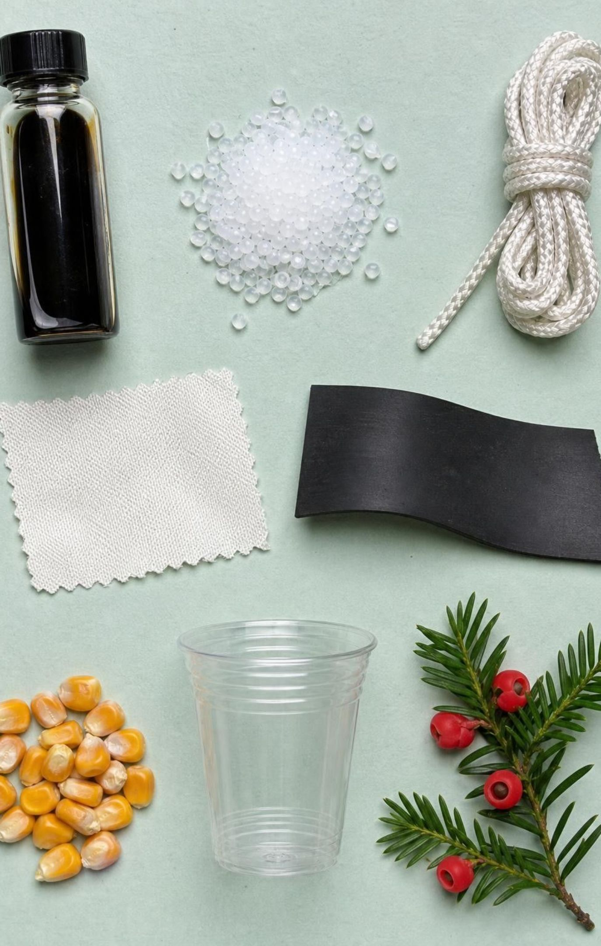
PUTTING IT TOGETHER
Putting it together
Every synthetic material starts as a natural resource changed by chemical reactions.
Petroleum feeds fuels, plastics, fabrics, rubber, dyes and medicines; corn feeds ethanol and PLA.
Structure decides properties: tangled chains flex; three swapped atoms keep sucralose sweet but calorie-free.
Every material choice is a trade-off for people and the environment; natural is not a safety rating.
When a solution causes a new problem, engineers revise the criteria and test again.
26
Notes:
Have students write a three-sentence summary of the two jackets using at least four vocabulary words, then trade with a partner who checks that natural resource and synthetic material are used correctly. Ask for one thing from each lab: Lab 1 (which test best separated natural from synthetic fibers), Lab 2 (the trade-off their group accepted), Lab 3 (the criterion they revised and why). Preview Lesson 19 on Earth's natural resources, where the uneven distribution of petroleum and ores becomes the story, and Lesson 29, where engineering solutions protect ecosystems.
CONNECTS TO: W10 mastery as the quiz; L19 Earth's Natural Resources and L29 Engineering Solutions next in the sequence.
PACING: about 6 min

Slide 27

EXIT TICKET
Exit ticket
Pick one product from today and write its natural resource, the chemical process and the synthetic material.
Name one benefit and one cost of that product for people or the environment.
Write one criterion and one constraint from your produce-bag design and label which is which.
A website says a cup is 'all natural, so it is safe.' Write one question you would ask before believing it.
27
Notes:
Collect on index cards or a shared form. Item 1 checks the core of MS-PS1-3; a complete answer has all three parts in order. Item 2 checks that students can state a trade-off instead of a verdict. Item 3 checks whether Lab 3's definitions landed. Item 4 checks the source-evaluation practice. Sort the cards into three piles before the next class and reteach from the largest pile.
EXPECTED RESPONSES: 1: for example 'petroleum, cracked and polymerized, polyethylene bag' or 'corn starch, fermented by yeast, ethanol.' 2: a bag is light and strong; it lasts for decades in a landfill. 3: criterion such as 'holds 1 kg for a 10 m walk'; constraint such as 'at most 15 material tokens.' 4: who wrote it, what evidence, natural compared with what, safe for what use.
WATCH FOR: Item 1 answers that skip the chemical process (for example 'oil makes plastic') signal that the reaction step has not landed.
CONNECTS TO: W10 mastery; chapter evidenceOfLearning.
PACING: about 5 min

