Slide 1
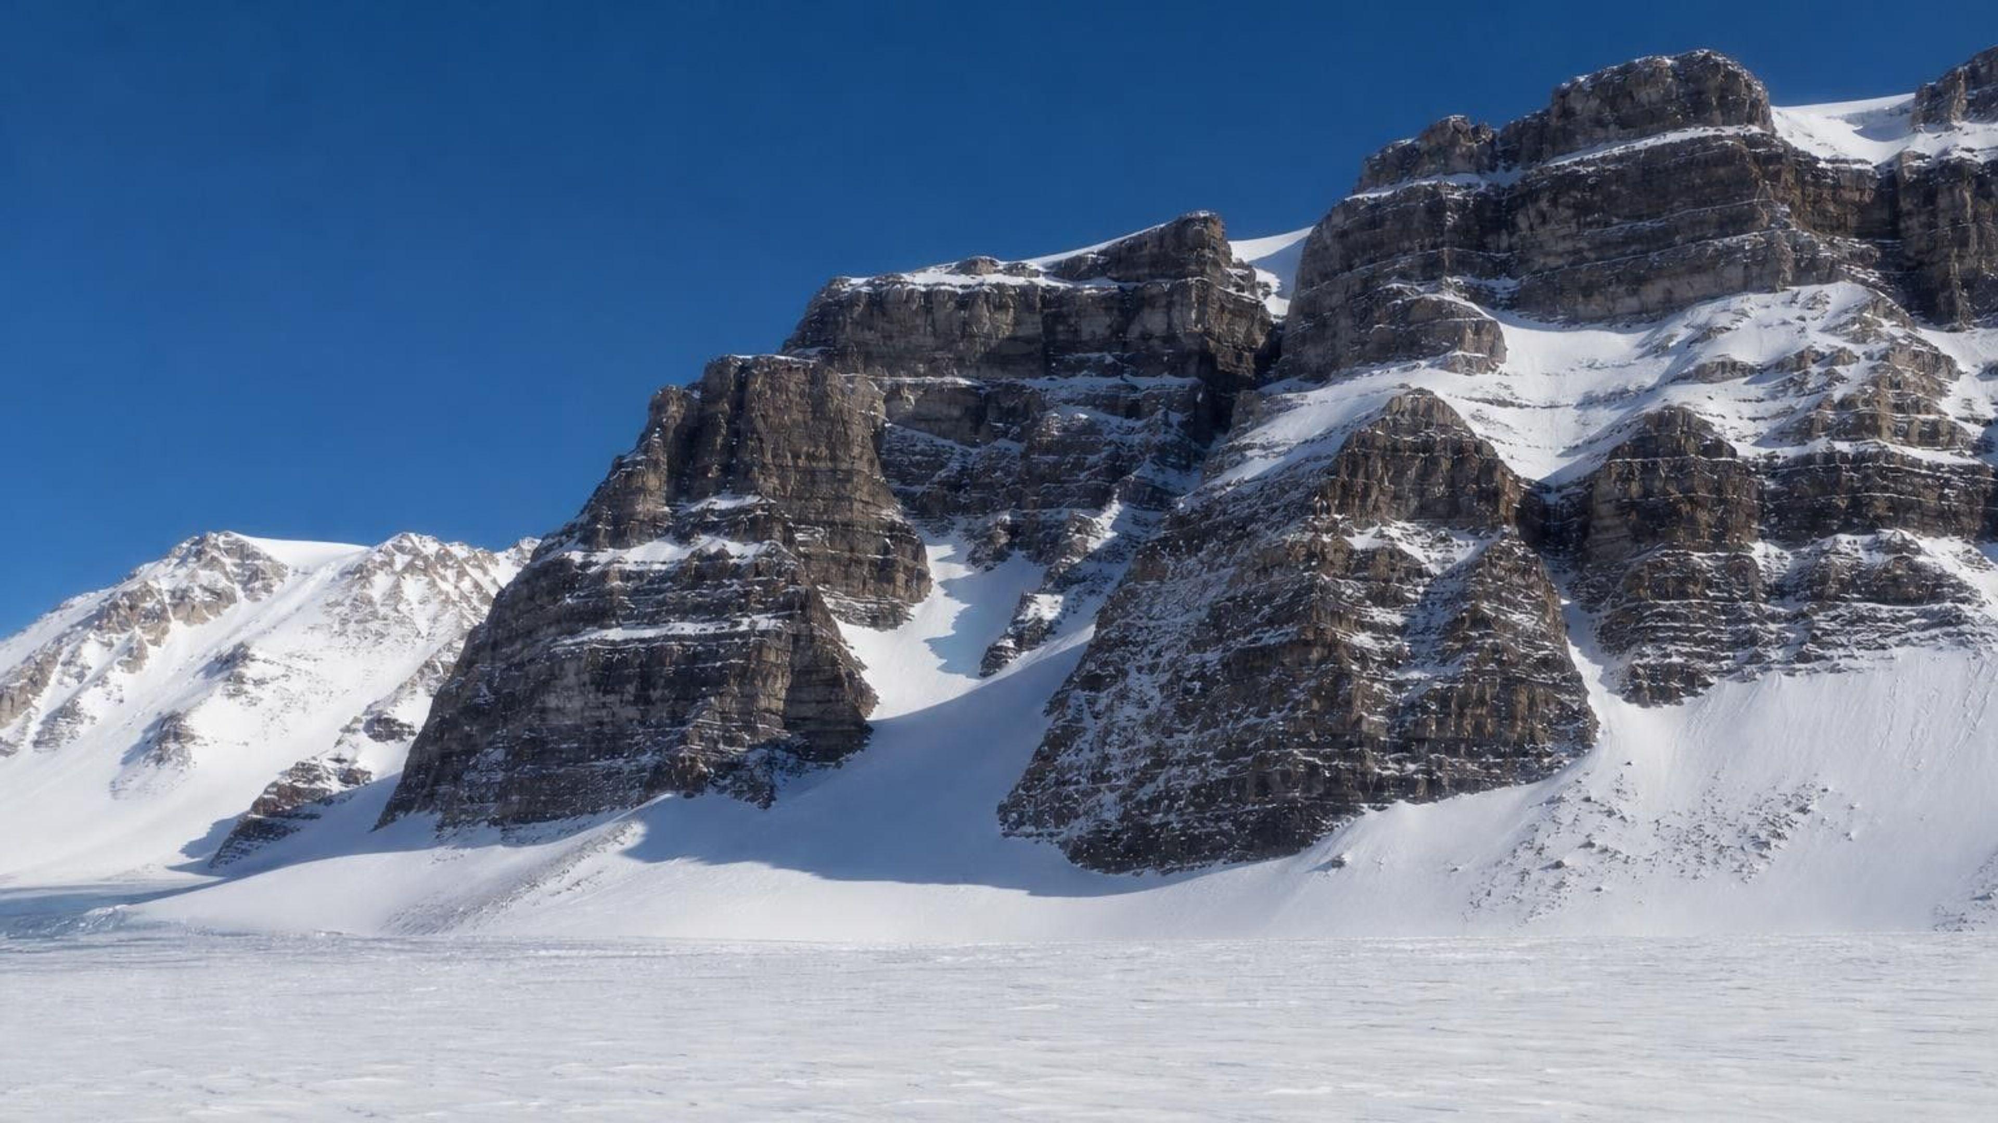
CHAPTER 16 OF 29 · PROCESSES THAT SHAPE EARTH
Chapter 16: Earth's Tectonic Plates
Lesson 16: What evidence convinced scientists that the continents move?
Angela's Wand · Bring Science Alive! 7th Grade Integrated
Notes:
This lesson is a detective story that took about 370 years to solve. A mapmaker noticed something odd in 1596, a German scientist put real evidence behind it in 1912, and the case was not closed until the late 1960s, when ships drilled into the ocean floor. Tell students the question for the week is not 'do the continents move' but 'what evidence would convince you, and what evidence finally convinced scientists.' Preview the three investigations: a card mystery where they fit torn landmasses together using fossil and rock clues, a paper model of a spreading seafloor, and a data decision about where a drill ship should sample. Nothing in the lesson needs chemicals, heat or sharp tools beyond scissors.
CONNECTS TO: Overview of Lab 1 (landmass mystery), Lab 2 (paper seafloor) and Lab 3 (drill-core decision). W1 opens on the next slide.
PACING: about 2 min

Slide 2
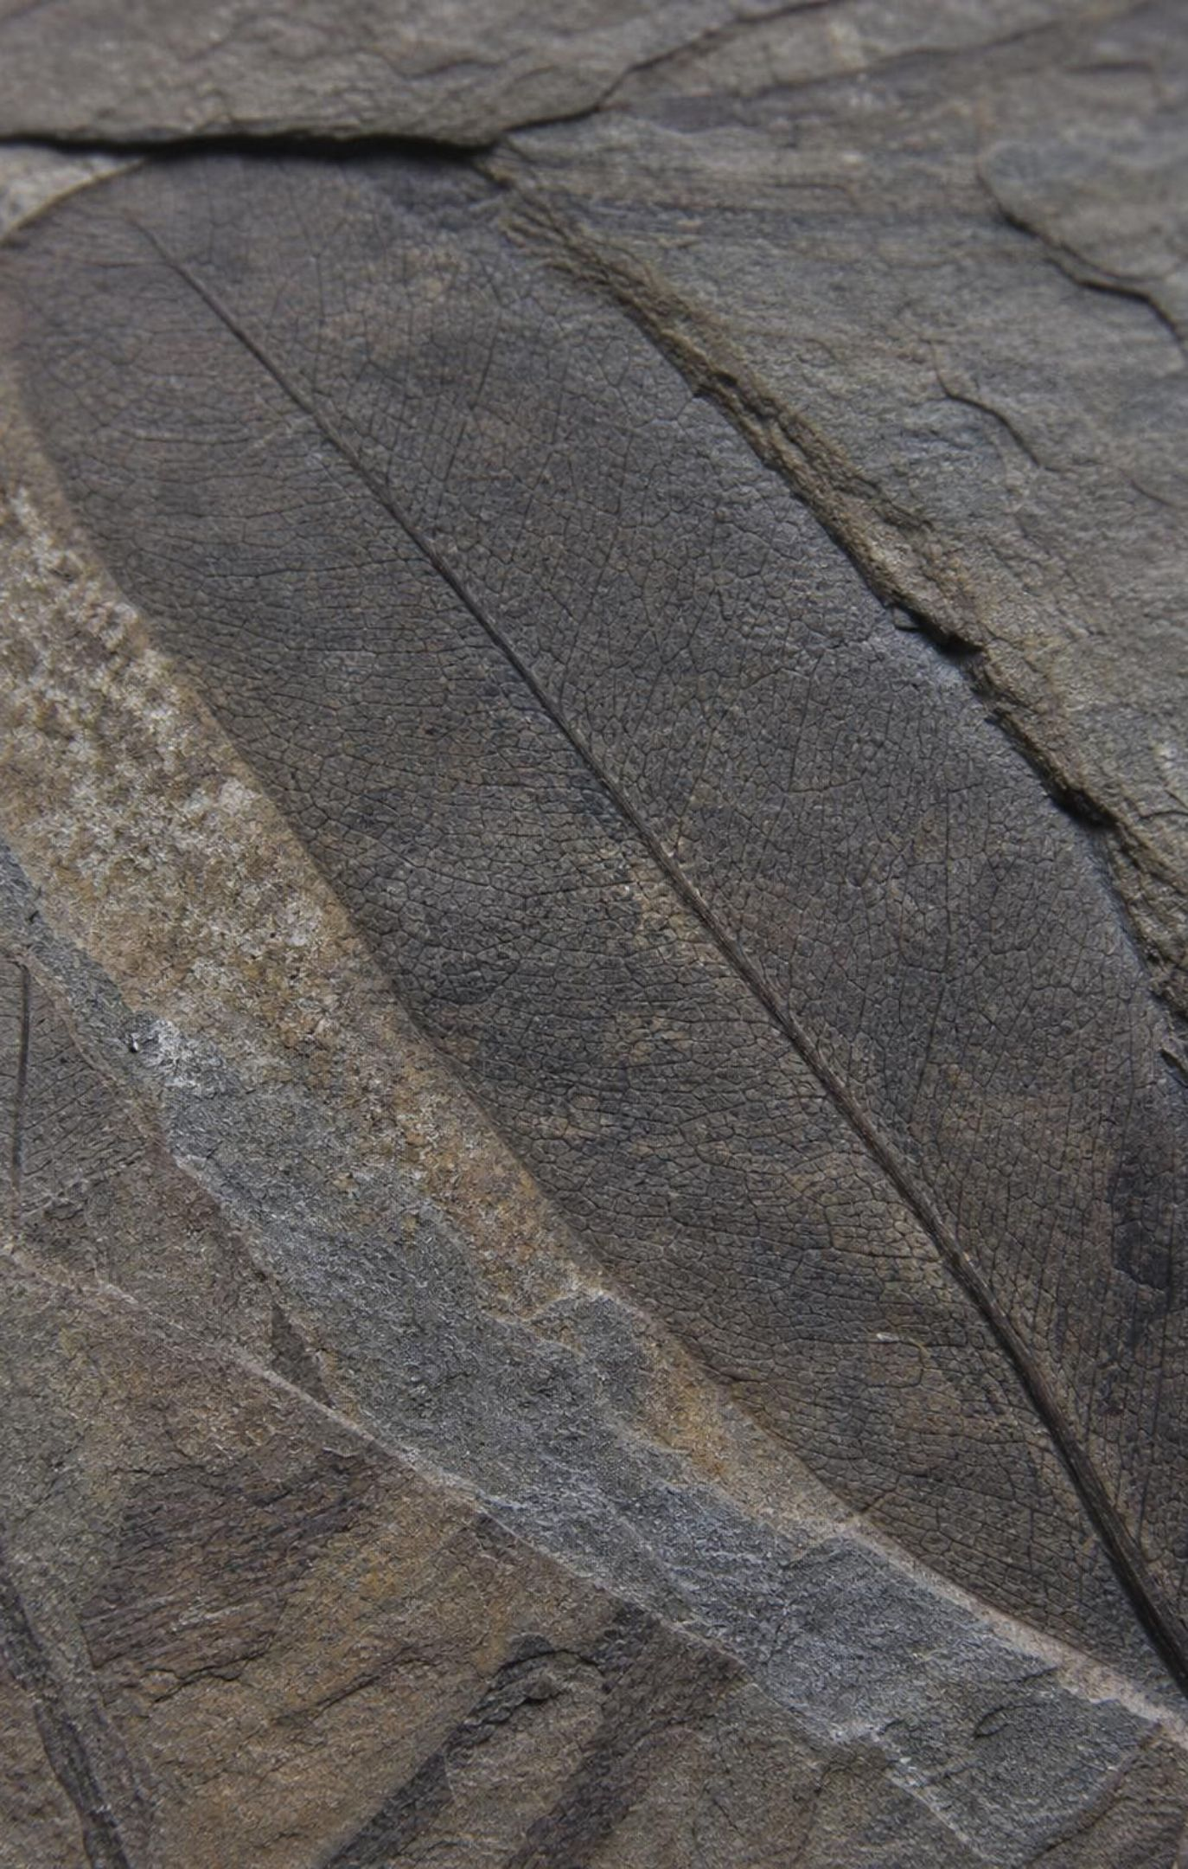
PHENOMENON
A forest where nothing grows today
High in Antarctica's Transantarctic Mountains, rocks about 250 million years old hold fossil tree trunks with growth rings, broad leaves of the seed plant Glossopteris, and bones of Lystrosaurus, a pig-sized land animal that could not swim across an ocean. The same plant and the same animal turn up in rocks of the same age in India and southern Africa. Today the site is ice, with months of total darkness.
Notice: what does a forest need that this place does not offer today?
Wonder: how does a land animal that cannot swim reach three continents?
Three possible stories: the animals moved, the climate moved, or the land moved.
2
Notes:
Give two silent minutes for a notice and a wonder, then collect answers on the board without judging them. Push students toward the three competing stories on the slide and ask what evidence could tell them apart. If the animals walked, there must have been a land route; if the climate changed, Antarctica must once have been warm enough for trees; if the land moved, Antarctica itself must once have been somewhere else. Teacher background: Lystrosaurus bones come from the Early Triassic Fremouw Formation near the Beardmore Glacier, and Glossopteris leaves and fossil wood come from Permian rocks nearby. The growth rings in the fossil wood show the trees lived through long dark winters, so they grew near the pole, not near the equator. Hold that detail for slide 8; it corrects a claim in the textbook. Do not resolve anything today; the whole lesson is the answer.
EXPECTED RESPONSES: Notice: trees need light, liquid water and soil; Antarctica today has ice and months of darkness. Wonder: was Antarctica warmer; was there a land bridge; did the continent move. Many students will choose 'the climate moved' first; ask whether a warmer climate explains how the same animal got to India.
WATCH FOR: 'The animals swam' or 'seeds floated across.' Record these on a parking lot; Lab 1 and slide 7 test them.
CONNECTS TO: W1 phenomenon worksheet records the notice, wonder and first explanation. W6 CER returns to this evidence.
PACING: about 8 min

Slide 3
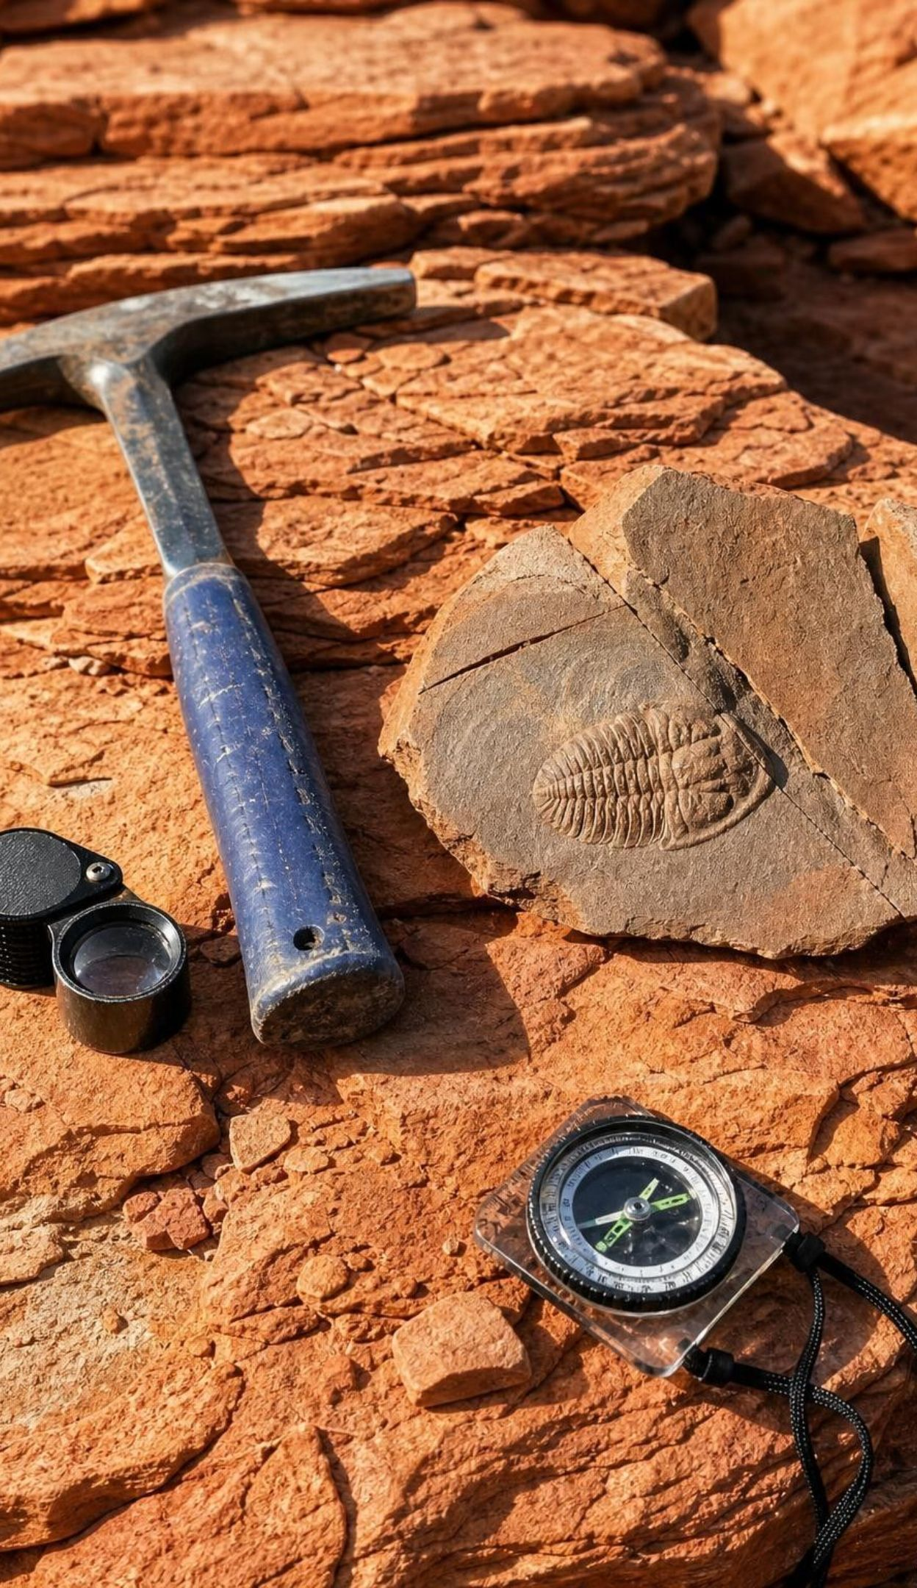
LEARNING TARGETS
What you will be able to do
Explain Wegener's continental drift hypothesis and the fossil, rock and shape evidence behind it.
Explain why scientists set the idea aside and what kind of evidence was missing.
Describe what earthquake waves, earthquake maps and sonar revealed about Earth and the seafloor.
Analyze seafloor age and distance data to show that new seafloor forms at a ridge and spreads outward.
Tell criteria from constraints in the design of a research drill ship.
Classify plate boundaries by motion and use rate times time to estimate how far plates move.
3
Notes:
Read the targets aloud and have students star the one that sounds hardest. Point out the shape of the week: targets 1 and 2 are the old evidence and why it was not enough, target 3 is the new evidence from the 1900s, target 4 is the evidence that settled the question, target 5 is the engineering story of how that evidence was collected, and target 6 is what the finished theory lets us calculate. The exit ticket on the last day touches all six.
CONNECTS TO: Targets map to Lab 1 and W8 (1), W3 (2), W4 (3), Lab 2, Lab 3 and W5 (4), W9 (5), W10 (6).
PACING: about 2 min

Slide 4
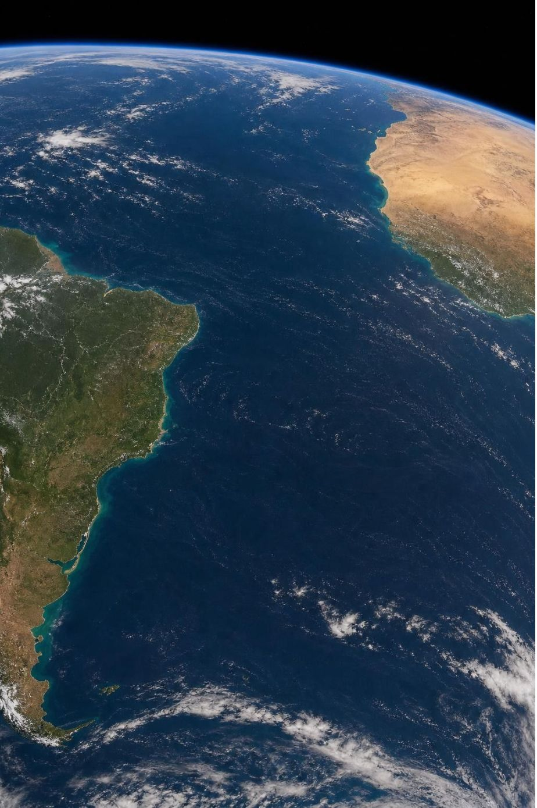
A puzzle on the map: 1596 and 1912
1596: mapmaker Abraham Ortelius noticed the Atlantic coasts of the Americas and Africa look torn apart.
A hunch is not a hypothesis. A hypothesis makes predictions you can go out and test.
January 1912: Alfred Wegener presented continental drift; his book followed in 1915.
His claim: all the continents were once one landmass, Pangaea ('all lands'), that broke apart.
His prediction: if the lands were joined, their rocks, fossils and ice scars should match across the join.
4
Notes:
Start with the puzzle-piece observation and ask what else would have to be true if the fit were real. Students should get to the idea that a torn page matches not just at the edge but in the printing that runs across it. That is the difference between Ortelius's hunch and Wegener's hypothesis: Wegener predicted that the 'printing' (rock types, fossils, ancient ice scratches) would line up across the join, and he went looking. Wegener was a meteorologist and polar explorer, not a geologist, which later counted against him. Give both dates: he presented the idea at a meeting in Frankfurt in January 1912 and published The Origin of Continents and Oceans in 1915. Ask: what is the difference between fitting the coastlines and fitting the continental shelves? Hold the answer for slide 14.
EXPECTED RESPONSES: If the lands were joined, fossils, rock layers and mountain belts should continue across the join; the fit should work for the submerged edges as well as the coasts.
WATCH FOR: Students may think a hypothesis is 'a guess.' Insist on the test: a hypothesis predicts something you could find or fail to find.
CONNECTS TO: W2 vocabulary relationships; W3 reading passage on Wegener.
PACING: about 5 min

Slide 5
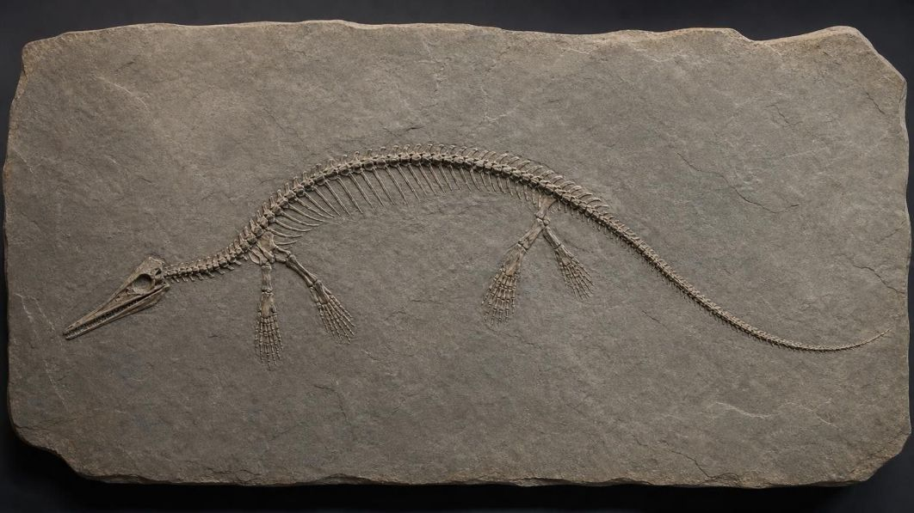




MODEL
Wegener's four lines of evidence
Model: What Wegener found, and what each find requires
Matching shapes: South America's east coast fits Africa's west coast. Requires: the two were once one piece.
Matching fossils: Mesosaurus (small shallow-water reptile) in Brazil and southern Africa; Lystrosaurus and Glossopteris on several southern lands. Requires: a land connection.
Matching rock belts: Old rock belts of the Appalachians continue in northwest Africa with the same rock types and ages. Requires: one belt later torn in two.
Ancient ice scratches: Scratches from glaciers about 300 million years ago point from today's oceans onto India, Africa, South America and Australia. Requires: one ice sheet over joined lands.
Each clue alone could have another explanation. Together they point to one answer.
5
Notes:
Walk the four boxes and, for each, ask 'what is the other possible explanation?' Matching shapes could be coincidence. Matching fossils could mean land bridges that later sank, which is exactly what many geologists believed in 1912. Matching rock belts could mean similar conditions in two places. The ice scratches are the hardest to explain away: in India they point from the sea onto the land, which makes no sense unless the ice came from land that is no longer there. Add the names students will use in Lab 1: Mesosaurus, a small reptile from shallow water that could not cross an open ocean; Lystrosaurus, a land animal found in Antarctica, southern Africa, India and also China and Russia; Glossopteris, an extinct seed plant with tongue-shaped leaves found on all the southern continents. Say 'found in' rather than 'found only in.' Stress that in 1912 all this evidence was on land, because no one could see the seafloor.
EXPECTED RESPONSES: Alternatives: coincidence, sunken land bridges, similar climates. Students should notice that one alternative, land bridges, could explain fossils but not the ice scratches or the rock belts.
WATCH FOR: 'The same fossils prove the continents moved.' Not alone; they prove the lands were connected somehow. The combination with shapes, rocks and ice scars is what makes drift the best explanation.
CONNECTS TO: Lab 1 uses these four kinds of evidence as card markings. W8 collaborative jigsaw assigns one line of evidence per expert group.
PACING: about 7 min

Slide 6
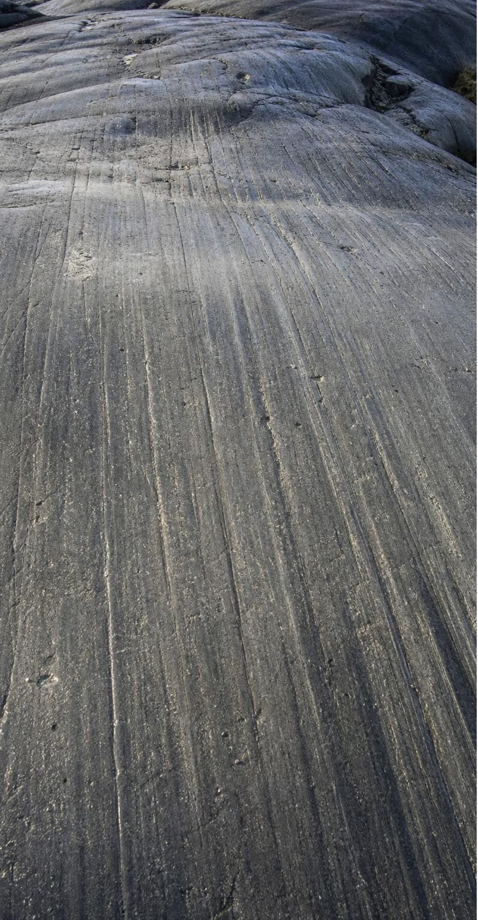
VOCABULARY IN CONTEXT
Three words for an idea on trial
hypothesis: A possible explanation, built on limited evidence, that makes predictions you can test. Wegener's hypothesis predicted matching rock belts on facing coasts, so geologists went to check.
continental drift: Wegener's hypothesis that the continents were once joined in Pangaea and have slowly moved apart. Continental drift explained the fossil matches but could not say what pushed the continents.
Pangaea: The supercontinent that held nearly all land, assembled about 300 million years ago and breaking up from about 200 million years ago. Glossopteris fossils mark the southern part of Pangaea, which scientists call Gondwana.
6
Notes:
Have students say the chain aloud: 'Pangaea is the thing, continental drift is the hypothesis about it, and a hypothesis is an explanation on trial.' Give the two dates for Pangaea and point out that 300 million and 200 million are not the same event: it took about 100 million years for the pieces to assemble, hold together and begin to break. Ask students to write one sentence using two of the three terms correctly and trade with a partner to check.
WATCH FOR: Students often say Pangaea 'exploded' or broke up in one event. It opened like a series of zippers over more than 100 million years, and the Atlantic is still widening.
CONNECTS TO: W2 vocabulary worksheet works with these relationships.
PACING: about 4 min

Slide 7
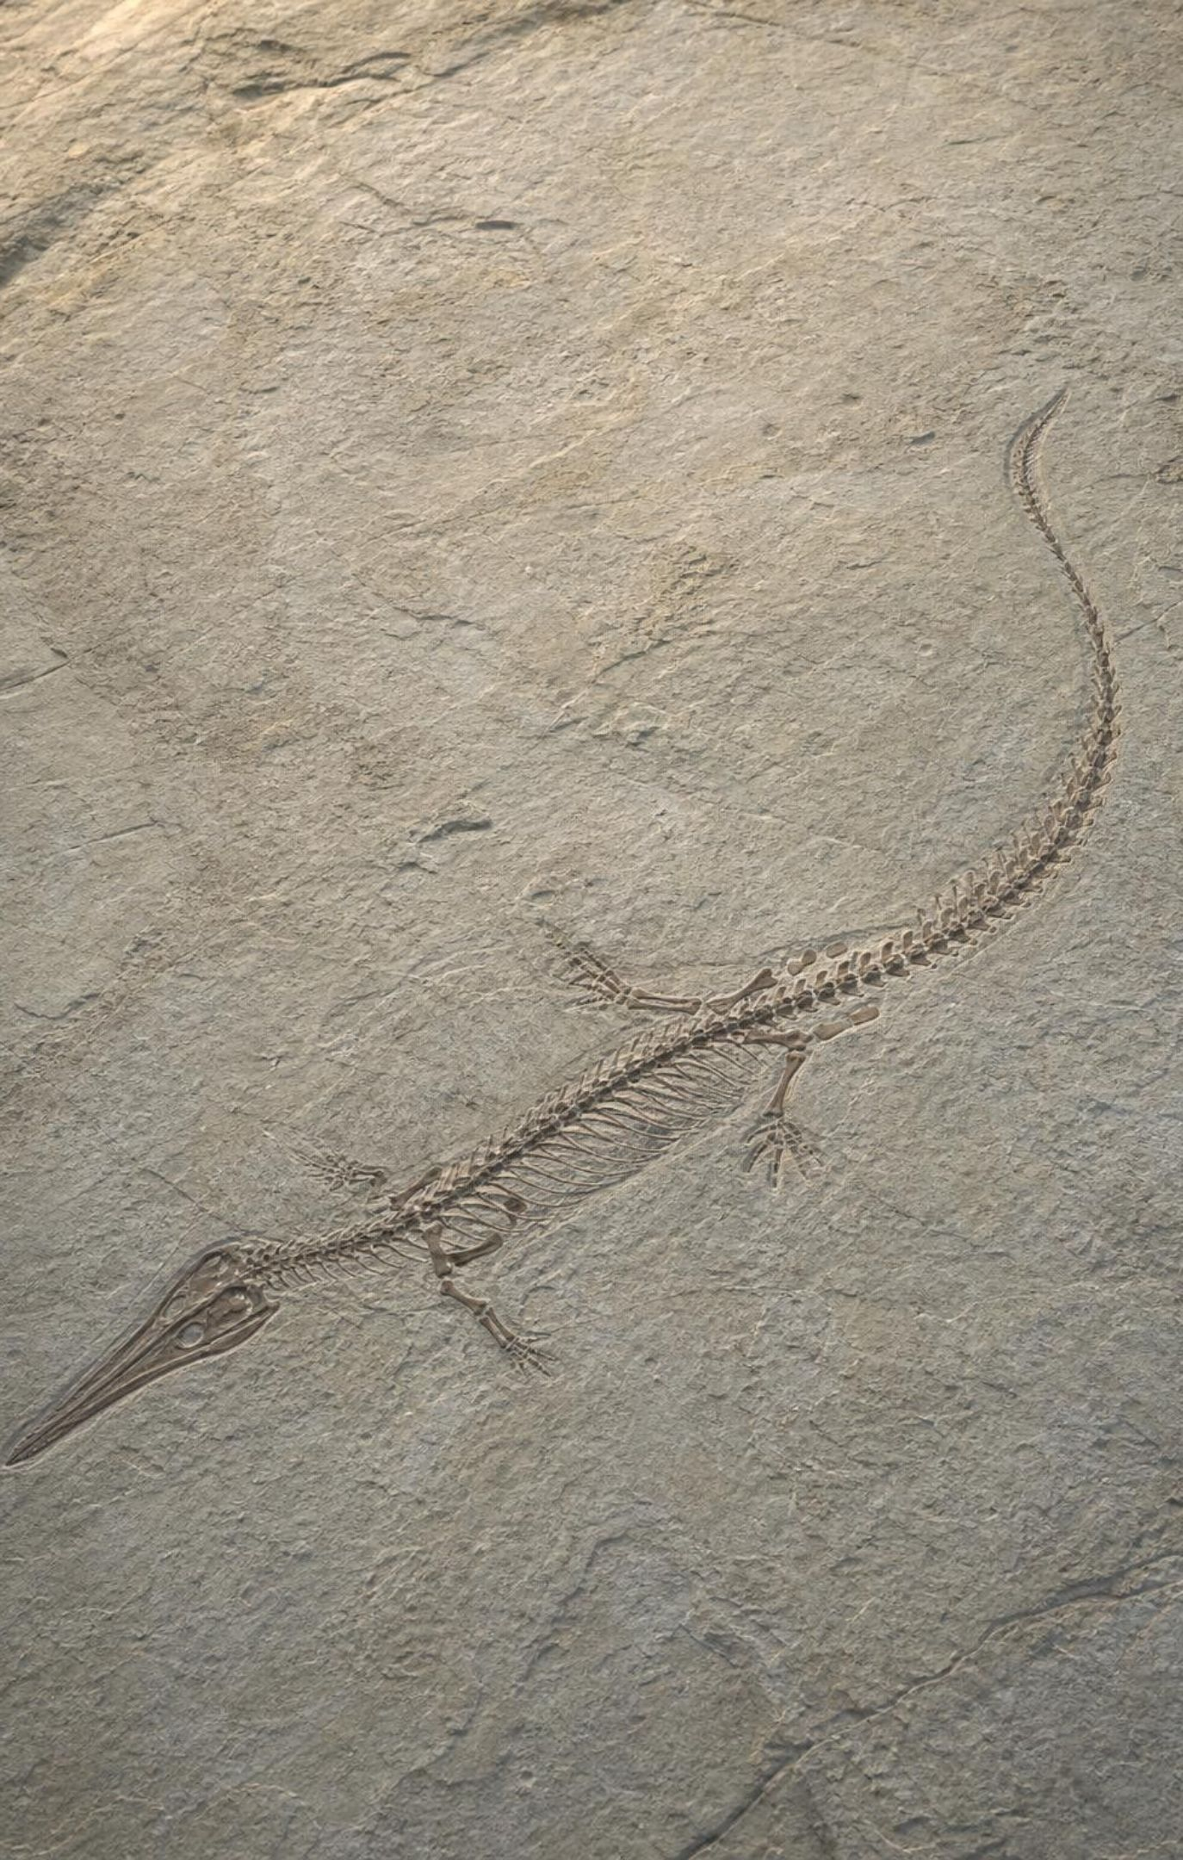
CHECK FOR UNDERSTANDING
Quick check: which clue is hardest to explain away?
Which find is hardest to explain without the two continents having been joined?
A. Seeds of the same plant family on two continents
B. Fossils of a small shallow-water reptile on two continents
C. Similar-looking sand on beaches of two continents
D. The same species of ocean bird nesting on two continents
7
Notes:
Vote with fingers, then defend. Birds fly and sand is sand, so C and D are weak. Seeds can sometimes travel by wind or water, so A is suggestive but not decisive. A small reptile of shallow inland or coastal water could not cross thousands of kilometers of salty open ocean, so B is the strongest. This is why Mesosaurus is the star witness of Lab 1. Ask the follow-up: what if someone claims a land bridge once connected the continents and then sank? That was a real competing idea; it fails because continental rock is too light to sink into the mantle, and no trace of such bridges exists on the seafloor.
EXPECTED RESPONSES: B. Students who choose A should be asked how far a seed can travel and still grow; accept A as 'good but weaker' if they reason about dispersal.
WATCH FOR: 'Fossils on two continents means the animals swam.' Have students compare the animal's size and habitat with the width of an ocean.
CONNECTS TO: Lab 1 evidence-strength rating; W7 misconception repair uses the swimming claim.
PACING: about 4 min

Slide 8

Why was continental drift set aside?
Wegener could not name a force strong enough to move continents.
The forces he suggested, tides and Earth's spin, were checked by physicists and found far too weak.
Continents plowing through solid ocean floor seemed impossible, and it is.
Many geologists preferred sunken land bridges to explain the fossils.
Supporters remained: Alexander du Toit in South Africa, and Arthur Holmes, who proposed mantle flow in 1931.
8
Notes:
Make the key point carefully: Wegener was not rejected for lack of evidence; he was rejected for lack of a mechanism, and his proposed mechanism was shown to be wrong. That is good science, not stubbornness. The objection that continents cannot plow through ocean floor was correct; the later answer is that the continent and the nearby ocean floor move together on the same plate. Wegener died on the Greenland ice sheet in 1930, before the seafloor evidence existed. Also fix the textbook's Glossopteris claim here: the book calls it a fern that needed warm climates and uses it to argue the continents sat near the equator. Glossopteris was a seed plant, and the growth rings in Antarctic fossil wood show it grew near the pole through dark winters. So use Glossopteris as evidence that the southern lands were joined, and that Antarctica's climate has changed, not that it was tropical.
EXPECTED RESPONSES: Students should be able to say what was missing: a force or process that could move continents, backed by evidence.
WATCH FOR: 'Scientists rejected Wegener because they were closed-minded.' Some were, but the main objection, no workable mechanism, was fair.
CONNECTS TO: W3 reading passage; W7 misconception repair.
PACING: about 6 min

Slide 9
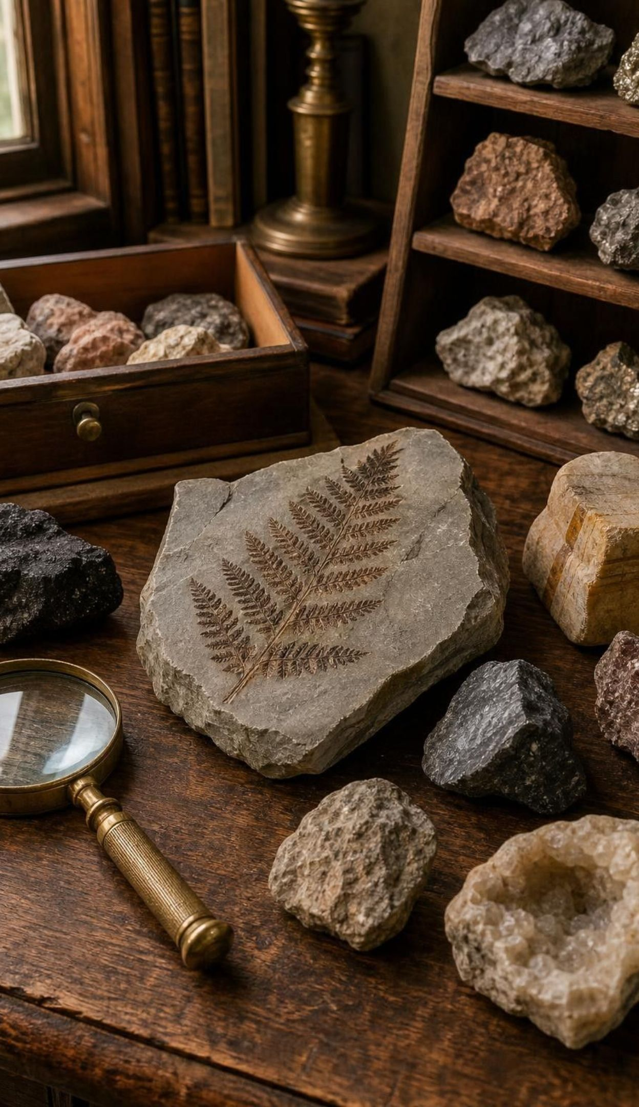
THINK, PAIR, SHARE
Discuss: you are at the 1926 meeting
For: fossils, rock belts, ice scratches and shapes all line up.
Against: no known force can move a continent, and the proposed forces fail.
Against: 'the fit is coincidence' or 'land bridges sank' could explain some clues.
Decide: accept, reject, or 'promising but unproven'? What finding would settle it?
In 1926 geologists met in New York to debate continental drift, and many of the speakers rejected it. With only the evidence available then, what would you have decided, and what one finding would have changed your mind?
9
Notes:
Give pairs four minutes. Assign half the room to argue for and half against, then let them switch to their honest view. The best answer is usually 'promising but unproven,' and the finding students ask for is almost always some way to see the continents moving or some way to see the ocean floor. That is exactly the evidence the rest of the lesson supplies. Teacher background: the 1926 symposium was organized by the American Association of Petroleum Geologists; several prominent American geologists attacked the idea strongly. Close by asking what tools the scientists of 1926 lacked: no seafloor maps, no global earthquake network of modern quality, no way to date seafloor rocks.
EXPECTED RESPONSES: Most pairs land on 'promising but unproven' and ask for a mechanism, a direct measurement of movement, or evidence from the seafloor. Some will reject it outright over the mechanism; accept that if they name the problem precisely.
WATCH FOR: Students may treat the meeting's verdict as proof that science is just opinion. Point out that scientists changed their minds when new evidence arrived, which is the system working.
CONNECTS TO: W3 reading; W6 CER asks for the same reasoning with more evidence.
PACING: about 7 min

Slide 10
What earthquake waves revealed inside Earth
MODEL
Model: Earth's layers, top to bottom, as read from seismic waves
Top to bottom: Crust: oceanic about 5-10 km thick, continental about 30-70 km /
Rigid upper mantle: with the crust it forms the lithosphere, roughly 100 km thick /
Hot mantle below: solid rock that creeps slowly, carrying the lithosphere /
Lower mantle: solid, under enormous pressure /
Outer core: liquid iron and nickel /
Inner core: solid iron and nickel
No drill has cut through the crust into the mantle. Seismic waves change speed and bend at each boundary, and that is how the layers were found.
10
Notes:
Explain the method before the result: an earthquake sends vibrations through the whole planet, and stations around the world record when each wave arrives. Waves change speed and bend when the rock they travel through changes, so the arrival times reveal boundaries no one can visit. Andrija Mohorovicic found the base of the crust in 1909 this way. For this lesson the crucial layer is the lithosphere: the crust plus the cold, rigid top of the mantle, roughly 100 km thick. Below it the mantle is still solid rock, but hot enough to creep slowly, centimeters a year, like extremely stiff putty over millions of years. Plates are pieces of lithosphere, not pieces of crust and not continents. The textbook says waves travel faster in denser rock; speed actually depends on stiffness as well as density, so say only that waves change speed and direction where the rock changes. The deepest hole ever drilled, in Russia, reached about 12 km, which is still inside the crust.
EXPECTED RESPONSES: Students should state that the lithosphere is rigid and includes the top of the mantle, that the mantle beneath is solid but can flow very slowly, and that plates are lithosphere.
WATCH FOR: 'The mantle is liquid magma' and 'plates are the crust.' The mantle is solid rock; plates include mantle rock.
CONNECTS TO: W4 diagram worksheet labels a cross-section through the lithosphere; W2 vocabulary.
PACING: about 6 min

Slide 11
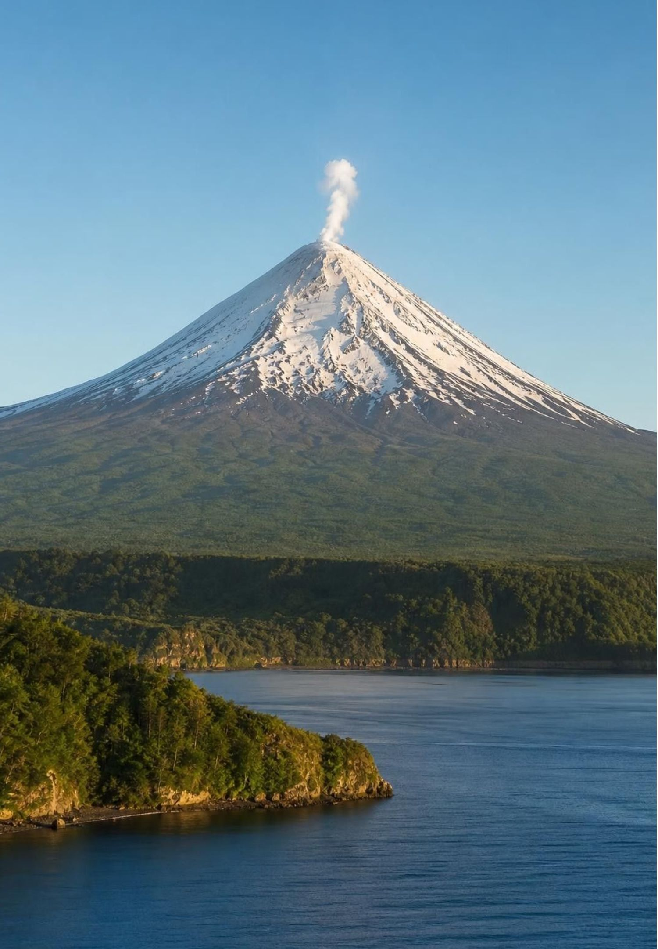
Belts of earthquakes and volcanoes
From 1899, seismic stations around the world began logging where earthquakes happen.
Earthquakes and volcanoes are not scattered; they crowd into narrow belts.
The biggest belt, the Pacific Ring of Fire, has most active volcanoes and most large earthquakes.
A second belt of earthquakes runs down the middle of the oceans, far from any coast.
The belts outline huge, mostly quiet blocks. Could those blocks be the moving pieces?
11
Notes:
Project a world map of earthquake locations if you have one, or describe it: the dots make lines, not a smear. Ask students what the lines could mean. The idea to reach is that the quiet blocks between the belts behave as rigid pieces and the belts are where pieces meet and grind. Point out the mid-ocean belt: in the 1950s scientists noticed a line of earthquakes running down the center of the Atlantic, exactly where the ridge was being mapped (slide 13). The Ring of Fire includes California, Alaska, Japan, Indonesia and the Andes. Keep the mechanism out of it for now; the pattern is the point.
EXPECTED RESPONSES: The belts could be cracks or edges; the quiet areas could be solid pieces. Students may name plates if they have heard the word; let them, but ask what evidence puts the plate edges where they are.
WATCH FOR: 'Earthquakes happen everywhere equally' and 'volcanoes are random.' The belts are the evidence against both.
CONNECTS TO: W4 diagram worksheet; W8 jigsaw card on earthquake belts.
PACING: about 5 min

Slide 12
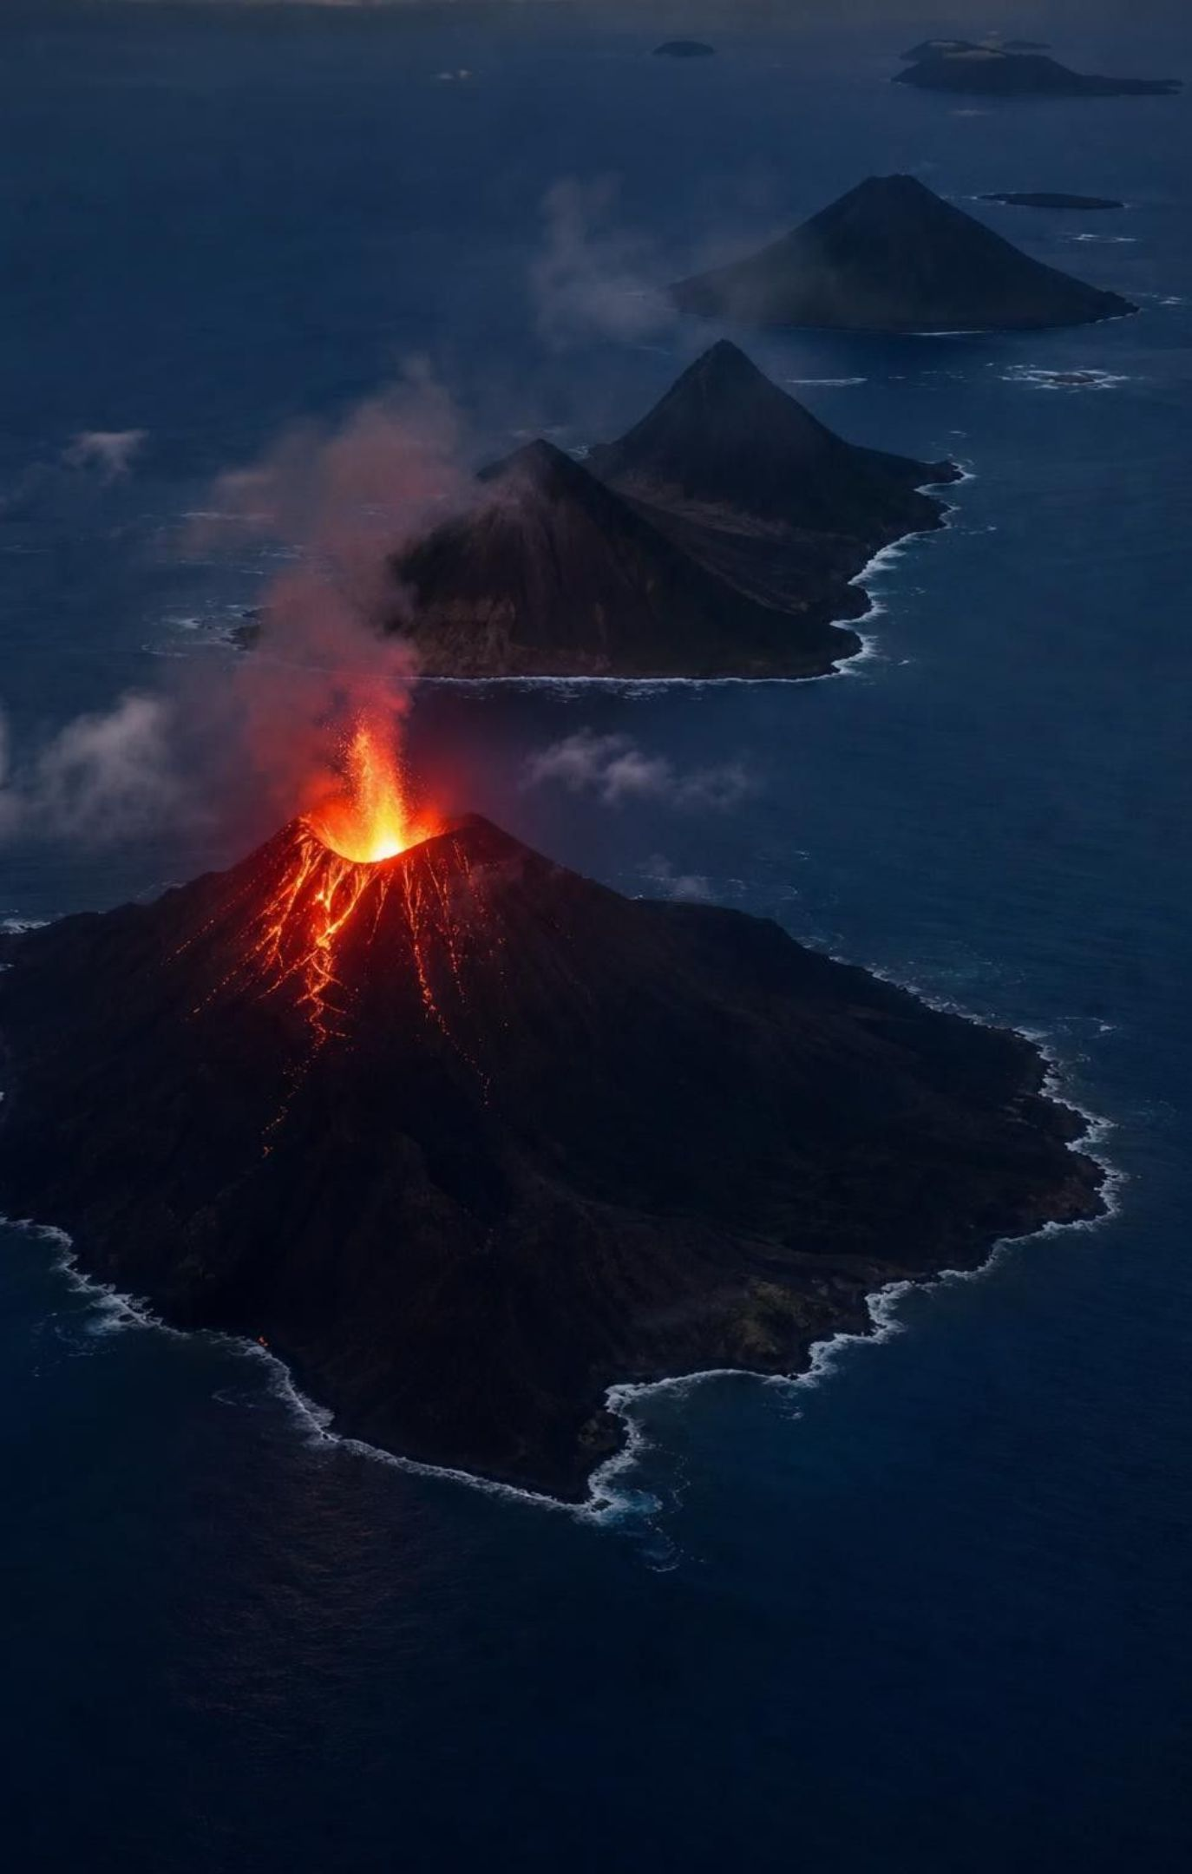
CHECK FOR UNDERSTANDING
Quick check: reading the belt pattern
A town sits in the middle of a large quiet block, 2,000 km from the nearest earthquake belt. Which statement best fits the evidence?
A. The town is on a piece that does not move
B. The town is on a moving piece but far from its edges, so it rarely shakes
C. The town must be on the ocean floor
D. The town is on a belt that has not become active yet
12
Notes:
Vote and defend. B is the best fit: the whole block moves, but the grinding and shaking happen at the edges where blocks meet. Use a book sliding across a desk: the book moves as one piece, and the scraping happens only at the bottom edge where it touches the desk. Ask where in the United States the belts run (the Pacific coast, Alaska) and where the quiet interior is (most of the Midwest). Mention that rare earthquakes do occur inside plates, so B says 'rarely,' not 'never.'
EXPECTED RESPONSES: B. Students choosing A should be asked whether the middle of a moving book is moving.
WATCH FOR: 'Plates are the continents' and 'the edge of a plate is the coastline.' Many plate edges run through oceans or across continents.
CONNECTS TO: W10 mastery item on belt patterns.
PACING: about 4 min

Slide 13
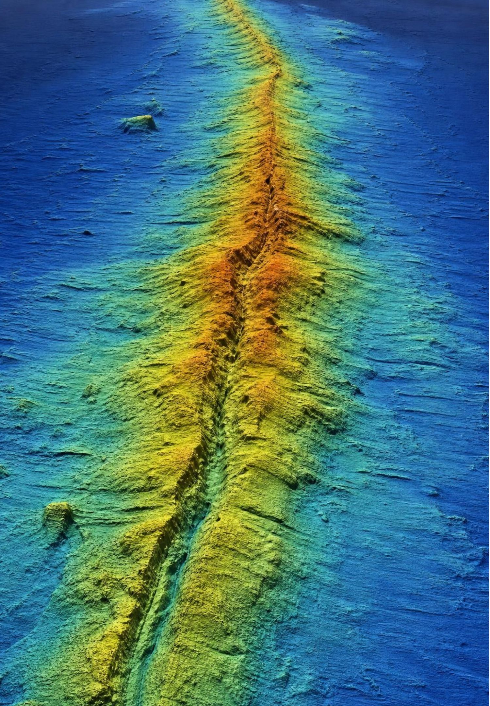
Mapping the seafloor with sound
For centuries, depth meant dropping a weighted rope and counting the length.
From the 1920s, echo sounding timed a sound pulse to the bottom and back.
A German ship (1925-27) used echo sounding to trace the ridge down the middle of the South Atlantic.
In the 1950s Marie Tharp and Bruce Heezen turned thousands of soundings into the first detailed maps.
Tharp found a deep valley running down the ridge crest, and earthquakes lined up inside it.
13
Notes:
Explain echo sounding with a number: sound travels about 1,500 meters per second in seawater, so an echo that returns in 4 seconds means the bottom is 2 seconds away, about 3,000 meters down. Marie Tharp worked at Columbia University's Lamont laboratory, plotting depth profiles by hand because women were not allowed on the research ships at first. When she drew the profiles across the Atlantic she noticed a notch at the top of the ridge in every one and argued it was a rift valley, a place where the seafloor was being pulled apart. Heezen at first dismissed it as 'girl talk,' then saw that earthquake locations fell inside the valley and changed his mind. Their 1977 map of the whole ocean floor is the picture most people have seen. Ask: what would a valley down the middle of a mountain chain tell you? Pulling apart.
EXPECTED RESPONSES: A rift valley on the ridge crest suggests the seafloor is splitting there; earthquakes inside it suggest the splitting is happening now.
CONNECTS TO: W3 reading passage; W8 jigsaw card on sonar mapping.
PACING: about 5 min

Slide 14
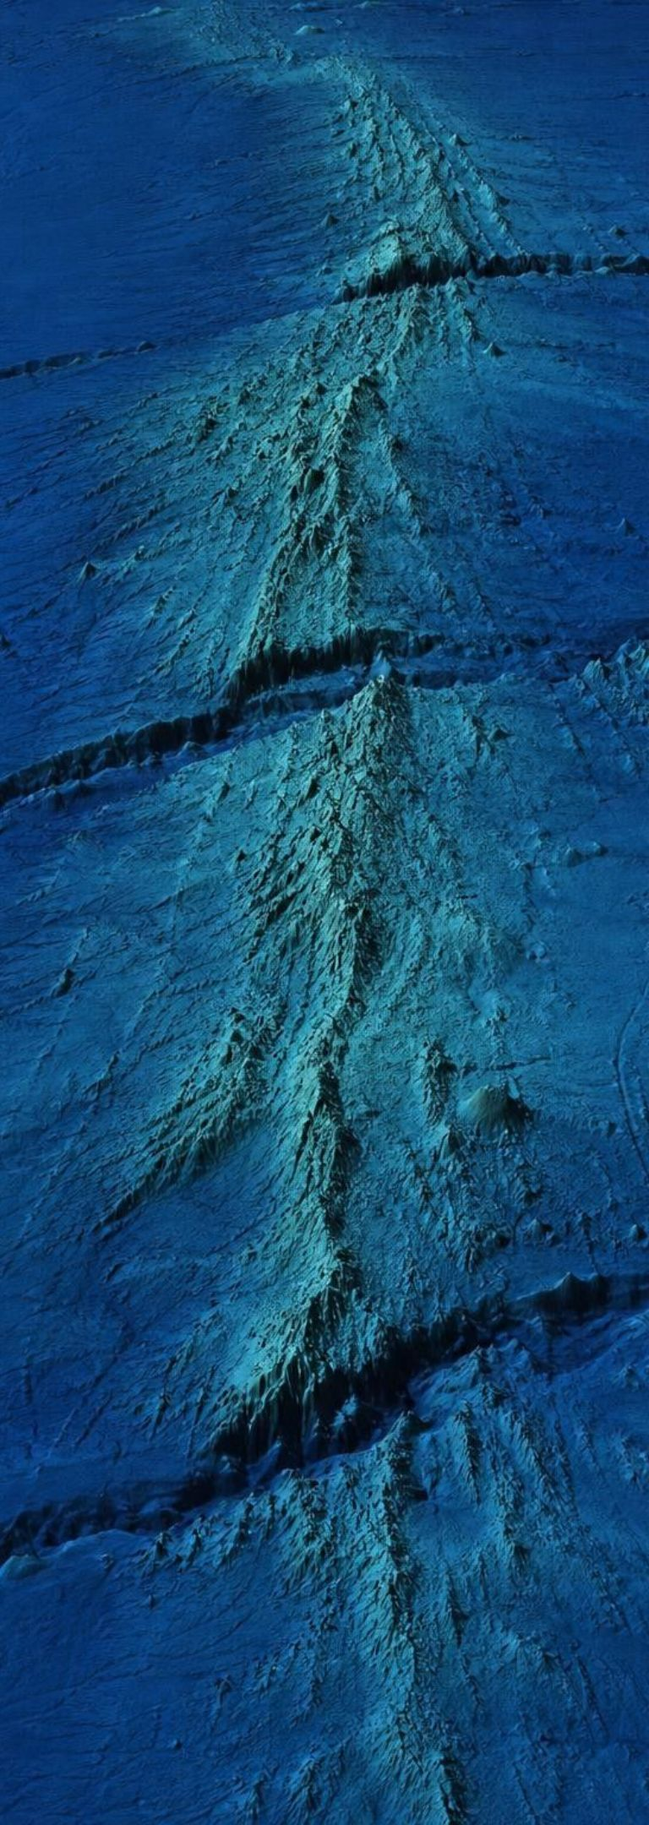




MODEL
Four structures sonar revealed
Model: Seafloor structures and what each one tells us
Mid-ocean ridge: A world-circling chain of underwater volcanic mountains, about 65,000 km long, with a rift valley along its crest.
Fracture zones: Long cracks that cross the ridge at right angles and offset it into segments. Between segments the two sides slide past each other.
Trenches: Narrow valleys up to 11 km deep, mostly around the Pacific, where earthquakes are deepest.
Continental shelves: The shallow, submerged edges of continents. Their outlines fit together even better than coastlines do.
A ridge, a crack, a trench and a shelf: each is a clue, and the next slide puts them in order.
14
Notes:
Return to the question from slide 4: coastline or shelf? The coastline is wherever sea level happens to sit today; the shelf edge is the real edge of the continental rock. In 1965 a computer fit of the continents at the shelf edge gave a much tighter match than the coasts. On fracture zones, be precise: the two sides move in opposite directions only on the stretch between offset ridge segments; beyond that the fracture zone is a scar where both sides move the same way. Trenches are where the deepest earthquakes occur, which will matter in the next slide. The deepest trench, the Mariana Trench, is nearly 11 km deep, deeper than Mount Everest is tall.
EXPECTED RESPONSES: Students should be able to say which structure goes with pulling apart (ridge, rift valley), which with sliding (fracture zones), and which with something going down (trenches).
WATCH FOR: 'The ridge is where plates collide.' The rift valley and the shallow earthquakes show pulling apart, not collision.
CONNECTS TO: W4 diagram worksheet interprets a ridge-to-trench cross-section; W2 vocabulary.
PACING: about 6 min

Slide 15
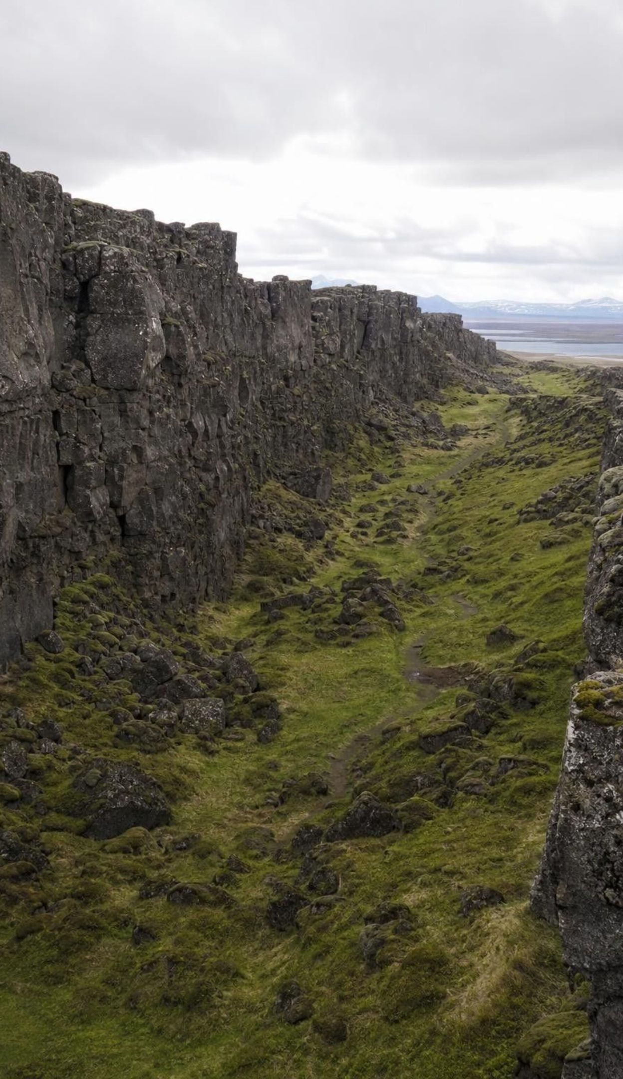
VOCABULARY IN CONTEXT
Three words for the pieces and their edges
lithosphere: Earth's rigid outer shell: the crust plus the cool, stiff top of the mantle, roughly 100 km thick, broken into plates. A plate is a slab of lithosphere, so it carries ocean floor and continent together.
mid-ocean ridge: The chain of underwater volcanic mountains where plates move apart and new seafloor forms. Iceland is one of the few places where the mid-ocean ridge rises above the sea.
trench: A long, narrow valley in the seafloor, several kilometers deep, where one plate bends down beneath another. The deepest earthquakes on Earth happen in plates sinking at trenches around the Pacific.
15
Notes:
Say the sentence 'plates are lithosphere, not crust and not continents' and have students repeat it. Then connect the three terms into one picture: lithosphere is made at the ridge, moves across the ocean basin, and goes down at a trench. Ask students to predict what should be true about the age of the seafloor if that picture is right. Do not give the answer; it is the next slide.
WATCH FOR: Students will say 'the crust moves.' Correct gently: the whole lithosphere moves, and it is thicker than the crust.
CONNECTS TO: W2 vocabulary worksheet; Lab 2 uses ridge and trench as the two ends of the paper model.
PACING: about 4 min

Slide 16
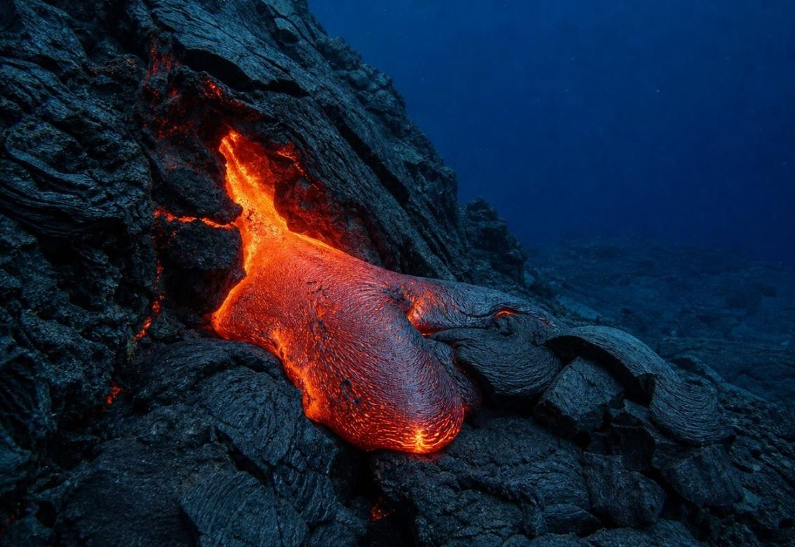
MODEL
Seafloor spreading: the prediction that could be tested
Model: The life of a piece of ocean floor, as proposed by Harry Hess in 1962
Plates pull apart at the ridge and the rift valley opens (open)
Molten rock rises into the gap and hardens into new seafloor (fill)
New seafloor moves outward on both sides, a few cm per year (spread)
1
2
3
Moving away, the seafloor cools, thickens and becomes denser (age)
At a trench the old, dense seafloor bends down into the mantle (subduction)
4
5
If this is right, seafloor must get older with distance from the ridge, and no seafloor should be very old.
16
Notes:
This is the turning point of the lesson, so slow down. Harry Hess, a geologist who had mapped seafloor from a Navy ship during the Second World War, proposed in 1962 that the ocean floor is made at the ridge and destroyed at trenches, like a conveyor belt. Robert Dietz used the name 'sea-floor spreading' in 1961 for the same idea. The beauty of the idea is that it makes a prediction anyone can test: sample the seafloor at different distances from the ridge and date it. If spreading is real, the ages must rise with distance, in matching steps on both sides, and nothing on the ocean floor should be as old as the continents. If the seafloor is ancient and fixed, ages should be old everywhere and show no pattern. Ask students to write the prediction in their own words before moving on. Teacher background only: in 1963 Fred Vine and Drummond Matthews proposed that stripes of magnetized rock running parallel to the ridge are a record of spreading, and ship surveys in 1965-66 found the mirror-image pattern on both sides that the idea predicted, the first strong test of spreading; the California standard does not assess this, so keep it to a mention if a student asks. The textbook lists convection, spreading and subduction as 'the three processes that drive plate motion'; the standard excludes mechanisms, and current research puts most of the driving force on the pull of the sinking plate. Present the flow as what happens, not why.
EXPECTED RESPONSES: Prediction: the youngest seafloor is at the ridge and age increases outward on both sides; the oldest seafloor is farthest from the ridge, often at a trench.
WATCH FOR: 'Magma pushes the plates apart like a wedge.' The flow shows what happens; the force is not assessed and is still studied.
CONNECTS TO: Lab 2 builds this conveyor from paper. Lab 3 and slide 18 test the prediction with data. W4 and W5.
PACING: about 6 min

Slide 17
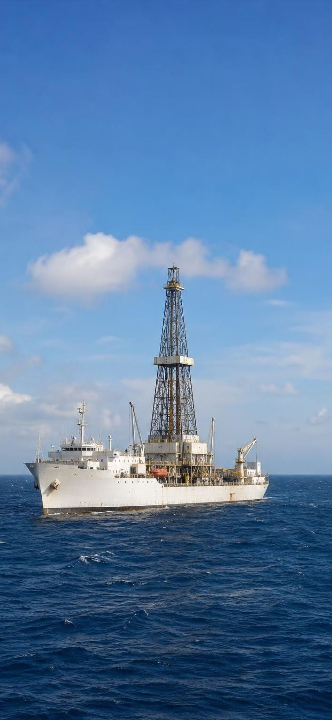
MODEL
Criteria versus constraints: building a drill ship
Model: The Glomar Challenger, launched 1968, had to meet these
A criterion describes success; a constraint is a wall the design works inside.
Criteria (what success requires) | Constraints (limits the design had to live within)
Lower drill pipe through more than 6,000 m of water | No anchor can hold in 6 km of water, so position had to be held by thrusters
Drill hundreds of meters into the rock beneath the seafloor | A drill bit wears out, so the ship had to return to the same hole or stop
Bring up cores with the layers unbroken and in order | Ocean weather and waves limited when drilling could happen
Work on both sides of a ridge within one voyage | A fixed budget and schedule set by the project's funders
17
Notes:
Define the two words with the test on the caption: does it describe success, or is it a limit? Then run the edge cases. 'Must cost under 20 million dollars' is a constraint. 'Must drill 1,000 m into rock' is a criterion. 'Must finish the Atlantic survey before winter storms' could be argued either way; let students argue it. Fix a textbook detail: the book says engineers redesigned an existing oil-drilling ship. The Glomar Challenger was a new ship, built in 1967-68 for the Deep Sea Drilling Project, though it borrowed oil-industry drilling methods. Its position was held by computer-controlled thrusters that listened to a sound beacon on the seafloor, because anchoring in several kilometers of water is impossible. The ability to re-enter a hole after changing a worn bit was added in 1970 with a funnel-shaped cone left on the seafloor. Its successor, the JOIDES Resolution, drilled from 1985 until its final expedition in 2024; teach it in the past tense.
EXPECTED RESPONSES: Students should produce one new criterion and one new constraint for a seafloor-sampling tool of their own, for example criterion: 'collect a core at least 10 m long'; constraint: 'must fit on the existing ship's deck.'
WATCH FOR: Students call every requirement a constraint. Apply the test each time: success or limit?
CONNECTS TO: W9 transfer task asks students to sort and write criteria and constraints for a drilling voyage. Lab 3 uses the drilling budget as its constraint.
PACING: about 6 min

Slide 18
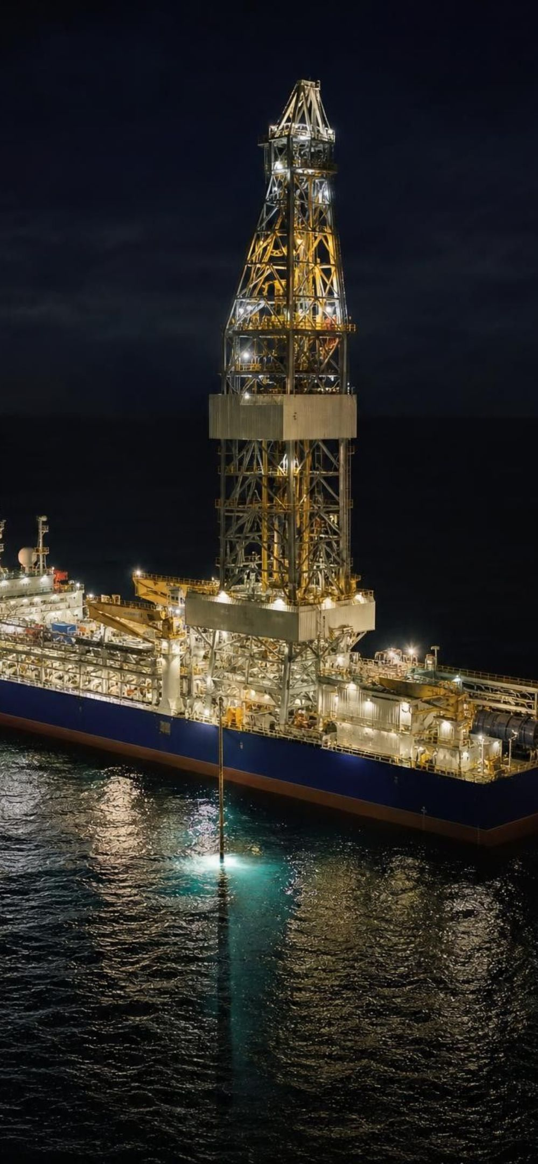
APPLY IT
Task: does the drill-core data fit spreading?
Simulated data for practice.
A drilling voyage sampled seafloor at seven sites across a ridge. For each side, find the half-spreading rate in km per million years. Does the age pattern fit the prediction?
Site | Distance from ridge (km) | Side | Age of oldest sediment on the lava (millions of years)
W3 | 900 | west | 45
W2 | 600 | west | 31
W1 | 250 | west | 12
R0 | 0 | ridge | 0.5
E1 | 300 | east | 14
E2 | 550 | east | 28
E3 | 1000 | east | 51
18
Notes:
This is a teaching dataset. The numbers are invented to behave like the real South Atlantic result, in which the Glomar Challenger's third voyage (late 1968 to early 1969) drilled 17 holes at 10 sites across the ridge and found ages rising with distance at about 2 cm per year on each side. Explain the age column: the drill goes through the sediment and into the lava beneath; the oldest sediment sitting directly on the lava settled soon after the seafloor formed, so its fossils date the seafloor. Give groups eight minutes. Step 1: for each site divide distance by age. Step 2: compare the west rates and the east rates. Step 3: decide whether the pattern fits the prediction from slide 16. The rates all come out near 20 km per million years, on both sides, so the pattern is symmetric and the prediction holds. Ask the extension: what age would you predict at 1,500 km east? About 75 million years. What age would the 'ancient fixed ocean' idea predict at every site? Old everywhere, with no trend.
EXPECTED RESPONSES: West: 900/45 = 20, 600/31 = 19.4, 250/12 = 20.8 km per million years. East: 300/14 = 21.4, 550/28 = 19.6, 1000/51 = 19.6. Both sides about 20 km per million years; ages rise steadily with distance on both sides; the ridge sample is youngest. The data fit seafloor spreading and do not fit a fixed, ancient ocean floor.
WATCH FOR: Groups may average ages instead of computing rates, or forget that 'symmetric' means both sides, not one. Ask them to check the east side against the west.
CONNECTS TO: Lab 3 is the full version with a drilling budget and site choices. W5 data worksheet graphs a similar dataset.
PACING: about 10 min

Slide 19
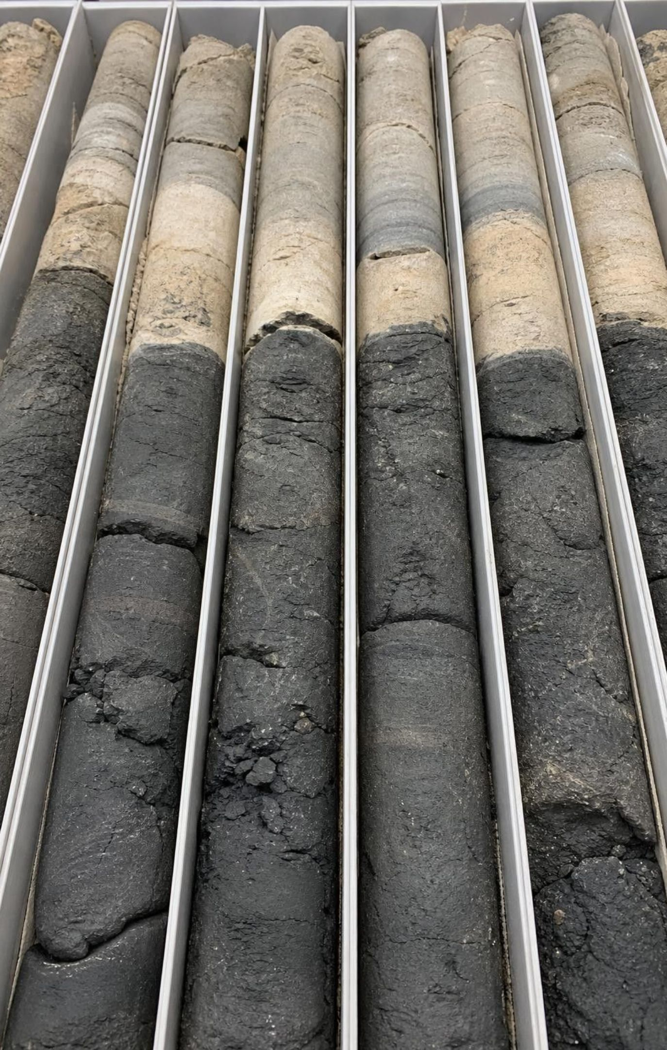
CHECK FOR UNDERSTANDING
Rate check: centimeters become oceans
Seafloor 1,000 km from a ridge is 50 million years old. What is the spreading rate on that side in centimeters per year?
A. 0.2 cm per year
B. 2 cm per year
C. 20 cm per year
D. 200 cm per year
19
Notes:
Have students set up the conversion on whiteboards before voting. 1,000 km = 1,000,000 m = 100,000,000 cm. Divide by 50,000,000 years: 2 cm per year. Then flip it: 2 cm per year times 1,000,000 years = 2,000,000 cm = 20 km per million years, which is the same rate students found in the task. The point to land is that a few centimeters a year is about how fast fingernails grow, and yet over 100 million years it carries seafloor 2,000 km from the ridge on each side, opening an ocean about 4,000 km wide. Rate times time is the habit to build: never decide a change is small until you have multiplied.
EXPECTED RESPONSES: B, 2 cm per year. 100,000,000 cm divided by 50,000,000 years = 2 cm per year, equal to 20 km per million years.
WATCH FOR: Unit slips: students who get 20 or 0.2 usually dropped a factor of 10 in the km-to-cm chain. Have them write the chain in full.
CONNECTS TO: W5 data worksheet and W10 mastery include a rate-times-time item; Lab 2 converts a model rate to a real one.
PACING: about 4 min

Slide 20
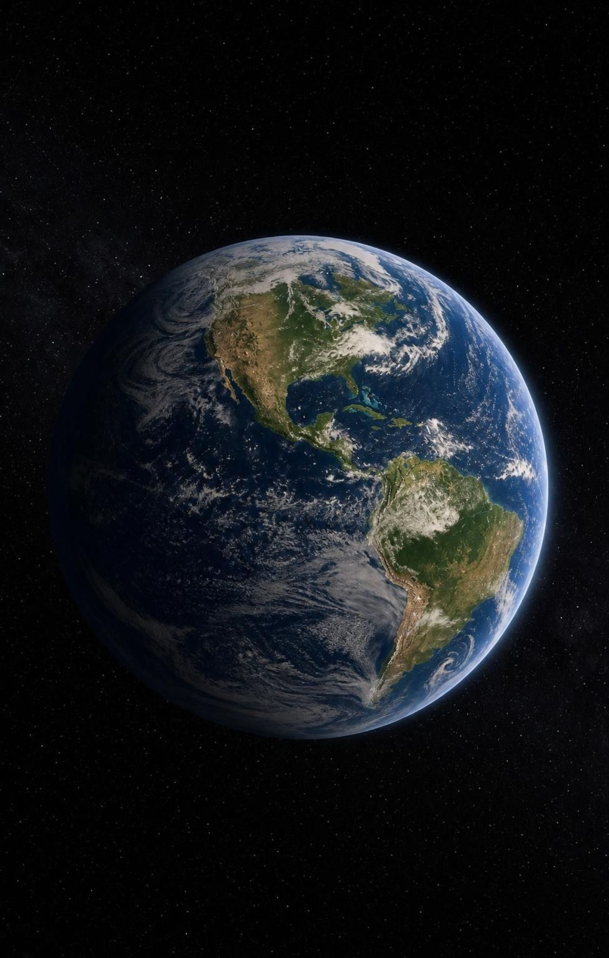
From hypothesis to theory
A hypothesis is an explanation on trial; a theory is one that has passed many independent tests.
By the late 1960s: fossils, rock belts, earthquake belts, seafloor maps and seafloor ages all agreed.
Plate tectonics: the lithosphere is broken into rigid plates that move slowly relative to each other.
New seafloor forms at ridges; old seafloor sinks at trenches; continents ride along on plates.
A theory stays open to revision. Scientists still study what moves plates and how plates began.
20
Notes:
Draw the contrast between 'theory' in everyday speech (a hunch) and in science (a well-tested explanation that ties together many lines of evidence). Plate tectonics earned the name because evidence from completely different sources, fossils on land, earthquakes, sonar maps and drill cores, all pointed to the same moving plates. Name a few of the people who assembled the theory in 1965-68, including John Tuzo Wilson, who explained fracture zones as transform faults, and Jason Morgan, Dan McKenzie and Xavier Le Pichon, who showed that the plates move as rigid pieces on a sphere. Also say what remains open: how much of the driving force comes from the sinking plate versus mantle flow, and when plate tectonics started, with published estimates from more than 4 billion to less than 1 billion years ago. The textbook's phrase 'the past 3 billion years' is one estimate, not a settled fact. About a dozen large plates plus many small ones make up the lithosphere; the count depends on how you group them, so never test a number.
EXPECTED RESPONSES: Students should be able to say the difference between hypothesis and theory in terms of how much testing and how many independent lines of evidence support each.
WATCH FOR: 'A theory is just a guess' and 'a theory is proven and final.' Both are wrong; a theory is well tested and still revisable.
CONNECTS TO: W2 vocabulary; W6 CER; W10 mastery.
PACING: about 5 min

Slide 21
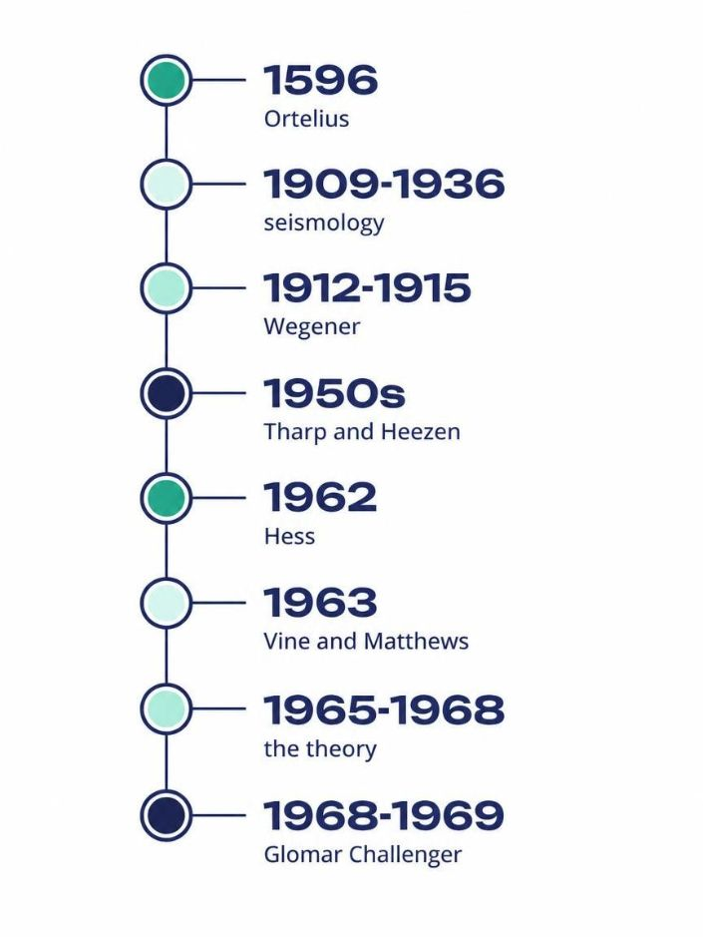
Model
Timeline: 370 years from hunch to theory
Model: Key steps toward plate tectonics
1596: Ortelius: A mapmaker notices the Atlantic coasts fit like torn pieces.
1909-1936: seismology: Earthquake waves reveal the crust-mantle boundary, the core and a rigid lithosphere.
1912-1915: Wegener: Continental drift presented, then published, with fossil, rock and ice evidence. No mechanism.
1950s: Tharp and Heezen: Sonar soundings mapped into the first detailed seafloor maps; a rift valley runs along the ridge.
1962: Hess: Seafloor spreading proposed: new floor at ridges, old floor lost at trenches.
1963: Vine and Matthews: Magnetic stripes beside ridges explained as a record of spreading; surveys confirm their mirror-image pattern by 1966.
1965-1968: the theory: Wilson, Morgan, McKenzie, Parker and Le Pichon describe rigid plates moving on a sphere.
1968-1969: Glomar Challenger: Drill cores across the South Atlantic ridge show age rising with distance, as predicted.
Each step added evidence of a new kind. The theory arrived when they all agreed.
21
Notes:
Walk the timeline and stress how long it took and how many people were involved. Ask which steps were new ideas and which were new tools: 1912 and 1962 are ideas; seismology, sonar and the drill ship are tools that made new evidence possible. Point out that the people who finished the theory were not the one who started it; Wegener had died in 1930. Note on the 1963 entry: magnetic stripes are history, so students can know the step happened, but California's standard does not assess how they work, so do not test it. If you run the floor timeline from the differentiation notes, give eight students one card each and have them stand in order along a wall.
WATCH FOR: 'One genius figured it out.' At least eight named people over 370 years, plus the crews who gathered the data.
CONNECTS TO: W3 reading passage covers the timeline; W8 jigsaw cards each take one step.
PACING: about 5 min

Slide 22
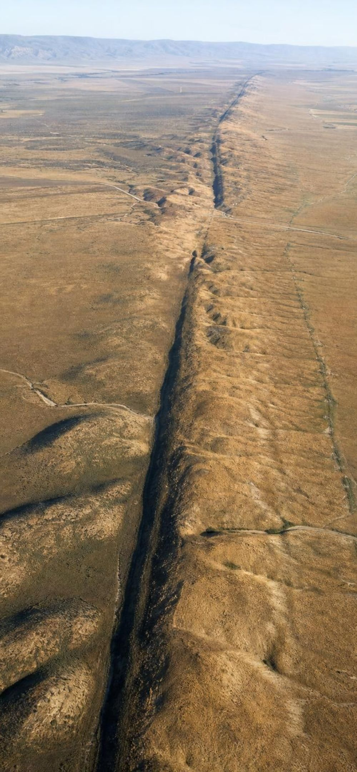
Three kinds of plate boundary
Convergent: plates move toward each other. Denser plate sinks (subduction); trench and volcanoes form.
Divergent: plates move apart. Molten rock fills the gap; a ridge or a widening sea forms.
Transform: plates slide past each other. Rock sticks, stress builds, then slips: earthquakes.
Rates are a few centimeters a year, about as fast as fingernails grow.
Boundary | Example | Motion | Approximate rate
Convergent | Nazca Plate under South America (the Andes) | toward each other | about 65-80 mm per year
Divergent | Arabian and African plates (Red Sea) | apart | about 15 mm per year in the south
Transform | Pacific and North American plates (San Andreas system) | sliding past | about 50 mm per year across the whole boundary
22
Notes:
Use three hand motions: palms pushing together, palms pulling apart, palms sliding past. For each row, ask what structure the motion builds and what evidence from the lesson shows it: convergent gives trenches and the deepest earthquakes; divergent gives the ridge and its rift valley; transform gives the fracture zones and shallow earthquakes. Rates: the textbook prints the San Andreas rate as 5 millimeters per year, which is a unit slip; the Pacific and North American plates slide past one another at about 5 centimeters (50 mm) per year across the whole boundary, and the San Andreas Fault itself carries only part of that, with other faults taking the rest. The Nazca convergence is about 80 mm per year in the south and about 65 in the north. The Red Sea opens at about 15 mm per year in its southern part. The magma that feeds Andean volcanoes comes from melting deep below the volcanoes; which rock melts is debated, so say 'melting deep below' rather than 'the sinking plate melts.'
EXPECTED RESPONSES: Convergent: trench, volcanoes, deep earthquakes. Divergent: ridge, rift valley, new seafloor. Transform: offset features, shallow earthquakes, no volcanoes.
WATCH FOR: 'Plates collide and crumple like cars' and 'the Red Sea is a river.' Collisions are centimeters a year; the Red Sea is a young ocean opening between two plates.
CONNECTS TO: W10 mastery classifies boundaries; W9 transfer task; next slide is the California example.
PACING: about 6 min

Slide 23
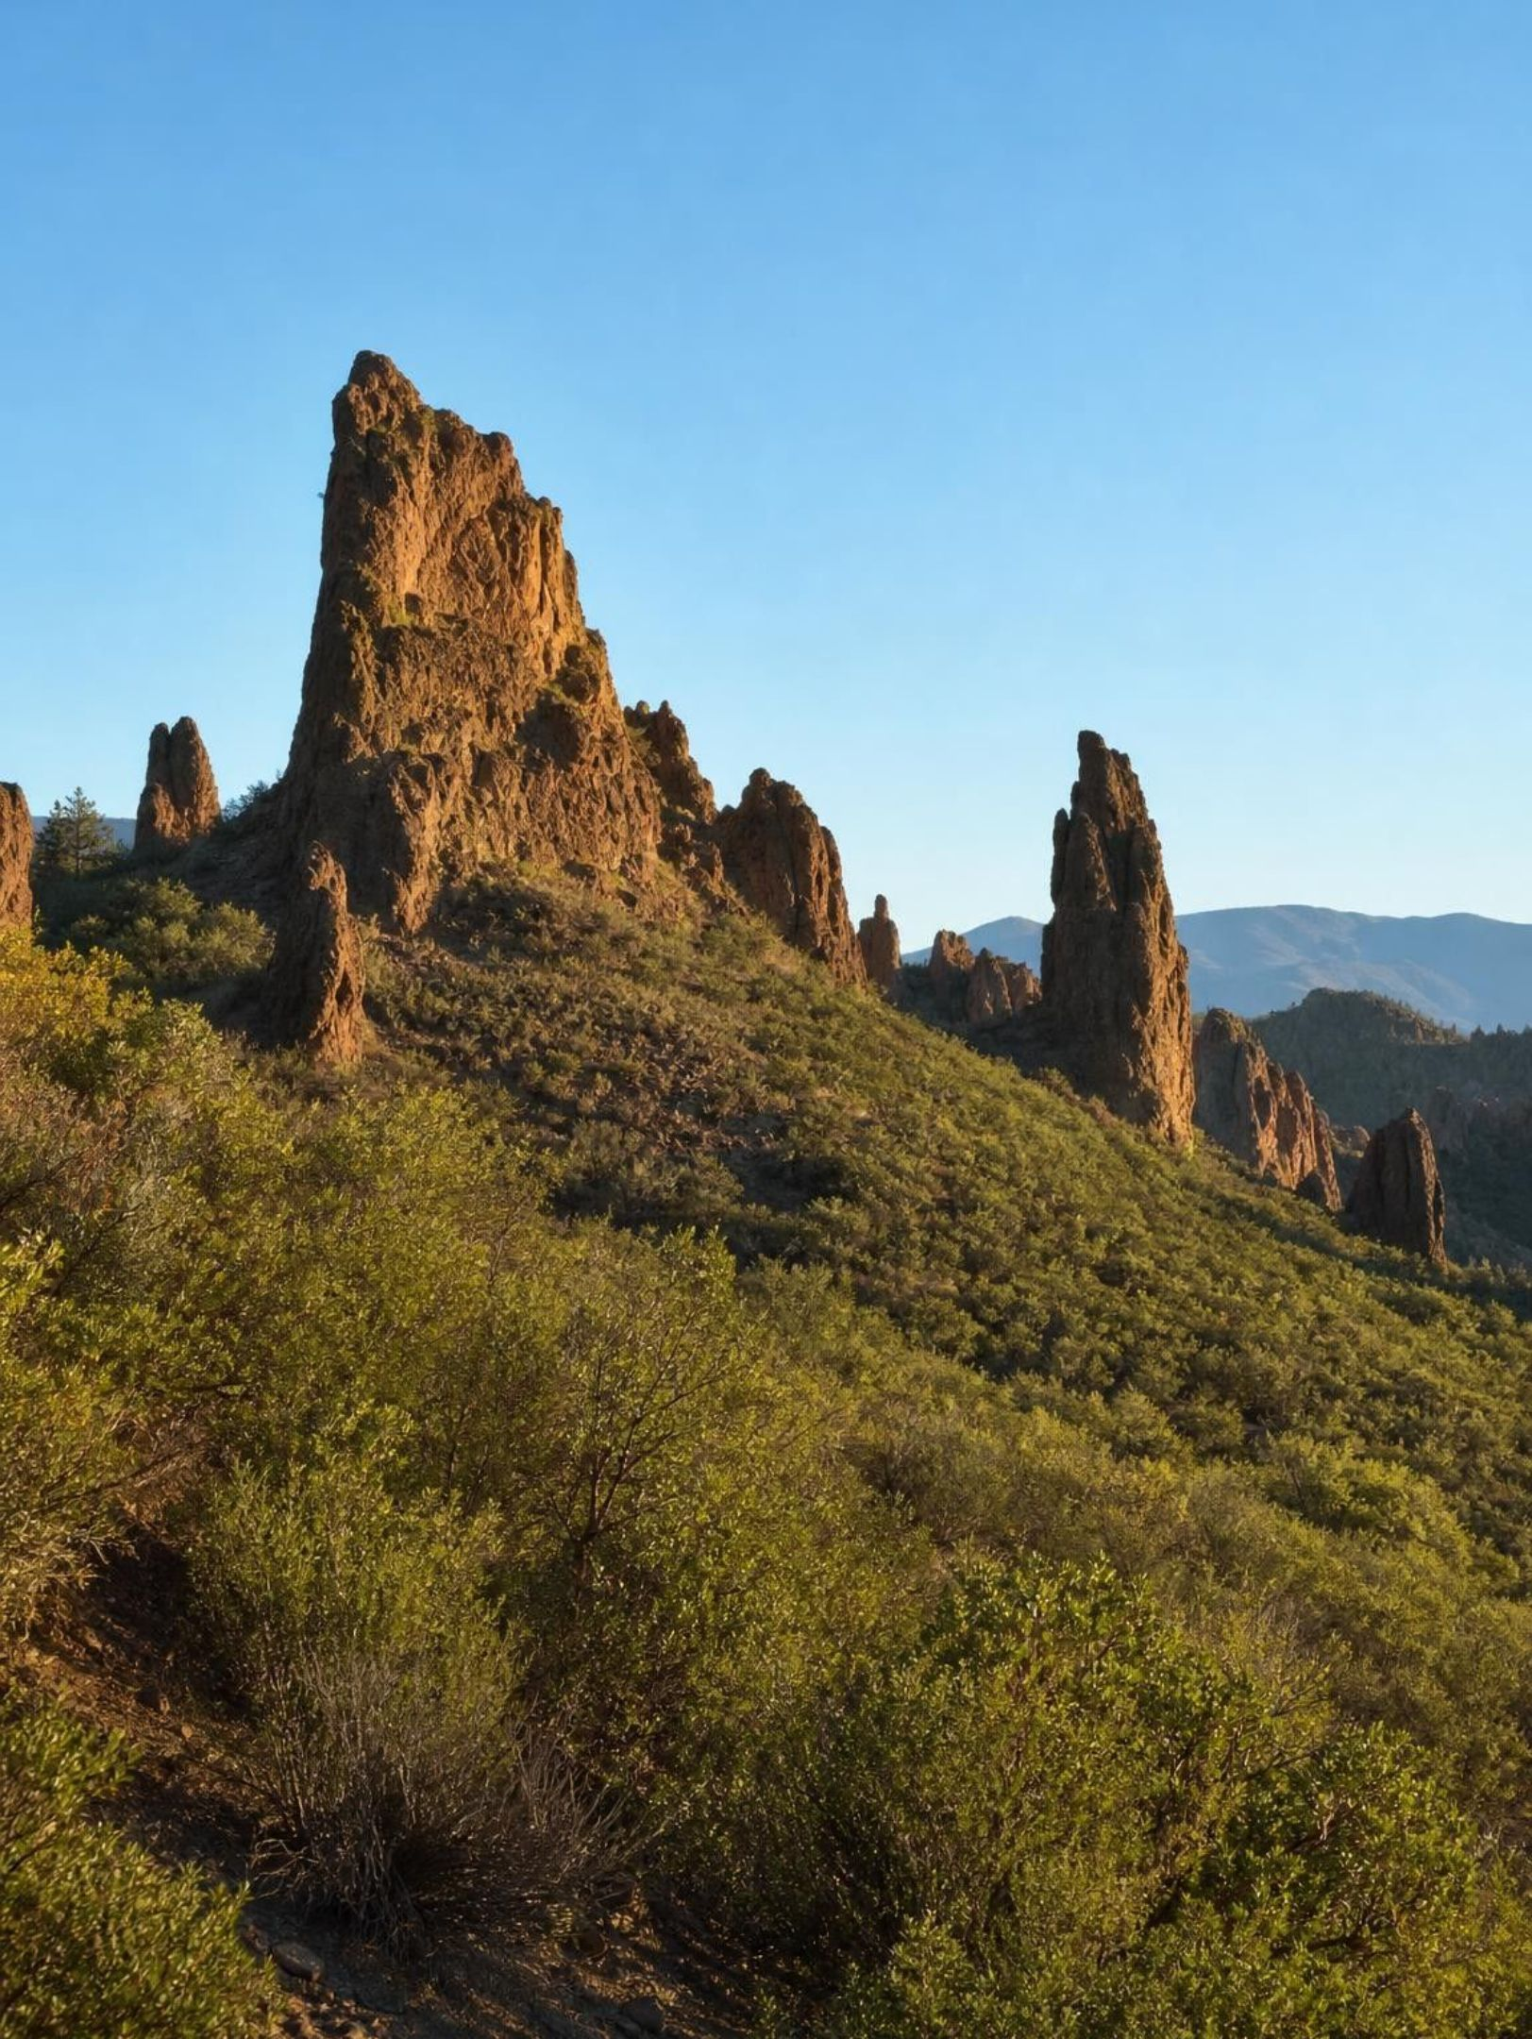
REAL-WORLD CONNECTION
California connection: a volcano cut in half
Pinnacles National Park, east of Salinas, is made of volcanic rock about 23 million years old. The other half of the same volcano, called the Neenach volcanic rocks, lies near Lancaster in southern California, about 315 km to the southeast. The San Andreas Fault runs between them. Over millions of years the Pacific side carried the Pinnacles half northwest, a few centimeters a year.
23
Notes:
This is a true story and a local one. Geologists matched the two halves by rock type, age and the order of the layers, the same kind of matching Wegener did across the Atlantic, but here we can also point at the fault that did the moving. Run the rate-times-time check: if the Pacific side moved at about 3 cm per year along this fault, 315 km (31,500,000 cm) takes about 10.5 million years. The rocks are 23 million years old, which is fine: the volcano had to exist before the fault could cut it, and the fault's motion has not been constant over its history. The Pinnacles are also a good place to see the transform boundary itself; ask students whether this boundary builds volcanoes (generally no: transform boundaries rarely build volcanoes, and the Pinnacles volcano formed before the fault split it) and why earthquakes are common along it (sticking and sudden slip). The central section of the San Andreas, from San Juan Bautista south past Pinnacles to Parkfield, creeps steadily instead of sticking, so the textbook's 'stress builds then slips' description fits the locked sections, not every section.
EXPECTED RESPONSES: Rate times time: 315 km at 3 cm per year is about 10.5 million years; the rocks are older than that, which is consistent because the volcano formed before it was split.
WATCH FOR: 'The fault made the volcano.' The volcano formed first; the fault split it later.
CONNECTS TO: W9 transfer; W10 mastery rate item; chapter differentiation extension on GPS measurements of plate motion.
PACING: about 5 min

Slide 24
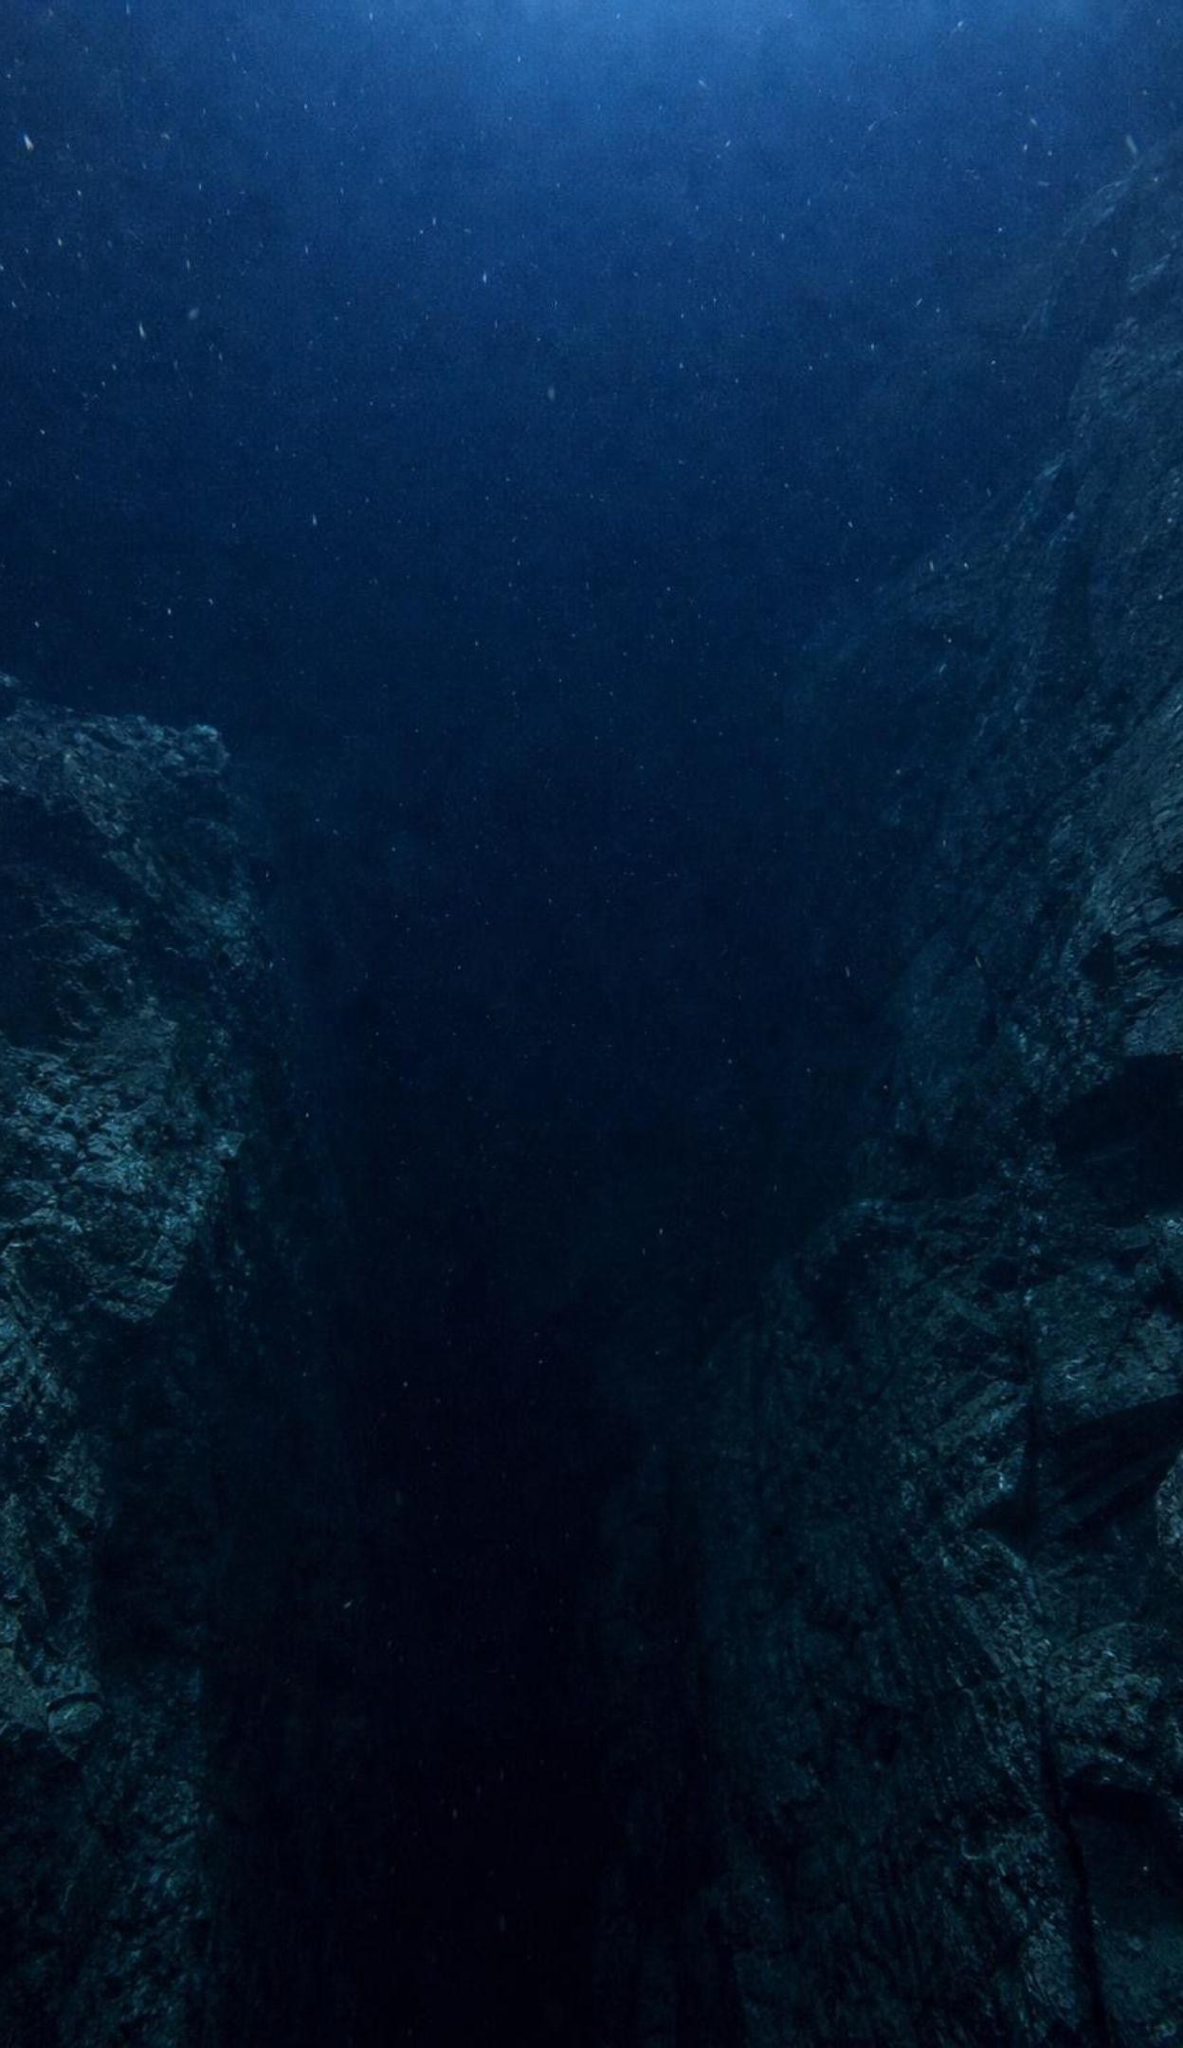
THINK, PAIR, SHARE
Discuss: if new seafloor keeps forming, why isn't Earth growing?
Where is the oldest seafloor found, and what is next to it?
Why are the deepest earthquakes found near trenches, not under ridges?
No ocean floor is older than about 200 million years; the continents hold rocks over 4 billion years old.
What would the age map look like if seafloor were never destroyed?
The ridge adds new seafloor every year on both sides. If Earth has stayed the same size, what must be happening somewhere else, and what evidence from the lesson supports it?
24
Notes:
Give pairs four minutes, then collect. The answer is subduction at trenches: old, cold, dense ocean lithosphere bends down into the mantle, so seafloor is removed about as fast as it is made. The evidence is the pattern of trenches at the far side of the oldest seafloor, the deep earthquakes that trace the sinking slab down from trenches, and the age limit: nothing on the ocean floor is older than about 200 million years while continental rocks reach past 4 billion. Correct a textbook simplification: the oldest seafloor is at a trench only where a trench exists. The Atlantic has almost no trenches, so its oldest floor lies against the continental shelves of the Americas, Africa and Europe. Teach 'older with distance from the ridge,' not 'oldest at the trench.' A few scientists once proposed that Earth really is expanding; the age data, trenches and modern satellite measurements rule it out.
EXPECTED RESPONSES: Seafloor must be destroyed somewhere; trenches with deep earthquakes are where it goes down; the 200-million-year age limit shows seafloor is recycled; without destruction the age map would show seafloor as old as the continents at the ocean edges.
WATCH FOR: 'The oldest seafloor is always at a trench' and 'continents sink too.' Continental rock is too light to subduct, which is why continents keep ancient rocks.
CONNECTS TO: W6 CER; W7 misconception repair; Lab 2 ends the paper strips in slots that stand for trenches.
PACING: about 6 min

Slide 25
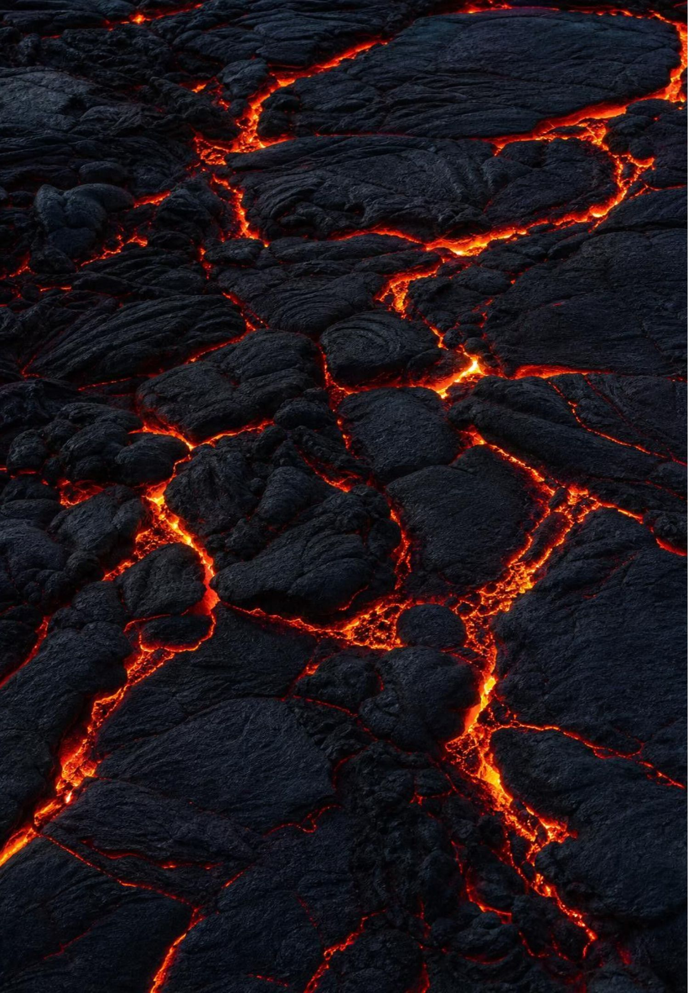
MISCONCEPTION CHECK
True or false? Continents float on liquid magma
"Continents float on an ocean of liquid magma and plow through the ocean floor like ships, which is why they can drift."
True or false? Explain your reasoning.
25
Notes:
Have students evaluate the statement in writing using evidence from the lesson, then share. Two errors to find. First, the mantle beneath the plates is solid rock, shown by the way earthquake waves travel through it; it is hot enough to creep slowly over millions of years, but it is not a liquid and there is no magma ocean. Second, continents do not move through the seafloor; the continent and the seafloor next to it are part of one rigid plate that moves together, and the edge of the plate is usually out in the ocean at a ridge or trench, not at the coastline. This was the exact objection raised against Wegener in the 1920s, and it was correct; the fix came when scientists realized the moving piece is the whole lithosphere, not the continent alone. Ask: so what is the 'drift' in continental drift? It is the plates moving, carrying continents as passengers.
EXPECTED RESPONSES: False on both counts: the mantle is solid rock that flows very slowly; continents ride on plates of lithosphere together with nearby seafloor and do not plow through it.
WATCH FOR: Students may swing to 'the mantle is completely rigid.' It is solid and it creeps; both are true at different time scales.
CONNECTS TO: W7 misconception repair; W6 CER; W10 mastery.
PACING: about 6 min

Slide 26
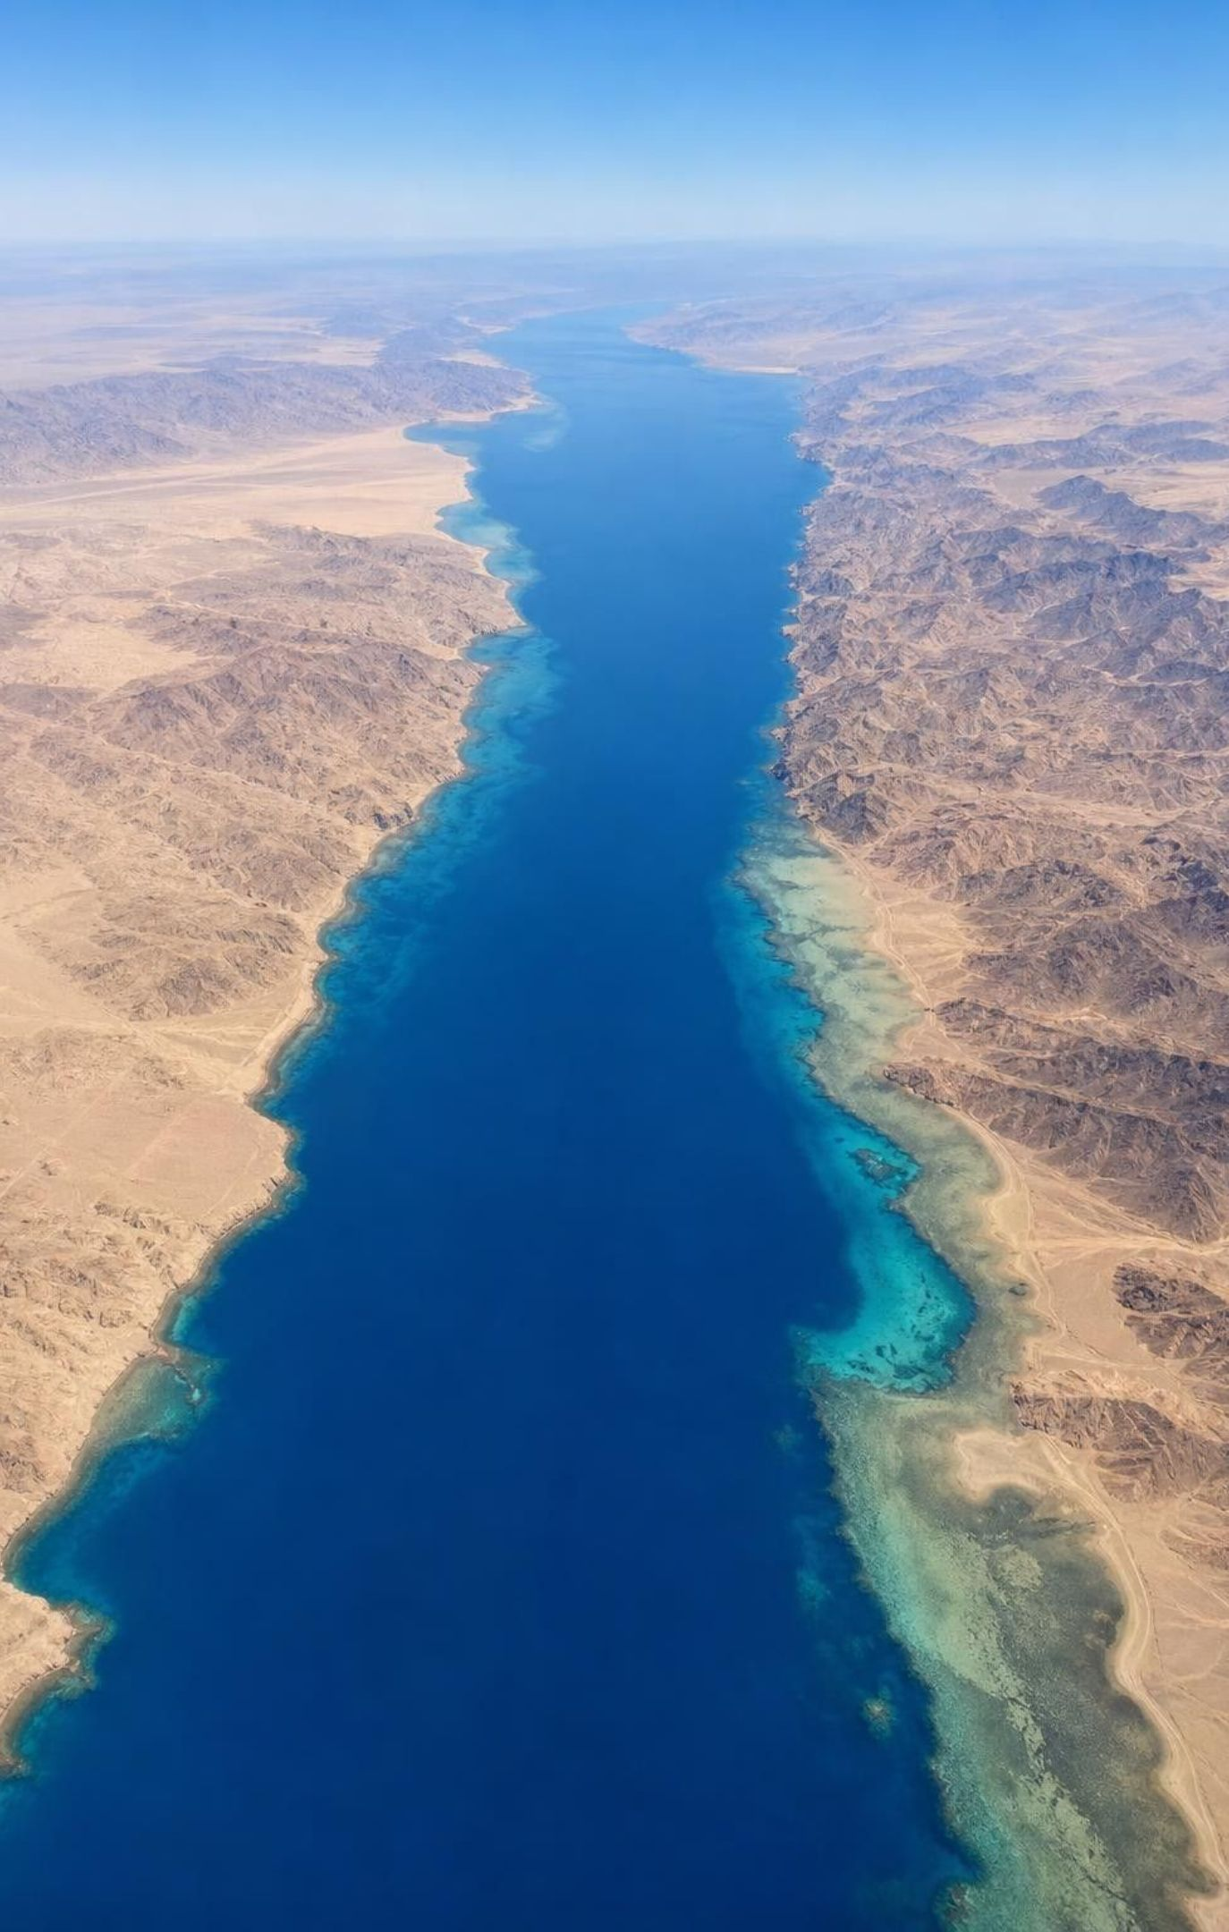
PUTTING IT TOGETHER
Putting it together
Wegener's land evidence (fossils, rock belts, ice scars, shapes) showed the continents were once joined.
Without a mechanism, drift was set aside; the objection was fair.
Seismic waves, earthquake belts and sonar revealed a rigid lithosphere, plate outlines and a global ridge.
Drill cores showed seafloor age rising with distance from the ridge: spreading confirmed.
Plate tectonics ties every line of evidence together, and rate times time turns centimeters into oceans.
26
Notes:
Have students write a four-sentence summary that uses at least five vocabulary terms, then trade with a partner who checks that lithosphere and plate are used correctly. Ask for one thing from each lab: Lab 1 (which evidence decided the fit), Lab 2 (what rule turned model years into distance), Lab 3 (which sites they chose to drill and why). Return to the phenomenon: the Antarctic forest grew on land that was joined to India and Africa in southern Pangaea, near the South Pole but ice-free and forested, and the plates have since carried the pieces apart. Preview Lesson 17: the rock cycle, where the recycling of seafloor at trenches reappears as part of how rocks change.
CONNECTS TO: W10 mastery as the quiz; L17 The Rock Cycle next; L25 returns to plate boundaries for volcanoes and earthquakes.
PACING: about 6 min

Slide 27
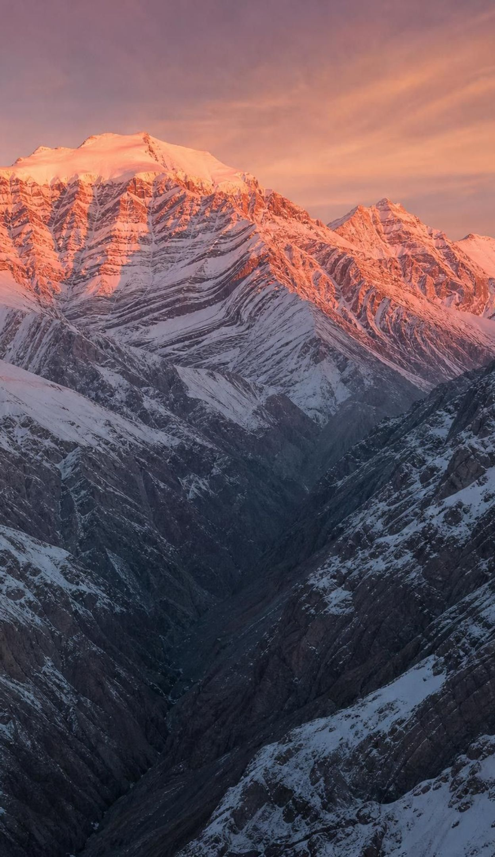
EXIT TICKET
Exit ticket
Name two different kinds of evidence Wegener used, and say what each one shows.
Why was continental drift set aside, and what evidence later filled the gap?
Seafloor 600 km from a ridge is 30 million years old. Find the spreading rate in km per million years.
A plate boundary has a deep trench and volcanoes. Which kind of boundary is it?
Write one sentence using 'lithosphere' correctly.
27
Notes:
Collect on index cards or a shared form. Item 1 checks the evidence target, item 2 the history and mechanism target, item 3 the rate calculation, item 4 boundary classification, item 5 the plates-are-lithosphere idea. Sort the cards into three piles before the next class and reteach from the largest pile. Cards that say 'the mantle is liquid' or 'plates are continents' go straight to the W7 misconception repair.
EXPECTED RESPONSES: 1: for example fossils of the same land animal on separated continents (a land connection) and matching rock belts on facing coasts (one belt torn in two). 2: no workable mechanism; seafloor age data, the ridge and trenches, and the plate picture supplied it. 3: 600 divided by 30 = 20 km per million years (2 cm per year). 4: convergent, with subduction. 5: for example 'A tectonic plate is a rigid piece of lithosphere that includes crust and the top of the mantle.'
WATCH FOR: Item 3 answers of 0.2 or 200 are unit slips; item 5 answers of 'the lithosphere is the crust' need the W2 relationship work again.
CONNECTS TO: W10 mastery; chapter evidenceOfLearning.
PACING: about 5 min

