Slide 1
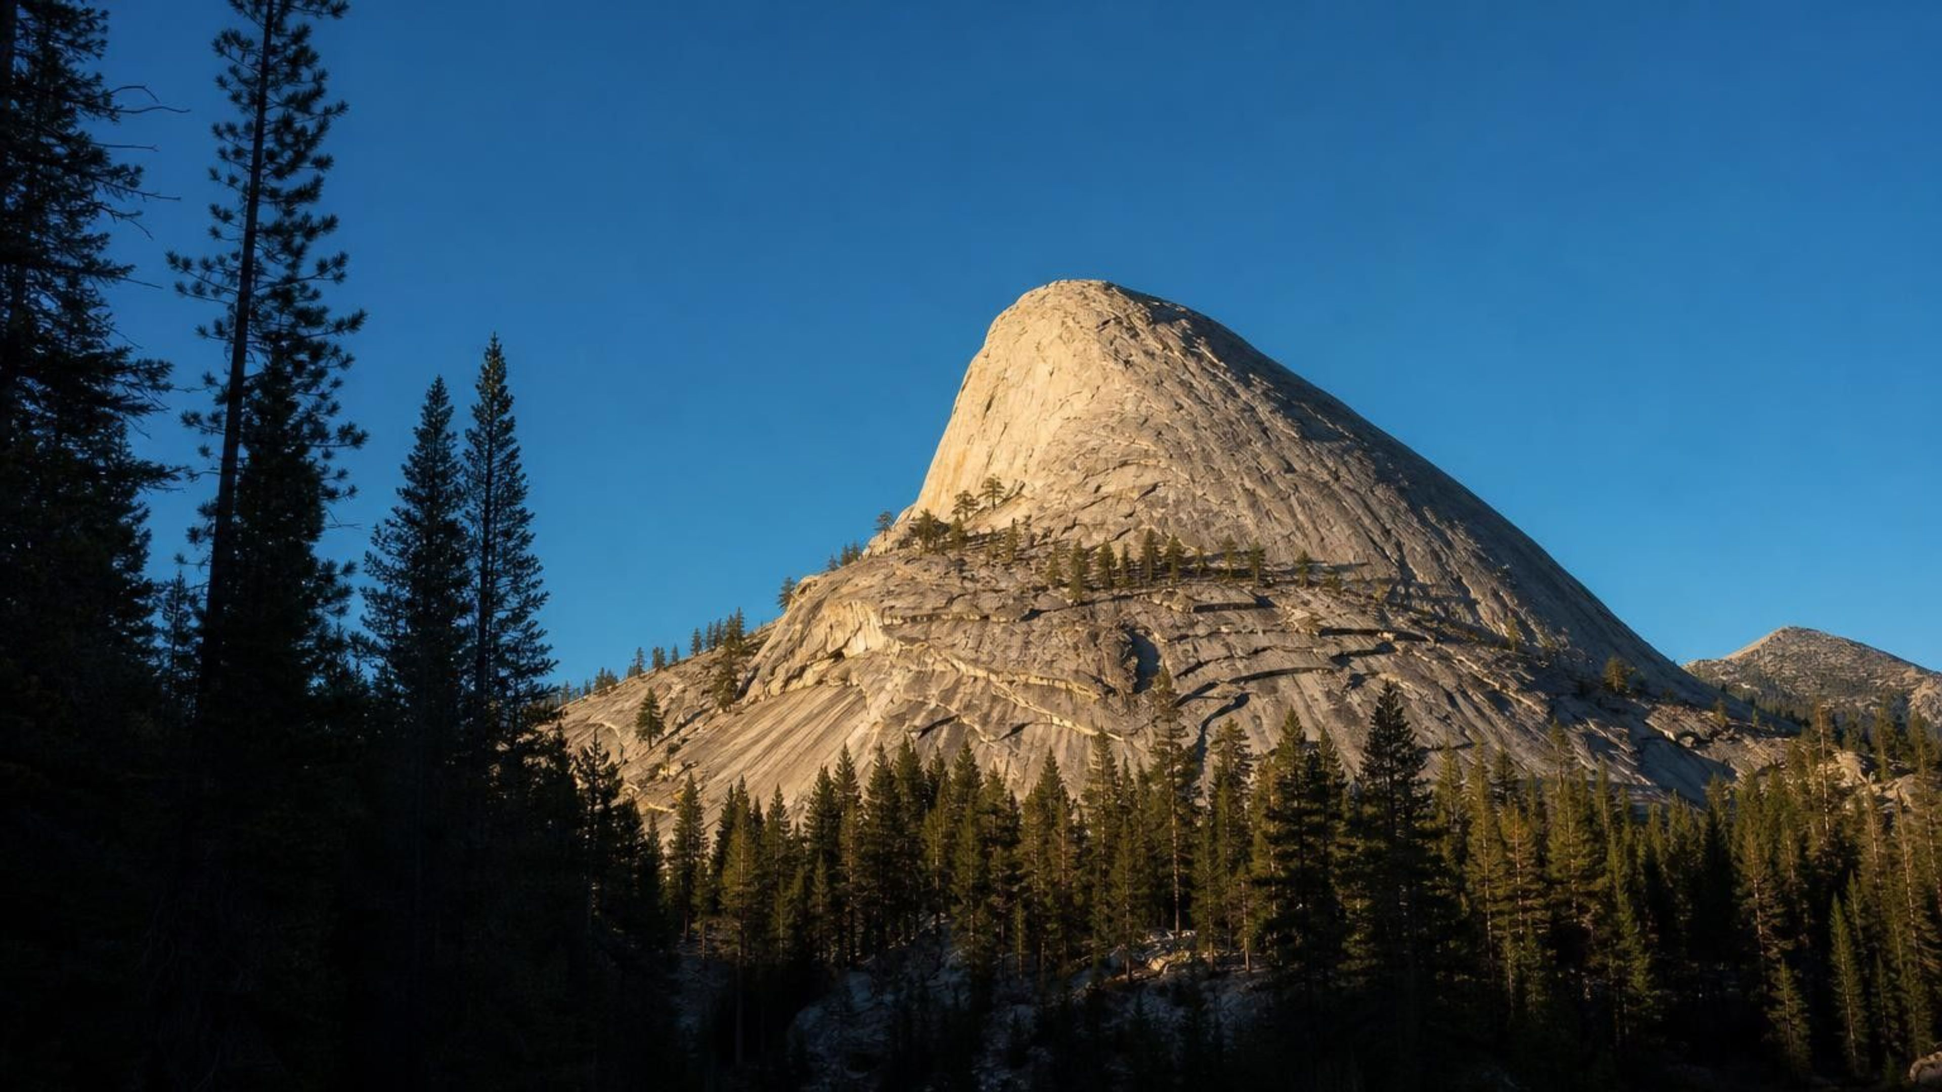
The Rock Cycle
Chapter 17 of 29 · Processes that Shape Earth
Lesson 17: How do Earth's materials move and change, and what supplies the energy?
Angela's Wand · Bring Science Alive! 7th Grade Integrated
Notes:
Open with the claim that no rock is permanent. Over this week students will learn to read a rock like a detective reads a scene: the size and arrangement of its grains tell how it formed. Then they assemble the three ways rocks form into one model, the rock cycle, and attach an energy source to every change. Preview the three investigations: making and recycling crayon-wax rocks, sorting mystery property cards into families, and running a dice-driven version of the cycle to see where material spends its time. No flames and no chemicals beyond a dropper of vinegar.
CONNECTS TO: Overview of Lab 1, Lab 2 and Lab 3; W1 opens on the next slide.
PACING: about 2 min

Slide 2
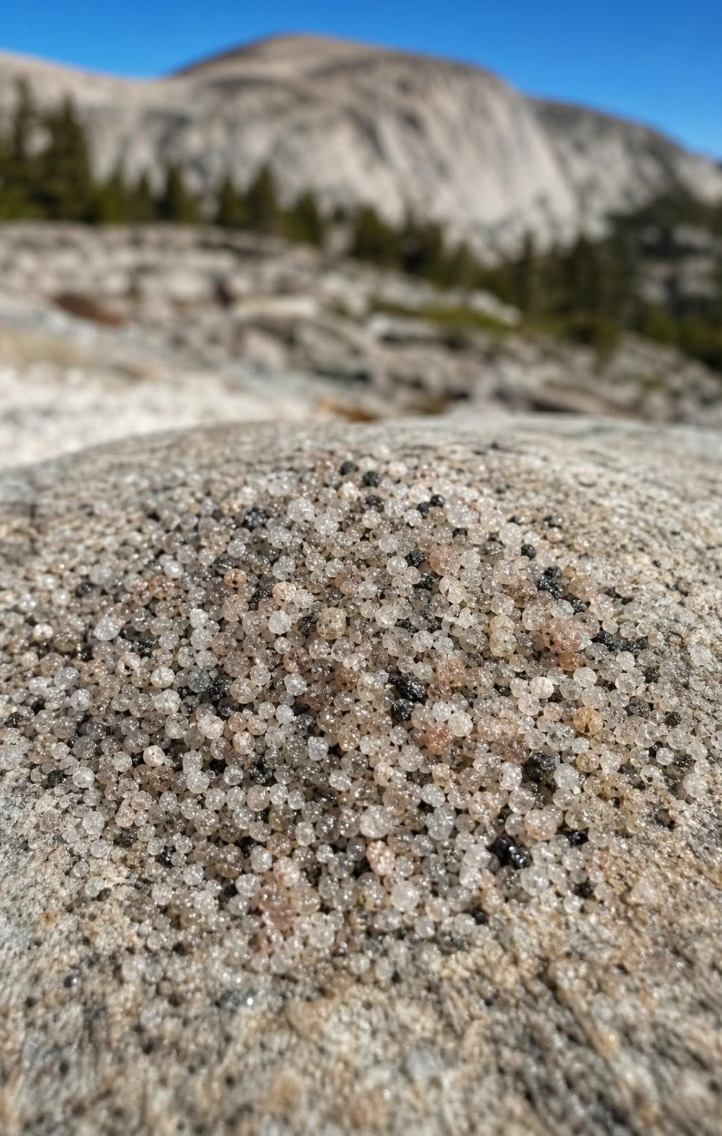
PHENOMENON
The sand at the foot of the dome matches the dome
A hiker at the base of a bare granite dome in the Sierra Nevada scoops up gritty sand. Under a lens the grains are pink, white, gray and glittering black, the same colors as the specks in the rock overhead. This granite hardened kilometers underground about 100 million years ago and never erupted. How is it in the open air, why is it turning into sand, and what happens to the sand next?
Notice: what do the sand grains and the rock specks have in common?
Wonder: what had to happen to the rock that once lay on top of this granite?
Predict: where will this sand be in a thousand years? In a million?
2
Notes:
If you have a small bag of coarse granite sand (sold as decomposed granite or path grit) and a hand lens, pass it around; otherwise project a photo of a Sierra Nevada dome such as Half Dome or Lembert Dome with the gritty slope at its base. Give two silent minutes for a notice and a wonder, then collect on the board without correcting. Push on the puzzle: rock that formed deep underground is now on top of a mountain. Something must have lifted it, and something must have stripped away the rock above it. Then point at the sand: the mountain is coming apart grain by grain. Ask where the energy for that comes from. Park the answers; the whole lesson returns to them.
EXPECTED RESPONSES: Notice: same colors, the sand grains look like broken-off specks, the grains are sharp-edged. Wonder: how did it get up there, how long does it take, is the dome shrinking. Predict: the sand washes downhill into rivers and lakes, maybe to the ocean; some will say it stays put forever.
WATCH FOR: Listen for 'rocks never change' and 'rock at the surface must have formed at the surface.' Record both; slides 8, 13 and 26 address them.
CONNECTS TO: W1 phenomenon worksheet records notice, wonder and a first explanation. Lab 2 q5 and the slide-25 rock-detective notes return to this evidence.
PACING: about 8 min

Slide 3
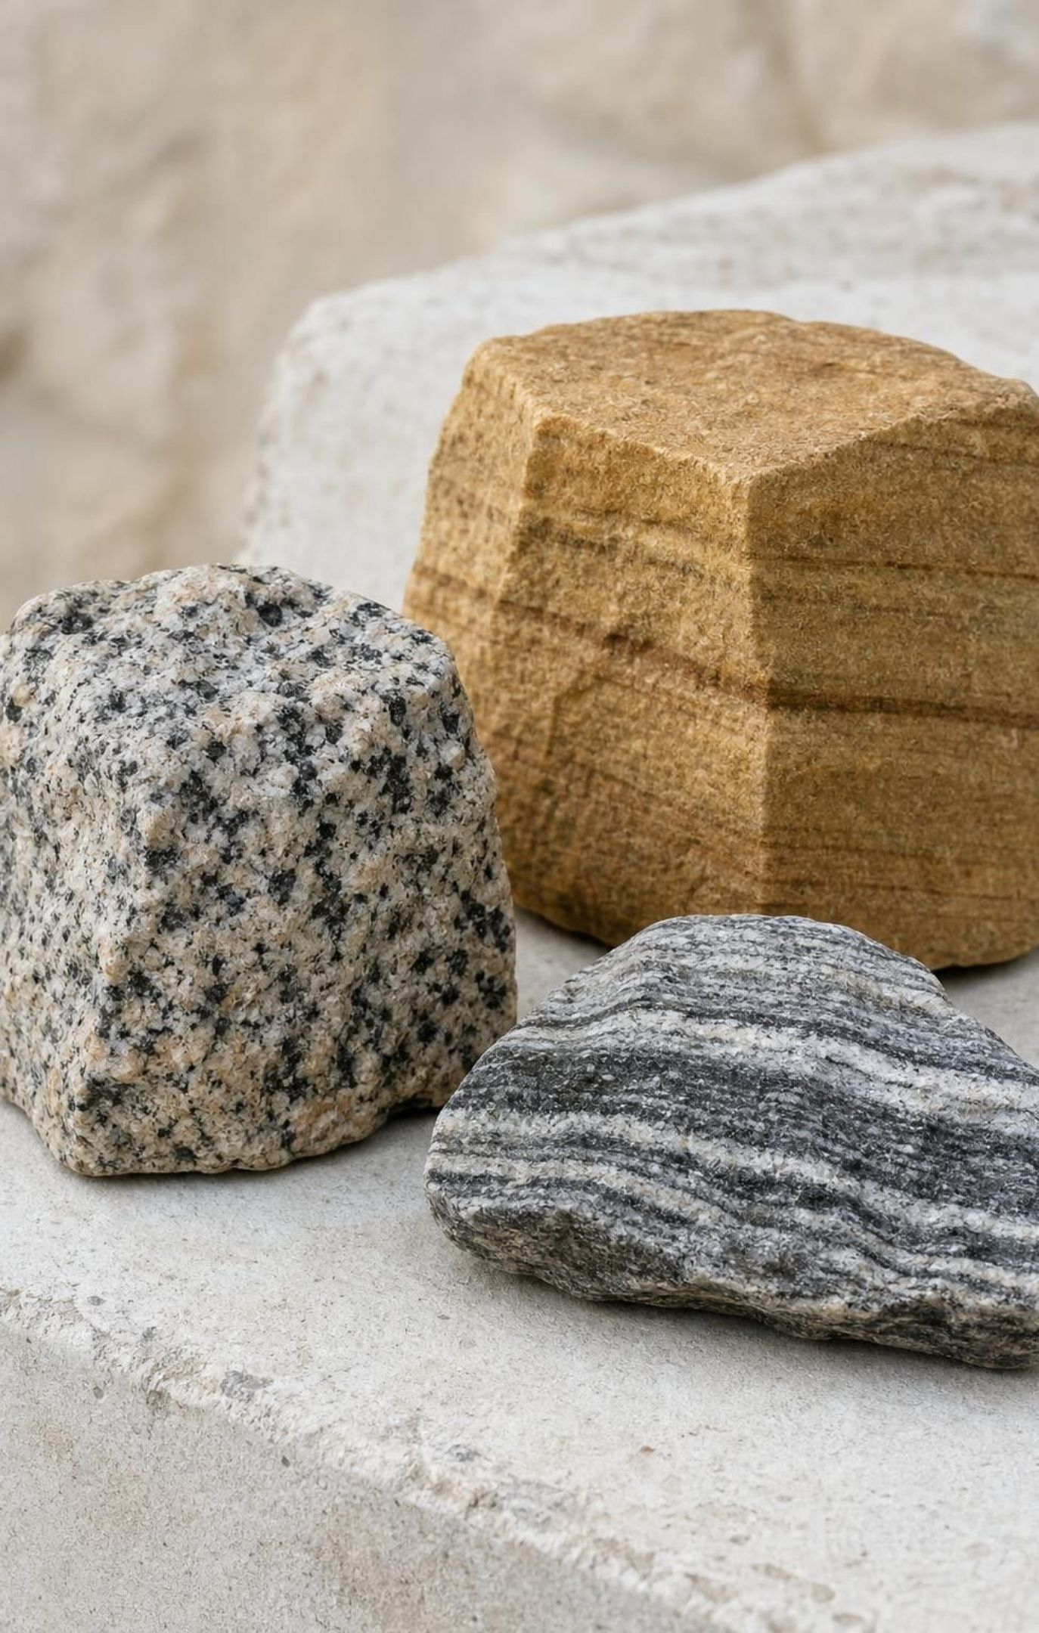
LEARNING TARGETS
What you will be able to do
Use a rock's grain size and arrangement as clues to how it formed.
Explain why cooling speed sets crystal size, and tell intrusive from extrusive rock.
Describe how weathering, erosion, deposition and burial make sedimentary rock.
Explain how heat and pressure change solid rock without melting it.
Build a rock-cycle model with many routes and name the energy behind each one.
Tell a rock's story from evidence, keeping observations and inferences apart.
3
Notes:
Read the targets aloud. Tell students that targets 1 through 4 are the three rock families, one at a time, and target 5 is where the families join into one model, which is the skill the state standard asks for. Target 6 is the detective skill they practice on the mystery cards. Have each student star the target that sounds hardest and revisit the stars on the synthesis slide.
CONNECTS TO: Targets map to W2 and Lab 2 (1), Lab 1 and W5 (2), Lab 1 and W3 (3), W6 and W7 (4), W4 and Lab 3 (5), Lab 2 and W8 (6).
PACING: about 2 min

Slide 4
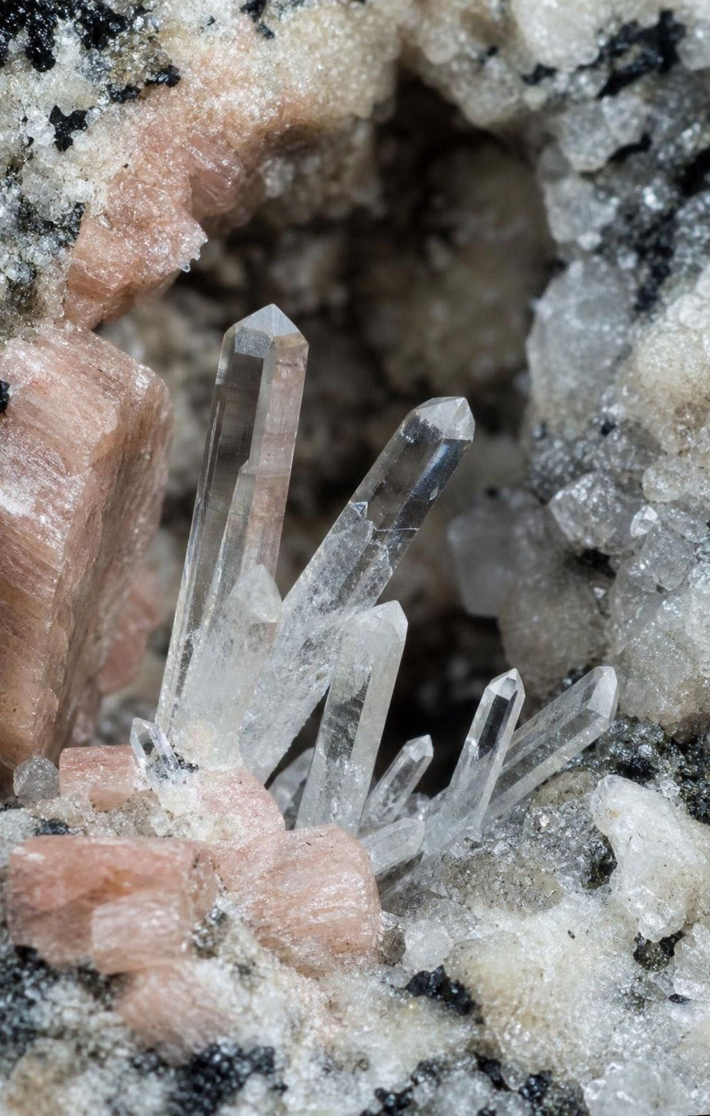
What is a rock made of? Building blocks inside building blocks
When atoms lock into a pattern that repeats over and over, they form a crystal.
A mineral is a naturally formed solid with a set makeup and its own crystal pattern.
Most rocks are built from one or more minerals; granite has four main ones.
A few rocks are mostly natural glass, with no repeating pattern at all.
Two clues tell how a rock formed: composition (what it is made of) and texture (grain size and arrangement).
4
Notes:
Climb the ladder: atoms, crystal, mineral, rock. Connect to Lesson 2, where students saw salt as an extended structure of repeating ions; that repeating pattern is what makes salt a crystal, and because it forms naturally it is also a mineral (halite). The textbook's definition leaves out 'naturally formed,' which would make sugar a mineral; add it. Then hold up the two clues. Composition is the ingredient list. Texture is how big the grains are and how they sit together: interlocking, layered, flattened and lined up. Tell students the state standard does not ask them to name minerals, so the skill here is reading texture, not memorizing names.
WATCH FOR: Students may think 'crystal' means clear and sparkly. Any solid with atoms in a repeating pattern is crystalline, including dull gray grains.
CONNECTS TO: W2 vocabulary relationships; Lab 2 cards describe texture, not mineral names.
PACING: about 5 min

Slide 5
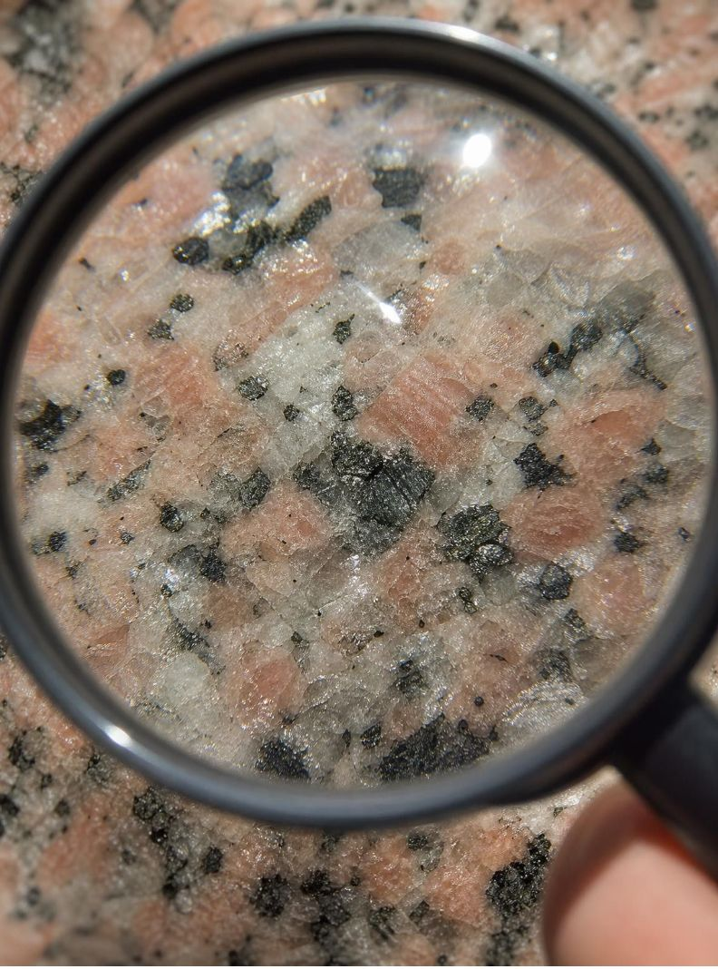
VOCABULARY IN CONTEXT
Three words for reading a rock
mineral
composition
texture
A naturally formed solid with a set chemical makeup and atoms in a repeating pattern. The glittering black flakes in granite are one mineral; the pink chunks are another.
What a rock is made of: which minerals, and so which elements, it contains. Granite's composition is rich in silica, so it is light colored and less dense than dark lava rock.
How big a rock's grains or crystals are, their shape, and how they fit together. Sand-sized grains in flat layers are a texture; interlocking crystals are a different texture.
5
Notes:
Have students say the three words with a gesture: mineral (pinch one speck), composition (count ingredients on fingers), texture (rub a surface). Explain that texture is the clue geologists trust most in the field because it records how the rock formed, while composition tells where the material came from. Give a quick test with any two very different rocks or photos: describe only the texture of each in one sentence.
WATCH FOR: Confusing texture with how a rock feels to the touch only. Texture includes what you see under a lens: grain size, shape and arrangement.
CONNECTS TO: W2 vocabulary worksheet; Lab 2 recording sheet uses 'key clue.'
PACING: about 4 min

Slide 6

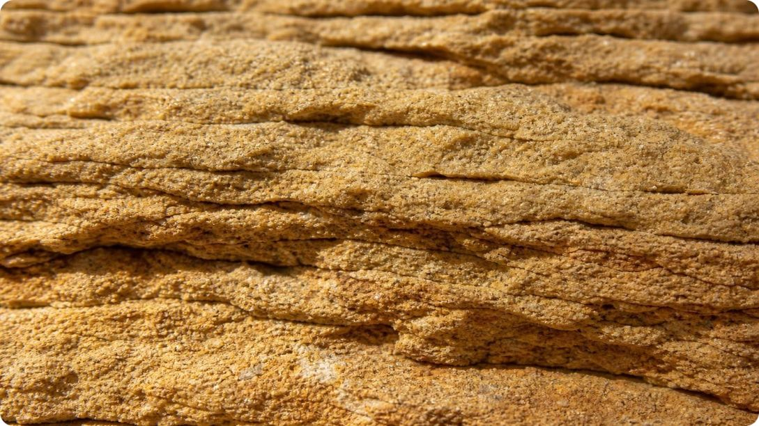
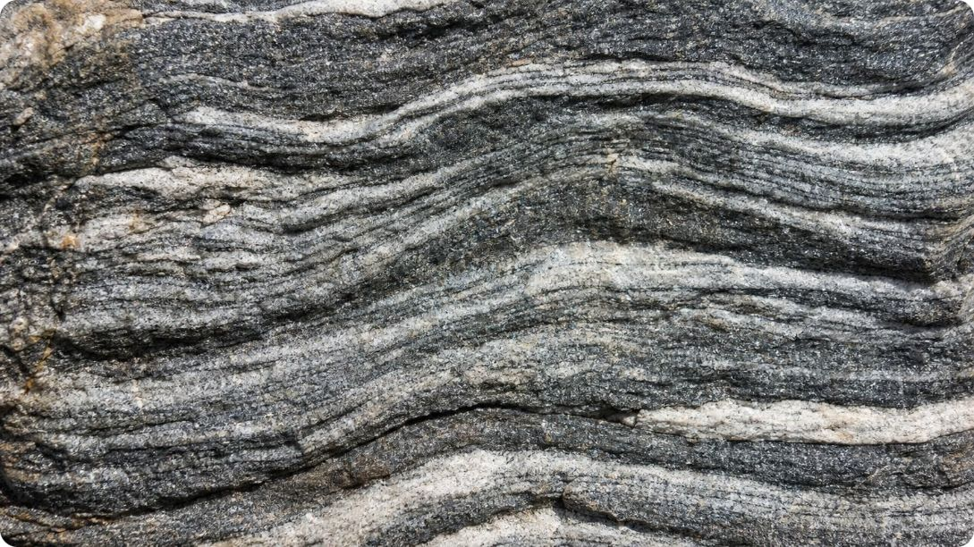
Model
Three families, three processes, three textures
Model: How to tell the rock families apart
Igneous: melted rock cooled and hardened
Sedimentary: pieces settled, were buried and cemented
Metamorphic: solid rock changed by heat and pressure
Interlocking crystals, large or tiny; sometimes glassy, sometimes full of gas holes. No layers of loose grains.
Separate grains, pebbles or shell bits stuck together, often in flat layers; grains may rub off.
Crystals flattened and lined up, sometimes in light and dark bands, or regrown into a fused, sugary mass.
The family name tells you the process; the texture is the evidence for it.
6
Notes:
Read each item as 'process, then evidence.' Stress that the family is defined by how the rock formed, not by how it looks, but that the look is how we tell. Ask students to predict which family the dome granite belongs to and why (igneous; interlocking crystals, no layers). Then preview the three sections of the lesson: each family gets its own set of slides and its own step in the crayon lab.
WATCH FOR: Students may sort by color. Color varies within every family; grain arrangement is the reliable clue.
CONNECTS TO: Lab 2 property cards are sorted with this slide; W4 diagram worksheet.
PACING: about 5 min

Slide 7
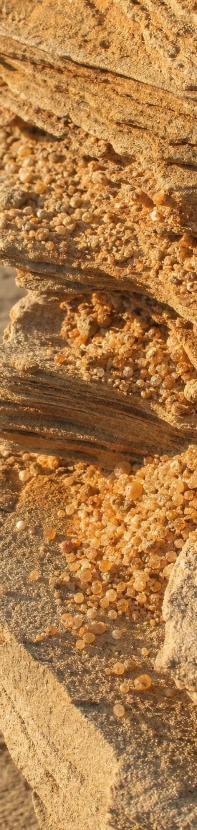
Quick check: read the texture
CHECK FOR UNDERSTANDING
A rock has rounded sand-sized grains in thin flat layers, and grains come off when you rub it. Which family, and what is the evidence?
B. Sedimentary: loose grains were deposited in layers and cemented
A. Igneous: the grains are crystals that grew from magma
C. Metamorphic: the layers are bands made by pressure
D. Cannot tell without knowing the minerals
7
Notes:
Vote with fingers, then ask one student per option to defend it. Rounded separate grains that rub off are not crystals that grew in place; they are pieces that were carried, dropped and glued. Bands in metamorphic rock are made of flattened crystals that do not rub off. Option D is the one to kill now: you do not need mineral names to read texture.
EXPECTED RESPONSES: B. Rounded grains that rub off and flat layers point to sediment that was deposited and cemented. Students who choose C are reading 'layers' as 'bands'; ask whether the grains are separate pieces or flattened crystals.
WATCH FOR: Layers equals metamorphic. Flat layers of separate grains are sedimentary; wavy bands of flattened crystals are metamorphic.
CONNECTS TO: Lab 2 card C; W10 mastery.
PACING: about 4 min

Slide 8
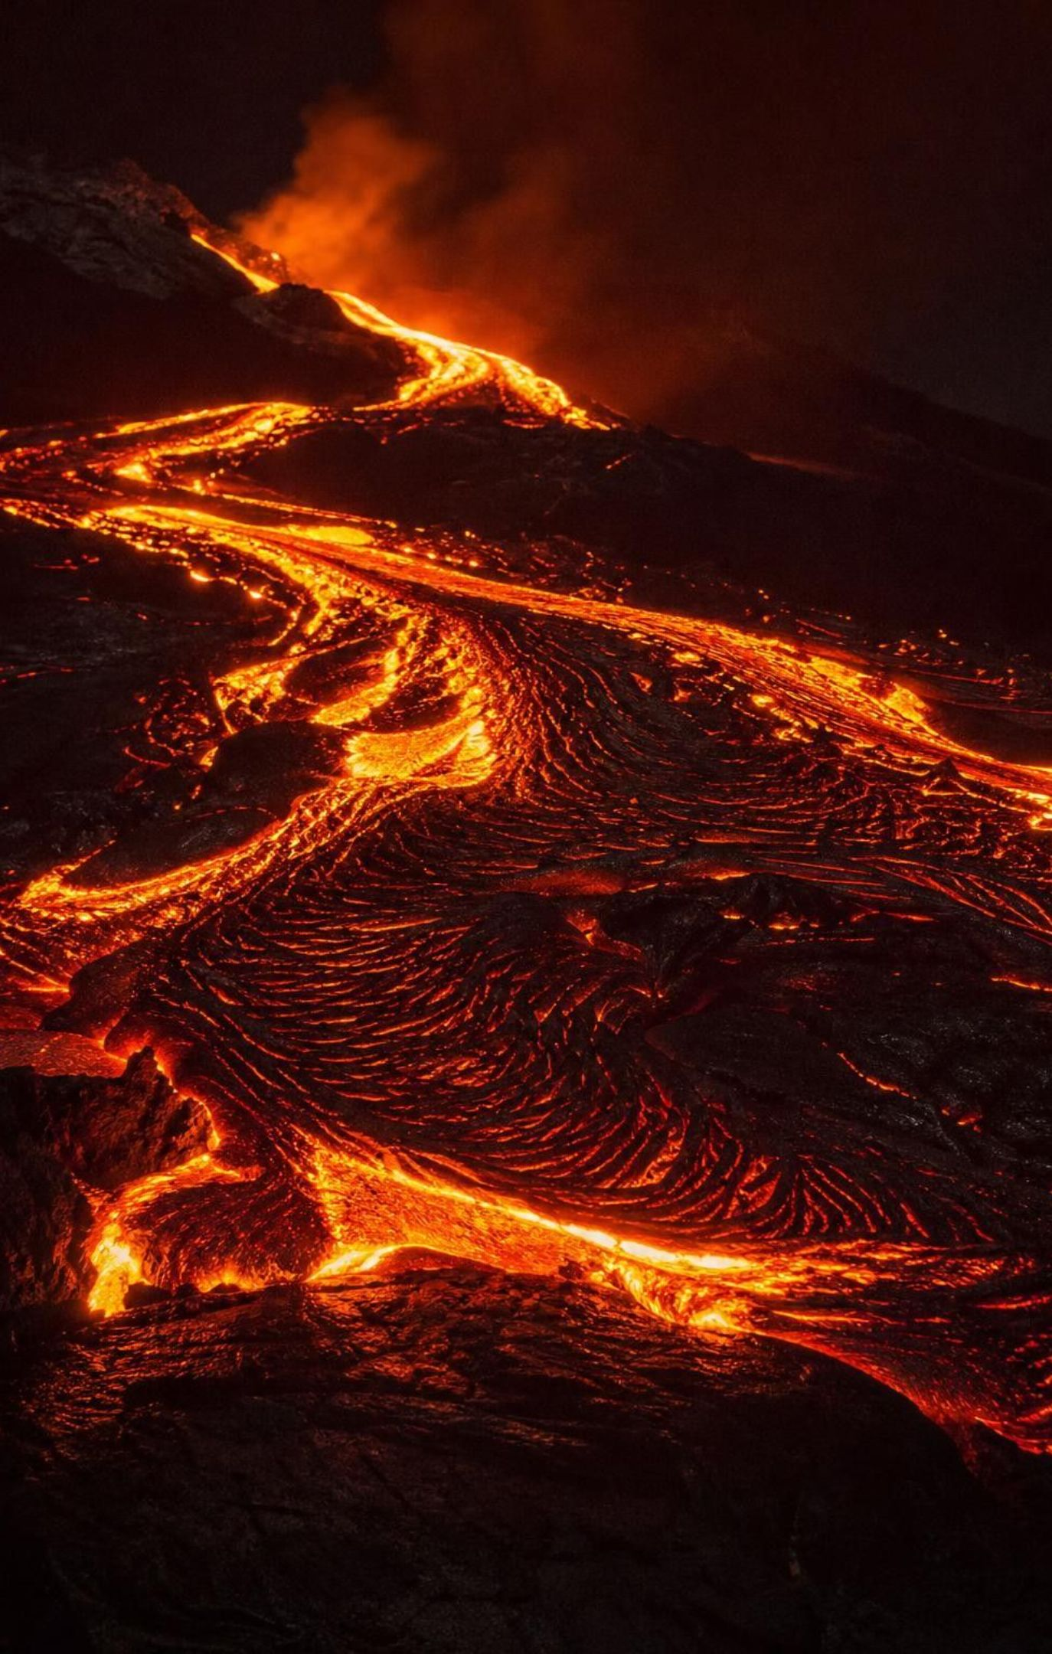
Igneous rock: cooling time sets crystal size
Magma is melted rock underground; lava is melted rock that reached the surface.
As melt cools, crystals start tiny and keep growing as long as the rock stays molten.
Slow cooling underground: large crystals you can see. This is intrusive rock, like granite.
Fast cooling at the surface: tiny crystals or glass. This is extrusive rock, like basalt.
Intrusive rock reaches the surface only after uplift and erosion strip away the rock above.
8
Notes:
The key idea is time. A crystal grows by adding atoms from the melt; the longer the melt stays liquid, the bigger the crystals get. Deep underground, magma is wrapped in warm rock and can take thousands to millions of years to harden, so its crystals grow to the size of rice grains or bigger. At the surface, lava loses heat to air or water in hours to a few years, depending on how thick the flow is, so most crystals stay too small to see. Blast the melt into the air as froth and it freezes almost instantly as glass: pumice. Now answer the phenomenon's first puzzle: the dome is intrusive, so kilometers of rock must have been removed from above it by uplift and erosion. Note for accuracy: cooling time is the main control, not the only one; some water-rich magmas grow giant crystals without slow cooling. Say 'main control.'
WATCH FOR: 'Big crystals mean different ingredients.' Same magma, different cooling time, different texture.
CONNECTS TO: Lab 1 fast and slow cooling step; W3 reading.
PACING: about 5 min

Slide 9
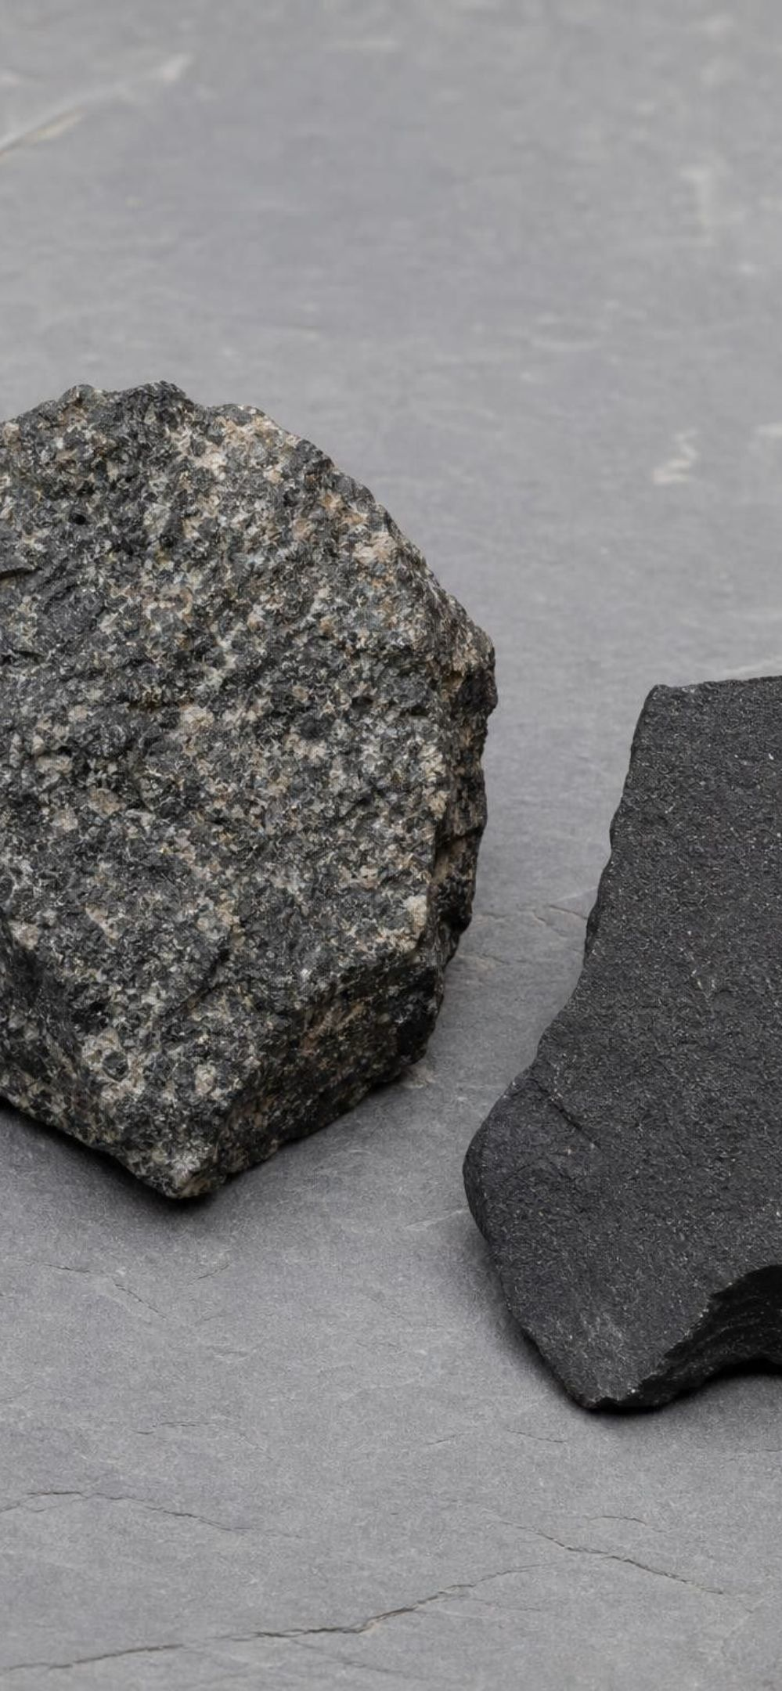
MODEL
Intrusive versus extrusive: same melt, different clock
Model: Two fates for the same magma
Intrusive (cools below the surface) | Extrusive (cools at the surface)
Insulated by surrounding warm rock | Loses heat quickly to air or water
Thousands to millions of years to harden | Hours to years to harden
Large interlocking crystals, coarse texture | Tiny crystals or glass; may hold gas holes
Examples: granite (light), gabbro (dark, denser) | Examples: basalt (lava flow), pumice and obsidian (glassy)
Seen at the surface only after uplift and erosion | Forms lava flows and volcanic layers at the surface
Gabbro and basalt can be made from the same ingredients; the difference is where and how fast they cooled.
9
Notes:
Walk the two columns, then the shared middle. The middle matters for the energy story: the melt exists because of heat from Earth's interior, and the rock hardens because that heat flows out into cooler surroundings. Correct the textbook's shorthand about 'light elements' and 'heavy elements': granite is silica-rich and light colored; gabbro and basalt are rich in iron and magnesium, which makes them dark and denser. Magnesium is actually lighter than silicon, so 'heavy elements' is misleading. Ask: if you found a dark rock with crystals too small to see, where did it cool? At the surface, fast.
WATCH FOR: The textbook says pumice has no crystals. It is mostly frothy glass but can carry crystals that grew before the eruption; say it cooled too fast for new crystals to grow.
CONNECTS TO: Lab 1 ice-water versus slow-cool comparison; Lab 2 cards A, B, H, J.
PACING: about 5 min

Slide 10
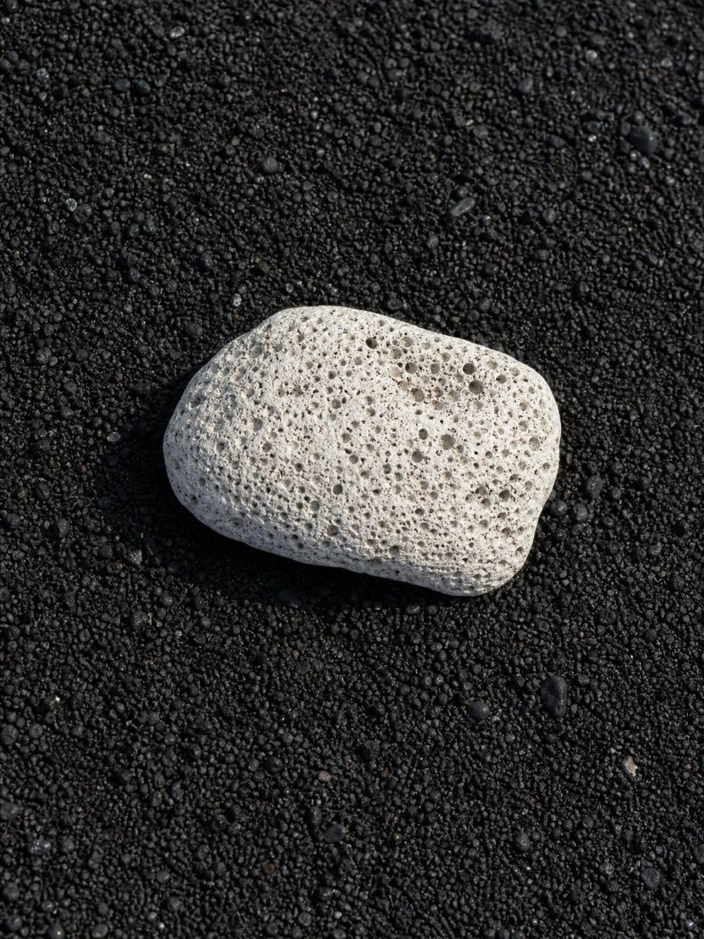
VOCABULARY IN CONTEXT
Words for melted rock and what it becomes
igneous rock
intrusive rock
extrusive rock
Rock that forms when magma or lava cools and hardens. A black lava flow hardening on a volcano's flank is becoming igneous rock.
Igneous rock that hardened slowly below the surface, so its crystals are large. The granite of the dome is intrusive; its specks are crystals the size of rice grains.
Igneous rock that hardened quickly at the surface, so its crystals are tiny or it is glassy. Basalt and pumice are extrusive; you need a lens to see any crystals in basalt.
10
Notes:
Link the prefixes: in-trusive pushes in and stays inside; ex-trusive pushes out. Have students write the pair as a two-row table with 'where,' 'how fast,' 'crystal size' and 'example.' Add that geologists also say magma for melt underground and lava for melt at the surface; the textbook uses 'pyroclastic material' for explosively erupted magma, but geologists use that word for the fragments blasted out, and lava for any melt that reaches the surface.
WATCH FOR: Lava and magma as two different substances. Same melt, different location.
CONNECTS TO: W2 vocabulary; W10 mastery.
PACING: about 3 min

Slide 11
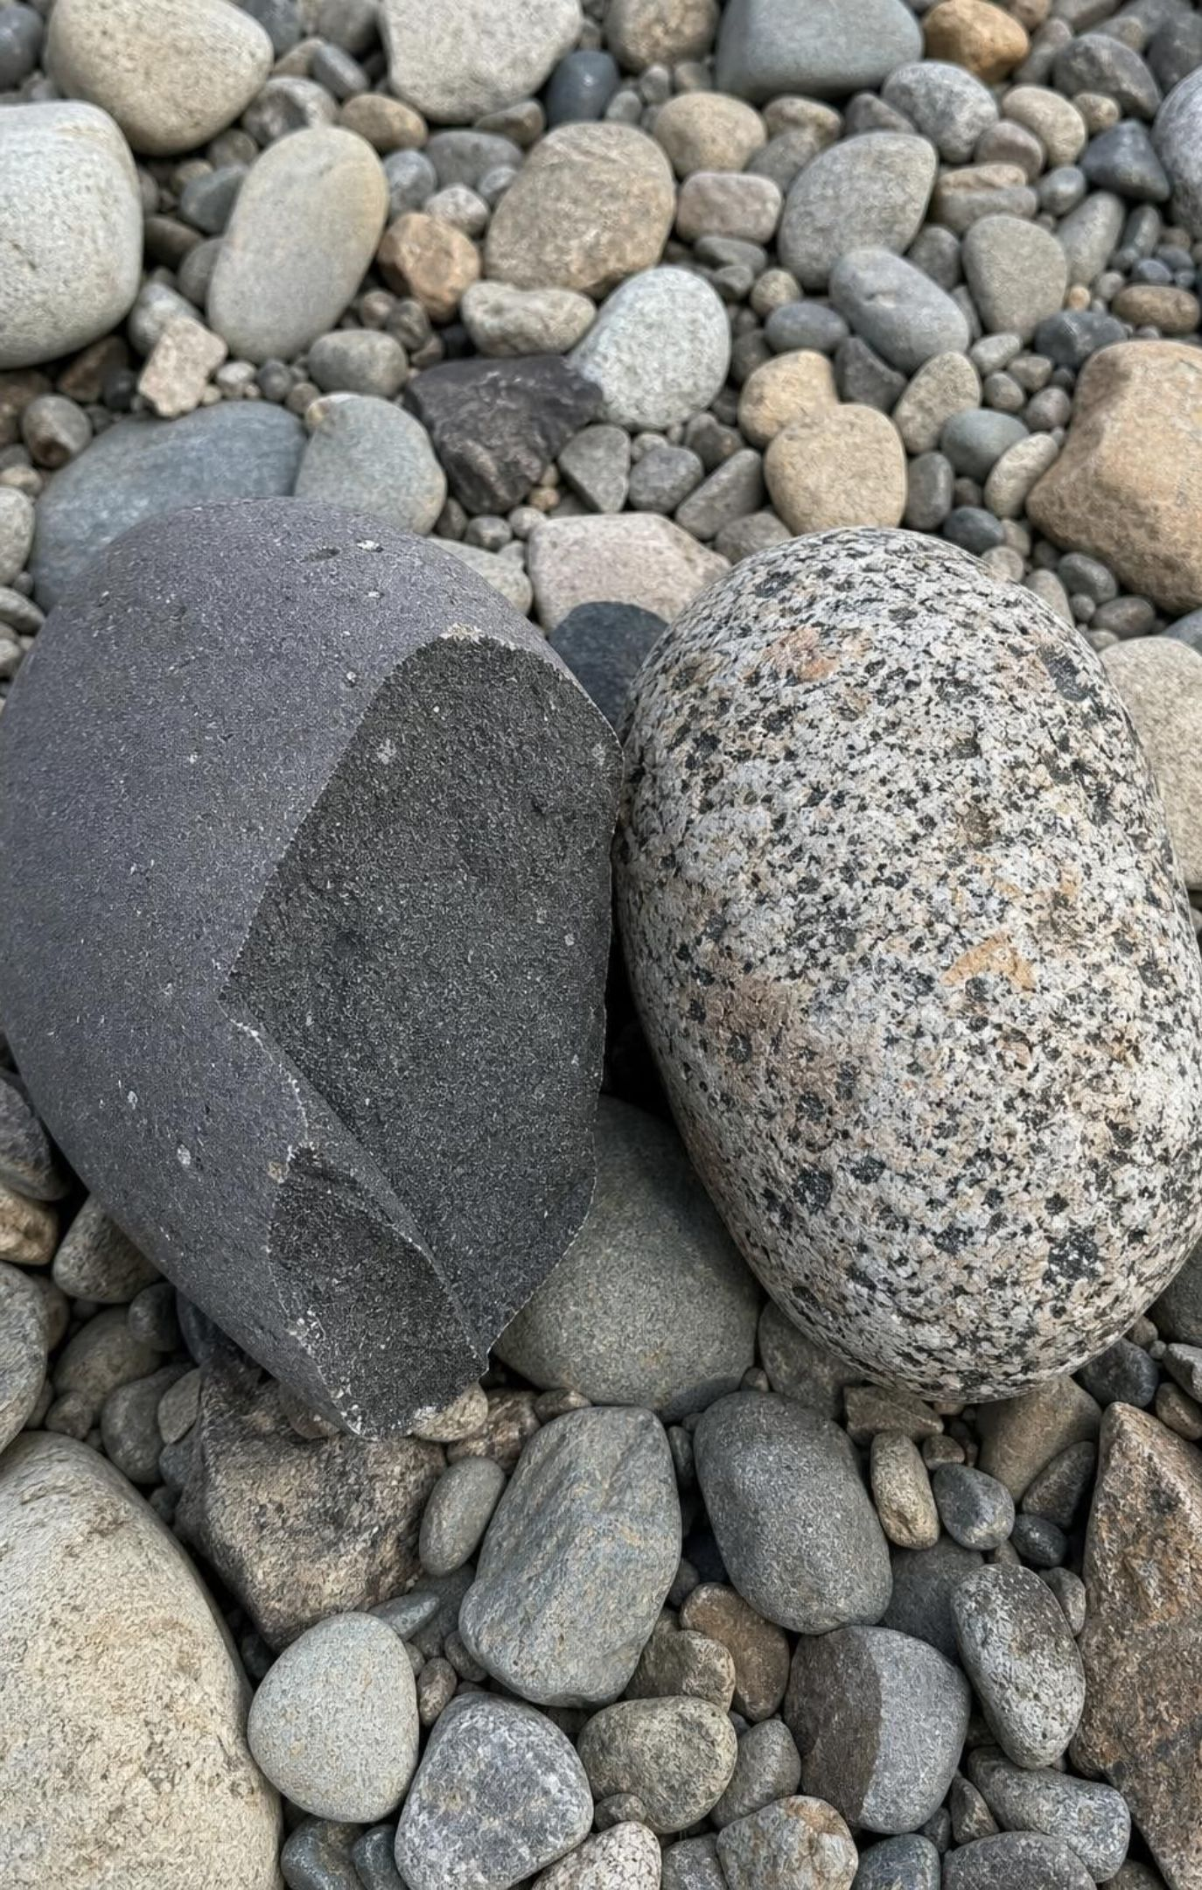
CHECK FOR UNDERSTANDING
Quick check: where did it cool?
Two rocks have the same ingredients. One has crystals you can see; the other is dark with crystals too small to see without a lens. What is the best explanation?
A. The coarse rock cooled slowly underground; the fine one cooled fast at the surface
B. The coarse rock is older, so its crystals had more time to grow after hardening
C. The fine rock lost most of its minerals while erupting
D. The two rocks must have different compositions after all
11
Notes:
Whiteboard vote, then reasoning. Option B is the sneaky one: crystals grow while the rock is molten, not after it hardens, so age after hardening does not matter. Option D contradicts the question. Remind students that this is exactly the comparison they will run with crayon wax in ice water versus slow cooling, and that the wax will show the limit of the model because it does not grow visible crystals.
EXPECTED RESPONSES: A. Cooling time controls crystal size; same ingredients, different clock. Students choosing B need the point that growth stops when the rock is solid.
WATCH FOR: Crystals keep growing inside solid rock over time (they do not, unless the rock is metamorphosed, which comes later).
CONNECTS TO: Lab 1 analysis question on fast versus slow cooling; W5.
PACING: about 4 min

Slide 12
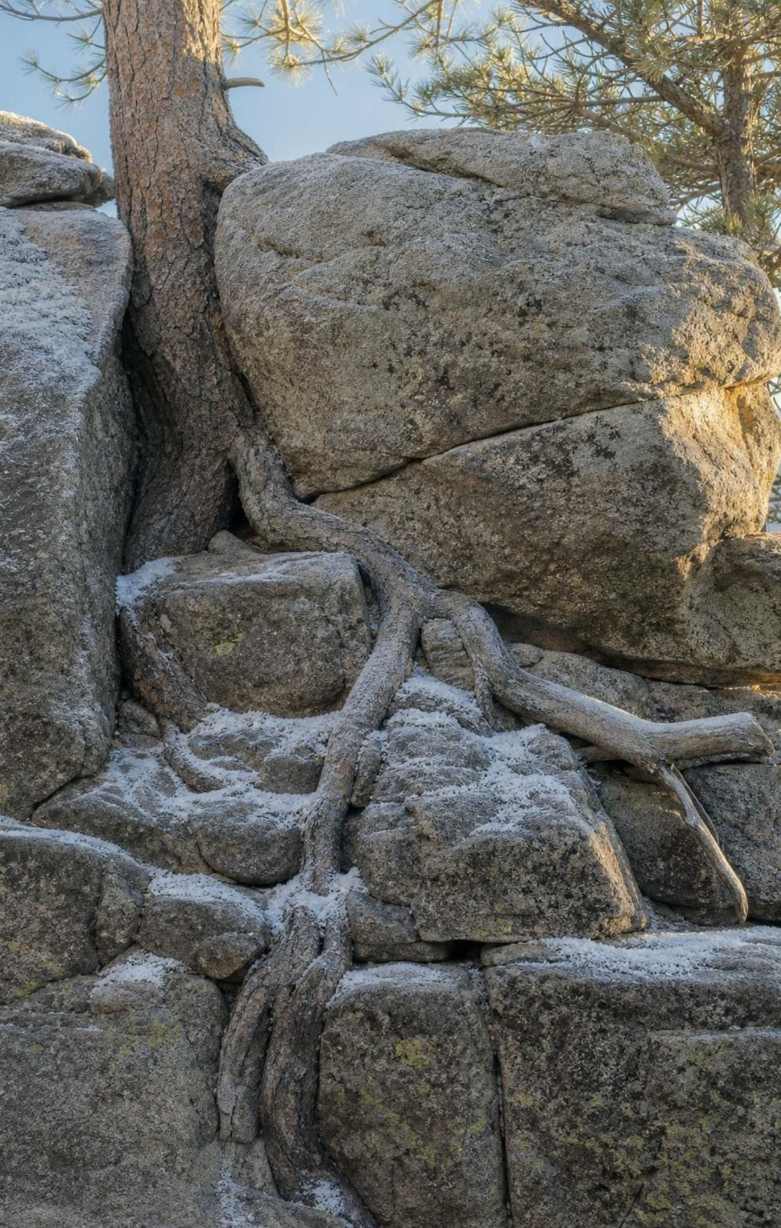
Sedimentary rock begins with breakdown at the surface
Physical weathering: ice, heat and cold, roots and wind crack rock into fragments called sediment.
Chemical weathering: water and air react with minerals, changing or dissolving them.
Erosion: wind, water, ice and gravity carry the sediment away.
Deposition: when the carrier slows and loses energy, it drops its load, biggest pieces first.
Burial: new layers press the grains together (compaction); minerals glue them (cementation).
12
Notes:
This is the dome's future. Freezing water wedges cracks open, roots pry, daily heating and cooling flex the surface, and grains fall off: physical weathering. Rain slightly acidic from carbon dioxide reacts with some minerals and turns them to clay or dissolves them: chemical weathering. Gravity and running water move the grains downhill: erosion. Where the water slows, in a lake or at the coast, it can no longer carry the load and drops it: deposition, coarse pieces first, fine ones farther out. Bury the layers under more layers and the weight squeezes out water and packs the grains; mineral-rich water seeping through leaves cement between them. Make the energy explicit at each step: the Sun drives the weather and the water cycle; gravity pulls everything downhill; the weight of overlying layers does the compacting.
WATCH FOR: Weathering and erosion used as one word. Weathering breaks; erosion moves.
CONNECTS TO: W3 reading passage; Lab 1 pressing step models compaction.
PACING: about 5 min

Slide 13
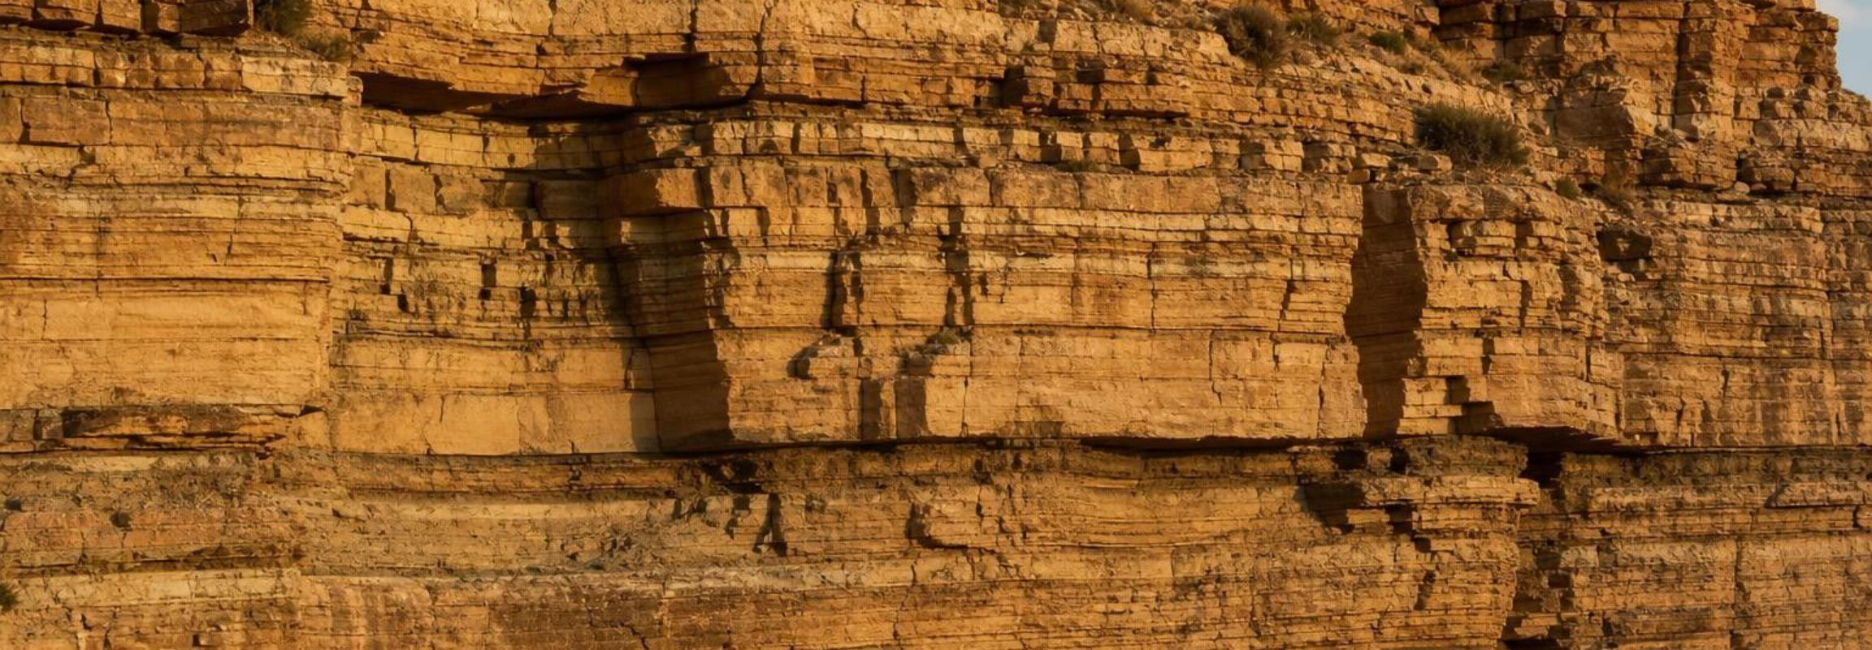
Model
From the dome to a sandstone: one sedimentary route
Model: Granite grains on their way to becoming rock again
1
2
3
4
5
6
Granite dome weathers; grains loosen
→ (weathering)
Rain and gravity carry grains into a stream
→ (erosion)
Stream enters a lake, slows, drops the sand
→ (deposition)
Layer after layer buries the sand
→ (burial)
Weight compacts; mineral cement glues grains
→ (compaction and cementation)
Sandstone: layered rock of the old granite's grains
Sun-driven weather and gravity power every step until burial; the weight of the layers does the rest.
13
Notes:
Trace the flow with the phenomenon in mind: the pink, white, black and gray grains of the dome could end up as a pink-speckled sandstone far away. Ask at each arrow: what is the energy source? Weathering and erosion: the Sun, which drives rain, wind and freeze-thaw, plus gravity. Deposition: the carrier loses energy as it slows. Burial, compaction: the weight of overlying layers, which is gravity again. Point out the texture this makes: separate grains, rounded by travel, in flat layers. Then ask what the sandstone would look like if the grains had traveled only a short distance from a cliff: sharp-edged chunks, a rock called breccia. Travel rounds grains and sorts them by size.
EXPECTED RESPONSES: Students should name the Sun and gravity for the surface steps and the weight of layers for compaction; some will say 'the river,' which is correct but should be pushed to what drives the river (Sun lifts the water, gravity brings it down).
WATCH FOR: Thinking cementation means the grains melt together. Cement is mineral deposited from water between cold grains.
CONNECTS TO: W4 diagram; W1 Pine Creek field notes; Lab 2 cards C and I.
PACING: about 5 min

Slide 14
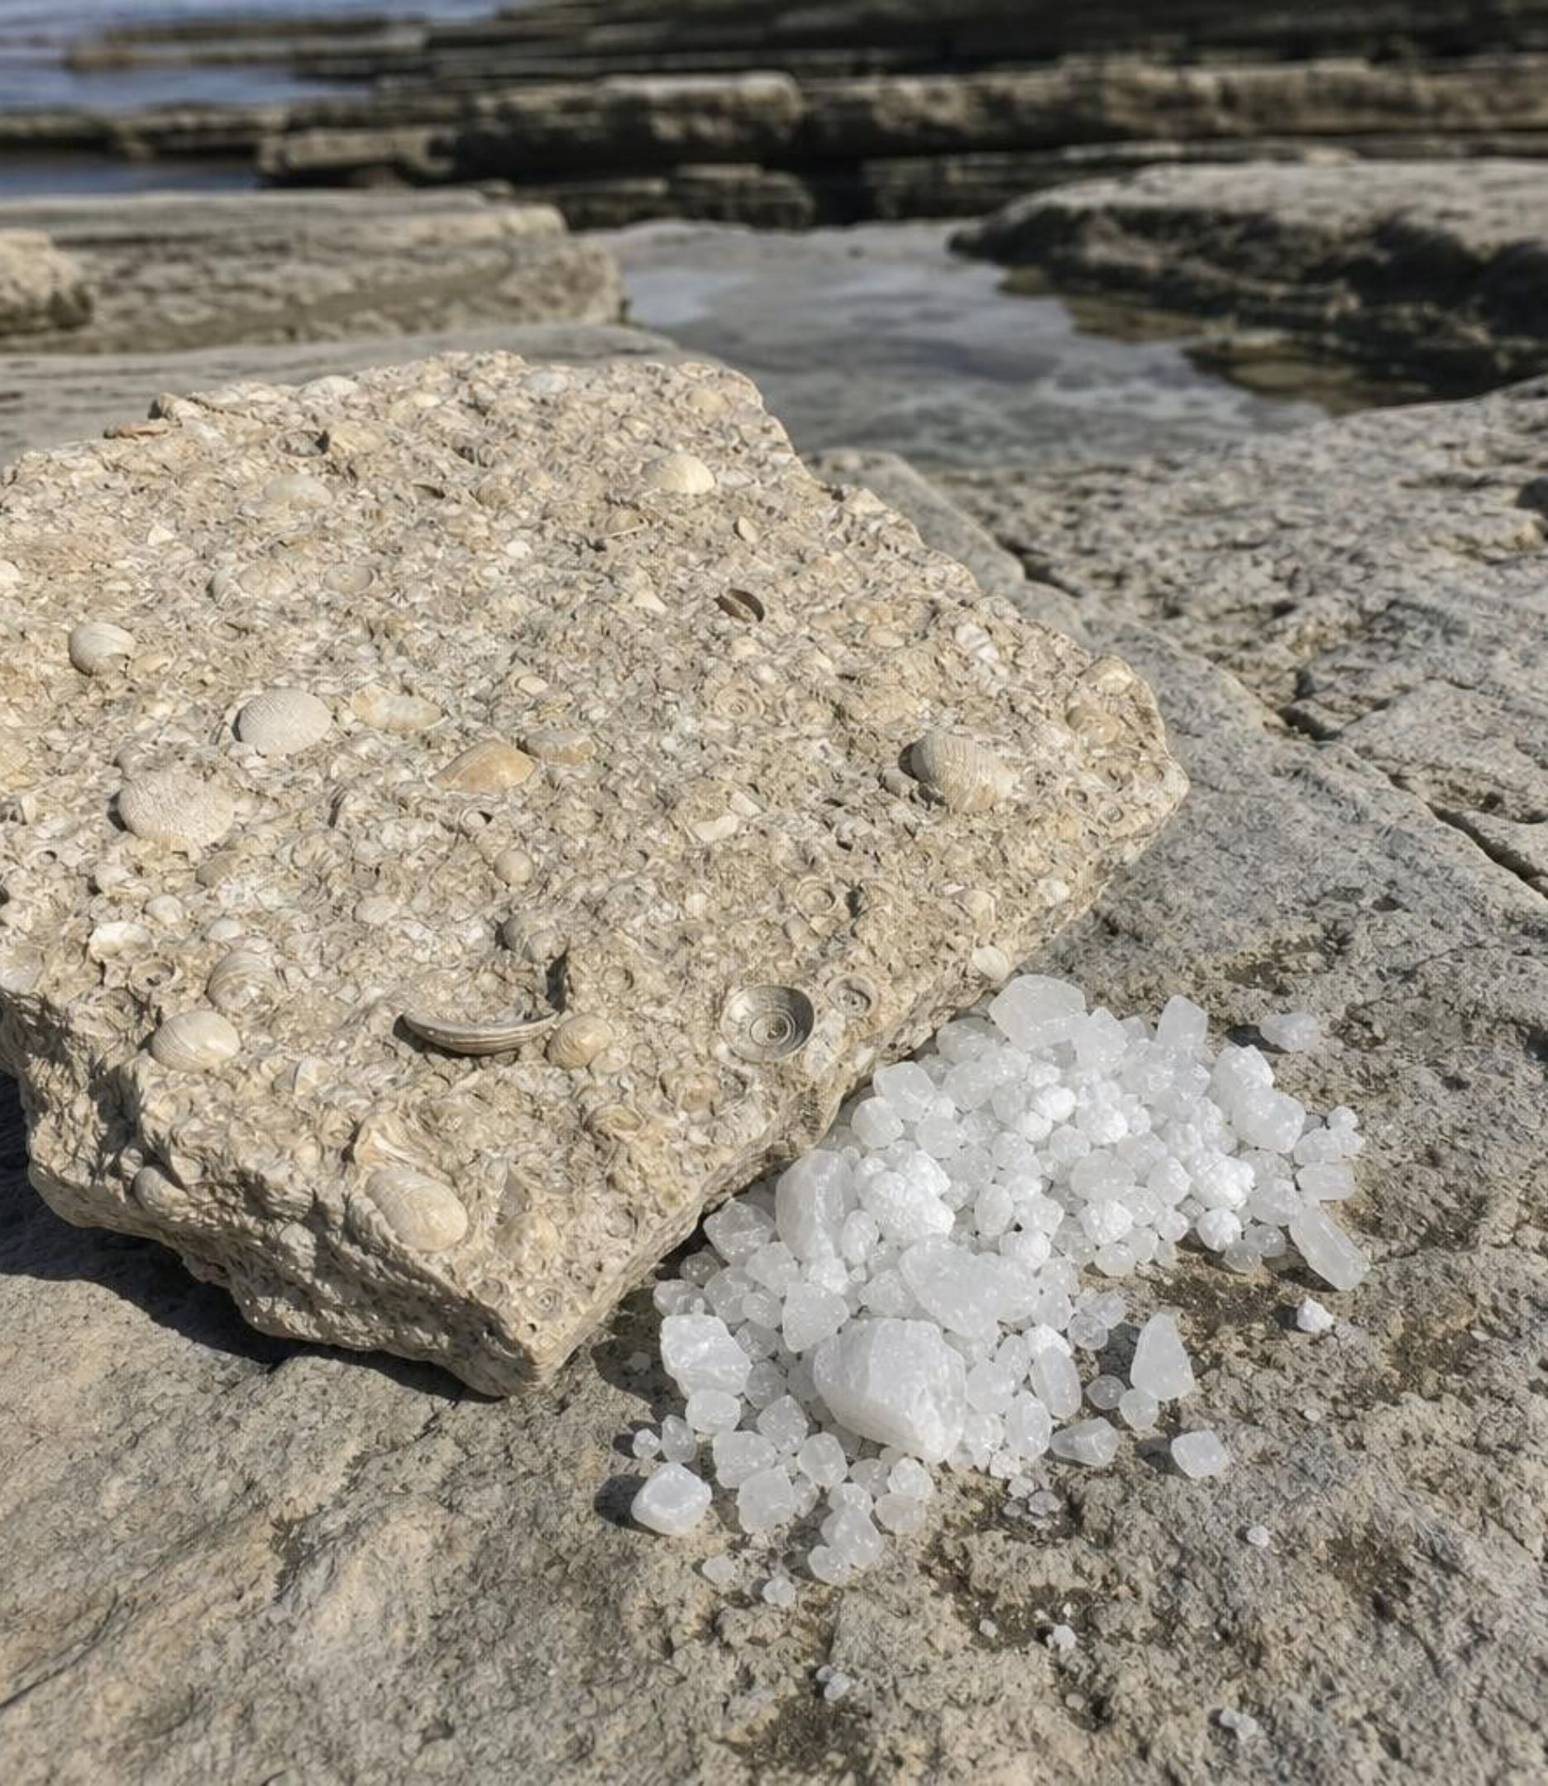
The dissolved route: shells and salt
Chemical weathering sends dissolved material down rivers to lakes and the sea. Two things can happen to it. Sea creatures pull it from the water to build shells; the shells pile up on the seafloor and become limestone. Or the water evaporates, the minerals grow too concentrated to stay dissolved, and they crystallize out as rock such as halite (rock salt). Both are sedimentary rock with no sand grains at all.
14
Notes:
Students usually picture sediment as grit. Add the invisible kind: material dissolved in water. Shells are the most common fate; most limestone is built from the remains of sea life, and chalk is a famous example. Evaporation is the other fate: a desert lake dries up and leaves a crust of halite and other minerals. The textbook says evaporation forms limestone; the better example is halite, and the textbook's own figure uses halite. California has both stories: shell-built limestone in the Coast Ranges and the salt flats of Badwater Basin in Death Valley, where a lake dried and left a crust of mostly halite. Energy: the Sun drives evaporation; living things do the shell-building using energy from food.
WATCH FOR: 'Sedimentary rock always has layers of sand.' Limestone and rock salt are sedimentary with no sand at all.
CONNECTS TO: Lab 2 cards D and K; W2 q8 (salt crust); W8 card 8 (shell limestone).
PACING: about 4 min

Slide 15
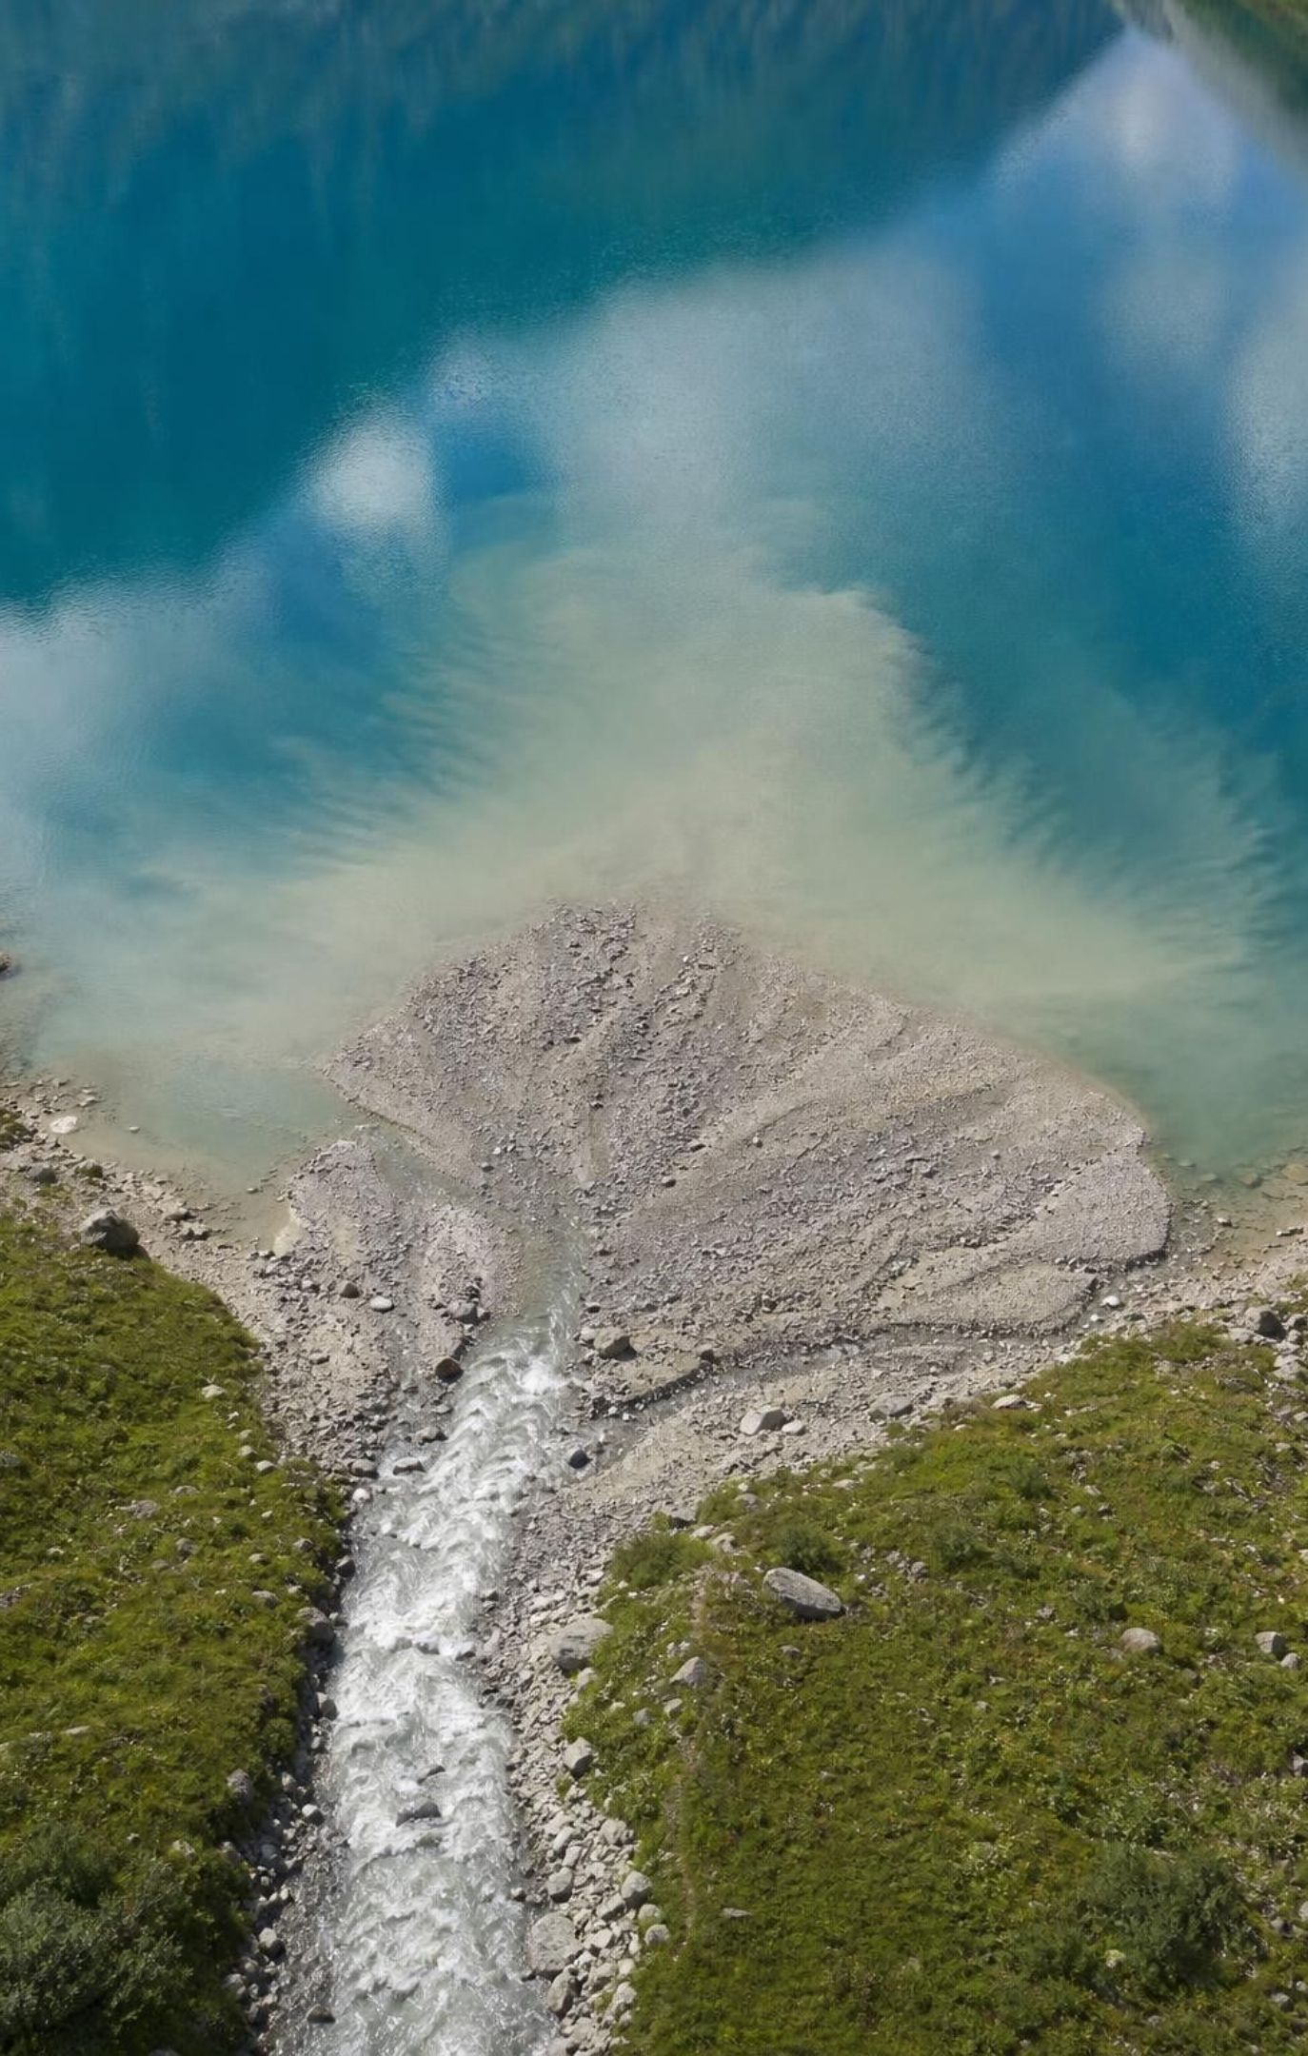
THINK, PAIR, SHARE
Discuss: where does the river drop its load?
Think about what keeps a pebble moving versus what keeps a mud particle moving.
Where does the water lose most of its energy?
Which rock would form near the mouth, and which far out in the lake?
A fast mountain stream carrying pebbles, sand and mud enters a calm lake. Predict the order in which the pieces settle, from the stream mouth outward, and explain using energy.
15
Notes:
Pairs get three minutes. Expect pebbles at the mouth, sand a little farther, mud farthest out, because the heaviest pieces need the most energy to stay moving and the water loses that energy as soon as it slows. Push for the energy language: moving water has kinetic energy; when it slows, it cannot carry the heavy pieces, so they settle first. Connect to rock: a pebbly rock near the old shore, sandstone beyond it, a fine mudstone far out. W1's Pine Creek notes and Lab 2 cards C and I use the same idea.
EXPECTED RESPONSES: Pebbles first, then sand, then mud; the water loses energy when it slows, so the heaviest pieces drop first. Some students will reverse the order thinking light things fall first; ask what a strong wind can and cannot lift.
WATCH FOR: Light pieces settle first because they are 'easier to drop.' Lighter pieces stay suspended longer.
CONNECTS TO: W1 (Pine Creek sand bar); Lab 2 card I (short transport, angular pieces).
PACING: about 6 min

Slide 16
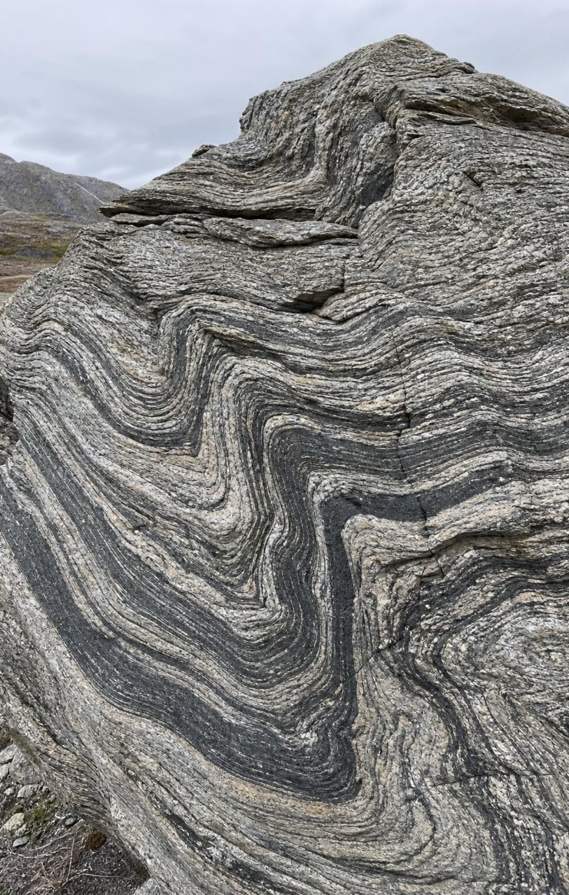
Metamorphic rock: changed while still solid
Deep burial or plate collisions put solid rock under great heat and pressure.
The rock never melts. Its crystals flatten, line up, and regrow into new or larger crystals.
Squeezing over wide areas lines crystals up in sheets or bands: schist and gneiss.
Heat from nearby magma regrows crystals in the rock it touches: limestone to marble.
Rock closest to the heat changes most; rock farther away changes less.
16
Notes:
Start by killing the baking image: the textbook compares metamorphism to cookie dough in an oven, but dough softens and rock does not. Metamorphic rock stays solid; atoms shift inside the crystals, crystals grow in new directions, and new minerals can form, all without a liquid. If the rock gets hot enough to melt, it stops being metamorphic and becomes magma. Two settings: where plates collide, enormous pressure plus heat over a wide region flattens and aligns crystals, giving the sheets of schist and the light-dark bands of gneiss; beside an intrusion of magma, heat flowing into the surrounding rock regrows its crystals, turning limestone into marble and sandstone into quartzite, with the change fading with distance from the magma. Geologists call these regional and contact metamorphism; the textbook's deformation and recrystallization labels are a simplified version, and recrystallization happens in both. Hot fluids moving through rock also drive change.
WATCH FOR: 'Heat and pressure melt the rock a little.' No liquid at this level; melting makes magma, and the product is igneous.
CONNECTS TO: Lab 1 warm-pressing step; Lab 2 cards E, F, G, L; W7 misconception repair.
PACING: about 5 min

Slide 17
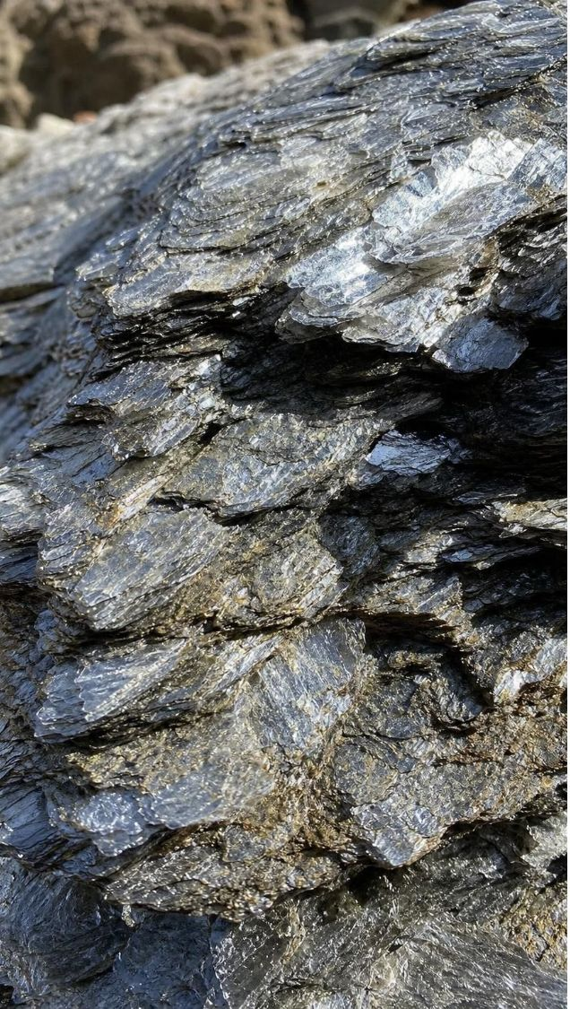
VOCABULARY IN CONTEXT
Words for change without melting
metamorphic rock
deformation
recrystallization
Slow bending and squeezing of solid rock that flattens its crystals and lines them up, often in bands. Deformation gives schist its flaky sheets and gneiss its light and dark bands.
Regrowth of a rock's crystals into new or larger crystals while the rock is solid. Recrystallization beside a magma body turns limestone into sugary-looking marble.
Older rock whose texture or minerals were changed by heat, pressure or hot fluids while it stayed solid. The wavy banded rock on the island was once ordinary rock squeezed between colliding plates.
17
Notes:
Use the crayon lab preview: squeezing warm shavings in foil flattens and smears the grains without melting them, which is the closest an ordinary material comes to deformation. Have students sort three descriptions into deformation or recrystallization: crystals lined up in sheets (deformation), limestone grains regrown into fused crystals (recrystallization), sandstone fused so grains no longer rub off (recrystallization).
WATCH FOR: Deformation as 'breaking.' It is slow bending and flattening of solid rock, not shattering.
CONNECTS TO: W2 vocabulary; Lab 1 step 4 (warm press).
PACING: about 3 min

Slide 18
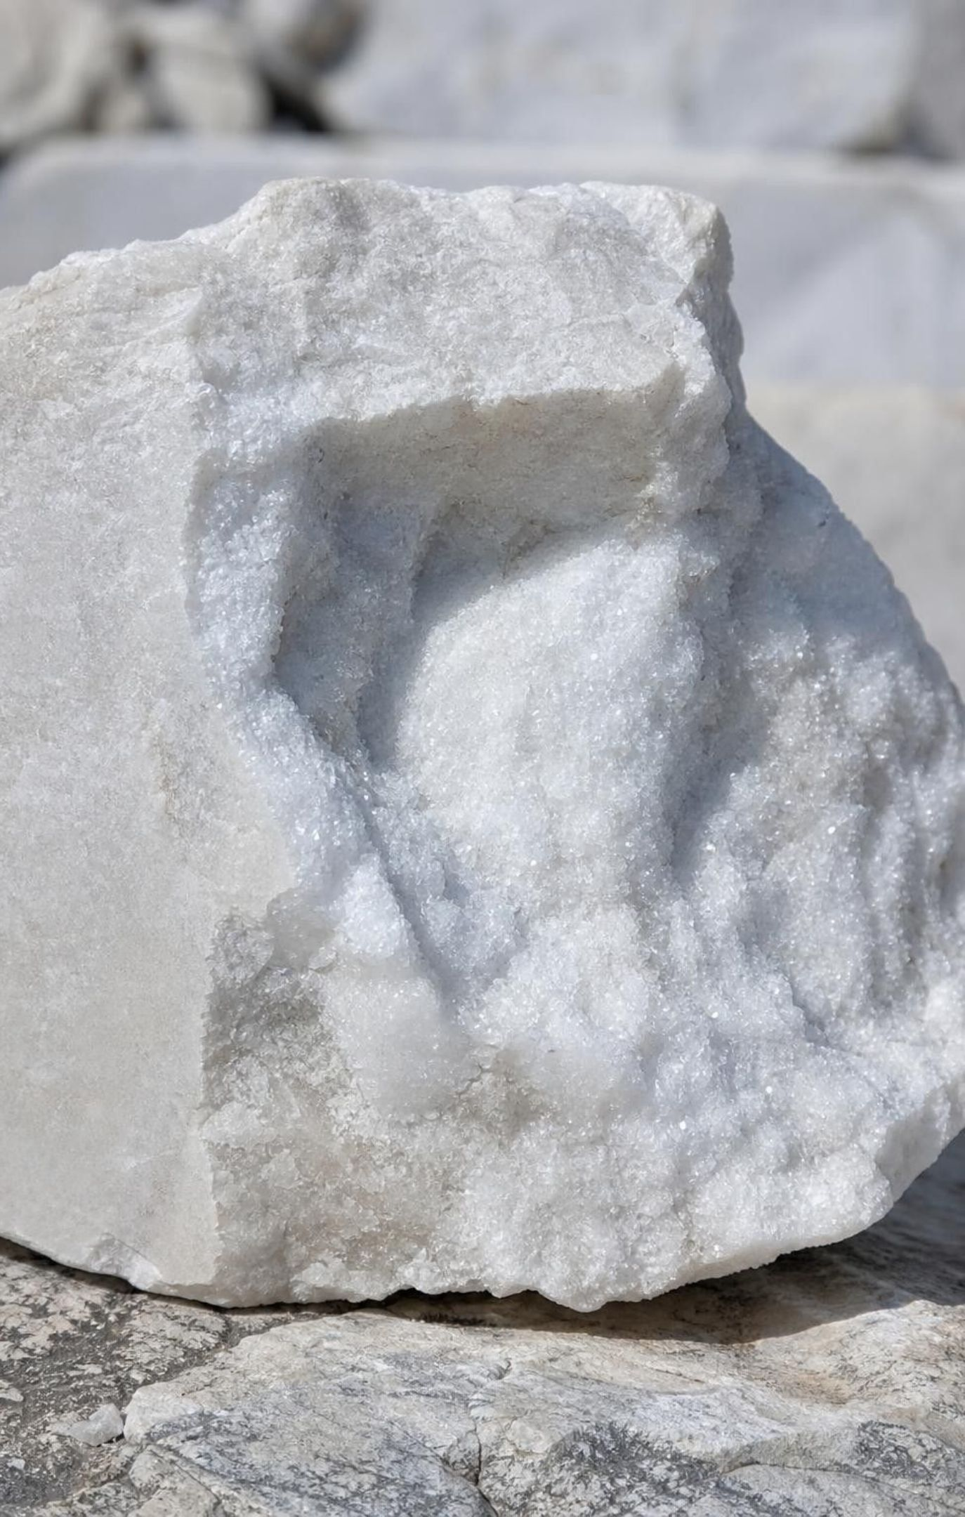
CHECK FOR UNDERSTANDING
Quick check: does it have to melt?
A student says marble forms when limestone gets hot enough to melt and then hardens again. What is wrong with this, and what actually happens?
A. Nothing is wrong; marble is melted limestone
B. Limestone cannot change at all; marble forms from magma
C. Heat regrows the limestone's crystals while the rock stays solid; melting would make igneous rock
D. Marble forms only from pressure, never from heat
18
Notes:
Quick vote, then have a student explain why C is right and why A would put marble in the wrong family. Rock that melts leaves the metamorphic path; its product after cooling is igneous. Marble keeps the limestone's ingredients but with regrown, interlocking crystals, which is why it fizzes with vinegar just as limestone does.
EXPECTED RESPONSES: C. Metamorphism changes solid rock; anything that melts and re-hardens is igneous. Students choosing A are holding the cookie-dough image.
WATCH FOR: Melting as part of metamorphism. Also 'pressure only': both heat and pressure matter, and heat alone does the work beside magma.
CONNECTS TO: W7 misconception repair; Lab 2 card G.
PACING: about 3 min

Slide 19
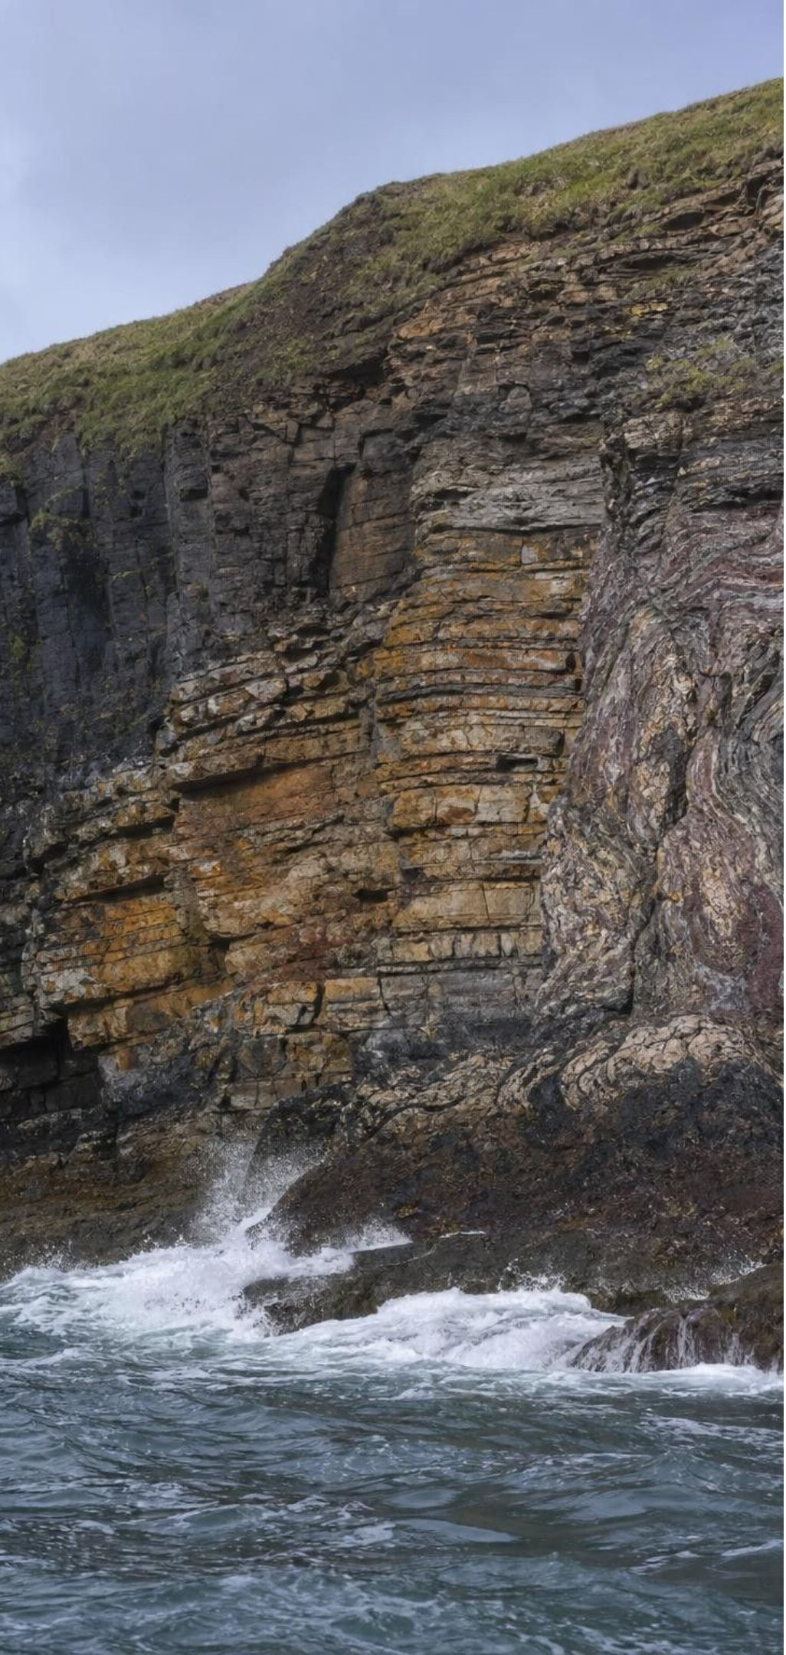
MODEL
The rock cycle: a web of routes, not a loop
Model: Five stations and the processes that move material between them
Magma → (cooling and crystallization)
Igneous rock → (weathering and erosion)
Sediment → (deposition, burial, compaction, cementation)
Sedimentary rock → (heat and pressure (no melting))
Metamorphic rock → (melting) (back to the start)
Shortcuts exist everywhere: any rock can weather, any rock can be metamorphosed, any rock can melt, and metamorphic rock can be changed again.
19
Notes:
The drawn ring is one route; the caption is the real model. Say the three universal rules and have students write them: any rock exposed at the surface can be weathered into sediment; any rock buried under heat and pressure can become metamorphic; any rock heated enough can melt into magma. Then build the shortcuts with the class: igneous straight to metamorphic (no sediment stage); sedimentary straight to magma; metamorphic to sediment after uplift; metamorphic to a different metamorphic rock. There is no required order and no timetable. Some arrows take moments (pumice cooling), some take millions of years (an intrusion cooling, a range eroding). Tell students the dice game in Lab 3 has exactly these five stations and that every roll is one of these arrows.
EXPECTED RESPONSES: Students should propose at least two shortcuts not on the ring and name the process on each.
WATCH FOR: Reading the ring as a required order (igneous, then sedimentary, then metamorphic). Return to this on the misconception slide.
CONNECTS TO: W4 diagram worksheet completes this model with energy labels; Lab 3 station tables; W7.
PACING: about 6 min

Slide 20
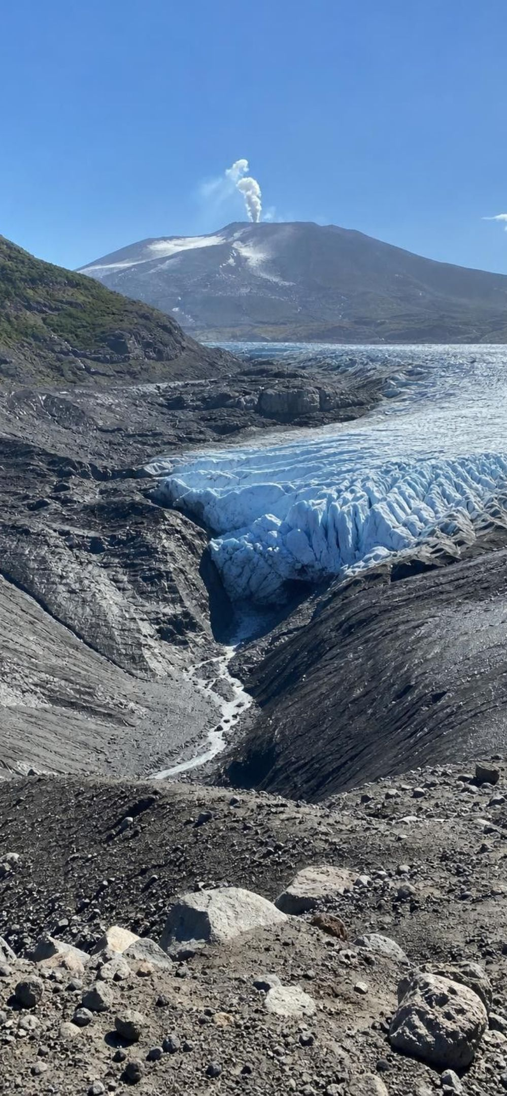
MODEL
Who pays for each change? Two energy budgets
Model: The energy behind the arrows
Sun and gravity: surface processes | Earth's hot interior: deep processes
Weather, rain, wind and freeze-thaw weather rock | Melts rock into magma
Rivers, glaciers and wind erode and carry sediment | Drives plate motion that collides, buries and squeezes rock
Gravity pulls sediment downhill and into low basins | Supplies the heat that recrystallizes and deforms rock
Evaporation leaves dissolved minerals as salt crusts | Pushes magma upward; lifts deep rock toward the surface
Weight of buried layers compacts sediment | Heat flowing out of magma lets it crystallize
Every arrow in the cycle has a bill, and the Sun or Earth's interior pays it.
20
Notes:
This slide is the second half of the state standard: the model must show the energy that drives the cycling. Walk both columns, then ask students to label every arrow on their slide-19 model with S (Sun and gravity) or I (interior). Weathering, erosion, deposition and evaporation: S. Compaction: gravity, so S-side, though some students will argue it is just weight; accept either as long as they name gravity. Melting, metamorphism, uplift, plate motion: I. Cooling of lava is a nice edge case: interior energy made the melt; the surface takes the heat away. Connect the interior column to Lesson 16: plates move because of heat inside Earth (with gravity pulling sinking plates down), and plate collisions supply the pressure for metamorphism and the uplift that exposed the dome.
EXPECTED RESPONSES: Correct S and I labels on at least six arrows; students should be able to say that the dome's granite was made by interior heat and is being destroyed by Sun-driven weather and gravity.
WATCH FOR: 'Pressure comes from heat.' Pressure deep in Earth comes from the weight of rock above and from plates pushing; the heat is a separate input from the same interior source.
CONNECTS TO: W4 energy labels; Lab 3 recording sheet has an energy column; W10.
PACING: about 5 min

Slide 21
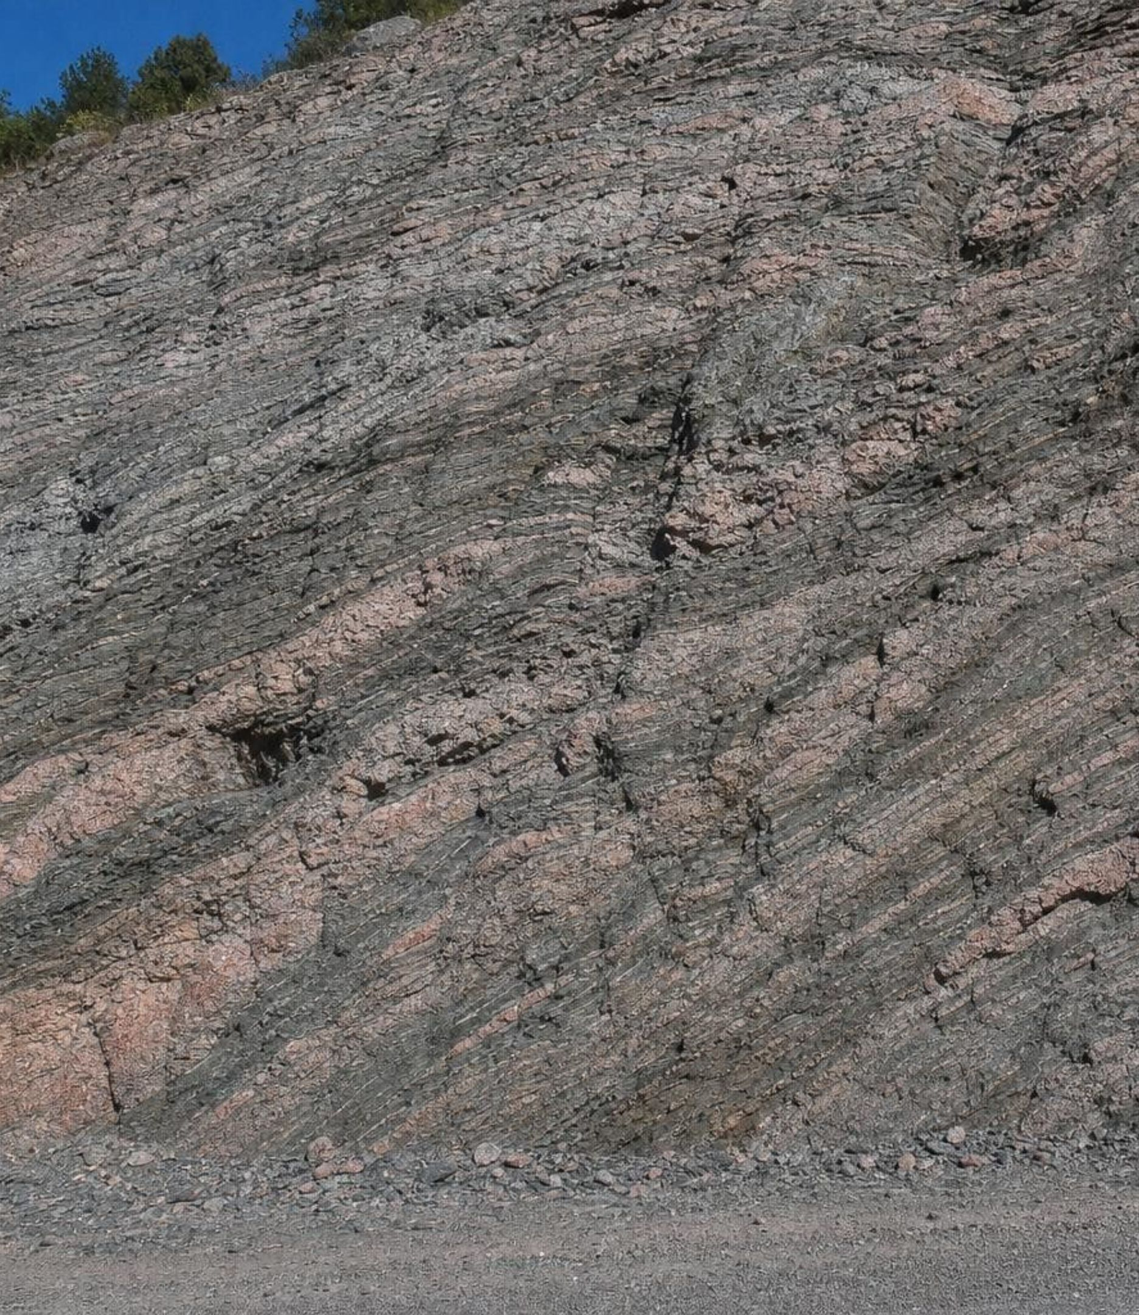
THINK, PAIR, SHARE
Discuss: a route that never melts
Describe a route that takes the dome's granite to a metamorphic rock without the material ever melting. Then describe a route that takes it to a new igneous rock. Which route needs the Sun, and where?
21
Notes:
Pairs write both routes as chains of process arrows. Route 1: granite weathers to sand (Sun, gravity), sand is deposited and buried into sandstone (gravity), deep burial or a plate collision turns it into quartzite (interior). Or the shortcut: granite is buried and squeezed straight into gneiss (interior) with no surface stage at all. Route 2: granite is carried down into the hot interior and melts (interior), magma rises and cools into new granite or erupts as lava (interior, then surface cooling). Collect routes on the board and count how many different valid ones the class found; the number is the point.
EXPECTED RESPONSES: At least two valid non-melting routes (via sediment and sandstone, or directly by heat and pressure) and one melting route, with the Sun named for weathering and erosion and the interior for melting and metamorphism.
WATCH FOR: Students who insist the granite must become sedimentary before it can become metamorphic are using the loop; point to the universal rules.
CONNECTS TO: W9 transfer; Lab 3 asks the same question of the dice data.
PACING: about 6 min

Slide 22
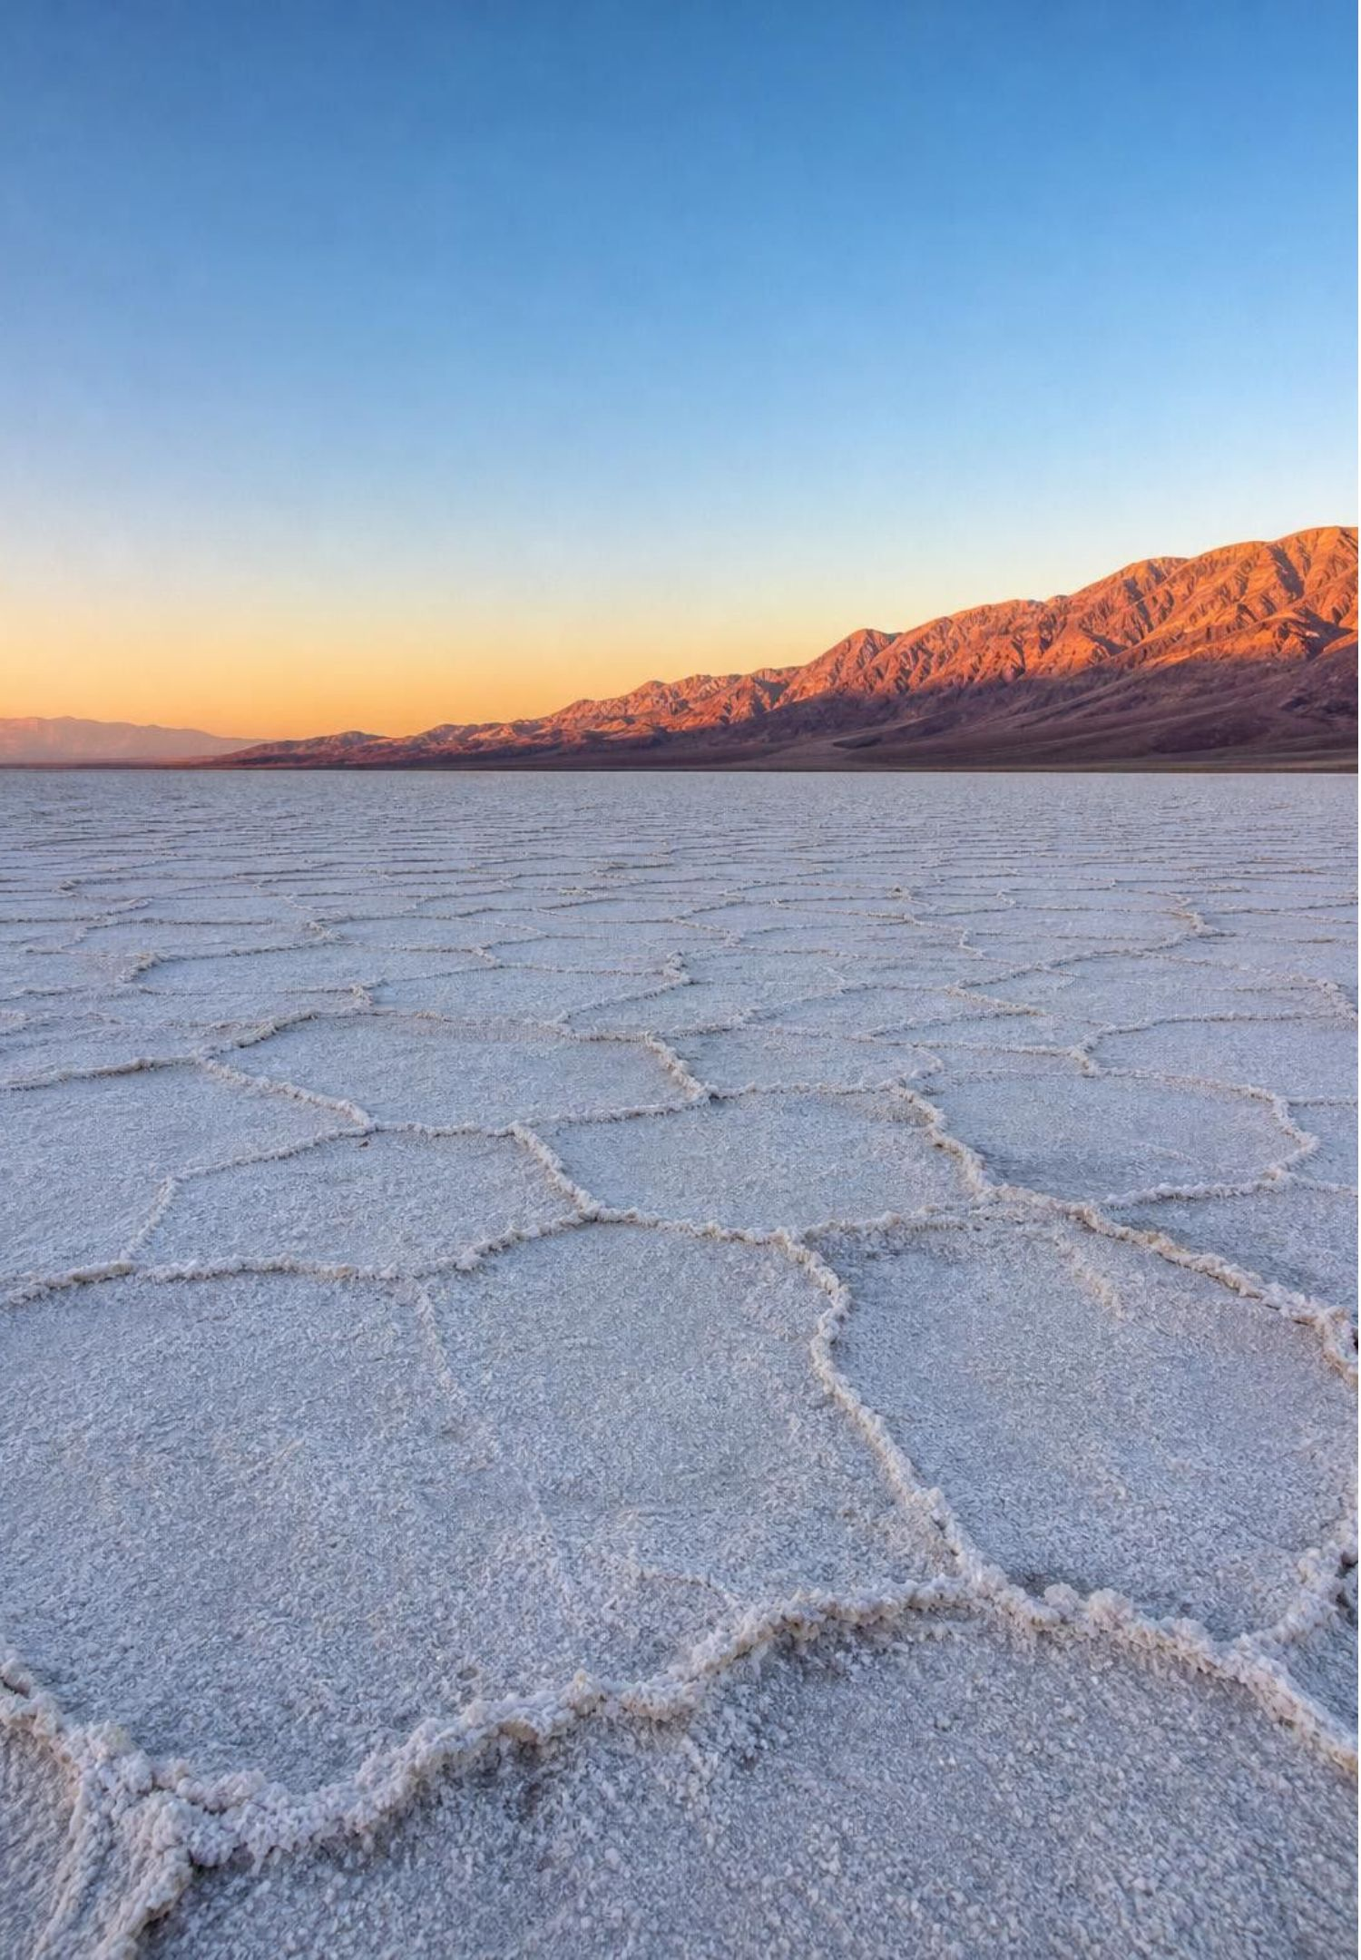
REAL-WORLD CONNECTION
California connection: the whole cycle within a day's drive
Yosemite's domes are granite that cooled kilometers underground about 100 million years ago; uplift and erosion exposed them. East of the Sierra, the Mono Craters are young obsidian and pumice domes that cooled too fast for many crystals to grow. At Badwater Basin in Death Valley, a crust of mostly halite marks where a lake dried up. In the Sierra foothills, burial and squeezing turned old sea-floor rock into marble.
22
Notes:
Connect each example to a station in the model. Yosemite: intrusive igneous, then uplift and erosion, which is the phenomenon itself; the sand at the base of the domes is called grus and is exactly the matching sand the hiker found. Mono Craters: extrusive igneous, glass because the thick, gas-rich melt cooled fast; the pumice there floats. Badwater: chemical sedimentary rock from evaporation, driven by the Sun; the crust re-forms after each rare flood. Sierra foothills: metamorphic belts of slate and marble formed when old ocean sediments and volcanic rocks were squeezed onto the edge of North America and later heated where the Sierra batholith intruded. If students have visited any of these, let them describe the rock. Every example is within a day's drive, and together they are the rock cycle on display.
CONNECTS TO: The phenomenon and Lab 2 Site 3 tell the dome story; W9 transfer is a building-stone decision that uses the same rock families.
PACING: about 4 min

Slide 23
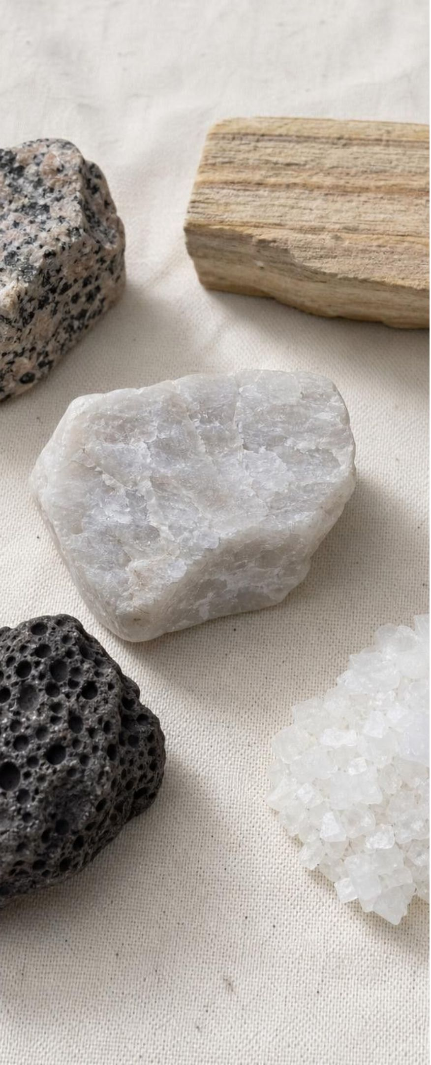
APPLY IT · SIMULATED DATA FOR PRACTICE.
Task: trace each sample's route and its energy
For each sample, name the family, the process that made it, the energy source, and one earlier form the material could have had. Then draw the samples' routes on your cycle model.
Sample | Texture observed | Setting where it was found
1 | Interlocking crystals the size of rice grains, pink, white, gray and black | Core of a mountain range, under a slope of matching sand
2 | Rounded sand grains in flat layers; grains rub off; a few pink grains | Canyon wall 200 km from the mountains
3 | Sand grains fused so none rub off; breaks across the grains | Deep road cut where the canyon rock was buried and squeezed
4 | Dark, dull, crystals too small to see; small round holes | Top of a layered volcanic hill
5 | White crust of cube-shaped crystals | Floor of a dry desert lake
23
Notes:
These five descriptions are invented for teaching and chain together on purpose. Give groups ten minutes. Sample 1 is intrusive igneous (slow cooling, interior heat) now exposed by uplift and erosion. Sample 2 is sedimentary, built from sand that could be sample 1's own weathered grains carried 200 km and deposited (Sun, gravity). Sample 3 is metamorphic, the sandstone of sample 2 recrystallized by heat and pressure (interior) into a quartzite-like rock. Sample 4 is extrusive igneous from a lava flow (interior melt, surface cooling); the holes are gas bubbles. Sample 5 is chemical sedimentary from evaporation (Sun). Then have groups draw the path 1 to 2 to 3 on their model and ask what could happen to sample 3 next (weather to sediment, melt, or change again). Push for 'earlier form': any rock for sample 1's magma, sample 1 for sample 2, sample 2 for sample 3.
EXPECTED RESPONSES: 1 igneous intrusive, interior; 2 sedimentary, Sun and gravity, earlier form the dome's grains; 3 metamorphic, interior, earlier form sample 2; 4 igneous extrusive, interior melt cooled at the surface; 5 sedimentary by evaporation, Sun. Routes drawn as 1 to sediment to 2 to 3.
WATCH FOR: Groups that call sample 3 sedimentary because it was once sandstone; the fused texture shows it changed. Groups that call sample 5 igneous because it has crystals; crystals also grow from water.
CONNECTS TO: Lab 2 uses twelve cards of the same style; W4 model; W6 CER.
PACING: about 10 min

Slide 24
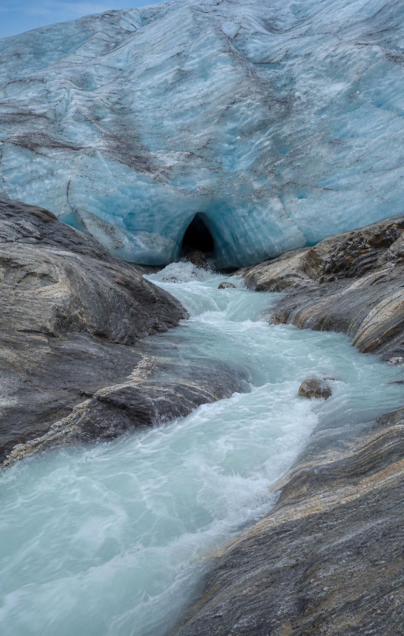
CHECK FOR UNDERSTANDING
Quick check: name the energy source
A glacier grinds a valley floor into rock flour.
Magma rises beneath a volcano.
Limestone beside an intrusion recrystallizes into marble.
A dry lake's water evaporates and leaves a salt crust.
Two plates collide and squeeze sandstone into quartzite.
Buried sand is compacted by the weight of the layers above it.
Hold up S for Sun and gravity, or I for Earth's interior, as each process is read aloud.
24
Notes:
Run it fast, one statement at a time, with one reason per answer. Statement 1 is S: glaciers are Sun-driven snowfall moved by gravity. Statement 6 is the discussion case: the weight is gravity, so S-side; accept 'gravity' said on its own. Statement 5 is I because plate motion is driven by Earth's interior heat, even though the squeezing feels like a push rather than heat.
EXPECTED RESPONSES: 1 S, 2 I, 3 I, 4 S, 5 I, 6 S (gravity). Students who answer I for statement 1 may think glaciers come from inside Earth; ask where snow comes from.
WATCH FOR: Everything underground is I, everything on the surface is S. Compaction happens underground but is driven by gravity.
CONNECTS TO: W4; W10 mastery.
PACING: about 4 min

Slide 25
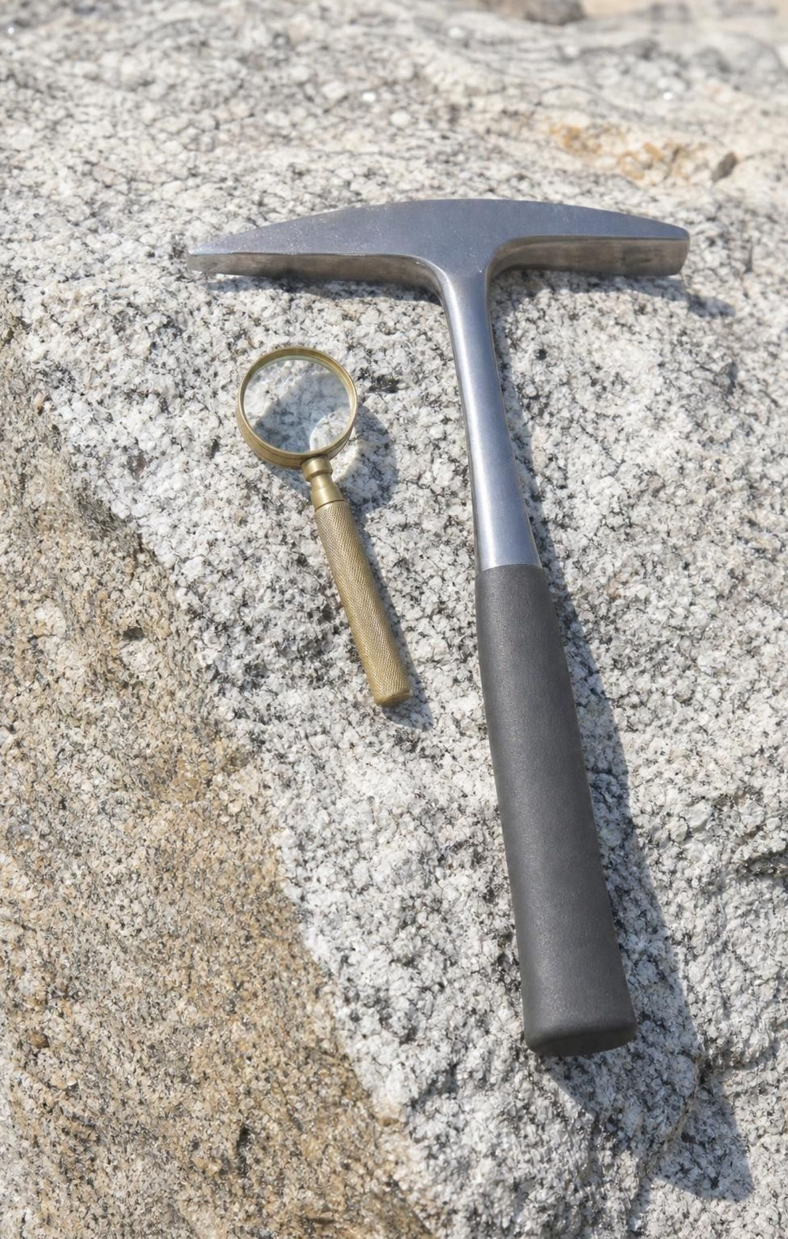
How geologists read a rock's story
In the field: a hand lens for texture, a hammer for a fresh surface, a map of how formations sit together.
In the lab: microscopes and instruments that measure composition and crystal size.
Observation: 'the grains are sand-sized and rounded.' Inference: 'water carried them a long way.'
One clue is a hint; several clues that agree make a strong explanation.
Most changes are too slow, too deep or too small to watch, so the evidence is the rock itself.
25
Notes:
Return to the phenomenon one last time and tell the dome's story as a chain of observations and inferences. Observation: interlocking coarse crystals. Inference: slow cooling underground. Observation: the rock is at the surface with no volcano. Inference: uplift and erosion removed the cover. Observation: matching sand at the base. Inference: weathering is taking it apart now. Have students practice the split on one Lab 2 card: write one observation sentence and one inference sentence. Stress the last bullet: nobody watched the Sierra granite cool, yet the explanation is strong because texture, setting and the sand all agree.
WATCH FOR: Treating an inference as an observation ('I observed that it cooled slowly'). Only the texture is observed.
CONNECTS TO: Lab 2 recording sheet; W6 CER; W9 transfer.
PACING: about 4 min

Slide 26
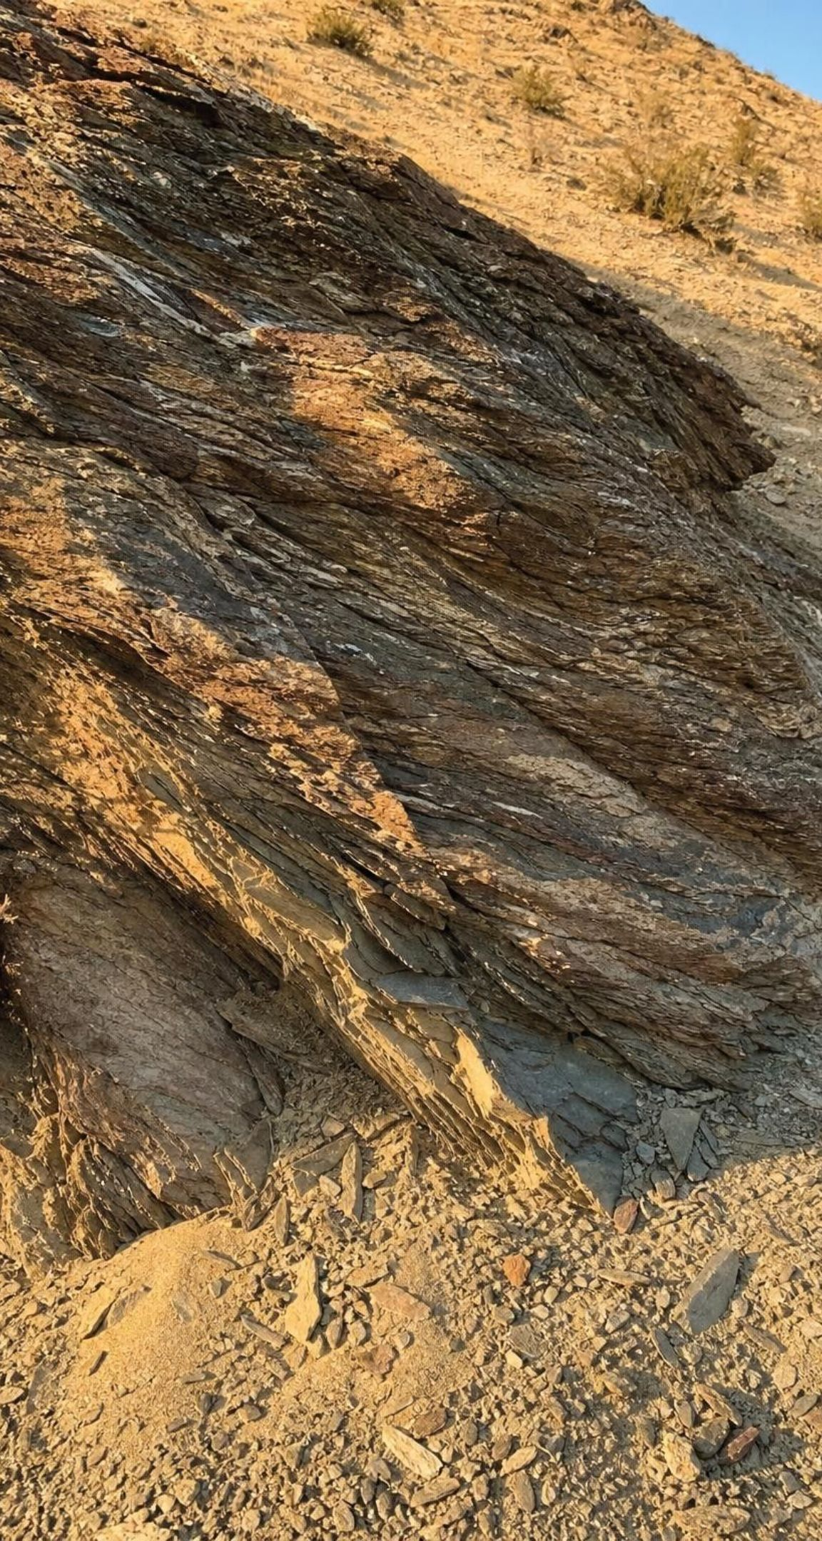
MISCONCEPTION CHECK
True or false? The cycle has a fixed order
"Every rock follows the same path: igneous rock weathers into sediment, the sediment becomes sedimentary rock, that rock is squeezed into metamorphic rock, and the metamorphic rock melts back into magma. A rock cannot skip a step."
True or false? Explain your reasoning.
26
Notes:
Have students write a verdict with one counterexample from the lesson or the labs. Expect: granite buried and squeezed straight into gneiss (skips sediment); sandstone melted straight into magma (skips metamorphic); a metamorphic rock uplifted and weathered into sediment (skips magma); lava cooling and then melting again. The loop drawing is a teaching convenience; the real model is three universal rules plus the arrows that follow from them. If Lab 3 has been run, ask for a traveler whose record shows a skipped station. Then test the second half of the misconception: can a rock stay at one station for a very long time? Yes; the dice model shows material sitting at Sediment or Metamorphic rock turn after turn, and real rock can stay a billion years.
EXPECTED RESPONSES: False. Any rock can take any of the three universal routes; students give at least one skipping route and note that there is no timetable.
WATCH FOR: Students may overcorrect to 'anything can happen instantly.' Each route has conditions: melting needs enough heat, metamorphism needs burial or collision, weathering needs exposure at the surface.
CONNECTS TO: W7 misconception repair; Lab 3 debrief.
PACING: about 5 min

Slide 27
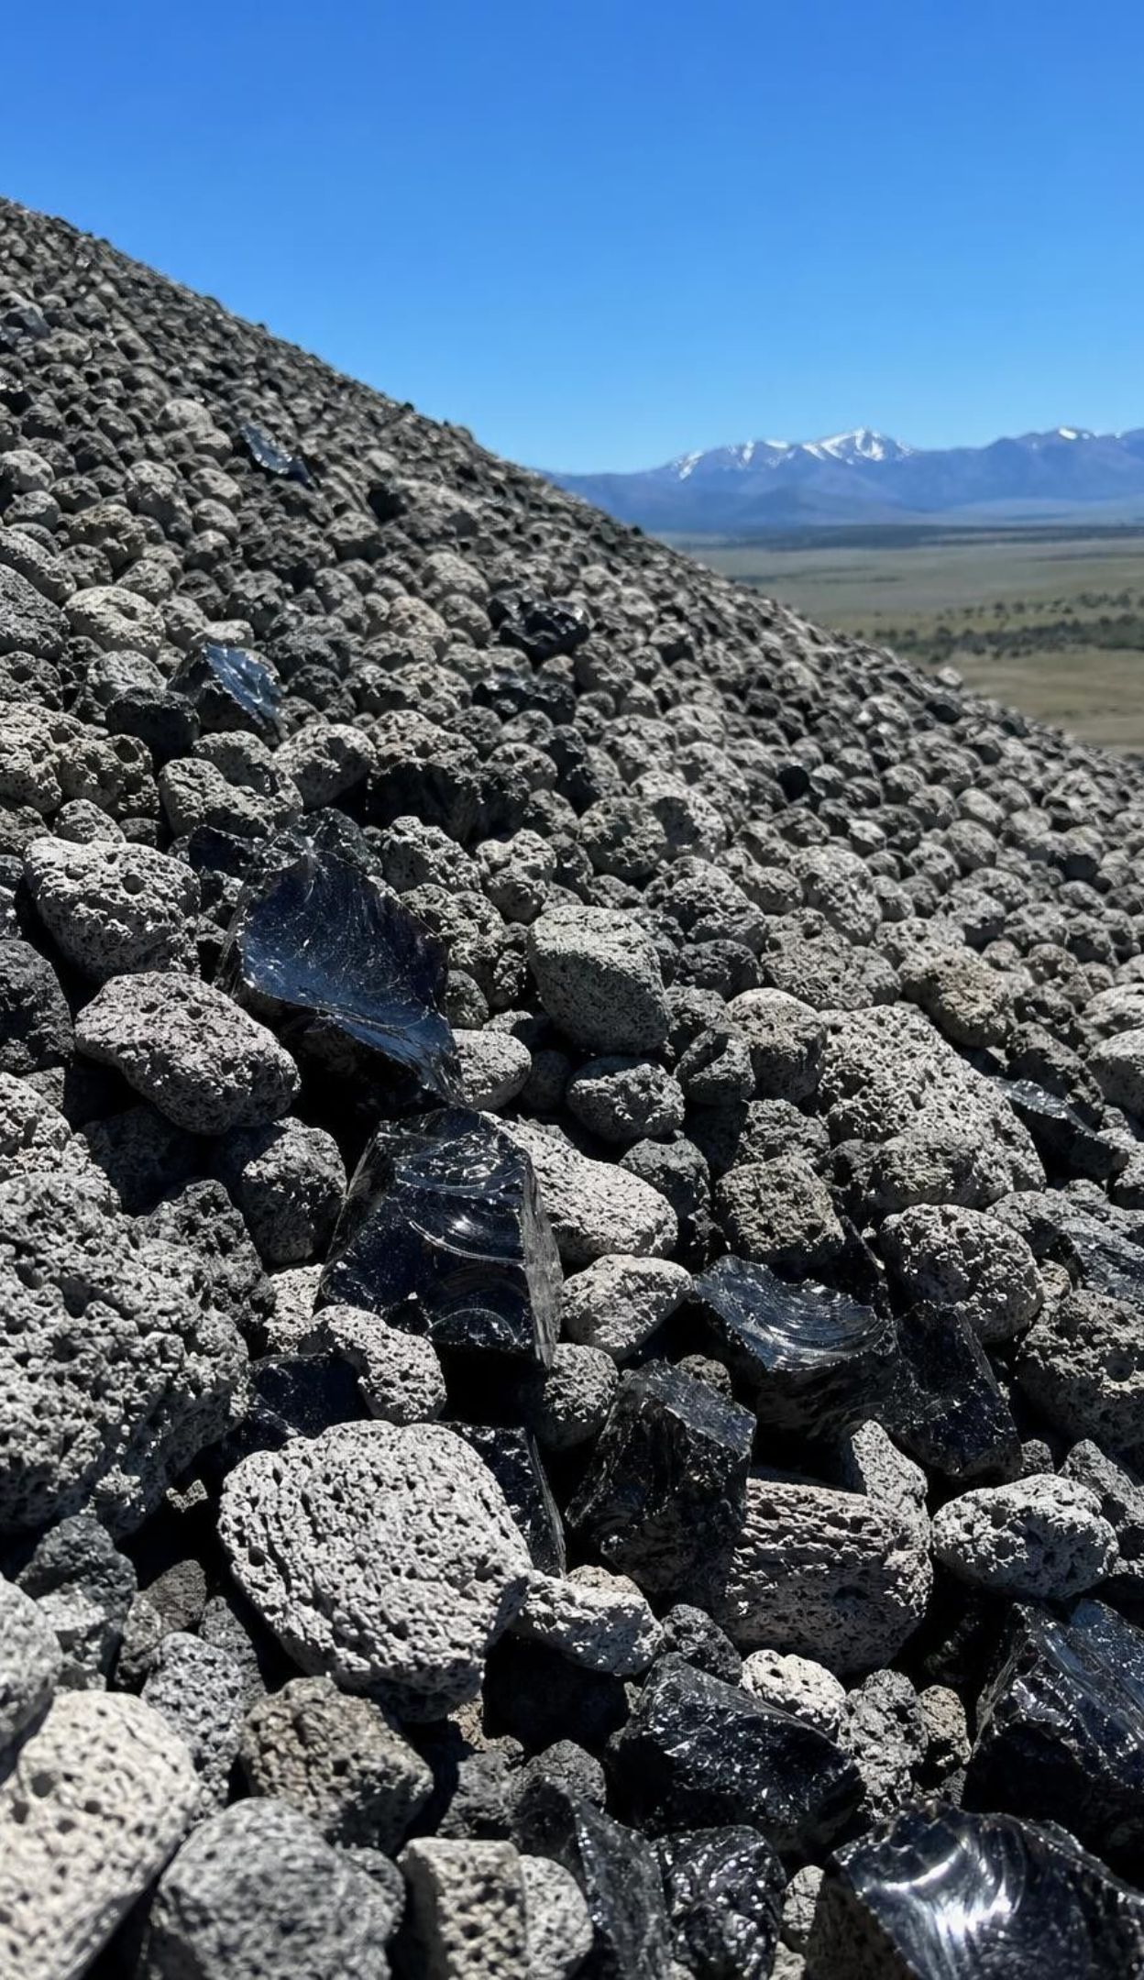
PUTTING IT TOGETHER
Putting it together
Texture records process: interlocking crystals, layered grains, or flattened and banded crystals.
Igneous: melt cools; slow underground means big crystals, fast at the surface means tiny or glass.
Sedimentary: weathering, erosion, deposition, burial, cementation, or minerals left by shells and evaporation.
Metamorphic: heat and pressure change solid rock; nothing melts.
The rock cycle is a web; any rock can become any other, with no required order.
Sun and gravity power the surface; Earth's interior powers melting, uplift and squeezing.
27
Notes:
Have students revisit the target they starred on slide 3 and write two sentences showing they can now do it, using at least three vocabulary terms. Then ask for one takeaway from each lab: Lab 1, which step changed the wax without melting it; Lab 2, which card was hardest to place and what settled it; Lab 3, which station held material longest and whether that matches Earth. Preview Lesson 18: water is the carrier in half of this cycle, and next week the water itself is the thing that cycles.
CONNECTS TO: W10 mastery as the quiz; L18 The Water Cycle next; L19 Earth's Natural Resources uses the rock families.
PACING: about 6 min

Slide 28
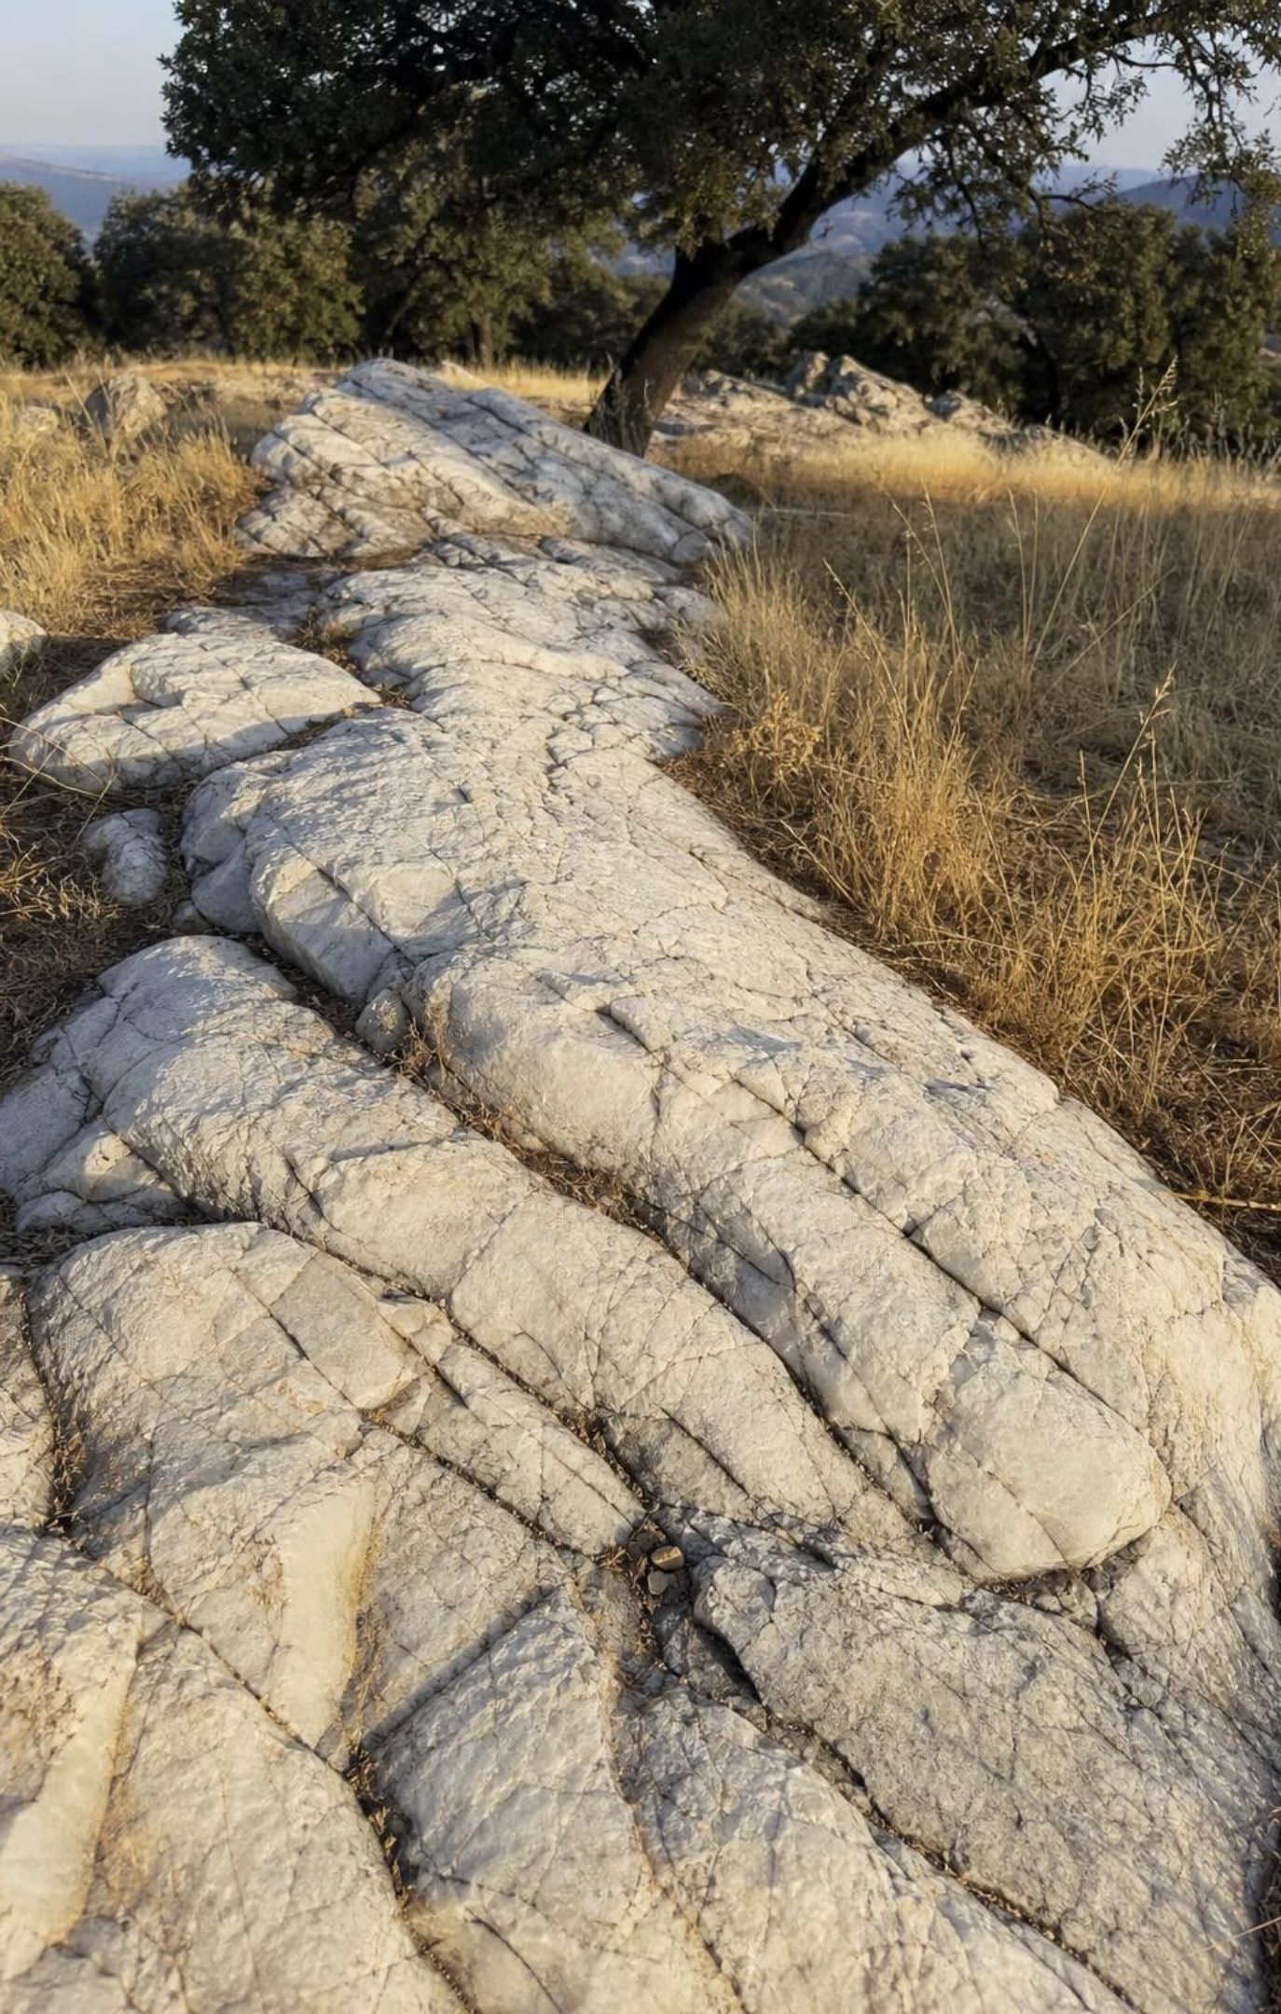
Exit ticket
Exit ticket
A rock has flattened crystals lined up in wavy bands. Name the family and the two conditions that made it.
Write a two-step route from basalt to sandstone, naming the process and the energy source for each step.
Explain in one sentence why granite found on a mountain top is evidence that rock above it was removed.
A classmate says marble is melted limestone. Correct the sentence.
28
Notes:
Collect on index cards or a shared form. Item 1 checks the metamorphic target, item 2 the model-with-energy target, item 3 the explanation target, item 4 the melting misconception. Sort the cards into three piles before the next class and reteach from the biggest pile; the most common weak spot is item 2, where students name the process but not the energy.
EXPECTED RESPONSES: 1: metamorphic; heat and pressure (deformation) while solid. 2: basalt weathers and erodes into sediment (Sun, gravity); sediment is deposited, buried, compacted and cemented into sandstone (gravity, weight of layers). 3: granite is intrusive, so it hardened underground; to be at the surface, the rock above had to be eroded away after uplift. 4: marble is limestone whose crystals were regrown by heat and pressure while the rock stayed solid.
WATCH FOR: Item 2 answers that say 'basalt melts and becomes sandstone' show the melting shortcut; item 4 answers that keep 'melted' show the cookie-dough image.
CONNECTS TO: W10 mastery; chapter evidenceOfLearning.
PACING: about 5 min

