Slide 1
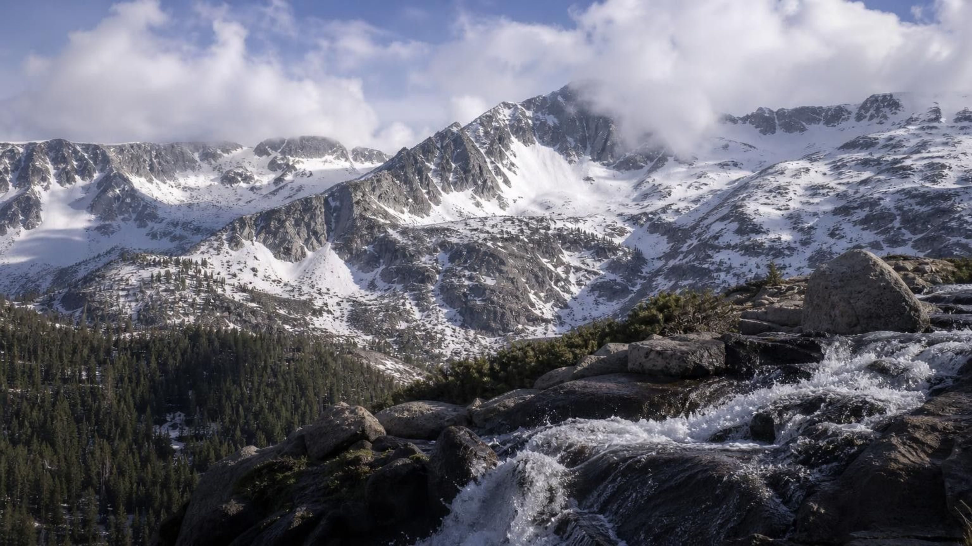
Chapter 18: The Water Cycle
The Water Cycle
Chapter 18 of 29 · Processes that Shape Earth
Lesson 18: What moves Earth's water, what changes its state, and why can it end up anywhere?
Angela's Wand · Bring Science Alive! 7th Grade Integrated
Notes:
This lesson pairs with the rock cycle from Lesson 17. There, energy from inside Earth did most of the work. Here the energy comes almost entirely from the Sun, and gravity does the rest. Tell students the water they drink today has been ocean, cloud, snow, river, sap in a plant and groundwater, many times over, and that by the end of the week they will be able to trace those routes and say what powered each step. Preview the three labs: a solar distiller they build, test and improve (Lab 1), evaporation and transpiration measured outdoors (Lab 2), and a dice game that models where water goes and how long it stays (Lab 3). Note for the record that the main standard here, MS-ESS2-4, sits in Grade 6 in California's integrated sequence; this textbook places it in seventh grade, so some students may be meeting it a second time.
CONNECTS TO: Overview of Lab 1, Lab 2 and Lab 3; W1 opens on the next slide.
PACING: about 2 min

Slide 2
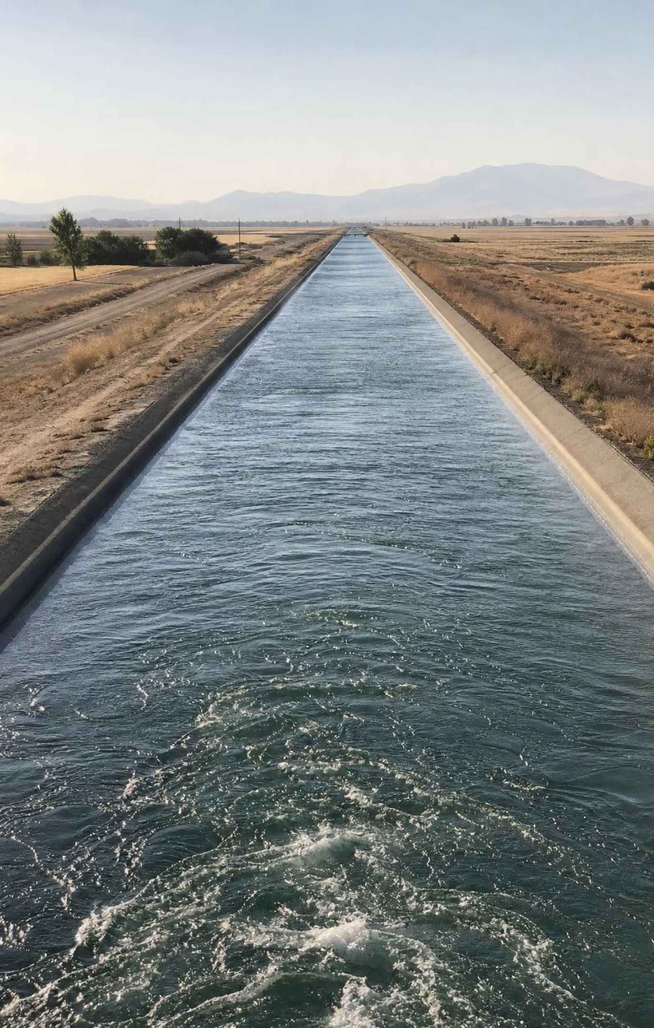
PHENOMENON
Snow in April, faucets in August
In early April the Sierra Nevada snowpack can be several meters deep. By late August the same slopes are bare rock and dry grass. Yet in August, hundreds of kilometers away, Central Valley canals still flow and town wells still pump water from hundreds of meters underground. The snow did not vanish. What moved it, and how did some of it end up deep in the ground?
Notice: there is no drain at the bottom of the mountain. Where could several meters of snow go?
Wonder: how does mountain snow reach a well hundreds of meters below a valley floor?
Predict: what fraction of the melted snow ever reaches the ocean?
2
Notes:
Give two silent minutes for a notice and a wonder, then collect ideas on the board without judging them. Push for mechanisms: what has to happen to snow before it can rise into the air? What has to happen before it can fall again? What pulls it downhill, and what pulls it underground? Expect 'it melts and runs into rivers' as the first answer; ask what happens to the melt that soaks into the soil, and to the part that disappears on a sunny day when the temperature never rises above freezing. Park every proposed pathway on a chart; the class will return to it on the routes discussion. Background: California's Department of Water Resources measures the snowpack around April 1 and estimates that in a typical year it supplies roughly 30 percent of the state's water. State that as approximate.
EXPECTED RESPONSES: Notice: snow is gone by summer; it is hot and dry in August; the valley still has water. Wonder: does the snow melt or evaporate; how long does it take to get underground; does any come back as snow next year. Predictions range widely; many students will say all of it reaches the ocean, which Lab 3 and the routes discussion will test.
WATCH FOR: 'The snow just melts and goes away' (water disappearing), and 'underground water is a lake in a cave'. Record both on the parking lot without correcting yet.
CONNECTS TO: W1 phenomenon worksheet records the notice, wonder and first explanation. W3 reading follows Sierra snow to the valley; W5 Part A graphs snowmelt feeding a creek.
PACING: about 8 min

Slide 3
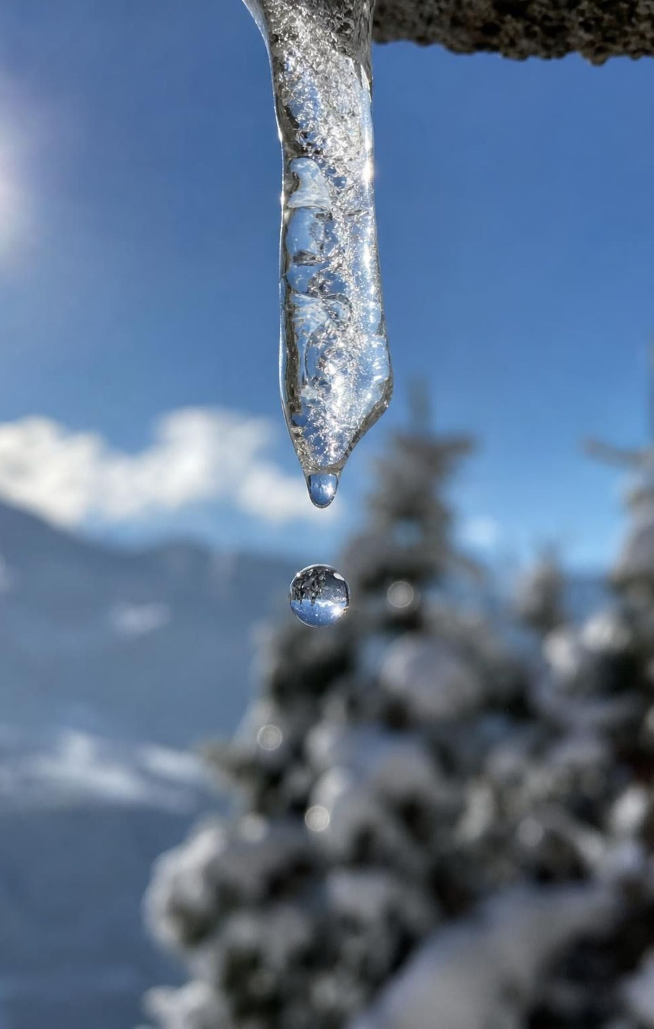
LEARNING TARGETS
What you will be able to do
1
Describe the main water cycle processes and the change of state each one involves.
2
Explain which processes the Sun powers, which gravity powers, and what cooling does.
3
Use a particle model to explain evaporation below boiling and condensation on cooling.
4
Trace several different routes water can take and explain why there is no fixed order.
5
Use test data from a water-collecting design to decide what to change and improve it.
3
Notes:
Read the targets aloud and have students star the one that seems hardest. Point out that targets 1 and 2 are the heart of the lesson, target 3 explains the mechanism at the particle level, target 4 is what the dice model is for, and target 5 belongs to the solar distiller. Tell them the exit ticket asks about all five.
CONNECTS TO: Targets map to W2 and W4 (1), W4 and W10 (2), W5, W6 and W7 (3), Lab 3 and W8 (4), Lab 1 and W9 (5).
PACING: about 2 min

Slide 4
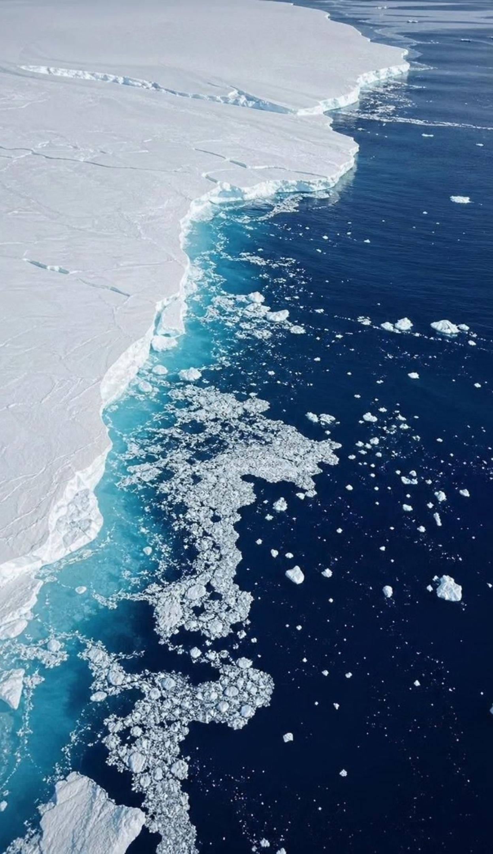
MODEL
Where Earth's water is right now
About 97 percent of Earth's water is salty ocean water.
Most of the fresh water is locked in ice sheets and glaciers or stored underground.
Rivers, lakes and the atmosphere together hold a tiny fraction, yet they are where most of the action is.
Model: Share of all Earth's water, by reservoir (approximate percent)
Approximate shares from U.S. Geological Survey estimates. Lakes, rivers, soil, the atmosphere and living things combined hold only about two hundredths of a percent; frozen ground holds about as much again.
4
Notes:
Start with the inventory so the cycle has places to connect. The ocean dominates; of the fresh water, ice and groundwater hold almost all of it. The surprising part is the last bar: the atmosphere holds about a thousandth of a percent of Earth's water, and rivers less than that, yet every drop of rain passes through the atmosphere and most of the water we use comes from rivers, lakes and wells. Ask: if the air holds so little water, how can it rain so much? The answer is turnover: water passes through the air quickly and constantly. That idea, how long water stays in each place, comes back on the residence-time slide and in Lab 3. Call these places reservoirs; the word means a storage place, not just a dam.
WATCH FOR: Students may think most fresh water is in rivers and lakes. Rivers hold a tiny share; groundwater holds far more.
CONNECTS TO: Lab 3 stations are these reservoirs. W1 Part C, W8 Card 12 and W10 q9 use these reservoir shares.
PACING: about 5 min

Slide 5
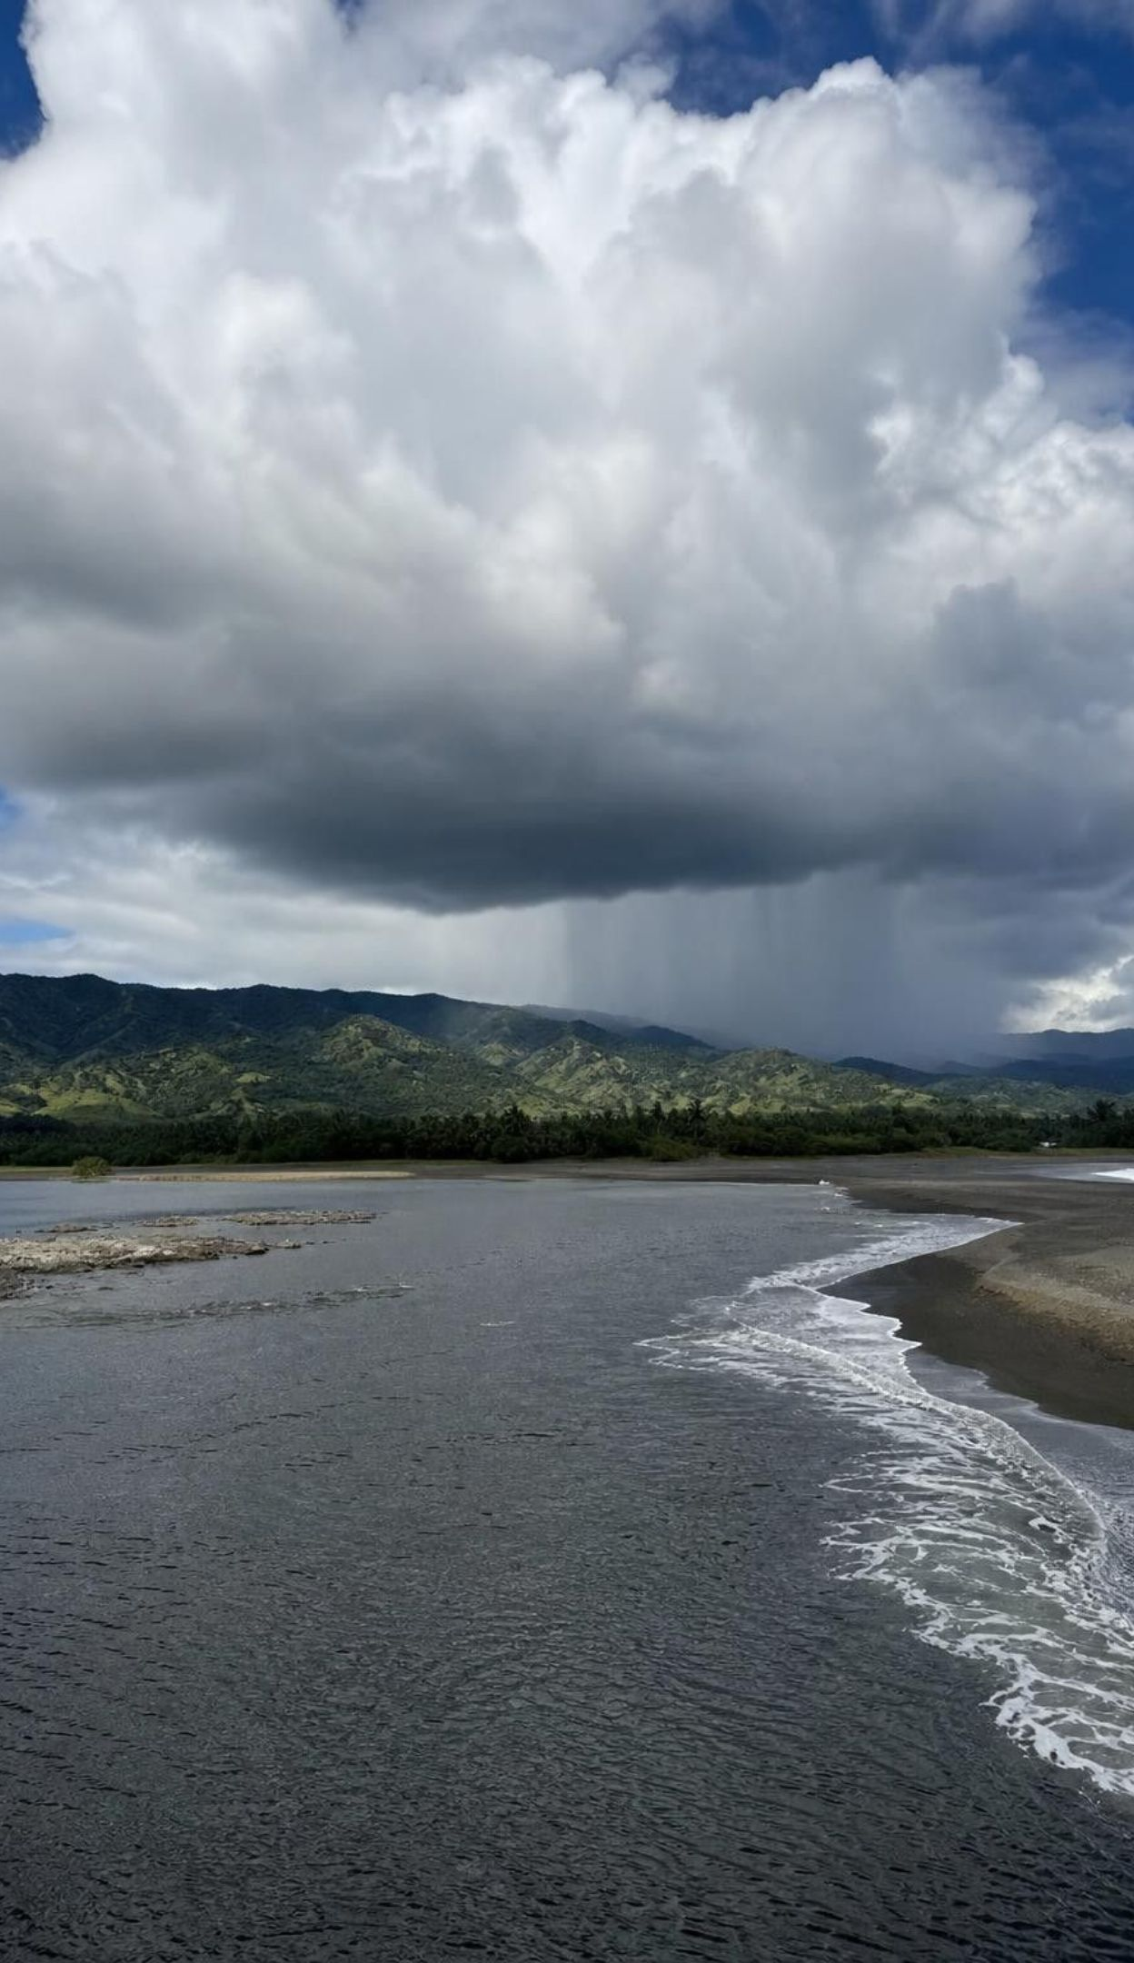
MODEL
The loop you have seen before, and what it hides
Model: The simplest water cycle model
Ocean and lakes → (evaporation (Sun))
Water vapor in the air → (condensation (cooling))
Clouds → (precipitation (gravity))
Rain and snow on land → (runoff and infiltration (gravity))
Rivers and groundwater → (flow back to the sea (gravity)) (back to the start)
A useful starting model. Real water skips steps, repeats steps and runs the loop in many directions at once.
5
Notes:
Most students can draw this loop from memory. Use it to name the three kinds of driver written on the arrows: the Sun supplies energy to lift water as vapor, cooling lets vapor become droplets, and gravity brings everything down and downhill. Then attack the loop's weakness. Ask: must every molecule visit every box? Can rain evaporate before it lands? (Yes; in dry air it often does.) Can groundwater skip the river and seep straight into the sea? (Yes.) Can snow turn to vapor without melting? (Yes, sublimation.) Can water sit in the ocean for a thousand years? (Yes.) Tell students the lesson's job is to replace this one-loop picture with a network, and that Lab 3 will let them walk the network.
WATCH FOR: One loop in fixed order. Keep asking 'must it?' at every arrow.
CONNECTS TO: W4 diagram worksheet asks students to redraw this as a multi-route model; Lab 3 generates the routes.
PACING: about 5 min

Slide 6
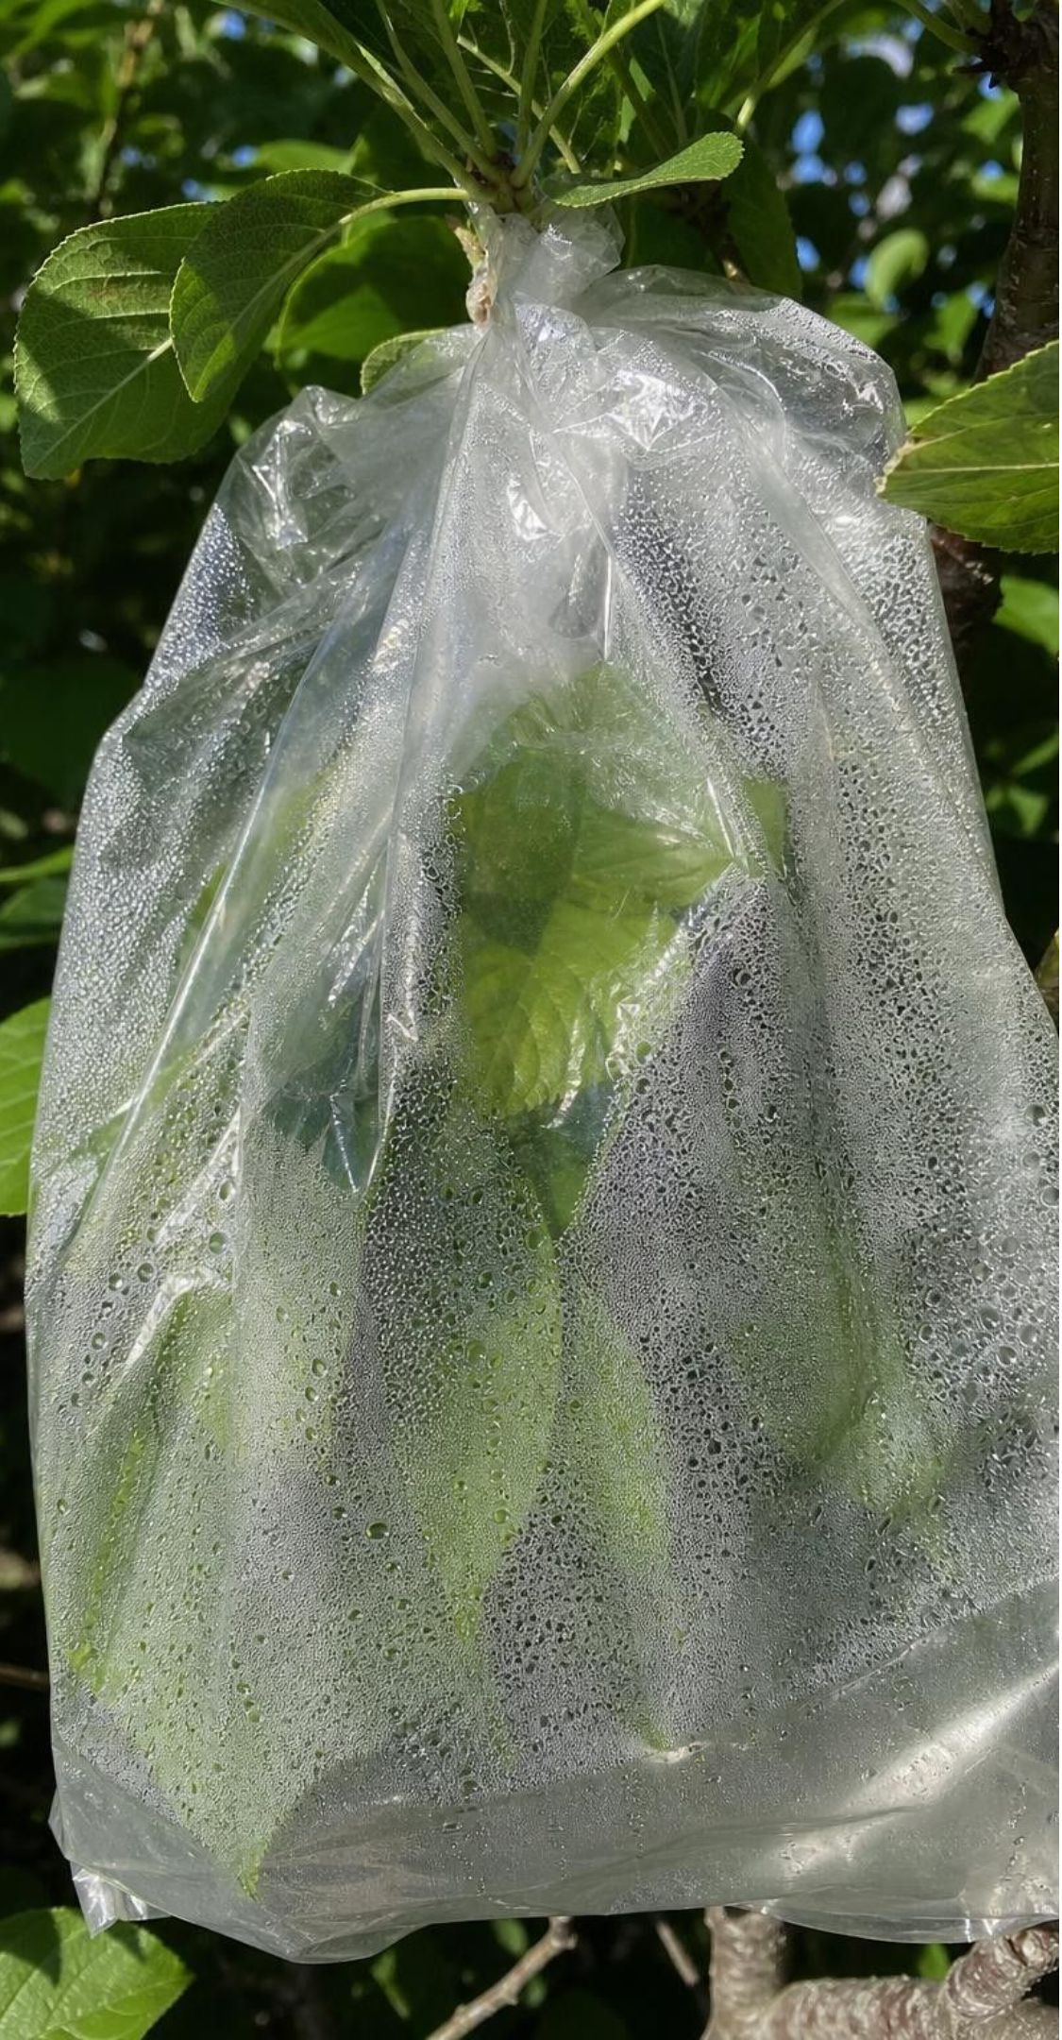
VOCABULARY IN CONTEXT
Three words for the upward half
water vapor: Water as an invisible gas. Clouds and fog are not vapor; they are droplets or ice crystals you can see. Humid summer air in Sacramento holds far more water vapor than a clear winter day in the desert, and both look the same.
evaporation: Liquid water becoming vapor at the surface of the liquid, at any temperature, because the fastest surface molecules escape. A wet swimsuit dries on a cool, breezy day without ever getting hot.
transpiration: Water moving from roots to leaves, evaporating inside the leaf and leaving through tiny pores (stomata) as vapor. A bag tied over a leafy branch in sunlight collects droplets within hours.
6
Notes:
Insist on the invisibility of water vapor; it is the single most useful fact in this lesson. Hold up a clear jar of air and say it contains water vapor right now. Ask where the visible cloud above a kettle begins: not at the spout, where the gas is still invisible, but a centimeter or two above it, where the vapor has cooled and condensed. For transpiration, say the water leaves the leaf as vapor; the textbook's section 1 describes liquid leaving the stomata and then evaporating, but its own concept spread and plant biology sources describe evaporation inside the leaf, which is what we teach.
WATCH FOR: 'Steam' meaning the visible cloud. Steam at the spout is invisible; the white plume is condensed droplets.
CONNECTS TO: W2 vocabulary sort; Lab 2 measures both evaporation and transpiration.
PACING: about 4 min

Slide 7
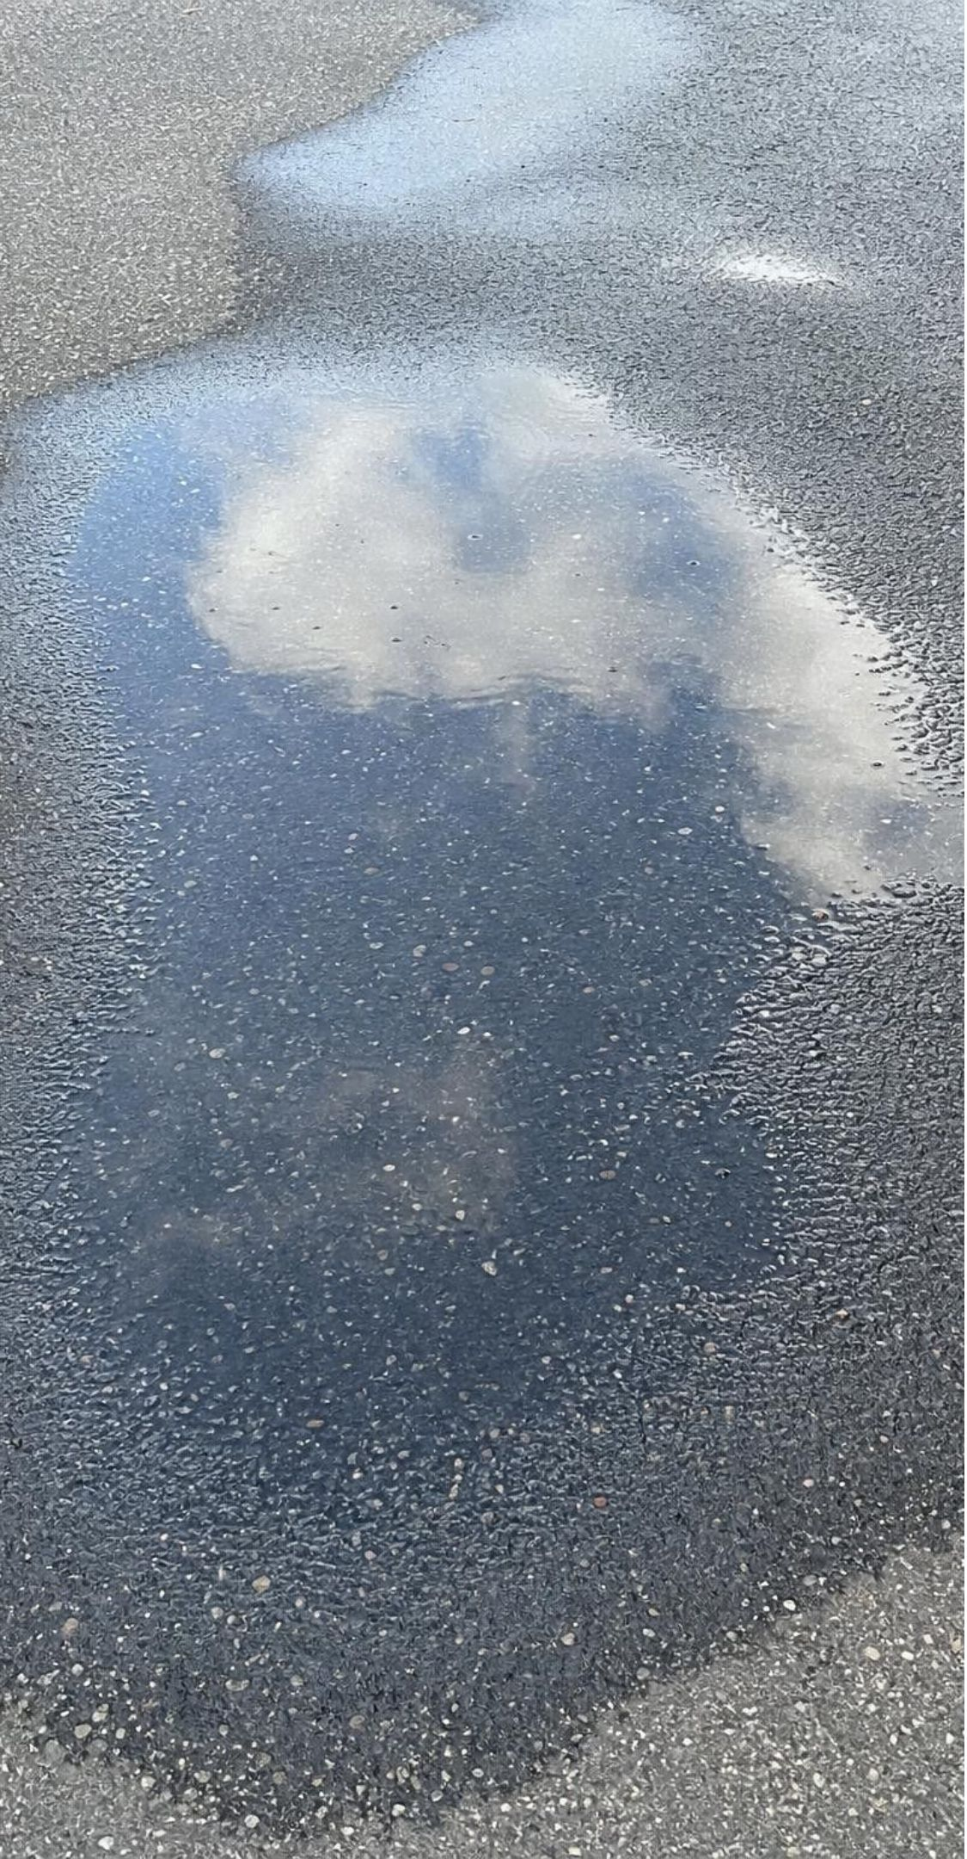
MODEL
How a puddle dries without boiling
Molecules in liquid water are close together and moving at many different speeds.
Sunlight adds energy, so more molecules move fast enough to break free from the surface.
Escaped molecules spread out as vapor; the liquid left behind is a little cooler.
Warmer, windier or drier air speeds evaporation; boiling is not required.
Model: Water molecules at a puddle surface
Liquid water (surface): particles tightly spaced; Close together; the fastest ones at the top can escape.
Water vapor above: particles loosely spaced; Far apart, moving freely, invisible.
Evaporation happens only at the surface and at any temperature. Boiling is different: vapor bubbles form inside the liquid.
7
Notes:
Build the mechanism from the particle model students know from Lessons 23 and 24 if you have taught them, or introduce it here: molecules in a liquid jostle at a range of speeds, and the Sun's energy raises the share that move fast enough to escape the surface. Emphasize that evaporation is a surface process and that it cools what is left behind, which is why sweat cools you and why a wet dog shivers. Ask students for three things that would make a puddle dry faster and have them explain each in molecule terms: more sunlight (faster molecules), wind (carries vapor away so more can escape), dry air (fewer vapor molecules returning). You do not need to quantify the energy; the assessment boundary excludes latent heat numbers.
WATCH FOR: 'Water must reach 100 °C to become gas.' Point to the drying swimsuit and the shrinking puddle on a 15 °C day.
CONNECTS TO: Lab 2 evaporation trays (sun versus shade); W5 Part B evaporation data; W7 misconception repair.
PACING: about 6 min

Slide 8
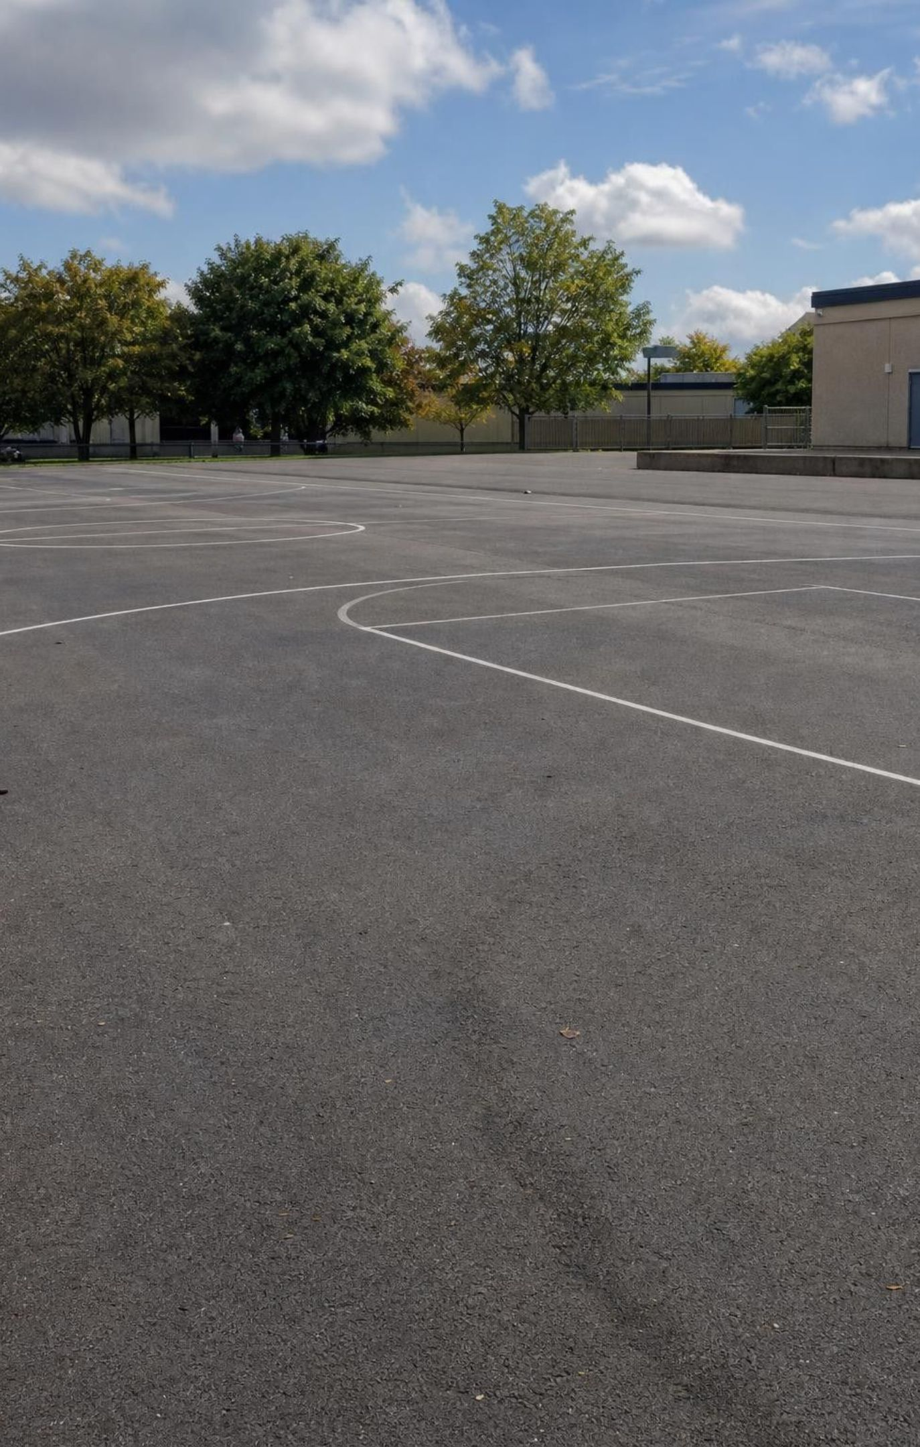
CHECK FOR UNDERSTANDING
Quick check: the shrinking puddle
A puddle on the blacktop is gone by lunchtime on a 22 °C day. Which statement best explains where the water went?
A. It soaked into the asphalt and is still there.
B. The fastest surface molecules escaped as invisible vapor, a few at a time, until none were left.
C. The puddle heated to 100 °C and boiled away.
D. The water turned into air.
8
Notes:
Vote with fingers, then defend. Some water may infiltrate through cracks, but intact asphalt is nearly waterproof, so A cannot account for a whole puddle. C fails on temperature. D confuses a change of state with a change of substance: water vapor is still water, not air. B is the particle model from the last slide. Follow up: what evidence would show the water is still around as vapor? (It could condense again on something cold; the humidity rose a little.)
EXPECTED RESPONSES: B. Students who choose D need the reminder that evaporation changes state, not substance; the molecules are still H2O.
WATCH FOR: 'Turned into air' is common and worth naming aloud; it treats a change of state as a change of identity.
CONNECTS TO: W7 Claim 2 repairs the boiling error; W10 q3 checks it.
PACING: about 4 min

Slide 9
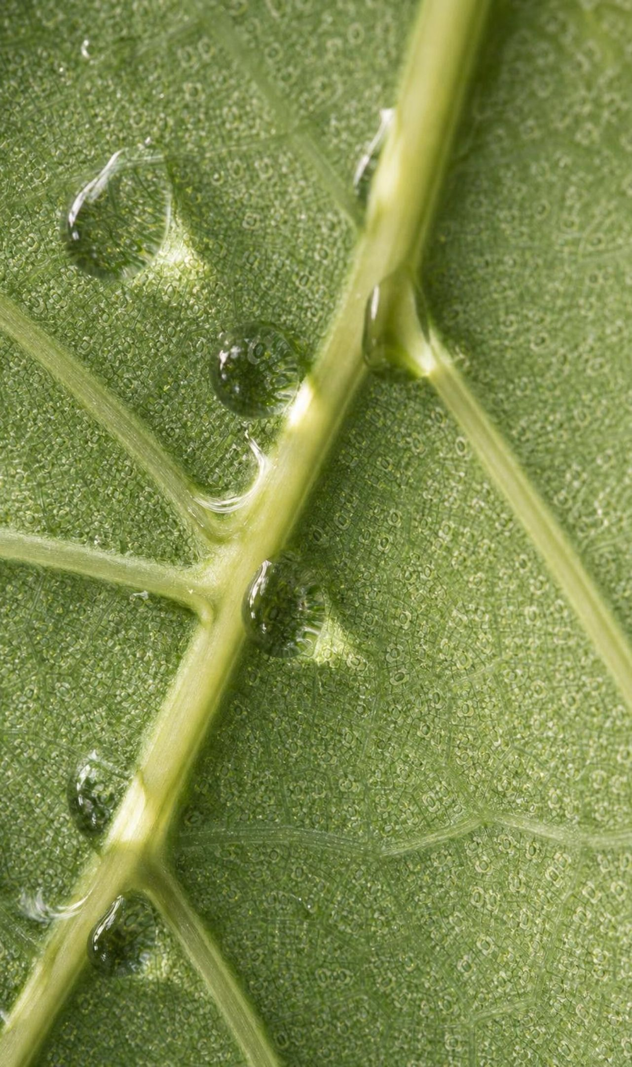
Plants are part of the pump
Roots take in liquid water, which rises up the stem and into the leaves.
1
Inside the leaf, water evaporates from cell surfaces and leaves through stomata as vapor.
2
Stomata open and close, so a plant can slow its water loss on a hot, dry afternoon.
3
Evaporation cools the leaf, the same way sweat cools skin.
4
Roughly nine tenths of the air's water vapor comes from open water; most of the rest comes from plants.
5
9
Notes:
Transpiration links the biosphere into the cycle. Ask why a forest feels cooler and more humid than a parking lot on the same afternoon: the trees are moving water into the air and the evaporation draws energy from the leaves. Mention that the nine-tenths figure is an estimate and that a small share also arrives by sublimation from snow and ice, which the next slides cover. Preview Lab 2: a bag over a leafy branch in sun collects measurable water in a day; the same bag in shade collects less. Ask for a prediction and the reason.
WATCH FOR: Students may think plants 'drink' water and keep it. Most of the water a plant takes in passes straight through to the air.
CONNECTS TO: Lab 2 transpiration bags; W3 reading.
PACING: about 4 min

Slide 10
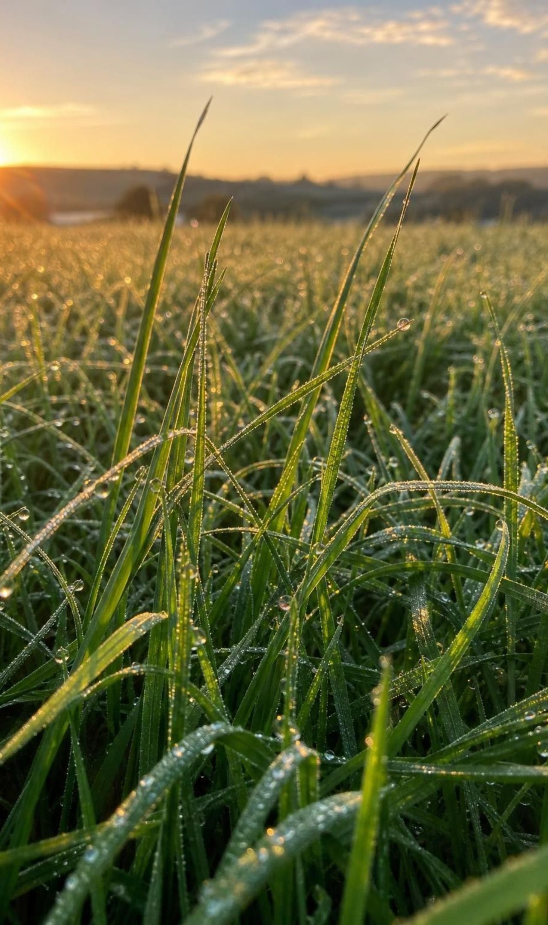
Cooling: vapor turns back into liquid
Rising air expands and cools; cold surfaces cool the air that touches them.
1
Cooler vapor molecules slow down, collide and stick together, usually on a speck of dust, salt or smoke.
2
Air can hold only so much vapor at a given temperature; at that limit it is saturated and condensing begins.
3
Condensation releases energy to the surroundings; evaporation took that energy in.
4
Clouds, dew and the wet outside of a cold can are all condensation.
5
10
Notes:
Give the two triggers plainly: cooling, or adding vapor until the air is saturated. A bathroom mirror fogs because the shower adds vapor to the air and the mirror is cooler than that air. A cloud forms because rising air expands and cools until its vapor condenses on tiny particles. Stress that neither the Sun nor gravity directly powers this step; the textbook's concept spread says every process is powered by one of the two, but condensation happens when water gives energy off as it cools. The Sun and gravity drive the cycle as a whole, including the rising of moist air, but this step is water losing energy, not gaining it. Ask students to feel the energy release indirectly: a steam burn is worse than a hot-water burn at the same temperature because the vapor releases extra energy as it condenses on skin (do not demonstrate).
WATCH FOR: 'Condensation needs something freezing cold.' Any surface cooler than the air's dew point will do; on a humid night, grass at 18 °C collects dew.
CONNECTS TO: W3 reading; W7 misconception repair; Lab 1 relies on condensation under the cover.
PACING: about 5 min

Slide 11
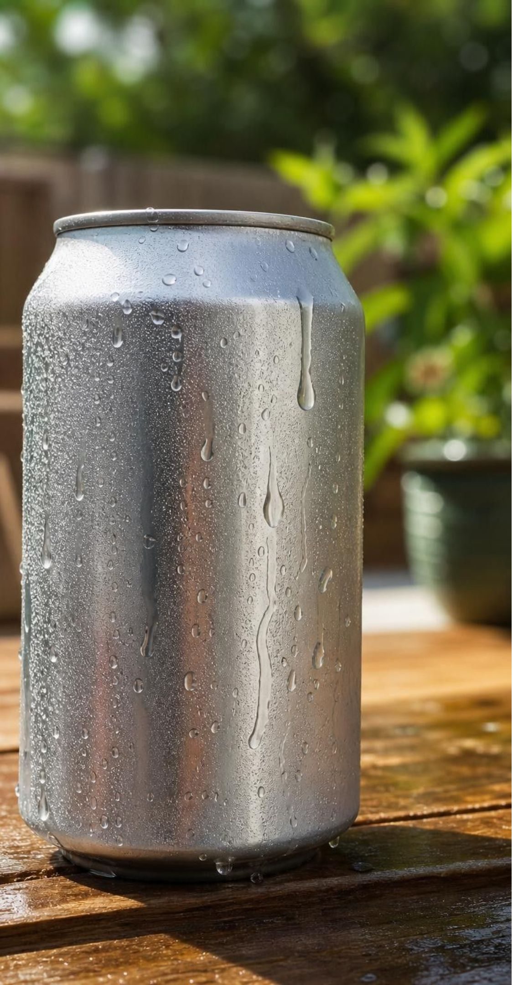
MODEL
A cold can on a warm day
Model: Where the droplets come from
Warm room air: Holds invisible water vapor, more on humid days.
Thin layer of air touching the can: Cooled by the metal to below the point where it can hold its vapor.
Droplets on the outside: Vapor molecules from the room slowed, stuck together and became liquid.
Inside the can: Sealed. Nothing passes through the metal; the inside liquid is not the source.
Test: An empty sealed cold can sweats too; a warm full can does not.
Condensation needs a surface cooler than the surrounding air's dew point, not a leak.
11
Notes:
Run this live if you can: one can from the fridge, one from the shelf, both unopened, on the desk for ten minutes. Students watch the cold one bead up while the warm one stays dry. Ask where the water came from and how they know it did not leak through the metal. Introduce the phrase dew point informally: the temperature at which a sample of air becomes saturated. The colder the can and the more humid the room, the faster the beads form. If you have a damp-day and dry-day comparison (or a humidifier), it makes the saturation idea concrete.
WATCH FOR: The leak explanation. The sealed empty can is the clean test; use it.
CONNECTS TO: W2 q8 applies this to a glass of ice water; W8 Card 5 shows the same process on a cold window.
PACING: about 5 min

Slide 12
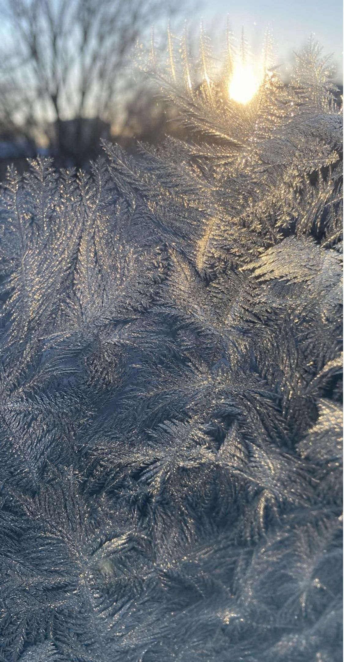
VOCABULARY IN CONTEXT
Three words for cooling and for ice
condensation: Water vapor becoming liquid water when air cools or becomes saturated. Energy is released. Fog over the bay at dawn is condensation; it clears as the Sun warms the air and the droplets evaporate again.
crystallization: Water becoming solid ice. Freezing is liquid to solid; deposition is vapor straight to ice, as in frost and many snowflakes. Frost on a car roof on a clear night formed by deposition; the puddle beside it froze from liquid.
sublimation: Ice becoming vapor directly, without melting. It takes in energy, usually from sunlight, and is fastest in dry, windy air. A snowbank shrinks on a sunny, windy week even though the air never rises above 0 °C.
12
Notes:
The textbook uses one word, crystallization, for both liquid-to-solid and gas-to-solid; it is also the NGSS wording, so keep it, but give students the two precise terms. Ask which direction each change goes and whether water gains or loses energy: condensation and crystallization release energy; sublimation and melting take it in. Add that ice crystals are built from water molecules arranged in a repeating pattern, which is why snowflakes have six-sided symmetry. Avoid stating that water always freezes below 0 °C; cloud droplets often stay liquid well below freezing until a particle or an ice crystal starts them off.
WATCH FOR: Confusing sublimation (ice to vapor) with deposition (vapor to ice). Use the snowbank and the frost as the two anchors.
CONNECTS TO: W2 vocabulary; Lab 3 has a sublimation move at the snowpack station.
PACING: about 4 min

Slide 13
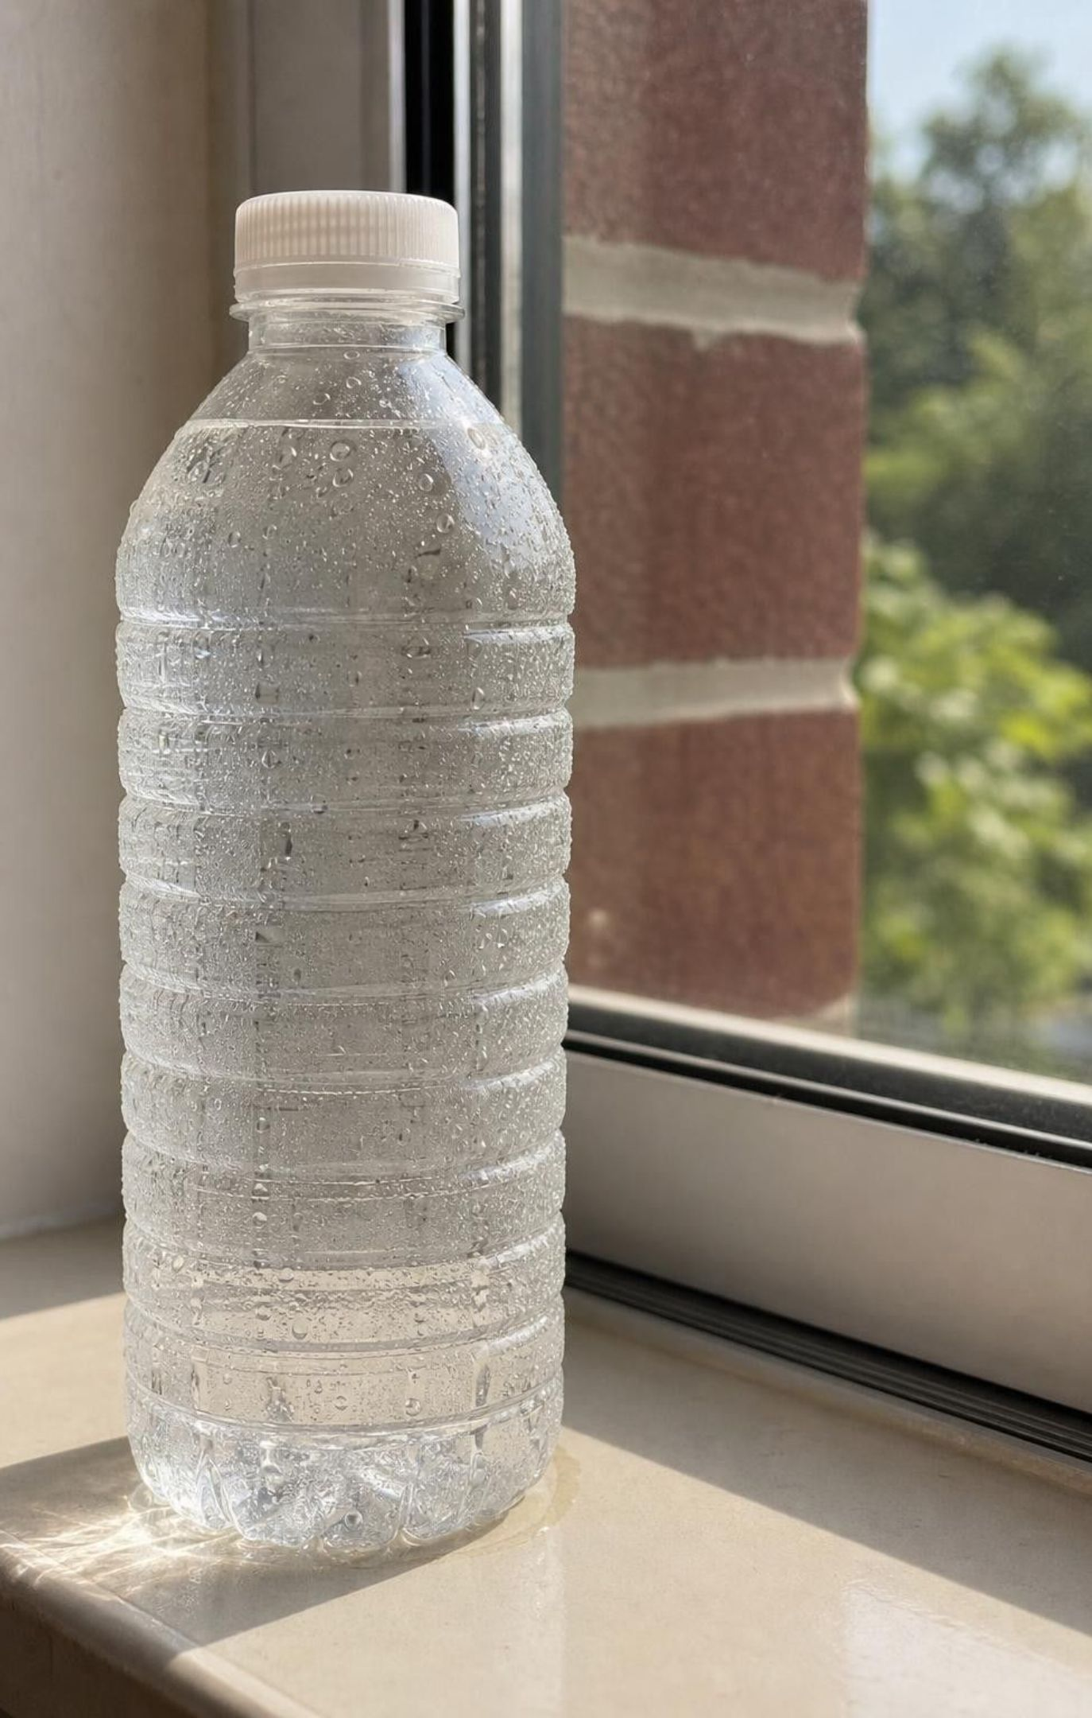
CHECK FOR UNDERSTANDING
Quick check: the sweating water bottle
A sealed, cold bottle of water gets wet on the outside in a warm classroom. Where did that water come from?
A. It leaked through tiny holes in the plastic.
B. It came out of the air in the room, which held invisible water vapor that condensed on the cold surface.
C. The bottle made new water from the cold.
D. It came from the student's hands.
13
Notes:
Quick vote, then ask for the one test that rules out A: an empty sealed cold bottle sweats just the same. Rule out C with conservation: cold does not create matter. Then ask the follow-up that matters for the water cycle: what is the cold bottle doing that a mountain slope does to rising air? Both cool air below the point where it can hold its vapor. Replace the bottle with a cold mountainside, and the beads with cloud droplets, and you have the cooling half of the cycle.
EXPECTED RESPONSES: B. A few students will hold out for A; the empty-bottle test is the answer, and they can run it at home.
WATCH FOR: The leak idea again; also 'cold makes water', which treats condensation as creation rather than a change of state.
CONNECTS TO: W2 q8 uses the same reasoning; W10 q4 checks it.
PACING: about 3 min

Slide 14
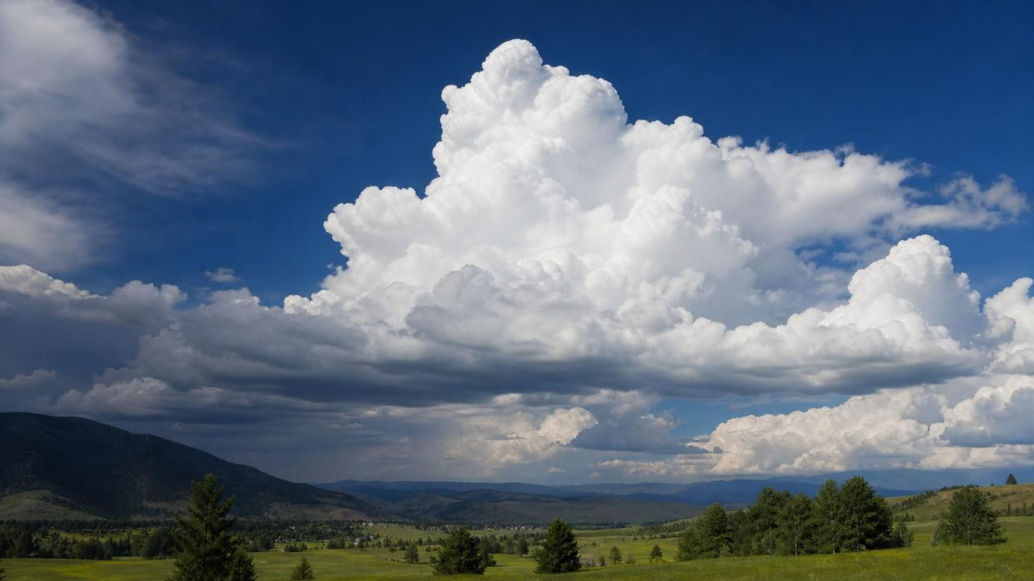
THINK, PAIR, SHARE
Discuss: what is a cloud made of?
A cloud is clearly made of water. Is it water vapor, liquid water, ice, or some mix? What evidence from your own experience supports your answer?
Notes:
Think-pair-share for four minutes, then take a class poll. Steer with questions: can you see water vapor (no, so a visible cloud cannot be only vapor)? What is fog, and what happens when you walk through it (your skin gets damp with tiny droplets)? What falls out of a very cold cloud (snow, so there must be ice crystals)? Land on: clouds are made of tiny liquid droplets, ice crystals, or both, floating in air that also holds invisible vapor. Connect to the lesson summary's wording problem without naming the book: 'condensed vapor' is a contradiction: once it is condensed it is no longer vapor.
EXPECTED RESPONSES: Most pairs start with 'vapor' or 'gas'. After the prompts, the class should agree on droplets and ice crystals, with vapor present but invisible. Evidence: fog wets skin; snow falls from clouds; contrails form behind planes in cold air.
WATCH FOR: 'Clouds are gas' and 'clouds are like cotton' (solid). Both are addressed by the fog-on-skin experience.
CONNECTS TO: W2 q9 (a breath cloud); W8 Card 4 (cloud base) and Card 11 (fog).
PACING: about 6 min

Slide 15
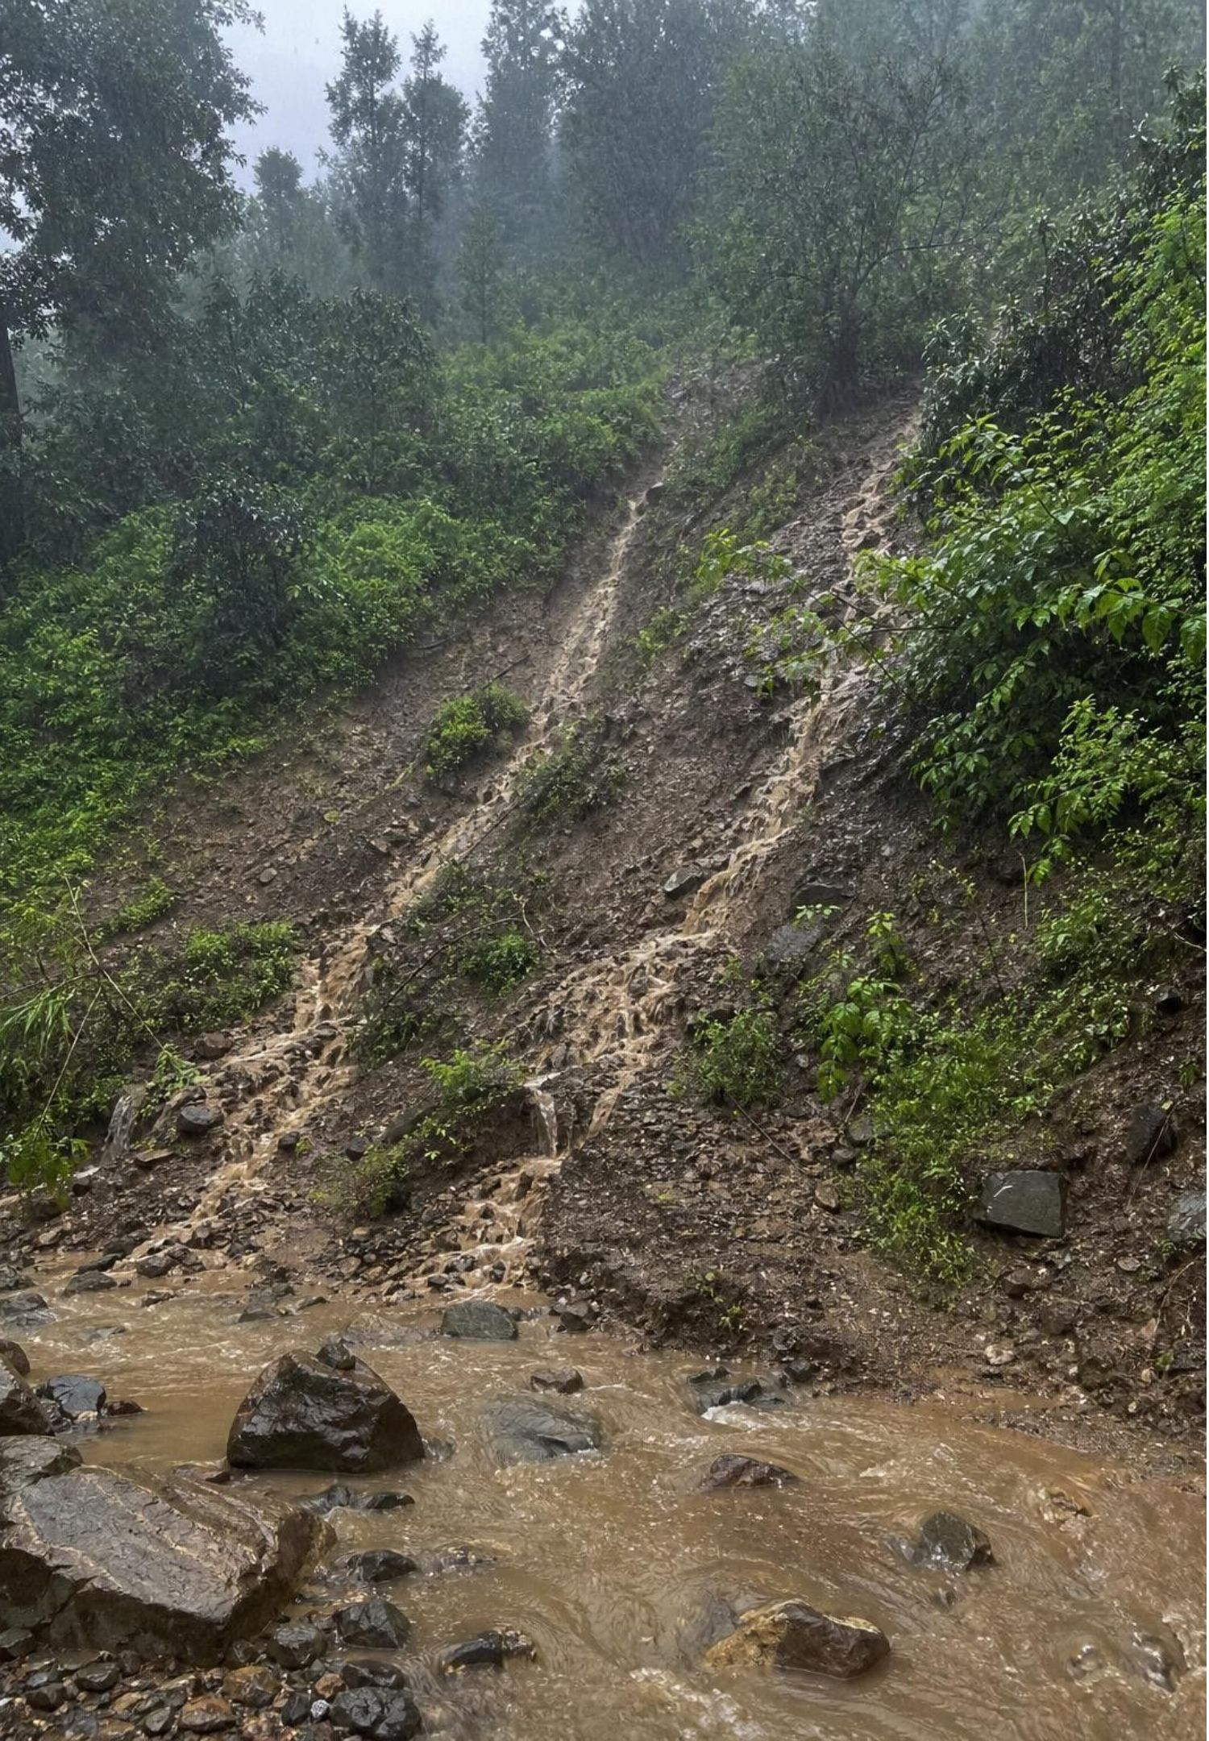
Gravity's half: rain, snow and the downhill journey
Cloud droplets are tiny; rising air holds them up even though gravity pulls on them.
Droplets collide and merge, or ice crystals grow, until they are heavy enough to fall.
Falling drops meet air resistance; larger drops flatten underneath and very large ones break apart.
On the ground, gravity keeps working: downhill as runoff, downward as infiltration.
Melting snow joins the same two paths; some snow sublimates instead.
15
Notes:
Precipitation is the first of four gravity-driven processes: precipitation, runoff, infiltration and groundwater flow. Explain why clouds do not simply fall: the droplets are so small that air resistance and rising air balance gravity, the same reason dust hangs in a sunbeam. Only when droplets merge into drops roughly a hundred times wider do they fall. Correct the teardrop picture: small raindrops are round and larger ones are flattened on the bottom like a bun because air pushes up on them. Then move to the ground: on a slope, water runs off; on soil, some soaks in. Ask what decides the split (slope, how hard it rains, whether the ground is paved, frozen, already wet, sandy or clay).
WATCH FOR: 'Rain falls because the cloud gets too heavy' as a whole. Individual drops fall when they grow heavy enough; the cloud does not fall as a unit.
CONNECTS TO: W3 reading; W4 diagram; Lab 3 moves from the atmosphere station.
PACING: about 5 min

Slide 16
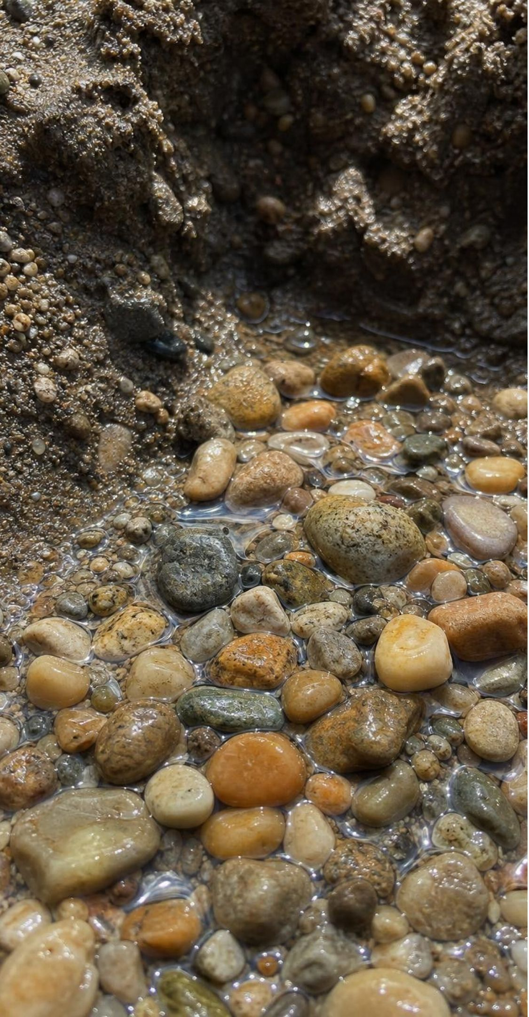
MODEL
Underground is not a cave: water in pores
Model: A cut through the ground beneath a valley
Top to bottom:
Soil: roots, air and some water in the spaces
Unsaturated zone: pores hold both air and water; water trickles down
Water table: the top of the fully saturated zone
Aquifer: sand and gravel with every pore full of water; wells draw from here
Clay layer: tiny pores, water barely moves through it
Bedrock: few connected pores; little water flows
Groundwater fills the spaces between grains, like water in a sponge, and moves slowly sideways and downward under gravity.
16
Notes:
Pour water onto a clear cup of gravel or coarse sand to show pores filling from the bottom up; the top of the wet zone is the water table. Define aquifer as a layer with enough connected pore space, holding enough water, that a well or a spring can draw on it; sand and gravel are good, clay and unfractured rock are poor. Groundwater keeps moving under gravity, slowly, toward lower ground: it feeds springs and streams and in many places seeps out under the sea. Ask: if the pores are full, where did that water come from (infiltration of rain and snowmelt, sometimes long ago) and what happens if a town pumps it out faster than it refills (the water table drops; wells go dry; the ground can sink). That last question is the bridge to the next slide and to Lesson 19.
WATCH FOR: Underground lakes and rivers. Caves exist but hold a negligible share of groundwater; the sponge picture is the right one.
CONNECTS TO: W4 Part B feeds a hillside spring from groundwater; W2 q13 separates groundwater from aquifer; Lab 3 groundwater station; L19 resources.
PACING: about 5 min

Slide 17
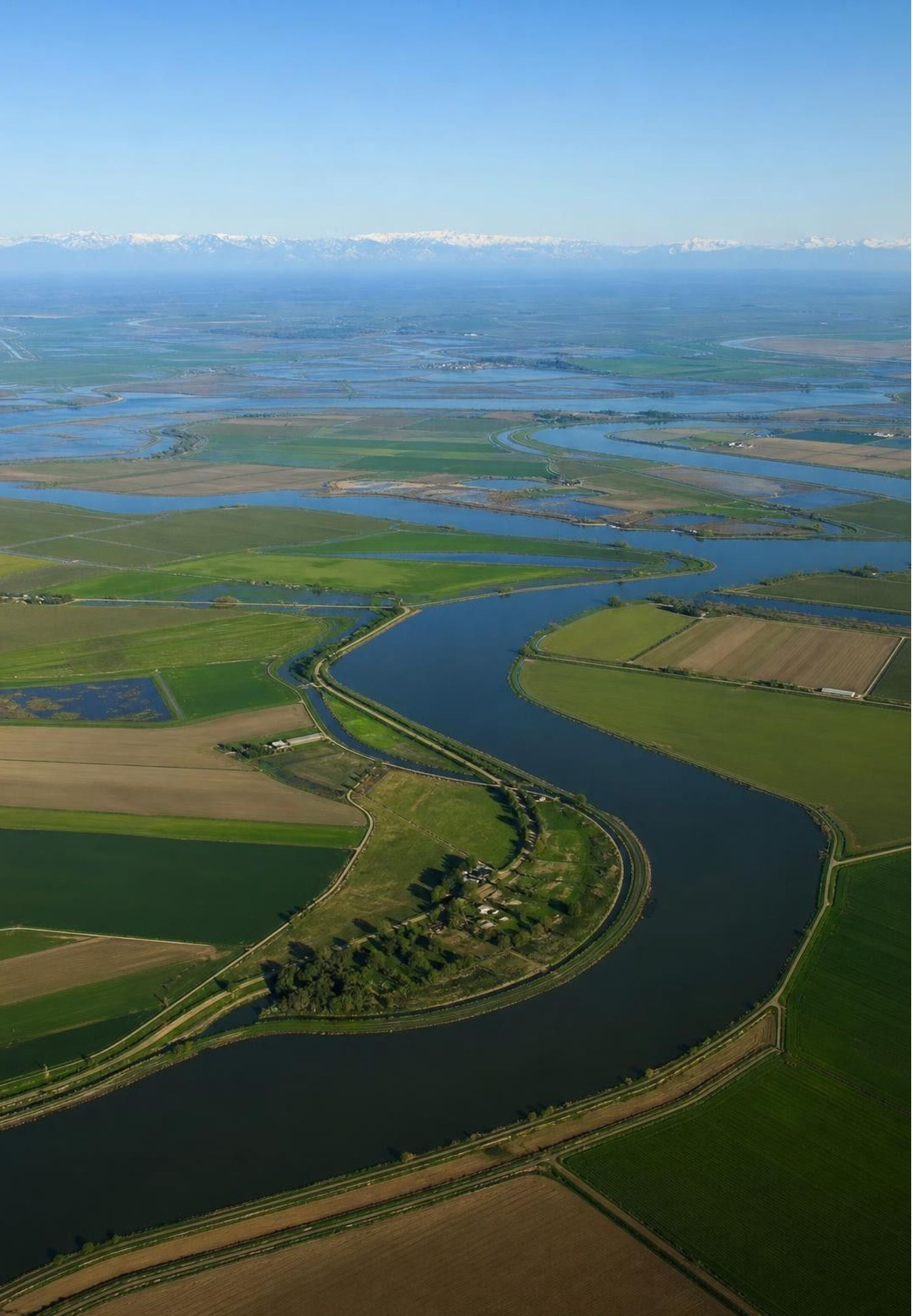
REAL-WORLD CONNECTION
California's water: the whole cycle in one state
Winter storms off the Pacific drop rain on the coast and snow on the Sierra Nevada.
The snowpack is a natural reservoir; its spring melt feeds rivers, dams and canals all summer.
Some melt infiltrates and joins the Central Valley aquifer system that farms and towns pump.
Evaporation from the ocean, the Delta and irrigated fields sends water back up to start again.
Pumping faster than infiltration refills the aquifer has sunk parts of the San Joaquin Valley by meters.
17
Notes:
Return to the phenomenon with the full toolkit. Ocean evaporation (Sun) loads Pacific air with vapor; storms lift and cool it (condensation and deposition) and gravity drops it as rain and snow. The snowpack holds water as solid until spring; melting (Sun) releases it to runoff (gravity) into rivers and reservoirs, and some infiltrates (gravity) to recharge groundwater. The state estimates the snowpack supplies roughly 30 percent of its water in a typical year, which is why the April 1 snow survey makes the news. Over the past century, groundwater pumping in parts of the San Joaquin Valley has outpaced natural recharge and the land surface has dropped by several meters in the worst spots, a problem called subsidence. Both figures are approximate; do not quiz them. Ask: which arrows in this story are sun-driven, which gravity-driven, and which are cooling?
WATCH FOR: 'The snow is lost' versus 'the snow is stored'. The snowpack is a reservoir, which is why a warm winter with rain instead of snow causes summer shortages even if total precipitation is normal.
CONNECTS TO: W3 reading traces this Sierra-to-valley pathway; W5 Part A graphs snowmelt feeding a creek; L19 groundwater as a resource.
PACING: about 5 min

Slide 18
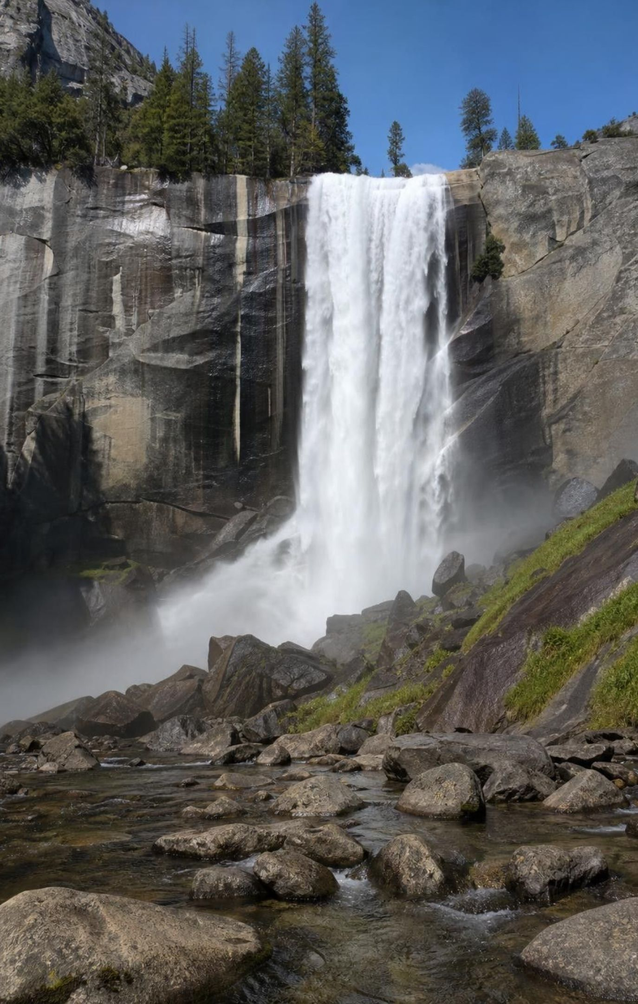
CHECK FOR UNDERSTANDING
Quick check: who is driving?
Which list contains only processes that gravity drives?
A. Evaporation, transpiration, melting
B. Precipitation, runoff, infiltration, groundwater flow
C. Condensation, crystallization
D. Runoff, evaporation, condensation
18
Notes:
Fingers up, then defend with one sentence each. A is the Sun's list: each one needs energy in. C is the cooling list: energy out. B is the gravity list: all four are water moving down or downhill. D mixes all three. Ask a follow-up for depth: name one process that needs the Sun AND gravity to make sense (a river exists because the Sun lifted the water and gravity brought it down and downhill; transpiration pulls water up against gravity using energy from evaporation at the leaf).
EXPECTED RESPONSES: B. Students who pick D usually treat runoff as the only gravity process; remind them that falling rain and sinking groundwater are gravity too.
WATCH FOR: Putting condensation in the Sun column 'because the Sun makes clouds'. The Sun lifted the vapor; cooling made the cloud.
CONNECTS TO: W4 labeling; W10 mastery; Lab 3 process tally.
PACING: about 3 min

Slide 19
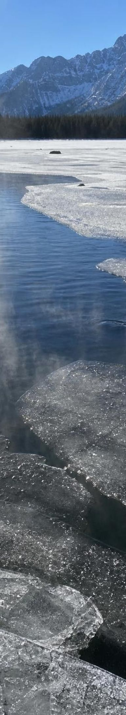
MODEL
Energy accounting: where water gains it and where it gives it off
Model: Changes of state in the water cycle
Water takes energy in (from the Sun) | Water gives energy off (as it cools)
Evaporation: liquid to vapor | Condensation: vapor to liquid
Transpiration: liquid to vapor inside leaves | Freezing: liquid to ice
Melting: ice to liquid | Deposition: vapor straight to ice (frost)
Every change of state is an energy transfer. The amount of water never changes; only its state and location do.
19
Notes:
This slide is the summary students will use on the exit ticket and the quiz. Walk the left column: each change breaks molecules apart from each other and needs energy, which the Sun ultimately supplies. Walk the right column: each change lets molecules settle closer together and releases energy to the air; that released energy is part of what feeds towering thunderstorm clouds. The middle row holds the gravity processes, which move water without changing its state. Have students copy the three groups into their notes as a table. Stay qualitative: how much energy per gram is beyond this lesson.
WATCH FOR: 'Melting is caused by gravity' or 'condensation is caused by the Sun'. Test every process against the question: does the water gain energy, lose energy, or just move?
CONNECTS TO: W2 Part A sort; W10 q7 and q8; Lab 3 tallies moves by driver.
PACING: about 4 min

Slide 20
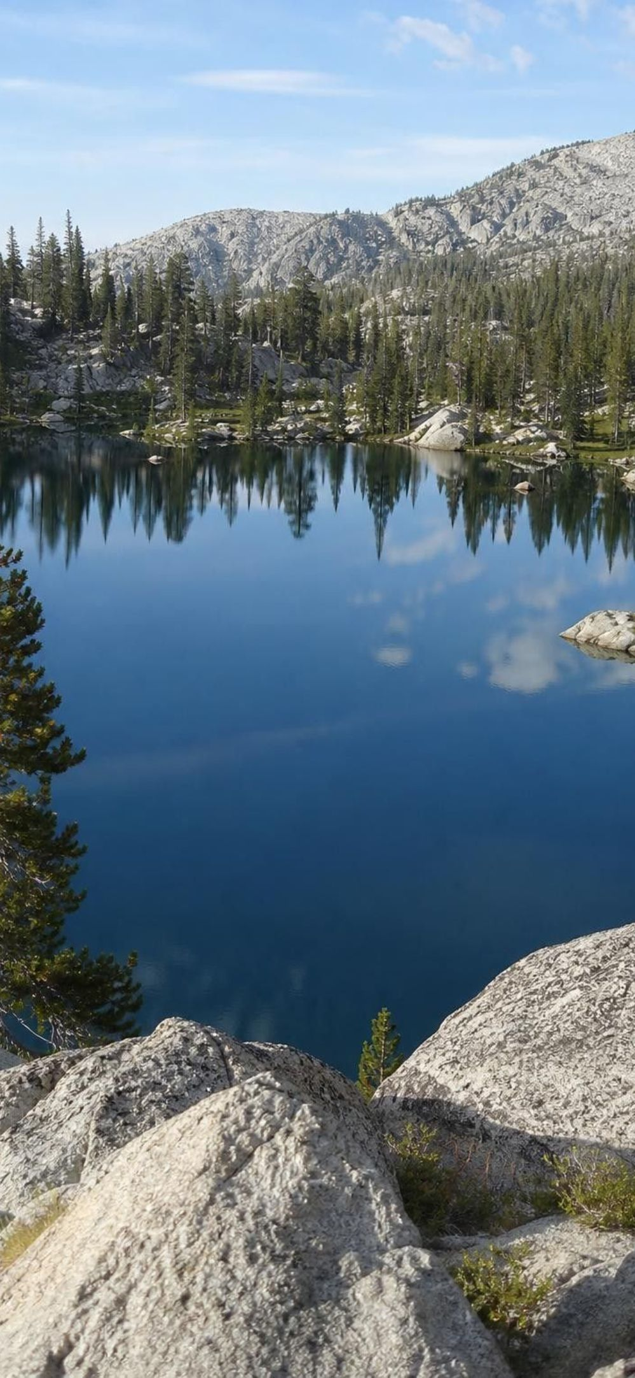
How long does water stay? It depends where it is
Some water races through the cycle; some barely moves. A molecule in the air usually falls back within about a week or two. A molecule in a river reaches the sea within months. In a deep aquifer or the deep ocean it can sit for centuries or longer.
Reservoir | Typical stay (approximate) | What moves it on
Atmosphere | about 9 days | condensation then precipitation
Rivers | weeks to months | flow to the sea; evaporation
Seasonal snowpack | months | melting; some sublimation
Lakes | years to centuries | outflow; evaporation; seepage
Groundwater | years to thousands of years | slow flow to springs, rivers, sea
Ocean | thousands of years | evaporation from the surface
Ice sheets | thousands of years or more | melting at the edges; sublimation
20
Notes:
These are residence times: the average time water spends in a reservoir before moving on. The numbers are rough estimates that differ from source to source, so present them as orders of magnitude, not facts to memorize. The pattern is what matters: small reservoirs with fast processes (air, rivers) turn over quickly; huge reservoirs with slow processes (ocean, deep groundwater, ice sheets) hold water for ages. Connect to the inventory slide: the atmosphere holds very little water, yet it can rain a lot because that little water is replaced every week or so. Tell students Lab 3 will produce their own residence-time data from a dice model, and they will compare the model's ranking with this table.
WATCH FOR: Students may read 'thousands of years' as 'that water is stuck forever'. Everything moves eventually; the ocean surface evaporates constantly even though the average molecule waits a long time.
CONNECTS TO: Lab 3 analysis compares model stays to this table; W5 Part A shows a snowpack's stay of a few months.
PACING: about 4 min

Slide 21
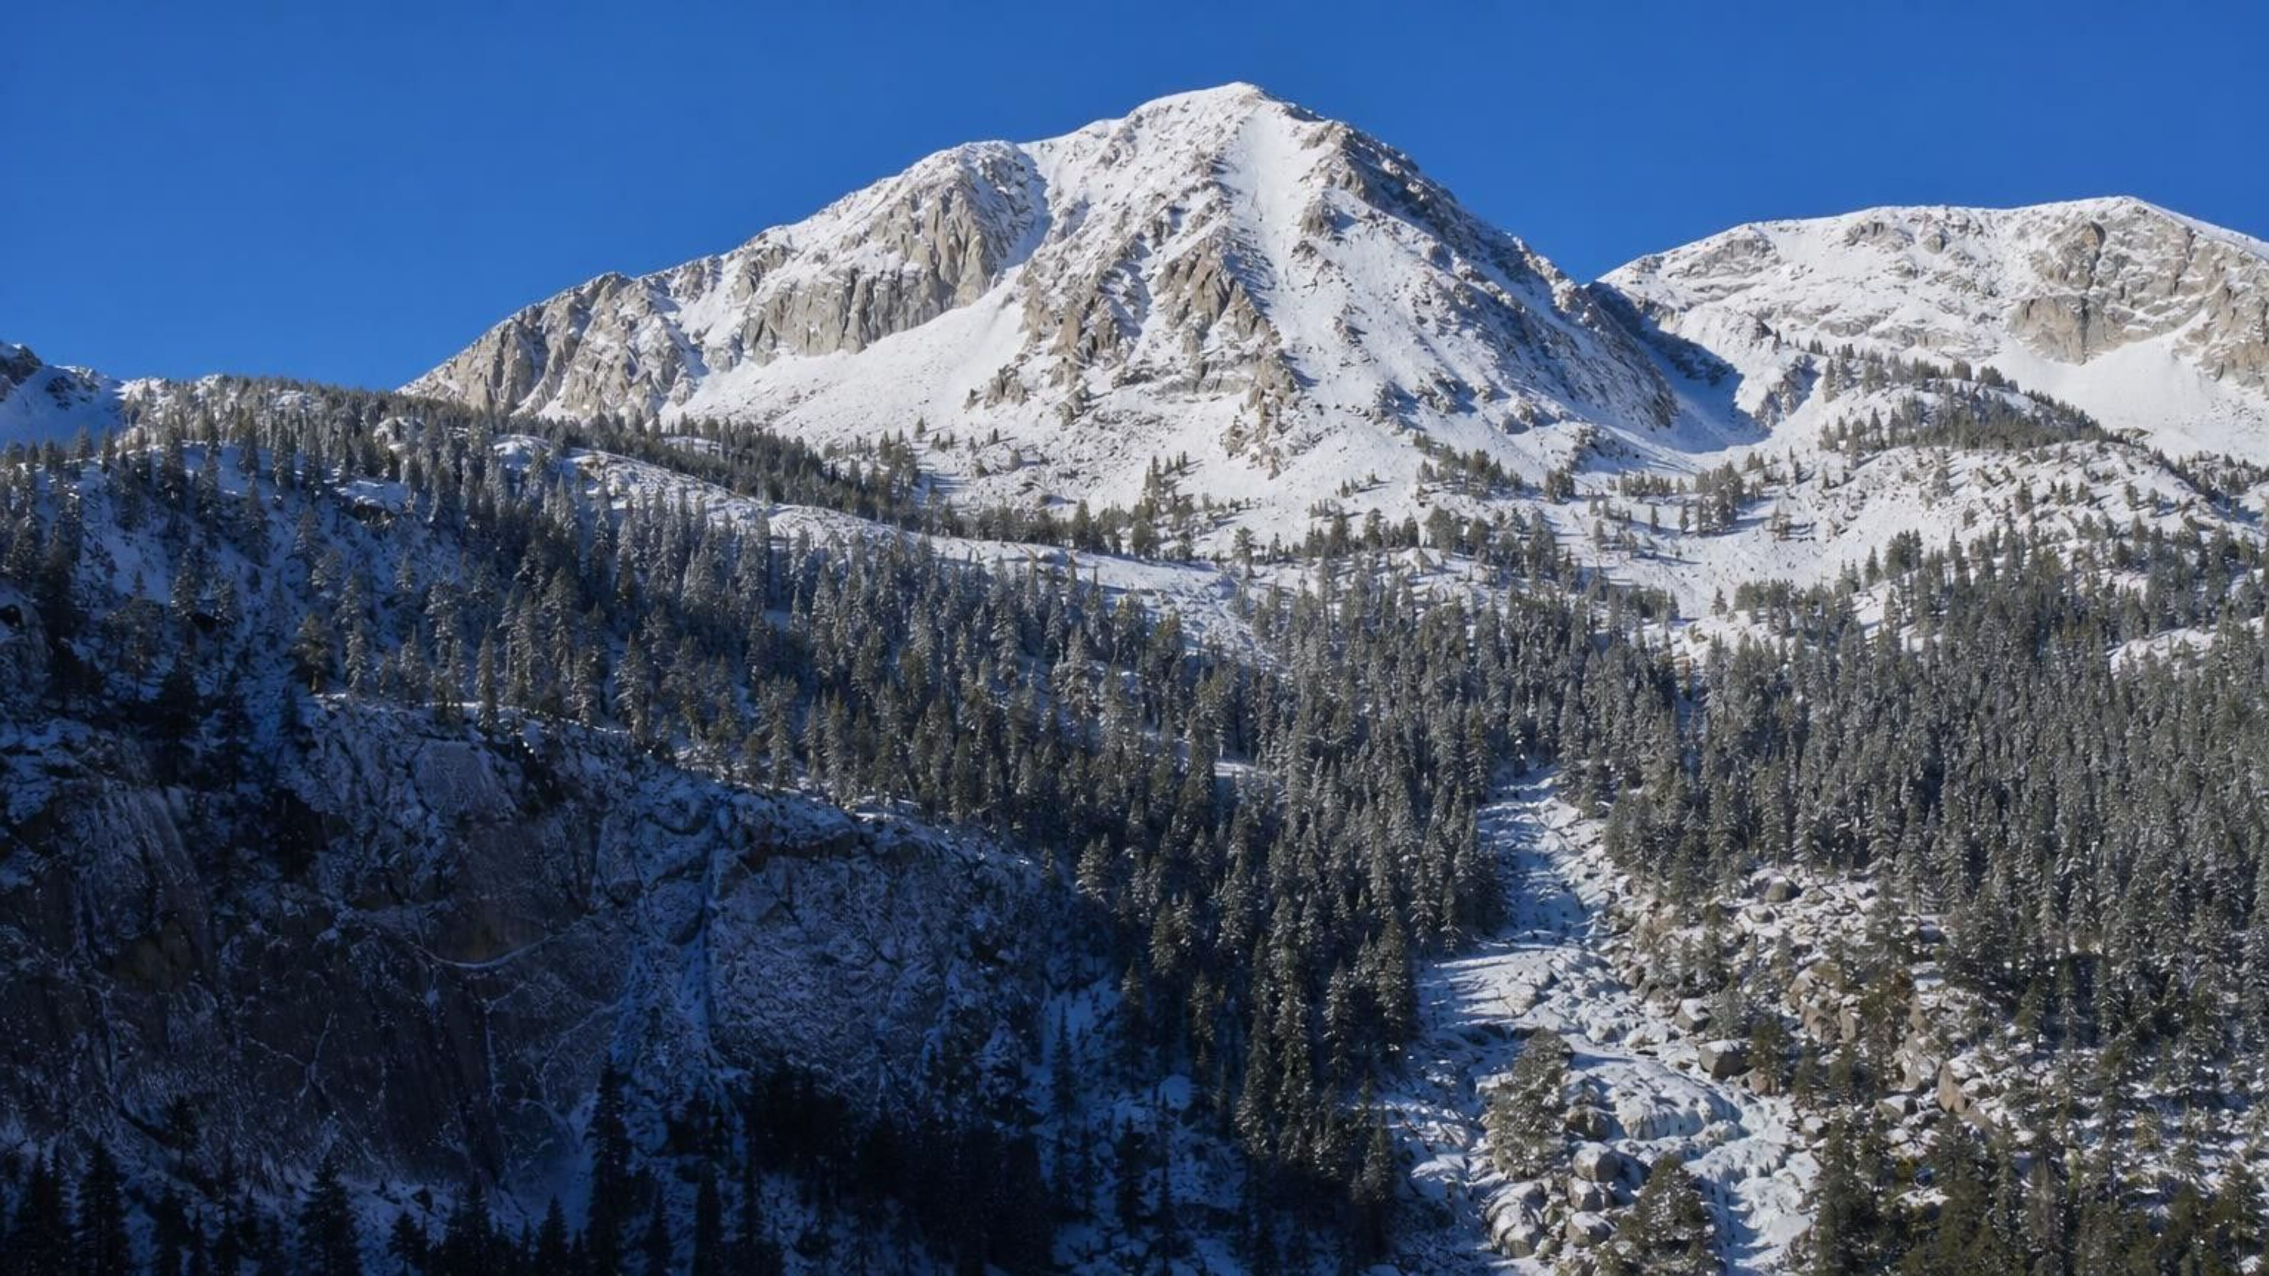
THINK, PAIR, SHARE
Discuss: three ways down the mountain
A molecule of water lands as snow on a Sierra peak in January. Describe three different routes it could take over the next year, naming each process and what drives it. Which places could it skip entirely?
Notes:
Groups of three, one route per person, then share. Push for variety: route 1 melts in May, runs off into a river, reaches a reservoir, is released to a canal and evaporates from a field. Route 2 sublimates in February straight back to the air, condenses over the Central Valley, falls as rain, infiltrates and joins an aquifer for decades. Route 3 melts, infiltrates into mountain soil, is taken up by a pine root, transpires in July, condenses as fog on the coast, drips off a tree. Ask which boxes each route skipped (the ocean, the river, the plant) and whether any route is 'wrong'. None is, as long as each step has a real driver. Return to the parking-lot pathways from day one and check them off.
EXPECTED RESPONSES: Routes that name at least three processes with correct drivers. Students should notice the ocean can be skipped for a long time, that a molecule can go up and down several times without reaching the sea, and that groundwater can hold it for far longer than a year.
WATCH FOR: Routes that run the single loop in order. Ask them to build one route that never touches the ocean.
CONNECTS TO: Lab 3 is the physical version of this discussion; W4 and W8.
PACING: about 7 min

Slide 22
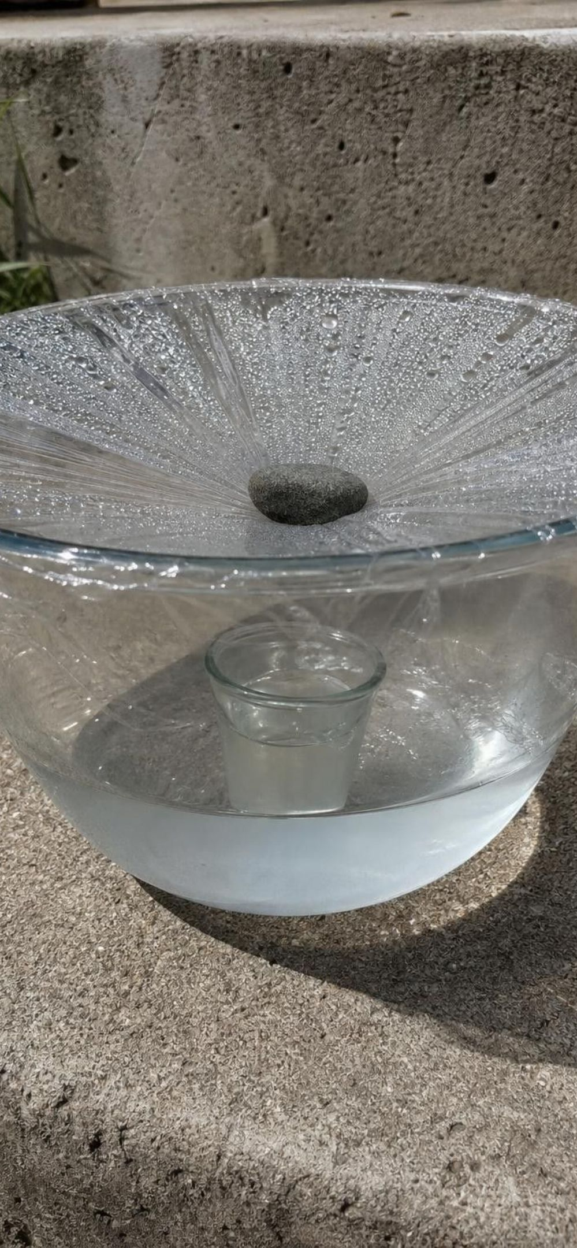
APPLY IT
Task: which solar still features are worth combining?
Simulated data for practice.
Five groups tested one change each to a basic solar still. Which features raised output, which lowered it, and what combined design would you build next?
Design | Change from the basic still | Fresh water collected in 24 h (mL)
A (basic) | Clear bowl, flat plastic-wrap cover, cup in the middle | 6
B | Black paper liner under the salt water | 11
C | Pebble on the cover so it sags to a point above the cup | 14
D | Two layers of plastic wrap instead of one | 4
E | Cover left loose with small gaps at the rim | 2
F | Started with warm (40 °C) salt water | 9
22
Notes:
This is a teaching dataset, invented to make the reasoning clear; it is not from a published test. Give groups eight minutes. Step 1: compare each design to A. B, C and F raised output; D and E lowered it. Step 2: explain each with the lesson's mechanisms. The black liner absorbs more sunlight, so the water warms and evaporates faster. The pebble turns the cover into a cone so condensed drops run down to one point above the cup under gravity instead of dripping back into the salt water. Two layers block some light and insulate the cover, so it stays warmer and condenses less. Gaps let vapor escape. Warm starting water gives a head start, but the gain fades as it cools. Step 3: the combined design is black liner plus weighted cone plus a tight seal; warm start is optional. Step 4: ask what one test would check whether B and C add up (build the combination and measure it). This is the MS-ETS1-3 move: combine the best characteristics of several solutions.
EXPECTED RESPONSES: Combine B and C (and possibly F) with a tight seal; drop D and E. Explanations should name sunlight absorption, condensation on the cover, gravity draining the cone, and vapor loss through gaps. A strong group will say the combination must still be tested because effects may not simply add.
WATCH FOR: Reading more layers of wrap as 'more protection, more water'. Ask what the cover has to do (let light in, stay cool enough to condense vapor).
CONNECTS TO: Lab 1 is the full build-test-improve version; W9 transfer uses a related design problem.
PACING: about 10 min

Slide 23
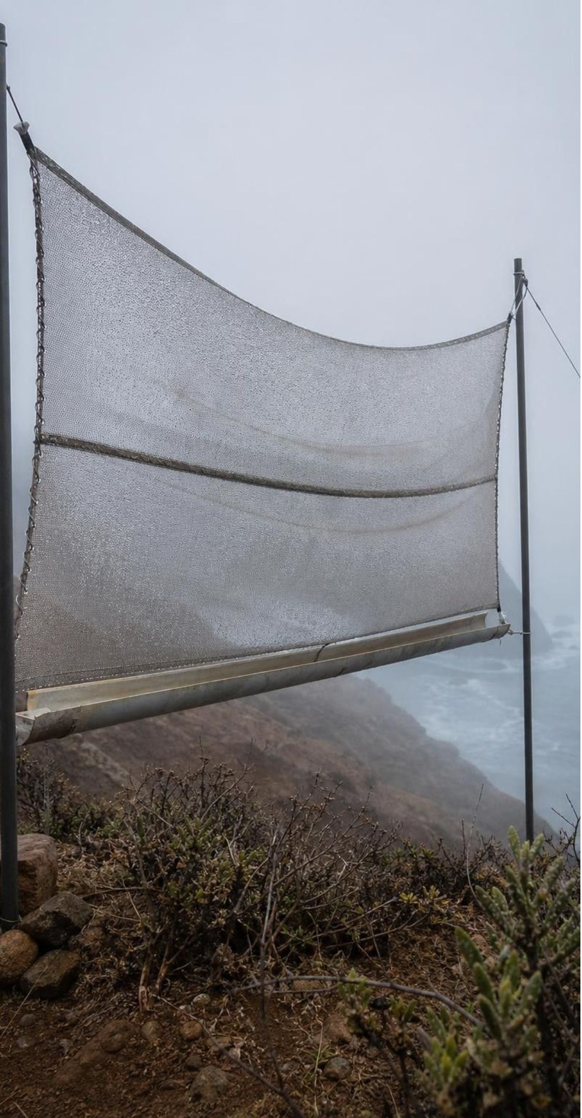
MODEL
Fog catchers: a design that the water cycle makes possible
Where moist air chilled over a cold ocean blows onto a dry coast, fog forms: a cloud touching the ground.
Fog droplets are too small to fall as rain, but they stick to a fine mesh and merge.
Once drops are heavy enough, gravity drains them down the net into a tank.
Decades of tests on mesh size and material improved the nets; each test informed the next.
Model: Iterative testing
Define the problem and criteria → Build a version → Test and measure output → Analyze what the data say → Change one feature
The loop repeats until the design meets its criteria within its constraints.
23
Notes:
Tell the Atacama Desert story in your own words: a coastal desert with almost no rain but frequent fog; nets strung on hillsides collect the fog droplets, which merge and drain into tanks by gravity. Name the two water cycle ideas at work: fog is condensation that happened at ground level, and gravity does the collecting once drops are big enough. Then focus on the engineering: researchers changed one input at a time (mesh hole size, strand material, strand thickness) and measured one output (liters collected per square meter per day). Typical nets catch only a few percent of the water in the fog that passes through; finer meshes can do better, but a mesh that is nearly solid makes fog flow around it, so 'smaller holes are always better' is not the whole story. The flow diagram is exactly what students do in Lab 1.
WATCH FOR: 'Fog catchers make water' or 'pull water from dry air'. They collect droplets that already condensed; no fog, no water.
CONNECTS TO: Lab 1 design loop; W9 transfer challenge; W8 Card 11 and W10 q11.
PACING: about 5 min

Slide 24

MISCONCEPTION CHECK
True or false? Evaporation needs boiling
"Water only turns into a gas when it boils, so a lake loses almost no water to the air unless the weather is very hot."
True or false? Explain your reasoning.
24
Notes:
Have students write a verdict with evidence from the lesson and from Lab 2 if it has run. False: evaporation is a surface process that happens at every temperature because the fastest molecules at the surface can escape; boiling is the special case where vapor forms inside the liquid. Evidence: the puddle gone by lunch on a mild day, the swimsuit that dries in a breeze, the Lab 2 trays that lost measurable depth even in shade, California reservoirs that lose a noticeable amount of water to evaporation every summer. Then ask for the honest part of the statement: evaporation is faster when it is hotter, so a hot week does cost a lake more water than a cool one. Good science keeps the true piece and fixes the false piece.
EXPECTED RESPONSES: False, with the particle explanation and at least one piece of everyday or lab evidence. Strong answers add that temperature changes the rate, not whether evaporation happens.
WATCH FOR: Students may overcorrect to 'temperature does not matter'. Rate depends on temperature, wind and humidity.
CONNECTS TO: W7 misconception repair; W6 CER; Lab 2 data.
PACING: about 5 min

Slide 25
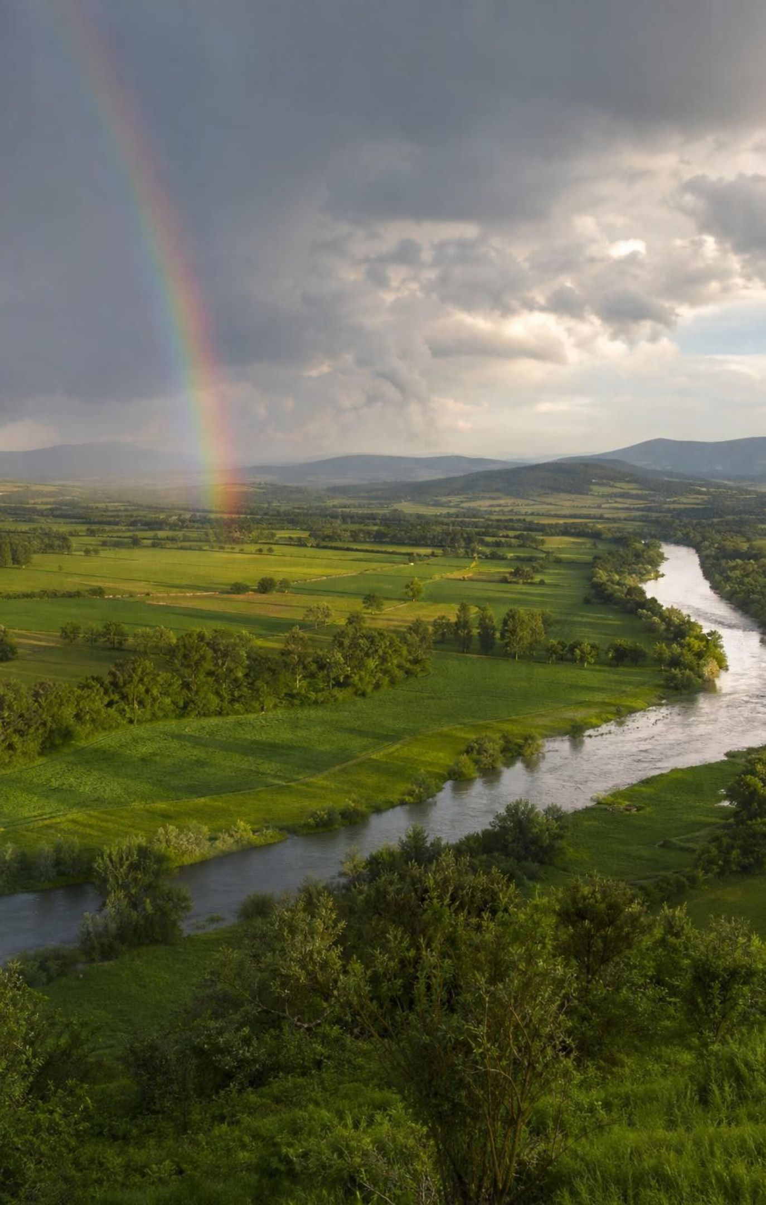
PUTTING IT TOGETHER
Putting it together
Water cycles among ocean, air, land, ground and living things; its amount stays the same.
The Sun supplies the energy for evaporation, transpiration, melting and sublimation.
Cooling lets vapor condense into droplets or deposit as ice, releasing energy.
Gravity brings water down as precipitation and moves it downhill and underground.
There is no fixed order; water skips and repeats places and stays days to millennia.
Engineers use the cycle on purpose: fog nets and solar stills, improved by iterative testing.
25
Notes:
Have students write a three-sentence explanation of the April snow and August faucets phenomenon using at least five vocabulary terms, then trade with a partner who checks that each process is paired with the right driver. Ask for one result from each lab: Lab 1 (what change raised output), Lab 2 (sun versus shade numbers), Lab 3 (which station held them longest). Preview Lesson 19: now that they know where groundwater comes from and how slowly it refills, they can explain why water, like minerals and energy, is unevenly distributed and why some of it is being used faster than nature replaces it.
CONNECTS TO: W10 mastery as the quiz; W6 CER as the written synthesis; L19 next.
PACING: about 6 min

Slide 26
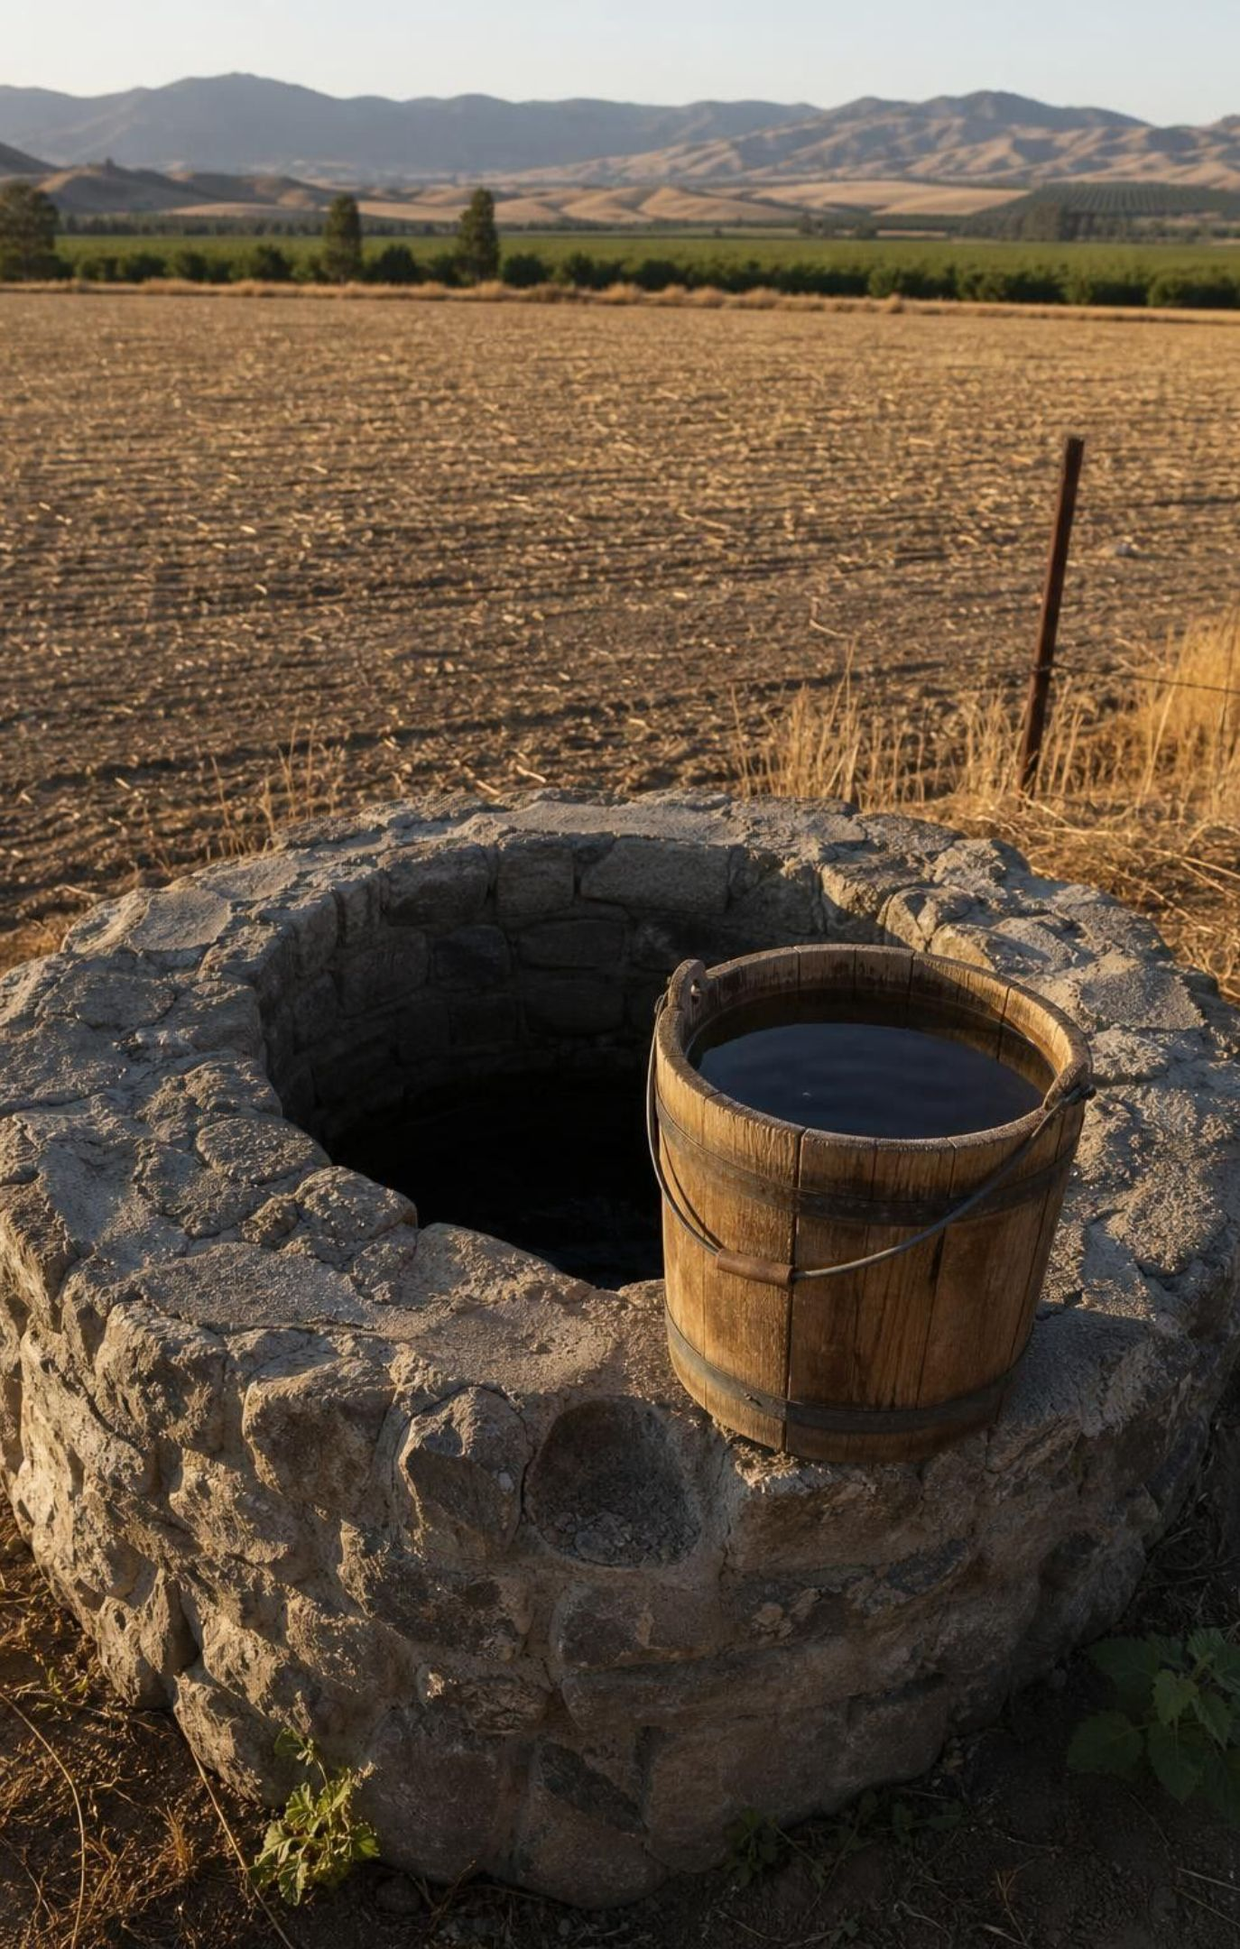
EXIT TICKET
Exit ticket
Name one process the Sun powers, one gravity powers, and one that happens because water cools.
A cold can sweats in a warm room. In one sentence, where did the water come from?
Write a route for a water molecule from the ocean to a well that never passes through a river.
Your solar still made 8 mL; after one change it made 13 mL. What should you do next, and why?
26
Notes:
Collect on cards or a shared form. Item 1 checks the three-column energy accounting; item 2 checks condensation; item 3 checks the multi-route model; item 4 checks whether the design loop landed. Sort the cards into reteach piles before the next class.
EXPECTED RESPONSES: 1: for example evaporation (Sun), infiltration (gravity), condensation (cooling). 2: from water vapor in the room air that condensed on the cold surface. 3: ocean evaporates, vapor condenses, rain falls on a hillside, infiltrates, flows as groundwater into an aquifer, is pumped by the well. 4: keep the change, change one more feature, and test again; compare with other groups' data before combining features.
WATCH FOR: Item 1 answers that put condensation under the Sun; item 3 routes that include a river despite the rule.
CONNECTS TO: W10 mastery; chapter evidenceOfLearning.
PACING: about 5 min

