Slide 1
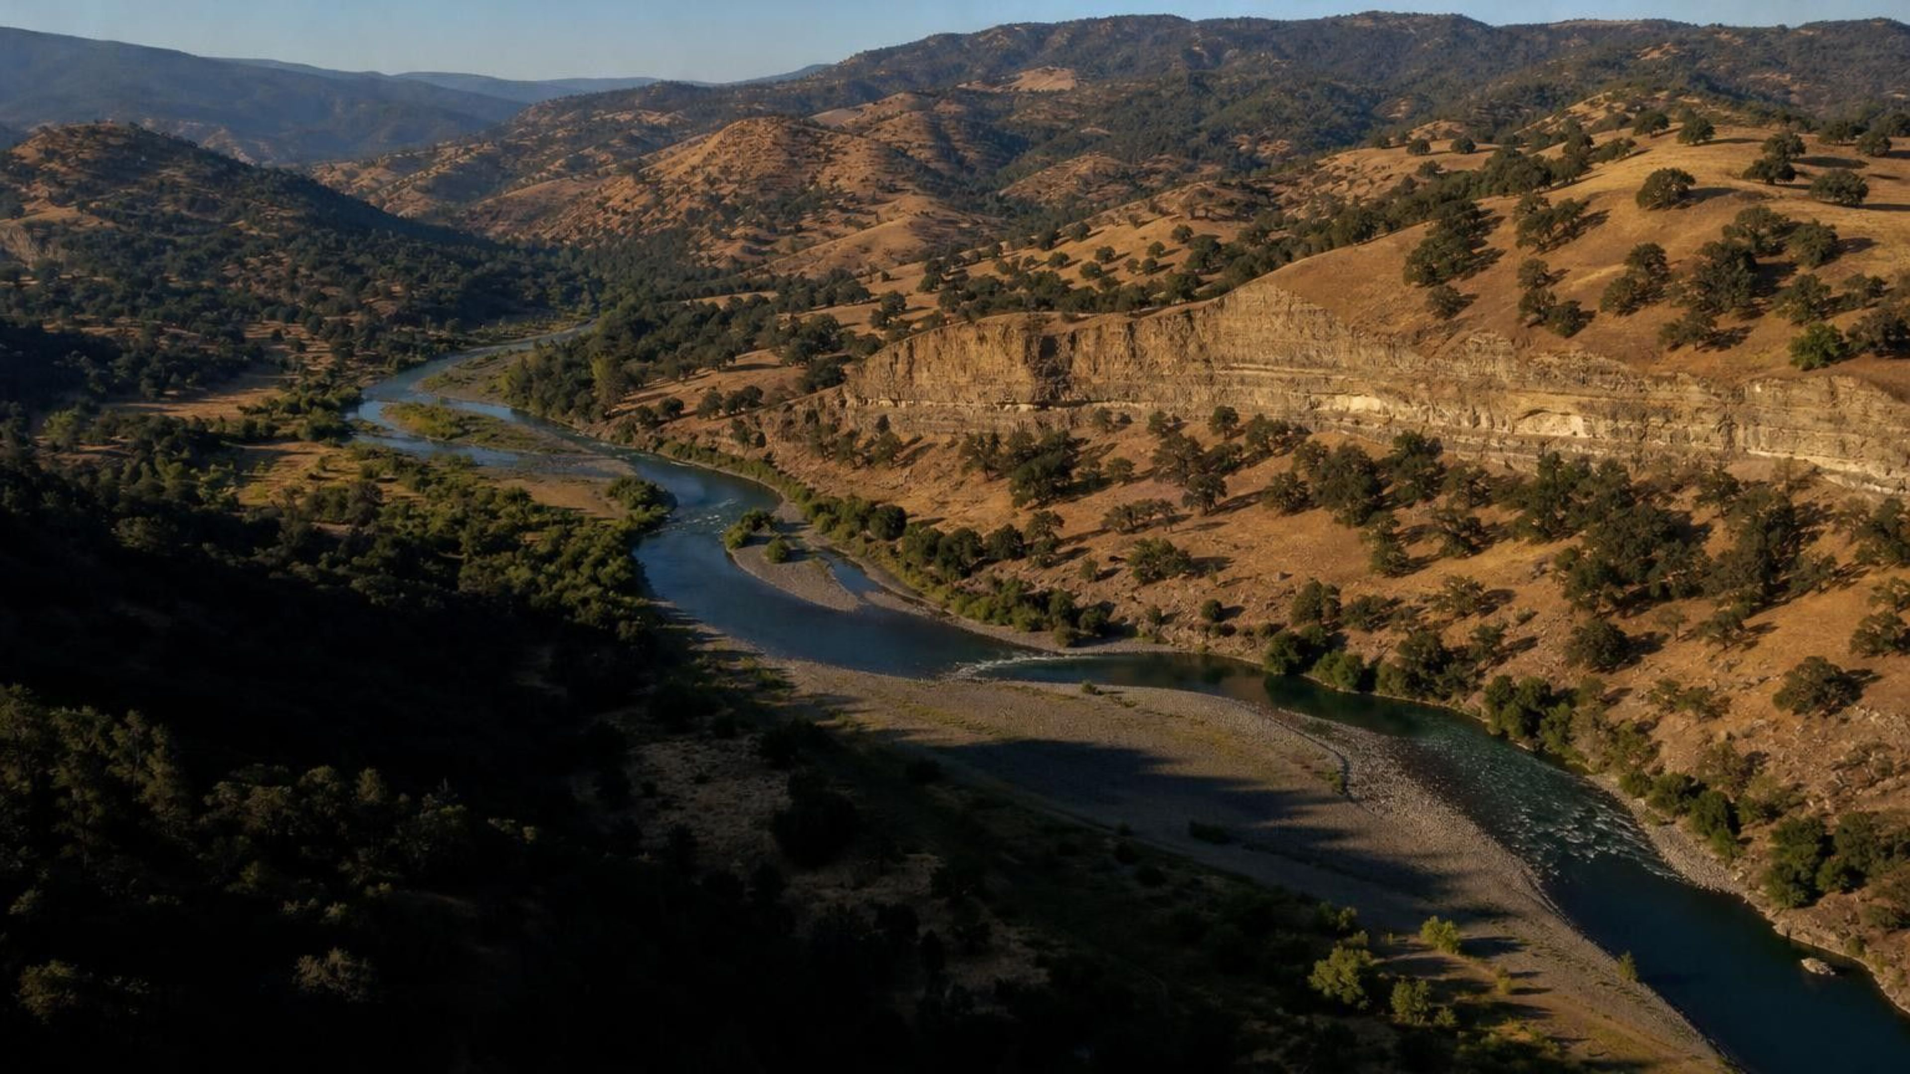
Earth's Natural Resources
Chapter 19 of 29 · Processes that Shape Earth
Lesson 19: Why are different resources found in different places, and what happens as we use them?
Angela's Wand · Bring Science Alive! 7th Grade Integrated
Notes:
Open with an object on your desk: a pencil, a phone, a water bottle. Every part of it came out of the ground, a forest or a river somewhere, and that somewhere was not random. Over this lesson students answer three questions: what process put each resource where it is, how fast nature can make more, and what happens to the map as people pump, drill, mine and log. Preview the three investigations: a buried-treasure mystery solved from geologic clue cards, a cookie mine with real costs, and a two-session water-supply decision for a fictional valley town. Nothing in the lesson needs chemicals or flames; Lab 2 uses food that is never eaten.
CONNECTS TO: Overview of Lab 1, Lab 2 and Lab 3; W1 opens on the next slide.
PACING: about 2 min

Slide 2
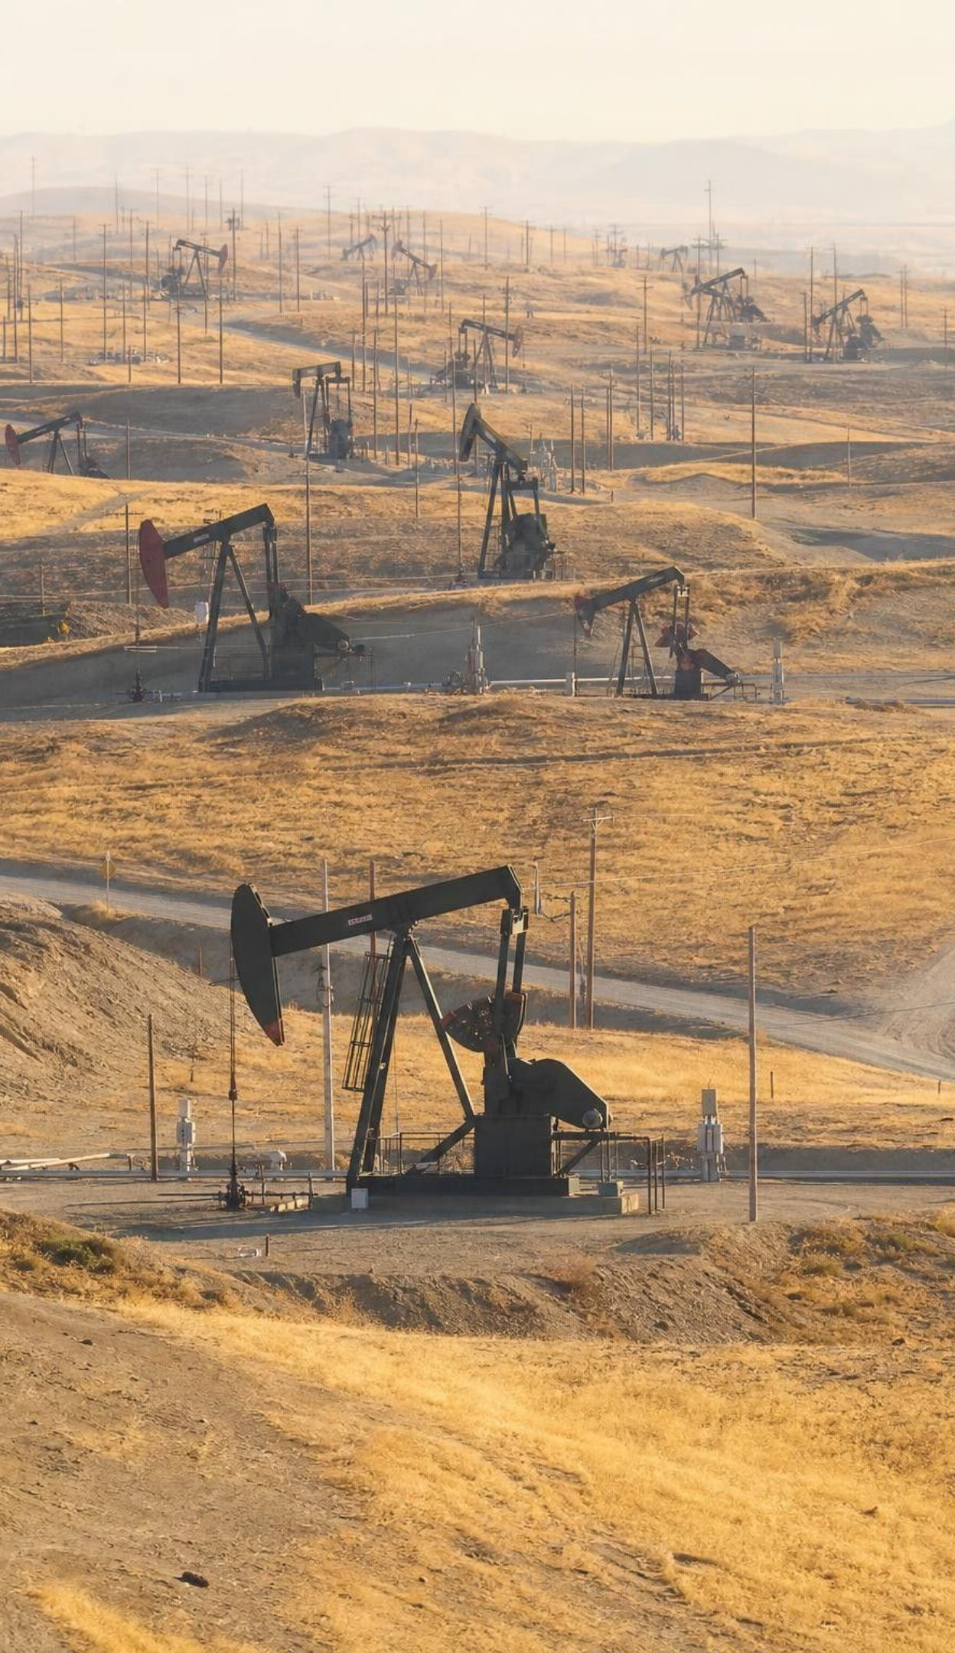
PHENOMENON
California's buried treasure map is lumpy
Stack four maps of California. Gold mines make a thin stripe along the Sierra foothills. Oil wells crowd into Kern County. Geothermal plants cluster in a few spots, mainly The Geysers north of San Francisco and the Imperial Valley. The biggest groundwater store is under the flat Central Valley. Nothing is spread evenly, and the patterns do not overlap. Why?
Notice: what shape does each pattern make: stripe, cluster or sheet?
Wonder: why does gold follow mountains while oil sits under a flat valley?
Predict: which of these four could run out in your lifetime?
2
Notes:
Project a California resource map if you have one, or sketch the four patterns on a blank outline of the state. Give students two silent minutes for a notice and a wonder, then collect answers without judging. Push toward the key idea: a pattern that strong is not luck. Each resource must have needed something that only certain places had. Keep a parking lot of first explanations ('gold is in mountains because mountains are old', 'oil is where the dinosaurs were') and return to them on slides 14, 15 and 18. The patterns are real: the Mother Lode belt runs along the western Sierra foothills; Kern County produces most of California's oil; The Geysers is the largest geothermal complex in the world; the Central Valley aquifer system is the state's largest groundwater store.
EXPECTED RESPONSES: Notice: gold is a line, oil and geothermal are clusters, groundwater is a wide sheet. Wonder: is there oil under the gold; why no oil in the mountains; who decided where to drill. Predict: oil and gold can run out; many students will say water cannot, which the lesson will test.
WATCH FOR: 'Dig deep enough anywhere and you find anything' and 'oil comes from dinosaurs.' Record both; do not correct yet.
CONNECTS TO: W1 phenomenon worksheet records notice/wonder and a first explanation. Lab 1 is the same reasoning on a fictional map.
PACING: about 8 min

Slide 3
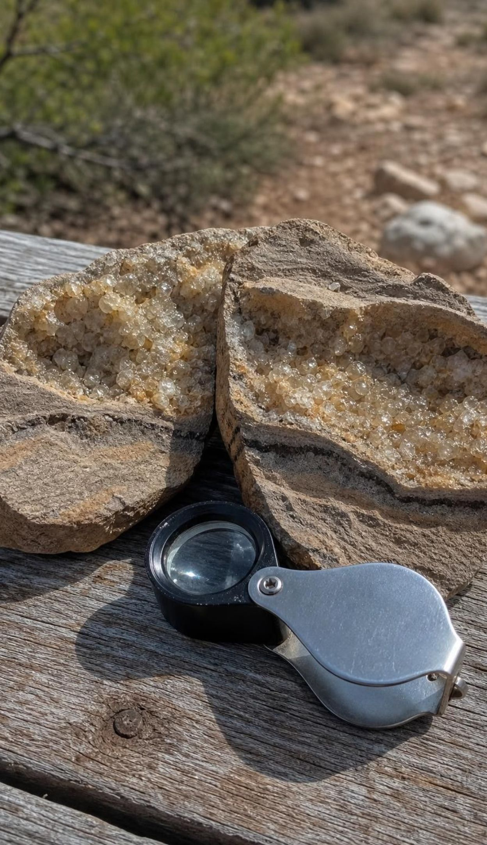
LEARNING TARGETS
What you will be able to do
1
Explain with evidence how past and present Earth processes put a resource in one place and not another.
2
Describe the recipe for an ore deposit, an oil reservoir, a geothermal field and an aquifer.
3
Sort resources as renewable or nonrenewable by nature's clock, and explain why renewable is not unlimited.
4
Use recharge and pumping data to decide whether a use of groundwater is sustainable.
5
Score competing designs against criteria and constraints, as the Hoover Dam team did.
3
Notes:
Read the targets aloud and have students star the one that sounds hardest. Point out that target 1 is the big one and the other four feed it: you cannot explain where a resource is without knowing its recipe (target 2), and you cannot say how the map will change without comparing rates (targets 3 and 4). Target 5 is the engineering strand and Lab 3's second session.
CONNECTS TO: Targets map to Lab 1 and W6 (1), W3 and W4 (2), W2 and W7 (3), Lab 3 and W5 (4), Lab 3 and W9 (5).
PACING: about 2 min

Slide 4
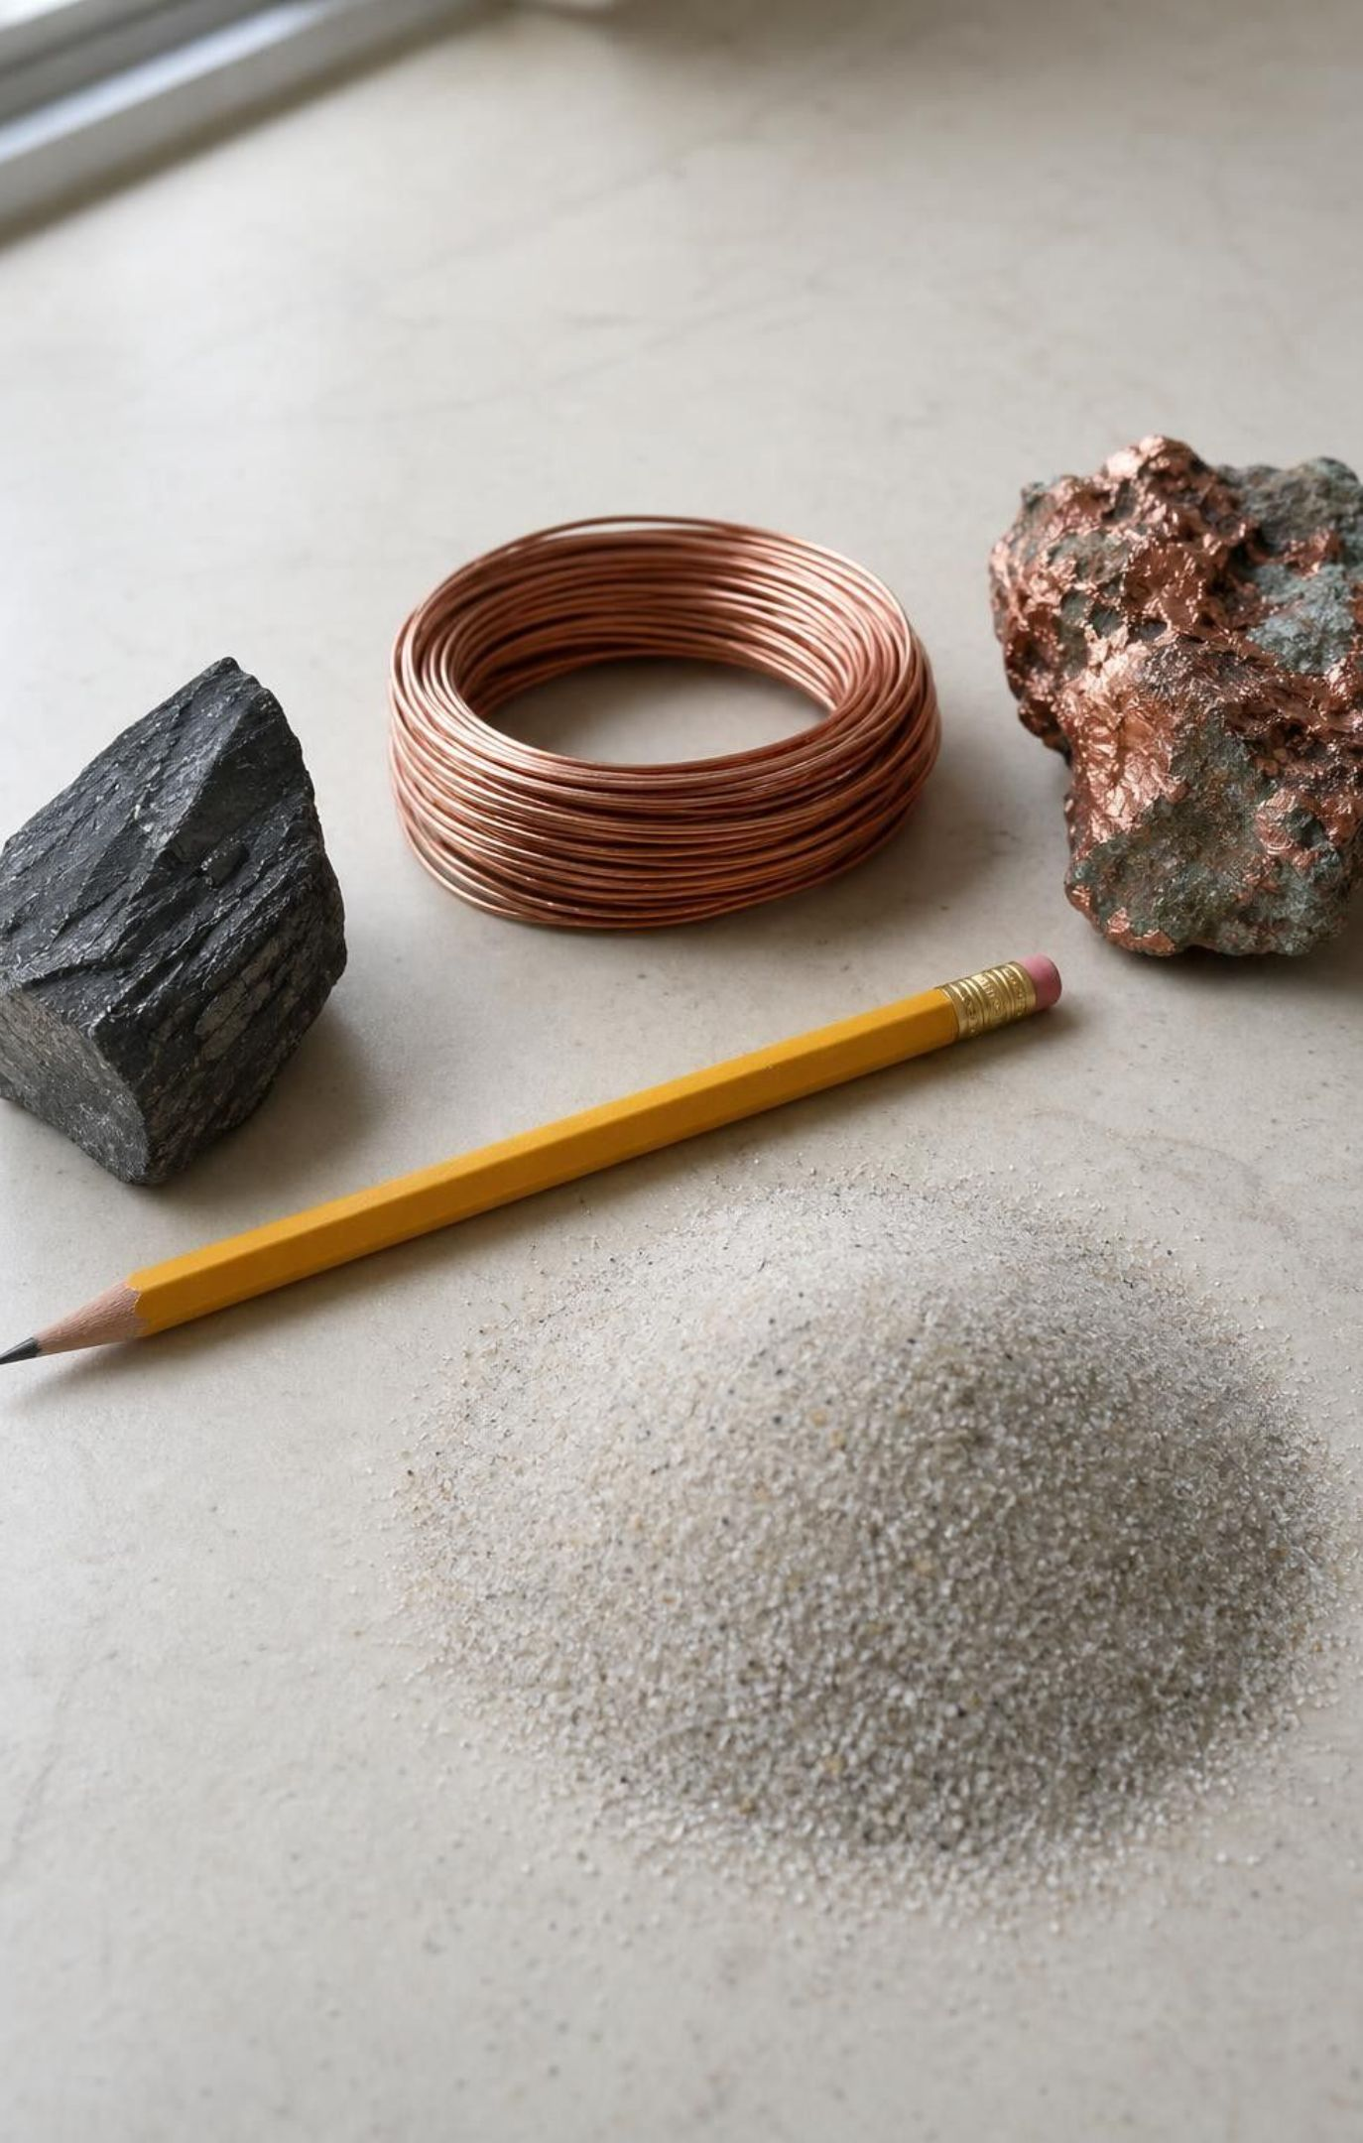
Everything on your desk came from somewhere
A natural resource is any material or energy source people take from nature and use.
Pencil: wood from a forest, graphite from a mine, metal band from ore, rubber from a plant or oil.
Phone: plastic from petroleum, copper and other metals from ore, glass from sand, and water to make it.
Some come from the surface (wood, soil, river water); some from deep underground (oil, ore, hot water).
This lesson follows six: fresh water, petroleum, geothermal heat, soil, copper ore and wood.
4
Notes:
Have pairs pick one object within reach and list every material in it, then guess where each came from: surface or underground, living or nonliving. Collect a few on the board. Point out that the textbook's phone figure of about 910 liters of water per phone is a snapshot from when the book was written; the point is that even water is an ingredient of a phone. Then set up the two questions that organize the lesson: where did it form, and how fast can nature make more?
EXPECTED RESPONSES: Students name wood, metal, plastic, glass and sometimes water; most are surprised that plastic is made from oil and that glass starts as sand.
WATCH FOR: Students may think plastic is 'made in a factory' with no natural source. Every manufactured material starts as a natural resource.
CONNECTS TO: W2 vocabulary word bank starts from 'natural resource'.
PACING: about 5 min

Slide 5
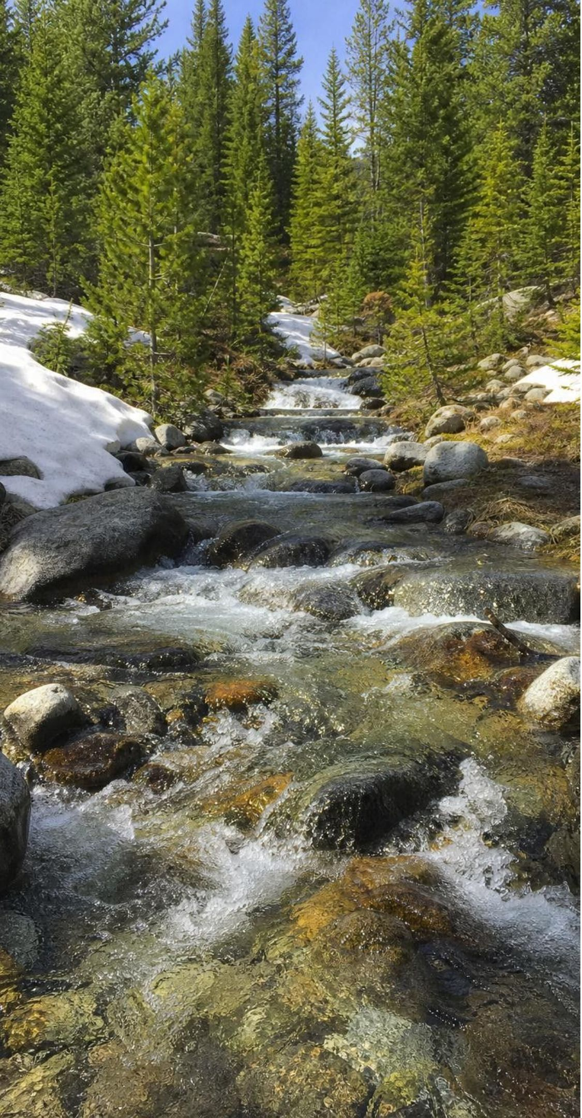
MODEL
Nature's clock: renewable or nonrenewable?
Model: How long nature takes to make more, compared with a human lifetime
Renewable (replaced within about a lifetime) | Nonrenewable (takes far longer than a lifetime)
Surface water: refilled by rain and snow every year | Petroleum: millions of years of burial and heating
Heat flow from Earth's interior: continuous | Copper and gold ore: millions of years of magma and hot fluids
Planted pine forest: ready to harvest in about 15 to 25 years | Thick fertile topsoil: centuries per centimeter
Shallow gravel aquifer in a rainy valley: refills in years | Deep desert aquifer: water that soaked in over a million years ago
The label comes from nature's replacement time. Whether a use is sustainable is a second question: rate of use versus rate of replacement.
5
Notes:
Walk both columns and ask for the rule that sorts them: how long nature needs to make more, judged against a human lifetime of roughly 80 years. Then stress the overlap at the bottom. Renewable does not mean unlimited. A lake in a drought, a forest cut faster than it regrows, or a geothermal reservoir pumped harder than water is returned all run low. The textbook's definition adds a 'such great supply' clause for resources that cannot be depleted; we leave that clause out because it is the source of the most common error in this lesson. Ask: which column does groundwater go in? Answer: both, depending on the aquifer, and that is slide 13's discussion.
EXPECTED RESPONSES: Students should state the rule in their own words and place a new example (sand and gravel for concrete: nonrenewable on a human timescale, though rivers do deliver some each year).
WATCH FOR: 'Renewable means it can never run out.' Flag it now; the misconception slide near the end tests it with The Geysers.
CONNECTS TO: W2 vocabulary and W7 misconception repair use this sort; W10 mastery reuses it.
PACING: about 6 min

Slide 6
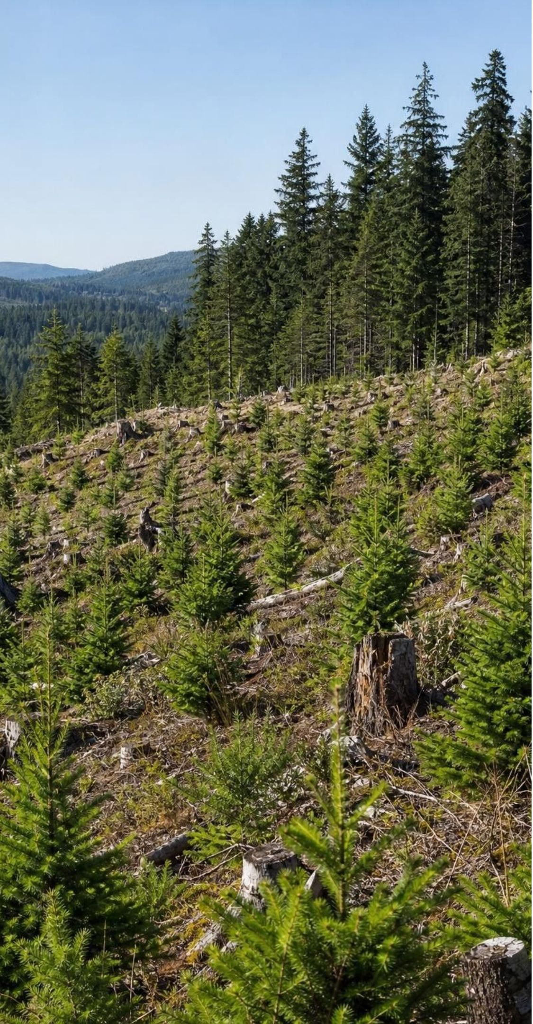
VOCABULARY IN CONTEXT
Four words to keep straight
renewable resource: A resource nature replaces within about a human lifetime. River water and a replanted forest are renewable; both can still run short if overused.
nonrenewable resource: A resource that takes far longer than a human lifetime to form, so using it shrinks the supply. Copper ore formed over millions of years; a mined-out deposit is gone for any practical purpose.
sustainable: A way of using a resource that leaves enough for future generations: use no faster than it is replaced. Pumping an aquifer is sustainable only when yearly pumping is no larger than yearly recharge.
6
Notes:
Say the two-part test aloud and have students repeat: first, how long does nature take to make more (this gives the label); second, are we using it faster than that (this tells whether the use is sustainable). Give a quick case: a shallow valley aquifer that rain refills within a few decades gets 4 units of recharge a year, and a town pumps 10 units a year from it. Renewable? Yes: nature refills it well within a lifetime. Sustainable? No: the stored water falls by 6 units a year. Students will meet this exact arithmetic in Lab 3 and W5.
WATCH FOR: Students merge 'renewable' and 'sustainable'. Keep them as two separate questions.
CONNECTS TO: W2 vocabulary relationships; Lab 3 recharge arithmetic.
PACING: about 4 min

Slide 7
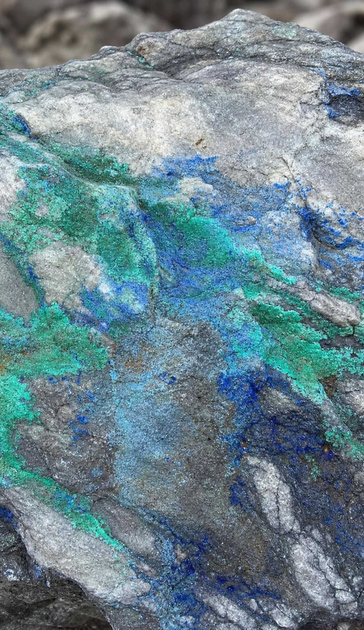
CHECK FOR UNDERSTANDING
Quick check: which is nonrenewable?
On a human timescale, which of these is nonrenewable?
A. Water in a river that is refilled by snowmelt every spring
B. Copper in an ore body that formed from hot fluids 30 million years ago
C. Heat flowing up from Earth's interior
D. Wood from a pine plantation replanted after each harvest
7
Notes:
Vote with fingers, then defend. Only the copper ore took far longer than a lifetime to form. Follow up to keep the second question alive: could any of the three renewable ones still run short? Yes: a river in a drought, a geothermal reservoir pumped faster than water is returned, a plantation cut faster than it regrows. The label and the sustainability of a use are different questions.
EXPECTED RESPONSES: B. Students who choose C are thinking of a particular hot-water reservoir rather than the heat flow itself; accept that distinction as the start of a good argument.
WATCH FOR: Choosing A or D with the reason 'it can run out' shows the renewable/sustainable merge.
CONNECTS TO: W10 mastery item on classification.
PACING: about 3 min

Slide 8
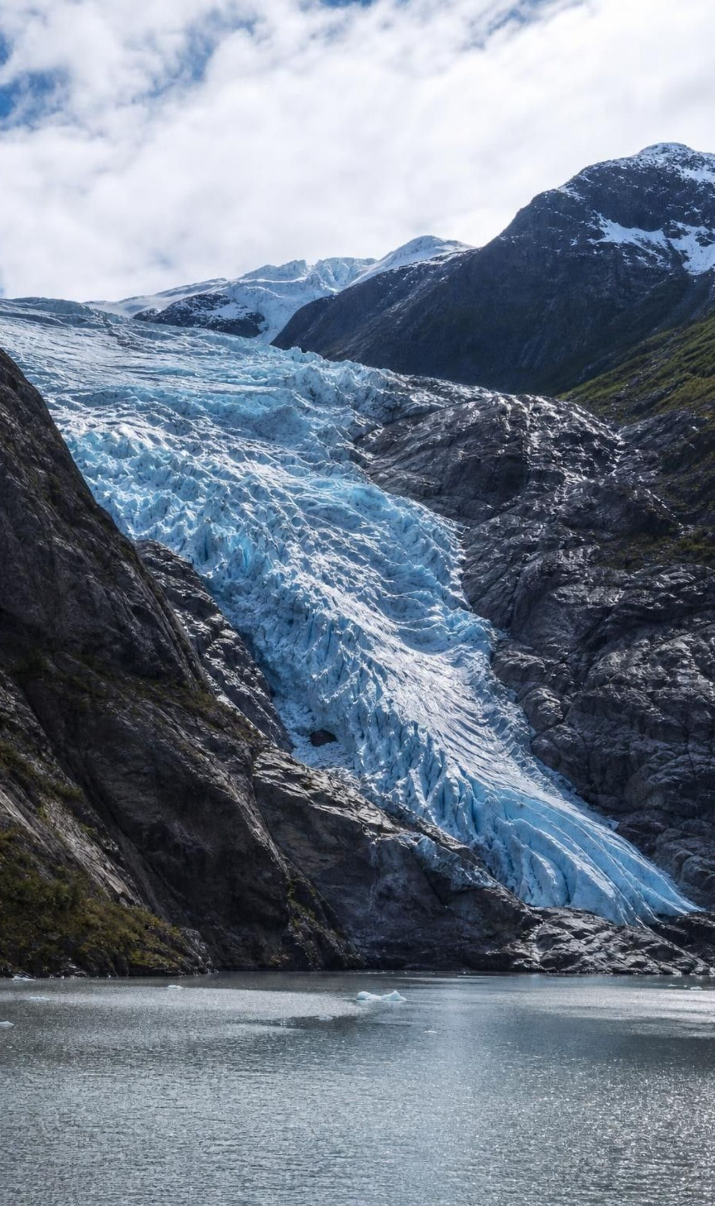
MODEL
Where Earth's fresh water is
Model: Share of Earth's fresh water by where it is stored (USGS estimate, rounded)
Fresh water is only about 2.5 percent of all water on Earth; the rest is salty. Of that small slice, most is frozen, and nearly all the rest is underground.
8
Notes:
Two surprises. First, fresh water is a tiny slice of Earth's water, about 2.5 percent (the textbook rounds to 3 percent). Second, of that slice, lakes, rivers and the rest of the unfrozen surface water are only about 1 percent; groundwater is about 25 times more. So for roughly 40 percent of the world's irrigation water and about half of Americans' drinking water, the resource is underground. Ask: if groundwater is so much larger than surface water, why do we worry about running out? Hold the answer: it depends on how fast it refills, which is the next three slides.
EXPECTED RESPONSES: Students should be able to say that most usable fresh water is underground and that ice is not available to most people.
WATCH FOR: Students often think lakes and rivers hold most fresh water. The bar shows the opposite.
CONNECTS TO: W5 data worksheet uses a water budget; W10 mastery.
PACING: about 4 min

Slide 9
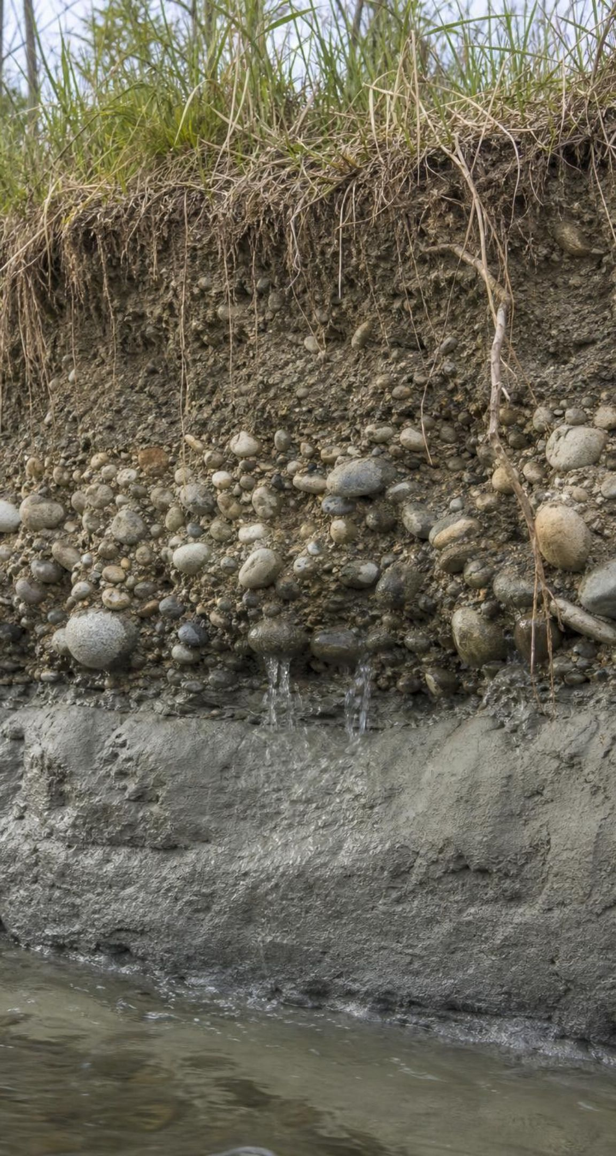
MODEL
Inside an aquifer
Model: A cross-section of a valley aquifer system, top to bottom
Soil and plant roots: rain soaks in here (recharge)
Unconfined aquifer: river gravel and sand, pores full of water below the water table
Clay layer: tiny pores, water barely moves; seals the layer below
Confined aquifer: porous sandstone; water entered far away or long ago
Bedrock: granite with few cracks; stores almost no water
Water is stored in the pore spaces between grains. Gravel and sand have big connected pores; clay has many tiny pores that hold water but will not let it flow to a well.
9
Notes:
Correct the picture most students carry: groundwater is not an underground lake or river. It is water filling the gaps between grains, like water in a sponge or a cup of gravel. Two properties matter. Porosity is how much empty space there is, which sets how much water can be stored. Permeability is how connected the pores are, which sets how fast water moves to a well. Gravel has both; clay has porosity but almost no permeability, so a clay layer seals an aquifer beneath it. Ask where a driller would put a well and why. Lab 3's first session measures storage and drain time in cups of gravel, sand and clay-rich soil, so students will get these two properties in their hands.
EXPECTED RESPONSES: Well in the gravel or the sandstone, not the clay or the granite; reason: big connected pores.
WATCH FOR: 'Groundwater is an underground river or lake.' Keep saying 'water in the pores'.
CONNECTS TO: Lab 3 session 1 (aquifer cups); W10 q3 (a clay well versus a gravel well).
PACING: about 6 min

Slide 10
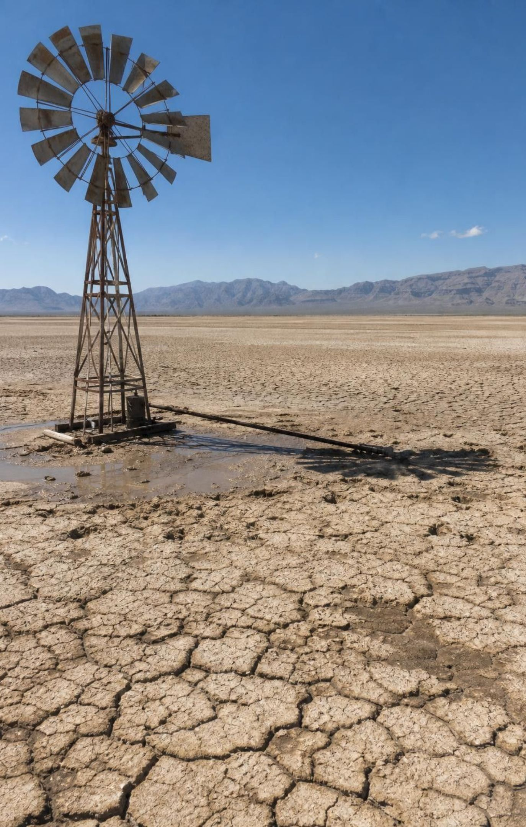
Why groundwater is uneven, and why it can run out
Rain and snow: wet regions recharge aquifers quickly; deserts recharge slowly or not at all.
Rock and sediment: thick gravel and sandstone store and give water; clay and granite do not.
Depth and age: deep aquifers under deserts may hold water that soaked in during wetter climates long ago.
The test of a use: pump less than the recharge and the level holds; pump more and it falls.
Pumping has already redrawn the map: some aquifers have dropped tens of meters in a century.
10
Notes:
Build the explanation as a chain of causes. Where it rains and the ground is porous, aquifers refill every year; that water is renewable on a human timescale. Where it is dry today but was wet thousands of years ago, there can still be huge aquifers (the textbook's own map shows them under the Sahara and central Australia), but the water in them is ancient and recharge is tiny, so pumping them is like mining. The Great Artesian Basin in Australia holds water that has been underground for more than a million years in parts of the basin. The textbook says 'most groundwater is nonrenewable'; the accurate statement is 'it depends on the aquifer': how long that aquifer takes to refill decides the label, and comparing its recharge rate with the pumping rate decides whether a particular use is sustainable. That second comparison is the heart of Lab 3.
EXPECTED RESPONSES: Students should list the three controls (precipitation, rock type, depth or age) and state the pump-versus-recharge rule.
WATCH FOR: 'Groundwater location depends only on rain.' The Sahara aquifers are the counterexample.
CONNECTS TO: Lab 3 decision data; W5 recharge versus pumping; W7 misconception repair.
PACING: about 6 min

Slide 11
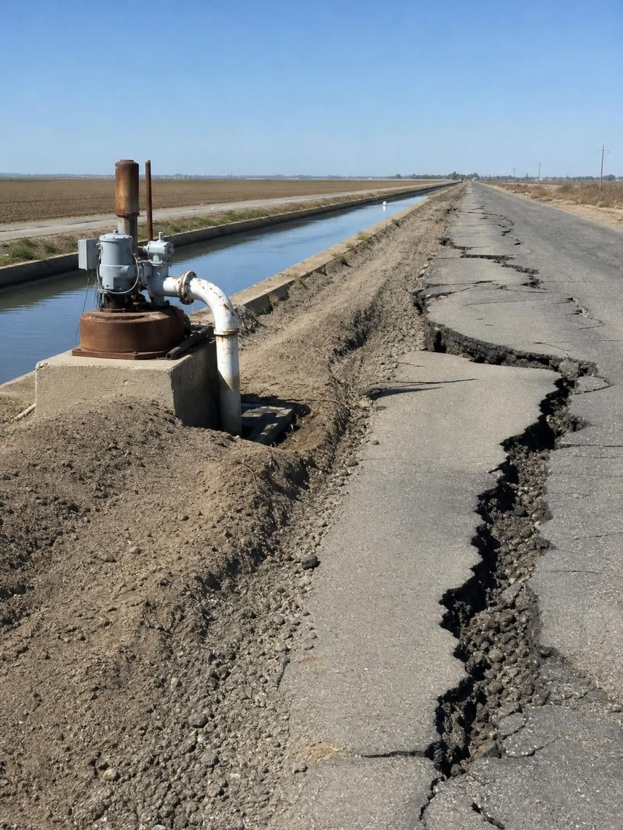
REAL-WORLD CONNECTION
California connection: the sinking Central Valley
Under the Central Valley lies California's largest groundwater store, in thick sediment washed down from the Sierra Nevada and Coast Ranges. In droughts, farms pump far more than recharge. As clay layers lose water, the ground compacts: parts of the San Joaquin Valley sank nearly 9 meters from the 1920s to 1970 and sank again in recent droughts. A 2014 law requires local agencies to balance pumping with recharge.
11
Notes:
This is the lesson's clearest case of humans acting as a geoscience process. The Central Valley aquifer formed because rivers spent millions of years dumping gravel, sand and clay into a basin between two mountain ranges, which is the 'past process' half of the standard. The 'current process' half is pumping: in dry years groundwater supplies well over half the valley's irrigation, and the water table falls. The subsidence figure comes from USGS measurements near Mendota (close to 30 feet by 1970). The 2014 law is the Sustainable Groundwater Management Act; local plans must reach balance by about 2040. Ask students what 'balance' means in the vocabulary of this lesson: pumping no larger than recharge, which is the definition of sustainable use. Note: canals and bridges crack when the ground sinks unevenly, so this is an engineering problem too.
CONNECTS TO: Lab 3 is a fictional version of this decision; W5 uses recharge versus pumping data.
PACING: about 5 min

Slide 12
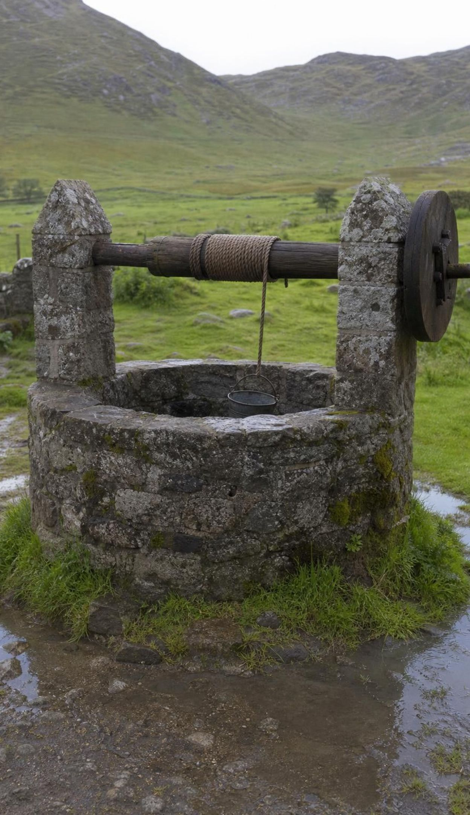
CHECK FOR UNDERSTANDING
Quick check: which well is the safest bet?
A town can drill one well. Which site will refill fastest after a wet winter?
A. Deep sandstone under a desert that gets 8 cm of rain a year
B. Thick river gravel in a valley that gets 80 cm of rain and snowmelt a year
C. A clay-rich layer in a valley that gets 80 cm of rain a year
D. Cracked granite on a mountain that gets 120 cm of rain a year
12
Notes:
Vote and defend. B has both ingredients: lots of recharge and porous, permeable sediment. D has the most rain but granite stores little; C has rain but clay will not release water to a well; A has porous rock but almost no recharge, so it is the one that behaves like a mine. Ask which site might still hold the most water in total. Possibly A, if the sandstone is thick and old, and that is the trap: total storage and recharge rate are different things.
EXPECTED RESPONSES: B. Students who choose D are reasoning from rainfall alone; students who choose A are reasoning from storage alone.
WATCH FOR: Rain alone or storage alone. Both ingredients are needed for a renewable supply.
CONNECTS TO: Lab 3 session 1 makes the rock-type part concrete; W5.
PACING: about 4 min

Slide 13
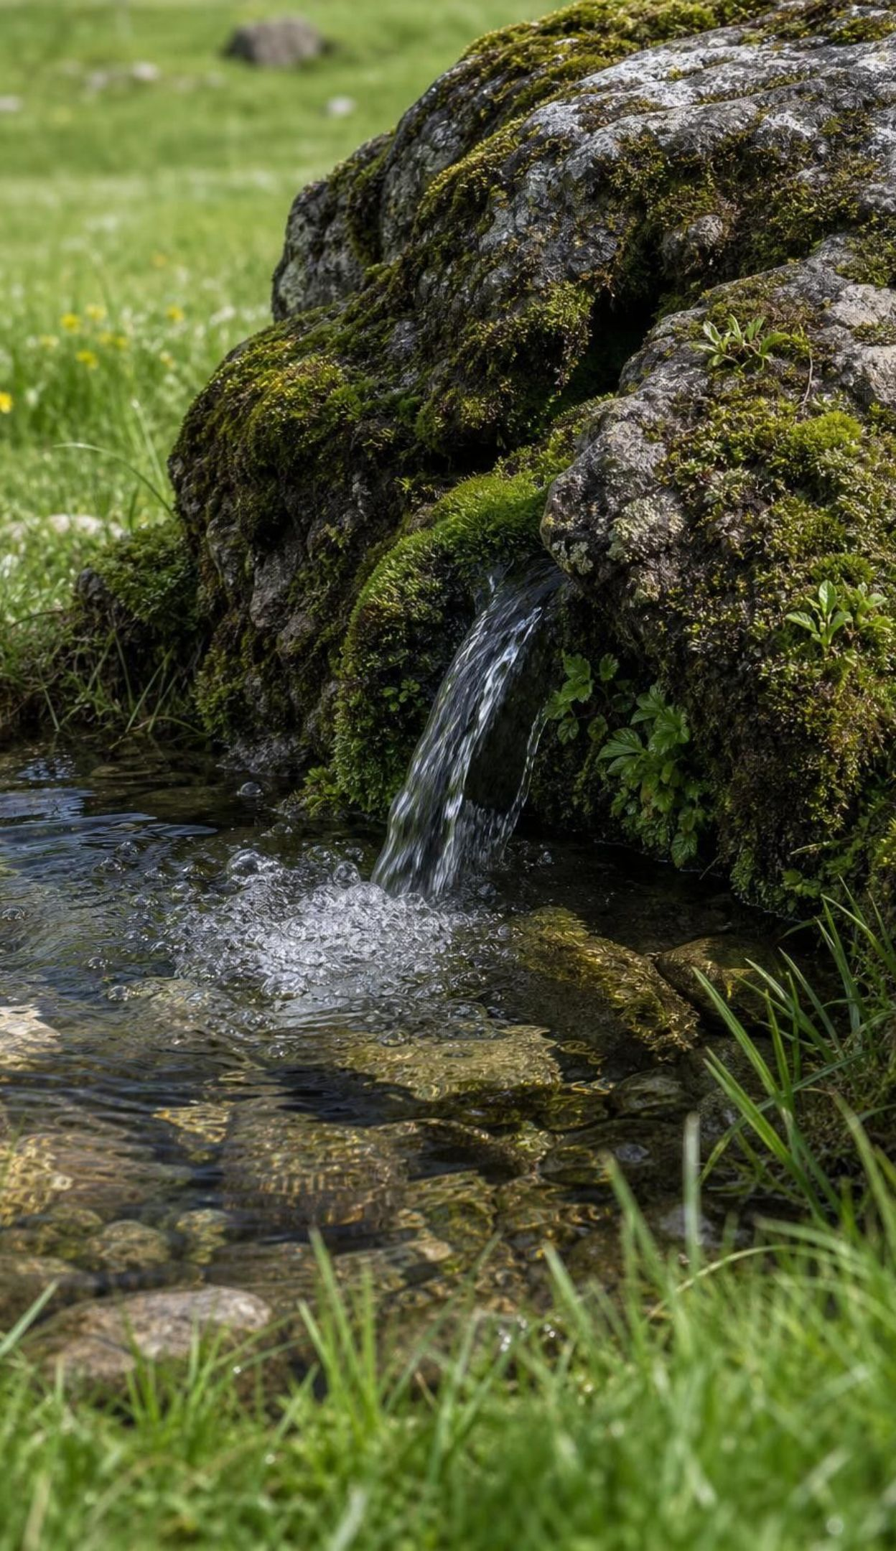
Think, pair, share
Discuss: is groundwater renewable?
What is the recharge rate: rain, snow, rivers, and porous ground to let it in?
How old is the water already there? Years, or a million years?
How much is being pumped compared with the recharge?
Does the answer change for the same aquifer in a wet decade and a dry decade?
The textbook says most groundwater is nonrenewable. A student says her family's well refills every spring. Who is right, and what would you need to know to decide for a particular aquifer?
13
Notes:
Give pairs four minutes, then collect. Steer toward 'both can be right about different aquifers' and the two-part test: the label depends on how fast nature refills that aquifer, and sustainability depends on pumping versus recharge. Press on the last bullet: a shallow aquifer can be renewable and still be overdrawn in a drought, which is exactly the Central Valley story. If a student raises fossil water, use the Great Artesian Basin: water that has been underground for more than a million years in parts of the basin, so its water is nonrenewable on any human timescale even though some recharge enters at the edges.
EXPECTED RESPONSES: Depends on the aquifer; needs recharge rate, water age and pumping rate; a wet decade can make an overdrawn aquifer look fine.
WATCH FOR: Absolute answers either way. Reward 'it depends, and here is what decides it'.
CONNECTS TO: Lab 3 debrief; W2 q10 and W8 q5 ask the same question; W7 misconception repair (statement 7).
PACING: about 6 min

Slide 14
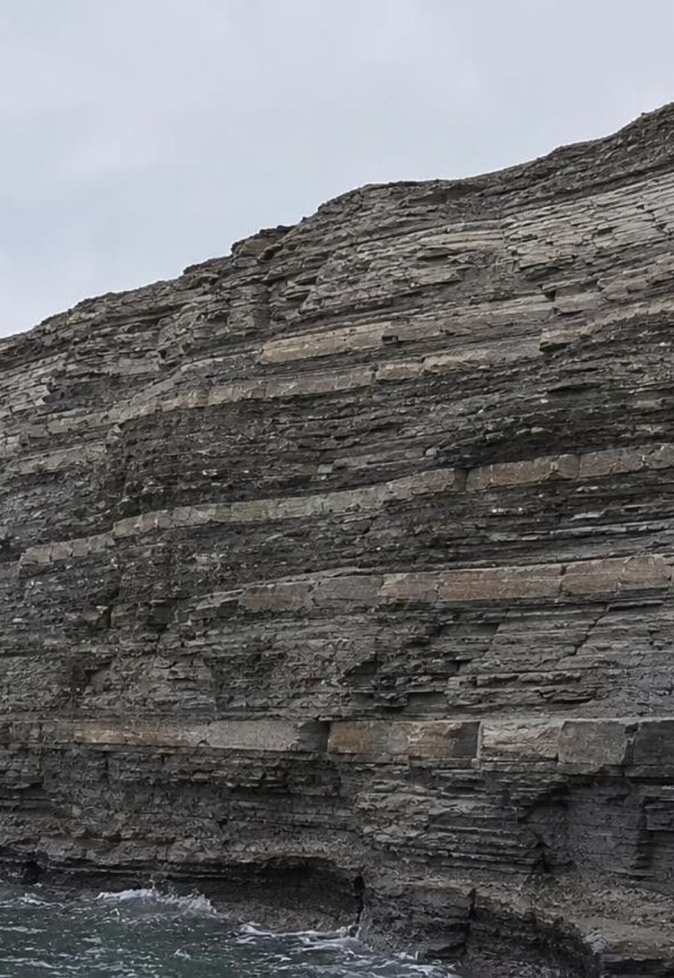
MODEL
How petroleum forms
Model: From plankton to an oil reservoir, over millions of years
Tiny marine organisms die and sink into oxygen-poor mud on a sea floor
01
(burial) Layers of sediment bury the mud deeper and deeper
02
(heating) Deeper rock is hotter: at roughly 60 to 120 °C the organic matter slowly changes into oil
03
(migration) Oil, lighter than water, migrates upward through porous rock
04
(trapping) A sealing layer (shale or salt) over a fold or fault stops it: a trap
05
(storage) Oil fills the pores of the reservoir rock beneath the seal
06
Every step must happen. Skip the low-oxygen mud, the right heating or the trap, and there is no oil field.
14
Notes:
Walk the flow and stress that it is a chain: each link is required. Correct two textbook wordings. First, the book says temperature rises as pressure rises; in fact rock is hotter at depth because Earth's interior is hot, and burial carries the organic mud down into that heat. Second, the book's summary says oil occurs wherever marine remains piled up; many ancient seas left no oil because the mud never reached the oil-forming temperature window, or the oil escaped because there was no trap. Also answer the parking-lot claim: oil did not come from dinosaurs; it came from microscopic plankton. Coal is different: it formed from land plants in swamps. Ask what a geologist looks for at the surface: folded sedimentary rock with marine fossils, shale over sandstone, and sometimes natural tar seeps.
EXPECTED RESPONSES: Students should be able to name the four ingredients: source (organic-rich mud), heat from burial, reservoir (porous rock), trap (seal over a fold or fault).
WATCH FOR: 'Oil from dinosaurs' and 'pressure makes oil.'
CONNECTS TO: W3 reading passage; W4 diagram of a trap; Lab 1 oil clue cards.
PACING: about 7 min

Slide 15
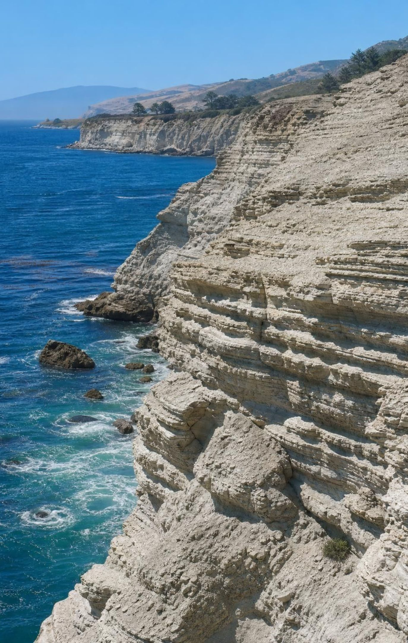
Why oil is here and not there
The recipe is rare: source mud, long heating, porous reservoir rock and a sealed trap, all in one place.
Giant fields such as Ghawar in Saudi Arabia lie where ancient seas left thick organic-rich sediment.
Kern County's oil comes largely from the Monterey Formation, plankton-rich mud from deep offshore basins.
Oil fuels most transportation; it supplies less than 1 percent of U.S. electricity.
Drained fields drop off the map; companies move on, so human removal changes the pattern.
15
Notes:
Return to the phenomenon map. Kern County's oil is not under the Sierra because the mountains are granite and metamorphic rock with no buried marine mud, and it is not under every part of the valley because the trap and the heating had to line up. The Monterey Formation is a nuance worth naming: the textbook says 'warm, shallow seas', but much of California's oil source rock was deposited in deeper offshore basins about 6 to 16 million years ago; what mattered was plankton-rich, low-oxygen mud, not the depth. The Kern River field near Bakersfield has produced since 1899. Also fix the book's opening line: oil provides most transportation fuel, not most electricity (about 0.7 percent of U.S. generation in 2025 per EIA). Close on the human half of the standard: a drained field is a blank on the map that was not blank a century ago.
EXPECTED RESPONSES: Students should explain the absence of oil under the Sierra by the missing source rock.
WATCH FOR: 'Oil must be under the mountains too, just deeper.' No source mud, no oil.
CONNECTS TO: W3 reading; Lab 1 cells with no trap; W6 CER.
PACING: about 5 min

Slide 16
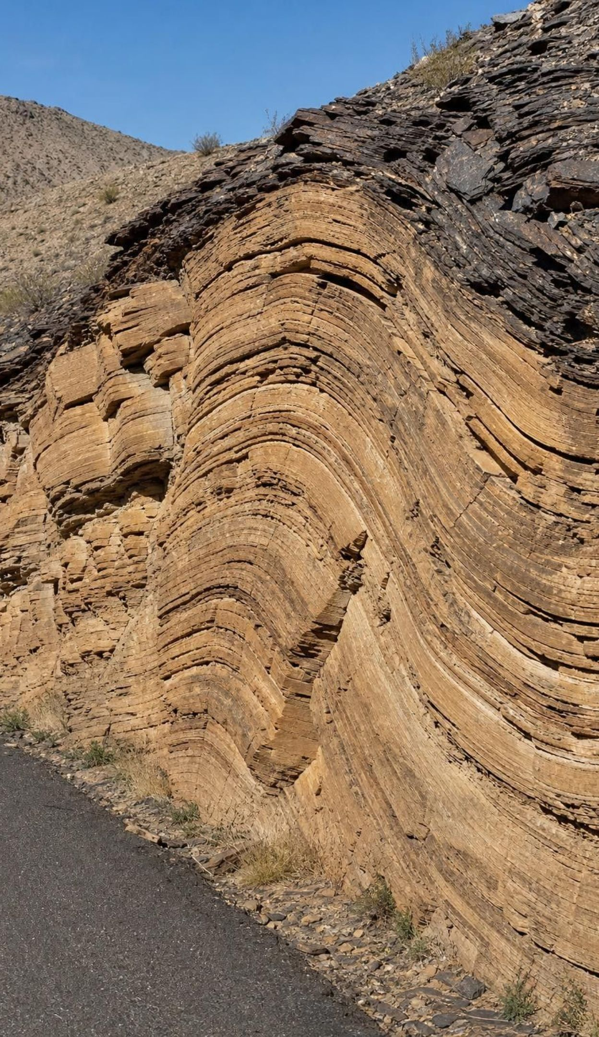
VOCABULARY IN CONTEXT
Words for finding oil and water underground
aquifer: Porous rock or sediment that stores groundwater and lets it flow to a well. River gravel under a valley floor is a typical aquifer; clay above it is not.
recharge: Water that soaks down into an aquifer; the recharge rate is how much arrives each year. A wet winter raised the recharge, and the water table came up two meters.
geologic trap: A fold or fault where a sealing layer stops rising oil and holds it in a porous reservoir rock. The sandstone arched upward beneath a shale cap, and oil collected in the top of the arch.
16
Notes:
Connect the three: water and oil both sit in pore spaces of porous rock. Water fills an aquifer from above by recharge; oil migrates upward from below and needs a seal to stop it. Ask: why does an oil trap need a seal but an aquifer does not? Because oil is lighter than water and keeps rising until something stops it, while water in an aquifer is already at the bottom of its journey. Have students draw a quick fold with a seal and label where the oil would sit (the top of the arch).
WATCH FOR: Students picture oil and water as underground pools. Both are in pores.
CONNECTS TO: W4 diagram worksheet interprets a trap and W10 q6 asks students to draw one; Lab 3 uses aquifer and recharge.
PACING: about 4 min

Slide 17
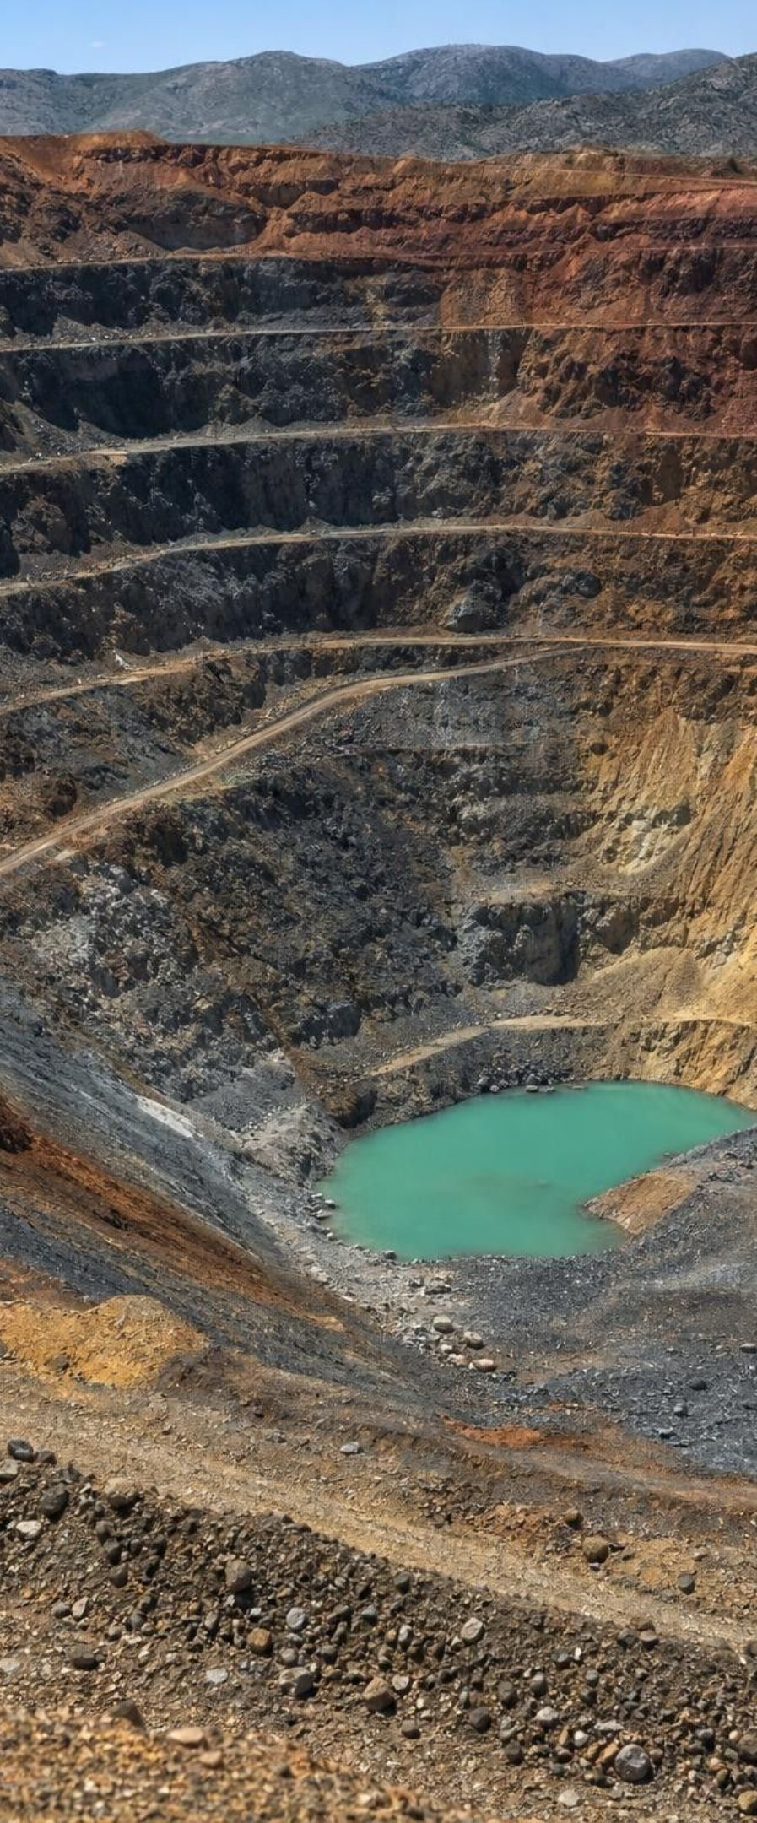




Four ways Earth concentrates metal ore
MODEL
Model: Processes that turn ordinary rock into ore
Igneous settling: Dense metal-rich crystals sink and collect in layers at the bottom of a cooling magma chamber (chromium, platinum, nickel).
Hydrothermal veins and porphyries: Hot water from cooling magma dissolves metals, flows through cracks and drops them as it cools. Most copper and much gold; common above sinking plates.
Sedimentary layering and placers: Iron settled out of ancient seas in thick layers; salt and gypsum formed as seas evaporated; dense gold flakes collected in river gravel.
Deep weathering: Long, hot, rainy weathering dissolves away everything else and leaves aluminum-rich bauxite or nickel-rich soil behind.
Ore is rock with enough metal to be worth mining. Each process concentrates a metal that is normally spread thinly through ordinary rock.
17
Notes:
Start with the idea of concentration: average crust holds about 0.006 percent copper; a copper ore body holds 0.3 to 1 percent or more, so some process gathered the metal about fifty to more than a hundred times. The textbook covers only the hydrothermal copper story; the standard asks about mineral resources generally, so we name all four processes. Hydrothermal porphyry copper is the giant: magma rising above a subducting plate releases hot, metal-rich water that fills a maze of cracks, which is why the Andes (Chile) and the American Southwest host the big copper mines. Sedimentary iron formed in ancient oceans more than 1.8 billion years ago, which is why iron ore sits in old continental cores. Bauxite sits in the wet tropics. Students are never asked to name minerals; they need the process-to-place link.
EXPECTED RESPONSES: Given 'a belt of old volcanoes above a former subduction zone', students should predict hydrothermal copper or gold; given 'hot, rainy tropics', bauxite.
WATCH FOR: 'Metals are found as pure nuggets.' Nearly all metal is locked in minerals at low concentrations; nuggets are rare placer exceptions.
CONNECTS TO: Lab 1 ore clue cards; Lab 2 ore grade; W8 collaborative evidence cards.
PACING: about 6 min

Slide 18
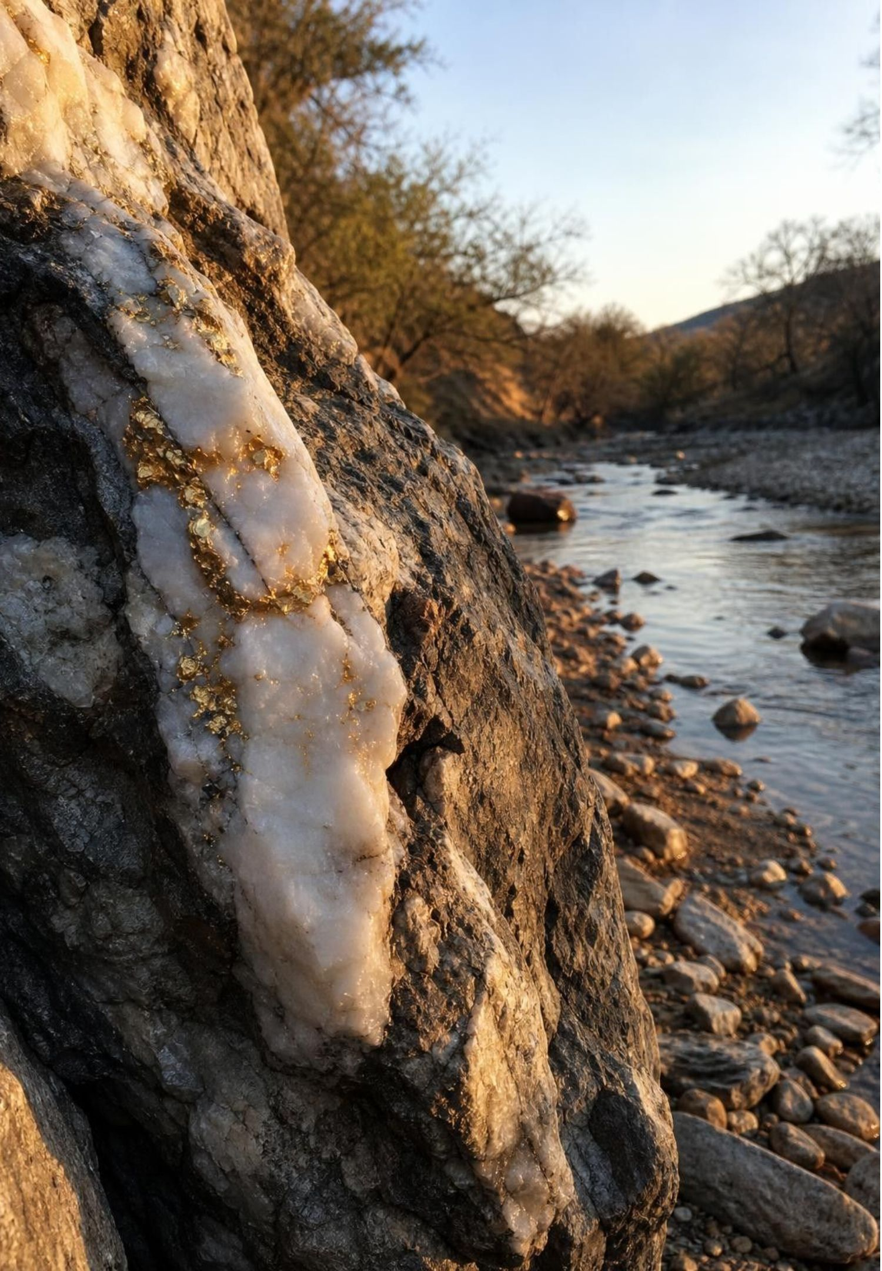
REAL-WORLD CONNECTION
California connection: why the gold is in the foothills
The Mother Lode is a belt of gold-bearing quartz veins in the western Sierra Nevada foothills. Between about 150 and 100 million years ago, while magma rising above a subduction zone was building the Sierra's granite, hot water carried dissolved gold up cracks and left it in quartz veins. Weathering later freed the gold; streams gathered the dense flakes in gravel. A find at Sutter's Mill in 1848 began the Gold Rush.
18
Notes:
This answers the phenomenon's stripe. The veins run along the foothills because a long fault zone left by the old plate collision (the Melones fault zone) gave the hot water a path upward, and the placer gold lies in river gravels downstream of the veins because gold is about seven times denser than ordinary sand and drops out first when a stream slows. Both are 'past geoscience processes' in the language of the standard: subduction and hydrothermal activity for the lode, weathering and transport for the placers. Then the human half: by the 1850s most easy placer gold was gone, miners turned to hard-rock mines and to hydraulic mining that washed whole hillsides into rivers (banned in 1884 after it buried farmland downstream). The resource map changed within a single generation. Ask: is gold renewable? No; the veins took millions of years, and the placers took thousands to millions of years of weathering and stream sorting.
CONNECTS TO: Lab 1 includes a quartz-vein cell and a placer-gravel cell; W10 Part B (Set B); W8 evidence cards.
PACING: about 5 min

Slide 19
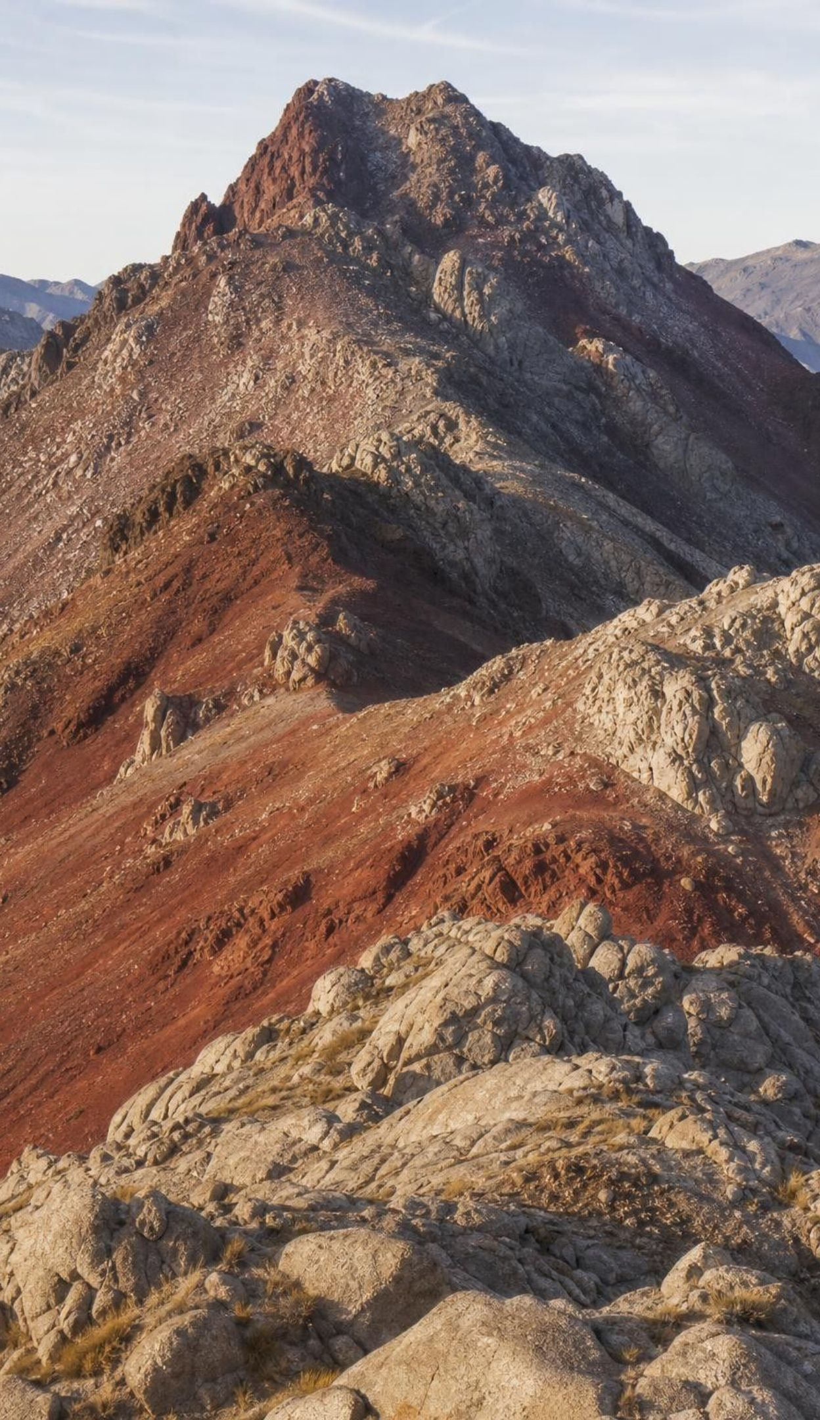
CHECK FOR UNDERSTANDING
Quick check: where would you look for copper?
A geologist wants a large copper deposit. Which setting is the best evidence?
A. A flat plain of young river mud with no bedrock exposed
B. A belt of old, eroded volcanoes with granite intrusions and quartz veins, above a former subduction zone
C. A salt flat where a shallow sea evaporated
D. A coral reef limestone with marine fossils
19
Notes:
Vote and defend. B matches the hydrothermal recipe: magma above a sinking plate released metal-rich hot water. A has no magma history; C would give salt and gypsum; D is a limestone that might be an oil reservoir if other conditions held but is not an ore setting. Push students to explain the cause, not just match the picture: the sinking plate melts, magma rises, hot fluids carry copper, cooling drops it.
EXPECTED RESPONSES: B, with the chain subduction → magma → hot fluids → veins.
WATCH FOR: Choosing C because 'salt is a mineral' confuses a sedimentary mineral resource with metal ore; it is a fair point and worth a sentence.
CONNECTS TO: Lab 1 prediction map; W10 mastery.
PACING: about 3 min

Slide 20
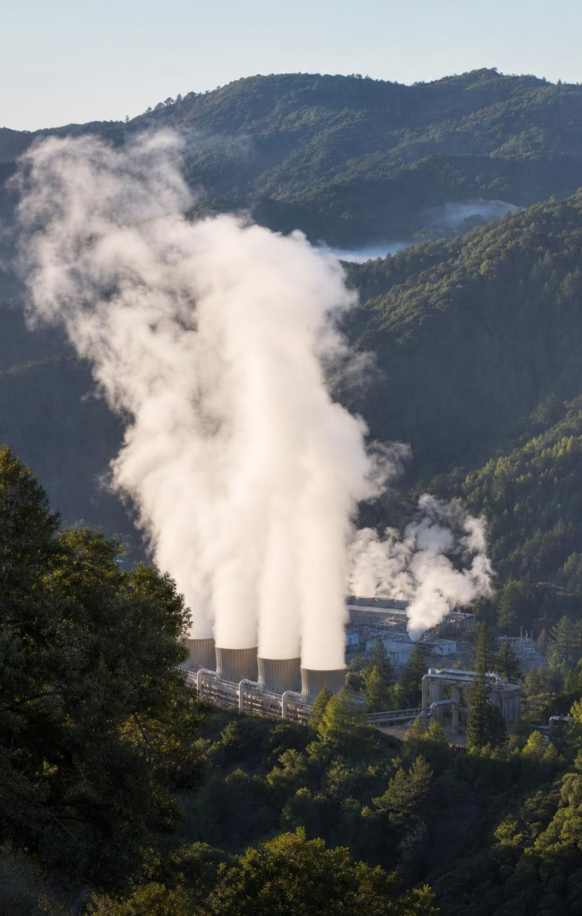
Geothermal energy: heat where the plates meet
Earth is hot inside; heat escapes fastest where magma is near the surface, at plate boundaries and volcanoes.
Groundwater that touches hot rock becomes hot water or steam, which can spin turbines or heat buildings.
The Geysers north of San Francisco is the world's largest geothermal complex; the Imperial Valley is another.
The heat flow is effectively endless, but a reservoir of hot water can be drawn down faster than it refills.
At The Geysers, steam pressure fell in the 1980s; treated wastewater is now injected to sustain the field.
20
Notes:
Explain the cause-and-effect chain the standard wants: plate boundary → magma near the surface → high heat flow → hot groundwater → geothermal field. Hot springs, geysers and recent volcanic rock are the surface clues. Then make the renewable point carefully. The textbook calls the supply inexhaustible and will always be available. Earth's heat is effectively endless, but a particular field depends on water being there to carry the heat up. The Geysers is a dry-steam field; from the 1970s through the 1980s operators took out far more steam than nature returned, and pressure and output dropped. Since 1997 Lake County and since 2003 Santa Rosa have piped treated wastewater to the field for injection, which restored part of the output. This is the lesson's best example that renewable is not the same as unlimited, and it reappears on the misconception slide. Also mention the Salton Sea field, where very hot, salty brines also contain lithium that companies are testing how to extract; keep it as 'being tested', not a settled resource.
EXPECTED RESPONSES: Students should name the surface clues (hot springs, volcanoes, plate boundary) and state that a reservoir can be overdrawn.
WATCH FOR: 'Geothermal can never run out.' The heat cannot; the water in a field can.
CONNECTS TO: Lab 1 geothermal clue cells; W4 geothermal model; misconception slide; W7.
PACING: about 5 min

Slide 21
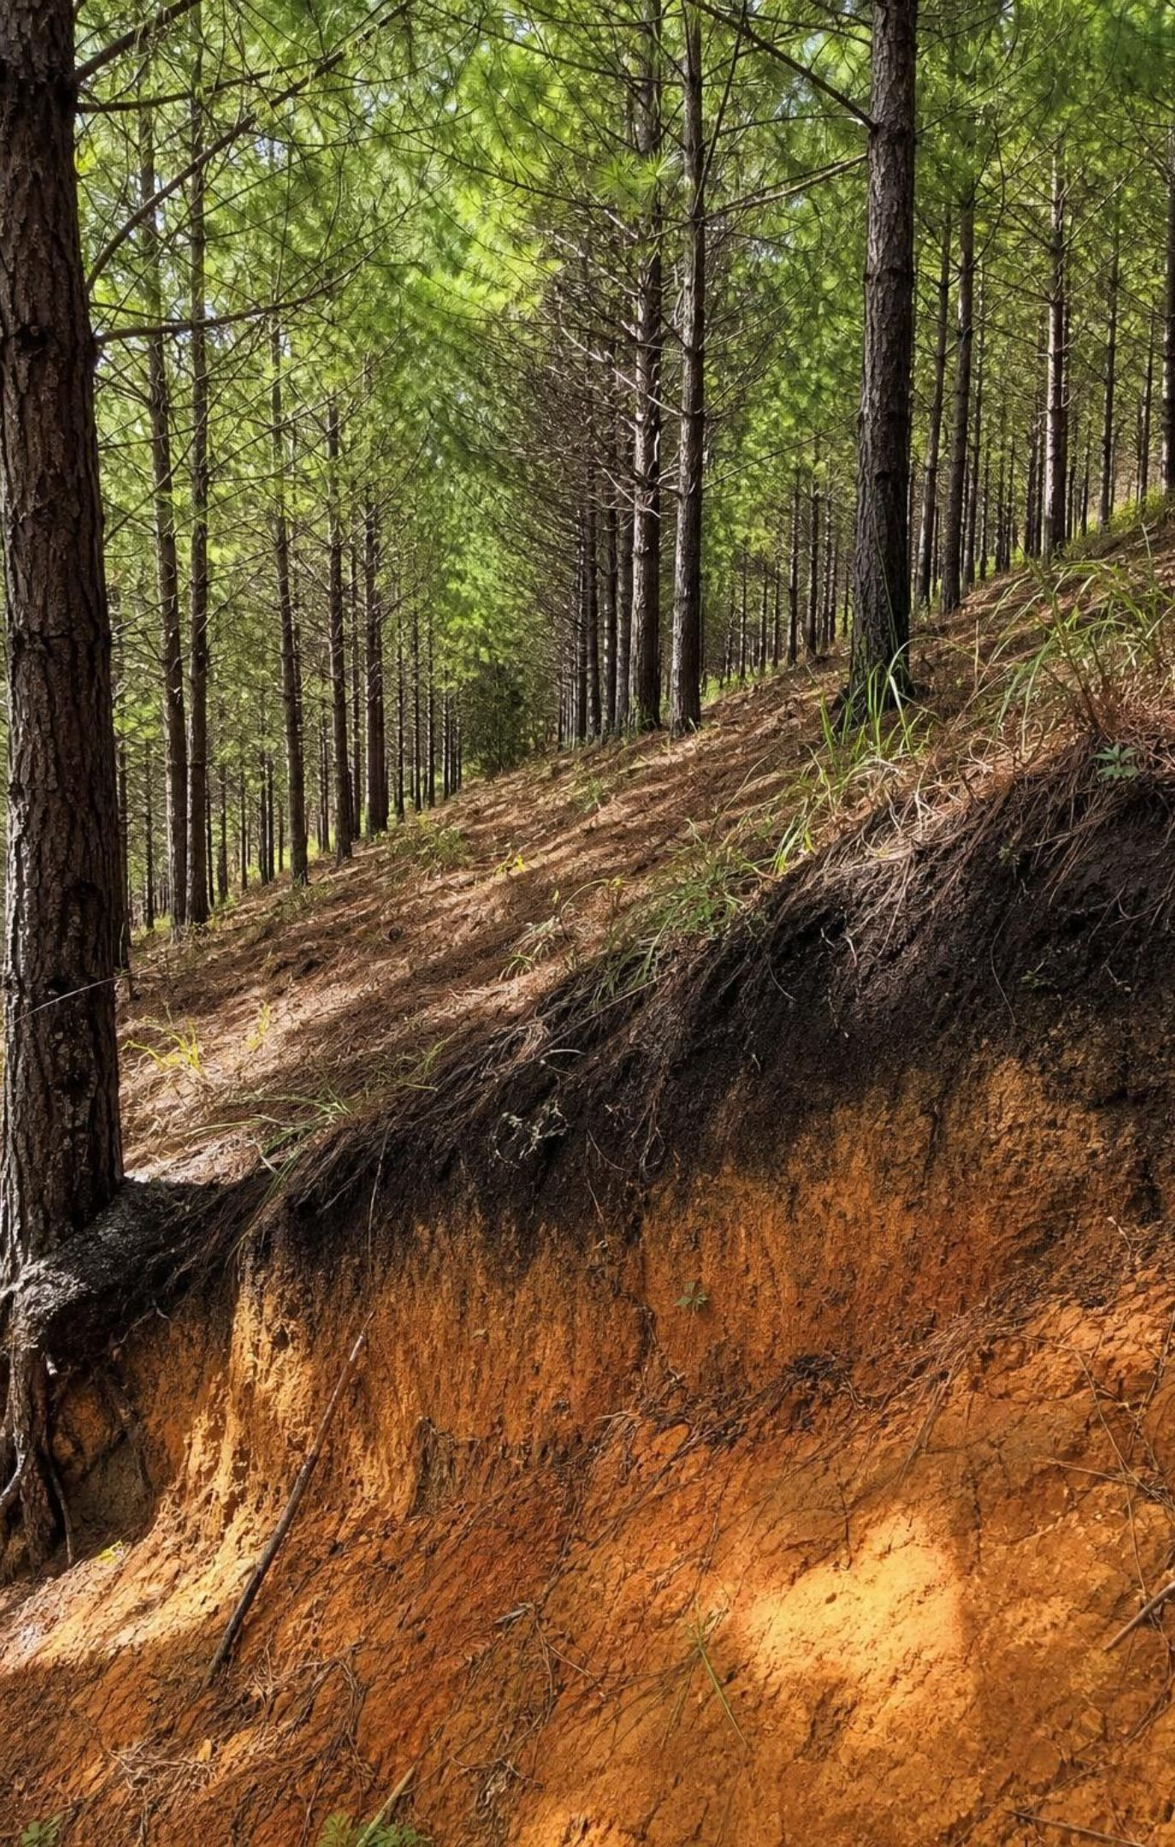
Soil and wood: resources that grow, slowly or fast
Soil forms as weathered rock grains mix with organic matter; one centimeter of topsoil can take centuries.
Rainy places weather rock faster, so soil may be thicker, but heavy rain also washes nutrients out.
Overgrazing and bare fields let wind and water strip topsoil far faster than it forms.
Forests grow where climate and soil allow; a planted pine stand regrows in decades, old growth in centuries.
Whether wood is renewable depends on the forest and the harvest rate, not on the tree's name.
21
Notes:
These two resources come from the biosphere, and both show the rate rule. Soil: on a human timescale thick fertile topsoil is nonrenewable because it is lost far faster than it forms, yet farmers can rebuild organic matter over decades with cover crops and less tillage; the textbook's Ethiopia example is about restoring degraded land. Wood: the textbook labels pine renewable and redwood nonrenewable. The accurate framing is harvest rate versus regrowth time: a plantation cut and replanted on a 20-year cycle is renewable; an old-growth stand whose trees took 500 years is not, whatever the species. Coast redwoods even resprout from stumps. Note that the book's deforestation figures are inconsistent (its area figure appears to be missing a zero) and are not assessed.
EXPECTED RESPONSES: Students should apply the rate rule to both: lost faster than formed (soil), harvested faster than regrown (old growth).
WATCH FOR: Species labels for renewability. It is about rates.
CONNECTS TO: W2 sort includes two kinds of forest; W7 statement 5 and W10 q10 cover soil.
PACING: about 4 min

Slide 22
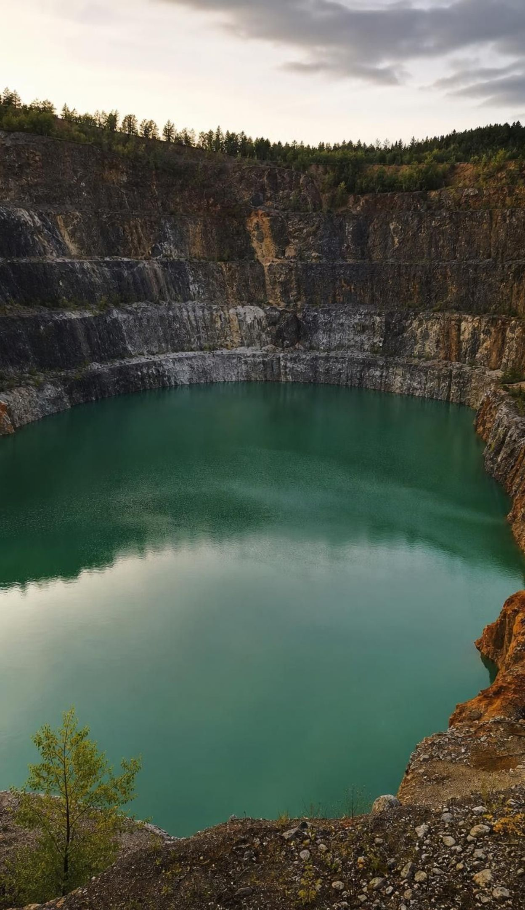
THINK, PAIR, SHARE
Discuss: are humans a geoscience process?
A mined-out copper pit and a drained oil field are blanks on the map that were not blank before.
The Central Valley sank as water was pumped; the ground itself changed.
Geologic processes took millions of years; removal takes decades.
Which of these changes could be reversed, and which cannot?
The standard says resource distribution results from past and current processes. Pumping, drilling, mining and logging are current processes. How are they like geologic processes, and how are they different?
22
Notes:
Give pairs four minutes. Expect: similar because they move material and change where it is; different because of speed, and because they mostly remove rather than create. Press on reversibility: an overdrawn gravel aquifer can recover in wet years; compacted clay layers do not re-expand, so lost storage in the Central Valley is permanent; a mined-out deposit is gone for any practical purpose, though recycling now supplies a large share of the copper used in new products. Tie back to sustainability: the choice is not between using and not using, but between rates.
EXPECTED RESPONSES: Similarities: both redistribute material and change the map. Differences: speed; removal versus formation; some human changes are reversible, some are not.
CONNECTS TO: Lab 2 debrief (the cookie after mining); W5 q9 and q10; Lab 1 q7.
PACING: about 6 min

Slide 23
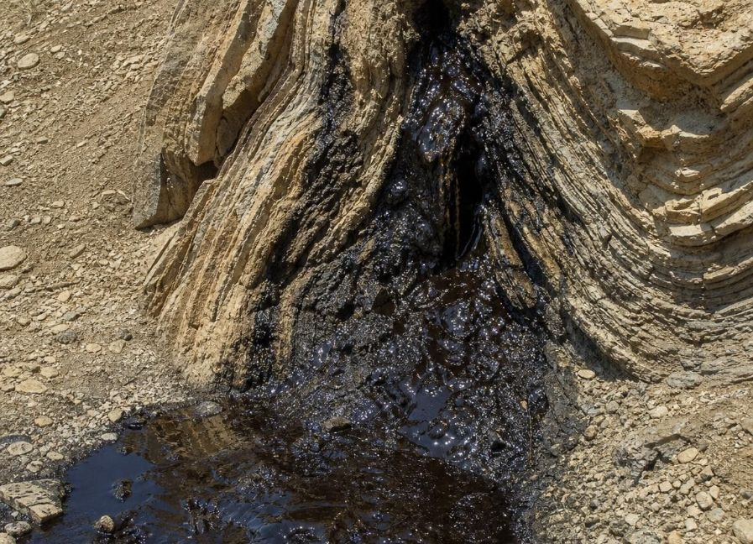
Task: read the clues, predict the resource
Apply it Simulated data for practice.
Four fictional sites were mapped by a survey crew. For each, decide which resource (if any) the evidence points to, and name the process that put it there.
Site | Rock and landscape | History clues | Rain per year | Your prediction and process
P | Folded sandstone with shale on top; marine fossils; a tar seep | Was an ocean basin 20 million years ago; buried 3 km, then folded | 25 cm
Q | Eroded old volcanoes; granite; quartz veins with green copper stains | Above a plate that sank 40 million years ago | 50 cm
R | Wide valley floor of thick gravel and sand; river fed by snowmelt | Rivers have filled the valley for 2 million years | 70 cm
S | Flat limestone with reef fossils; layers not folded; no seal on top | Was a shallow sea; never buried deeper than 1 km | 30 cm
23
Notes:
These are invented sites for teaching. Give groups eight minutes, then compare. P has the whole oil recipe: source and burial, a fold and a seal, even a seep. Q is the hydrothermal copper recipe. R is a productive, renewable aquifer: porous sediment plus steady recharge. S is the trap question: a shallow sea and fossils are not enough; with no deep burial and no seal, expect no oil field (it may still be a modest aquifer if the limestone is cracked, which is a good extension). Ask every group to state the process, not just the resource, because the explanation is what the standard assesses. This is a warm-up for Lab 1, where the grid is bigger and the answer is hidden.
EXPECTED RESPONSES: P: petroleum (burial, heating, fold, seal). Q: copper ore (subduction, magma, hydrothermal fluids). R: groundwater (porous gravel, snowmelt recharge). S: no oil (insufficient burial, no trap); possibly some groundwater.
WATCH FOR: Students who give S oil because of the fossils are using one clue; insist on the full chain.
CONNECTS TO: Lab 1 the buried-treasure mystery; W8 evidence cards; W6 CER.
PACING: about 10 min

Slide 24
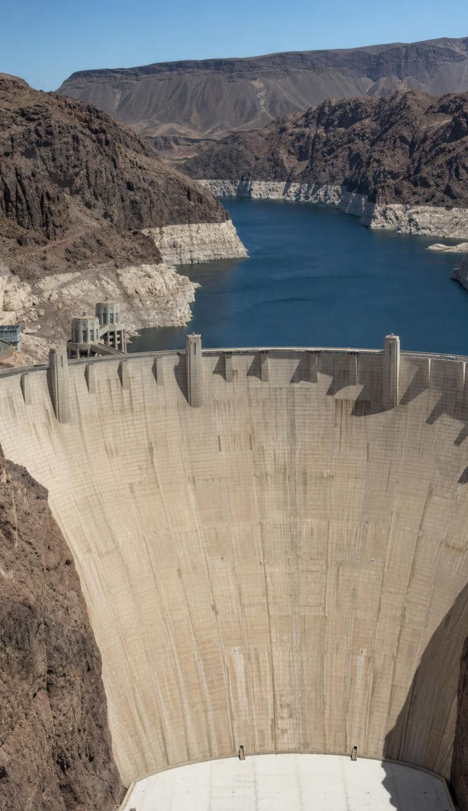
MODEL
Engineering: how the Hoover Dam team chose a design
Model: Criteria the dam had to meet versus constraints it had to fit
Criteria (what success required) | Constraints (limits on the solution)
Store enough Colorado River water for a growing Southwest | Cost to build and maintain
Generate electricity | The shape of the canyon and its rock
Protect downstream communities from floods | Harm to the river and its ecosystems
The team scored each design against both lists. The arch-gravity dam won for this canyon: the curve steers part of the water's push into the canyon walls, and the wide base resists by weight.
24
Notes:
This is the lesson's engineering strand and the model for Lab 3. A criterion describes success; a constraint is a limit. Ask students to sort a few new items (must be finished in five years: constraint; must hold back a flood of a given size: criterion). Two accuracy points: the arch does not lower the water's pressure, it redirects part of the load into the canyon walls; and earth-fill dams are not weak as a class (the earth-fill Garrison Dam in North Dakota holds a reservoir nearly as large as Lake Mead); the team's judgment was for this narrow canyon and this huge storage goal. Then the trade-offs: the dam blocked fish, traps sediment that once reached the delta, and changed the river's temperature below it. Built 1931 to 1936; about 21,000 workers over the project. In Lab 3, students will build their own decision matrix for a town's water supply.
EXPECTED RESPONSES: Students should classify new items correctly and explain why the strongest design is not automatically the best (a small irrigation dam would weigh cost more heavily).
WATCH FOR: 'The strongest option always wins.' The criteria and constraints decide, and they change with the site.
CONNECTS TO: Lab 3 decision matrix; W9 transfer design decision.
PACING: about 6 min

Slide 25
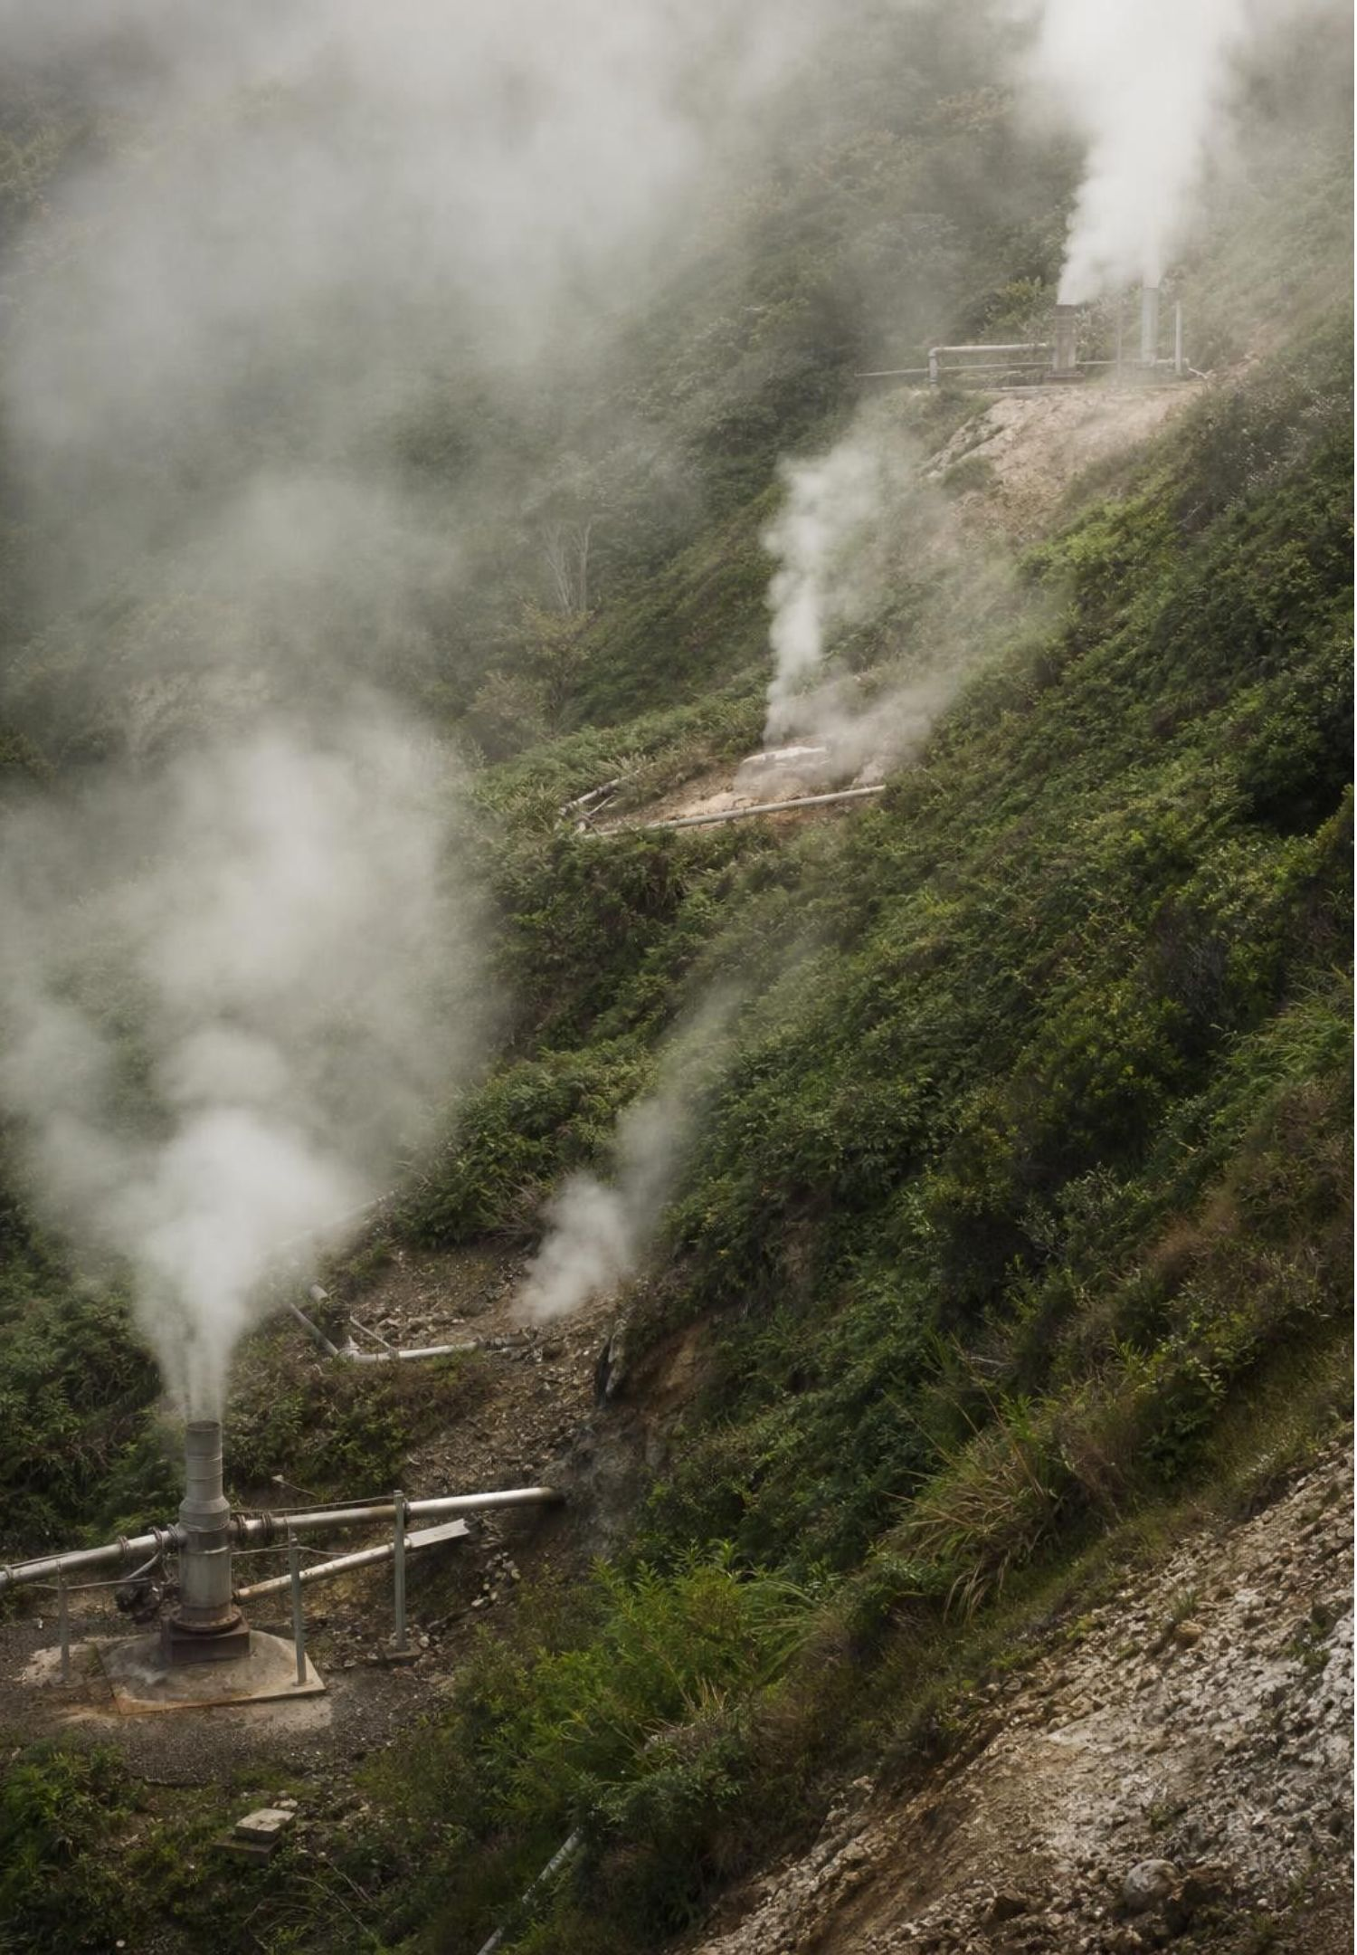
MISCONCEPTION CHECK
True or false? Renewable means it cannot run out
"Geothermal energy is renewable, so a geothermal power plant can take as much steam as it wants forever and the supply will never drop."
True or false? Explain your reasoning.
25
Notes:
Have students write a verdict with evidence from the lesson. The first half is right: geothermal energy is renewable because Earth's heat flow is effectively endless on any human timescale. The second half is wrong: a plant taps a reservoir of hot water or steam, and if it removes steam faster than water seeps back in, pressure and output drop. That is what happened at The Geysers by the late 1980s, and it is why treated wastewater is now injected there. Generalize: renewable describes nature's replacement rate; sustainable describes whether our use rate stays under it. The same logic covers an overpumped shallow aquifer and an overcut forest.
EXPECTED RESPONSES: False in the second half. Renewable (the heat keeps coming) but a reservoir can be drawn down if withdrawal exceeds return; The Geysers is the evidence.
WATCH FOR: Students may swing to 'so geothermal is nonrenewable.' No: the label stays renewable; the use can still be unsustainable.
CONNECTS TO: W7 misconception repair; W2 q9 and W10 q9 test the same idea.
PACING: about 5 min

Slide 26
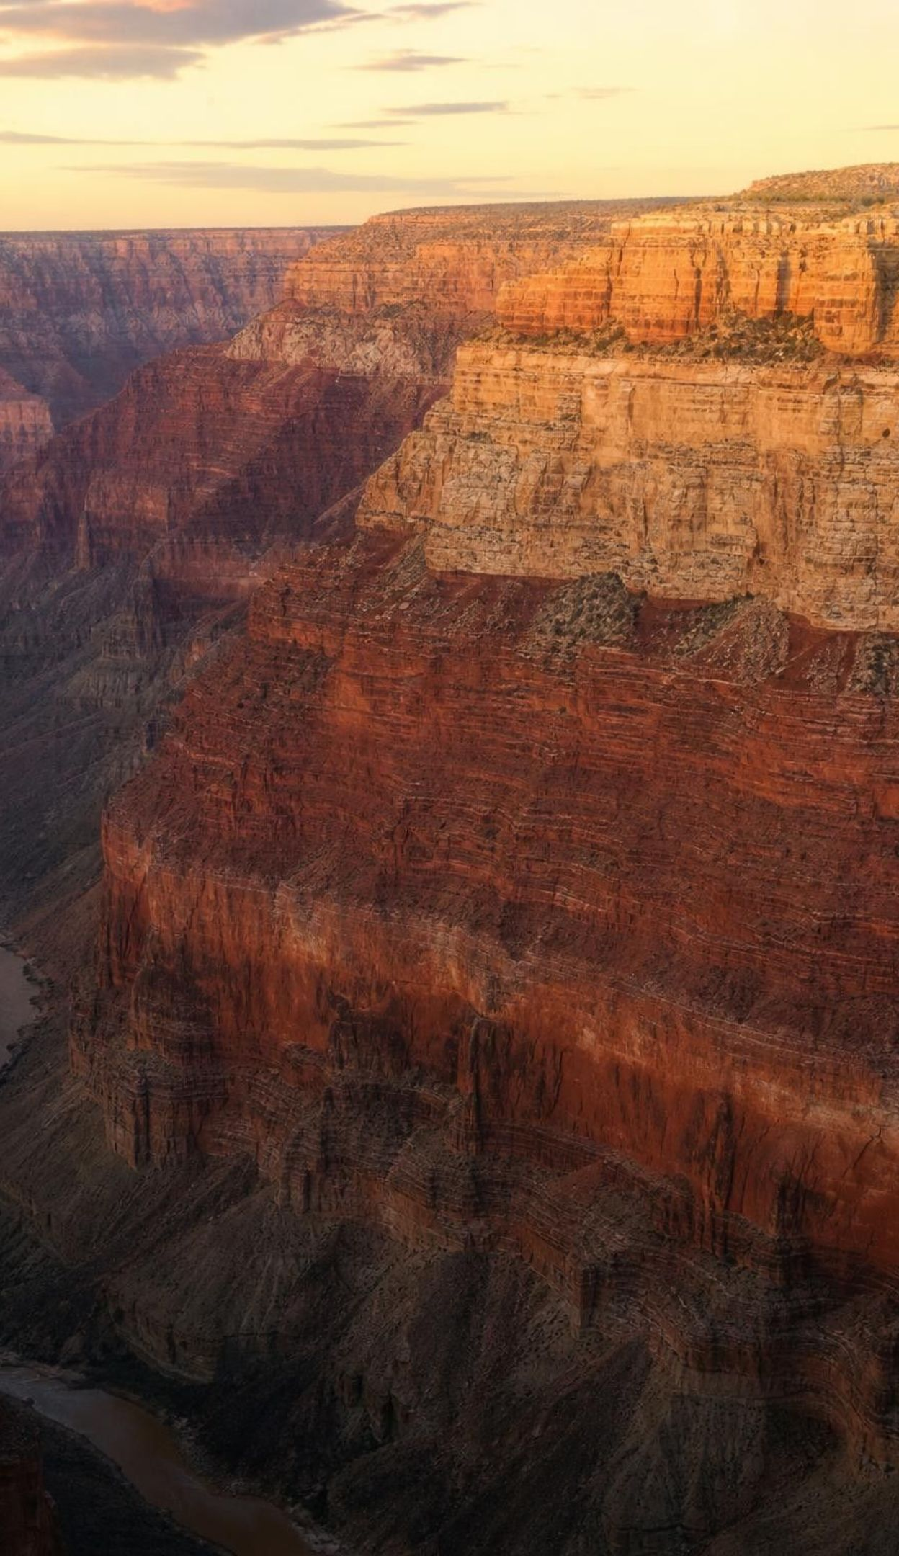
PUTTING IT TOGETHER
Putting it together
A resource map is a map of Earth's history: each resource formed only where its recipe came together.
Oil: buried plankton mud, long heating, porous reservoir rock and a sealed trap.
Ore: crystals settling in magma, hot fluids, sedimentary layers or deep weathering.
Geothermal heat: plate boundaries. Groundwater: porous rock plus recharge, now or in a wetter past.
Renewable or not is nature's clock; sustainable or not is our rate against nature's rate.
Pumping, drilling, mining and logging are current processes that are redrawing the map.
26
Notes:
Have students write a three-sentence explanation of one California pattern from the phenomenon slide (gold stripe, oil cluster, geothermal spots or the groundwater sheet), naming the past process and one current process changing it. Trade with a partner who checks for both halves. Then collect one takeaway from each lab: Lab 1 (which clue was most reliable), Lab 2 (what the cookie looked like after mining), Lab 3 (which plan they chose and why). Preview the next unit, which turns from the resources people take from Earth to the resources living things need in ecosystems.
CONNECTS TO: W10 mastery as the quiz; W6 CER as the written assessment.
PACING: about 6 min

Slide 27
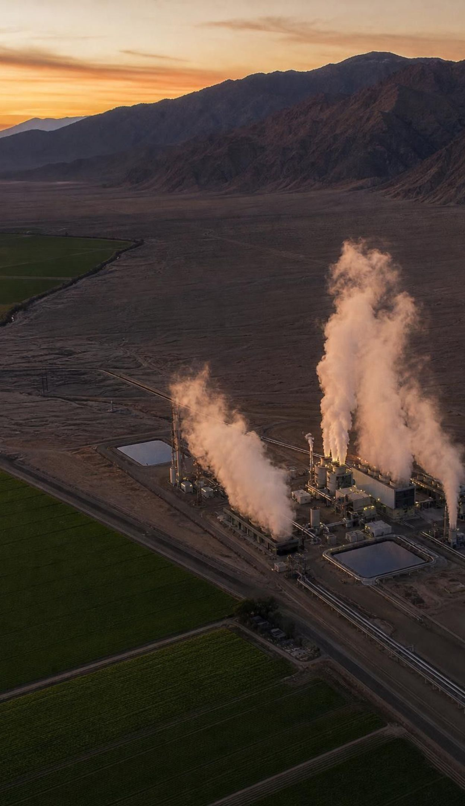
Exit ticket
Exit ticket
Name one surface clue a geologist uses to predict copper ore, and the process it points to.
A shallow aquifer refills in about 20 years; a town pumps 9 units/yr, recharge is 4. Renewable? Sustainable?
Why is there oil under Kern County but not under the Sierra Nevada? One sentence.
Give one way human use has changed where a resource is found.
27
Notes:
Collect on index cards or a shared form. Item 1 checks the process-to-place link; item 2 checks the two-part test with numbers; item 3 checks the full explanation the standard asks for; item 4 checks the 'current processes' half. Sort cards into piles before the next class and reteach from the largest pile.
EXPECTED RESPONSES: 1: old volcanoes or quartz veins with copper stains above a former subduction zone; hydrothermal fluids from magma. 2: renewable, because rain refills the aquifer in about 20 years, well within a lifetime; but the use is not sustainable: pumping 9 against recharge of 4 lowers the stored water by 5 units a year. 3: Kern County sits on buried plankton-rich marine mud that was heated and trapped; the Sierra is granite with no source rock or trap. 4: Central Valley water table and ground sinking; drained oil fields; mined-out pits; placer gold gone after the Gold Rush.
WATCH FOR: Item 2 answers of 'nonrenewable because it is running out' show the renewable/sustainable merge.
CONNECTS TO: W10 mastery; chapter evidenceOfLearning.
PACING: about 5 min

