Slide 1
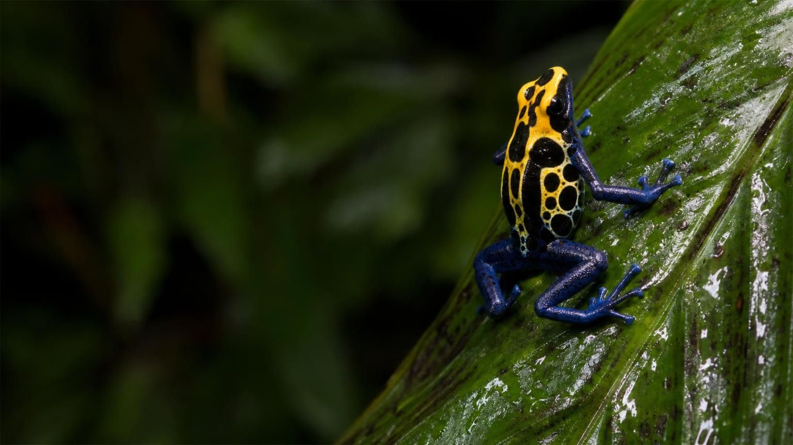
CHAPTER 20 OF 29 · RESOURCES IN ECOSYSTEMS
Chapter 20: Resources in Living Systems
Lesson 20: What do living things need, and what happens when a needed resource runs short?
Angela's Wand · Bring Science Alive! 7th Grade Integrated
Notes:
This lesson opens the ecology unit. Over the next three weeks we answer three questions: what living things take from their surroundings, why a population cannot grow forever, and how to read data about resources and populations without fooling ourselves. Tell students they will run a bead-and-card deer meadow, grow real duckweed under different light and nutrients, and act as wildlife managers deciding what to do before a drought. Mention that the duckweed cups get set up next period and need two weeks, so the lesson is spread out on purpose.
CONNECTS TO: Overview of Lab 1, Lab 2 and Lab 3; W1 opens the next slide.
PACING: about 2 min

Slide 2
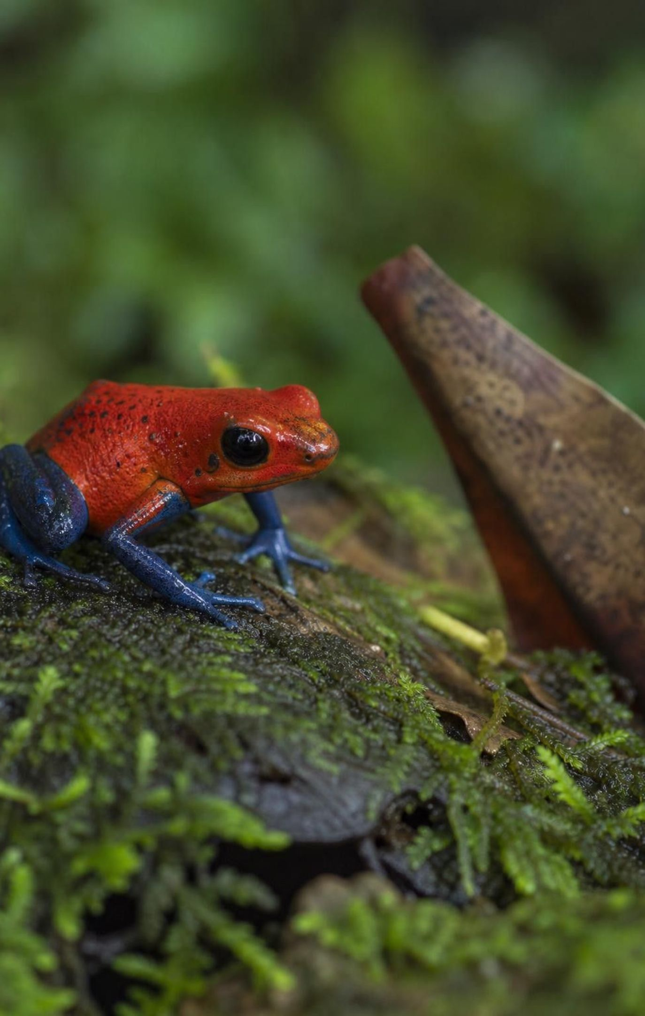
PHENOMENON
The frog that stops being poisonous
Tiny, brightly colored rainforest frogs carry poison in their skin; some were once used to coat blowgun darts. Frogs of the same species raised in a zoo or a home tank can be handled safely, and wild-caught frogs slowly lose their poison in captivity. Same frog, same air, about the same temperature. What is missing?
Notice: what is the same for a wild frog and a captive frog? What is different?
Wonder: why would the poison fade slowly instead of vanishing the day the frog is caught?
Predict: if a captive frog ate exactly what a wild frog eats, would it become poisonous?
2
Notes:
Give two minutes of silent writing on the notice and wonder prompts, then collect ideas on a parking-lot chart without judging them. Expect guesses like 'the frog gets lazy', 'it is stress', 'the tank is too clean', 'it is the food'. Do not confirm the answer yet; the lesson returns to the frogs on slide 24. Make sure the word poison is used, not venom: poison harms when eaten or touched, venom is injected. Only a few dart frog species are dangerous to touch; most are mildly toxic, and we will never handle live animals in this chapter.
EXPECTED RESPONSES: Students should notice that the surroundings, not the frog's body plan, changed, and should wonder about food. Keep the diet idea on the chart as a hypothesis to test later.
WATCH FOR: Watch for 'captivity makes animals tame, so they stop being poisonous'. Tameness is behavior; poison is a chemical that has to come from somewhere.
CONNECTS TO: W1 phenomenon worksheet records the notice-and-wonder work; slide 24 resolves it.
PACING: about 6 min

Slide 3
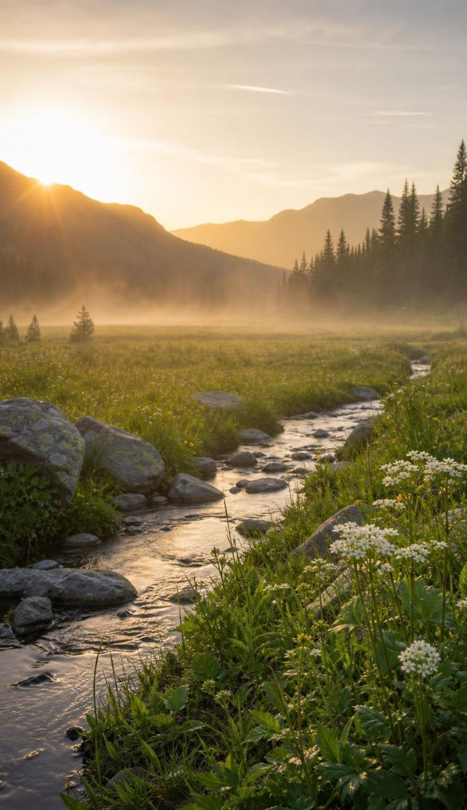
LEARNING TARGETS
What you will be able to do
1
Sort what an organism needs into living and nonliving resources, and tell a resource from a condition.
2
Explain how competition for a limited resource changes how many individuals survive and reproduce.
3
Use data on a resource and a population to find a carrying capacity and predict change.
4
Explain why a pattern in data is not proof of cause, and name the mechanism that links them.
5
Describe how water, light, nutrients and temperature shape biomes, and order the levels of life.
3
Notes:
Read the targets aloud. Point out that targets 1 and 2 belong to this week, 3 and 4 are what the two labs and the case file are for, and 5 comes at the end. Ask students to star the target that connects most to the frog puzzle; most will pick 1 (what a frog needs), which is right. Tell them the exit ticket covers all five.
CONNECTS TO: Targets map to W2 (1), Lab 1 and W3 (2), Lab 2, W4 and W5 (3), Lab 3 and W6 (4), W10 (5).
PACING: about 2 min

Slide 4
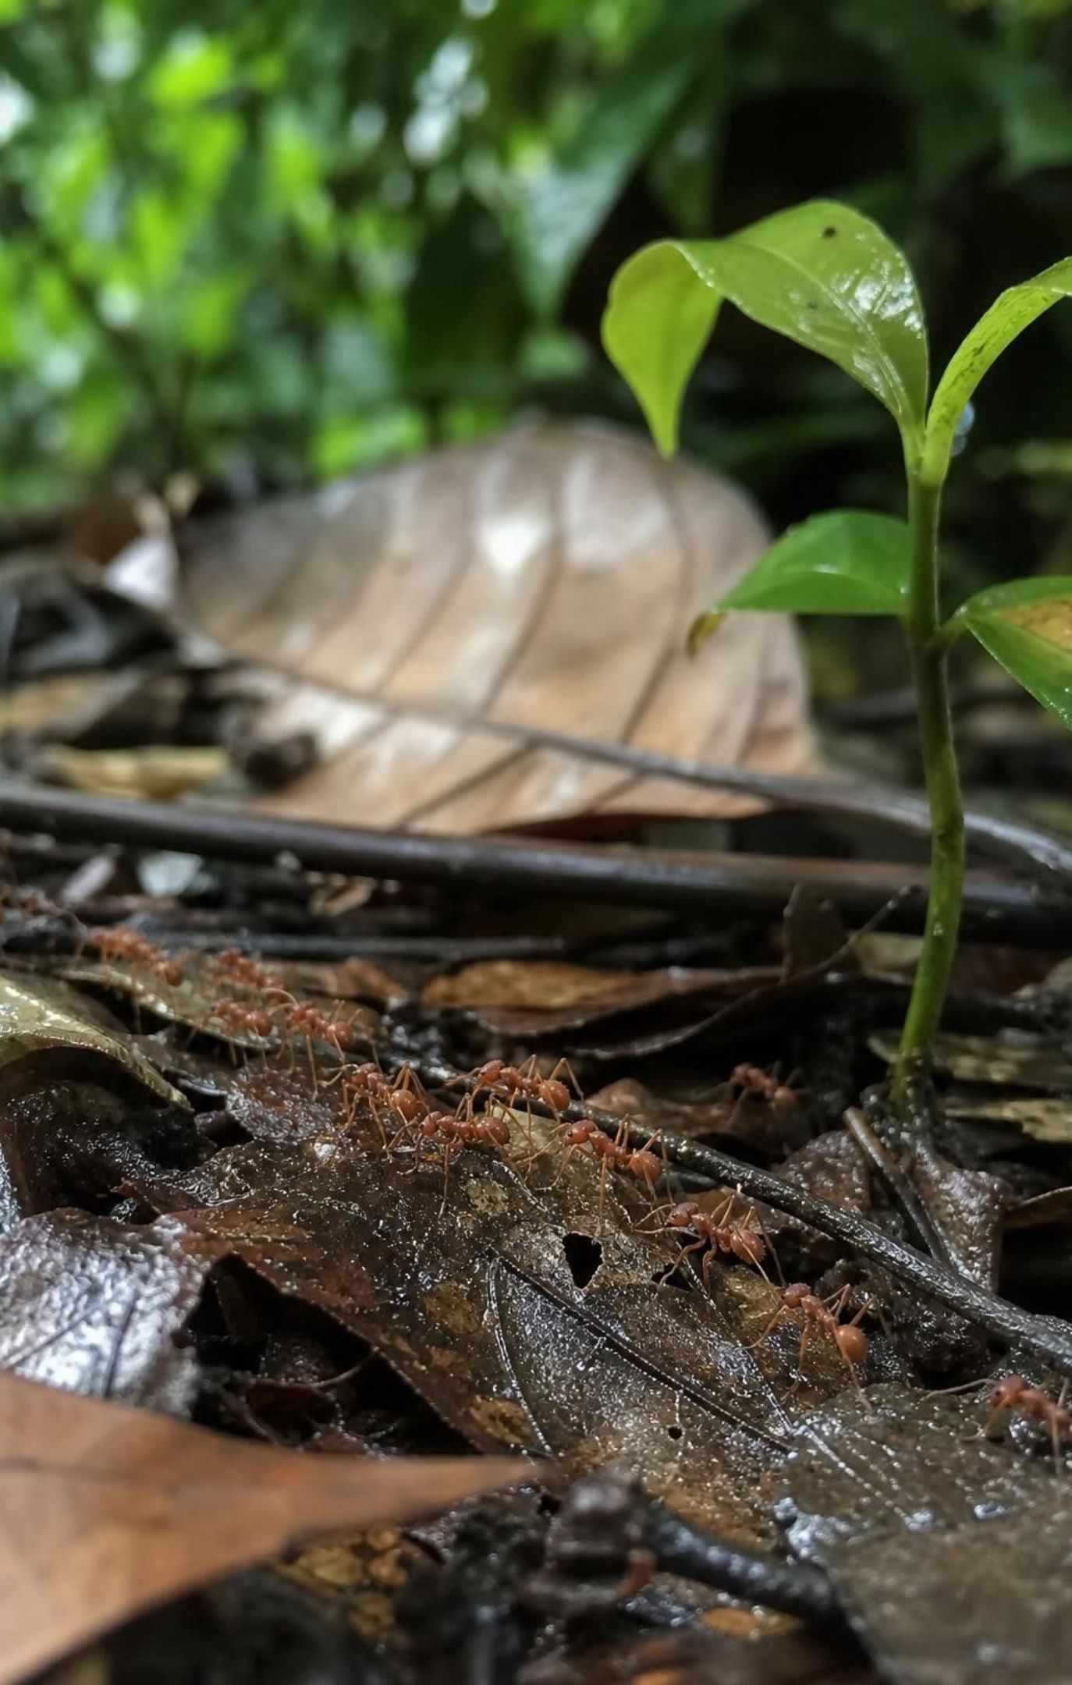
What counts as a resource?
A resource is anything a living thing must take in to survive, grow and reproduce.
Biotic resources come from living things: grass for a horse, ants for a frog.
Abiotic resources are nonliving: water, oxygen, sunlight, soil nutrients, space.
A resource can be used up. What one organism takes, another cannot have.
Temperature is not a resource. It affects organisms, but nobody consumes it.
4
Notes:
Start with a horse and ask for everything it needs; list the answers in two columns without naming them, then let students name the columns (living and nonliving). Add space to the nonliving column; students forget it. Then make the key distinction: a resource is something organisms take in and use up, so they can compete for it. Temperature, wind and the length of the day affect which organisms can live somewhere, but a horse does not use up the warmth of a meadow. We call those conditions. The textbook blurs this by calling temperature a limited resource; we keep them apart because competition only happens over resources. Rainfall is a borderline case: rain delivers water, and water is the resource.
WATCH FOR: Students often call sunlight a condition because 'you cannot use it up'. Light is energy a plant captures; the light one leaf absorbs cannot reach the leaf below it, so it is a resource and plants compete for it.
CONNECTS TO: W2 vocabulary sort; Lab 2 tests light and nutrients as resources.
PACING: about 6 min

Slide 5
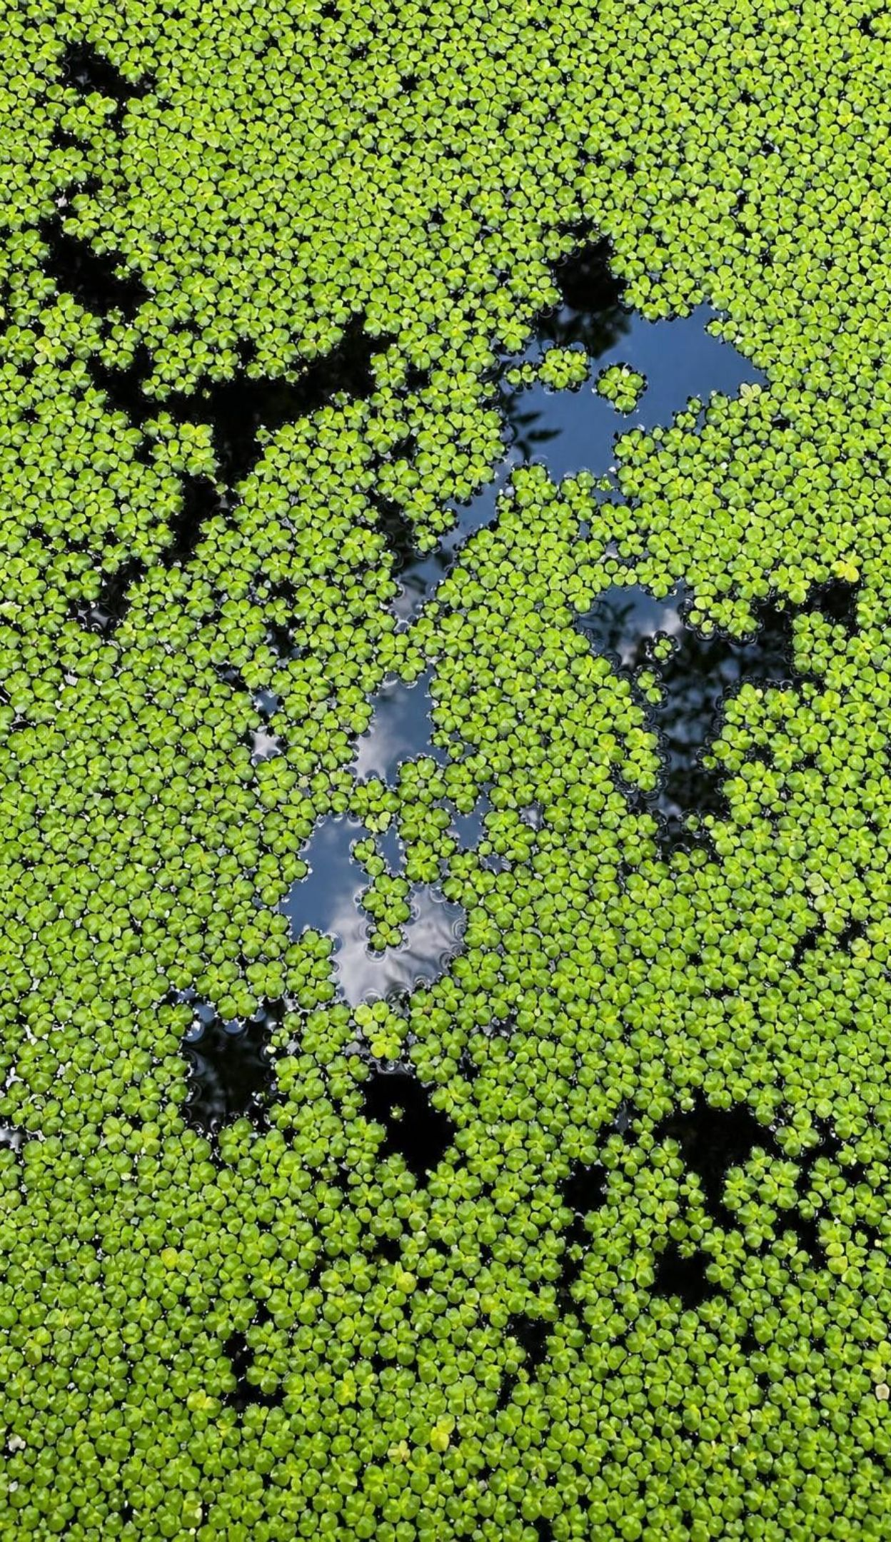
VOCABULARY IN CONTEXT
Three words to keep straight
resource: Material or energy a living thing must take in from its surroundings to survive, grow and reproduce. Water, oxygen and grass are resources for a horse; sunlight, water and soil nitrogen are resources for grass.
organism: One individual living thing. One foal, one dandelion, one duckweed frond, one bacterium.
population: All the organisms of one species living in the same area at the same time. The deer of one valley; the duckweed in one cup; the ants on one rainforest floor.
5
Notes:
Have students say 'an organism is one; a population is all of one kind in one place' and repeat it. Then test it: a horse herd with a foal, two yaks and a hundred grass plants in a meadow. How many organisms? (Count them all.) How many populations? (Three: horses, yaks, that grass species.) Add species briefly: a group whose members can breed together and have offspring that can also breed. Horses and donkeys can produce mules, but mules are infertile, so horses and donkeys remain separate species. The textbook says only members of one species can reproduce together; the 'offspring that can also reproduce' part is the accurate version.
WATCH FOR: Students use 'population' for the number of people in a city, which is a count, not a group. Here a population is the group; its size is a number we measure.
CONNECTS TO: W2 works with exactly these relationships; Lab 1 counts a population round by round.
PACING: about 4 min

Slide 6
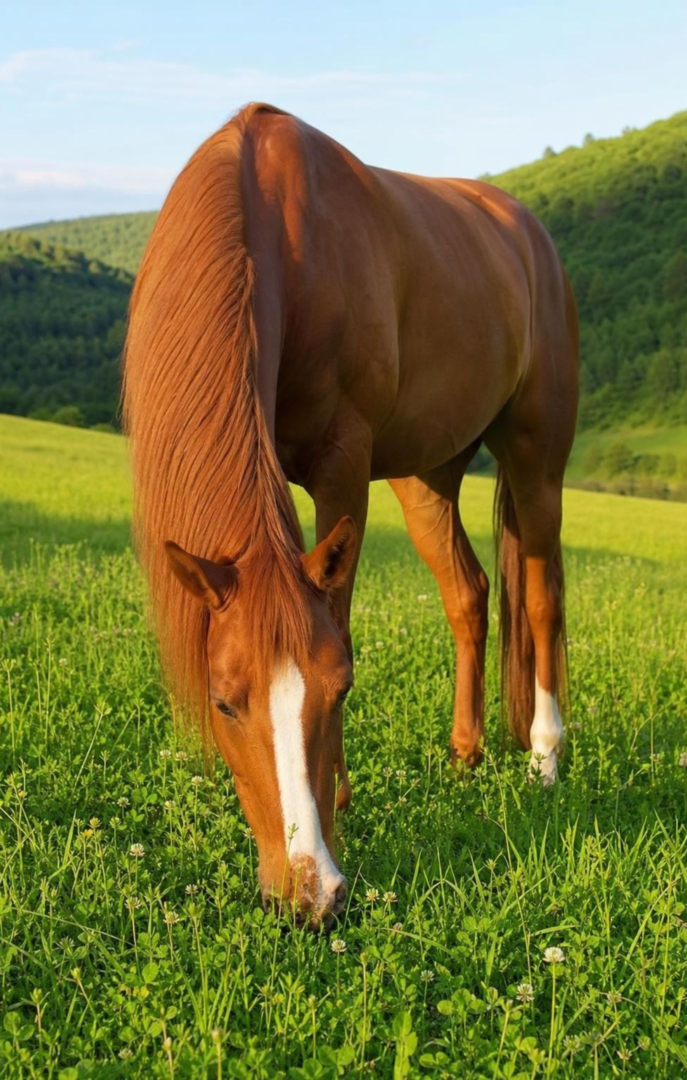
MODEL
Same meadow, different shopping lists
Model: What a grass plant needs and what a horse needs
A meadow grass plant | A horse
Sunlight (energy) | Grass and other plants (food, a biotic resource)
Carbon dioxide from the air | Salt and minerals from a salt lick
Every species has its own mix of resources. Some are shared, which is where competition between species begins.
6
Notes:
Walk through each side. Grass builds its own food from sunlight, carbon dioxide and water (Lesson 4), so its list is mostly abiotic. The horse must eat the grass, so a biotic resource sits at the top of its list. The middle shows what both need. Ask: could a horse and a grass plant compete? Only over something in the middle: water in a drought, or space when hooves trample seedlings. Could two horses compete? Over everything on the horse list. Could grass and oak seedlings compete? Over light, water and soil nitrogen. Note that oxygen is in the middle on purpose: plants take in oxygen too, for the same energy-releasing process animals use, especially in their roots and at night.
WATCH FOR: Students will say plants do not need oxygen because they make it. Plants release more oxygen than they use when the sun is up, but they still use it.
CONNECTS TO: W2 'which term fits'; Lab 2 tests which of the grass plant's resources limit a floating plant.
PACING: about 5 min

Slide 7
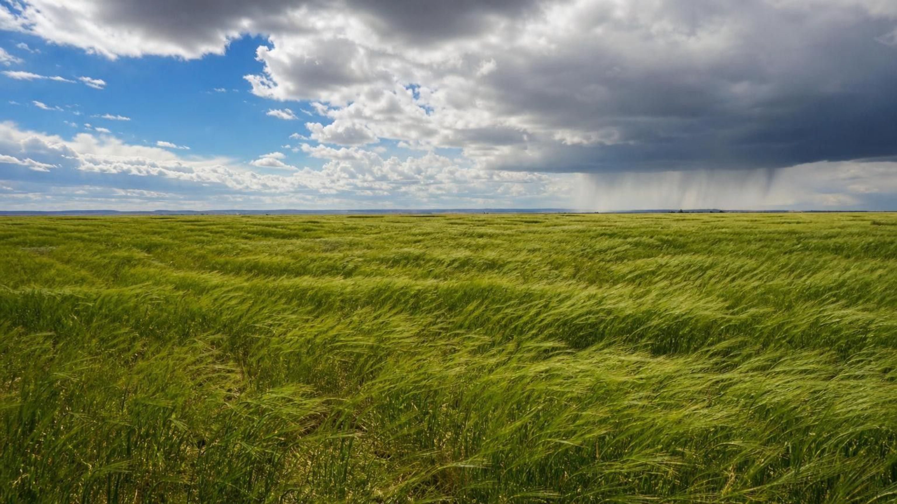
CHECK FOR UNDERSTANDING
Quick check: resource or condition?
For each item, hold up R for resource or C for condition, and be ready to say which organism uses it: grass, soil nitrogen, temperature, sunlight, rainfall, space, wind.
Notes:
Run it quickly with cards or fingers. Grass: R, for a horse or a yak. Soil nitrogen: R, for plants. Temperature: C; it limits where organisms live but is not consumed. Sunlight: R, for plants; the light one leaf catches cannot reach the leaf below. Rainfall: tricky; the rain delivers water, which is the resource, so accept R with that explanation and C for the rain event itself. Space: R; a crowded cup of duckweed runs out of surface. Wind: C. Call on a student to explain the temperature answer in one sentence.
EXPECTED RESPONSES: R: grass, soil nitrogen, sunlight, space, and water from rainfall. C: temperature and wind. Full explanation: a resource is taken in and used up; a condition affects organisms without being consumed.
WATCH FOR: Many students mark temperature as R because 'animals need warmth'. Ask whether a horse has less warmth available after a yak stands in the sun.
CONNECTS TO: W2 and W10 reuse this sort.
PACING: about 4 min

Slide 8
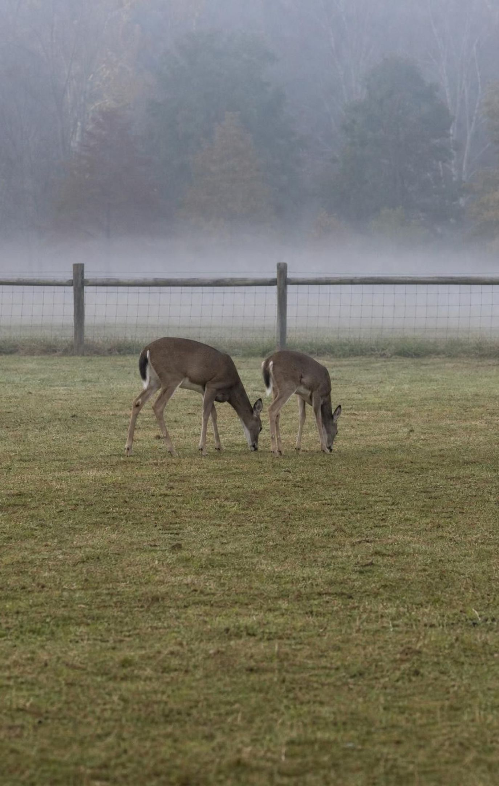
Why a population cannot grow forever
Every area holds only so much of each resource: so much grass, so much water, so much space.
When individuals of one species need the same scarce resource, they compete for it.
Those that get enough survive and leave offspring; those that do not, go hungry or die.
The resource that runs short first is the limiting resource. It sets the ceiling.
The ceiling has a name: the carrying capacity of that area for that species.
8
Notes:
Build the logic step by step with the horses. A meadow has a fixed amount of grass each summer. Four horses have plenty; four hundred do not. As the herd grows, each horse gets a smaller share until some cannot get enough to survive or to raise a foal. Deaths rise, births fall, and the herd levels off. Name the two ideas: the limiting resource is whichever one runs short first (grass here, but it could be water at a single pond, or shelter from a storm), and the carrying capacity is the population size the area's resources can support over time. Stress 'over time': a real herd drifts above and below the carrying capacity, and the number moves when the resource moves. The textbook does not use these two terms; the performance expectation and our labs do.
WATCH FOR: Students think competition is a fight and the strongest wins. Most competition is quiet: a mouthful eaten by one grazer is gone for all the rest.
CONNECTS TO: Lab 1 makes the carrying capacity appear from simple rules; W3 reading passage.
PACING: about 5 min

Slide 9
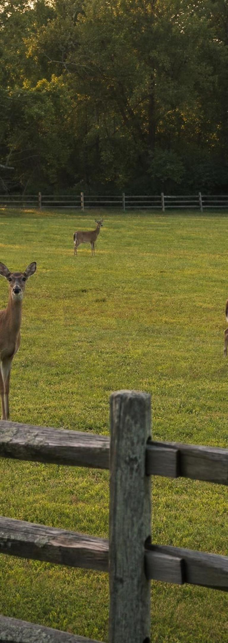
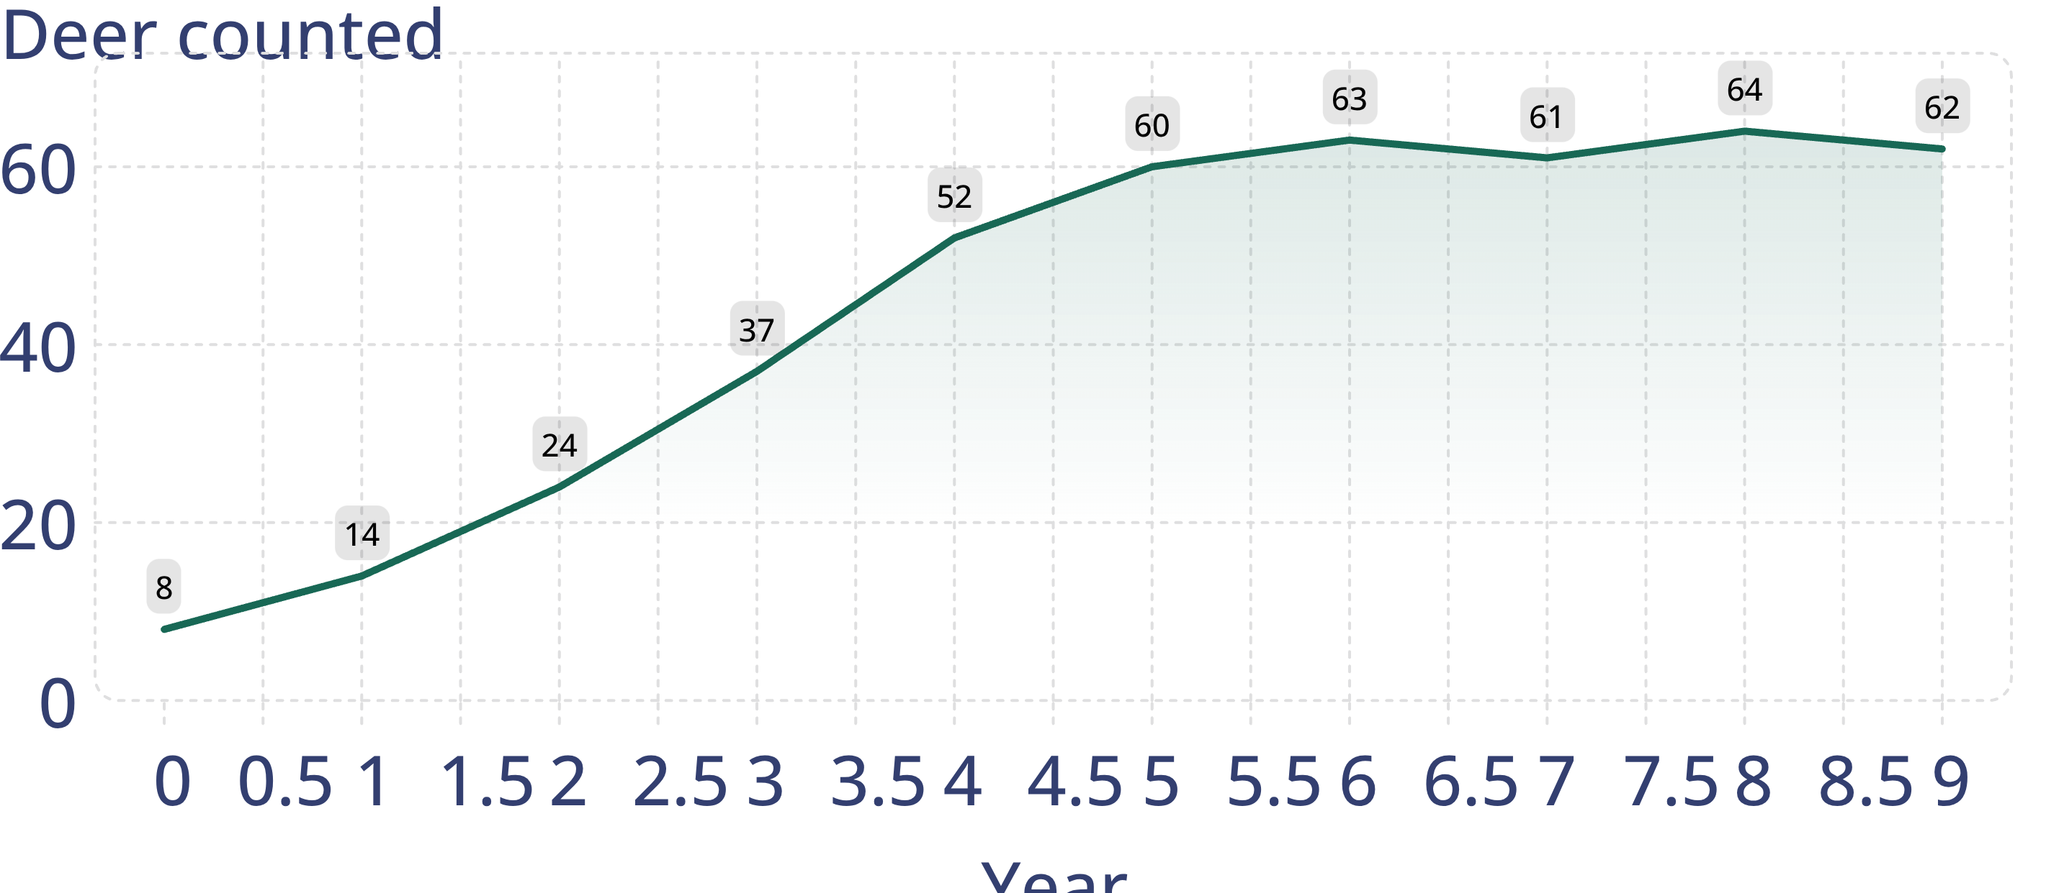
MODEL
A population levels off
Model: Deer in a fenced meadow (teaching data)
simulated data
Simulated counts for a fenced meadow with no predators. Growth is fast while grass is plentiful, then flattens near about 62 deer.
9
Notes:
This is a teaching dataset, invented to show the shape. Trace it with students: from year 0 to year 3 the herd nearly doubles every year because every deer finds plenty. From year 4 the increase shrinks, and from year 5 the count wobbles around 62. Ask: were there predators? No, the meadow is fenced. Then what stopped the growth? Grass per deer fell until deaths balanced births. Have students estimate the carrying capacity (about 60 to 64) and notice that the line does not sit exactly on one number. Ask what the graph would do if a drought cut the grass in half, and sketch their predictions on the board for later.
EXPECTED RESPONSES: Carrying capacity about 62; growth slows as grass per deer shrinks; a drought would push the line down to a new, lower level and it might overshoot before settling.
WATCH FOR: Some students read the flat part as 'the deer stopped having fawns'. Births continue; deaths now match them.
CONNECTS TO: Lab 1 produces this shape from beads; W4 reads the same leveling-off shape in two duckweed tubs.
PACING: about 5 min

Slide 10
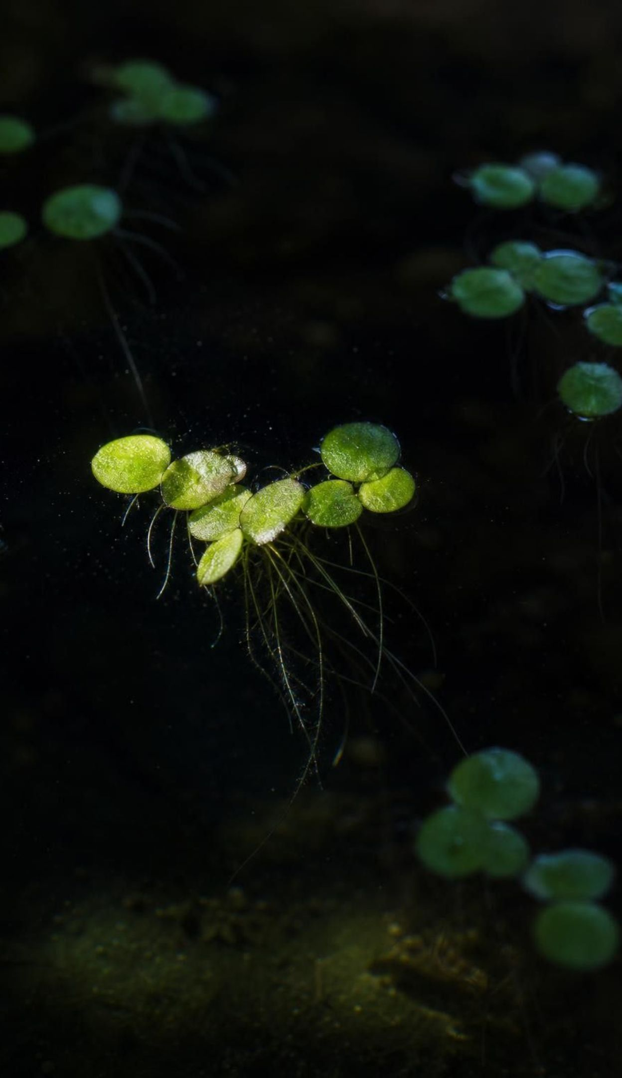
VOCABULARY IN CONTEXT
Words for the ceiling
competition: An interaction in which organisms need the same scarce resource, so what one takes the others cannot have. Two seedlings under one patch of light; two herds on one hillside of grass.
limiting resource: The resource in shortest supply compared with need; it caps growth even when everything else is plentiful. In a dark cupboard, light limits duckweed no matter how much fertilizer is added.
carrying capacity: The largest population an area's resources can support over time; it rises or falls when the resources change. A meadow that feeds about 60 deer in normal years may feed only 30 in a drought.
10
Notes:
Connect the three: competition is how a limiting resource gets divided, and the carrying capacity is where that division stops the population growing. Use the barrel-with-short-stave picture if it helps: a barrel holds water only up to its shortest stave, and a population grows only up to its scarcest resource. Ask students to write one sentence using all three terms about the fenced deer meadow and read two aloud.
WATCH FOR: Carrying capacity is not a fixed property of the species. It belongs to a place and a time: the same deer have a different carrying capacity in a wet valley and a dry one.
CONNECTS TO: W2 vocabulary relationships; W3 reading (the St. Matthew Island reindeer).
PACING: about 4 min

Slide 11
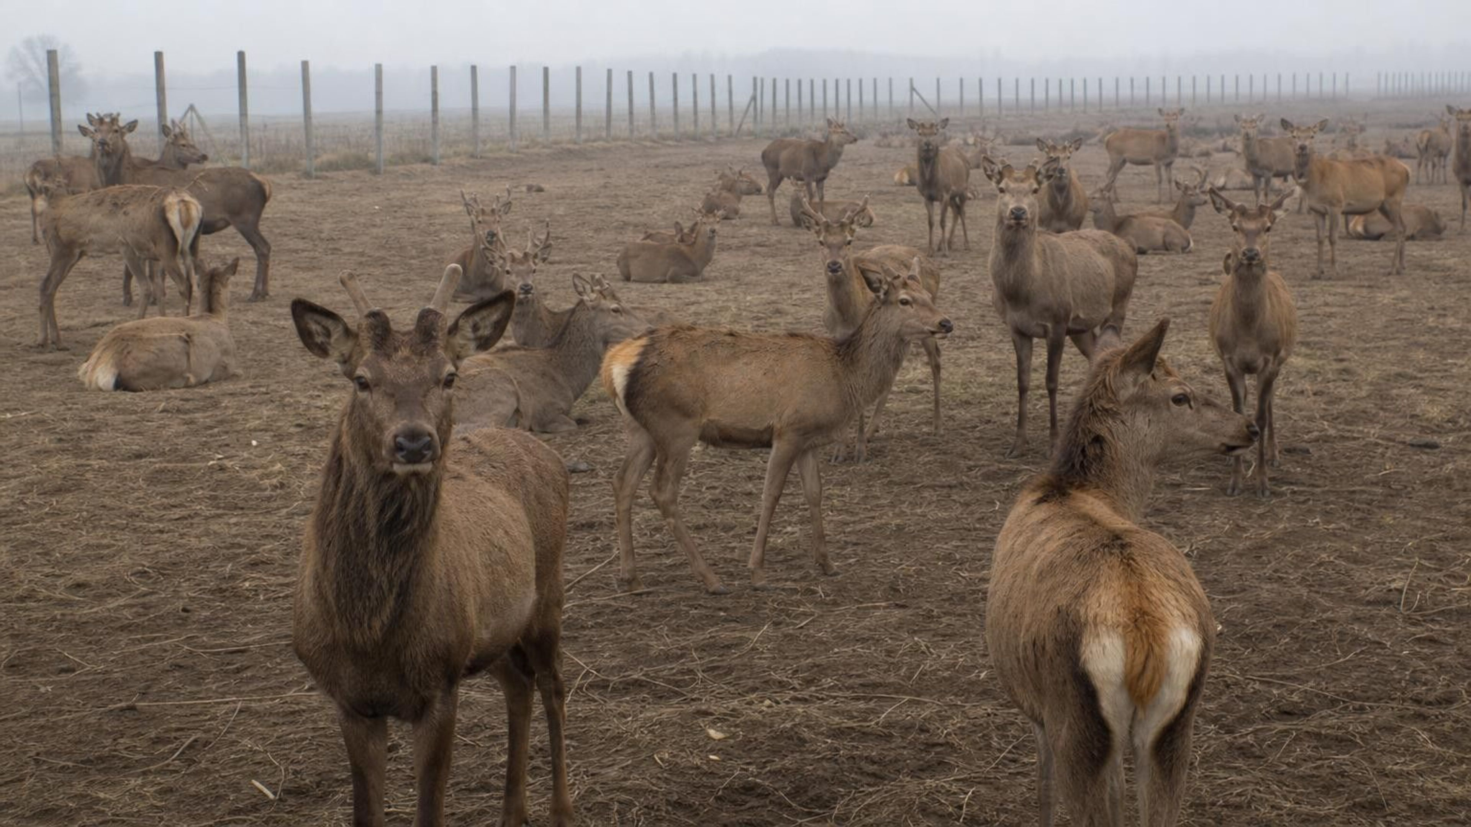
CHECK FOR UNDERSTANDING
Quick check: read the deer graph
Between which two years did the deer population grow the most? In which years was grass per deer probably smallest? If 30 deer were removed in year 9, what would you expect in year 10 and why?
Notes:
Have students answer on whiteboards. Part 1: year 3 to 4 (37 to 52, a gain of 15; year 2 to 3 is close behind at 13). Part 2: the flat years, 5 to 9, when the herd is near the ceiling. Part 3: with 30 removed, each remaining deer has more grass, so births rise and deaths fall; expect the herd to climb back toward 62 over a few years, not instantly. This third part is the key prediction: resources per individual, not the total, drive growth.
EXPECTED RESPONSES: 1: years 3-4 (a gain of 15). 2: years 5-9. 3: the population grows again because each deer has more grass; it heads back toward about 62 but takes time because growth comes from births.
WATCH FOR: Students may predict the herd 'stays at 32 because that is how many are left'. Press them on what happens to grass per deer.
CONNECTS TO: Lab 1 drought rounds; W4 q9 asks the same remove-half prediction for a duckweed tub.
PACING: about 4 min

Slide 12
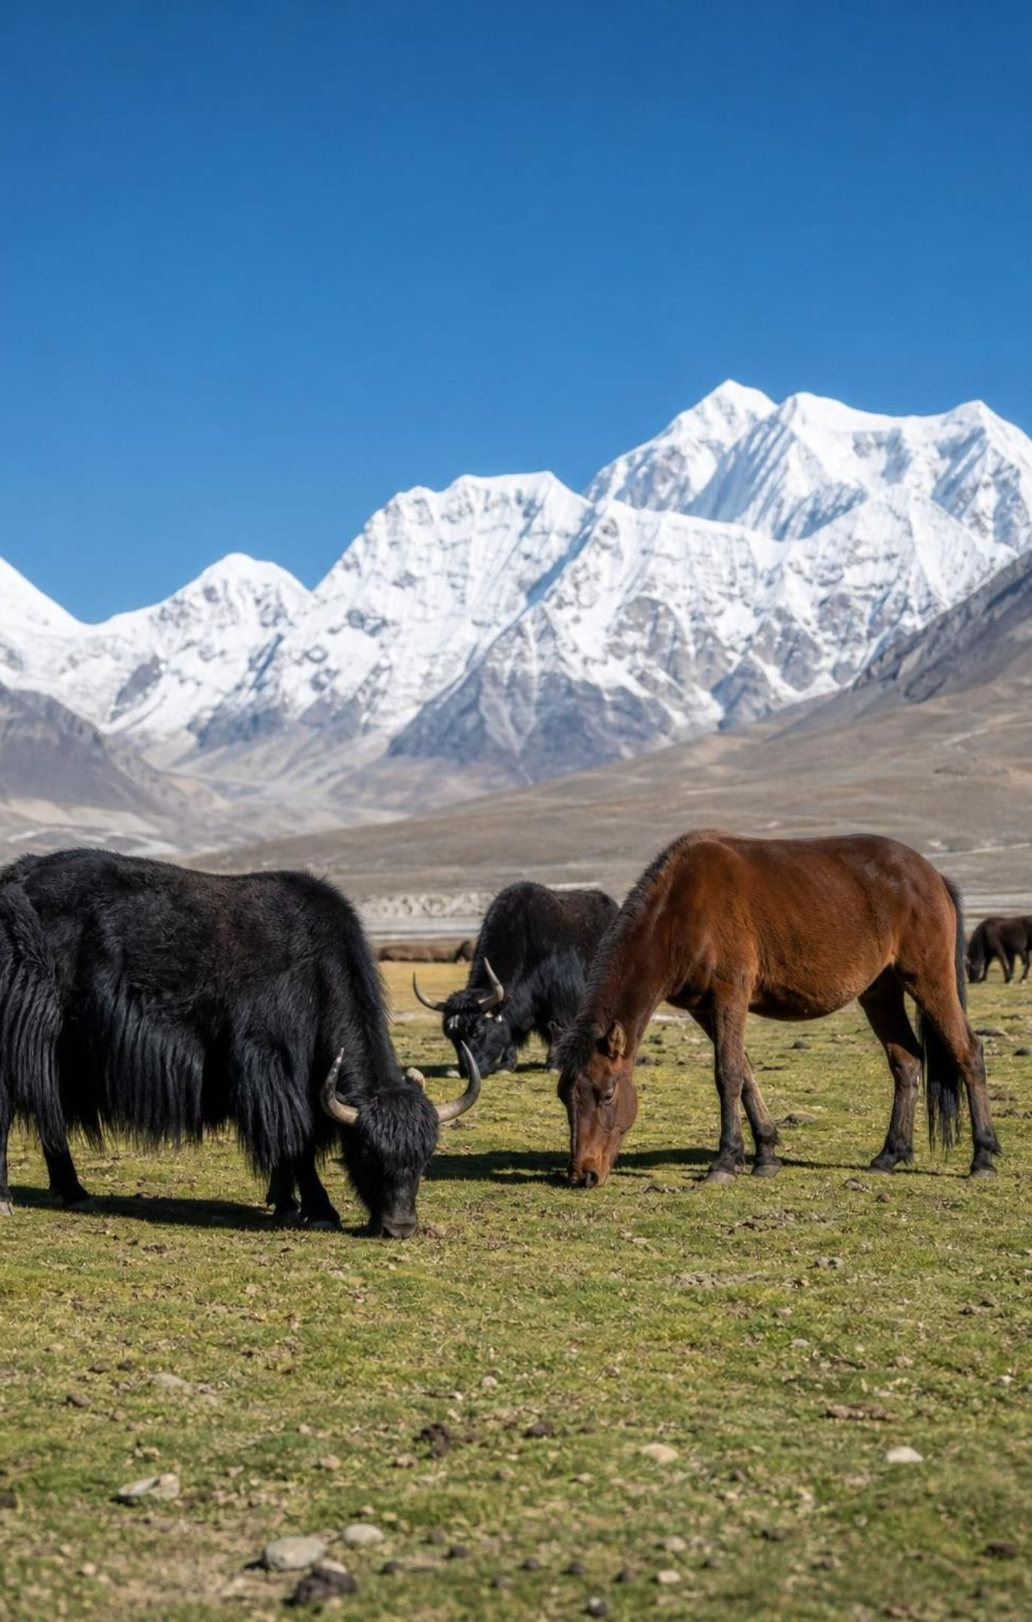
When two species want the same thing
Yaks and horses both eat grass. Every mouthful a yak takes is gone for the horses.
In a dry year with little grass, both populations are likely to shrink.
Species that use a shared resource in slightly different ways compete less.
Yaks tend to wrap taller grass with the tongue; horses can crop grass very short.
If each style works best on grass of a different height, both species can share a meadow.
12
Notes:
Competition between species follows the same rule as within a species: the resource is finite, and one species' use lowers what is left for the other. Then introduce the idea that differences in how a resource is used can ease competition. Be careful with the textbook's version: it says yaks pull grass out by the roots while horses clip only the tops, and the feeding descriptions we found do not support that. What is supported is that cattle-like grazers wrap longer grass with the tongue and that horses, with front teeth in both jaws, can bite grass very close to the ground. Say the premise out loud: if each way of eating works best on grass of a different height, the two species overlap less. Ask students for another pair of species that share one resource in different ways (birds that feed at different heights in a tree; a hawk by day and an owl by night hunting the same mice).
WATCH FOR: Students may conclude that different species never compete. They do, whenever the shared resource gets scarce enough; the differences only reduce it.
CONNECTS TO: Lab 3 adds cattle to a deer range; W8 cards 7-9 show two species sharing one resource (card 8 is two grazers).
PACING: about 5 min

Slide 13
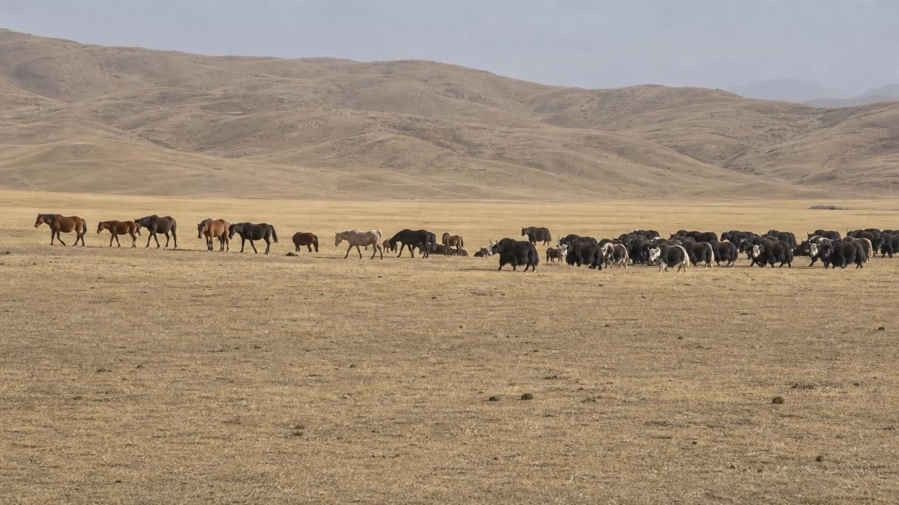
THINK, PAIR, SHARE
Discuss: two herds, one dry summer
A meadow feeds a horse herd and a yak herd. Rain fails and grass grows at half its usual amount. What happens to each herd this year? What would change if the yaks ate only tall grass and the horses only short grass?
Notes:
Give pairs three minutes, then take answers. Push for mechanism, not just 'they shrink': less grass means less food per animal, so more animals fail to get enough, so fewer young are raised and more adults die, especially late in the season. For the second part, if the two species really used different parts of the grass, each would compete mainly with its own kind, and the drought would still hurt both because the total grass fell. Close by asking which single measurement would tell you whether competition between the herds is happening: the number of horses the meadow supports with and without yaks present.
EXPECTED RESPONSES: Both herds shrink because the limiting resource fell; competition between them makes it worse. With separate feeding heights, each herd mostly competes with itself; both still shrink in the drought but neither drives the other out.
WATCH FOR: Listen for 'the horses will fight the yaks and win'. Competition here is about who gets to the grass, not combat.
CONNECTS TO: Lab 1 analysis q9 asks for the same prediction with a second bead species; Lab 3 q12 compares cattle and deer diets.
PACING: about 6 min

Slide 14
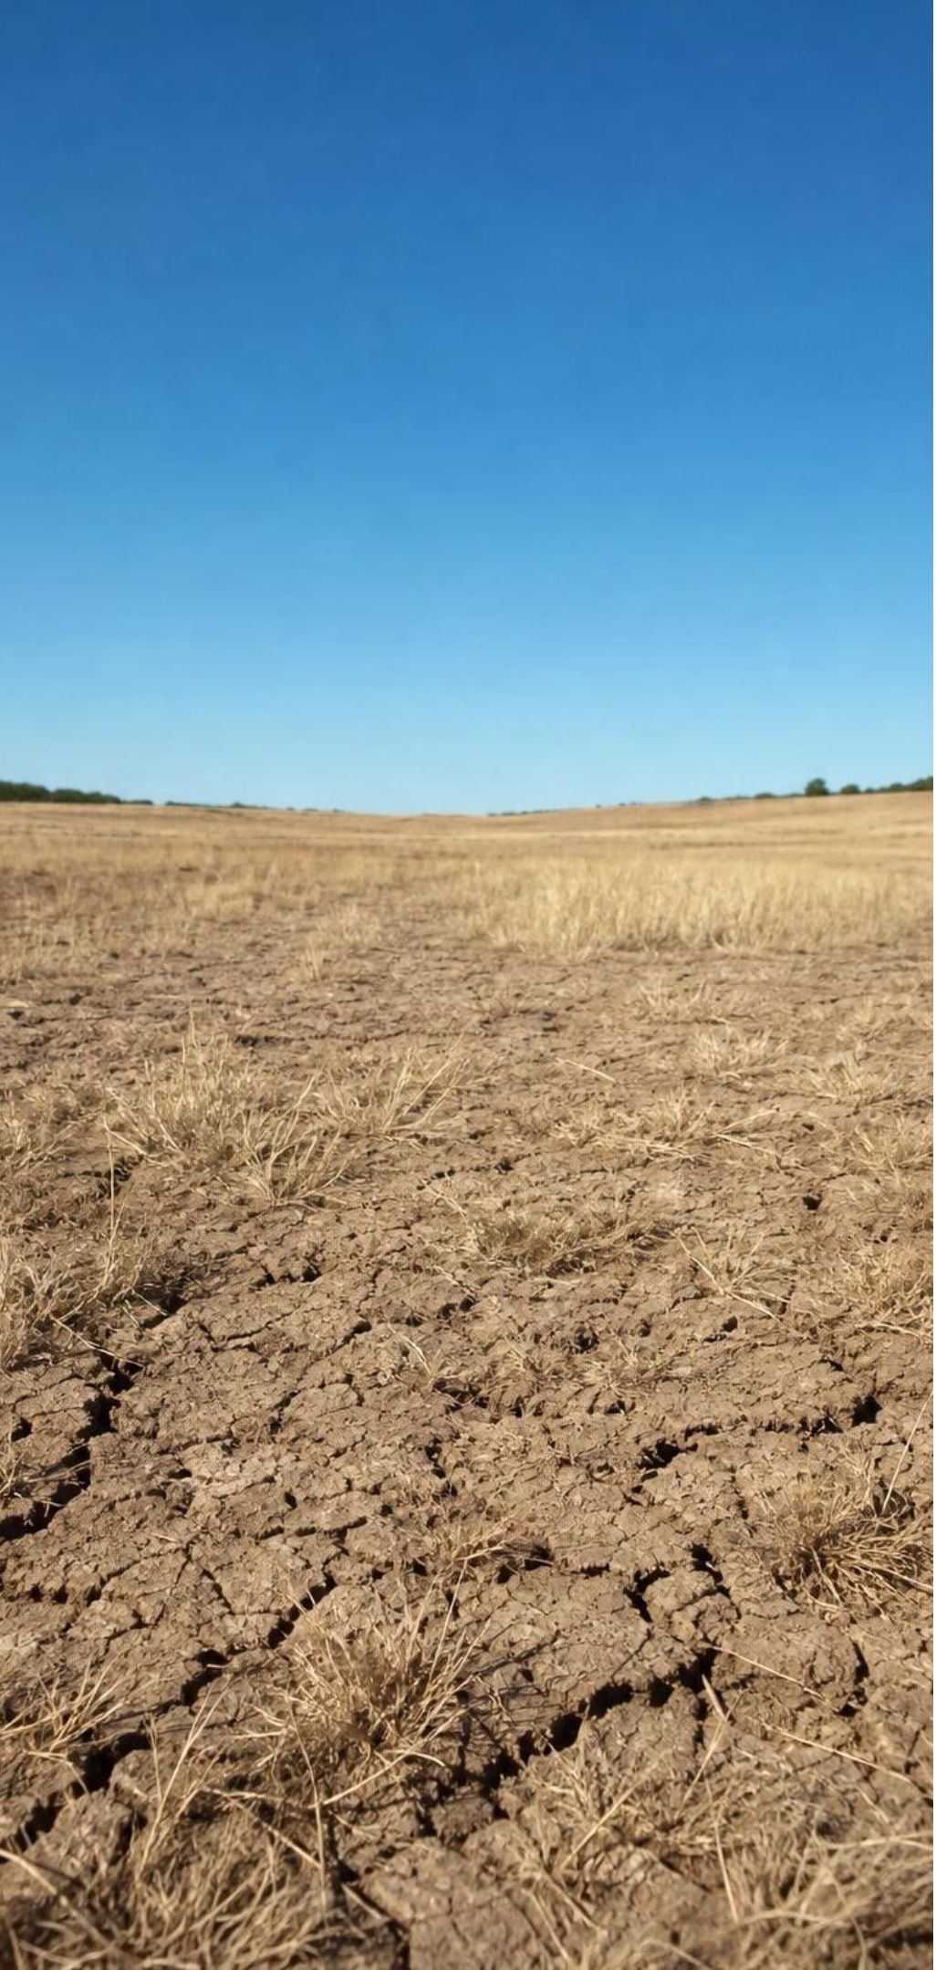
MODEL
Rain to grass to grazers: a chain of causes
Model: How a dry year reaches the herd
Less rain falls →
Less water in the soil →
1
2
(water is a resource for grass)
(grass growth needs water)
Less grass grows (kg per hectare) →
Less food per grazer; competition rises →
3
4
(grass is a resource for grazers)
(scarce resource is divided)
Fewer young raised, more deaths →
Grazer population shrinks
5
6
(births fall, deaths rise)
Each arrow is a mechanism you can name. That is what turns a pattern in data into a cause-and-effect explanation.
14
Notes:
This chain is the explanation behind the graphs we are about to read. Walk it left to right and have students say what each arrow stands for. Point out the unit on the grass box: kilograms per hectare is the mass of grass grown on an area of land, not a count of grass plants; the textbook calls it a population size, but it is a biomass measure. Then run the chain backward: a wet year means more grass, more food per grazer, more young, a larger herd. Ask where a second grazer species plugs in (at the 'less food per grazer' box) and where a predator would plug in (at deaths). The chain is what makes a prediction possible: if you know rain fell, you can predict the direction of change at every box.
WATCH FOR: Students sometimes draw the arrow from grazers to rain. Rain is not affected by the herd; the chain runs one way here.
CONNECTS TO: W5 follows the rain-grass-grazer chain with pronghorn data; Lab 3 case file follows it with deer and cattle.
PACING: about 5 min

Slide 15
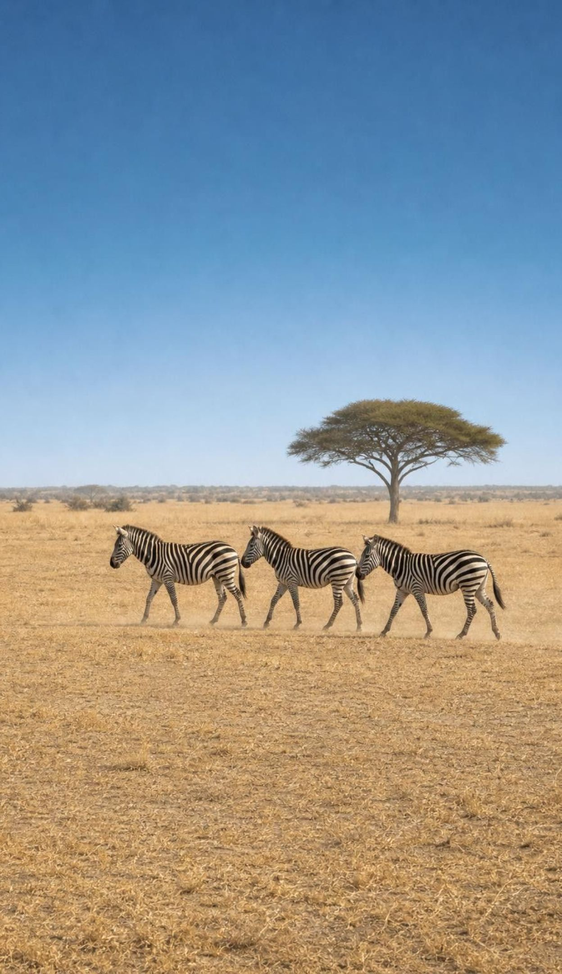
Reading resource data without fooling yourself
A graph that rises together shows a pattern. A pattern is evidence, not proof of cause.
To claim cause and effect, name the mechanism: grass needs water; zebras eat grass.
Check what else changed. A new competitor, a hard winter or disease can hide behind rainfall.
Predict only inside the range you measured. Beyond the last data point, you are guessing.
Populations recover by births, so they lag behind the resource when it comes back.
15
Notes:
This slide is the heart of the data skill. Use the textbook's two graphs as the example without showing their numbers: one plots grass against rainfall and one plots zebras against rainfall. Each is a scatter of points that rises to the right, which is a pattern. The zebra caption claims zebras rise because more grass is available, but the graph never measured grass, so the mechanism is assumed, not shown. The two graphs also cover different rainfall ranges, so you cannot read a grass value off one and feed it into the other. Then teach the three habits: name the mechanism, check for other changes, and stay inside the measured range. Add the lag idea: when rain returns after a drought, grass bounces back in one season, but a deer herd grows only as fast as fawns are born, so the count stays low for a few years.
WATCH FOR: Students hear 'correlation is not causation' as 'graphs prove nothing'. Patterns are real evidence; the point is what else you need before you say 'because'.
CONNECTS TO: Lab 3 skeptic's round; W5 data worksheet; W7 misconception repair.
PACING: about 6 min

Slide 16
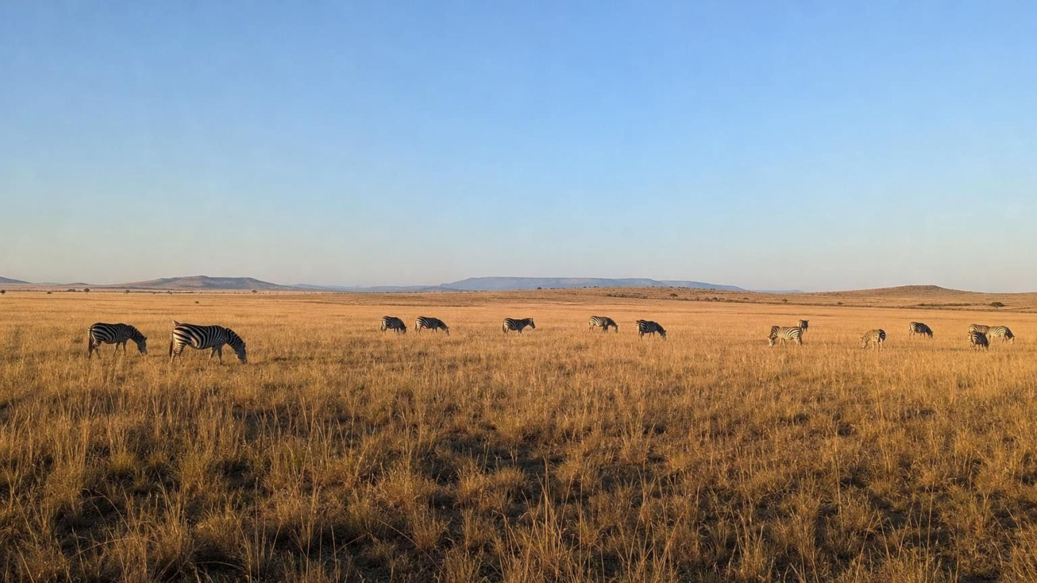
CHECK FOR UNDERSTANDING
Quick check: pattern or cause?
A graph shows that years with more rain had more zebras. A student says, 'More rain causes more zebras.' What two more things would you want before you agree, and what would you refuse to predict?
Notes:
Collect answers on whiteboards. Look for: a mechanism (rain grows grass, zebras eat grass) and a check that nothing else changed in the wet years (no new competitor, no change in predators or hunting). The refusal: predicting zebra numbers for a rainfall far beyond the wettest year on the graph, or for a different region. Bonus: ask whether rain directly feeds a zebra. It does not; water is a resource for the zebra too, but the food link runs through grass, which is why the chain diagram had a grass box in the middle.
EXPECTED RESPONSES: Wanted: the mechanism (rain to grass to zebra) and evidence that other factors stayed the same. Refused: predictions outside the measured rainfall range or for other places.
WATCH FOR: A student who says 'it is only a pattern, so it means nothing' has over-corrected; the pattern plus the chain is good evidence.
CONNECTS TO: W5, W7, Lab 3.
PACING: about 4 min

Slide 17
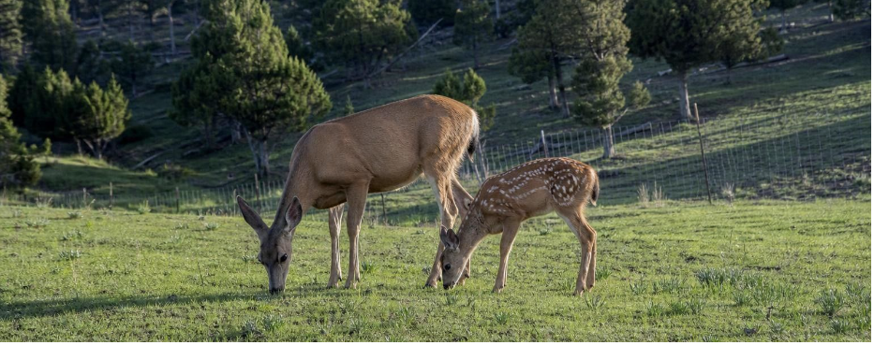
APPLY IT
Task: six years in Cedar Hollow
Year | Rainfall (mm) | Spring forage (kg/ha) | Deer counted in fall | Average fawn mass (kg) | Cattle on the range
1 | 420 | 840 | 300 | 30 | 0
3 | 290 | 560 | 230 | 25 | 0
5 | 510 | 1050 | 350 | 32 | 0
7 | 470 | 950 | 320 | 29 | 200
9 | 270 | 520 | 160 | 23 | 200
11 | 520 | 1060 | 260 | 30 | 200
Simulated data for practice.
Which years were scarce? What happened to deer numbers and to fawn mass in those years? Cattle arrived in year 7. Predict the deer count and fawn mass for a year with 280 mm of rain, and say what you cannot predict.
17
Notes:
Teaching dataset: Cedar Hollow is invented, and these are six of the twelve years students will see in full in Lab 3. Give groups eight minutes. Step 1: find the scarce years (3 and 9, forage under 600 kg/ha). Step 2: in those years deer counts fell and fawns were lighter, which is the PE's two effects, numbers and individual growth. Step 3: compare years 5 and 11, both wet: year 11 has 90 fewer deer. Two explanations compete: cattle now share the forage, and the herd is still rebuilding after the year-9 crash. Step 4: the 280 mm prediction. Rainfall of 280 sits inside the measured range (270 to 520), so a prediction is fair: forage about 550 kg/ha, deer probably below 200 with cattle present, fawns about 23 to 25 kg. What they cannot predict: the exact count, and anything for rainfall far outside 270 to 520 mm.
EXPECTED RESPONSES: Scarce years: 3 and 9. In those years deer counts fell (230, 160) and fawn mass fell (25, 23 kg). Forage is roughly 2 kg/ha per mm of rain. Prediction for 280 mm: forage about 550-560, deer under about 200 with cattle present, fawn mass about 23-25 kg; the exact number and anything outside the measured rainfall range cannot be predicted. Year 11 versus year 5 shows cattle competition and recovery lag.
WATCH FOR: Groups that say 'year 11 proves rain does not matter' have missed the cattle column. Ask what else changed between years 5 and 11.
CONNECTS TO: Lab 3 is the full twelve-year case file with the decision; W5 data worksheet; W6 CER.
PACING: about 10 min

Slide 18
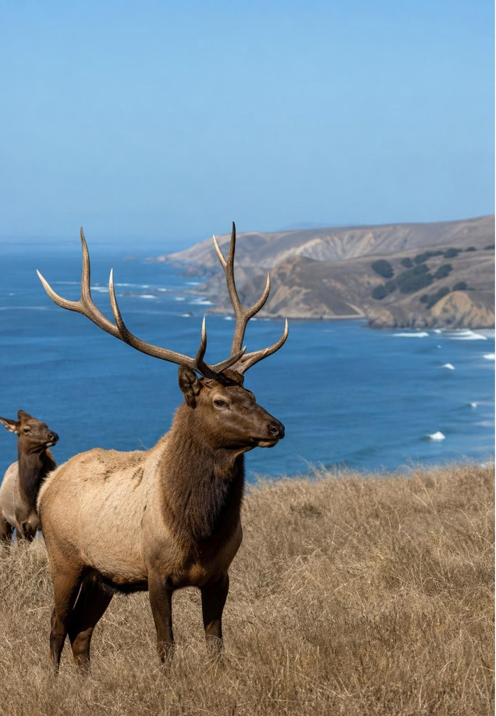
REAL-WORLD CONNECTION
California connection: tule elk behind a fence
At Point Reyes National Seashore, north of San Francisco, a herd of tule elk at Tomales Point lived inside a fence and could not roam to find more forage. In the dry years of 2012 to 2015, the National Park Service's counts of that herd fell from about 540 elk to about 280. Park biologists found no sign that the elk died of thirst; there were too many elk for the poor dry-year forage inside the fence.
18
Notes:
This is a real case in our state and a good test of the lesson. Ask: what was the limiting resource? Forage: in the dry years the plants inside the fence could not feed that many elk, and the Park Service found no evidence that elk died from lack of water. Some groups argued that water was short too; the Park Service reported that water remained through the drought, which makes this a good example of a rival explanation tested with evidence. Why did the fence matter? A free-roaming herd can move to where resources are; a fenced herd faces the carrying capacity of one piece of land. Why would the count fall by about half and not go to zero? The herd fell until the survivors could find enough to eat, roughly what the dry-year range could feed. Then connect to the data skill: the drop lines up with the dry years and the mechanism is clear, but a careful scientist still checks other explanations, as the Park Service did for water. Note that tule elk as a whole recovered from a few hundred animals in the 1970s to about 5,700 statewide by 2020, so this is a story about one fenced herd in dry years, not about the species. In December 2024 the Park Service decided to remove the fence and a lawsuit paused the work; check the current status before you teach this.
WATCH FOR: Students may conclude that tule elk are disappearing. The drop was one fenced herd in a drought; tule elk statewide grew from a few hundred animals in the 1970s to thousands today.
CONNECTS TO: W9 transfer task; Lab 3 q8 asks how the water question was settled at Tomales Point and in the Cedar Hollow case file.
PACING: about 5 min

Slide 19
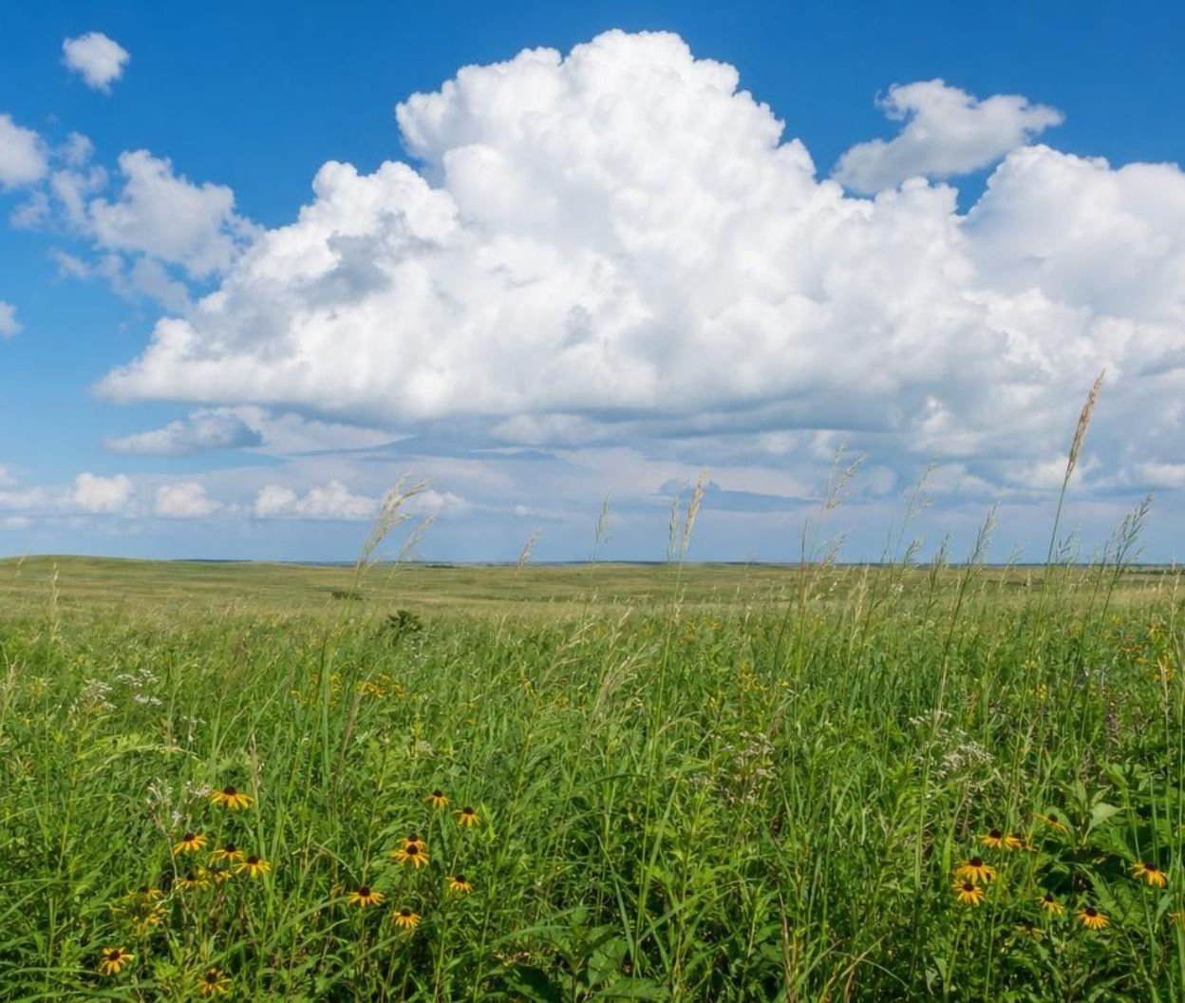
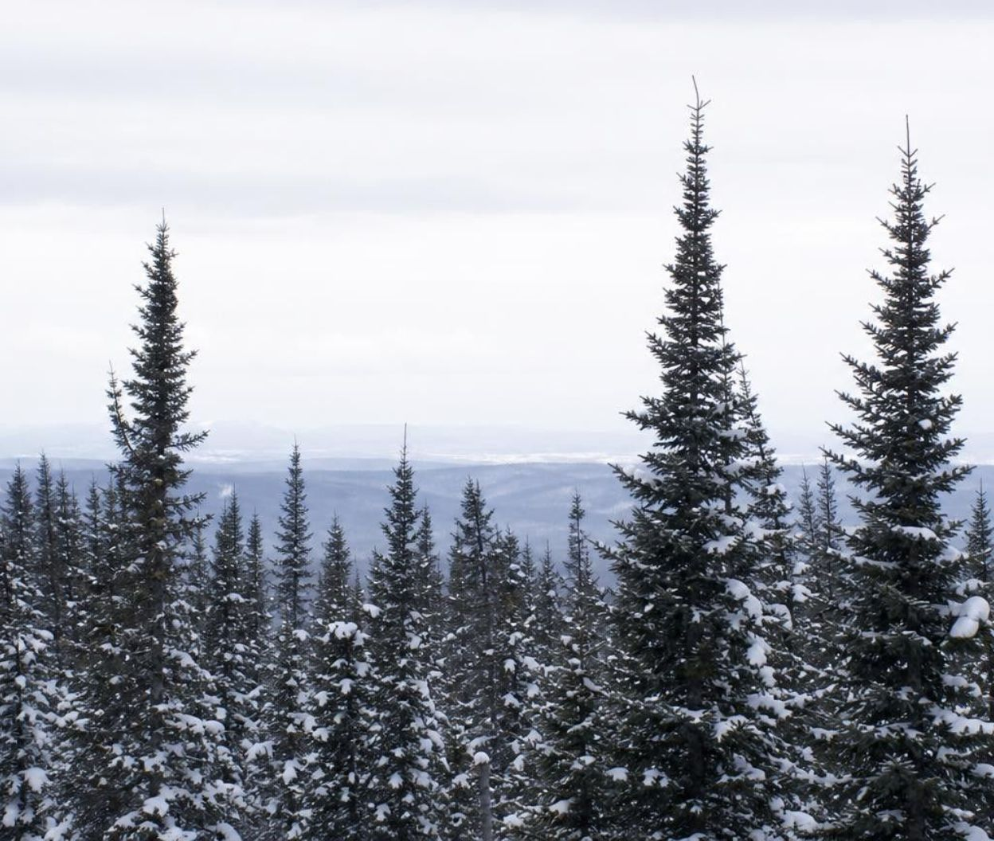
Biomes: resources and conditions draw the map
A biome is a huge region defined by its climate and the living things that climate supports.
On land, water (from rain) and temperature decide which plants can grow; plants decide the animals.
Temperate grasslands (prairie, steppe, pampas) sit at middle latitudes; savannas are tropical.
Boreal forests get enough water for trees but face long snowy winters; mostly evergreen conifers win.
In water, light and nutrients are the limiting resources. Light fades fast with depth.
19
Notes:
Zoom out from one meadow to the planet. The same logic that set the deer ceiling sets where whole kinds of ecosystems appear: a place gets a certain amount of water and a certain temperature range, and only some plants can live with that combination. Grasses win where rain is enough for grass but not for a forest. Trees win where water is plentiful. Correct the book's map caption gently: prairies and steppes are middle-latitude grasslands, but savannas, with wildebeest and zebras, are tropical grasslands with a long dry season. For the boreal forest say 'mostly evergreen conifers'; larches drop their needles and dominate much of Siberia. Do not teach that needles exist to shed snow; the reasons are several. In lakes and oceans the key resources are light, which fades with depth as the water and the particles in it absorb it (in many lakes within a few meters), and dissolved nutrients.
WATCH FOR: Students think the animals define the biome. The climate sets the plants and the plants set the animals; the animals are the last link.
CONNECTS TO: W8 evidence cards (the life-on-land and life-in-water sets); W10.
PACING: about 6 min

Slide 20
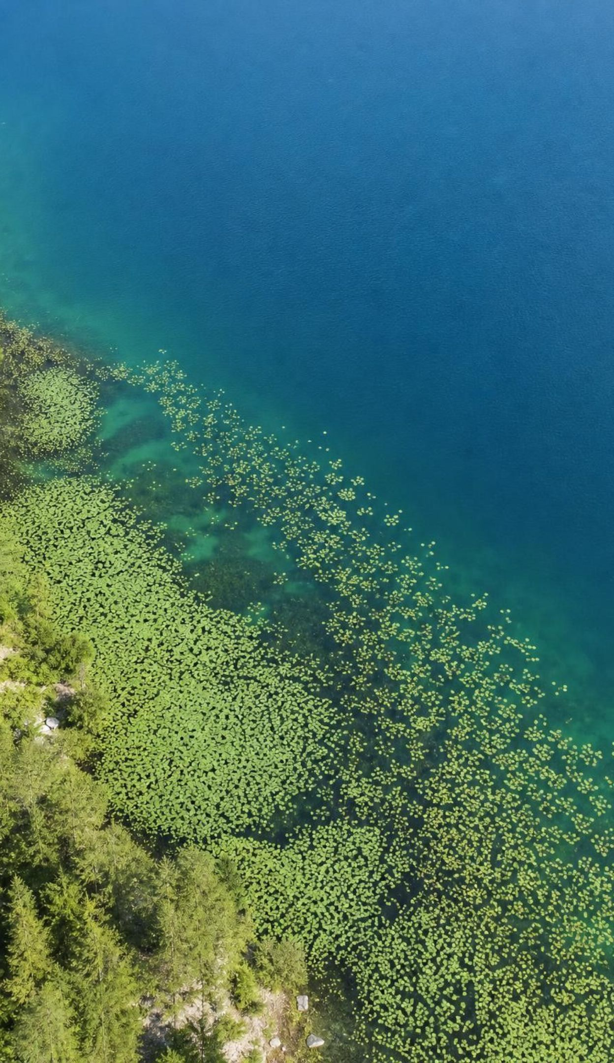
MODEL
A lake from top to bottom: where the light goes
Model: Light and life at different depths of a lake
Top to bottom:
Surface: full sunlight; floating leaves of lilies and duckweed
Shallow water: enough light for rooted plants and algae
Deeper water: dim; few plants, animals that eat what sinks
Bottom: dark; decomposers live on fallen material
Water absorbs light, so the resource that powers plants is richest at the surface and fades with depth. Nutrients often do the opposite, collecting near the bottom.
20
Notes:
Use the layers to explain why lake plants float or keep leaves at the surface: that is where the light resource is. Then ask why a pond plant that could reach the bottom would still fail there (no light to make food, even with plenty of nutrients in the mud). Connect to Lab 2: cup C has nutrients but sits in a dark box, which is the bottom layer in miniature. Ask what happens to duckweed that gets shaded by other duckweed as the cup fills; students should predict that growth slows, which is the space-and-light limit they will measure in cup D.
EXPECTED RESPONSES: Plants cluster where light is; a dark layer has no producers; shading by neighbors turns light into a limiting resource even in a sunny cup.
WATCH FOR: Students often think the deep water is dark because it is far from the Sun, or that a bottom plant just needs more fertilizer. Water and the particles and algae in it absorb and scatter light, so in many lakes little light is left a few meters down, and no amount of nutrients can stand in for the energy light supplies.
CONNECTS TO: Lab 2 cups C and D; W8 card 4 (how deep a lake plant can grow); W10 q11.
PACING: about 4 min

Slide 21
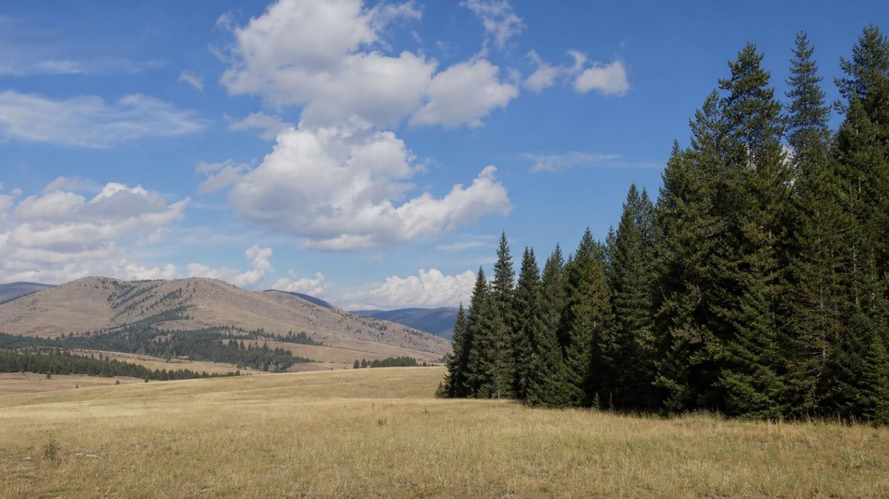
THINK, PAIR, SHARE
Discuss: where would you look for a grassland?
You are given only two numbers for a region: how much rain falls in a year and how warm it is. Could you predict whether it holds a grassland, a forest or a desert? What third fact would help most?
Notes:
Let pairs argue for three minutes. The expected reasoning: very little rain, desert; medium rain, grassland; plenty of rain, forest, with temperature deciding which kind of each (a cold grassland is a steppe, a hot one a savanna; a cold forest is boreal, a hot wet one tropical). The third fact that helps most is how the rain is spread through the year: a savanna gets a lot of rain in total but has a long dry season that stops trees from taking over, and grass survives the dry months. Some students will suggest soil or fire; both are good and both affect grasslands. Close with: resources and conditions draw the map of biomes, and the animals follow the plants.
EXPECTED RESPONSES: Yes, roughly: rain amount separates desert, grassland and forest; temperature separates the cold and warm versions. Most useful third fact: the timing of rain (a dry season), with soil and fire as reasonable alternatives.
WATCH FOR: Students may say that grasslands exist because grazers eat the trees. Grazing and fire help keep grasslands open, but rainfall sets the stage first.
CONNECTS TO: W8 evidence cards include biome cases; W10.
PACING: about 6 min

Slide 22
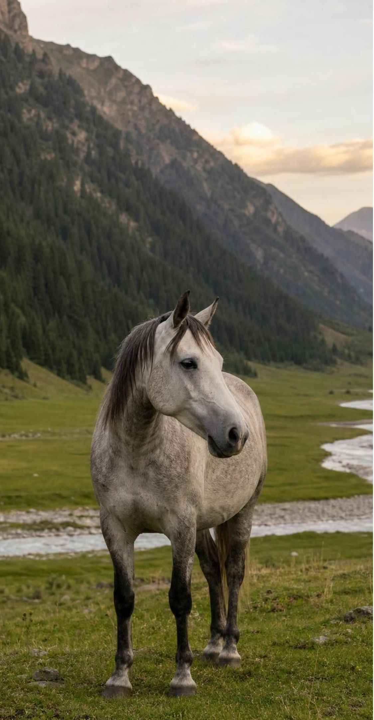
MODEL
Life in nested levels
Model: From one organism to the whole biosphere
Top to bottom:
Biosphere: every ecosystem on Earth, from deep rock to the high atmosphere
1
Ecosystem: a community plus its water, soil, air and light
2
Community: all the populations that live and interact in one area
3
Population: all the horses of one valley
4
Organism: one horse
5
Each level contains the one below it. The textbook skips the community level; most biology references include it.
22
Notes:
Read from the bottom up and give one example of each with a different organism, say a duckweed frond: one frond, the duckweed in the cup, the duckweed plus the algae and bacteria in the cup, all of that plus the water, light and nutrients, and finally the biosphere. Explain why the community level is worth having: it separates the living part of an ecosystem from the nonliving part, which is exactly the biotic-abiotic distinction from slide 4. Say plainly that the textbook lists four levels and that the community level sits between population and ecosystem. Ask where a biome fits (a very large ecosystem type, between ecosystem and biosphere) and where a city fits (an ecosystem that humans built but that still runs on resources from outside it).
EXPECTED RESPONSES: Students can give a five-level example for a new organism and place community between population and ecosystem.
WATCH FOR: Students often put 'species' as a level. A species is a kind of organism, not a place-based group; a population is one species in one place.
CONNECTS TO: W2 uses ecosystem and biosphere in new situations; W10.
PACING: about 4 min

Slide 23
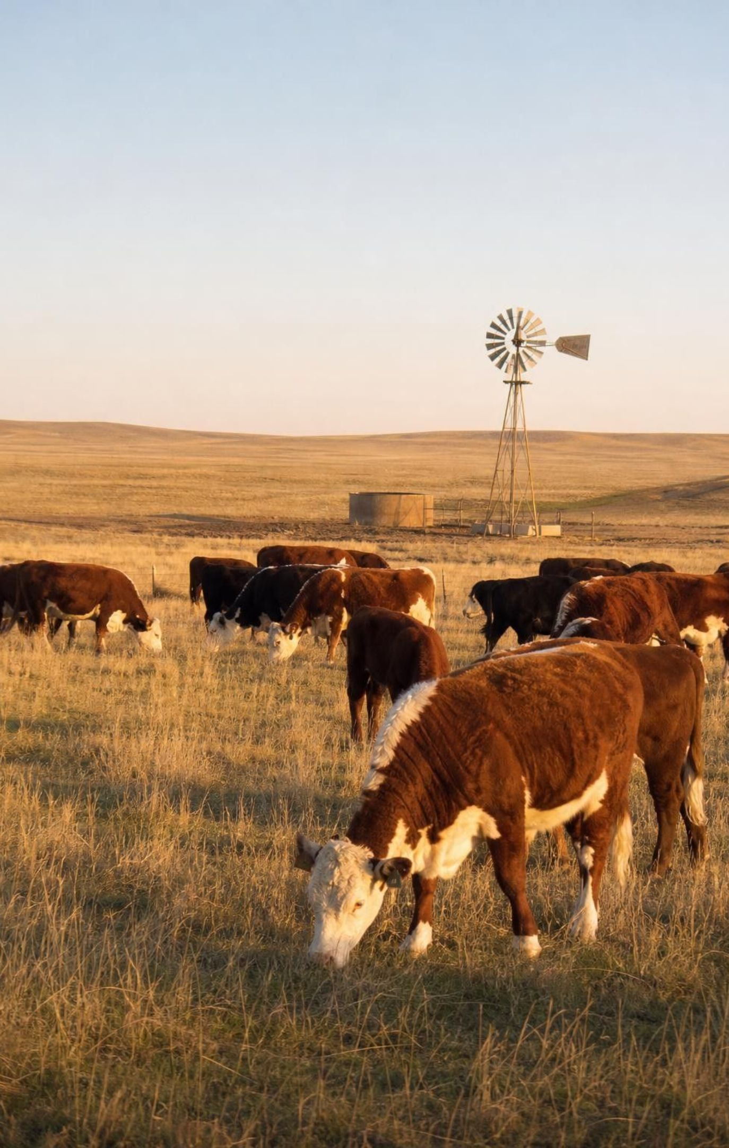
Humans use resources too
Every person is an organism in an ecosystem, even in a city; food and water come from somewhere.
Grazing cattle, sheep and goats on grasslands adds competitors for the same grass.
Turning grassland into farms and neighborhoods shrinks the ecosystem that was there.
Taking water from rivers and wells lowers the resource other populations depend on.
Because people live almost everywhere, our resource use reaches the whole biosphere.
23
Notes:
Bring the lesson home. Ask students to trace one thing they ate today back to an ecosystem: bread to a wheat field, which replaced a prairie; milk to cattle, which graze land that elk or deer also use. The Cedar Hollow case file makes this concrete: adding cattle changed the deer's carrying capacity without changing the rain. Then flip it: people can also raise a carrying capacity on purpose, by restoring a wetland or removing a fence, which is the Lesson 29 engineering strand. Keep the tone factual, not guilty; the point is that humans sit inside the resource rules, not outside them.
WATCH FOR: Students may separate 'nature' from 'people'. A city is an ecosystem too; it just imports most of its resources.
CONNECTS TO: W9 transfer; Lab 3 plans; preview of L29.
PACING: about 4 min

Slide 24
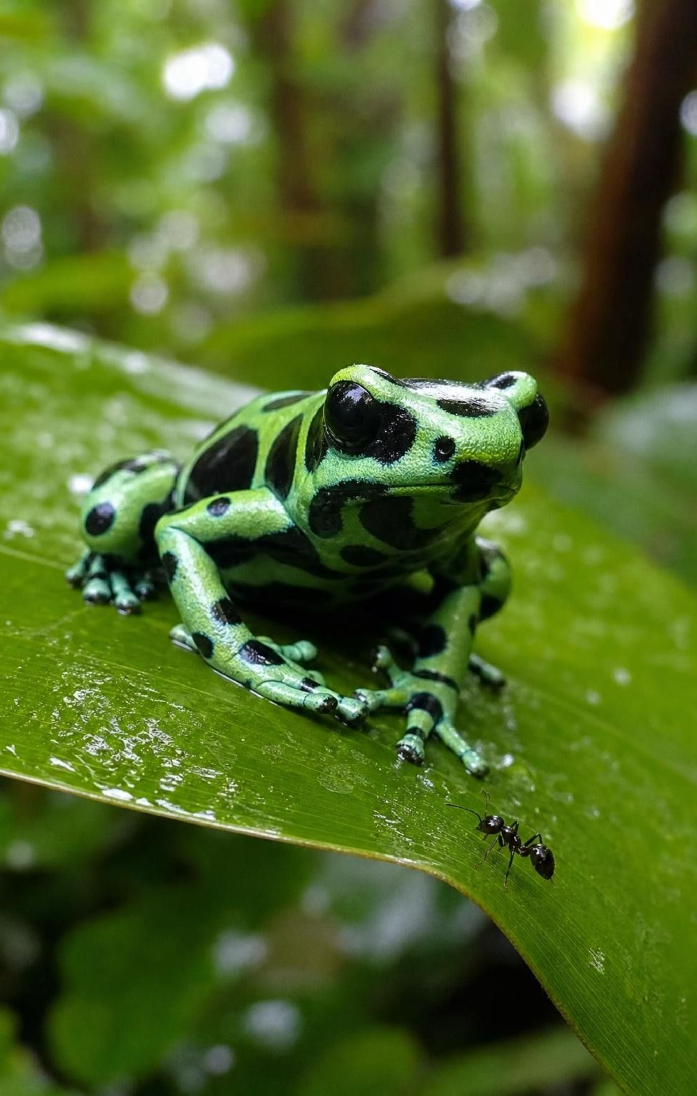
Back to the frogs: a resource that shapes the organism
Wild dart frogs eat tiny prey, especially certain ants, mites, beetles and millipedes.
Those prey carry bitter chemicals called alkaloids. The frog stores them in its skin glands.
A frog cannot make these alkaloids itself. No alkaloid prey, no poison.
Captive-bred frogs eat fruit flies and crickets, which carry none, so they never become poisonous.
Wild-caught frogs slowly use up the alkaloids they stored, so their poison fades over time.
24
Notes:
Return to the parking-lot chart and check each hypothesis against this explanation. 'Food' wins; 'tameness' and 'stress' lose because they cannot put a chemical into skin. Ask the testable question from slide 2: if captive frogs were fed alkaloid-carrying ants, would they become poisonous? Researchers have done versions of this experiment, and frogs fed alkaloid-containing prey do store the alkaloids. The lesson here is that a resource can change what an organism is, not only how many organisms there are. The frog's bright colors are a warning that only works when the poison is real, so a captive frog's warning is a bluff. Keep the names of chemicals light; students do not need to memorize them.
WATCH FOR: Students may generalize to 'all poisonous animals get it from food'. Many make their own toxins: cane toads make their skin poison, and bees and rattlesnakes make their venom. Dart frogs are a case where the diet is the source.
CONNECTS TO: W10's synthesis revisits the first explanation from W1; W7 misconception repair uses a student who wrote 'captivity makes them tame'.
PACING: about 5 min

Slide 25
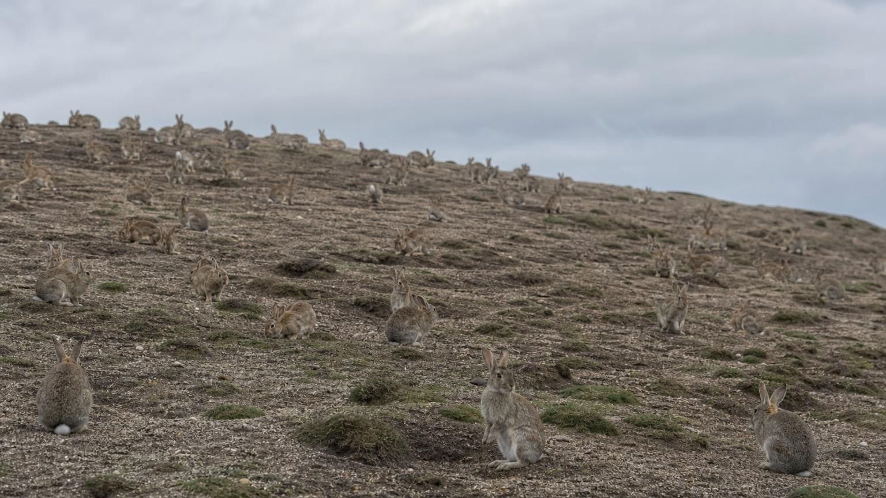
MISCONCEPTION CHECK
True or false? No predators, no limit
"If a population has no predators and no disease, it will keep growing year after year for as long as the area exists."
True or false? Explain your reasoning.
Notes:
Ask students to write a verdict with evidence from the lesson before anyone speaks. The statement is false. Every population needs resources, every area holds only so much, and the limiting resource runs short as the population grows. The fenced deer meadow with no predators leveled off at about 62; the bead meadow in Lab 1 had no predators and stopped at exactly the number of patch cards plus lush cards; cup D of duckweed slowed as the surface filled. Predators and disease can hold a population below its carrying capacity, but resources set the ceiling with or without them. Then ask the follow-up: can a population go above the carrying capacity? Briefly, yes, and then deaths rise until it falls back, which is what happened in the first drought round of Lab 1, when 36 deer met a meadow that could now hold only 20.
EXPECTED RESPONSES: False. Resources are finite; competition for the limiting resource raises deaths and lowers births until the population levels off near the carrying capacity, as the deer graph, Lab 1 and the duckweed cups showed.
WATCH FOR: Students may swing to 'populations never change once they hit the ceiling'. They drift around it and move whenever the resource moves.
CONNECTS TO: W7 misconception repair; W6 CER.
PACING: about 6 min

Slide 26
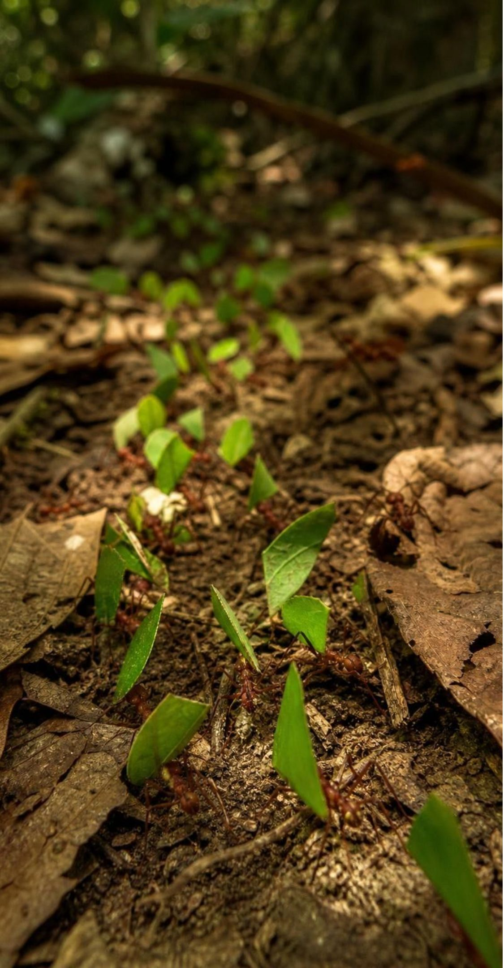
PUTTING IT TOGETHER
Putting it together
Organisms take in biotic and abiotic resources; conditions like temperature set limits but are not used up.
A limiting resource is divided by competition, so a population levels off near a carrying capacity.
Two species that share a resource both shrink when it is scarce; using it differently eases the competition.
Patterns are evidence; a cause claim adds a mechanism, rules out other changes, stays in the measured range.
Water, light, nutrients and temperature draw the map of biomes; life nests from organism to biosphere.
A resource can even shape what an organism is: no alkaloid prey, no frog poison.
26
Notes:
Have students write a four-sentence summary that uses resource, limiting resource, competition and carrying capacity, then swap with a partner who checks that temperature was not called a resource. Collect one finding from each lab: Lab 1 (what two numbers set the ceiling), Lab 2 (which cup grew least and why), Lab 3 (which plan they chose and the one number that convinced them). Preview Lesson 21: competition is one kind of interaction; next come predators, parasites and partners, and the pattern of who-needs-what will matter again.
CONNECTS TO: W10 mastery as the quiz; L21 Interactions Among Organisms next.
PACING: about 6 min

Slide 27
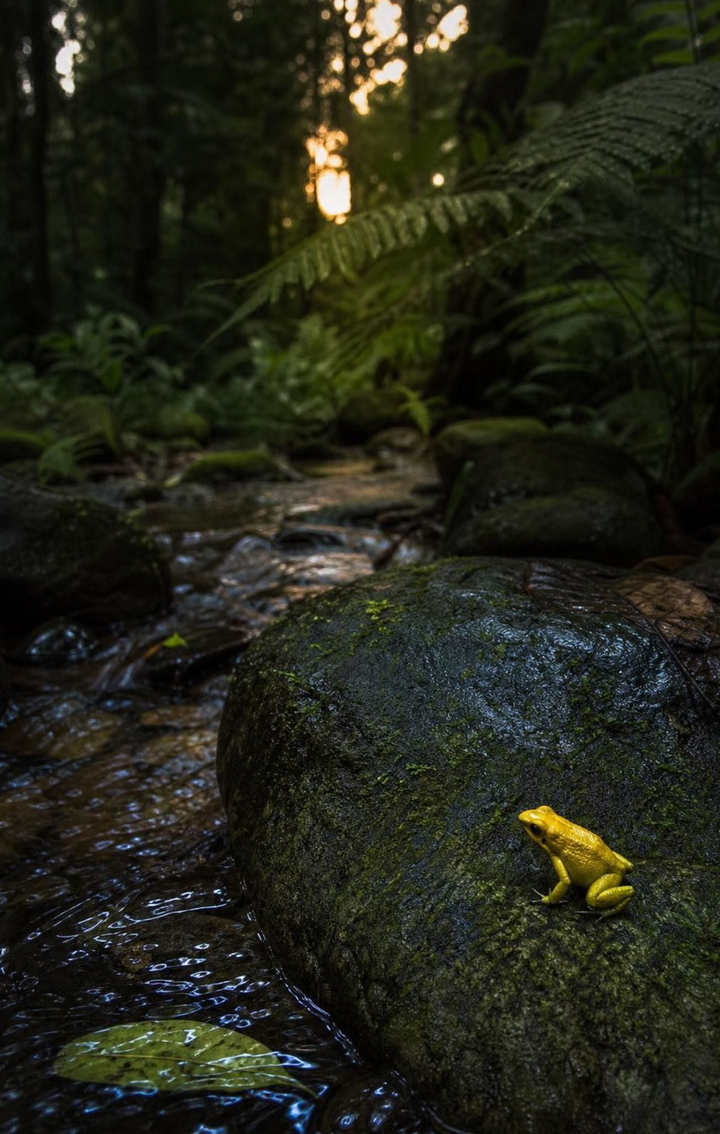
EXIT TICKET
Exit ticket
1
Name one biotic resource, one abiotic resource and one condition for a horse.
2
A meadow supports about 40 deer. A drought halves the grass. What happens to the herd, and why?
3
A graph shows more rain and more zebras together. What sentence must a scientist add before saying 'because'?
4
Why is a dart frog born in a zoo not poisonous? One sentence.
27
Notes:
Collect on index cards or a shared form. Item 1 checks the resource-versus-condition target; item 2 checks carrying capacity and mechanism; item 3 checks the data habit; item 4 checks whether the phenomenon was resolved. Sort the cards by which item was weakest and reteach that one before the quiz.
EXPECTED RESPONSES: 1: biotic such as grass or other plants; abiotic such as water, oxygen or space; condition such as temperature or wind. 2: the herd shrinks toward a lower carrying capacity, about half, because less grass per deer means fewer fawns and more deaths. 3: something like 'rain grows the grass that zebras eat, and nothing else changed in the wet years'. 4: its food carries no alkaloids, so it never stores any poison.
WATCH FOR: Item 1 answers that list temperature as a resource, and item 2 answers that say the herd 'dies out', signal reteaching.
CONNECTS TO: W10 mastery; chapter evidenceOfLearning.
PACING: about 5 min

