Slide 1
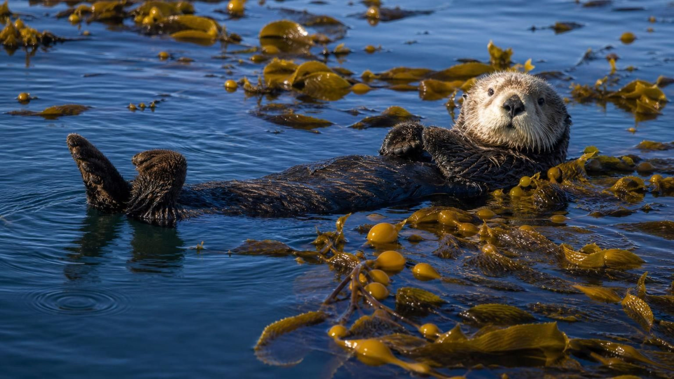
CHAPTER 21 OF 29 · RESOURCES IN ECOSYSTEMS
Chapter 21: Interactions Among Organisms
Lesson 21: How do species affect each other, and why do the same patterns appear in every ecosystem?
Angela's Wand · Bring Science Alive! 7th Grade Integrated
Notes:
This lesson builds on Lesson 20, where populations were limited by food, water and space. Now we ask what happens when two species meet: one eats the other, both want the same thing, both gain, one gains while the other is untouched, or one quietly drains the other. Tell students they will run three investigations: a bead simulation of foxes and voles that produces its own population graph, a card mystery that asks whether every ecosystem contains every kind of relationship, and a design challenge to protect a frog-call sensor from highway noise. No live animals, no chemicals.
CONNECTS TO: Overview of Lab 1, Lab 2 and Lab 3; W1 opens with the next slide.
PACING: about 2 min

Slide 2
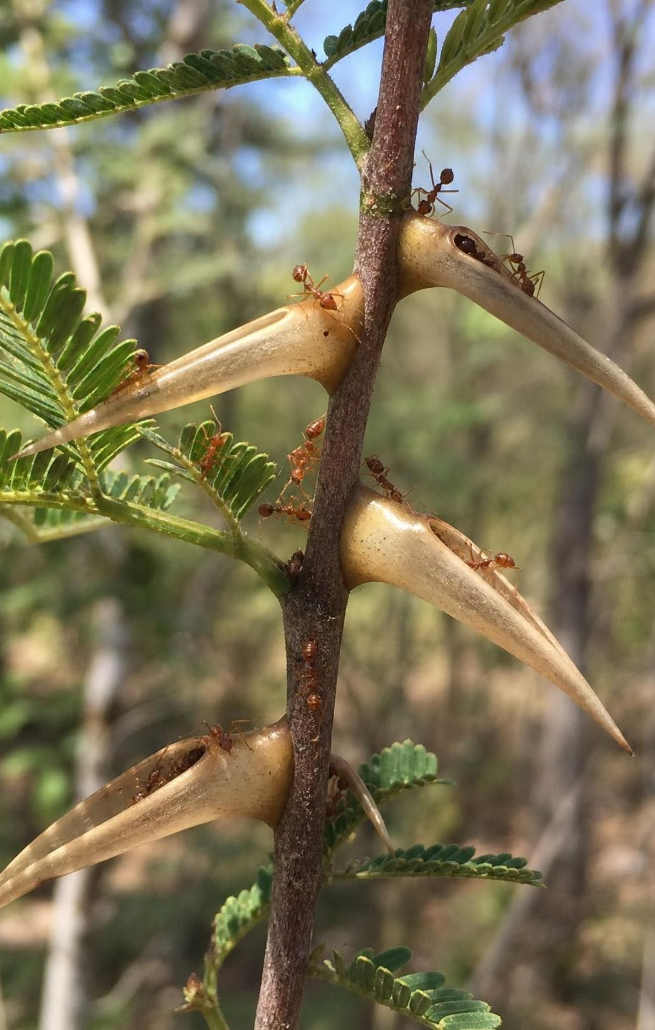
PHENOMENON
The tree that feeds its own bodyguards
A bullhorn acacia grows fat hollow thorns and leaks sugary nectar from its leaf stalks. The tree cannot eat that sugar, and hollow thorns do not help it grow. Yet a colony of fierce ants moves into the thorns, drinks the nectar, and swarms out stinging whenever anything touches a branch. The acacia stands untouched while nearby trees are stripped bare. Why would a tree pay to feed ants?
Notice: what does the tree give, and what does it get?
Notice: what do the ants give, and what do they get?
Wonder: what happens to the tree if the ants vanish? To the ants if the tree dies?
Predict: is this a friendship, or is each side acting for itself?
2
Notes:
Give two minutes of silent writing, then pairs, then collect. Push past 'the ants protect the tree' to the resource view: the tree pays sugar and shelter; the ants pay patrol time and stings; each side gets more survival and more offspring than it would alone. The ants also chew off vines and seedlings that touch the trunk, which removes the tree's competitors. Mention the Central American bullhorn acacia with its protein-rich leaf-tip packets and the East African whistling-thorn acacias, which have a similar arrangement of swollen thorns and nectar with different ant species. Then plant the seed for later: in a long-running experiment in Kenya, when researchers fenced giraffes and elephants out of a plot for about ten years, the trees made fewer swollen thorns and less nectar, the protective ants were pushed out by a less helpful ant, and the trees ended up worse off. The deal holds only while both sides keep paying. Do not name the interaction yet; students will label it on slide 14.
EXPECTED RESPONSES: Tree gives sugar and housing, gets protection from browsers and from vines; ants give defense, get food and a nest. Many students will say friendship; ask them what each ant actually gets for stinging a goat.
WATCH FOR: Students may say the tree 'decides' or 'wants' to feed ants. Keep the language to what each partner gains; intent is not part of the explanation.
CONNECTS TO: W1 phenomenon worksheet; the acacia returns on slides 14 and 17 and in the exit ticket.
PACING: about 8 min

Slide 3
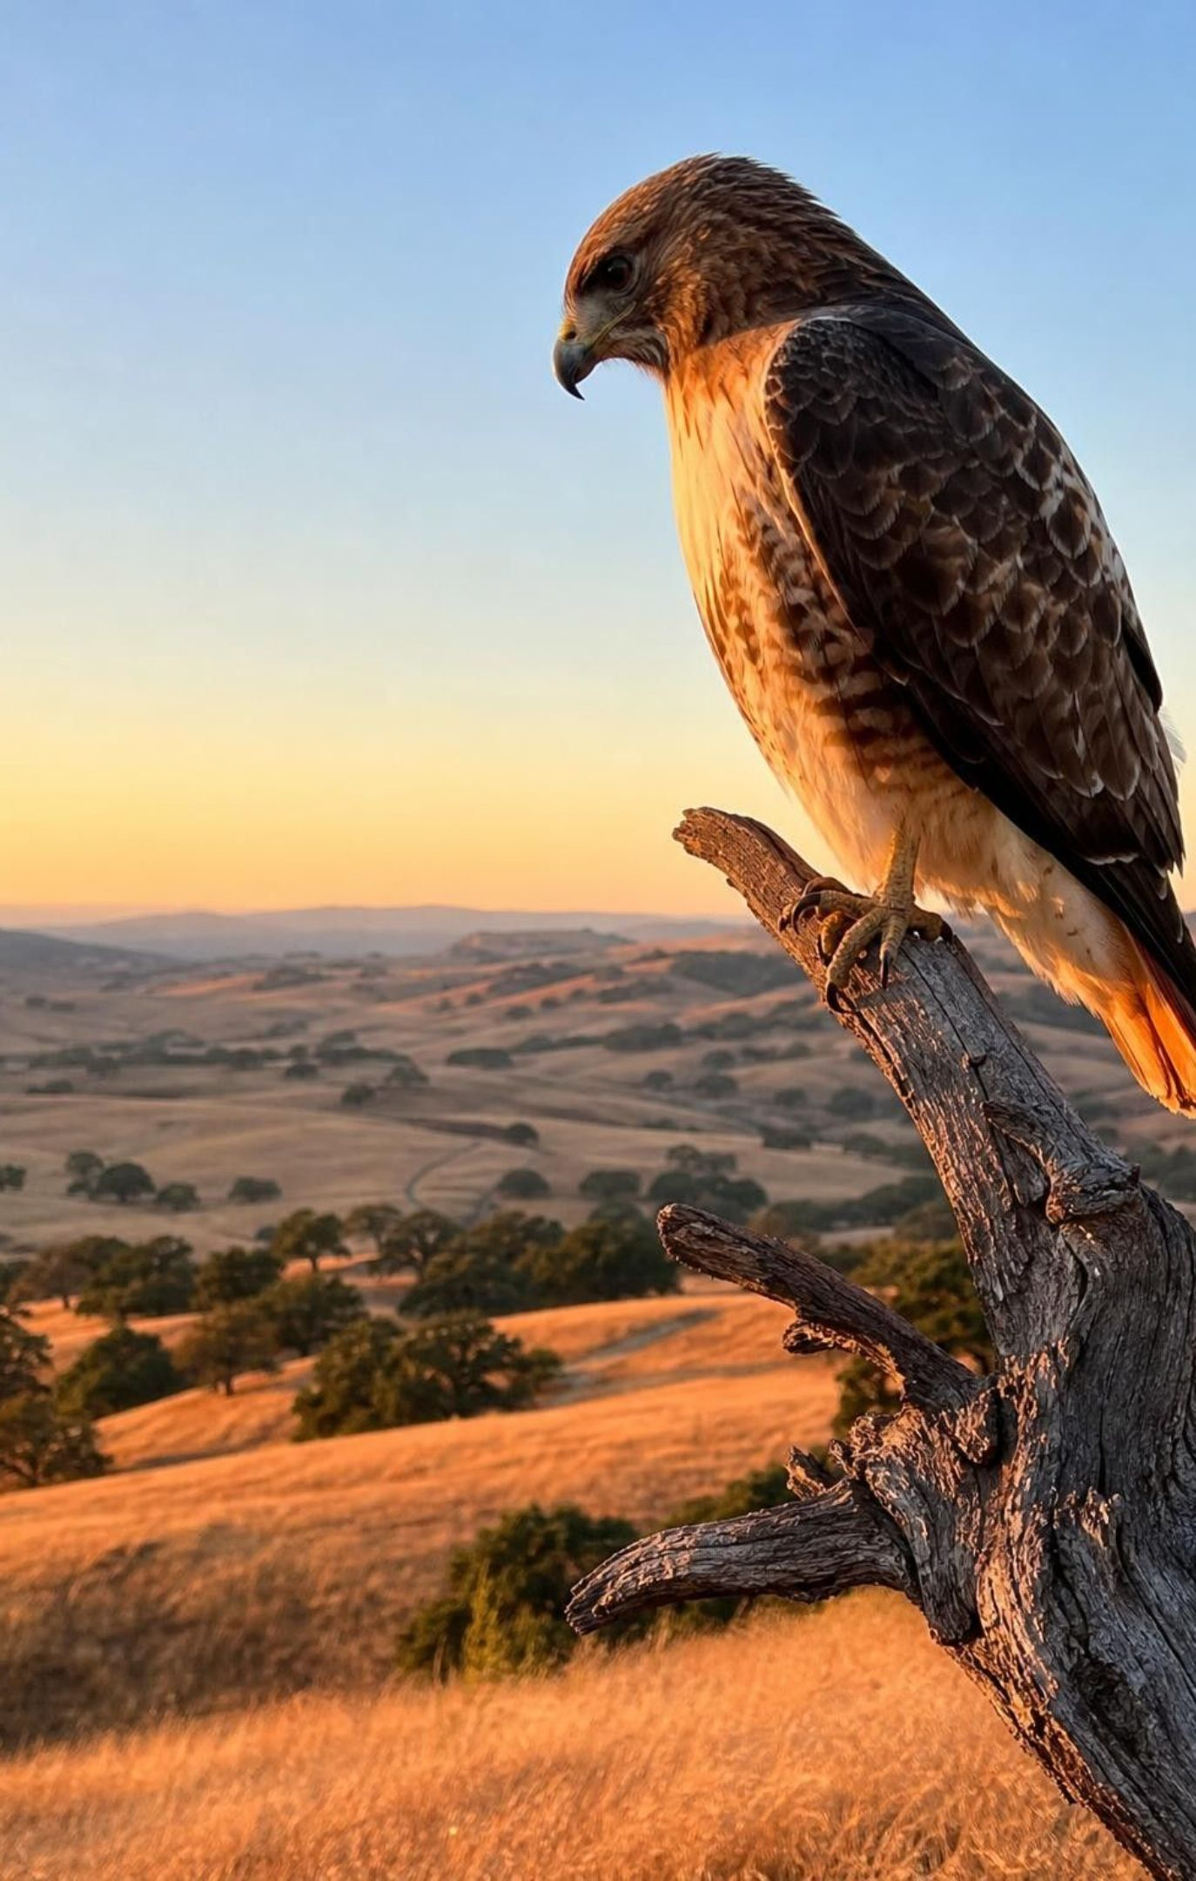
LEARNING TARGETS
What you will be able to do
1
Rate an interaction as plus, minus or zero for each partner and name its type.
2
Explain how predator and prey populations push each other up and down, with a delay.
3
Predict how a change in one population ripples to the others it interacts with.
4
Explain why the same five patterns appear in ecosystems with none of the same species.
5
Write criteria and constraints for a design problem that involves wildlife, and compare designs.
3
Notes:
Read the targets aloud and connect each to an activity: the rating skill is Lab 2, W2 and W8; the predator-prey delay is Lab 1, W4 and W5; the ripple prediction is the task on slide 22 and W6; the patterns-across-ecosystems target is the mystery at the heart of Lab 2 and the main idea of MS-LS2-2; the criteria-and-constraints target is Lab 3 and W9. Ask students to copy the target they think will be hardest and revisit it at the end.
CONNECTS TO: Targets map to Labs 1-3, W4, W5, W6, W9.
PACING: about 3 min

Slide 4




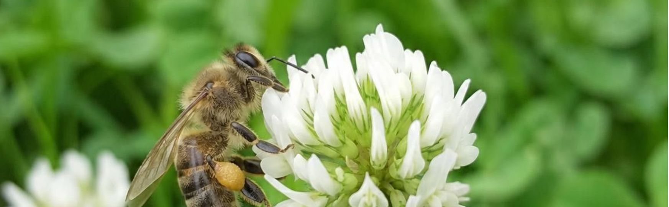

Five ways two species can meet
One eats the other: predation (+ for the eater, − for the eaten).
One lives on or in the other and drains it: parasitism (+ −).
Both need the same scarce resource: competition (− −).
Both gain: mutualism (+ +).
One gains, the other shows no measurable change: commensalism (+ 0).
4
Notes:
This is the map for the whole lesson, so spend a moment on the symbols. Plus means the interaction helps that species survive and reproduce; minus means it hurts; zero means scientists cannot measure a gain or a loss. The symbols describe populations, not feelings and not one meal. Competition came from Lesson 20: when two species need the same limited thing, each gets less than it would alone, so both are minus even if one of them usually wins. Ask students to guess where the acacia and its ants belong; do not confirm yet. Then say that the rest of the lesson takes these five one at a time, starting with the most familiar.
WATCH FOR: Students often rate competition as plus for the winner. Both get less than they would alone, so both are minus.
CONNECTS TO: W2 vocabulary relationships; Lab 2 uses exactly this rating.
PACING: about 4 min

Slide 5
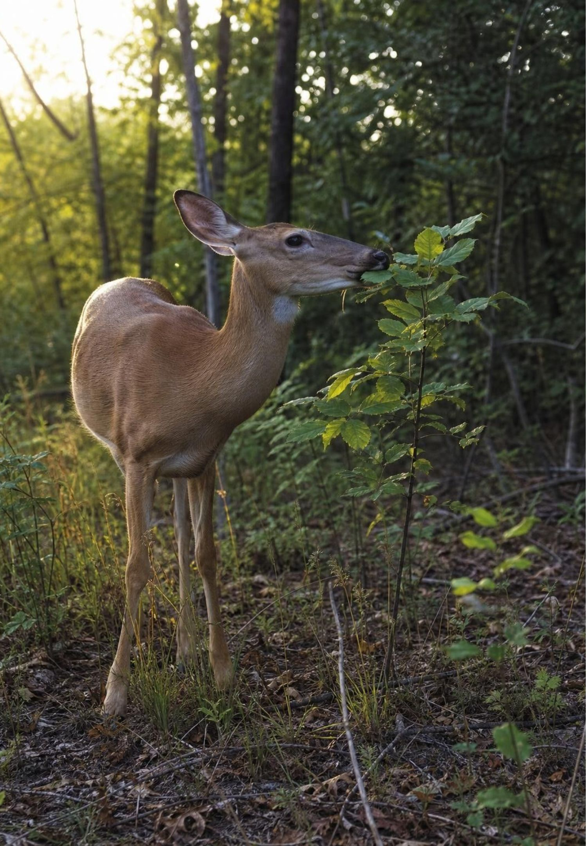
Predation: getting food from another living thing
A predator gets food by eating all or part of another living organism, the prey.
In this lesson that includes plant eaters: a deer browsing a seedling is a predator of that seedling.
Carnivores eat mostly animals. Herbivores eat mostly plants. Omnivores regularly eat both.
Hunting predators usually kill their prey; grazers usually leave the plant alive but weaker.
Every ecosystem on Earth has all three kinds, even when the species are completely different.
5
Notes:
Define predation broadly, the way the textbook does: any one-sided feeding on a living organism. Be honest that other books call plant eating 'herbivory' and keep 'predator' for hunters; students will meet both uses, and the lesson's version is chosen so every feeding relationship can be rated plus-minus. For the three kinds, give California examples: a mountain lion is a carnivore, a mule deer is an herbivore, a coyote in a suburb is an omnivore that eats rabbits, fallen fruit and garbage. On omnivores, correct the book's 'similar amounts' wording: the mix varies; black bears eat mostly plants and are still omnivores. Then ask: a cow grazes a grass plant and the plant survives. Is the grass harmed? Yes, it lost tissue it had built and will make fewer seeds, so the grass population is minus. That is why fencing deer out of a hillside changes which plants grow there.
WATCH FOR: Students insist a predator must kill. In this lesson the test is whether one organism takes food from another living one, not whether the prey dies.
CONNECTS TO: W2, W3 reading passage, W10.
PACING: about 5 min

Slide 6
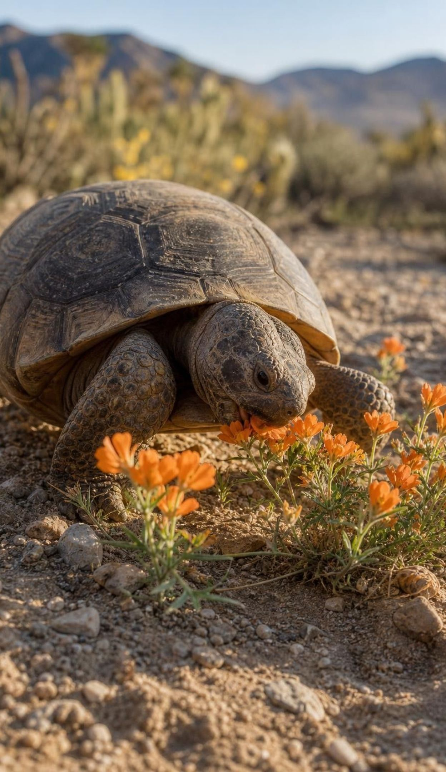
VOCABULARY IN CONTEXT
Three words for one kind of interaction
predation: An interaction where a predator gets food by eating all or part of another living thing. A sea otter cracking open a sea urchin, and a sea urchin chewing through a kelp stalk, are both predation.
predator: The organism that does the eating. Hunters count, and in this lesson so do grazers and browsers. A desert tortoise is a predator of spring wildflowers.
prey: The organism that gets eaten, whether it is an animal, a plant or a microbe. For a Cooper's hawk in a city park, pigeons are prey.
6
Notes:
Have students say each term with a California pair of their own: predator and prey in the ocean, in the desert, in their neighborhood. Point out the pattern they are already using: the pairs change completely from place to place, but the relationship is the same shape. That is the lesson's big idea in miniature. Collect three pairs on the board and keep them for the grid on slide 17.
WATCH FOR: Prey is not only 'small animals'. A giant kelp plant is prey for a sea urchin that is a tiny fraction of its size.
CONNECTS TO: W2 vocabulary worksheet.
PACING: about 3 min

Slide 7
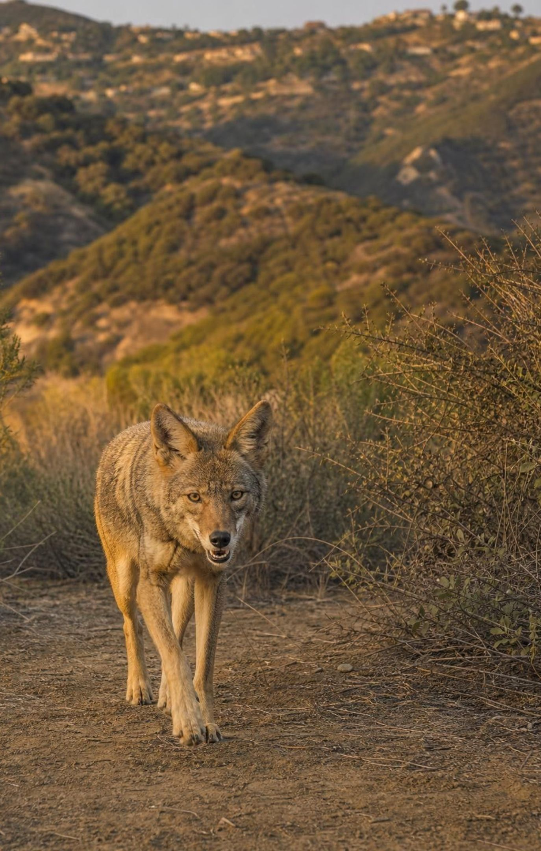
CHECK FOR UNDERSTANDING
Quick check: which kind of predator?
A coyote living near a Los Angeles canyon eats rabbits and ground squirrels, but also fallen figs, avocados from yards and food from unsecured trash. Which word fits best?
A. Carnivore
B. Herbivore
C. Omnivore
D. Parasite
7
Notes:
Vote with fingers, then defend. The coyote regularly eats both animals and plant food, so it is an omnivore; there is no need for the amounts to be equal. Parasite is the distractor to discuss: a parasite lives on or inside its host and takes a little at a time; a coyote does neither. Follow up: if the trash and fruit disappeared, would the coyote become a carnivore? Its diet would shift, which shows that these labels describe what a species mostly eats, not a fixed rule.
EXPECTED RESPONSES: C, Omnivore. Students who choose carnivore usually focus on the rabbits; ask them what the figs are.
WATCH FOR: Omnivore means 'eats exactly half and half'. It means regularly eats both.
CONNECTS TO: W2 and W10 reuse the three predator types.
PACING: about 3 min

Slide 8
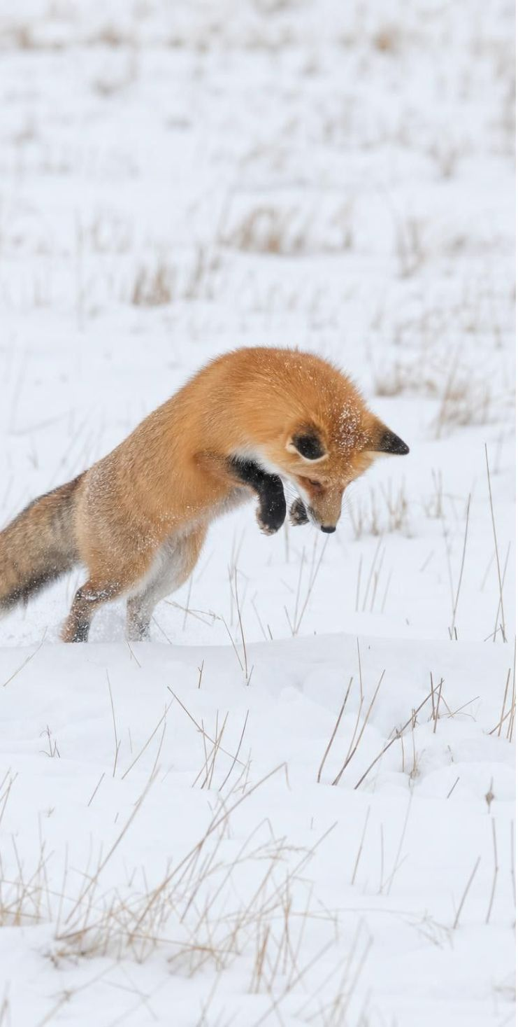
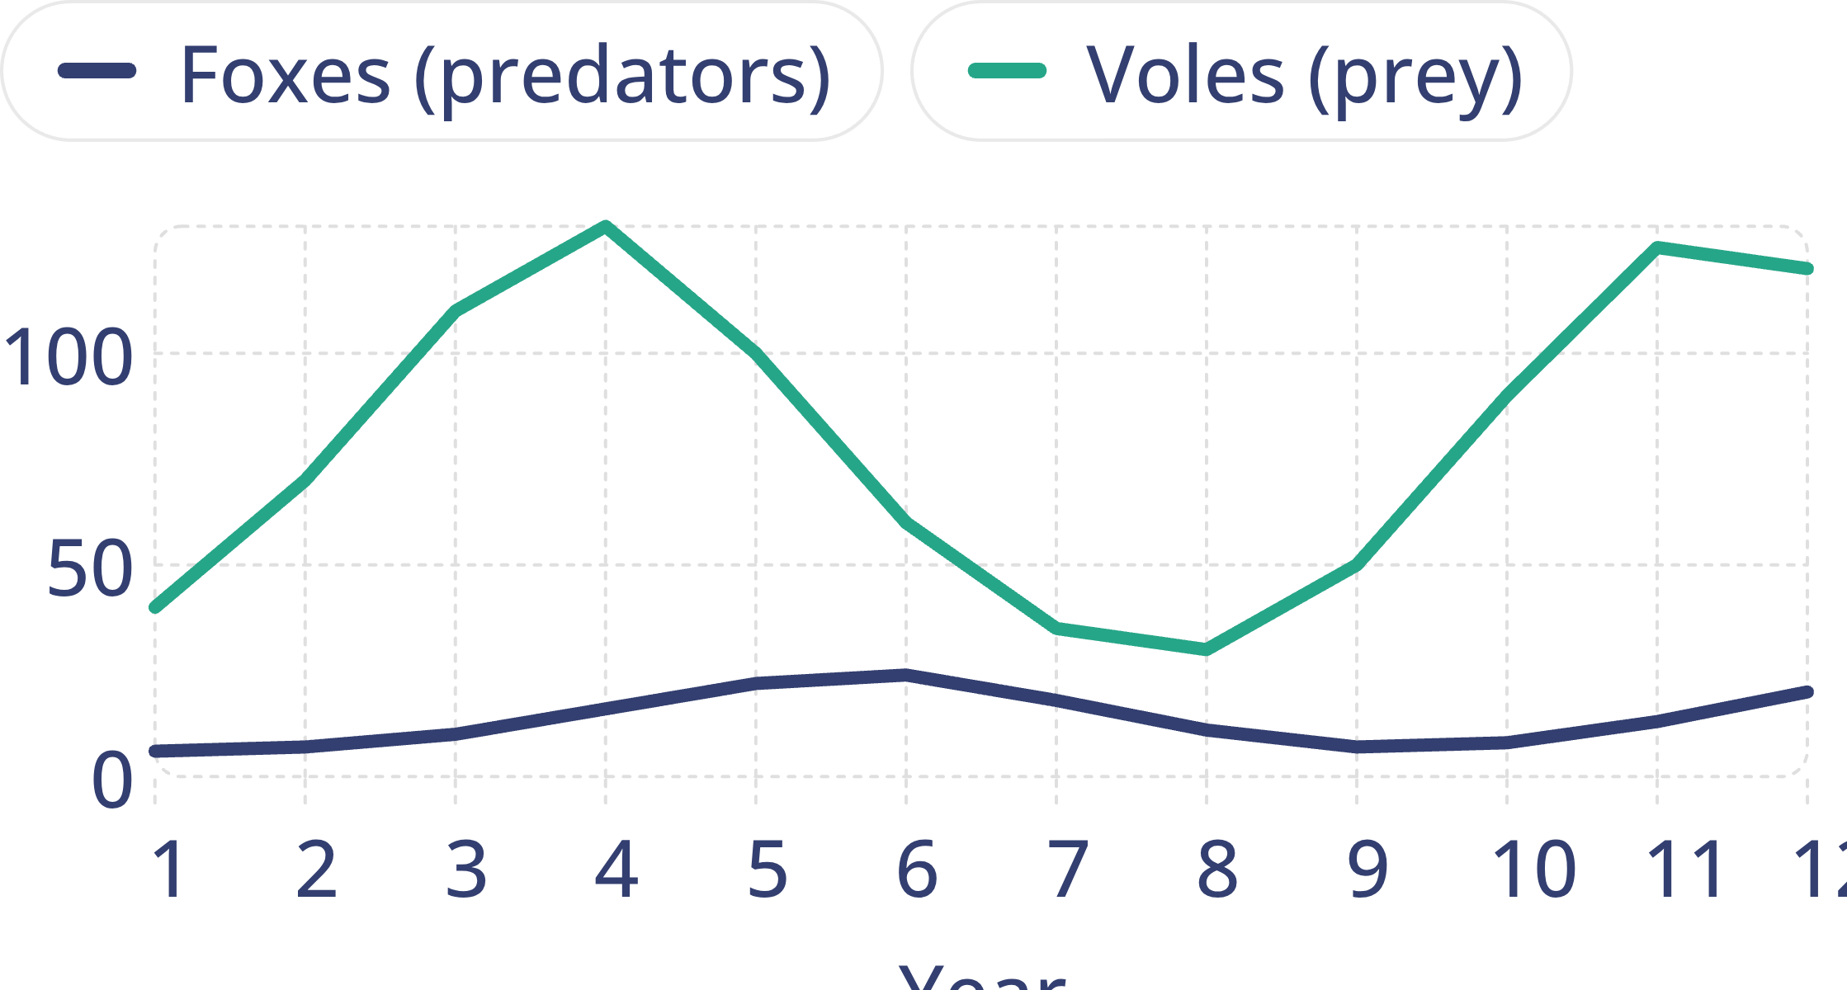
MODEL
Foxes and voles: a teaching graph of two linked populations
Model: Vole and fox counts in a 12-year teaching dataset
simulated data
Invented numbers for teaching. Notice that the fox peak (year 6) comes two years after the vole peak (year 4).
x: Year · y: Population size (count)
8
Notes:
Say plainly that these numbers are invented to show the pattern cleanly; real counts are bumpier. Walk the graph year by year. Years 1 to 4: voles climb; with plenty of food the foxes raise more pups, but it takes time, so the fox line climbs slowly. Year 4: voles peak at 130. Years 5 to 6: the many foxes eat voles faster than voles breed, so voles fall while foxes are still rising; foxes peak at 24 in year 6. Years 7 to 8: with few voles, foxes starve or fail to breed, and foxes fall; the vole low is year 8, the fox low is year 9. Year 9 onward: with few foxes, voles recover and the cycle begins again. Ask: how many years does the fox peak lag behind the vole peak? Two. Why a lag at all? Because reproducing and starving both take time. In real data the lag is months to years depending on the species.
EXPECTED RESPONSES: Vole peak year 4, fox peak year 6, a lag of two years; voles fall while foxes are still rising; foxes fall after voles are scarce.
WATCH FOR: Students read the lines as rising and falling together. Insist on the lag: point to year 5, where voles are already falling and foxes are still rising.
CONNECTS TO: Lab 1 (Beads, Cards and Cycles) produces a graph like this from beads; W5 data worksheet uses a cleaner dataset.
PACING: about 6 min

Slide 9
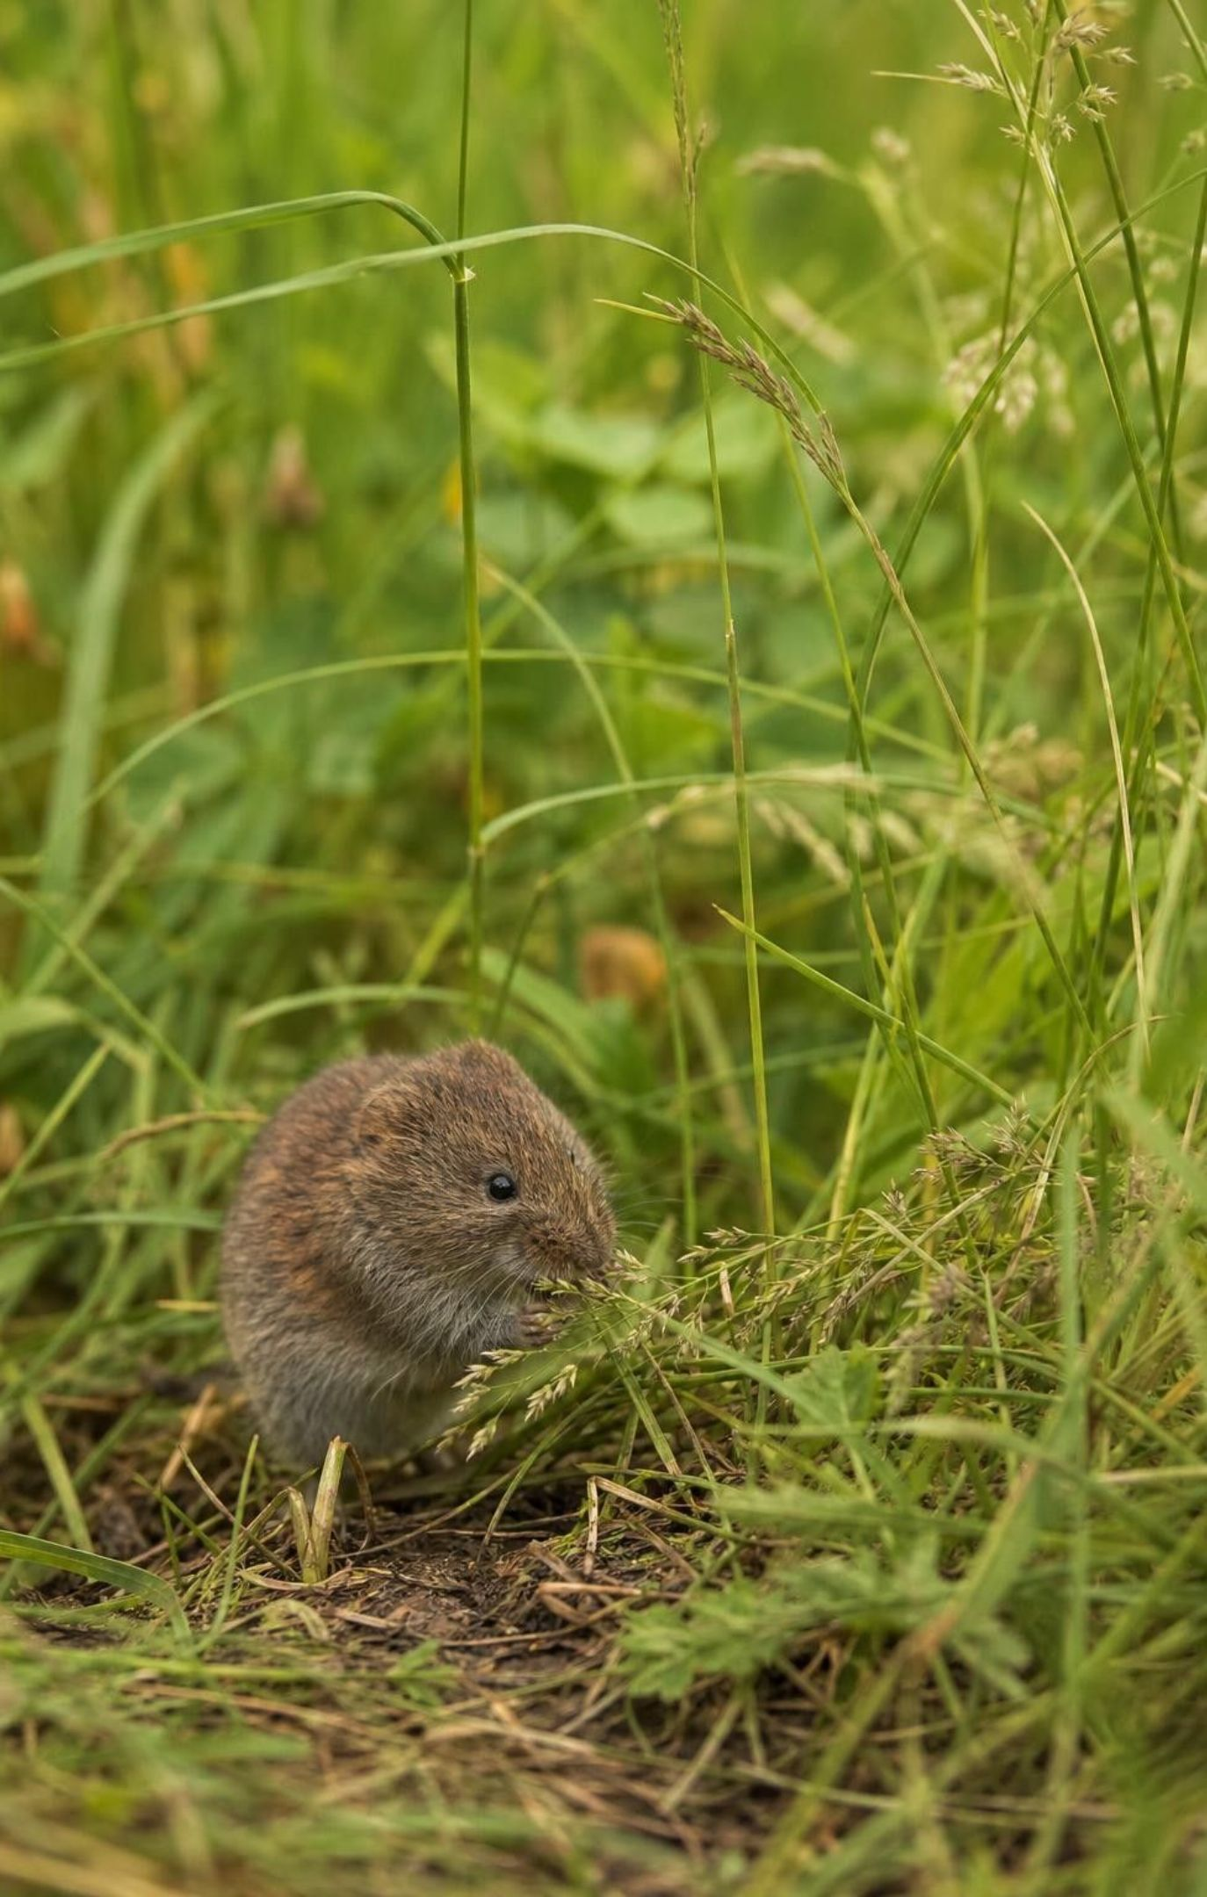
Reading the cycle as cause and effect
More prey means more food, so more predators survive and raise young (after a delay).
More predators eat more prey, so the prey population falls.
Fewer prey means predators starve or fail to breed, so the predator population falls.
Fewer predators means more prey survive, so the prey population rises again.
Each arrow takes time, which is why predator peaks trail prey peaks.
9
Notes:
Turn the graph into four cause-and-effect sentences and have students say them in a chain. Then test the chain against the textbook's Isle Royale account: in the early 2000s moose there declined, partly because winter ticks weakened them; with fewer moose, wolves had less to eat and by 2007 their number had dropped; with few wolves, more moose survived and the moose population grew. Each step matches one bullet. Make the point that the chain is a pattern seen in many ecosystems, not a law that always produces neat waves. Isle Royale's wolves were also hit by disease and inbreeding, fell to two animals by 2016 to 2018, and nineteen new wolves were brought to the island in 2018 and 2019. Those are 'other factors', and they matter.
WATCH FOR: Students conclude that predators drive prey to zero. Usually predators run short of food first and decline, which is what lets the prey recover.
CONNECTS TO: W7 misconception repair uses a student who thinks the lines move together.
PACING: about 5 min

Slide 10
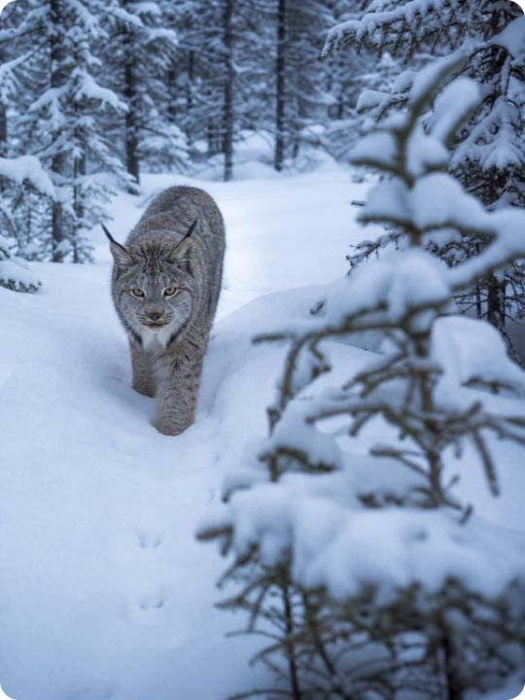
Model
The predator-prey loop
Model: A repeating cause-and-effect loop
Prey population rises → (takes a season or more)
Predators find more food; predator population rises later → (takes a season or more)
Heavy predation; prey population falls → (takes a season or more)
1
2
3
Predators go hungry; predator population falls → (takes a season or more)
Light predation; prey population recovers → (and the loop repeats) (back to the start)
4
5
Every arrow takes time, so the predator line always trails the prey line.
10
Notes:
Ask students to put a finger on the node that matches year 4 of the fox-vole graph (prey rises, about to peak), then year 6 (predators peak), then year 8 (prey low), then year 9 (predators low). The loop is the same whether the pair is wolves and moose, otters and urchins, or foxes and voles, which is why ecologists can look at a population graph from an ecosystem they have never visited and recognize the pattern. Then ask what could break the loop: a disease in the predators, a hard winter that kills prey no matter what the predators do, or a prey species that has other predators as well. Those are the reasons real graphs are messy.
EXPECTED RESPONSES: Students match years 4, 6, 8 and 9 to the rising-prey, predator-peak, prey-low and predator-low nodes.
WATCH FOR: Some students think the loop means populations return to exactly the same numbers each cycle. Real peaks differ in size every time.
CONNECTS TO: Lab 1 debrief; W4 diagram worksheet.
PACING: about 4 min

Slide 11
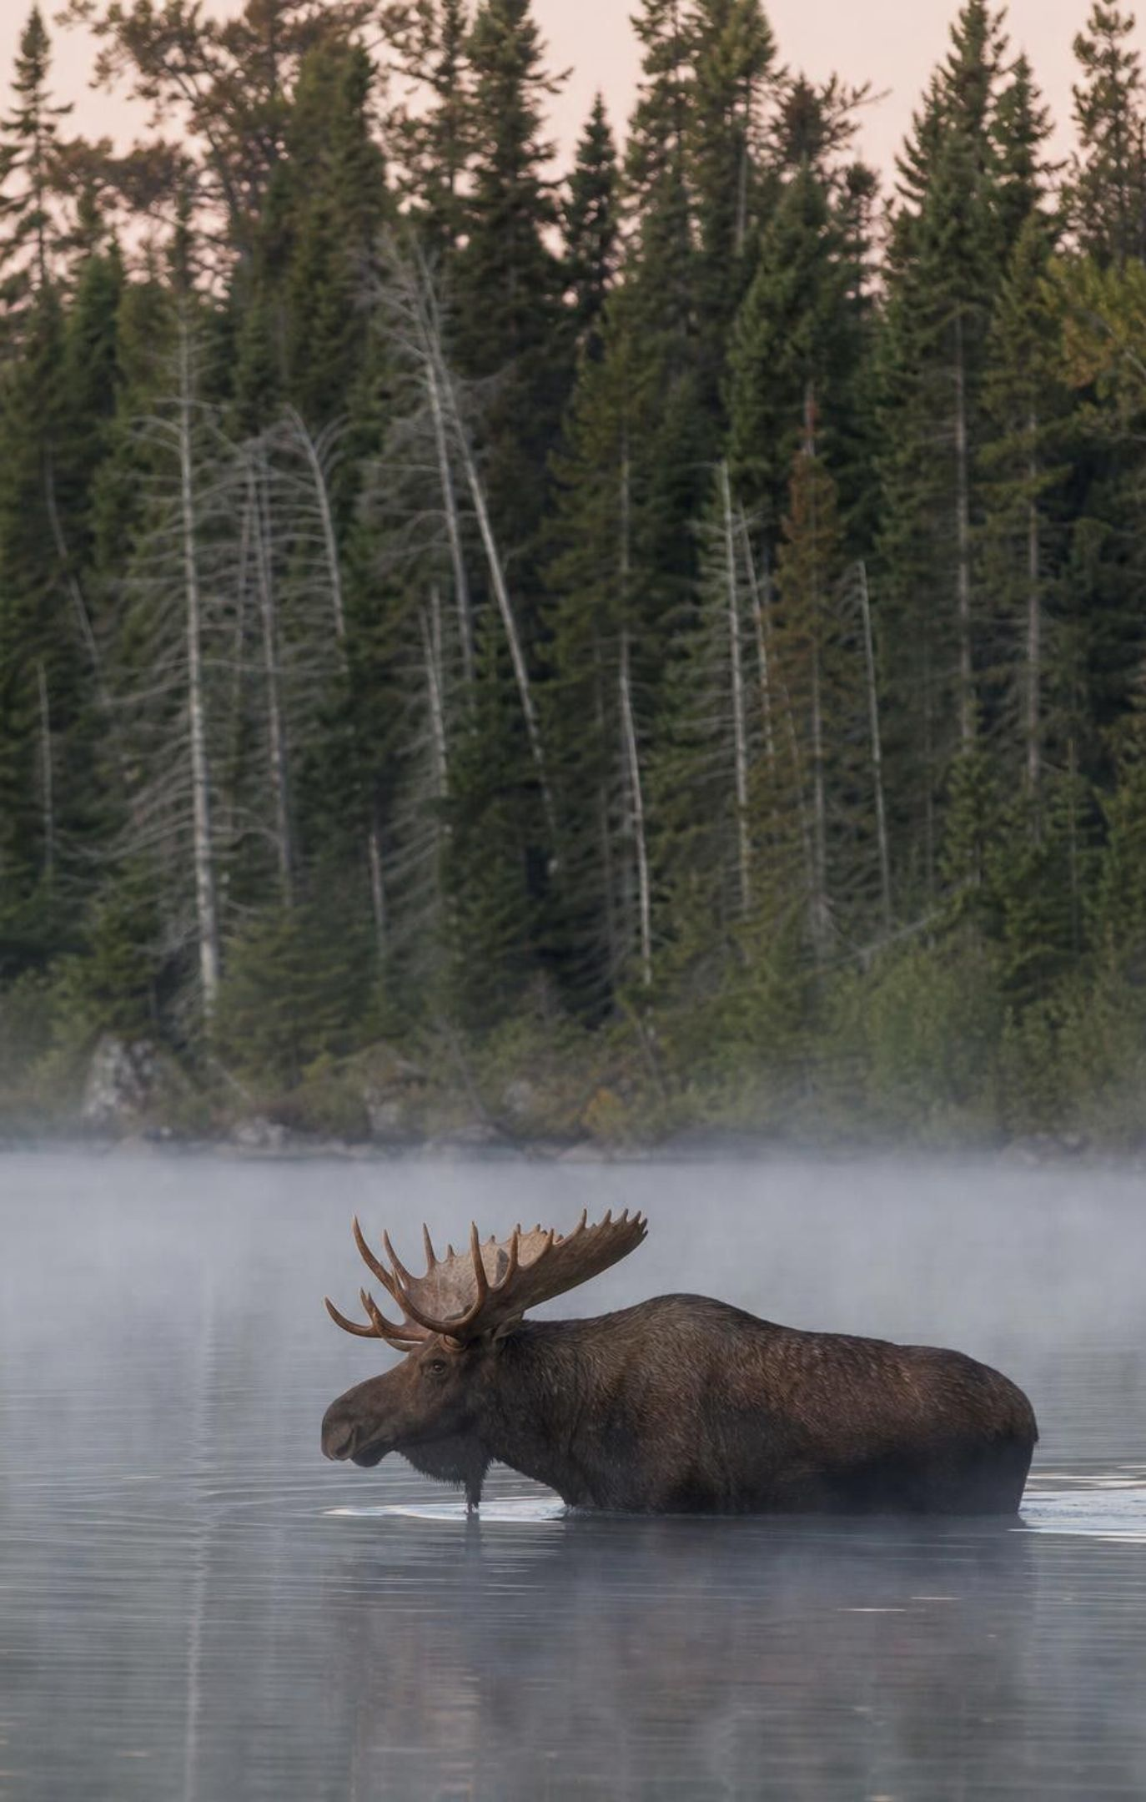
THINK, PAIR, SHARE
Discuss: is the predator-prey cycle a law?
Moose: winter ticks, deep snow, summer heat, the amount of young forest to browse.
Wolves: disease, inbreeding on a small island, ice bridges that let new wolves arrive.
The pattern is real, but it is one cause among several, not a rule that works alone.
On Isle Royale, moose numbers fell in the early 2000s and wolf numbers fell a few years later. Is predation the only thing that moved those lines? What else could push a moose or wolf population up or down?
11
Notes:
Give pairs three minutes. The textbook says the island lets scientists watch wolves and moose without other factors; push back gently with the evidence. Moose are strongly affected by winter ticks, deep snow and the amount of young forest; wolves were hit by a dog virus in the 1980s and later by inbreeding, which left them with spine defects. When the pack shrank to two animals, the park service relocated nineteen wolves to the island in 2018 and 2019. Ask: if you only had the two population lines and no other information, could you prove that wolves caused the moose decline? No; you would need to rule out the other causes. That is exactly why Lab 1 is a controlled model: in the bead meadow nothing else changes, so whatever cycle appears must come from the rules. Close with the claim students should carry forward: 'the predator-prey cycle is a common pattern, not a law'.
EXPECTED RESPONSES: Weather, food supply, disease, parasites (ticks), inbreeding and migration can all move the lines; the predator-prey link is real but shares the stage with other causes.
CONNECTS TO: Lab 1 analysis question on model limitations; W3 reading passage on Isle Royale.
PACING: about 6 min

Slide 12
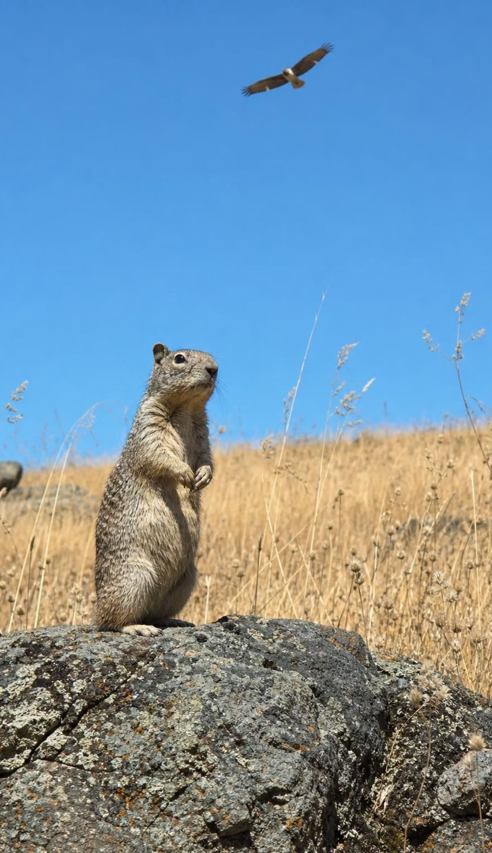
CHECK FOR UNDERSTANDING
Quick check: which comes first?
A biologist graphs a hawk population and the population of the ground squirrels it eats, over fifteen years. If the two are linked by predation, which pattern should she expect?
A. Hawks peak first, then squirrels peak a year or two later.
B. Squirrels peak first, then hawks peak a year or two later.
C. Both peak in the same year, every time.
D. Squirrels rise and fall while hawks stay the same.
12
Notes:
Vote, then ask a student who chose B to explain the delay: hawks can only raise more chicks after there is extra food, so their peak comes after the squirrel peak. Option A would mean the prey responds to the predator before the predator has eaten anything. Option C is the textbook's 'together' wording, which skips the lag. Option D would mean hawks do not depend on squirrels at all; possible if they have many other prey, which is worth a sentence. Then ask: what should she expect right after the hawk peak? A squirrel decline, then a hawk decline.
EXPECTED RESPONSES: B. The predator peak follows the prey peak because reproducing takes time; after the predator peak, prey fall, then predators fall.
WATCH FOR: Option C is common; return to year 5 of the fox-vole graph where the lines move in opposite directions.
CONNECTS TO: W5 data worksheet; W10 mastery.
PACING: about 3 min

Slide 13
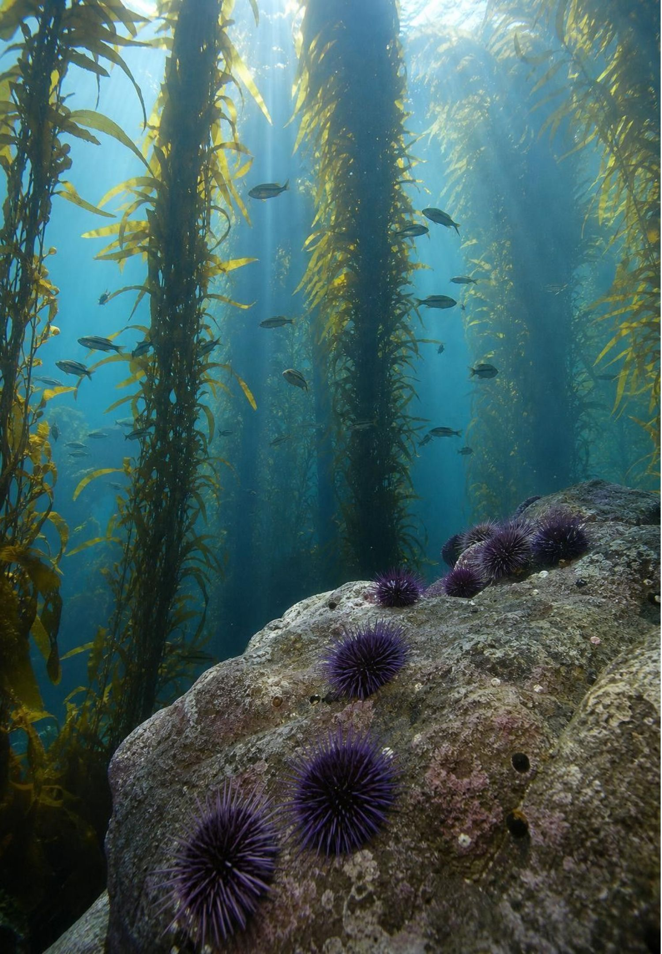
REAL-WORLD CONNECTION
California connection: otters, urchins and kelp
Along the Central Coast, from Monterey Bay south, sea otters eat purple sea urchins. Urchins eat giant kelp, chewing through the stalks near the seafloor. Where otters hunt, urchins stay scarce and kelp forests grow tall enough to shelter fish, crabs and abalone. Where otters are gone, urchins multiply, mow the kelp down, and leave 'urchin barrens' of bare rock. Three species, two predation links, one pattern.
13
Notes:
Southern sea otters were hunted almost to extinction for their fur by the early 1900s; a small group survived near Big Sur, and the population has slowly spread along the Central Coast. Divers and kelp-mapping surveys show the contrast: dense kelp canopy where otters are common, barrens where they are absent. After 2013 a sea-star disease killed off sunflower sea stars, another urchin predator, and much of the Northern California kelp forest collapsed under an urchin boom. Ask students to rate each link: otter and urchin (+ −), urchin and kelp (+ −), and then the chain: what does removing the otter do to the kelp? Kelp falls, even though otters never touch kelp. That is a ripple effect, and it is the same shape as wolves, elk and willows in Yellowstone. Local places to see it: Monterey Bay Aquarium's kelp exhibit and the otters off Moss Landing.
CONNECTS TO: Lab 2 kelp-forest cards (K3 otter and urchin) and analysis question q9 on the otter-urchin-kelp chain; W9 transfer task; the ripple task on slide 22.
PACING: about 5 min

Slide 14
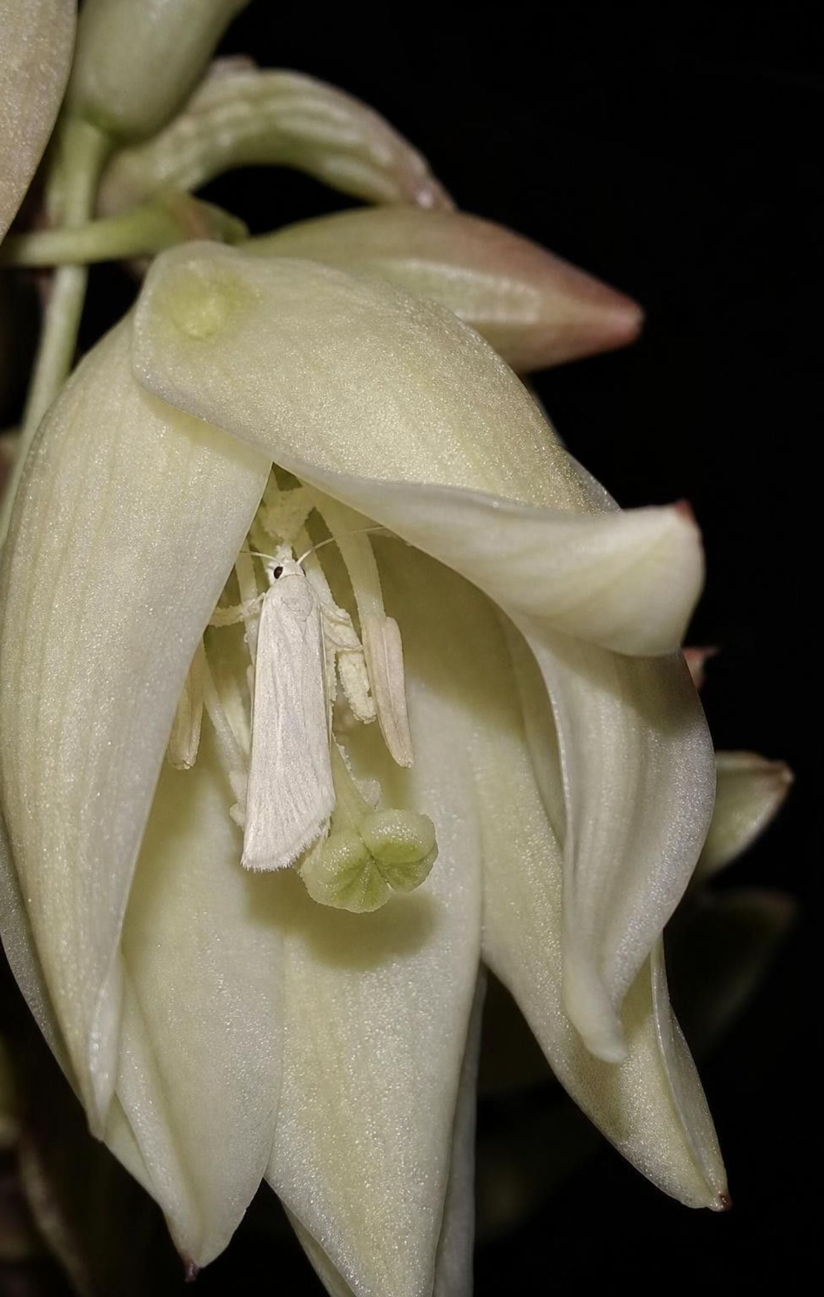
Mutualism: both partners gain
Acacia and ants: sugar and shelter for the ants; stinging guards and vine removal for the tree.
Yucca and yucca moth: the moth pollinates the flower and lays eggs; its larvae eat a few seeds.
Sea turtle and cleaner fish: the fish eat algae off the shell; the turtle stays clean and healthy.
Lichen: a fungus shelters an alga or cyanobacterium, which makes sugar for both.
Some partners cannot live apart, so if one population falls, the other can fall with it.
14
Notes:
Now confirm the acacia: plus for the tree, plus for the ants, a mutualism. Stress that each partner is acting for itself; the tree is not generous and the ants are not loyal. Yucca and yucca moth, found in California's Mojave Desert, are the tightest example: the moth is the yucca's only pollinator and the yucca's seeds are the only food for the moth's larvae, so neither population can grow without the other. Lichens are a partnership of a fungus with a green alga or a cyanobacterium (or both); the book says 'alga', and the fuller version matters because many of those algae can live on their own while the fungus usually cannot. The last bullet is the one students will use in predictions: when partners depend on each other, a decline in one shows up in the other, which is a different pattern from predator and prey, where the lines move in opposite directions.
WATCH FOR: Students hear 'both benefit' and assume no cost. The tree pays sugar; the moth larvae eat seeds. Mutualism means each side's gain outweighs its cost.
CONNECTS TO: Lab 2 cards D3 (Joshua tree and yucca moth), R3 (leafcutter ants and fungus) and K1 (señorita and blacksmith); W6 CER.
PACING: about 5 min

Slide 15
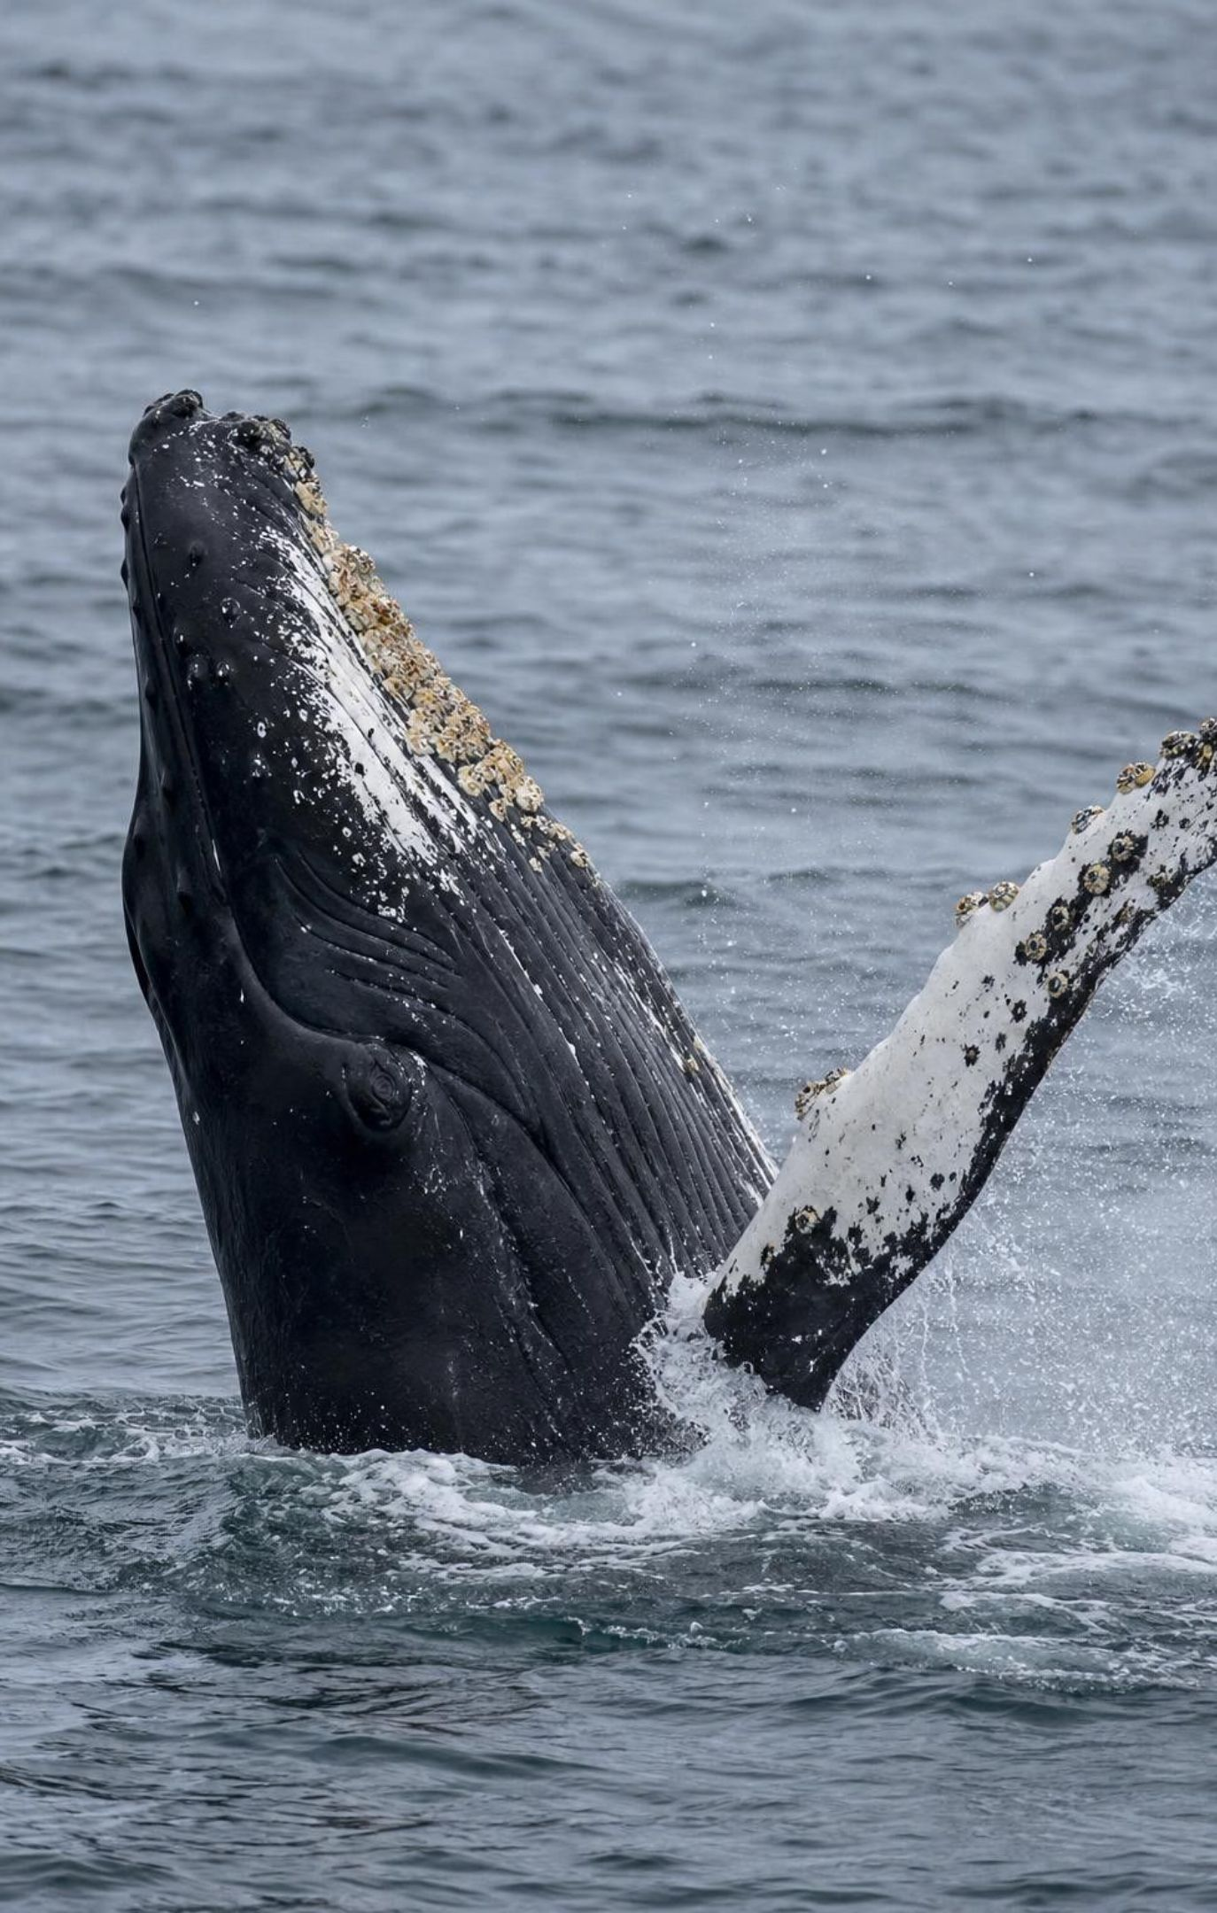
Living on another organism: what is the effect?
Commensalism: one partner gains, the other shows no measurable change (+ 0).
Example: barnacles ride a whale to new feeding water; the whale seems unaffected.
Parasitism: one partner lives on or in the other and takes resources from it (+ −).
Example: ticks drink blood from a moose; most moose survive, but a heavy load can kill a calf.
The test is the effect on the host, not where the organism lives.
15
Notes:
These two look alike from the outside: a small organism attached to a large one. The difference is what the host loses. Barnacles on a whale filter food from the water, not from the whale; as far as anyone has measured, the whale is neither helped nor harmed. A tick takes blood and can carry disease, so its host is minus. Add the fleas-on-a-kitten example from the book, and correct one detail: fleas and lice are insects, but ticks are arachnids with eight legs, like spiders. Ask students where cleaner fish on a sea turtle fit: they also live on a host, but the host gains, so that is mutualism. Three different labels for 'lives on something bigger', decided by the effect on the host.
WATCH FOR: Students call every hitchhiker a parasite. Ask what the host loses; if the answer is nothing measurable, it is commensalism.
CONNECTS TO: Lab 2 city-park cards C1 (lichen on oak) and C3 (pigeon lice), and the other live-on cards D2, R1 and R2; W2 and W8.
PACING: about 5 min

Slide 16
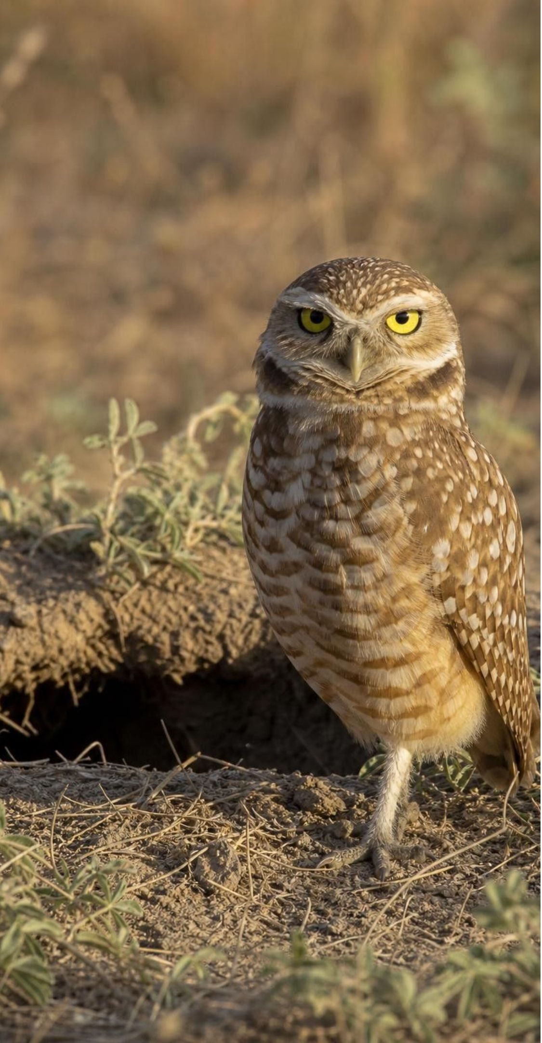
VOCABULARY IN CONTEXT
Three relationships, decided by the effect on each partner
mutualism: An interaction in which both species gain something that helps them survive or reproduce. Bees get nectar from clover in a park lawn, and the clover gets pollinated.
commensalism: An interaction in which one species gains and the other shows no measurable gain or loss. A burrowing owl nests in a burrow that a ground squirrel dug and abandoned.
parasitism: An interaction in which one species lives on or in a host and takes resources from it, weakening but usually not killing it. Feather lice chew the feathers of a pigeon, which then loses more heat in winter.
16
Notes:
Have students write the plus-minus-zero code next to each term: + +, + 0, + −. Then ask which code parasitism shares with predation, and what separates them: a parasite stays on or inside its host and takes small amounts over time; a hunting predator kills and eats. Point out that commensalism is the hardest to prove, because showing 'no effect' takes careful measurement, and that ecologists sometimes move an example from commensalism to parasitism or mutualism when better data arrive.
WATCH FOR: Students may think parasites are always tiny. Mistletoe is a parasitic plant; a tapeworm can be meters long.
CONNECTS TO: W2 vocabulary worksheet; Lab 2 rating table.
PACING: about 3 min

Slide 17
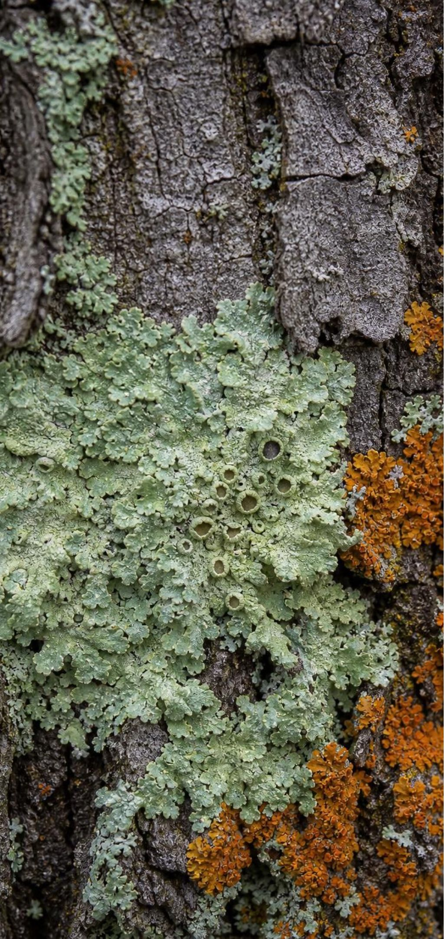
MODEL
The plus-minus-zero grid
Model: Five interactions, rated by the effect on each species
Mutualism (+ +): | Both gain. Acacia and ants; yucca and yucca moth; fungus and alga in a lichen.
Commensalism (+ 0): | One gains; the other shows no measurable change. Barnacles on a whale; lichen on oak bark.
Predation (+ −): | One eats all or part of the other. Otter and urchin; urchin and kelp; deer and seedling.
Parasitism (+ −): | One lives on or in the other and drains it. Tick and moose; lice and pigeon; mistletoe and oak.
Competition (− −): | Both need the same scarce resource and each gets less. Starlings and bluebirds for nest holes.
The species change from ecosystem to ecosystem; these five codes do not.
17
Notes:
This is the tool students will use in Lab 2, W2 and W8. Return to the pairs collected on slide 6 and sort them into the grid with the class. Then make the pattern claim explicit: a kelp forest, a desert, a rainforest and a city park share almost no species, yet each contains all five codes. Ask why that might be. Lead toward resources: in every ecosystem, food is limited, so something eats something, something competes with something, and partnerships that save resources get kept. Any place with living things and limited resources will produce these five patterns, which is why an ecologist can predict them in an ecosystem nobody has studied yet.
EXPECTED RESPONSES: Students sort their own pairs correctly; some will want a sixth category for 'neither affected' (0 0), which is fine to mention as 'no interaction'.
WATCH FOR: Predation and parasitism share a code. The difference is lives-on-and-drains versus eats; students should not treat the code as the whole definition.
CONNECTS TO: Lab 2 grid; W2 symbol-code grid; W8 jigsaw on population consequences.
PACING: about 5 min

Slide 18
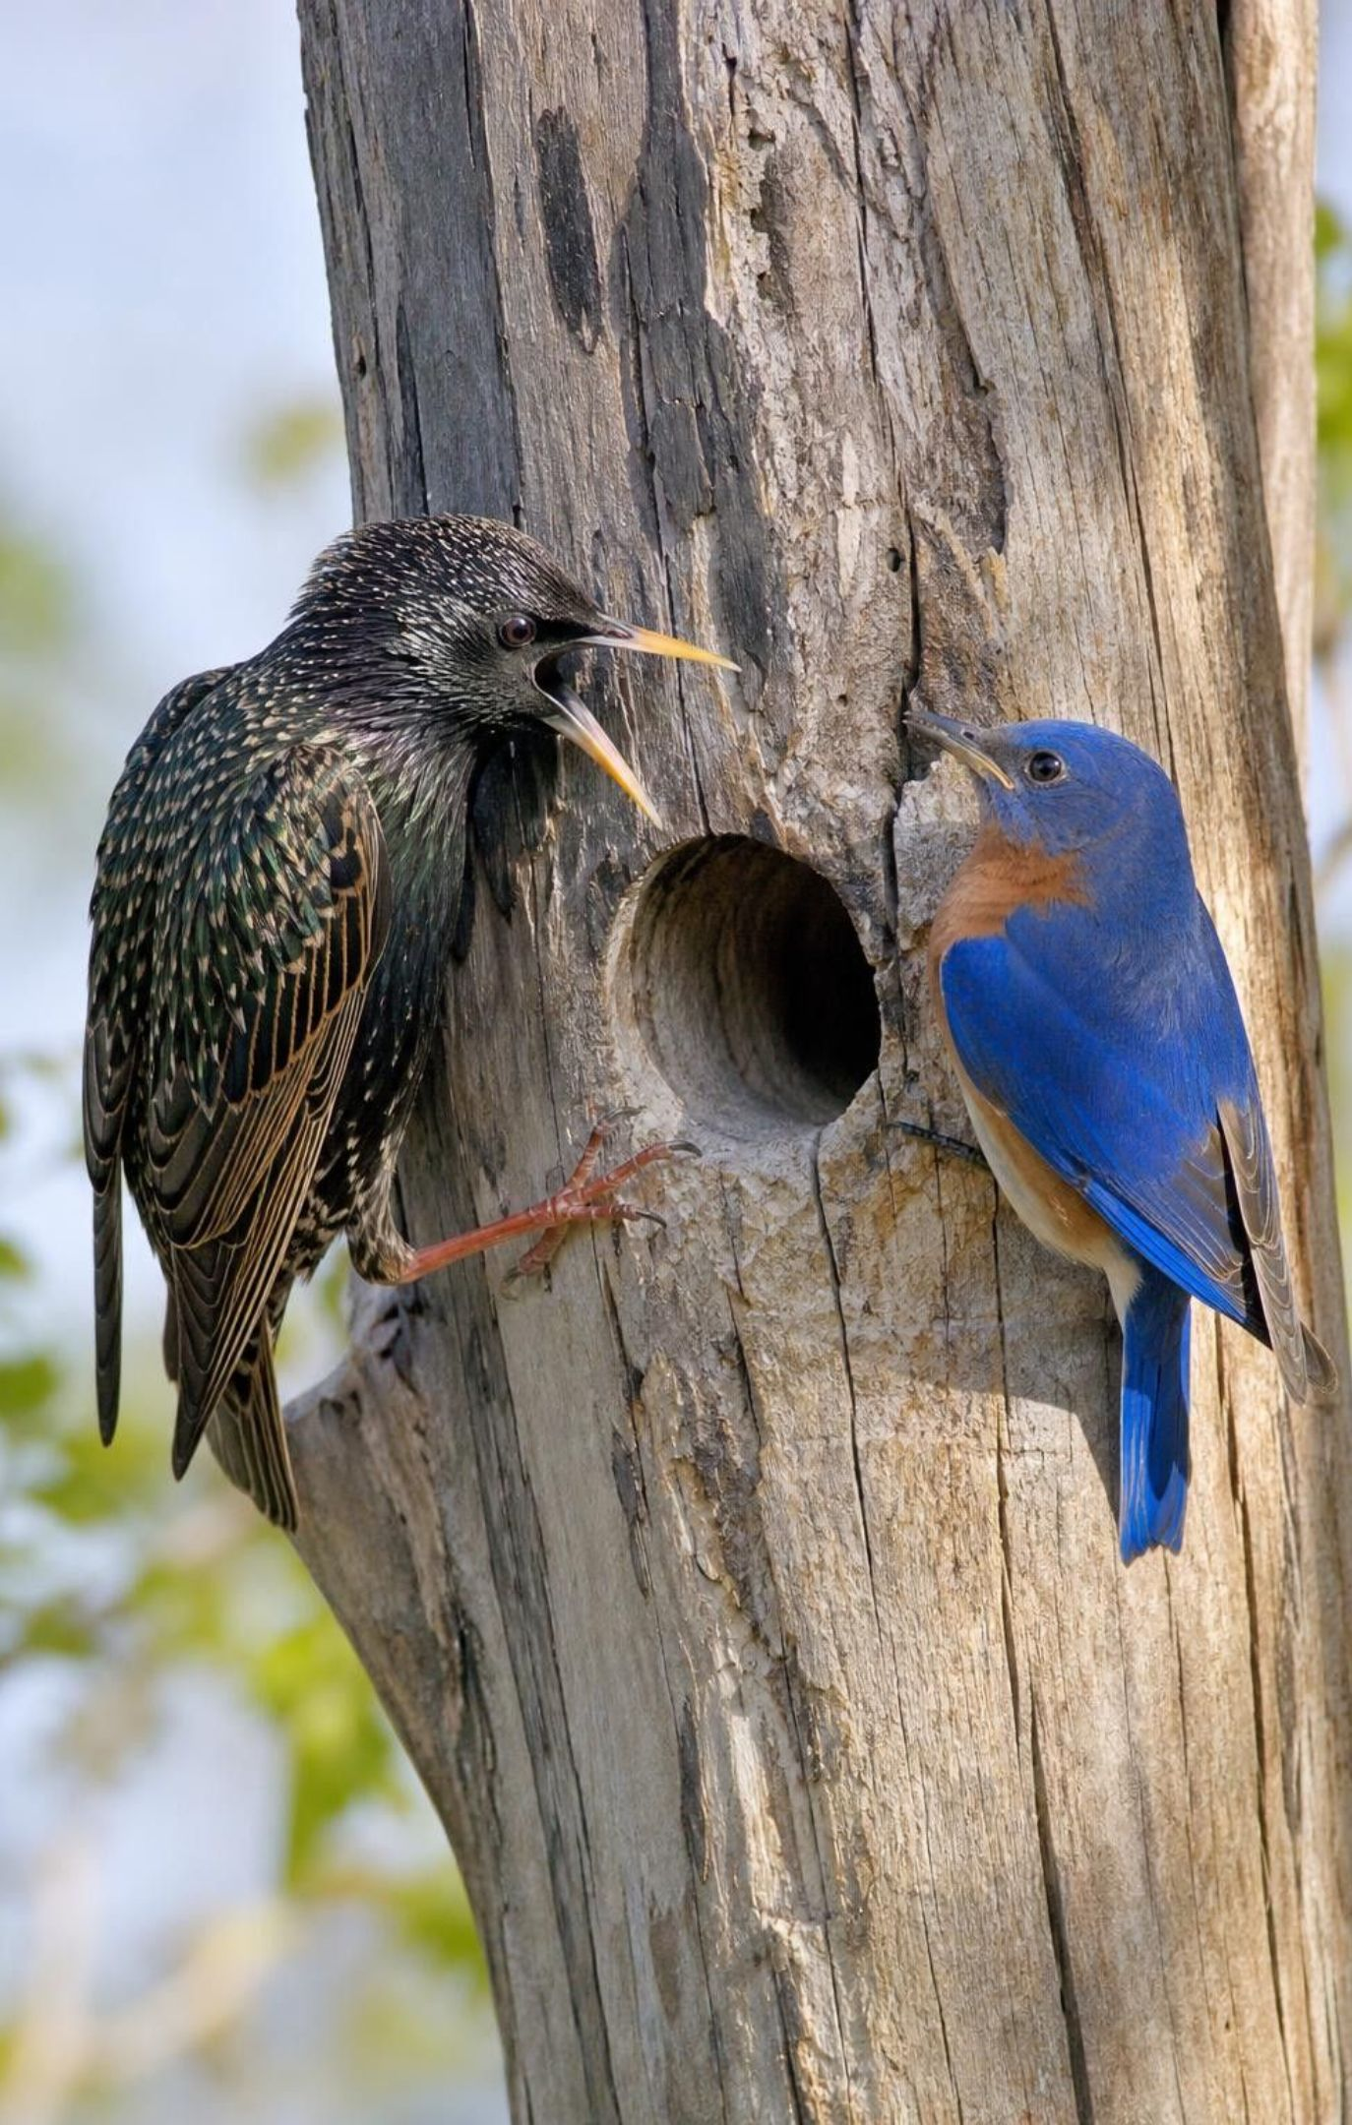
Competition: both lose, even when one wins
Two species need the same limited resource: food, nest holes, light, space.
Each gets less than it would alone, so both populations are minus.
Starlings usually win nest holes from bluebirds, but defending holes costs starlings too.
Competition is a pattern from Lesson 20; here it is one of the five interaction codes.
Managers can reduce a competitor to help a species they want to protect.
18
Notes:
Keep this brief; competition was Lesson 20's topic. The one new idea is the rating: minus-minus, because each species gets fewer resources than it would in the other's absence. Students resist the idea that the 'winner' is harmed; ask what the starlings spend defending holes and whether every starling pair gets one. Then connect to management, which the book raises with the snow leopard example: a preserve can help a species it cares about by reducing its competitors, its parasites or its predators, or by increasing its prey. Those are exactly the levers in the task on slide 22.
WATCH FOR: Students rate competition as plus for the winner and minus for the loser. Both are minus relative to living alone.
CONNECTS TO: L20 review; W6 and the ripple task.
PACING: about 3 min

Slide 19
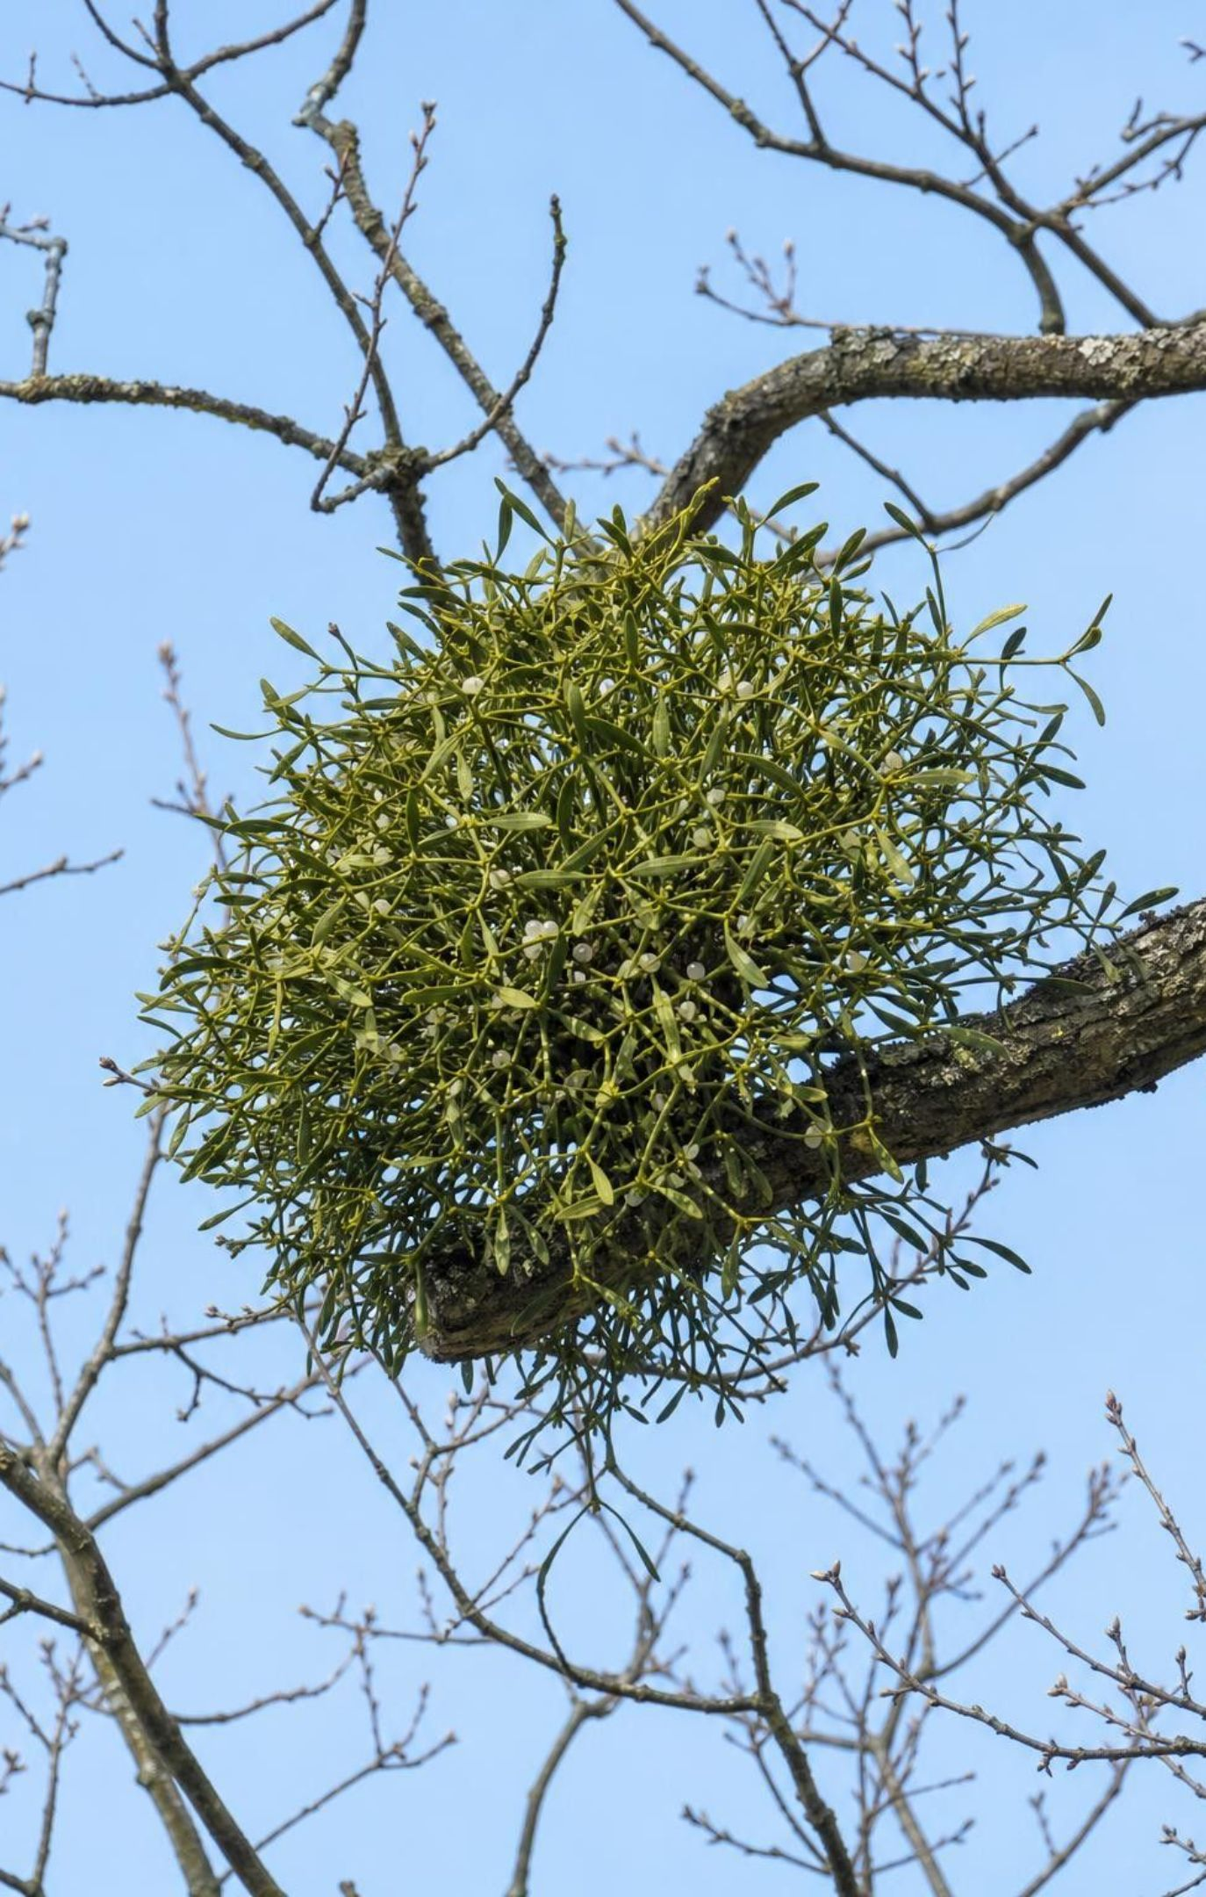
CHECK FOR UNDERSTANDING
Quick check: name that interaction
Mistletoe grows on an oak branch and sinks root-like strands into the wood to take water and minerals. Branches beyond it grow slowly and may die back. Which interaction is this?
A. Predation
B. Parasitism
C. Commensalism
D. Mutualism
19
Notes:
Vote and defend. The mistletoe lives on the oak, takes resources from it over years, and weakens but does not usually kill it: parasitism, plus for the mistletoe and minus for the oak. Predation is the thoughtful wrong answer, since the code is the same; the difference is that a predator eats and moves on, while a parasite stays on or in a living host and drains it. Ask what evidence would move this to commensalism: oak branches growing just as well with mistletoe as without. Nobody has found that, so parasitism stands. The question says water and minerals rather than food because mistletoe also photosynthesizes; ecologists call it a partial parasite, and the rating does not change.
EXPECTED RESPONSES: B, Parasitism. Students should cite that the mistletoe lives on the host, takes resources over time, and the host is weakened but not killed.
WATCH FOR: Students may say plants cannot be parasites. Mistletoe, dodder and broomrape are all parasitic plants.
CONNECTS TO: W10 mastery; Lab 2 card D2 (desert mistletoe on catclaw acacia) tests the same idea in another ecosystem.
PACING: about 3 min

Slide 20
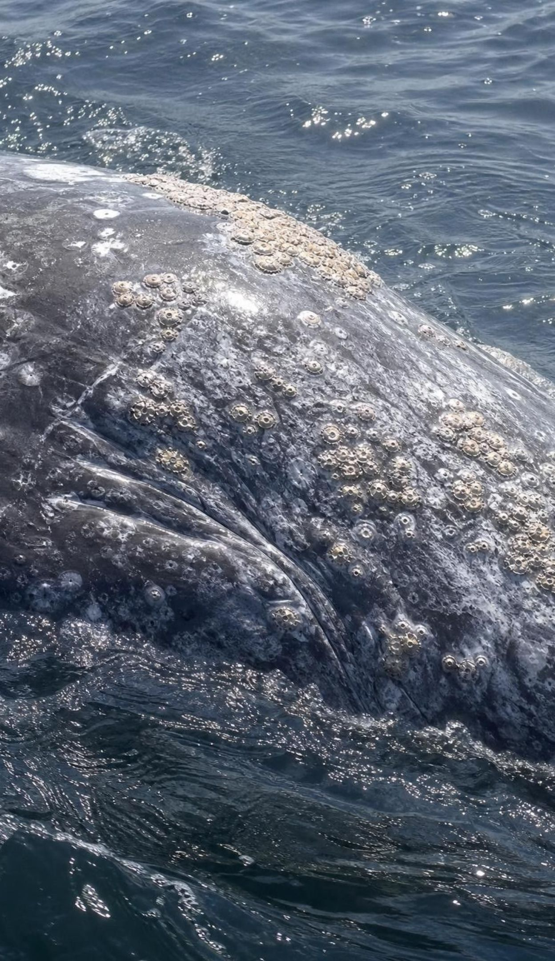
THINK, PAIR, SHARE
Discuss: is zero ever really zero?
What would you measure: swimming speed, energy use, skin damage, number of calves?
If barnacles cost the whale even a little, the label would move toward parasitism.
If barnacles somehow helped, for example by armoring the skin, it would move toward mutualism.
Zero means 'no effect we can measure', and labels follow the evidence.
Commensalism gets a 0 for the host. How could a scientist show that a whale carrying hundreds of kilograms of barnacles is truly unaffected? What would change the label if they measured it?
20
Notes:
Give three minutes in pairs. The goal is not a final answer about whales; it is to see that classification is a claim backed by evidence, and a 0 is the hardest claim to support because you must show the absence of an effect. Students usually propose comparing whales with heavy and light barnacle loads on speed, energy or calves. Point out the difficulty: whales with heavy loads might be older or sicker to begin with, so the comparison needs care. Close by saying that in Lab 2 every card gives measurements for both partners, and the group must decide what the evidence supports, including a 0 when the numbers show no difference.
EXPECTED RESPONSES: Measure something about the whale that could change (speed, energy, health, reproduction) for whales with and without heavy loads; a measurable cost would make it parasitism; a measurable gain would make it mutualism.
CONNECTS TO: Lab 2 cards K2, C1 and R2 (the zeros) and analysis question q11; chapter accuracy note on zero.
PACING: about 5 min

Slide 21
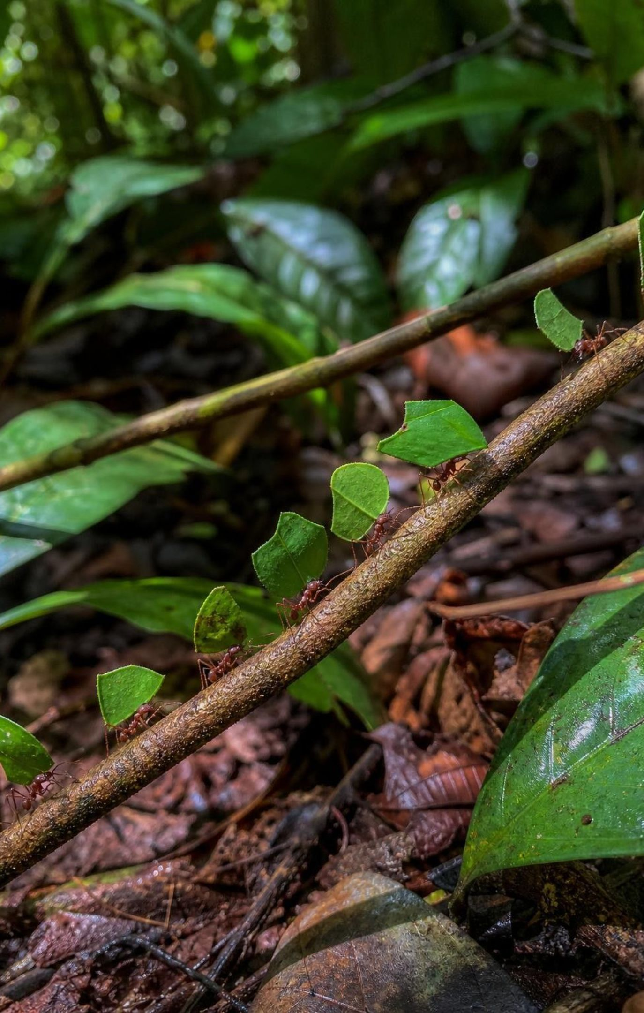
Same patterns, different species
Kelp forest: otter eats urchin; urchin eats kelp; young rockfish shelter in the kelp canopy.
Mojave Desert: tortoise eats wildflowers; Joshua tree and yucca moth; mistletoe on catclaw acacia.
City park: hawk eats pigeons; starlings and bluebirds compete; lice on pigeons; lichen on oaks.
Rainforest: jaguar eats peccary; leafcutter ants farm a fungus; hummingbirds compete.
No species in common, yet the same five codes appear in each place.
21
Notes:
This slide is the heart of MS-LS2-2. Read each ecosystem's line and have students call out the code for each pair. Then ask the prediction question: if someone described a fifth ecosystem, say a high mountain lake you have never seen, what interactions would you bet are there? Students should predict all five, and should be able to say what each one would look like in general terms (something eats something; two species want the same food; some partnership). Ask why the patterns are shared: every ecosystem has limited resources and living things that need them, so the same kinds of relationships form no matter which species are present. Lab 2 makes students prove this with cards, and asks them to predict the missing interaction in each ecosystem before it is revealed.
WATCH FOR: Students may think a pattern must involve the same species to count as 'the same'. The pattern is the shape of the relationship, not the names.
CONNECTS TO: Lab 2; W9 transfer task; W6 CER.
PACING: about 5 min

Slide 22
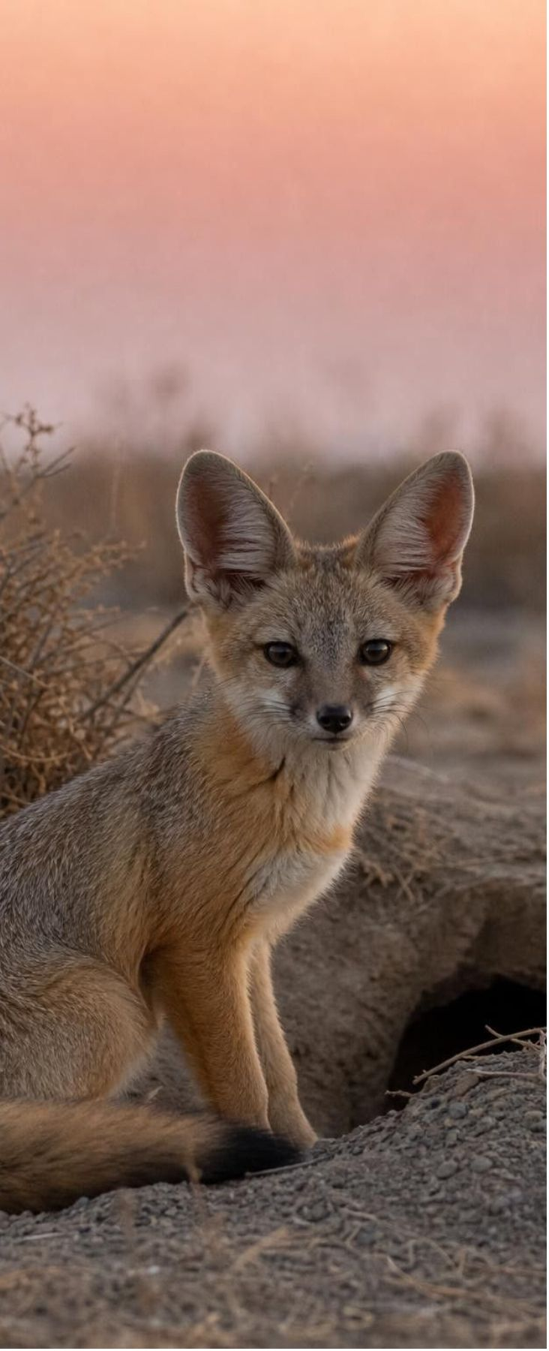
APPLY IT
Task: predict the ripple at High Mesa Preserve
High Mesa Preserve exists to protect kit foxes, but their numbers are falling. Use the interaction table to predict what would happen to kit foxes if coyotes were reduced, and name one other action that should help.
Interaction (teaching scenario) | Effect on kit fox | Effect on the other species | Type
Kit foxes eat kangaroo rats | + | − (kangaroo rat) | predation
Coyotes hunt the same kangaroo rats | − | − (coyote) | competition
Coyotes kill kit foxes they catch | − | + (coyote) | predation
Fleas live in kit fox fur and drink blood | − | + (flea) | parasitism
Kit foxes den in burrows badgers dug and left | + | 0 (badger) | commensalism
Kangaroo rats eat grass seeds | 0 (not directly) | rat +, grass − | predation
Simulated data for practice.
22
Notes:
The preserve and its table are invented, though each interaction is the kind that occurs in California deserts. Give groups eight minutes. Step 1: find every row with a minus for kit foxes (coyote competition, coyote predation, fleas). Step 2: trace the coyote rows: fewer coyotes means less competition for kangaroo rats, so more rats per fox, and fewer foxes killed, so kit foxes should rise. Step 3: look for ripples: fewer coyotes also means more kangaroo rats survive overall, which is good for foxes, but more rats eat more grass seed, so the grass population may fall; and if coyotes also ate jackrabbits (not in the table), those could rise too. Step 4: a second action: treat dens for fleas, protect kangaroo rat habitat, or protect badgers so more old burrows exist. Ask each group which action is cheapest and which has the fewest side effects, which previews the criteria-and-constraints thinking of Lab 3.
EXPECTED RESPONSES: Kit foxes should increase: two minus rows disappear or shrink (competition and predation by coyotes). Ripples: more kangaroo rats, possibly less grass seed, and possibly more of whatever else coyotes ate. Other actions: flea control, more kangaroo rats, protecting badgers and their burrows.
WATCH FOR: Groups may stop at 'fewer coyotes, more foxes'. Push for at least one effect two steps away, which is what 'predict patterns of interactions' means.
CONNECTS TO: W6 CER uses a similar invented preserve with data; W9 transfer task.
PACING: about 10 min

Slide 23
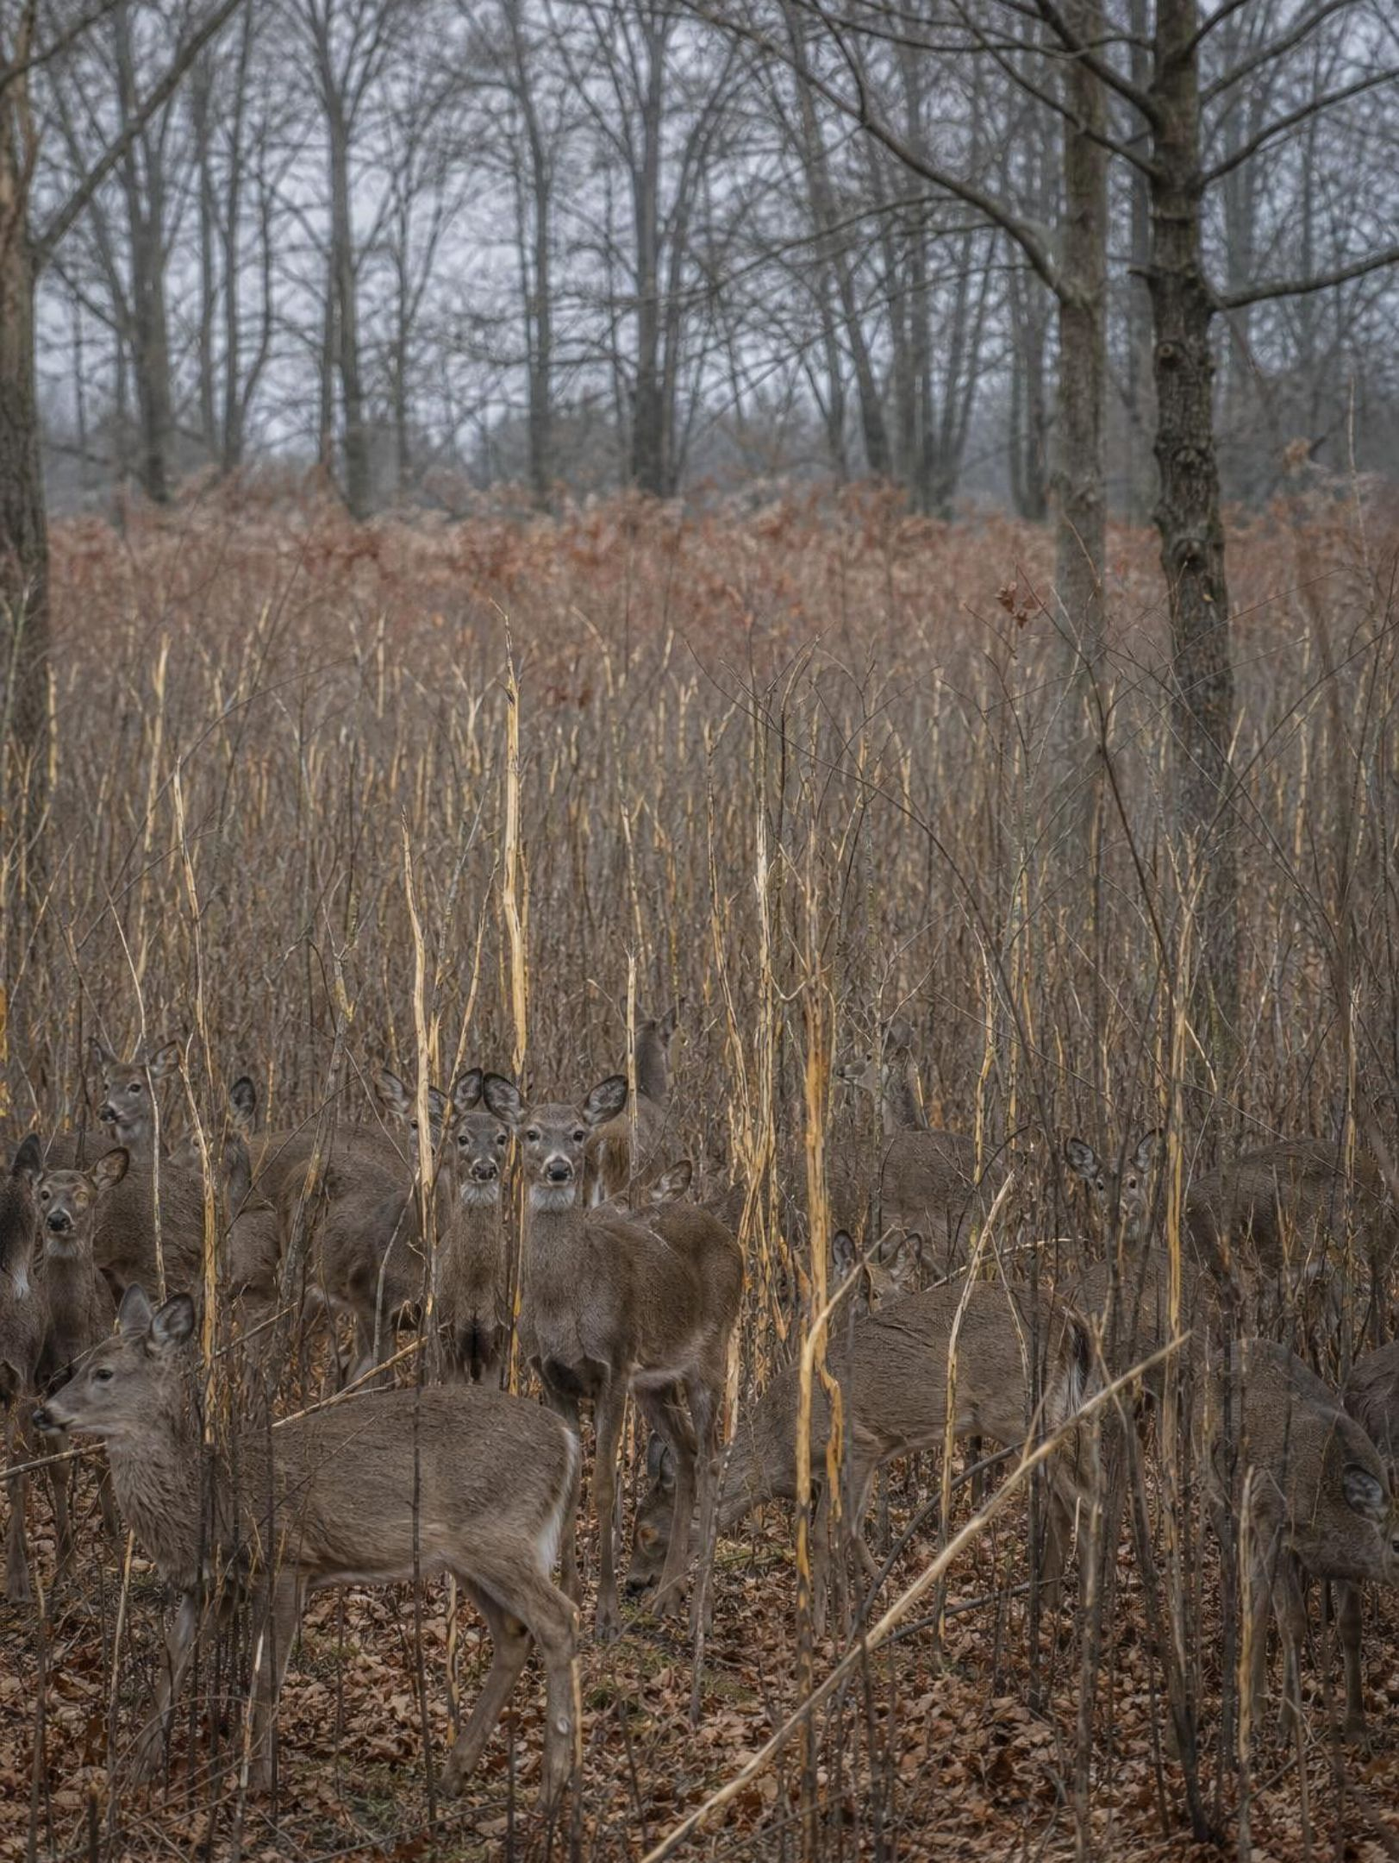
MISCONCEPTION CHECK
True or false? Remove the predators and the prey will thrive
"The best way to help a deer population in a park is to remove every predator, because then no deer will be killed and the herd will grow and stay healthy."
True or false? Explain your reasoning.
23
Notes:
Have students evaluate the statement in writing with evidence from the lesson. Yellowstone is the textbook case: after wolves were gone by the mid-1900s, elk numbers grew and heavily browsed willows and aspens along streams. When wolves were returned in 1995, elk numbers fell, along with other factors such as cougars, bears, drought and hunting outside the park, and some streamside plant communities and the birds that use them began to recover. The kelp forest gives the same answer: urchins without otters create barrens. So the statement is false in two ways: prey without predators strip their own food and then starve or weaken, and the ripple reaches plants and other animals. Be careful not to overclaim: wolves were one factor among several in Yellowstone, and ecologists still debate how much of the plant recovery they caused.
EXPECTED RESPONSES: False. Prey without predators grow until they overgraze, then weaken, starve or crash; the plants and the species that depend on them suffer too. Evidence: Yellowstone elk and willows, urchin barrens without otters.
WATCH FOR: Students may flip to 'more predators is always better'. Too many predators also crash, because they run out of prey; the loop on slide 10 is the balance.
CONNECTS TO: W7 misconception repair; W6 CER.
PACING: about 6 min

Slide 24
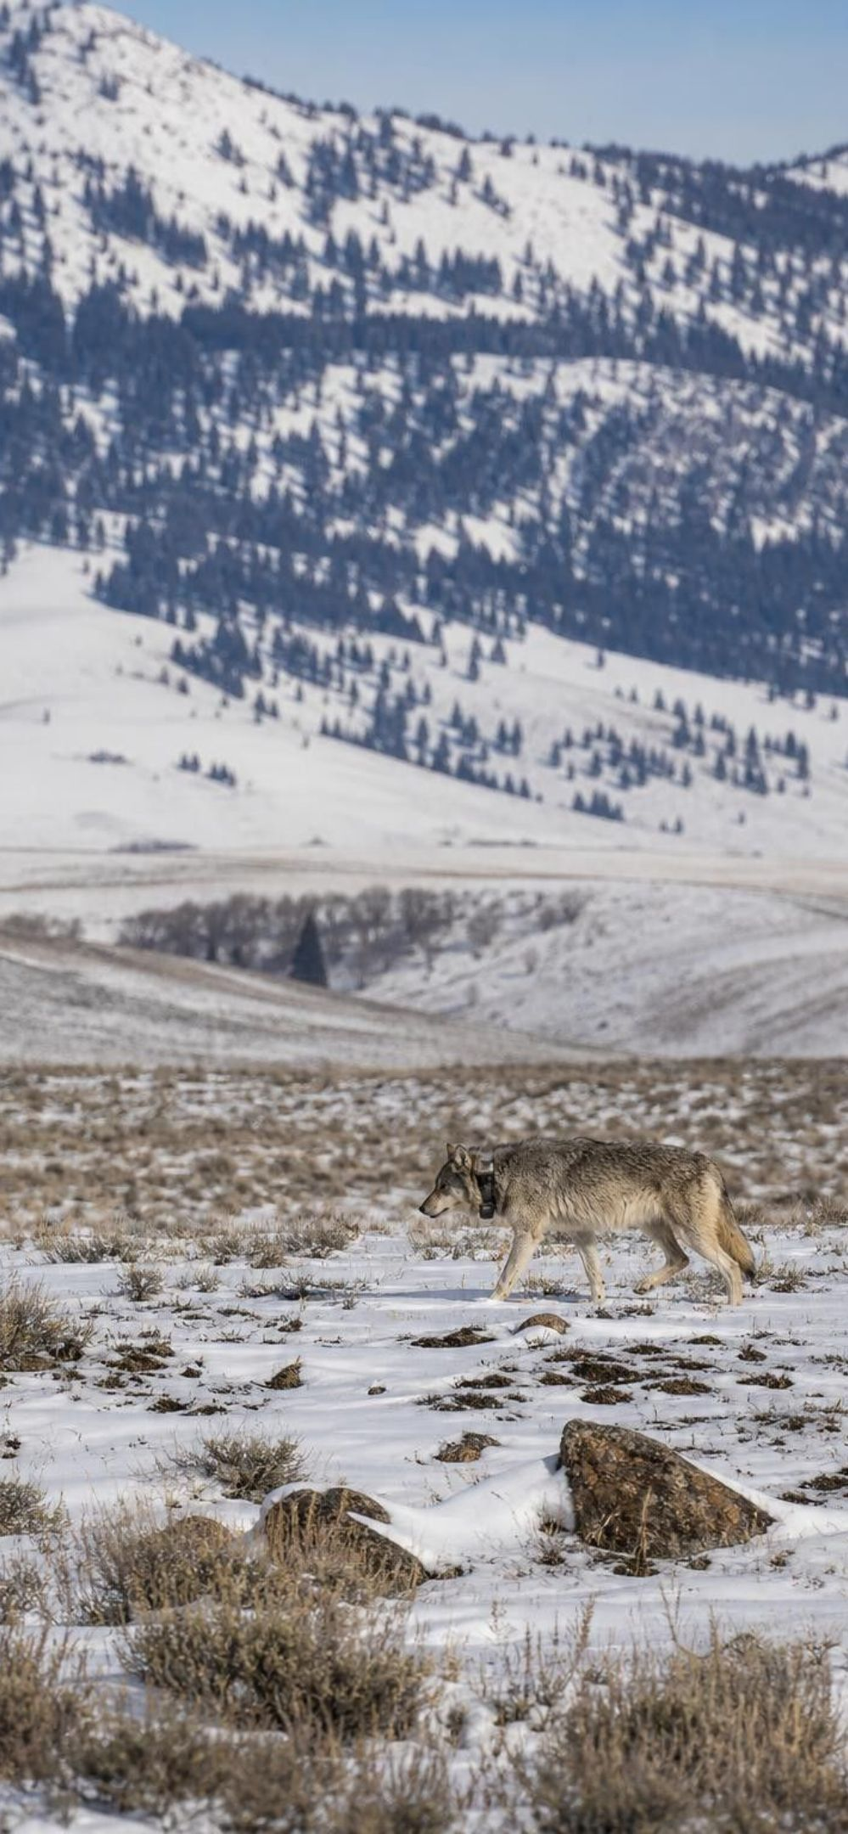
MODEL
Monitoring wolves: criteria versus constraints
Model: What the Yellowstone tracking tool had to do, and what limited it
Criteria (what success requires) | Constraints (what limits the design)
Shows whether each released wolf is alive | Cost of equipment and staff time
Shows whether wolves stay in the park or leave | Must not change how wolves hunt, travel or breed
Works across more than 3,400 square miles of mountains | Wolves move in packs over hundreds of square miles
Gives data accurate enough to count the population | Rough terrain and winter weather limit where people can go
Scientists chose radio collars with unique signals, read by handheld antennas and from aircraft.
24
Notes:
This is the lesson's engineering spread, retold. When wolves were brought back to Yellowstone in 1995, scientists needed to know whether the animals survived, where they went and whether they bred. Walk the two columns: criteria are the requirements that define success; constraints are the limits that rule designs out. Ask students to sort a few extra statements: 'the collar must weigh less than two percent of the wolf's body mass' (a constraint that protects the animal); 'the signal must be picked up from at least five kilometers away' (a criterion, measurable). Then describe the chosen solution: collars that send out a radio signal unique to each wolf, tracked with handheld antennas on the ground and from aircraft; today GPS collars that report by satellite are used as well. The lesson for Lab 3 is that the clearer the criteria and constraints, the easier it is to compare designs fairly.
EXPECTED RESPONSES: Collar mass limit is a constraint (protects the animal and its behavior); signal range is a criterion (a measurable requirement).
WATCH FOR: Students treat 'cheap' as a criterion. Cost is a limit on what is allowed, so it is a constraint; a criterion says what the design must achieve.
CONNECTS TO: Lab 3 session 1; W9 transfer task.
PACING: about 5 min

Slide 25
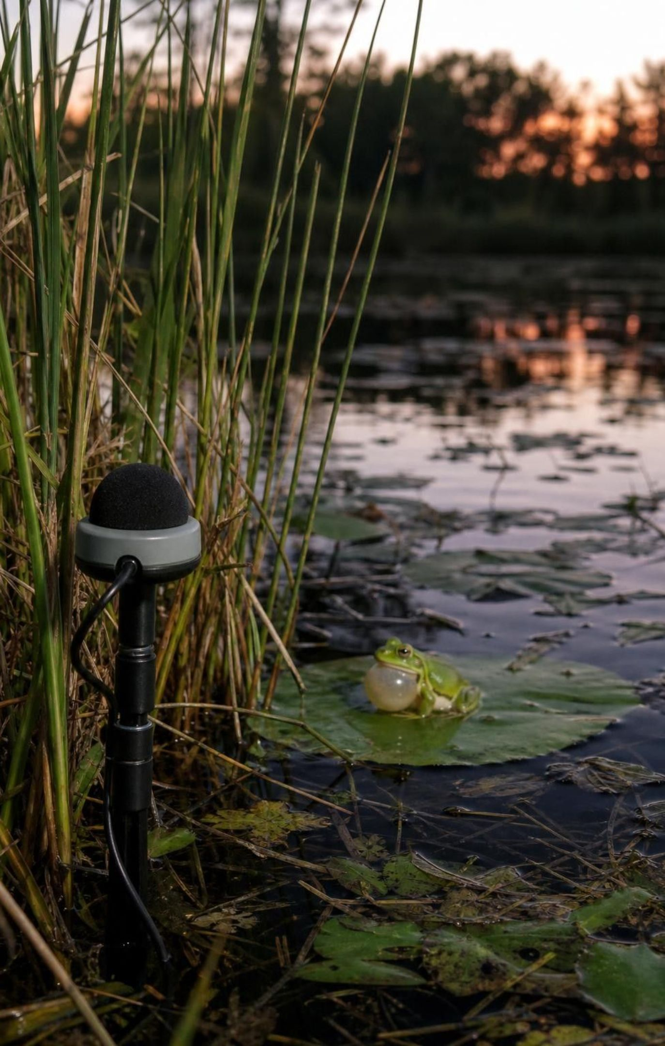
Design brief: shield the frog listener
Biologists count pond frogs by recording their calls with a sensor near the water.
A highway on one side drowns out the calls, so the counts are useless.
Design a shield that cuts highway noise reaching the sensor but leaves the pond side open.
Criteria you will measure: highway noise drop, frog sound kept, stability in a bump test.
Constraints: kit credits, build time, size, nothing touching the sensor or crossing the pond line.
25
Notes:
Introduce Lab 3 as the same kind of problem the wolf scientists faced: get good population data without disturbing the animals. In the classroom, one phone plays a steady traffic-noise loop as the highway, and a second phone or a listener at the sensor position measures how loud it is; a free sound-level app makes it numeric, and a counting test with a soft 'frog' sound works without one. Walk the criteria and ask which are measurable as written. 'Cuts noise' is not; 'cuts the reading by at least 5 decibels' is. Have groups write their own measurable versions before they see the lab sheet. Point out the constraint that protects the wildlife: the shield must not block the pond side, because a shield that silences the frogs too has failed the real purpose. Keep playback at the posted setting, a little louder than conversation (about 65 to 75 dB at the sensor); nobody needs a loud phone for this.
WATCH FOR: Students assume the loudest possible 'highway' makes a better test. The volume must stay the same for every test; that is a controlled variable, not a bigger challenge.
CONNECTS TO: Lab 3, Shield the Frog Listener (two sessions); W9 transfer task.
PACING: about 5 min

Slide 26
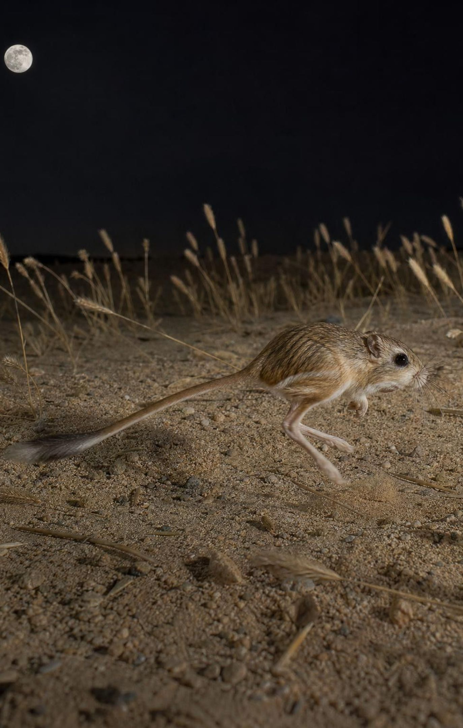
The manager's toolkit: using patterns to act
To help a species, look at every interaction it has and find the minus signs.
Reduce a predator, a competitor or a parasite, or add prey or partners: each changes a sign.
Every change ripples: fewer coyotes means more kangaroo rats and maybe less grass seed.
Monitor the population before and after, or you cannot tell whether the plan worked.
The same toolkit works in a kelp forest, a desert or a park, because the patterns are shared.
26
Notes:
Tie the lesson together. Scientists can manage a population they care about because its interactions follow patterns they have seen elsewhere: find the interactions that are minus for the species, pick a lever, predict the ripples, then measure. Bring back the examples: Yellowstone added a predator to reduce elk; kelp-forest managers protect otters to reduce urchins; a preserve for kit foxes might reduce coyotes or treat for fleas. Each is the same move applied to different species. Ask students to name one lever for the acacia: protect the ants, since without them browsers strip the tree. Then preview Lesson 22, which asks what happens when a whole ecosystem is disturbed and how it changes over time.
CONNECTS TO: Synthesis; W9 transfer; L22 Changing Ecosystems next.
PACING: about 4 min

Slide 27
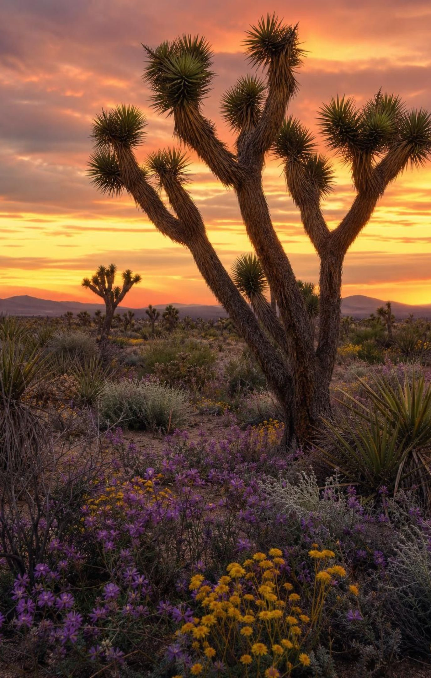
PUTTING IT TOGETHER
Putting it together
Every interaction between two species can be rated + − 0 for each partner: five patterns.
Predators and prey push each other up and down, with the predator trailing the prey.
Mutualists gain together; commensals ride for free; parasites drain a living host.
The species change from kelp forest to desert to park, but the five patterns do not.
Precise criteria and constraints let people monitor and manage populations without harming them.
27
Notes:
Have students write a four-sentence summary that uses at least four interaction terms and the word pattern, then trade with a partner who checks that each term is matched with the right code. Ask for one thing from each lab: Lab 1 (how many rounds the fox peak trailed the vole peak), Lab 2 (which missing interaction they predicted and whether the reveal matched), Lab 3 (one criterion they wrote and whether their shield met it). Return to the target each student marked as hardest on slide 3 and ask whether it still is.
CONNECTS TO: W10 mastery as the quiz; chapter evidenceOfLearning.
PACING: about 6 min

Slide 28
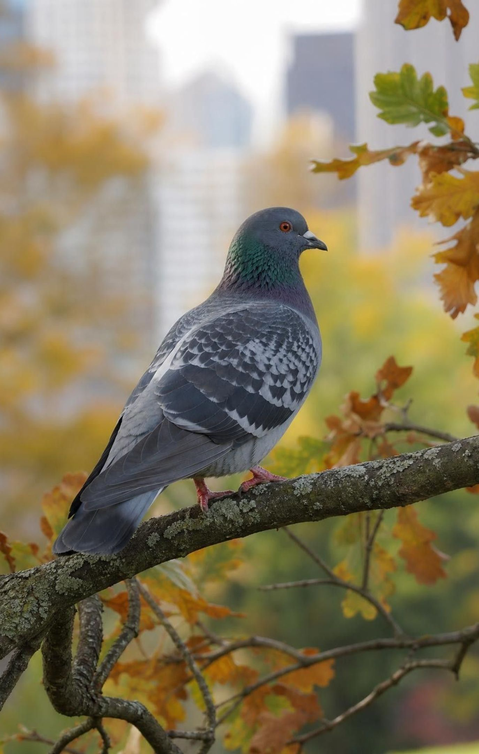
EXIT TICKET
Exit ticket
Rate the acacia and its ants with + − 0 symbols, name the interaction, and say what each partner gets.
A fox peak comes two years after a vole peak. Explain the delay in one sentence.
Lice on a pigeon and lichen on an oak both live on a host. Which is parasitism, and how do you know?
Write one criterion and one constraint from the frog-sensor shield and label which is which.
28
Notes:
Collect on index cards or a shared form. Item 1 checks the rating skill and the acacia resolution; item 2 checks the lag idea; item 3 checks that students classify by effect rather than by location; item 4 checks the engineering vocabulary. Sort the cards before next class and reteach from the largest pile. Students who wrote 'the lines move together' for item 2 need the fox-vole graph again, year 5 specifically.
EXPECTED RESPONSES: 1: + +, mutualism; tree gets protection from browsers and vines, ants get nectar and a nest. 2: foxes can only raise more pups after there is extra food, so their numbers rise later. 3: lice, because the pigeon loses feather material and heat (host minus); the oak shows no measurable change (zero). 4: criterion such as 'reading drops by at least 5 dB'; constraint such as 'nothing may block the pond side' or 'kit materials only'.
WATCH FOR: Item 3 answers of 'both are parasites because both live on something' signal the lives-on-equals-parasite error from slide 15.
CONNECTS TO: W10 mastery; chapter evidenceOfLearning.
PACING: about 5 min

