Slide 1
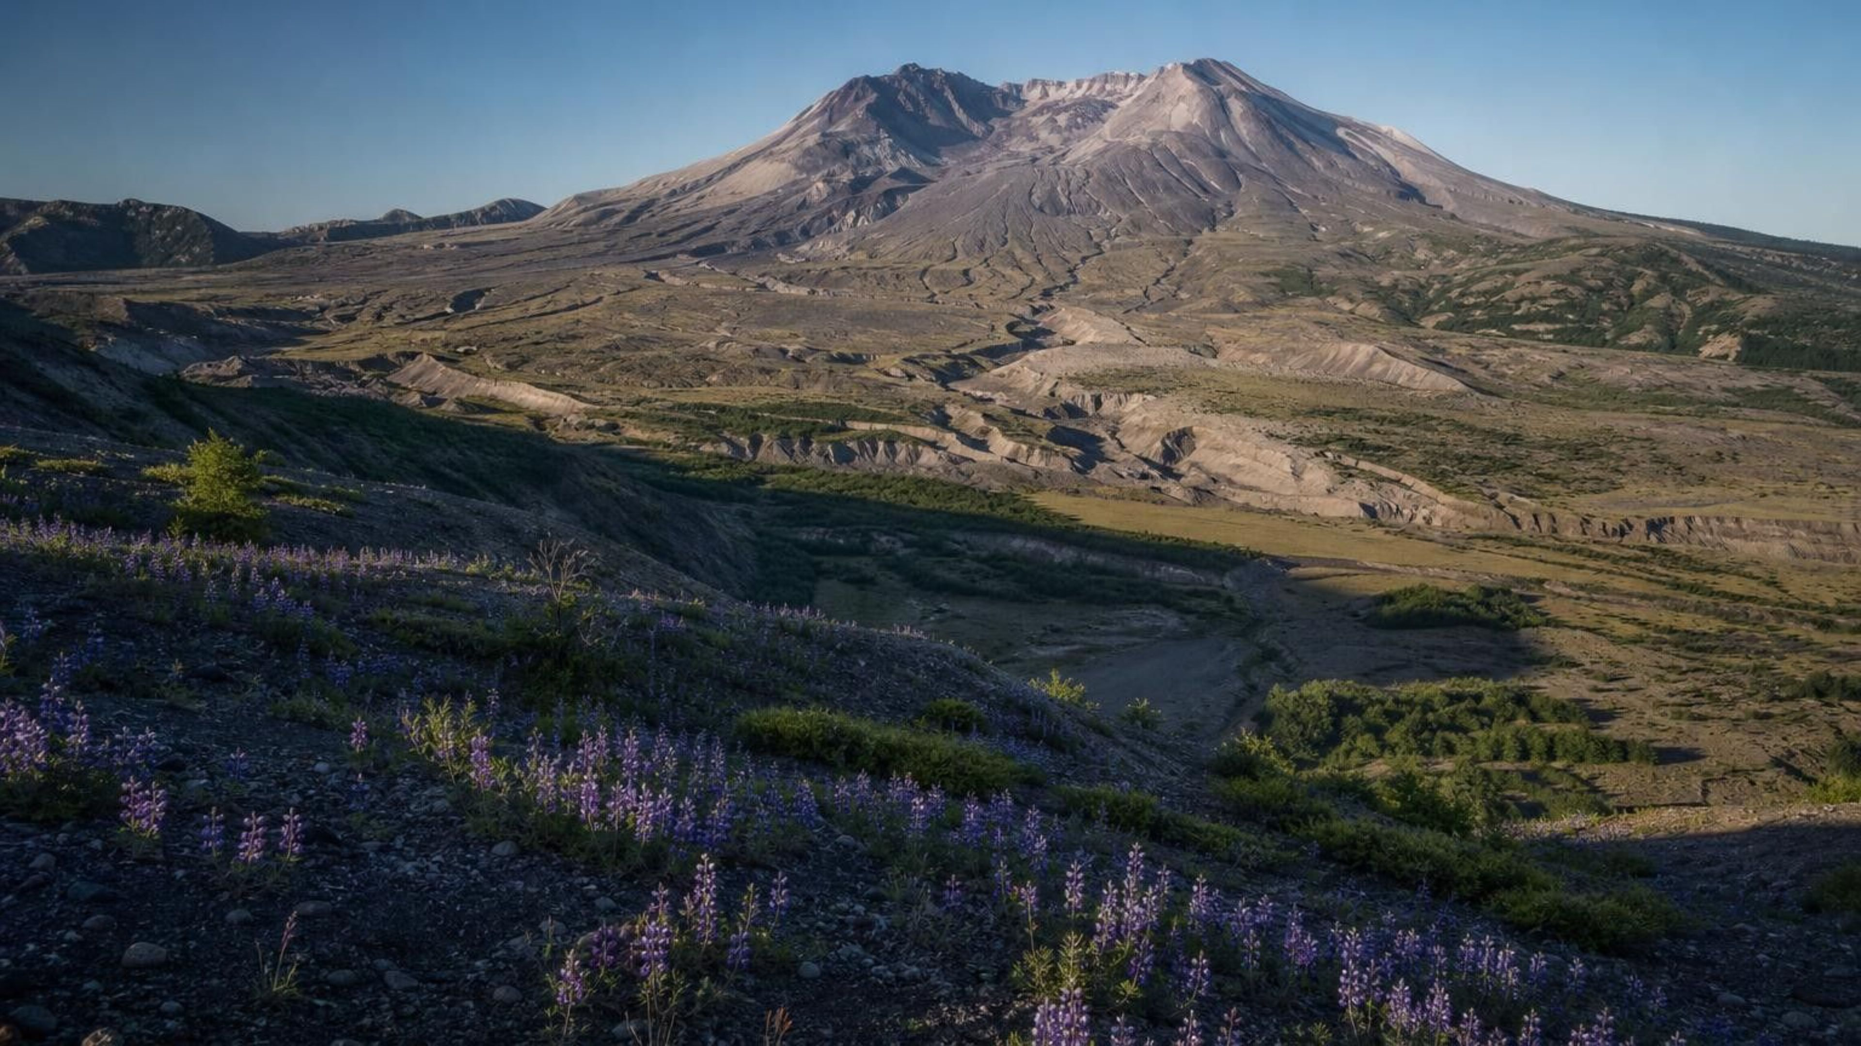
CHAPTER 22 OF 29 · RESOURCES IN ECOSYSTEMS
Changing Ecosystems
Lesson 22: How do ecosystems change, and how do we prove that a change affected the living things there?
Angela's Wand · Bring Science Alive! 7th Grade Integrated
Notes:
This lesson sits at the end of the ecosystems unit. Students already know that resources limit populations (Lesson 20) and that organisms interact through feeding, competition and partnership (Lesson 21). Now we put those ideas in motion: what happens to populations when the ecosystem itself changes? Tell students the anchor is a real volcano in Washington State and that they will run three investigations: a sequencing mystery with evidence cards, a string model of a grassland that they can 'break', and a survey of a disturbed patch of ground on our own campus. The skill we are building all week is making an argument from evidence, not just telling a story.
CONNECTS TO: Overview of Lab 1, Lab 2 and Lab 3; W1 opens on the next slide.
PACING: about 2 min

Slide 2
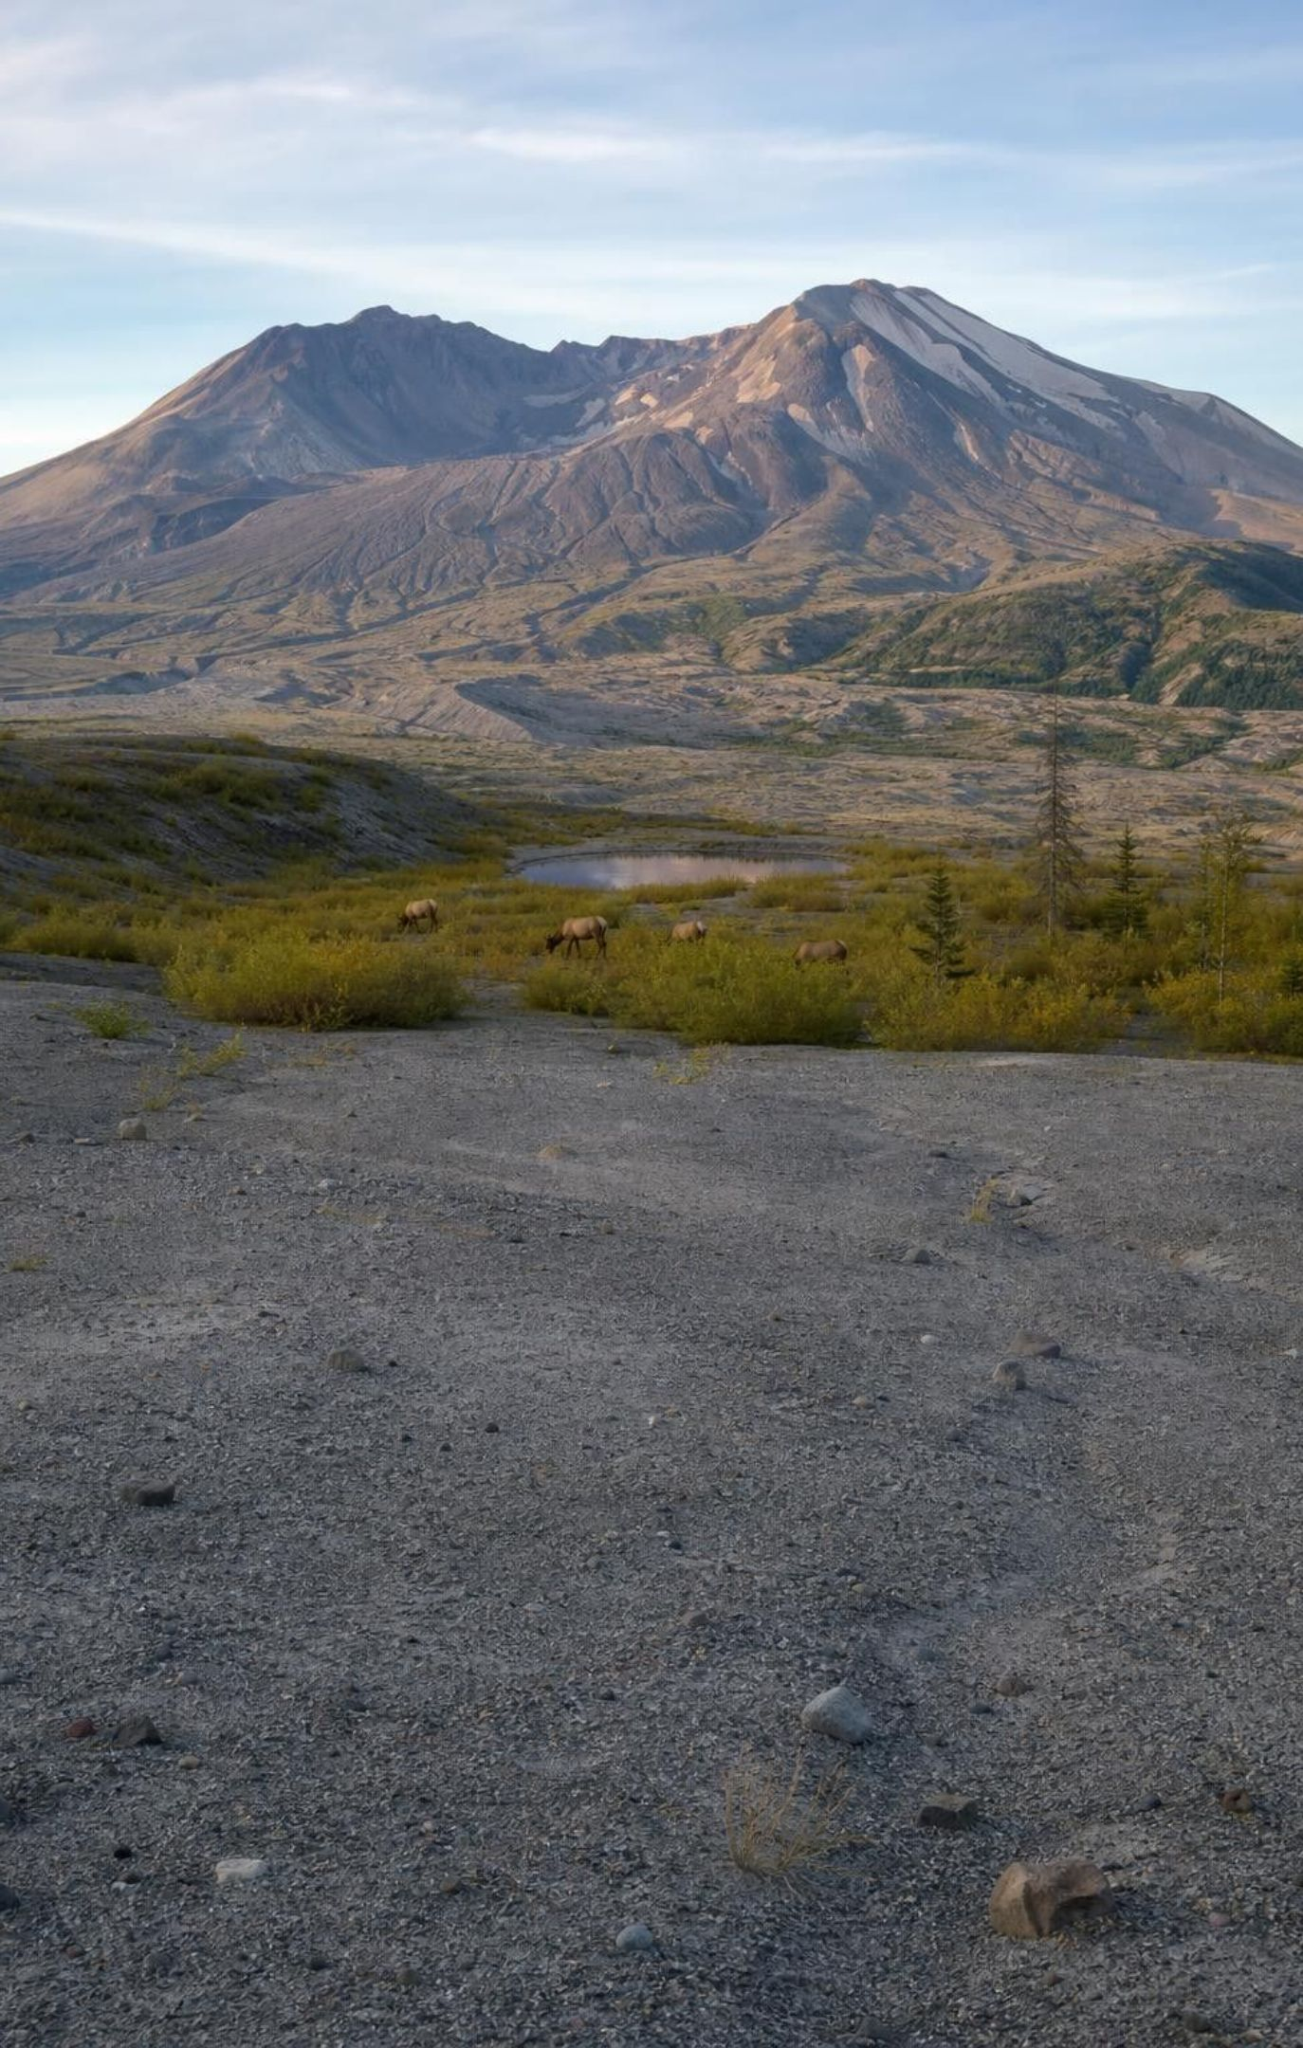
PHENOMENON
The mountain that blew its top and grew back green
May 18, 1980: the north side of Mount St. Helens collapsed and a sideways blast flattened or scorched forests across about 600 square kilometers. Hot pumice buried the valley to the north under a bare gray plain. Forty years later the same valley has lupine meadows, willow thickets, elk herds and ponds full of frogs. No one planted the plain.
Notice: compare the 1980 photo with the recent one. What is different? What is the same?
Wonder: where did the first living things come from?
Predict: will the valley ever look exactly like it did before 1980?
2
Notes:
Show two public-domain U.S. Geological Survey photographs of the pumice plain or Spirit Lake area, one from summer 1980 and one recent. Give two silent minutes for a notice and a wonder, then collect on the board without judging. Push on three things. First, the ground: in 1980 it was hot pumice and ash with no soil, so what could possibly grow? Second, the arrivals: if plants came back, did they walk in, blow in, or were they already there? Third, the endpoint: is the green valley 'back to normal' or something new? Write the strongest student questions on a parking lot; the lesson answers most of them. Teacher background: the collapse was the largest landslide in recorded history, 57 people died, and the sideways blast caused devastation as far as about 30 kilometers (19 miles) from the volcano. Keep the human loss brief and respectful.
EXPECTED RESPONSES: Notice: trees gone, everything gray, then purple flowers and bushes; the mountain shape changed; the lake is still there. Wonder: how long did it take; did animals survive; did people help. Predict: split class; most say 'eventually' or 'never the same'.
WATCH FOR: 'Everything died' and 'people must have replanted it.' Park both claims; slides 10, 11 and 26 return to them with evidence.
CONNECTS TO: W1 phenomenon worksheet records the notice, wonder and first explanation. W3 reading passage tells the recovery story in detail.
PACING: about 8 min

Slide 3
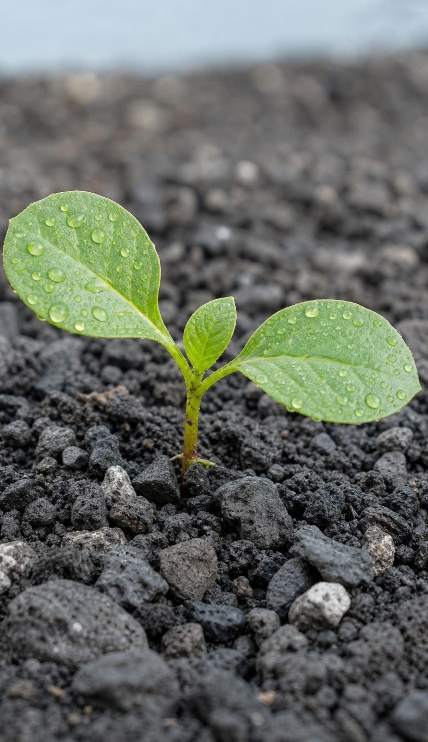
LEARNING TARGETS
What you will be able to do
1
Describe gradual and sudden changes and explain why every ecosystem is a dynamic system.
2
Explain how succession rebuilds a community, and tell primary succession from secondary.
3
Trace how changing one living or nonliving part shifts other populations, including cascades.
4
Build an argument from empirical evidence that a change affected populations.
5
Identify criteria and constraints in an engineering plan to restore a damaged ecosystem.
3
Notes:
Read the targets aloud. Ask students to star the one that sounds hardest. Point out that target 4 is the big one: on the last day they will write an argument using data, and every lab this week produces data they could use. Targets 1 and 2 belong to the first two days, 3 to the middle of the week, and 5 to the engineering story at the end.
CONNECTS TO: Targets map to W2 (1), Lab 1 and W4 (2), Lab 2 (3), Lab 3, W5 and W6 (4), W9 (5).
PACING: about 2 min

Slide 4
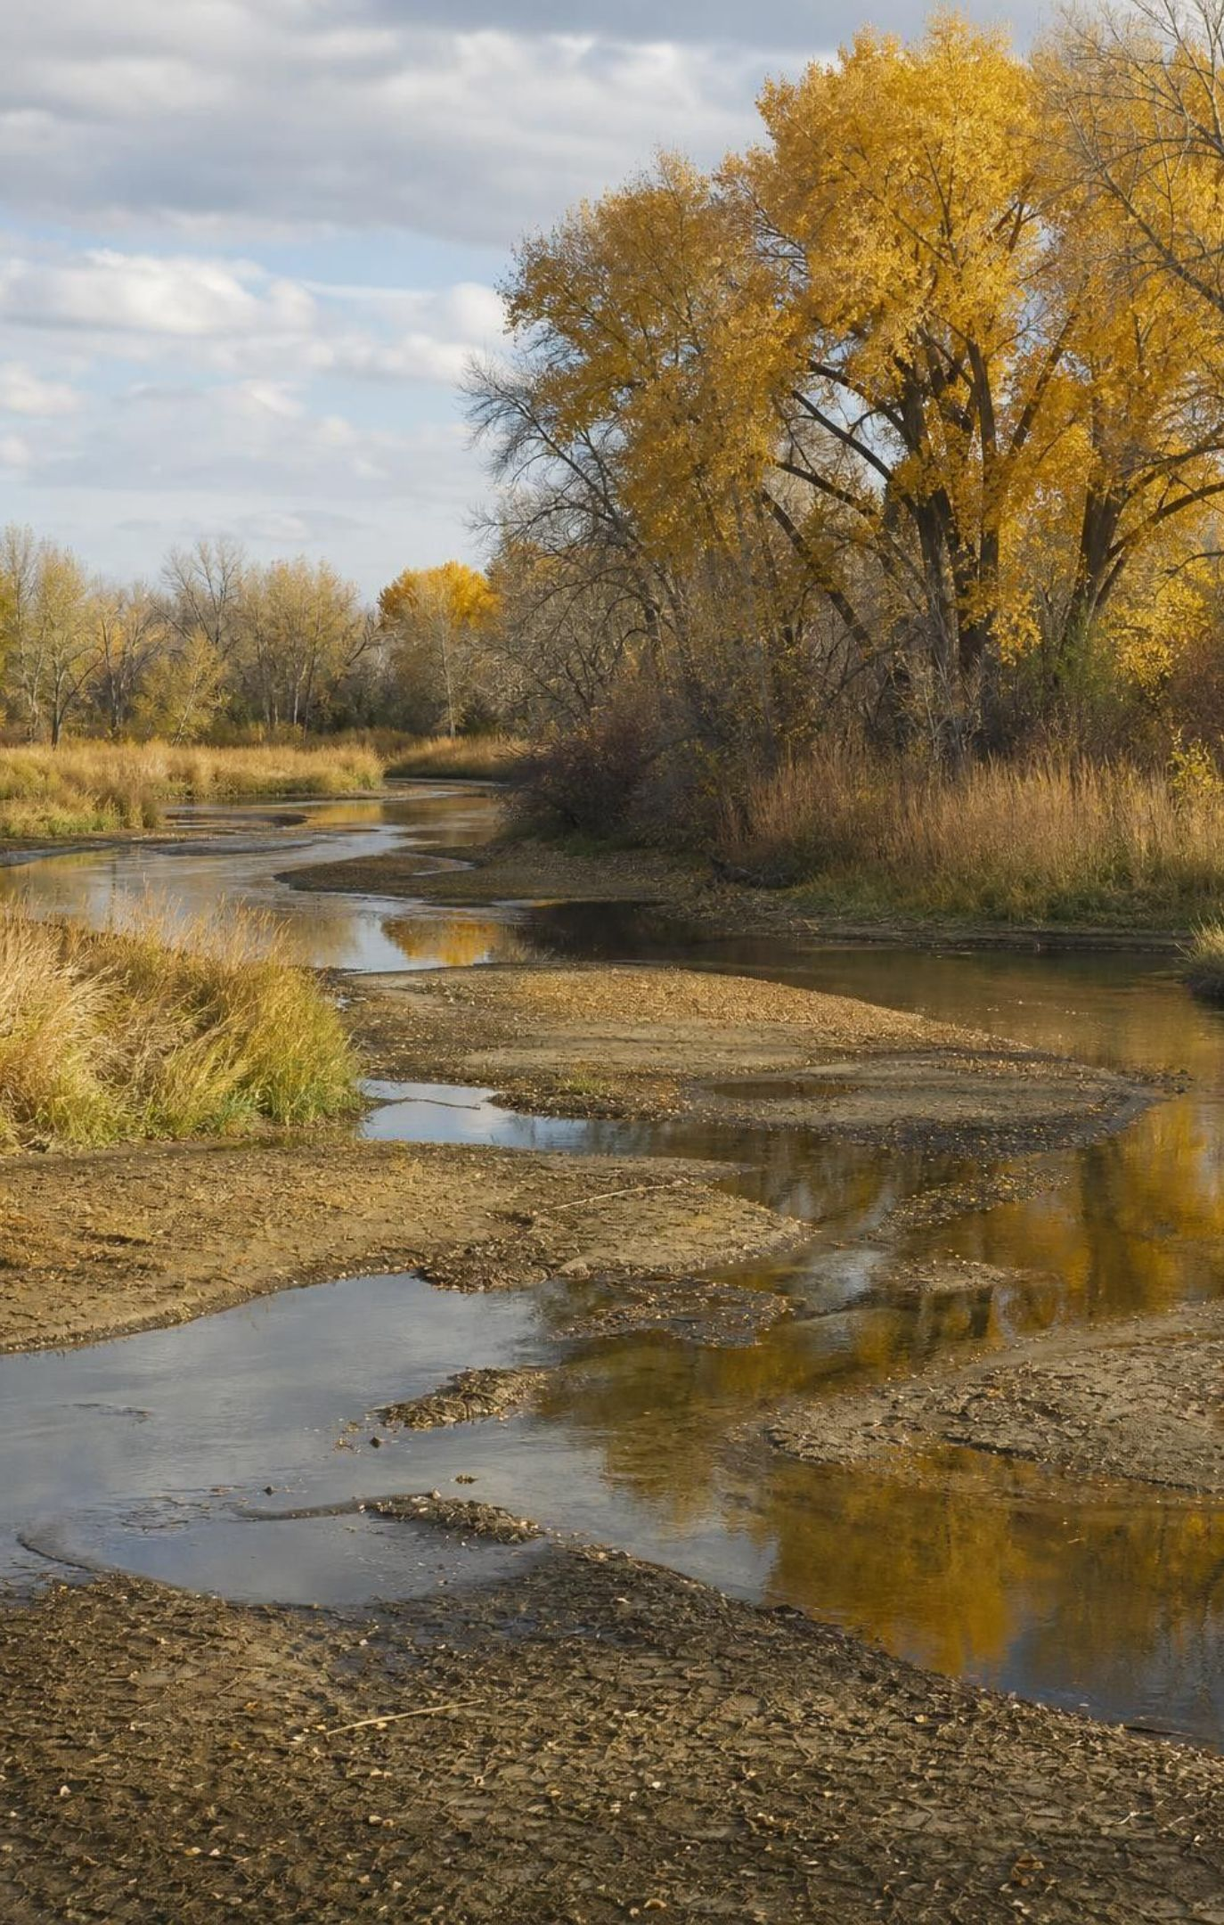
Every ecosystem is a dynamic system
A dynamic system is one whose parts are always changing. In an ecosystem the water level, soil, temperature and the number of every species shift from season to season and year to year. Some changes creep along for centuries. Others happen in an afternoon. Either way, a change in one part can travel to many others.
Nonliving parts change: water, light, soil, temperature, sediment.
Living parts change: a species arrives, booms, crashes or disappears.
The changes are linked: alter one part and others follow.
4
Notes:
Start with a place students know: the schoolyard, a local creek, a park. Ask what is different there in August versus February. Then ask what was there 100 years ago and what might be there in 100 years. The goal is to replace the picture of an ecosystem as scenery with the picture of a system in motion. Introduce the two categories we will use all lesson: nonliving (physical) parts and living (biological) parts. The performance expectation uses exactly those words: physical or biological components. Ask for one example of each kind of change from the Mount St. Helens photos.
WATCH FOR: 'If it is changing, something is wrong.' Counter with seasons: change is the normal state; the interesting questions are how fast and caused by what.
CONNECTS TO: W2 Part B concept map starts from a change in an ecosystem and links it to its effects.
PACING: about 4 min

Slide 5
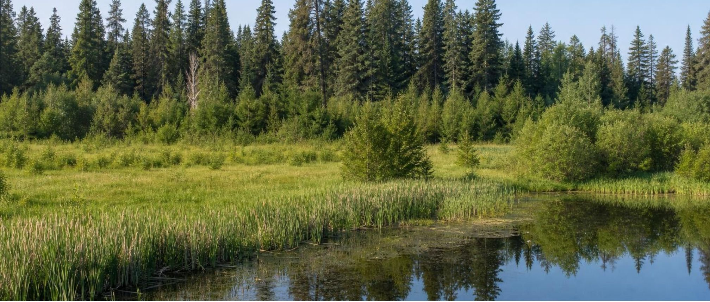
MODEL
Gradual change: a pond becomes a forest
Model: One common path of gradual change
1
2
3
4
5
Open pond
→ (dead plants pile up, water gets shallower)
Marsh
→ (soil builds, drier ground)
Wet meadow
→ (shade and deeper soil)
Shrubs and young trees
→ (tall trees take over)
Forest
Arrows point forward in time, not to food. The pace varies from decades to thousands of years, and not every pond follows this exact path.
5
Notes:
Walk the chain and at each arrow ask: which populations lose and which gain? When the pond gets shallow, fish and ducks lose; cattails, frogs and dragonflies gain. When the marsh dries to a meadow, frogs lose; voles, rabbits and foxes gain. When trees shade the meadow, sun-loving grasses lose; deer and tree-nesting birds gain. The key move: the living things cause the next change. Dead cattails are what fill the pond; dead meadow plants are what build the soil. That is why this is succession and not just weather. Do not give year numbers; the textbook's figure uses tidy labels, but real ponds vary enormously.
WATCH FOR: Students read the arrows as 'eats'. Say explicitly: these arrows mean 'becomes, over time'.
CONNECTS TO: W4 Figure 1 shows another gradual path (forest recovery after a fire); Lab 1 uses the same stage-by-stage reasoning.
PACING: about 5 min

Slide 6
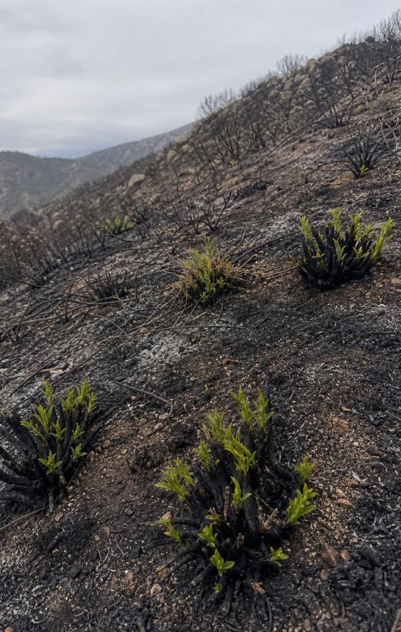
Sudden change: disturbances
A disturbance is an event that removes living things from part of an ecosystem and changes its resources. Some are natural: eruptions, wildfires, floods, hurricanes, landslides, droughts. Some are caused by people: clearing land, oil spills, draining wetlands, bringing in a species that did not live there before.
Natural: volcano, fire, flood, storm, landslide, drought.
Human-caused: land clearing, pollution, dams and levees, new species.
Both kinds reset the ecosystem; what happens next depends on what survived.
6
Notes:
Ask students to call out disturbances they have seen or heard about in California: wildfires are the obvious one, plus floods, mudslides and droughts. Sort them live into natural and human-caused, then complicate it: a fire started by a power line, or a flood made worse by paved ground, is both. Land the final bullet hard, because it sets up the next three slides: the question after any disturbance is not 'is everything gone' but 'what is left and what can arrive'.
WATCH FOR: Students may treat all human-caused change as sudden and all natural change as gradual. A glacier melting is natural and gradual; a hurricane is natural and sudden; draining a marsh is human and can be either.
CONNECTS TO: W2 vocabulary; Lab 3 asks students to identify the disturbance on the campus plot.
PACING: about 4 min

Slide 7
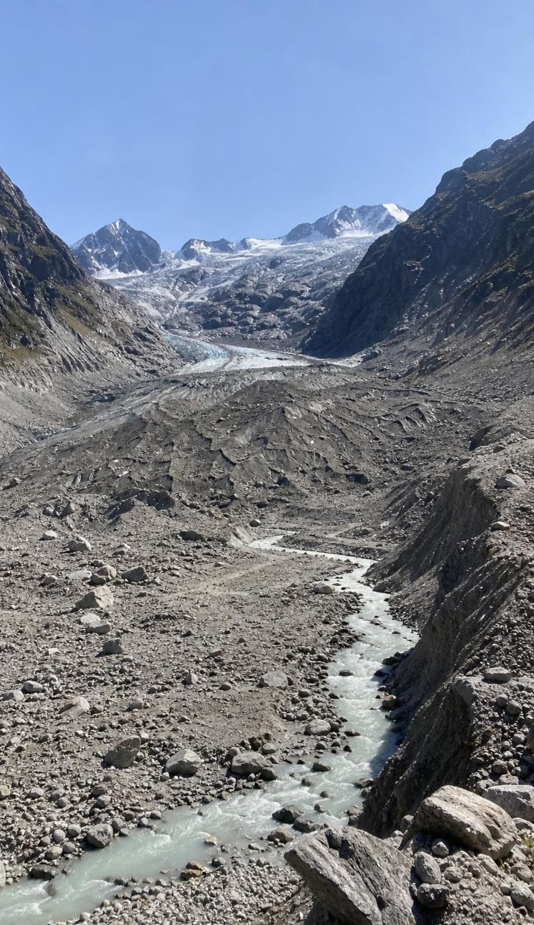
CHECK FOR UNDERSTANDING
Quick check: gradual or sudden, natural or human?
A glacier melts back and leaves bare gravel.
A bulldozer clears a hillside for new houses.
A wildfire burns a chaparral slope in one afternoon.
Cattails slowly fill a pond over many decades.
A ship releases water carrying mussels from another continent.
For each change, hold up G (gradual) or S (sudden), then N (natural) or H (human-caused). Be ready to defend one.
7
Notes:
Run it fast. The glacier and the pond are gradual and natural. The bulldozer is sudden and human. The wildfire is sudden; its cause can be either, which is a good 30-second argument. The mussels are human-caused; whether the change is sudden or gradual is debatable: the release is one event, but the population takes years to spread. Use that last item to preview invasive species on slide 23.
EXPECTED RESPONSES: 1 G/N, 2 S/H, 3 S/N or S/H, 4 G/N, 5 H with S or G both defensible.
WATCH FOR: Students who think 'human' always means 'bad' and 'natural' always means 'fine'. A natural eruption can erase a forest; a human-built diversion can rebuild a wetland.
CONNECTS TO: W2 Part A uses a similar sort for primary versus secondary succession.
PACING: about 4 min

Slide 8
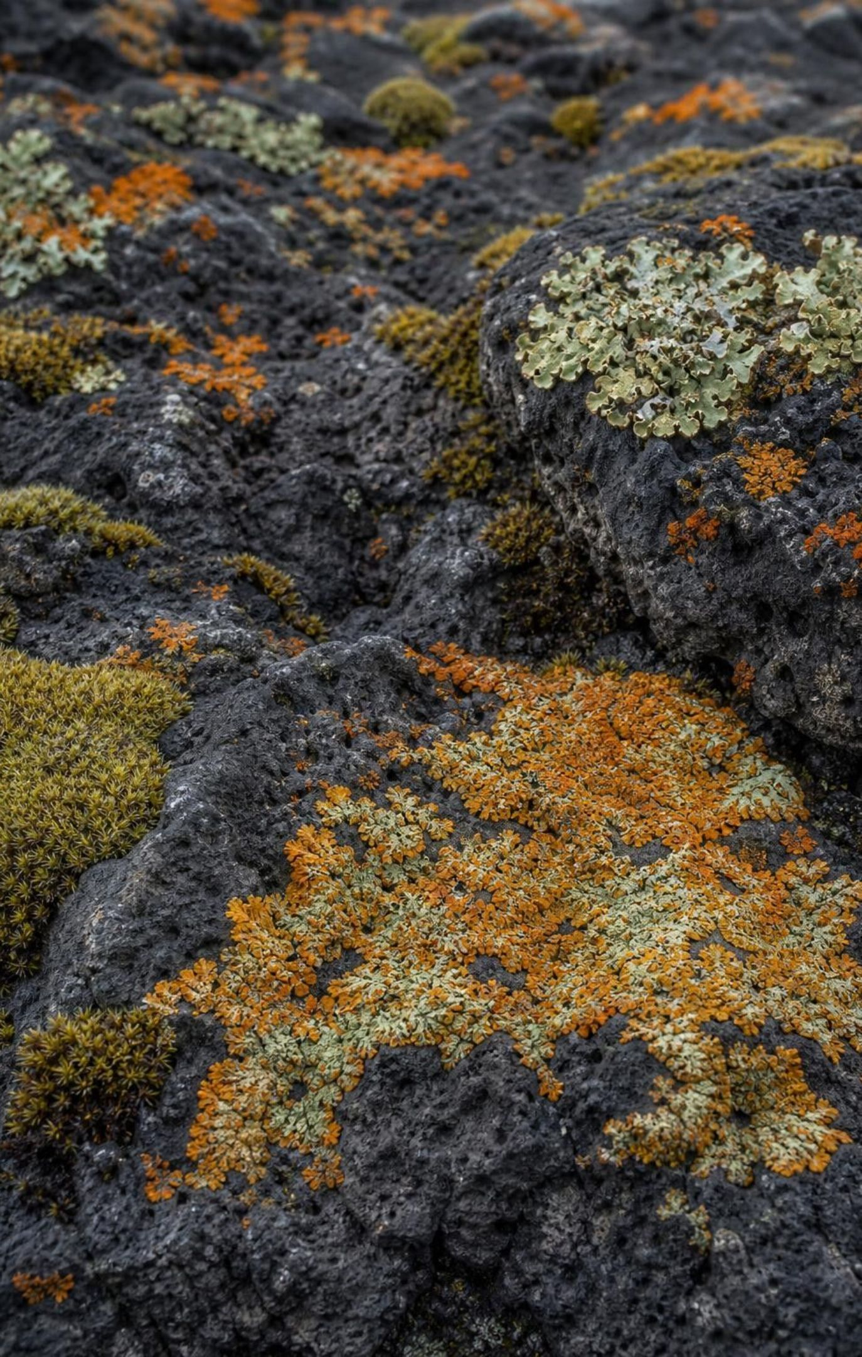
Succession: how living things rebuild a place
Ecological succession is the gradual replacement of one community by another as living things change the conditions. The first arrivals, called pioneer species, can survive on bare or damaged ground. As they live and die they add organic matter, hold moisture, make shade and shelter, and that lets species with bigger needs move in.
Pioneers tolerate harsh ground: lichens, mosses, lupine, fireweed.
Each community changes the soil, shade and shelter for the next.
Later stages have more species, more soil and bigger plants.
8
Notes:
Connect this to the lesson's opening image of the glacier: gravel first, then mosses and small flowers, then soil, then meadow. Ask why a Douglas fir seed landing on fresh pumice in 1981 would probably fail while a lupine seed could succeed. (The lupine can get nitrogen from the air with the help of bacteria in its roots and tolerates poor, dry ground; the fir seedling needs soil moisture and nutrients.) Stress the engine of succession: organisms change their own environment. That is why succession is not the same as a place simply getting older.
WATCH FOR: 'Pioneer species are the strongest.' They are the most tolerant of harsh conditions, and they are often pushed out later by species that outcompete them once conditions improve.
CONNECTS TO: Lab 1 sequencing mystery; W3 reading passage.
PACING: about 5 min

Slide 9
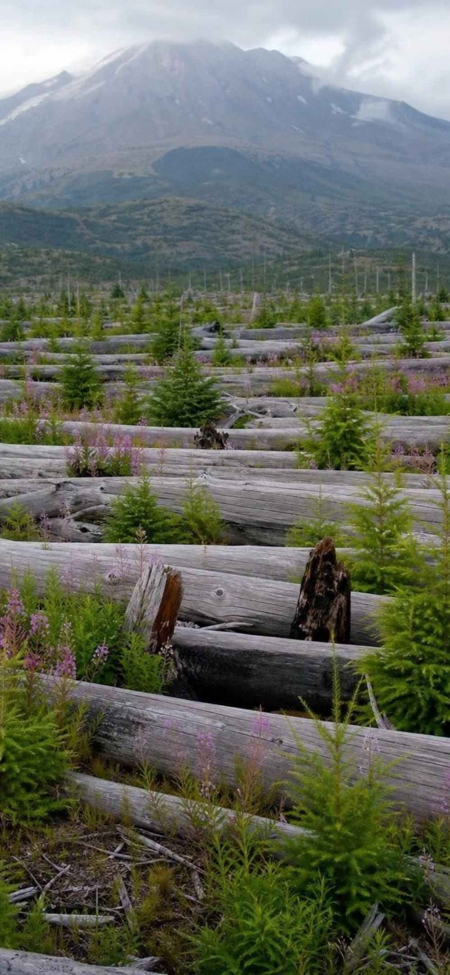
MODEL
Two starting lines: primary and secondary succession
Model: Primary versus secondary succession
Primary succession | Secondary succession
Starts on new ground with no soil: lava, pumice, glacier gravel | Starts where a disturbance left soil behind: fire, blowdown, cleared field
No seeds or roots in place; everything must arrive | Seeds, roots, fungi and burrowing animals often survive
Pioneers must make soil before most plants can grow | Soil already holds water and nutrients
Slow: decades to centuries for a forest | Faster: years to decades for shrubs and young trees
Example: the Mount St. Helens pumice plain | Example: the blown-down forest around the mountain
The difference is the starting material. Soil and survivors make secondary succession much faster.
9
Notes:
Use Mount St. Helens as the single example for both, because the 1980 eruption created both kinds side by side. North of the crater, hot pumice buried everything and built the pumice plain: new ground, no soil, primary succession. Farther out, the blast knocked down the forest but left the soil, roots, buried seeds and animals in burrows: secondary succession. Ask students to predict which zone turned green first, then tell them: the blowdown zone, by years, because it started with soil and survivors. The shared column matters as much as the differences: both kinds run on living things improving conditions, and neither is guaranteed to rebuild the original forest.
WATCH FOR: Students assume 'primary' means 'more important' or 'first in time'. It means starting from scratch, with no soil.
CONNECTS TO: Lab 1 q4 asks groups which zone shows primary and which secondary succession, citing cards. W4 Figure 2 uses the same comparison.
PACING: about 6 min

Slide 10
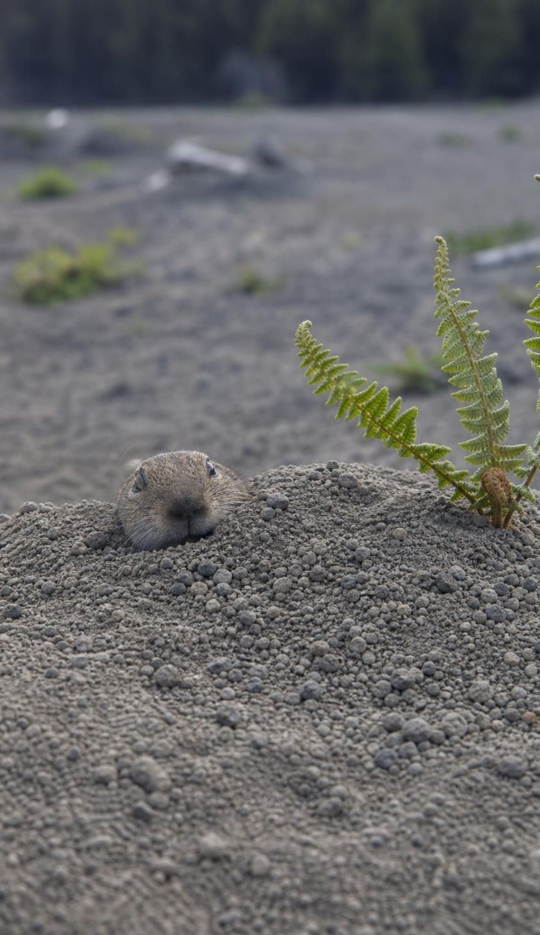
VOCABULARY IN CONTEXT
Words for a place that is recovering
disturbance: An event that removes living things from part of an ecosystem and changes its resources. A wildfire, a flood, a landslide, or a field cleared for building.
pioneer species: A hardy organism that can settle bare or damaged ground first and begins to improve it for others. Lichens on bare rock; prairie lupine on volcanic pumice.
biological legacy: Living things or their remains that survive a disturbance in place and give recovery a head start. Seeds in the soil, roots that resprout, logs, and gophers in burrows after an eruption.
10
Notes:
Have students write each term with their own example, not the one on the slide. Spend the most time on biological legacy, because it is the idea that corrects the 'everything died' picture. At Mount St. Helens the survivors included pocket gophers in burrows, plants pressed flat under late snowbanks, seeds and fungi in the soil, and frogs and salamanders in lakes. Gophers turned out to matter a lot: their digging mixed old soil up into the ash, making small patches where seeds could take hold. Ask: which kind of succession has more biological legacies, primary or secondary? (Secondary, by definition.)
CONNECTS TO: W2 vocabulary worksheet; Lab 1 cards G, I and A show legacies in the blowdown zone.
PACING: about 4 min

Slide 11
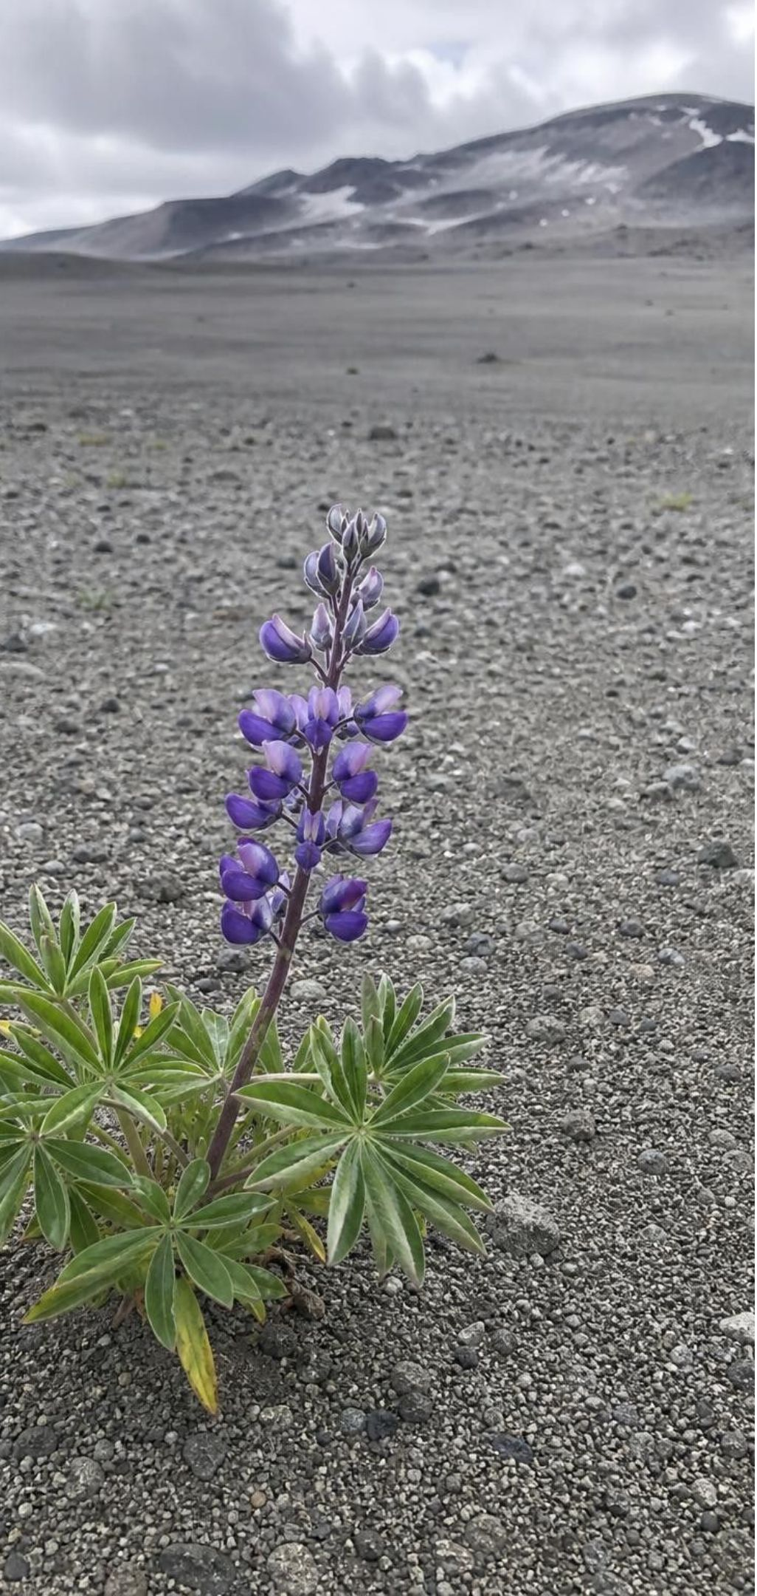
Four decades on the pumice plain
MODEL
Model: Recovery on the Mount St. Helens pumice plain
1
May 1980: eruption: Pyroclastic flows bury the valley north of the crater in hot pumice. No soil, no plants.
2
1980-1981: first arrivals: Spiders and insects drift in on the wind; seeds blow in; survivors emerge at the edges.
3
1981-1982: the first lupine: Scientists find a single prairie lupine growing on the bare pumice, kilometers from any other plant.
4
Mid-1980s to 1990s: lupine patches: Lupines enrich the ash with nitrogen; other plants take root inside the patches; elk return.
5
2000s: meadows and thickets: Willows and alders line the streams; ponds hold frogs and insects; meadows spread.
6
2020s: still early: Shrubs and young trees in places, but no mature conifer forest yet. Recovery continues.
Dates mark when scientists recorded each change. The pace depended on survivors, arrivals, and chance.
11
Notes:
Show this slide after Lab 1 as its reveal: the pumice-zone evidence cards follow these stages. Walk the timeline and keep pointing at the mechanism: each stage made the next possible. Spiders arrived first because they travel on silk threads in the wind and could eat the insects that also blew in; they did not need plants. The lupine mattered because it is a legume: bacteria in its roots take nitrogen from the air, so the plant can grow in ash that has almost none, and when it dies it leaves nitrogen behind. Scientists measured more nutrients and more seedlings inside old lupine patches than outside them. Elk returning to graze added droppings carrying seeds and nutrients. Make the last entry explicit: forty years is early in primary succession, and the pumice plain today is a meadow-and-shrub ecosystem, not the old forest. This is real data from long-term studies, but the deck gives no counts; counts in the worksheets are simulated. Sources differ on the year of the first lupine (1981 in a university account, June 1982 in a magazine account of the ecologist credited with the find), so the slide gives both.
WATCH FOR: 'Forty years is a long time, so it must be finished.' On bare pumice, forty years is the beginning.
CONNECTS TO: Lab 1 reveal (run Lab 1 before this slide). W3 reading passage tells the full recovery story; W6 CER uses lupine plot data from the pumice plain.
PACING: about 6 min

Slide 12
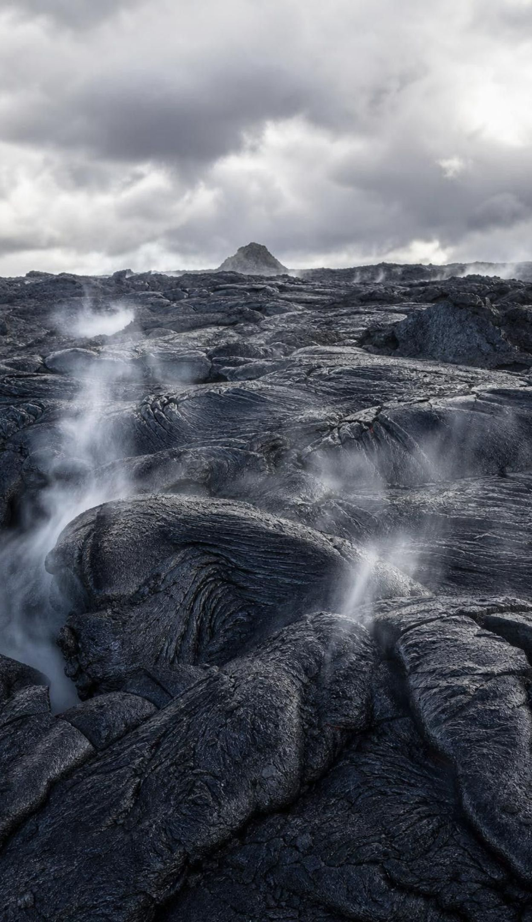
CHECK FOR UNDERSTANDING
Quick check: primary or secondary?
A fresh lava flow that cooled into black rock last year.
A chaparral hillside burned in a fast-moving wildfire.
Gravel exposed by a melting glacier in the Sierra Nevada.
A cornfield abandoned by a farmer.
A forest knocked flat by a volcanic blast, soil still in place.
Decide whether each place will recover by primary or secondary succession, and name the clue that told you.
12
Notes:
Hold up P or S. Lava: primary, no soil. Burned chaparral: secondary; many chaparral shrubs resprout from roots and some seeds need fire to open, which is a nice California aside. Glacier gravel: primary. Abandoned cornfield: secondary, with soil and a seed bank full of weeds. Blown-down forest: secondary. After the vote, ask which of the five will take longest to reach shrubs and trees, and why.
EXPECTED RESPONSES: 1 P (no soil), 2 S (soil and roots survive), 3 P (bare gravel), 4 S (soil and seeds), 5 S (soil in place). Longest: the lava flow, then the glacier gravel.
WATCH FOR: Students who call the burned hillside primary because it 'looks dead'. Looks are not the clue; soil is.
CONNECTS TO: Lab 1 analysis question q4 asks the same decision with evidence.
PACING: about 4 min

Slide 13
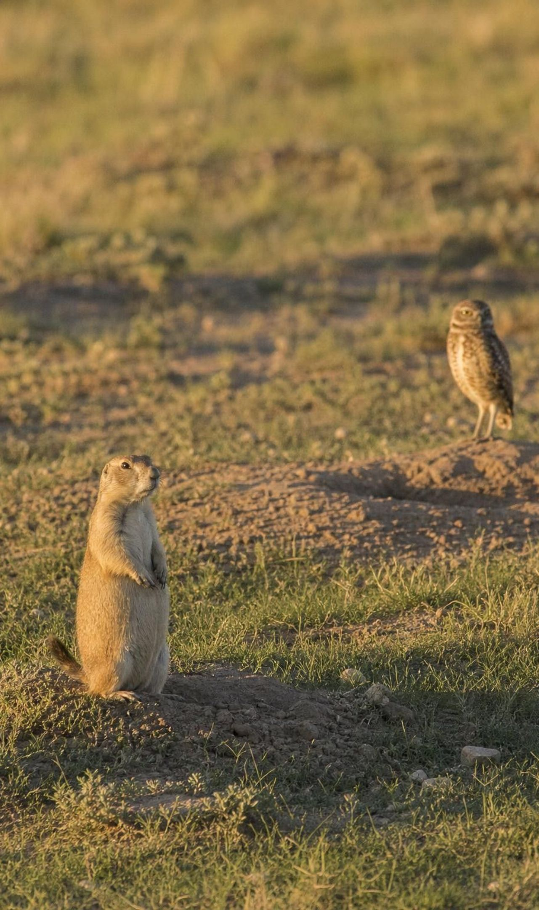
Changing a living part: the prairie dog town
Prairie dogs are ground squirrels that form big colonies, called towns, on the Great Plains. They dig burrow systems, clip the plants around their burrows, and are eaten by many predators. Surveys of many similar grasslands, some with colonies and some without, show a pattern in other populations that repeats from site to site.
Burrows shelter burrowing owls, rabbits, snakes and black-footed ferrets.
Digging mixes the soil and lets water and air in.
Clipping produces fresh regrowth that grazers like bison seek out.
Clipping also holds back shrubs, so shrub-dependent animals lose.
Prairie dogs themselves are the main food of black-footed ferrets.
13
Notes:
Shift from the ground to the living things. Prairie dogs are small, but they change the place in at least four ways: shelter (burrows), soil (digging), plants (clipping) and food (their own bodies). Ask students to predict what happens to each listed population if prairie dogs disappear from a valley. Then state how scientists actually know: not by guessing, but by comparing many grasslands with and without colonies and seeing the same differences again and again. That repeated comparison is the evidence. Note on accuracy: the textbook says prairie dogs make more grass for bison and reduce flowering plants for pronghorn; park sources say the clipping produces more nutritious regrowth that attracts both bison and pronghorn, and that shrubs are what prairie dogs really hold back. Use the slide's wording.
WATCH FOR: 'Prairie dogs are good for everything.' Shrub-dependent species lose; the last two bullets set up the discuss slide.
CONNECTS TO: Lab 2 builds this grassland community as a string web.
PACING: about 5 min

Slide 14
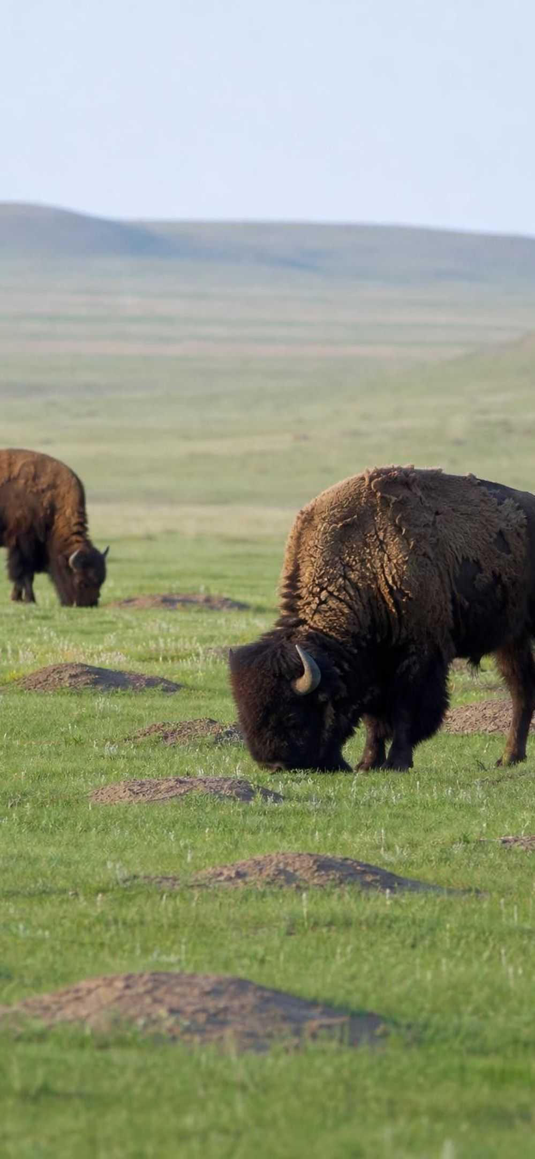
Model
One species, many threads
Model: How a prairie dog colony reaches other populations
Center: Prairie dog colony
Burrows: shelter: Burrowing owls, rabbits, rattlesnakes and ferrets use them. Gain.
Digging: soil: Water and air get into the soil; nutrients mix. Plants near burrows gain.
Clipping: plants: Fresh regrowth draws bison and pronghorn (gain); shrubs are held back (lose).
Prey: food: Black-footed ferrets, badgers, hawks and eagles eat prairie dogs. Gain.
Shrub users: Birds and insects that need shrubs have fewer of them. Lose.
A keystone species: its effect on the community is far larger than its size or numbers suggest.
14
Notes:
Have students trace each spoke and say aloud whether the population at the end gains or loses when prairie dogs are present. Then ask the reverse: if prairie dogs vanish, flip every arrow. Introduce the term keystone species here: a species whose removal changes far more than its own numbers would predict, like pulling the keystone out of a stone arch. Ask what evidence would show that a species is a keystone, and lead them to 'compare places with and without it'. Mention that the species is in real trouble: the species' range has shrunk to about 5 percent of its original size, mainly from land clearing, deliberate poisoning and plague, and the black-footed ferret, which eats almost nothing else, nearly went extinct.
WATCH FOR: Every common species is a keystone. Abundance is not the test; the size of the ripple when it is removed is.
CONNECTS TO: Lab 2 turns these threads into strings and counts what changes when one card is removed.
PACING: about 5 min

Slide 15
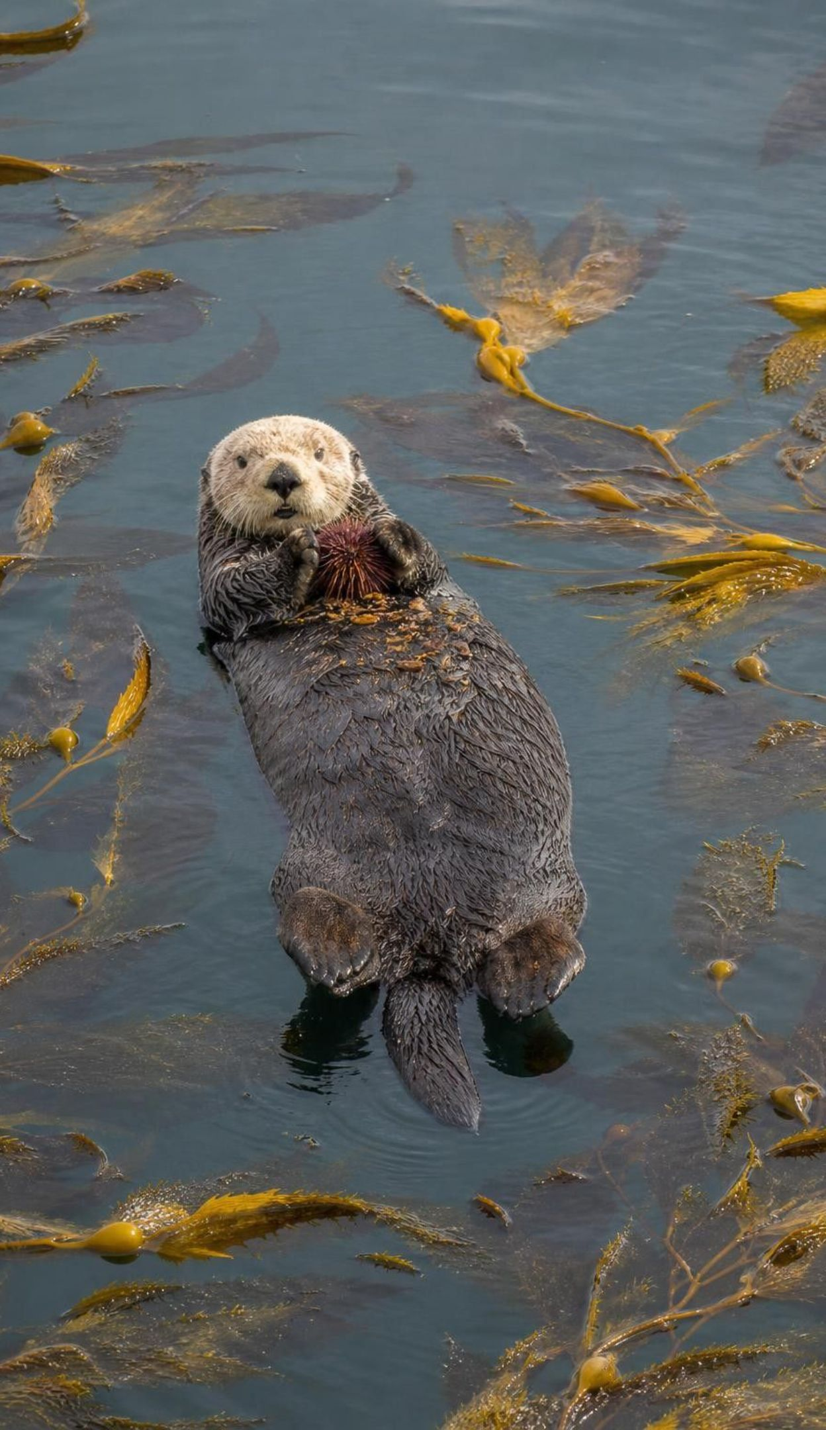
VOCABULARY IN CONTEXT
Words for ripples through a community
keystone species: A species whose presence shapes the whole community far more than its numbers suggest. Prairie dogs on the plains; sea otters in a kelp forest.
cascading change: A chain of effects in which one population change alters resources for the next, and the next. Fewer otters, more urchins, less kelp, fewer fish that hide in kelp.
resilience: An ecosystem's ability to absorb a disturbance and recover its main populations and functions. A grassland that regrows the same grasses within two years of a fire.
15
Notes:
Pair the first two terms: a keystone species is the kind of species whose loss starts a cascade. Resilience is the counterweight: some ecosystems absorb a shock and bounce back; others flip into a different state and stay there. Ask students which of the two Mount St. Helens zones showed more resilience (the blowdown zone, because its soil and survivors let it recover faster). Have them write all three terms with an example that is not on the slide.
CONNECTS TO: W2 vocabulary; the connection slide (21) applies all three to a California kelp forest.
PACING: about 4 min

Slide 16
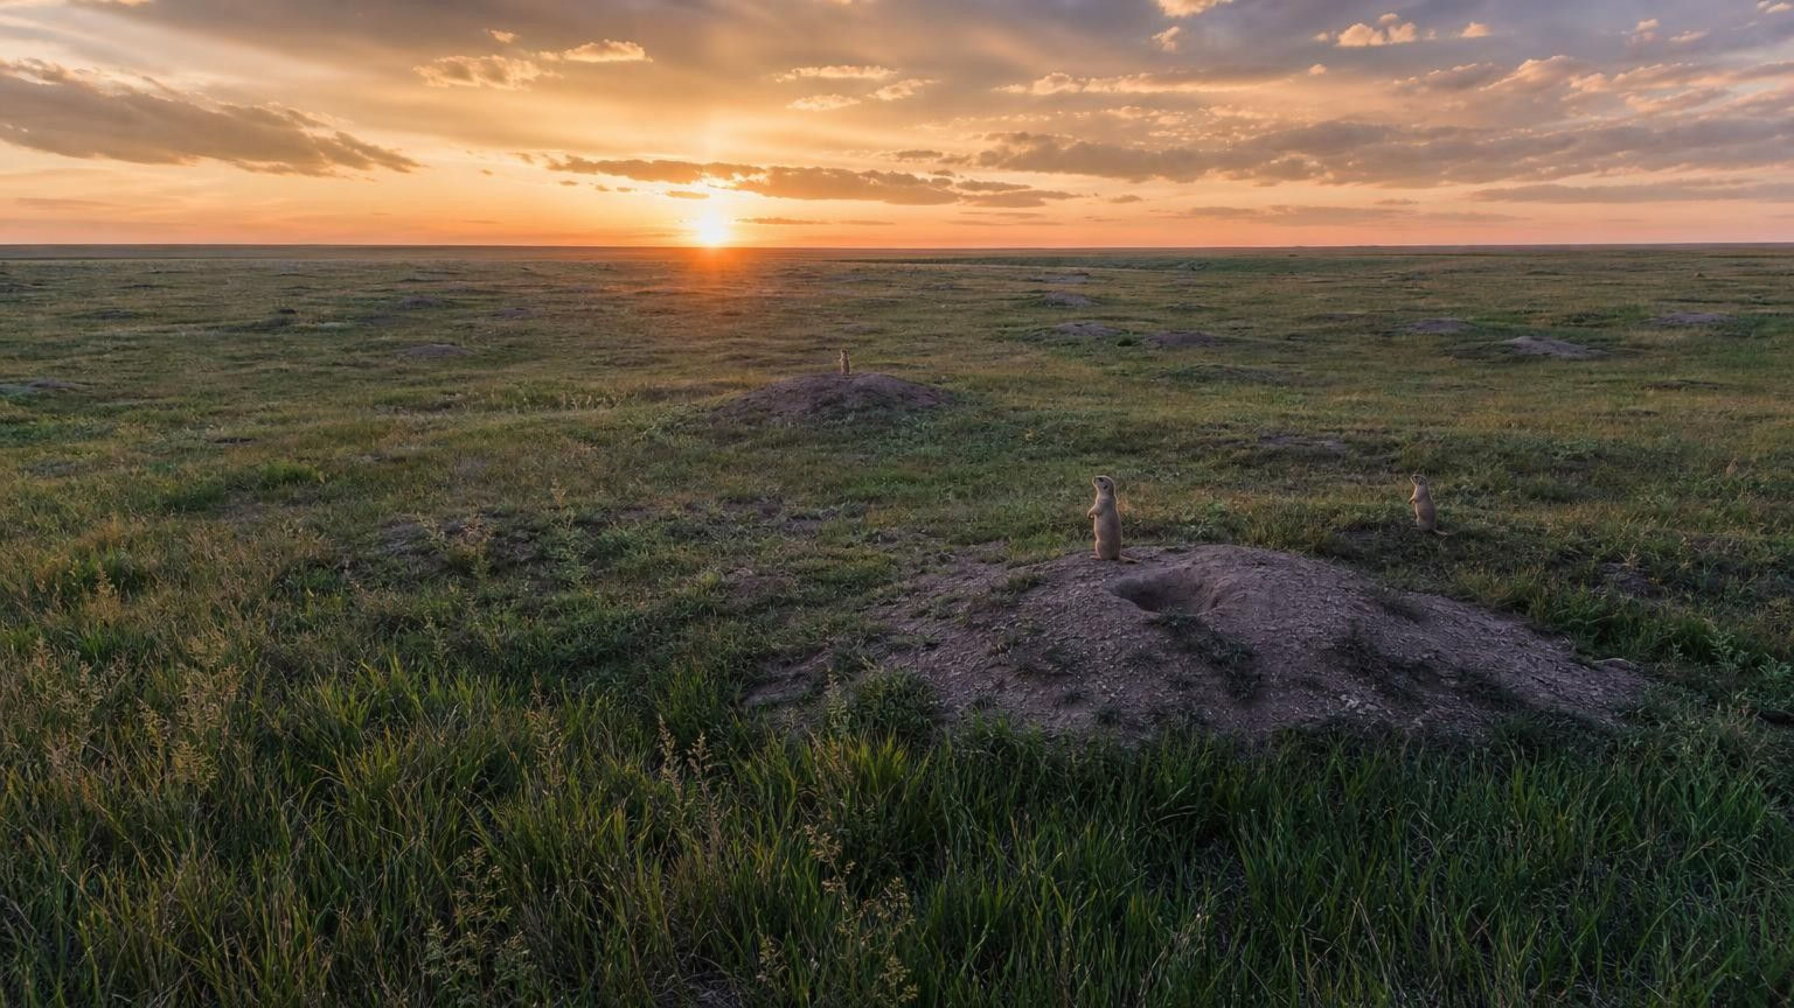
THINK, PAIR, SHARE
Discuss: are prairie dogs good or bad for a grassland?
A rancher says prairie dogs ruin grassland. A biologist says the grassland depends on them. Can both be looking at real evidence? What would you need to measure to settle it?
Notes:
Run as a two-minute pair argument, each partner taking one side, then switch. Collect the best point from each side. Steer toward the lesson's real answer: 'good or bad' is not a scientific question. The scientific questions are which populations go up, which go down, by how much, and whether the pattern repeats across many sites. The rancher may be seeing real losses of some forage plants near colonies; the biologist is seeing real gains in owls, ferrets and soil. Close by asking what measurement each person should make to test their claim, and point out that the same with-and-without comparison serves both.
EXPECTED RESPONSES: Both can be right about different populations; measure plant cover, grazer use, owl and ferret numbers, soil moisture, in colonies versus matched sites without colonies; need several sites, not one.
WATCH FOR: Settling the argument by majority vote or by who sounds more confident. Insist on what would be measured.
CONNECTS TO: W8 prairie dog evidence sort includes the rancher's view and the evidence to weigh it; W6 (CER) practices the written argument.
PACING: about 6 min

Slide 17
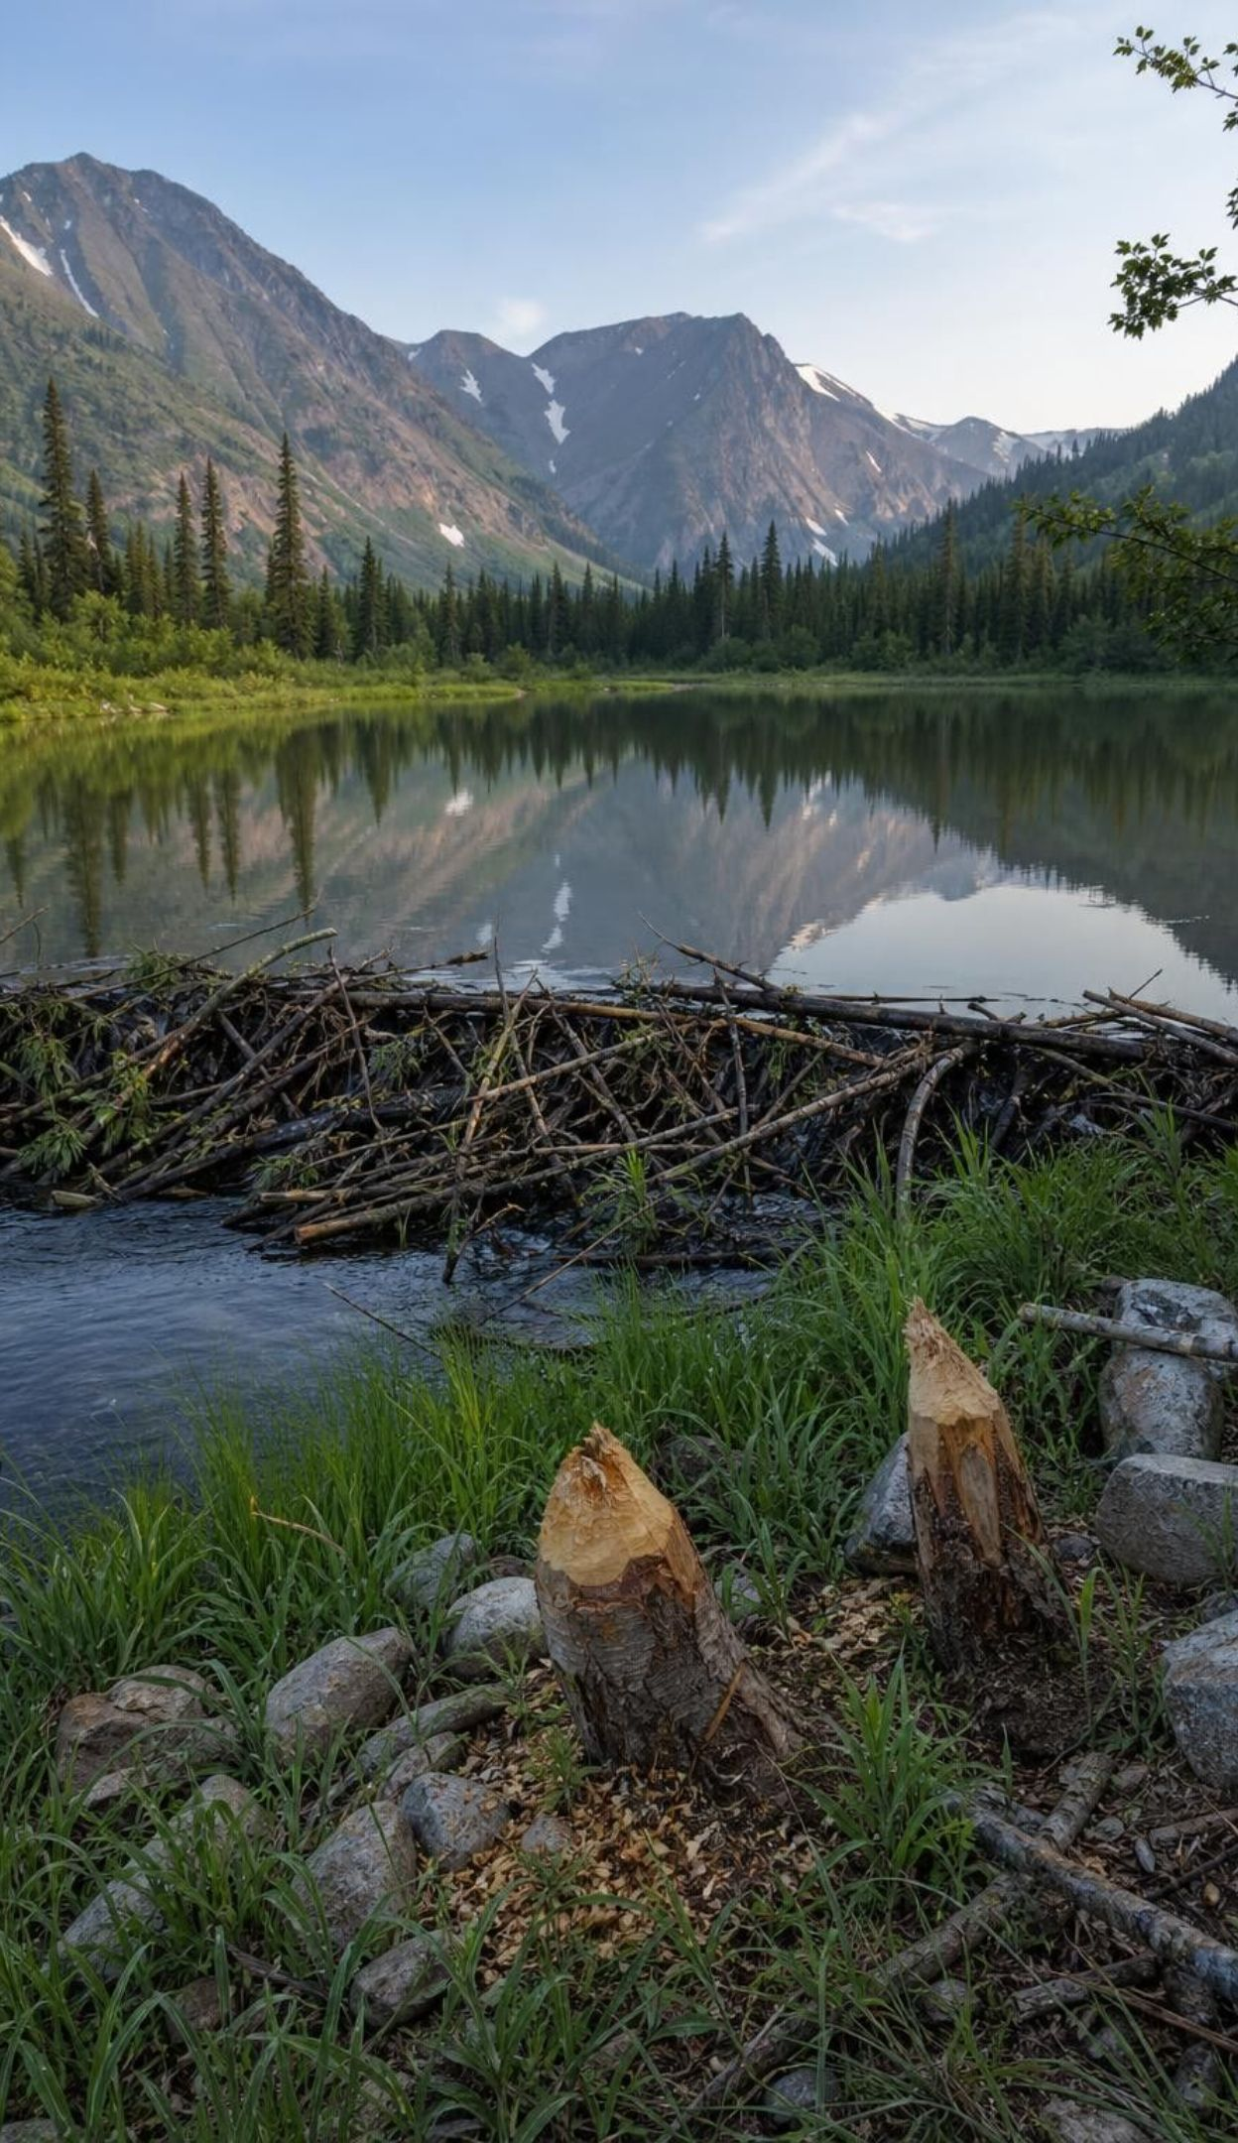
Changing a nonliving part: the beaver's pond
A beaver cuts trees and piles them into a dam across a stream. Upstream, fast shallow water becomes a deep, slow pond. Along the bank, the felled trees let sunlight reach the ground. Downstream, water spreads out and soaks the soil. The beaver changed physical parts of the ecosystem: water depth, water speed, light and moisture.
Deep, slow water: pond plants, fish, frogs and insects move in.
Fast-water species lose their habitat in the flooded stretch.
More light on the ground: small plants grow, feeding moose and elk.
Wetter soil downstream: lush plant communities support more animals.
17
Notes:
Point out the twist: the beaver is a living thing, but the change it makes is mostly to nonliving parts: water and light. Ask students to classify each bullet as a physical change and name the population that responds. Then ask how scientists would know beavers caused the lush downstream growth rather than, say, a rainy year. Lead them to the comparison: streams with beaver ponds versus similar streams without them, in the same region and the same years. The second bullet matters: species that need cold, fast, oxygen-rich water, such as some trout and stonefly larvae, lose that stretch of stream. Every change has losers.
WATCH FOR: Students call the beaver dam a change to a living part because a beaver built it. Ask what changed for the fish: the water, not the beaver.
CONNECTS TO: W5 data worksheet analyzes with-and-without and before-and-after beaver stream surveys. W2 Part D applies these ideas to a park creek.
PACING: about 5 min

Slide 18
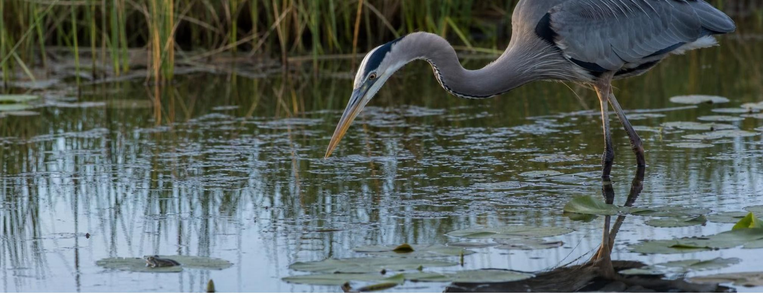
MODEL
How one dam travels through the ecosystem
Model: A cascading change from a beaver dam
1
2
3
4
5
Beaver builds dam
→ (physical change)
Stream becomes a deep, slow pond
→ (new habitat and food)
Pond plants and insects increase
→ (more prey)
Frogs and fish that eat them increase
→ (more prey)
Herons and otters that eat those increase
Each arrow means 'leads to more of'. A parallel chain runs the other way for fast-water species.
18
Notes:
Trace the chain, then ask students to build the losing chain on the board: fast water lost, stonefly larvae decline, trout that eat them lose food in that stretch, kingfishers that eat small fish shift elsewhere. Then ask what happens if the beavers are trapped out and the dam breaks: the pond drains, the cascade runs in reverse. This is the same structure as the prairie dog map but drawn as a chain, which is the form a cascading change usually takes. Ask: where in the chain would you measure to test whether the dam really caused the heron increase?
WATCH FOR: Reading the arrows as a food chain only. The first arrow is a physical change, not eating.
CONNECTS TO: Lab 2 traces chains like this one, wave by wave, in a grassland web.
PACING: about 5 min

Slide 19
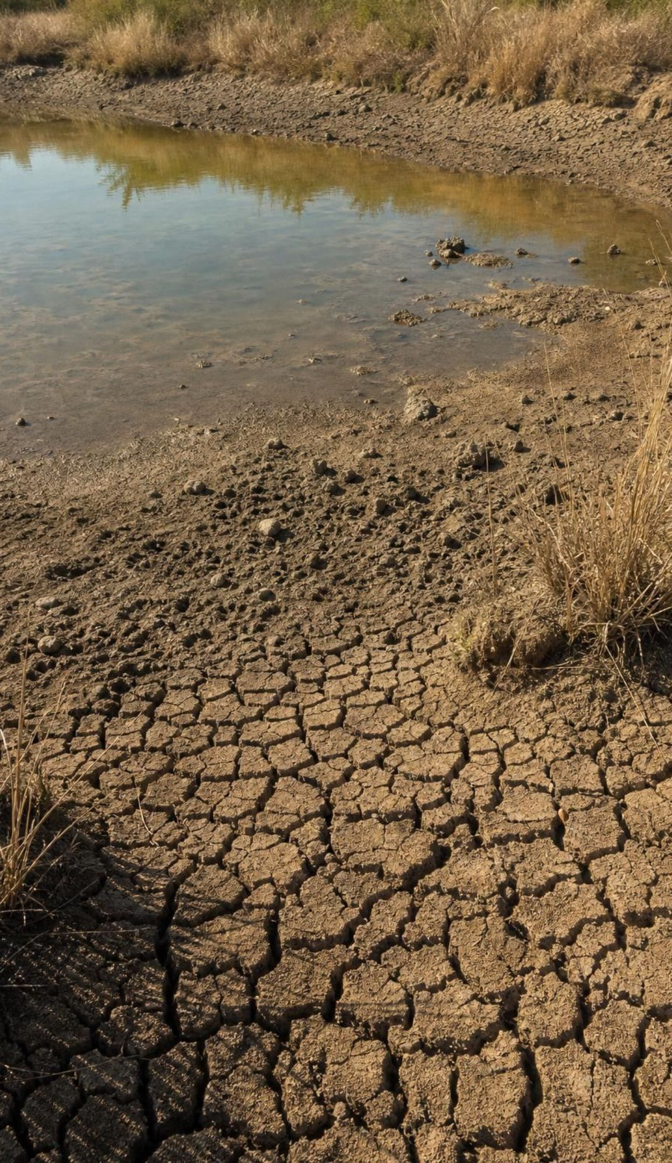
CHECK FOR UNDERSTANDING
Quick check: which part changed?
A levee stops a river from spreading sediment onto a marsh.
Black-footed ferrets return to a valley after decades of absence.
A beaver dam floods a stream.
A new fungus kills most of the bats in a cave.
A drought dries a pond to half its size.
For each event, say whether a living (biological) or nonliving (physical) part changed first, then name one population that would respond.
19
Notes:
Quick votes with one reason each. Levee: physical (sediment and water); marsh plants respond. Ferrets: biological; prairie dogs respond. Beaver dam: physical (water depth and speed); fast-water insects and pond frogs respond. Fungus: biological; the insects bats eat respond. Drought: physical (water); fish and frogs respond. Push on the levee: it is human-built, but what it changed is physical. Then ask students which of these five is a cascading change (all of them can be, which is the point).
EXPECTED RESPONSES: 1 physical, marsh grass or crabs; 2 biological, prairie dogs decline; 3 physical, frogs up and trout down in that stretch; 4 biological, night insects increase; 5 physical, fish and frogs decline.
WATCH FOR: Calling the beaver dam and the levee biological because a living thing built them. The test is what changed for the other organisms.
CONNECTS TO: W10 q6 asks the same question about a beaver dam.
PACING: about 4 min

Slide 20
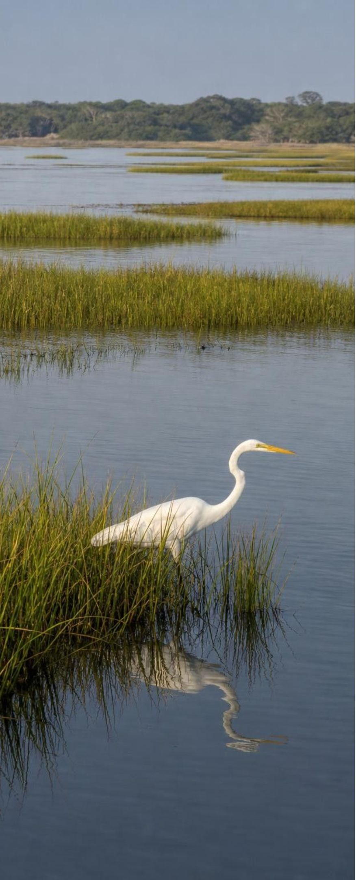
APPLY IT
Task: what does the evidence support?
A coastal marsh was surveyed in 1990 and again in 2020. In between, a levee cut off the river sediment that used to spread over the marsh, and a canal let salty bay water in. Teams counted the same things the same way both years. Study the table, then write one claim the data support, one claim they do not support, and one thing you would still need to know.
What was counted | 1990 | 2020 | Change
Marsh cordgrass cover (% of plot) | 82 | 36 | down
Periwinkle snails (per square meter) | 41 | 13 | down
Young shrimp (per net pull) | 58 | 21 | down
Great egrets (per survey walk) | 6 | 7 | about the same
Mullet, an open-water fish (per net pull) | 14 | 31 | up
Open water (% of plot) | 9 | 48 | up
Simulated data for practice.
20
Notes:
The numbers are a teaching dataset, invented to look like a real marsh survey; say so. Give groups six minutes. The pattern is clear: marsh plants and the animals that live among them fell while open water and an open-water fish rose. A supported claim: the marsh changed from mostly plants to mostly open water, and populations that depend on the grass declined. An unsupported claim: the levee caused it. The data show a before-and-after pattern, not the cause; the canal, sea level, storms or something else could also matter. What they still need: a similar marsh nearby that kept its sediment supply and had no canal, surveyed in the same years, or surveys from several years in between. Egrets staying the same is a good trap: ask why a bird that hunts in shallow water might not care whether the shallows are grass or open water. Collect the three statements from each group on the board and label each one supported, unsupported, or needs more.
EXPECTED RESPONSES: Supported: grass cover, snails and young shrimp decreased while open water and mullet increased; populations tied to the grass declined. Not supported: that the levee alone caused it, or that the marsh is 'dead' (egrets and mullet are doing fine). Still needed: a comparison marsh without the levee and canal; data from the years between; sediment and salt measurements.
WATCH FOR: Treating one before-and-after comparison as proof of cause. The next slides show how scientists strengthen it.
CONNECTS TO: W5 (data) works with a dataset of this kind; W6 (CER) asks for the full written argument.
PACING: about 10 min

Slide 21
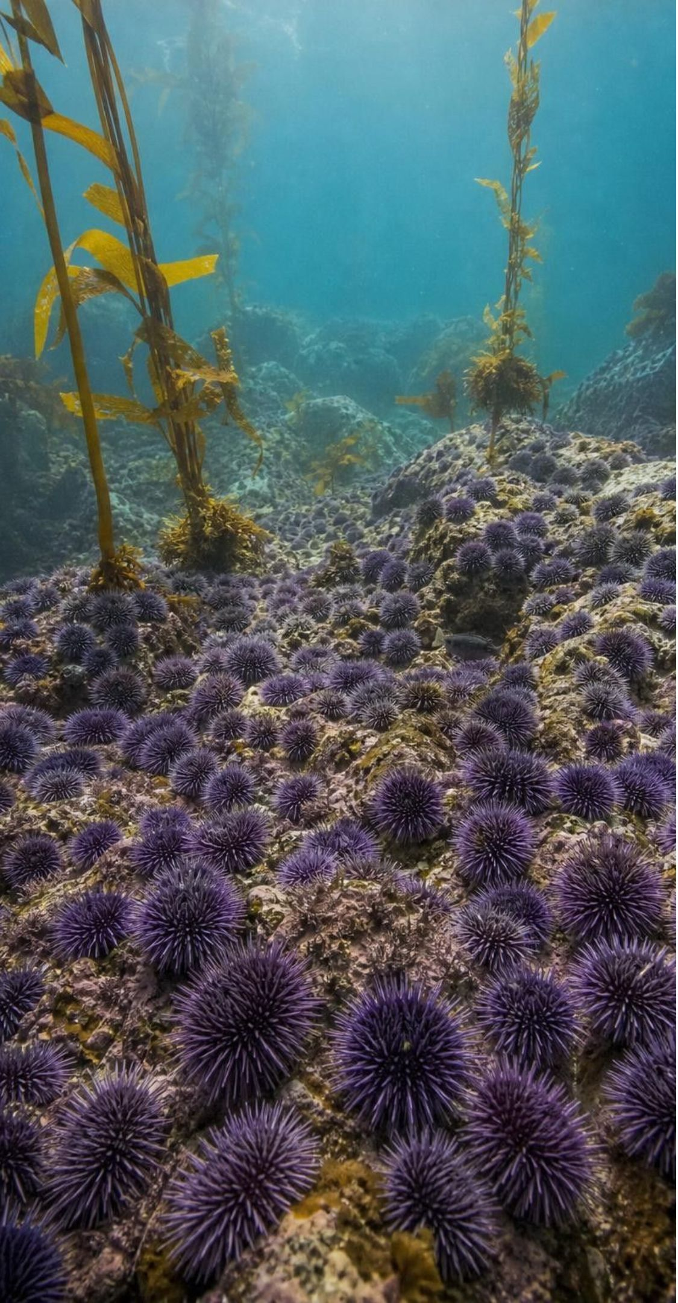
REAL-WORLD CONNECTION
California connection: the kelp forest that lost its keystones
Along the northern California coast, giant forests of bull kelp shelter fish, abalone and urchins. Sea otters and sunflower sea stars eat purple sea urchins and keep them in check. Starting in 2013 a wasting disease killed most of the sea stars, and a marine heat wave weakened the kelp. Purple urchins multiplied and ate the kelp down to bare rock.
Keystone predators lost: sea stars died, and otters were already absent north of San Francisco.
Cascade: fewer predators, far more urchins, more than 90 percent of the bull kelp gone by 2016.
Ripple: red abalone starved, and the recreational abalone fishery closed in 2018.
Resilience test: urchin barrens can persist for years even after conditions improve.
21
Notes:
This is a documented cascading change in our own state, studied by the California Department of Fish and Wildlife and university scientists. Walk the chain: a change to a living part (the sea star die-off) plus a change to a nonliving part (warm water) removed the brake on urchins; urchins ate the kelp; everything that lived in the kelp lost habitat; abalone, which eat drifting kelp, starved. Ask students to identify the keystone species, the cascade and the resilience question. Point out that the evidence came from divers counting urchins and measuring kelp at the same sites year after year, plus aerial surveys of kelp canopy. Where sea otters still live, around Monterey, urchin outbreaks have been less severe, which is a with-and-without comparison in real life. If students ask about recovery: divers and volunteers have been removing urchins from some coves, and kelp has returned in patches, but scientists say the barrens are stubborn.
WATCH FOR: Blaming the urchins. Urchins were always there; what changed was the loss of the predators that held their numbers down.
CONNECTS TO: W10 q7 and q8 use a sea star, urchin and kelp cascade; W2 q5 uses otters, urchins and kelp; the chapter extension follows the northern California kelp collapse.
PACING: about 6 min

Slide 22
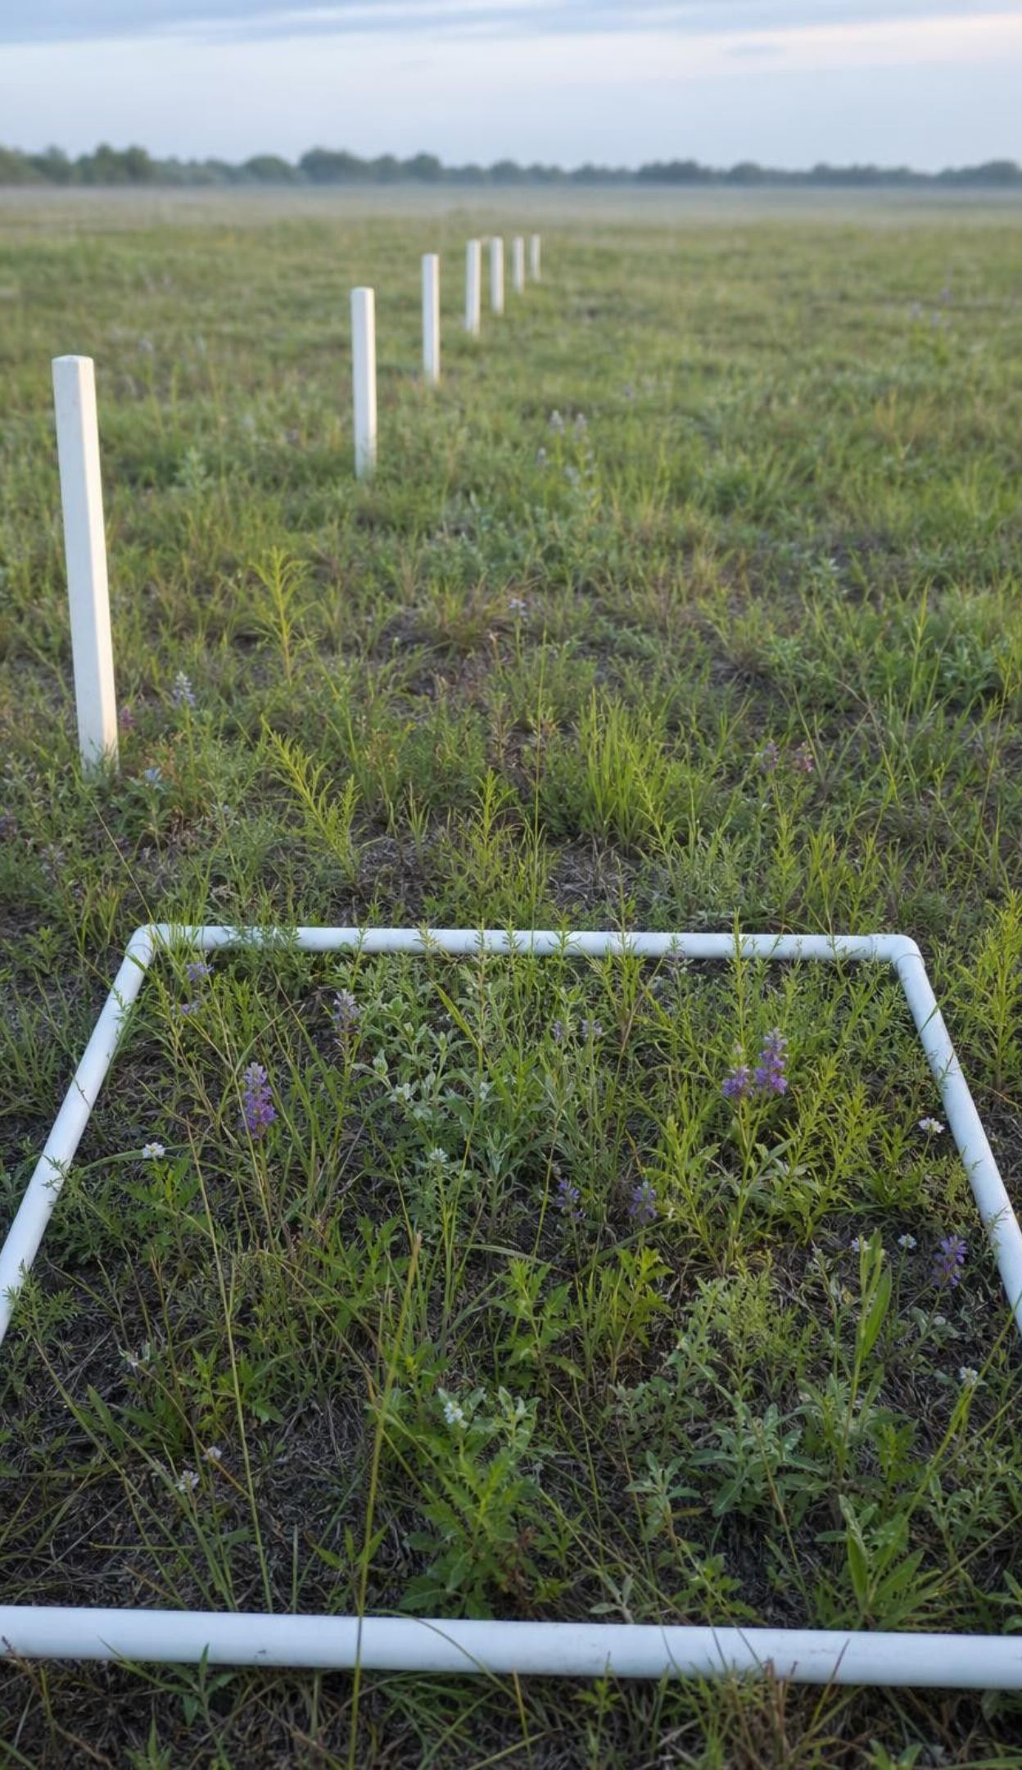
What makes an argument strong?
A pattern tells you what changed. A strong argument also tells you why, and shows that the pattern is not a coincidence. Ecologists build that strength in three ways, and the best studies use more than one.
Before and after: the same place, the same counts, repeated over time.
With and without: many similar places that differ mainly in the one change.
A mechanism: a reason the change should affect that population, which you can test.
Repetition: the pattern shows up at many sites, not just one.
22
Notes:
Return to the marsh task. The table was before-and-after only. Ask students how to add each of the other three. With-and-without: find marshes that still get sediment. Mechanism: cordgrass needs sediment to keep up with sinking ground and cannot tolerate too much salt; test it by measuring salt and ground height. Repetition: survey several marshes with levees and several without. Then connect to the labs: Lab 2 proposes mechanisms in a model and then checks one against real survey data, Lab 3 gives with-and-without comparisons repeated across many plot pairs, and W6 asks for all of it in writing. The PE's exact words are 'argument supported by empirical evidence', and this slide is the checklist.
WATCH FOR: 'More data points from the same place' is not the same as 'more places'. Both help, for different reasons.
CONNECTS TO: Checklist for W6 (CER), W7 (Jordan's dam argument, which lacks a comparison creek) and Lab 3 q10, which rates the class argument against these four features.
PACING: about 5 min

Slide 23
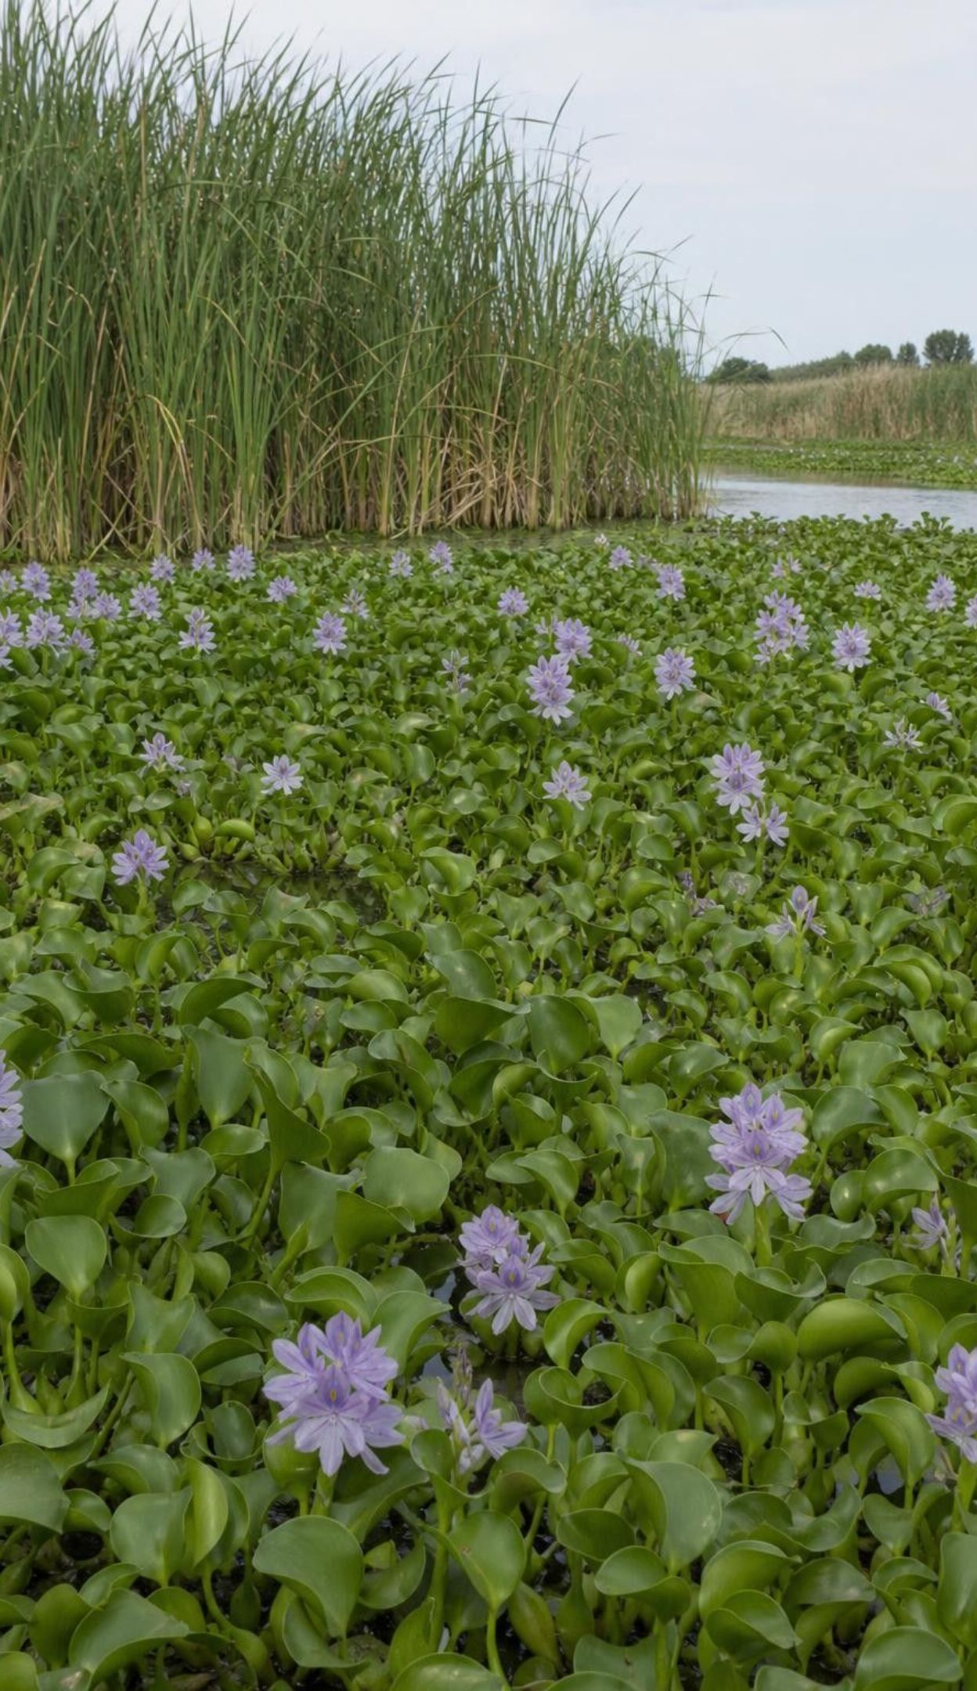
When people move a species: invasive species
People carry living things around the world on purpose and by accident: in ship water, on boots, in garden pots. Most arrivals fail or stay rare. An introduced species becomes invasive when it spreads and harms native populations or the way the ecosystem works, often because the predators and diseases that limited it at home are missing.
Introduced: moved by people outside its native range.
Invasive: introduced, spreading, and causing harm.
California example: water hyacinth mats choke Delta channels and shade native plants.
A new species is a change to a living part, with cascades like any other.
23
Notes:
Keep the definitions sharp, because students use 'invasive' for any unwanted animal. Ask them to name introduced species they know in California (eucalyptus trees, European starlings, nutria in the Delta, zebra and quagga mussels in reservoirs). Then ask which are invasive by the slide's test. Point out the contrast with the cattle egret in the textbook's Gulf of Mexico example: that bird crossed the Atlantic on its own and spread with farmland, so it is a newly arrived species, not an introduced one. The accuracy point is small but worth making, because the definition is the whole idea.
WATCH FOR: 'Introduced' and 'invasive' used as synonyms, and 'invasive' used for any native pest.
CONNECTS TO: W7 q7 applies the definition of invasive; W10 q10 asks about cattle egrets.
PACING: about 4 min

Slide 24
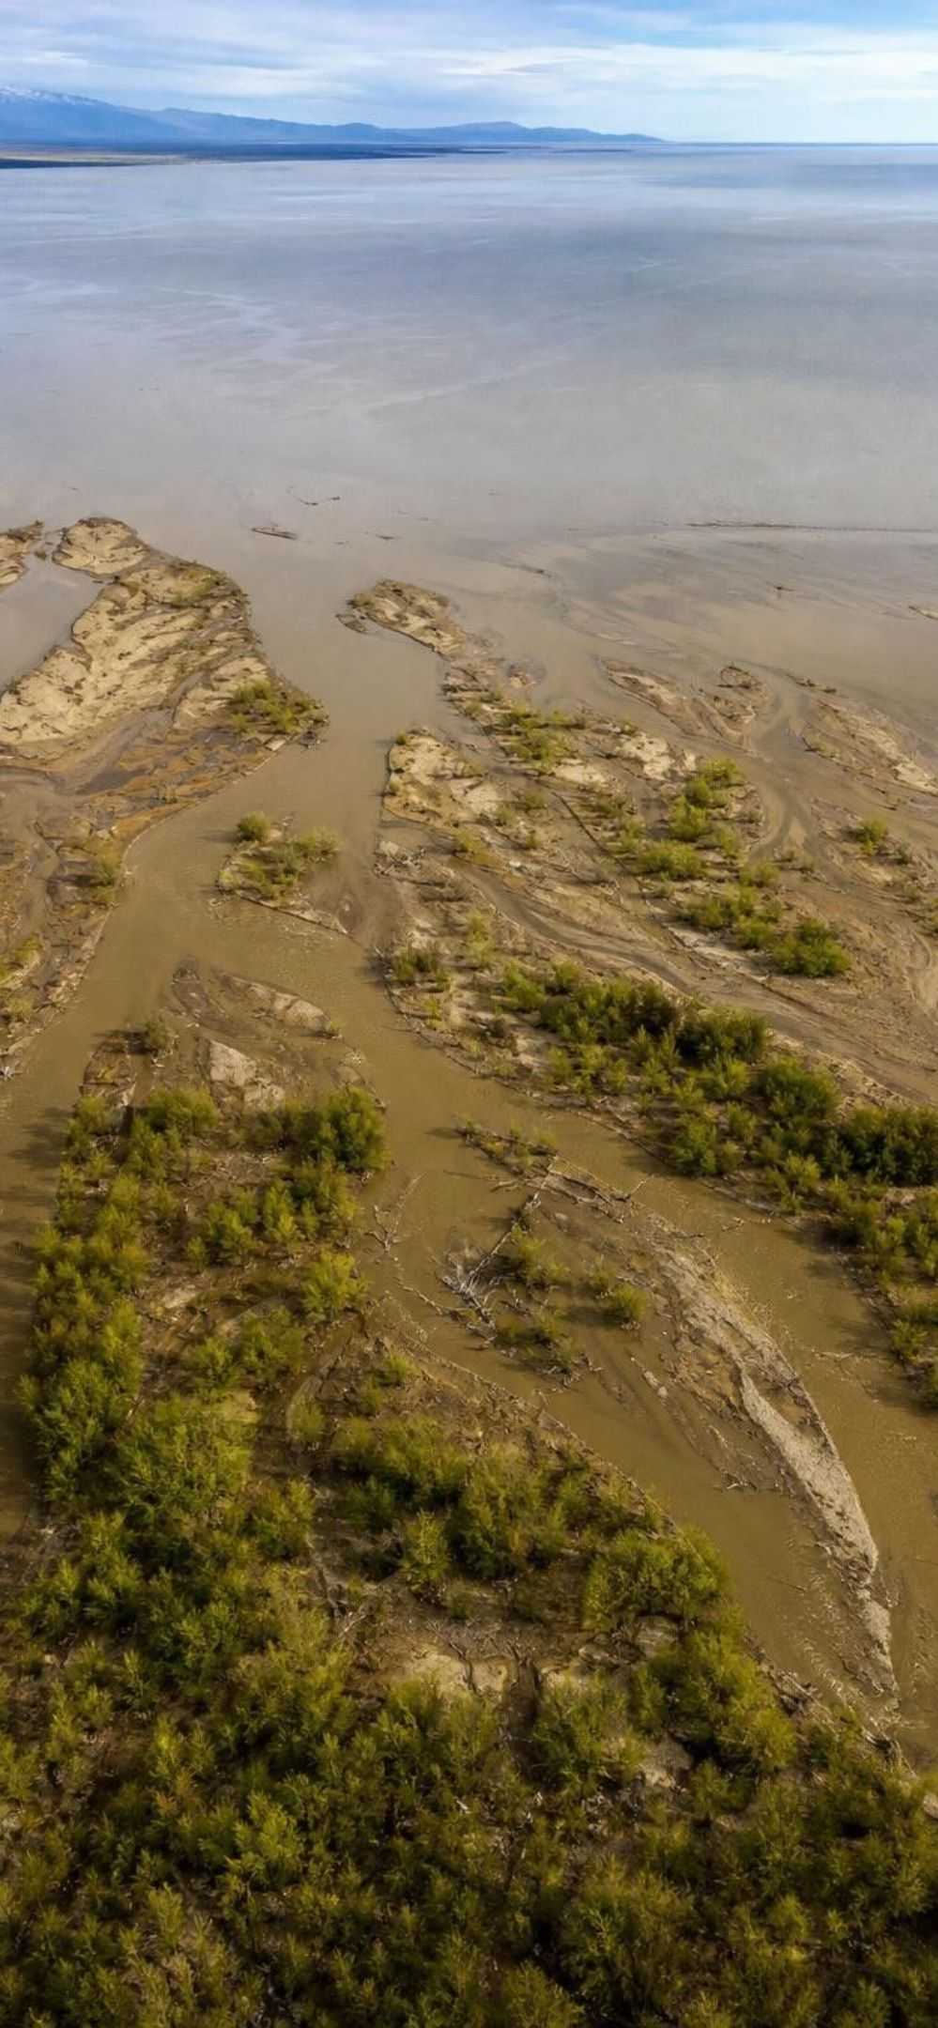
MODEL
Engineering a comeback: criteria and constraints
Model: Two ways to rebuild a Louisiana wetland
Open channel (Wax Lake Outlet) | Gated diversion in a levee (Caernarvon)
Channel dug in 1941 to ease flooding at Morgan City | Gates built into a levee near New Orleans, 1988-1991
Carries Atchafalaya River water and sediment into a shallow bay | Opened to let river water into the marsh, closed when floods threaten
New delta land keeps forming; plants colonize the sandbars | Main goal: push back salt water; land-building is debated
Works where few people live close by | Works where neighborhoods sit right behind the levee
Same criterion, different constraints, different design. Precision about both is what makes a design fit its place.
24
Notes:
Set up the problem: Louisiana's coastal marshes were built by river sediment, and levees that protect towns also starve the marshes, so they sink and shrink. Engineers want them back for wildlife and storm protection. Define criteria (what counts as success) and constraints (what the design cannot violate). Then show the two answers. Wax Lake is an open channel: the river built about a square kilometer of new land per year on average, with big variation from floods and storms, but it only works because the area is lightly settled. Caernarvon is a door in a levee: it can be shut when the river is high. Accuracy notes: the textbook's map label says Mississippi, but the Wax Lake Outlet carries Atchafalaya water; the state agency says Caernarvon's main purpose is holding back salt water, and how much land it builds is debated. Ask students which constraint forced the New Orleans design to be different.
WATCH FOR: Thinking the best design is the one that builds the most land. The best design is the one that meets the criteria inside the constraints of its place.
CONNECTS TO: W9 (transfer): criteria and constraints for the Arroyo Verde creek restoration.
PACING: about 6 min

Slide 25
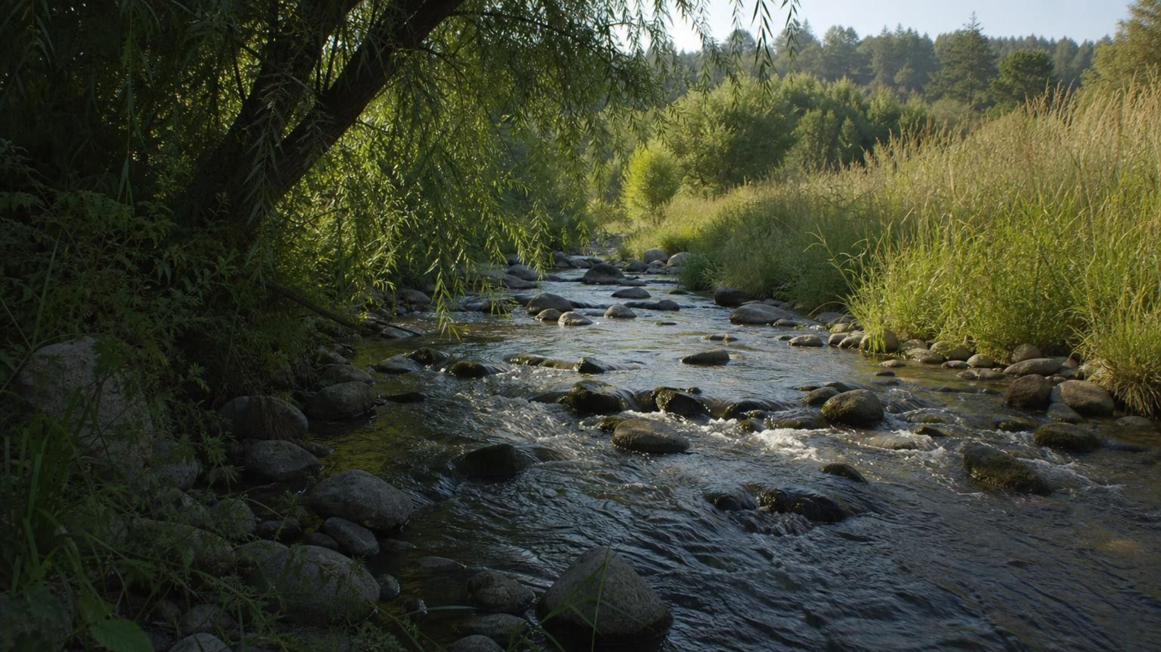
THINK, PAIR, SHARE
Discuss: what would restoring a creek near us require?
Imagine a channelized, concrete-lined creek near school being restored to a natural streambed. List two criteria for success and two constraints, and say which one would be hardest to satisfy.
Notes:
Many California creeks were lined with concrete for flood control. Give pairs three minutes. Criteria students usually propose: native fish and frogs return; shade trees along the bank; water stays cool. Constraints: the creek must still carry a flood without flooding homes; the land next to it belongs to someone; cost; the creek is only a few meters wide. Push for precision: 'fish come back' is vague; 'steelhead or native minnows seen in three of five years' is a criterion someone could check. Then connect to the PE: how would they gather evidence that the restoration affected populations? Before-and-after counts plus a similar unrestored creek.
EXPECTED RESPONSES: Criteria: native species return, cooler water, bank plants, less erosion. Constraints: flood capacity, space, cost, property, time. Hardest: flood capacity, because a natural bed carries less water than a concrete channel of the same width.
CONNECTS TO: W9 (transfer) turns this discussion into a written creek restoration design, decision and justification.
PACING: about 6 min

Slide 26
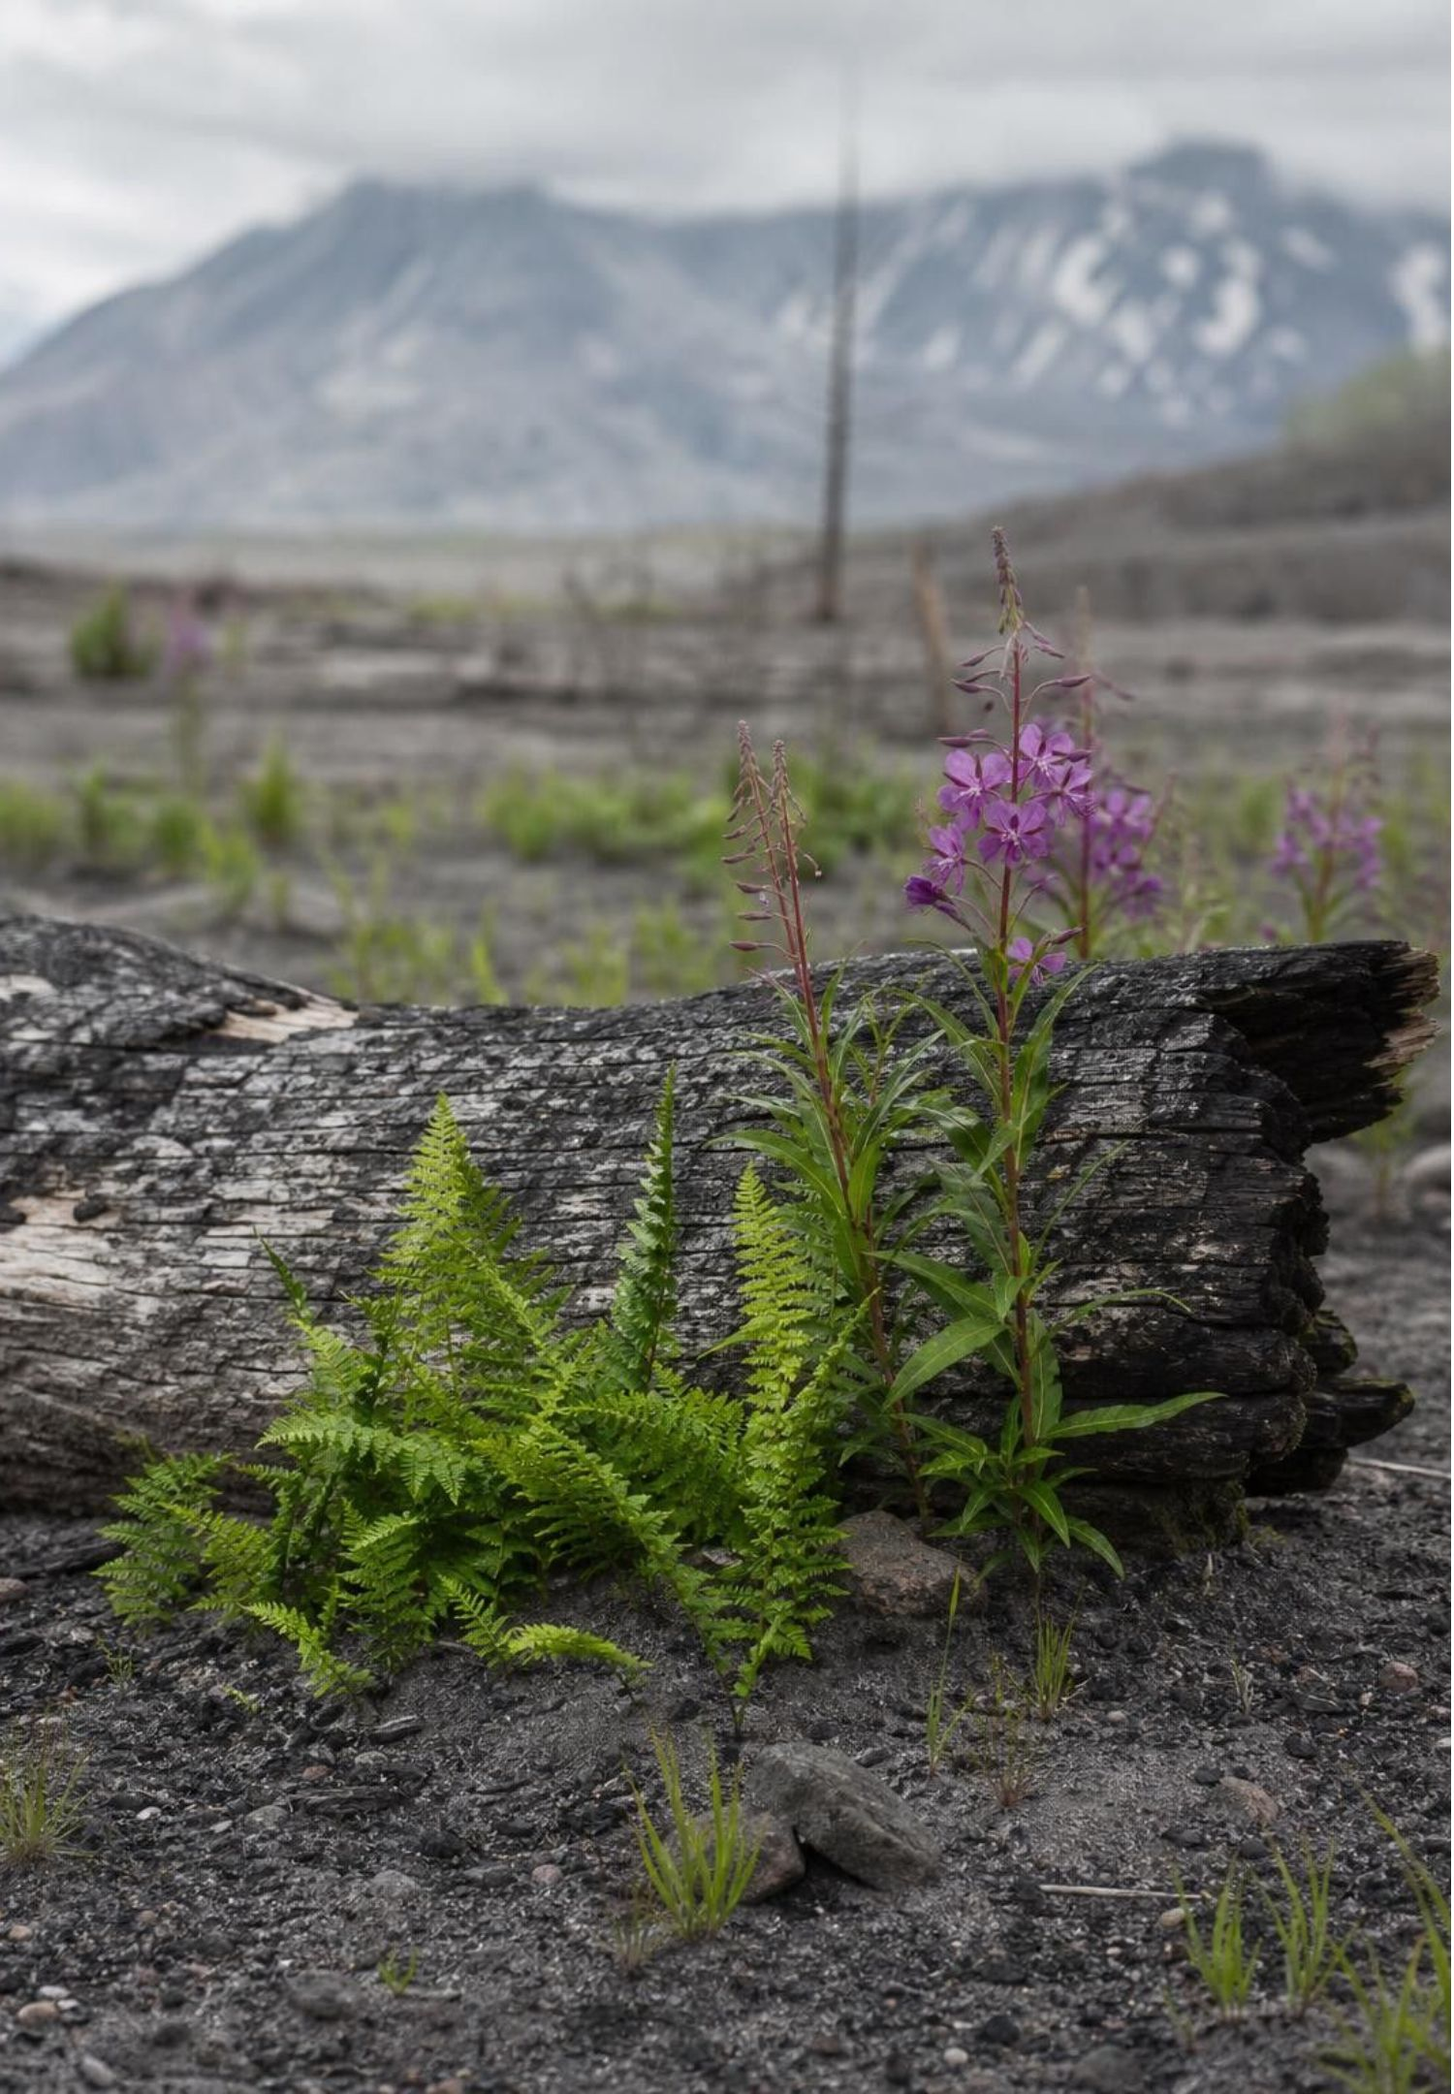
MISCONCEPTION CHECK
Is this right?
"A student says: 'The 1980 eruption killed everything on Mount St. Helens, so the new ecosystem had to be built entirely by seeds and animals that arrived from outside.'"
True or false? Explain your reasoning.
26
Notes:
Give students one minute to decide and find the evidence. The statement is partly right and importantly wrong. Right: the pumice plain really was sterile, new ground, and its first plants and spiders did arrive from outside. Wrong: 'everything' and 'entirely'. Across the blast zone, gophers survived in burrows, plants survived under snow, seeds and fungi survived in soil, and amphibians survived in lakes. These biological legacies drove the fast recovery of the blowdown zone and even seeded the edges of the pumice plain. Ask students to rewrite the statement so that it is accurate, and to say which kind of succession each zone shows. Then ask the harder question: what evidence would you need to know whether a plant on the pumice plain came from a survivor or an arrival? (Where it is growing, whether nearby survivors exist, and its seed type.)
EXPECTED RESPONSES: Mostly wrong. Rewrite: the blast killed most living things, but survivors in burrows, under snow, in soil and in lakes helped recovery alongside new arrivals; the pumice plain shows primary succession and the blowdown zone secondary.
WATCH FOR: Students who swing to the opposite error: 'so nothing really died'. The blast flattened hundreds of square kilometers of forest; both survivors and arrivals matter.
CONNECTS TO: W7 misconception worksheet repairs a fictional student's argument; W10 q5 tests the same claim.
PACING: about 5 min

Slide 27
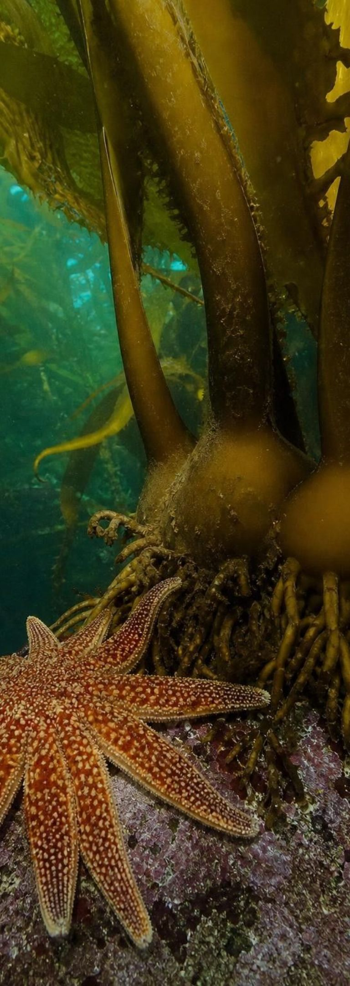

PUTTING IT TOGETHER
Putting it together
Ecosystems are dynamic systems: change is normal, gradual or sudden, natural or human-caused.
Succession rebuilds a place as living things improve it; primary starts without soil, secondary with it.
Survivors (biological legacies) plus new arrivals drive recovery, which may end somewhere new.
Change one living part (prairie dogs, sea stars) or one physical part (a dam, sediment) and populations shift.
Keystone species and cascades mean small changes can cause large ones.
A strong argument uses before-and-after, with-and-without, a mechanism and repetition.
27
Notes:
Have students pick the bullet they could explain best and the one they could explain least, then pair up so each explains their best to someone who picked it as their least. Return to the parking lot from slide 2 and resolve each question with a bullet from this slide. Finally, name the four pieces of evidence they generated this week: the Lab 1 timeline and cover data, the Lab 2 removal counts and owl survey, the Lab 3 plot counts, and the marsh table. Each is the kind of evidence a written argument needs; W6 asks for one built from the lupine plot data.
CONNECTS TO: W6 CER as the written argument; W10 mastery as the quiz; W8 prairie dog evidence sort as review.
PACING: about 5 min

Slide 28
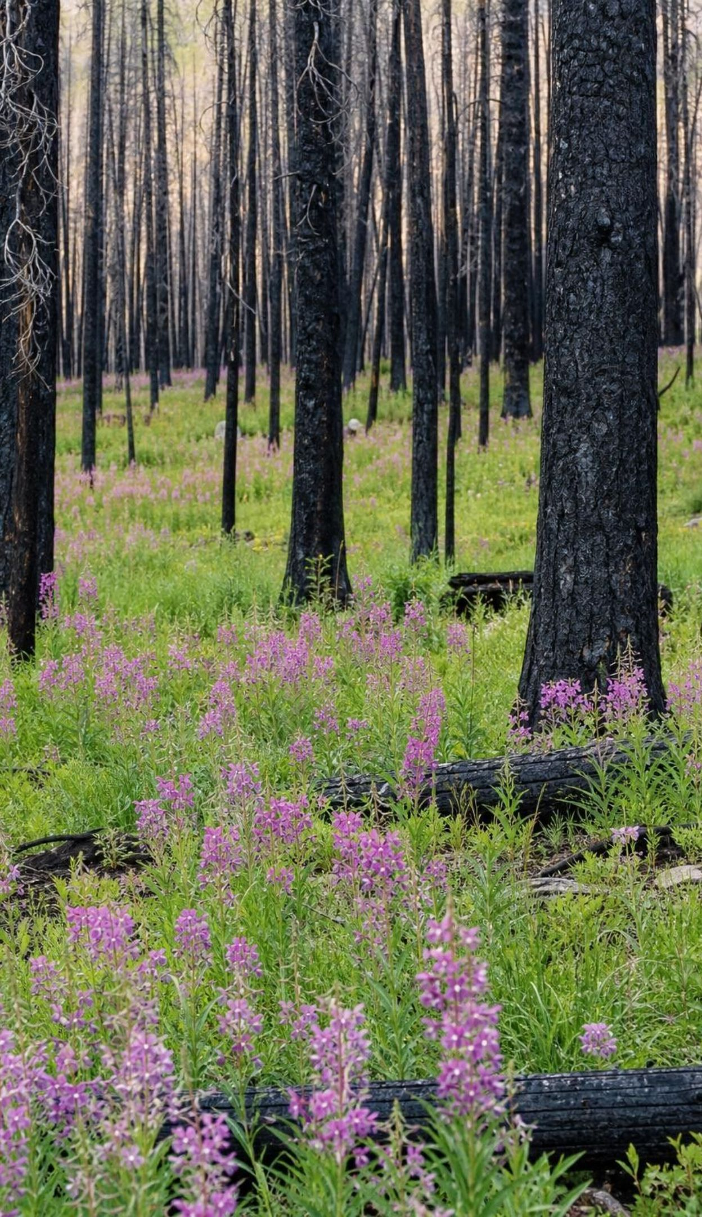
EXIT TICKET
Exit ticket
A wildfire burns a forest but leaves the soil. Primary or secondary succession? Give the clue.
Name one living and one nonliving change to an ecosystem, and a population each change would affect.
A friend shows one before-and-after graph as proof that a dam caused a fish decline. What is missing?
28
Notes:
Three questions on an index card, five minutes, collected at the door. Question 1 checks the succession distinction, question 2 checks the physical-biological split the PE uses, and question 3 checks whether students can name what a single before-and-after comparison lacks. Sort cards into three piles for tomorrow: secure, partly there, needs the reteach. Students who miss question 3 should revisit their W7 corrections before writing W6.
EXPECTED RESPONSES: 1: secondary, because the soil (and roots and seeds) survived. 2: e.g., living: prairie dogs removed, burrowing owls decline; nonliving: a dam deepens water, fast-water insects decline. 3: a comparison river without a dam, more years of data, a mechanism, and other possible causes ruled out.
WATCH FOR: Question 3 answers that say 'more data from the same river' only; ask for a comparison site too.
CONNECTS TO: W10 mastery check revisits all three; W6 CER and W7 repair follow.
PACING: about 5 min

