Slide 1
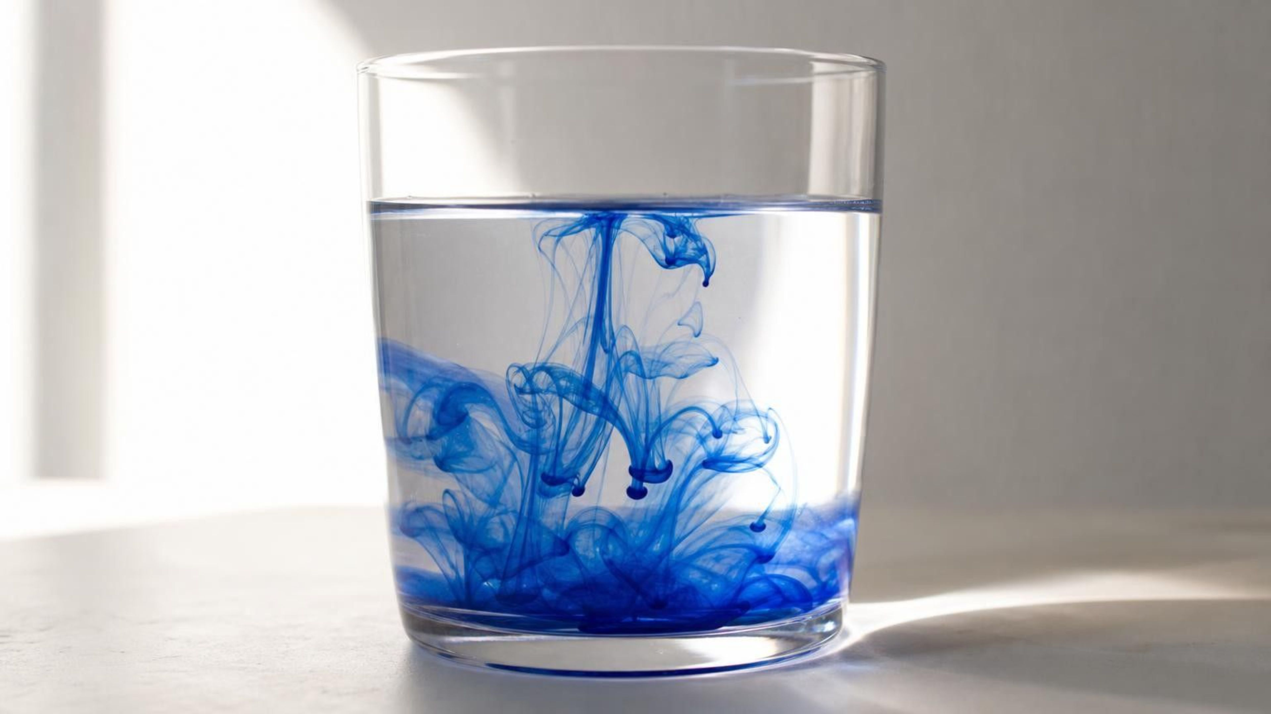
The Motion of Particles
Chapter 23 of 29 · States of Matter
Lesson 23: What are particles doing in a solid, a liquid and a gas, and what changes when energy goes in or out?
Angela's Wand · Bring Science Alive! 7th Grade Integrated
Notes:
This lesson builds the particle model that the rest of the unit depends on. Students will find out that every sample is made of particles that never stop moving, that the way they move decides whether the sample is a solid, a liquid or a gas, and that adding or removing energy changes that motion until the state changes. Preview the three labs: a three-cup mystery read only from spreading dye, a tray of marbles shaken at three 'temperatures', and an energy-token model in which students act as particles. No flames, no hands-on water above 50 °C, and no energy calculations anywhere in the chapter.
CONNECTS TO: Overview of Lab 1, Lab 2 and Lab 3; W1 phenomenon worksheet opens on the next slide.
PACING: about 2 min

Slide 2
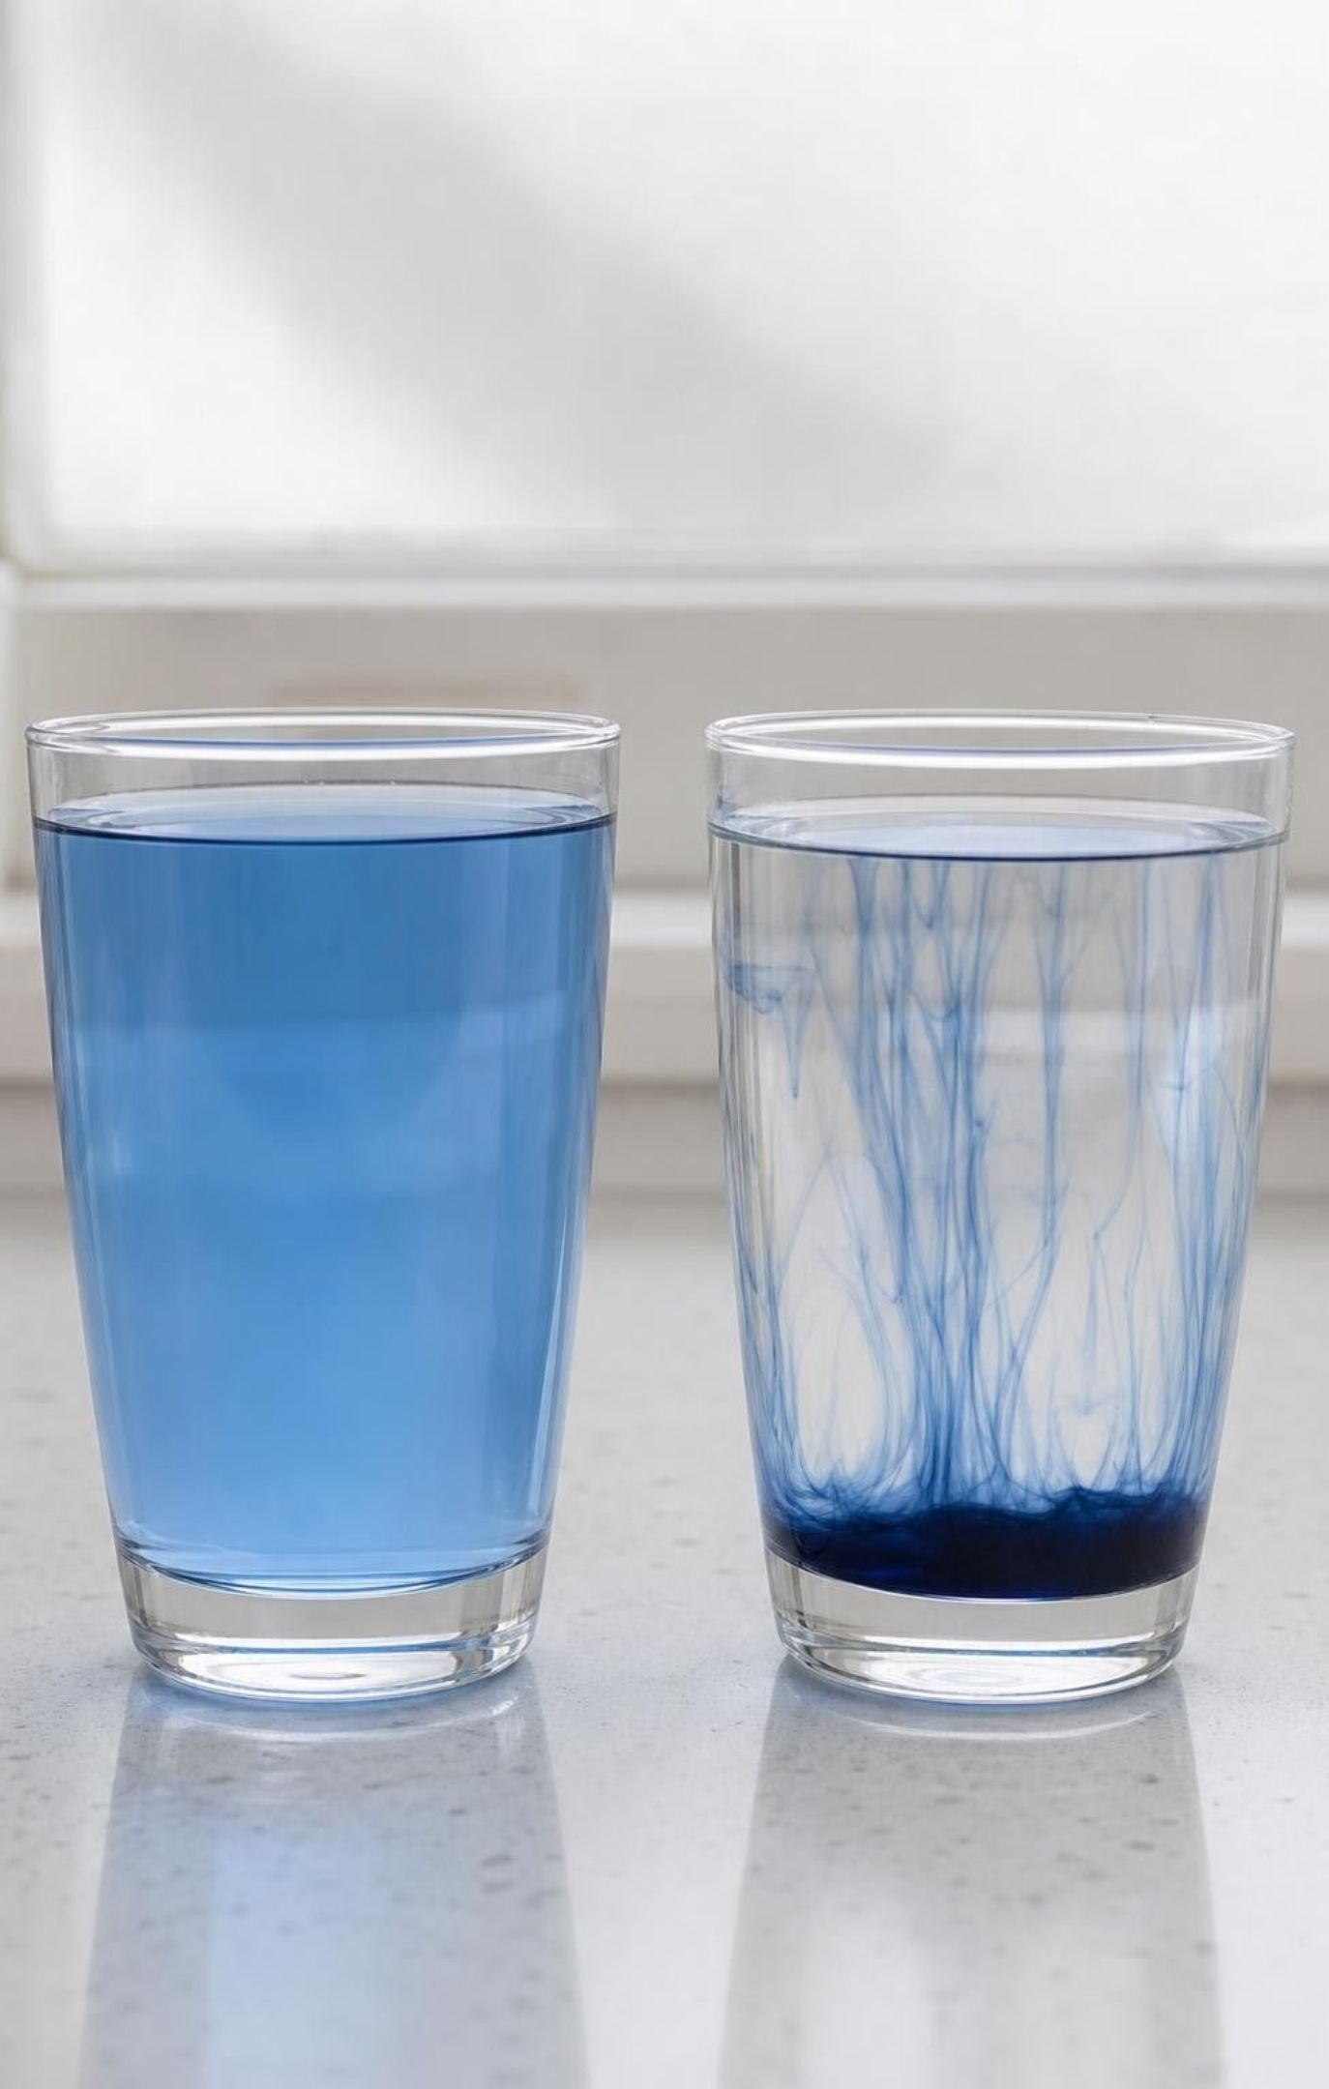
PHENOMENON
Two drops, two speeds, and nobody stirred
Two clear cups of still water sit side by side. One came from the refrigerator; the other is about as warm as a hot bath. One drop of blue food coloring falls into each cup at the same moment, and nobody stirs or bumps either one. In two minutes the warm cup is evenly blue. Ten minutes later the cold cup is still streaky, with a dark patch near the bottom.
Notice: what is the same about the two cups, and what is different?
Wonder: if nobody stirred, what moved the color through the water?
Predict: would the cold cup ever turn evenly blue? What would a drop do in ice?
2
Notes:
If you can, run this live: two identical clear cups with 200 mL each, one of refrigerator water and one of warm tap water at about 40 to 45 °C that you prepare and pour yourself (never above 50 °C). Put a white sheet of paper behind and under the cups, wait a minute for the water to stop swirling, then release one drop into each at the same moment. Give two silent minutes for a notice and a wonder, then collect ideas without judging them. Push on one question: the water looks perfectly still, so what is moving the dye? Park every 'heat pushes it' or 'warm water is thinner' idea on the board to test later. Do not resolve the phenomenon now; slides 11 to 13 and Lab 1 return to it.
EXPECTED RESPONSES: Notice: same cups, same amount of water, same dye; only the temperature differs; the warm cup mixes first; in the cold cup the drop sinks and stays as a blob. Wonder: what is moving the dye; would stirring change the result; does cold water ever mix; would salt or sugar spread the same way. Predict: yes, the cold cup should become evenly blue eventually, only more slowly; dye frozen into ice would barely spread.
WATCH FOR: 'Warm water is thinner, so the dye falls through it' and 'heat pushes the dye around'. Both describe water as a smooth material. The lesson replaces that picture with particles that are always moving.
CONNECTS TO: W1 phenomenon worksheet records the notice, wonder and a first explanation; Lab 1 turns this into a three-cup mystery.
PACING: about 8 min

Slide 3
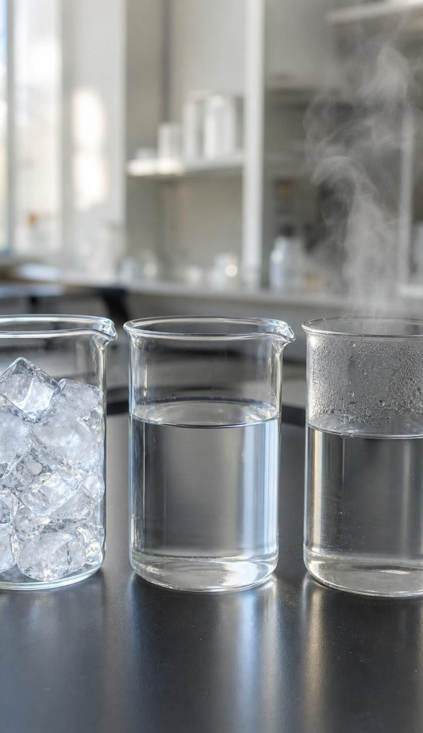
LEARNING TARGETS
What you will be able to do
1
I can describe how particles are arranged and how they move in a solid, a liquid and a gas.
2
I can explain that temperature measures the average motion of a sample's particles.
3
I can model how particle motion, temperature and state change as energy is added or removed.
4
I can explain how colliding gas particles make pressure, and how pressure helps set the state.
5
I can use melting points, boiling points and a state diagram to predict a substance's state.
3
Notes:
Read the targets aloud and point out the verbs: describe, explain, model, use. The third target is the big one. By the end of the lesson, students should be able to take any pure substance, add or remove energy in their heads, and predict what its particles, its temperature and its state will do. Tell them that no target involves calculating energy; every model in this chapter is a drawing, a gesture, a table or a graph.
CONNECTS TO: Learning targets on the chapter page; W10 mastery checks every target.
PACING: about 2 min

Slide 4
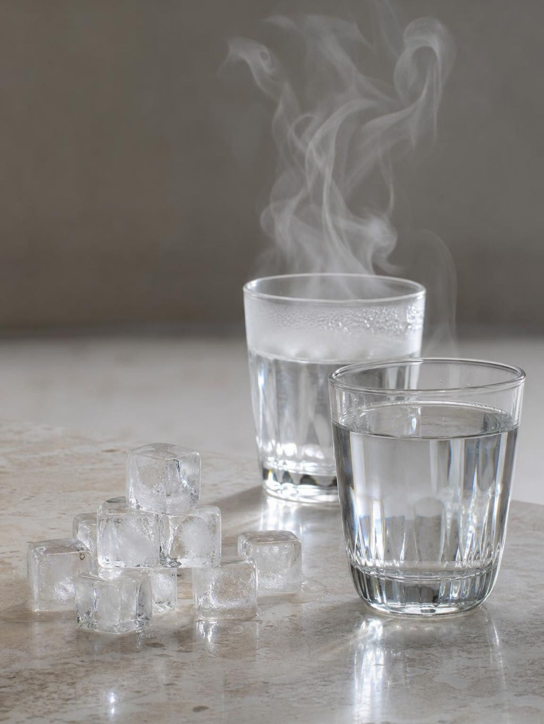
One substance, three states
Ice, liquid water and water vapor are all made of the same water molecules.
A state of matter is set by how close the particles are and how freely they move.
The particles never change size, shape or mass when the state changes.
In every state, the particles are always moving.
Scientists say 'particles' for the atoms or molecules a substance is made of.
4
Notes:
Start at the scale students can see, then zoom in. A single drop of water (about 0.05 mL) holds roughly 1.7 × 10²¹ molecules, so everything we observe in a cup is the combined behavior of an unimaginably large crowd; this is the crosscutting idea of scale, proportion and quantity. Introduce the term state of matter: a description of a sample's form that comes from the spacing and motion of its particles, not from any change in the particles themselves. Ask: if ice, water and vapor are the same molecules, what could possibly be different? Steer toward two answers, how far apart they are and how they move. Introduce three gestures and use them every time a state is named: fists pressed together and trembling (solid), palms sliding over each other (liquid), hands flying apart (gas).
WATCH FOR: Students may say steam is made of 'hot molecules' or 'bigger molecules'. Insist on the same molecule with different spacing and motion.
CONNECTS TO: W2 vocabulary relationships; W4 diagram worksheet.
PACING: about 4 min

Slide 5
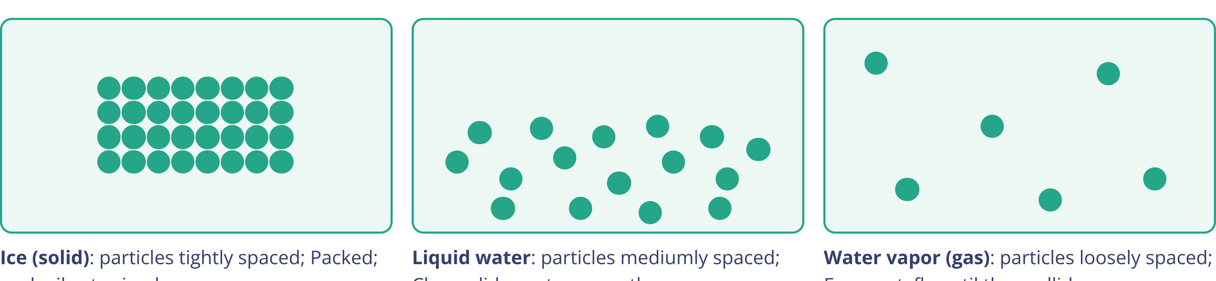
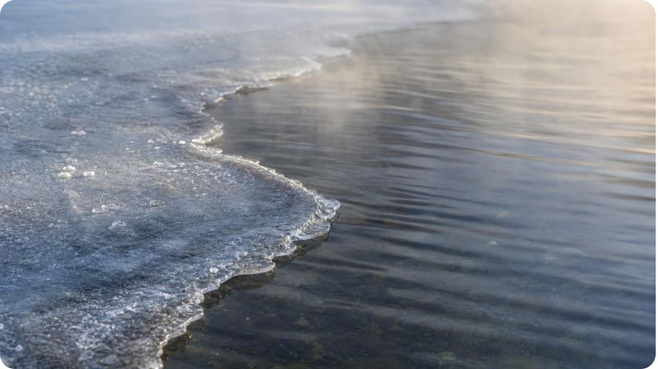
MODEL
Water's particles in three states
Model: The same water molecules as ice, liquid and vapor
Every particle is the same size in all three panels. Real gas particles are far more spread out than any drawing can show.
5
Notes:
Read the panels from left to right. The same particles, the same size, appear in every panel; only the spacing and the motion change. Ice: a tight pattern, each particle vibrating around its own spot. Liquid: still close together, but the pattern is gone and the particles slide past one another. Vapor: far apart, each particle flying in a straight line until it collides. Be honest about the drawing's limits. In steam at 100 °C the molecules are on average about 12 times farther apart than in the liquid, and the same mass of water takes up about 1,600 times more room as vapor, so no slide can draw gas spacing to scale. Flag one exception for later: for water, the liquid is a little denser than the ice, which is why ice floats; most substances are the other way round.
WATCH FOR: Students draw the gas particles larger than the solid particles, or draw the liquid as widely spaced as a gas. Ask them to compare: the liquid panel should look almost as crowded as the solid.
CONNECTS TO: W4 diagram worksheet; Lab 2 three-panel drawing; chapter evidence of learning.
PACING: about 5 min

Slide 6
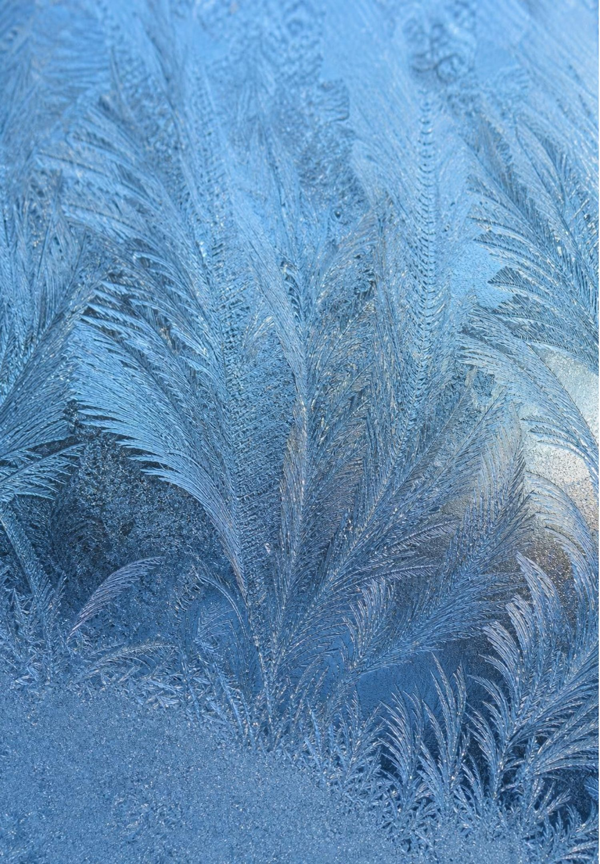
Solids: packed in place, but never still
Particles are packed tightly and touch their neighbors, often in a repeating pattern.
Each particle vibrates around one spot. It cannot trade places with its neighbors.
So a solid keeps its own shape and nearly its own volume, whatever container it is in.
Warm a solid and the vibrations grow, so it expands very slightly. The particles do not grow.
Gesture: fists pressed together, trembling.
6
Notes:
Ask students to hold a pencil perfectly still, then tell them that every particle in it is vibrating trillions of times a second. The sample is still; the particles are not. Give two everyday clues. A tight metal jar lid loosens under hot tap water because the metal's particles vibrate harder and sit slightly farther apart on average. Sidewalks and bridges have gaps so they can expand on hot days. Point out that 'nearly its own volume' is deliberate: solids change volume by a tiny amount when their temperature changes. Not every solid has a neat pattern either; glass and many plastics are solids whose particles are locked in place without a repeating arrangement. Ice and dry ice look alike because both are solids, even though they are different substances.
WATCH FOR: 'Particles in a solid do not move at all.' This is the most common error in the chapter; W7 returns to it.
CONNECTS TO: Lab 2 level 1 (gentle shake); W7 misconception repair; W3 reading.
PACING: about 4 min

Slide 7
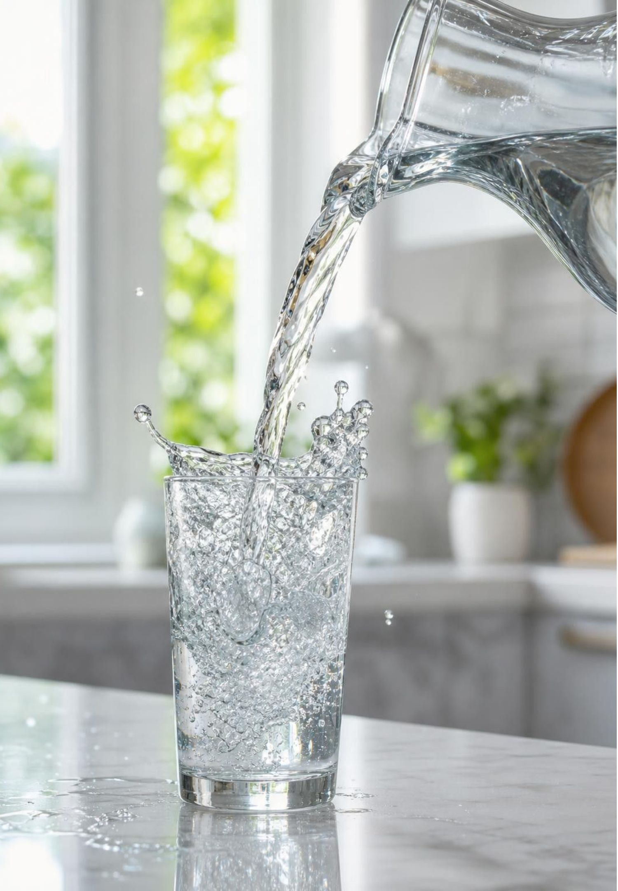
Liquids: close together, sliding past each other
Particles stay close together and touching, but they are not locked in place.
They slide and tumble past one another, so a liquid can flow and be poured.
Gravity pulls the particles down until they fill the bottom of the container.
A liquid's shape changes with its container; its volume stays nearly the same.
Gesture: palms sliding over each other.
7
Notes:
Pour 100 mL of water from a tall cylinder into a wide bowl and back: the shape changes, the volume does not. Then connect to the phenomenon. In liquid water the molecules are constantly jostling, so a dye molecule is bumped into a new position trillions of times a second. Nobody needs to stir; the particles' own motion spreads the color. The textbook compares a liquid to sand pouring through an hourglass. Ask students where that comparison breaks down: each sand grain is itself a tiny solid made of many particles, and poured sand piles up in a cone while water levels out flat.
WATCH FOR: Students picture liquid particles as far apart because liquids flow. Liquid particles are nearly as close as in a solid; the difference is freedom to move, not distance.
CONNECTS TO: Lab 2 level 2 (medium shake); Lab 1 dye spreading; W3 reading.
PACING: about 4 min

Slide 8

Gases: far apart, flying free
Particles are far apart, with empty space between them.
Each moves in a straight line until it hits another particle or a wall, then changes direction.
So a gas spreads out to fill its container, taking its shape and its whole volume.
Squeeze a gas and the same particles simply move closer together.
Water vapor and carbon dioxide gas are invisible. A white cloud is tiny droplets of liquid water.
Gesture: hands flying apart.
8
Notes:
Give a sense of speed. At room temperature the nitrogen molecules in the air average about 470 meters per second, faster than a cruising jet airliner. Then ask the obvious question: if they are that fast, why does a smell take several seconds to cross a room? Because each molecule collides billions of times a second, so its path zigzags and it makes slow progress in any one direction; drifting air currents usually carry a smell faster than diffusion alone. If you have a photo of a kettle, point out the clear gap right at the spout: that is the invisible vapor. The white plume farther out is droplets that formed as the vapor cooled. Smoke, likewise, is solid specks carried along by the air.
WATCH FOR: 'Steam is the white cloud' and 'gas particles are bigger or lighter than liquid particles'. The white cloud is liquid water; the particles are the same in every state.
CONNECTS TO: Lab 2 level 3 (vigorous shake); W2 vocabulary; W8 evidence sort.
PACING: about 5 min

Slide 9
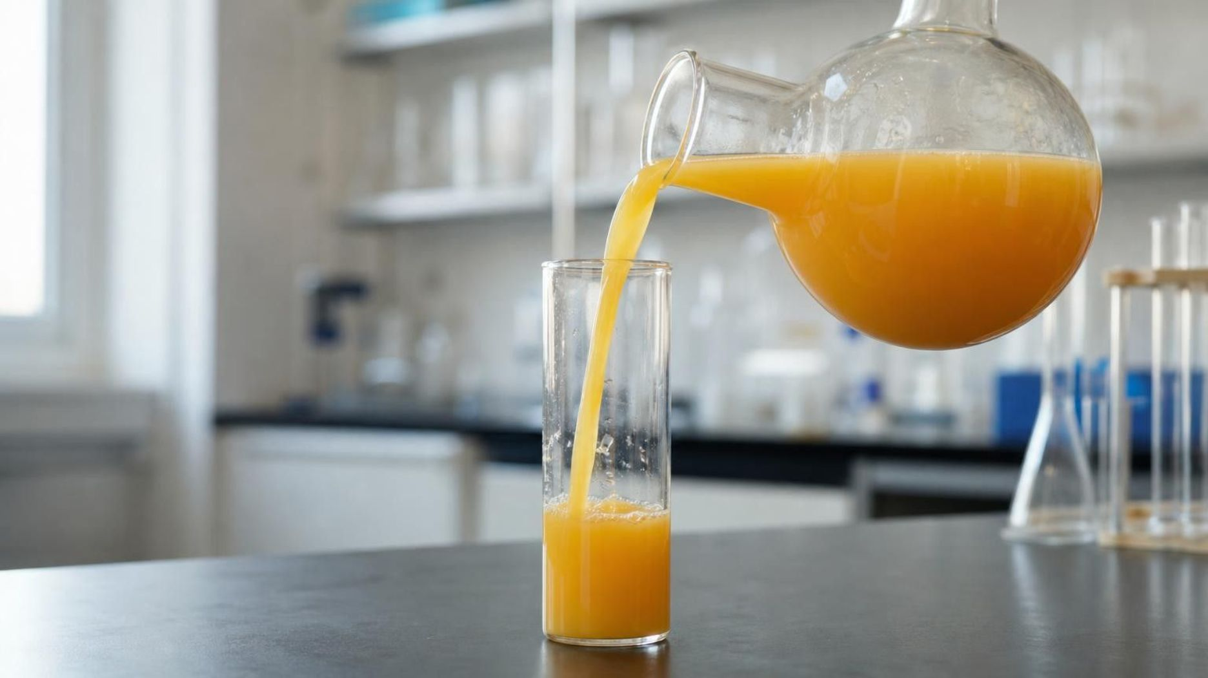
CHECK FOR UNDERSTANDING
Quick check: which state is it?
A sample keeps the same volume when it is poured into a new container, but its shape changes. What state is it in, and what are its particles doing?
A. Solid: its particles vibrate in fixed spots
B. Liquid: its particles stay close but slide past each other
C. Gas: its particles are far apart and fly freely
D. You cannot tell without knowing its temperature
9
Notes:
Vote with fingers, then ask two students who chose different answers to defend them before you reveal. Keeping its volume rules out a gas, which would spread to fill the new container; changing its shape rules out a solid. Follow up by asking for one sample that would fit option A (a coin, an ice cube) and one for option C (the air in a balloon). Option D is tempting because the lesson keeps saying temperature matters, but the observed behavior is already enough evidence of the state.
EXPECTED RESPONSES: B. It keeps its volume, so its particles stay close together; it changes shape, so they must be free to slide past one another.
WATCH FOR: Students who pick A because 'it keeps its volume' have used only one of the two clues.
CONNECTS TO: W2 vocabulary; W10 mastery.
PACING: about 3 min

Slide 10
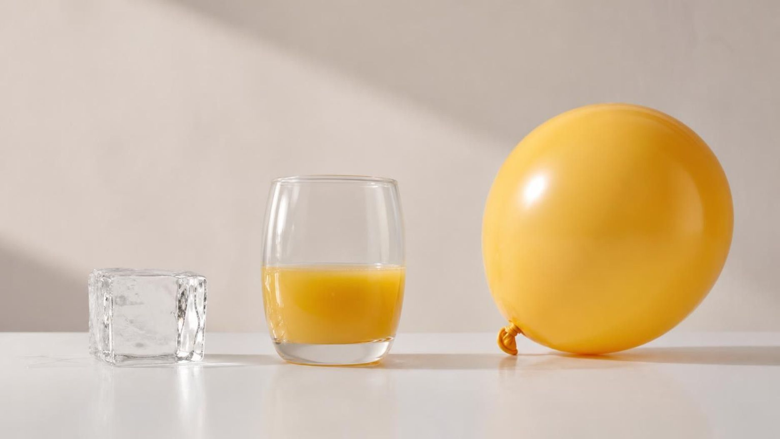
Vocabulary in context
Words for the three states
solid
liquid
gas
A state in which particles are packed close in fixed spots and can only vibrate, so the sample keeps its own shape and nearly its own volume. An ice cube, a coin and a block of dry ice are all solids.
A state in which particles stay close but slide past one another, so the sample flows and takes its container's shape while keeping its volume. Juice poured from a carton into a glass changes shape but not volume.
A state in which particles are far apart and move freely until they collide, so the sample fills any container it is in. The helium in a balloon presses on every part of the inside of the rubber.
10
Notes:
Ask students to add the gesture and one example of their own to each card, then test one another in pairs: one partner gives a particle description, the other names the state and makes its gesture. Point out that each definition describes the particles first and the visible behavior second. The visible behavior is the evidence; the particle behavior is the explanation. The umbrella term, state of matter, names the form a sample takes because of its particles' spacing and motion.
WATCH FOR: Defining states only by what you can see or feel ('a solid is hard'). Butter and wax are soft but solid; the definition is about particles.
CONNECTS TO: W2 vocabulary relationships.
PACING: about 3 min

Slide 11
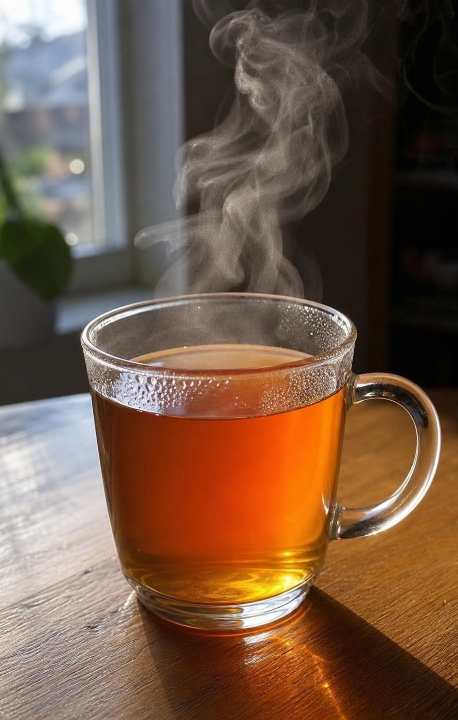
Temperature measures average particle motion
The particles in any sample move at many different speeds, changing every time they collide.
Temperature is a measure of their average motion energy, which scientists call kinetic energy.
Higher temperature means faster particles on average; lower temperature means slower on average.
Thermal energy is the total motion energy of all the particles in the sample.
A bathtub of warm water has a lower temperature than a cup of hot tea, but far more thermal energy.
11
Notes:
This is the idea the textbook leaves unsaid, and students met it in Grade 6: a thermometer reports the average motion of the particles around it. Back to the cups. In the warm cup the water molecules move faster on average, so they knock the dye molecules into new places more often and harder, and the color spreads sooner. In the cold cup the molecules still move, only more slowly on average. Stress the word average: at any moment, some molecules in the cold cup are moving faster than some in the warm cup. Use the bathtub and the tea to separate temperature (an average per particle) from thermal energy (a total for the whole sample). There are no energy calculations in this chapter; keep everything qualitative.
WATCH FOR: 'Temperature and thermal energy are the same thing' and 'cold is something that flows into things'. Cooling means energy leaving, not cold arriving.
CONNECTS TO: Lab 1 three-cup mystery; W5 data worksheet; Grade 6 MS-PS3-4 background.
PACING: about 5 min

Slide 12
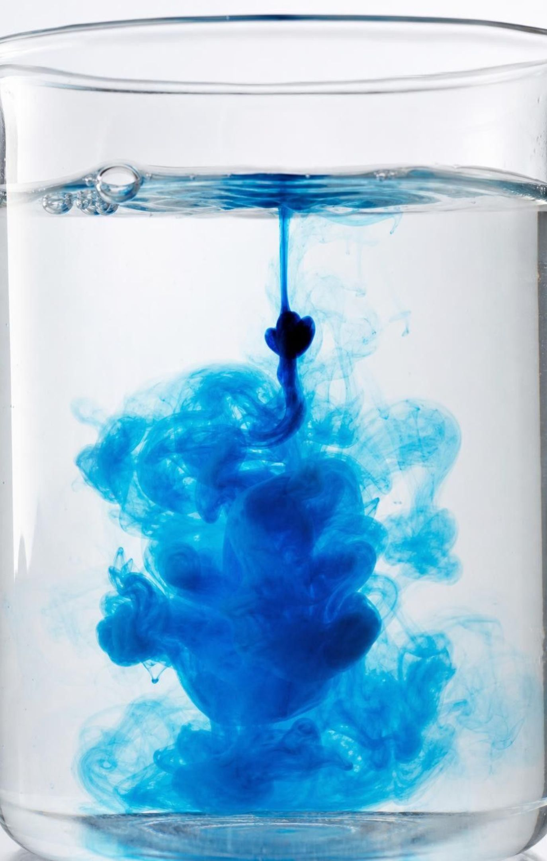
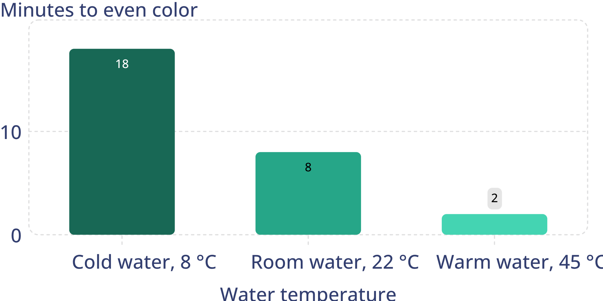
MODEL
Warmer water, faster spreading
Model: Minutes until one dye drop looked evenly mixed
simulated data
Teaching dataset (simulated): class averages for 200 mL of still water and one drop of food coloring. Your own times will differ.
12
Notes:
Tell students plainly that this is a simulated teaching dataset built to show the typical pattern, not a published measurement. Read it together: as the temperature goes up, the time to even color goes down, but not by a steady amount (going from 8 to 22 °C saves ten minutes; going from 22 to 45 °C saves six). Ask for the cause-and-effect chain in four links: higher temperature, faster particles on average, more frequent and harder bumps on the dye, faster spreading. Then add an honest complication: what we see in a cup is not pure diffusion. The drop is a little denser than water and sinks, and small temperature differences inside the cup set up gentle currents that carry color. Faster particle motion is still the main reason the warm cup wins, but call what we see 'spreading'.
WATCH FOR: Students read the short warm-water bar as 'the warm water had less dye'. The bars are times, not amounts.
CONNECTS TO: Lab 1 graph and class data; W5 data worksheet.
PACING: about 5 min

Slide 13
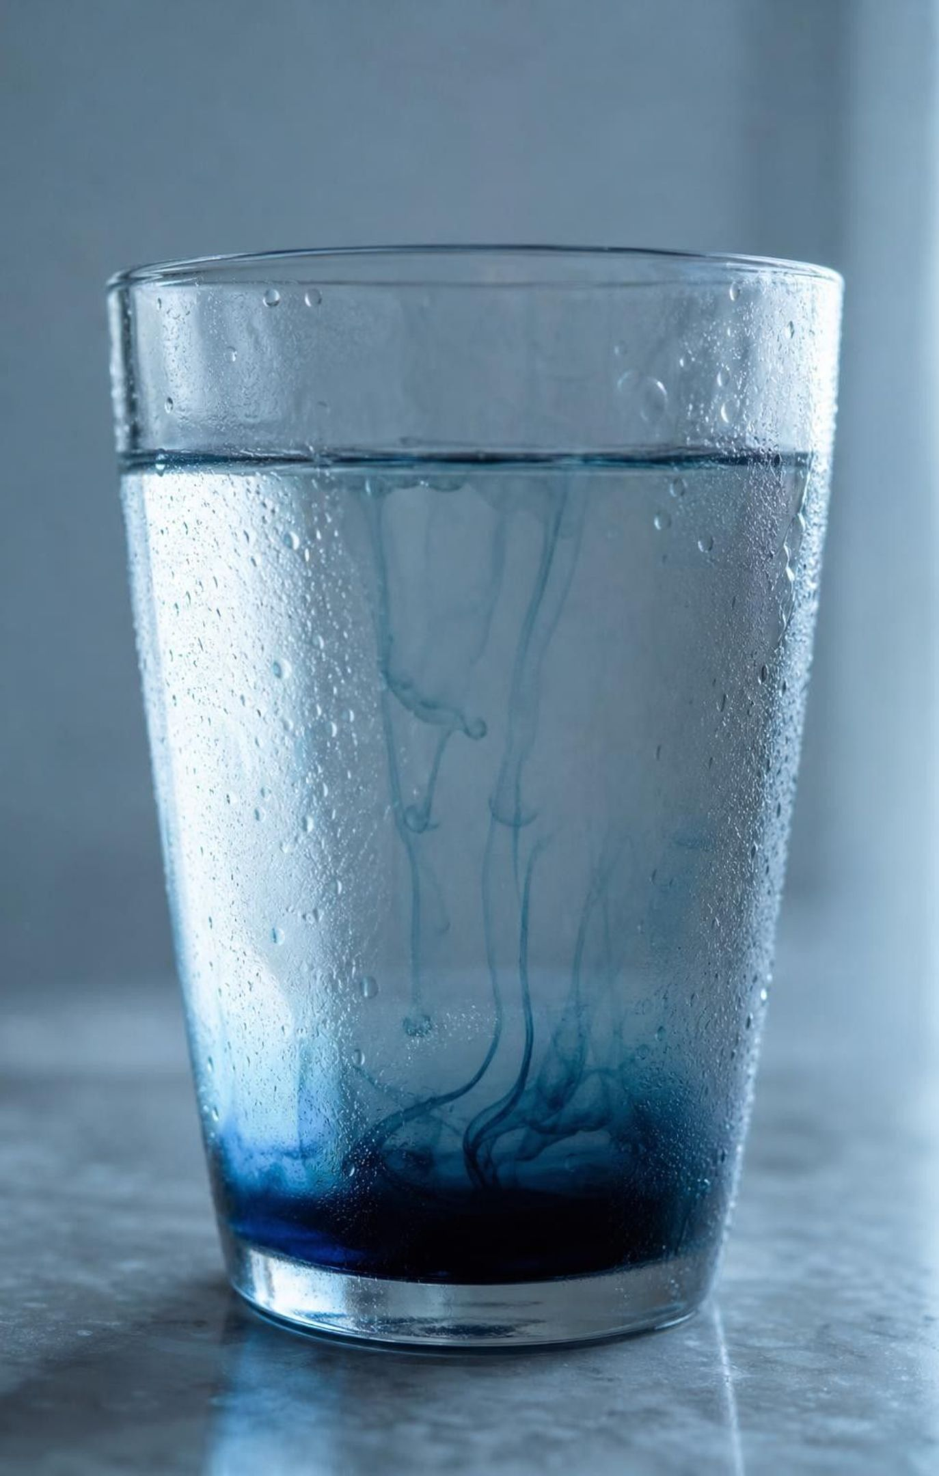
Think, pair, share
Discuss: would the cold cup ever turn evenly blue?
Use the words particle, motion and temperature.
Then: if dye were frozen into the middle of an ice cube, would it spread? Why or why not?
If you left the cold cup alone for a whole day, would it ever become evenly blue? What does your answer tell you about the particles in cold water?
13
Notes:
Think for one minute, pair for two, then share. Listen for students who say the cold cup will 'never' mix because the particles in cold water are 'not moving'. That is the solid-state misconception showing up in a liquid. The ice question separates the states: a liquid's particles trade places, a solid's particles do not, so dye locked inside ice stays where it is (diffusion in solids is extremely slow), and a drop of food coloring on top of an ice cube only spreads as the surface melts.
EXPECTED RESPONSES: Yes. The molecules of cold water are still moving, only more slowly on average, so they keep knocking the dye around until the color is even; it just takes longer. Dye frozen inside ice would barely spread, because the particles of a solid only vibrate in place and cannot trade places.
WATCH FOR: 'Cold particles do not move.' Particles slow down when a sample is cooled, but they never stop.
CONNECTS TO: Lab 1 analysis (q6); W3 reading; return to the W1 first explanation.
PACING: about 6 min

Slide 14
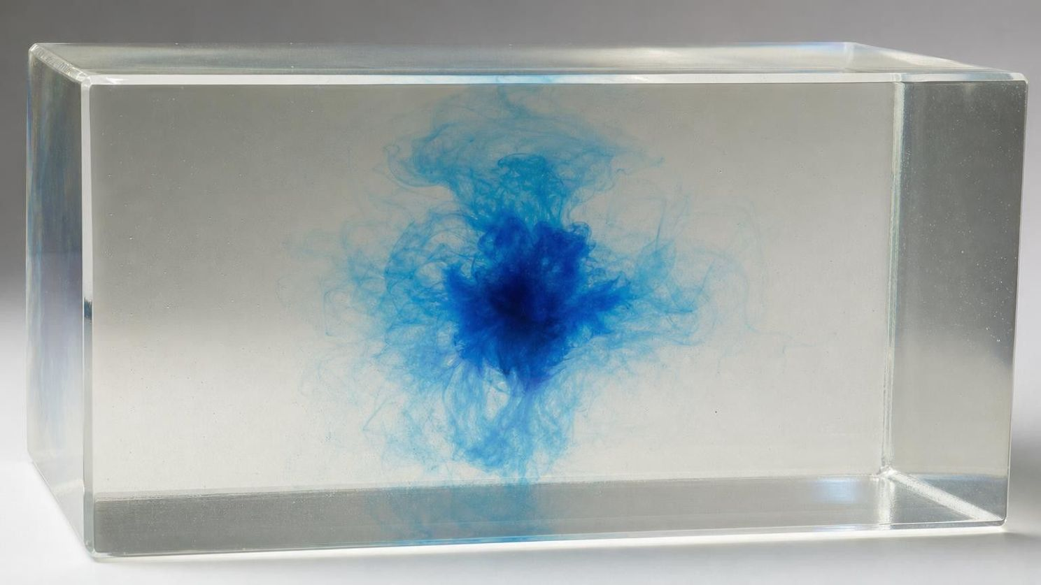
VOCABULARY IN CONTEXT
Words for motion and energy
temperature
thermal energy
diffusion
A measure of the average motion energy (kinetic energy) of a sample's particles. Higher temperature means faster particles on average. The molecules in water at 45 °C move faster, on average, than those in water at 8 °C.
The total motion energy of all the particles in a sample. It depends on both the temperature and how many particles there are. A swimming pool at 26 °C holds far more thermal energy than a mug of cocoa at 70 °C.
The spreading of particles from where they are crowded to where they are fewer, caused only by their own random motion. In set gelatin, where nothing can flow, dye particles slowly diffuse outward from a drop.
14
Notes:
Have pairs write one sentence that uses all three words correctly about the phenomenon cups, for example: 'The two cups hold the same amount of water, but the warm cup has the higher temperature, so its particles move faster on average, it holds more thermal energy, and diffusion in it is faster.' Point out a preview of slide 16: when a substance is melting or boiling, added thermal energy does not raise the temperature; it loosens or separates the particles instead.
WATCH FOR: Students define diffusion as 'mixing'. Stirring also mixes; diffusion needs no outside push.
CONNECTS TO: W2 vocabulary; W3 reading.
PACING: about 3 min

Slide 15
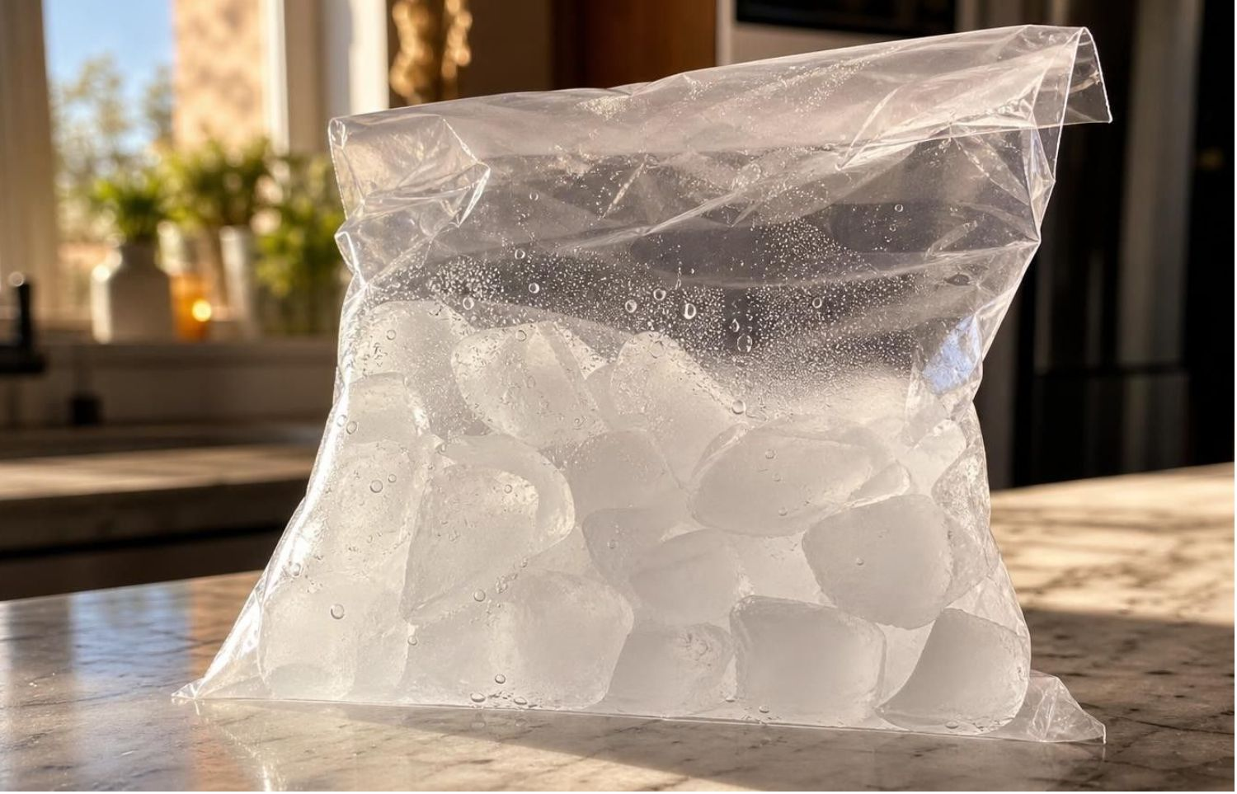
CHECK FOR UNDERSTANDING
Quick check: adding energy to cold ice
A sealed bag of ice at −10 °C sits in a warm room and slowly gains thermal energy. What happens first?
A. The ice melts right away, while it is still at −10 °C
B. The ice warms toward 0 °C: its particles vibrate faster, but it stays solid
C. The particles grow until they no longer fit in a pattern
D. Nothing happens until the ice reaches 100 °C
15
Notes:
Vote, then ask how a thermometer could tell option A from option B. Under A, the temperature would stay at −10 °C while puddles formed; under B, it climbs first. Freezer ice is usually about −18 °C, so ice straight from a freezer warms for a while before any of it melts. One detail for careful thinkers: in a large piece, the outside reaches 0 °C first and starts to melt while the middle is still colder; our model treats the whole sample as warming evenly. This sets up the heating curve on the next slide.
EXPECTED RESPONSES: B. Energy added to a solid below its melting point makes its particles vibrate harder, so its temperature rises toward 0 °C; it stays solid until it reaches its melting point.
WATCH FOR: Option A (any energy melts ice at once) and option C (particles grow). Both come up again in W7.
CONNECTS TO: Lab 3 solid rounds; W7 misconception repair.
PACING: about 3 min

Slide 16
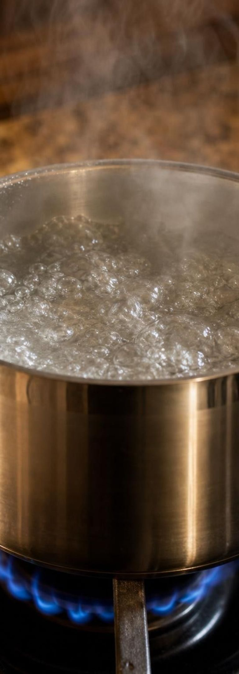
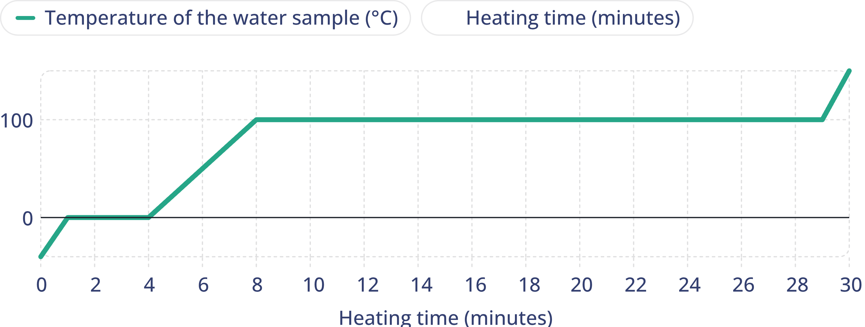
MODEL
The heating curve: two flat steps
Energy goes in at a steady rate the whole time. Watch what the temperature does.
Model: Water heated at a steady rate at sea-level pressure (idealized)
simulated data
Idealized curve: the flat steps are melting at 0 °C and boiling at 100 °C. Times are illustrative, not measured.
16
Notes:
Walk the curve one segment at a time and say what the particles are doing in each. Rising, solid: the vibrations grow. Flat at 0 °C: ice and water together; the energy is loosening particles from their fixed spots instead of speeding them up, so the temperature holds. Rising, liquid: the particles slide past one another faster. Flat at 100 °C: liquid and vapor together; the energy is pulling particles completely apart. Rising, gas: the vapor particles fly faster. Ask why the boiling step is so much longer than the melting step: separating particles completely from their neighbors takes much more energy than loosening them. Read right to left, the same curve describes cooling: energy leaves, and the temperature holds at 100 °C while vapor condenses and at 0 °C while water freezes. This is the heart of MS-PS1-4, and no energy numbers are needed. The curve assumes a sample kept at sea-level pressure and a heater that never changes; the times are illustrative.
WATCH FOR: 'If the heat is on, the temperature must be rising.' The flat steps are the evidence against it. Also 'turning the burner up makes boiling water hotter': at sea level it stays at 100 °C and simply boils faster.
CONNECTS TO: Lab 3 token model reproduces this curve; W4 diagram worksheet; W9 transfer problem.
PACING: about 6 min

Slide 17
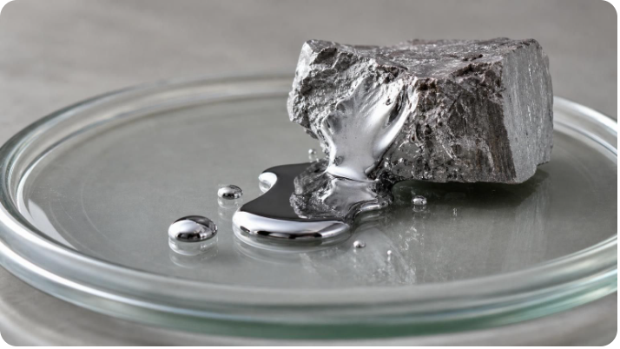
VOCABULARY IN CONTEXT
Words for changes of state
melting point
boiling point
sublimation
The temperature at which a pure solid turns into a liquid as energy is added, at a stated pressure. The liquid freezes at the same temperature. At sea-level pressure gallium melts at about 30 °C, so it melts slowly in a warm hand.
The temperature at which a pure liquid turns into a gas all through the liquid, at a stated pressure. Lower pressure means a lower boiling point. Water boils at 100 °C at sea level but at about 85 °C on top of Mount Whitney.
A change straight from solid to gas, with no liquid in between. At sea-level pressure, dry ice (solid carbon dioxide) sublimates at −78.5 °C.
17
Notes:
These two temperatures are properties: each pure substance has its own, so a measured melting point helps identify an unknown, as long as the pressure is stated. Add two cautions the textbook skips. First, sharp melting and boiling points belong to pure substances; wax, glass, butter and most mixtures soften over a range of temperatures. Second, a liquid can turn into a gas below its boiling point by evaporation at its surface, which is why puddles dry on cool days. Boiling is different: bubbles of vapor form inside the liquid itself. Lab 3 gives its model substance a melting point and a boiling point in token units.
WATCH FOR: 'All substances have one melting point' and 'water must reach 100 °C to become a gas'. Only pure substances have sharp points, at a stated pressure, and evaporation happens at any temperature.
CONNECTS TO: Lab 3 rule card; W8 evidence sort; W10 mastery.
PACING: about 4 min

Slide 18
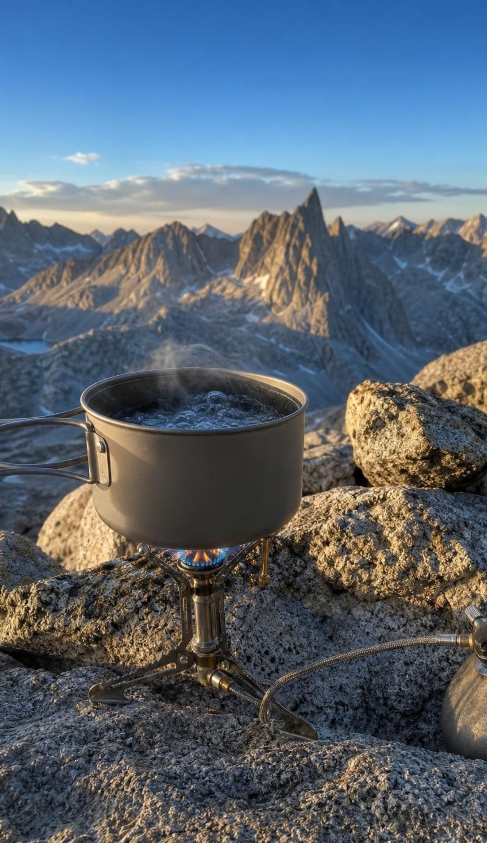
REAL-WORLD CONNECTION
California connection: cooking on Mount Whitney
Mount Whitney in the Sierra Nevada rises 4,421 m, the highest summit in the lower 48 states. Air pressure at the top is only about 58 kPa, not much more than half of sea-level pressure. Water there boils at about 85 °C, so backpackers' noodles cook slowly. About 135 km away, at Badwater Basin in Death Valley, 86 m below sea level, water boils just above 100 °C.
Boiling starts when vapor bubbles inside the water can push back against the pressure above it.
Less air pressure above the water means bubbles can form at a lower temperature.
A pressure cooker does the opposite: about 200 kPa inside, so water boils near 120 °C.
18
Notes:
Ask two questions. Would boiling water scald a hiker on the summit a little less than at the beach? (Slightly less, because 85 °C water is cooler.) Can the hiker cook pasta faster by turning up the stove? (No; more heat makes the water boil harder, not hotter.) Then connect to particles: boiling needs particles moving fast enough to form bubbles of vapor that can hold their own against the water and air pressing on them, and fewer air particles pressing down means they need less speed. The summit pressure varies with the weather by a kilopascal or two, so 85 °C is an approximate value. The next slide explains what pressure is in particle terms.
WATCH FOR: 'Boiling water is always 100 °C.' That is true only near 101 kPa.
CONNECTS TO: W8 evidence sort (the summit cards); slide 22 state diagram; NIST boiling data in the chapter references.
PACING: about 4 min

Slide 19
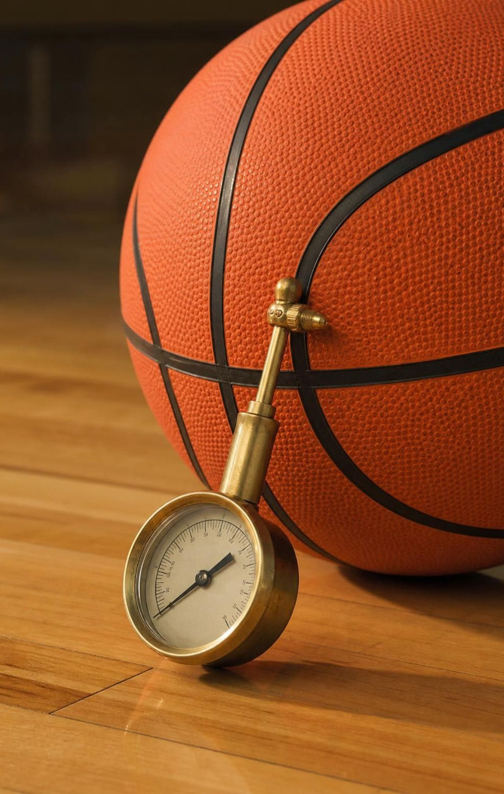
Pressure: particles hitting the walls
Pressure is force spread over an area. The same push on a smaller area makes more pressure.
A gas pushes on its container because huge numbers of particles hit every bit of wall each second.
More particles hitting the same area, or particles hitting faster, means more pressure.
Scientists measure pressure in kilopascals (kPa). Air at sea level presses with about 101 kPa.
Air high on a mountain is less crowded, so it hits surfaces less often and its pressure is lower.
19
Notes:
Start with feet: snowshoes keep a hiker on top of soft snow because the same weight is spread over a bigger area. Then switch to particles. Each gas particle that hits a wall gives it a tiny push, and so many hit every second that the pushes add up to a steady pressure. One kilopascal is 1,000 newtons on every square meter; sea-level air presses on each square meter of a tabletop with about 101,000 newtons, roughly the weight of ten tonnes, and the table does not collapse because air pushes up from underneath just as hard. Tell the bottle story: a plastic bottle capped on a mountaintop crumples on the drive down, because the crowded low-altitude air outside hits it more often than the thin mountain air sealed inside. Finally, warmer gas particles move faster, so they hit harder and more often; that is why a ball left in a hot car feels firmer.
WATCH FOR: 'Air pressure only pushes down.' Gas particles hit from every direction, so pressure pushes on every surface, sideways and upward too.
CONNECTS TO: Lab 2 Part B wall-hit counts; W8 evidence sort (bottle, syringe and tire cards).
PACING: about 5 min

Slide 20
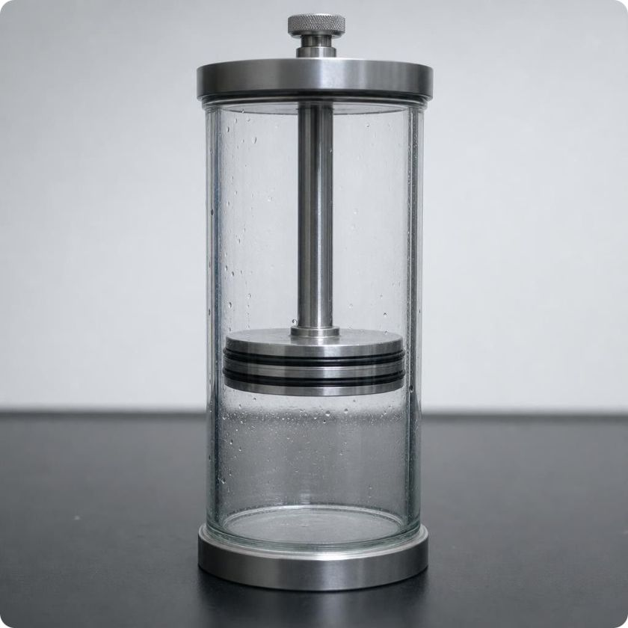
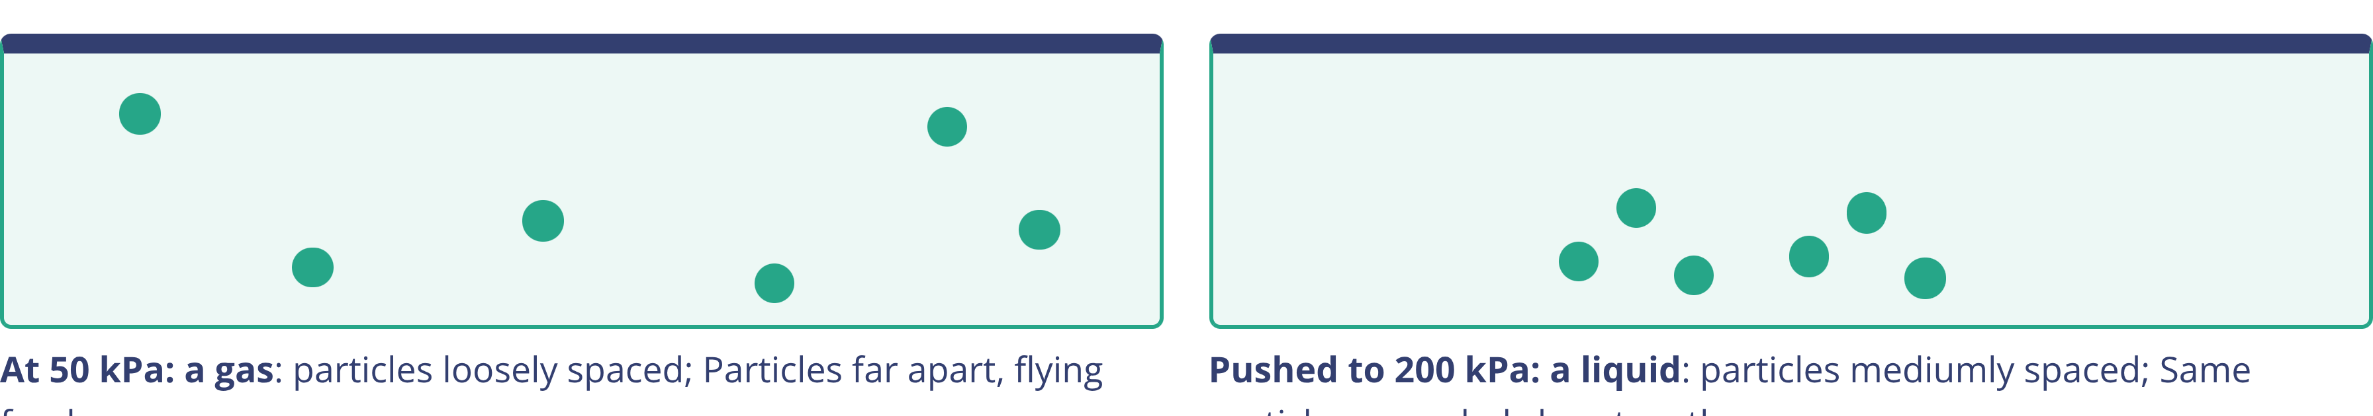
MODEL
Same temperature, more pressure: gas to liquid
Model: Water at 100 °C in a sealed cylinder with a piston
Pushing the piston in crowds the particles. At 100 °C, water above about 101 kPa is a liquid.
20
Notes:
Describe the setup: a cylinder closed by a piston that can slide, holding only water vapor, kept at 100 °C. At 50 kPa the sample is all gas. Push the piston in and the same particles are crowded into less space; they hit the walls more often, so the pressure rises. Once the pressure reaches about 101 kPa, the crowded particles begin to stick together as liquid; keep pushing and more of the vapor condenses until it is all liquid, and squeezing that liquid raises the pressure to 200 kPa, even though the temperature never changed. One honest detail for curious students: to keep the sample at 100 °C while it condenses, energy has to flow out of it, because particles give off energy as they come together. Stress again that no particle changed size.
WATCH FOR: 'Squeezing makes the particles smaller.' Only the space between them shrinks.
CONNECTS TO: Lab 2 Part B smaller container; slide 22 state diagram; W8 evidence sort.
PACING: about 4 min

Slide 21
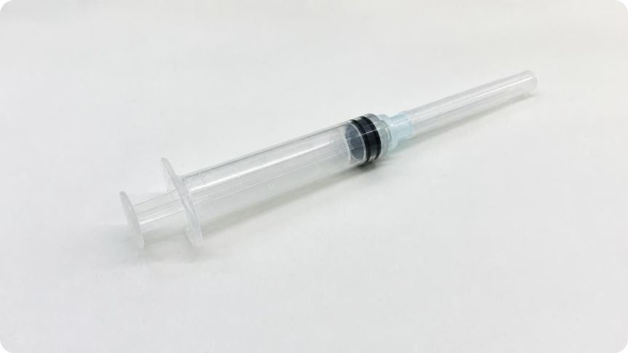
CHECK FOR UNDERSTANDING
Quick check: the sealed syringe
You seal air in a syringe, cap the tip, and push the plunger halfway in while the temperature stays the same. What happens inside?
A. The air particles shrink, so the pressure stays the same
B. The same particles crowd closer and hit the walls more often, so the pressure rises
C. Some air particles are destroyed, so the pressure drops
D. The particles stop moving, so the pressure drops to zero
21
Notes:
If you have plastic syringes with caps (no needles), pass them around so students can feel the plunger push back, and let go to watch it spring back out as the crowded particles push from inside. Ask which answer explains the push-back. Then ask what would happen to the pressure if the syringe were also warmed: the particles would move faster and hit harder and more often, so the pressure would rise further. Keep it qualitative; no gas-law formulas are needed.
EXPECTED RESPONSES: B. No particles are made, destroyed or resized. The same number now share less space, so more of them hit each bit of wall every second and the pressure goes up, which you can feel as the plunger pushing back.
WATCH FOR: Option A, shrinking particles, is the most common wrong choice and links back to the melting misconception.
CONNECTS TO: Lab 2 Part B; W10 mastery.
PACING: about 3 min

Slide 22
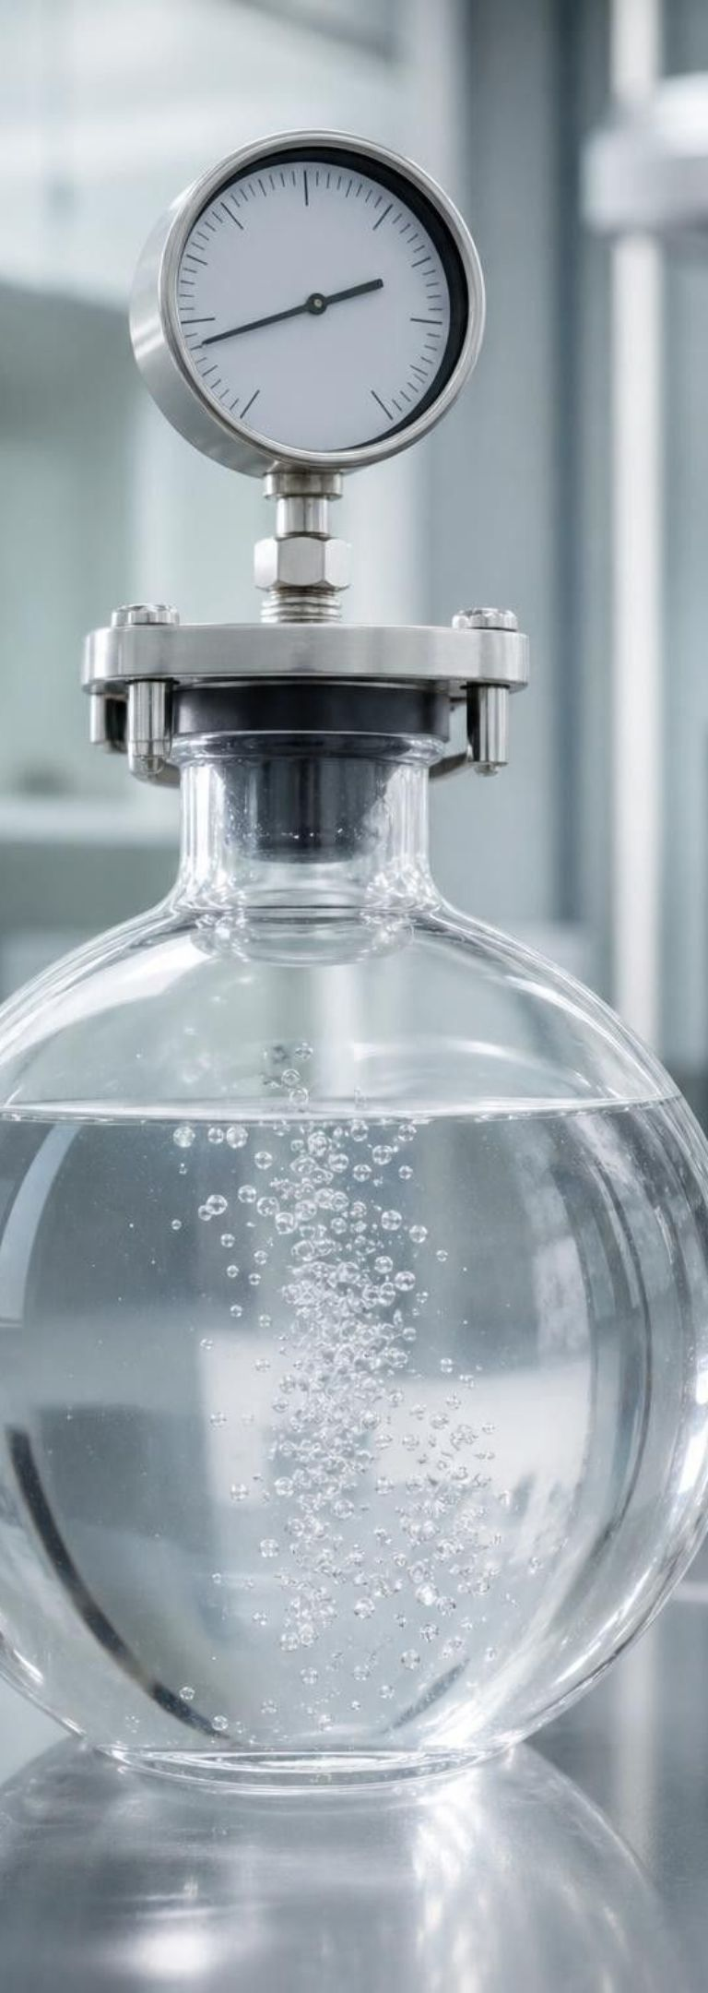
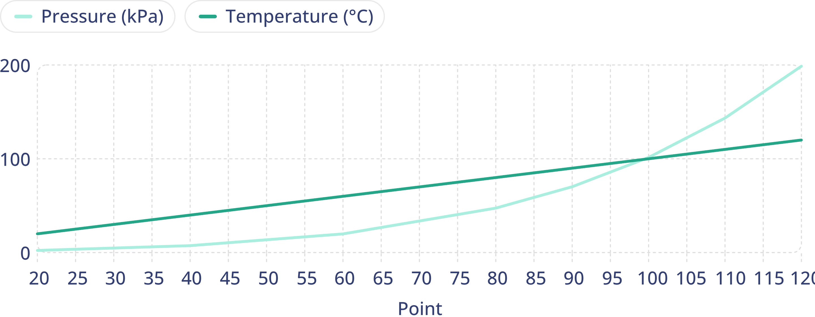
MODEL
Reading water's state diagram: liquid or gas?
Find the temperature on the bottom axis, go up to the pressure, and see which side of the boiling line the point lands on.
Model: The liquid-gas part of water's state diagram (20 to 120 °C)
Above and left of the line: liquid. Below and right: gas. On the line, both exist together. At these pressures water is solid below 0 °C, off the left edge. Values from NIST.
22
Notes:
Model the reading out loud. Point A, 50 °C and 150 kPa, lands above and to the left of the boiling line, so water there is liquid. Point B, 110 °C and 50 kPa, lands below and to the right, so water there is gas. Point C, 100 °C and 101 kPa, sits right on the line: that is sea-level boiling, where liquid and vapor exist together. Then read the line itself as a list of boiling points: about 81 °C at 50 kPa, 100 °C at 101 kPa, about 120 °C at 200 kPa. Ask where the Mount Whitney summit belongs (about 85 °C at 58 kPa, on the line). This slide shows only the liquid-gas part of the diagram; the full diagram, like the textbook's, adds a melting line that runs almost straight up at 0 °C, with solid to its left, because pressure changes water's melting point by only a tiny fraction of a degree in this range. Two cautions. Because a point on a line is a boundary, we never ask for 'the state' exactly there. And the textbook's example point (95 °C, 80 kPa) sits barely inside the gas region, because water boils at about 93.5 °C at 80 kPa; predictions are trustworthy only well inside a region. Every substance has its own state diagram; carbon dioxide's has no liquid region at all at ordinary air pressure.
WATCH FOR: Students read the line as a state ('the boiling line is gas'). The regions are states; the line is where a change of state happens.
CONNECTS TO: W8 evidence sort; W10 mastery; the task on the next slide.
PACING: about 6 min

Slide 23
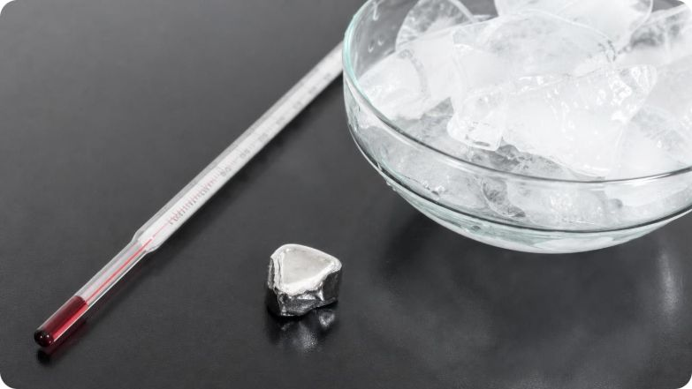
APPLY IT
Task: predict the state of three pure substances
Use the melting and boiling points at 101 kPa to predict each substance's state in each place. Then explain one prediction in terms of particle motion.
Pure substance at 101 kPa | Melts at | Boils at | Freezer, −18 °C | Cool room, 18 °C | Hot car, 50 °C
Water | 0 °C | 100 °C
Gallium | about 30 °C | above 2,000 °C
Carbon dioxide | no liquid at 101 kPa | sublimates at −78.5 °C
Compare each place's temperature with the substance's melting and boiling points.
Below the melting point: solid. Between the two: liquid. Above the boiling point: gas.
Pick one cell and describe what the particles are doing there.
Bonus: which of your nine answers would change if the pressure were 50 kPa?
23
Notes:
Give pairs six minutes, then go cell by cell. Water: solid, liquid, liquid. Gallium: solid, solid, liquid; it melts in the hot car, and a palm at about 33 °C melts it slowly too. Carbon dioxide: gas in all three, because at 101 kPa it is a gas at any temperature above −78.5 °C and is never a liquid at this pressure. Each place was chosen to be at least 10 degrees from every melting or boiling point, so the answers are clear-cut; a real sample right at a boundary can be in two states at once. A strong particle explanation for gallium in the hot car: its atoms gained enough energy to break out of their fixed positions and slide past one another, so it flows. Sublimation surprises most students; the dry-ice fog on the next slide follows from it.
EXPECTED RESPONSES: Water: solid (−18 °C), liquid (18 °C), liquid (50 °C). Gallium: solid, solid, liquid. Carbon dioxide: gas, gas, gas. Sample explanation: in the freezer, water molecules only vibrate in fixed spots, so it is ice; in the cool room they slide past one another as liquid water. Bonus: none of the nine answers changes at 50 kPa, because every place is still far from every boundary; for example, water's boiling point drops only to about 81 °C, still well above 50 °C.
WATCH FOR: Students treat −78.5 °C as carbon dioxide's melting point and predict liquid carbon dioxide at room temperature.
CONNECTS TO: W10 mastery; W8 collaborative evidence sort; chapter evidence of learning.
PACING: about 10 min

Slide 24
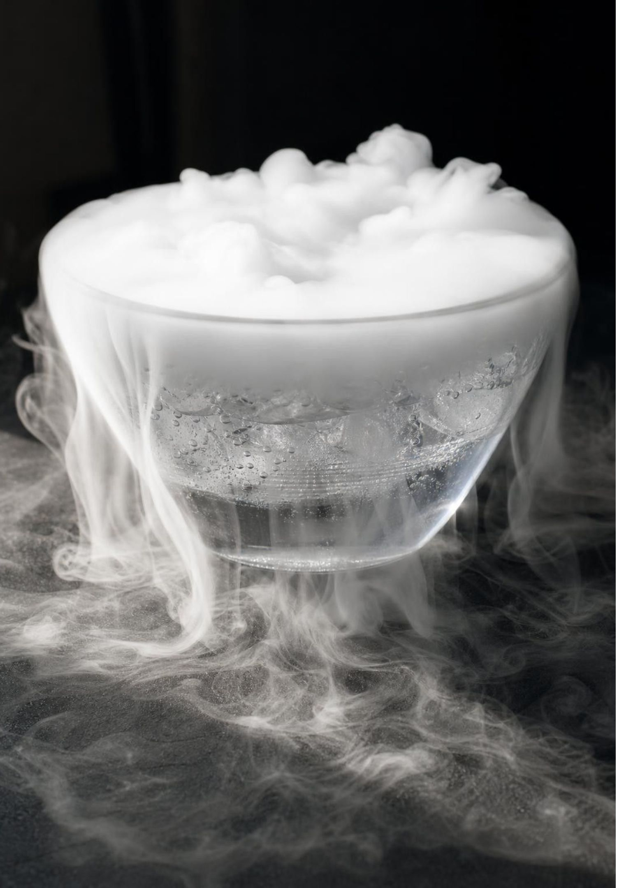
THINK, PAIR, SHARE
Discuss: what is the white fog over dry ice?
Clue 1: the bubbles are very cold carbon dioxide gas.
Clue 2: the warm water gives off invisible water vapor, and the room air already holds some.
Dry ice dropped in warm water bubbles and spills a white fog over the rim. Carbon dioxide gas is invisible. So what is the fog made of, and why does it sink?
24
Notes:
Show a photo or a video rather than handling dry ice. If you demonstrate live, only the teacher touches dry ice, with insulated gloves and tongs, in a ventilated room, and it is never sealed in a closed container, which can burst as the gas builds up. After pairs share, resolve it: the textbook's opening calls the fog 'smoky vapor', but the visible part is tiny droplets of liquid water, the same as the white plume from a kettle. The invisible carbon dioxide is what supplied the cold and what carries the droplets along. This is also a good moment to revisit sublimation: the dry ice went from solid straight to gas, with no puddle of liquid carbon dioxide, because carbon dioxide cannot be a liquid at ordinary air pressure.
EXPECTED RESPONSES: The fog is tiny droplets of liquid water. The very cold carbon dioxide gas chills the water vapor it meets, from the warm water and from the air, and the vapor condenses into droplets too small to fall quickly. The fog sinks and spills over the rim because it is carried by cold carbon dioxide gas, which is denser than the room air around it.
WATCH FOR: 'The fog is carbon dioxide you can see' or 'the fog is smoke'.
CONNECTS TO: W8 collaborative evidence sort (the dry-ice card).
PACING: about 6 min

Slide 25
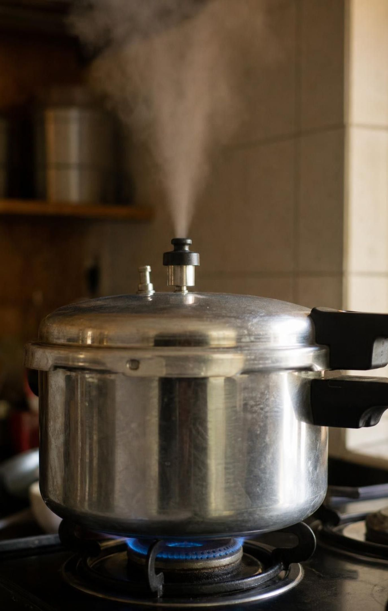
Why scientists always state the conditions
A state, a melting point or a boiling point is incomplete without the temperature and pressure.
So scientists report results at agreed conditions, or say exactly which conditions they used.
STP, short for standard temperature and pressure, means 0 °C and 100 kPa (older sources: 101.325 kPa).
At STP gallium is a solid and carbon dioxide is a gas. Water sits exactly at its melting point.
That is why recipes say 'adjust for high altitude' and lab reports list the pressure.
25
Notes:
Tie this to replication: a team in Denver and a team in San Diego can compare boiling data only if both report the pressure, because water boils several degrees lower in Denver. Be careful with water at STP. 0 °C is water's melting point, where ice and liquid water can exist together, so the textbook's statement that water is a solid at STP is not quite right; which state you get depends on whether energy is being added or removed. Mention that the current IUPAC standard pressure is 100 kPa, while many references still use the older 101.325 kPa (one atmosphere); the difference matters for careful work but not for any prediction in this chapter.
WATCH FOR: 'Standard conditions means room temperature.' STP is 0 °C, colder than any classroom.
CONNECTS TO: W6 CER, which requires melting points at a stated pressure; chapter accuracy note on water at STP.
PACING: about 4 min

Slide 26
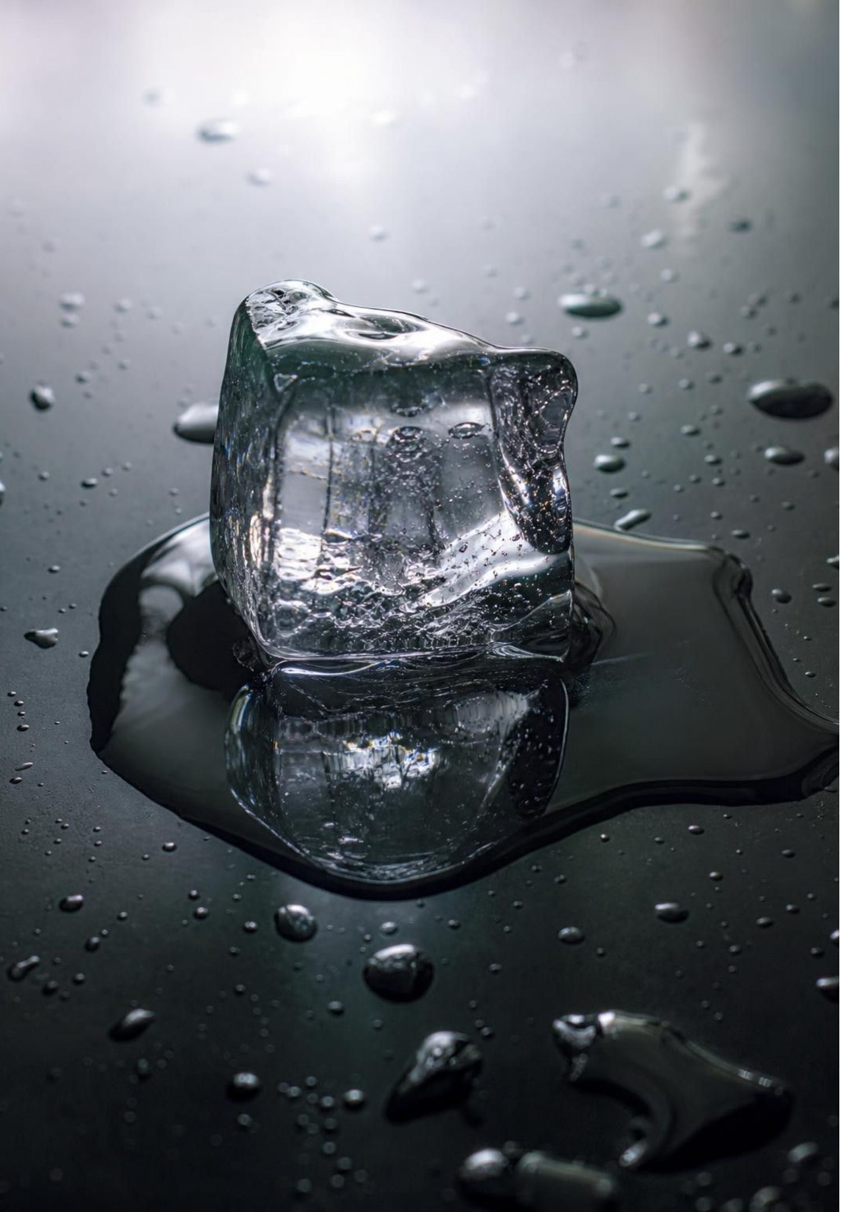
MISCONCEPTION CHECK
True or false? Melting particles get softer and bigger
"When ice melts, its water molecules soften and get bigger, and when the water boils the molecules swell up, which is why the gas takes up so much more room."
True or false? Explain your reasoning.
26
Notes:
Students write true or false with a reason, then vote. Everything after the first comma is false. A water molecule in ice, in liquid water and in vapor has the same size, shape and mass. Melting happens because the molecules gain enough energy to break free of their fixed spots and slide; boiling happens because they gain enough to separate completely. Vapor takes up about 1,600 times the room of the liquid because the same molecules are far apart, not because each one grew. Ask for evidence: a sealed bag holding 10 g of ice still holds 10 g of water after melting, and vapor from a kettle that hits a cold plate turns back into the same liquid water.
EXPECTED RESPONSES: False. The molecules stay the same size, shape and mass in every state. Melting and boiling change how the molecules move and how far apart they are. The gas takes up more room because its molecules are far apart, not because they swelled.
WATCH FOR: Half-fixes such as 'the molecules don't get bigger but they do get softer' or 'the molecules melt'. Samples melt; particles do not.
CONNECTS TO: W7 misconception repair; chapter misconceptions list.
PACING: about 5 min

Slide 27

PUTTING IT TOGETHER
Putting it together
Solid, liquid, gas: the same particles, with different spacing and different motion.
Particles in every state are always moving. Temperature measures their average motion.
1
2
Add energy: particles speed up until a change of state, when the energy loosens or separates them.
Remove energy: particles slow down until the substance condenses or freezes.
3
4
Gas pressure comes from particles hitting walls; pressure and temperature together set the state.
A state diagram maps those conditions, so always state the temperature and pressure.
5
6
27
Notes:
Have students write a four-sentence summary that uses at least five vocabulary terms and explains the two phenomenon cups. Then ask for one piece of evidence from each lab: Lab 1 (warmer water spread the dye sooner), Lab 2 (harder shaking broke up the packed marbles, and less space meant more wall hits), Lab 3 (the temperature held steady while tokens went into loosening and separating the particles). Preview Lesson 24: the same particle model explains how thermal energy moves from warmer things to cooler ones and why a melting substance holds its temperature.
CONNECTS TO: W6 CER as the written assessment; W10 mastery; L24 Heat, Temperature, and State Changes next.
PACING: about 5 min

Slide 28
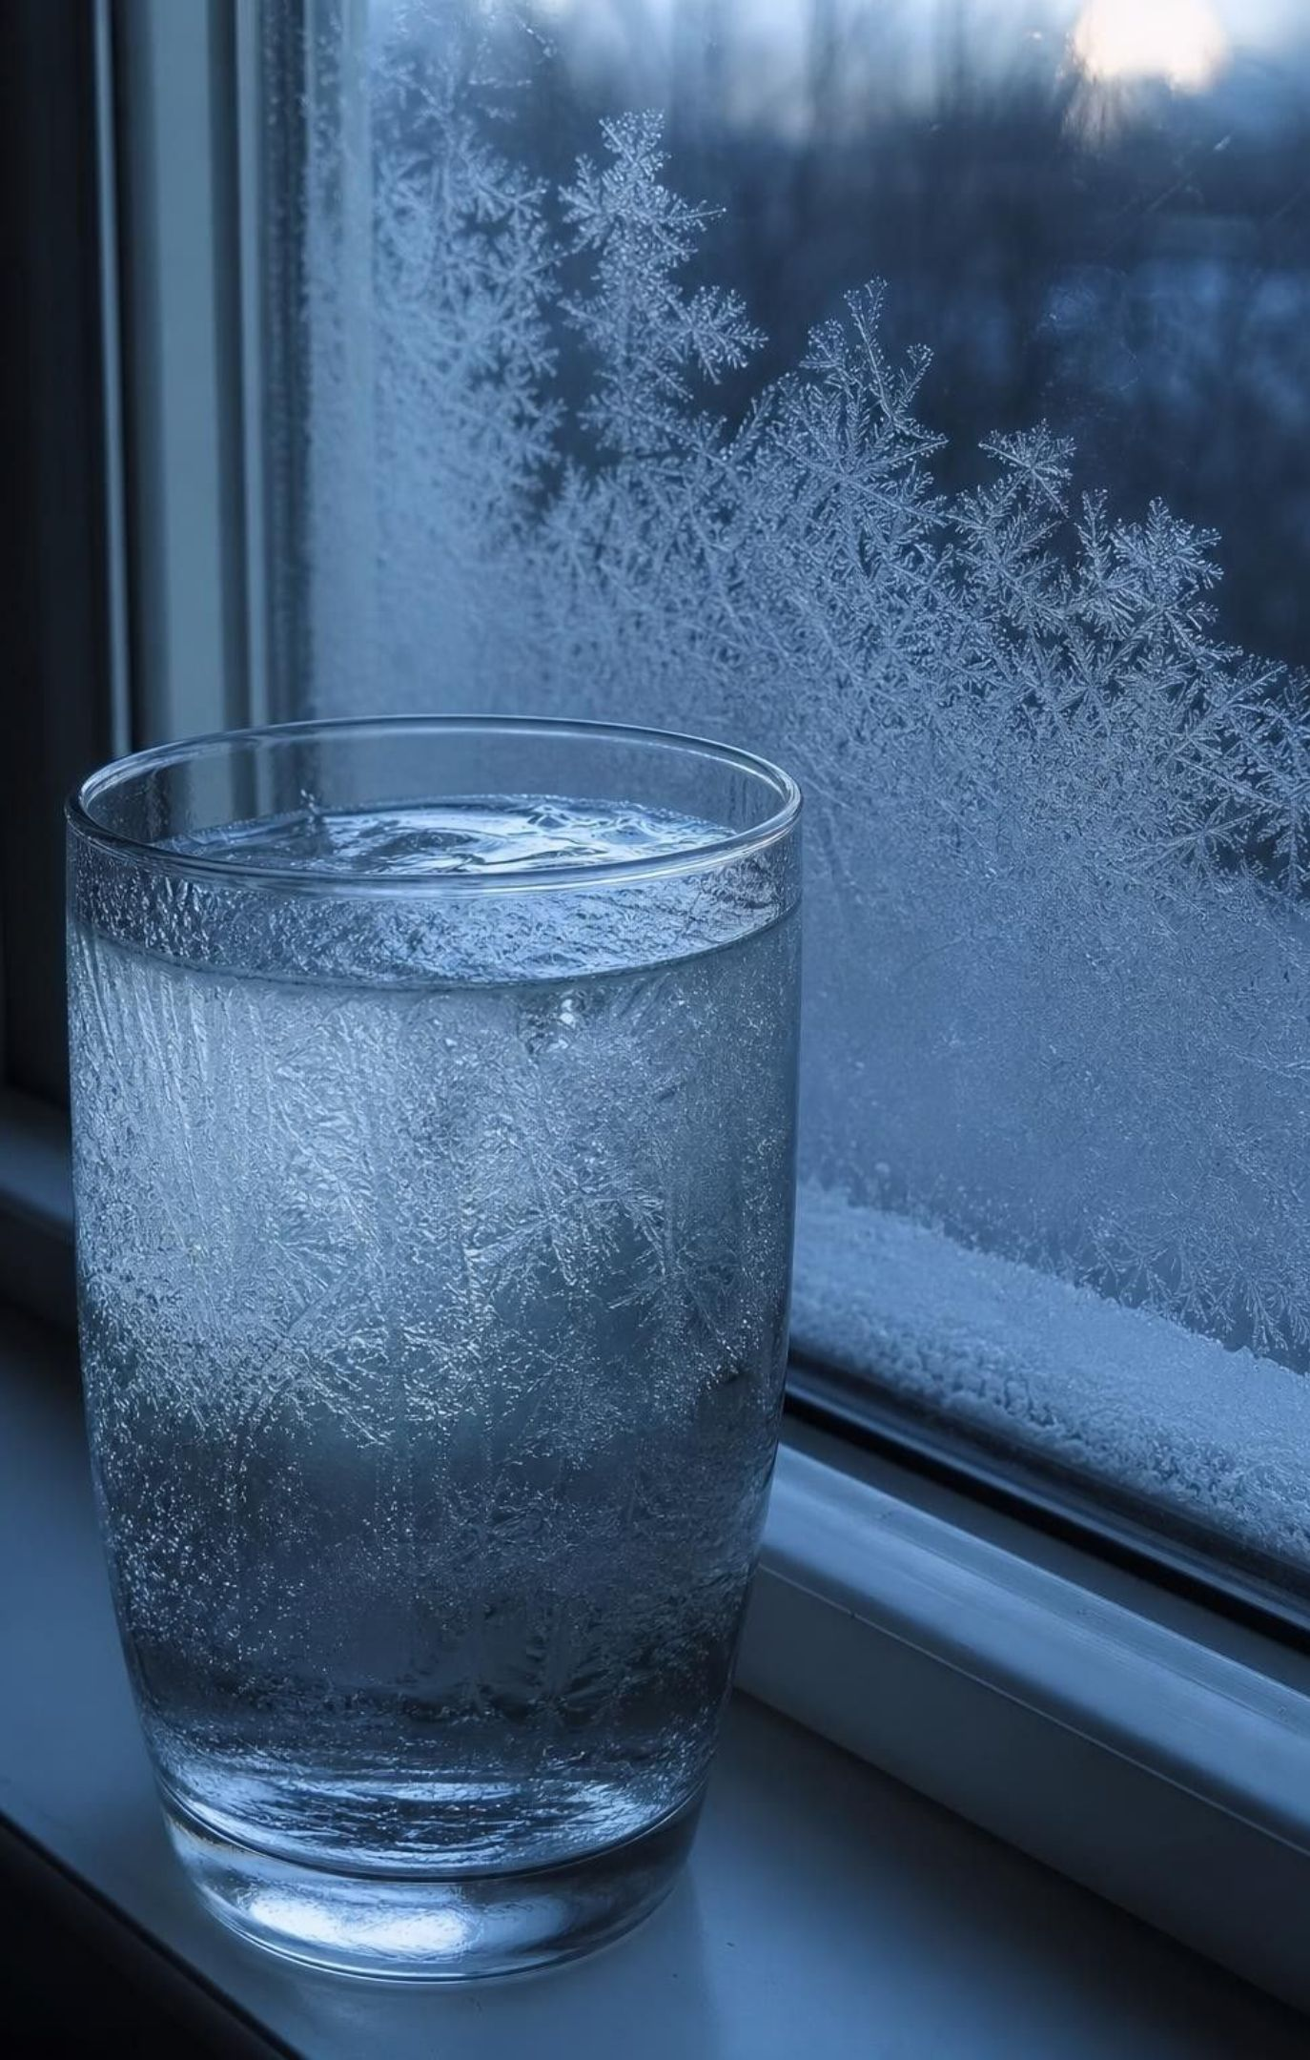
EXIT TICKET
Exit ticket
Draw one pure substance as a solid, a liquid and a gas. Keep every particle the same size.
A cup of water cools from 20 °C to −15 °C at 101 kPa. Describe its particles, temperature and state.
Why does food coloring spread faster in warm water than in cold?
Liquid or gas: water at 70 °C and 101 kPa? Water at 95 °C and 50 kPa? (It boils near 81 °C at 50 kPa.)
28
Notes:
Collect on index cards. Item 1 catches students who enlarge the gas particles or space the liquid like a gas; item 2 catches students who skip the steady temperature at the freezing point; item 3 is the phenomenon in one sentence; item 4 checks that pressure matters to boiling. Sort the cards into three piles before the next class and reteach from the largest pile.
EXPECTED RESPONSES: 1: same-size particles packed in a pattern, close but disordered, and far apart with motion arrows. 2: the molecules slow down and the temperature falls to 0 °C; it stays at 0 °C while the water freezes, as the slowed molecules lock into fixed positions and energy leaves; then the ice cools to −15 °C, its molecules vibrating more slowly in place. 3: warmer water's particles move faster on average, so they knock the dye particles around more often and harder. 4: liquid at 70 °C and 101 kPa (below 100 °C); gas at 95 °C and 50 kPa (above about 81 °C).
WATCH FOR: Bigger gas particles in item 1; a steady fall straight to −15 °C in item 2; 'water boils at 100 °C at every pressure' in item 4.
CONNECTS TO: W10 mastery; chapter evidence of learning.
PACING: about 5 min

