Slide 1

CHAPTER 24 OF 29 · STATES OF MATTER
Chapter 24: Heat, Temperature, and State Changes
Lesson 24: How does adding or removing energy change a substance's particles, temperature and state?
Angela's Wand · Bring Science Alive! 7th Grade Integrated
Notes:
Lesson 23 gave us particles that are always moving. This lesson asks what happens to those particles, and to a thermometer reading, when energy flows into or out of a substance. Tell students they will run three investigations: they will watch a cup of ice sit in a warm bath and track both temperatures, solve a mystery about which cup of water can melt the most ice, and engineer a container that keeps an ice cube from melting. No flames anywhere; the warmest water they touch is about bath temperature.
CONNECTS TO: Overview of Lab 1 (melting curve), Lab 2 (which cup holds more thermal energy) and Lab 3 (insulation design); W1 opens on the next slide.
PACING: about 2 min

Slide 2
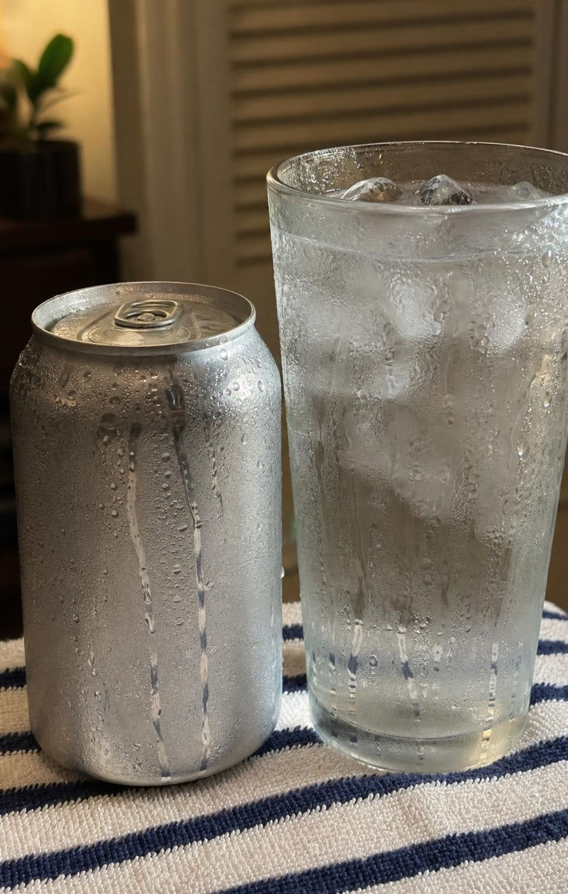
PHENOMENON
The sweating glass and the stubborn thermometer
A can of cold juice and a tall glass of ice water sit on a towel in a 27 °C room. Within a minute both turn misty; soon drops run down their sides, though neither leaks. A thermometer in the stirred ice water reads 0 °C for most of an hour while the ice shrinks. Only when the last ice is gone does the reading start to climb.
Notice: what changes on the glass and in the glass, and what stays the same?
Wonder: where could water on the outside of a sealed can come from?
Predict: what will the thermometer do after the last ice is gone?
2
Notes:
If you can, run this live: fill a tall glass with ice and a little water 15 minutes before class, put a thermometer in it, and set a cold can beside it. A humid day works best; on a dry day breathe on a cold spoon to show the same misting. Give two quiet minutes for notices and wonders, then collect them without judging. Press on two points. First, the can is sealed, so the water cannot have come from inside. Second, the room is warmer than the glass, so energy must be flowing in, yet the thermometer does not move. Ask: if energy is going in and the temperature is not going up, what could the energy be doing? Do not answer yet. Park every idea on a chart; slide 22 returns to this glass with the full explanation.
EXPECTED RESPONSES: Notice: misting, beads, drops, wet towel; the reading stays at 0 °C; the ice gets smaller. Wonder: is the water leaking, or coming from the air? Why does the ice water not warm up? Predict: the temperature rises after the ice is gone, toward room temperature but never above it.
WATCH FOR: 'The cold is leaking out', 'water soaks through the can', and 'ice water has no energy' are all common. Record them as ideas to test, not as wrong answers.
CONNECTS TO: W1 phenomenon worksheet records notices, wonders and a first explanation; students revise it in Period 8.
PACING: about 8 min

Slide 3
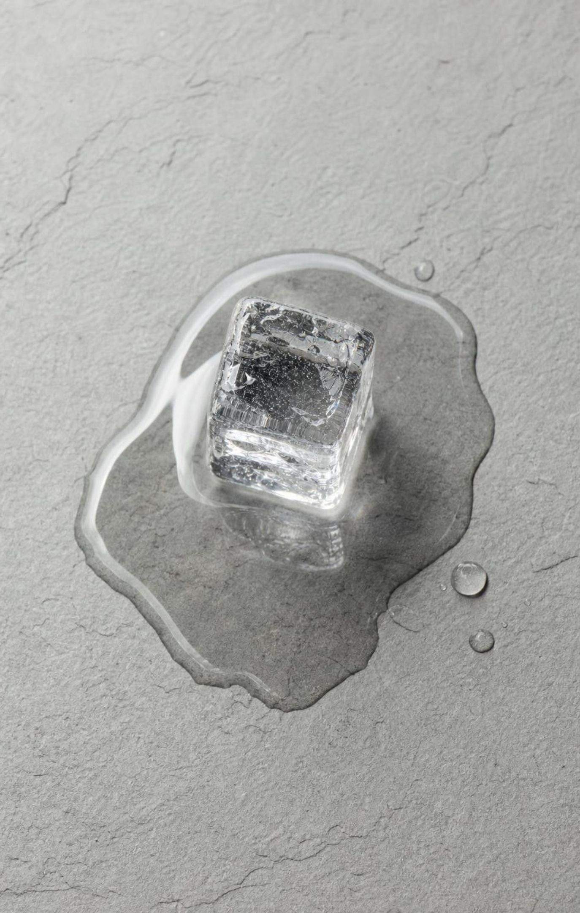
LEARNING TARGETS
What you will be able to do
Tell temperature, thermal energy and heat apart, and compare samples by temperature and amount of matter.
Predict which way energy flows as heat between two objects, and when it stops.
Use a particle model to predict all six changes of state when energy is added or removed.
Read heating and cooling curves and explain why the temperature holds steady during a change of state.
Explain why substances melt and boil at different temperatures using attractions between particles.
Design and improve a container that slows the energy flowing into an ice cube.
3
Notes:
Read the targets aloud and have students put a star next to the one that sounds hardest. Most will star target 4; tell them Lab 1 is designed to make it obvious. Point out that targets 1 and 2 are about three words people mix up all the time, targets 3 to 5 are about state changes, and target 6 is an engineering challenge where those ideas have to work in a real device.
CONNECTS TO: Target 1: slides 4-6, Lab 2, W2, W3. Target 2: slides 7-10, W7. Target 3: slides 11-15, W2, W4, W9. Target 4: slides 16-18, Lab 1, W3, W4, W5. Target 5: slide 20, W8. Target 6: Lab 3.
PACING: about 2 min

Slide 4
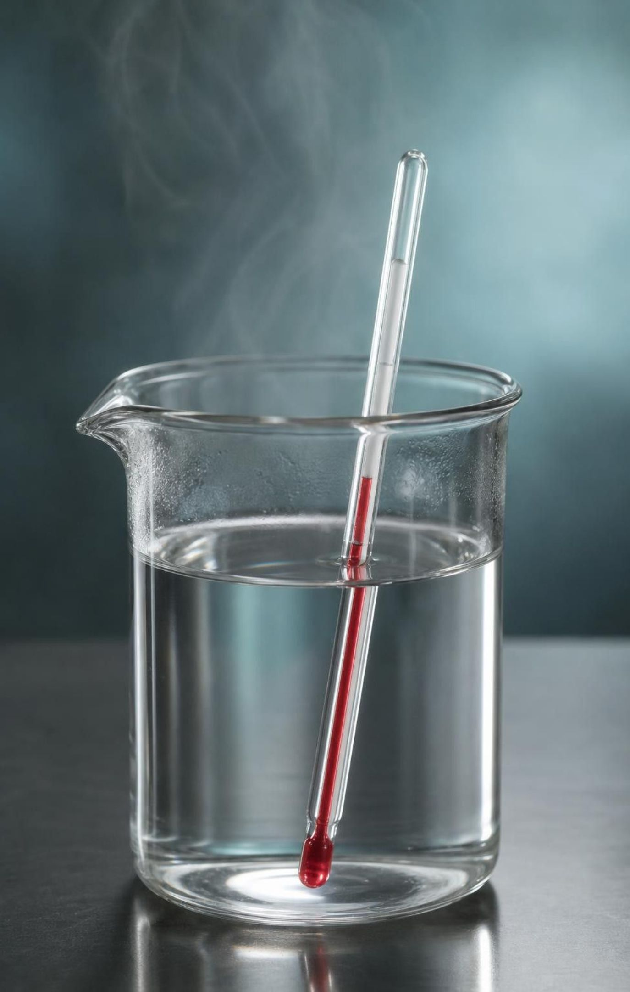
Temperature: a reading of the average
Particles are always moving: vibrating in solids, sliding past each other in liquids, flying freely in gases.
Kinetic energy is energy of motion. In one substance, faster particles carry more of it.
Temperature tracks how much kinetic energy a sample's particles have on average.
Warmer water: its molecules move faster on average. Colder water: slower on average.
A thermometer reports that average. It cannot tell you how much matter, or how much total energy, is there.
4
Notes:
Start with a quick recap from Lesson 23: every particle is moving all the time, even in an ice cube. Then introduce the word average. Ask: if every student in the school brought some money, the average per student and the total for the whole school are different numbers; which one changes if twice as many students show up with the same amounts? The total doubles; the average stays the same. Temperature is like the average. Also explain how a thermometer works: energy flows into or out of the thermometer until it reaches the same temperature as the sample, and then the liquid or sensor shows that temperature. That is why you wait for the reading to settle. Keep 'faster' for comparing the same substance at two temperatures; different substances at the same temperature can have different average speeds, because lighter particles move faster.
WATCH FOR: 'Temperature tells you how much heat something has.' Temperature is an average per particle; it says nothing about the size of the sample.
CONNECTS TO: W2 vocabulary relationships; W3 reading passage.
PACING: about 5 min

Slide 5
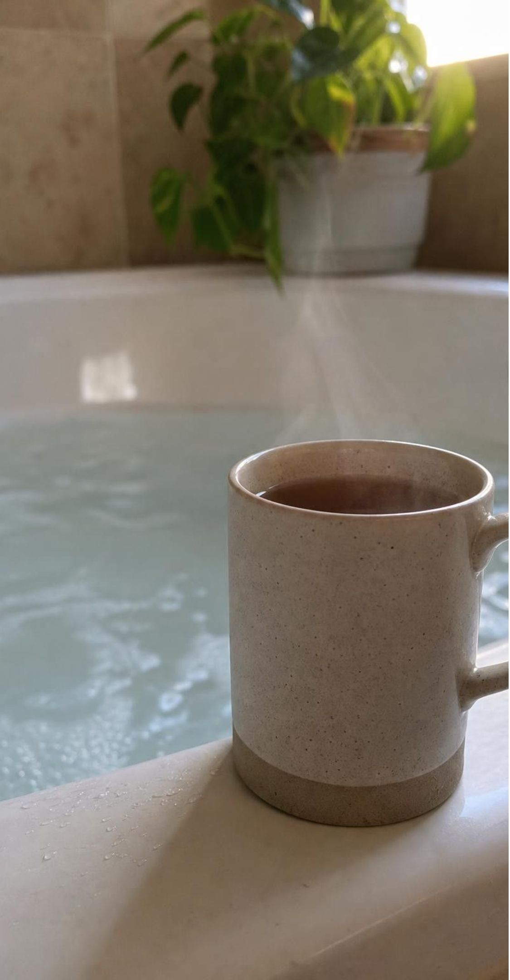
MODEL
Hotter is not the same as more thermal energy
Thermal energy adds up the energy of every particle in a sample, so it depends on how much matter there is as well as on its temperature.
Model: A mug of tea and a bathtub
Mug of tea: 250 g at 80 °C | Bathtub: 150 kg at 40 °C
Higher temperature | Lower temperature
Molecules more energetic on average | Molecules less energetic on average
About 1/600 as many molecules | About 600 times as many molecules
Much less thermal energy in total | Far more thermal energy in total
Cooling to 0 °C, melts about 0.25 kg of snow | Cooling to 0 °C, melts about 75 kg of snow
Snow amounts are rounded estimates for snow already at 0 °C, with no energy lost to the air.
5
Notes:
Ask first: which has more thermal energy? Many students will say the tea, because it is hotter. Walk down the two columns. The tea's molecules are more energetic on average, so its temperature is higher. But the bathtub has about 600 times as many molecules, so its total, its thermal energy, is far larger. The bottom row shows what that means in practice: dump each one on a snowbank and the bathtub melts hundreds of times more snow before it cools to 0 °C. Students do not need to calculate these amounts; the point is the size of the difference. Add one more idea: thermal energy also depends on state. Water at 0 °C has more thermal energy than the same mass of ice at 0 °C, because energy was needed to pull the molecules free when it melted. Lab 2 tests these ideas with real cups.
WATCH FOR: Students may overcorrect to 'bigger always has more thermal energy'. It depends on both amount and temperature; a large block of ice can have less thermal energy than a slightly smaller tub of warm water.
CONNECTS TO: Lab 2 (four mystery cups); W5 data worksheet (Twice the Ice); W3 reading.
PACING: about 5 min

Slide 6
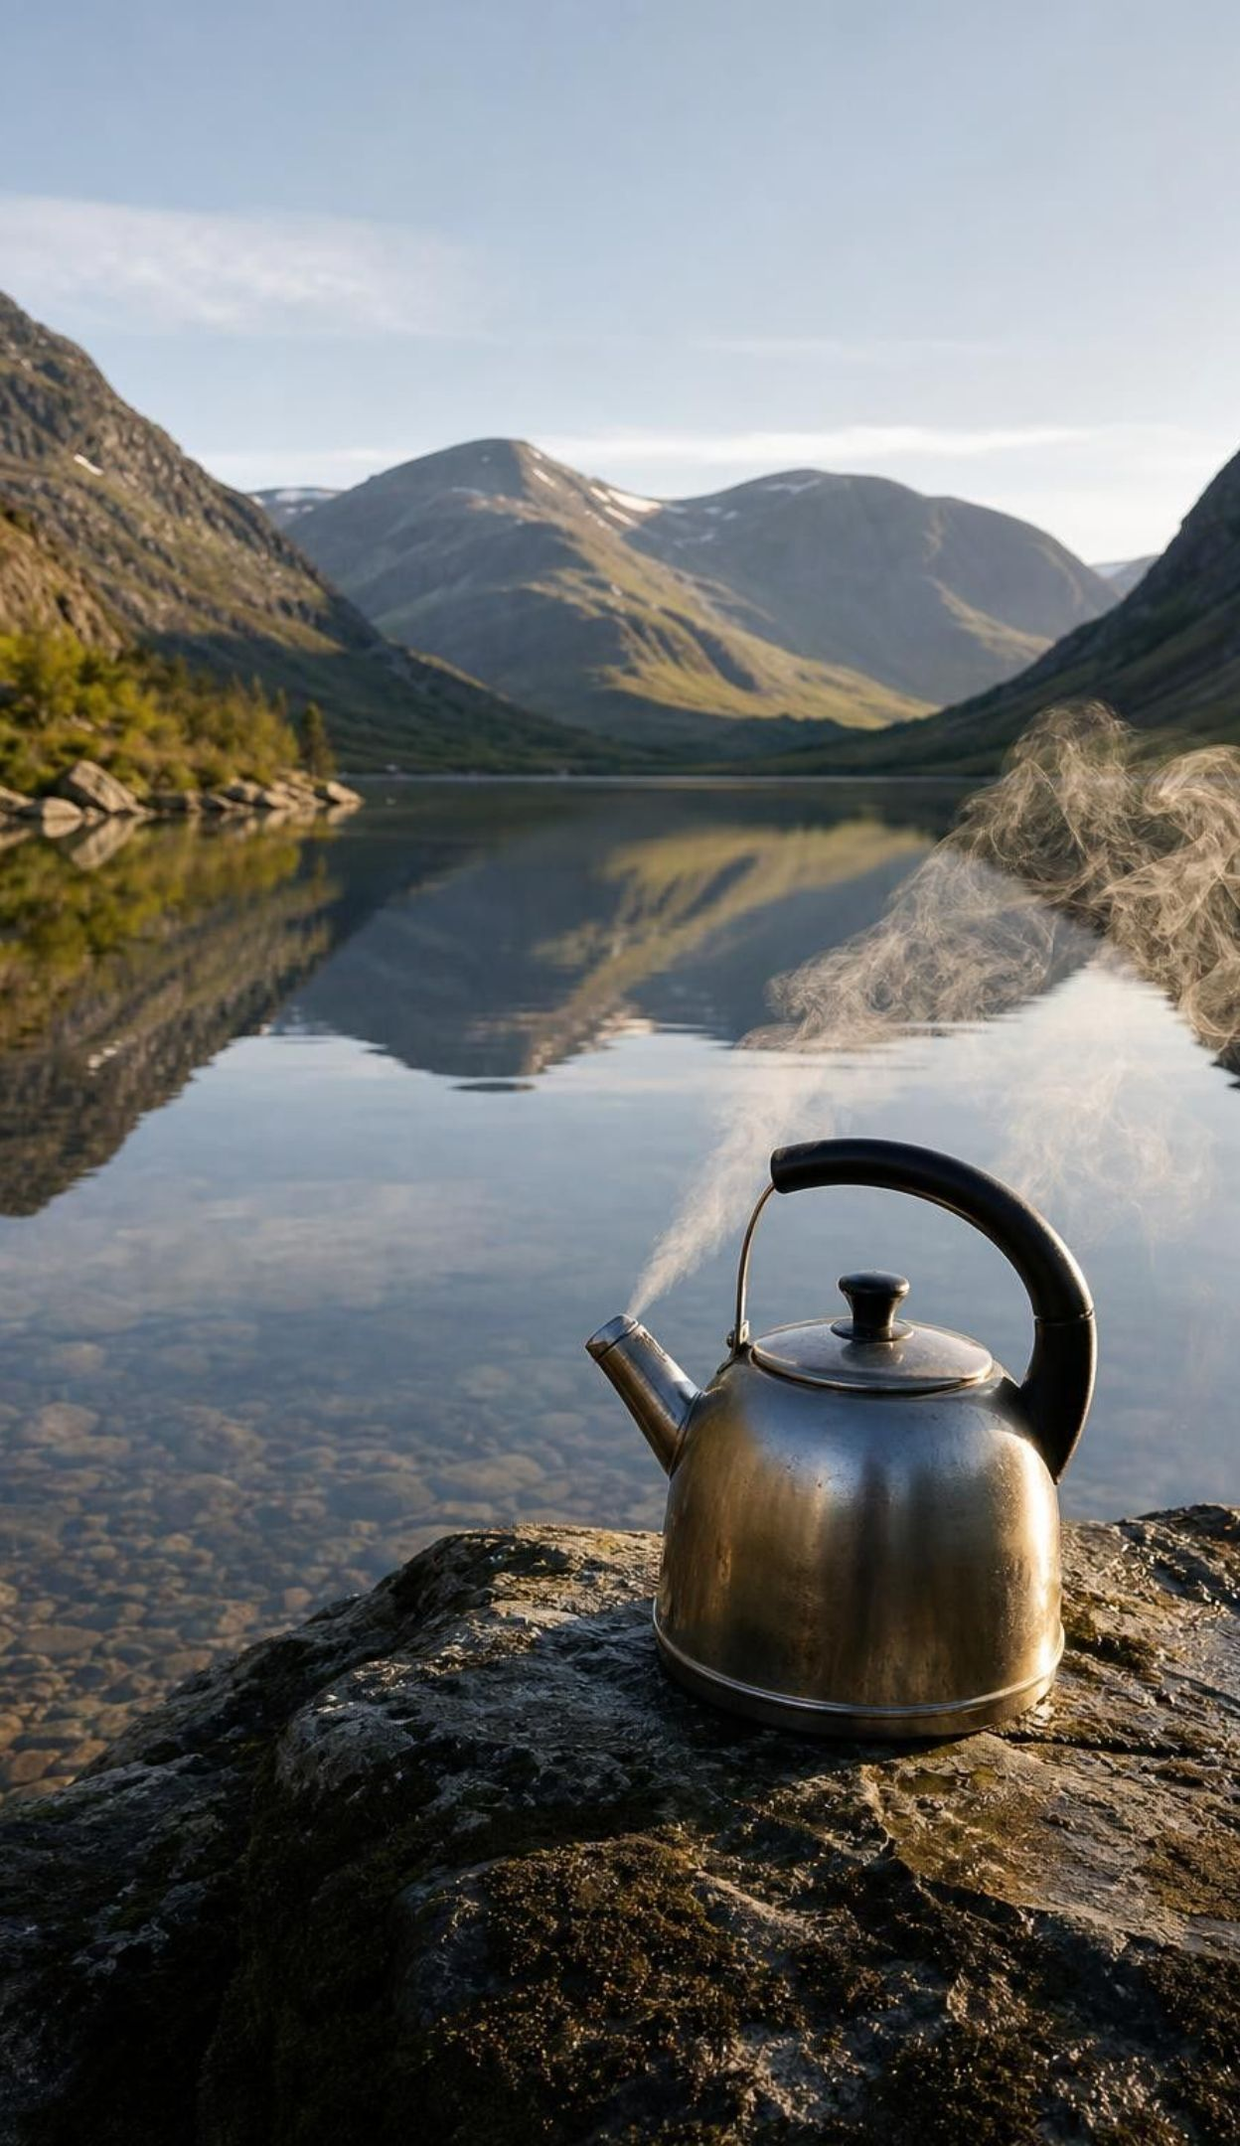
VOCABULARY IN CONTEXT
Three words to keep apart (part 1)
temperature: Tracks how much kinetic energy a sample's particles have on average; it is what a thermometer reports. A drop and a pot of boiling water at sea level have the same temperature, 100 °C.
thermal energy: The energy of every particle in a sample added together. It depends on amount of matter, temperature and state. A lake at 15 °C holds far more thermal energy than a 90 °C kettle.
kinetic energy: The energy an object or particle has because it is moving. As soup warms, its water molecules gain kinetic energy and move faster on average.
6
Notes:
Have students copy the three definitions in their own words and add a sketch: one thermometer with one number for temperature, a crowd of particles with a plus sign for thermal energy, and a moving ball for kinetic energy. Then give a fast oral quiz: a swimming pool and a teaspoon of water are both at 25 °C. Same temperature? Yes. Same thermal energy? No, the pool has far more. Same average kinetic energy per molecule? Yes. The third word, heat, comes on the next slide, because it is a different kind of word: it names energy that is moving.
WATCH FOR: Students write 'thermal energy is how hot something is'. Push them to include 'total' and 'all the particles'.
CONNECTS TO: W2 vocabulary relationships; W10 mastery.
PACING: about 4 min

Slide 7
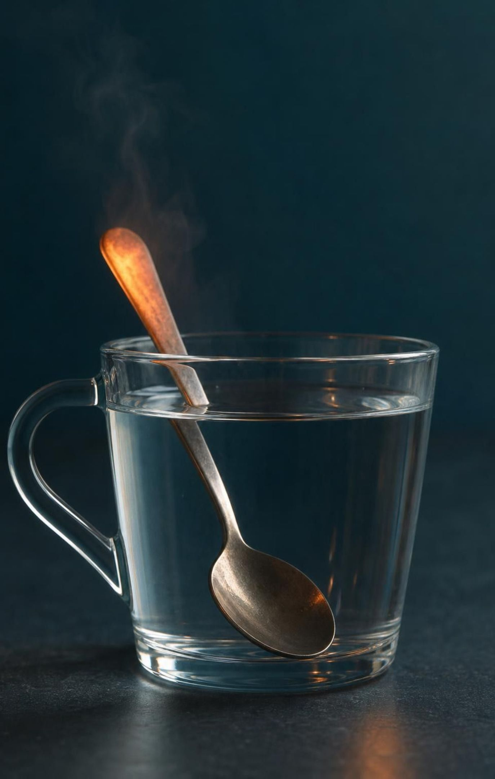
Heat: energy on the move from warm to cool
Heat is energy that moves from warmer matter to cooler matter because their temperatures differ.
Where two objects touch, their particles collide billions of times every second.
On average, more energetic particles pass energy to less energetic ones in those collisions.
The warmer object cools and the cooler one warms until both reach the same temperature.
After that, energy still passes both ways, but in equal amounts, so no net heat flows.
Objects store thermal energy, not heat. And cold never flows; only energy does.
7
Notes:
Emphasize that in science 'heat' means energy in transit, never energy sitting inside an object. A cup of cocoa does not 'have heat'; it has thermal energy, and some of it leaves as heat into the cooler air and your hands. Use the collision picture: at the boundary, a fast-jiggling particle in the warm object bumps a slower one in the cool object, and on average the slower one speeds up while the faster one slows down. Ask: does this ever stop? The net flow stops at equal temperatures, but the particles keep colliding; the trades just balance. Point out that heat can also travel by radiation, like sunlight warming your face; that is a topic for another lesson, and in this lesson we focus on objects that touch. Finish with the ice pack: your knee feels cold because energy is leaving it.
WATCH FOR: 'Cold moves into my hand' and 'heat rises' (warm air rises; heat is not a substance). Rephrase every 'cold went into' statement as 'energy went out of'.
CONNECTS TO: Lab 1 (energy flows from the bath into the ice); Lab 3 (from the room into the cube); W7 misconception repair.
PACING: about 5 min

Slide 8
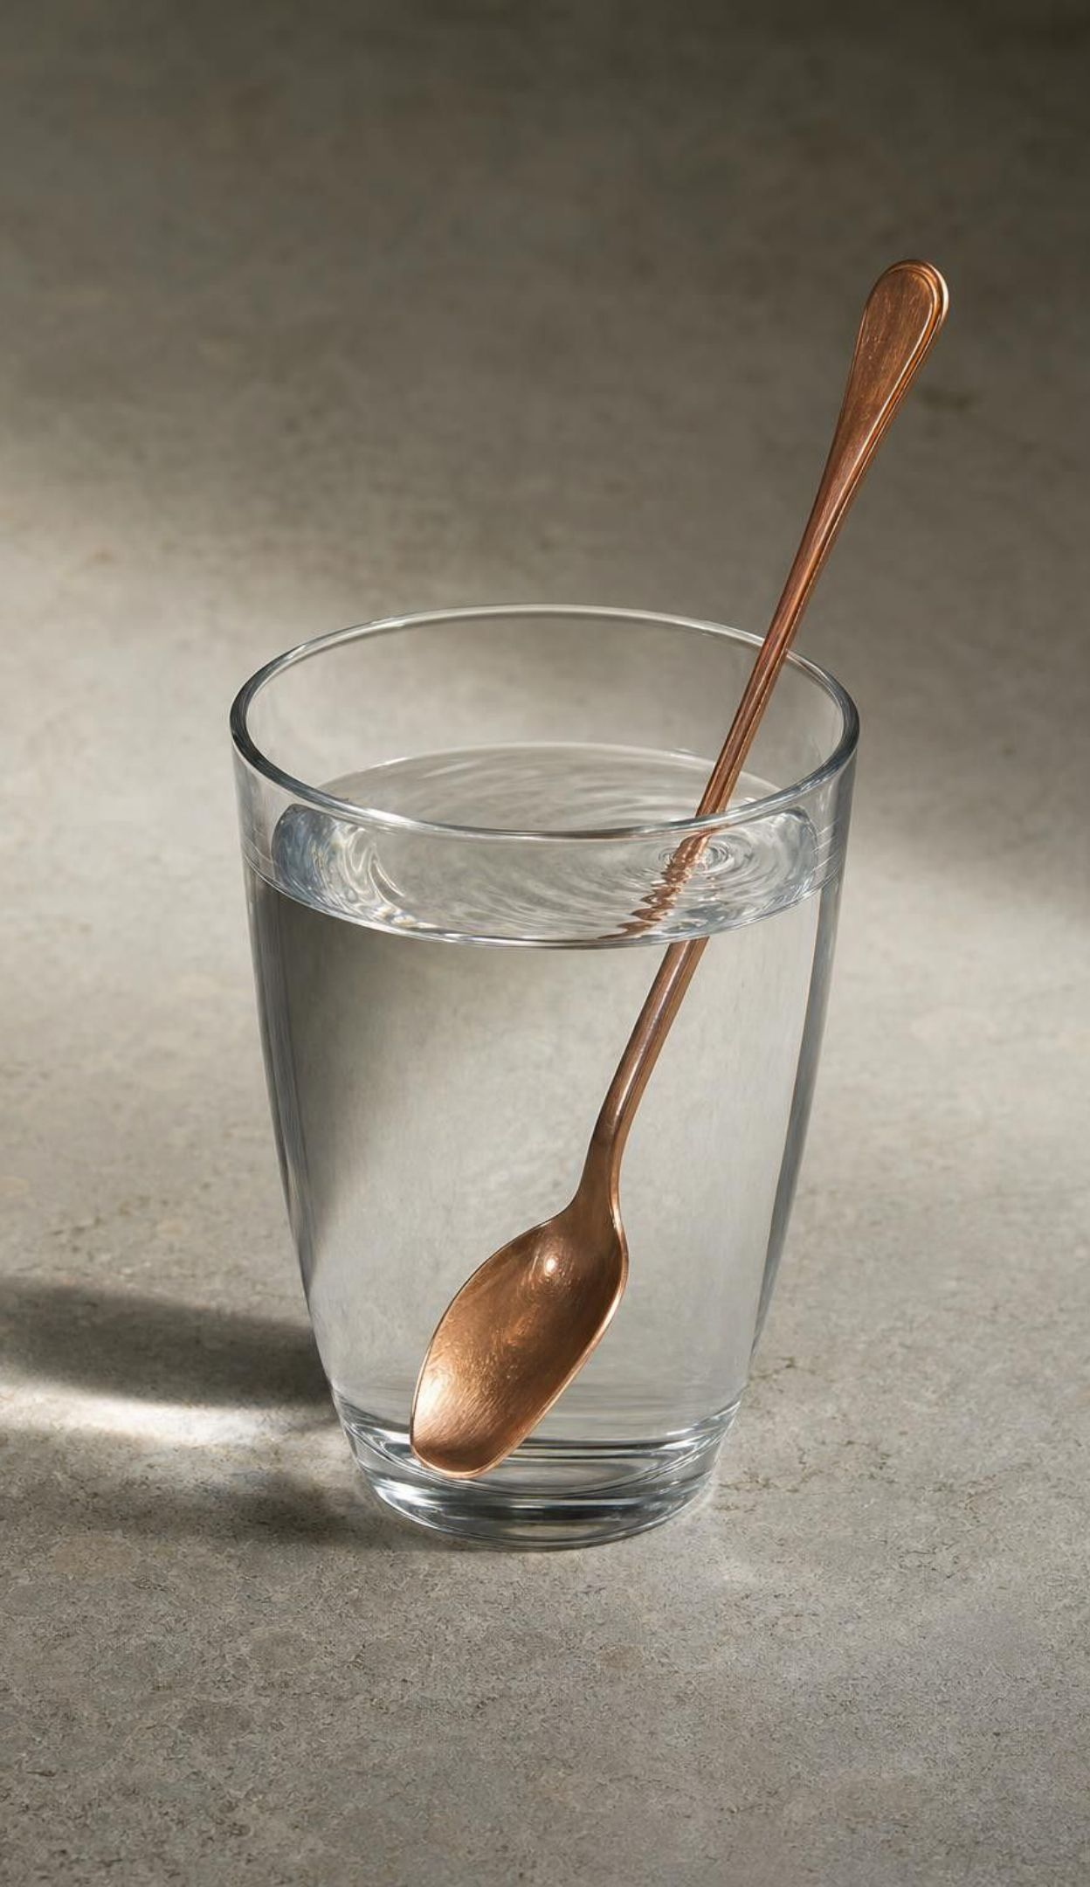
MODEL
Following energy across a boundary
Model: How heat flows between two touching objects
Warm object: more energetic particles
Collisions where the objects touch
Energy passes to less energetic particles
Warm object cools; cool one warms
Same temperature: no net heat
Heat always flows from higher to lower temperature. The flow stops when the temperatures are equal, though the particles never stop moving.
8
Notes:
Trace the chain with a concrete case: a 70 °C metal spoon dropped into a cup of 20 °C water. The spoon's atoms vibrate energetically; water molecules bump into its surface; on average each bump leaves the water molecule a little more energetic and the spoon atom a little less. Over a few minutes the spoon cools and the water warms until both read the same, perhaps 22 °C. Ask what the final temperature could not be: it cannot be above 70 °C or below 20 °C, and it will be much closer to 20 °C because there is far more water than spoon. Then ask what happens next if the cup sits on a table: the 22 °C water and spoon slowly lose energy to the 20 °C room until all three match.
WATCH FOR: Students think the final temperature is the average of the two starting temperatures. That is only true for equal masses of the same substance; more matter pulls the final temperature toward its own.
CONNECTS TO: W7 misconception repair (heat and cold statements); the bath data in Lab 1 and on slide 23.
PACING: about 4 min

Slide 9
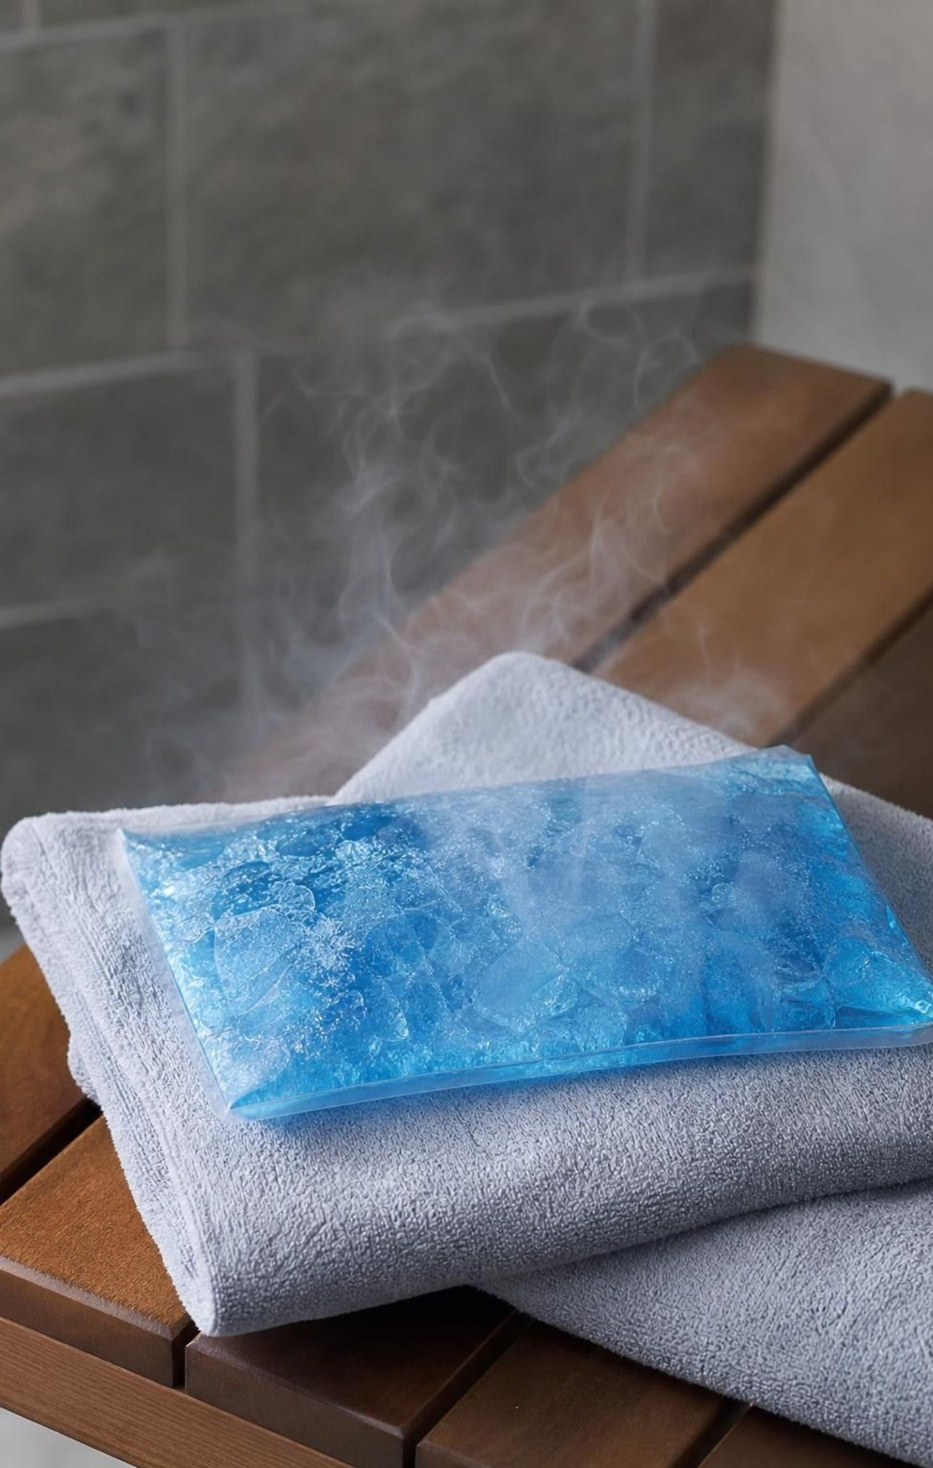
CHECK FOR UNDERSTANDING
Quick check: which way does the energy go?
An ice pack on a sore knee.
A 70 °C spoon dropped into a cup of 20 °C water.
A glass of milk and the refrigerator air it has sat in all night.
Your hand wrapped around a can of cold juice.
A swimmer's skin (about 34 °C) in a 40 °C hot tub.
For each pair, say which way energy flows as heat, or whether no net heat flows. Name the warmer object each time.
9
Notes:
Run it with hand signals: point left or right for direction, or a flat hand for no net flow. Call on students to justify each answer with the word 'warmer'. Item 3 is the important one: the milk and the air are at the same temperature, so no net heat flows even though their particles are still colliding. Item 5 surprises some students: the skin gains energy because the water is warmer than skin, which is why a hot tub can overheat you. Use item 4 to rephrase 'the cold goes into my hand' correctly.
EXPECTED RESPONSES: 1: from the knee to the ice pack (knee is warmer). 2: from the spoon to the water. 3: no net heat; same temperature after a night together, so the exchange is equal. 4: from the hand to the can. 5: from the hot-tub water to the skin.
WATCH FOR: Answers such as 'cold flows from the ice pack into the knee' (item 1) and 'none, because milk and air are both cold' (item 3 for the wrong reason: the reason is equal temperature, not coldness).
CONNECTS TO: W7 misconception repair; W10 mastery.
PACING: about 4 min

Slide 10
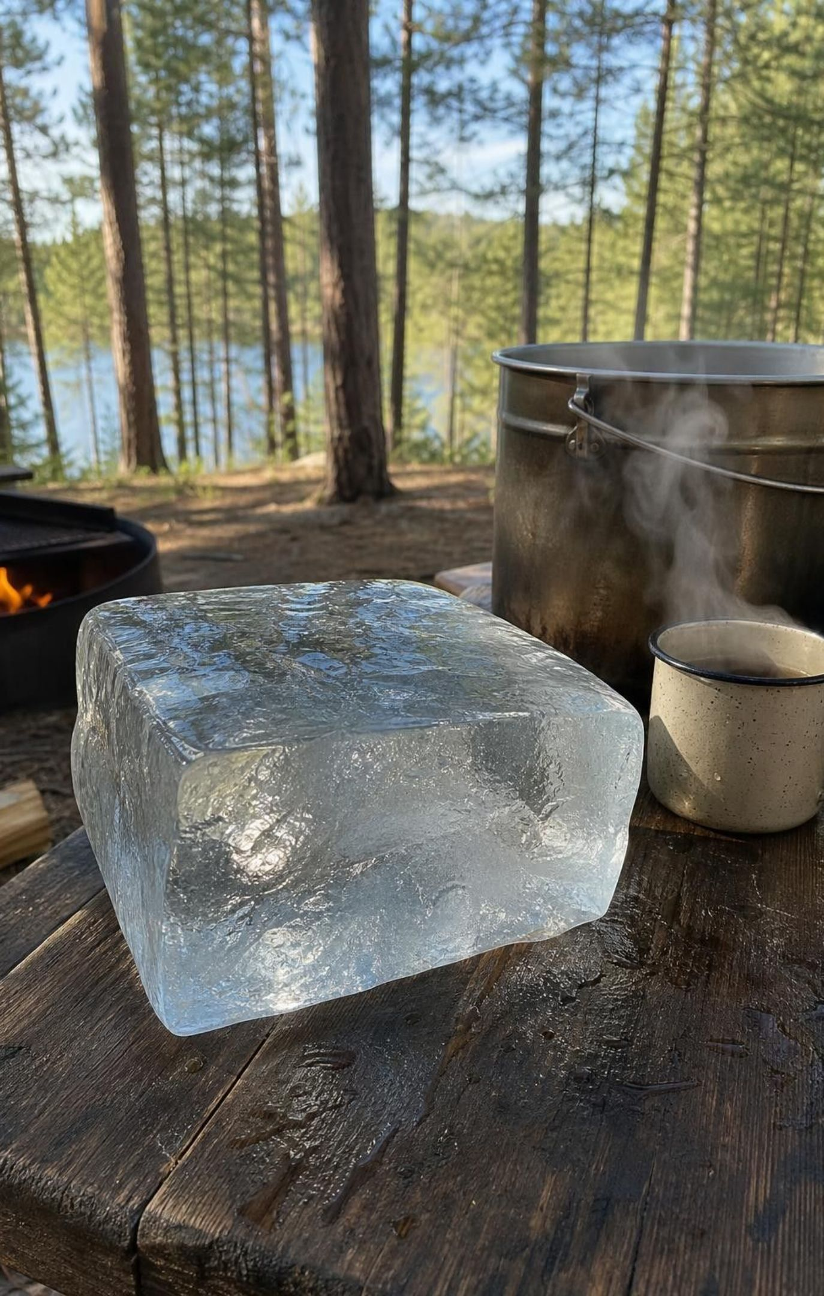
THINK, PAIR, SHARE
Discuss: which water melts more ice?
Think about: each option's temperature, and how many water particles each one has.
Think about: how far each can cool before it stops giving energy to the ice.
Then: would a full tank of water at exactly 0 °C melt any ice at all?
A camper must melt a big block of ice for drinking water. Option A: one mug of nearly boiling water. Option B: a large pot of lukewarm water from a sun-warmed tank. Which melts more ice, and why?
10
Notes:
Give pairs three minutes. Most will start with the mug because it is hotter. Ask them to think about the total: the mug's molecules are more energetic on average, but the pot has many times more molecules. Every bit of energy that melts ice comes from the water cooling down, and water can only give energy to the ice until it reaches 0 °C. A mug of 95 °C water cooling to 0 °C melts a little more than its own mass of ice. Water at 30 °C melts only about a third of its own mass, so the pot needs more than three times the mug's water just to tie; a pot holding ten times as much water melts about three times as much ice. The third question is the twist: a tank of 0 °C water has a large amount of thermal energy, yet it melts essentially no ice, because there is no temperature difference to drive heat. Do not settle every detail; Lab 2 lets them test it with real cups.
EXPECTED RESPONSES: Option B, if the pot holds much more water: more particles means more total thermal energy, and it can give energy to the ice for a long time while it cools to 0 °C. The 0 °C tank melts none because heat flows only when there is a temperature difference. Strong answers say the result depends on the amounts, not on temperature alone.
WATCH FOR: 'The hotter water always wins' and 'the 0 °C tank has no energy'. Both fall apart in Lab 2.
CONNECTS TO: Lab 2, Which Cup Holds More Thermal Energy?; W5 data worksheet.
PACING: about 6 min

Slide 11
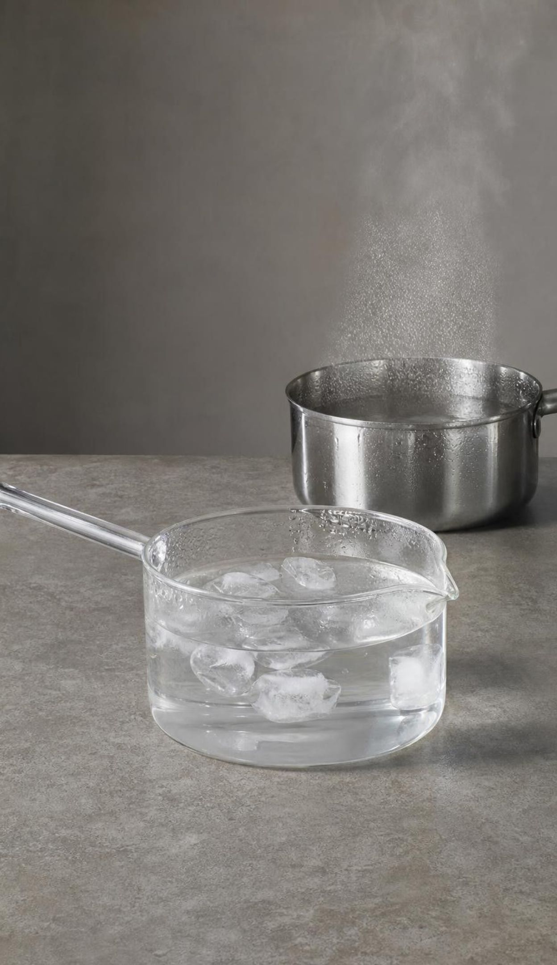
Three states, six changes
Solid: particles held in fixed positions by their attractions, vibrating in place.
Liquid: particles still close together, but able to slide past one another.
Gas: particles far apart, moving freely and colliding.
Add energy: melting (solid → liquid), evaporating or boiling (liquid → gas), subliming (solid → gas).
Remove energy: freezing (liquid → solid), condensing (gas → liquid), depositing (gas → solid).
The particles themselves never change; only their motion, spacing and arrangement do.
11
Notes:
Tie each state to what the particles are doing, using Lesson 23's model. Then name the six changes and sort them into two families: the three that need energy added and the three that release energy. Stress the last bullet with water: ice, liquid water and water vapor are all H2O molecules; a state change is a physical change, not a new substance. Mention that 'boiling' and 'evaporating' both turn liquid into gas; the difference comes on slide 19. Ask for a quick example of each change from daily life and write them on the board; you will reuse them on the check slide.
WATCH FOR: 'When water boils it turns into air' or 'into hydrogen and oxygen'. It becomes water vapor, the same molecules spread far apart.
CONNECTS TO: W4 diagram worksheet; W2 vocabulary.
PACING: about 5 min

Slide 12
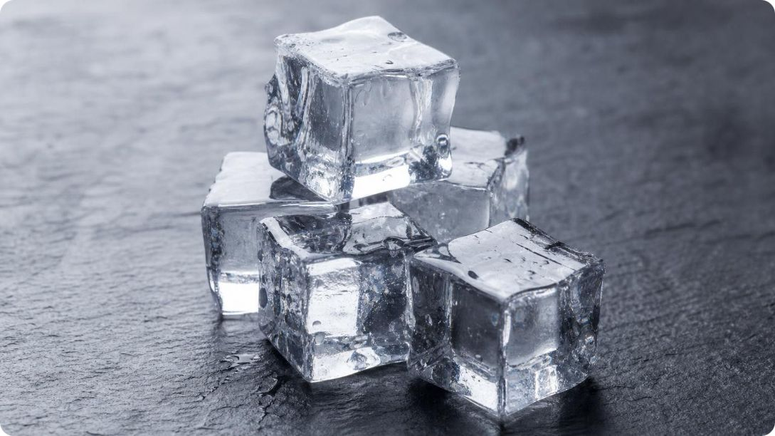
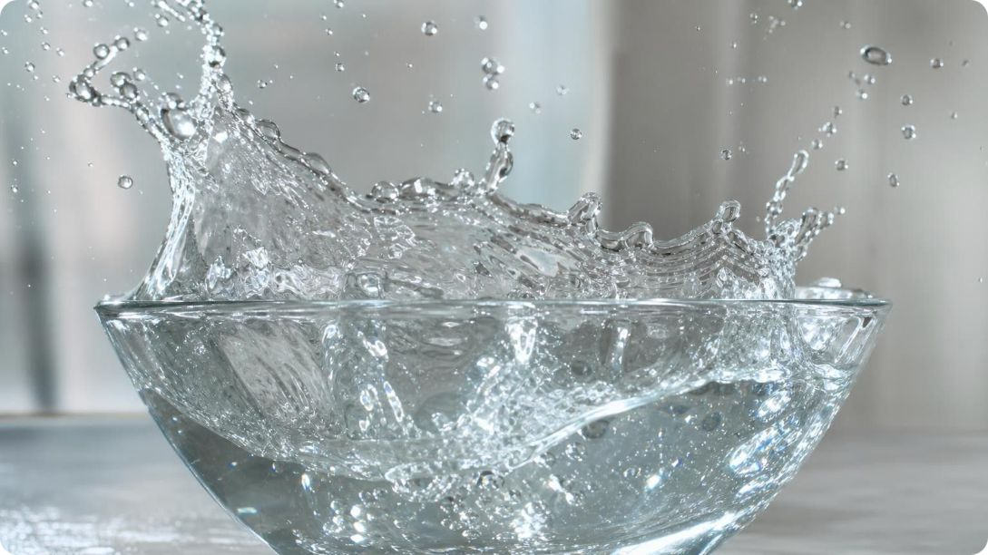
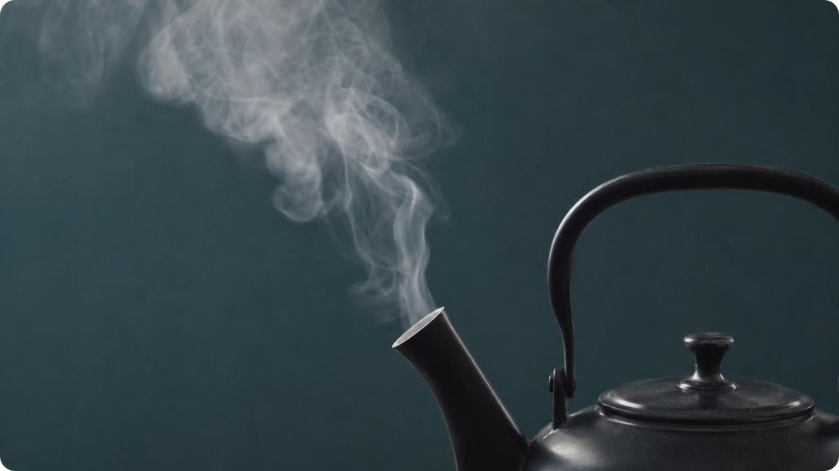
MODEL
Same molecules, three arrangements
Model: Water as a solid, a liquid and a gas
Ice (solid): particles tightly spaced; Vibrate in fixed positions
Liquid water: particles mediumly spaced; Close, sliding past each other
Water vapor (gas): particles loosely spaced; Far apart, moving freely
A model: real molecules are far too small to see, and real water vapor is far more spread out.
12
Notes:
Ask students what changes from panel to panel (spacing, freedom of motion) and what does not (the particles themselves, and their size). Then ask what would have to happen to a particle in the left panel for it to join the middle panel: it must gain enough energy to break out of its fixed position. And for a middle-panel particle to reach the right panel: it must gain enough to escape its neighbors entirely. Point out one honest flaw: ice is actually slightly less dense than liquid water, because its molecules lock into an open pattern, so for water the solid panel should not be drawn more tightly packed than the liquid. That quirk is why ice floats. For most substances the solid really is the most tightly packed.
WATCH FOR: 'Particles in a solid do not move.' They vibrate constantly; that vibration is why a solid has a temperature.
CONNECTS TO: W4 diagram worksheet (draw and complete particle models); Lab 1 three-panel drawing.
PACING: about 4 min

Slide 13
MODEL
The six-change map
Every change has a partner that runs the opposite way. Partners differ only in whether energy goes into the substance or comes out of it.
Model: Changes of state and the direction of energy
Center: Energy in (+) or out (−)
Evaporating or boiling: liquid → gas: energy in
Melting: solid → liquid: energy in
Subliming: solid → gas: energy in
Freezing: liquid → solid: energy out
Condensing: gas → liquid: energy out
Depositing: gas → solid: energy out
Each change is undone by the change directly across from it: the same two states, with energy moving the other way.
13
Notes:
Have students pair the opposites: melting with freezing, evaporating with condensing, subliming with depositing. Then ask the key question for the energy-out changes: where does the released energy go? Into the surroundings. That is why steam burns are so severe: water vapor condensing on skin releases a lot of energy right there. And it is why the drops forming on the cold glass are actually adding energy to it. Sublimation and deposition need real examples: dry ice at normal air pressure sublimes; snow slowly sublimes on dry, sunny, windy days; frost on a windshield and ice crystals in cold clouds grow by deposition. If you can, show deposition: pack a steel can with crushed ice and a few spoonfuls of salt, stir, and within minutes frost grows on the outside (the can's surface drops well below 0 °C). Some of that frost forms when vapor deposits straight to ice; some may form as tiny droplets that then freeze.
WATCH FOR: Students reverse the energy direction for freezing ('freezing takes energy because it gets cold'). Freezing releases energy; the freezer has to carry it away.
CONNECTS TO: W2 vocabulary (sorting the six changes by energy); W4 diagram worksheet (particle drawings for melting and boiling); the slide 21 frost-protection connection.
PACING: about 6 min

Slide 14
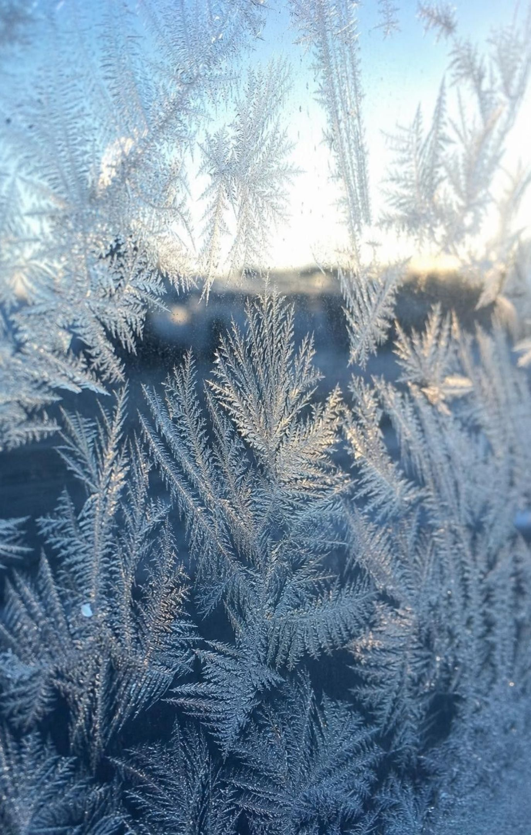
VOCABULARY IN CONTEXT
Names for the changes (part 2)
condensation: The change from gas to liquid, as gas particles lose energy and their attractions hold them together. Releases energy. Condensation of water vapor from the air formed drops on the cold can.
sublimation: The change from solid straight to gas, without becoming a liquid first. Takes in energy. A block of dry ice shrank by sublimation and left no puddle.
deposition: The change from gas straight to solid, without becoming a liquid first. Releases energy. Deposition coated the windshield with feathery frost overnight.
14
Notes:
These are the three terms students most often confuse. Have them write each with a two-arrow sketch: gas to liquid, solid to gas, gas to solid. Point out the trap with the word 'deposit': in everyday talk it means putting money in a bank; in science it means gas becoming solid. Remind students that the white fog around dry ice is not carbon dioxide gas, which is invisible; it is tiny drops of water condensed from the air by the very cold gas. So a dry-ice cooler shows two different changes at once: sublimation of the carbon dioxide and condensation of water from the air.
WATCH FOR: Calling the dry-ice fog 'carbon dioxide gas' or 'smoke'. The gas is colorless; the fog is condensed water.
CONNECTS TO: W2 vocabulary; W10 mastery.
PACING: about 4 min

Slide 15
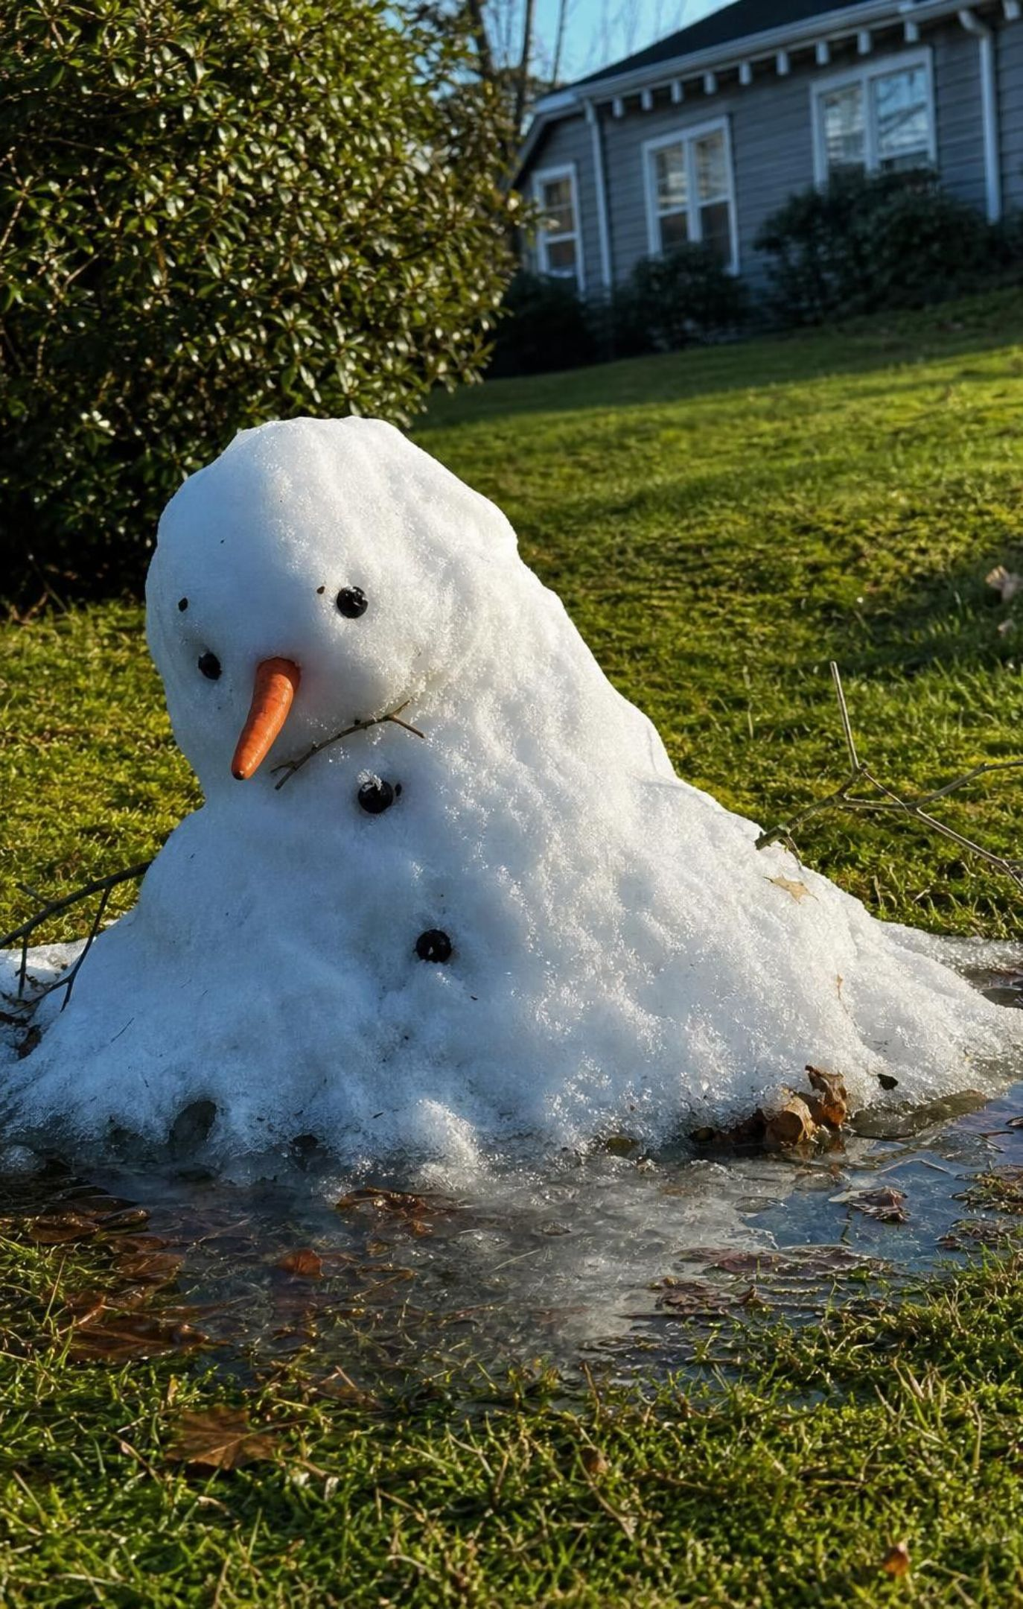
CHECK FOR UNDERSTANDING
Quick check: name that change
Feathery frost grows on a car windshield on a clear winter night.
A puddle on the playground is gone by lunchtime.
Melted candle wax drips onto the table and hardens.
A block of dry ice in a cooler shrinks but leaves no puddle.
Cold glasses fog up when you walk into a warm, steamy kitchen.
A snowman slumps on a sunny afternoon.
Name the change of state in each case, and say whether energy goes into or out of the substance that changes.
15
Notes:
Give one minute of silent writing, then go through them with whiteboards. For each, ask which substance is changing: for the glasses it is the water vapor in the kitchen air, not the glasses. The wax item is a chance to mention that candle wax is a mixture, so it hardens over a range of temperatures rather than at one sharp freezing point, but it is still freezing. The snowman is mostly melting; on very dry, sunny days some snow also sublimes directly.
EXPECTED RESPONSES: 1: deposition, energy out of the water vapor. 2: evaporation, energy in. 3: freezing, energy out of the wax. 4: sublimation, energy in. 5: condensation, energy out of the water vapor (into the cold glasses). 6: melting, energy in (some sublimation is also acceptable).
WATCH FOR: Item 5 answered as 'the glasses sweat' or 'evaporation'. The vapor in the air condenses on the cold lenses.
CONNECTS TO: W2 vocabulary; W10 mastery.
PACING: about 5 min

Slide 16
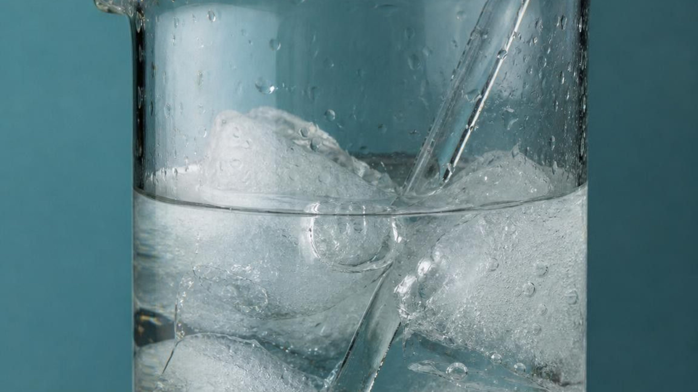
Why the thermometer gets stuck at 0 °C
While ice melts, energy keeps flowing in, yet the temperature stays at 0 °C (at normal air pressure).
That energy pulls particles free of the attractions holding them in place.
It does not make the particles move faster on average, so the thermometer reading does not rise.
Only after all the ice has melted does the added energy raise the temperature again.
The same holds while water boils at 100 °C at sea level, and while it freezes or condenses.
This works for pure substances. Mixtures such as salt water or wax change state over a range.
16
Notes:
This is the explanation for Lab 1's flat stretch and for the stubborn thermometer on slide 2. Have students take out their Lab 1 graphs. Ask: during the flat stretch, was energy entering the cup? The bath kept cooling, so yes. Where did it go? Into breaking particles out of the solid's fixed arrangement. A useful picture: the energy is spent unhooking particles from each other, not speeding them up. Thermal energy rises during melting even though temperature does not, because the liquid's particles have more energy stored in their freer arrangement. The reverse is true for freezing: as water freezes, it gives off energy while staying at 0 °C. Stress the conditions. These fixed temperatures are for a pure substance at a steady pressure. Salt water starts to freeze below 0 °C and keeps getting colder as it freezes; wax softens over a range.
WATCH FOR: 'The temperature stopped because the bath ran out of energy' or 'the ice is blocking the heat'. The bath data show energy kept flowing in.
CONNECTS TO: Lab 1 graph annotation; W5 data worksheet; W3 reading.
PACING: about 5 min

Slide 17
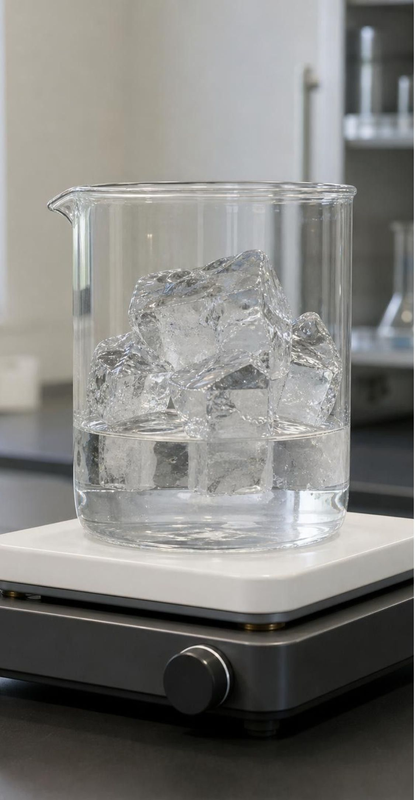
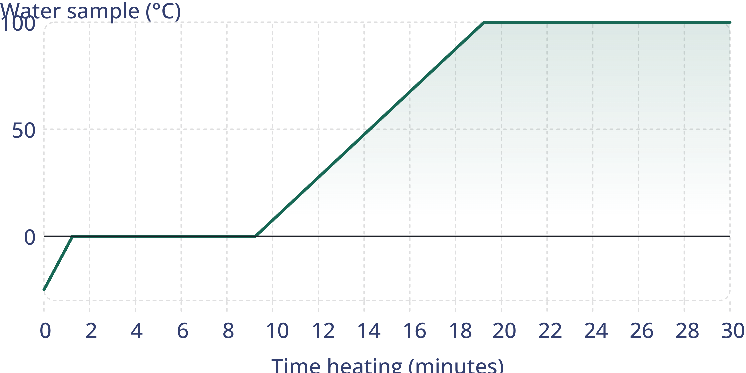
MODEL
Reading a heating curve
A steady heater warms a sample of ice at sea-level air pressure. Where is the energy speeding particles up, and where is it changing the state?
Model: Idealized heating curve for water
simulated data
Idealized teaching curve: a steady heater, normal sea-level air pressure, perfect stirring. Boiling all the water away would take far longer than shown.
17
Notes:
Walk the curve in four stretches. From 0 to about 1 minute the ice warms from −25 °C to 0 °C: still solid, molecules vibrating harder. From about 1 to 9 minutes the line is flat at 0 °C: the ice is melting, and the energy is unhooking molecules. From about 9 to 19 minutes the liquid warms to 100 °C: molecules moving faster on average. From about 19 minutes on the line is flat at 100 °C: the water is boiling, and the energy is pulling molecules completely away from each other. Ask why the boiling stretch is so long: it takes far more energy to separate water molecules completely into a gas than to loosen them into a liquid. Then ask what a cooling curve for steam would look like: the same shape run backwards, with flat stretches at 100 °C (condensing) and 0 °C (freezing). This is idealized; Lab 1's real curve will have rounded corners because real stirring and thermometers are not perfect.
WATCH FOR: Reading a flat stretch as 'the heater was off' or 'nothing is happening'. Energy is flowing in the whole time.
CONNECTS TO: Lab 1 (compare the real melting curve); W5 data worksheet; W4 diagram.
PACING: about 5 min

Slide 18
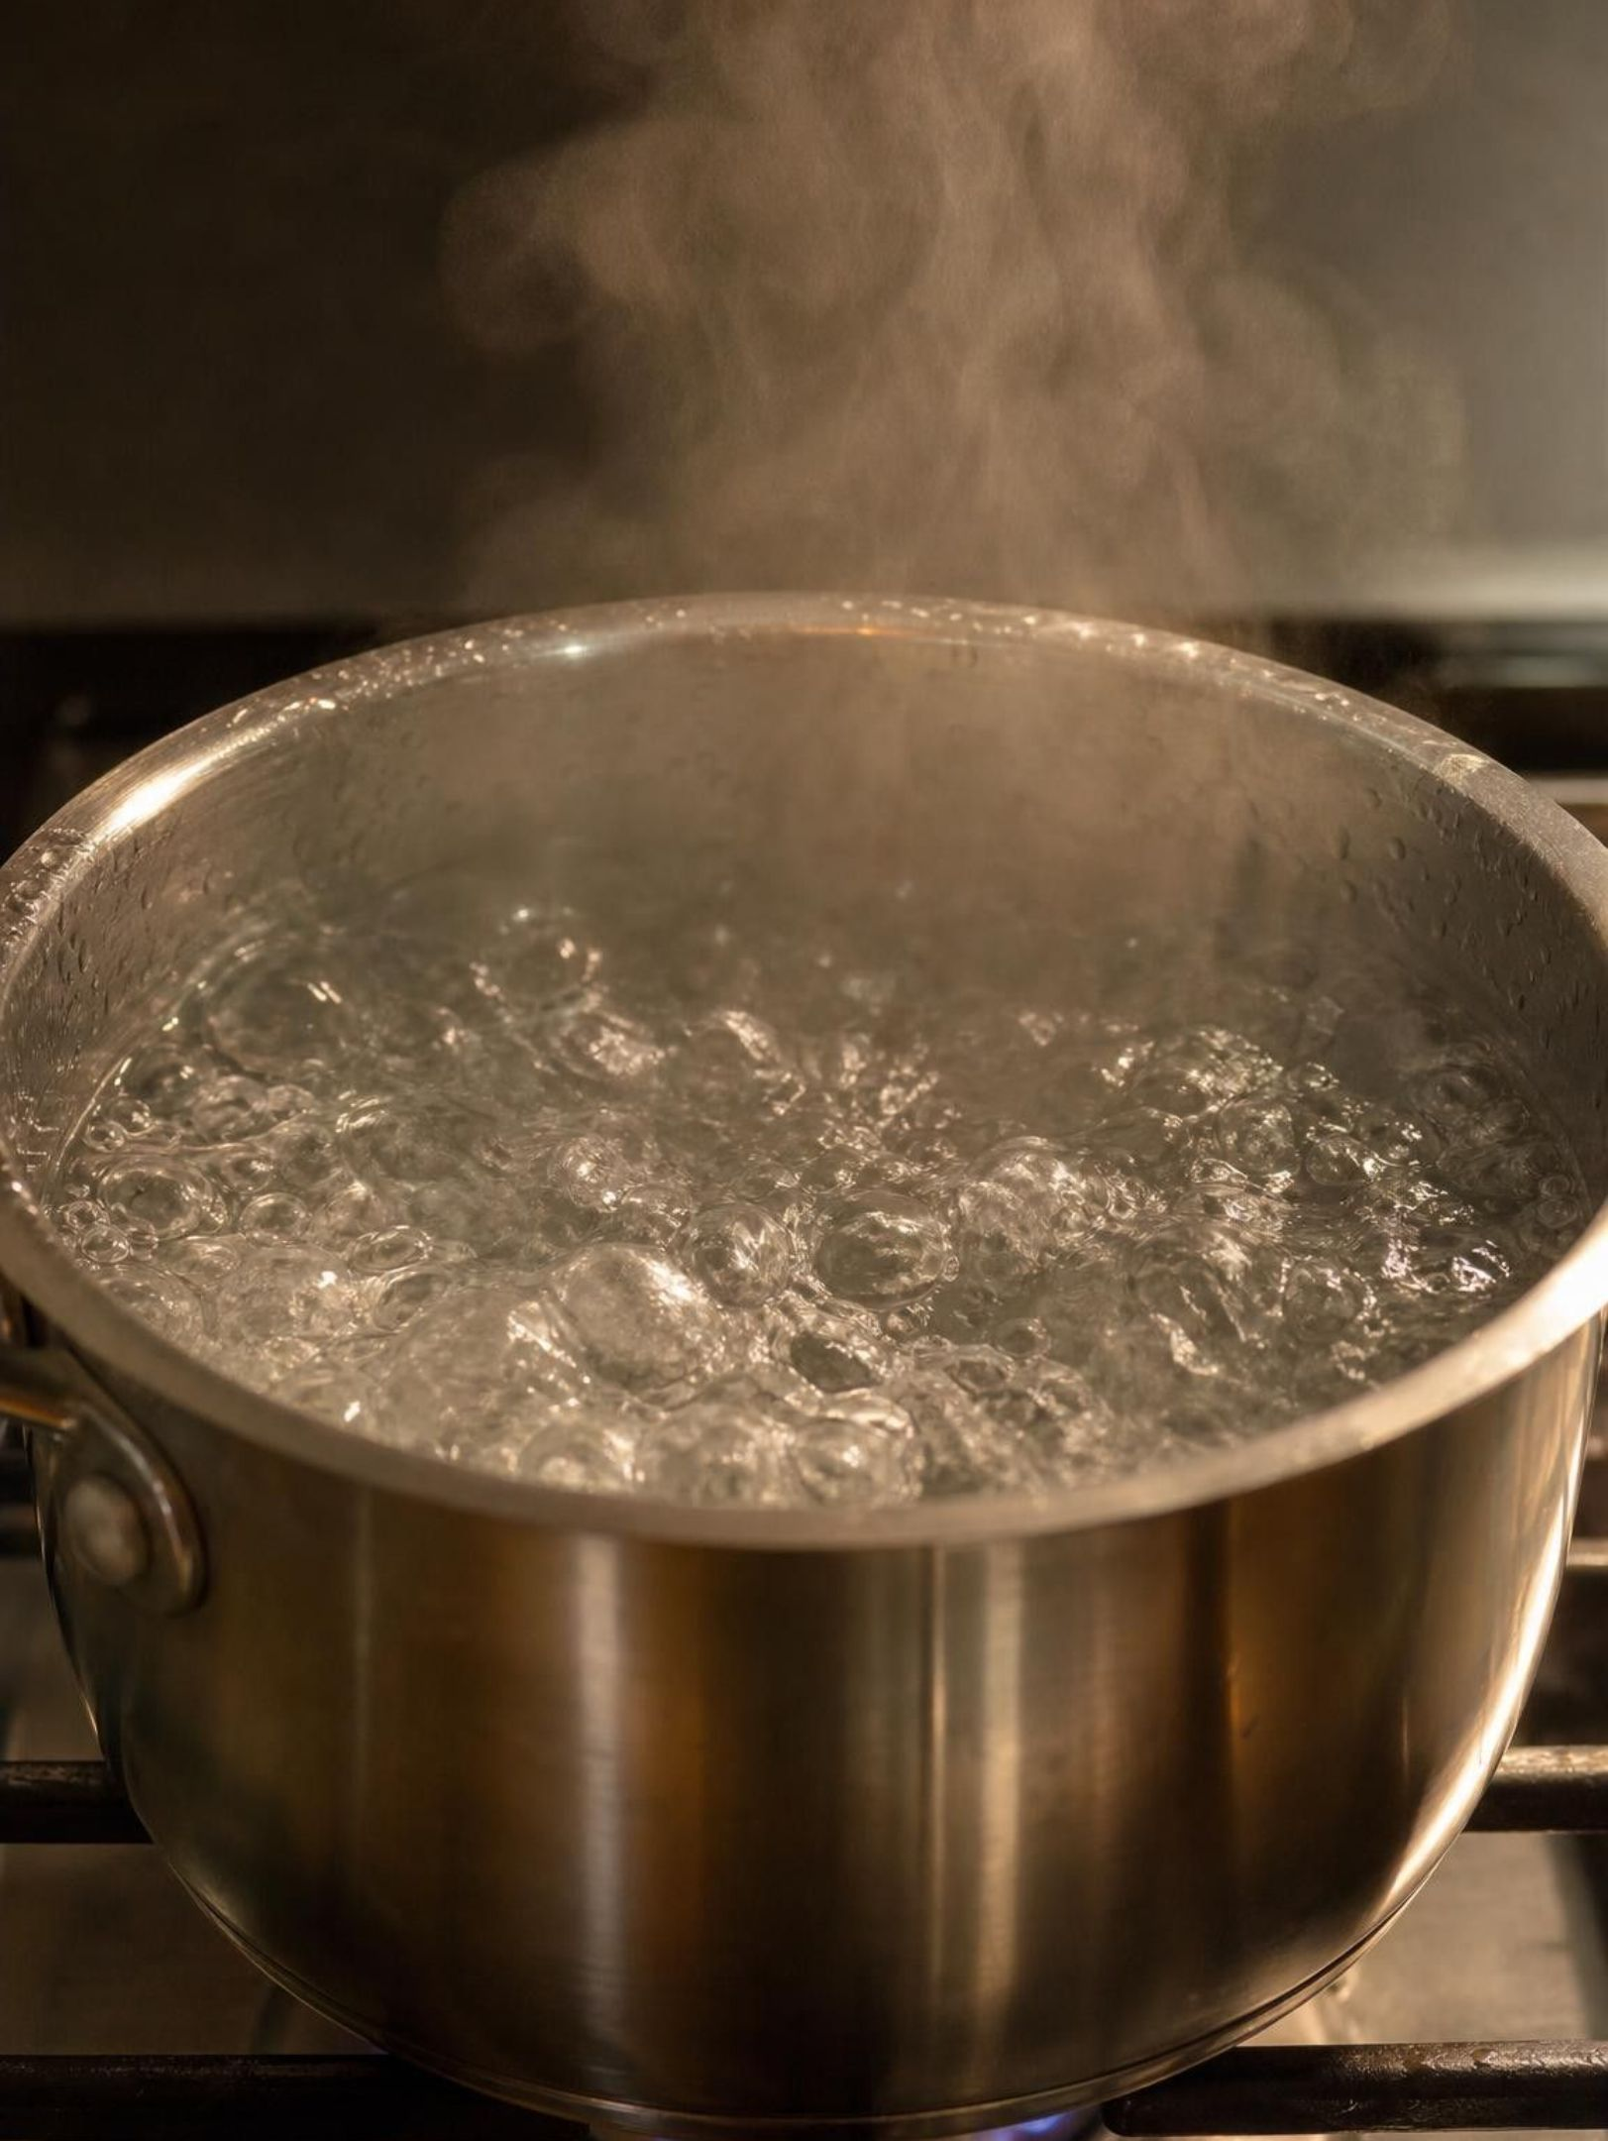
CHECK FOR UNDERSTANDING
Quick check: read the curve
On the heating curve, during which minutes is the water (a) all solid, (b) melting, (c) all liquid and warming, (d) boiling? During which stretches is the molecules' average kinetic energy rising?
18
Notes:
Students answer on whiteboards. Then ask one more: at minute 3 and at minute 9, the thermometer reads the same. Which sample has more thermal energy? The one at minute 9: it has taken in six more minutes of energy, and almost all of it has melted, so far more of its molecules have been freed from the solid. That separates temperature from thermal energy one more time. Finish with a cooling version: 'A cup of water in the freezer reads 0 °C for an hour. Is it gaining or losing energy during that hour?' Losing, as it freezes.
EXPECTED RESPONSES: (a) 0 to about 1 minute; (b) about 1 to 9 minutes; (c) about 9 to 19 minutes; (d) about 19 minutes onward. Average kinetic energy rises from 0 to about 1 minute and from about 9 to 19 minutes, the sloped stretches; it stays the same on the flat stretches. At minute 9 the sample has more thermal energy than at minute 3.
WATCH FOR: Students say the average kinetic energy rises during boiling 'because the gas particles are fast'. During the flat stretch the temperature, and so the average kinetic energy, is constant.
CONNECTS TO: W5 data worksheet; W10 mastery; Lab 1 analysis.
PACING: about 4 min

Slide 19
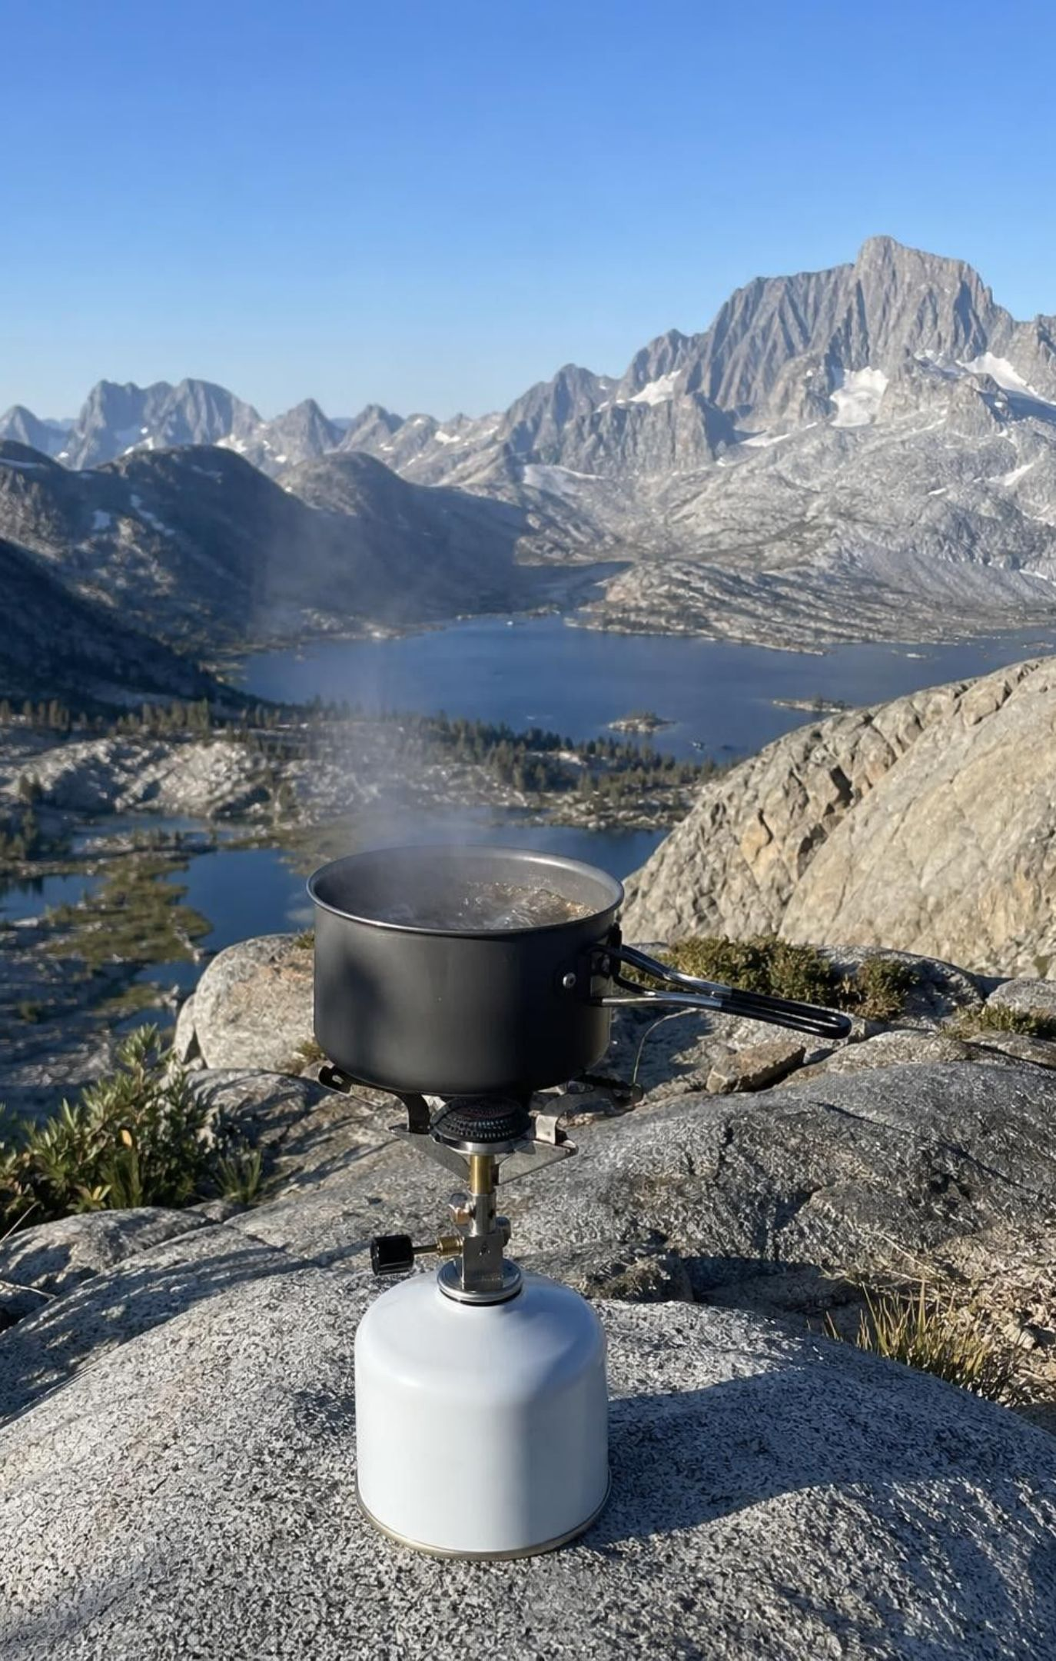
Evaporation and boiling are not the same
Evaporation: the most energetic particles escape from the liquid's surface, at many temperatures.
That is why puddles dry and laundry dries on a cool, breezy day.
Evaporation carries energy away, so the liquid left behind cools. Sweating works this way.
Boiling: at the boiling point, bubbles of vapor form throughout the liquid, not just at the top.
The big bubbles in boiling water are water vapor, not air.
Boiling point depends on air pressure: water boils near 90 °C at 3,000 m, as at Yosemite's Tioga Pass.
19
Notes:
Use the particle model: at any temperature, the particles in a liquid have a range of energies. A few at the surface are moving fast enough, in the right direction, to break away. Because the fastest ones leave, the average energy of those left behind drops, which is why evaporation cools. Let students feel it with a drop of water on the back of the hand while they blow on it. Boiling is different: at the boiling point, vapor can form bubbles inside the liquid that push back against the air pressure above. Lower air pressure, as high in the Sierra Nevada, means bubbles form at a lower temperature, so water boils near 90 °C at about 3,000 meters and pasta takes longer to cook. The small bubbles that appear on a pot's bottom before boiling are dissolved air coming out; the big rolling bubbles are water vapor.
WATCH FOR: 'Water has to be at 100 °C to evaporate' and 'the bubbles are oxygen and hydrogen'.
CONNECTS TO: W7 misconception repair; W10 mastery; Lesson 18 water cycle.
PACING: about 5 min

Slide 20
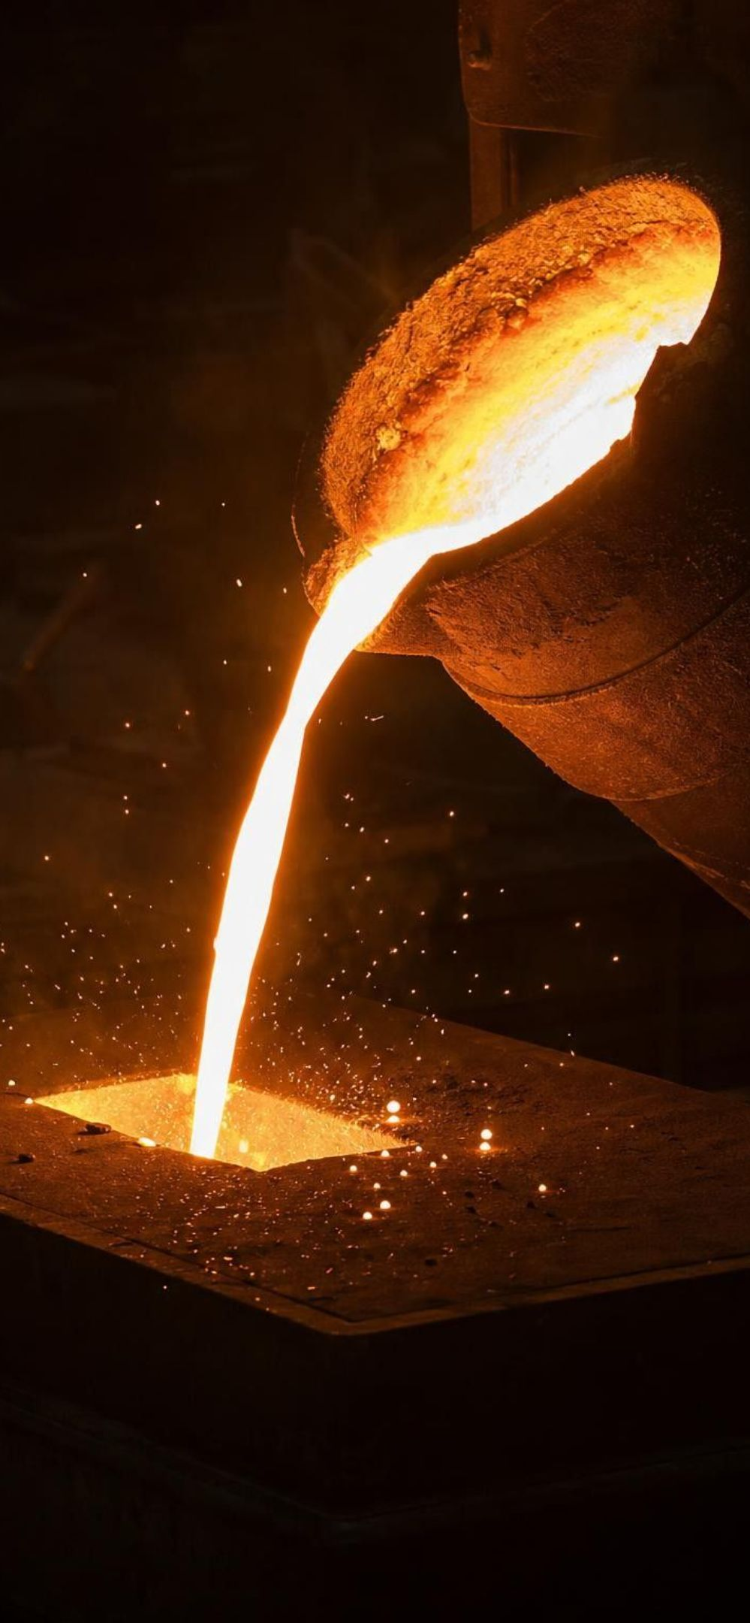
Why substances change state at different temperatures
The particles of every substance attract one another, but how strongly depends on the substance.
Stronger attractions take more energy to overcome, so melting and boiling happen at higher temperatures.
Helium atoms barely attract: helium boils at −269 °C and will not freeze at normal air pressure.
Melting and boiling points are properties that help identify a pure substance.
Substance | Melts at (°C) | Boils at (°C)
Helium | does not freeze | -269
Nitrogen | -210 | -196
Ethanol (alcohol) | -114 | 78
Water | 0 | 100
Table salt | 801 | 1465
Iron | 1538 | 2861
20
Notes:
All values are at normal sea-level air pressure, rounded to the nearest degree. Ask students to rank the substances by how strongly their particles attract, using only the table. Helium is weakest, then nitrogen, then ethanol, then water; table salt and iron hold together far more strongly. Water's attractions are strong compared with helium's but modest compared with salt's. Use the textbook's tape picture in your own words: weakly attracting particles are like balls with barely sticky tape; strongly attracting ones are like balls wrapped in duct tape. It takes more energy, and so a higher temperature, to pull duct-taped balls apart. Connect to identification: in Lesson 3 students used melting points to identify substances; this is why that works.
WATCH FOR: 'Things with high boiling points are heavier.' Particle mass plays some part, but here the main idea is the strength of attraction.
CONNECTS TO: W8 Substance Experts jigsaw (melting and boiling points of twelve substances); W10 mastery; Lesson 3 properties.
PACING: about 4 min

Slide 21
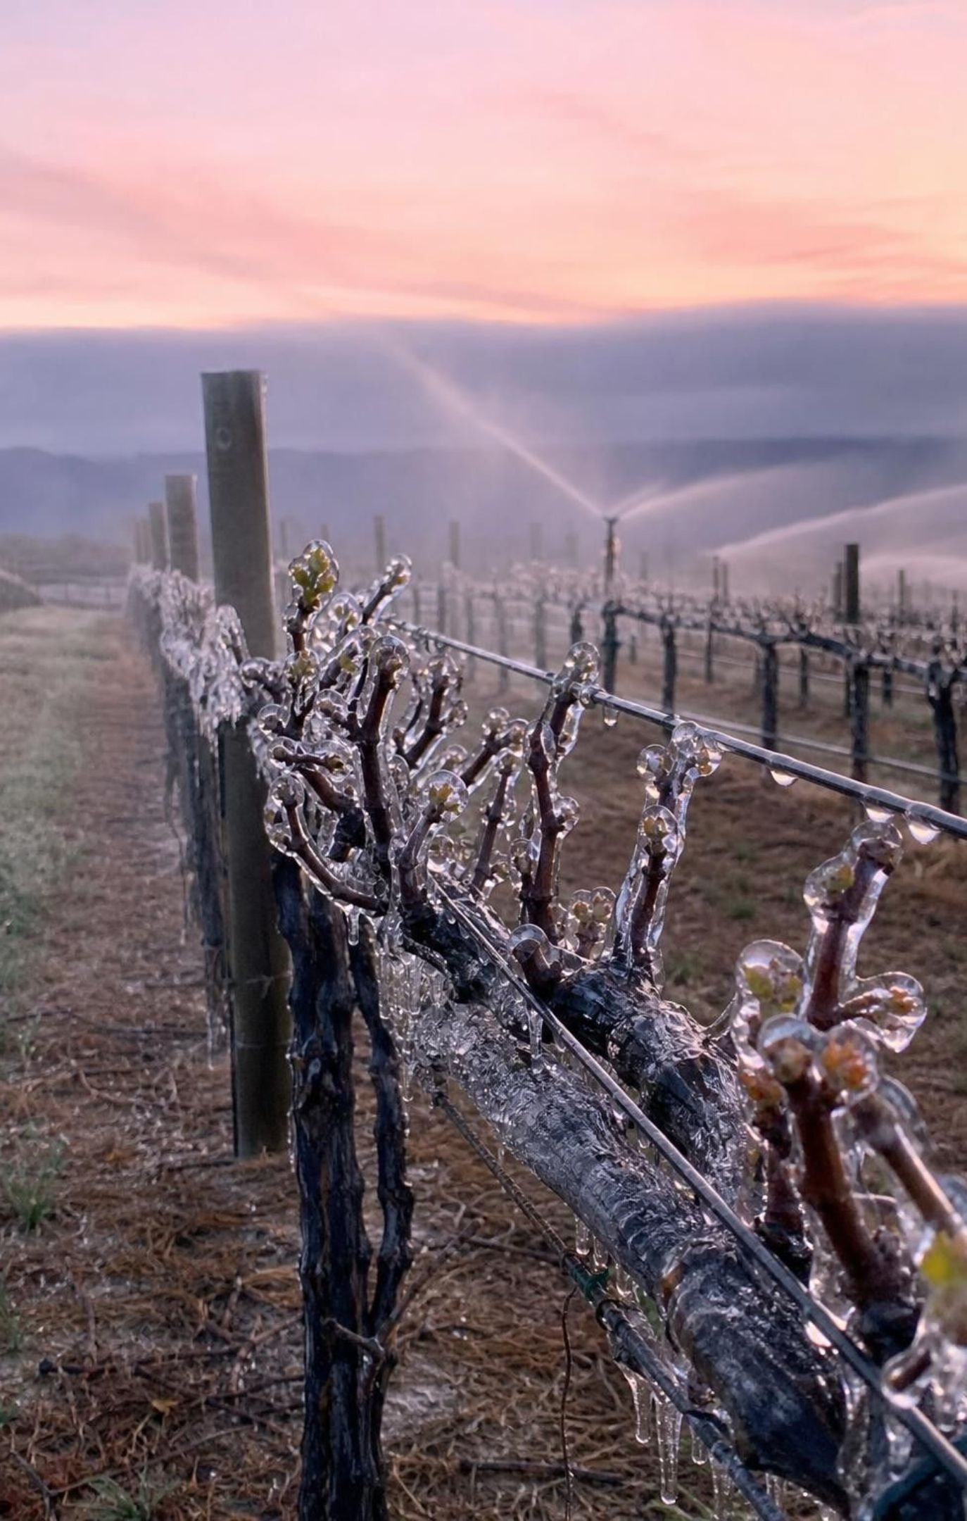
REAL-WORLD CONNECTION
California connection: sprinklers on a frosty night
On clear spring nights a frost can kill grape buds and strawberry blossoms. Some California growers switch on sprinklers. As the water freezes on the plants it releases energy, and as long as liquid keeps freezing, the coat of ice and water stays near 0 °C, warmer than the frosty air, so the tissue inside is protected.
Freezing releases energy: it is melting run backward.
The ice-water coat holds at the melting point, just like the cup in Lab 1.
The sprinklers must keep running until the ice melts in the morning, or evaporation can chill the plants.
The cost: in 2008, frost-night pumping stranded young salmon and steelhead in Russian River streams.
21
Notes:
This sounds backward to students: protect plants from freezing by covering them in ice? Use the six-change map: freezing releases energy into the surroundings, which here means the plant. And as long as there is a mixture of ice and liquid water on the plant, it stays at the melting point, 0 °C, just as their Lab 1 cup did, even though the air may be several degrees below freezing. Many buds and blossoms survive 0 °C but are damaged a couple of degrees colder. The method has real costs. If the sprinklers stop too early, evaporation of the water cools the plants below the air temperature. And frost nights bring every grower's pumps on at once: in 2008, rapid pumping from streams in the Russian River watershed in Sonoma and Mendocino counties dropped water levels fast enough to strand young coho salmon and steelhead, and in 2011 the State Water Resources Control Board adopted a rule requiring growers there to manage frost-protection pumping. Ask students to name the trade-off: crops versus streams. Growers also use wind machines that mix warmer air down from above.
CONNECTS TO: Lab 1 (the 0 °C plateau); W9 transfer problem (choosing a frost-protection plan for a vineyard).
PACING: about 5 min

Slide 22
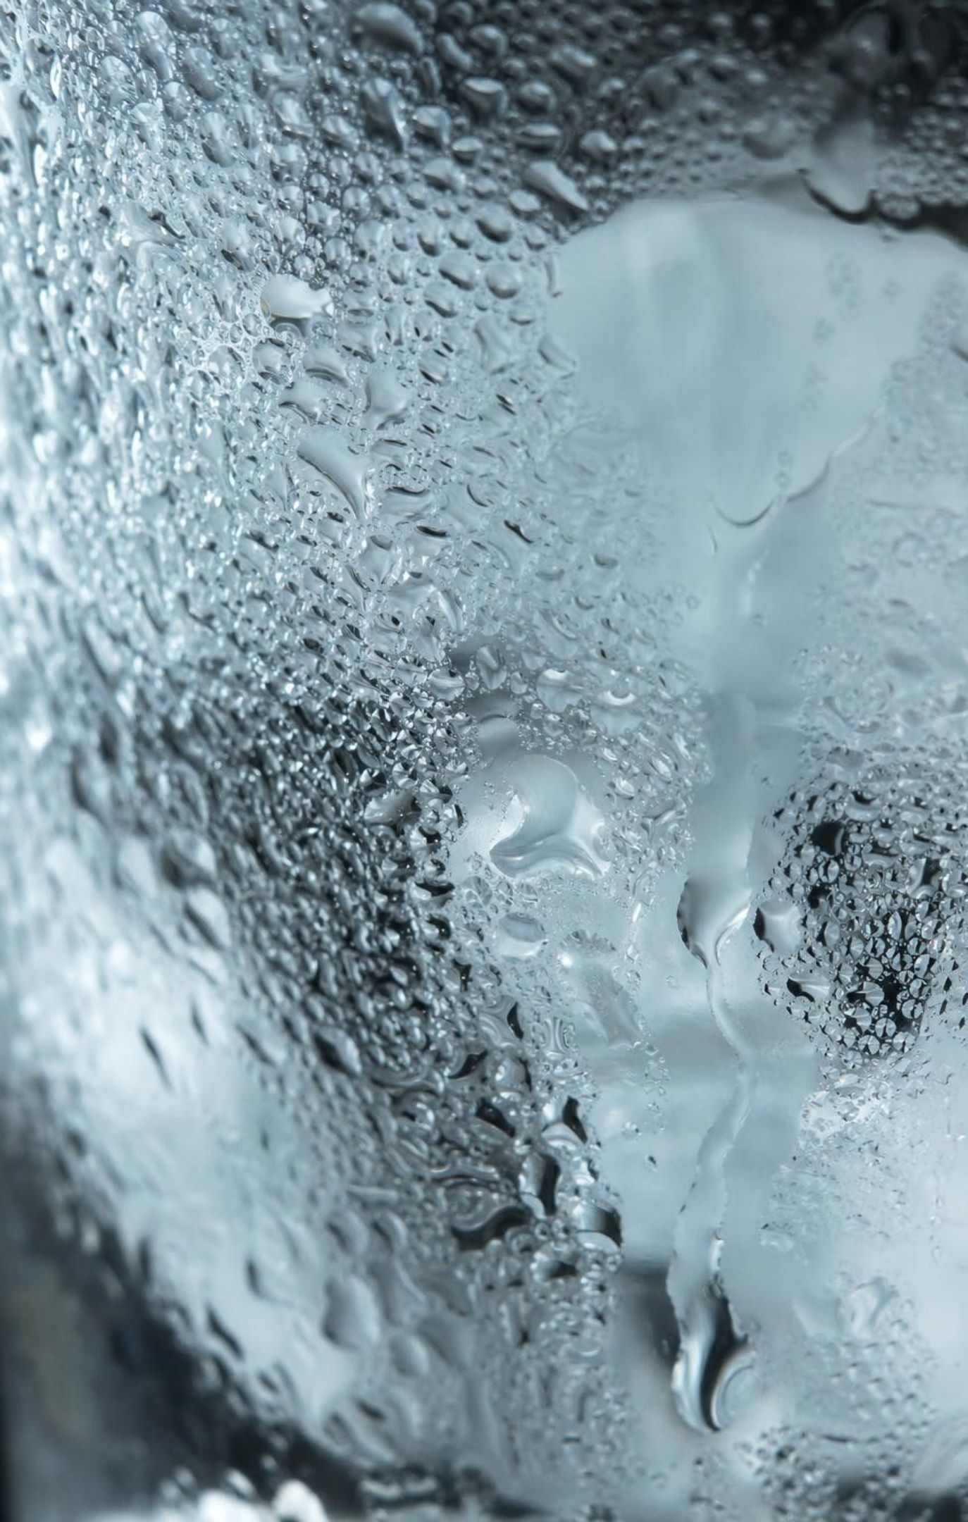
THINK, PAIR, SHARE
Discuss: back to the sweating glass
Where is the water before it shows up on the glass?
What happens to a water vapor particle that collides with the cold surface?
The vapor releases energy as it condenses. Where does that energy go next?
Would the glass sweat as much in dry desert air? Would a glass of warm water sweat at all?
Use particles and energy to explain both puzzles: where the drops on the outside of the glass came from, and why the ice water stayed at 0 °C for most of an hour.
22
Notes:
Give pairs four minutes and ask each pair to write two sentences, one per puzzle. Drops: the room air contains invisible water vapor; vapor particles that hit the cold glass lose energy to it, slow down, and their attractions hold them together as liquid, which is condensation. Thermometer: energy flows from the warm room into the glass the whole time, but while ice remains it goes into melting the ice, so the ice water stays at its melting point. The subtle point in bullet 3: condensation releases energy into the glass, so a sweating glass actually melts its ice a little faster than a dry one would. In dry air there is less vapor, so the glass may stay dry; a glass of warm water does not sweat because its surface is not cold enough to make the vapor condense. Have students revise their W1 explanation now.
EXPECTED RESPONSES: Drops come from water vapor in the air that loses energy to the cold glass and condenses; the can is sealed, so nothing leaked. The temperature stays at 0 °C because energy entering the glass is used to melt the ice, not to speed up the molecules, until the ice is gone. Condensation adds energy to the glass. Dry air gives fewer drops; warm glasses do not sweat.
CONNECTS TO: W1 revision; W6 CER (where the water on a cold can comes from).
PACING: about 6 min

Slide 23
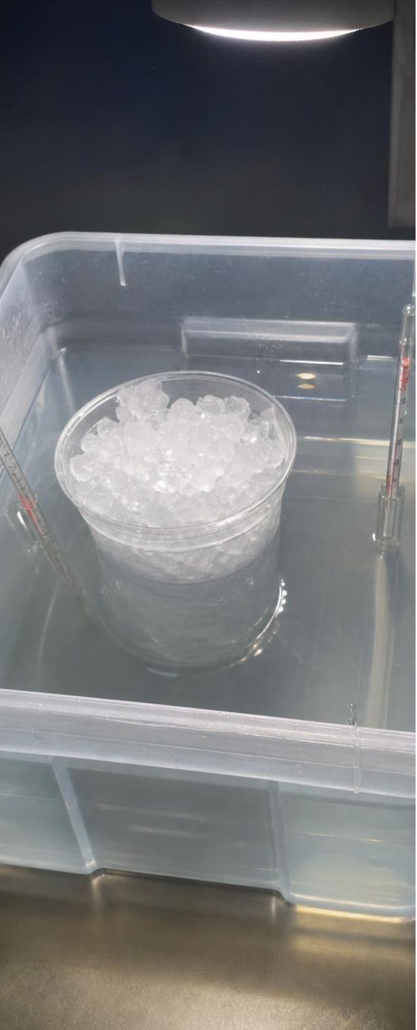
APPLY IT
Task: the bath and the cup
A group set a cup holding 150 g of crushed freezer ice in a tub of 2 liters of warm water, stirred both, and read two thermometers. Teaching data:
Time (min) | Ice cup (°C) | Warm bath (°C) | What is in the cup
0 | -6 | 44 | Ice, no liquid yet
2 | 0 | 42 | Ice and a little water
5 | 0 | 40 | Slush
8 | 0 | 38 | A few small chunks
11 | 3 | 35 | All liquid (last ice gone at about 10.5 min)
15 | 21 | 33 | Liquid
20 | 28 | 32 | Liquid
During which minutes was the ice melting? Give two pieces of evidence.
Was energy flowing into the cup between minutes 2 and 8? How do you know?
Where did that energy go, if not into raising the temperature?
Why did the cup's temperature finally rise, and what final temperature do you predict?
Simulated data for practice.
23
Notes:
Tell students plainly that this is a teaching dataset built to behave the way the Lab 1 setup should; their own data will be bumpier. Give groups eight minutes. The strongest evidence that energy entered the cup during the flat stretch is the bath: it dropped from 42 °C to 38 °C while the cup read 0 °C. Where did the bath's energy go? Into melting the ice (and a little into the room air). After the last ice melted, the same flow of energy went into speeding up water molecules, so the cup warmed quickly. The cup can never pass the bath; both will drift toward room temperature, about 22 °C, if left long enough, because the bath is also losing energy to the air. If anyone asks why the bath dropped faster early on, the temperature difference was largest then, and a bigger difference drives energy faster. If you are running this during the round 2 test wait in Lab 3, project the table and let groups work at their stations.
EXPECTED RESPONSES: 1: from about minute 1 to about minute 10.5; evidence: the cup stayed at 0 °C, ice was visibly shrinking, and the reading rose only after the last ice was gone. 2: yes, the bath kept cooling (42 to 38 °C) and heat flows from warmer to cooler. 3: into freeing water molecules from the solid, melting the ice. 4: once no ice was left, the energy sped up the molecules; the cup and bath will both end near room temperature, about 22 °C, after a long time (in the short run the cup approaches the bath's temperature, about 30 °C).
WATCH FOR: Students may claim the bath 'gave its cold to the room' or that the cup 'absorbed cold'. Insist on energy language.
CONNECTS TO: Lab 1 (students compare their own curve); W5 data worksheet; W4 heating curve.
PACING: about 10 min

Slide 24
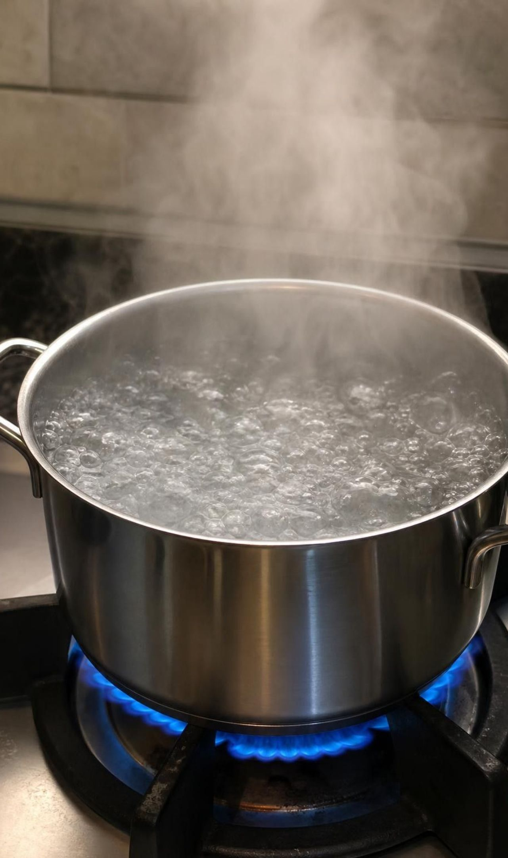
MISCONCEPTION CHECK
True or false? More heat always means hotter
"If you keep adding heat to something, its temperature has to keep going up. Turn the stove higher under a pot of boiling water and the water will get hotter than 100 °C."
True or false? Explain your reasoning.
24
Notes:
Have students vote, then write a two-sentence response with evidence. The claim is false for a substance that is changing state. An open pot of boiling water at sea level stays near 100 °C whether the burner is low or high; turning it up makes the water boil faster, turning more liquid into vapor each minute, but does not raise the temperature, because the extra energy goes into separating molecules. Lab 1 is the evidence they gathered themselves: the bath kept supplying energy while the ice water stayed at 0 °C. Add the honest limits: a pressure cooker raises the pressure, which raises the boiling point to about 120 °C, and once all the water has boiled away the pot itself heats up fast, which is why you never leave an empty pot on a burner.
EXPECTED RESPONSES: False. While a pure substance melts or boils at a steady pressure, added energy goes into the change of state and the temperature stays at the melting or boiling point. A hotter burner makes the water boil away faster but stays near 100 °C at sea level.
WATCH FOR: Students may overcorrect to 'adding heat never raises temperature'. It does, whenever no change of state is happening.
CONNECTS TO: W7 misconception repair; Lab 1 analysis; chapter misconceptions list.
PACING: about 5 min

Slide 25
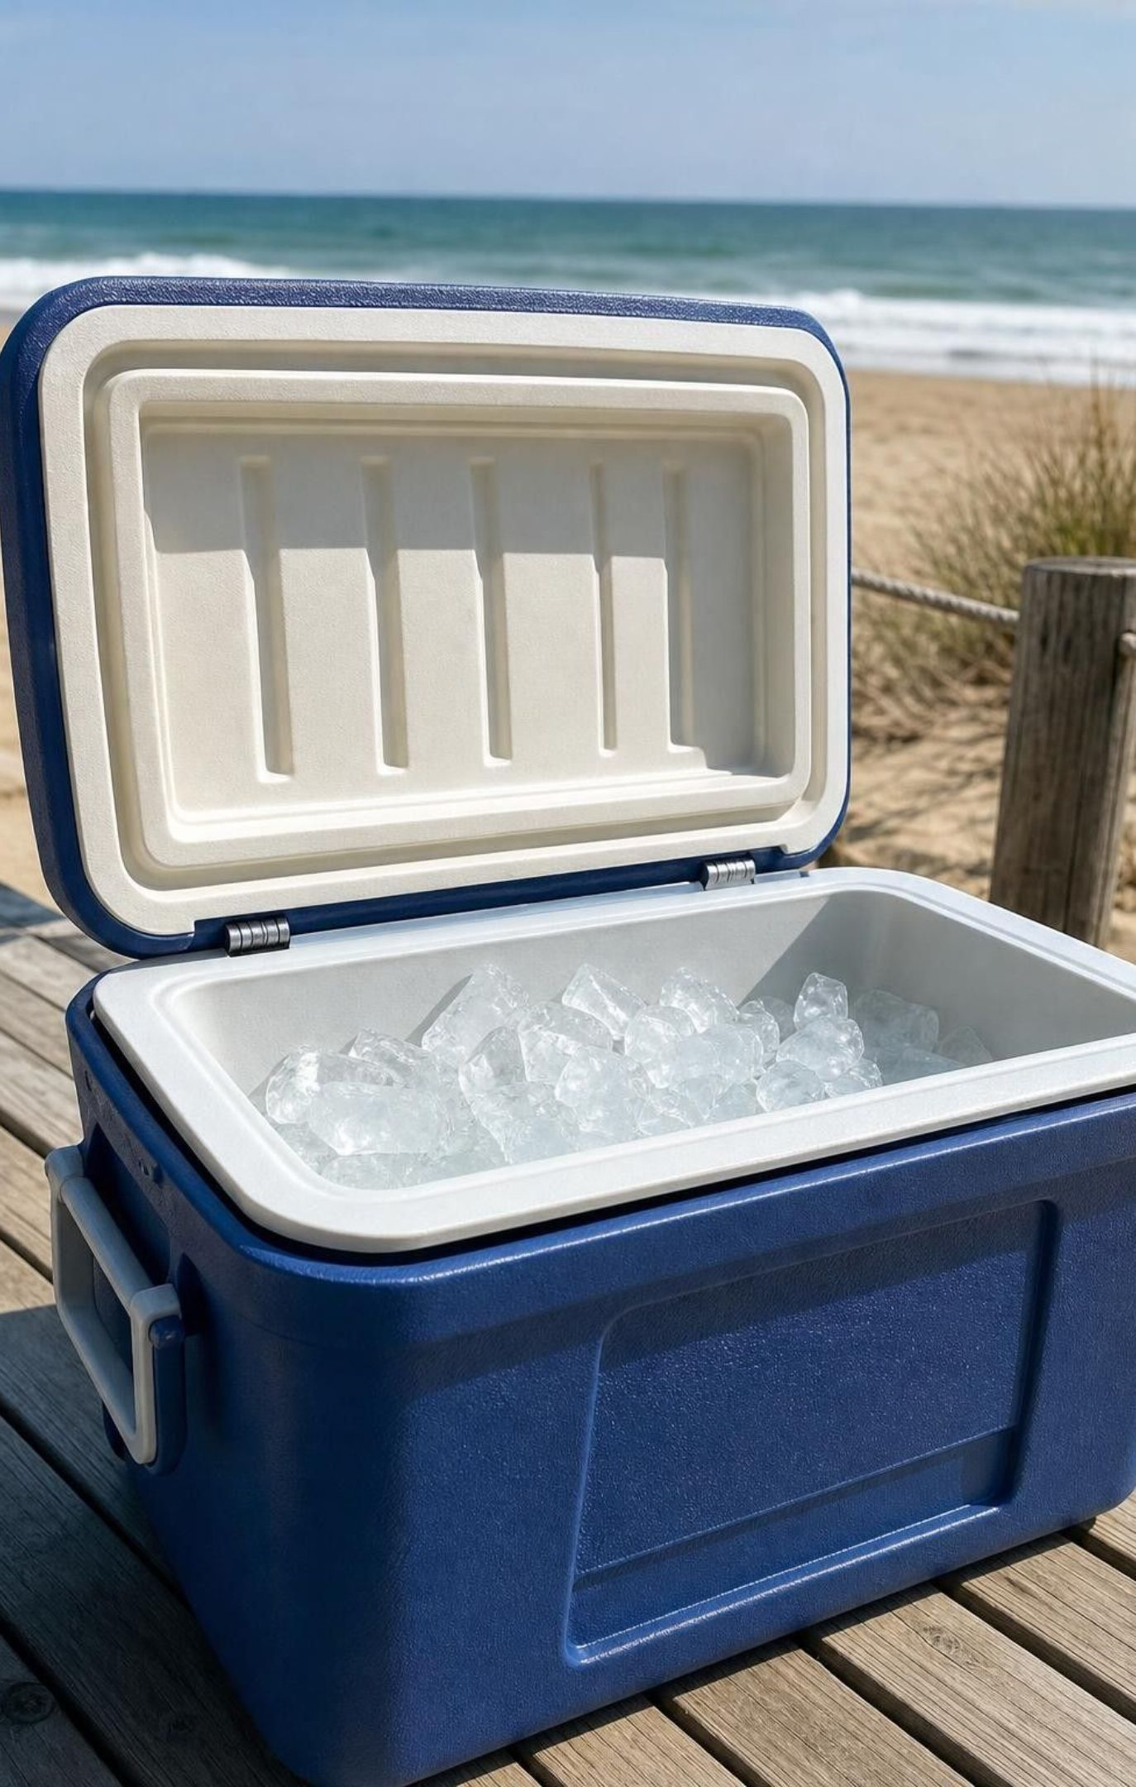
PUTTING IT TOGETHER
Putting it together
Temperature is an average; thermal energy is a total; heat is energy moving from warmer to cooler.
Heat flows until temperatures are equal. The amount a sample can give depends on its mass and temperature.
Adding energy melts, evaporates or sublimes a substance; removing energy freezes, condenses or deposits it.
During a change of state, a pure substance stays at one temperature while energy separates or joins particles.
Stronger attractions between particles mean higher melting and boiling points.
Insulators slow energy transfer by trapping still air; they do not make cold or heat.
25
Notes:
Ask students to write a four-sentence summary that uses temperature, thermal energy, heat and two state-change names correctly, then trade with a partner who underlines each term and checks that 'heat' always means energy moving. Ask one question about each lab: Lab 1, what was the bath doing during the flat stretch? Lab 2, why did the hottest cup not win? Lab 3, which feature of the best designs mattered most? Preview the next unit: the same energy ideas explain how magma melts rock and why volcanoes erupt.
CONNECTS TO: W10 mastery as the quiz; W6 CER; Lesson 25 next.
PACING: about 5 min

Slide 26

EXIT TICKET
Exit ticket
01
A 35 °C bathtub or an 80 °C cup of cocoa: which has the higher temperature? Which has more thermal energy?
02
You hold an ice cube. Which way does energy flow, and what happens to the cube's temperature while it melts?
03
Name the change, and whether energy goes in or out: frost forms on grass overnight.
04
Sketch a cooling curve for water vapor cooled from 110 °C to −10 °C and label where it condenses and freezes.
26
Notes:
Collect on index cards. Item 1 catches the temperature-versus-thermal-energy confusion; item 2 catches 'cold flows' and the rising-temperature error; item 3 checks the six-change vocabulary with energy direction; item 4 checks the plateau idea in the cooling direction. Sort the cards into piles by error before the next class and reteach from the largest pile.
EXPECTED RESPONSES: 1: the cocoa has the higher temperature; the bathtub holds more thermal energy, since it contains far more water. 2: energy flows from the hand into the ice; the cube stays at 0 °C while it melts (at normal air pressure). 3: deposition; energy goes out of the water vapor. 4: a falling line from 110 to 100 °C, a flat stretch at 100 °C labeled condensing, a falling line to 0 °C, a flat stretch at 0 °C labeled freezing, then a falling line to −10 °C.
WATCH FOR: Item 4 drawn with no flat stretches, or with the flat stretches in the wrong places; item 2 answered 'cold flows into my hand'.
CONNECTS TO: W10 mastery; chapter evidenceOfLearning.
PACING: about 5 min

