Slide 1
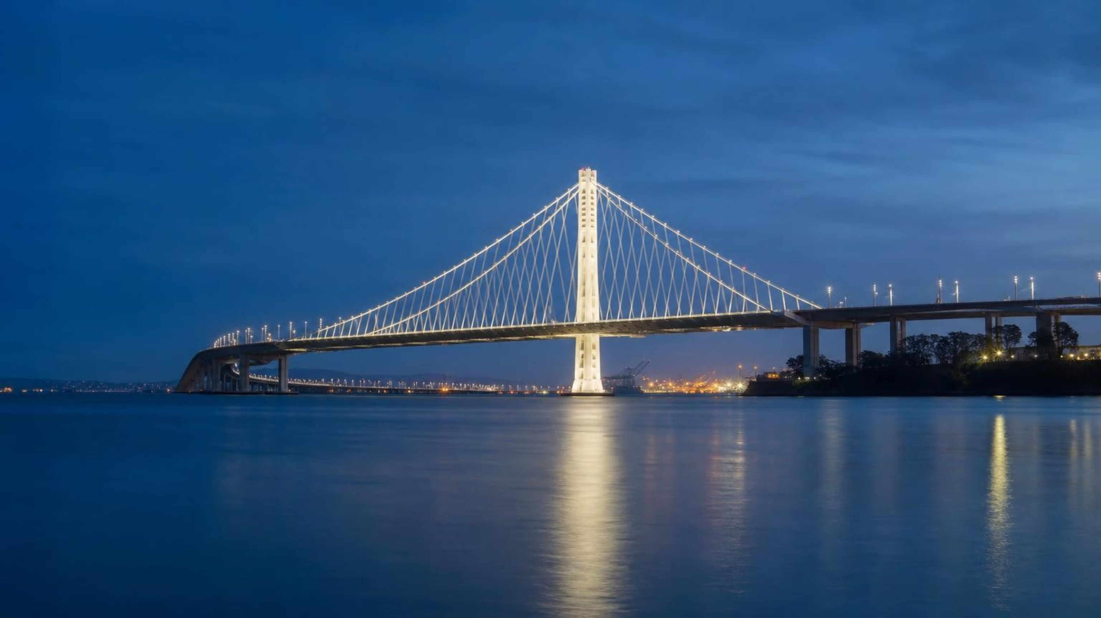
CHAPTER 25 OF 29 · EARTH'S NATURAL HAZARDS
Volcanic Eruptions and Earthquakes
Lesson 25: Where will the ground shake or erupt next, and how do people get ready?
Angela's Wand · Bring Science Alive! 7th Grade Integrated
Notes:
This lesson asks two linked questions. First, why do earthquakes and volcanoes happen where they do, and why are they so much more common in some places than others? Second, since we cannot stop them, how do scientists and engineers use data to protect people? Tell students they will run three investigations: plotting a mystery map of earthquakes and volcanoes to find hidden plate boundaries, building a craft-stick bridge and shaking it on a measured shake table, and ranking three possible bridge sites with hazard data. Connect back to Lesson 16: plate boundaries were mapped partly by where earthquakes happen; now we look at what those earthquakes and eruptions mean for the people who live there.
CONNECTS TO: Overview of Lab 1, Lab 2 and Lab 3; W1 phenomenon worksheet follows the next slide.
PACING: about 2 min

Slide 2
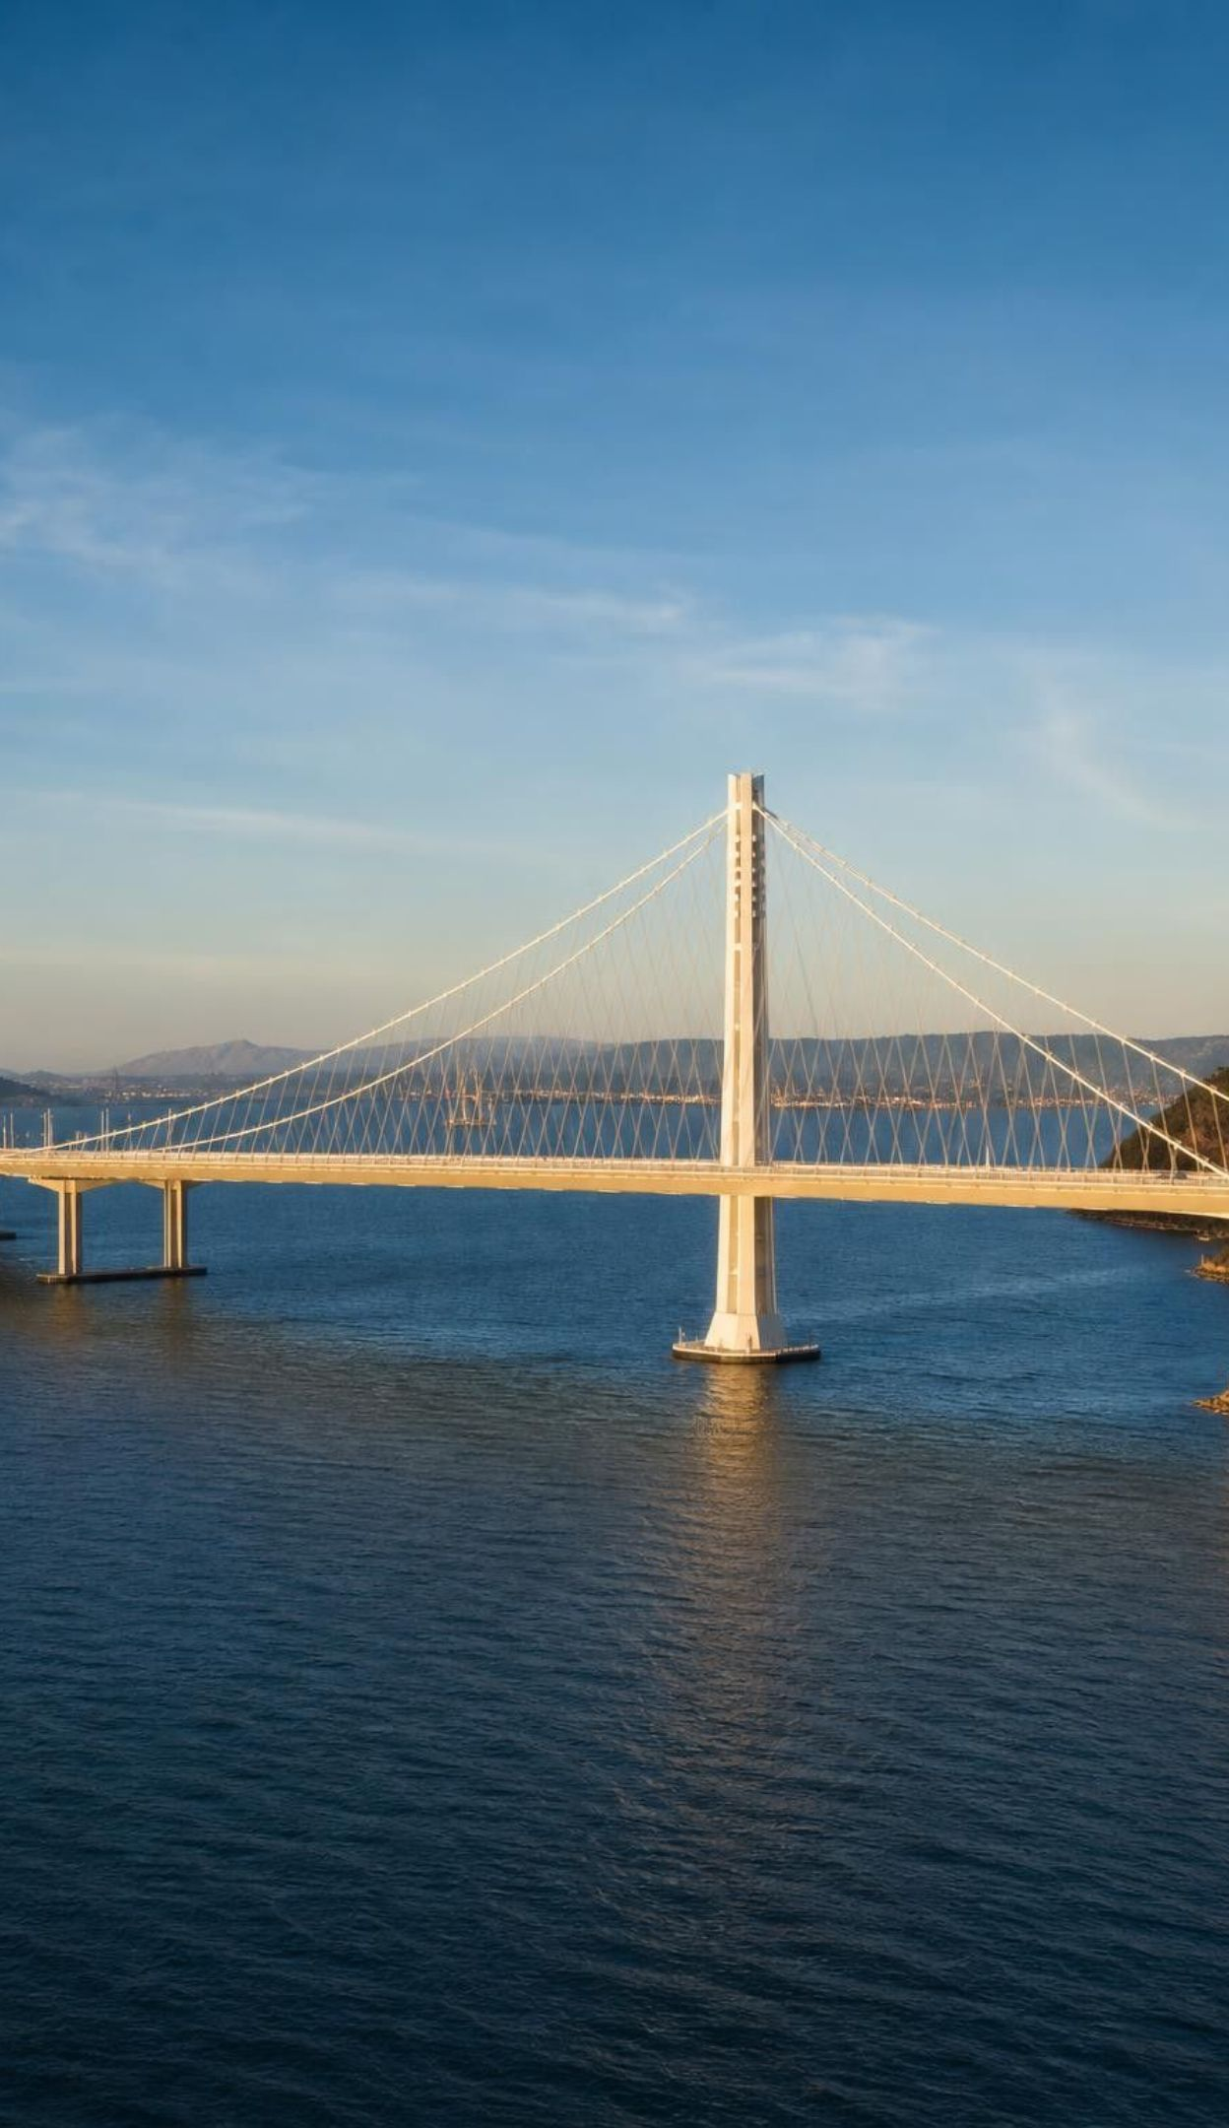
PHENOMENON
Fifteen seconds, and a bridge built for 1,500 years
October 17, 1989, 5:04 p.m.: rock beneath the Santa Cruz Mountains slipped, and the ground shook hard for about 15 seconds. Roughly 100 km north, part of the Bay Bridge's upper deck dropped onto the deck below. No one knew it was coming. Yet the new eastern span, opened in 2013, was designed to reopen quickly after the strongest shaking expected in about 1,500 years.
Notice: what numbers are on the slide, and what does each one measure?
Wonder: how could a bridge about 100 km away be damaged?
Wonder: how can anyone plan for 1,500 years with only about 250 years of written records?
2
Notes:
Give two quiet minutes for students to write one notice and one wonder each, then collect them on the board without judging. Point at the tension in the slide: the earthquake came with no warning, yet engineers designed for a specific level of shaking over a specific time span. Ask: how is that possible? Students may say 'they guessed'. Push back gently: engineers do not guess; they use data about how often earthquakes of each size have happened on nearby faults, including evidence written in rocks and soil that is much older than any human record. Park the question of the distant damage: the bridge sits partly on soft bay mud and artificial fill, and soft ground shakes harder. Slides 11, 19, 20 and 24 return to each piece. The earthquake was magnitude 6.9; do not explain magnitude yet.
EXPECTED RESPONSES: Notice: 15 seconds, 100 km, 1989, 2013, 1,500 years. Wonder: why the bridge broke far away, whether anyone could have warned people, what 'expected in 1,500 years' means, how strong the new bridge is. Predict: some will say the ground was softer there, some that the waves travelled along the bay, some that the old bridge was weak.
WATCH FOR: Students may assume the worst damage is always at the epicenter, or that scientists should have predicted the earthquake. Note both for slides 11 and 19.
CONNECTS TO: W1 phenomenon worksheet; chapter phenomenon; Lab 3 uses the same reasoning about ground type and design targets.
PACING: about 8 min

Slide 3
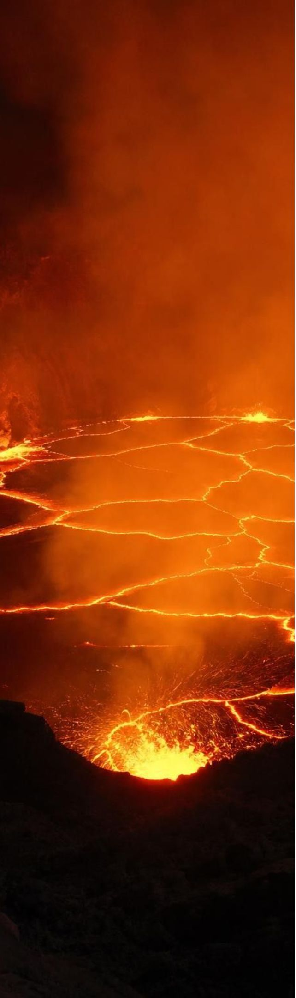
LEARNING TARGETS
What you will be able to do
1
2
Use earthquake and volcano maps to find plate boundaries, identify their type and spot the exceptions.
Explain how mostly solid rock melts into magma and why some eruptions explode.
3
4
Explain how stress builds on a locked fault and what the waves from an earthquake do.
Compare earthquakes with the logarithmic magnitude scale and use frequency data to forecast.
5
6
Explain why eruptions can often be forecast but earthquakes cannot be predicted.
Define precise criteria for a bridge, test designs fairly and choose a site using hazard data.
3
Notes:
Read the targets aloud and ask students to star the one that sounds hardest. Group them: targets 1 to 3 are about causes (where and why), targets 4 and 5 are about data and forecasting, and target 6 is engineering. The standard behind the whole lesson asks students to analyze hazard data, forecast future events and help choose ways to reduce the harm, so every lab ends with a decision, not just an observation.
CONNECTS TO: Targets map to Lab 1 and W4 (1), W4, W7 and W10 (2), W3 and W4 (3), W5 and Lab 3 (4), W6, W8, W9 and the slide 18 task (5), Lab 2 and Lab 3 (6).
PACING: about 2 min

Slide 4
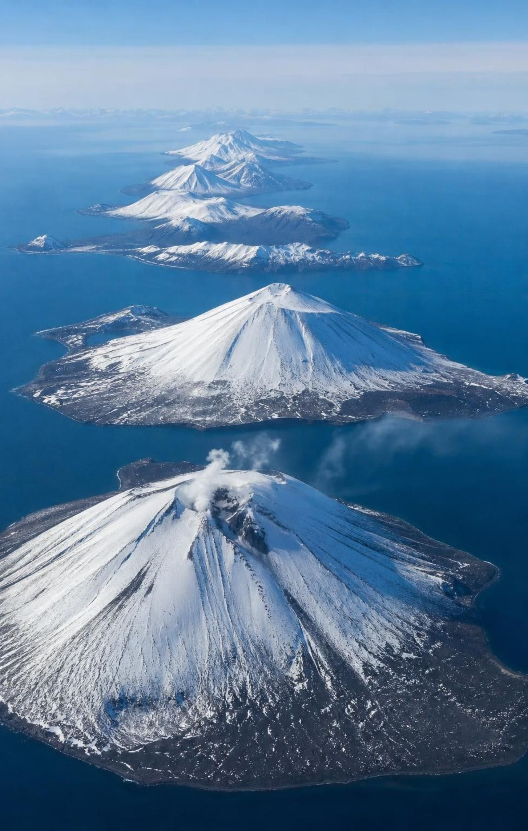
The pattern: hazards come in belts, not polka dots
Plot a year of strong earthquakes and active volcanoes on a world map and you get narrow belts.
The biggest belt circles the Pacific Ocean: the Ring of Fire, from Chile to Alaska, Japan and New Zealand.
Most belts follow plate boundaries, where plates pull apart, push together or slide past each other.
Exceptions: hot spots such as Hawaii and faults inside plates such as New Madrid, Missouri.
Some regions, such as Minnesota and Florida, have few earthquakes and no active volcanoes.
4
Notes:
If you can, project a live world earthquake map (the USGS Latest Earthquakes map filtered to the past 30 days, magnitude 4.5 and up) next to a map of active volcanoes. Ask students to describe the pattern before naming it. They should see thin lines around the Pacific, a line down the middle of the Atlantic, a belt from the Mediterranean through the Himalaya, and scattered dots elsewhere. Then connect to Lesson 16: those lines are plate boundaries, and in fact earthquake locations were one of the main ways boundaries were mapped. Stress the exceptions now so students do not overgeneralize: Hawaii erupts more than 3,000 km from the nearest boundary, and the New Madrid zone produced strong earthquakes in 1811 and 1812 in the middle of the North American Plate. A map of past events shows where activity tends to happen; it is not a timetable.
WATCH FOR: Students may decide that every boundary has both earthquakes and volcanoes, or that nothing ever happens away from boundaries. The next slide separates the settings.
CONNECTS TO: Lab 1 recreates this pattern on a fictional map; W7 (claim 1, 'scattered randomly') asks students to correct the opposite idea.
PACING: about 5 min

Slide 5
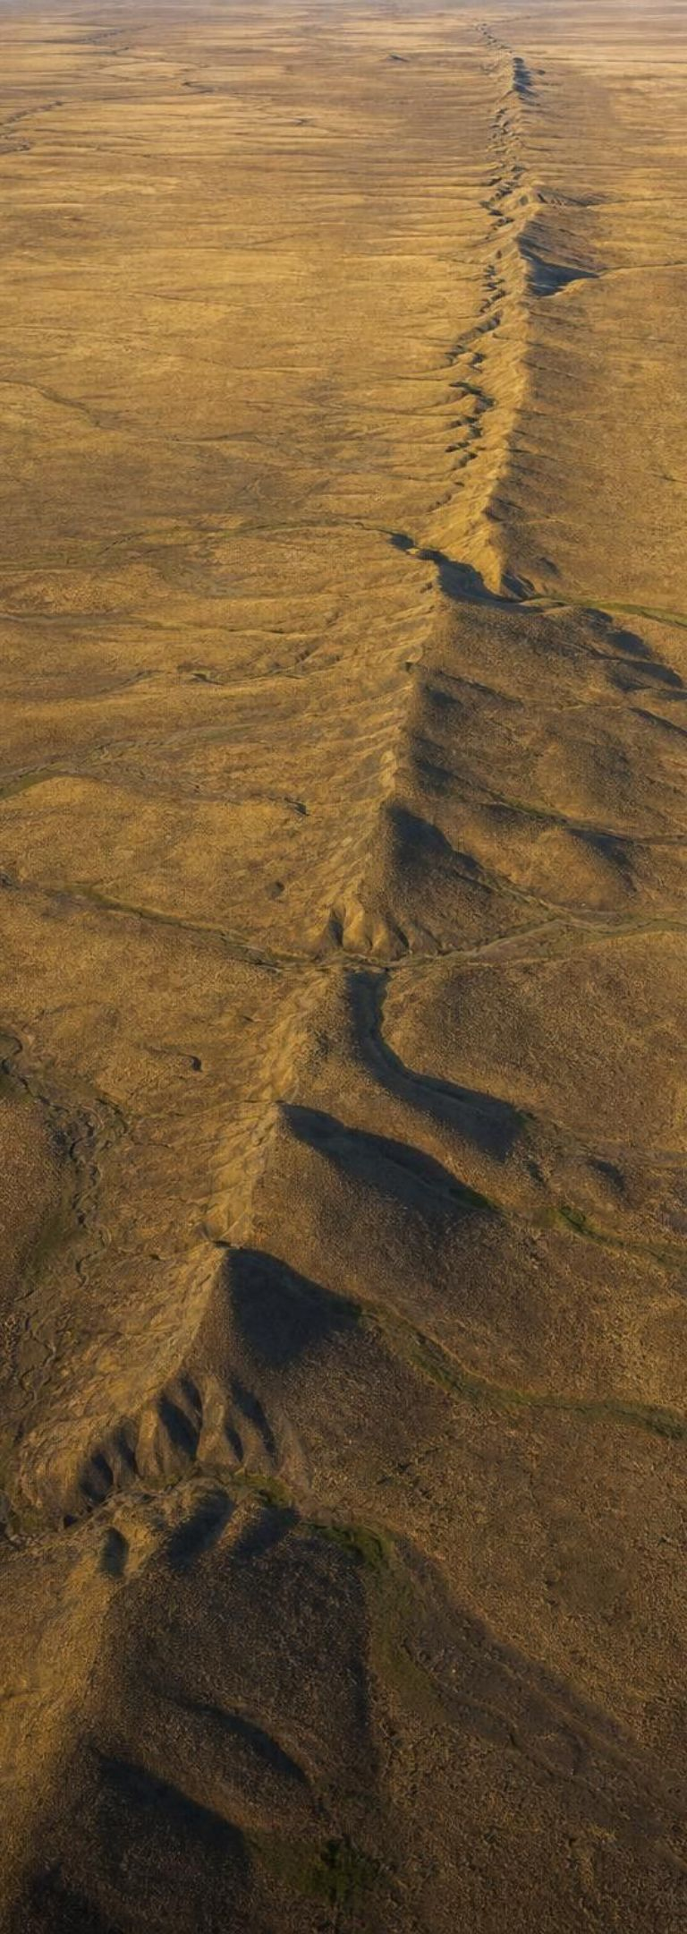
Five settings, five different hazard mixes
MODEL
Model: Where earthquakes and volcanoes come from
Convergent (subduction): | One plate sinks beneath another. Volcano chains; earthquakes from shallow to 700 km deep, including the largest.
Divergent: | Plates pull apart. Volcanoes and small, shallow earthquakes, mostly along undersea ridges.
Transform: | Plates slide past each other sideways. Many shallow earthquakes, almost no volcanoes.
Hot spot: | A hot plume rises under a plate. Volcanoes and earthquakes far from any boundary.
Fault inside a plate: | Blocks of rock shift along an old crack. Occasional, sometimes strong, earthquakes; no volcanoes.
Volcanoes need rock that melts; earthquakes need rock that sticks and then slips. Some settings have both.
5
Notes:
Go box by box and ask, for each setting, two questions: does rock melt here, and does rock stick and slip here? Subduction zones do both, which is why they produce chains of volcanoes and the world's biggest earthquakes (Chile 1960, Alaska 1964, Japan 2011). Divergent boundaries melt rock but the plates are thin and hot, so their earthquakes stay small and shallow. Transform boundaries grind but do not melt rock, so they shake without erupting: the San Andreas Fault is the California example. Hot spots melt rock deep inside a plate. Faults inside plates store stress slowly and can surprise people who assume they live far from danger. Point out that the textbook calls subduction earthquakes 'deep'; that is only half true. The locked contact between the plates near the trench produces shallow giants, and the sinking plate produces deeper earthquakes as it descends.
WATCH FOR: 'Subduction earthquakes are always deep.' Lab 1 data includes a magnitude 8.7 earthquake only 25 km down at the trench.
CONNECTS TO: Lab 1 classification table uses exactly these five settings; W4 diagram worksheet.
PACING: about 6 min

Slide 6
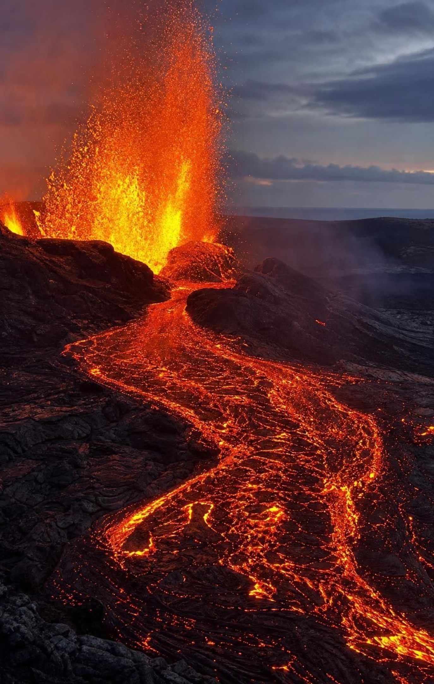
How mostly solid rock becomes magma
The mantle is mostly solid rock. It is hot, but high pressure keeps most of it from melting.
Add water: a sinking plate releases water, so the hot rock above it melts at a lower temperature.
Lower the pressure: where plates pull apart, hot rock rises and partly melts as the pressure drops.
Add a hot plume: unusually hot rock rises from deep in the mantle and partly melts near the top.
Magma is less dense than the rock around it, so it rises through cracks; at the surface it is lava.
6
Notes:
Start with a quick poll: is the mantle mostly liquid or mostly solid? Many students will say liquid. Tell them seismic waves show it is mostly solid rock that flows extremely slowly, over millions of years, like very stiff putty. So magma is special; it forms only where something tips the balance. Use a kitchen analogy for each route. Adding water is like adding salt to ice: the melting temperature drops, so rock that was solid starts to melt even though it did not get hotter. Lowering pressure is like opening a shaken soda: the change in pressure lets something happen that was being held back. A hot plume is simply rock hotter than its surroundings rising and melting as the pressure on it falls. The textbook says crust from the sinking plate mixes with the mantle; the main ingredient that matters is the water it carries. It also describes hot spots as rising columns of magma; the plume is mostly solid rock until near the top.
WATCH FOR: 'There is a layer of lava under the crust.' Ask: if that were true, why would volcanoes appear only in belts and clusters?
CONNECTS TO: W4 diagram worksheet (Figure 2, q2 and q3); W7 misconception repair (claim 2); W10 q1; Lab 1 q4 asks why the volcano chain sits above a certain depth of the sinking plate.
PACING: about 6 min

Slide 7
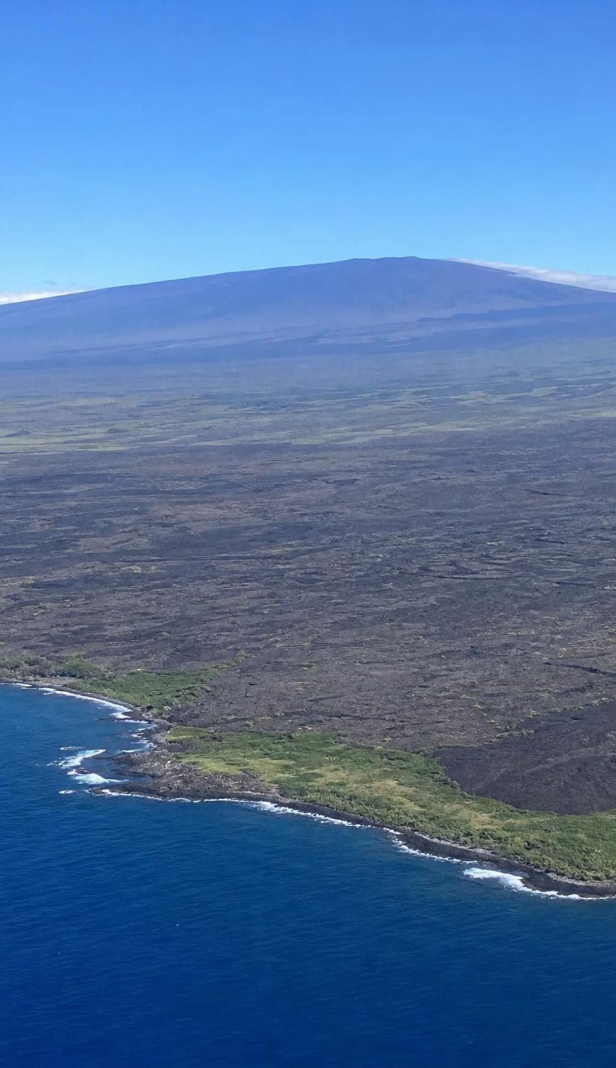
VOCABULARY IN CONTEXT
Words for where hazards come from
natural hazard: A natural event, such as an earthquake or an eruption, that can hurt people or damage what they build. An eruption on an empty island is a natural event; one beside a town is a natural hazard.
magma: Molten or partly molten rock, with dissolved gases and crystals, below Earth's surface; at the surface it is lava. Magma collecting 6 km below the volcano lifted the ground above it.
hot spot: A place where a hot plume from deep in the mantle feeds volcanoes, sometimes far from any plate boundary. The island of Hawaii sits over a hot spot in the middle of the Pacific Plate.
7
Notes:
Have students copy the definitions into their notes in their own words, then test each term with a quick example. Ask: is a landslide in an empty canyon a natural hazard? It is a natural event; it becomes a hazard when people, roads or homes are exposed. The difference matters for the rest of the lesson because 'risk' depends on both the hazard and what is in its path. For magma versus lava, ask what changes when magma reaches the surface: its name, and also its gas, which escapes as the pressure drops. For hot spot, remind them that Hawaii is the exception that proves the boundary rule.
WATCH FOR: Using 'lava' for molten rock underground. Insist on magma below, lava above.
CONNECTS TO: W2 vocabulary worksheet; W10 mastery.
PACING: about 4 min

Slide 8
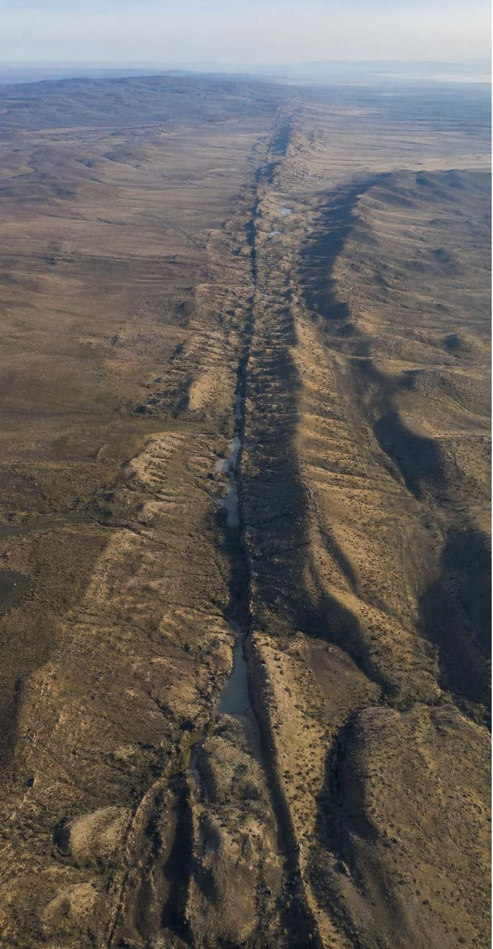
CHECK FOR UNDERSTANDING
Quick check: name the setting
Seismologists map a 600 km line of shallow earthquakes, some as large as magnitude 7.5, with no volcanoes anywhere along it. What is the most likely setting?
A. A divergent boundary on the seafloor
B. A transform boundary
C. A subduction zone
D. A hot spot
8
Notes:
Students vote with fingers (1 to 4), then defend. The key evidence is the combination: earthquakes that are shallow and strong, and no volcanoes. A divergent ridge does have shallow quakes, but they are small and the ridge erupts. A subduction zone would have volcanoes inland and deeper earthquakes too. A hot spot has volcanoes by definition. A transform boundary grinds without melting rock, so it fits. Ask for a real example: the San Andreas Fault.
EXPECTED RESPONSES: B, a transform boundary. Shallow, strong earthquakes with no volcanoes fit plates sliding past each other; no rock melts there. A divergent boundary would have volcanoes and only small quakes; a subduction zone would have volcanoes and deeper quakes; a hot spot has volcanoes.
WATCH FOR: Choosing C because 'big earthquakes mean subduction'. Big earthquakes happen at transform boundaries too; the missing volcanoes are the clue.
CONNECTS TO: Lab 1 uses the same reasoning on every line of points.
PACING: about 3 min

Slide 9
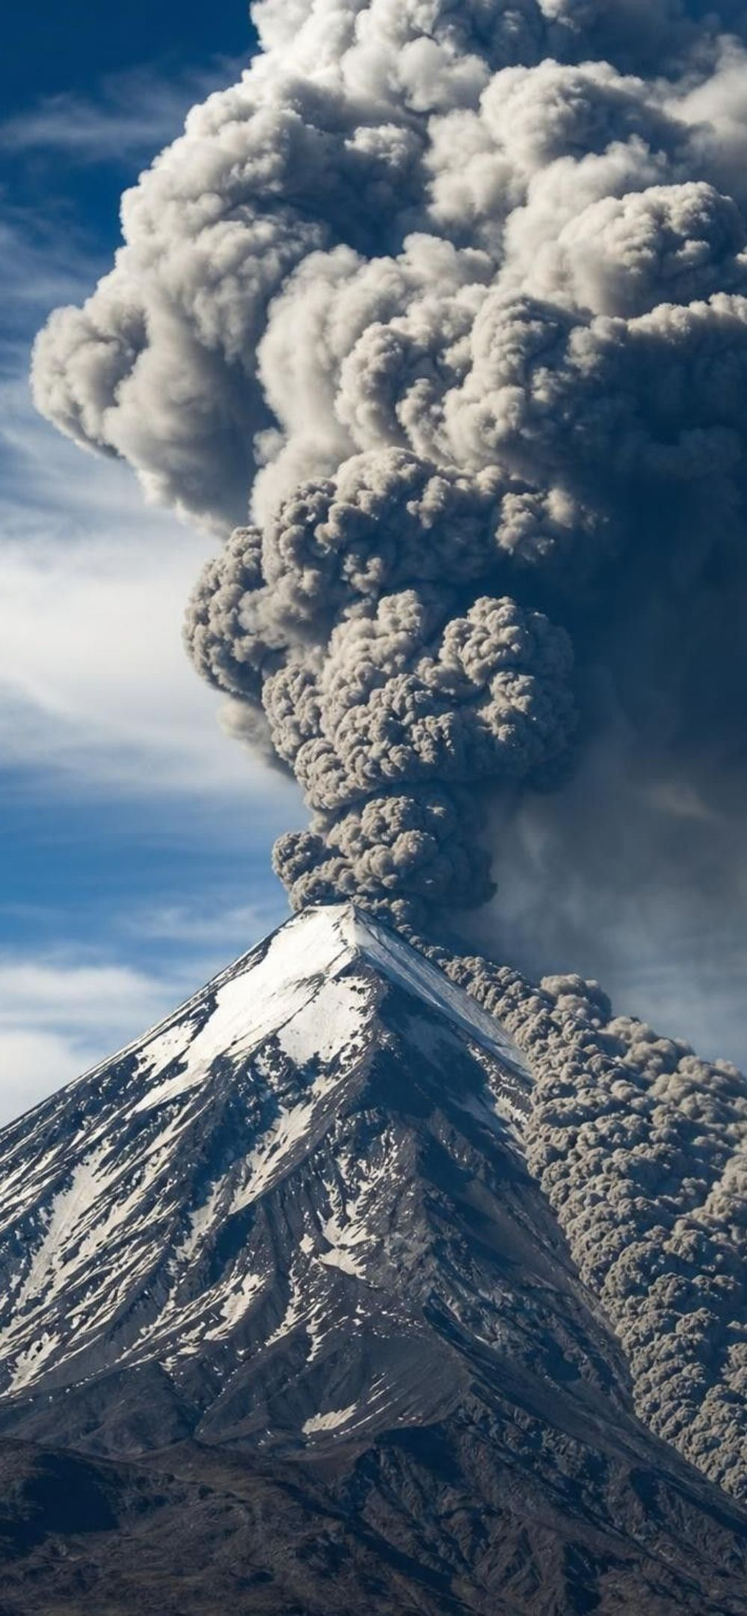
MODEL
Runny magma pours; thick magma explodes
Model: Two kinds of eruption · How thick the magma is, and how much gas it holds, decide how an eruption behaves.
Runny (low-viscosity) magma | Thick (high-viscosity) magma
Flows easily, like warm syrup | Flows slowly, like cold peanut butter
Gas bubbles escape gently | Gas stays trapped and pressure builds
Lava flows and lava fountains | Blasts of ash, rock and gas; pyroclastic flows
Builds broad, gently sloping volcanoes | Builds steep cone-shaped volcanoes
Rarely kills people, but destroys what is in its path | The deadliest eruptions; ash can fall hundreds of km away
9
Notes:
Demonstrate with two clear cups if you like: honey and water, or a straw blown into syrup and into water. Bubbles slip out of a runny liquid but get trapped in a thick one. Magma is thicker when it is richer in silica and cooler; thick magma that holds a lot of dissolved gas cannot let the gas out gently, so pressure builds until the rock above fails. Hawaiian eruptions are the classic runny case; Mount St. Helens in 1980 and Lassen Peak in 1915 are thick-magma examples. Define pyroclastic flow: a ground-hugging avalanche of hot gas, ash and rock, often faster than 80 km per hour, that no one can outrun. Be careful with 'nonexplosive eruptions are harmless': the 1973 Eldfell eruption in Iceland was mostly lava and still destroyed hundreds of buildings, and Kilauea's 2018 lava flows destroyed hundreds of homes. Lava rarely kills people because it usually moves slowly enough to walk away from.
WATCH FOR: 'Lava is the most dangerous part of an eruption.' Ash, pyroclastic flows and volcanic mudflows (lahars) kill far more people.
CONNECTS TO: W6 CER (thick magma at Mount Corva); W7 misconception repair (claim 8); W10 q9; Lab 3 volcanic hazard row (lahars and ash).
PACING: about 6 min

Slide 10
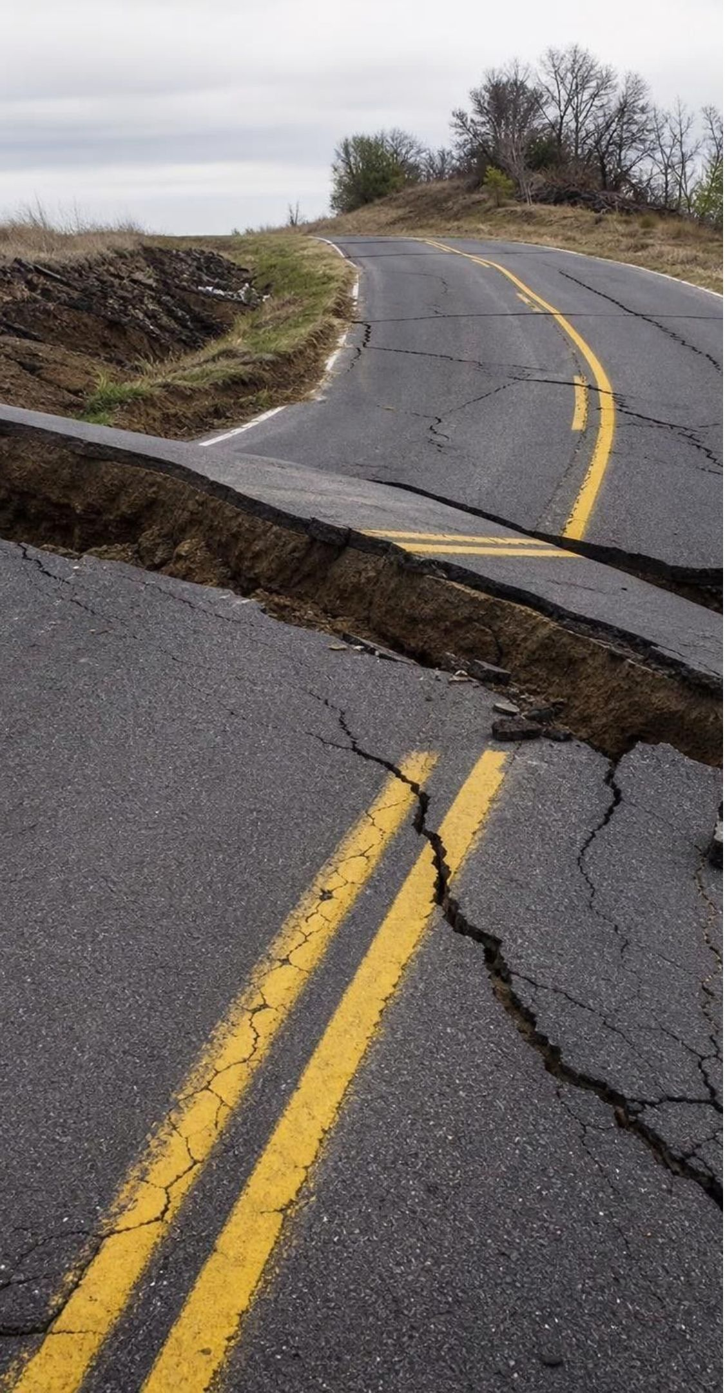




MODEL
Stick, build, slip: why faults jerk instead of glide
Model: The earthquake cycle on a locked fault
Rough fault surfaces lock together
→ (for years to centuries)
Plates keep moving; rock bends and stress builds
→ (until)
1
2
Seismic waves spread out; the fault locks again
→ (and the cycle repeats) (back to the start)
Stress overcomes friction; rock slips at the focus
→ (in seconds)
4
3
The plates move a few centimeters a year. The fault moves meters in seconds, then waits.
10
Notes:
Model it: stretch a rubber band attached to a block or a book resting on sandpaper and pull the band slowly at a steady speed. The book sits still, then jerks forward, then sits still. The hand moving steadily is the plate; the jerks are earthquakes; the stretching band is stored stress. Ask: did the hand ever speed up? No. Earthquakes happen not because plates suddenly speed up but because friction holds the fault until the stored stress wins. Then explain the time scales: the Pacific and North American plates move past each other at about 5 cm a year, yet in 1906 the ground along the San Andreas Fault jumped several meters in less than a minute. This is a good place to note that some sections of faults creep steadily and produce only small earthquakes; the stick-slip cycle describes the locked sections.
WATCH FOR: 'Earthquakes happen when plates crash into each other suddenly.' Plates move steadily; the fault's release is sudden.
CONNECTS TO: W4 diagram worksheet; chapter standard MS-ESS2-2 (gradual change punctuated by sudden events).
PACING: about 5 min

Slide 11
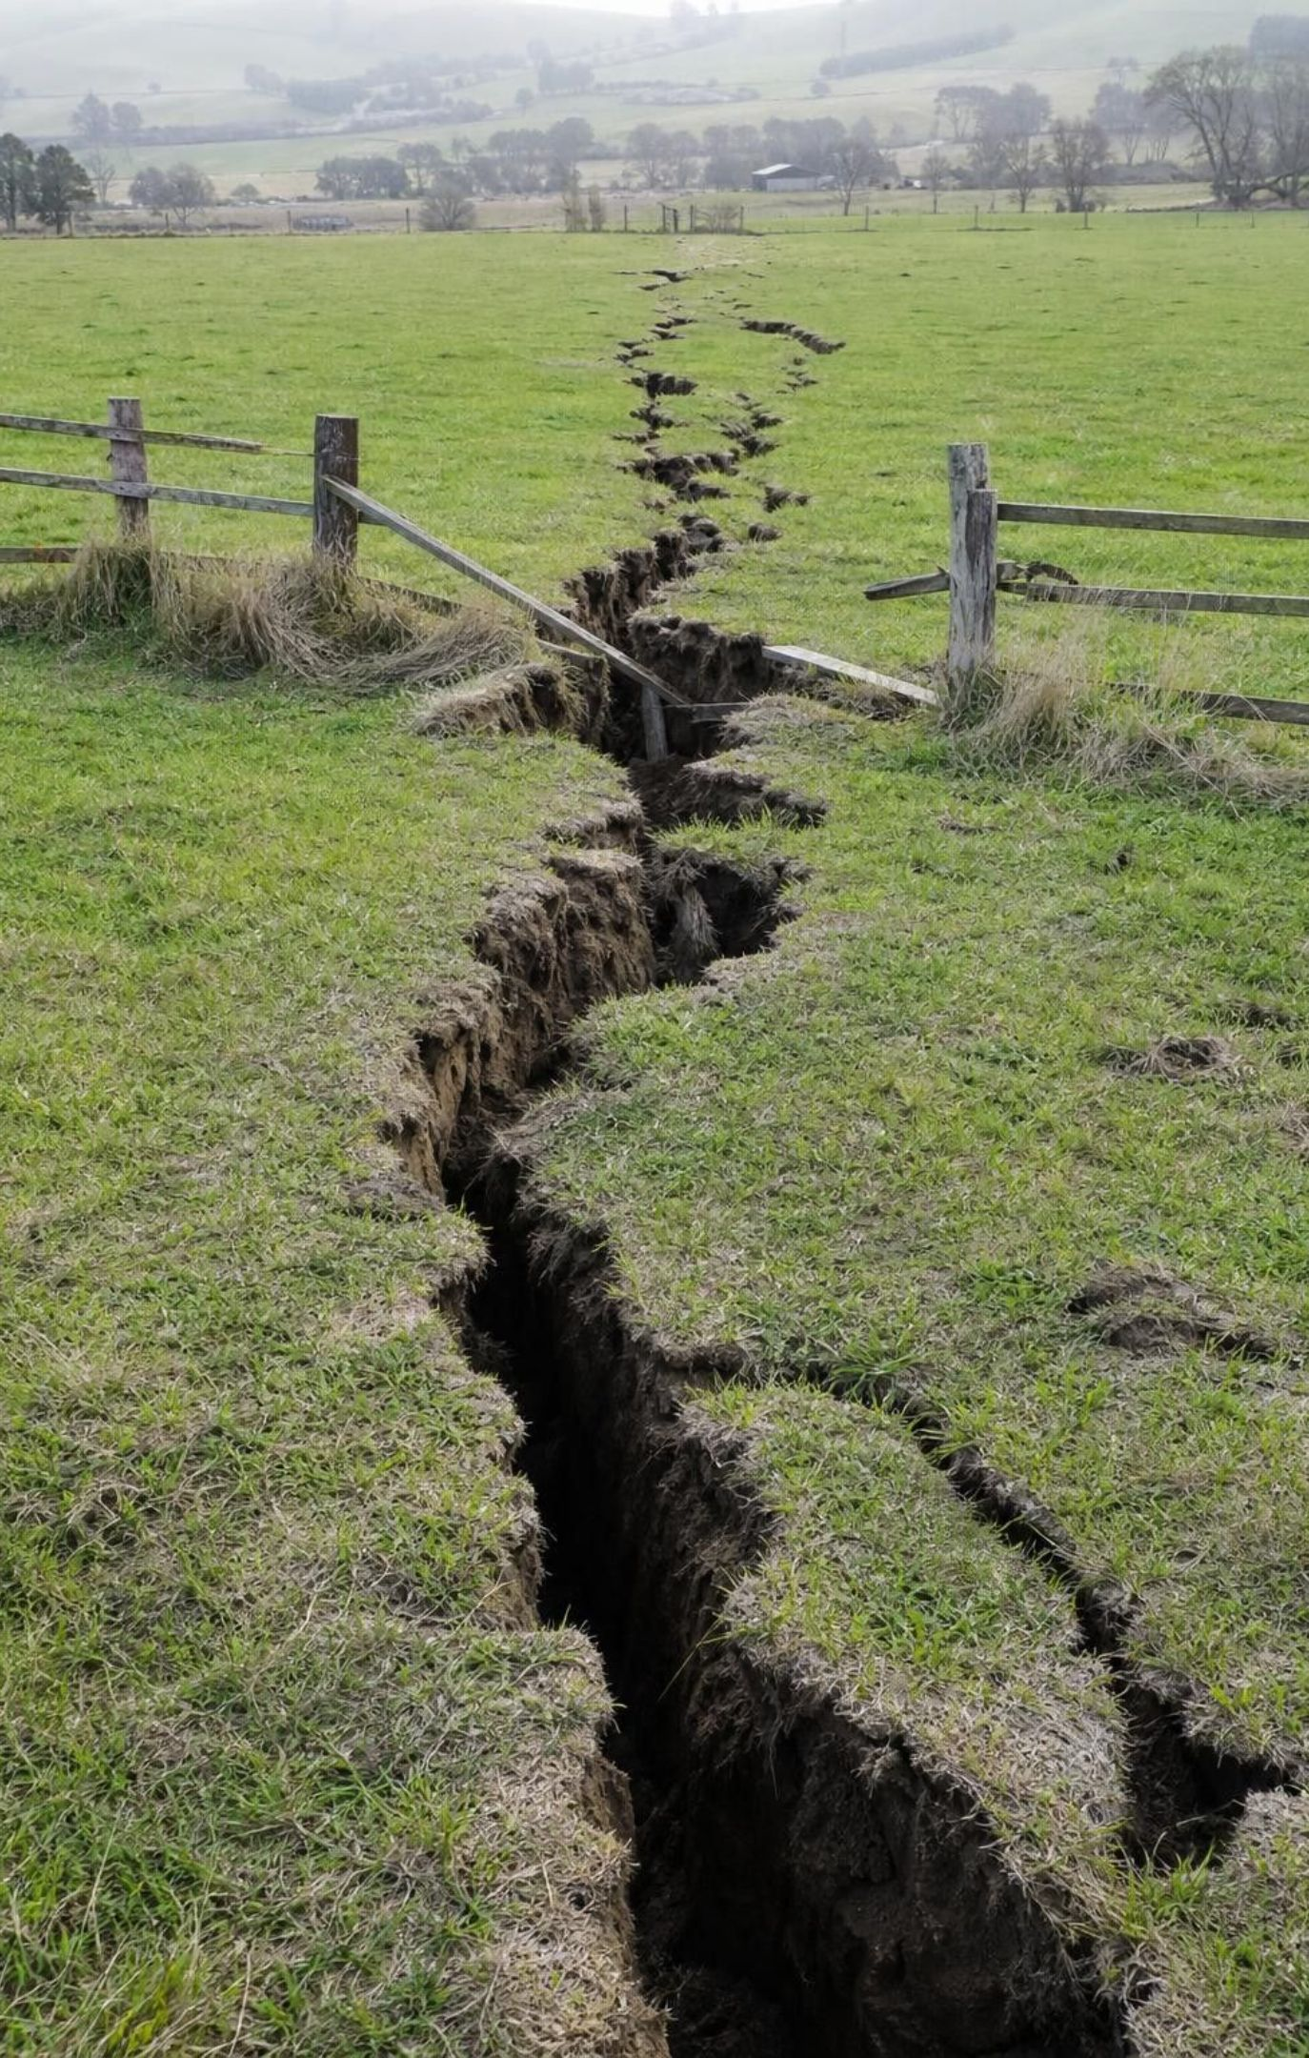
Focus, epicenter and the waves that travel out
The focus is where rock first slips, underground. The epicenter is the spot on the surface right above it.
P waves (body waves) are fastest. They push and pull the rock and arrive first, often as a sharp jolt.
S waves (body waves) arrive next. They shake rock side to side and can be violent near the source.
Surface waves arrive last and travel along the ground, rolling it up and down and swaying it sideways.
S waves and surface waves do most of the damage. Soft ground can make the shaking much stronger.
11
Notes:
Draw a cross-section on the board: a fault, a star for the focus, and a dot on the surface directly above for the epicenter. Have students stand and model the waves: a slinky pushed and pulled for P waves, flicked sideways for S waves. Point out the time gap between P and S arrivals: the farther the station, the bigger the gap, which is how seismologists locate earthquakes, and how ShakeAlert can warn people farther away before the strong shaking arrives. Correct the textbook gently: it says body waves are often too small to feel, but S waves are body waves and near the focus they can be among the most damaging. Return to the phenomenon: the Bay Bridge and the collapsed Cypress Street Viaduct in Oakland stood on soft bay mud and fill, which amplified the shaking roughly 100 km from the epicenter.
WATCH FOR: 'The epicenter is where the earthquake happens.' The earthquake starts at the focus underground; the epicenter is only its map location.
CONNECTS TO: W3 reading; W4 diagram worksheet; Lab 3 ground-type data.
PACING: about 6 min

Slide 12
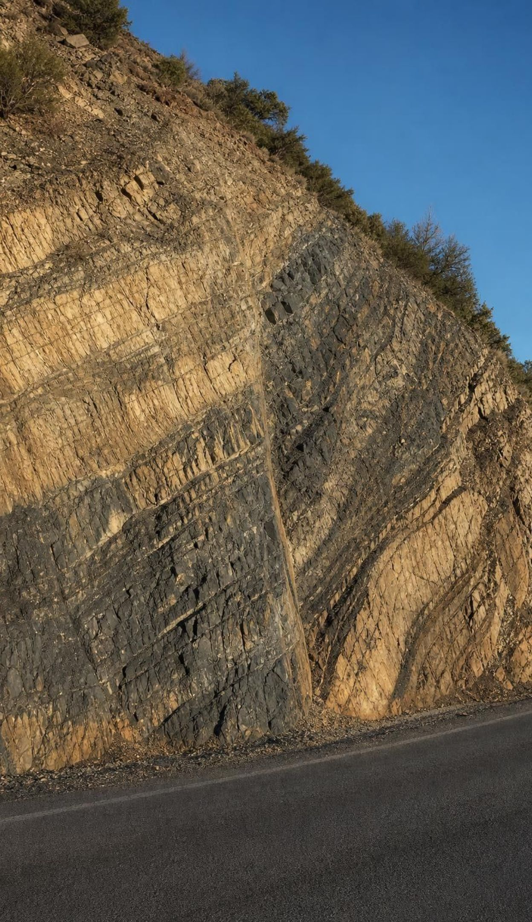
VOCABULARY IN CONTEXT
Words for an earthquake's anatomy
focus: The place underground where rock first slips and an earthquake begins. The Loma Prieta earthquake's focus was about 18 km below the Santa Cruz Mountains.
epicenter: The point on Earth's surface directly above an earthquake's focus. News maps mark the epicenter with a star, even though shaking spreads far beyond it.
seismic wave: A vibration that carries energy away from an earthquake through rock: body waves inside Earth, surface waves along it. The P wave reached the station 20 seconds before the S wave, so the earthquake was far away.
12
Notes:
Have pairs quiz each other: one says a term, the other points to it on the board cross-section. Then ask the tricky question: can the focus and the epicenter ever be in the same place? Only if the earthquake starts right at the surface, which is rare; most foci are kilometers down. Note that seismologists also call the focus the hypocenter. For seismic waves, make sure students can order the arrivals: P, then S, then surface waves.
WATCH FOR: Mixing up focus and epicenter. The epicenter is always on the surface.
CONNECTS TO: W2 vocabulary worksheet; W10 mastery.
PACING: about 4 min

Slide 13
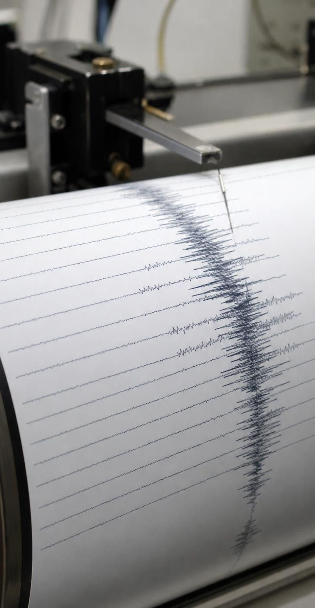
CHECK FOR UNDERSTANDING
Quick check: reading a seismogram
A seismometer 400 km from an earthquake records the shaking. Which waves arrive first, and what does the time gap between the first two arrivals help scientists find?
A. Surface waves arrive first; the gap shows the magnitude
B. P waves arrive first; the gap grows with distance, so it helps locate the earthquake
C. S waves arrive first; the gap shows how deep the ocean is
D. All the waves arrive together, so there is no gap
13
Notes:
Thirty seconds of think time, then vote. Ask a student who chose B to explain why the gap grows with distance: P waves travel faster than S waves, so the longer the trip, the farther behind the S waves fall, like a fast runner and a slow runner who start together. With gaps from three stations, scientists can draw three circles and find the epicenter where they meet. Students who chose A are confusing arrival order with size.
EXPECTED RESPONSES: B. P waves are fastest and arrive first; S waves fall farther behind the longer they travel, so the P-to-S gap tells the distance to the earthquake, and three stations locate it.
WATCH FOR: Thinking the biggest waves must arrive first. The biggest shaking usually comes later, which is what makes early warning possible.
CONNECTS TO: W10 mastery (q5 wave order and the q8 drawing).
PACING: about 3 min

Slide 14
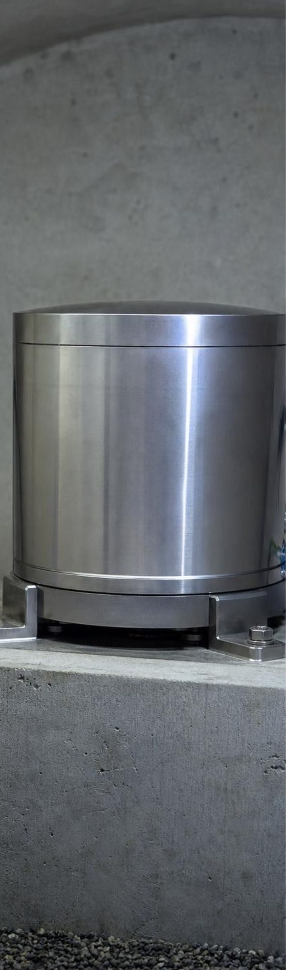
Magnitude is logarithmic: each step is ten times more
Magnitude is one number for an earthquake's size at its source, worked out from seismograms.
Each step of 1 means 10 times more ground motion on a seismogram and about 32 times more energy.
Intensity is different: it describes shaking at one place (Roman numerals I to XII) and varies by place.
Magnitude | Ground motion compared with M5 | Energy compared with M5 (about)
5 | 1 time | 1 time
6 | 10 times | 32 times
7 | 100 times | 1,000 times
8 | 1,000 times | 32,000 times
9 | 10,000 times | 1,000,000 times
14
Notes:
Work the table as a pattern before explaining it: ask students what happens to the ground-motion column each row (times 10) and to the energy column (times about 32). Explain 'logarithmic' as 'counting the zeros': a magnitude 7 has ground motion 100 times a magnitude 5, two more zeros. The energy factor of about 32 per step comes from the physics of how magnitude is calculated (10 to the power 1.5 is about 31.6). So two steps is 32 x 32, about 1,000, and four steps is about a million. Then separate magnitude from intensity: the 1989 earthquake had one magnitude, 6.9, but the shaking was strong in Santa Cruz, violent on the bay mud of Oakland's Cypress Street Viaduct, and mild in Sacramento. Mention that seismologists today use the moment magnitude scale, not the original Richter scale, though news reports still say 'Richter'. Eruptions have their own logarithmic scale, the Volcanic Explosivity Index.
WATCH FOR: Reading the scale like a ruler. Slide 26 confronts this directly.
CONNECTS TO: W5 data worksheet; Lab 1 q7; Lab 3 q3; W10 mastery.
PACING: about 6 min

Slide 15
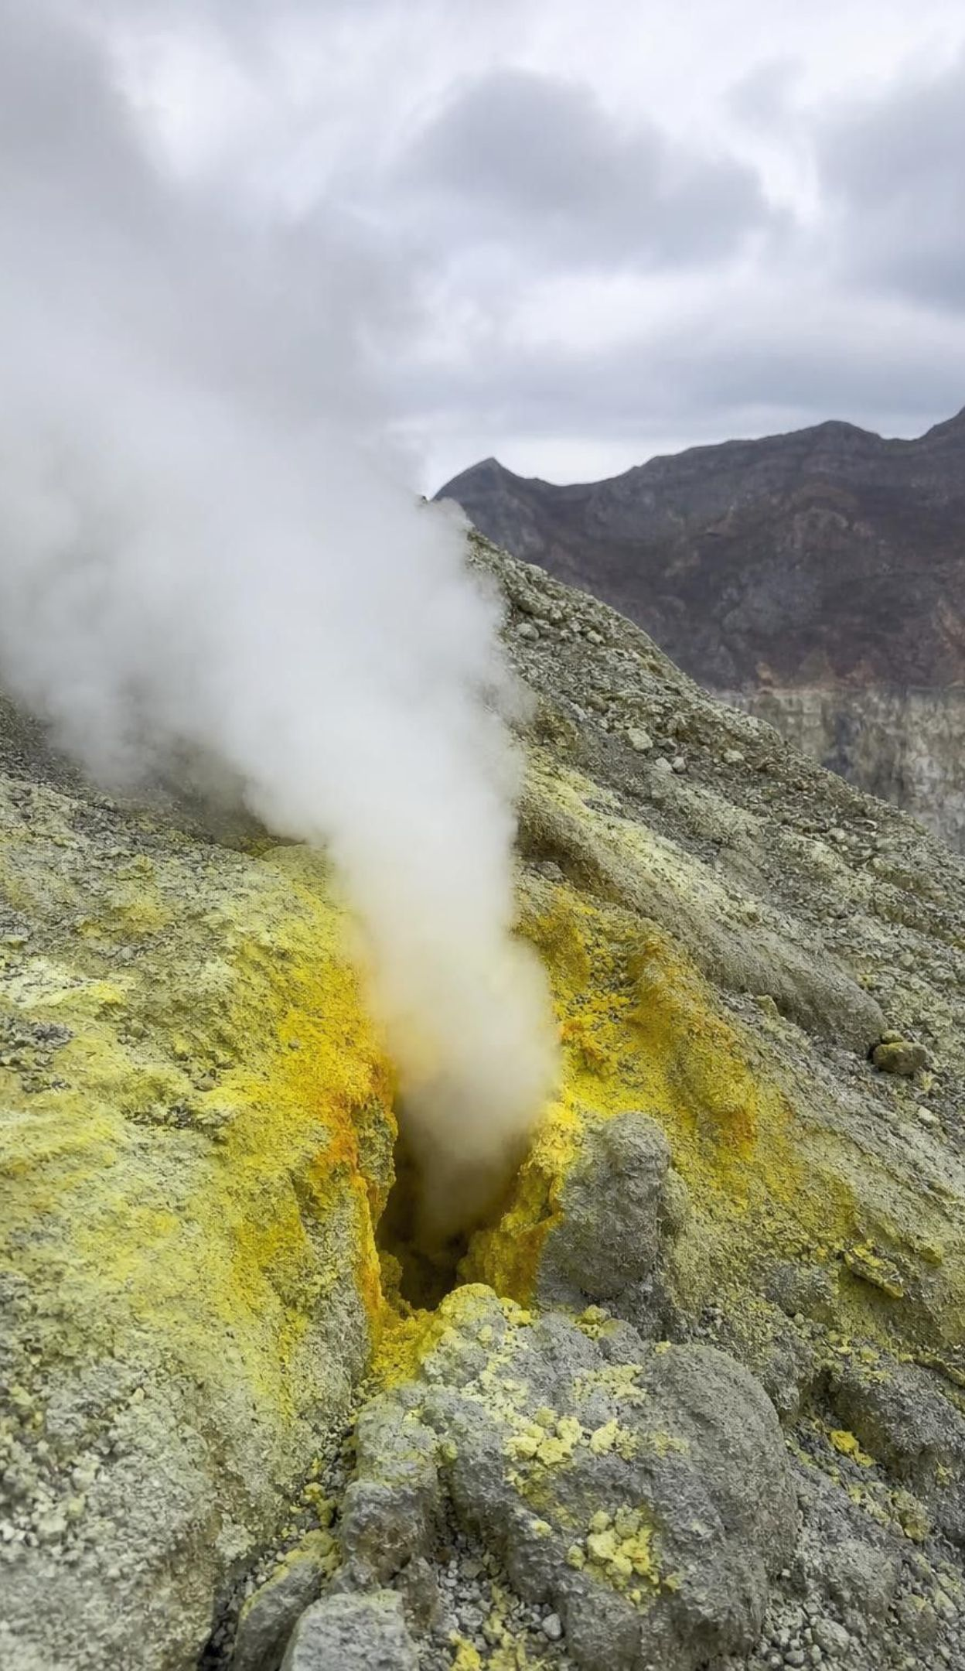
VOCABULARY IN CONTEXT
Words for forecasting
precursor event: A smaller, measurable change that often comes before a larger event. A swarm of small earthquakes and swelling ground were precursor events before the eruption.
frequency: How often an event happens during a set amount of time. Near the fault, magnitude 5 earthquakes have a frequency of about two per decade.
forecast: An estimate of how likely an event is in an area over a time span, such as a 30-year chance. A forecast gives a 72 percent chance of a magnitude 6.7 or larger in the Bay Area by 2043.
15
Notes:
Contrast forecast and prediction directly, because the whole lesson depends on it. A prediction would say 'a magnitude 7 will strike Hayward next Tuesday at noon'. A forecast says 'there is a one-in-three chance of a magnitude 6.7 or larger on the Hayward or Rodgers Creek Faults in 30 years'. Weather offers a familiar version: a 70 percent chance of rain does not promise rain. For frequency, have students compute one: 12 magnitude 5 earthquakes in 60 years is 2 per decade. Ask why frequency matters to an engineer: a bridge expected to last 100 years will feel many frequent, moderate quakes and perhaps one rare, strong one.
WATCH FOR: Using 'forecast' and 'prediction' as synonyms. Ask students to rewrite a prediction as a forecast.
CONNECTS TO: W2 vocabulary worksheet; Lab 3 frequency calculations.
PACING: about 4 min

Slide 16
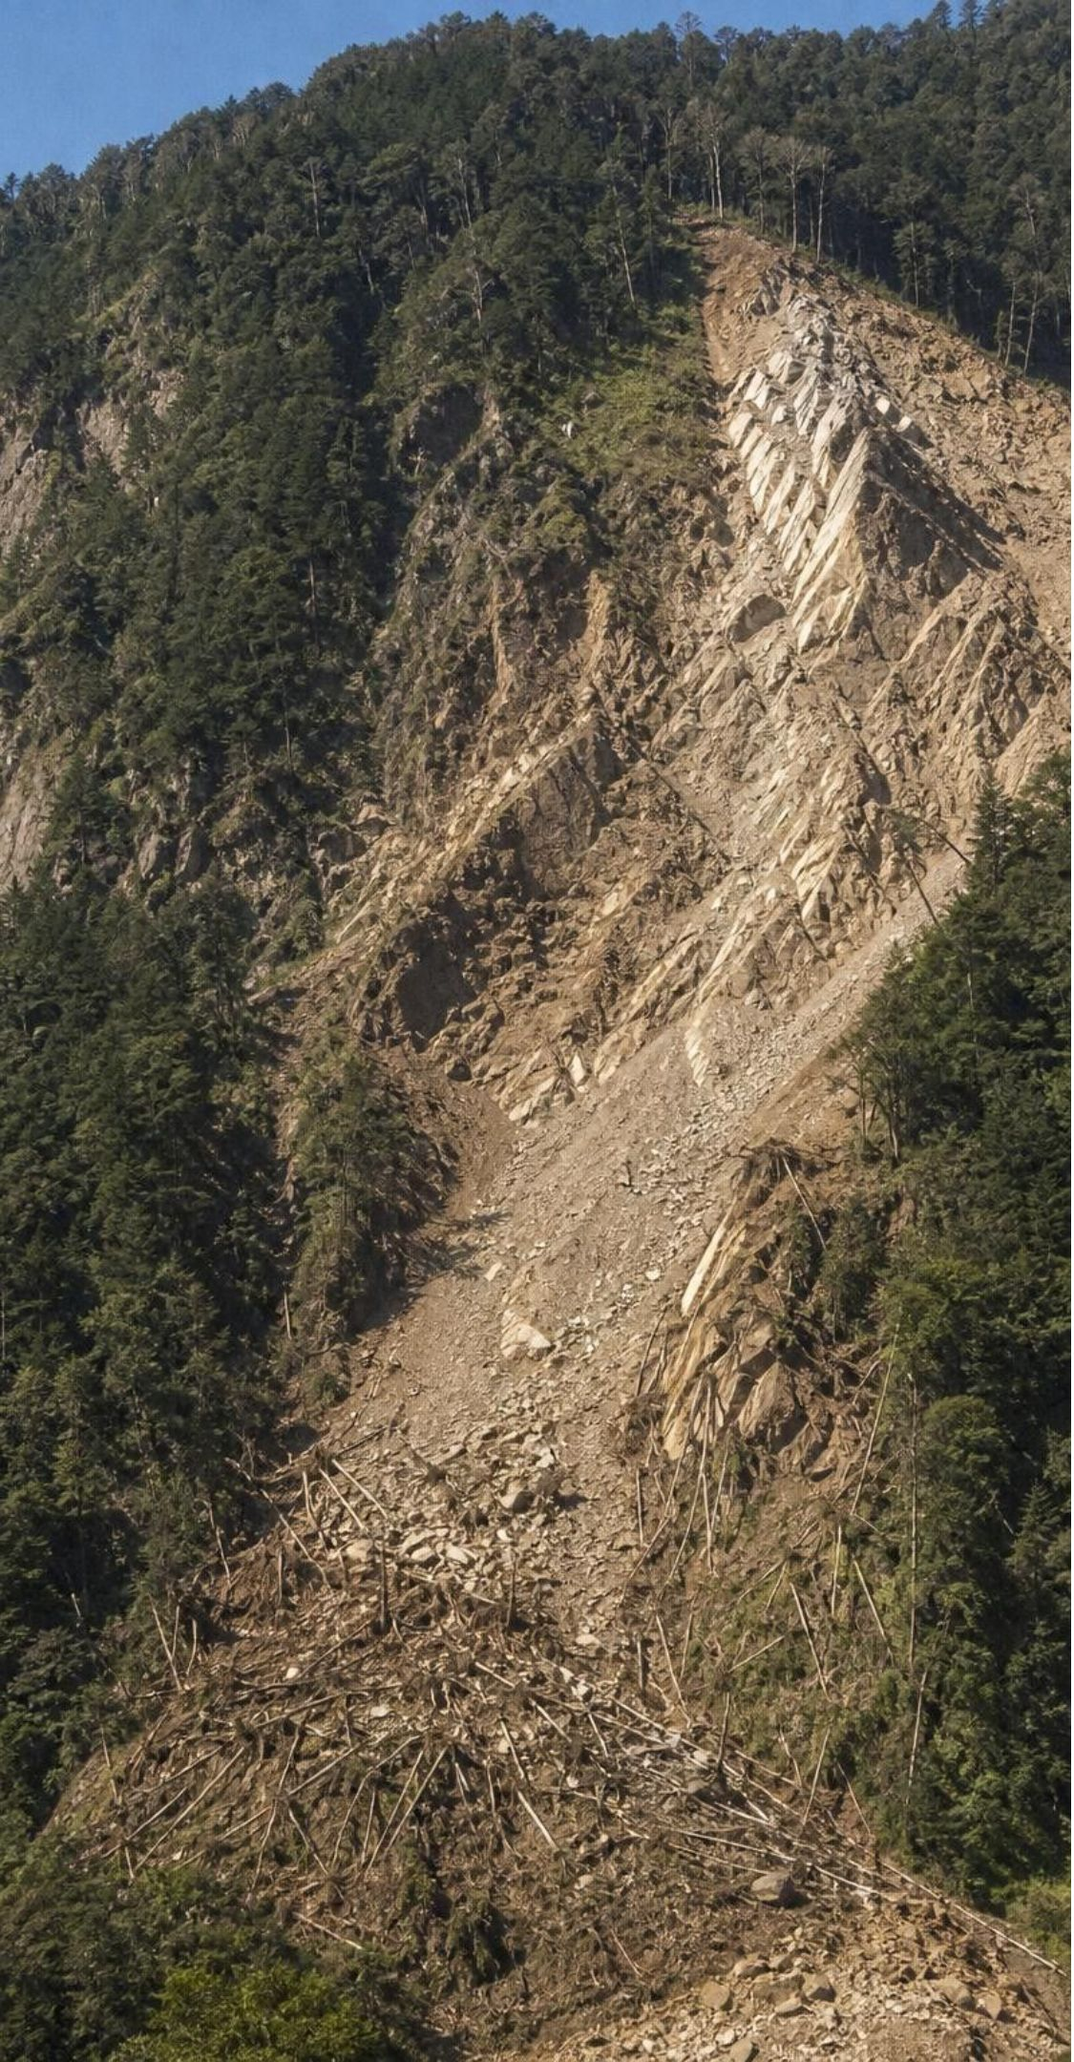
CHECK FOR UNDERSTANDING
Quick check: how much bigger?
About how many times more energy does a magnitude 7 earthquake release than a magnitude 5 earthquake?
A. 2 times
B. 20 times
C. About 100 times
D. About 1,000 times
16
Notes:
Whiteboards, then reveal. The difference is 2 magnitude steps. Energy grows by about 32 per step, so 32 x 32 is about 1,000. Students who answer 100 have used the ground-motion factor (10 x 10) instead of the energy factor; give partial credit and ask which quantity the question asked for. Students who answer 2 are reading the scale as a ruler. Follow-up: the 1700 Cascadia earthquake (about magnitude 9) compared with the 1989 Loma Prieta earthquake (6.9)? About two steps, so roughly 1,000 times the energy, and the shaking lasted minutes rather than seconds.
EXPECTED RESPONSES: D, about 1,000 times: 2 steps, and energy grows about 32 times per step, so 32 x 32 = 1,024. Ground motion would be 10 x 10 = 100 times.
WATCH FOR: Answering C by mixing up ground motion and energy; answering A by treating the scale as linear.
CONNECTS TO: W5 data worksheet; W10 mastery; Lab 3 q3.
PACING: about 3 min

Slide 17
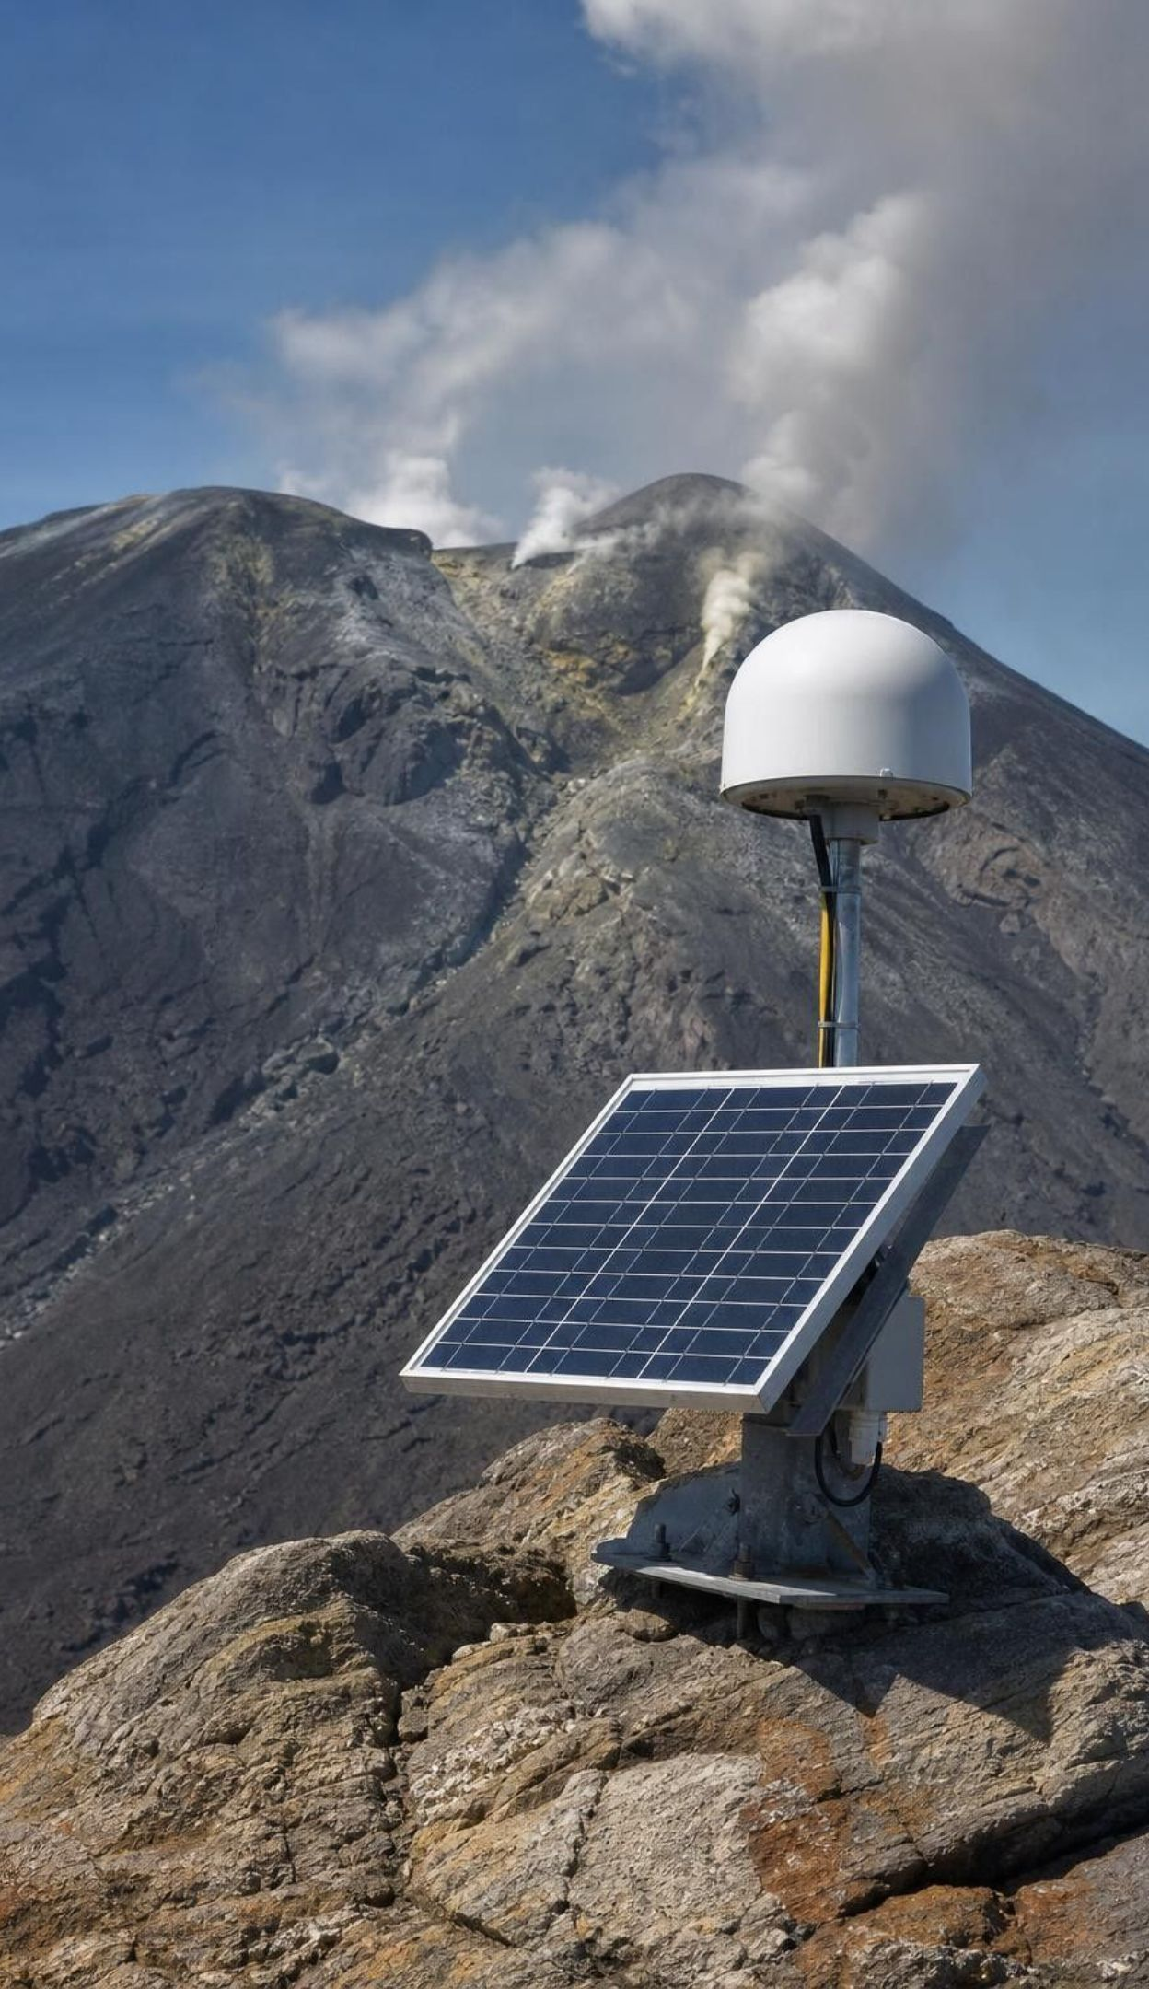
Volcanoes often give themselves away
Rising magma cracks rock: swarms of small earthquakes appear beneath the volcano.
Gas escapes: instruments measure more sulfur dioxide and carbon dioxide.
The ground swells: GPS stations and satellite radar detect bulging, millimeters to meters.
Scientists compare the signals with the volcano's past eruptions: how often and how big.
Iceland, 2010: weeks of quakes and swelling at Eyjafjallajökull came before it erupted on March 20.
A forecast is not a promise: unrest can last for years, or fade with no eruption at all.
17
Notes:
Explain why each precursor happens: magma pushing upward breaks rock (small earthquakes), releases gas as the pressure on it drops (gas), and takes up room (swelling). Monitoring a volcano means watching all three and comparing them with its normal background. Tell the Eyjafjallajokull story accurately: earthquakes and measurable uplift built through early March 2010, the first eruption began late on March 20, and about 500 nearby residents were evacuated once it started; a larger summit eruption in April led to more evacuations and shut down air travel across Europe. Months of monitoring meant people were prepared, even though no one could name the start time. Then the caution: Long Valley Caldera in California has had earthquake swarms, uplift and gas since 1980 without erupting. A forecast says an eruption is becoming more likely; it does not say when.
WATCH FOR: 'Scientists can predict exactly when a volcano will erupt.' They forecast rising likelihood; some eruptions give little warning.
CONNECTS TO: W6 CER; W8 jigsaw set A (Lassen, Long Valley, alert levels); W3 paragraph 3 (the volcano-fault contrast); next slide's task.
PACING: about 6 min

Slide 18
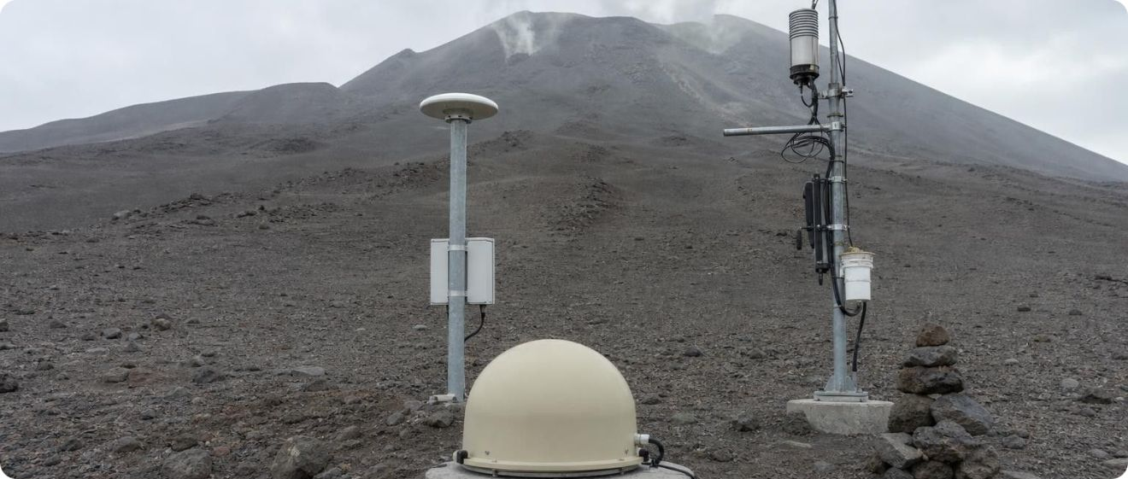
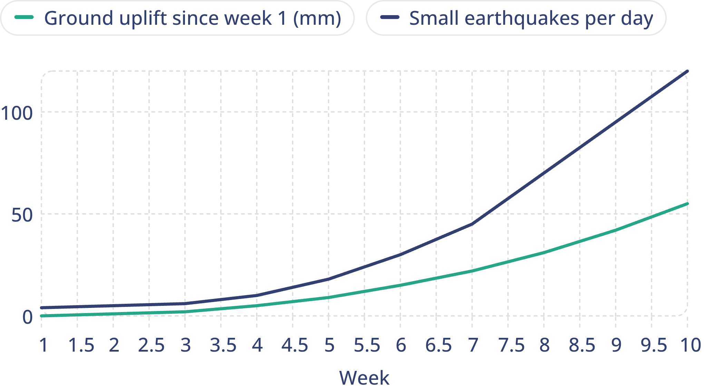
APPLY IT
Task: read the monitoring data. When would you raise the alert?
Model: Ten weeks at Mount Calder (teaching dataset)
simulated data
Simulated monitoring data for a fictional volcano. Sulfur dioxide output also doubled between weeks 6 and 9.
In which week would you raise the alert level, and what would you tell the nearby town? Can these data tell you the day the eruption will start? Explain.
x: Week · y: Earthquakes per day; ground uplift (mm)
18
Notes:
Tell students plainly that Mount Calder is fictional and the numbers are a teaching dataset shaped like real unrest. Give pairs six minutes. Steps: (1) describe each line with numbers: earthquakes rise from about 4 to 120 per day, uplift from 0 to 55 mm, and both speed up after week 4; (2) explain what each signal means: magma rising and taking up space; (3) choose a week and justify it; (4) write one sentence for the town. Then discuss: groups will pick different weeks, and that is realistic. Volcano observatories use stepped alert levels (in the United States: normal, advisory, watch, warning) so they can raise them gradually. The key point is the final question: no, the data cannot give a date. The signals could keep climbing for weeks, or level off and fade. That is still far more warning than any earthquake gives.
EXPECTED RESPONSES: Both signals were near background in weeks 1 to 3, began rising in week 4 and accelerated: earthquakes 10 to 120 per day and uplift 5 to 55 mm from week 4 to week 10, with gas doubling. A reasonable answer raises an advisory around week 5 or 6 and a higher alert around week 8 or 9, telling the town that an eruption is becoming more likely and to review evacuation routes. The data cannot give a day: unrest can continue or fade, so the message is about rising likelihood.
WATCH FOR: Students who say 'it will erupt in week 11' by extending the line. Ask what else could happen to the curves.
CONNECTS TO: W6 CER (a restless volcano); W9 transfer (a monitoring and alert plan); W10 q2; Lab 3 volcanic hazard row.
PACING: about 10 min

Slide 19
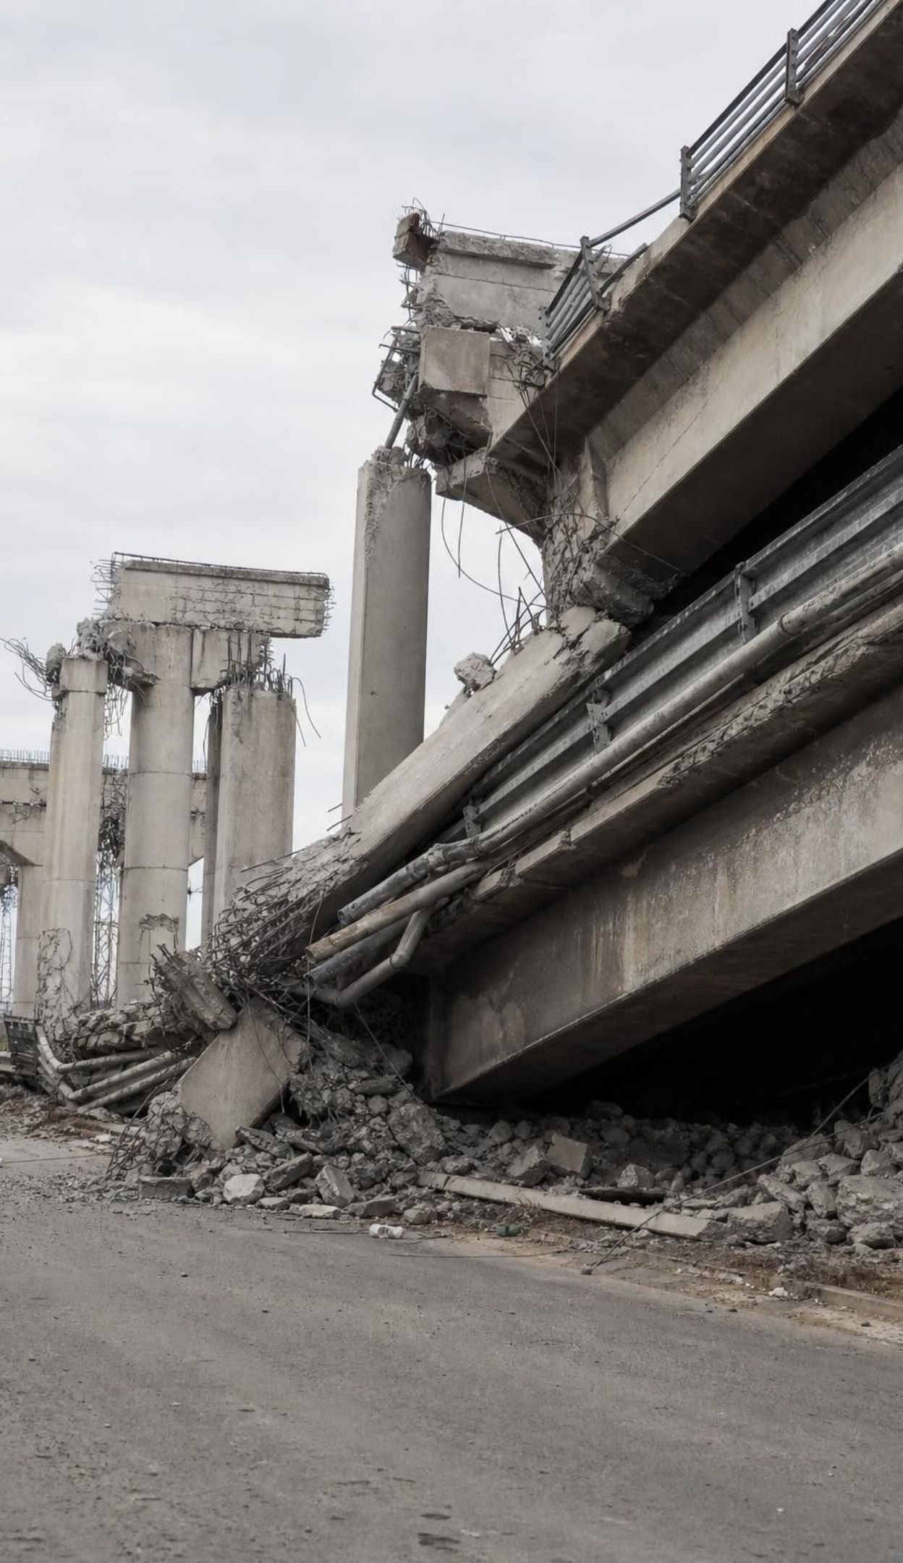
Earthquakes: forecast the chances, not the date
No reliable warning sign before earthquakes has been found, so no one can predict the date of the next one.
Scientists study where faults are, how fast plates move and how often past earthquakes struck.
Old earthquakes leave clues in soil and rock: offset layers, buried marshes, sand from tsunamis.
From these data they forecast probabilities: the odds of a strong earthquake in a region over 30 years.
Hazard maps turn those chances into colors that guide building codes, land use and insurance.
19
Notes:
Contrast this slide with the last one. Ask: why does a volcano give warning when a fault does not? Magma has to travel upward and push rock aside, which takes time and makes measurable changes. A locked fault simply holds until it breaks, and the rock gives no dependable sign beforehand. Scientists have tested animal behavior, groundwater levels, radon gas and electrical signals; none has worked reliably, and USGS notes that no scientist has ever predicted a major earthquake. Some big earthquakes follow smaller foreshocks, but a foreshock cannot be recognized until the bigger earthquake arrives. Then explain how forecasting still works: scientists dig trenches across faults and find layers broken by past earthquakes, date them, and work out average intervals. Average intervals are not schedules; the gaps between real earthquakes vary a lot.
WATCH FOR: 'A fault that is overdue will rupture soon.' An average interval of 200 years does not mean the next one comes at 200 years.
CONNECTS TO: W3 reading; W5 Part B (trench dates and gaps); W7 misconception repair (claim 7); Lab 3 rare-shaking data and q8.
PACING: about 5 min

Slide 20
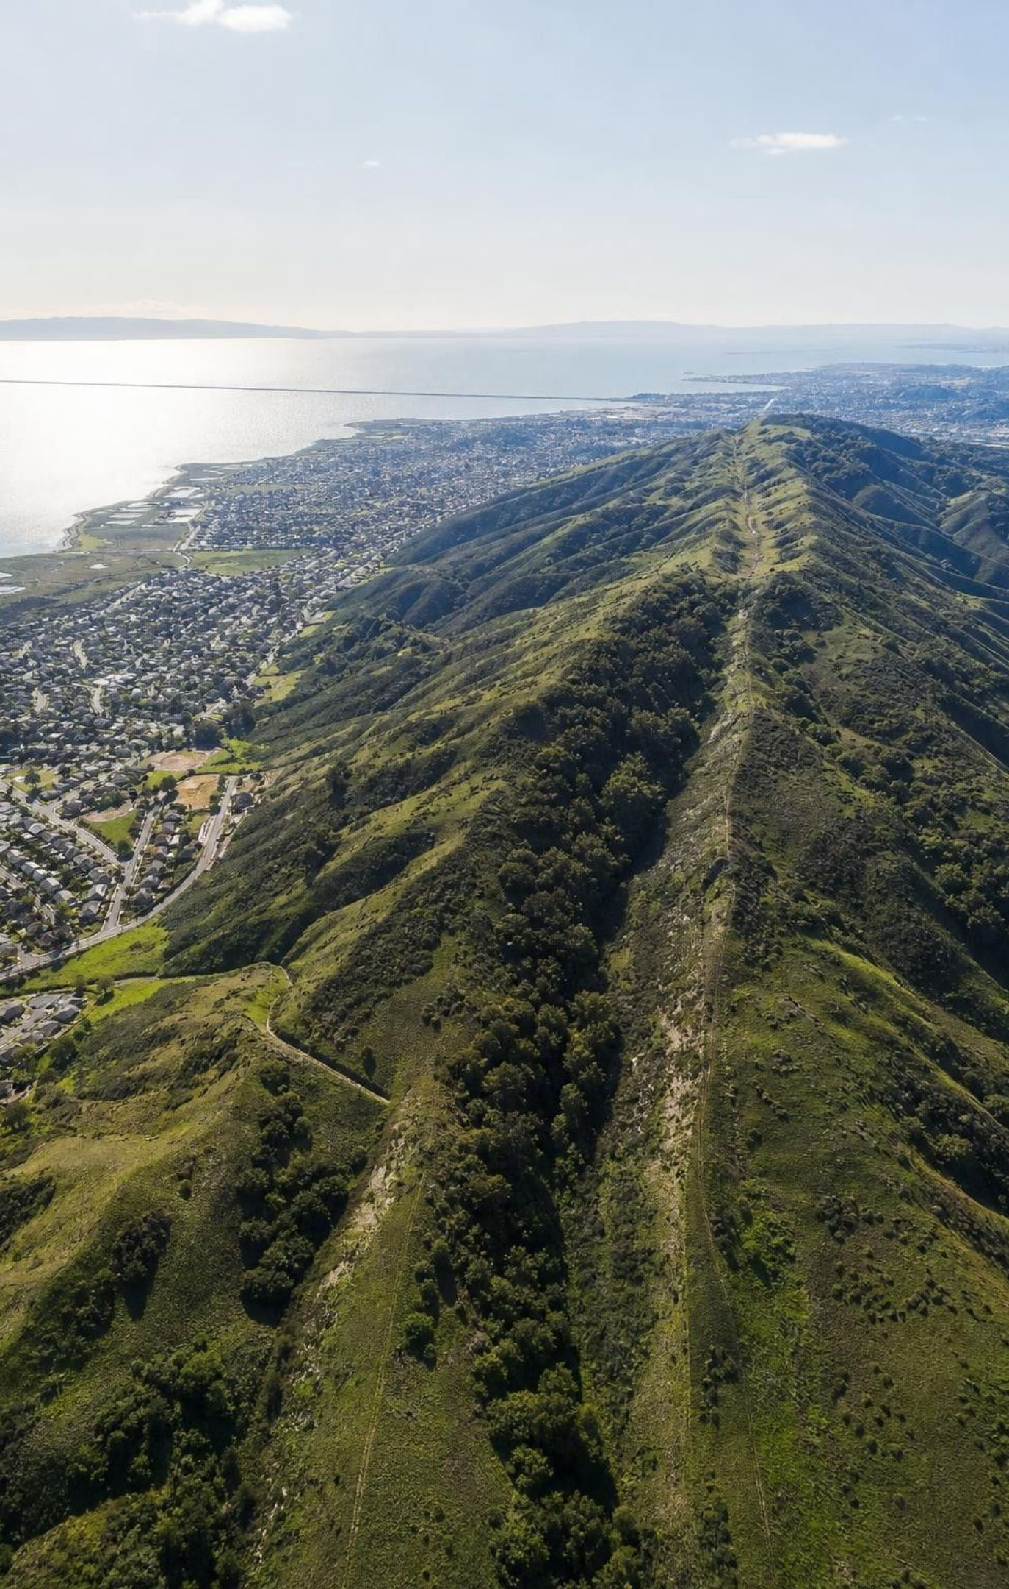
REAL-WORLD CONNECTION
California connection: the Bay Area's real forecast
USGS scientists combined fault maps, plate motion and the record of past earthquakes to forecast the San Francisco Bay region for 2014 to 2043. ShakeAlert, the West Coast early-warning system, does not predict earthquakes either: it detects one that has already begun and can send seconds of warning before strong shaking arrives.
Earthquake size | Chance of at least one in the Bay Area, 2014-2043
M6.0 or larger | 98 percent
M6.7 or larger | 72 percent
M7.0 or larger | 51 percent
M7.5 or larger | 20 percent
20
Notes:
This is real data from the USGS fact sheet 'Earthquake Outlook for the San Francisco Bay Region 2014-2043'. Ask students what pattern they see: the bigger the earthquake, the lower the chance, because small earthquakes are much more frequent than large ones. Connect to the logarithmic scale: each step up in magnitude is far rarer and far more powerful. Mention that the same fact sheet gives the Hayward and Rodgers Creek Faults a 33 percent chance of an M6.7 or larger, more than the San Andreas Fault's 22 percent, even though the San Andreas is more famous. Then explain ShakeAlert: sensors detect the fast, mild P waves near the start of an earthquake, computers estimate the size and location in seconds, and alerts go to phones (through the MyShake app and phone alerts) and to systems that can slow trains and open fire-station doors. People close to the epicenter may get no warning at all; people farther away may get seconds to tens of seconds, enough to drop, cover and hold on.
WATCH FOR: Calling ShakeAlert a prediction system. It is detection plus fast communication.
CONNECTS TO: W3 reading; W5 data worksheet (frequency and a 30-year forecast); next slide's discussion.
PACING: about 6 min

Slide 21
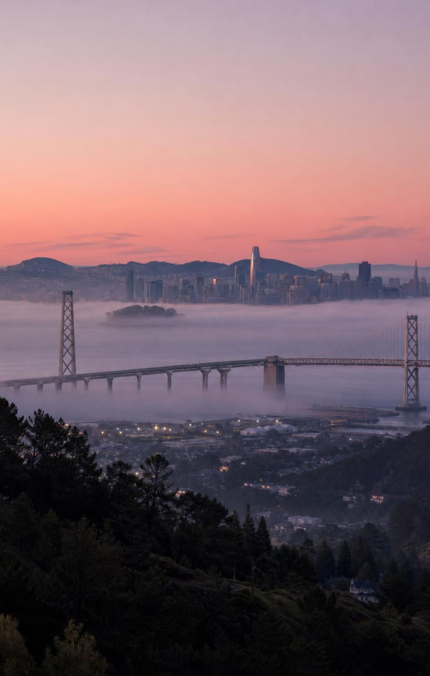
THINK, PAIR, SHARE
Discuss: does 72 percent mean 'it will happen'?
Think about: what the other 28 percent means.
Think about: whether a fault keeps a schedule.
Think about: what a city should do with a 72 percent chance, and what a family should do.
A neighbor says, 'Scientists say 72 percent, so the big one will definitely hit before 2043, and if it doesn't, they were wrong.' What does the forecast really mean? Is the neighbor right?
21
Notes:
Give pairs three minutes, then take answers. The neighbor is wrong twice. First, 72 percent is not 100 percent; there is roughly a one-in-four chance that no M6.7 or larger strikes the region in that window, and that would not make the forecast wrong, just as a sunny day after a 70 percent rain forecast does not make the forecaster wrong. Second, the forecast says nothing about which year, and it is a chance somewhere in the region, not at your house. Then ask what a city should do with a better-than-even chance over 30 years: retrofit weak buildings and bridges, map soft ground, update building codes, plan for water and power after a quake. Push on the deeper idea: a forecast is useful precisely because it lets people prepare without knowing the date.
EXPECTED RESPONSES: The forecast means a 72 percent chance that at least one M6.7 or larger earthquake strikes somewhere in the Bay Area between 2014 and 2043. It may not happen in that window (about 28 percent), and it gives no date or exact place. The neighbor treats a probability as a promise. A city should strengthen buildings and bridges and plan for the aftermath because the chance is high, even without a date.
WATCH FOR: Students may conclude 'then forecasts are useless'. Ask whether a 72 percent chance of a damaging event in 30 years is worth preparing for.
CONNECTS TO: W3 reading; W5 data worksheet; Lab 3 q8.
PACING: about 6 min

Slide 22
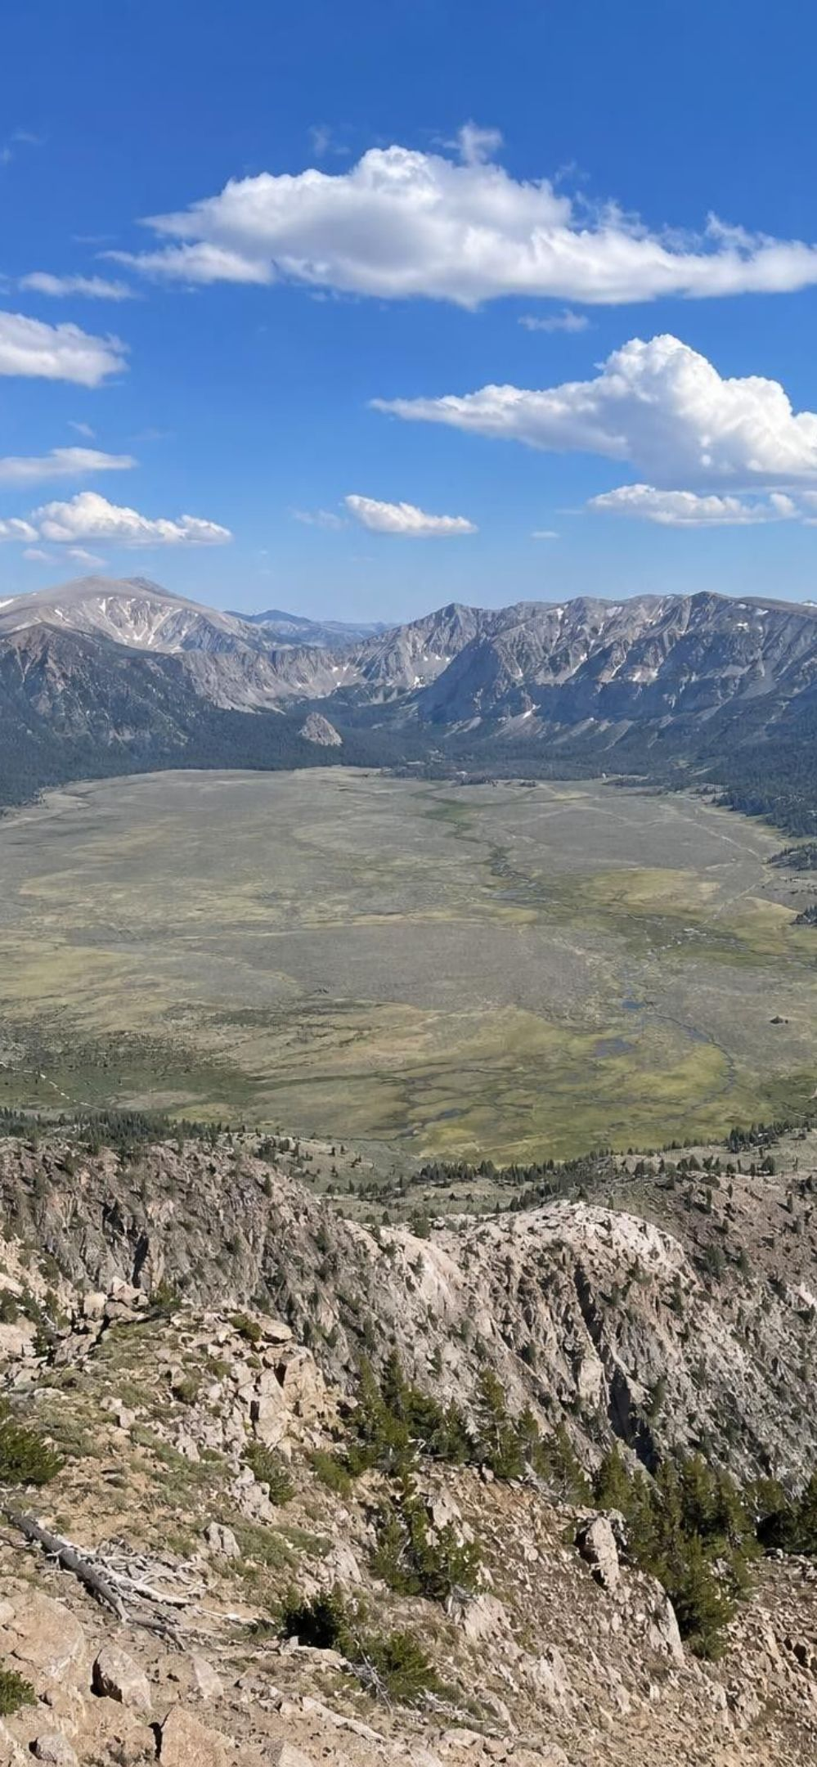
REAL-WORLD CONNECTION
California's three headline hazards
Model: Faults, a subduction zone and a caldera
San Andreas Fault: Transform boundary between the Pacific and North American plates. Shallow quakes; great ones in 1857 and 1906. No volcanoes.
Cascadia subduction zone: About 1,000 km from Cape Mendocino to Vancouver Island. Last great quake January 26, 1700, about M9. Feeds Mount Shasta and Lassen Peak.
Long Valley Caldera: A 16 x 32 km caldera near Mammoth Lakes left by a huge eruption 760,000 years ago. Quake swarms, uplift and gas since 1980.
Three different settings, three different hazard mixes, one state.
22
Notes:
Walk the state from south to north and then east. San Andreas: a transform boundary, so shallow earthquakes and no volcanoes; land west of the fault, including Los Angeles and Point Reyes, moves northwest relative to land east of it, about 5 cm a year across the whole boundary zone, with the San Andreas taking part of that. The 1857 Fort Tejon and 1906 San Francisco earthquakes both ruptured hundreds of kilometers of it. Cascadia: the Juan de Fuca Plate, and the smaller Gorda Plate in the south, sink beneath North America from Cape Mendocino northward. Its last great earthquake, about magnitude 9 on January 26, 1700, sent a tsunami across the Pacific that Japanese villages recorded; geologists in Oregon and Washington found drowned forests and buried marshes from the same event. The same subduction feeds the Cascade volcanoes; Lassen Peak erupted from 1914 to 1917, the last Cascade eruption before Mount St. Helens in 1980. Long Valley: a caldera, a giant collapse basin, left by an eruption about 760,000 years ago; since 1980 it has had swarms, uplift and gas, and the youngest eruptions nearby, along the Mono-Inyo chain and in Mono Lake, are only a few hundred years old. It is not at a plate boundary: its magma is linked to the stretching of the crust east of the Sierra Nevada, so it is one of the exceptions. USGS ranks Shasta, Lassen and Long Valley as very high threat volcanoes, a ranking of potential impact, not of which will erupt next.
WATCH FOR: 'California will fall into the ocean.' The San Andreas moves land sideways. Also 'Long Valley is a supervolcano about to erupt': unrest is monitored closely, and a repeat of the ancient eruption is not expected; future eruptions there are most likely to be small to moderate.
CONNECTS TO: Lab 1 debrief (the map is loosely modeled on western North America); W4 diagram and W8 jigsaw (California hazards); Lab 3.
PACING: about 7 min

Slide 23
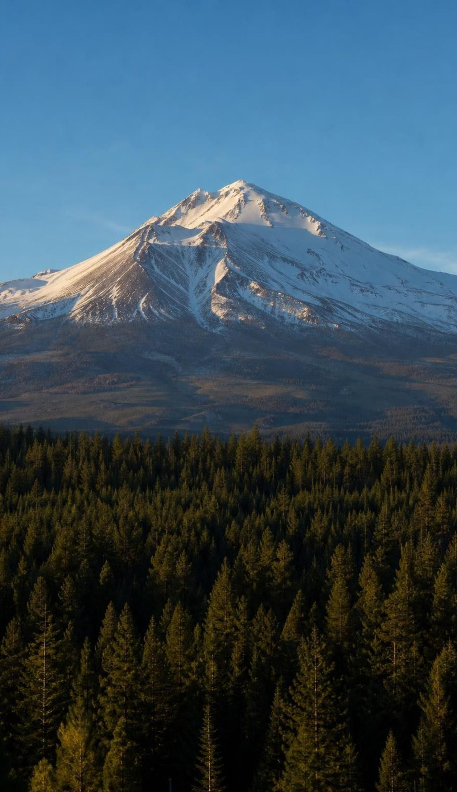
CHECK FOR UNDERSTANDING
Quick check: which California hazard?
Which California hazard is capable of a magnitude 9 earthquake and a tsunami that crosses the Pacific Ocean?
A. The San Andreas Fault
B. The Cascadia subduction zone
C. Long Valley Caldera
D. The Hayward Fault
23
Notes:
Vote, then ask for the reasoning, not just the name. Only subduction zones have locked plate contacts big enough (hundreds of kilometers long and wide) to produce magnitude 9 earthquakes, and because the seafloor is lifted suddenly, they also make ocean-crossing tsunamis. The San Andreas and Hayward Faults are transform faults; they can produce large and very destructive earthquakes (about magnitude 7 to 8) but not magnitude 9, and because they move sideways they do not lift the seafloor much. Long Valley's earthquakes are mostly swarms of small and moderate ones.
EXPECTED RESPONSES: B, the Cascadia subduction zone. Only a large subduction zone has a locked fault area big enough for a magnitude 9, and its sudden seafloor uplift creates a tsunami; it did both in 1700. Transform faults like the San Andreas and Hayward top out around magnitude 7 to 8.
WATCH FOR: Choosing A because the San Andreas is the most famous. Fame is not magnitude.
CONNECTS TO: W10 mastery; Lesson 26 (tsunamis) builds on this.
PACING: about 3 min

Slide 24
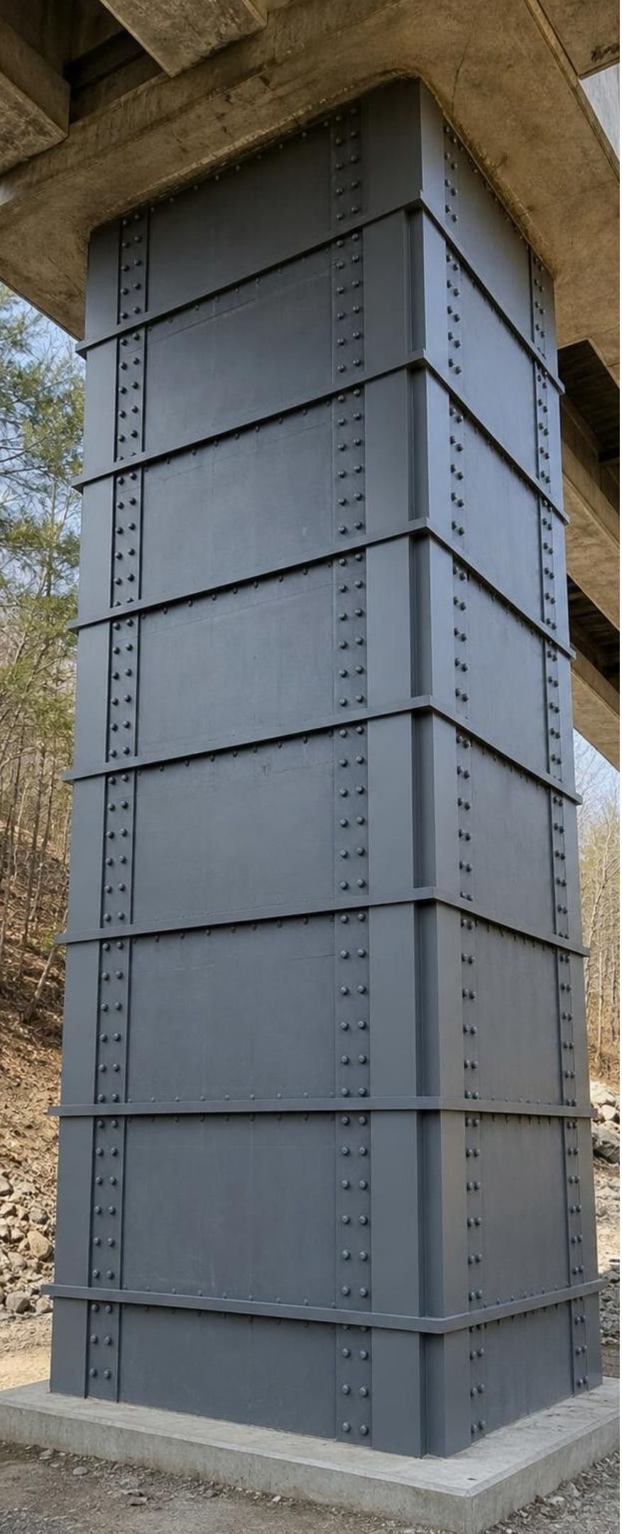
Mitigation and the bridge engineer's question
Mitigation lowers harm: hazard maps keep building off the worst ground; codes make structures stronger.
Engineers ask how strong and how frequent local shaking is, and how important the structure is.
Criteria say what success means, in numbers. Constraints are the limits: money, time, materials, site.
Bridge type | Frequent, moderate shaking | Rare, strong shaking | Very rare, strongest shaking
Ordinary (farm road) | Minor damage, stays open | Closed, still standing | Closed, still standing
Important (main road) | No damage | Damaged, emergency use only | Closed, still standing
Lifeline (only hospital route) | No damage | Minor damage, stays open | Damaged, emergency use only
24
Notes:
Start with mitigation examples students can name: retrofitting old buildings, bolting houses to foundations, keeping new homes and offices off mapped active fault traces (California's Alquist-Priolo Act requires this), base isolators like the rubber-and-steel bearings Japan placed under new buildings after the 1995 Kobe earthquake, and early-warning alerts. Then focus on the table, which is this lesson's own simplified version of how engineers set targets. Read it across: a more important bridge must perform better at every level of shaking. Read it down: every bridge is allowed more damage in rarer, stronger shaking, because designing every bridge to come through everything untouched would cost far too much. The lifeline row is the Bay Bridge's situation: hundreds of thousands of vehicles a day and a key route after a disaster. Show how a criterion becomes precise: 'strong' becomes 'carries the load with minor damage and stays open after rare, strong shaking'. Lab 2 asks students to turn these phrases into measurements.
WATCH FOR: 'Earthquake-proof' buildings. Engineers design for chosen levels of shaking and accept some damage in the rarest events; nothing is proof against everything.
CONNECTS TO: Lab 2 (the importance cards use these three rows); Lab 3 (the hospital bridge is a lifeline); W8 jigsaw (card D3 and the county decision in q3).
PACING: about 7 min

Slide 25
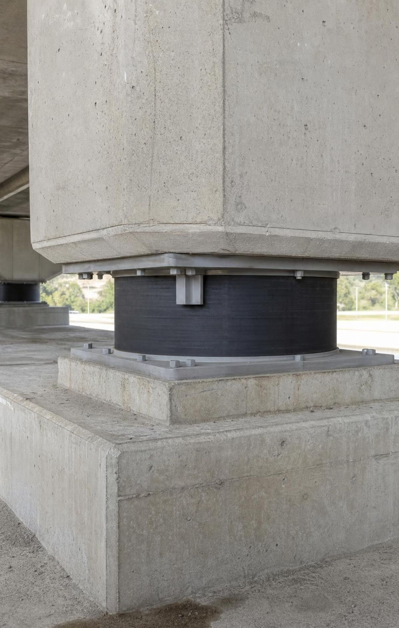
THINK, PAIR, SHARE
Discuss: why not build every bridge to the lifeline target?
Think about: cost, and how many bridges a county has.
Think about: how often each level of shaking happens.
Think about: which roads people depend on right after an earthquake.
Building every bridge to survive the strongest possible earthquake with no damage would make every road safer. Why don't counties do that? What would they give up, and who should decide?
25
Notes:
Give groups four minutes, then share. Draw out the trade-offs: money spent making a farm bridge earthquake-ready cannot be spent on the hospital route, schools or retrofits; very rare shaking may never come during a bridge's life; but some routes, like the only road to a hospital, must work exactly when the disaster happens. Bring in the constraint idea: budgets, time, materials and the site itself all limit solutions. Ask who should decide: engineers set what is technically possible, but communities and their elected leaders decide how much risk they will accept and what to spend. This is the reasoning students will use in Lab 3.
EXPECTED RESPONSES: It would cost far too much and take far too long; money would be taken from other safety needs; very strong shaking is very rare, so most bridges would never need that strength. Bridges that people depend on after a disaster, such as hospital routes, are worth the extra cost. Decisions involve engineers, governments and the public.
WATCH FOR: 'If it isn't earthquake-proof, it's unsafe.' Safety is a level chosen for each structure, not all-or-nothing.
CONNECTS TO: Lab 2 importance cards; Lab 3 budget; W8 q3 (why project d is rejected).
PACING: about 6 min

Slide 26
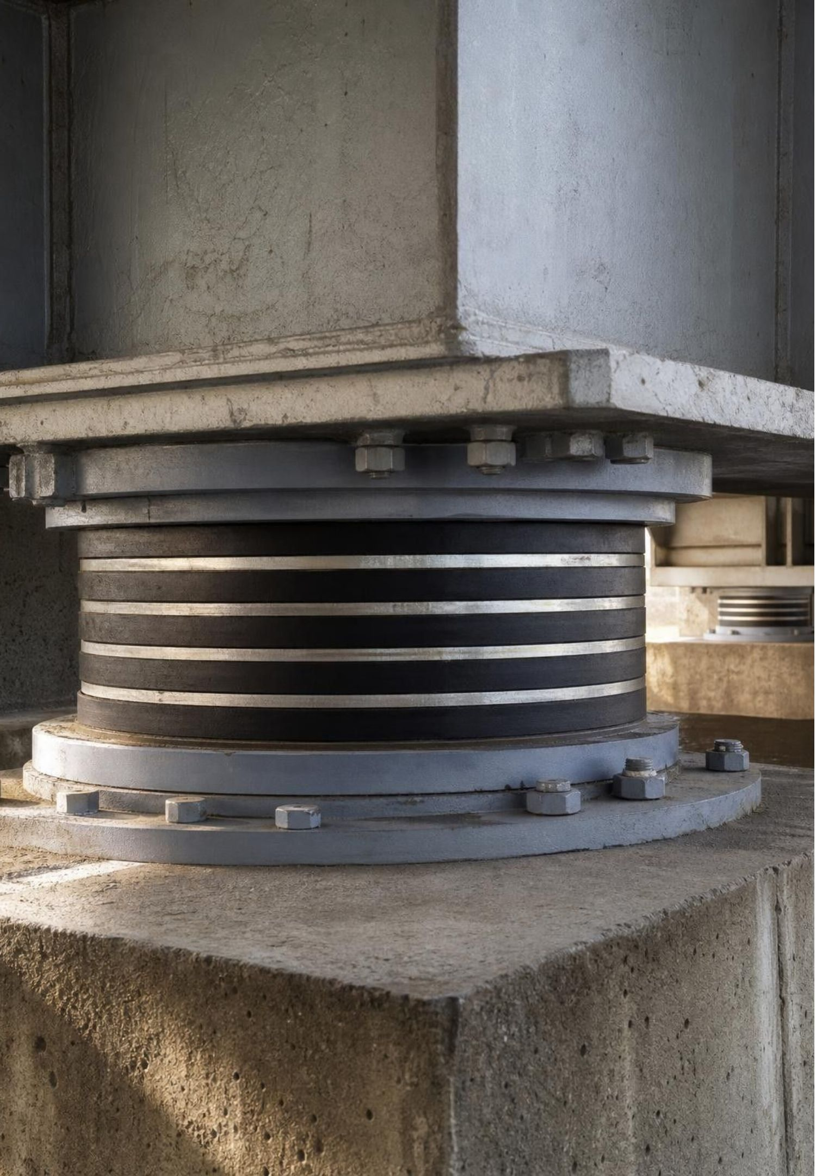
MISCONCEPTION CHECK
True or false? A magnitude 6 is just a bit stronger than a 5
"A magnitude 6 earthquake is only a little stronger than a magnitude 5, the same way 6 is only a little more than 5. So a magnitude 8 is about twice as strong as a magnitude 4."
True or false? Explain your reasoning.
26
Notes:
Have students write true or false with a calculation, then share. False on both counts. From magnitude 5 to 6, ground motion on a seismogram increases 10 times and energy about 32 times. From magnitude 4 to 8 is four steps: ground motion 10 x 10 x 10 x 10 = 10,000 times and energy about 32 x 32 x 32 x 32, roughly a million times. The 'twice' idea comes from reading 8 as double 4, which only works on a linear scale like a ruler. Ask why scientists use a logarithmic scale at all: earthquakes range from tiny ones that only instruments detect to giants with tens of billions of times more energy, and a linear scale would need impossibly long numbers. Close by repeating the useful rule: each step is 10 times the shaking on a seismogram and about 32 times the energy.
EXPECTED RESPONSES: False. Each step of 1 is 10 times the ground motion and about 32 times the energy. An M8 has 10,000 times the ground motion of an M4 and roughly a million times the energy (32 to the fourth power is about 1,050,000).
WATCH FOR: Students who overcorrect to 'M8 is 4 x 32 = 128 times'. The factors multiply, they do not add.
CONNECTS TO: W7 misconception repair; W10 mastery.
PACING: about 5 min

Slide 27
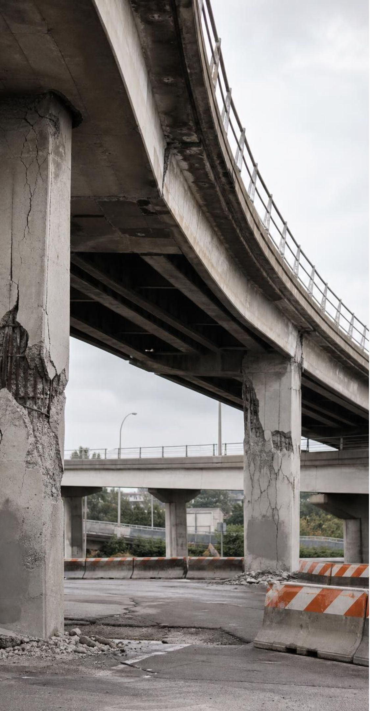
PUTTING IT TOGETHER
Putting it together
Earthquakes and volcanoes cluster along plate boundaries; hot spots and faults inside plates are exceptions.
Magma forms only where something lets mostly solid rock melt: added water, lower pressure or a hot plume.
Faults lock, store stress for years and slip in seconds, sending P, S and surface waves outward.
Magnitude is logarithmic; intensity describes shaking at a place and depends on distance and ground.
Eruptions often give precursors and can be forecast; earthquakes get probability forecasts, not dates.
Engineers turn hazard data into precise criteria matched to how important a structure is.
27
Notes:
Ask students to write a five-sentence answer to the essential question, 'How can people forecast and prepare for volcanic eruptions and earthquakes when only one of them usually gives warning signs?', using at least five vocabulary words. Trade with a partner, who checks for the forecast-versus-prediction distinction and for at least one number. Then ask for one takeaway from each lab: Lab 1 (which boundary had the deepest earthquakes and why), Lab 2 (which bridge feature survived the strongest shaking), Lab 3 (which site the group chose and the hazard they could not fully mitigate). Return to the phenomenon one last time: engineers could design the new Bay Bridge span for 1,500-year shaking because geologists can read the history of past earthquakes in rocks and soil, even though no one can predict the next one.
CONNECTS TO: W10 mastery; Lesson 26 (mass wasting, tsunamis and floods) continues natural hazards.
PACING: about 6 min

Slide 28
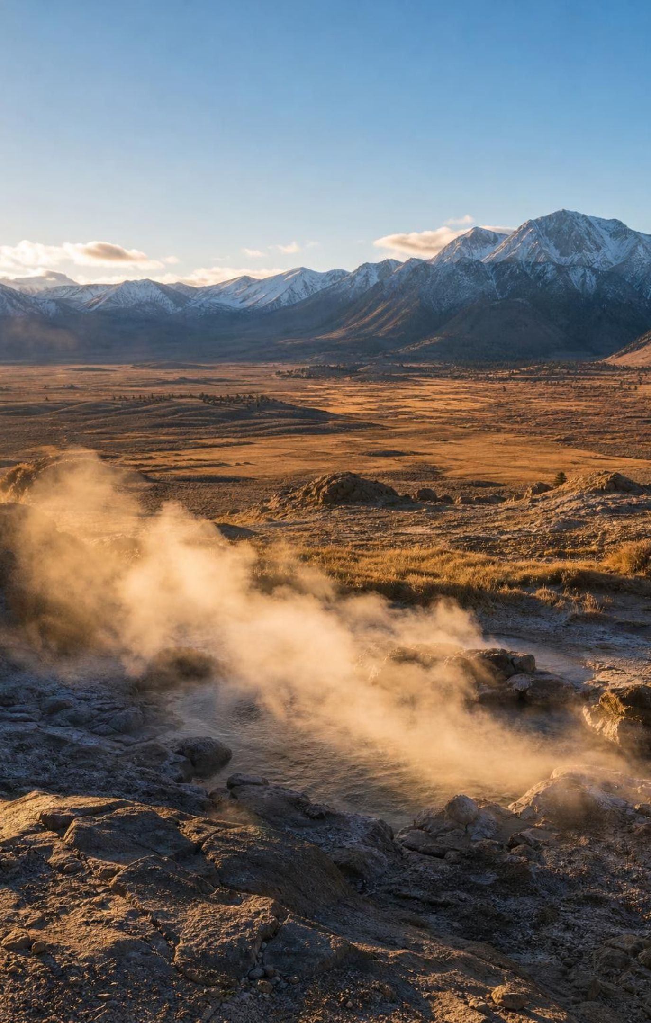
EXIT TICKET
Exit ticket
A line of earthquakes gets deeper toward the east and has volcanoes above it. What is happening there?
How many times more energy does a magnitude 8 release than a magnitude 6? Show your work.
Give one reason an eruption can often be forecast and one reason an earthquake's date cannot.
Why might a lifeline bridge need a different design target than a farm-road bridge?
28
Notes:
Collect on cards. Item 1 checks boundary reasoning from depth data (Lab 1), item 2 the logarithmic scale, item 3 the central contrast of the standard, and item 4 the link between importance and criteria. Sort the cards into piles by the item missed most often and reteach from the biggest pile before W10.
EXPECTED RESPONSES: 1: one plate is sinking (subducting) eastward beneath another; the quakes follow the sinking plate, and water from it melts the mantle above to feed the volcanoes. 2: about 1,000 times (two steps, 32 x 32 = 1,024). 3: rising magma causes measurable precursors (small quakes, gas, swelling); locked faults give no reliable warning sign before slipping. 4: a lifeline bridge must keep working right after a strong earthquake because people depend on it, so it needs a higher performance target, which costs more; a farm-road bridge can be allowed more damage.
WATCH FOR: Item 2 answers of 2 or 64 (linear or added factors); item 3 answers that say earthquakes 'have no warning, so nothing can be done'.
CONNECTS TO: W10 mastery; chapter evidenceOfLearning.
PACING: about 5 min

