Slide 1
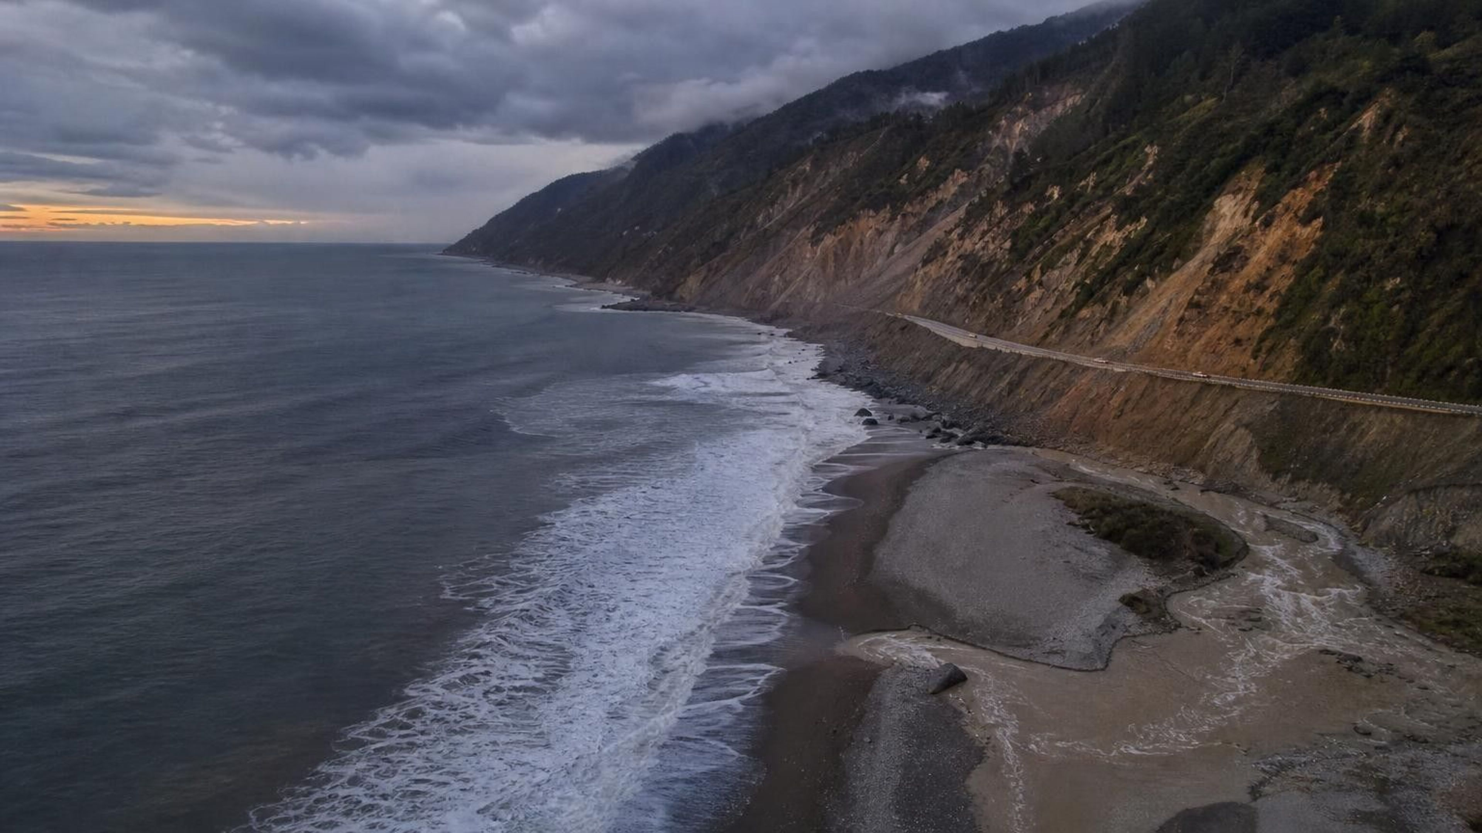
CHAPTER 26 OF 29 · EARTH'S NATURAL HAZARDS
Chapter 26: Mass Wasting, Tsunamis, and Floods
Lesson 26: How can data tell us where the ground, the sea or a river is likely to turn dangerous?
Angela's Wand · Bring Science Alive! 7th Grade Integrated
Notes:
Lesson 25 was about hazards that start deep in the Earth: eruptions and earthquakes. This lesson is about three hazards that happen at the surface and that water helps drive: slopes that fail, tsunamis and floods. Tell students the lesson has two big questions running through it. First, how do scientists use data to forecast where a hazard is likely and how much warning people will get? Second, how do engineers use those forecasts to design things that reduce the harm? They will tilt and soak model hillsides, flood a stream tray to test bridges, and write a tsunami warning procedure from data. Let students know that some examples involve real disasters and that they can step out or talk with you privately if a topic is hard for them.
CONNECTS TO: Overview of Lab 1 (landslide tray), Lab 2 (flood bridge) and Lab 3 (tsunami warning); W1 opens on the next slide.
PACING: about 2 min

Slide 2
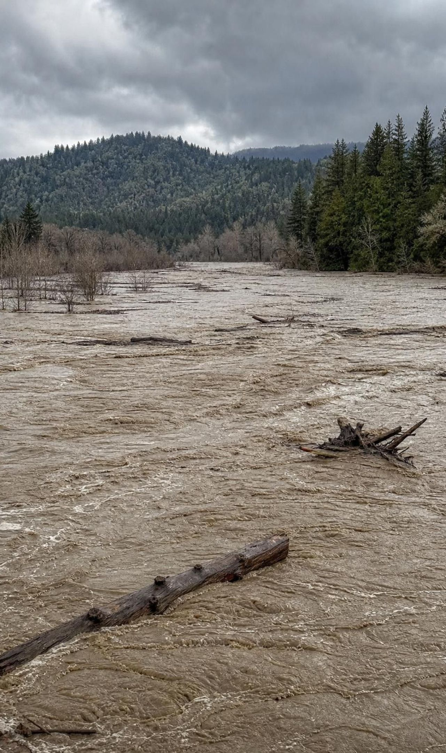
PHENOMENON
One county, one year, two kinds of killer water
Del Norte County, 1964. In March an earthquake in Alaska, 2,600 km away, sent a tsunami to Crescent City. The first surge, about four hours later, only wet the waterfront; the fourth, about 6 m high, wrecked about 30 blocks. In December, atmospheric-river storms swelled the Klamath River until logs and current knocked out the Highway 101 bridge. And south of town, that same highway keeps sliding.
Notice: which hazard started far away, and which started close to home?
Wonder: why was the fourth surge worse than the first?
Predict: which of the three could be forecast ahead of time, and how far ahead?
2
Notes:
Show a map with Crescent City, the Klamath River and Alaska if you can. Give two silent minutes for notices and wonders, then collect them on the board without judging. Push on three things. Distance: the earthquake was 2,600 km away and nobody in Crescent City felt it, yet the sea still came. Order: the first surges were small and during a lull some people went back downtown, then a later surge was the largest; ask why a tsunami might come as several waves. Warning: ask which hazard gave the most notice. The tsunami took about four hours to arrive; the December storms built over days; landslides on Last Chance Grade often give little warning at all. Do not resolve anything yet. Tell students they will return to each hazard: slides 9 and 16 come back to this coast, and slide 22 returns to the December flood.
EXPECTED RESPONSES: Notice: the tsunami started far away, the flood came from storms over the region, the slides are right there. Wonder: why the first wave was small; why waves came hours apart; why logs mattered; why the highway keeps sliding. Predict: the flood and the distant tsunami could be seen coming; a landslide or a nearby earthquake gives little notice.
WATCH FOR: Students may assume the first tsunami wave is the biggest, or that a tsunami is a single wave. Park it; slides 14, 16 and 25 deal with it.
CONNECTS TO: W1 phenomenon worksheet records notice and wonder and a first explanation.
PACING: about 8 min

Slide 3
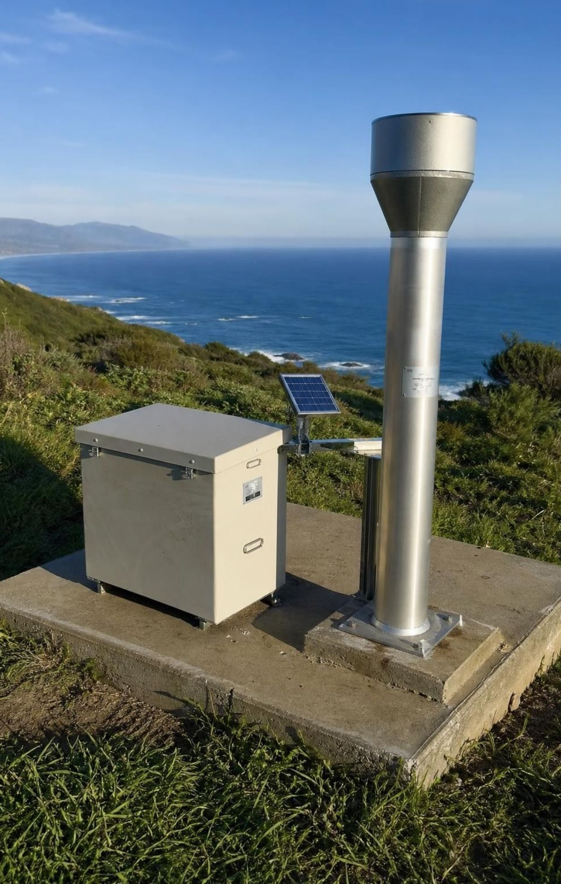
LEARNING TARGETS
What you will be able to do
Explain how slope angle, water, shaking and lost roots make a slope fail, and name four kinds of movement.
Explain what makes a tsunami and use depth to calculate when its waves will arrive.
Explain runoff and storm-surge floods, and read flood records as yearly chances.
Use maps, records, sensor readings and travel times to forecast where a hazard is likely and how soon.
Evaluate competing designs against criteria and combine the best features into a better one.
3
Notes:
Read the targets aloud and have students star the one they think will be hardest. Point out the pattern: targets 1 to 3 are about the science of each hazard, target 4 is about using data to forecast, and target 5 is engineering. The labs line up with them: Lab 1 with target 1, Lab 3 with targets 2 and 4, Lab 2 with targets 3 and 5. The exit ticket touches every target.
CONNECTS TO: Targets map to Lab 1 and W3 (1), W4, W6 and Lab 3 (2), W5 and Lab 2 (3), Lab 3 and W8 (4), Lab 2 and W9 (5); W10 mastery covers all five.
PACING: about 2 min

Slide 4
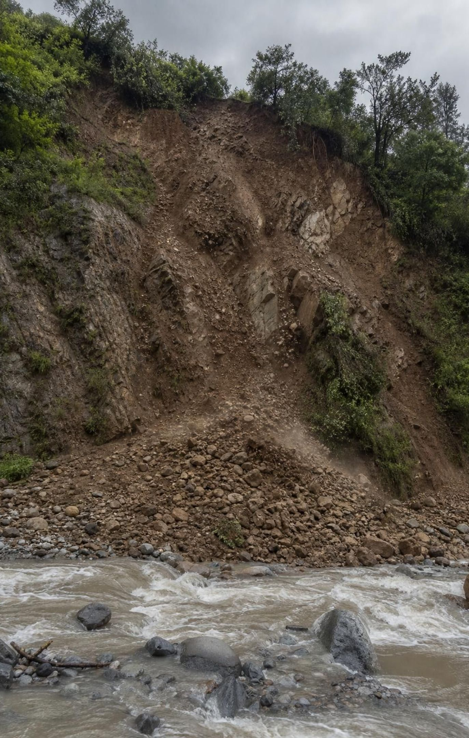
Three hazards, one pull
Mass wasting: gravity moves soil and rock downhill, from millimeters a year to meters per second.
Tsunami: a sudden shove of the seafloor lifts or drops the whole column of water above it.
Flood: more water arrives than the ground, the river channel or the coast can hold.
Gravity drives all three; water and shaking are the usual triggers.
Forecasting asks two questions: where is it likely, and how much warning will there be?
4
Notes:
Make the gravity point explicit. Gravity pulls the soil down the slope, pulls the lifted hump of seawater back down so it spreads as waves, and pulls rain and river water downhill to low ground. What differs is the trigger and the speed. Then show the textbook's opening comparison: on hazard maps, Northern California has far more mass-wasting potential than Missouri, while Missouri has had more flood events. Ask why. Northern California has steep coastal ranges, weak rock, heavy winter rain and earthquakes; Missouri is mostly gentle terrain cut by big rivers that drain a huge area. The pattern in the data comes from the land and the climate. Close by asking which hazard gives the most warning; collect guesses for later.
WATCH FOR: Students may say water 'causes' a landslide by itself. Water is a trigger; gravity does the moving.
CONNECTS TO: W2 vocabulary worksheet; W3 reading.
PACING: about 4 min

Slide 5
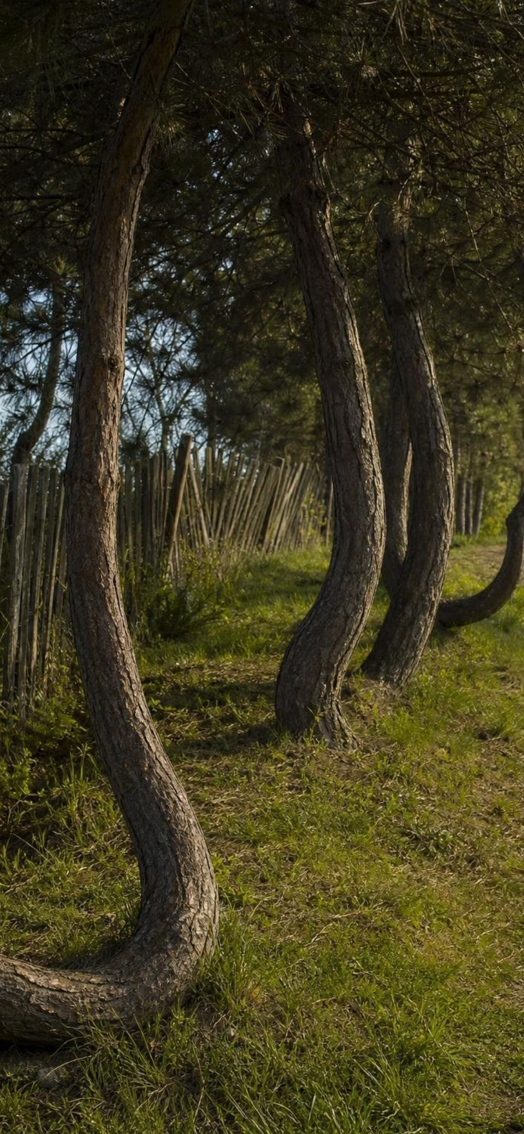
MODEL
Four ways a slope can move
Model: Kinds of mass wasting, slowest to fastest
Creep: Too slow to watch, often millimeters to centimeters a year. Clues: tilted posts and walls, trees with curved trunks.
Slide or earthflow: A mass of soil and rock moves on a weak surface or flows as a soggy mass, slowly or fast, often after soaking rain.
Debris flow (mudflow): A water-soaked slurry of mud, rock and trees races down a channel after intense rain, often on burned slopes.
Rock fall: Rock breaks from a cliff and drops, bounces or rolls; set off by shaking, freezing and thawing, or waves undercutting the base.
Real slopes blend types. Geologists also name topples, spreads and slumps, and earthflows range from very slow to fast.
5
Notes:
Walk the four from slowest to fastest. Creep is happening on many hillsides right now; ask students where they have seen a leaning fence or a tree bent like a J at the base. Slides and earthflows move a big mass at once; the La Conchita slides were this kind. Debris flows are the fastest and most dangerous moving-mud type: they behave like wet concrete and can carry boulders bigger than a car. The textbook calls these mudflows; geologists usually say debris flow, and save mudflow for the fine-grained kind. Rock falls need no water at all. Stress that the textbook gives each type one fixed speed, but real earthflows can creep for years and then speed up after a wet winter.
WATCH FOR: 'Creep happens on every slope' or 'earthflows are always fast.' Both are oversimplified.
CONNECTS TO: Lab 1 asks students to name the type of movement in each trial; W2 vocabulary worksheet; W3 reading.
PACING: about 5 min

Slide 6
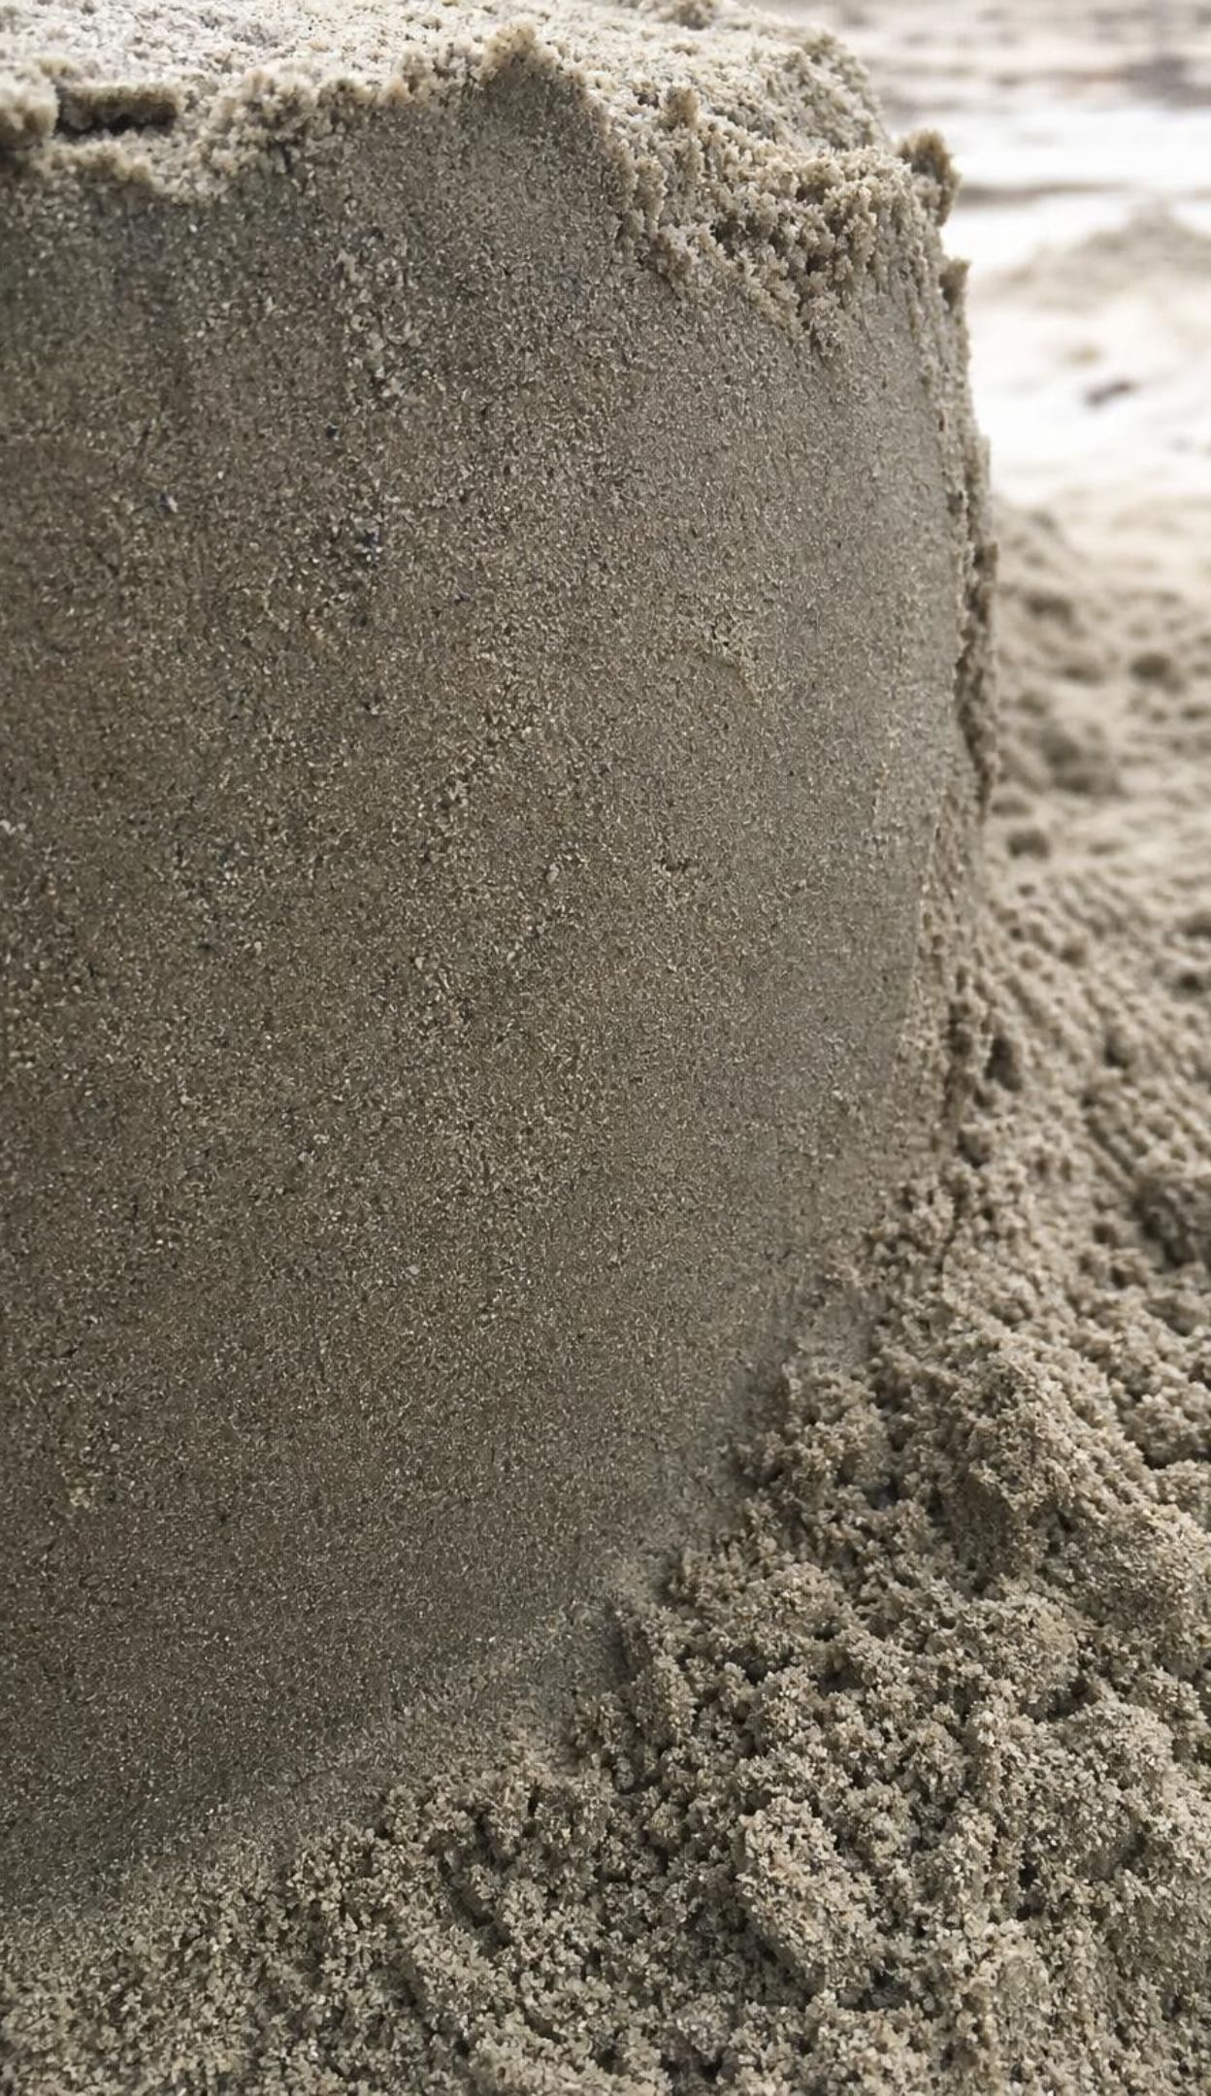
Why a slope fails: a tug-of-war
Gravity pulls every grain downslope. Friction and grip between grains hold it back.
The steeper the slope, the more of gravity's pull points downhill.
A little water forms films that pull sand grains together: that is why damp sand builds steep castles.
Saturated soil: water pressure in the gaps lightens grain-to-grain grip, and the water adds weight.
Shaking, waves or road cuts removing the toe, and fire killing roots, can tip a slope past its limit.
6
Notes:
Use a book on a tilted binder as the model: tilt slowly until it slides, and ask what changed. More of gravity's pull pointed down the slope, until it beat friction. Then the water story, which is the key idea for Lab 1. Ask who has built a sandcastle with dry sand: it pours into a cone at a fixed angle, about 30 to 35 degrees. Damp sand stands nearly vertical because thin films of water between the grains pull them together. But pour in more water until the sand is saturated and the castle slumps into a puddle. In a saturated slope, the water fills every gap and its pressure pushes outward on the grains, so they press on each other less and grip less; the water also makes the slope heavier. Then add triggers: an earthquake shakes grains loose (the 2016 Minamiaso slide in the textbook's opening photo), waves or road cuts remove the toe that props the slope up, and fire kills the roots that knit soil together.
WATCH FOR: 'Water lubricates the slope.' Water's real effects are lighter grain contact and added weight, and a little water can actually strengthen sand.
CONNECTS TO: Lab 1 measures the failure angle at five water contents; W7 misconception worksheet.
PACING: about 6 min

Slide 7
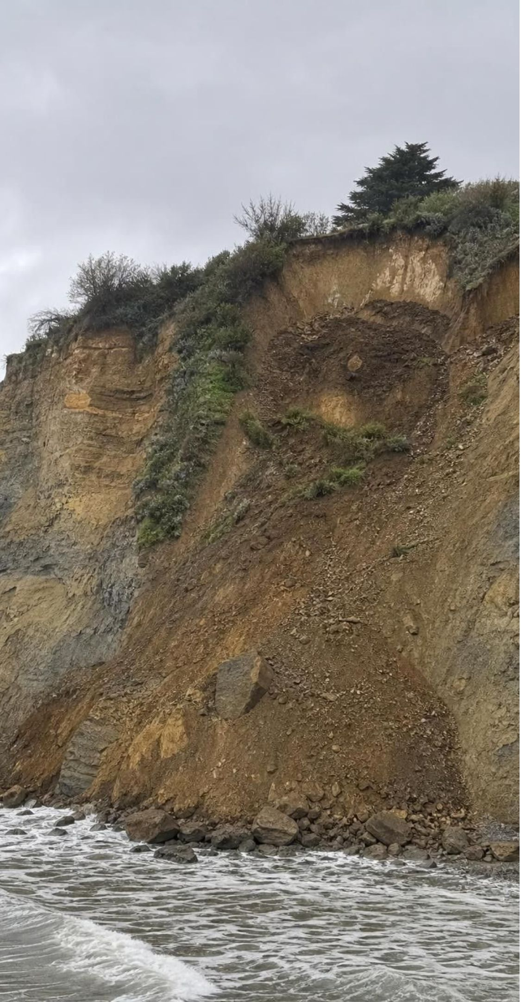
VOCABULARY IN CONTEXT
Words for moving ground
mass wasting: Any downhill movement of soil, rock or other earth material driven by gravity, whether it takes years or seconds. The bluff showed mass wasting of every speed, from creep at the top to fresh slides at the base.
saturated: Holding as much water as the gaps between grains can take; saturated soil grips less and weighs more. After a week of rain the hillside was saturated, and the road crew closed the highway below it.
debris flow: A fast, water-soaked slurry of mud, rock and often trees that pours down a channel like wet concrete. The debris flow left boulders the size of cars in the creek bed below the burned slope.
7
Notes:
Have students write each term with a quick sketch: an arrow down a hill for mass wasting, a cup of sand with water to the top for saturated, a channel full of boulders for debris flow. Ask for the difference between damp and saturated in their own words. Ask why a debris flow is more dangerous than creep even if creep moves more total soil over a century: speed, and no time to get out of the way.
WATCH FOR: Using 'saturated' to mean 'a little wet'. Saturated means every gap is full.
CONNECTS TO: W2 vocabulary worksheet; Lab 1 uses all three terms.
PACING: about 4 min

Slide 8
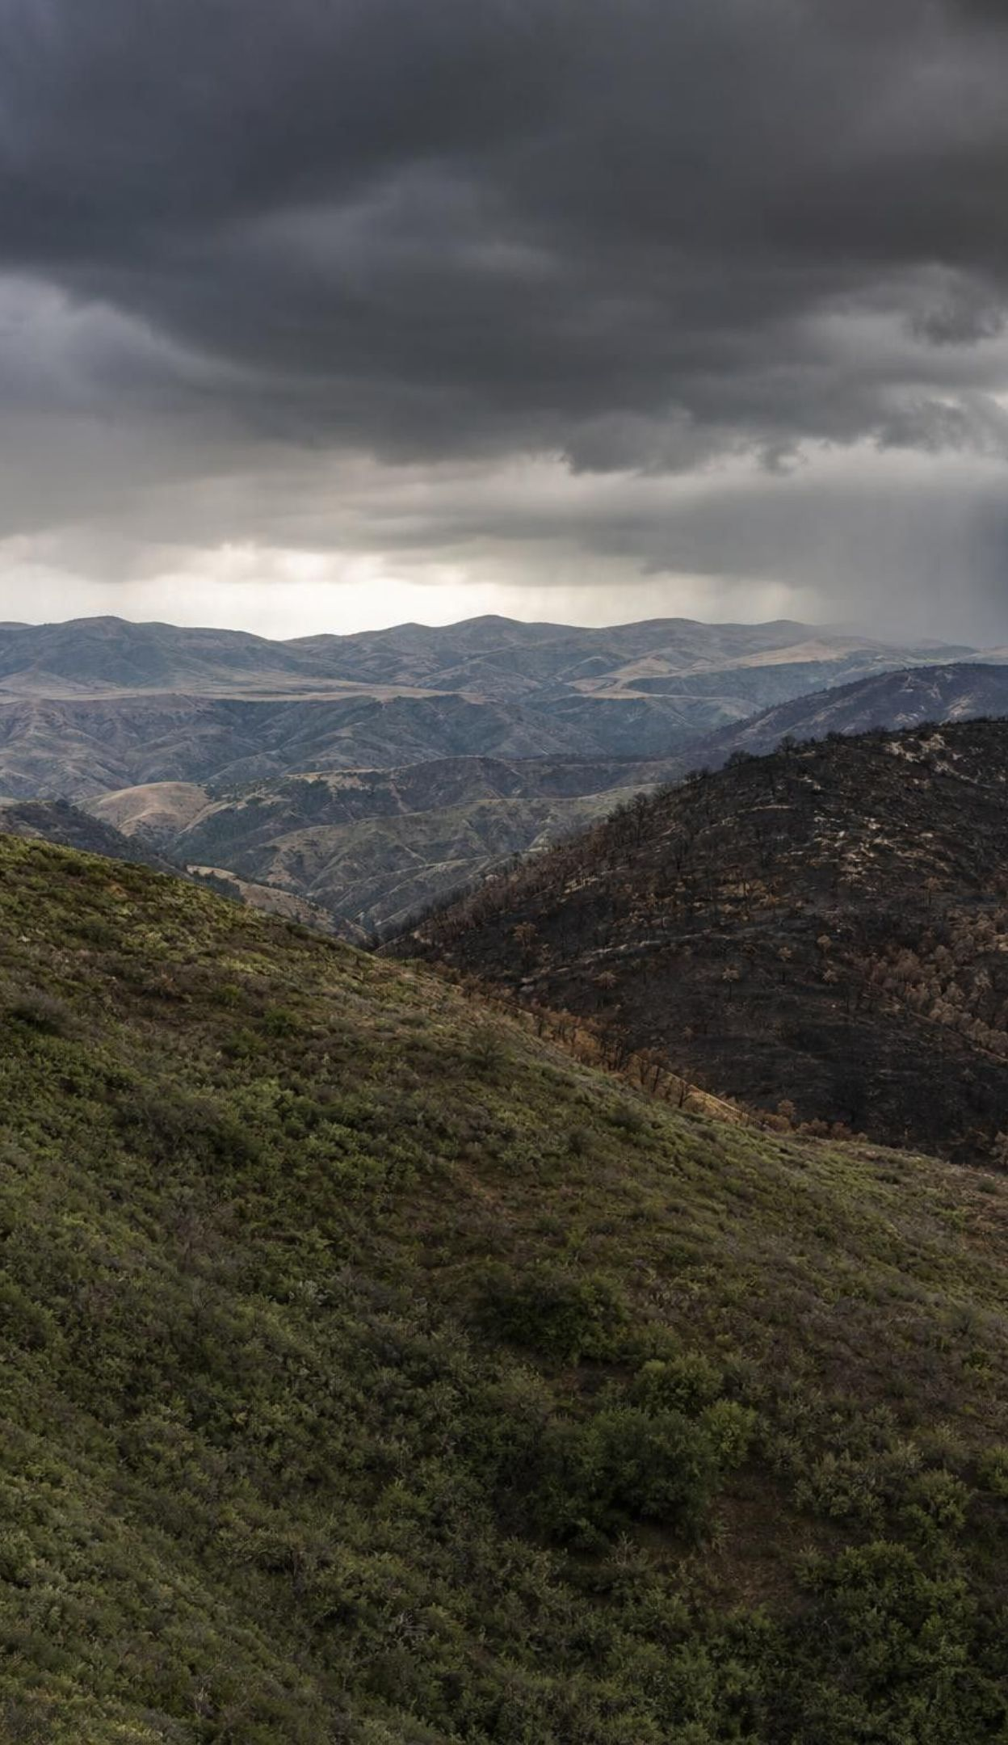
CHECK FOR UNDERSTANDING
Quick check: which hillside fails first?
Four hillsides have the same soil. Which is most likely to fail in the next big storm?
A. A 15-degree slope, dry, covered in deep-rooted shrubs
B. A 35-degree slope, damp after a light shower, roots intact
C. A 35-degree slope, soaked by a week of rain, burned last summer
D. A 15-degree slope, soaked by a week of rain, grass-covered
8
Notes:
Vote with fingers, then ask for the reason. C stacks every factor: steep, saturated, and no roots after the fire. Make students say which factor each option is missing. B is steep but only damp, and damp soil can actually be stronger than dry. D is soaked but gentle, so less of gravity's pull points downhill. A has none of the risk factors. Follow up: which data would you want to know about slope C before the storm? The forecast rain rate over 15 minutes and the soil moisture.
EXPECTED RESPONSES: C: steep, saturated and stripped of roots by fire. Strong answers name at least two factors and explain that saturation lightens grain contact and adds weight while roots no longer hold the soil.
WATCH FOR: Choosing B because 'any water makes it weaker'. Light dampness can strengthen soil.
CONNECTS TO: Lab 1 tests slope and water content directly; W10 mastery.
PACING: about 4 min

Slide 9
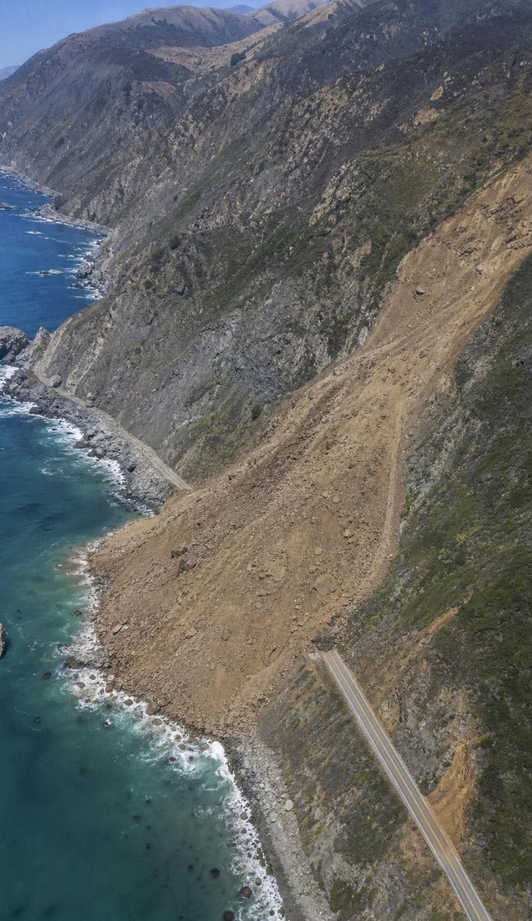
REAL-WORLD CONNECTION
California's restless coast
La Conchita sits below a 180 m bluff with slides recorded since 1865. In 2005, after about two weeks of heavy rain, part of the 1995 slide moved again, killing 10 people and destroying or damaging 36 houses. At Big Sur in 2017, the Mud Creek slide buried about a quarter mile of Highway 1. In Rancho Palos Verdes, slow-moving ground sped up to more than 30 cm a week in 2024.
Same recipe each time: steep slopes, weak rock and a lot of water.
Waves cutting the base of sea cliffs remove the slope's support.
Last Chance Grade, US 101 in Del Norte County: decades of slides; Caltrans plans a tunnel to bypass it.
9
Notes:
Use this slide to show that mass wasting is a California pattern, not a rare accident. La Conchita: USGS reports landslides there since at least 1865, and the whole bluff is an ancient slide. The 2005 flow was part of the 1995 slide moving again at the end of a 15-day wet spell, moving around 10 meters per second high on the slope; a wall built after 1995 was overtopped. Mud Creek: on May 20, 2017, the slope above Highway 1 collapsed, burying a quarter mile of road under debris about 20 meters deep, and the road was closed for about 14 months. Rancho Palos Verdes: the Portuguese Bend landslide complex had crept slowly for decades, then after the very wet winters of 2023 and 2024 parts moved more than a foot a week; after the city drilled wells in late 2024 to pump water out of the slide, it slowed to a few centimeters a week, though winter rain in early 2026 sped it up slightly again. That last detail is the mitigation lesson: take the water out and the slope steadies; let rain back in and it speeds up. Last Chance Grade ties back to the phenomenon: Caltrans has spent decades repairing a sliding stretch of US 101 and has chosen to tunnel around it.
WATCH FOR: 'Landslides come out of nowhere.' The textbook says so of La Conchita, but the site had a long, mapped history. Past slides are the best clue to future ones.
CONNECTS TO: W3 reading; Lab 1 session 2 tests covers, drains and toe walls; W9 transfer.
PACING: about 6 min

Slide 10
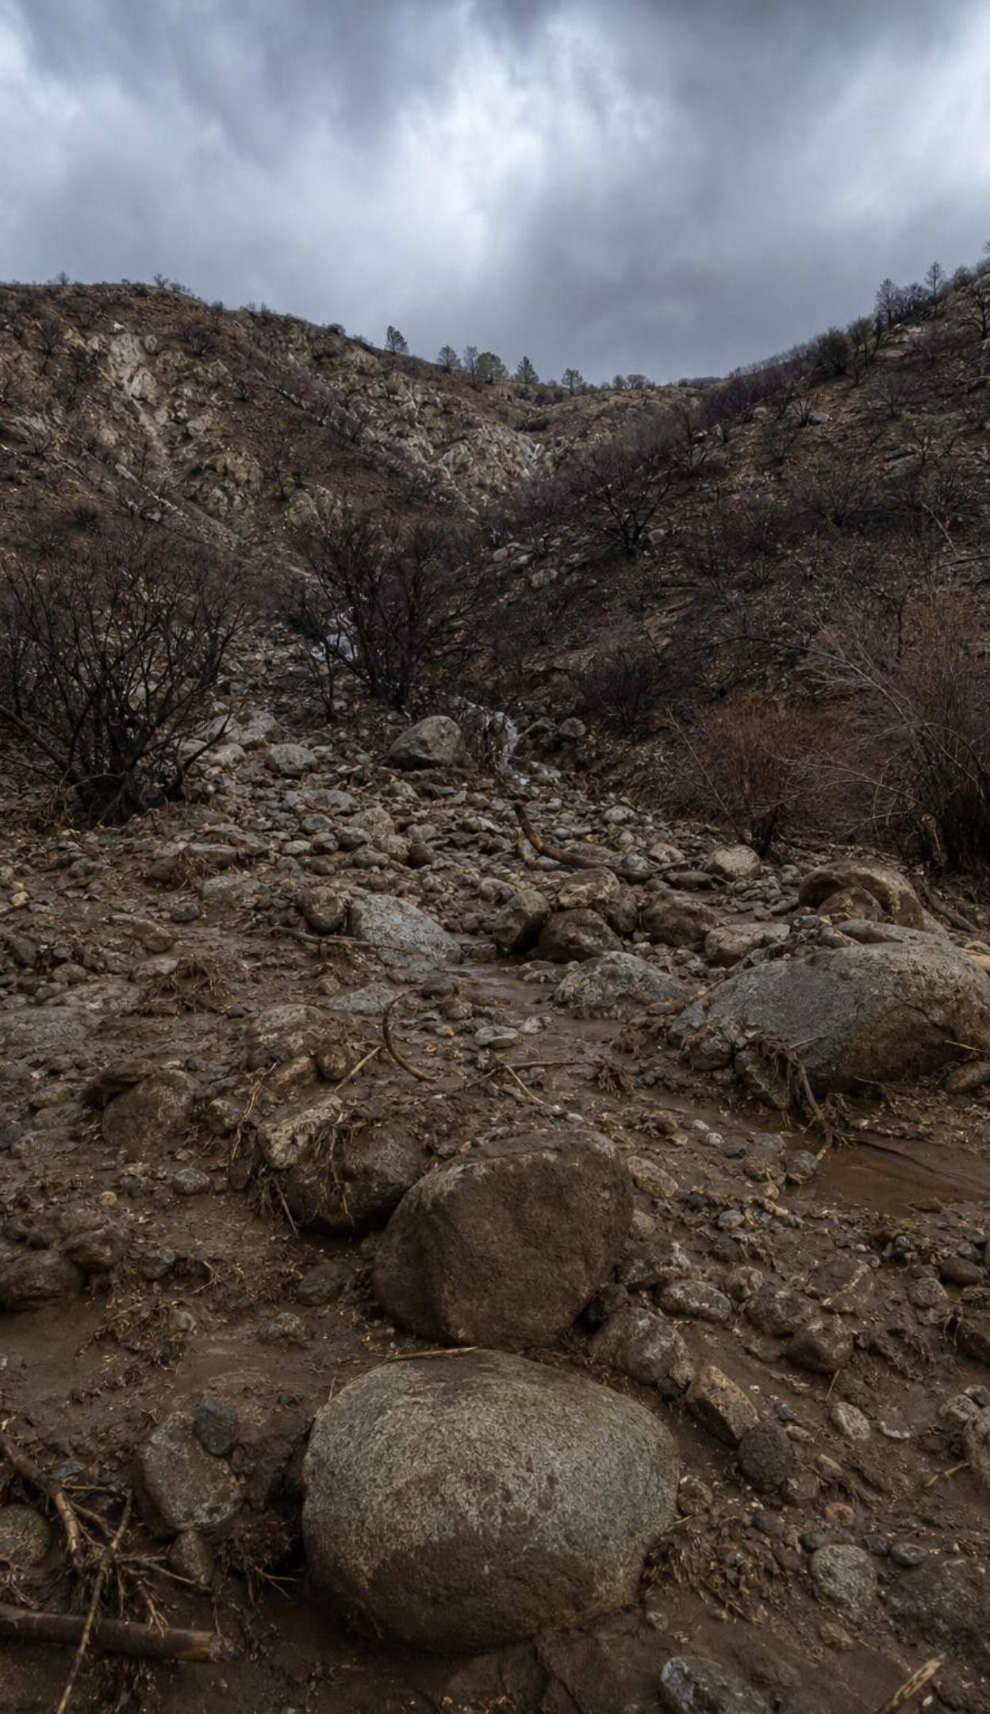
After the fire: debris flows
Fire burns the plants, roots and leaf litter that held soil and soaked up rain.
Burned soil can shed water, so rain runs off fast and sweeps up ash, sand and boulders.
Montecito, Jan. 9, 2018: on slopes burned by the Thomas Fire weeks before, intense rain set off debris flows.
The flows killed 23 people and damaged more than 400 homes.
On burned slopes, the danger depends most on how hard rain falls in about 15 minutes, not the daily total.
USGS maps burned watersheds and rain thresholds; the National Weather Service issues the warnings.
10
Notes:
The Thomas Fire burned the mountains above Montecito in December 2017. Early on January 9, 2018, a narrow band of rain along a cold front crossed the burn area around 4 a.m.; one nearby gauge recorded 0.86 inch in 15 minutes, a rate expected about once a century there. Debris flows carrying boulders more than 4 meters across ran down the creeks and through neighborhoods. Twenty-three people died. Explain why this hazard can be forecast in a limited way: after a fire, USGS scientists estimate which watersheds are most likely to produce debris flows and at what 15-minute rain intensity, and forecasters issue watches and warnings when such rain is expected, so counties can order evacuations. But the exact minute and the exact creek cannot be predicted, and many people did not evacuate. Ask: why might a warning for 'intense rain for 15 minutes' be harder for people to take seriously than a warning for a hurricane?
WATCH FOR: 'Debris flows need days of rain.' On burned slopes a short, intense burst is enough; no earlier rain is needed.
CONNECTS TO: W3 reading; W9 transfer (debris-flow defenses for a burned canyon); Lab 1 analysis q10 asks what to monitor on a burned slope.
PACING: about 5 min

Slide 11
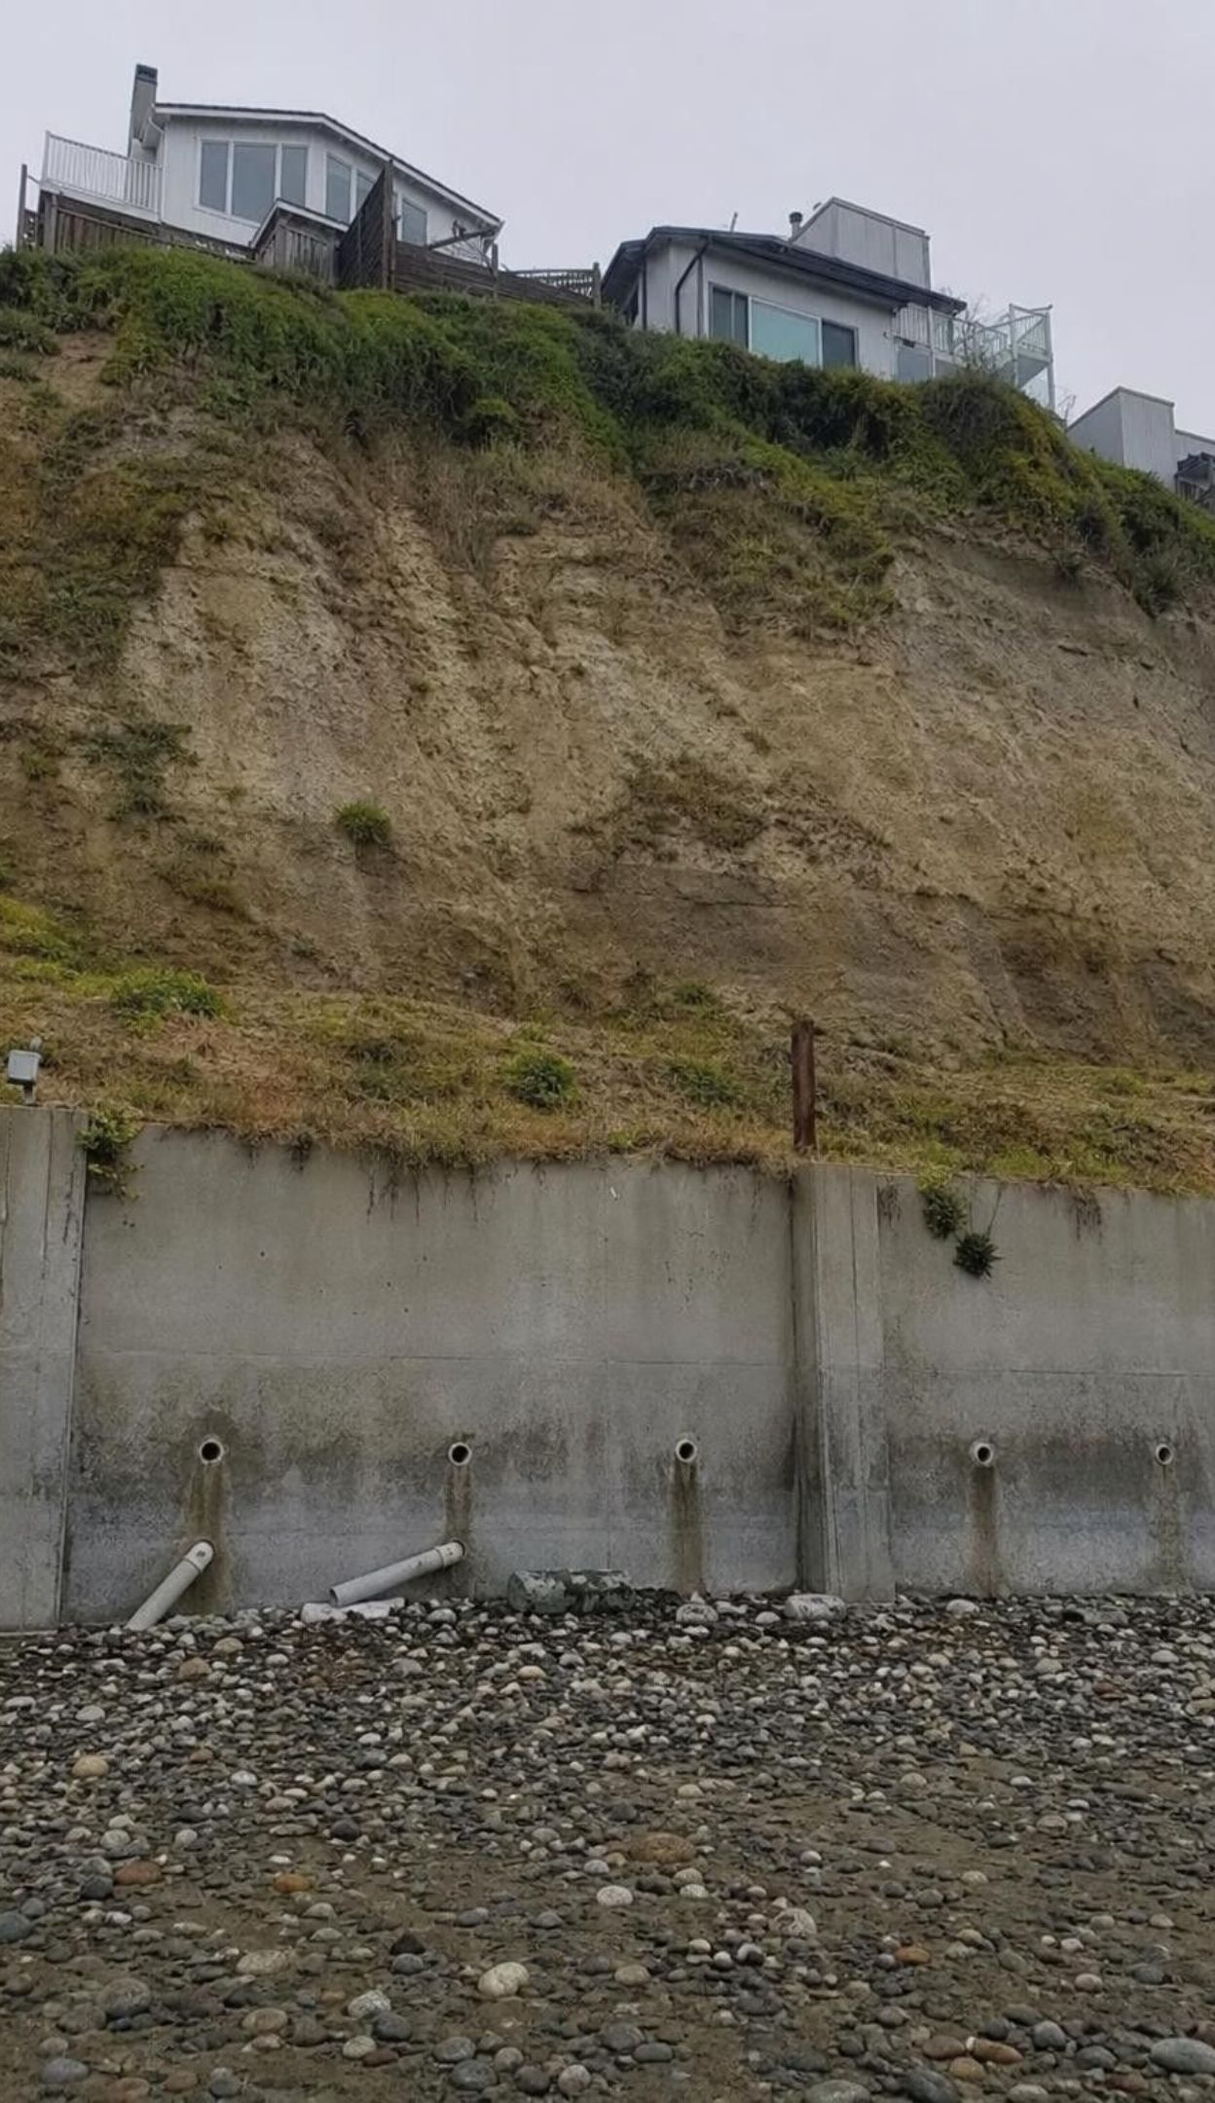
Think, pair, share
Discuss: wall, drain, monitor or move?
Think about: what each option protects, and against which kind of movement.
Think about: what happens if a slide is bigger than the wall was built for.
Think about: who pays, and who decides whether people must leave their homes.
A town sits below a bluff that has slid twice in ten years. The county can afford one: a taller wall at the base, drains that pump water out, sensors with alerts, or buying out the homes. Which would you choose, and why?
11
Notes:
Give pairs three minutes, then take one argument for each option. Push for evidence from the last two slides. A wall catches small slides but can be overtopped, as at La Conchita. Drains attack the cause, water, as at Portuguese Bend, but need power and upkeep. Sensors and alerts give minutes to hours of warning for slow-building slides, but not for a sudden failure. Buyouts remove people from harm but cost the most and break up a community. Make the engineering point: the best plans usually combine two or more, the same move the DART engineers make later in this lesson. Accept any choice backed by evidence and a stated trade-off.
EXPECTED RESPONSES: Drains, because they reduce the water that triggers slides; a wall plus alerts, because the wall stops small slides and alerts cover big ones; buyouts, because no structure can stop a slide as large as the bluff. Strong answers name a limit of their choice and suggest a combination.
WATCH FOR: 'A big enough wall solves it.' Every structure has a design limit.
CONNECTS TO: Lab 1 session 2 tests three mitigations; W8 collaborative; W9 transfer.
PACING: about 7 min

Slide 12
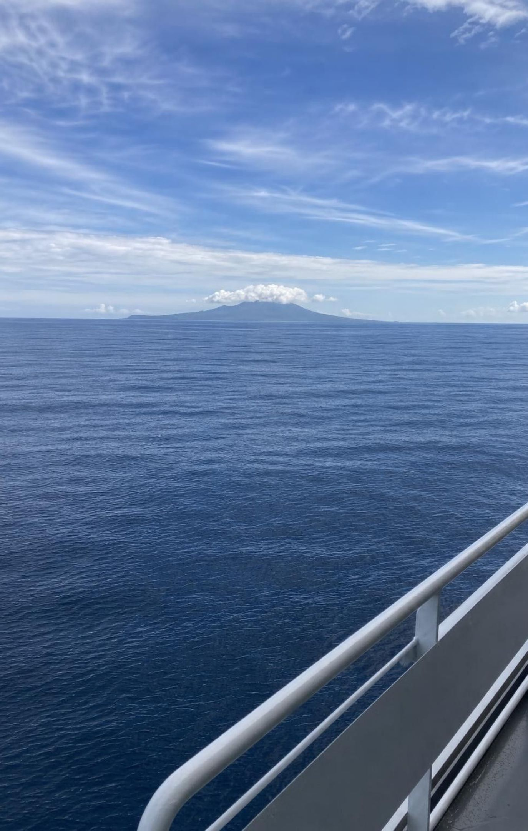
What makes a tsunami
A tsunami starts when a huge volume of seawater is suddenly lifted or dropped.
Most come from large undersea earthquakes where one plate dives under another.
In those quakes the edge of the upper plate springs up, raising the seafloor and the sea above it.
Undersea landslides, volcanic eruptions and asteroid impacts can also make tsunamis.
Tides do not make them, and neither does wind; 'tidal wave' is the wrong name.
Most tsunamis happen in the Pacific, around the Ring of Fire.
12
Notes:
Model it with a tray of water and your flat hand on the bottom: push the hand up quickly and watch the bulge spread out in every direction. That is the key: the whole depth of water moves, not just the surface. Connect to Lesson 25: at a subduction zone the two plates stick, the upper plate is bent down and squeezed, and when the fault slips the upper plate's edge springs up while areas closer to land drop. The textbook says the sinking plate drags the water down; the bigger effect in large quakes is the upper plate springing up, though both up and down movements happen. Contrast with wind waves: they stir only the top few meters and have crests a few seconds apart; a tsunami's crests can be many minutes apart. The textbook gives about 80 percent of tsunamis around the Ring of Fire.
WATCH FOR: 'Tidal wave' and 'a tsunami is a giant wind wave'. Neither tides nor wind are involved.
CONNECTS TO: W4 diagram worksheet; L25 subduction zones.
PACING: about 5 min

Slide 13
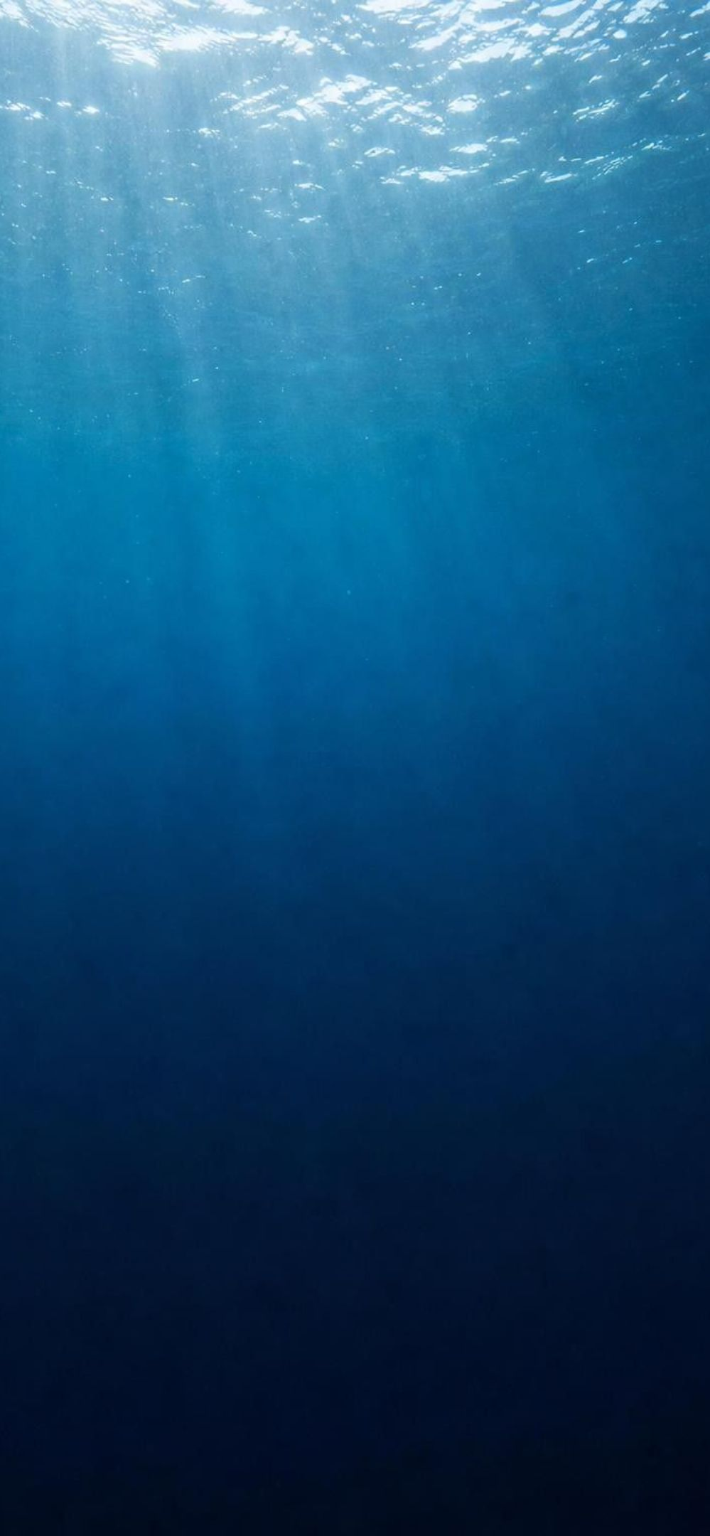
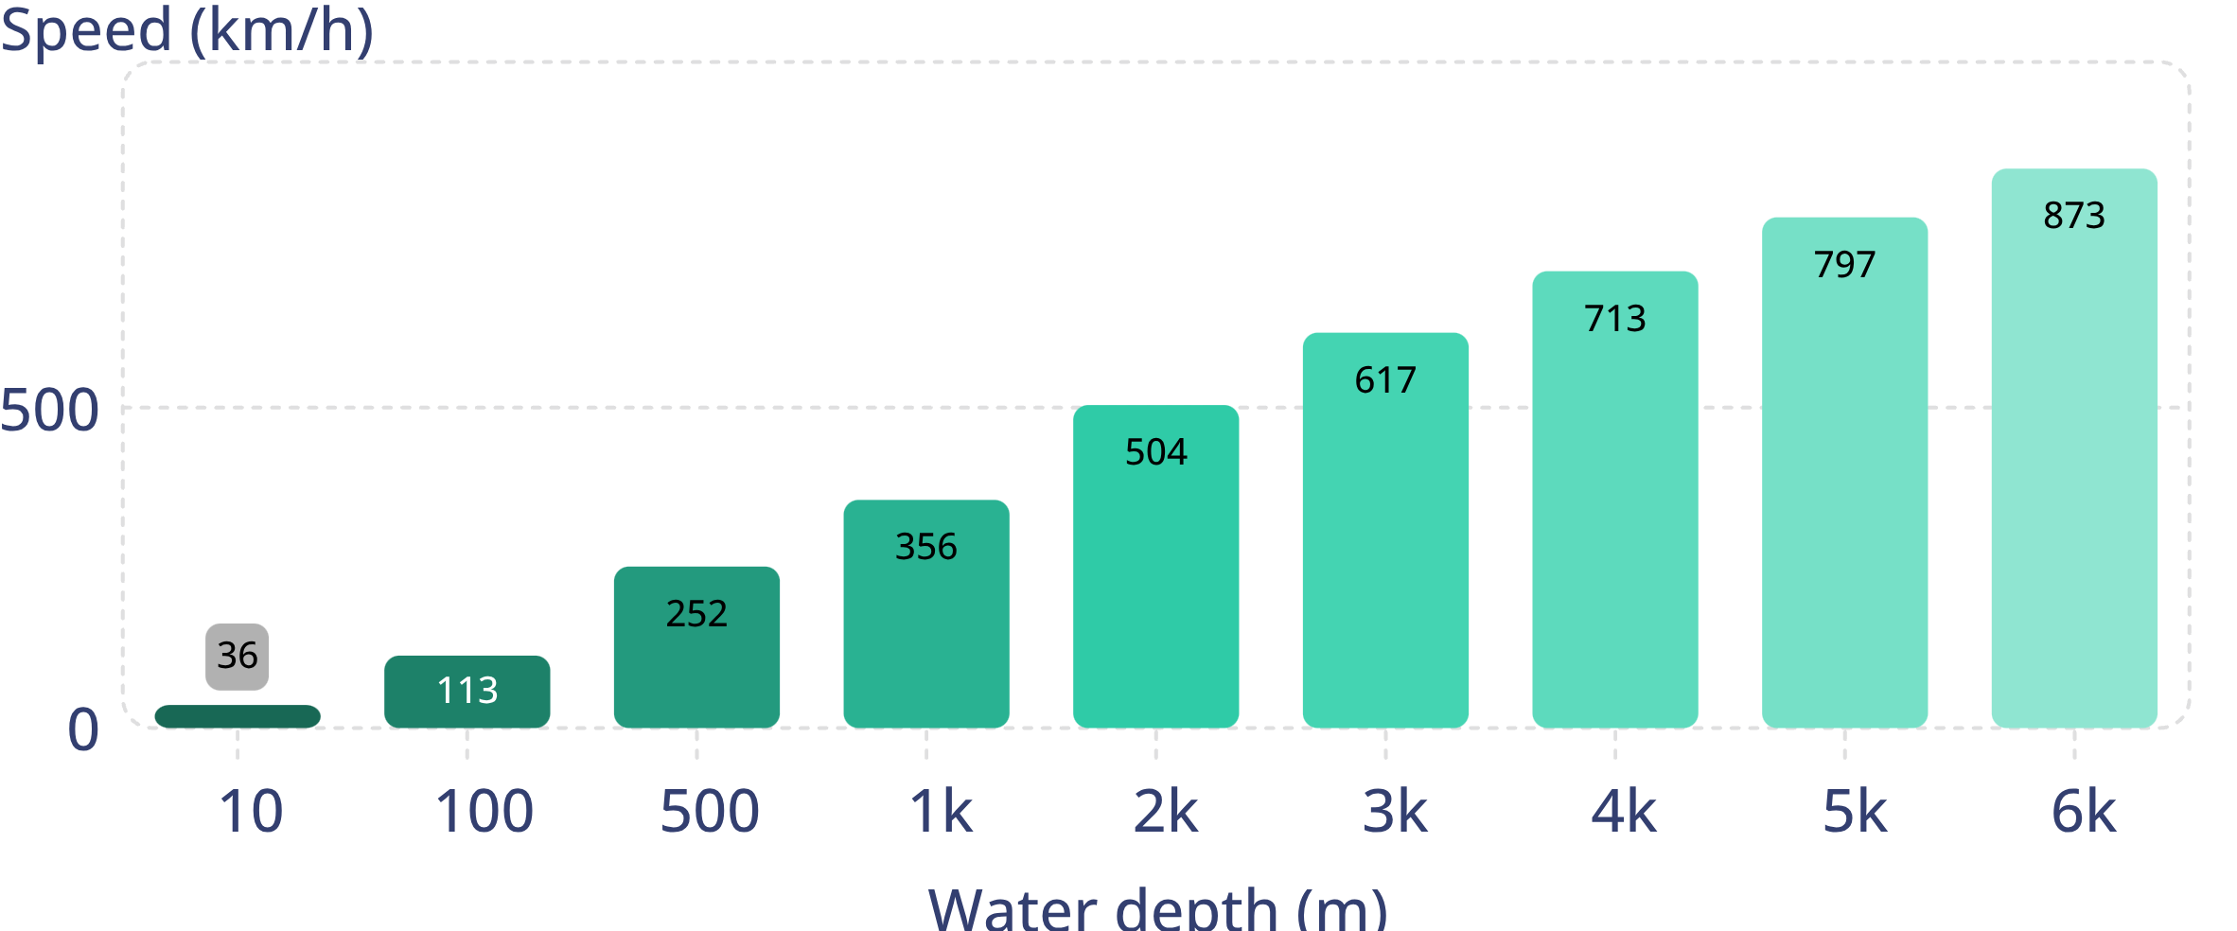
MODEL
A tsunami's speed depends on water depth
Model: Tsunami speed at different ocean depths
Calculated from the long-wave rule: speed in m/s = square root of (9.8 x depth in m), converted to km/h. Calculated values, not measurements.
13
Notes:
This is the most important graph of the tsunami section. A tsunami is so long compared with the ocean's depth that the whole column of water moves, and the seafloor controls how fast it can go. Read three points aloud: over the deep Pacific, about 4,000 to 5,000 meters, it travels about 700 to 800 km/h, as fast as a jet airliner. Over a 100-meter-deep continental shelf it slows to about 110 km/h. In 10 meters of water near the beach it is down to about 36 km/h, still faster than anyone can run. Ask students to describe the shape of the curve: speed rises fast at first and then more slowly as depth increases. For students ready for more, show the rule: speed in meters per second is the square root of 9.8 times the depth in meters; at 4,000 m that is about 198 m/s, or about 713 km/h. Point out that because the speed depends only on depth, warning centers can calculate arrival times as soon as they know where the quake was.
WATCH FOR: 'Bigger tsunamis travel faster.' In this long-wave regime speed depends on depth, not on how big the wave is.
CONNECTS TO: Lab 3 uses this chart as its speed table; W6 CER argues from travel-time data that depth sets a tsunami's speed.
PACING: about 5 min

Slide 14
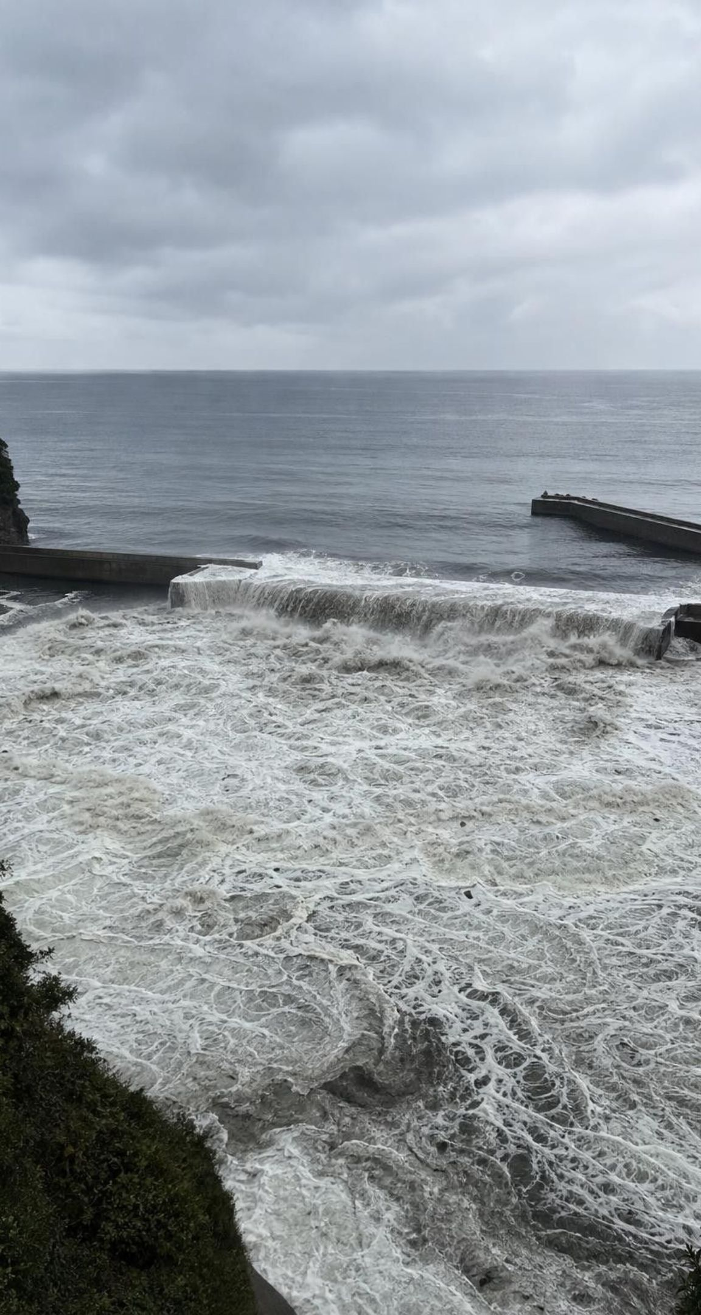
From deep ocean to shore: slower, shorter, taller
Deep ocean: often under 1 m tall, crests 100 km or more apart, moving 700-800 km/h. Ships barely notice.
Over the shallow shelf the front slows first, and the water behind catches up.
The same energy is squeezed into less length and depth, so the water piles up higher.
Near shore it moves about 30-50 km/h and can reach many meters high in big events.
It comes as a series of surges over hours; the sea may pull back first.
Run-up is how high the water climbs on land above normal sea level.
14
Notes:
Use a traffic picture: cars on a freeway at full speed, spaced far apart; then the lead cars hit a slow zone and everyone bunches up. The tsunami's front reaches shallow water first and slows, the rest catches up, the wavelength shortens, and because the energy has nowhere else to go the height grows. That is why a wave a sailor would not notice in the open ocean can flood a town. Then two safety-relevant facts. First, a tsunami is several surges, often 10 minutes to an hour apart, and the first is often not the largest. Second, if the trough arrives first, the sea pulls back and exposes the seafloor; that drawdown is a sign that a surge is coming, not a chance to explore. Define run-up: the height above normal sea level that the water reaches on land; the very large numbers quoted for 2011, near 40 m, are run-up.
WATCH FOR: 'A tsunami is a curling surfing wave.' Most arrive as a fast-rising flood or a churning wall of foam.
CONNECTS TO: W4 diagram worksheet; misconception slide 25.
PACING: about 5 min

Slide 15
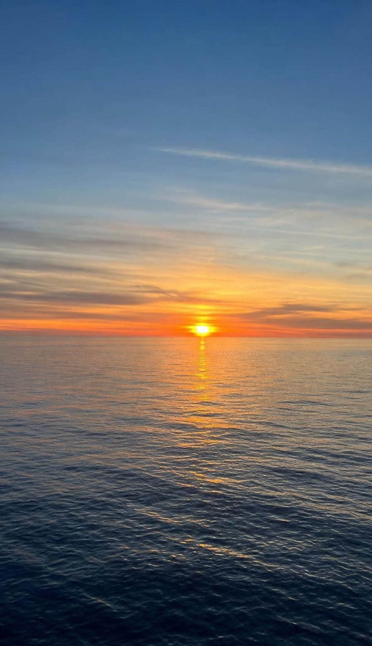
CHECK FOR UNDERSTANDING
Quick check: how long until it arrives?
A tsunami must cross 2,800 km of ocean that is about 4,000 m deep. The chart gives about 710 km/h at that depth. About how long will the trip take?
A. About 40 minutes
B. About 4 hours
C. About 10 hours
D. About 40 hours
15
Notes:
Whiteboards, one minute. Time equals distance divided by speed: 2,800 km divided by 710 km/h is about 3.9 hours. Ask why the real trip to a beach would take a little longer: the last part of the path crosses shallow water, where the wave is much slower. Tie back to the phenomenon: Alaska to Crescent City is about 2,600 km in a straight line, and the first surge took about four hours, so the average speed was a bit over 600 km/h, a sensible value for a path that is deep for most of the way and shallow at the end.
EXPECTED RESPONSES: B, about 4 hours: 2,800 / 710 = 3.94 h. Strong answers add that shallow water near the coast adds time.
WATCH FOR: Multiplying instead of dividing, which gives an impossible answer. Ask students to check units: km divided by km per hour leaves hours.
CONNECTS TO: Lab 3 arrival-time table; W6 CER warm-up calculations; W10 mastery.
PACING: about 4 min

Slide 16
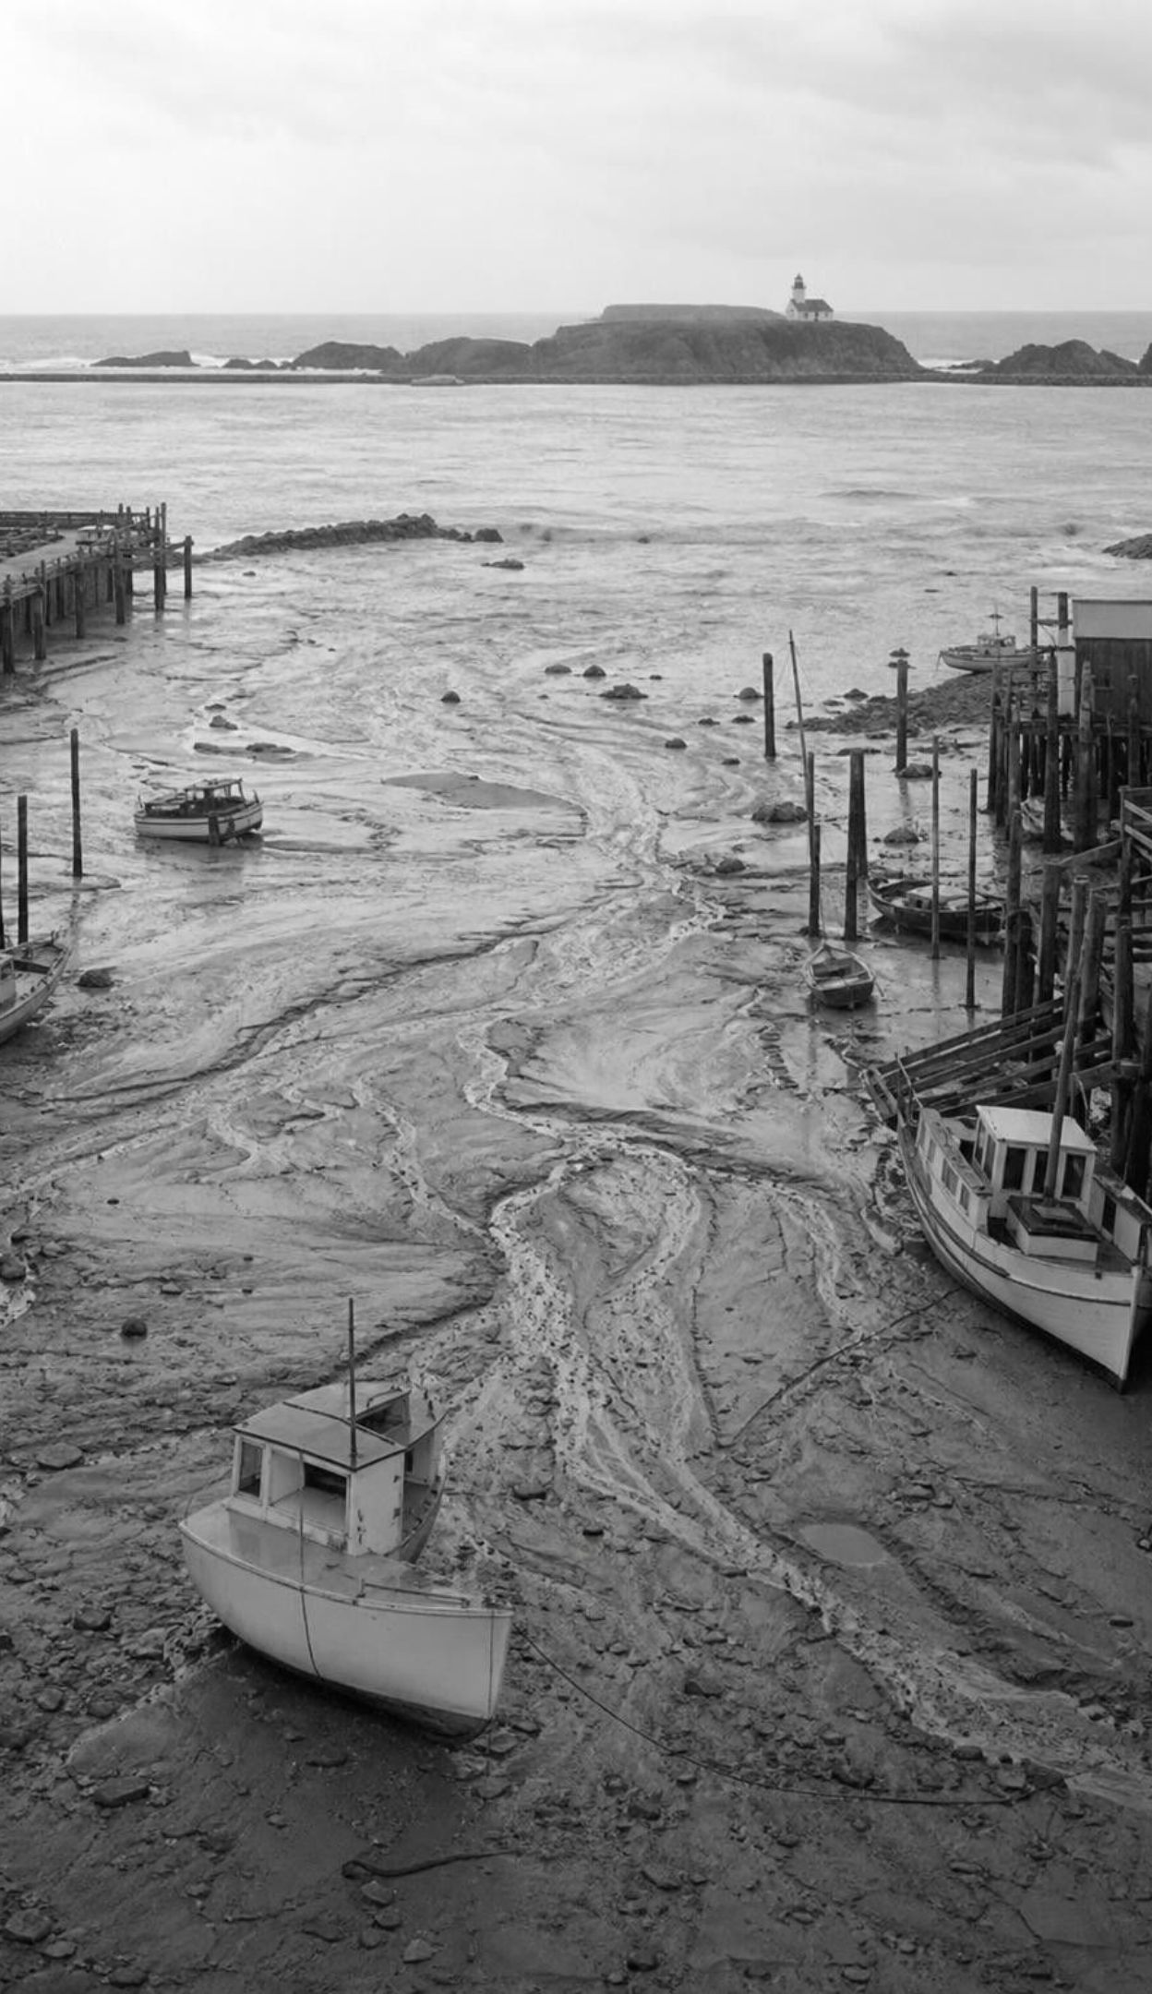
REAL-WORLD CONNECTION
Crescent City, March 1964: the fourth surge
On March 27, 1964, a magnitude 9.2 earthquake struck Alaska. About four hours later the first surge reached Crescent City and flooded the waterfront lightly. In a lull after the early surges, some people went back downtown. The fourth surge, about 6 m high, came after the sea drained from the harbor; about 30 blocks were wrecked and 11 people in the town died.
A tsunami arrives as several surges, and the first is often not the largest.
Crescent City's seafloor and harbor shape focus tsunami energy there, so it is hit harder than most coasts.
A U.S. tsunami warning center in Palmer, Alaska, was set up in response to this disaster.
16
Notes:
Tell the story carefully and without drama. The warning reached county officials late, and sheriff's deputies were still going door to door when the first surge arrived; many residents had also seen earlier tsunami alerts bring only small surges. The first surge did little damage. A group went back to a waterfront tavern to clean up and collect the cash box. Later surges were larger: the tavern was torn off its foundation, and most of that group drowned. The fourth surge, about 6 meters, came after the water drained out of the harbor and swept through downtown. The lessons are scientific: tsunamis arrive as a series, later surges can be larger, and the danger lasts for hours. Then fast-forward. In March 2011 the warning center's forecast said the Japan tsunami would reach Crescent City at 7:23 a.m., and it was observed at 7:34 a.m. People had about ten hours to clear the waterfront; the harbor was wrecked, and one man drowned at the mouth of the Klamath River. The harbor was then rebuilt to resist tsunamis, with one dock designed to absorb wave energy. In July 2025 a tsunami from a magnitude 8.8 earthquake off Kamchatka sent surges several feet high into the harbor; Crescent City was the only place outside Russia's coast with significant damage, but the energy-absorbing dock failed as planned and the rest of the basin held. Ask: what changed between 1964 and 2025, and what did not change? Better forecasts, plans and designs; the waves themselves.
WATCH FOR: Students may decide the 1964 deaths were simply people 'being foolish'. Redirect: earlier small surges and false alarms had taught people the wrong lesson, which is why warning procedures must think about trust.
CONNECTS TO: Lab 3 q9 and q10 (cancel rule and false alarms); W7 q4 (the 1964 surge sequence); W8 card 7 (warning time from a distant source); W6 extension (the 2011 travel time).
PACING: about 6 min

Slide 17
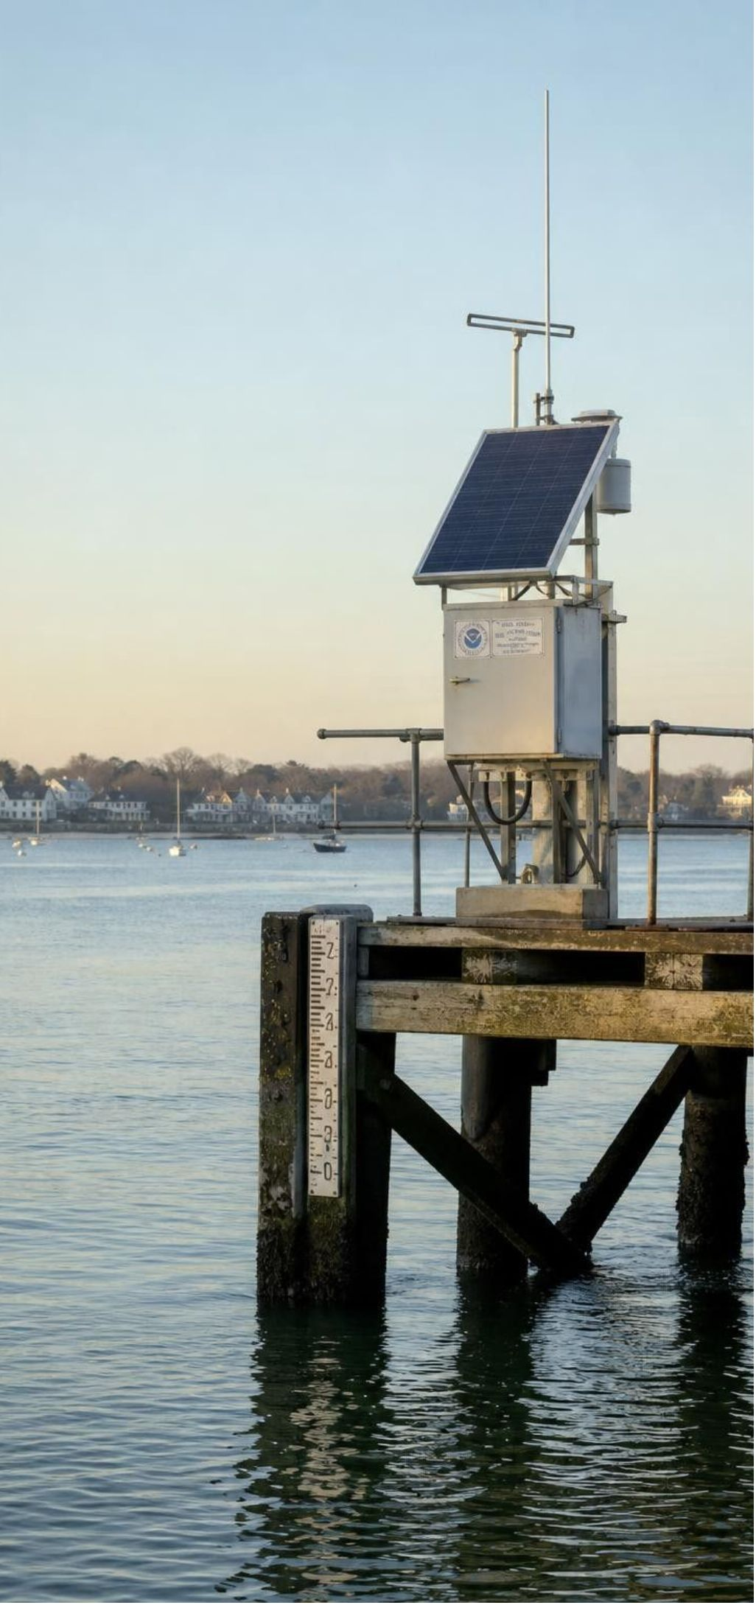
MODEL
From earthquake to warning
Model: How a tsunami warning is built
1
2
Seismometers locate the quake and estimate its size (minutes)
(within minutes) First message from earthquake data alone
3
4
(as waves pass sensors) DART buoys and tide gauges show whether waves formed
(data feed the models) Models forecast arrival times and heights for each coast
5
6
(messages to the public) Coasts get a warning, advisory or watch; local officials evacuate
(hours later) Alert ends only after the dangerous surges are over
Warning centers forecast a tsunami after an earthquake happens. No one can predict the earthquake itself.
17
Notes:
Walk the chain and time it. Within minutes, seismometers around the world give the quake's location, depth and magnitude, and the warning center sends a first message based only on those. That message is cautious because the center does not yet know whether a large tsunami formed. As waves pass DART stations on the deep seafloor and tide gauges on coasts, the center learns their real size and runs forecast models. Then it issues alerts by coast: a warning when dangerous flooding is expected (generally a forecast above about 1 meter), an advisory when strong currents and waves are expected but not widespread flooding, a watch when the threat is still being evaluated. Local officials turn those into evacuation orders. Finally, the alert stays on until the dangerous surges are over. Stress the caption: the center forecasts a tsunami that has already started; the textbook's phrase 'accurately predicted' overstates what anyone can do.
WATCH FOR: 'Scientists predict tsunamis.' They forecast arrival and size after a quake; the quake itself cannot be predicted.
CONNECTS TO: Lab 3 builds a procedure on this chain; W4 diagram worksheet.
PACING: about 5 min

Slide 18
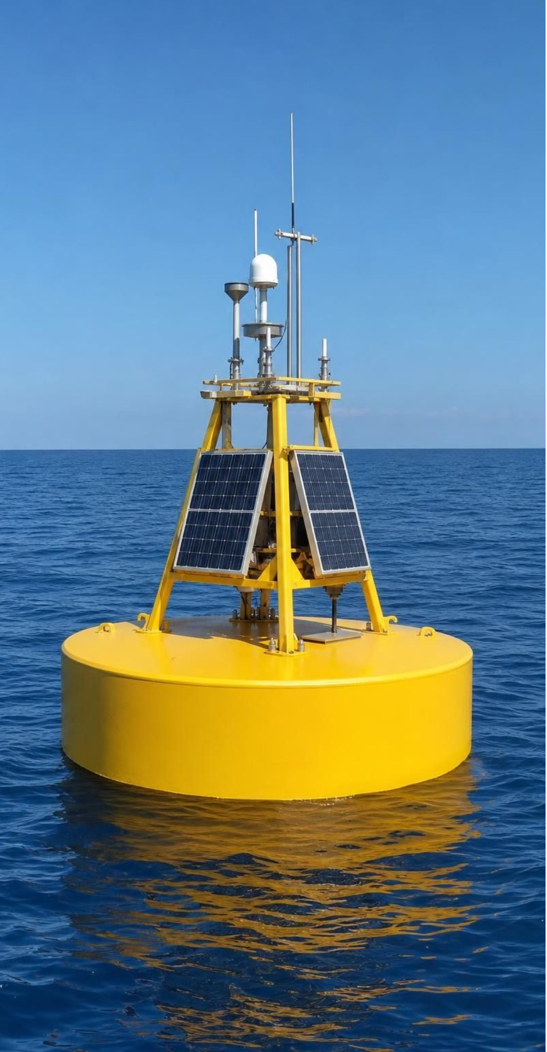
Engineering the DART: test, diagnose, combine
Goal: measure a tsunami under 1 m tall in deep water, fast enough to warn coasts.
Seafloor pressure sensor, then sound through the water, then a surface buoy, a satellite, the warning center.
Tests of a prototype off Oregon showed data dropouts: readings that never reached the buoy.
Two likely causes: a sound beam that missed the buoy, and software limits.
Three fixes: a wider beam, a tiltmeter to check the sensor's alignment, software that asks for lost data.
Each fix helped; combined, they made the system more reliable than any single one.
18
Notes:
Explain why the sensor sits on the seafloor: the surface is always moving with wind waves, but the bottom is still, and a tsunami passing overhead changes the weight of water above the sensor by a tiny but measurable amount. Water blocks radio, so the sensor's acoustic modem sends the data up as sound to a buoy, which can use radio to reach a satellite. Then tell the engineering story as a process. The team tested a prototype for months and found dropouts. They named two likely causes. They designed three solutions, two aimed at getting the sound signal to the buoy and one at recovering data that still went missing. They kept all three because each attacked the problem in a different way. That is the move students will make in Lab 2 and Lab 3: find the best feature of each design and combine them.
WATCH FOR: 'Combining solutions means adding as many parts as possible.' Each DART fix was kept because it addressed a cause, and every part still had to meet the cost and power constraints.
CONNECTS TO: W4 diagram worksheet traces the DART data path; Lab 3 q8 combines two procedures; Lab 2 session 2 combines bridge features; W9 transfer combines defenses.
PACING: about 6 min

Slide 19
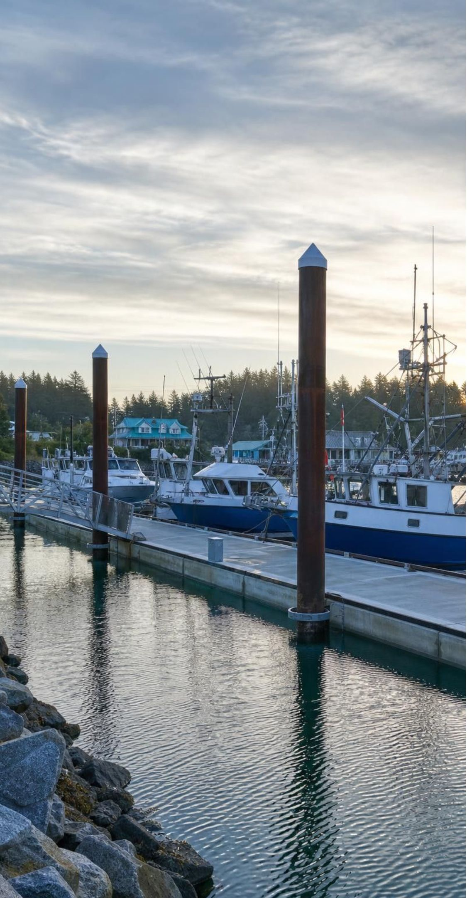
VOCABULARY IN CONTEXT
Words for waves and warnings
tsunami: A series of very long ocean waves made when a large volume of water is suddenly lifted or dropped, usually by an undersea earthquake. The tsunami crossed the Pacific at jet speed, then slowed and grew as it crossed the shelf.
DART system: NOAA's deep-ocean tsunami stations: a seafloor pressure sensor sends readings by sound to a buoy, which relays them by satellite. When the wave passed overhead, the DART system station recorded a rise of a few centimeters, enough to confirm a tsunami had formed.
mitigation: Action that reduces the harm a hazard can do, such as warnings, walls, drains and evacuation plans; it lowers risk but cannot remove it. After 2011, Crescent City rebuilt its harbor as mitigation, with deep-driven piles and one dock designed to absorb surge energy.
19
Notes:
Have students write the definitions and add one example of mitigation from each hazard so far: slopes (drains, covers, walls, buyouts), tsunamis (warning centers, evacuation routes, sea walls). Ask why 'mitigation' is a better word than 'prevention' for all three hazards. Nobody can prevent an earthquake or an atmospheric river; we can only reduce the harm.
WATCH FOR: Equating mitigation with structures only. Warnings, maps, drills and land-use rules are mitigation too.
CONNECTS TO: W2 vocabulary worksheet; Lab 3 uses tsunami arrival times and DART readings throughout.
PACING: about 4 min

Slide 20
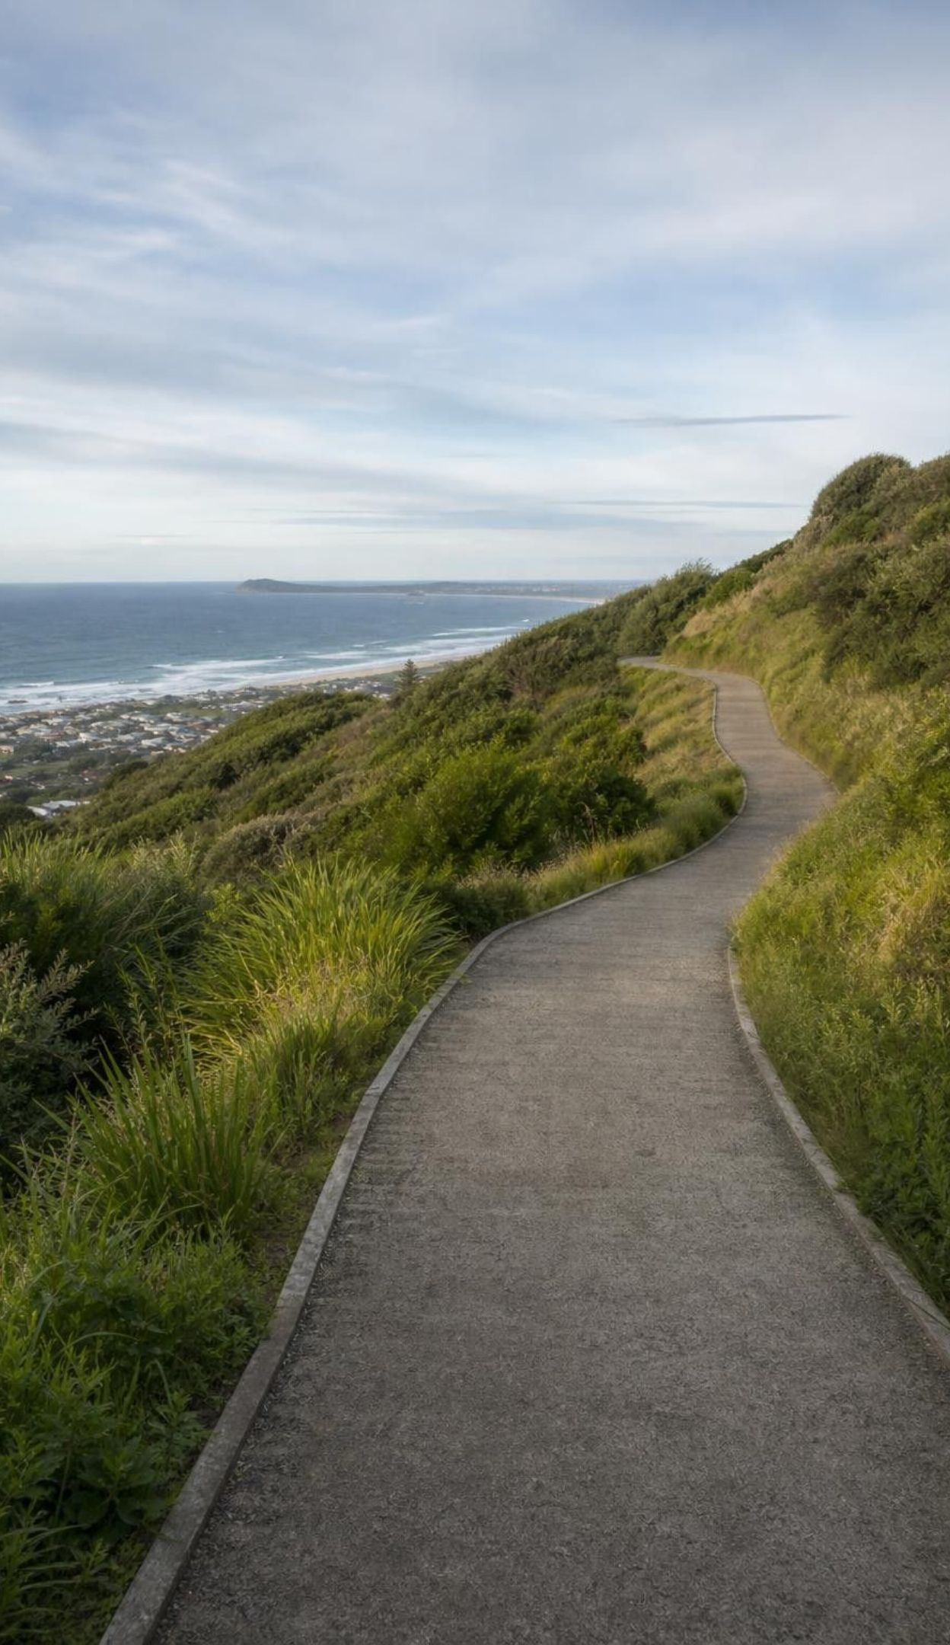
Think, pair, share
Discuss: when the earthquake is the warning
Think about: how long the shaking lasts, and how long a message takes.
Think about: who can still get to high ground in time, and who cannot.
Think about: what a town could build or teach years before the earthquake.
A big Cascadia earthquake off the North Coast could send surges ashore in well under half an hour. Why can't a warning center protect people as it can for an Alaska or Japan tsunami? What should the plan be?
20
Notes:
Give pairs three minutes. Draw a timeline on the board: shaking for several minutes; a first message a few minutes after the quake; first surges possibly within 10 to 20 minutes at some places. Compare with about four hours from Alaska and about ten from Japan. The point is the clarification statement of the standard: some hazards give enough notice for forecasts to help, and some do not. For a local tsunami, official guidance on the North Coast is that the shaking itself is the warning: strong or long shaking near the coast means move to high ground or inland right away, without waiting for an official alert. Plans therefore lean on preparation: tsunami hazard maps, marked evacuation routes, drills, and in some places tall, strong buildings or towers people can climb. Ask students which of those a school could do.
EXPECTED RESPONSES: There is not enough time: the waves may arrive before a message and evacuation can happen. The plan must rely on people recognizing strong shaking as the warning, knowing their route to high ground, and on maps, signs, drills and possibly evacuation structures built in advance.
WATCH FOR: 'The warning system will always tell us in time.' Local tsunamis can outrun any message.
CONNECTS TO: Lab 3 q7 (the Local zone); W8 jigsaw on warning time by hazard; W6 CER.
PACING: about 6 min

Slide 21
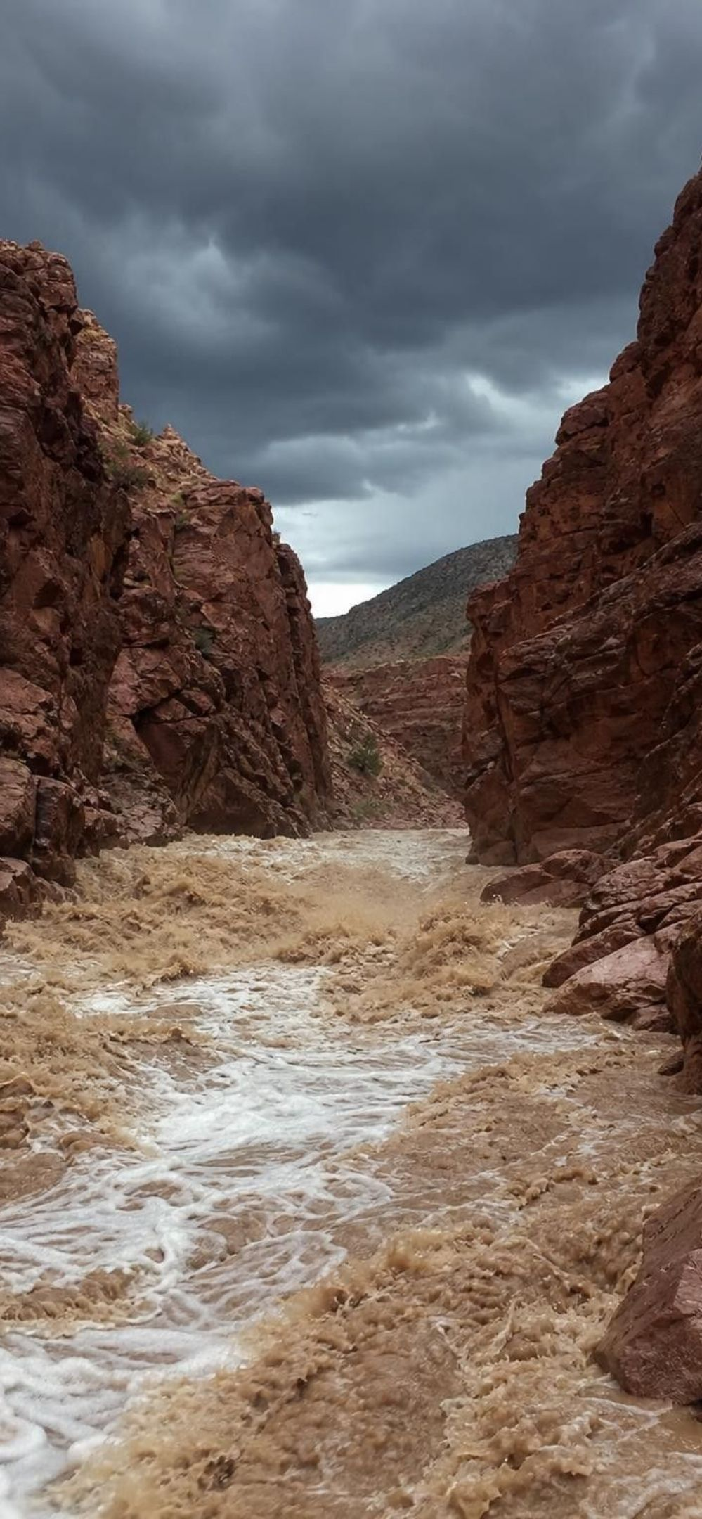
MODEL
Two ways to flood
Model: Runoff floods and storm-surge floods
Runoff (river and flash) floods | Storm-surge floods
Rain or snowmelt arrives faster than the ground can soak it up | Storm winds pile seawater against the coast
Worse on saturated, frozen, paved or burned ground | Worst on low, gently sloping coasts at high tide
Water gathers in streams; rivers rise over hours to days | Hurricanes bring the biggest surges on Gulf and Atlantic coasts
Flash floods can strike within minutes, even in deserts | In California, winter storms add a smaller surge to high tides and big waves
Houston, 2017: Hurricane Harvey flooded the city mainly with runoff from days of extreme rain, not with storm surge.
21
Notes:
Runoff is a race between how fast water arrives and how fast the ground can take it in. Pour water slowly onto a sponge, then all at once: the extra runs off. Saturated soil, pavement and burned slopes all lose the race sooner. Storm surge is different: wind dragging on the sea surface for hours piles water against the shore, and low air pressure adds a little more. The textbook's Houston example is useful because it is a twist: Harvey was a hurricane, yet most of its flooding came from rain that fell for days after it stalled. California almost never gets hurricanes, so our coastal flooding comes from winter storms, very high tides and big waves, while our inland flooding is runoff from atmospheric rivers, which is the next slide.
WATCH FOR: 'Floods only happen where it rains a lot.' Dry places with thin soil and little plant cover can flood quickly from one storm.
CONNECTS TO: W5 data worksheet; Lab 2 floods its stream tray with runoff.
PACING: about 5 min

Slide 22
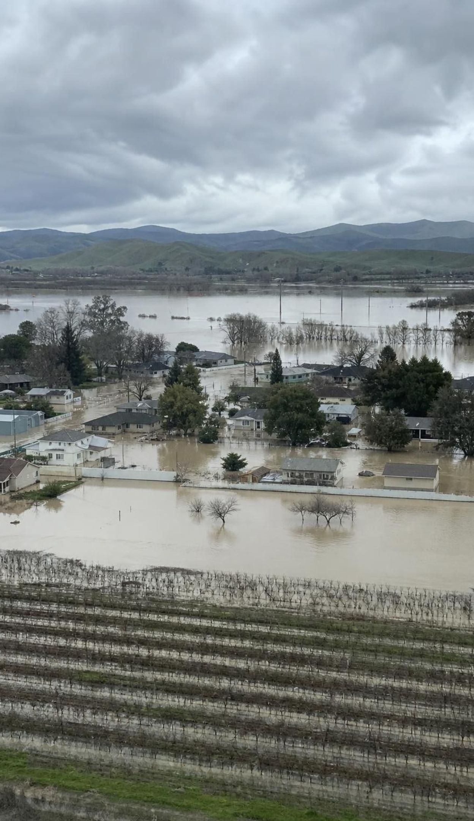
REAL-WORLD CONNECTION
California's atmospheric rivers: our water and our floods
Atmospheric rivers are long, narrow bands of water vapor flowing in from the Pacific. A few each year bring about 30 to 50 percent of the West Coast's precipitation. In 1861-62, weeks of them flooded the Central Valley into a lake about 480 km long. In December 1964, they swelled the Klamath River. In March 2023, the Pajaro River broke through a levee during one and flooded the town of Pajaro.
Mountains force the moist air up; it cools and drops heavy rain and snow.
Forecasters can often see one coming several days ahead.
At Lake Mendocino, operators use those forecasts to decide when to hold or release water.
22
Notes:
Start with the two-sided truth: atmospheric rivers fill California's reservoirs and snowpack, and they also cause most of the state's big floods. The Great Flood of 1861-62 came from storms lasting about 43 days. The December 1964 storms dropped up to 15 inches of rain in 24 hours in places; logs carried by the Klamath River battered the Douglas Memorial Bridge on Highway 101 until spans washed out, and the town of Klamath was nearly destroyed. The 2023 Pajaro levee break forced thousands of people to evacuate. Then the forecasting payoff, which is exactly what the standard means by data informing technology: because atmospheric rivers can be seen days ahead, operators at Lake Mendocino now release water before a forecast storm to make room, and hold water when no storm is coming, instead of following a fixed calendar. Ask: how is that like the tsunami warning chain, and how is it different?
WATCH FOR: 'Atmospheric rivers are always disasters.' Most are weak and beneficial; a small number of strong ones cause the damage.
CONNECTS TO: Lab 2 uses a simulated stream record to choose a design flood; W5 data worksheet ranks flood peaks; W8 jigsaw river cards.
PACING: about 6 min

Slide 23
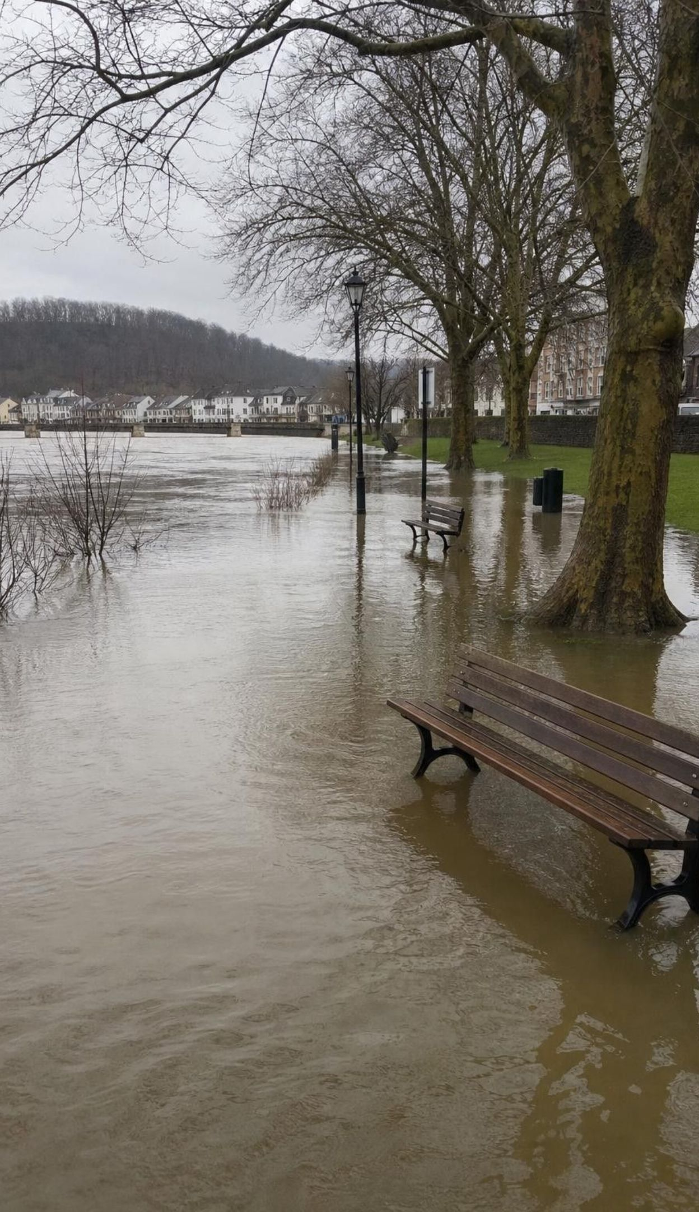
Check for understanding
Quick check: what does '1 percent a year' mean?
A town sits where a flood of a certain size has a 1 percent chance each year (a '100-year flood'). One hit last year. Which statement is correct?
A. The next flood that size will come in about 99 years.
B. This year's chance of a flood that size is still about 1 percent.
C. The chance is zero for the next century.
D. The chance is now 2 percent, because big floods come in pairs.
23
Notes:
Vote, then compare with coin flips: a coin that just landed heads still has a 50 percent chance of heads next time. Floods do not keep a calendar. Then give the more useful number: over a 30-year home loan, the chance of at least one 1-percent flood is about 26 percent, because the chance of escaping it every year is 0.99 multiplied by itself 30 times, about 0.74. Ask why insurance companies and engineers care about that 26 percent. A real nuance for advanced students: a wet decade or a changing climate can shift the true chances, which is why scientists keep updating the records.
EXPECTED RESPONSES: B. The yearly chance stays about 1 percent; last year's flood does not change it. Strong answers mention that two such floods can happen in back-to-back years.
WATCH FOR: '100-year flood' read as a schedule (A or C).
CONNECTS TO: Lab 2 q1 and q6 compute yearly chances and expected floods; W5 data worksheet; W10 mastery.
PACING: about 4 min

Slide 24
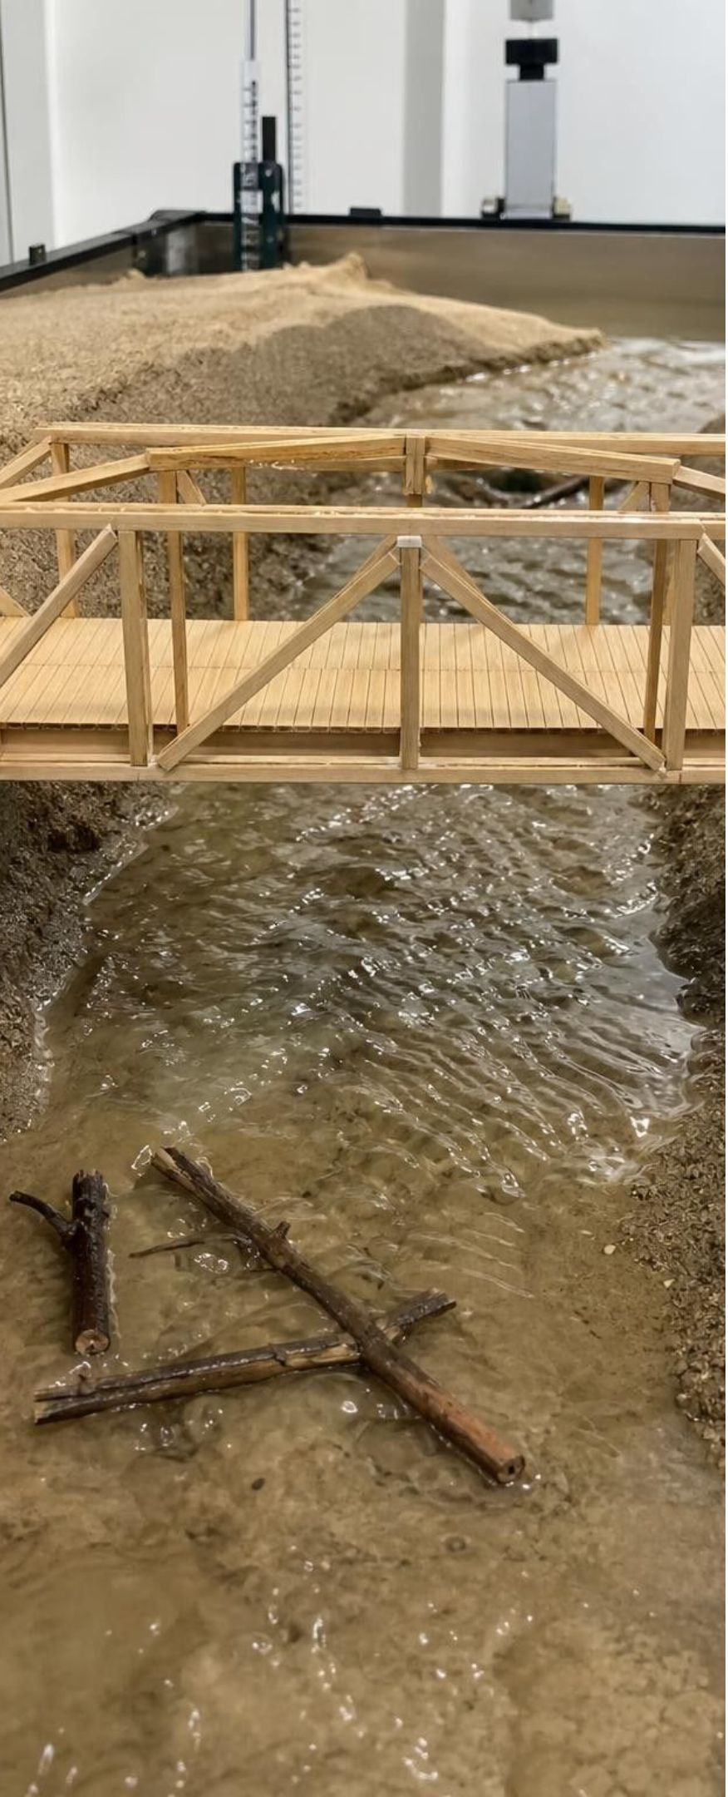
APPLY IT
Task: three bridges, four tests. Which features win?
Rank the three designs against the criteria, then name the best feature of each that you would combine into a new bridge within the 20-point budget.
Design | Deck above bed (cm) | Piers in channel | Logs trapped (of 10) | Deepest scour (mm) | Held 200 g after flood? | Cost (points)
A: low beam | 3 | 2 | 7 | 12 | No | 14
B: high arch | 6 | 0 | 1 | 2 | Yes | 22
C: truss on gravel-armored pier | 5 | 1 | 4 | 3 | Yes | 18
Simulated data for practice.
24
Notes:
Tell students this is a teaching dataset from an imagined class test in a stream tray; criteria: no more than 3 of 10 logs trapped, scour under 5 mm, carries 200 g after the flood, budget 20 points. Give groups eight minutes. Step 1: check each design against every criterion. A fails three (logs, scour, load). B meets every performance criterion but is over budget. C meets scour and load and the budget, but traps 4 logs. Step 2: name the best feature of each. B's open span with no pier in the channel lets logs pass and avoids pier scour; C's gravel armor kept scour low around its pier; A was cheap. Step 3: combine. A strong combination is a single open span like B, built with C's cheaper truss deck, with gravel armor at the banks where the ends sit, aiming for 18 to 20 points. Ask what they would test first. Connect to the Klamath bridge in 1964: logs piling against piers in the channel helped bring it down.
EXPECTED RESPONSES: No design meets everything. A fails three criteria (logs, scour, load); B meets every performance criterion but breaks the 20-point budget, a hard constraint; C meets the budget, scour and load but traps 4 logs, one over the limit. So C ranks first, B second (it cannot be built as drawn), A last. Best features: B's open span with no pier in the channel and its high deck (1 log trapped, 2 mm scour); C's gravel armor and cheaper truss; A's low cost. Combined design: one clear span at about 5 to 6 cm, a truss deck, gravel armor where the ends sit on the banks, within 20 points.
WATCH FOR: Choosing B because it scored best on performance and ignoring the budget constraint, or averaging scores without checking that each criterion is met.
CONNECTS TO: Lab 2 session 2 decision matrix and redesign; W9 transfer combines debris-flow defenses the same way.
PACING: about 10 min

Slide 25
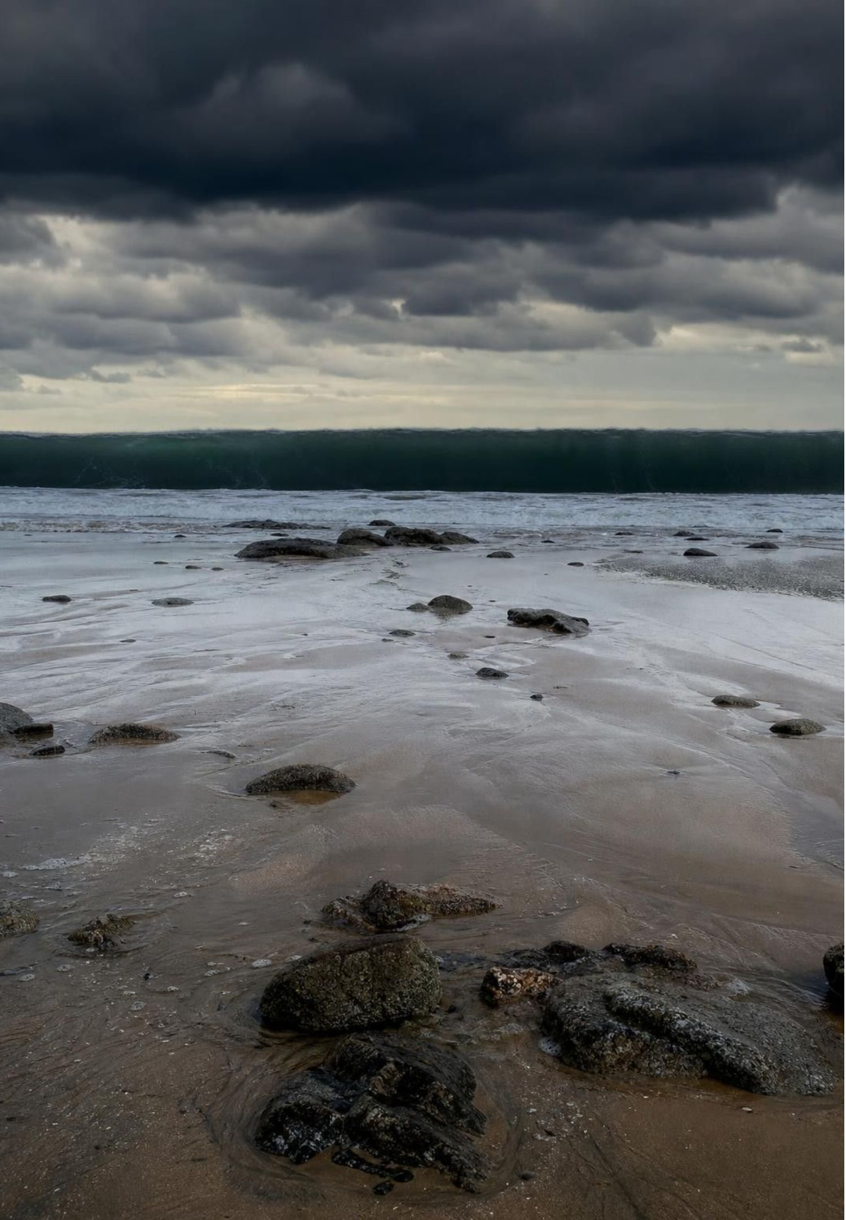
MISCONCEPTION CHECK
True or false? The first wave is the big one
"A tsunami is one huge wave. Once it has hit and the water drains away, it is safe to go back down to the shore."
True or false? Explain your reasoning.
25
Notes:
Have students write true or false with two pieces of evidence from the lesson, then share. False on both counts. A tsunami arrives as several surges, often 10 minutes to an hour apart, and the first is often not the largest; the draining water may be the trough before the next surge. Evidence: Crescent City in 1964, where the fourth surge did the most damage after people had gone back; the warning chain on slide 17, which ends the alert only after the dangerous surges are over; and the official guidance that dangerous currents can last for many hours. Close with the decision rule: go back only when officials say the danger is over.
EXPECTED RESPONSES: False. A tsunami arrives as several surges over hours; the first is often not the largest, and water draining away can mean another surge is coming. Crescent City 1964 is the evidence.
WATCH FOR: Overcorrecting to 'the last wave is always the biggest.' The largest can be any of the surges; the point is that no one knows which until it is over.
CONNECTS TO: W7 misconception worksheet; Lab 3 q9 cancel rule.
PACING: about 5 min

Slide 26
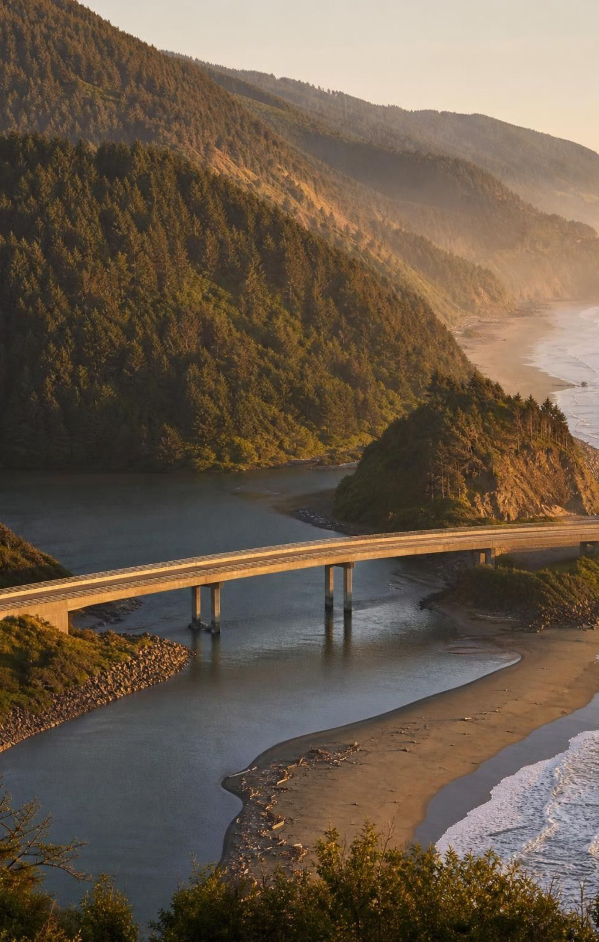
PUTTING IT TOGETHER
Putting it together
Gravity moves soil, seawater and rivers; water and shaking set them off.
Slopes fail when steepness, saturation, shaking or lost roots tip the tug-of-war.
A tsunami's speed depends on depth, so distance and depth give its arrival time.
Floods come from runoff or storm surge; flood risk is a yearly chance, not a schedule.
Forecasts range from days ahead (atmospheric rivers) to none (local quakes and many slides).
Good mitigation combines tested designs, warnings and plans; no single fix removes the risk.
26
Notes:
Return to the Del Norte phenomenon and have students answer its two questions in writing. Why does this coast face all three hazards? Steep, weak, rain-soaked coastal mountains; a position facing the Pacific Ring of Fire with a seafloor and harbor that focus tsunamis; and rivers fed by atmospheric-river storms. Why do some come with warning? The Alaska tsunami needed four hours to cross the ocean, and today it would be detected and forecast; the December storms could now be seen days ahead; a slide on Last Chance Grade or a Cascadia tsunami gives little or no notice. Then ask for one result from each lab: the failure angle of saturated sand, the feature they borrowed for their second bridge, and the rule in their warning procedure that prevented false alarms.
CONNECTS TO: W10 mastery as the quiz; L27 Biodiversity next, where hazards return as disturbances to ecosystems.
PACING: about 5 min

Slide 27
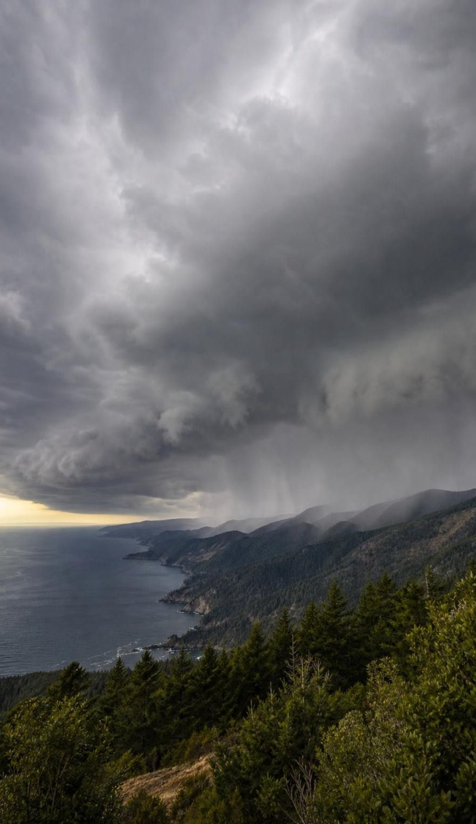
EXIT TICKET
Exit ticket
Name two conditions that made the Montecito or La Conchita slopes fail, and explain one of them.
A tsunami must cross 1,500 km of 5,000 m deep ocean (about 800 km/h). About how long will that take?
A flood has a 2 percent chance each year. Can it happen two years in a row? Explain.
Name one hazard that can be forecast days ahead and one that gives almost no warning, and explain why.
27
Notes:
Collect on index cards or a short form. Item 1 checks the slope mechanisms (saturation, steepness, fire, the bluff's history). Item 2 checks the depth-speed calculation. Item 3 checks probability thinking. Item 4 checks the forecast idea at the heart of the standard. Sort the cards into piles before the next class and reteach from the largest pile.
EXPECTED RESPONSES: 1: soaked or saturated soil after heavy or intense rain (water pressure lightens grain contact and adds weight); steep slopes; burned slopes with no roots; a bluff with a history of slides. 2: 1,500 / 800 = about 1.9 hours, a little under 2 hours. 3: Yes; each year has its own 2 percent chance regardless of last year. 4: An atmospheric-river flood or a tsunami from far away can be forecast hours to days ahead because it can be seen or detected while it travels; a local tsunami or a sudden landslide gives little or no notice because the trigger and the arrival are only minutes apart.
WATCH FOR: Item 2 answers that multiply (1,200,000 h) or confuse 1.9 h with 1 h 90 min; item 3 answers of 'no, it just happened'.
CONNECTS TO: W10 mastery; chapter evidenceOfLearning.
PACING: about 5 min

