Slide 1
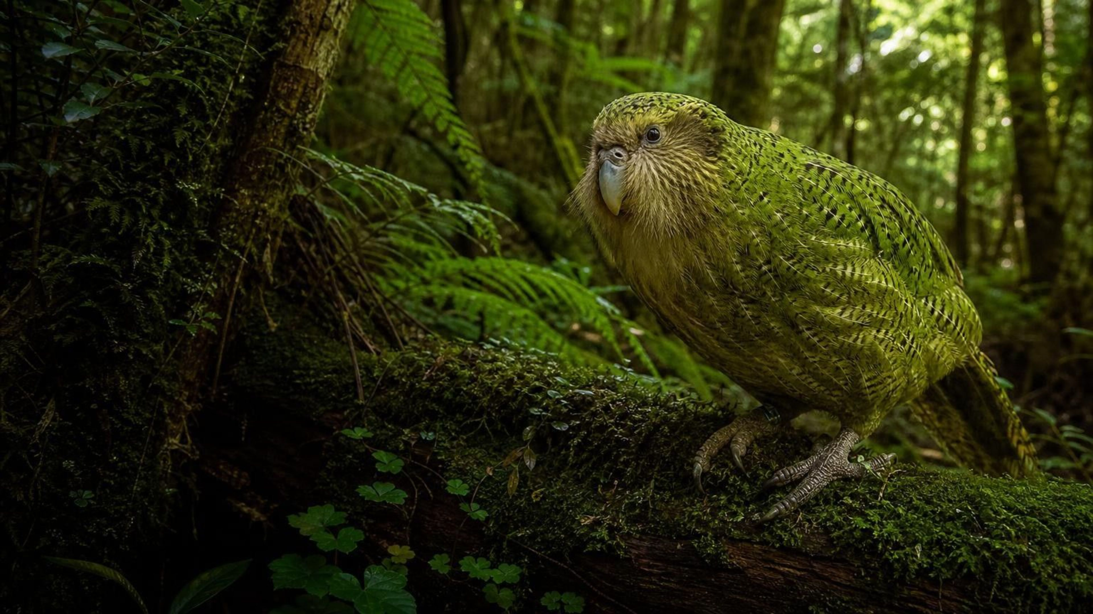
Biodiversity
Chapter 27 of 29 · Humans and Changing Ecosystems
Lesson 27: Why does the variety of life matter, and how do we choose the best plan to protect it?
Angela's Wand · Bring Science Alive! 7th Grade Integrated
Notes:
This lesson opens the unit on humans and changing ecosystems. We will measure biodiversity ourselves, compare three very different ecosystems, follow what happens when one species disappears, and finish by judging real-world style plans to protect species, the way conservation teams and engineers do. Tell students the three labs up front: a quadrat survey in the schoolyard, a two-cove mystery built from kelp forest survey data, and a decision lab in which they must choose a plan for a damaged kelp coast on a budget.
CONNECTS TO: Overview of Lab 1, Lab 2 and Lab 3; W1 opens on the next slide.
PACING: about 2 min

Slide 2
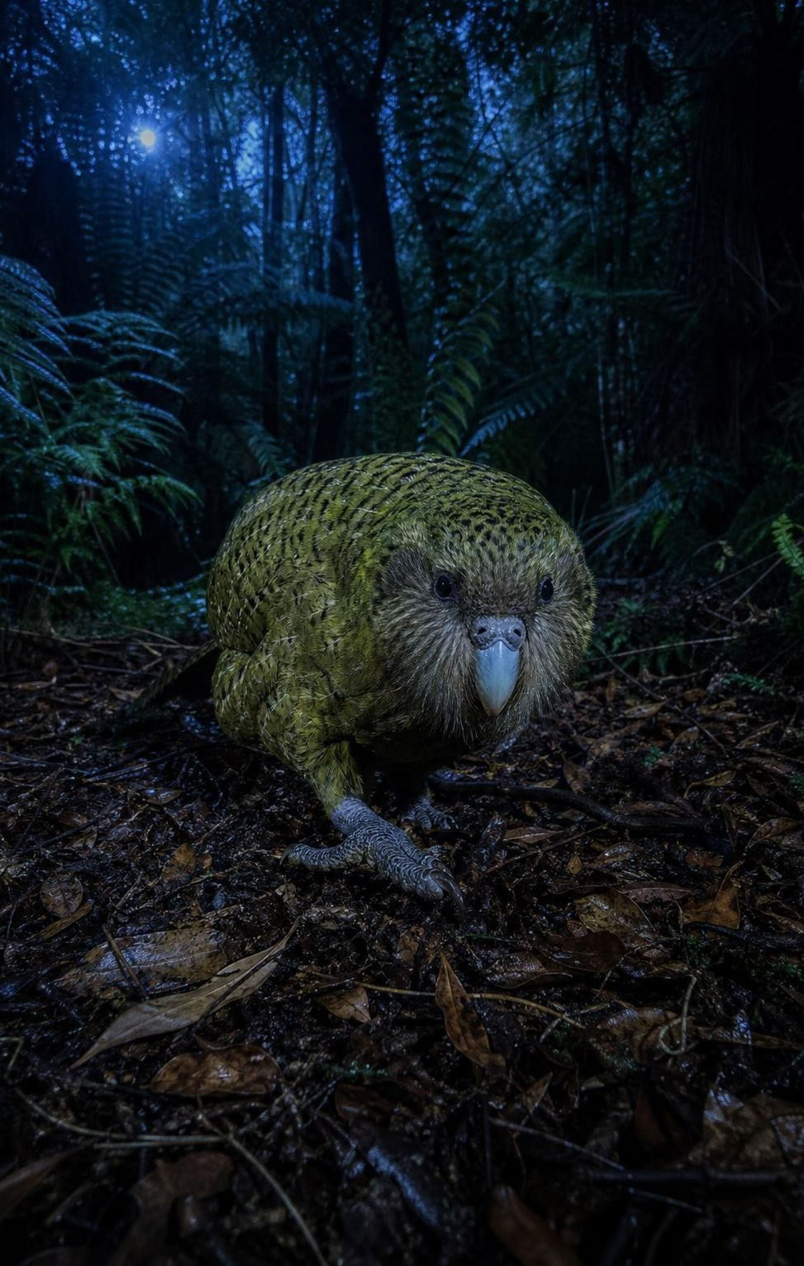
PHENOMENON
From 51 birds to 325: the kākāpō comeback
The kākāpō is a heavy, flightless parrot that feeds at night and lives only in New Zealand. In 1995 just 51 were known to be alive. Rangers moved every known bird to offshore islands, cleared those islands of predators such as cats and rats, and watched over each nest. On 1 September 2026 the official count reached 325, after a record 90 chicks survived from one breeding season.
Notice: which numbers changed, and what did people change?
Wonder: why could a flightless parrot thrive in New Zealand before people came?
Predict: what will limit how far this comeback can go?
2
Notes:
Show a photo of a kākāpō if you have one: moss-green, owl-faced, as heavy as a house cat. Give two silent minutes for a notice and a wonder, then collect ideas without judging. Push on the wonder: New Zealand had no land mammals except bats before people arrived, so a ground-dwelling bird that freezes and relies on camouflage was safe from hunting birds that search by sight. Cats, rats and stoats hunt by smell, and freezing does not help. Park the prediction question; slide 23 comes back to it as a design task. Mention that the kākāpō breeds only in years when rimu trees fruit heavily, every two to four years, which is why 90 chicks in one season was a record.
EXPECTED RESPONSES: Notice: 51 in 1995, 325 in 2026, more than six times as many; people moved the birds to islands and removed predators. Wonder: why the birds could not escape cats, why islands are safer, whether they can ever return to the mainland. Predict: room on predator-free islands, food in non-breeding years, disease, low genetic variety, money and staff.
WATCH FOR: 'Now they are safe, so the work is over.' Record it for slide 25. Also watch for 'the parrot was too slow or stupid to survive'; its traits suited an ecosystem with no ground mammals.
CONNECTS TO: W1 phenomenon worksheet records the notice and wonder and a first explanation; the slide 23 task returns to the kākāpō.
PACING: about 8 min

Slide 3
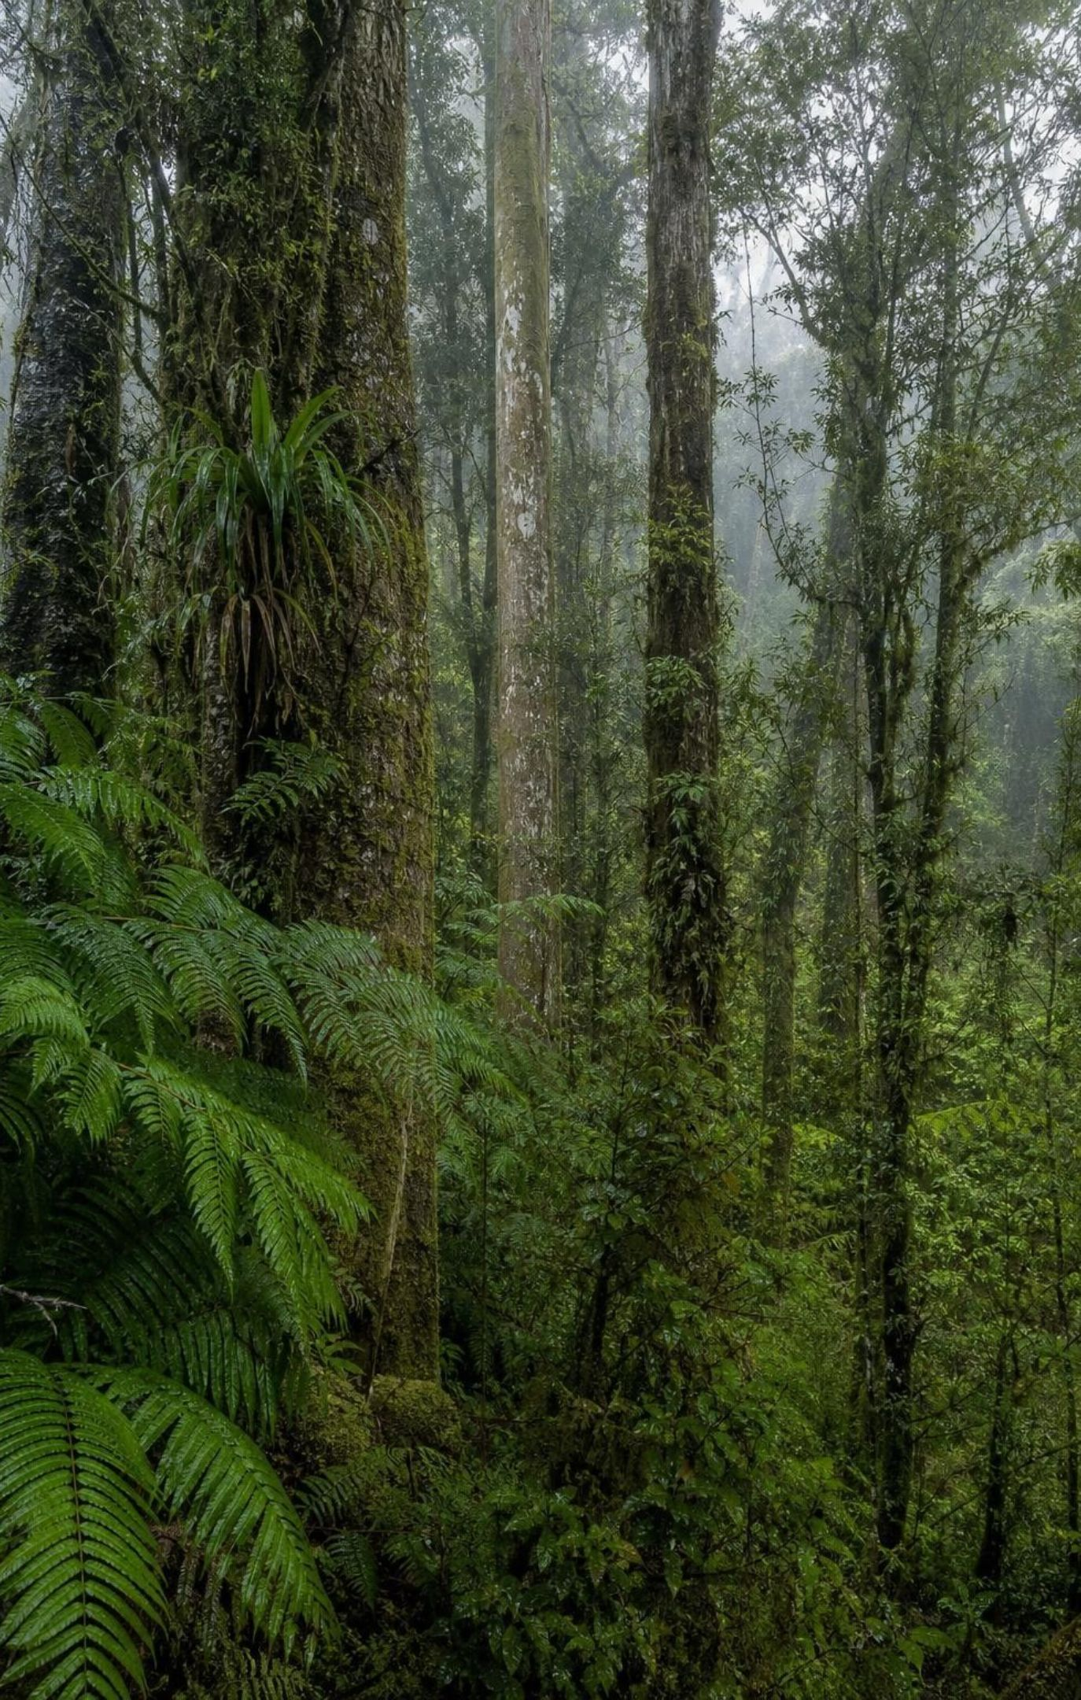
What you will be able to do
Learning targets
Describe biodiversity at three levels and measure it with richness and a diversity index.
Explain why each ecosystem has its own natural level, and why the tundra is fragile.
Trace how losing a keystone species or another population changes many others.
Explain how specialized niches pack a rainforest, and how people depend on biodiversity.
Evaluate competing plans against criteria and constraints, then combine their best parts.
3
Notes:
Read the targets aloud and ask students which one the kākāpō story already touches (the last one: someone chose islands as the plan, and that plan had costs). Tell them the final target is what the state standard asks seventh graders to do: evaluate competing design solutions for maintaining biodiversity and ecosystem services. Every lab builds toward it.
CONNECTS TO: Learning targets match chapter.json; W10 mastery checks all five.
PACING: about 2 min

Slide 4
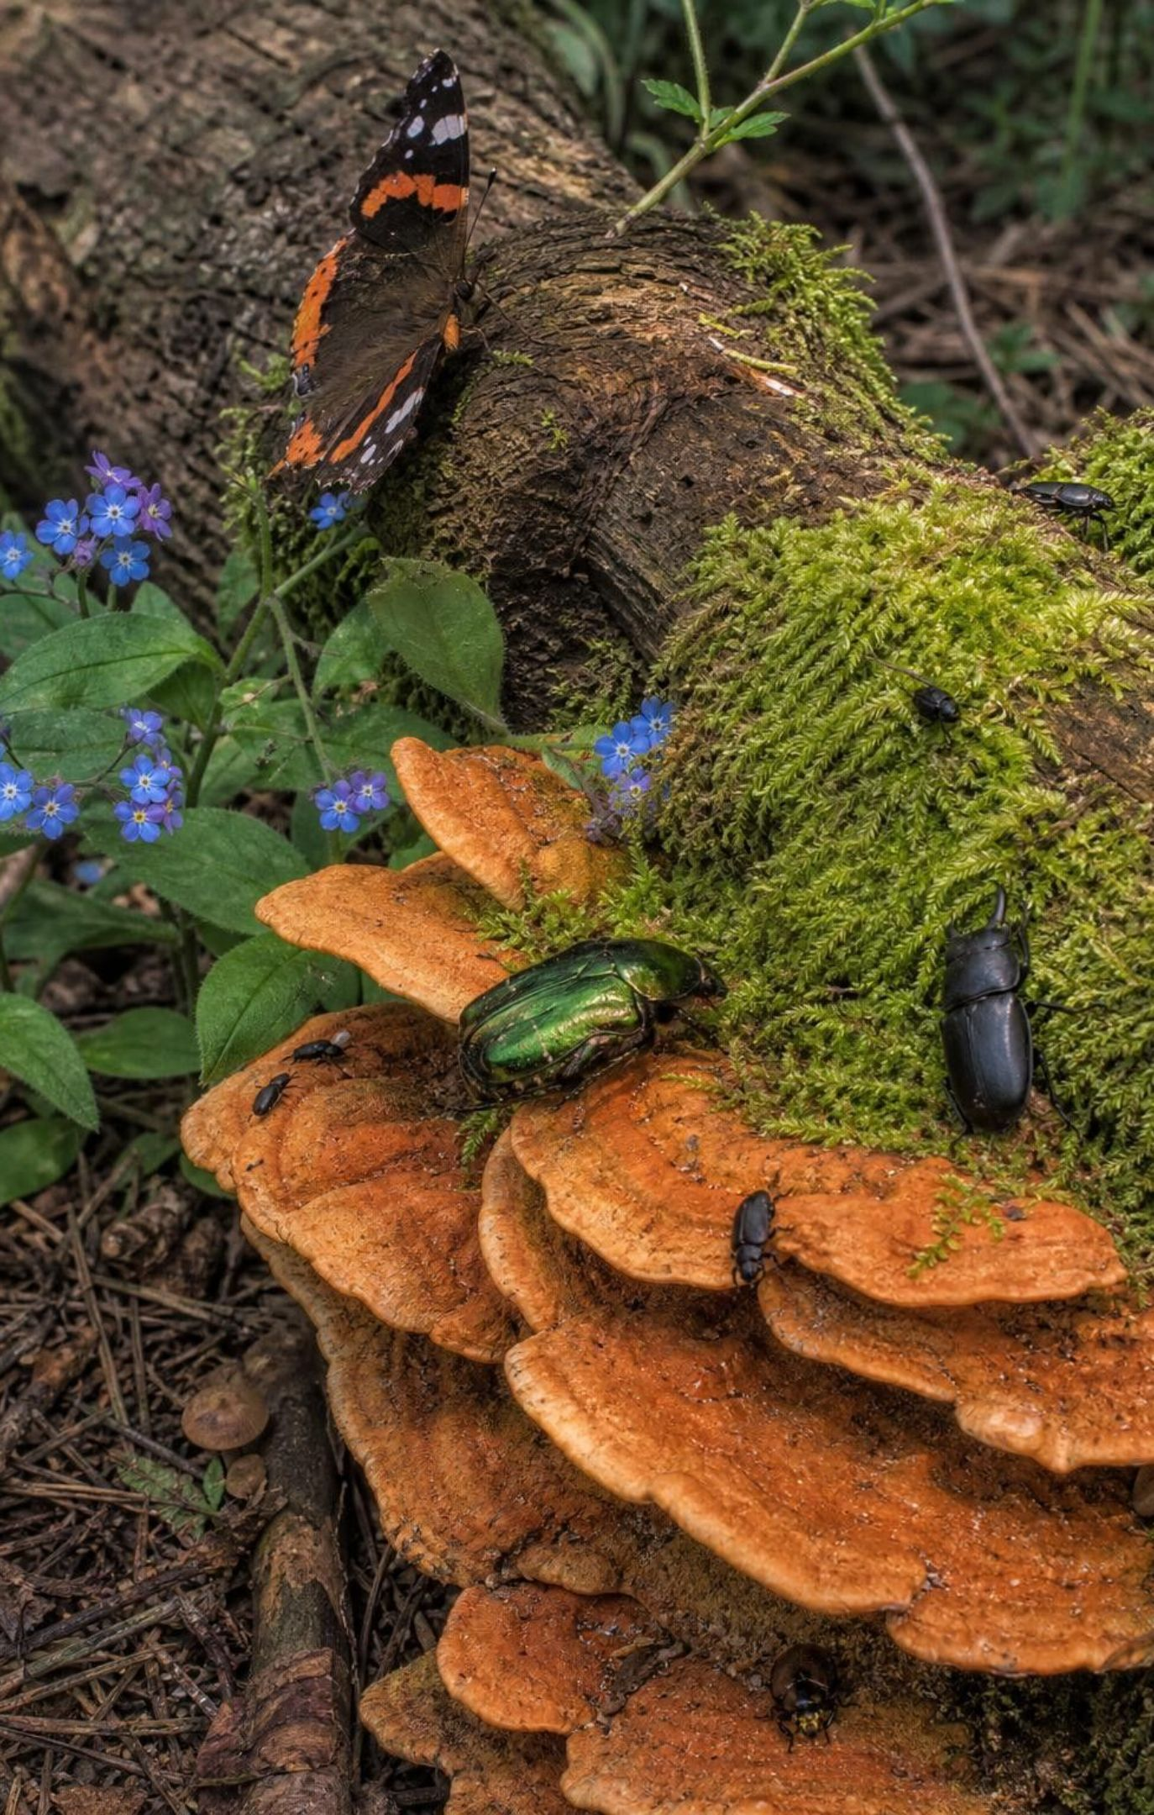
Biodiversity: more than a species count
Biodiversity is the variety of life, at three levels: genes, species and ecosystems.
Species richness counts how many kinds live in a place.
Evenness asks whether individuals are shared fairly equally or one kind dominates.
Scientists have named a little over 2 million species; many millions more are unnamed.
Insects are about half of all named species; plants hold most of life's mass but far fewer kinds.
4
Notes:
Use two bowls of candy as a quick picture: bowl 1 has ten colors with about the same number of each; bowl 2 has the same ten colors but 91 of 100 pieces are red. Same richness, very different evenness, and bowl 1 is more diverse. Then the genetic level: all but one of the founders of today's kākāpō came from one island, so the birds are closely related; scientists think inbreeding helps explain why many kākāpō eggs fail to hatch. The ecosystem level is the variety of habitats in a region, such as kelp forest, sandy beach and salt marsh along one stretch of coast. Point out that the number of named species keeps growing, and most unnamed species are small insects, fungi and microbes.
WATCH FOR: Students equate biodiversity with 'lots of animals'. Plants, fungi and microbes count, and a million identical crop plants have very little biodiversity.
CONNECTS TO: W2 vocabulary; W3 reading (genes, species and ecosystems); Lab 1 measures richness and evenness.
PACING: about 5 min

Slide 5
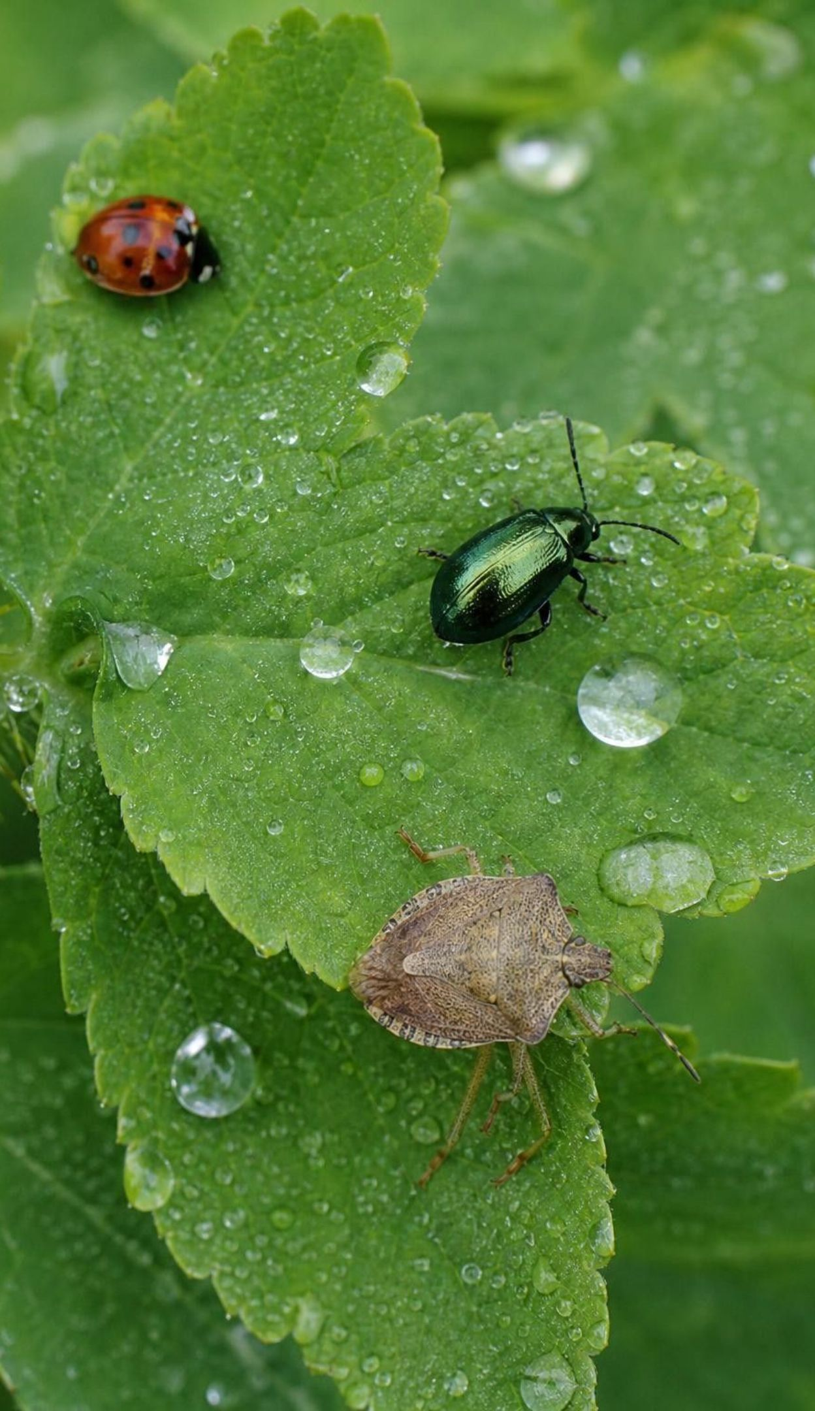
Model
Who has been named? Shares of known species
Model: Approximate share of named species in each group
Approximate shares from the lesson's circle graph, based on about 1.9 million named species when the book was written; newer catalogs list over 2 million.
5
Notes:
This is the lesson's own circle graph turned into bars so the sizes are easy to compare. Work the proportion together: if insects are about 52 percent of 1.9 million named species, multiply 1.9 million by 0.52 to get about 990,000, close to a million insect species. Then ask what share is producers (plants, algae and many single-celled organisms) and compare it with mass: plants alone make up roughly four-fifths of the mass of all life on Earth. Counting kinds and weighing living material are different measurements. Note the honesty point: the book's figure labels insects 50 percent but its text says 52, and only 52 makes the bars add to 100.
WATCH FOR: Students read 'insects 52%' as 'half of all living things are insects'. It is half of the named species, not of individuals or of mass.
CONNECTS TO: W5 data worksheet practices proportions and Simpson's index; W10 mastery numeric item.
PACING: about 5 min

Slide 6
Three words for measuring variety
VOCABULARY IN CONTEXT
species richness: The number of different species, or recognizable kinds, found in a place or a sample.
A mowed lawn quadrat with grass, clover and one dandelion-like weed has a richness of 3.
biodiversity index: One number combining richness and evenness. Simpson's index runs from 0 (one kind) toward 1 (many, evenly mixed).
Two patches with the same 4 plants: 0.66 when shares are 50, 25, 12.5 and 12.5 percent; 0.14 when one plant has 92.5 percent.
proportion: A part compared with the whole, as a fraction, decimal or percentage.
If 20 of 80 points touch clover, clover's proportion is 20 ÷ 80 = 0.25, or 25 percent.
6
Notes:
Show how Simpson's index is built from proportions: find each kind's proportion p, square it, add the squares, and subtract the total from 1. Squaring makes a dominant kind count heavily, so a patch where one plant is nearly everything gets a sum close to 1 and an index close to 0. A student-friendly meaning: the index is the chance that two points picked at random land on different kinds. Work the first example quickly on the board: 0.5² + 0.25² + 0.125² + 0.125² = 0.34, and 1 − 0.34 = 0.66. Lab 1 uses exactly this.
WATCH FOR: A higher index does not mean more individuals; it means a more even mix of more kinds.
CONNECTS TO: Lab 1 calculation table; W5 data; W7 misconception (correcting a diversity index); W2 vocabulary.
PACING: about 4 min

Slide 7
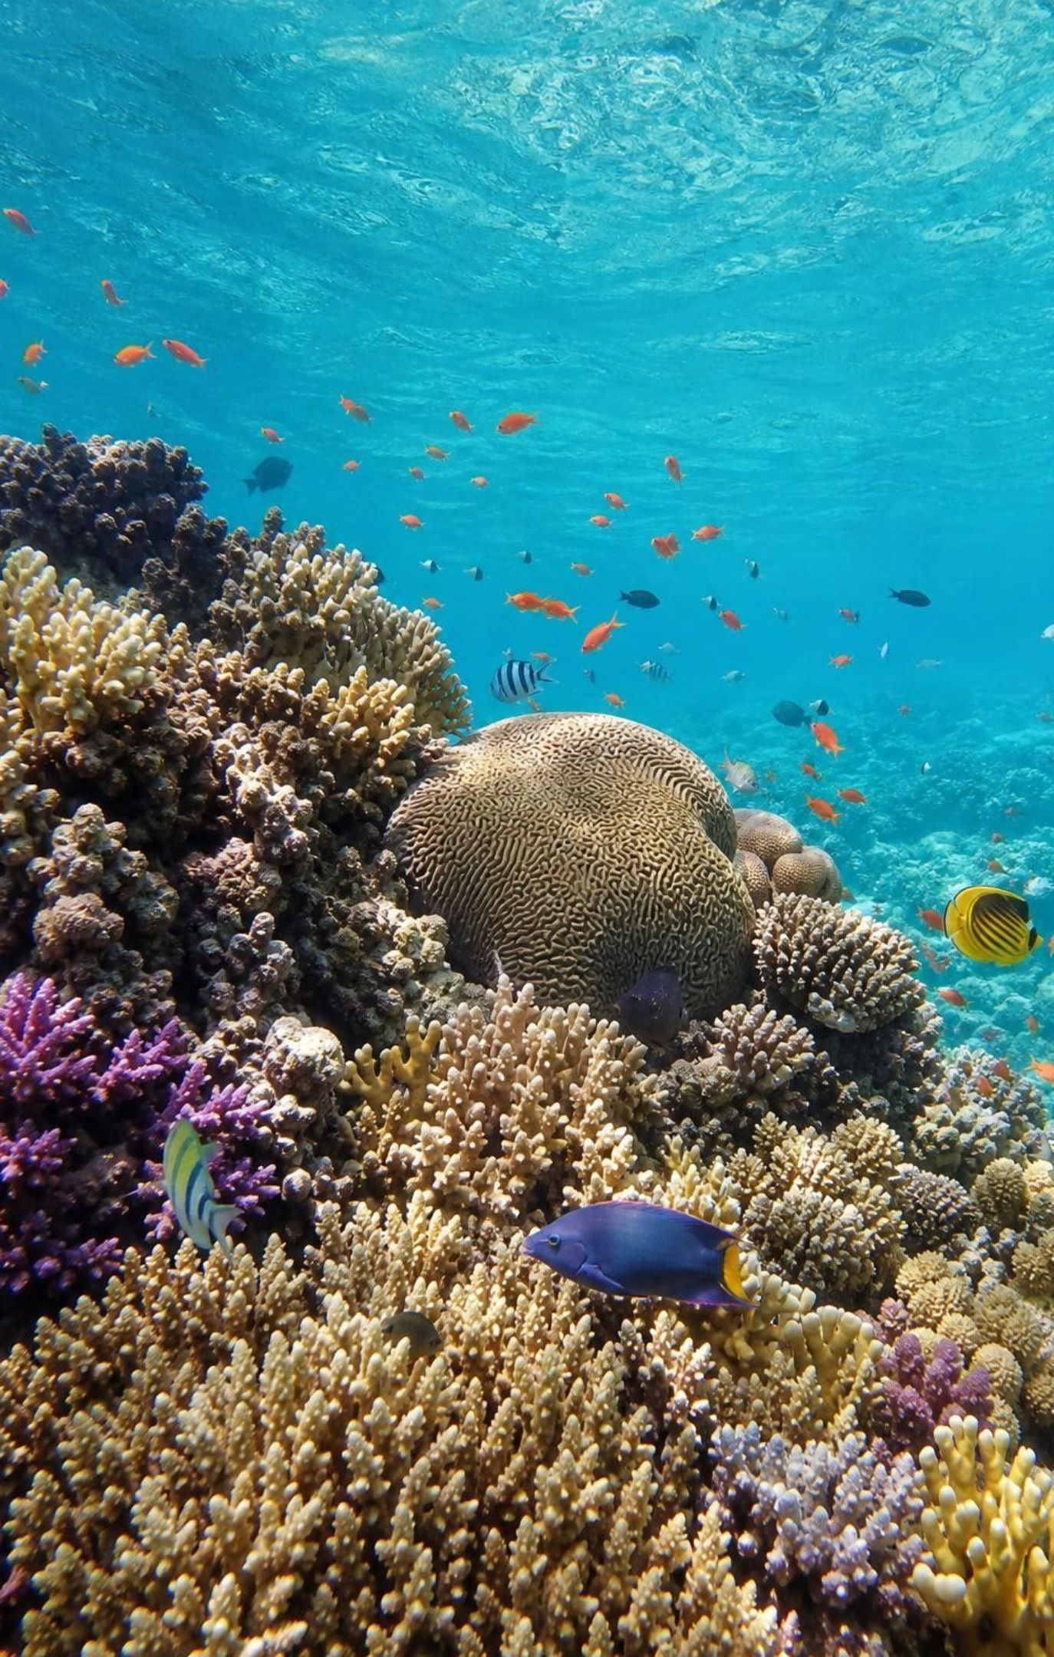
Every ecosystem has its own natural level
On land, biodiversity is highest in warm, wet tropics and falls toward the poles.
In the sea, it peaks in warm, sunlit shallows such as coral reefs and in rich coastal waters.
Arctic tundra: low. Kelp forest: in between. Rainforest and coral reef: very high.
A healthy ecosystem keeps the full set of species that naturally belong there.
So compare a tundra with healthy tundra, not with a rainforest.
7
Notes:
Use the lesson's Key Science Concept maps if you have them projected. Ask why tropical rainforests are so rich: warmth, light and rain all year mean producers grow all year, and steady resources support more consumers and specialists. Polar regions have short growing seasons, so fewer species can make a living. Stress the health idea: scientists judge an ecosystem by how complete its natural set of species and their roles is. A tundra with its caribou, lemmings, Arctic foxes, mosses and sedges intact is healthy even with few species.
WATCH FOR: 'Low biodiversity means a damaged or unhealthy ecosystem.' Low can be natural; health means no loss from the natural set.
CONNECTS TO: W3 reading; W10 mastery.
PACING: about 5 min

Slide 8
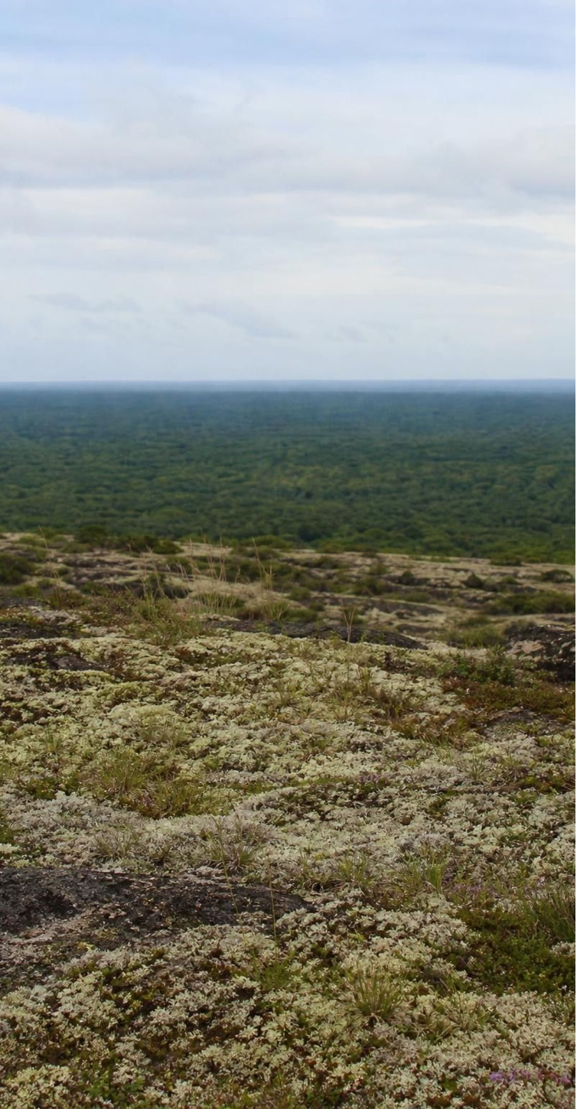
MODEL
Low and high: why the tundra is more fragile
Model: Arctic tundra compared with tropical rainforest
Arctic tundra | Tropical rainforest
Long, cold winters and a short growing season | Warm and wet nearly all year
Few species; many eat several kinds of food | Huge numbers of species, many of them specialists
Each role is filled by one or a few species | Some roles are shared by several species
Losing one species can ripple widely | Some losses are buffered, but not all
Fragility is a tendency: high biodiversity helps but does not protect against every disturbance.
8
Notes:
Walk across the compare chart one row at a time. The key row is the third: when only one species does a job, such as hunting seals on the sea ice, there is no backup if it declines. In a rainforest, several bird and bat species may disperse the seeds of the same tree, so losing one does less damage. Then guard against the overcorrection: coral reefs are among the richest ecosystems on Earth and are still badly damaged when marine heat waves bleach the corals. Richness lowers the risk; it does not remove it.
WATCH FOR: 'High biodiversity ecosystems cannot be harmed.' Use coral bleaching as the counterexample.
CONNECTS TO: W3 reading paragraph 2 compares the tundra with the rainforest; Lab 2, where Lupine Cove keeps one urchin predator (sea otters) after the sea stars die and Driftwood Cove has none; W10 mastery q2.
PACING: about 5 min

Slide 9
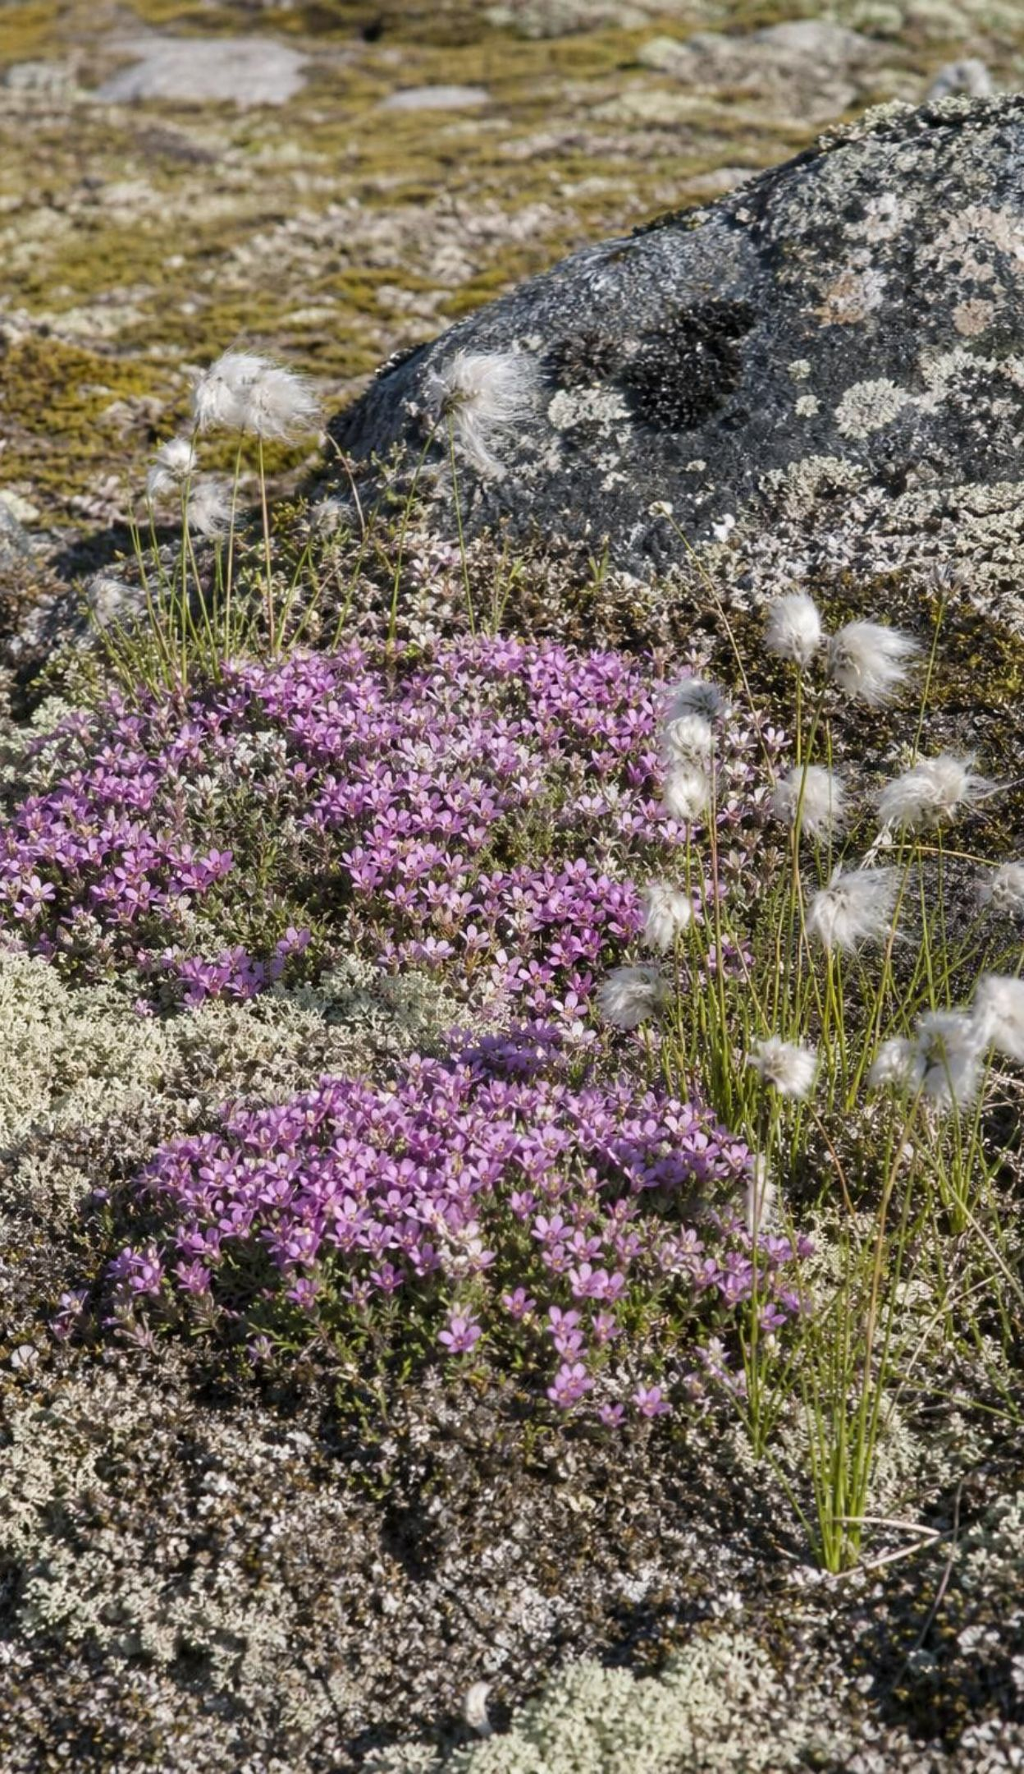
CHECK FOR UNDERSTANDING
Quick check: which plot is healthier?
A survey finds 35 plant species in an Arctic tundra plot and 280 in a rainforest plot. Which conclusion does this evidence support?
A. The rainforest plot is healthier because it has eight times as many species.
B. The tundra plot must have been damaged by people.
C. Neither: each plot must be compared with healthy plots of its own ecosystem type.
D. The tundra plot is healthier because fewer species compete.
9
Notes:
Vote with fingers, then ask a student for each letter to explain. The trap is A, which compares across ecosystem types. Ask: what extra data would let you judge the tundra plot's health? Species lists from undisturbed tundra plots nearby, or the same plot's list from 30 years ago.
EXPECTED RESPONSES: C. Health means keeping the natural set of species, so each plot is compared with healthy plots of the same ecosystem; 35 may be normal for tundra. Useful extra evidence: reference plots, older surveys, whether native species are missing or invasive species present.
WATCH FOR: Students who pick D are reasoning about competition, not health; ask whether fewer competitors makes a place healthier.
CONNECTS TO: Lab 1 q9 returns to judging health; the slide 17 discussion extends it to invasive species.
PACING: about 4 min

Slide 10
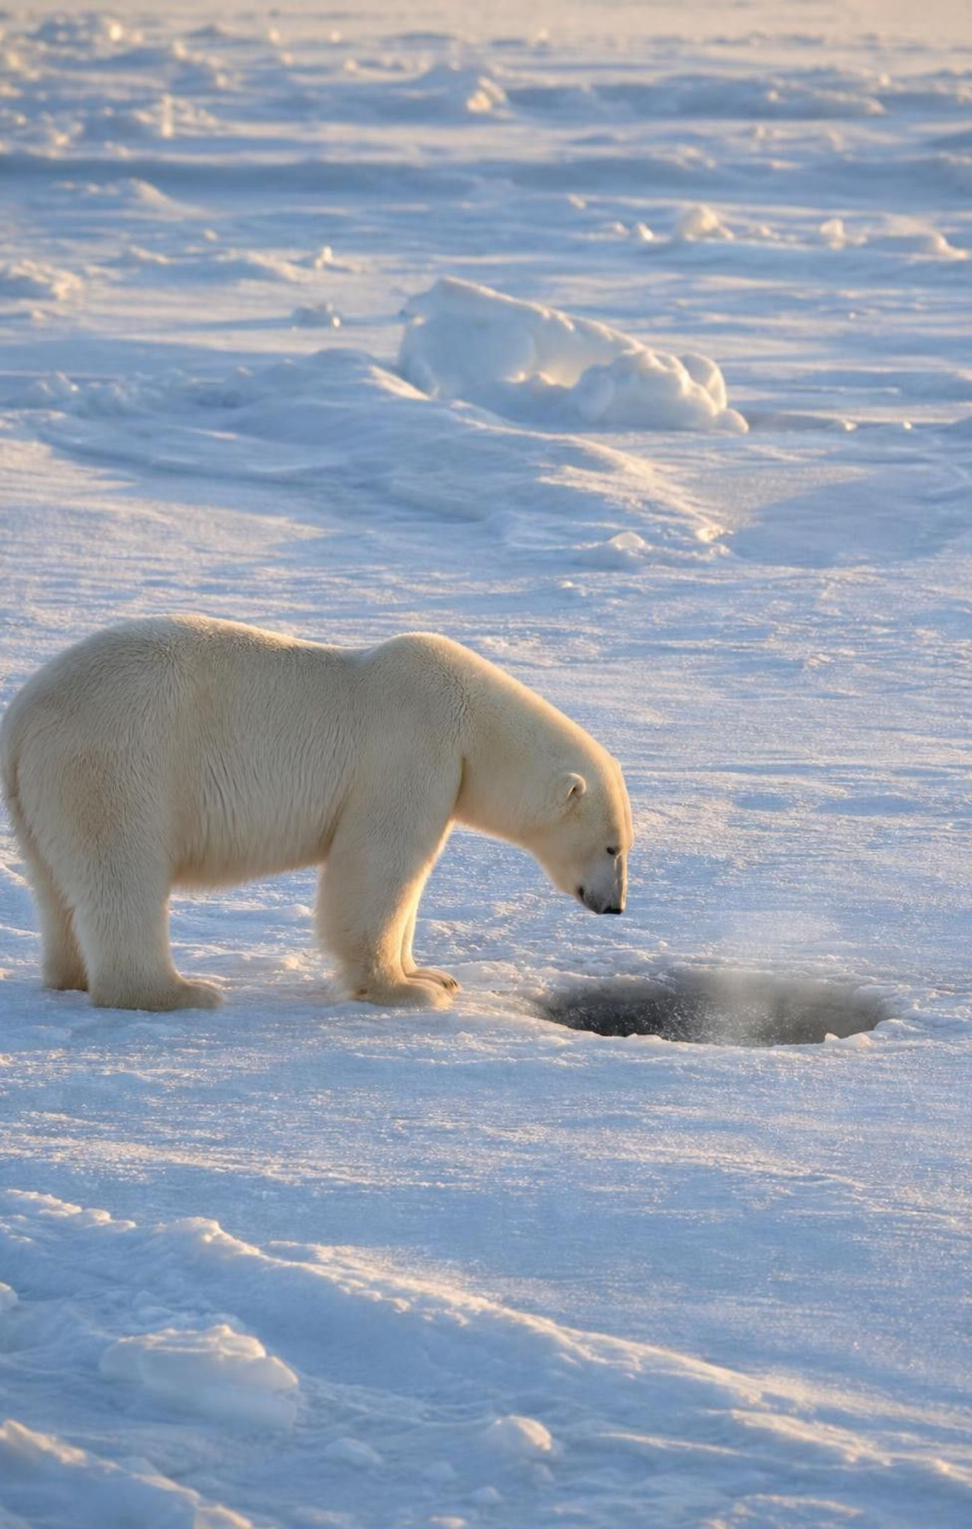
Fragile tundra: one hunter, many diners
Polar bears are the chief hunters of grown seals, waiting at breathing holes in the sea ice.
Arctic foxes and gulls eat their leftovers, an important food in the lean winter months.
Warming breaks up sea ice earlier, so bears catch fewer seals and leave fewer scraps.
With so few species, there may be no one to take over a lost role.
Polar bears do not hibernate; only pregnant females den, to give birth.
10
Notes:
Describe the hunt: seals must surface to breathe, and a bear waits motionless beside the hole, sometimes for hours. Seals are far easier to catch from ice than in open water, so the ice is the bear's hunting platform. Bears often eat the fat and leave much of the carcass, which foxes and gulls scavenge. Correct the textbook's error plainly: polar bears are active all winter, which is why ice loss hurts them; only pregnant females den. Add one honest detail: Arctic foxes do catch some ringed seal pups by digging into their snow dens, so 'chief hunter of grown seals' is the accurate phrase.
WATCH FOR: 'Polar bears sleep all winter.' Also 'polar bears live on land in the tundra'; they depend on sea ice and come ashore when it melts.
CONNECTS TO: Evidence of learning: tundra fragility explanation; W10 mastery.
PACING: about 5 min

Slide 11

MODEL
A small change spreads through the tundra web
Model: Less sea ice, less food for scavengers
Warmer Arctic → (melts the ice)
01
Less sea ice, breaking up earlier → (fewer hunting platforms)
02
Loading...
Fewer seals caught by polar bears → (fewer leftovers)
03
Fewer carcasses left on the ice → (scavengers go hungry)
04
Less winter food for Arctic foxes and gulls
05
Each arrow is a cause-and-effect link; the change at the start is physical, the changes downstream are in populations.
11
Notes:
Have students copy the chain and add a sign to each step (warmer +, ice −, seals caught −, carcasses −, scavenger food −). Then ask for one more box at the end: what happens to fox and gull populations, and to the lemmings foxes also eat? This is the crosscutting idea of stability and change: a small change in one part of a system can cause large changes elsewhere. Ask why this chain might be shorter or weaker in a richer ecosystem (other food sources, other scavengers).
EXPECTED RESPONSES: Fox and gull numbers could fall or they could shift to other foods; if foxes eat more lemmings, lemmings may decline. A richer ecosystem may offer other carcass sources or other prey, so the effect could be smaller.
WATCH FOR: Students drawing the arrow from fox to seal as 'eats'. In this diagram arrows mean 'causes', not 'is eaten by'.
CONNECTS TO: Evidence of learning: tundra fragility explanation; W3 reading paragraph 2 (polar bear scraps and scavengers); W10 mastery q2.
PACING: about 4 min

Slide 12
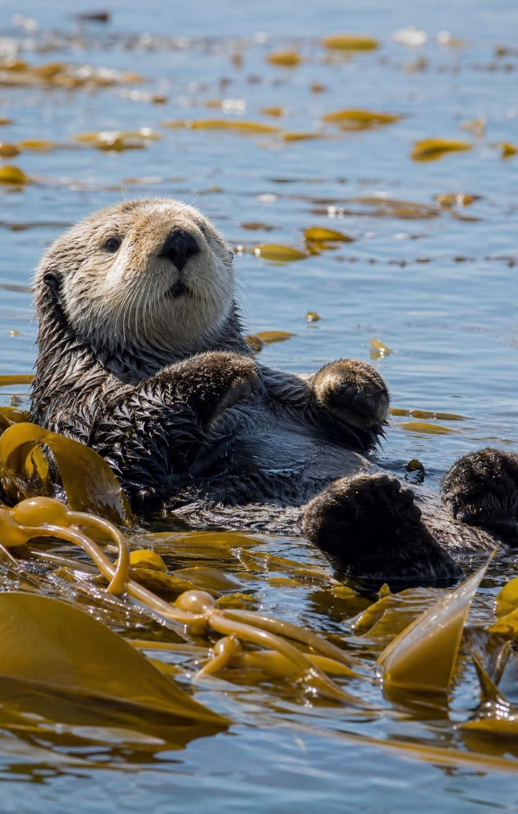
The kelp forest's keystone: the sea otter
Sea otters eat urchins, crabs, clams and abalone; urchins graze on kelp.
Fur hunters wiped out otters along most of the Pacific coast by the early 1900s.
Without otters, urchins swarmed and grazed kelp down to bare 'urchin barrens'.
Kelp is food and shelter for many fish and invertebrates, so they declined too.
Where protected otters returned, kelp recovered in many places, though not everywhere.
12
Notes:
Explain kelp: large brown algae, not plants, anchored by a holdfast and buoyed toward the light by gas-filled floats. Sea otters have no blubber and eat about a quarter of their body weight a day, so a few otters eat a lot of urchins. When otters disappeared, urchins left their cracks, crawled over the rock and chewed through kelp holdfasts. Add the honest complications: sunflower sea stars also eat urchins, and in some places kelp came back slowly or only partly after otters returned. Keep 'in many places' rather than 'everywhere'. Also correct the book gently: otters live in estuaries and seagrass beds too, not only in kelp.
WATCH FOR: 'Otters eat kelp' or 'otters protect kelp by eating the kelp's enemies on purpose'. Otters eat urchins for food; the kelp benefit is an indirect effect.
CONNECTS TO: Lab 2 case file; Lab 3.
PACING: about 5 min

Slide 13
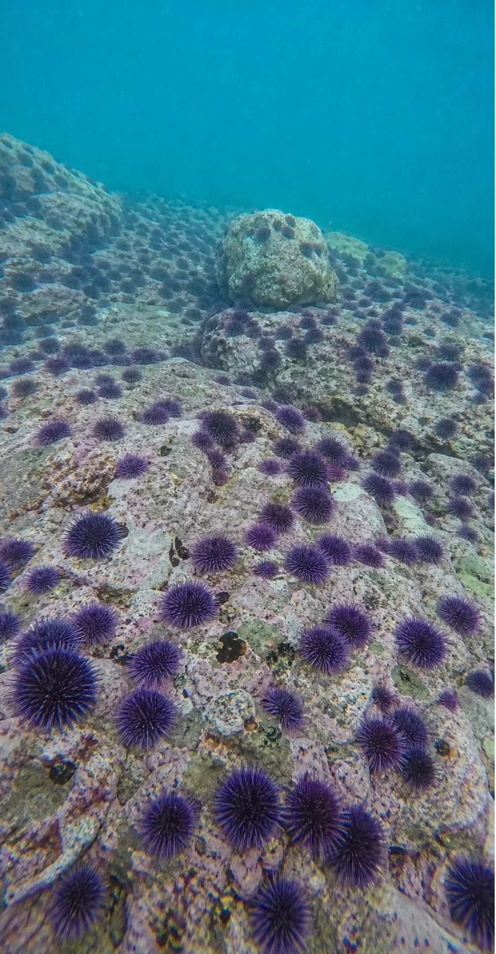
MODEL
A keystone at work: otters, urchins, kelp
Model: Removing one predator changes a whole forest
Fur hunters remove sea otters → (urchin predator gone)
Sea urchins multiply and leave their cracks → (grazing fronts spread)
Urchins graze kelp down to bare rock → (food and shelter lost)
Fish, abalone and other kelp dwellers decline
The effect on the kelp is indirect: otters never eat kelp.
13
Notes:
Ask: which arrows are direct feeding effects and which are indirect? Otter to urchin is direct; otter to kelp and otter to fish are indirect, passing through the urchins. Then define keystone species carefully: the otter's effect is far larger than its numbers. Urchins and kelp vastly outnumber otters, yet the otters decide what the forest looks like. Mention that the kelp itself, the very abundant species that builds the habitat, is called a foundation species. Ask students what the arrow chain would look like reversed, when otters return.
EXPECTED RESPONSES: Direct: otters reduce urchins. Indirect: otters increase kelp and kelp-dwelling fish. Reversed: otters return, urchins fall and hide in cracks, kelp regrows, kelp dwellers return, if other conditions allow.
WATCH FOR: 'Keystone means the most numerous species.' It means the biggest effect relative to numbers.
CONNECTS TO: Lab 2 causal-chain drawing; W6 CER and W10 q9 trace a similar indirect chain from an invasive ant through native ants to lizards; W8 traces one from feral pigs through golden eagles to island foxes.
PACING: about 4 min

Slide 14
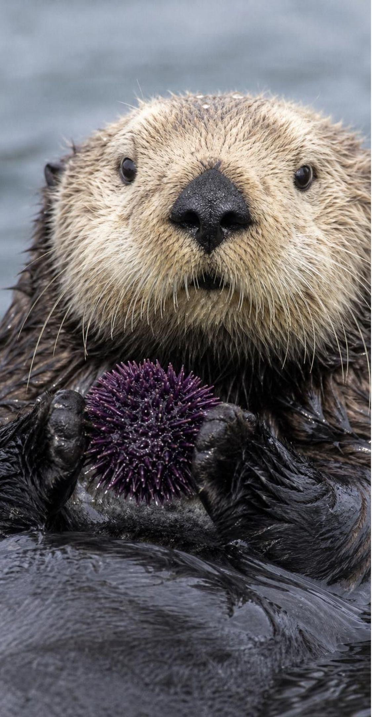
VOCABULARY IN CONTEXT
Words for losing and holding up species
keystone species: A species whose effect on its ecosystem is far larger than its numbers suggest. A small number of sea otters keeps urchins scarce enough for a kelp forest to stand.
extirpation: Loss of a species from one area while it survives elsewhere; a local extinction. Sea otters were extirpated from Washington by 1910 but survived in Alaska.
extinction: Death of the last member of a species anywhere. It cannot be undone. Both species of gastric brooding frog disappeared in the 1980s and are now listed as extinct.
14
Notes:
Use the arch analogy from the lesson, then show its limit: in a real arch, removing the keystone drops everything at once, while in an ecosystem the effects unfold over years and depend on other species. For extirpation, make the reversibility point: 59 sea otters from Alaska were released on the Washington coast in 1969 and 1970, and Washington has otters again. Nothing like that can happen after an extinction.
WATCH FOR: Students treat extirpation as permanent or think extinction can be reversed by finding 'a few somewhere'.
CONNECTS TO: W2 vocabulary; W10 mastery.
PACING: about 4 min

Slide 15
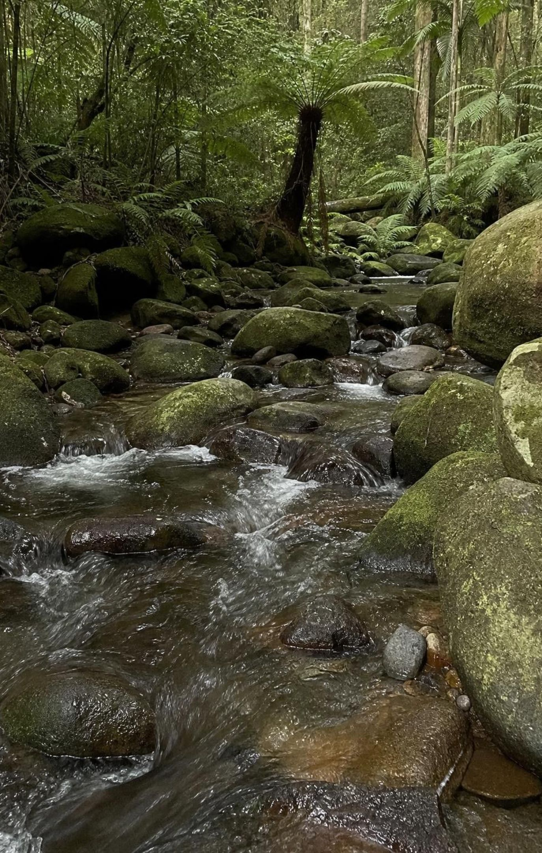
CHECK FOR UNDERSTANDING
Quick check: extirpated, extinct or neither?
Sea otters vanish from the Oregon coast but survive in Alaska.
The last southern gastric brooding frog dies, and none survive anywhere.
1987: the last wild California condor is caught; 27 condors live on in zoos.
A tree that grows only in one valley is lost when the valley is cleared, with no seeds saved.
Label each case extirpation, extinction or neither, and give a one-line reason.
15
Notes:
Run it with whiteboards. Case 3 is the stretch: condors were gone from the entire wild but not from Earth. Scientists call that 'extinct in the wild', a broader loss than extirpation from one region, but not extinction, because the 27 captive birds kept the species alive and their descendants were released from 1992 on. Case 4 is extinction only because the tree grew nowhere else and no seeds or plants were kept; ask what would change if a botanical garden had seeds.
EXPECTED RESPONSES: 1 extirpation (lost from one area, alive elsewhere). 2 extinction (no individuals anywhere). 3 neither, or 'extinct in the wild': the species survived in captivity and was later released. 4 extinction, because the species lived nowhere else and nothing was saved; if seeds were saved it would be extinct in the wild.
WATCH FOR: Calling case 3 extinction. Ask whether the condors in the sky over Big Sur today could exist if the species had gone extinct.
CONNECTS TO: W2 vocabulary; W10 mastery.
PACING: about 5 min

Slide 16
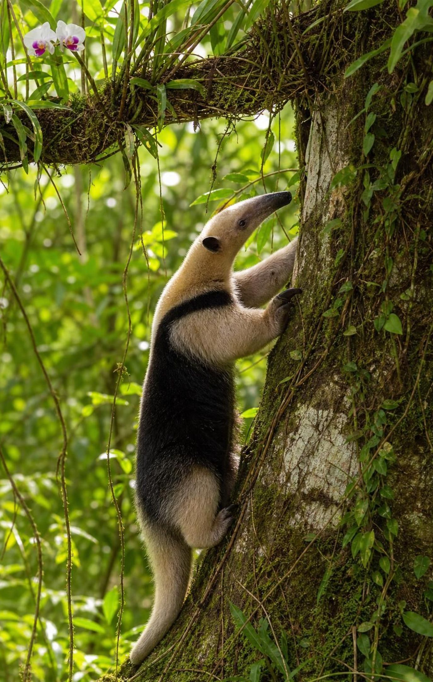
Rainforests: room for specialists
Warmth, light and rain all year feed a huge mass and variety of producers.
Steady food lets species specialize: one diet, one forest layer, one partner.
The lesser anteater eats mainly ants and termites; few rivals share that niche.
Many orchids grow on high branches, catching light and rain far above the soil.
Specialists compete less with each other, so many species can live side by side.
16
Notes:
Describe the anteater's tools: hooked claws that rip open nests and a long sticky tongue that collects insects before they scatter. A tundra animal could not survive on one food, because no single food is available all year; in a rainforest, ants and termites are. Orchids that grow on branches are epiphytes: their roots grip bark and soak up rain running down the tree. Ask: why does specialization lead to more species? Because two species that eat different things, or live in different layers, are not competing, so both can stay.
WATCH FOR: 'Specialists are better adapted than generalists.' Specialists do well where their resource is steady; generalists do better where conditions swing.
CONNECTS TO: W3 reading paragraph 2 (rainforest specialists); W10 mastery q11 (why specialists are hit hard when habitat is cleared); W4 diagram (which species can survive when habitat is lost or broken up).
PACING: about 5 min

Slide 17
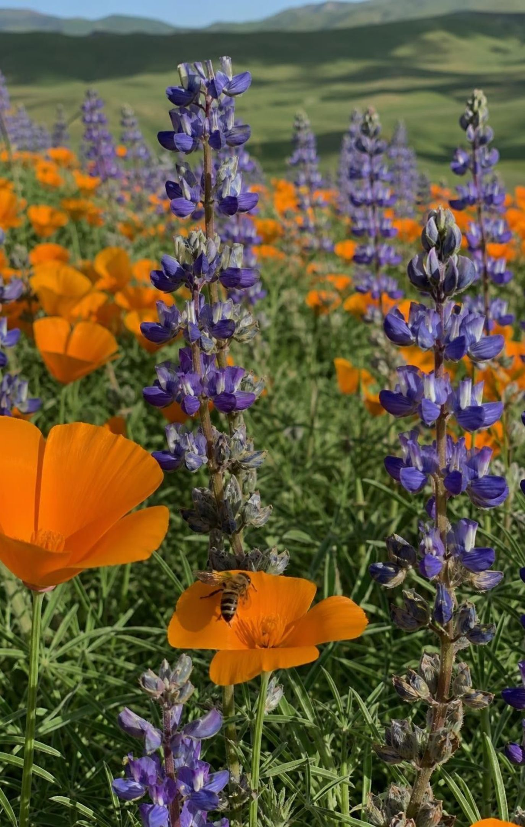
THINK, PAIR, SHARE
Discuss: is more species always healthier?
What does each place naturally hold?
What are the invasive plants doing to the native plants and animals?
Which one feeds native pollinators, insects and birds?
A roadside strip has 15 plant species, 10 of them invasive species from other continents. A nearby native meadow has 11, all native. Which is healthier, and what would you need to know?
17
Notes:
Give pairs three minutes, then take positions. Steer toward the idea of integrity: the meadow has fewer species but they are the ones that belong, with their partners (native bees, butterflies whose caterpillars eat only certain plants). Many California roadside weeds, such as yellow star-thistle, came from other continents and crowd out natives. Invasive species raise the local count while often lowering native biodiversity and the services natives provide. Ask what one number from Lab 1 would and would not tell you here.
EXPECTED RESPONSES: The meadow is likely healthier: its species are native and support native animals, while the strip's extra species are invasive and may be pushing out natives. To be sure: a list of what the area naturally held, whether natives are declining in the strip, which animals use each place. Richness alone cannot answer it.
WATCH FOR: 'Any plant is good for the environment.' Some introduced plants are harmless; invasive ones spread and cause harm.
CONNECTS TO: Lab 1 q9; W3 reading and W6 CER (invasive species).
PACING: about 7 min

Slide 18
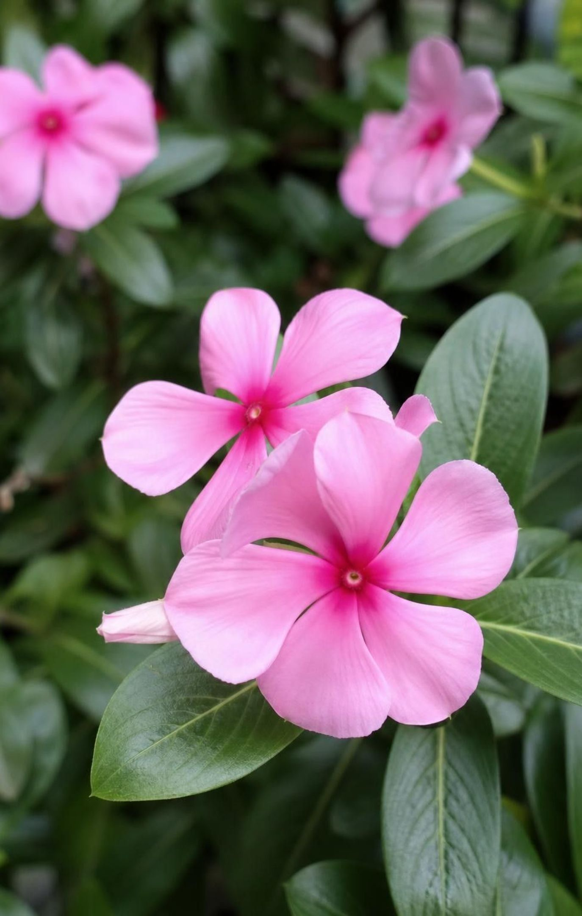
People depend on biodiversity
Medicines: Madagascar periwinkle gave vinblastine and vincristine, used against some cancers.
Willow bark's salicin led chemists to aspirin; foxglove plants yield heart medicines.
Food and materials: every crop and farm animal, silk and timber came from wild species.
Knowledge: gastric brooding frogs vanished before we learned how they switched off stomach acid.
Ecosystem services: pollination, clean water, soil held in place, nurseries for fish.
18
Notes:
Vincristine is part of the treatment that turned childhood leukemia from usually fatal to usually curable. Be precise about aspirin: willow bark contains salicin, and chemists later made acetylsalicylic acid in the lab, so willow inspired aspirin rather than containing it. Foxgloves are poisonous; the heart drugs digitoxin and digoxin come from purple and woolly foxglove and are carefully dosed. The gastric brooding frog swallowed its eggs and raised the young in its stomach, which stopped making acid; it disappeared within about a decade of being discovered. Bacteria that break down oil and microbes in soil are part of biodiversity too. Define ecosystem services and preview Lesson 28, which puts a price on them.
WATCH FOR: 'Natural remedies are always safe.' Many medicinal plants are toxic; their value comes from careful study and dosing.
CONNECTS TO: W3 reading paragraph 7 (medicines and ecosystem services); W9 q2 (services a tidal marsh provides); W10 mastery; L28 ecosystem services.
PACING: about 5 min

Slide 19
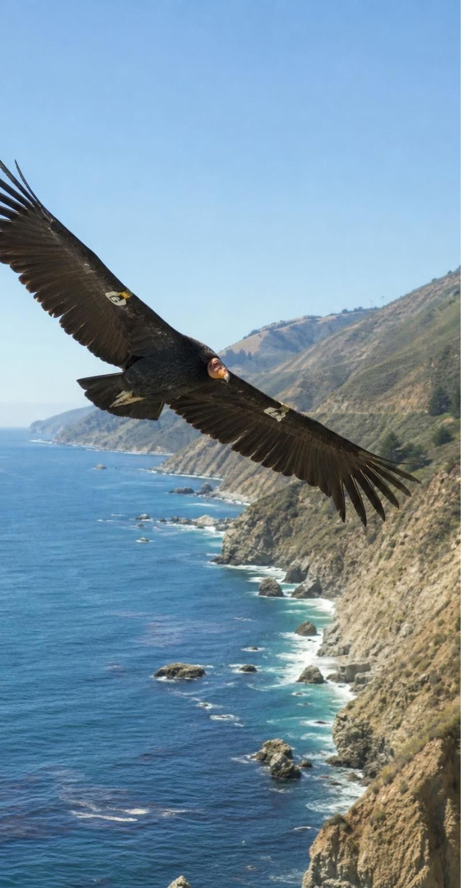
REAL-WORLD CONNECTION
California connection: comebacks that still need help
California condors fell to 22 birds in 1982, and by 1987 every survivor was in captivity. Releases began in 1992; at the end of 2025 there were 607 condors, 392 of them flying free. About 50 southern sea otters survived the fur trade near Big Sur; the 2019 population index was 2,962. White abalone have fallen about 99 percent since the 1970s.
Condors: lead from bullet fragments in carcasses is still the leading known cause of death.
Sea otters: threatened since 1977; shark bites have become a major cause of death.
North coast red abalone: sport fishing closed since 2018 after the kelp collapse, now until 2036.
White abalone raised in captivity have been released off southern California since 2019.
19
Notes:
Each comeback used a different design solution. Condors: capture every bird, breed them in zoos, release the young, and since July 2019 require lead-free ammunition for all hunting in California, because condors are scavengers that swallow bullet fragments in carcasses. Sea otters: a hunting ban (the 1911 fur seal treaty, then state and federal protection) let the Big Sur remnant grow, though it still occupies only part of its old range. Abalone: fishing closures (all abalone south of San Francisco since 1997), captive breeding and outplanting. Tie to the unit's anchor: abalone in southern California have declined since the 1960s from overfishing, a disease called withering syndrome and warm water. Ask: which of these comebacks could keep going if people stopped helping tomorrow?
WATCH FOR: Mixing up the species' stories: the north coast abalone collapse followed the kelp collapse, while the southern decline began decades earlier with overfishing and disease.
CONNECTS TO: Lab 3's fictional Driftwood Cove is patterned on the otter-free north coast; W8 collaborative (the island fox, another California recovery); slide 25 misconception.
PACING: about 6 min

Slide 20
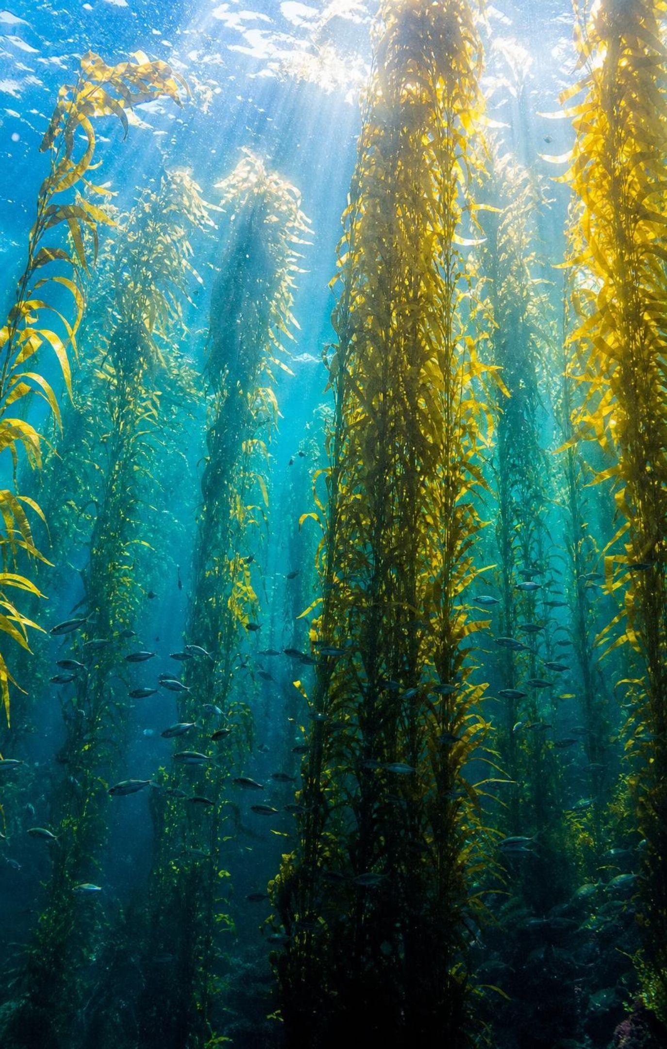
Judging a plan: criteria, constraints, trade-offs
Criteria: what success means, such as kelp cover, fish species or clean water.
Constraints: the limits, which are scientific, economic and social.
Compare every plan against the same criteria, using test or pilot data.
Few plans win on everything; name the trade-off you accept.
Often the best plan combines the strongest parts of several.
20
Notes:
Connect to the standard's wording: competing design solutions for maintaining biodiversity and ecosystem services. Give an example of each constraint type for the condor: scientific (lead can travel far from where an animal was shot), economic (copper bullets cost more), social (hunters' acceptance; a law only works if people follow it). Emphasize the systematic part: write the criteria before looking at the plans, so you do not bend the criteria to fit a favorite. Science can tell us what each plan will probably do; deciding which trade-off to accept is a community choice.
WATCH FOR: 'The cheapest plan is the best' or 'the plan that helps the species most is the best'. A plan must meet the criteria within the constraints.
CONNECTS TO: Lab 3; W8 collaborative scores five real island fox solutions against shared criteria and constraints; W9 q1 sorts a shoreline problem's requirements into criteria and constraints.
PACING: about 5 min

Slide 21
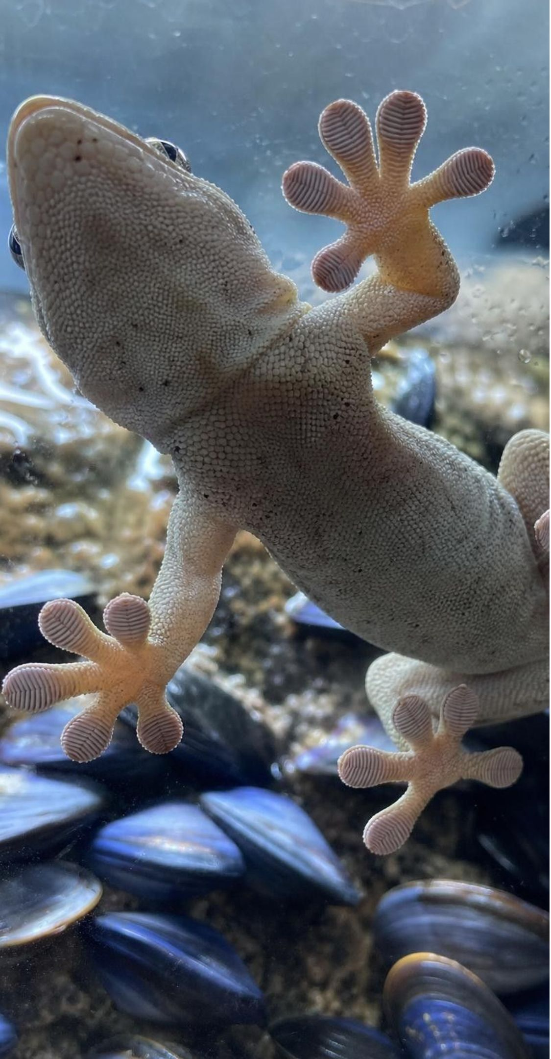
MODEL
Engineers test, compare, then combine
Model: Designing an adhesive that works wet or dry
Criteria: sticks wet and dry, peels off gently → (build and test)
Test a gecko-like textured pad: dry yes, wet no → (build and test)
Test a mussel-like glue: wet yes, peels off poorly → (keep the best of each)
Combine: textured pad coated with mussel-like glue → (check the criteria)
Retest: held and released in wet and dry lab tests
Based on a 2007 lab prototype; a bandage for patients would need more testing.
21
Notes:
This is the lesson's engineering story, a case of biomimicry. Gecko toe pads carry millions of tiny hairs that cling by weak attractions between molecules, so they stick and unstick easily on dry surfaces but fail under water. Mussels make protein glues that grip wet rock. In 2007 researchers built an array of tiny pillars and coated it with a mussel-like polymer; it held and released over a thousand times, wet or dry. The point for us: neither design passed every criterion, but each passed a different one, and the test data showed which characteristic to keep from each. That is exactly what Lab 3 asks of conservation plans.
WATCH FOR: 'The engineers just mixed two things together.' They tested each against the criteria first, then combined the parts that performed best.
CONNECTS TO: Lab 3 hybrid design; W9 q4 (how a half-marsh, half-pond design borrows the best feature of two designs that each fail).
PACING: about 5 min

Slide 22
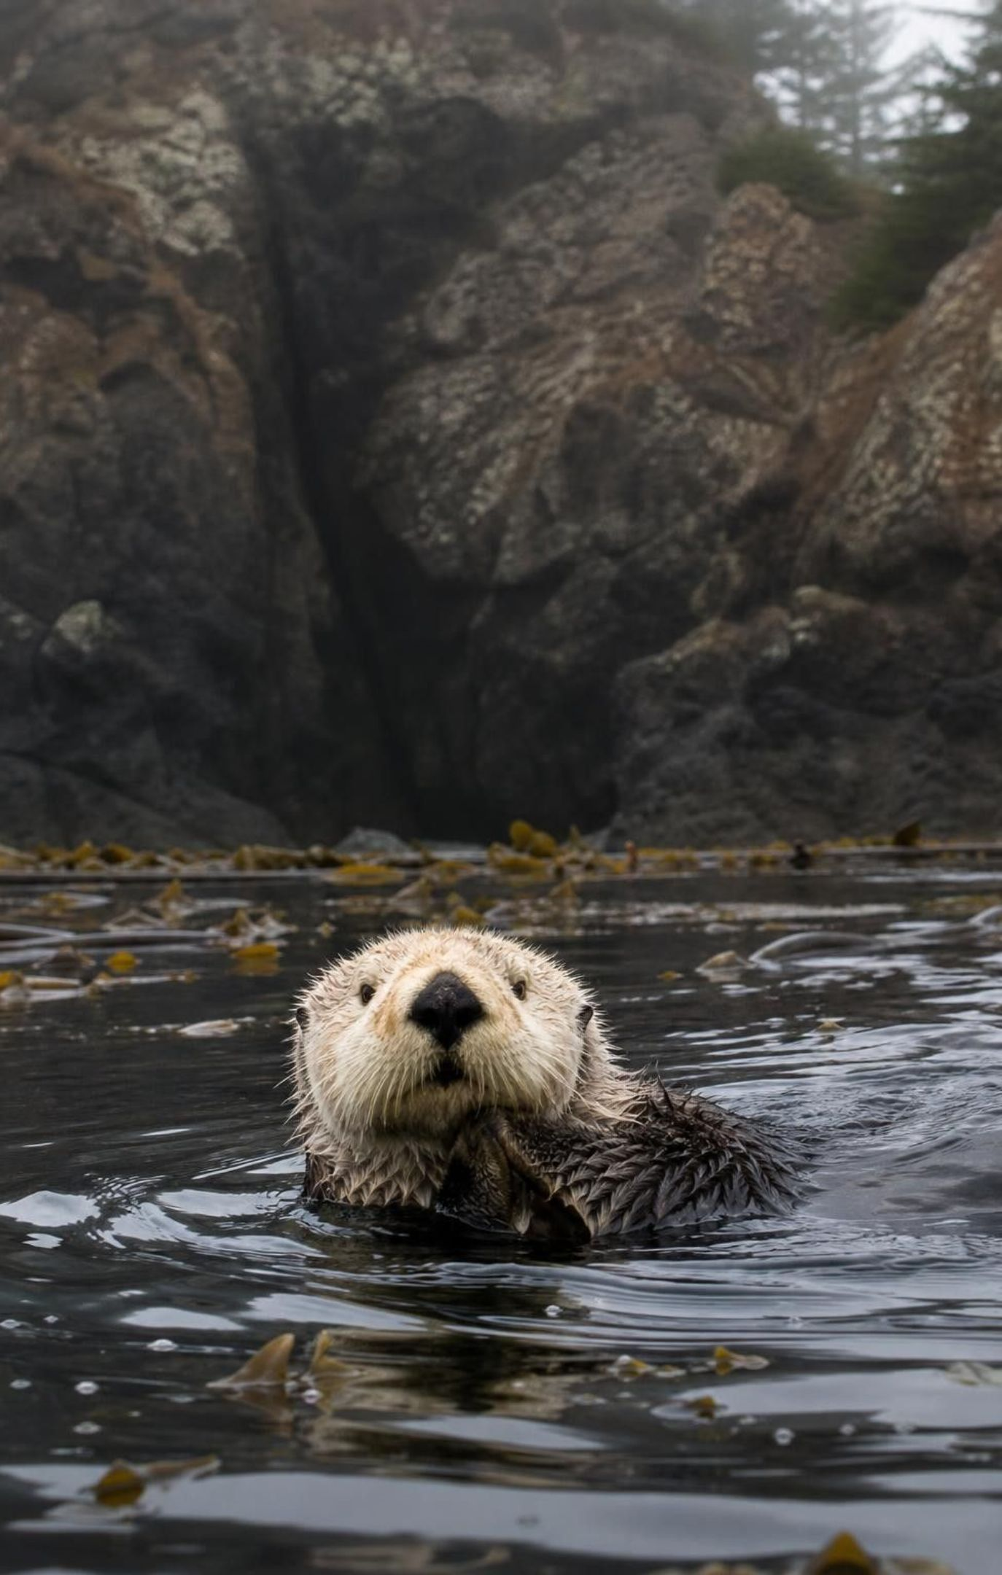
THINK, PAIR, SHARE
Discuss: otters back on the north coast?
Who gains, and who loses?
What evidence would each side want to see?
Could a plan reduce the harm to one group?
Returning sea otters to Northern California could help kelp recover, but otters also eat abalone, crabs and urchins that people harvest. How should this trade-off be decided?
22
Notes:
This is a real question. In 2022 the U.S. Fish and Wildlife Service sent Congress a feasibility assessment that found returning sea otters to northern California and Oregon could be done under certain conditions and could bring ecological and economic benefits, while noting that some shellfish fisheries could be affected; it did not recommend for or against. Have groups list stakeholders: kelp and its fish, shellfish divers, dive and kayak businesses, tribes with long ties to these coasts, fishing towns, people who never visit but value otters. Ask what small, monitored test would give evidence before a big decision.
EXPECTED RESPONSES: Gains: kelp and kelp-dwelling species, tourism, possibly fisheries for kelp-forest fish. Losses: abalone, crab and urchin harvests in otter areas. Evidence: results from places where otters returned, a small trial area, economic studies. Ways to reduce harm: start in a limited zone, monitor shellfish, support affected fishers.
WATCH FOR: 'Scientists should just decide.' Science describes likely outcomes; the decision weighs values and fairness.
CONNECTS TO: Lab 3 community-support constraint and shellfish support step; W8 collaborative (the island fox), where a social constraint, objections to killing feral pigs, also shaped the solutions; W9 q1 labels constraints scientific, economic or social.
PACING: about 7 min

Slide 23
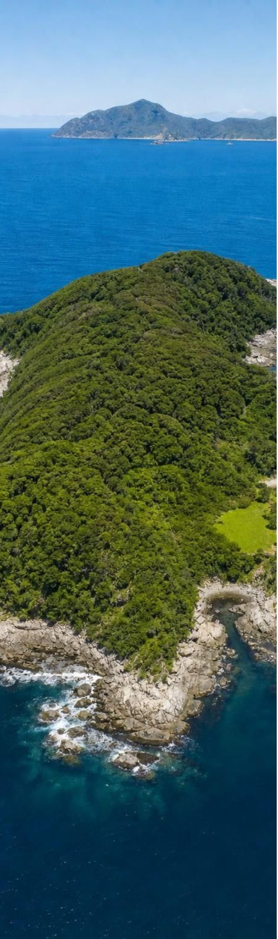
APPLY IT
Task: where should 40 young kākāpō go?
Criteria: low predator risk, enough food to breed, room for at least 40 more birds.
Constraint: at most 30 points over 10 years.
Option | Predator risk | Food for breeding | Cost (points, 10 yr) | Room for more birds
A. Add birds to existing islands | Very low | Shared rimu; may run short | 5 | About 10
B. Clear a new, larger island | Low once cleared; rats may swim back | Plenty of rimu | 40 | 150 or more
C. Fenced mainland sanctuary | Low if the fence holds; breaches happen | Some rimu | 25 | About 60
Simulated data for practice.
Use the table to judge three options against the criteria and the budget. Which would you choose, and which trade-off are you accepting?
23
Notes:
Tell students the table is a teaching dataset: the options are real kinds of solutions, but the numbers are invented. The real situation is close: in 2023 New Zealand's Department of Conservation said the kākāpō's island homes were almost full, and with Ngāi Tahu it trialled moving a few male kākāpō into a 3,400-hectare fenced mainland sanctuary; some were later moved back to the islands. Give groups eight minutes to fill a pass-or-fail mark for each criterion and the constraint, then choose. Push them to name what they would monitor in the first year of their choice.
EXPECTED RESPONSES: A passes predator risk and budget but fails room (about 10, not 40) and risks food shortage. B passes predator risk, food and room but fails the budget (40 > 30). C passes budget (25) and room (60), with some food and a moderate predator risk if the fence is breached. Most groups choose C, or A for a few birds now plus C; a group may argue for B if more money can be raised, accepting the budget overrun. Strong answers name the trade-off (predator risk and food in C) and a monitoring plan (fence checks, predator tracking tunnels, bird weights).
WATCH FOR: Choosing the option that is best on one column only (A is safest, B has the most room) without checking every criterion.
CONNECTS TO: Lab 3 and W9 q3 use the same pass-or-fail method.
PACING: about 10 min

Slide 24
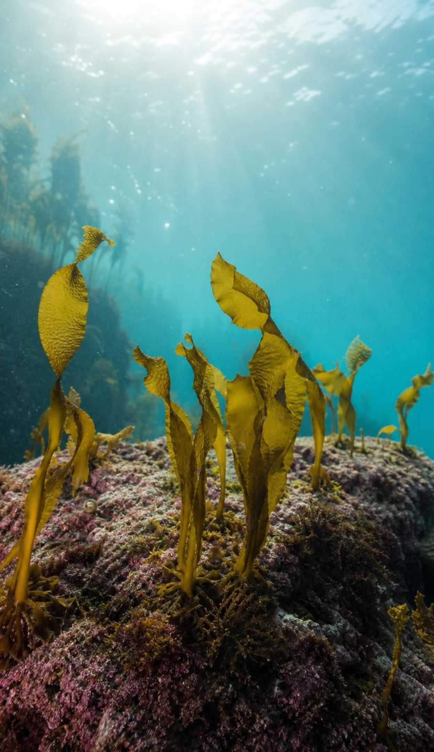
CHECK FOR UNDERSTANDING
Quick check: combine the best parts
Plan X brings kelp back fast but stops working when its funding ends. Plan Y is slow but keeps working on its own. Which choice best uses both test results?
A. Choose X, because fast results matter most.
B. Choose Y, because it costs less over time.
C. Run X for the first years as a bridge while Y builds up, then stop X.
D. Wait until someone designs a plan with no weaknesses.
24
Notes:
Quick vote, then ask what each plan contributes: X's characteristic is speed; Y's is staying power. A combination keeps both, like the gecko texture plus the mussel glue. Then raise the catch: a combination costs more than either alone, so the budget constraint still has to be checked, which is exactly the squeeze in Lab 3.
EXPECTED RESPONSES: C. X supplies early results, Y supplies lasting results; together they can meet both a speed criterion and a lasting criterion, if the budget allows. A and B each drop one strength; D never acts while the forest keeps declining.
WATCH FOR: Thinking a combination is automatically better. It must still be tested against every criterion and constraint.
CONNECTS TO: Lab 3 hybrid design; W10 mastery.
PACING: about 4 min

Slide 25
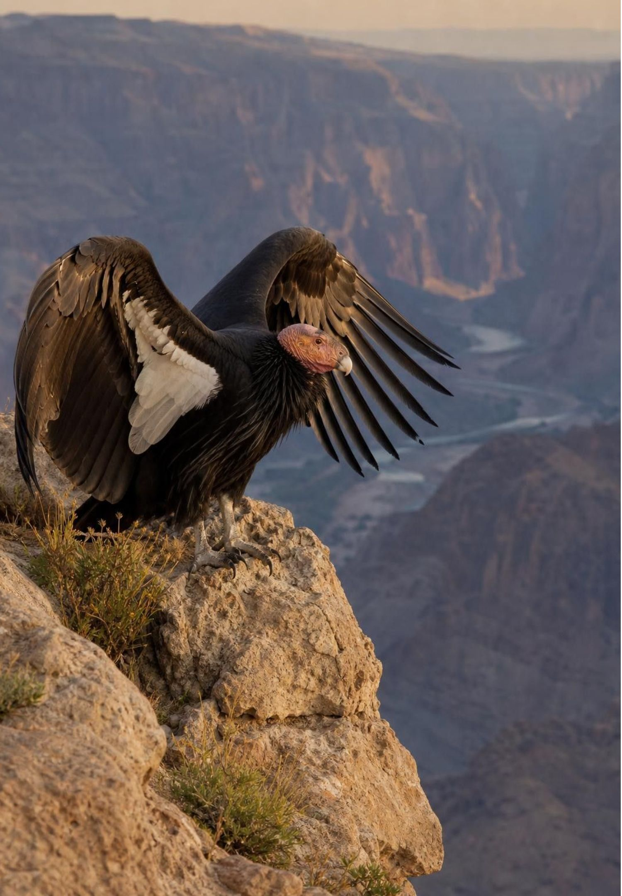
MISCONCEPTION CHECK
True or false? Numbers are up, so the job is done
"Kākāpō and condor numbers have risen for years, so the protections can stop now and both populations will keep growing on their own."
True or false? Explain your reasoning.
25
Notes:
Have students write true or false with two pieces of evidence, then share. False for both. Kākāpō live only where cats, rats and stoats are kept out; predators reaching an island, or birds moved to the mainland without protection, could undo decades of work, and the population's low genetic variety remains. Condors still die of lead poisoning, the leading known cause of death in the wild; the free-flying population depends on continued releases, treatment of poisoned birds and lead-free ammunition. A recovered population is one that can persist when its threats are controlled, which is why recovery plans include monitoring and long-term protection, not just a target number.
EXPECTED RESPONSES: False. Kākāpō survive only on predator-free islands and still need predator control and nest care; condors still die from lead and rely on releases and lead-free ammunition. Rising numbers show the plan is working while it runs, not that the threats are gone.
WATCH FOR: Students may overcorrect to 'these species can never survive without people'. The aim is for threats to be controlled well enough that populations persist.
CONNECTS TO: W1 q7 (why 325 kākāpō may still not be safe), revisited; chapter misconceptions list.
PACING: about 6 min

Slide 26
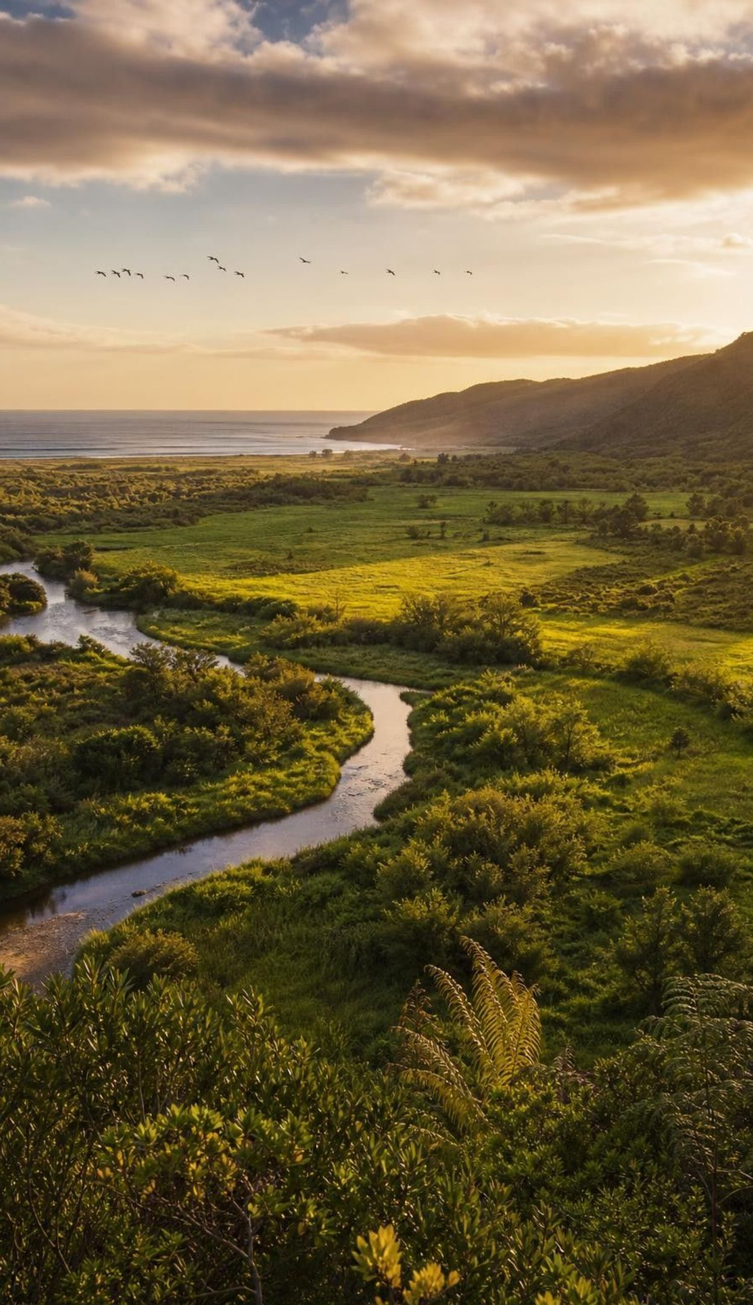
PUTTING IT TOGETHER
Putting it together
Biodiversity is variety at three levels; richness and evenness both matter.
Each ecosystem has its own natural level; health means keeping the species that belong.
Low-biodiversity systems like the tundra are easier to knock off balance.
Keystone species, like sea otters, hold up far more of a system than their numbers suggest.
People depend on biodiversity for medicines, food, materials, ideas and ecosystem services.
Good conservation plans are judged on criteria and constraints, combined and monitored.
26
Notes:
Ask each student to write a four-sentence answer to the essential question using at least four vocabulary terms, then trade with a partner who checks that every claim has an example. Collect one result from each lab: Lab 1 (which patch had the higher index, and was the sample big enough), Lab 2 (the one difference that explained the collapse), Lab 3 (the hybrid they chose and the trade-off they accepted). Preview Lesson 28, where the services a healthy ecosystem provides, such as pollination of California's almonds, are given a dollar value.
CONNECTS TO: W10 mastery as the quiz; L28 The Importance of Healthy Ecosystems.
PACING: about 5 min

Slide 27
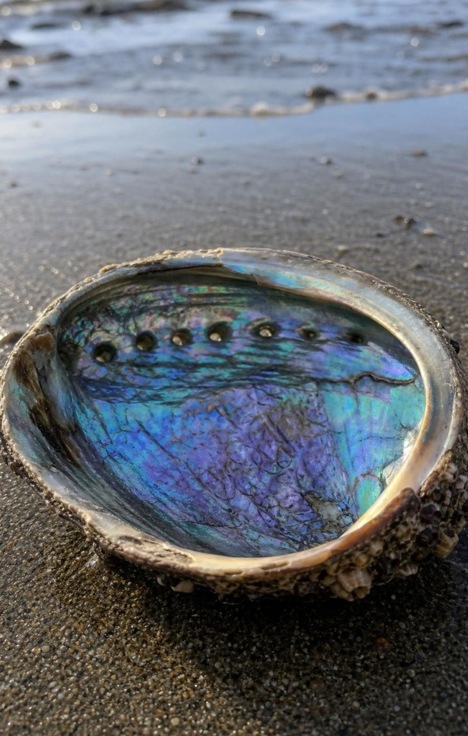
EXIT TICKET
Exit ticket
Two patches each have 5 plant kinds. Why might their biodiversity index differ?
Why can losing one predator matter more in the tundra than in a rainforest?
California's last wild gray wolf was killed in 1924; wolves lived on in Canada. Extirpation or extinction?
Name one criterion and one constraint for judging a plan to protect condors.
27
Notes:
Collect on index cards. Item 1 checks evenness; item 2 checks fragility reasoning with a specific link; item 3 checks the extirpation definition with a new California case (gray wolves have since returned on their own, first in 2011); item 4 checks the language of design evaluation. Sort cards into 'got it', 'partly' and 'not yet' piles and reteach from the largest pile.
EXPECTED RESPONSES: 1: one patch may be dominated by one kind while the other is evenly mixed, so evenness differs. 2: the tundra has few species, so no other species may fill the predator's role, and many species depend on it (for example scavengers on polar bear kills); rainforests often have several species in similar roles. 3: extirpation, because wolves were lost from California but survived elsewhere. 4: criterion, for example fewer condor deaths from lead or a growing wild population; constraint, for example cost of lead-free ammunition, hunter acceptance or what the law allows.
WATCH FOR: Item 3 answered 'extinction'; item 1 answered 'one patch has more plants' (count of individuals, not evenness).
CONNECTS TO: W10 mastery; chapter evidenceOfLearning.
PACING: about 5 min

