Slide 1
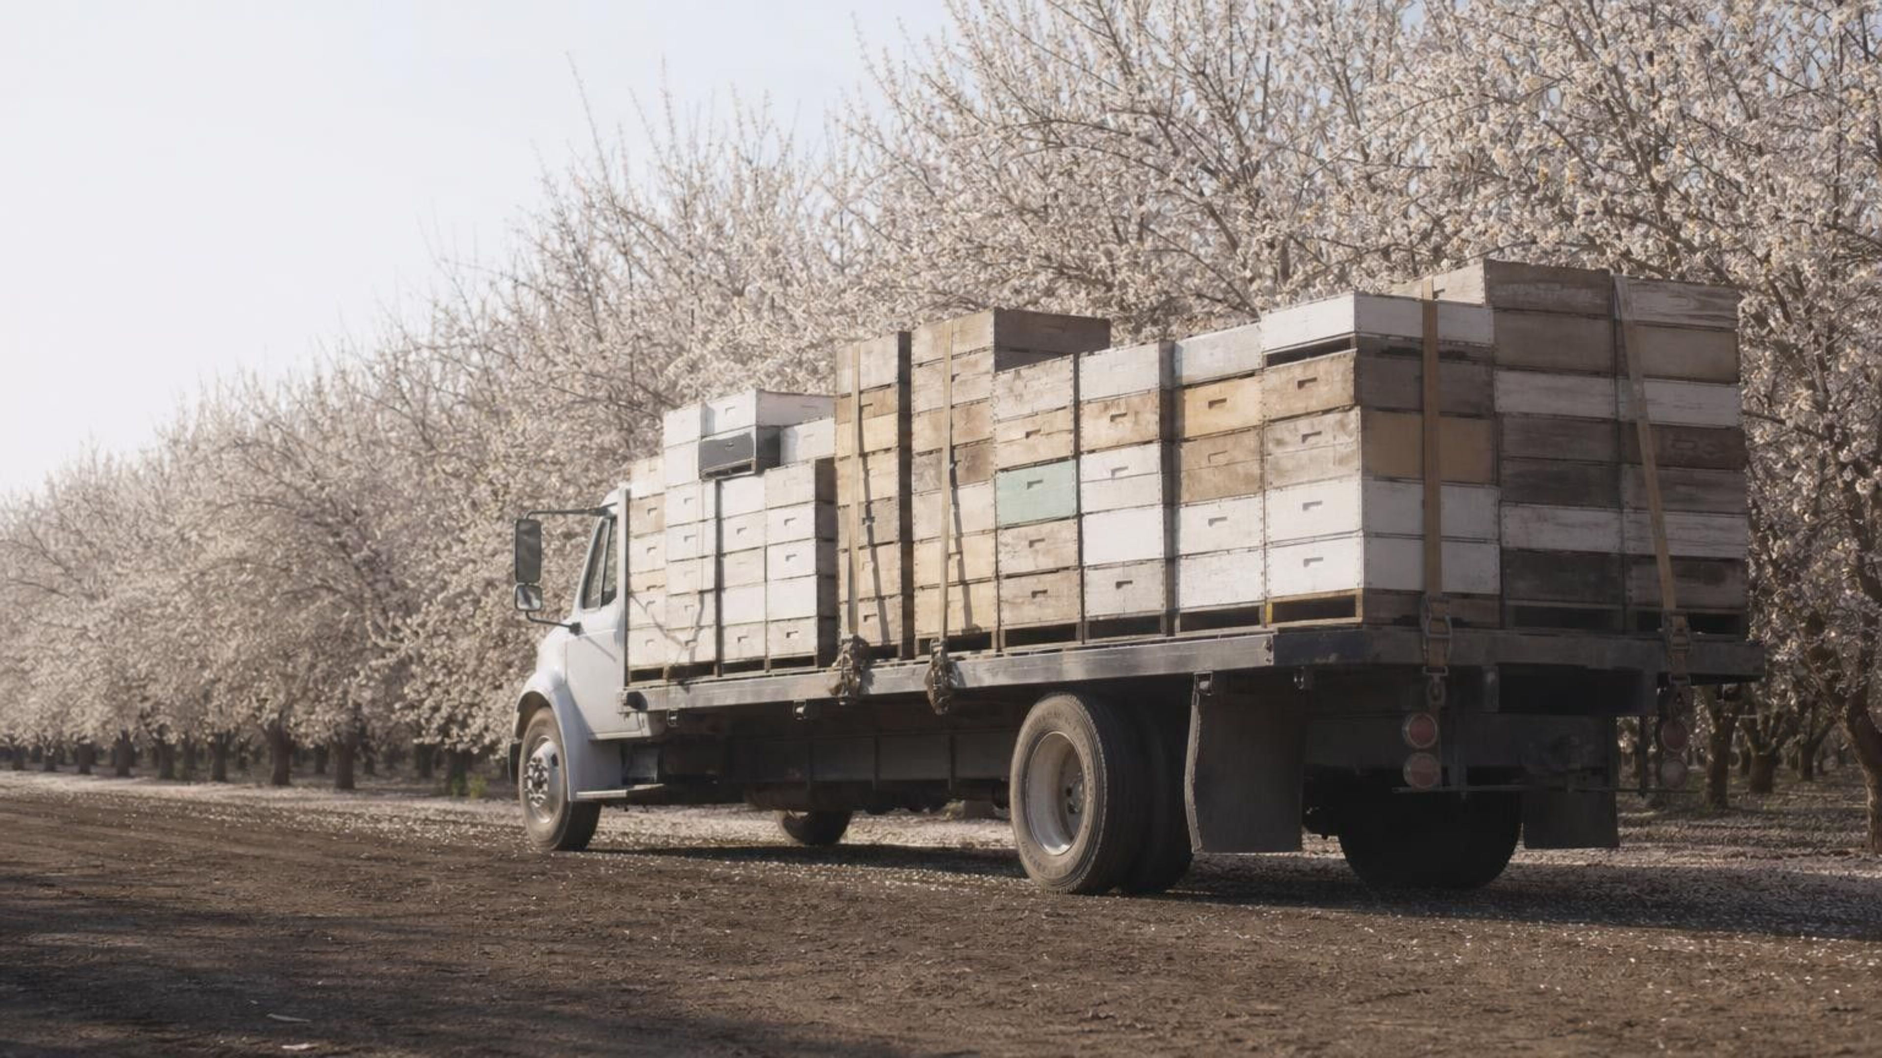
Chapter 28: The Importance of Healthy Ecosystems
Chapter 28 of 29 · Humans and Changing Ecosystems
Lesson 28: What do living systems do for people, and what would it cost to replace them?
Angela's Wand · Bring Science Alive! 7th Grade Integrated
Notes:
Open by asking where the water in the classroom faucet was before it reached the pipes, and who or what cleaned it. Most students will say a treatment plant; tell them that for many cities, forests, soil and wetlands do much of the work first, without sending a bill. That is the idea of this lesson: ecosystems do jobs for people. Preview the three investigations: a cotton-swab orchard where students act as bees, a water filter they design and improve against a budget, and a town council meeting where they decide whether to protect an ecosystem or pay for a machine to replace it.
CONNECTS TO: Overview of Lab 1, Lab 2 and Lab 3; W1 phenomenon worksheet begins on the next slide.
PACING: about 2 min

Slide 2
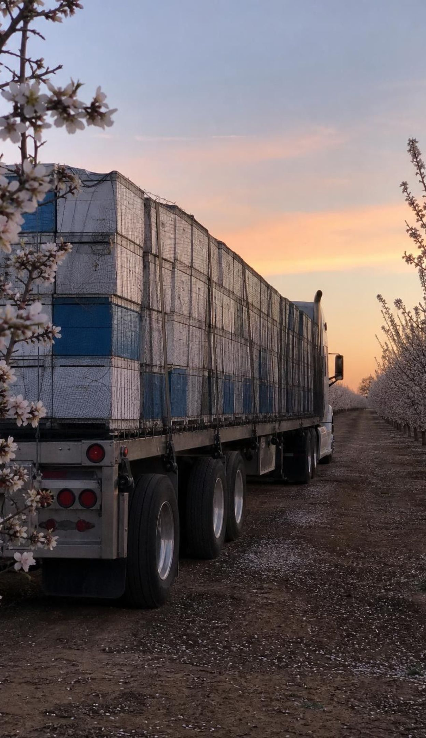
Phenomenon
The bee trucks of February
Each winter, trucks stacked with beehives roll into California's Central Valley from as far away as Florida, Texas and North Dakota. When the almond trees bloom, usually from mid-February, growers rent millions of honey bee colonies, by one estimate close to every managed colony in the country. A few weeks later the trucks leave. Why pay to haul in tens of billions of bees?
Notice: what is being moved, how far, and at what time of year?
Wonder: what does a bee do in an almond blossom that the tree cannot do for itself?
Predict: what would happen to the harvest in a year when many hives died over the winter?
2
Notes:
Give two silent minutes for a notice and a wonder, then collect ideas on the board without judging them. Push on three points. First, the growers are paying for pollination, not honey; the rent is the price of a service. Second, the timing: bloom lasts only about three to four weeks, so bees are needed in huge numbers for a short time. Third, honey bees are not native; colonists brought them from Europe. Ask: before the valley was planted with orchards, who pollinated its wildflowers? Park that question. The 'close to every managed colony' estimate comes from a 2025 university analysis of 2024 demand: about 2.7 million colonies for about 1.4 million acres, roughly 99 percent of the colonies counted in the United States on January 1, 2024. The numbers change every year, so treat them as estimates.
EXPECTED RESPONSES: Notice: hives moved thousands of kilometers, in winter, just before bloom, for a few weeks. Wonder: why the trees need bees; why there are not enough local bees; what happens to the bees after. Predict: fewer pollinated blossoms means fewer nuts, higher hive rents, and growers competing for scarce colonies.
WATCH FOR: 'The bees make the almonds' or 'the bees are there to make honey.' The bees move pollen; the tree makes the nut. Note also the idea that honey bees are native wild pollinators.
CONNECTS TO: W1 phenomenon worksheet records notice, wonder and a first explanation; Lab 1 returns to the orchard.
PACING: about 8 min

Slide 3
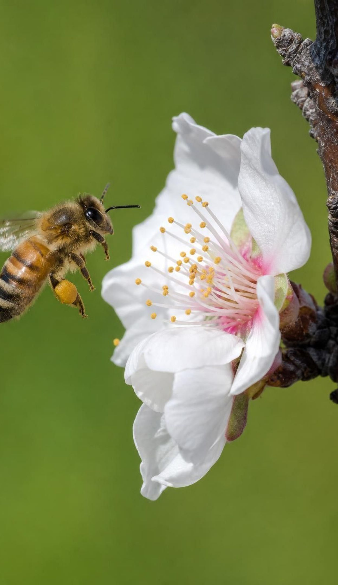
LEARNING TARGETS
What you will be able to do
1
Define an ecosystem service and name the living things and processes behind each kind.
2
Use model data to explain why almond blossoms need bees to bring pollen from a different variety.
3
Trace how one small change, a drug given to cattle, spread through an ecosystem to people.
4
Design, test and improve a water filter, and compare it with a forested watershed.
5
Weigh protect-or-replace choices using scientific, economic and social criteria.
3
Notes:
Read the targets aloud and have students star the one that sounds hardest. Point out the arc: first we name the services, then we look at three cases where a service was disrupted (crops, health, floods), and then we act as engineers and decision-makers. The last target is the big one for this lesson: deciding between competing solutions with evidence. The exit ticket on the last day touches all five.
CONNECTS TO: Targets map to slides 4-8 and W2 (1), Lab 1 and W5 (2), slides 16-18 and W3 (3), Lab 2 and W4 (4), Lab 3, W6, W8 and W9 (5); W7 and W10 review all five.
PACING: about 2 min

Slide 4
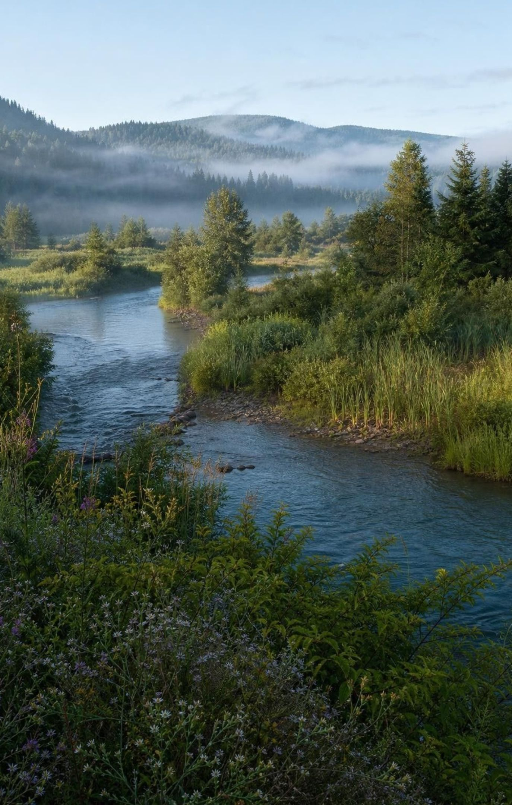
What counts as an ecosystem service?
An ecosystem service is a benefit people get from the normal work of an ecosystem.
The workers are organisms and nonliving parts together: bees, fungi, roots, soil, sand and water.
Some services supply things we use: food, wood, fresh water, chemicals for medicines.
Others keep the system running or protect us: pollination, soil building, water filtering, flood buffering.
Stone and metals are natural resources too, but they form by geology, not by living ecosystems.
No one sends a bill, so services are easy to overlook until they stop.
4
Notes:
Stress the direction of benefit: the ecosystem works, people benefit. Give a quick tour with one example each: a forest that holds soil on a hillside, fungi turning leaves into soil nutrients, bees moving pollen, a marsh slowing waves. Then separate natural resources: a pine board is grown by a forest, but the copper in a wire formed in rock over geologic time. Both are natural resources; only the first is a product of a living ecosystem. Ask students for one service they used before school today (drinking water, food, the oxygen they breathe, shade from a tree).
WATCH FOR: Students define an ecosystem service as something people do for nature, such as a beach cleanup. Ask: who is doing the work, and who benefits?
CONNECTS TO: W2 vocabulary worksheet; the slide 8 check.
PACING: about 5 min

Slide 5
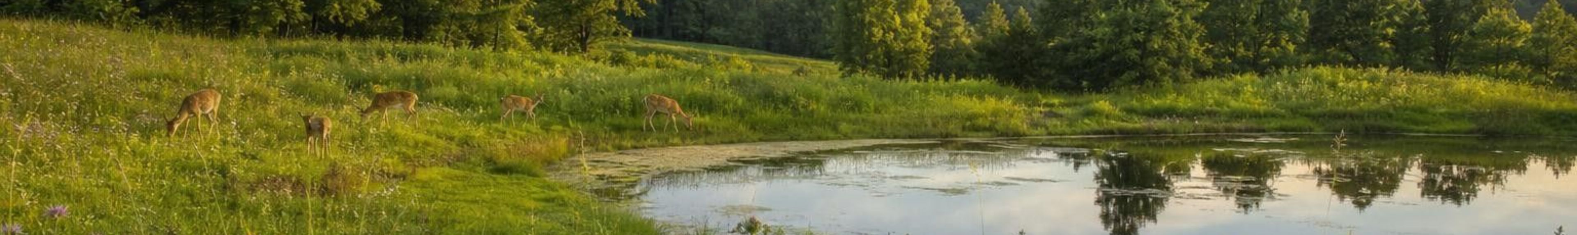
Four kinds of work a healthy ecosystem does
Model
Model: Sorting ecosystem services
Center: Healthy ecosystem
Supplies:
Keeps the system running:
Regulates and protects:
Enriches people's lives:
Food, wood, fibers, fresh water, chemicals used in medicines
Photosynthesis, decomposition, soil formation, nutrient cycling
Pollination, water filtering, flood and erosion control, pest and disease control, carbon storage
Recreation, beauty, culture, scientific discovery
One common way to group services, from a 2005 international assessment that lists pollination as regulating. Many services fit more than one group: pollination also keeps plants reproducing and supplies food.
5
Notes:
This four-part grouping follows the Millennium Ecosystem Assessment, a large international scientific study published in 2005 that named the groups provisioning, regulating, supporting and cultural services; every service on the textbook's wheel fits one of them. That assessment lists pollination as a regulating service, while many school books call it supporting, so accept either with a reason (W2 q14). Read each group and ask students to add one example of their own. Then give a tricky one: where does a vulture eating a carcass go? (Regulates and protects: disease control.) Where does a wild banana with disease-resistant traits go? (Supplies, because it provides material for new crop varieties, and it is also part of biodiversity.) Make the point that the categories are a tool for thinking, not boxes with walls.
WATCH FOR: Students may think each service belongs in exactly one box. Overlap is normal.
CONNECTS TO: W2 vocabulary sort; W10 mastery.
PACING: about 5 min

Slide 6
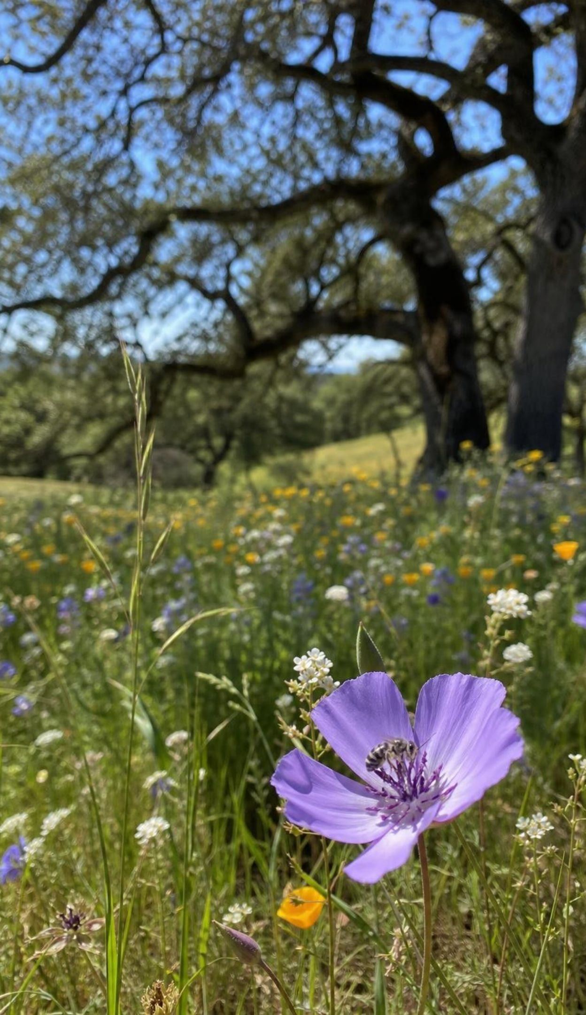
Vocabulary in context
Words for what nature provides
ecosystem service: A benefit people get from the normal work of an ecosystem's living and nonliving parts. Native bees nesting in an oak woodland pollinate the orchard next door.
natural resource: A material or energy source from nature that people use; some are grown by ecosystems, some form by geology. Lumber is grown by a forest; copper ore formed in rock.
biodiversity: The variety of life in a place: how many kinds of organisms, and how much individuals of each kind differ. A wild banana forest holds many kinds of bananas with different traits.
6
Notes:
Have students write each definition in their own words and add a local example. For biodiversity, highlight the second half: variety within one species matters too, because different traits help some individuals survive a new disease or a dry year. That idea comes back with bananas on slide 15. Ask: is a field of one corn variety high or low in biodiversity? Low, even if it is very green and productive.
WATCH FOR: Biodiversity heard as 'lots of organisms'. A huge orchard has many trees but low biodiversity.
CONNECTS TO: W2 vocabulary worksheet; W10 mastery.
PACING: about 4 min

Slide 7
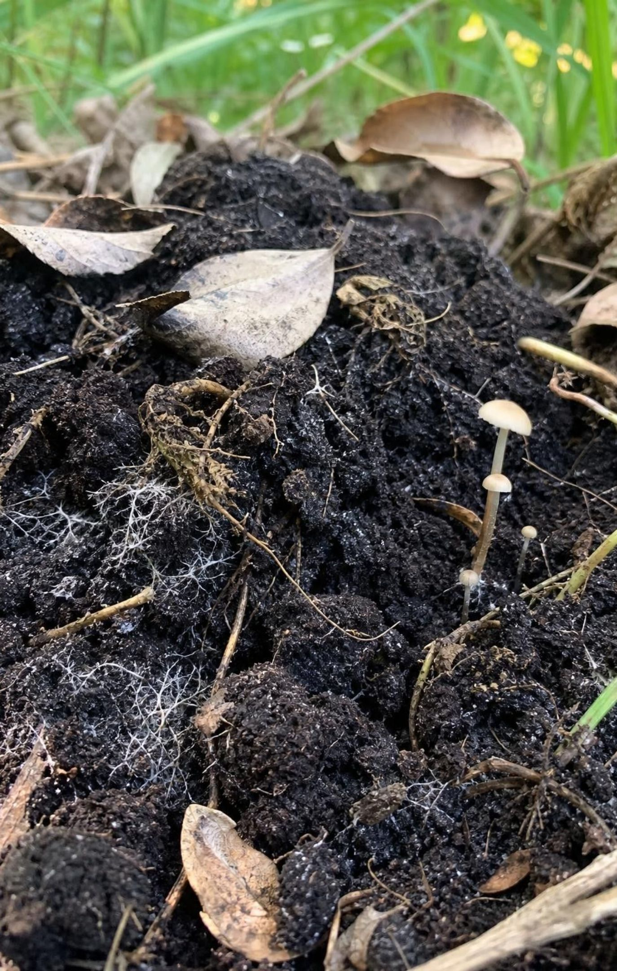
The meadow's quiet work: building soil
Plants take nutrients such as nitrogen from the soil as they grow, then drop leaves, stems and seeds.
Animals eat plants and one another, leaving wastes and, eventually, their bodies.
Fungi and bacteria break down that dead matter and release nutrients back into the soil.
Over many years this recycling builds dark, crumbly topsoil that holds water and feeds roots.
Matter cycles; the energy in dead matter is used by decomposers and leaves as heat.
A farm stays fertile through the same decomposer work in its own soil.
7
Notes:
Connect to Lessons 6 and 7. Ask what happens to a fallen leaf over a year. Students should say decomposers eat it. Push further: the atoms in the leaf go into the decomposers' bodies, into the air as carbon dioxide from their respiration, and into the soil as nutrients plants can take up. The energy does not go back into the soil; decomposers use it and it leaves as heat. Then the service: a farmer cannot buy a thick living topsoil quickly, because it took the work of countless decomposers over many years to build. Fertilizer can add nutrients but cannot replace the soil's structure and its living community.
WATCH FOR: 'Decomposers recycle energy' or 'the meadow's soil feeds the farm next door.' Matter cycles, energy does not, and each field depends on its own soil life.
CONNECTS TO: L06 and L07 for matter cycling; W2 vocabulary worksheet.
PACING: about 5 min

Slide 8
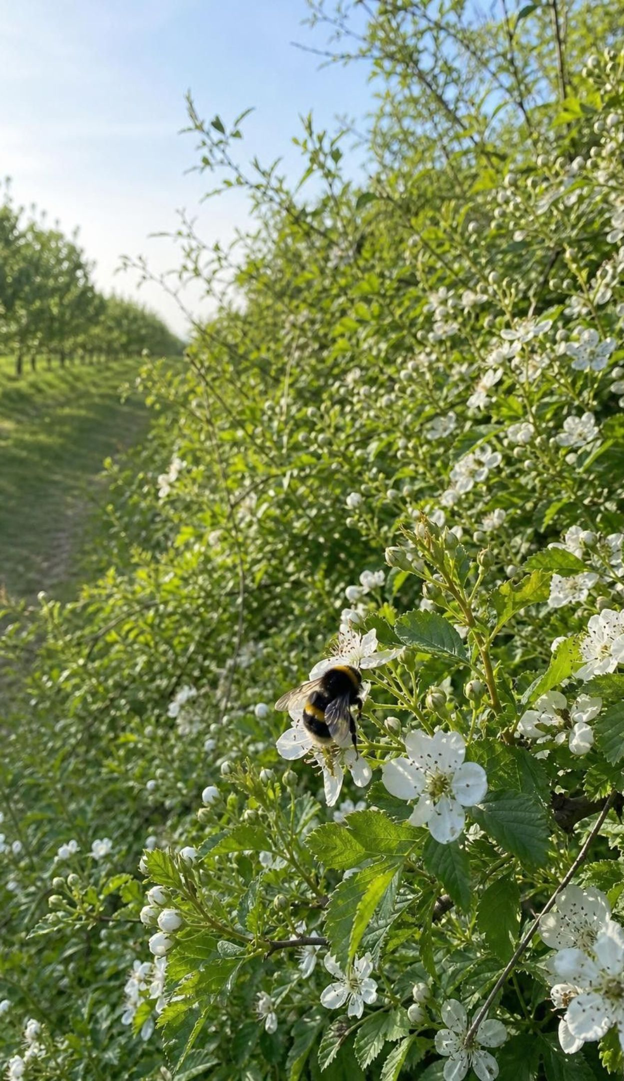
CHECK FOR UNDERSTANDING
Quick check: service, resource, or neither?
Wild bees nesting in a hedgerow visit the blossoms in the next orchard.
Copper ore is dug from a mine to make electrical wire.
A farmer sprays fertilizer on a field.
Marsh grasses slow storm waves before they reach a road.
Fungi in a forest floor turn fallen leaves into soil nutrients.
Label each S (an ecosystem service), R (a natural resource but not an ecosystem service), or N (neither: a human action).
8
Notes:
Run it with hand signals (one finger S, two R, three N), then ask for a reason on each. The copper item separates geological resources from ecosystem products. The fertilizer item is a human action that adds nutrients; ask what ecosystem service it is partly replacing (nutrient cycling by decomposers). The marsh and fungi items are services even though no one sees them working.
EXPECTED RESPONSES: 1 S (pollination), 2 R (a resource formed by geology), 3 N (a human action, a partial substitute for nutrient cycling), 4 S (flood and erosion protection), 5 S (decomposition and nutrient cycling).
WATCH FOR: Marking the fertilizer S because it helps plants. A service is work the ecosystem does, not work people do.
CONNECTS TO: W2 vocabulary worksheet; W10 mastery.
PACING: about 4 min

Slide 9
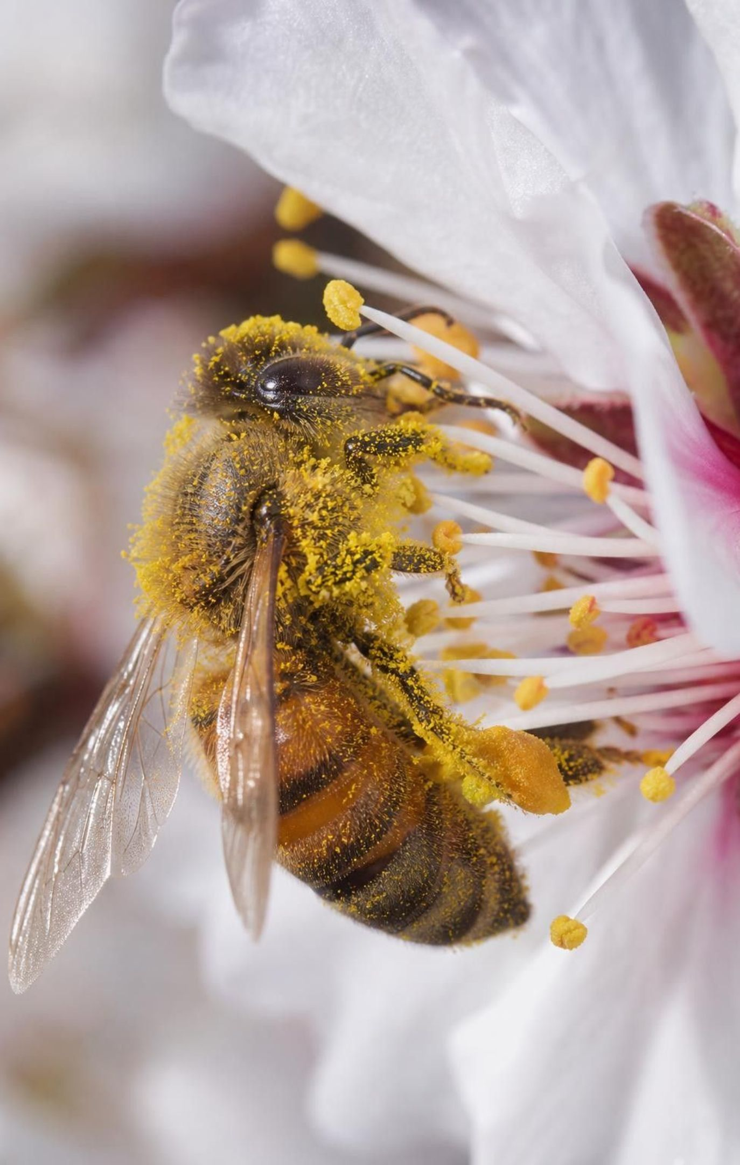
Pollination: the first step toward a nut
Pollen grains from a flower's anthers carry the male cells a plant needs to make seeds.
Pollination is moving pollen onto a stigma, the sticky tip of the flower's female part.
A pollen tube then grows down to an ovule; once fertilized, the ovule becomes a seed.
The almond you eat is a seed; its fuzzy hull and shell are the fruit, a cousin of the peach.
Most almond varieties reject their own pollen: they need pollen from a different, compatible variety.
Wheat, rice and corn are wind- or self-pollinated, so not every crop needs bees.
9
Notes:
Sketch a blossom on the board: petals, anthers holding pollen, and the stigma in the center. A bee pushes in to drink nectar and gather pollen; pollen sticks to its branched body hairs and rubs off on the next stigma it touches. Explain self-incompatibility in plain words: an almond tree's chemistry rejects pollen from its own variety, and because every tree of a variety is grown from grafted buds of the same original tree, every Nonpareil tree counts as 'self'. So bees must carry pollen between varieties. Mention the fun fact that almonds are related to peaches and plums; the hull splits open in late summer. Then correct a big myth: grain crops that feed most of the world do not need bees.
WATCH FOR: 'Any bee visit pollinates the flower' and 'without bees there would be no food.' Pollen has to be the right kind, and grains are wind- or self-pollinated.
CONNECTS TO: Lab 1 uses blue and pink chalk for two varieties; W5 data worksheet.
PACING: about 5 min

Slide 10
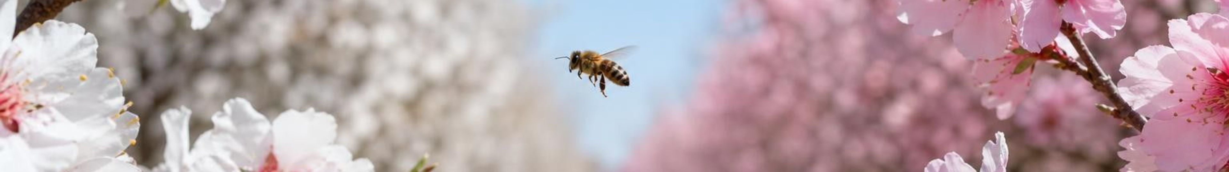
MODEL
From blossom to almond
Model: Cross-pollination in an almond orchard
Bee feeds at a Nonpareil blossom → (brushes the anthers)
Pollen sticks to its hairy body → (crosses to the next row)
Bee flies to a pollinizer-variety tree → (presses into a blossom)
01
02
03
Nonpareil pollen lands on a stigma → (a tube grows down)
Pollen tube reaches the ovule → (fertilized ovule develops)
Seed grows into a nut by late summer
04
05
06
Bees carry pollen both ways, so both compatible varieties can set nuts. Harvest usually runs from about August into October.
10
Notes:
Walk the arrows and ask students to say each step back. Then reverse it: what happens when the same bee flies from the pollinizer back to a Nonpareil tree? The Nonpareil blossom gets pollinizer pollen and can set a nut. This is why growers plant the pollinizer variety in alternating rows: shorter trips between varieties. Tell students that Lab 1 builds exactly this situation with chalk 'pollen' and a cotton-swab 'bee', and that a blossom in the lab counts as able to set a nut only when its stigma shows the other color.
WATCH FOR: Students think pollination happens inside one flower and the bee is only feeding. In almonds, the pollen must travel to a different variety.
CONNECTS TO: Lab 1 procedure and the O/S/N codes.
PACING: about 4 min

Slide 11
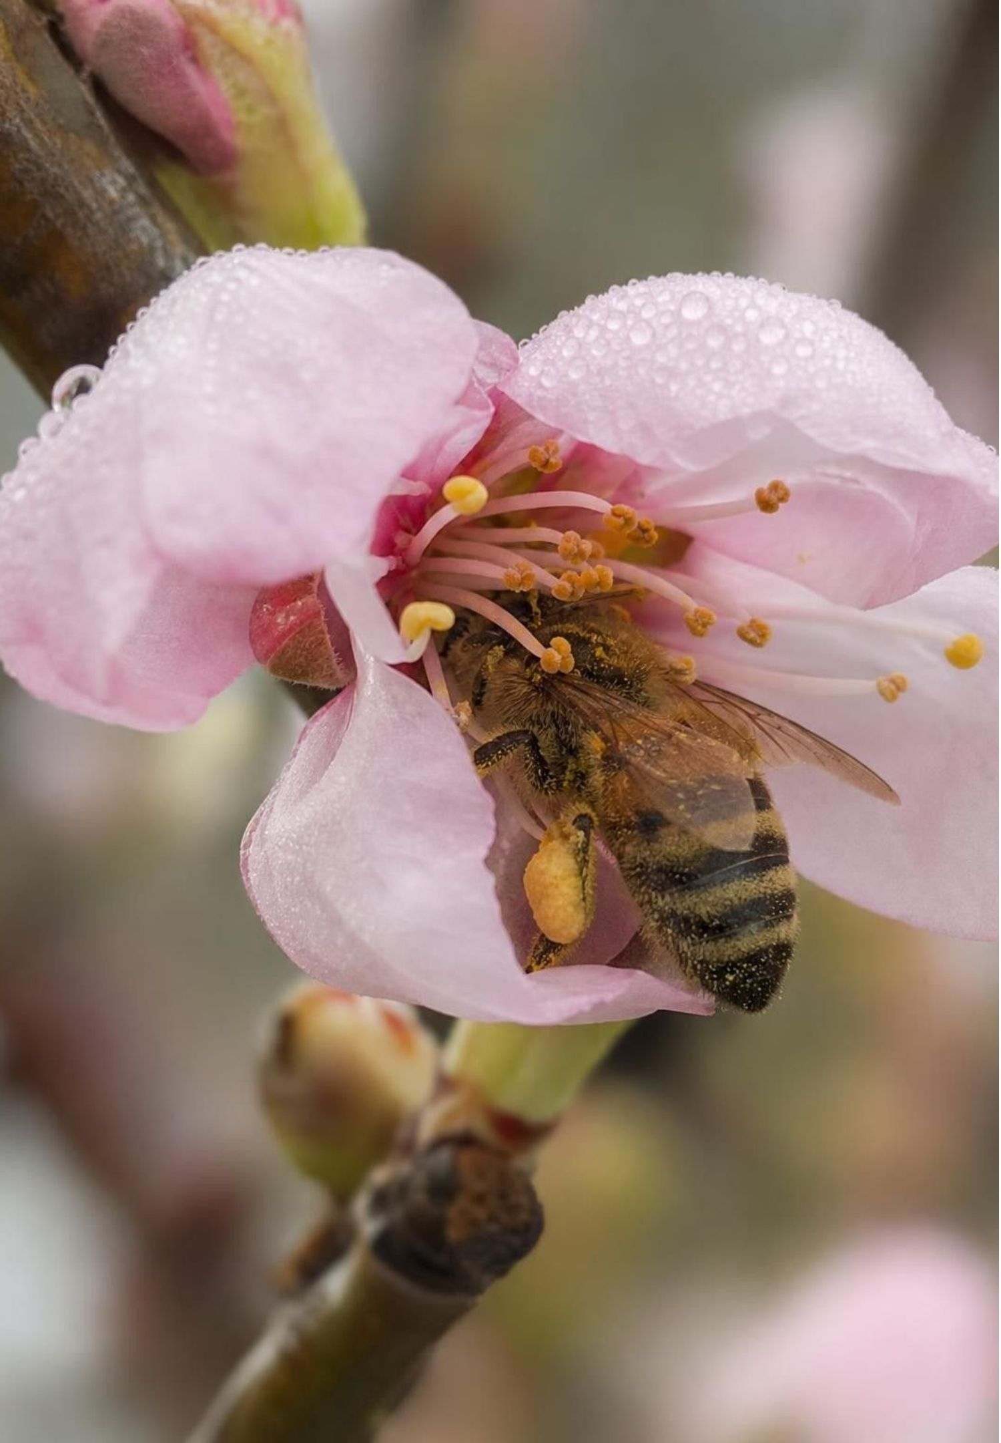
VOCABULARY IN CONTEXT
Two pollination words
pollination: Moving pollen from anthers to a stigma, the first step toward seeds and fruit; wind or animals can carry it. Bees pollinate almond blossoms while gathering nectar and pollen.
cross-pollination: Pollination with pollen from a different plant; most almond varieties need pollen from a different variety. A bee carrying pink-variety pollen to a blue-variety blossom cross-pollinates it.
11
Notes:
Have students add a third column to their vocabulary notes: 'needs an animal?' Pollination does not always: wind pollinates grasses, including wheat and corn. Cross-pollination in almonds almost always does, because almond pollen is heavy and sticky and is not carried well by wind. Introduce the word pollinizer for the variety planted to supply compatible pollen, and pollinator for the animal that carries it.
WATCH FOR: Mixing up pollinizer (a plant variety) and pollinator (an animal).
CONNECTS TO: W2 vocabulary worksheet; Lab 1 recording sheet background.
PACING: about 3 min

Slide 12
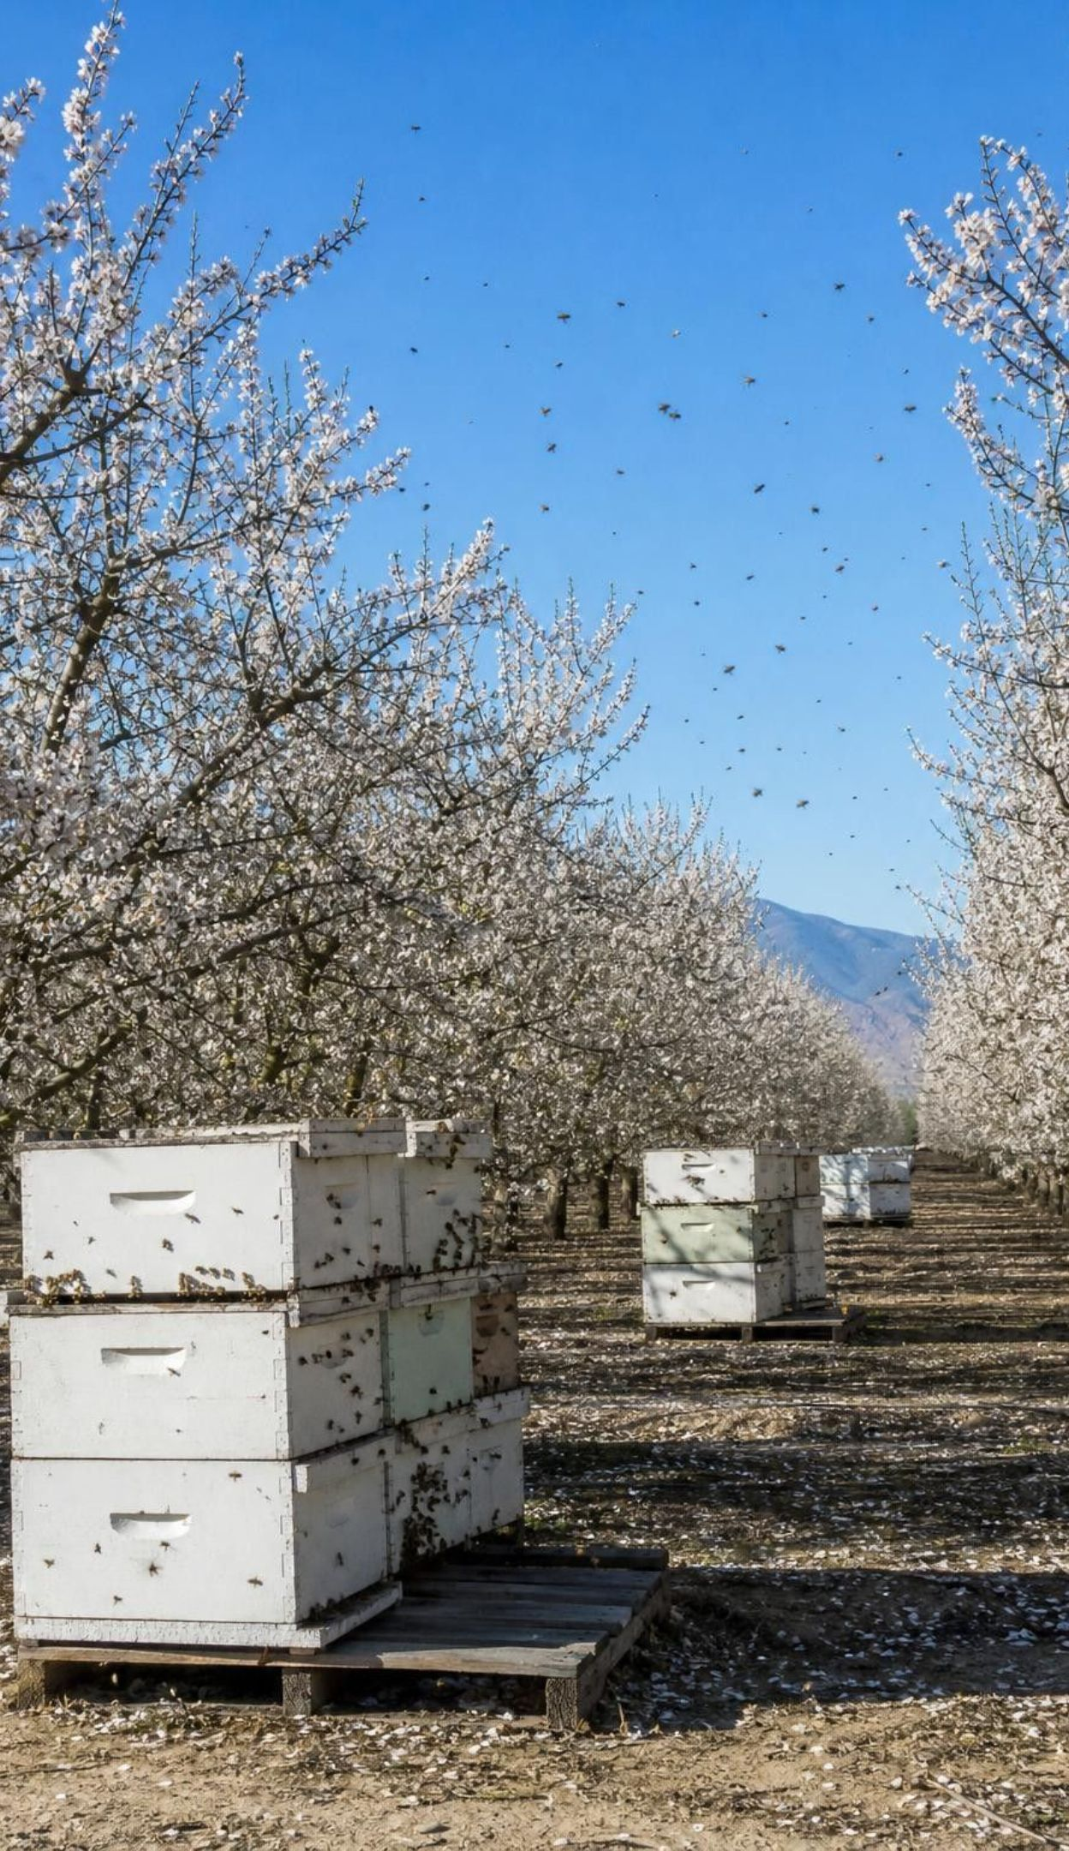
REAL-WORLD CONNECTION
California connection: renting a pollination service
California grows roughly 80 percent of the world's almonds on about 1.4 million acres of bearing orchards. Growers usually stock about two honey bee colonies per acre for varieties that need cross-pollination, and fewer for newer self-fertile varieties. One 2025 analysis put the 2024 demand near 2.7 million colonies, rented at an average of more than $200 each.
Honey bees came from Europe with colonists; the U.S. has about 4,000 native bee species.
Wild bees visit almond blossoms mostly where orchards border natural habitat or strips of wild plants.
These numbers change every year; treat them as estimates and always check the year.
12
Notes:
Do the rough math with the class: 1.4 million acres times about two colonies is about 2.8 million; self-fertile varieties stocked at about one colony per acre help explain why the analysis estimated about 2.7 million rather than 2.8 million. At over $200 a colony, the rent is more than half a billion dollars a year. Why so many rented bees? A valley planted almost entirely in orchards offers flowers for only a few weeks; the rest of the year there is little for wild bees to eat, and bare orchard floors leave few nesting sites. A study of 23 California orchards found wild bees on almond flowers only where natural habitat or a strip of semi-natural vegetation was next to the trees. Beekeepers face problems too: mites, viruses, poor nutrition and the stress of long trips weaken colonies, and in bad years many die over winter.
WATCH FOR: Students treat estimates as exact facts or assume the numbers never change. Model the language: 'about', 'estimated', 'in 2024'.
CONNECTS TO: Lab 1 q8 calculation and q9 information card; W5 data worksheet on orchard data and replacement cost; the slide 25 task.
PACING: about 5 min

Slide 13
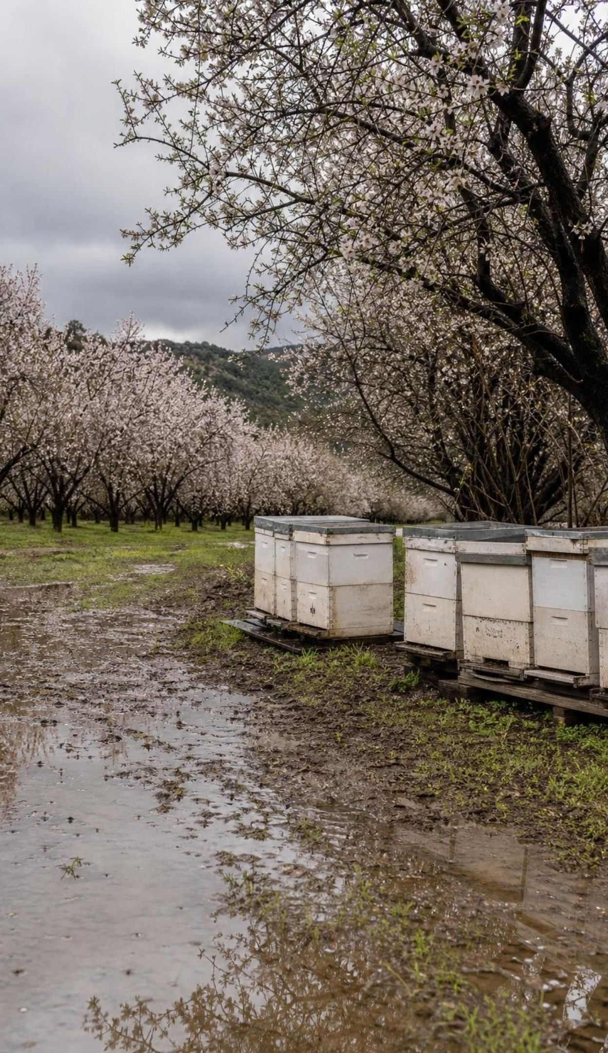
THINK, PAIR, SHARE
Discuss: why rent bees, and what could go wrong?
Think about what a bee needs all year, not just during the few weeks of bloom.
What happens if winter colony losses are high, or the weather at bloom is cold and rainy?
Name one solution besides renting more hives.
Before orchards, wild bees pollinated the valley's wildflowers. Why can't wild bees alone pollinate today's huge almond orchards, and what are the risks of depending on one rented species?
13
Notes:
Think-pair-share for four minutes, then a whole-class round. Steer toward three ideas. Habitat: native bees need flowers from early spring to fall and places to nest (bare ground, hollow stems, wood); a landscape of one crop gives a short feast and a long famine, plus pesticide exposure. Risk: relying on one species means one disease, mite outbreak or bad winter can raise prices for every grower at once, and moving millions of colonies together can spread disease. Solutions: plant hedgerows and cover crops that flower before and after almonds, leave nesting sites, manage native bees such as the blue orchard bee, plant self-fertile varieties, and keep pollinizer rows close. Tell students Lab 1 ends by evaluating these options.
EXPECTED RESPONSES: Wild bees cannot survive in large numbers where there is food for only a few weeks and few nest sites; risks include colony losses, rising rent, disease spreading between colonies, and bad weather at bloom; solutions include hedgerows, cover crops, native bee nesting sites, self-fertile varieties and closer pollinizer rows.
WATCH FOR: 'Just add more bees.' More hives cost money every year and depend on the health of the national honey bee supply.
CONNECTS TO: Lab 1 q9 and q11; W5 data worksheet.
PACING: about 7 min

Slide 14
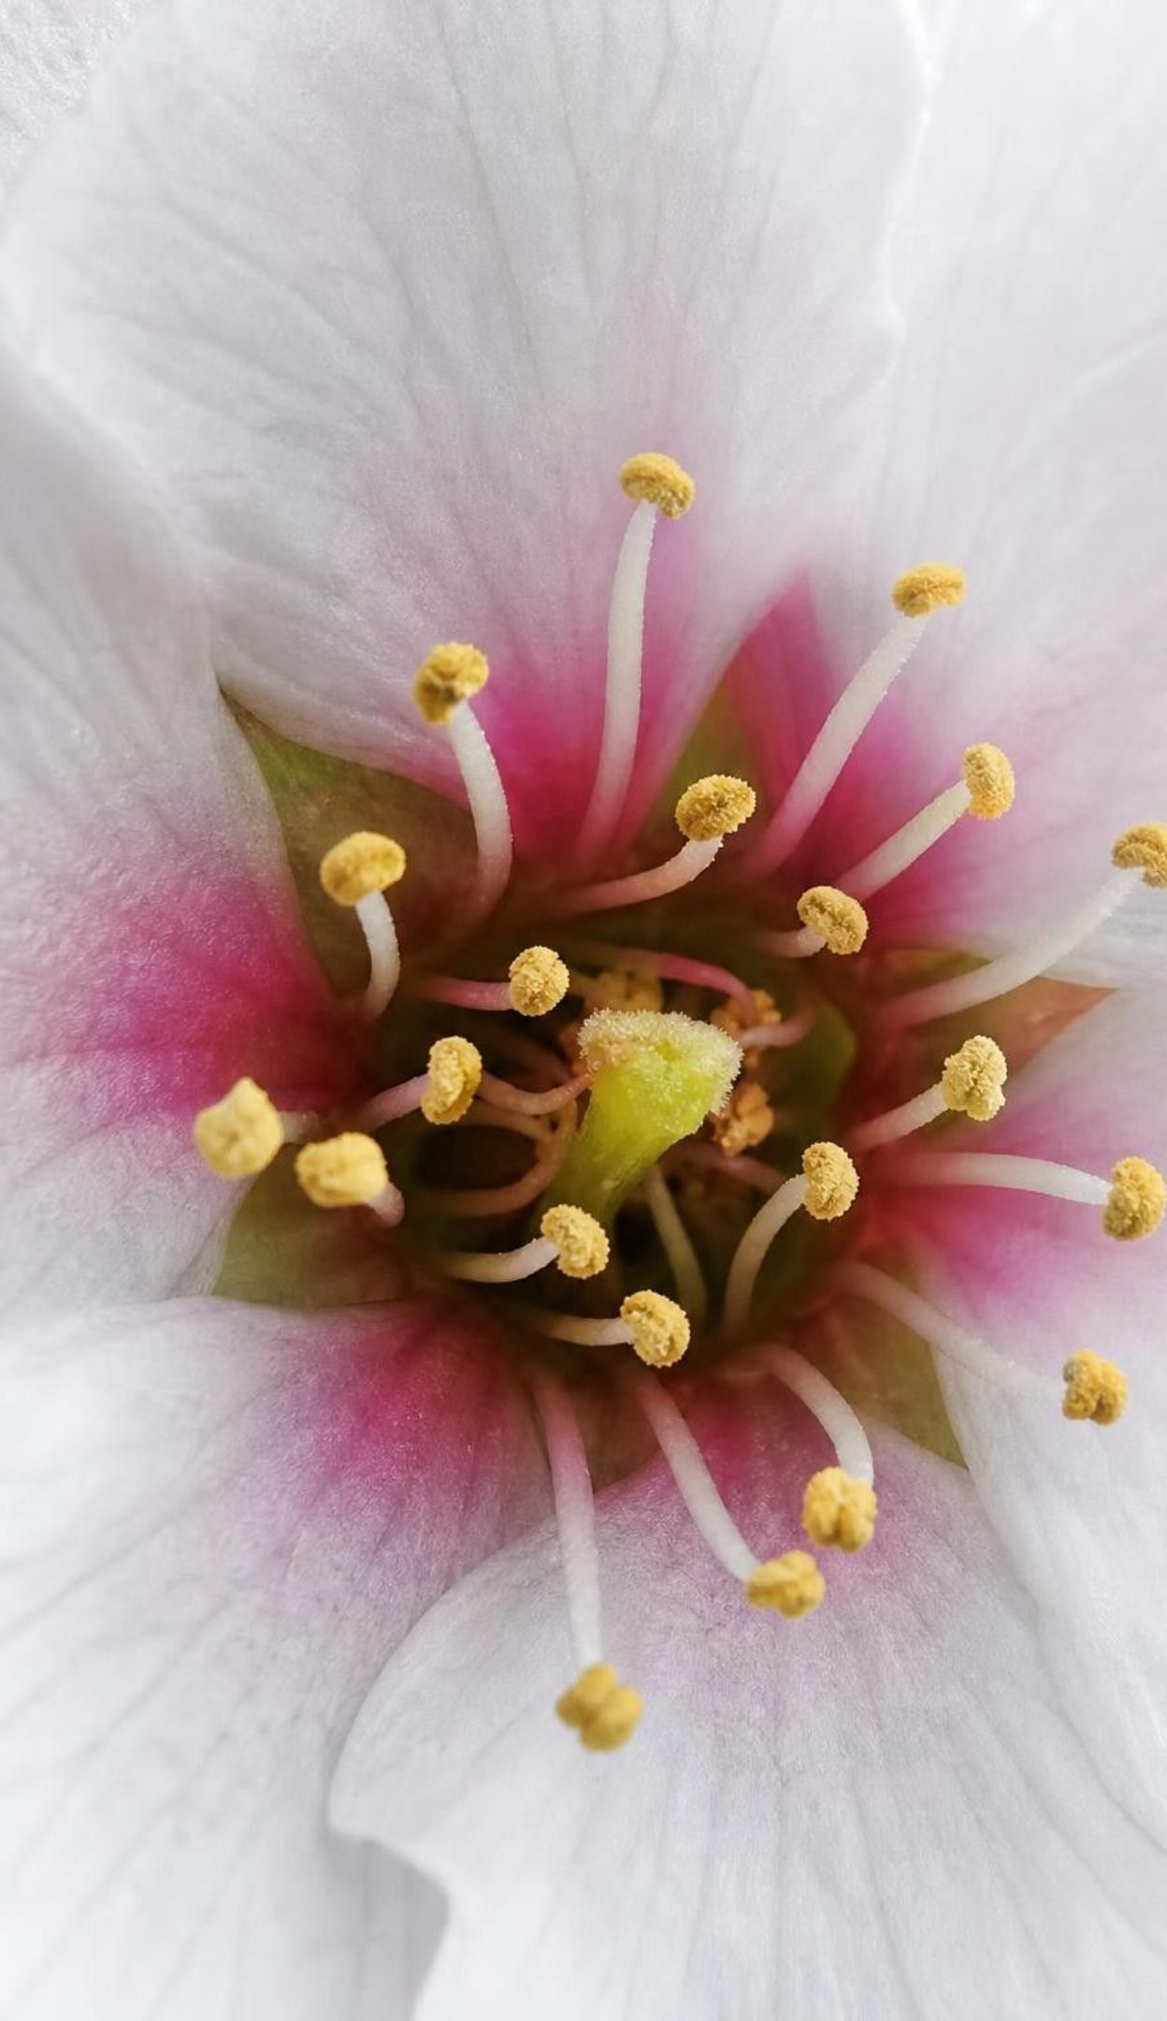
CHECK FOR UNDERSTANDING
Quick check: which blossom becomes a nut?
In Lab 1, the main variety (Nonpareil) is blue and the pollinizer is pink. Which blue blossom can set a nut?
A. Its stigma shows only blue chalk
B. Its stigma shows some pink chalk
C. Its petals were brushed many times by the swab
D. Any blossom the bee visited at least once
14
Notes:
Vote with fingers, then defend. Only a blossom that received pollen from a different, compatible variety can be fertilized, so the stigma must show pink. Many brushings of blue pollen do nothing for a blue blossom. Ask the follow-up: in which orchard layout would a bee land on a blue blossom while carrying pink pollen most often? Let students predict now and check in the lab. If this slide comes after Lab 1, ask groups to quote their S (own pollen only) counts as evidence.
EXPECTED RESPONSES: B, its stigma shows some pink chalk. A is own-variety pollen, which almond blossoms reject; C and D describe visits, not the right pollen arriving on the stigma.
WATCH FOR: Choosing D: a visit is not the same as cross-pollination.
CONNECTS TO: Lab 1 q3 and q6; W10 mastery.
PACING: about 4 min

Slide 15
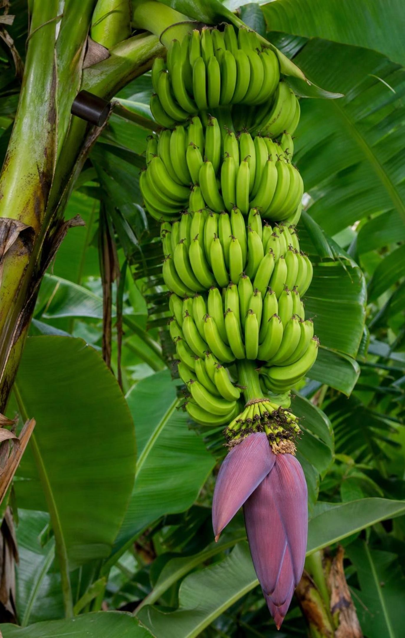
Biodiversity as insurance: the banana problem
Most bananas sold in U.S. stores are one variety, Cavendish, grown from shoots of parent plants: close copies.
Copies share weaknesses, so a disease that kills one plant can sweep through a whole plantation.
Cavendish took over because it resisted an older strain of Panama disease, a fungal wilt.
A newer strain, Tropical Race 4, does kill Cavendish and has spread to several continents.
Wild bananas carry varied traits, so breeders search them for disease resistance.
Disease resistance: inherited traits that make infection less likely or less harmful.
15
Notes:
Tell the story in order. In the mid-1900s the main export banana, Gros Michel, was hit by Panama disease, a soil fungus that makes the plant wilt; the export trade switched to Cavendish, which resisted that strain. Gros Michel did not go extinct; small farmers still grow it. Now a new strain called Tropical Race 4 kills Cavendish, cannot be controlled by fungicides, and has reached Asia, Australia, Africa and Latin America. Because every Cavendish plant is a copy grown from a cutting, there is little variety for natural selection or breeders to work with. Wild banana relatives in Southeast Asia have many different traits, some of which resist the fungus. Protecting those wild places protects the raw material for future crops. Note for accuracy: the textbook names yellow Sigatoka as the killer; that is a leaf-spot disease that cuts yields, not the wilt threatening Cavendish.
WATCH FOR: 'Bananas are about to go extinct.' Cavendish plantations are at risk, and banana diversity in general is not gone; the lesson is about relying on one variety.
CONNECTS TO: W8 jigsaw on bananas and biodiversity; L27 biodiversity.
PACING: about 5 min

Slide 16

MODEL
One drug, many links: India's vultures
Model: A chain of effects from cattle to people
Cattle treated with the painkiller diclofenac → (carcasses go to vultures)
Vultures eat treated carcasses and die of kidney failure → (drug builds up)
Vultures fall 97-99.9% (1992-2007) → (fewer scavengers)
01
02
03
Carcasses left for feral dogs and rats → (more food for dogs)
More dogs, more bites → (dogs spread rabies)
More rabies exposures and human deaths
04
05
06
Experiments confirmed the drug-to-vulture links; the links to dogs and people rest on population counts and district comparisons. India banned veterinary diclofenac in 2006, and at least one vulture species' decline has since slowed.
16
Notes:
Explain that vultures are scavengers: they eat animals that are already dead, and a large flock can strip a carcass in under an hour. In India, where many cattle die in the open, vultures were a free sanitation crew. In the 1990s a cheap veterinary painkiller, diclofenac, came into wide use; it is safe for cattle but causes kidney failure in the Gyps vultures that eat treated carcasses, even in small doses. Three species collapsed by roughly 97 to 99.9 percent in about fifteen years. With the cleanup crew gone, carcasses fed growing numbers of feral dogs and rats. Dogs are the main source of human rabies. Point out the size mismatch: a medicine for cows became a public-health problem for people. Mention that rabies is preventable with prompt medical care after a bite; anyone bitten by an animal should see a doctor.
WATCH FOR: Students think the drug harmed people directly or that vultures carry rabies. Trace each arrow: the harm reached people through the food web.
CONNECTS TO: W3 reading on India's vultures; W7 misconception worksheet.
PACING: about 6 min

Slide 17
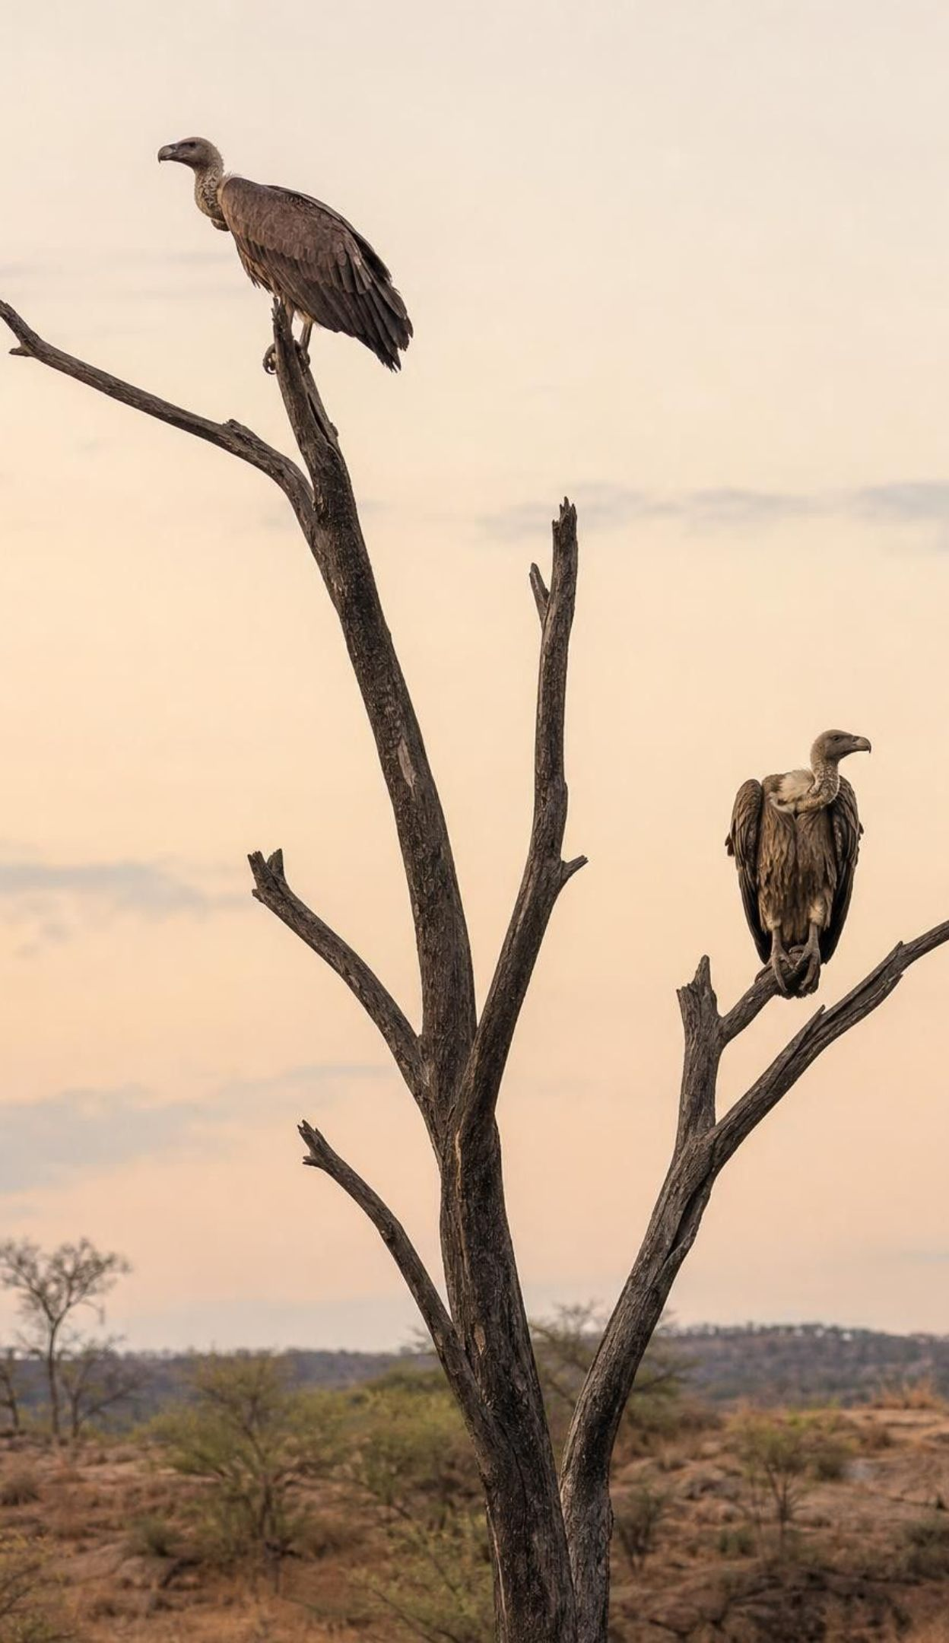
Think, pair, share
Discuss: a pattern, or a cause?
What else was changing in India between 1992 and 2007?
How could you compare places that lost their vultures with places that never had many?
If vultures were the cause, what would you expect to see in each kind of place?
A graph shows vultures falling while feral dogs rose. Does that alone prove the vulture loss caused more dogs and more rabies? What extra evidence would convince you?
17
Notes:
Give pairs three minutes. Then explain that two lines moving in opposite directions show a pattern, a correlation, not a cause. Other things changed too: India's human population and cities grew, and so did garbage that feeds dogs. Researchers handled this by comparison. Economists compared districts that had been good vulture habitat with districts where vultures were always rare, before and after diclofenac spread. Human death rates rose by more than 4 percent in the vulture districts but not in the others, and sales of rabies vaccine rose after 1996. That design, plus a mechanism that makes sense (dogs eating carcasses), makes a cause much more convincing. The researchers point to more dogs and rabies as one likely pathway, along with other disease spread from rotting carcasses.
EXPECTED RESPONSES: No, a pattern alone is not proof; growing cities and more garbage could also explain more dogs. Convincing evidence: a comparison of places with and without vulture loss, timing that matches the drug's spread, a mechanism (dogs feeding at carcass dumps), and records of dog bites or rabies vaccine use rising where vultures vanished.
WATCH FOR: 'If two things change together, one caused the other.' Also the opposite overcorrection: 'we can never know.' Good comparisons can make a cause convincing.
CONNECTS TO: W3 reading questions on evidence; L21 interactions.
PACING: about 7 min

Slide 18
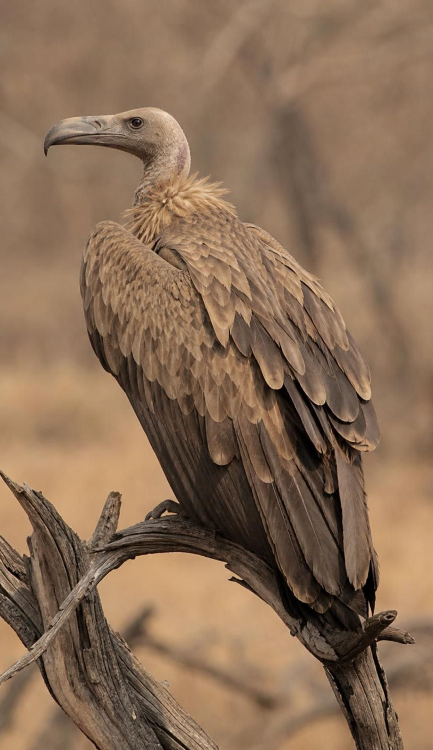
CHECK FOR UNDERSTANDING
Quick check: small change, big effect
Which statement best explains how a drug given to cattle ended up affecting human health in India?
A. The drug made beef unsafe for people to eat.
B. Losing a scavenger left carcasses for other scavengers that spread disease to people.
C. Vultures carry rabies, so dying vultures spread it to dogs.
D. The drug harmed dogs directly and made them aggressive.
18
Notes:
Quick vote, then ask one student to say the whole chain aloud without notes. Highlight that the answer is about an interaction: one population's loss opened food for another population. Ask a transfer question: what other scavengers or decomposers do jobs we rarely notice? (Carrion beetles, flies, crabs on a beach, bacteria and fungi.)
EXPECTED RESPONSES: B. The effect traveled through the food web: fewer vultures, more uneaten carcasses, more feral dogs and rats, more bites and rabies exposures. A, C and D are not supported: the harm to people came through dogs, not through the drug or the vultures themselves.
WATCH FOR: Choosing C: vultures were not spreading rabies; their absence let dogs increase.
CONNECTS TO: W7 misconception worksheet; W10 mastery.
PACING: about 3 min

Slide 19
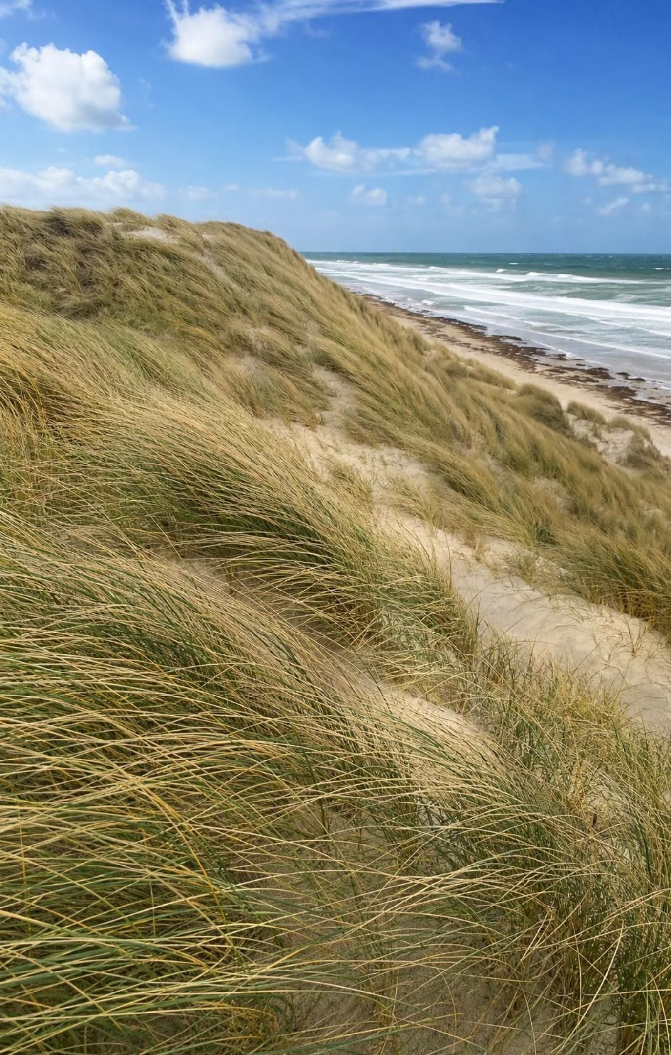
Dunes and marshes: living flood barriers
Dune grasses spread roots and buried stems through sand, holding it in place and trapping more.
A tall, plant-covered dune is a wall of sand that storm waves must wear down before reaching homes.
Marsh plants slow moving water and take energy out of waves; mud settles among the stems.
NOAA reports that about 15 feet of marsh can absorb roughly half of incoming wave energy.
Paving or building on dunes and marshes removes the buffer, and rising seas add to the risk.
Flooding is the most common and most costly kind of natural disaster in the United States.
19
Notes:
Ask students to picture a storm wave hitting bare sand, then hitting a dune knitted together by grass roots. The grass does not stop the storm; it keeps the sand in place so the dune can take the hit and rebuild between storms, because the plants trap blowing sand. Marshes work by friction: thousands of stems slow the water and calm the waves, and the slowed water drops its mud, which builds the marsh up. Then the human side: parking lots, roads and houses built on dunes remove the plants, and foot traffic tramples them. The textbook says marshes absorb floodwater; it is more accurate to say they absorb wave energy and slow the water. Last bullet source: FEMA. Avoid saying floods are the top killer; heat causes more U.S. weather deaths.
WATCH FOR: 'Dunes are just piles of sand' and 'marshes soak up the whole flood like a sponge.' Plants hold the sand; marshes mainly slow water and waves.
CONNECTS TO: Lab 3 Decision 2 (Shell Point); W6 CER on seawall or dunes; L26 floods.
PACING: about 5 min

Slide 20
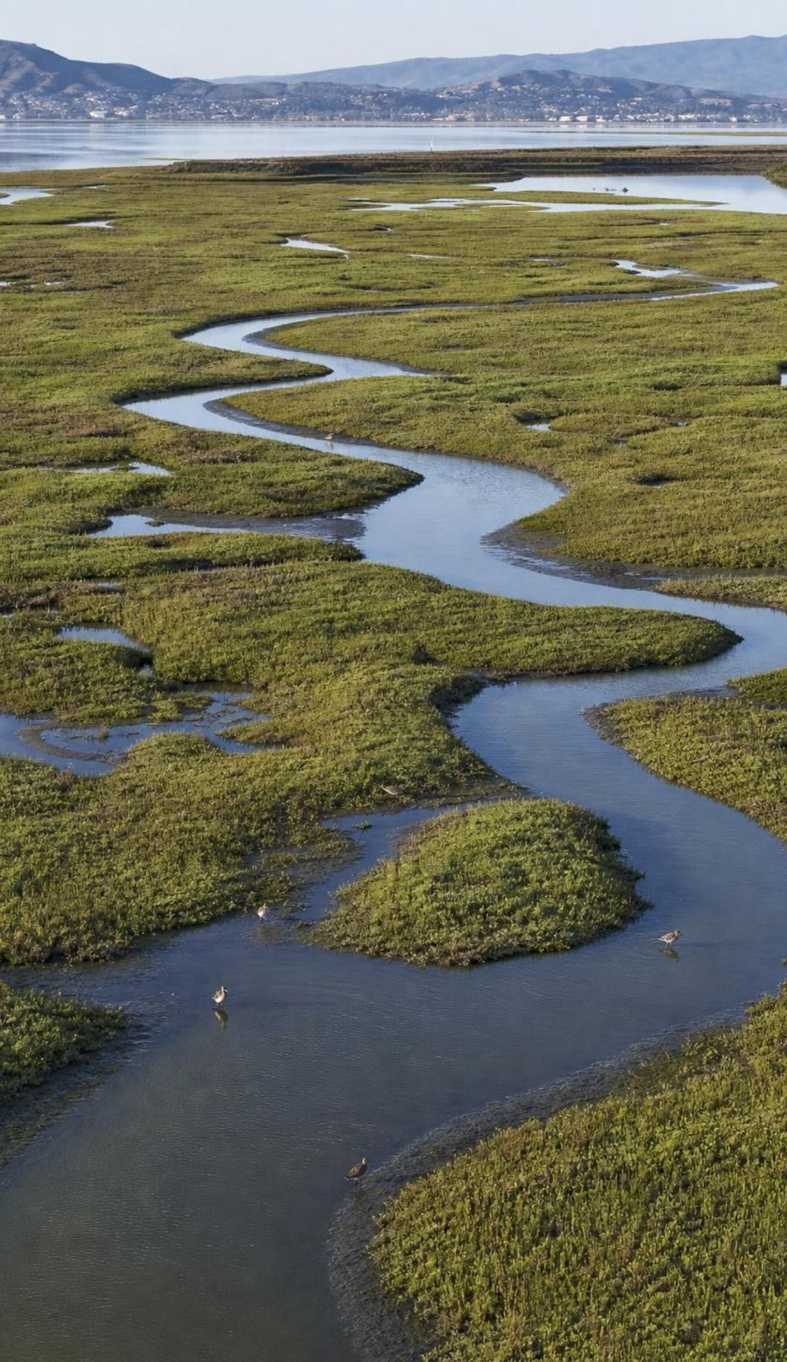
REAL-WORLD CONNECTION
California connection: giving the bay back its marshes
Around South San Francisco Bay, salt companies once walled off thousands of acres of tidal marsh into ponds to make salt. In 2003 about 15,100 acres of those ponds were bought for restoration. The South Bay Salt Pond Restoration Project has been opening levees so tides can rebuild marsh, with three goals: wildlife habitat, places for people to visit, and flood protection for shoreline towns.
Restored marsh can build upward by trapping sediment, which may help it keep pace with rising seas.
Flood plans pair restored marsh with levees on the landward side: nature plus structure.
The project is planned over decades, and its results are monitored as it goes.
20
Notes:
Show the bay on a map if you can: Silicon Valley's cities sit right at the edge of the water. The ponds were bought from a salt company with public and private money and are being restored in phases; it is the largest tidal wetland restoration on the West Coast. Ask students what the project is betting on: that a living marsh can soften waves, grow with the sea and give birds and fish a home, while a levee behind it holds back the highest water. This is a hybrid design, and students will meet the same idea in Lab 3. Be clear that the restoration takes many years and its outcomes are still being measured.
WATCH FOR: Students may think restoration means 'leave it alone and it fixes itself'. Here engineers open levees in planned steps and build new ones inland.
CONNECTS TO: Lab 3 Decision 2 hybrid question (q7); W6 CER.
PACING: about 4 min

Slide 21
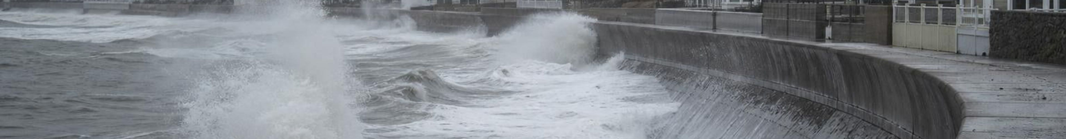
MODEL
Two ways to protect a beach town
Model: Seawall versus restored dunes and marsh · General trade-offs; how well each works depends on the site, the size of storms and the upkeep.
Concrete seawall | Restored dunes and marsh
Strong as soon as it is built | Takes several years for plants to establish
High building cost; repairs after big storms | Lower building cost; needs replanting and sand after big storms
Waves bounce off; the beach in front can narrow | Plants take energy out of waves and trap sand
Little habitat for plants or animals | Habitat for birds, fish and insects; trails for people
Does not grow as the sea rises | Can build up or shift inland if given room
21
Notes:
Read the two columns as a debate. Ask: which side would a homeowner who flooded last winter choose? Which would a shorebird biologist choose? Which would the town's budget officer choose? Point out that the seawall is a human-made replacement for a service the dunes used to provide for free, and that it brings side effects: waves reflecting off a wall can carry sand away from the beach in front of it. The restored dunes are slower to reach full strength but provide several services at once. Many towns combine both, which is why the 'both' column includes hybrid designs.
WATCH FOR: 'Nature is always better' or 'concrete is always stronger.' Each option meets some criteria better than the other.
CONNECTS TO: Lab 3 options 2A, 2B and 2C; W6 CER on seawall or dunes.
PACING: about 5 min

Slide 22
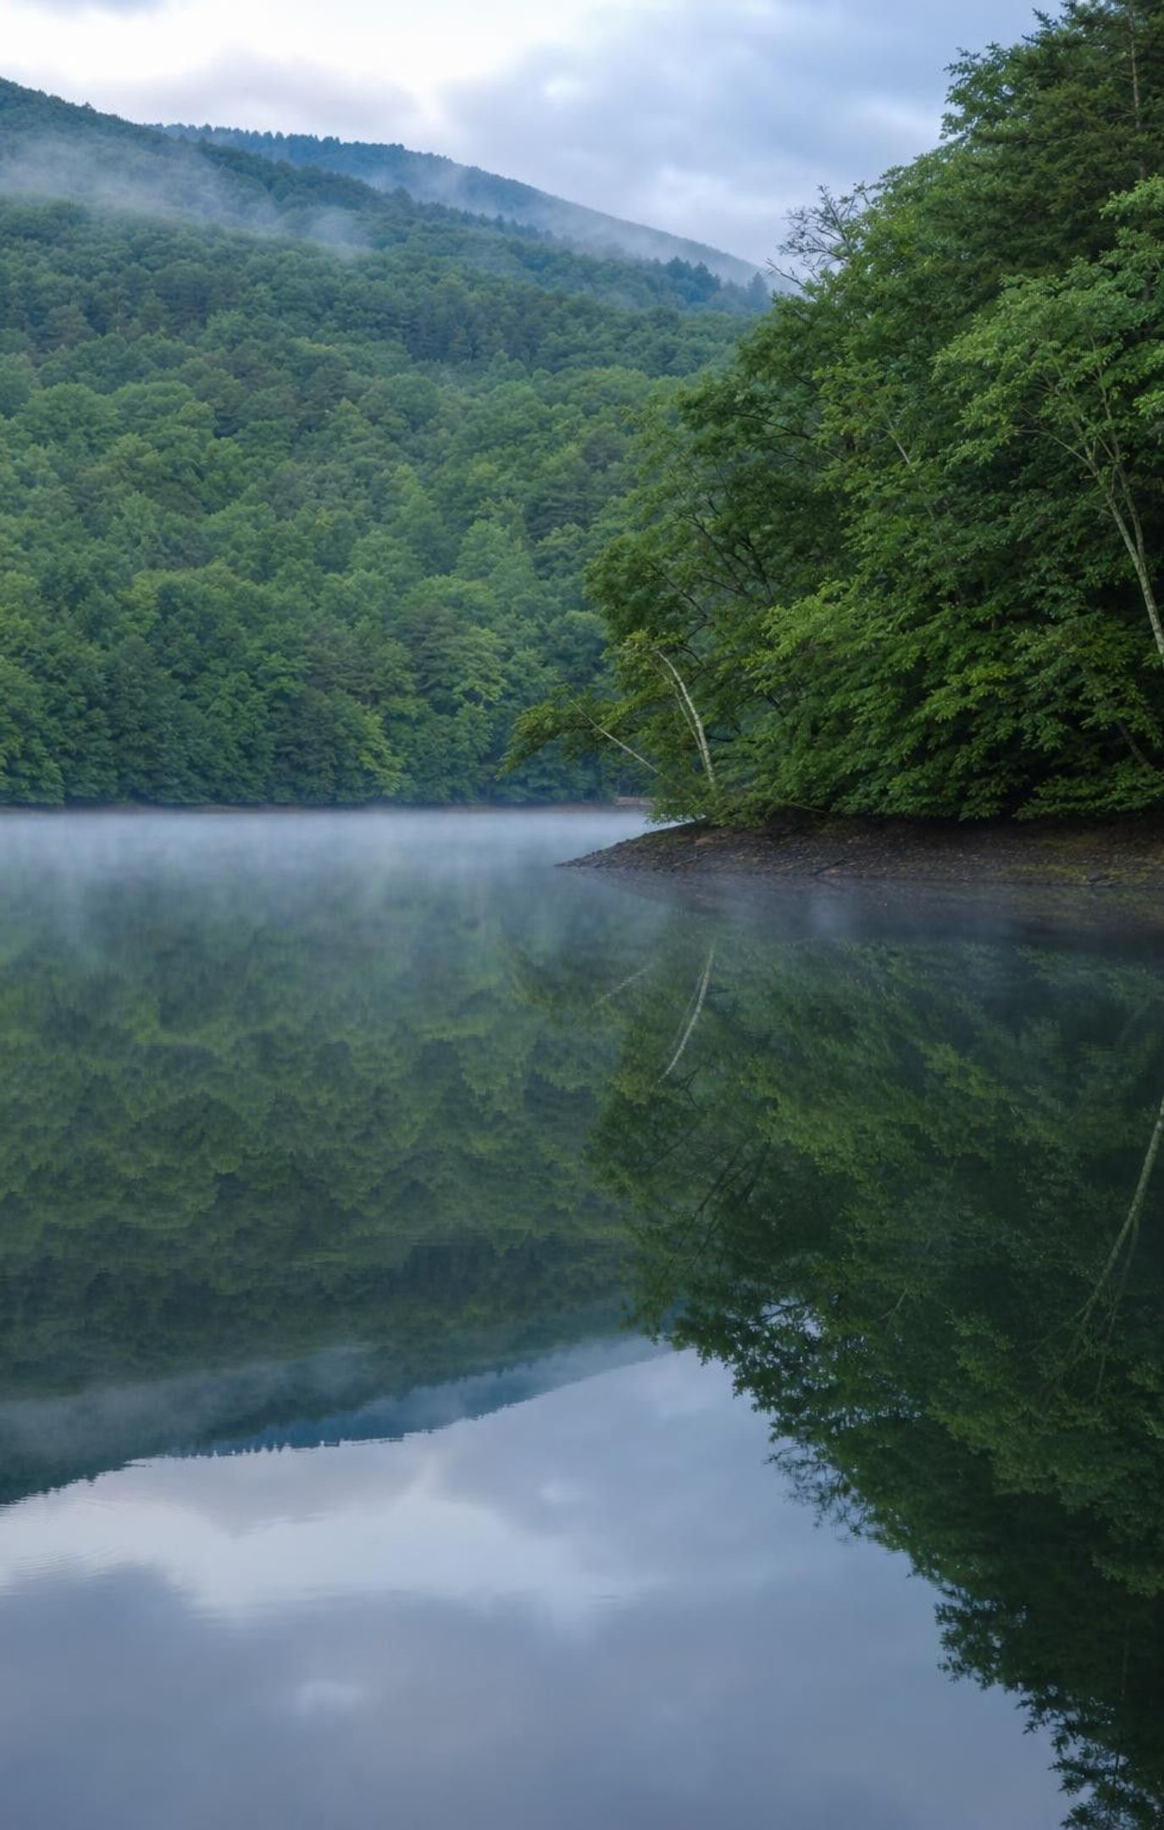
Engineering case: New York City's water
About nine million people use more than a billion gallons a day from upstate reservoirs.
Federal rules (1989) said surface water must be filtered unless the source could be kept very clean.
Criteria: clean, safe water; enough of it; a system that keeps working as the city grows.
Constraints: affordable for decades, and good for people and the environment upstate.
Choice: protect the mostly forested Catskill and Delaware watersheds instead of building a giant plant.
The water is still disinfected and tested; the forests and soils do much of the filtering.
22
Notes:
Tell the real story, which is a little different from the textbook's. Most of New York's water comes from the Catskill and Delaware reservoirs and was never filtered. Federal rules adopted in 1989 required filtration unless a city could show its source met strict standards and was protected. In the 1990s the city estimated a filtration plant for that water could cost up to about $6 billion to build and more than $300 million a year to run (an expert panel argued it might cost as little as half that). Instead, the city, upstate towns, the state and the federal government signed a 1997 agreement: the city buys land and easements, upgrades upstate sewage plants and septic systems, and pays farmers to keep manure and soil out of streams, budgeted at about $1.5 billion over ten years. Since 1993 federal regulators have accepted that the protected watershed keeps the water clean enough to skip filtration, as long as the protections continue. The water is still disinfected. The smaller Croton system, about a tenth of the supply, is filtered.
WATCH FOR: 'New York's water needs no treatment.' Watershed protection replaces filtration, not disinfection.
CONNECTS TO: Lab 2 q9 compares the class filters with this watershed; W4 diagram worksheet on how a watershed cleans water; Lab 3 Decision 1.
PACING: about 6 min

Slide 23
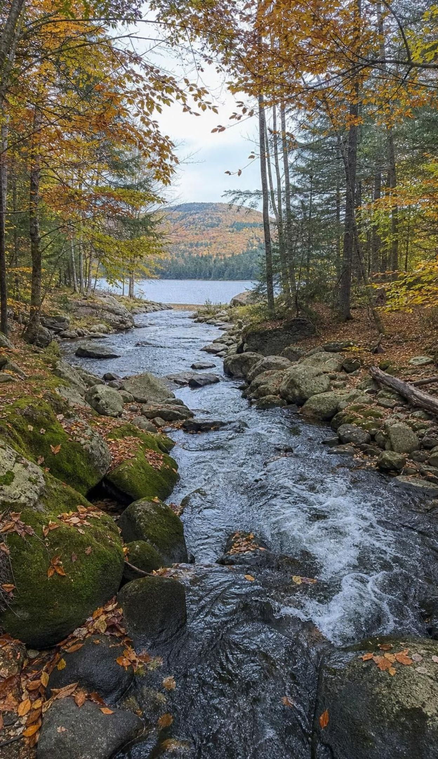
VOCABULARY IN CONTEXT
Words for water and value
watershed: All the land that drains rain and melted snow into the same stream, lake or reservoir. The Catskill forests are part of the watershed for New York City's reservoirs.
turbidity: How cloudy water is because of particles floating in it; higher turbidity means murkier water. Lab 2 rates turbidity by comparing filtered water with reference cups.
replacement cost: An estimate of a service's worth: what people would pay for a human-made substitute that does the same job. A filtration plant's cost is the replacement cost of a forest's water cleaning.
23
Notes:
Ask students to name their own watershed: which creek or river does rain on the school roof eventually reach? (Look it up ahead of time if you can.) For turbidity, show a jar of muddy water settling: turbidity drops as particles sink. For replacement cost, stress that it is an estimate with limits: it counts only the job the substitute does, not the habitat, trails or wildlife that a forest also provides, and it can overstate value if no one would actually build the substitute.
WATCH FOR: 'Replacement cost is the true price of nature.' It is one way to estimate part of the value.
CONNECTS TO: Lab 2 clarity scale; Lab 3 q3 and q6; W2 vocabulary.
PACING: about 3 min

Slide 24
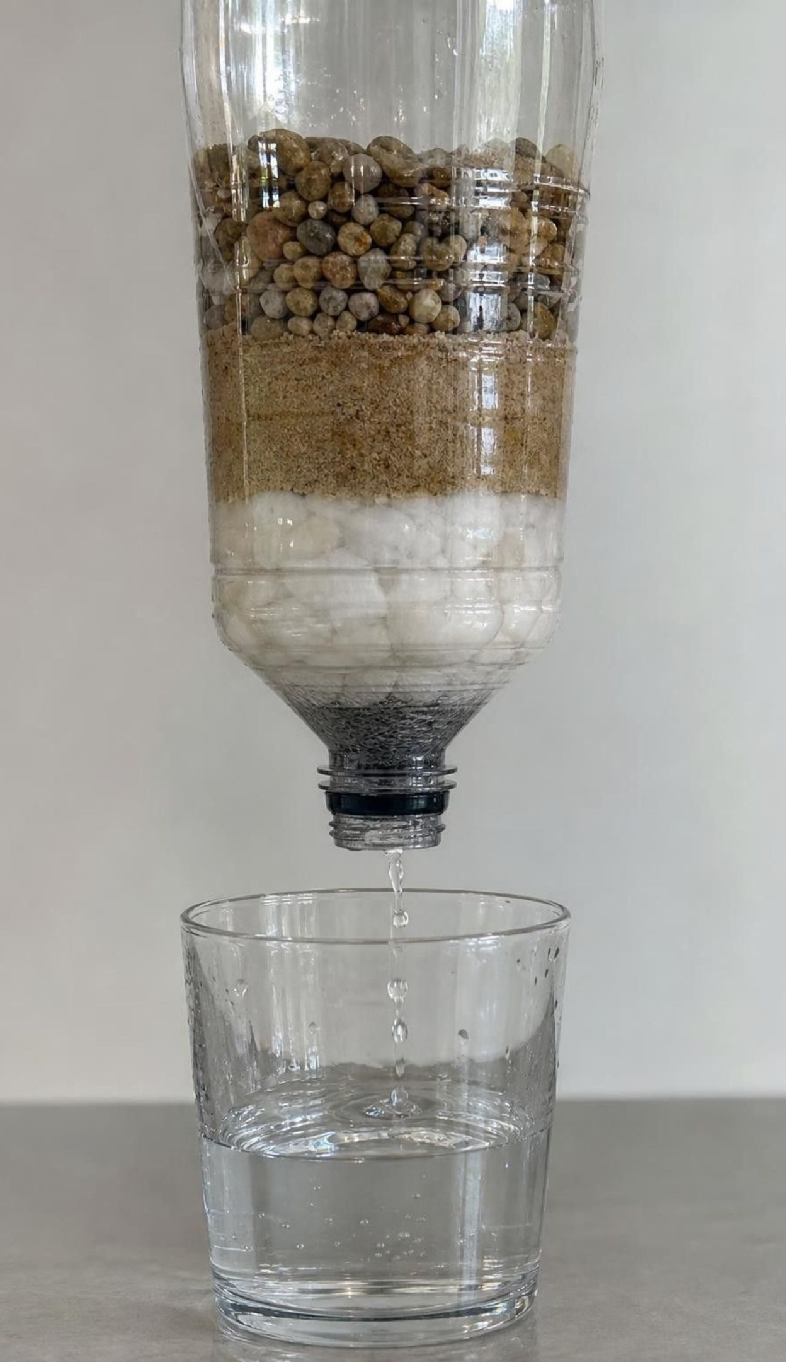
Check for understanding
Quick check: criterion or constraint?
The filtered water must reach a clarity rating of at least 3.
The team may spend no more than $10 in classroom money.
At least 150 mL must come out within 3 minutes.
Only sand, gravel, cotton balls and coffee filters may be used.
All layers must fit in the top half of one bottle.
For the Lab 2 filter challenge, label each C (criterion: what success requires) or K (constraint: a limit you must stay within).
24
Notes:
Have students write C or K on mini whiteboards. Then tie back to New York: clean water and enough of it were criteria; cost and protecting the environment were constraints. Emphasize precision: 'clean' is not testable, but 'a clarity rating of at least 3' is. Ask a student to rewrite a vague criterion, such as 'the filter should be fast', into a precise one.
EXPECTED RESPONSES: C, K, C, K, K. The clarity rating and the 150 mL in 3 minutes describe success; the budget, the allowed materials and the size limit restrict how teams may reach it.
WATCH FOR: Calling every rule a criterion. A criterion is about what the design must achieve; a constraint limits the ways you may achieve it.
CONNECTS TO: Lab 2 recording sheet; W9 transfer design challenge.
PACING: about 4 min

Slide 25
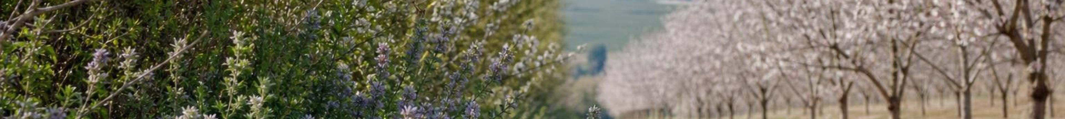
APPLY IT · SIMULATED DATA FOR PRACTICE.
Task: the Valley Orchard pollination plan
A fictional 200-acre almond orchard needs a 10-year pollination plan. Find the 10-year cost of each plan, then decide which you would choose and what you would still want to know.
Plan | Up-front cost | Yearly cost | 10-year total | Other effects
A: rent 2 hives per acre (400 hives at $200) | $0 | $80,000 |  | Depends on hive supply and price each year
B: plant 2 miles of flowering hedgerow and rent 1.5 hives per acre (300 hives) | $24,000 | $63,000 |  | Feeds wild bees, birds and pest-eating insects; wild bees help most near the hedgerow
C: rent 2.5 hives per acre (500 hives) | $0 | $100,000 |  | Extra bees help most in cold, rainy bloom years
25
Notes:
Tell students the orchard and the numbers are a teaching dataset; the $200 hive rent is close to recent averages, and the hedgerow figures are invented. Give groups eight minutes. Step 1: compute each 10-year total (up-front plus ten times the yearly cost). Step 2: decide. Step 3: name what is uncertain. Plan B's yearly cost is the rent for 300 hives ($60,000) plus $3,000 of hedgerow upkeep. Push on the key uncertainty: Plan B is only as good as the wild bees it attracts, and the California study found wild bees mostly near orchard edges. A careful grower might test Plan B on part of the orchard first and count bee visits and nut set. This task is a small version of Lab 3: competing solutions, costs, and what money leaves out.
EXPECTED RESPONSES: A: $0 + 10 x $80,000 = $800,000. B: $24,000 + 10 x $63,000 = $654,000. C: $0 + 10 x $100,000 = $1,000,000. Many choose B because it is cheapest and supports wild bees and other wildlife, but full credit names the risk that wild bees may not make up for 100 fewer hives across the whole orchard and proposes a test (try it on some blocks, count bee visits, compare nut set). Some choose C as insurance against bad weather; that is defensible if they argue it with the cost difference.
WATCH FOR: Students pick the cheapest plan without asking whether it still meets the pollination criterion, or dismiss B because it costs more in year 1.
CONNECTS TO: Lab 1 q8 and q9; W5 data worksheet; Lab 3; W9 transfer.
PACING: about 10 min

Slide 26

MISCONCEPTION CHECK
True or false? Clear water is clean water
"If the water coming out of a Lab 2 filter is crystal clear, it is safe to drink, so a town with a good enough filter does not need a healthy watershed."
True or false? Explain your reasoning.
Notes:
Have students write true or false with two reasons, then share. False, for two different reasons. First, clarity measures only particles big enough to make water look cloudy. Bacteria and viruses are far smaller than sand grains can trap, and dissolved substances such as salts, fertilizer nitrate and some pesticides pass through any sand filter and are invisible. That is why every public water system disinfects and tests, and why no one tastes Lab 2 water. Second, even if a filter could do the whole job, it costs money every year, clogs, needs power and parts, and provides nothing else, while a forested watershed filters continuously and also provides habitat, recreation and flood control. New York City still disinfects its watershed water: the forest replaces the filter, not the safety steps.
EXPECTED RESPONSES: False. Clear water can still carry germs and dissolved chemicals that sand, gravel and cotton cannot remove, so it must be disinfected and tested. A filter also costs money to build and run and clogs, while a protected watershed cleans water continuously and provides other services; the best systems protect the source and still treat the water.
WATCH FOR: Overcorrecting to 'filters are useless.' Filters remove particles well; they are one step, not the whole safety system.
CONNECTS TO: Lab 2 q8 and q9; W7 misconception worksheet.
PACING: about 6 min

Slide 27
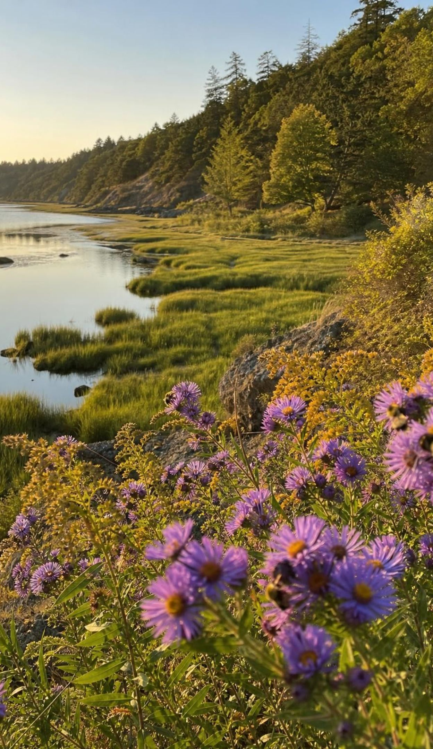
PUTTING IT TOGETHER
Putting it together
Ecosystem services come from organisms and nonliving parts doing their everyday work.
Almond growers rent honey bees because huge one-crop orchards support few wild pollinators.
Biodiversity is insurance: wild relatives hold traits, such as disease resistance, that crops may need.
Small changes ripple: a cattle drug, fewer vultures, more dogs, more rabies.
Substitutes such as rented hives, filters and seawalls can work, but they cost money and do one job.
Good decisions compare options against precise criteria and constraints, using evidence.
27
Notes:
Have each student write a five-sentence summary that uses at least five vocabulary words and one number from a lab. Pairs trade and check that each summary names who does the work in each service. Then go around the room for one thing from each lab: Lab 1 (which layout set the most nuts and why), Lab 2 (one feature worth copying from another team), Lab 3 (one option the group changed its mind about). Preview Lesson 29: engineers design solutions that protect ecosystems while meeting people's needs, using the same criteria-and-constraints reasoning.
CONNECTS TO: W10 mastery as the quiz; W9 transfer; L29 Engineering Solutions for Protecting Ecosystems next.
PACING: about 5 min

Slide 28
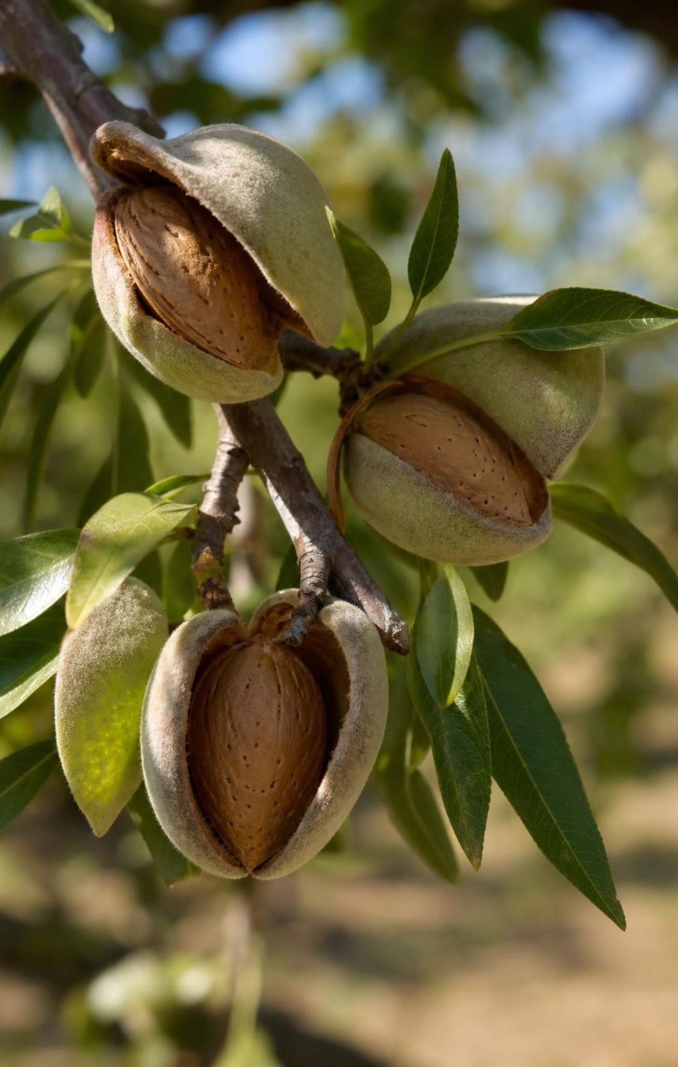
EXIT TICKET
Exit ticket
Name one ecosystem service near your home and the organisms that provide it.
Explain why a Nonpareil blossom dusted only with Nonpareil pollen will not become a nut.
A seawall costs $28 million to build plus $0.4 million a year. What is its 30-year cost?
Give one benefit of a restored dune that the seawall's price tag does not show.
28
Notes:
Collect on index cards. Item 1 checks that students can name a service and its workers; item 2 checks cross-pollination; item 3 checks the multi-year cost method used in Lab 3; item 4 checks that students see value beyond replacement cost. Sort the cards into three piles before the next class and reteach from the largest pile.
EXPECTED RESPONSES: 1: for example, trees in a park shading and cooling the street, or bees in a garden pollinating squash. 2: Nonpareil cannot be fertilized by its own variety's pollen; it needs pollen from a different, compatible variety carried by a pollinator. 3: $28 million + 30 x $0.4 million = $28 million + $12 million = $40 million. 4: habitat for shorebirds and insects, a place to walk, sand that stays on the beach, protection that can grow as the sea rises.
WATCH FOR: Item 3 answers of $28.4 million (forgetting to multiply the yearly cost by 30) or $40.4 million; item 2 answers that say the blossom 'was not visited enough'.
CONNECTS TO: W10 mastery; chapter evidenceOfLearning.
PACING: about 5 min

