Slide 1
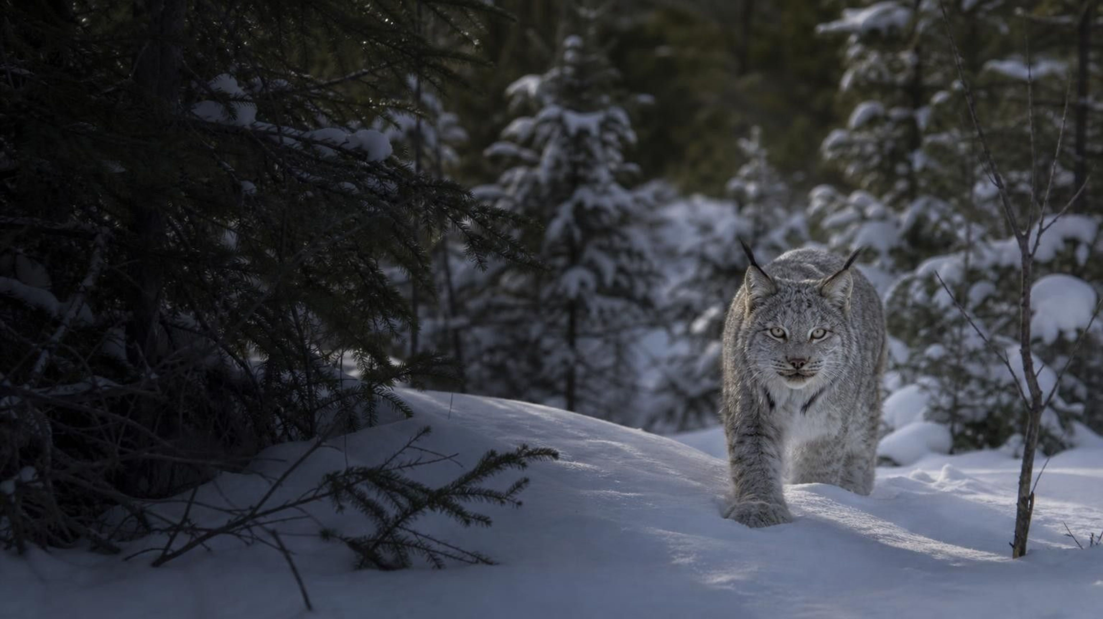
Engineering Solutions for Protecting Ecosystems
Chapter 29 of 29 · Humans and Changing Ecosystems
Lesson 29: More people, more use per person. How do we choose fixes that protect ecosystems?
Angela's Wand · Bring Science Alive! 7th Grade Integrated
Notes:
This lesson closes the unit on humans and changing ecosystems. Lessons 27 and 28 showed why biodiversity and ecosystem services matter; now we ask how human numbers and habits put pressure on them, and how engineers and communities design, test and choose fixes. Preview the three investigations: a token game of a fished lake that students will push to collapse and then try to rescue, a fishing net they will design so small fish escape, and a decision about protecting farm families from a bat-borne virus without destroying the bats, where every option has a cost. Nothing needs heat, chemicals or live animals.
CONNECTS TO: Overview of Lab 1, Lab 2 and Lab 3; W1 opens on the next slide.
PACING: about 2 min

Slide 2
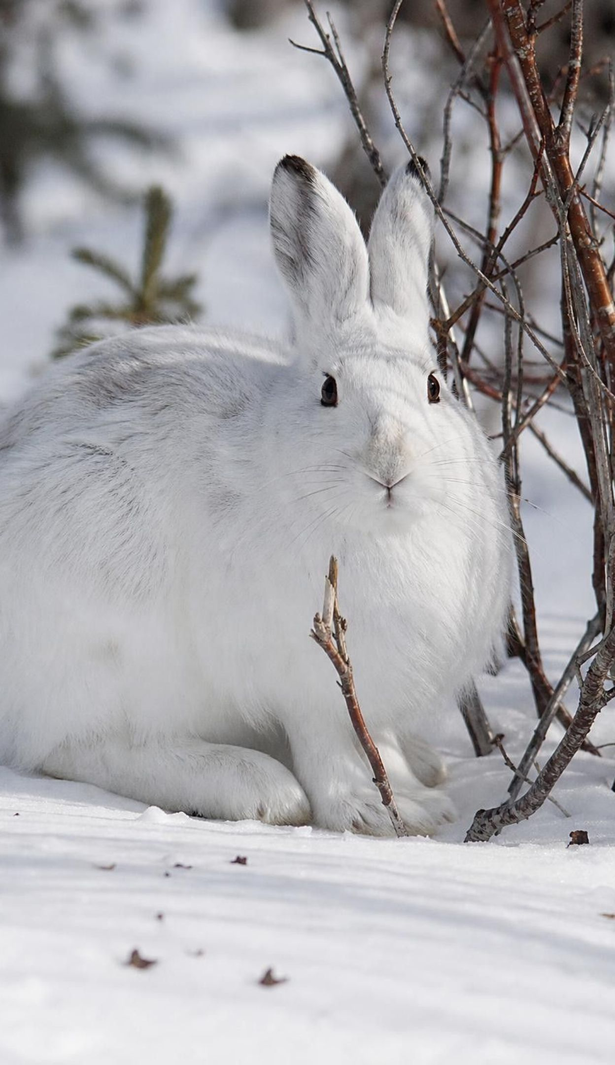
PHENOMENON
Ten-year waves and one rising line
For about a century, Hudson's Bay Company traders recorded how many lynx pelts trappers sold each year in northern Canada. The counts rose and fell in waves about ten years apart, just after waves in snowshoe hares, the lynx's main food. Over the same years the human population only climbed, from about 1 billion around 1800 to about 8.2 billion in 2025 (UN estimate).
Notice: what repeats in the lynx record? What never repeats in the human record?
Wonder: what stops a lynx population from climbing forever?
Predict: where does the food for 8.2 billion people come from, and what happens there?
2
Notes:
Give two silent minutes for a notice and a wonder, then collect ideas without judging them. Push on two questions. First, why would a population fall at all? Students usually say 'they ran out of food' or 'something ate them'; both are good starting hypotheses. Second, why has the human line never turned down in the last two centuries, when we also need food? Park the answers; slides 6 and 7 come back to them. Point out the source years: 8.2 billion is the United Nations estimate for 2025 (World Population Prospects 2024), and the textbook's 'well over 7 billion' was true when the book was written.
EXPECTED RESPONSES: Notice: the lynx and hare numbers go up and down again and again; the lynx peaks come a little after the hare peaks; the human line only rises and gets steeper after 1900. Wonder: Do the lynx eat all the hares? Do the hares run out of plants? Why don't people crash? Predict: farms, fishing grounds, forests and trade from far away; those places lose habitat, fish or water.
WATCH FOR: 'The human population is growing faster than ever.' The total is still rising, but the yearly growth rate has been falling since the 1960s; flag it for slide 7. Also listen for 'rabbits': the lynx's prey is the snowshoe hare.
CONNECTS TO: W1 phenomenon worksheet; Lab 1 Part A models the wild-versus-human contrast.
PACING: about 8 min

Slide 3
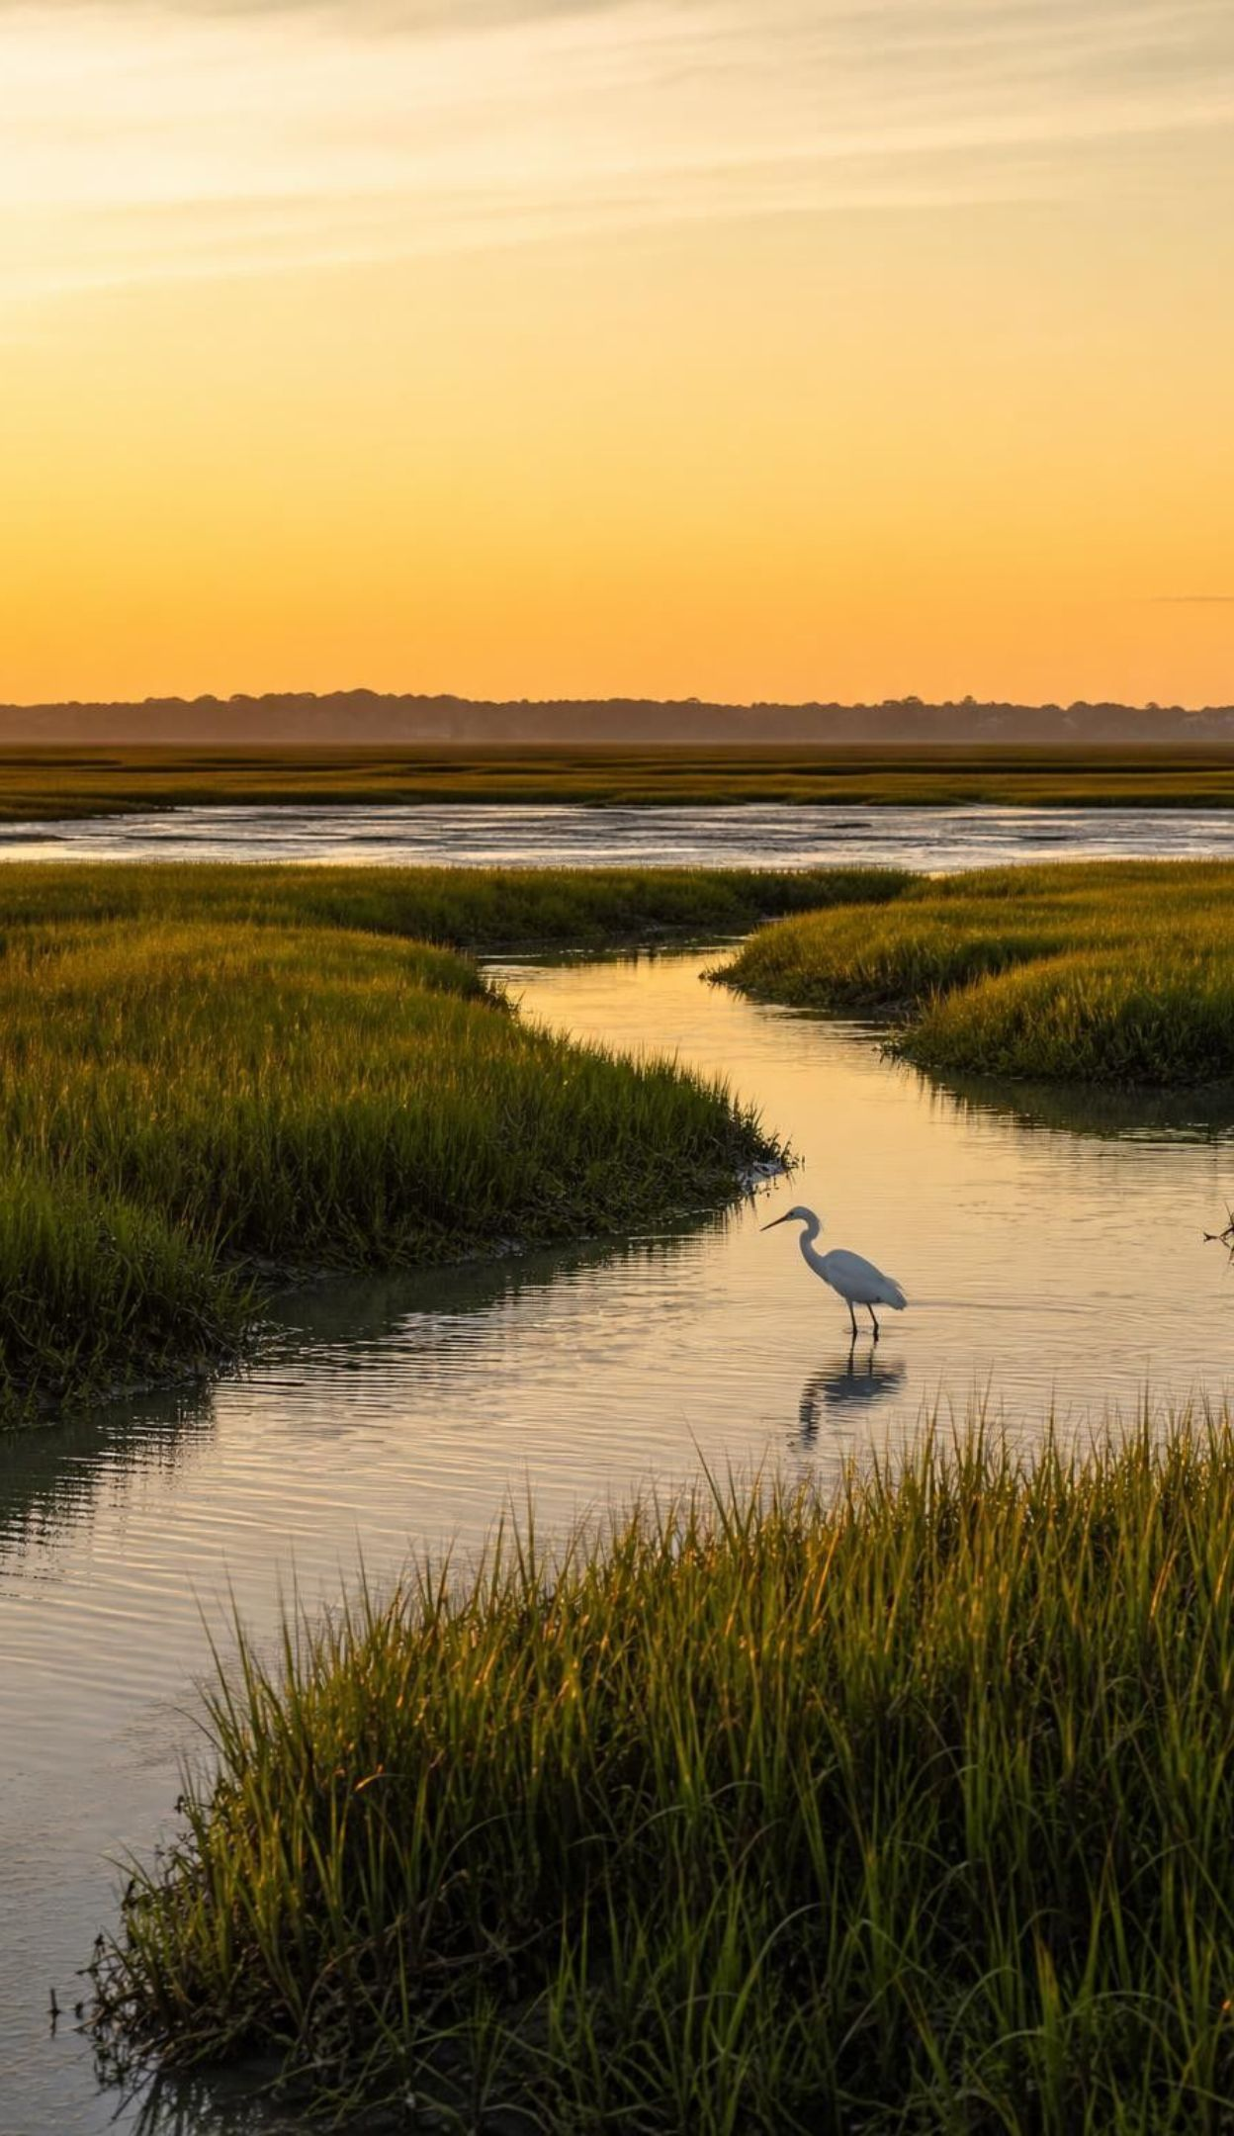
LEARNING TARGETS
What you will be able to do
1
Explain how the number of people and the use per person together set the demand on ecosystems.
2
Explain why lynx and hares rise and fall while the human population keeps rising.
3
Trace a human disruption through an ecosystem and back to people.
4
Write precise criteria and constraints, then test a net design against them.
5
Weigh competing solutions with a criteria matrix and say what science can and cannot decide.
6
Compare monitoring data with a healthy-ecosystem model to judge whether a fix is working.
3
Notes:
Read the targets quickly and connect each to an activity: the first two to the lake game in Lab 1, the third to the Lake Malawi chain and the six disruptions, the fourth to the net challenge in Lab 2, the fifth to the Nipah decision in Lab 3, and the last to the Long Island Sound story. Ask students to star the target they expect to be hardest; revisit the stars on the synthesis slide.
CONNECTS TO: Lab 1, Lab 2, Lab 3; W10 mastery checks every target.
PACING: about 2 min

Slide 4
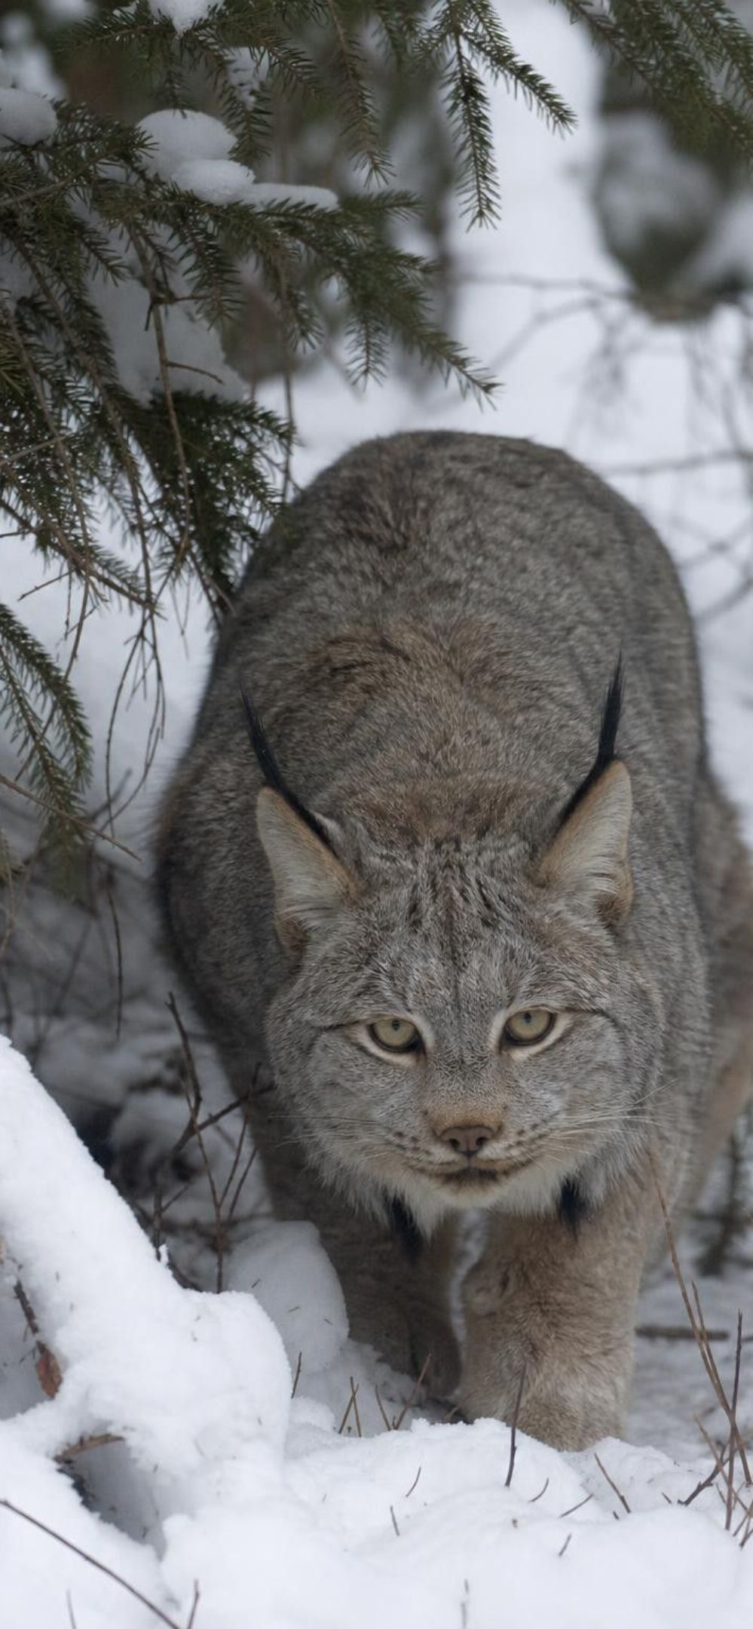
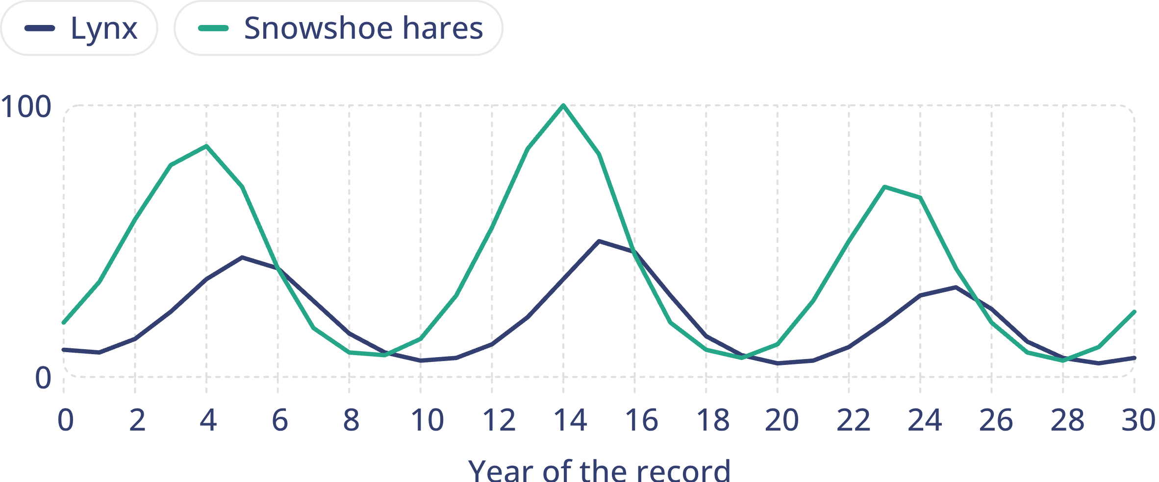
MODEL
Snowshoe hares and lynx: waves that repeat
Model: Hare and lynx records (teaching dataset)
simulated data
Simulated teaching data shaped like the fur-trade records: peaks about 9 to 10 years apart, lynx peaks a year or so after hare peaks. These are not the actual counts.
4
Notes:
Have students trace one full wave with a finger: hares climb, peak and crash; lynx climb a little later, peak and crash a little later. Ask why the lynx curve trails the hare curve. Lynx raise far more kittens when hares are plentiful, so lynx numbers build only after hares are already high, and lynx keep declining for a while after the hares crash. Then explain where the real record comes from: pelts that trappers sold to the Hudson's Bay Company. Those sales also depended on how hard people trapped and on fur prices, so the record is a pattern in trapping as well as in animals. Modern field counts in the Yukon confirm that the cycle is real.
WATCH FOR: Reading the lower lynx line as 'lynx matter less'. Predators are almost always fewer than their prey; what matters is that predator numbers respond to prey numbers.
CONNECTS TO: Lab 1 Part A (the otter rule produces a boom and a crash); W5 data worksheet.
PACING: about 5 min

Slide 5

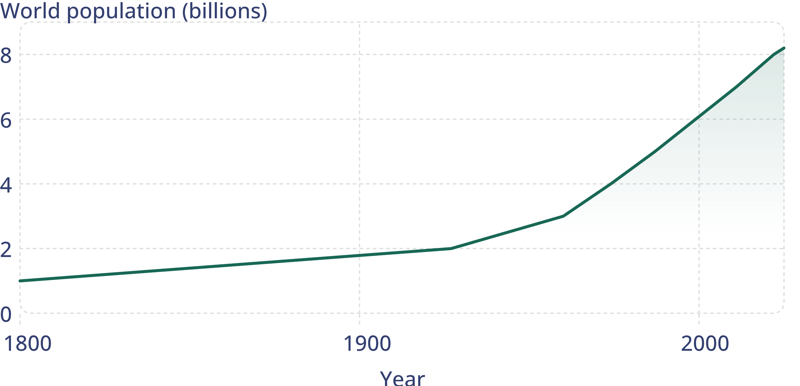
MODEL
People on Earth, 1800 to 2025
Model: World population milestones
United Nations estimates: about 1 billion around 1800 (the UN dates it to 1804); 8 billion on 15 November 2022; about 8.2 billion in 2025 (World Population Prospects 2024).
5
Notes:
Ask how long each added billion took: the second took about 127 years from 1800 (123 from the UN date of 1804), the third 33, the fourth 14, and each billion since has taken about 11 to 13 years. Then ask whether the line is getting steeper or straighter after 1990. It is still rising, but by roughly the same amount each decade, so the growth rate, the percent added each year, is falling. Contrast with slide 4: no waves, no crash. Stress the labels: every number on this slide comes with its source and year.
WATCH FOR: Reading 'a billion every 12 years' as faster and faster growth. Adding the same amount to a bigger total is a smaller percentage each time.
CONNECTS TO: Lab 1 Part B; W5 data worksheet.
PACING: about 5 min

Slide 6
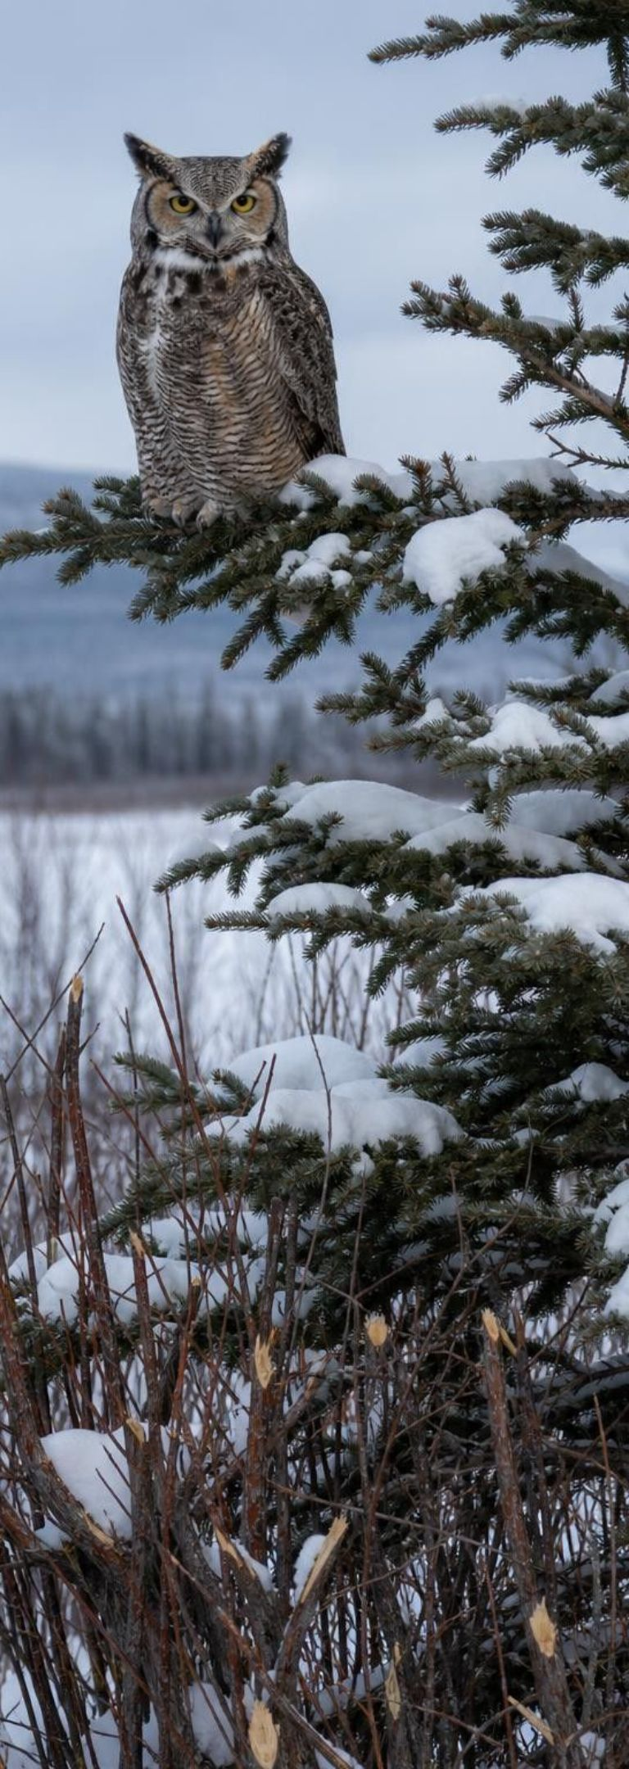
Why the wild waves fall, and why scientists still argue
Plenty of hares: lynx raise many kittens. After hares crash, most kittens die and adults starve or leave.
Hares are eaten by lynx, coyotes, owls and hawks, and a crowded forest runs short of good winter twigs.
Yukon experiments that added food and fenced out predators suggest food and predators act together.
The old records count pelts sold, which also rose and fell with trapping effort and fur prices.
The big idea: a wild population lives on the food its own ecosystem makes this year.
6
Notes:
Walk through the cycle as a loop: many hares, so predators thrive and hares overeat their winter browse; predators then kill most hares, and the survivors are hungry and stressed; hares crash; predators crash a year or two later; plants and hares recover; repeat. Tell students that ecologists still disagree about how much each factor matters, and that this is normal science, not a failure. Large experiments in the Yukon fenced out mammal predators, added food, and did both; neither treatment alone changed hare numbers as much as the two together. End on the last bullet: lynx cannot import hares.
WATCH FOR: 'Lynx eat all the hares.' Hares never reach zero, many predators share them, and food quality matters too.
CONNECTS TO: Lab 1 Part A otter rule; W5 data worksheet (what the fur records can and cannot show about causes).
PACING: about 5 min

Slide 7
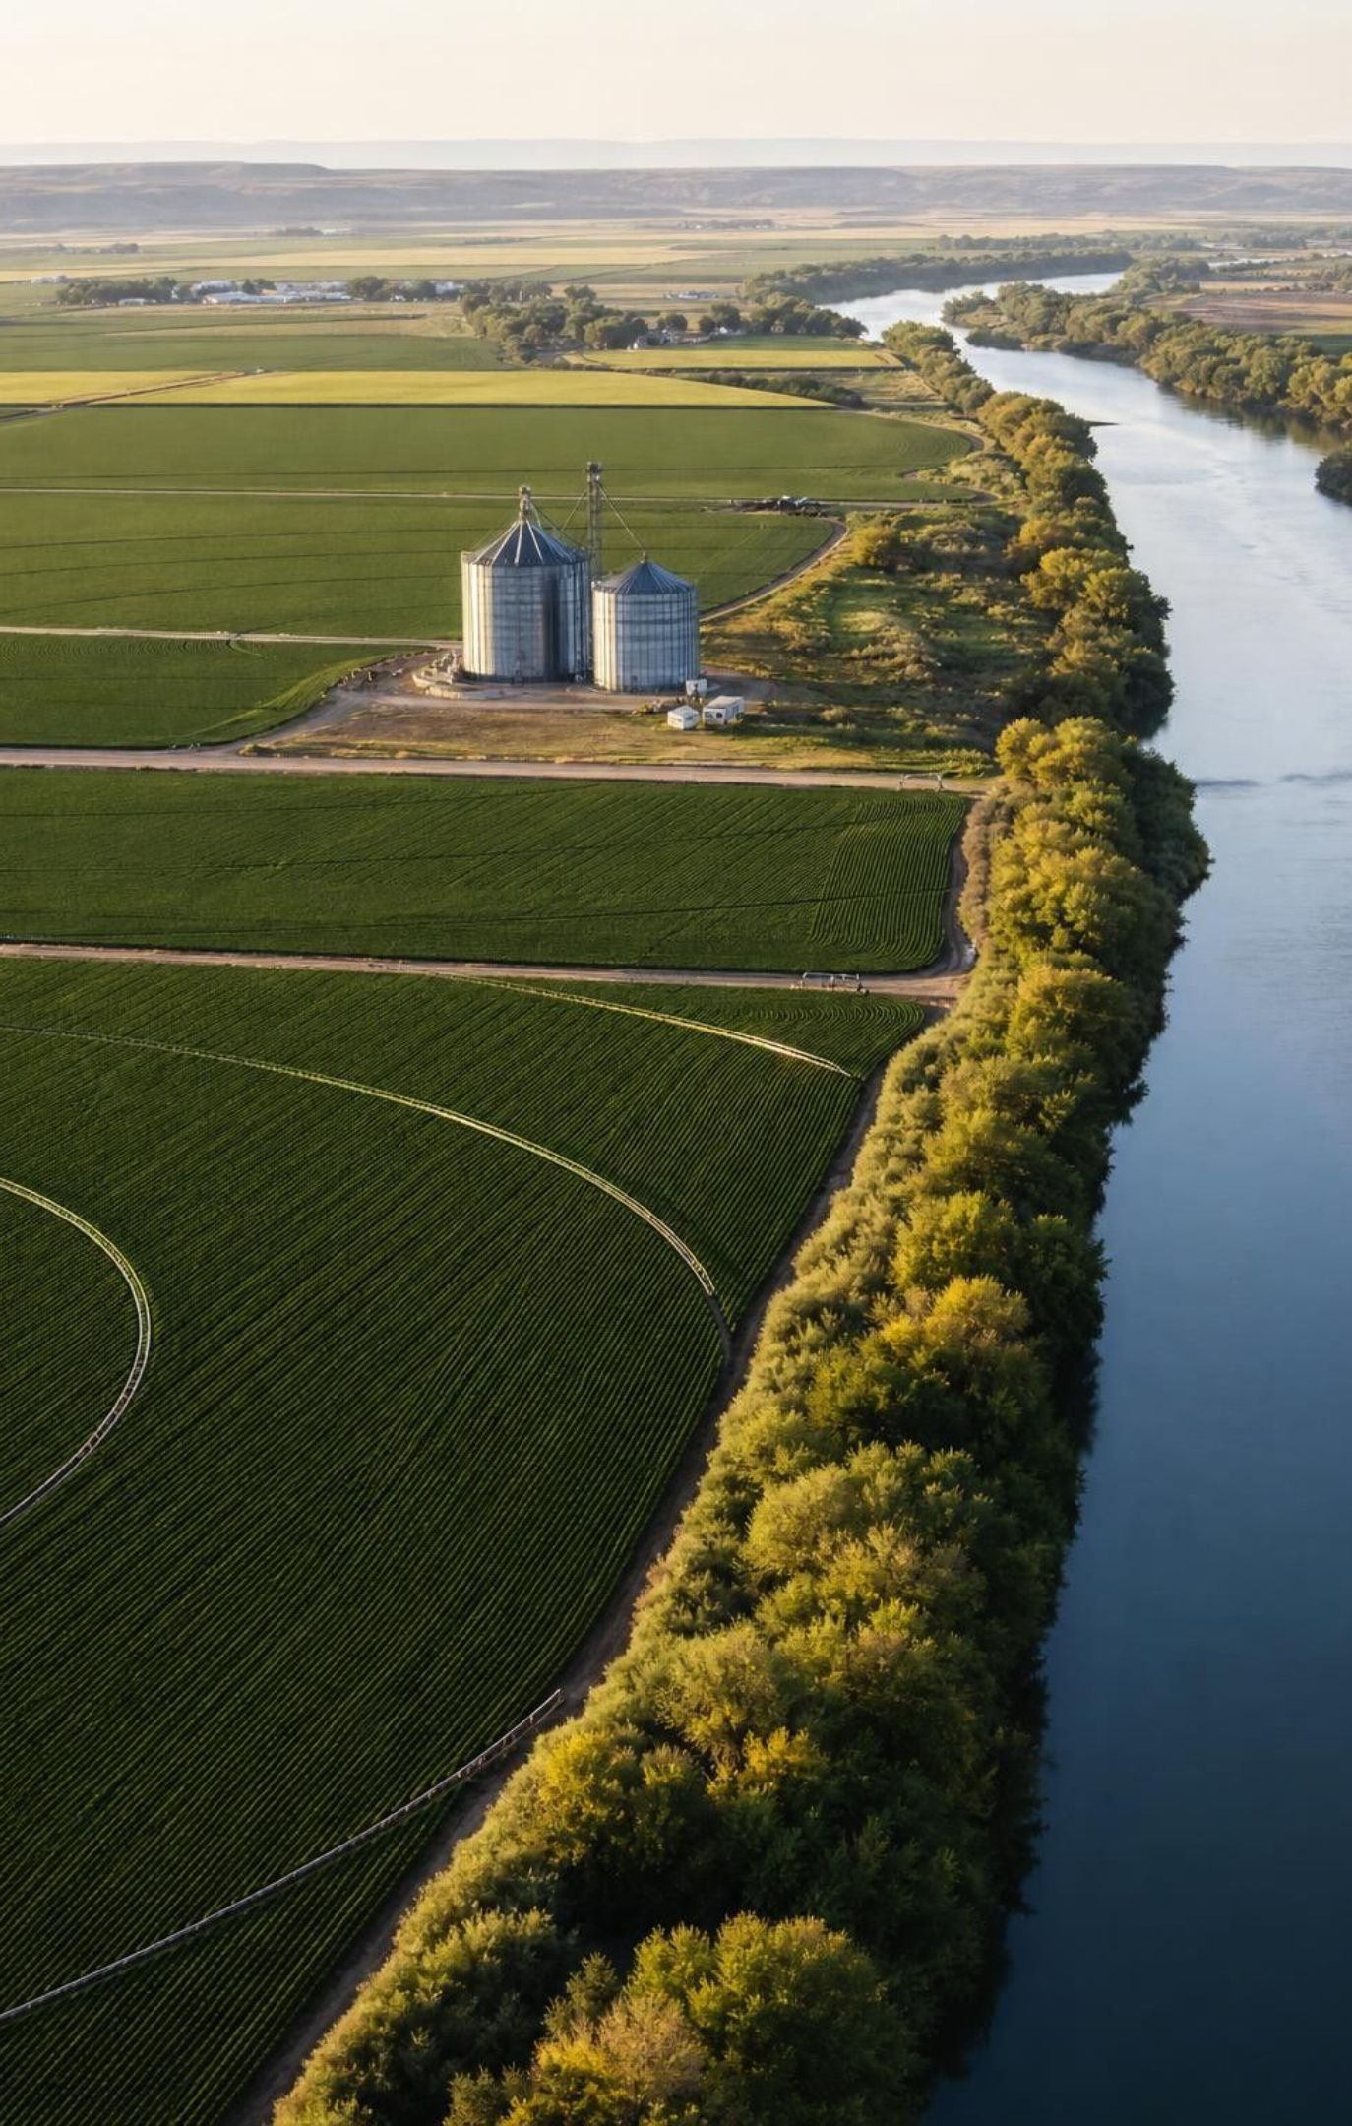
Why the human line has not turned down
People do not rely on one food or one place: trade moves food, fuel and wood around the world.
Farm machinery, fertilizer, irrigation and new crop varieties made far more food per hectare.
Clean water, vaccines and medicine lowered death rates, especially for young children.
Growth is slowing: under 1 percent a year now, about 2 percent a year in the 1960s (UN).
UN projection (2024): a peak of about 10.3 billion people in the mid-2080s.
Every person still draws food, water, wood and energy from ecosystems somewhere.
7
Notes:
Connect back to slide 6: a lynx population lives on what one forest makes this year; a human population lives on what the whole planet makes, moved by trade and multiplied by technology. That is why the local feedback that crashes the lynx has not crashed us. But the pressure does not vanish; it is spread out to farms, fisheries, forests and mines far away. Lab 1 makes this concrete: the otter rule and the village rule differ in one step only, whether missing fish can be imported. Point out that projections are not promises; they depend on future birth and death rates.
WATCH FOR: 'Technology means ecosystems no longer matter.' Every technology on this slide still runs on land, water and energy.
CONNECTS TO: Lab 1 Part A and its debrief; W1 phenomenon worksheet (revisit the first explanation).
PACING: about 5 min

Slide 8
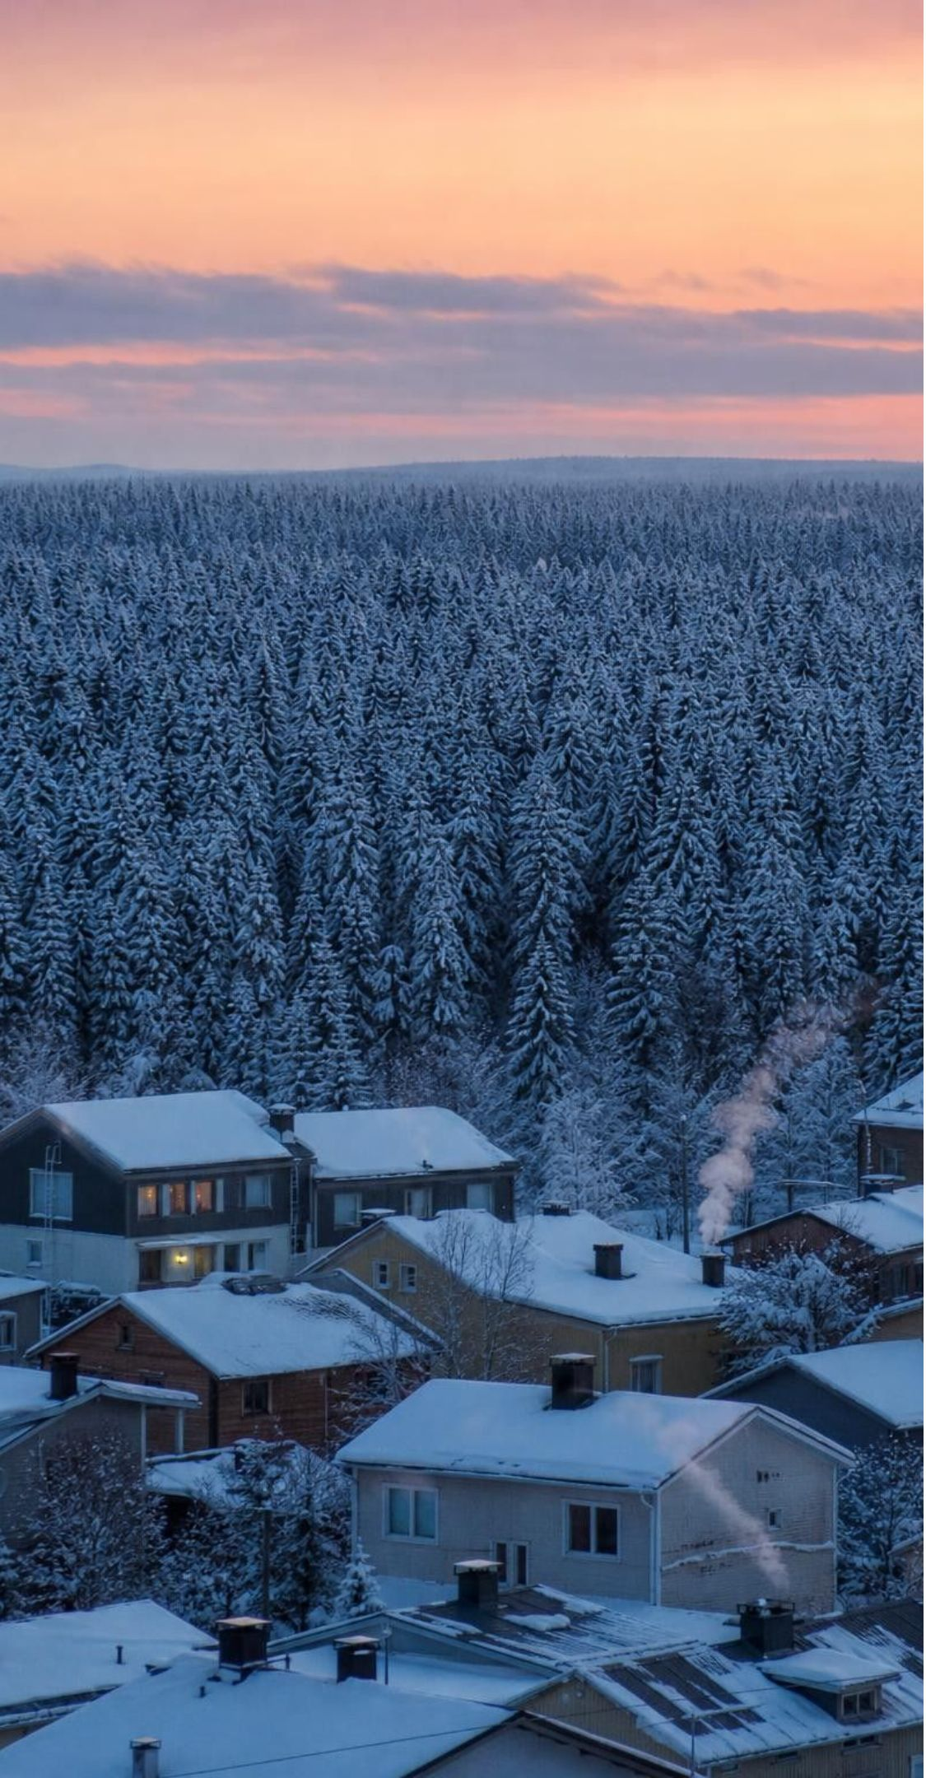
CHECK FOR UNDERSTANDING
Quick check: one forest, two populations
A lynx population and a town of people both get food from the same forest. A bad year cuts the forest's food in half. Which population is more likely to shrink within a year or two, and why?
A. The lynx: they can only eat what this forest makes this year.
B. The town: each person needs more food than a lynx does.
C. Neither: populations do not respond to their food supply.
D. Both equally: every population follows the same rules.
8
Notes:
Take a quick vote with fingers, then ask a student who chose A to explain and a student who chose B or D to argue back. Push further: could the town shrink? Yes, if it had no trade, no stored food and no money, as in famines of the past. The difference is not that people are exempt from limits; it is that a town can draw on other ecosystems.
EXPECTED RESPONSES: A. The lynx have no way to bring in hares from elsewhere, so fewer kittens survive and some adults starve or leave. The town buys or trucks in food from farms and stores elsewhere, so its population barely changes, but the extra demand lands on those other places.
WATCH FOR: Choosing D because 'all populations follow the same rules'. The biology is the same; the difference is access to other ecosystems through trade and storage.
CONNECTS TO: Lab 1 Part A.
PACING: about 4 min

Slide 9
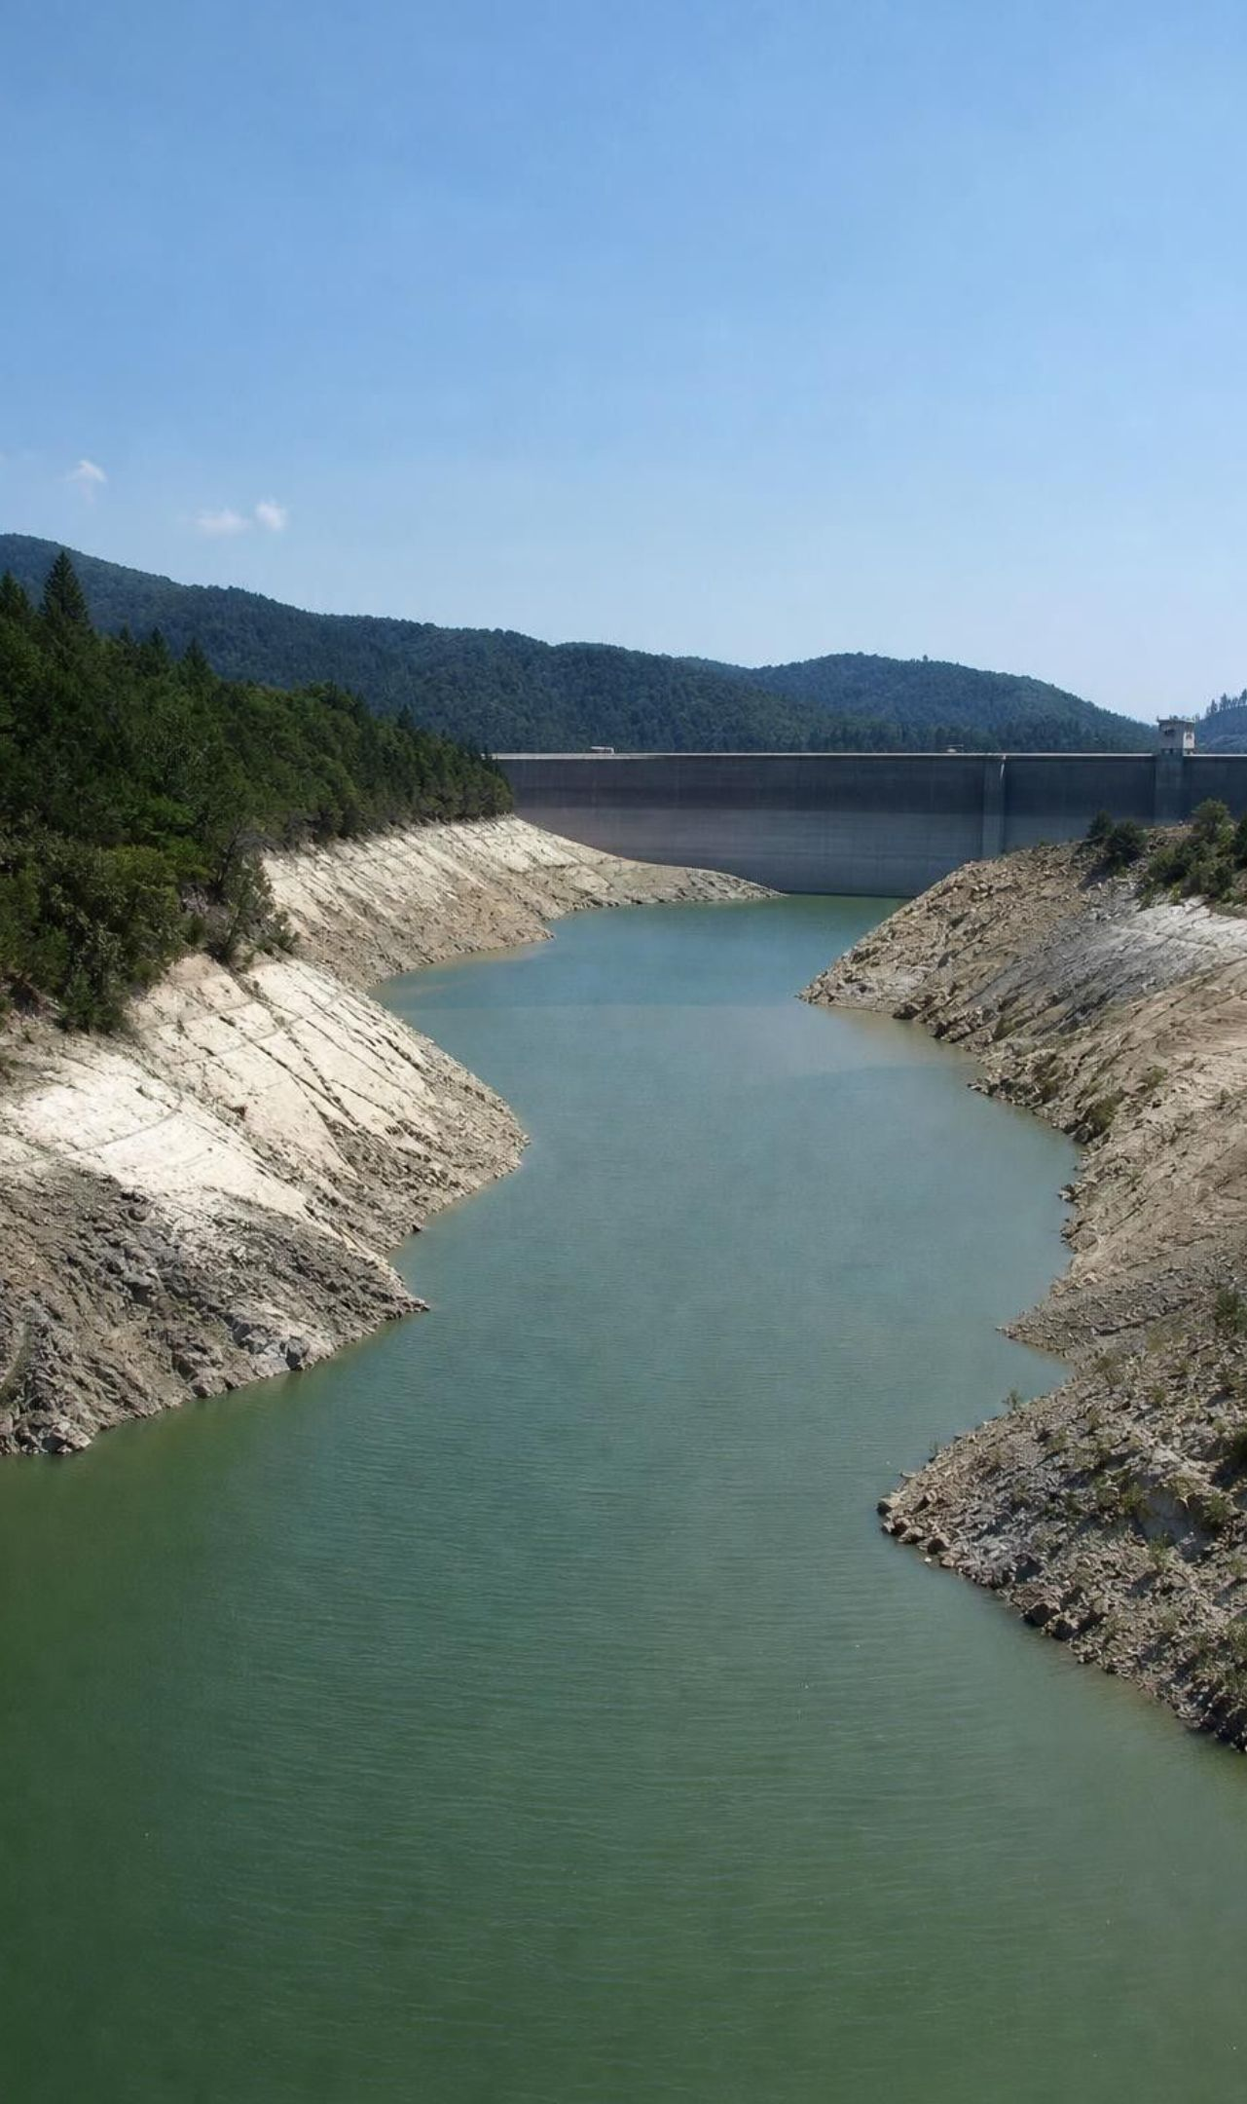
Total use = number of people × use per person
Per capita means per person: divide a group's total by its number of people.
Total use = population × per capita use.
Double the people, same use each: total doubles. Double both: the total is four times as big.
The lesson's graph shows world energy use per person more than doubling since 1900.
If total use is faster than an ecosystem replaces a resource, the stock shrinks.
9
Notes:
Model the idea with the class itself: if each student uses 2 pencils a month, a class of 30 uses 60. If 30 more students arrive, 120. If instead each student starts using 4, also 120. Two different causes, the same pressure. Then add the ecosystem side: a forest that grows enough wood for 100 houses a year can supply 100 houses a year indefinitely, but 150 houses a year shrinks the forest, and a smaller forest grows less wood. Students met this trap in Lab 1; name it now.
WATCH FOR: Treating per capita as 'a lot of people'. It is an amount per person, found by division.
CONNECTS TO: Lab 1 Part B; W7 misconception (per capita errors); W10 mastery.
PACING: about 5 min

Slide 10
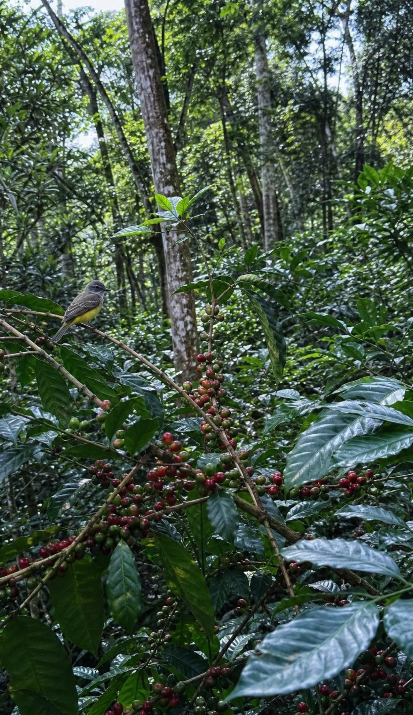
Vocabulary in context
Words for counting demand
per capita: Per person: a group's total divided by its number of people. A town of 20,000 using 3 million liters a day uses 150 liters per capita.
ecosystem services: Benefits people get from working ecosystems. A marsh filters nitrogen out of water and soaks up storm surge.
biodiversity: The variety of species, their numbers and their habitats in a place. A shaded coffee farm holds many more bird species than a full-sun farm.
10
Notes:
Have students give one example of each from their own town or a place they know. For ecosystem services, push past food to services people forget: pollination, flood control, water filtering, soil building. For biodiversity, stress that it includes how many of each species live there and the variety of habitats, not just a count of species.
WATCH FOR: Thinking ecosystem services are things ecosystems 'sell', or that only wild places provide them; farms, parks and city trees provide services too.
CONNECTS TO: W2 vocabulary.
PACING: about 4 min

Slide 11
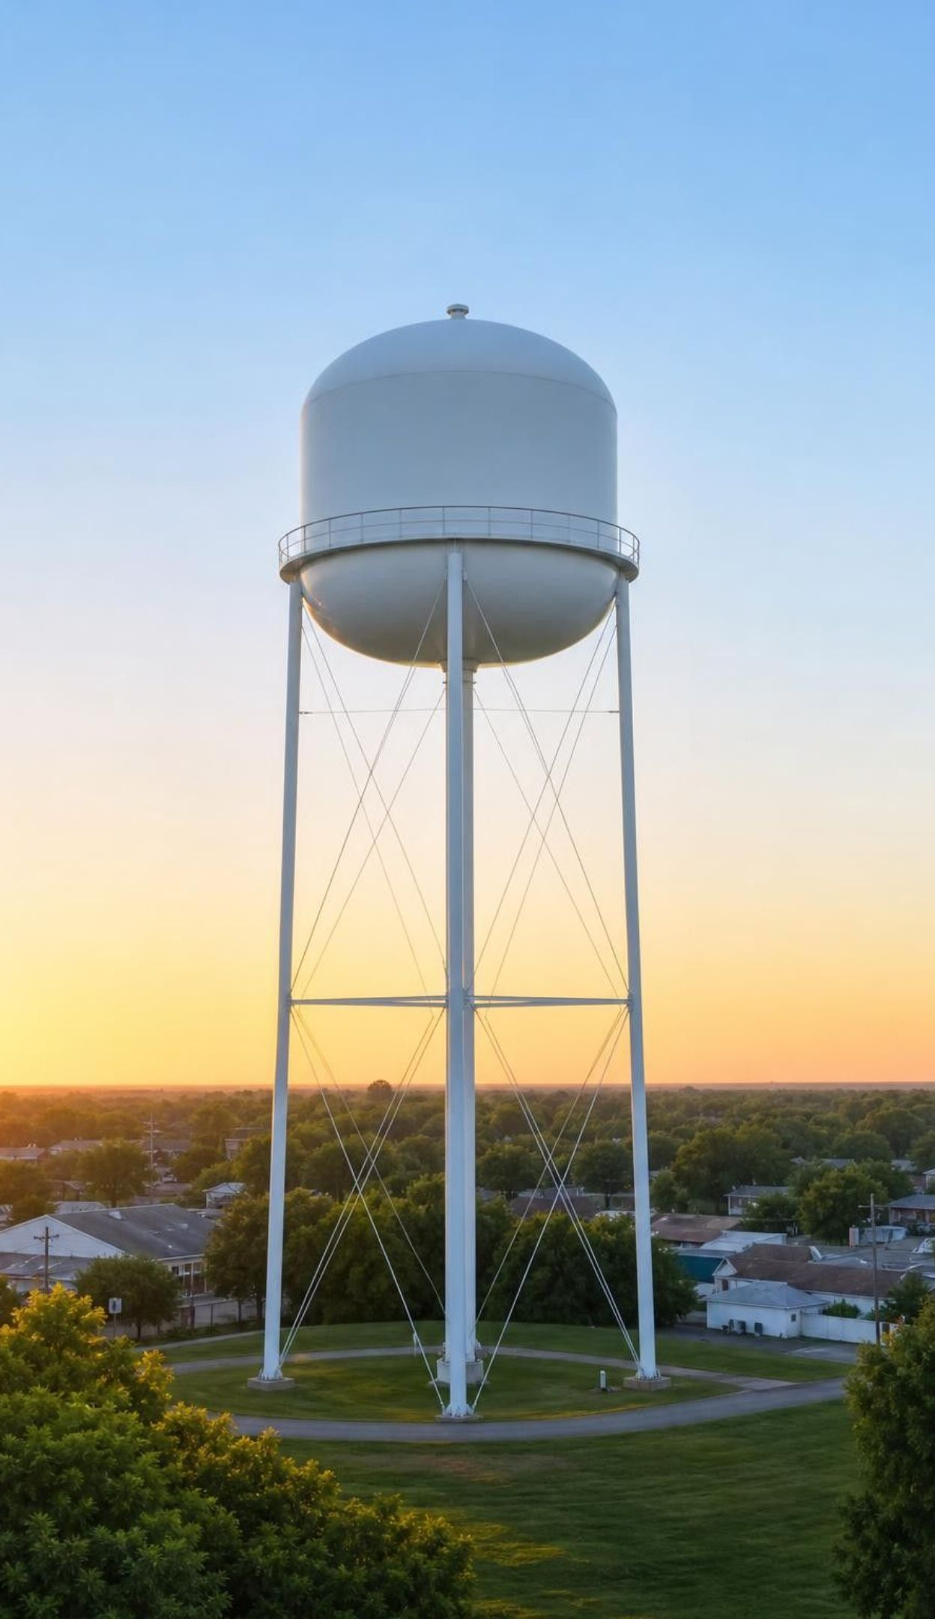
CHECK FOR UNDERSTANDING
Quick check: per capita math
Bonus: what if the town stayed at 20,000 but each person used 20 percent more?
Which change raised total use more, and why?
A town of 20,000 people uses 3,000,000 liters of water a day. What is the per capita use? How much would it use in total if it grew to 30,000 people and each used the same?
11
Notes:
Let pairs work for one minute, then reveal. Ask students to state each answer with units and 'per what': liters per person per day. The bonus shows that a change in habits can matter as much as growth in numbers.
EXPECTED RESPONSES: 3,000,000 ÷ 20,000 = 150 liters per person per day. 30,000 × 150 = 4,500,000 liters a day. Bonus: 150 × 1.2 = 180 liters each; 20,000 × 180 = 3,600,000 liters a day. Growing to 30,000 raised total use more (by 1,500,000 liters) than the 20 percent habit change (by 600,000 liters), because the population rose by 50 percent.
WATCH FOR: Dividing the wrong way (20,000 ÷ 3,000,000 gives about 0.007). Ask whether 0.007 liters a day per person is believable.
CONNECTS TO: W7 misconception; W10 mastery.
PACING: about 4 min

Slide 12
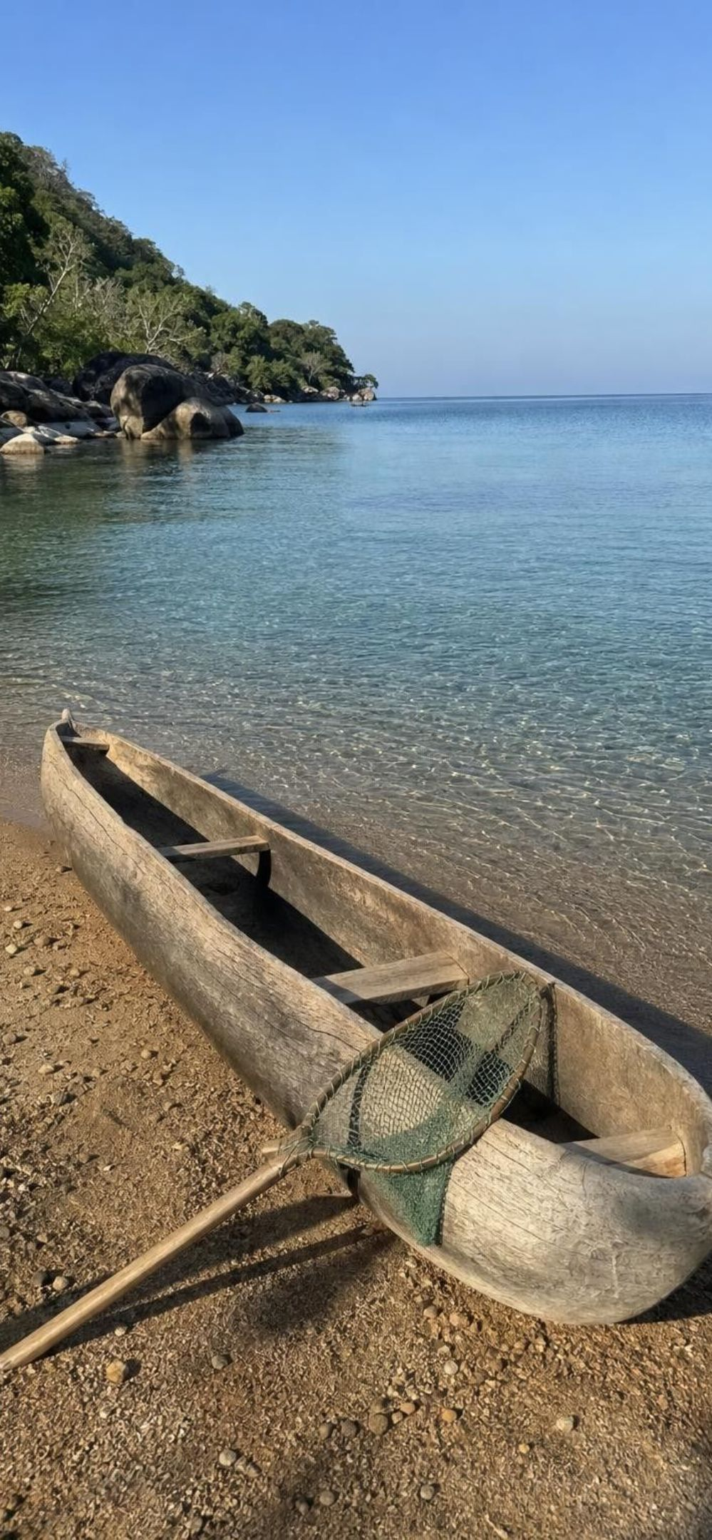
Model
Lake Malawi: a chain that loops back to people
Model: Overfishing and bilharzia
More people fishing with fine-mesh nets →
(small fish are caught too)
1
Fewer small snail-eating fish →
(snails lose a predator)
2
More freshwater snails →
(snails host the parasite)
3
More parasite larvae in shallow water →
(larvae burrow into waders' skin)
4
More people infected with bilharzia
5
The chain as the lesson describes it. Field studies found less infection where snail-eating fish were more common, which supports the chain but does not prove every step.
12
Notes:
Lake Malawi, in southeastern Africa, holds hundreds of fish species. The lesson tells how growing fishing pressure removed small fish that eat snails, letting the snails that carry the bilharzia parasite multiply. Bilharzia, also called schistosomiasis, is caused by a blood fluke; its larvae leave infected snails and burrow into the skin of people wading or washing in the water. Ask students to find the step where an engineering change could break the chain. The lesson's answer is the first arrow: nets with larger holes keep catching big fish but let the small snail-eaters slip through. That solution had to be cheap and easy to make, because these families depend on fishing for food and income.
WATCH FOR: Thinking the fish spread the disease, or that the snails are the parasite. The snail is a host; the parasite is a separate organism.
CONNECTS TO: Lab 2 net design challenge; W3 reading (nets and by-catch).
PACING: about 5 min

Slide 13
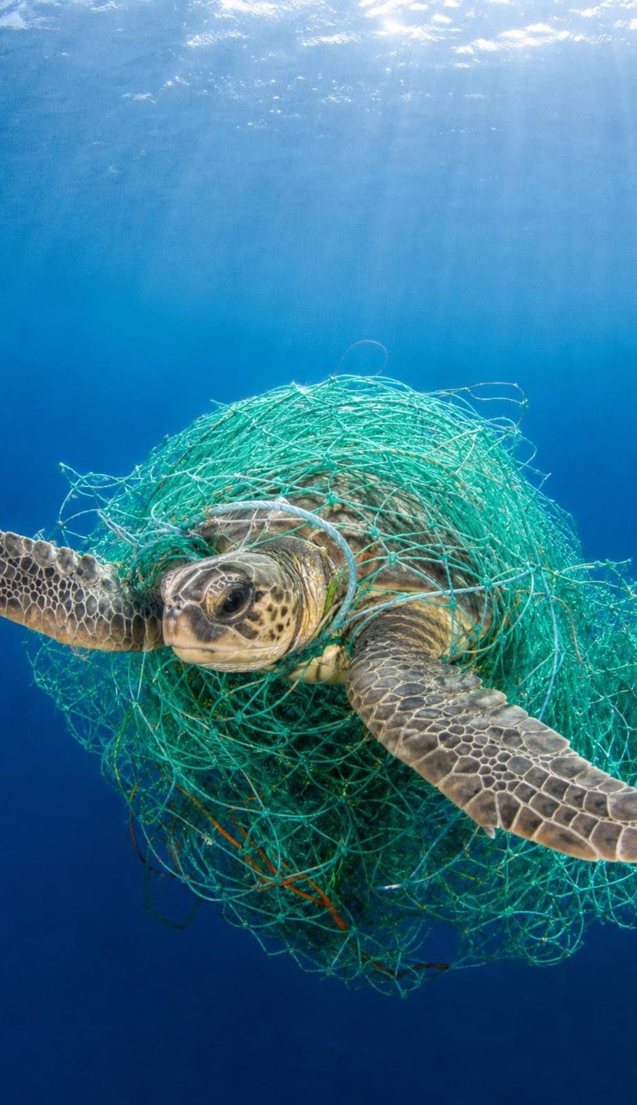
VOCABULARY IN CONTEXT
Words for harm to living things
over-exploitation: Harvesting a species faster than its population can replace what is taken. Netting small fish along with big ones at Lake Malawi.
by-catch: Animals caught by fishing gear that the fishers were not trying to catch. Sea turtles tangled in a net set for swordfish.
habitat degradation: Damaging a natural area so it can no longer support its living things. Clearing tropical forest to plant full-sun coffee.
13
Notes:
Ask how the three words relate. By-catch is often part of over-exploitation, because a species can be over-harvested even when nobody wants to catch it. Habitat degradation can shrink a population with no harvest at all. Ask which words fit the Lake Malawi small fish: they were by-catch, and taking them faster than they could be replaced was over-exploitation.
WATCH FOR: Thinking over-exploitation means taking all of a species. Any harvest faster than replacement counts.
CONNECTS TO: Lab 2; W2 vocabulary; W3 reading.
PACING: about 4 min

Slide 14
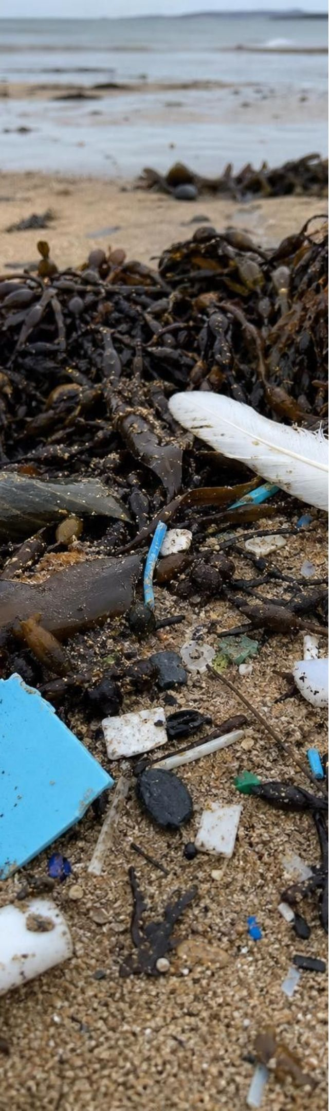
Six ways people disrupt ecosystems
MODEL
Model: The lesson's six disruptions
Center: Human disruptions
Over-exploitation: Overfishing at Lake Malawi let disease-carrying snails multiply.
Pollution: Plastics break into fragments that turtles and seabirds swallow.
Emerging disease: Nipah virus passed from fruit bats to farm pigs to farmworkers.
Habitat degradation: Forest cleared for full-sun coffee removes winter habitat for warblers.
Invasive species: Carp that escaped fish farms crowd out native fish.
Climate change: Rising seas flood coastal cities and drown marshes.
The lesson's six categories, each with its example. Real problems often combine several.
14
Notes:
Give each table one disruption. They have two minutes to explain its example as a cause-and-effect chain with at least three links, and to name one ecosystem service that is lost. Then share out. Name the response the lesson pairs with each: larger-mesh nets; less plastic and new materials; keeping pigs away from bat trees and wearing protective gear; coffee grown under shade trees; electric barriers in Chicago-area canals; and climate models that guide coastal planning.
WATCH FOR: 'Biodegradable plastic solves the problem.' Many such products break down only in industrial composting facilities, not in the ocean.
CONNECTS TO: W8 collaborative jigsaw (all six pressures); W2 vocabulary.
PACING: about 5 min

Slide 15
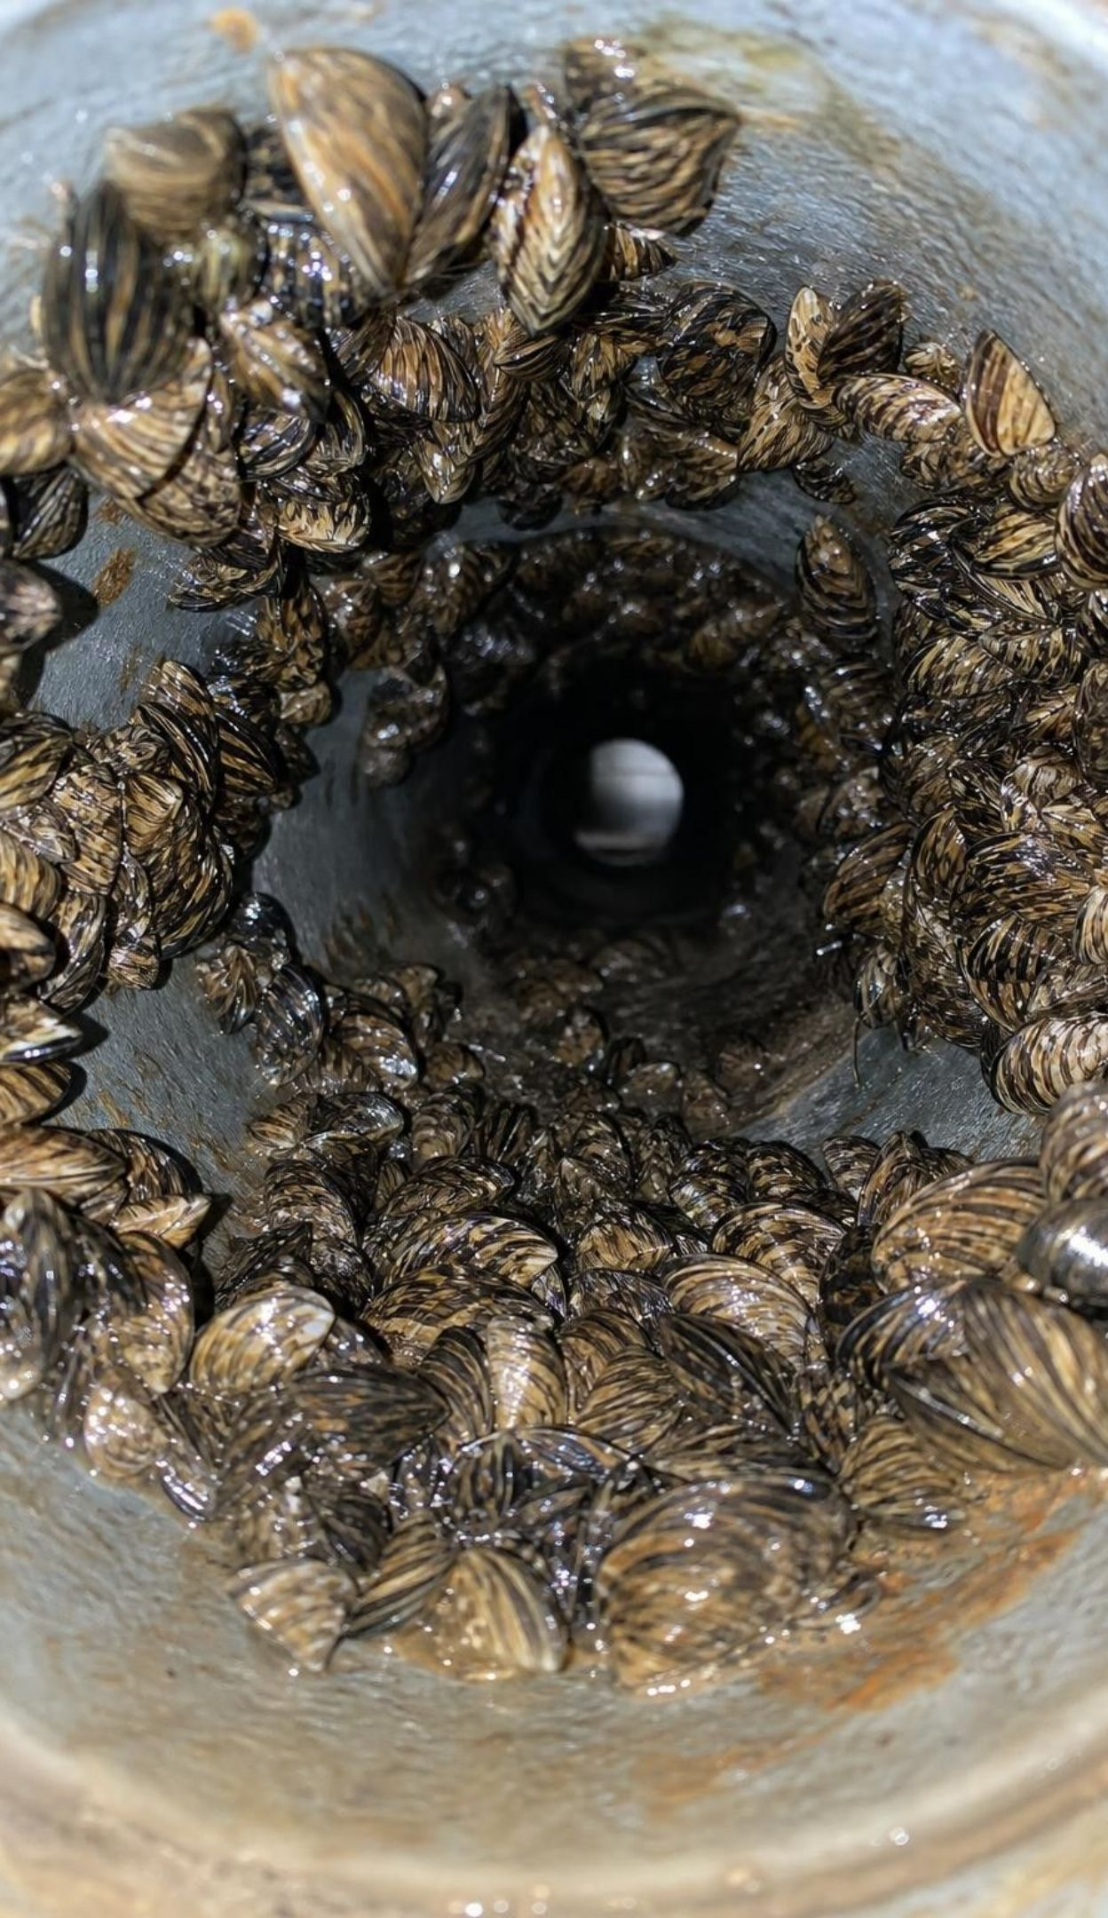
VOCABULARY IN CONTEXT
Words for new arrivals and long-term change
invasive species: A species moved by people to a new place, where it causes harm. Quagga mussels, found in Lake Mead in 2007, now clog pipes in California reservoirs.
emerging disease: A disease newly appearing in people, often after new contact with wild animals. Nipah virus in Malaysian pig farmers in 1998 and 1999.
climate change: A long-term shift in Earth's climate, now driven mainly by burning fossil fuels. Higher seas make high-tide flooding more common on California's coast.
15
Notes:
Stress the two-part test for invasive: moved by people, and harmful. Ask for a non-native species that is not invasive, such as tomatoes, oranges or wheat. For emerging disease, connect to habitat: when people and their animals move into wild habitat, they meet new viruses. For climate change, separate weather (this week) from climate (patterns over decades).
WATCH FOR: Calling every non-native species invasive, or calling one hot week climate change.
CONNECTS TO: W2 vocabulary; W9 transfer (quagga mussels at a reservoir).
PACING: about 4 min

Slide 16
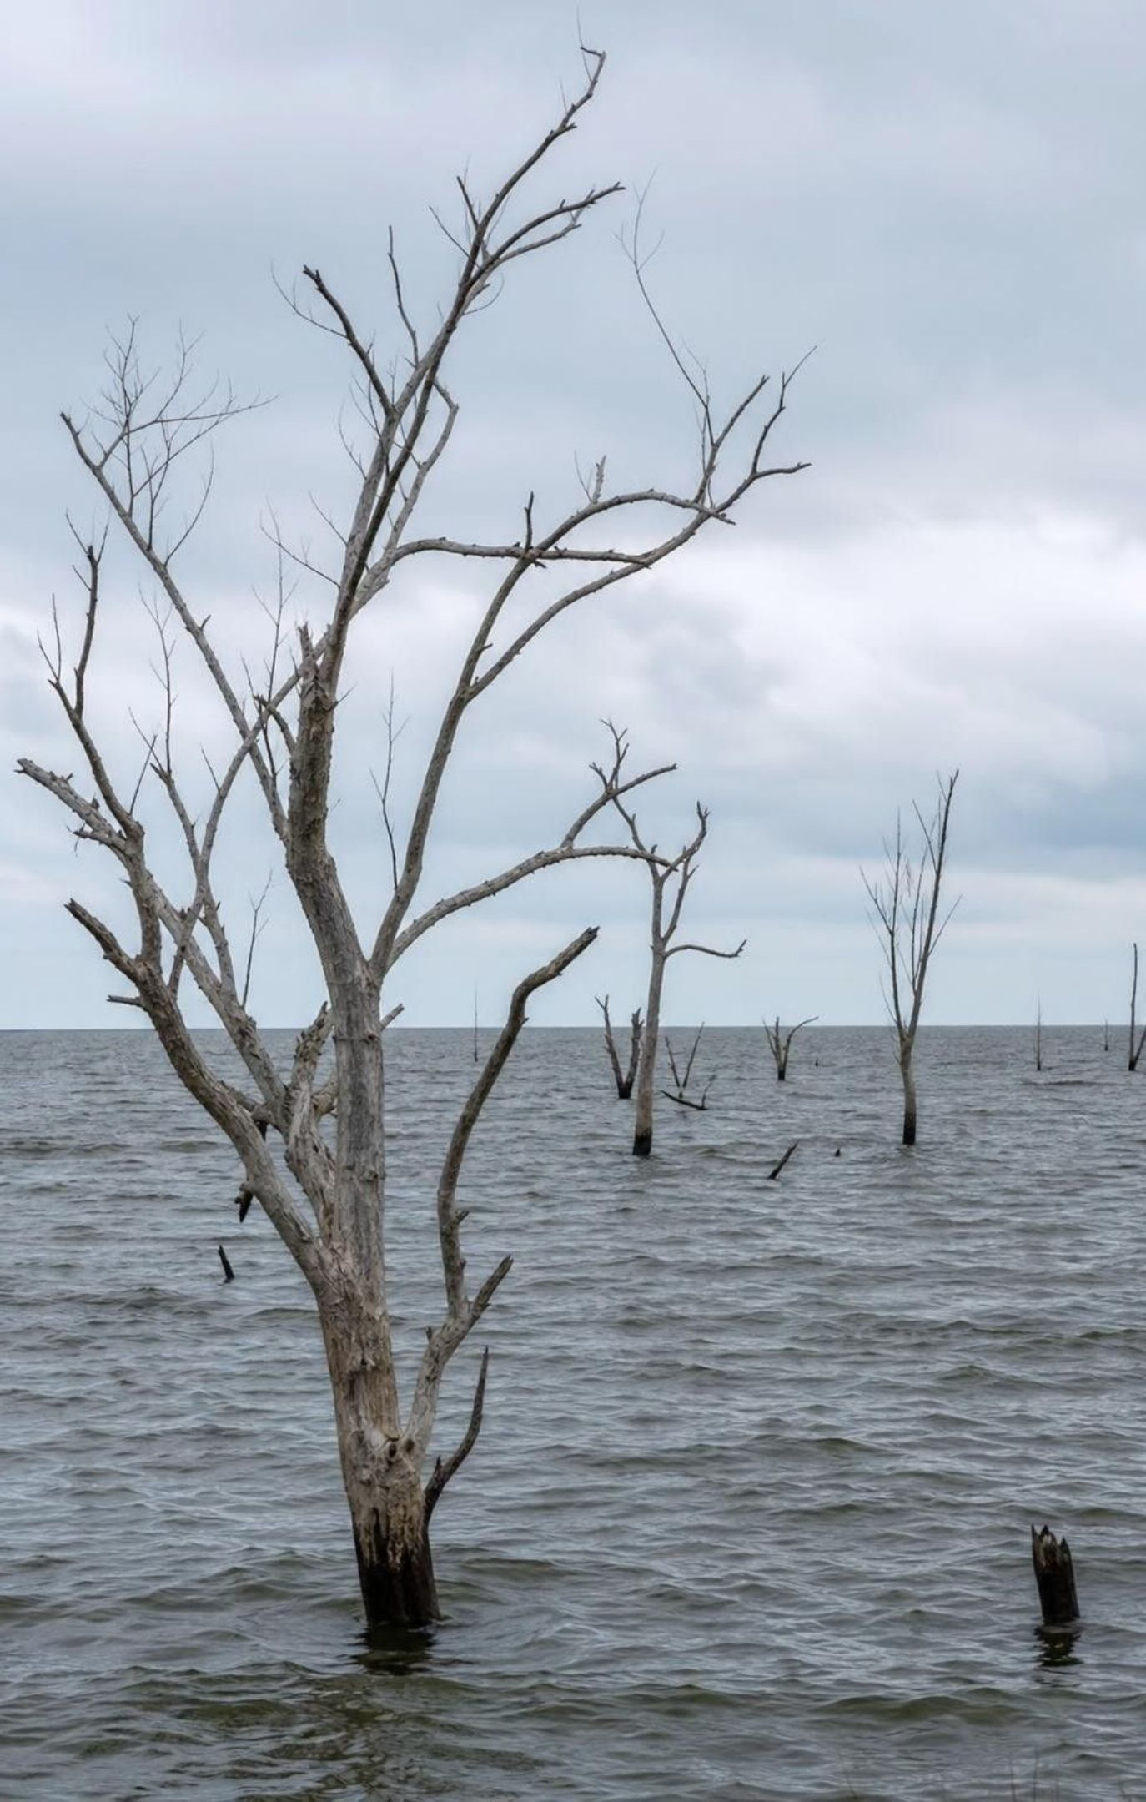
THINK, PAIR, SHARE
Discuss: which disruption is hardest to undo?
Think about time: how long would recovery take?
Think about spread: can the harm move on its own?
Think about extinction: can a lost species come back?
Of the six disruptions, which would be hardest to reverse once it has happened? Rank your top two and give a reason for each.
16
Notes:
Give three minutes in groups, then hear two or three rankings and compare reasons. Strong answers reason about mechanisms: invasive species reproduce and spread on their own and are nearly impossible to remove once established; extinctions cannot be undone; plastics last for decades and fragment; much of the carbon dioxide added to the air stays for centuries, so climate change continues after emissions fall. Over-exploitation can often be reversed if harvest stops early enough, as some Long Island Sound fish showed.
EXPECTED RESPONSES: Invasive species: they breed and spread without help, so removal is rarely complete. Climate change: carbon dioxide stays in the air for a very long time and seas keep rising. Habitat degradation: a cleared forest takes decades to regrow, and species may disappear first. Plastic pollution: fragments last a long time and are hard to collect. Over-exploitation is often easiest to reverse if fishing stops in time; emerging diseases can sometimes be controlled by changing contact with animals.
WATCH FOR: Assuming that stopping the cause undoes the harm right away. Extinct species, established invaders, plastic fragments and added carbon dioxide stay after the activity that caused them stops.
CONNECTS TO: W8 collaborative jigsaw.
PACING: about 6 min

Slide 17
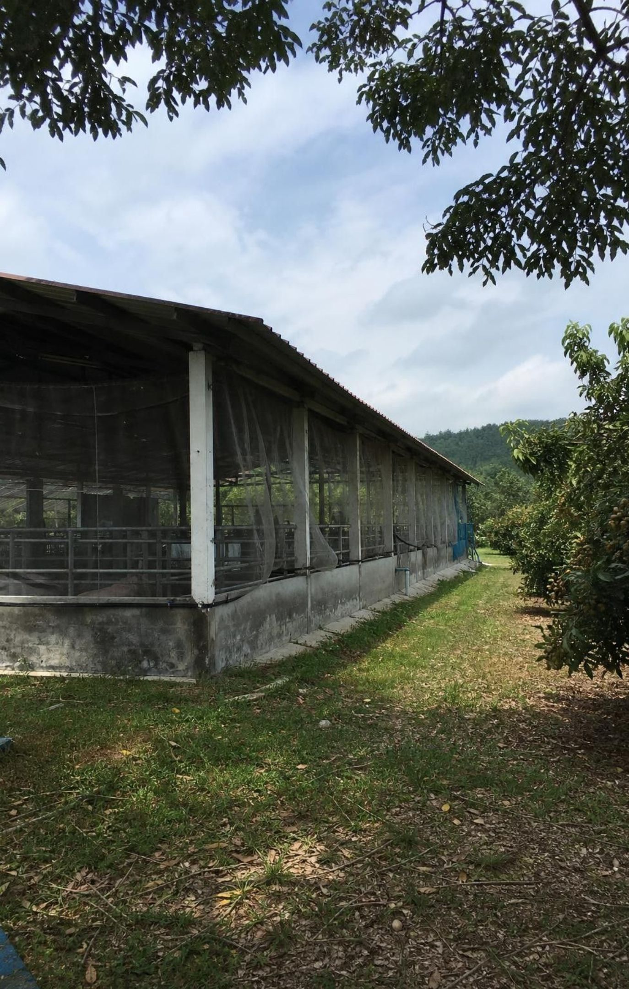
Engineers start by defining the problem
Criteria: what a solution must do, stated so you can test it. 'Keep 8 of every 10 big fish.'
Constraints: limits it must work within, such as cost, materials, time, laws and skills.
Lake Malawi: the fix had to be cheap, easy to make and still feed families.
Nipah: keep pigs away from trees where bats roost; wear gloves and protective gear.
Tradeoff: shade coffee gives fewer beans per hectare but keeps forest birds and pollinators.
17
Notes:
Write a vague goal on the board: 'Make fishing better.' Ask why no engineer can test it. Rewrite it with the class as criteria (what counts as success, with numbers) and constraints (limits the design cannot cross). Show how the Lake Malawi community's constraints shaped the solution: a high-tech answer would fail if families could not afford it or repair it. Then define tradeoff with the coffee example: there is rarely a design that wins on every criterion.
WATCH FOR: Mixing up the two. A criterion describes what success looks like; a constraint is a limit on how the design can be made or used, such as a budget.
CONNECTS TO: Lab 2 criteria; Lab 3 matrix; W6 CER (coffee designs); W9 transfer.
PACING: about 5 min

Slide 18
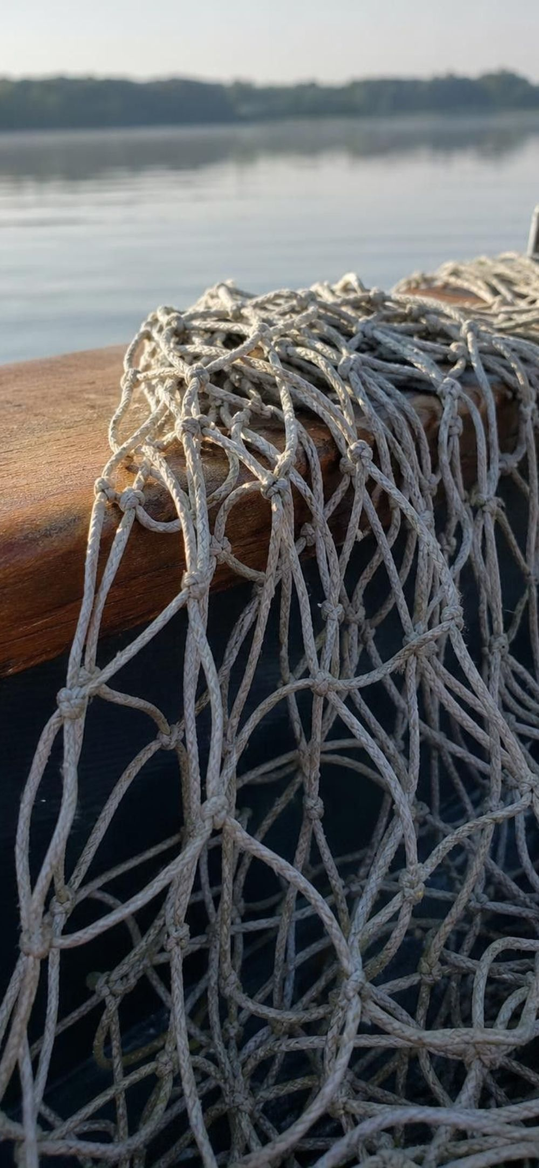
CHECK FOR UNDERSTANDING
Quick check: criterion, constraint or tradeoff?
1
The net must keep at least 8 of every 10 large fish it catches.
2
Each net can use no more than 20 strands of string.
3
Bigger holes spare small fish but let a few large fish escape too.
4
Fishers must be able to repair the net with tools they already own.
5
At least 8 of every 10 small fish must slip through.
Label each statement about a new fishing net C (criterion), K (constraint) or T (tradeoff).
18
Notes:
Run it with hand signals: one finger for C, two for K, three for T. Ask for a reason on each. Statements 1 and 5 are measurable goals; statements 2 and 4 are limits on how the net is made or used; statement 3 names something gained and something given up.
EXPECTED RESPONSES: 1 C, 2 K, 3 T, 4 K, 5 C.
WATCH FOR: Calling statement 4 a criterion because it is important. Importance does not decide it; a limit on how the design is made or used is a constraint.
CONNECTS TO: Lab 2; W2 vocabulary; W10 mastery.
PACING: about 4 min

Slide 19
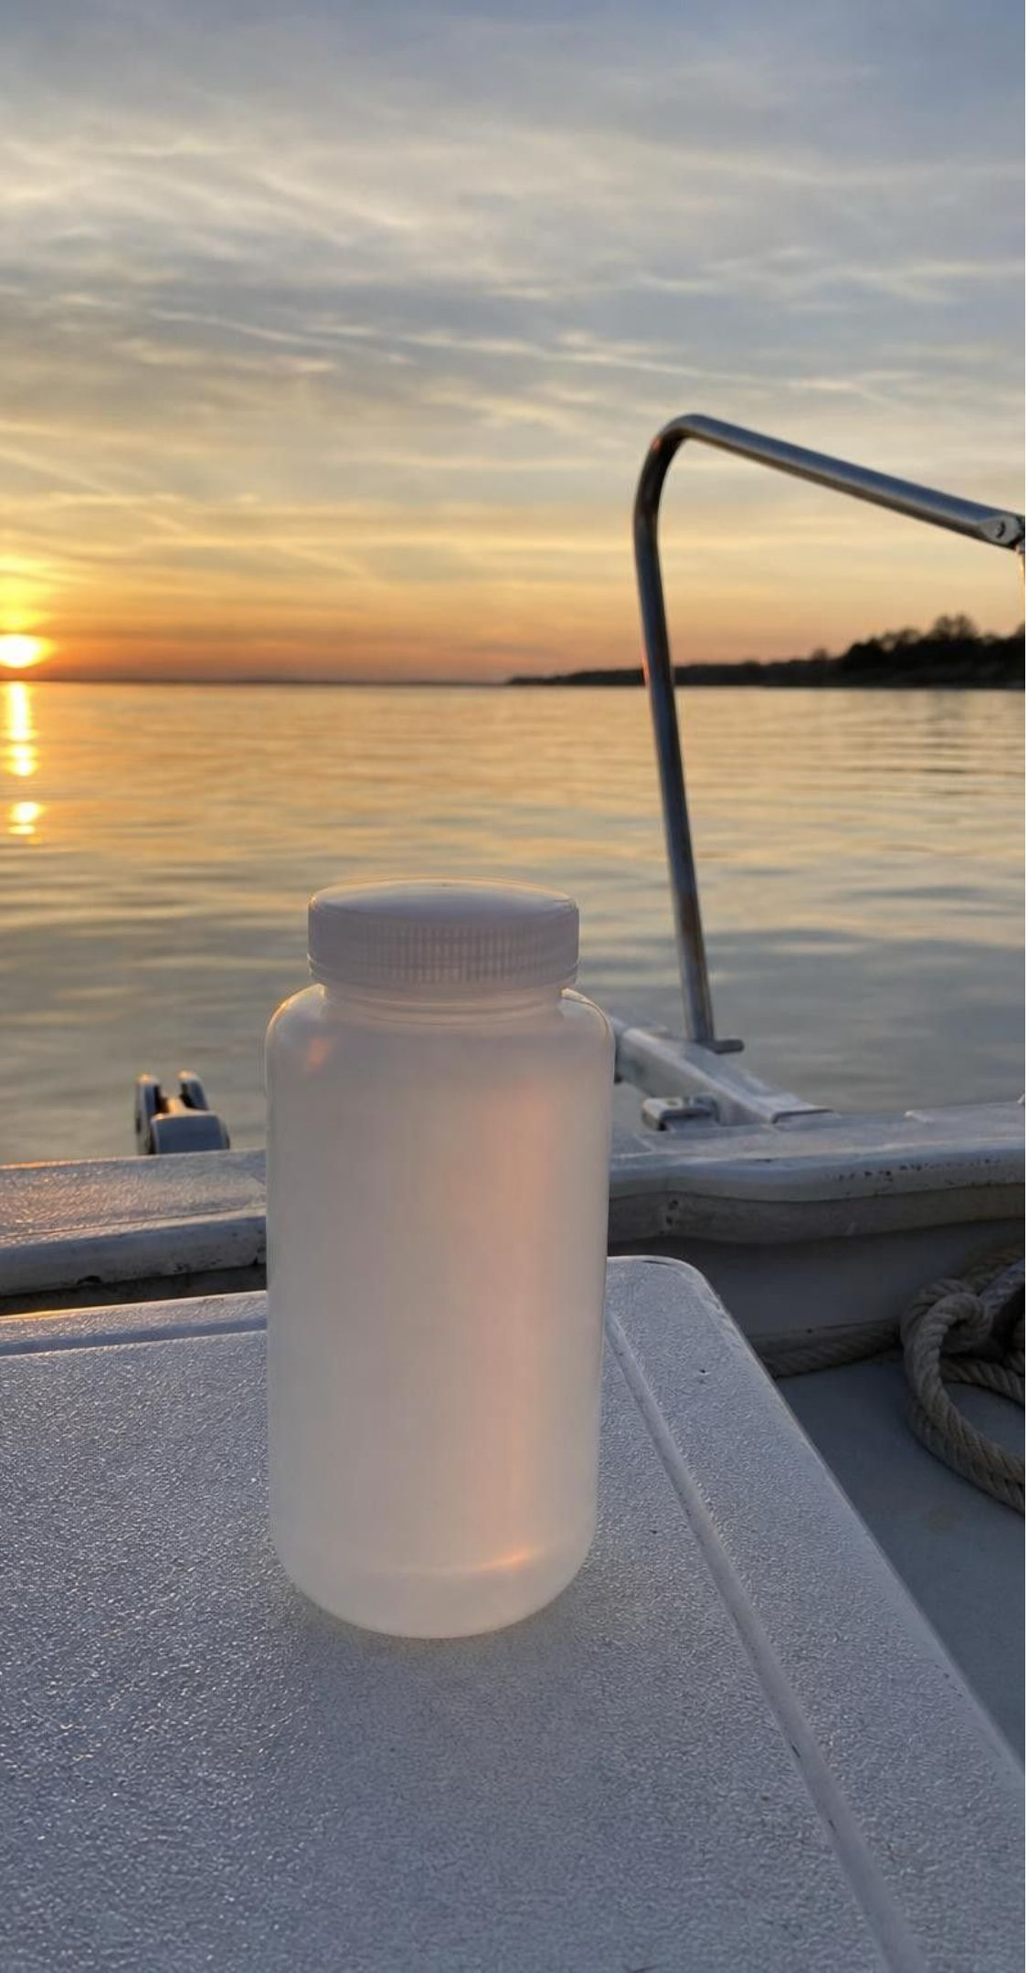
MODEL
Test, compare, adjust: restoring Long Island Sound
Model: Monitoring against a model of a healthy sound
Measure nitrogen, oxygen and wildlife → (data)
1
Compare with the model of a healthy sound → (gap found)
2
Find the cause: too much nitrogen → (target chosen)
3
Act: limit nitrogen from sewage plants → (time passes)
4
Wait, then measure again → (repeat) (back to the start)
5
Scientists compare each round of measurements with a model that describes normal levels for a healthy sound.
19
Notes:
Explain that beautiful and healthy are not the same thing. Scientists wrote down what a healthy sound should have: enough dissolved oxygen for fish and lobsters, low nitrogen, and normal populations of wildlife. Every round of boat sampling and net tows is compared with that model. The gap pointed to nitrogen, so communities cut the nitrogen released by sewage treatment plants and kept measuring. Ask: why not stop measuring once oxygen improved? Because a fix can fade, new problems can appear, and some species, such as lobsters, may not respond.
WATCH FOR: Thinking the model is a perfect copy of nature. It is a set of targets to compare against.
CONNECTS TO: Lab 1 Part C uses criteria the same way; W4 diagram.
PACING: about 5 min

Slide 20

What the Long Island Sound data showed
1987: high nitrogen and low oxygen across large areas of the sound's bottom water.
Extra nitrogen feeds algae. Living algae add oxygen, but they soon die and sink.
Bacteria breaking down the dead algae use up oxygen; fish and lobsters suffocate or leave.
Low-oxygen area: about 208 sq mi on average in 1987-1999, about 83 sq mi in 2021-2025.
Many fish recovered; lobsters did not, partly because the water has grown warmer.
20
Notes:
Correct the textbook carefully: it says algae take oxygen out of the water during photosynthesis, but photosynthesis releases oxygen. The drain is decomposition, plus respiration at night, in bottom water that does not mix with the air in summer. Share the figures from the Long Island Sound Partnership: the average summer low-oxygen area shrank by about 60 percent after nitrogen limits. Then the lobsters: NOAA Fisheries reports that warmer water and other stresses keep the southern New England lobster stock depleted. Ask what that means for the plan: one fix cannot solve every problem, which is why monitoring continues.
WATCH FOR: 'Algae use up oxygen by photosynthesis.' Ask where much of the oxygen in ocean surface water comes from.
CONNECTS TO: W4 diagram (the nitrogen-oxygen model and its test-and-revise loop).
PACING: about 5 min

Slide 21
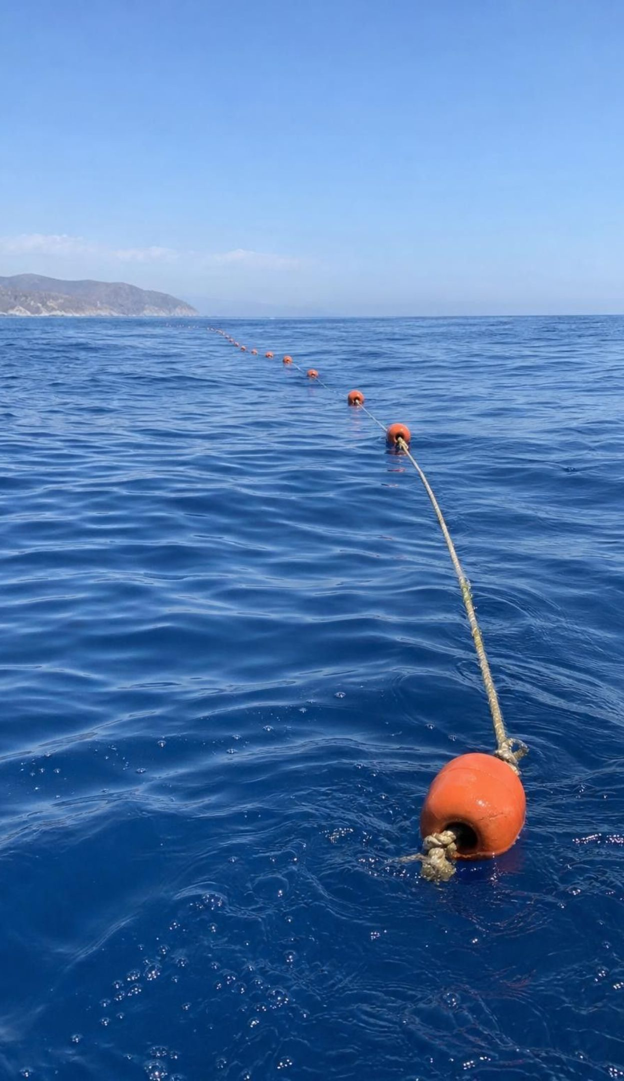
REAL-WORLD CONNECTION
California connection: changing nets to cut by-catch
Swordfish off California were long caught with large-mesh drift gillnets, set at dusk and left to drift all night. Along with swordfish, the nets tangled sea turtles, dolphins, whales and sharks.
2018: a California law paid fishers to give up drift gillnets and ended state permits by 2024.
December 2022: a federal law began a five-year phase-out of large-mesh drift gillnets.
2023: NOAA approved deep-set buoy gear: baited hooks set deep by day and watched by the crew.
Swordfish feed deep in the daytime, where few turtles or dolphins are, so by-catch drops.
21
Notes:
This is a real California example of the lesson's Lake Malawi idea: change the gear so it catches the target and spares the rest. Ask students to name the criteria (catch swordfish, cut by-catch, keep fishing families in business) and the constraints (cost of new gear, new skills, laws, ocean conditions). Ask what tradeoff fishers faced: new gear means learning new methods and uncertain catches at first, which is why a buyout was part of the state law. Students design their own selective net in Lab 2.
WATCH FOR: Thinking by-catch means only unwanted fish. Sea turtles, dolphins, whales, sharks and seabirds are by-catch too, and a mesh rule cannot release animals bigger than the target.
CONNECTS TO: Lab 2; W3 reading (net designs that cut by-catch).
PACING: about 5 min

Slide 22
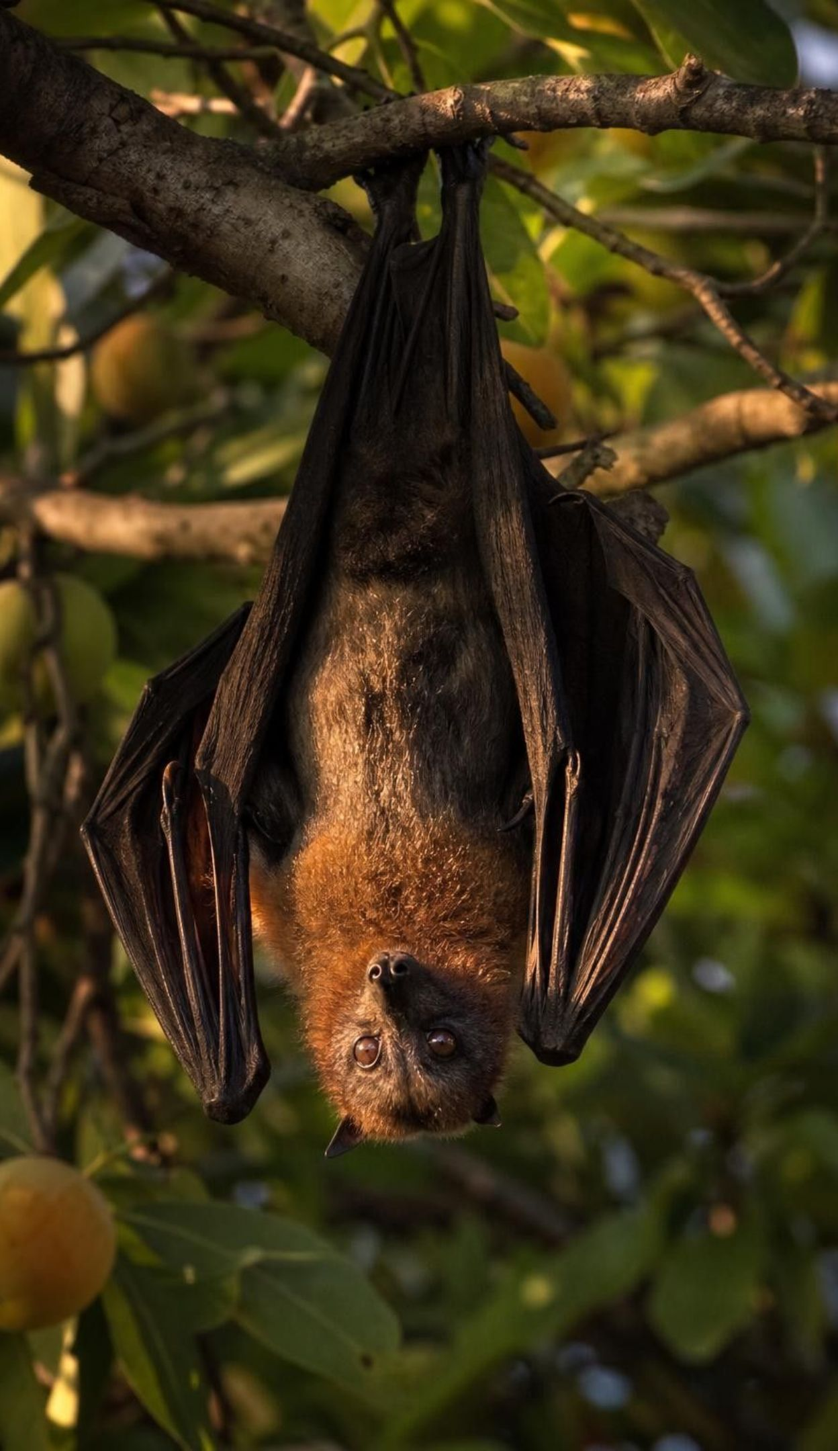
THINK, PAIR, SHARE
Discuss: should a farming district get rid of its bats?
Sort your questions into two columns: science can predict / people must decide.
Example: 'Would chasing the bats away lower the risk or just move it?' Which column?
Example: 'Should pig farmers or the whole district pay for new sheds?' Which column?
Fruit bats near pig farms can carry Nipah virus, but they also pollinate fruit trees and spread forest seeds. Which questions about protecting farmworkers can science answer, and which can only the community answer?
22
Notes:
Give groups four minutes to list at least three questions in each column, then share. Remind them of the lesson's Nipah story: fruit bats carry the virus without getting sick, and pigs ate fruit that bats had dropped. Health agencies advise keeping bats away from pig feed and sheds; there is still no approved vaccine for people; and bat experts warn that chasing a roost away can simply move the bats, while flying foxes help pollinate durian, a valuable fruit crop. Science can predict how much each plan lowers the risk, how sure that estimate is, what it costs and what happens to the bats. Only people can decide how to weigh health against income, who pays, and how much risk is acceptable. Connect to the lesson's closing point: science can predict the results of choices, but it cannot tell a community what to value.
EXPECTED RESPONSES: Science column: how much each plan lowers the chance of an outbreak; whether driving bats away scatters them; how much fruit the orchards lose without bat pollination; what sheds, moves and testing cost; how sure each estimate is. People column: whether a farm family's two hard years are worth a lower risk; who should pay for new sheds or moves; how much risk is acceptable; whether protecting the bats matters if it costs money.
WATCH FOR: 'Get rid of the bats and the risk is gone.' Driving a roost away can move the bats closer to other farms, and losing them costs pollination and seed spreading; whether the risk is worth that cost is a values question.
CONNECTS TO: Lab 3; W7 misconception (who decides).
PACING: about 6 min

Slide 23
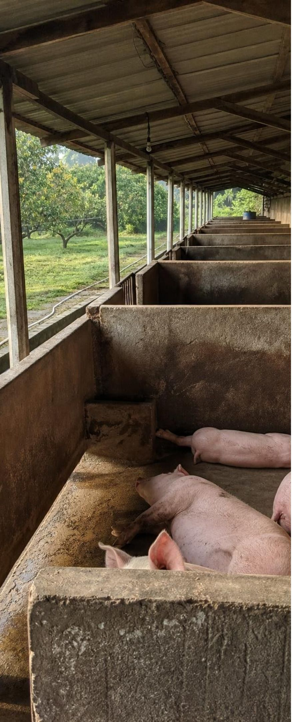
Apply it
Task: score three Nipah plans with a weighted matrix
Simulated data for practice.
Criterion (weight) | Move pig pens away | Bat-proof the sheds | Remove the bat roost
Human health (3) | 4 | 3 | 2
Bats and their services (2) | 4 | 4 | 0
Farm income (1) | 3 | 4 | 1
Low cost (1) | 1 | 2 | 4
Weighted total | ? | ? | ?
Multiply each score by its weight and add down each column. Which plan wins? Then raise the farm-income weight from 1 to 3. Does the winner change?
23
Notes:
Scores run from 0 (worst) to 4 (best) and come from the Lab 3 case file's scoring rules; the weights here are a practice set for four of its six criteria. Model the first column aloud: 4 × 3 + 4 × 2 + 3 × 1 + 1 × 1 = 24. Let pairs finish, then try the higher farm-income weight. Ask at what weight the two leaders tie, and why removing the roost never comes close. Students did this with six criteria in Lab 3, where they negotiated their own weights and checked worst-case estimates; this short version checks that each student can do the arithmetic alone and see one weight flip the winner.
EXPECTED RESPONSES: Weights 3, 2, 1, 1: Move pens 12 + 8 + 3 + 1 = 24; Bat-proof sheds 9 + 8 + 4 + 2 = 23; Remove the roost 6 + 0 + 1 + 4 = 11. Moving the pens wins. Farm-income weight 3: Move pens 12 + 8 + 9 + 1 = 30; Sheds 9 + 8 + 12 + 2 = 31; Roost 6 + 0 + 3 + 4 = 13. Now the sheds win. The two leaders tie at a farm-income weight of 2 (27 each), because each point of that weight adds 3 to moving pens but 4 to the sheds. Removing the roost stays far behind because it scores 0 for bats and low on health and income.
WATCH FOR: Adding raw scores and ignoring weights, or treating the top total as proof that a plan has no downsides.
CONNECTS TO: Lab 3; W9 transfer.
PACING: about 10 min

Slide 24
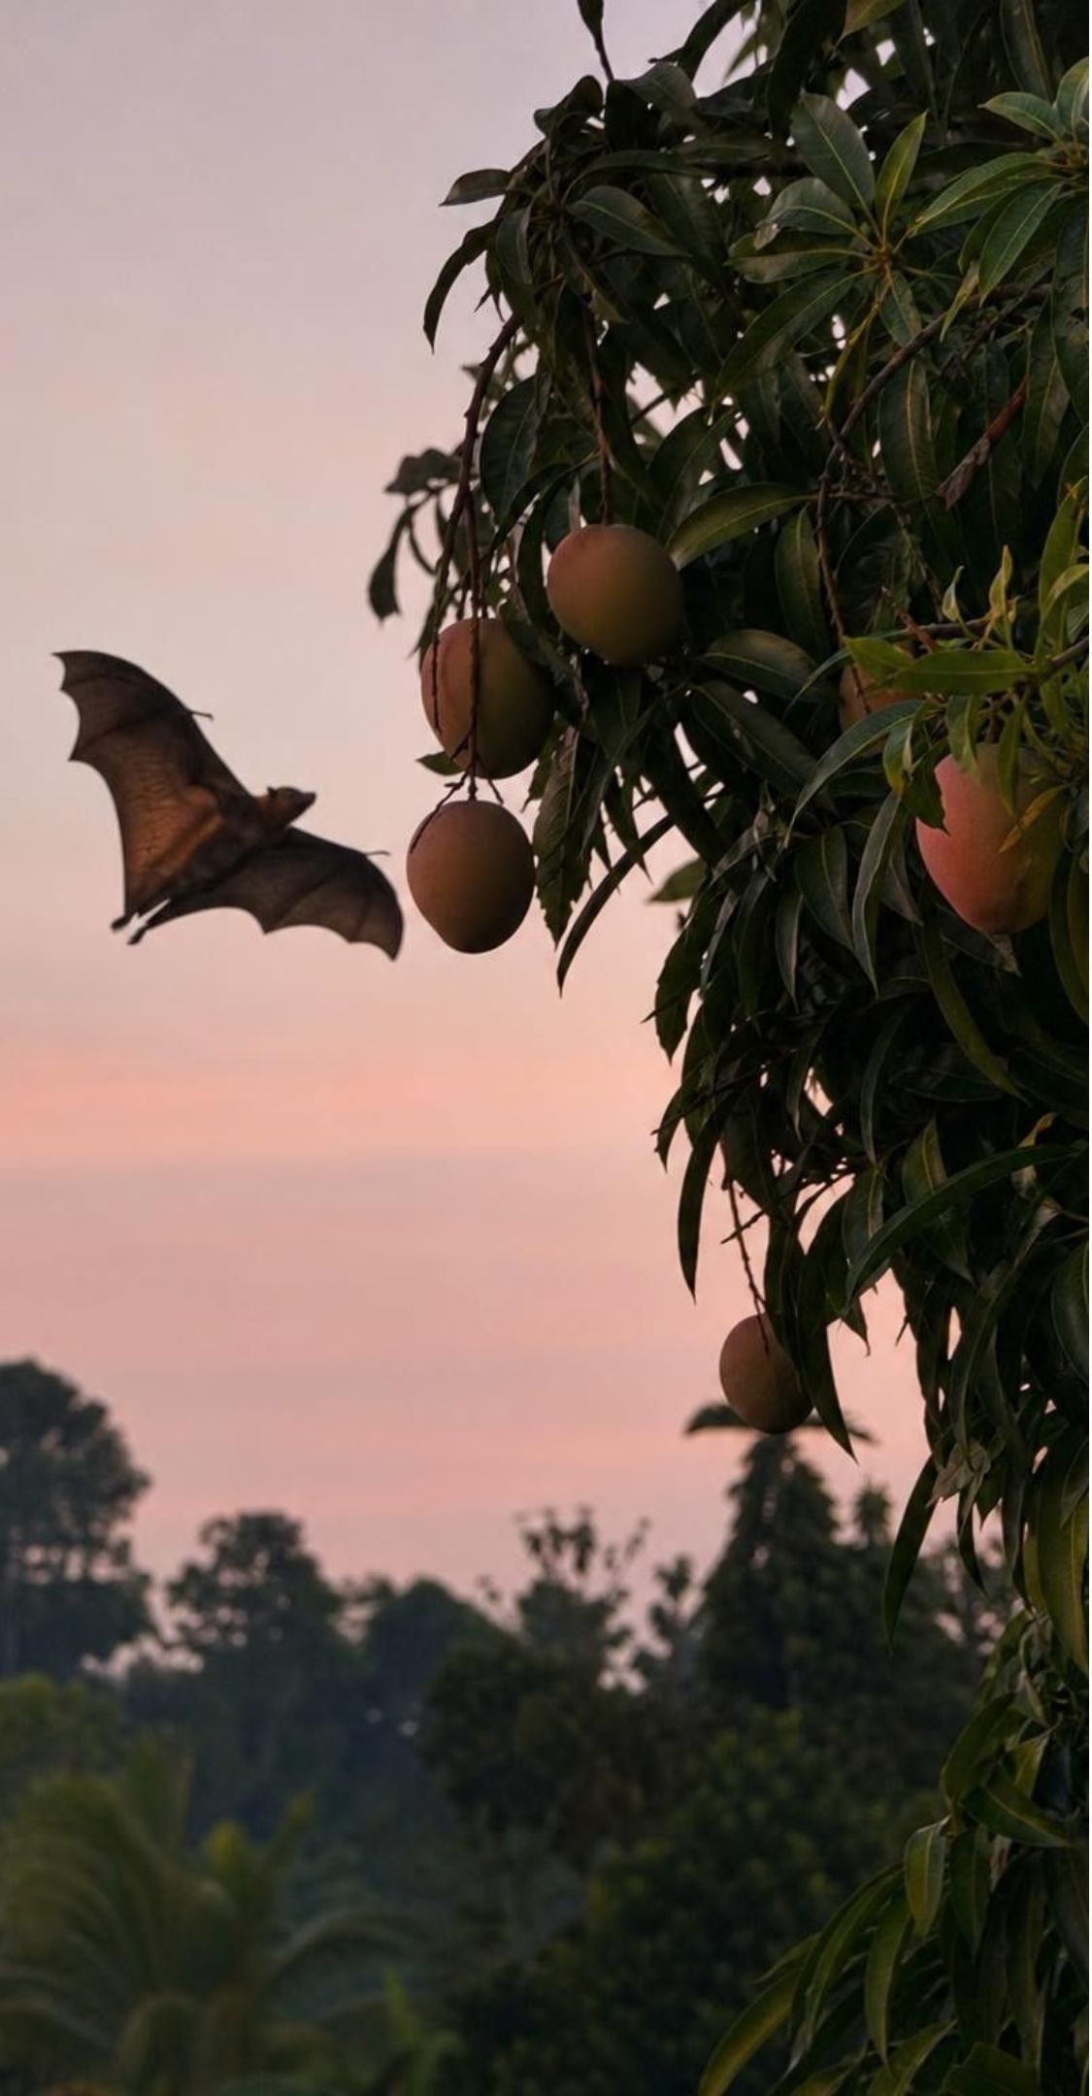
CHECK FOR UNDERSTANDING
Quick check: what can science decide?
Which statement about the Nipah decision is accurate?
A. Science predicts what each plan will do; people decide how much each result matters.
B. Science can tell the town which plan is best.
C. A weighted matrix removes opinions from the decision.
D. The plan with the top score has no tradeoffs.
24
Notes:
Quick vote, then ask a student to explain why each wrong answer is wrong. Tie the answer to the task slide: the scores came from data, but the weights came from people, and raising the farm-income weight from 1 to 3 changed the winner.
EXPECTED RESPONSES: A. The predictions (chance of an outbreak, bats kept, cost) come from science and engineering; the weights come from values, so different stakeholders can reach different answers from the same data. B is wrong because 'best' depends on the weights. C is wrong because the weights are opinions written down openly, which is useful but not opinion-free. D is wrong; every plan here gives something up.
WATCH FOR: Thinking a number makes a decision objective. The matrix makes value choices visible; it does not remove them.
CONNECTS TO: Lab 3 analysis; W7 misconception; W10 mastery.
PACING: about 3 min

Slide 25

MISCONCEPTION CHECK
True or false? Stop growth and impact stops growing
"If the world's population stopped growing tomorrow, humans' impact on ecosystems would stop growing too."
True or false? Explain your reasoning.
Notes:
Have students vote, then defend their vote with Lab 1 evidence. False. Total use equals population times use per person, and use per person has been rising; in Lab 1 Part B a village of only 15 families that doubled its fish per family collapsed the lake sooner than the fast-growing village. Impact also depends on how resources are produced: shade coffee or full sun, treated or untreated sewage, selective or unselective nets. The statement also ignores lag: plastic already in the ocean and carbon dioxide already in the air keep having effects.
EXPECTED RESPONSES: False. Use per person can keep rising, so total use can rise with a steady population; impact also depends on technologies and habits; and some impacts continue after their cause stops. The reverse also holds: better-engineered activities can lower impact even while population grows.
WATCH FOR: Students who say true are usually thinking only of headcount. Ask them to compare 100 people using 2 units each with 100 people using 3 units each.
CONNECTS TO: Lab 1 Part B; W5 data worksheet (q10: slower growth, still more pressure); W10 mastery (q12).
PACING: about 5 min

Slide 26
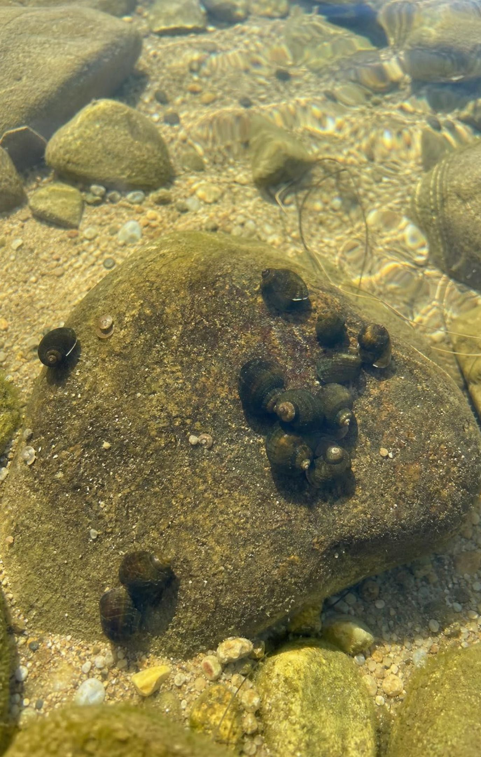
PUTTING IT TOGETHER
Putting it together
Wild populations rise and fall with the food their own ecosystem makes; people draw on the whole planet.
Demand on ecosystems = number of people × use per person, shaped by the technologies we choose.
Disruptions travel along cause-and-effect chains and often loop back to people.
Good solutions start with precise criteria and constraints, then get tested and revised.
Choosing among solutions takes data and values: science predicts, communities decide.
26
Notes:
Ask students to return to the target they starred on slide 3 and write one sentence showing they can now do it. Then ask which of the three labs changed their thinking most, and why, and collect two or three answers. Point forward: the segment wrap-up asks them to revise their segment model and use it to explain the integrated phenomenon.
CONNECTS TO: W10 mastery; Lab 1, Lab 2 and Lab 3 debriefs.
PACING: about 5 min

Slide 27
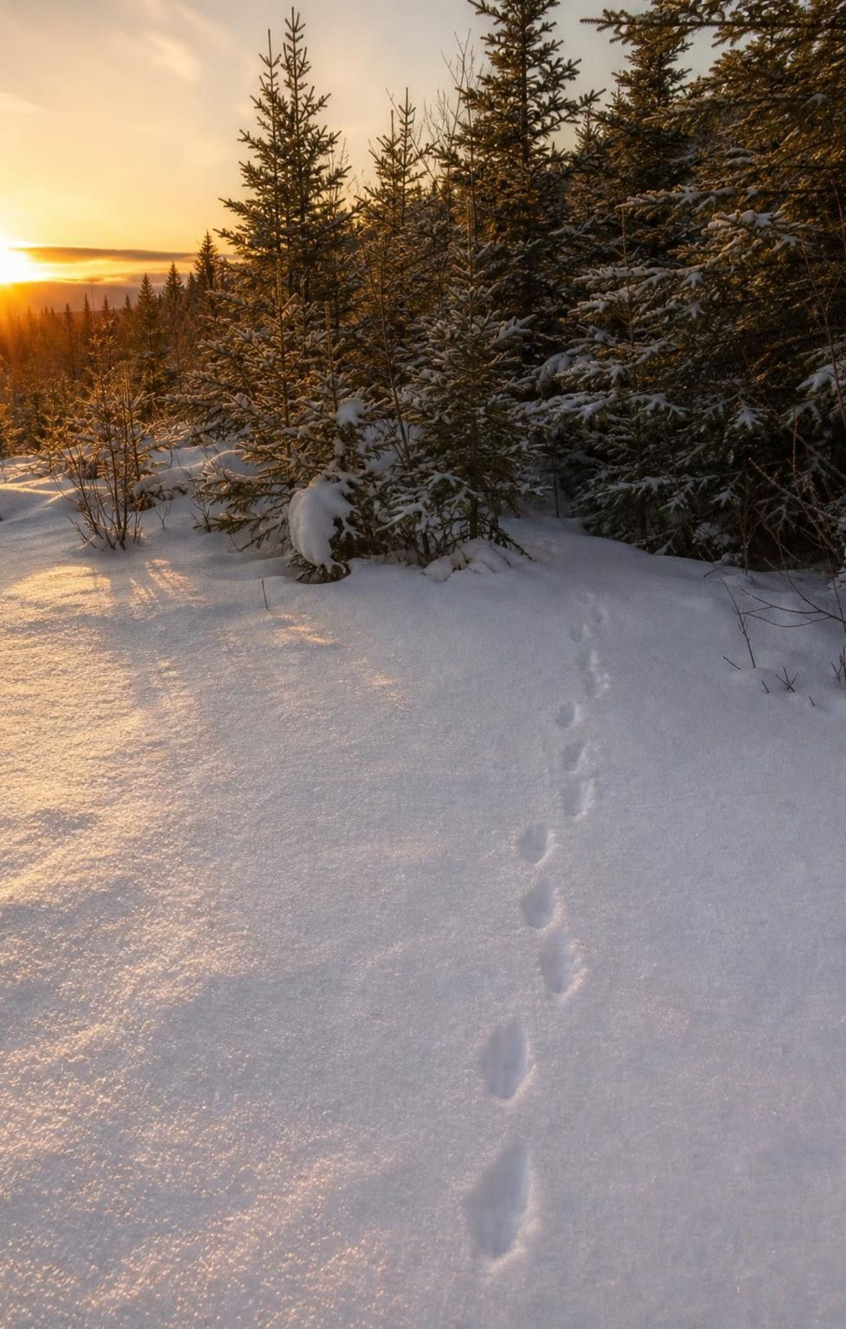
EXIT TICKET
Exit ticket
1. A city of 50,000 people uses 10,000,000 liters of water a day. Find the per capita use.
2. Give one reason the lynx population falls but the human population has not.
3. A net keeps 27 of 30 big fish and lets 48 of 60 small fish escape. Did it reach 80 percent on both?
27
Notes:
Collect the tickets and sort them into three piles: all correct, one error, two or more errors. Use the piles to group students for the W10 review.
EXPECTED RESPONSES: 1. 10,000,000 ÷ 50,000 = 200 liters per person per day. 2. Lynx depend on the hares their own forest produces this year; people use trade, farming technology and stored food from many ecosystems (any one). 3. Big fish kept: 27 ÷ 30 = 90 percent, which meets the criterion. Small fish released: 48 ÷ 60 = 80 percent, which meets it exactly.
WATCH FOR: In question 3, computing the small fish kept (12 of 60, 20 percent) instead of the small fish released.
CONNECTS TO: W10 mastery.
PACING: about 5 min

